Slide 1
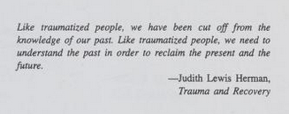

Slide 2
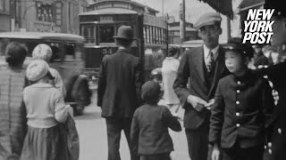
Hiroshima Before the Bombing - 1935

Slide 3
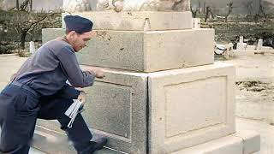
Atomic Bombing of Hiroshima, Japan, on August 6th, 1945

Slide 4
Atomic Bombing of Hiroshima, Japan, on August 6th, 1945

Slide 5
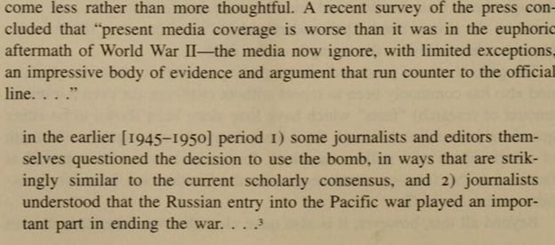
The Decision to Use the Atom Bomb
- Gar Alperovitz

Slide 6
The Decision to Use the Atom Bomb
- Gar Alperovitz

Slide 8
What we’ll be learning today:
Discuss the Manhattan Project & Atomic Scientists
About the true nature of the atomic bombings and why the justification of the dropping of the bombs was unjustified.
About the result of the dropping of atomic bombs, the way it changed the world and relating the event to the current day with western imperialists risking nuclear war with Russia and China.
Scenes of a simulated nuclear war and scenes from The Day After (1983)

Slide 9
The Manhattan Project

Slide 10
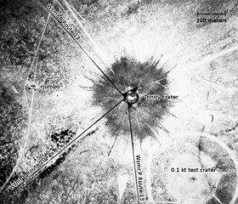
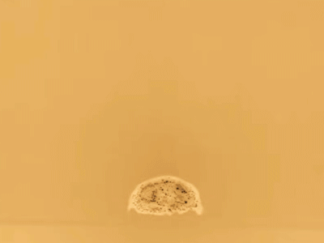
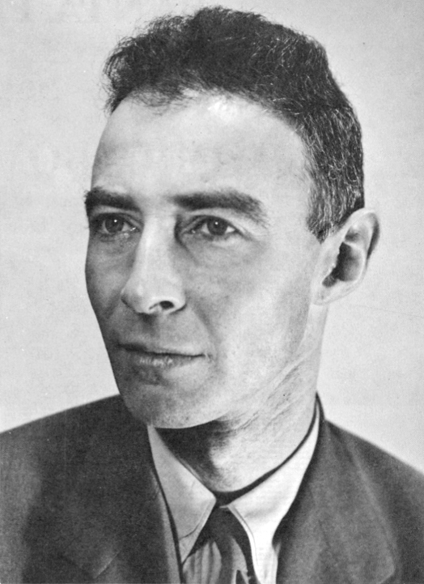
Manhattan Project
Why was the Atom Bomb developed?
In the early 1930’s, British scientists split lithium atoms with protons and an era of nuclear science began. By 1938, with the discovery of neutrons earlier in the decade, scientists Otto Hahn and Fritz Straussman shocked the world by splitting a uranium atom with neutrons, creating fission of the nucleus of the atom, which could result in a nuclear chain reaction.
Politically, the world was beginning to see more and more the threat of Nazi fascism and though research was kicked off at different times in several different countries, many atomic scientists of which many were Jewish, such as Albert Einstein, came to the United States and requested to FDR that nuclear weapons be developed to beat the Nazis in the race for a successful nuke, which Nazis would’ve used indiscriminately.
Nazis had been trying to develop nuclear weaponry, but gave up in 1942 to focus on V-1 and V-2 rocketry, but this wasn’t known until 1944 and Nazis could have begun research again at any point. However, the first US bomb, Trinity, developed in part by American communists like J. Robert Oppenheimer, was tested successfully in July 1945, just 1 month before the bombing of Hiroshima and Nagasaki.

Slide 11
The Truth about Hiroshima and Nagasaki

Slide 12
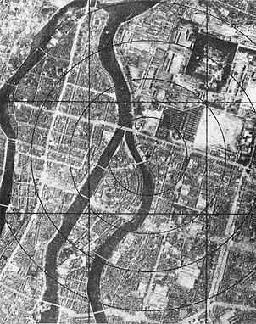
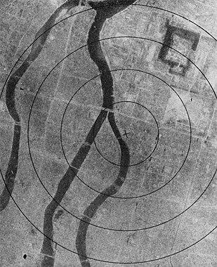
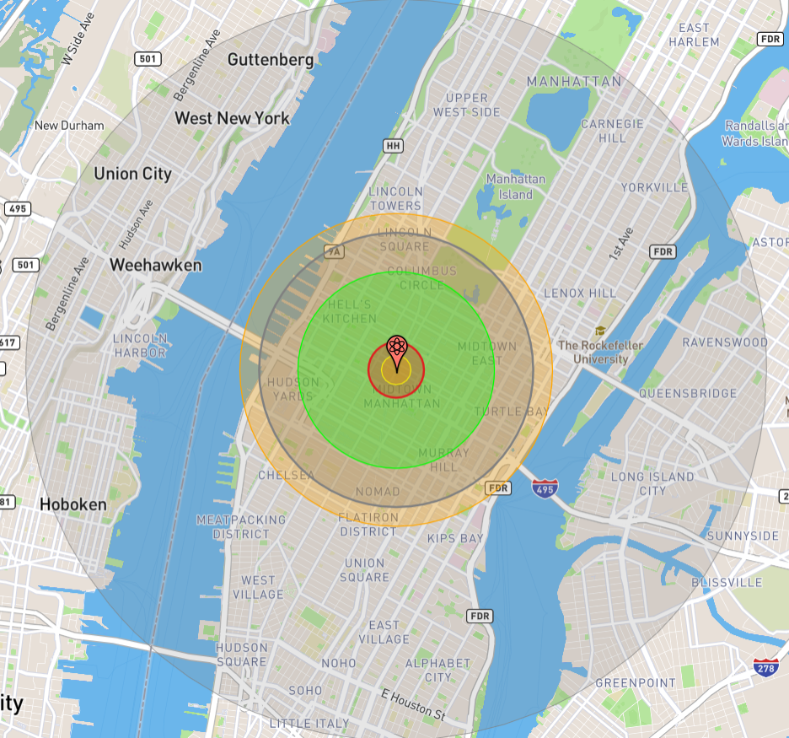
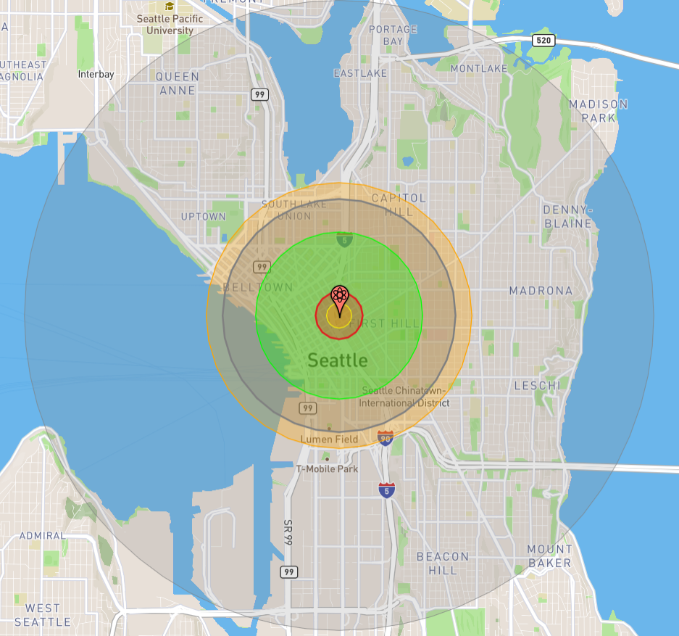
The Atomic Bombings
Hiroshima
On August 6th, 1945, at 08:15 Hiroshima time, a enriched uranium fission bomb called “Little Boy”, was dropped from the Enola Gay B-29 Bomber over Hiroshima. It detonated at about 2,000 meters above the city.
The intended target area was the Aioi Bridge in the middle of the city, but winds caused the bomb to detonate over Shima Surgical Clinic. It detonated with a force of ~16 kilotons of TNT, or about 15,000 tons of TNT. 1 mile in all directions was completely destroyed, and fires spread for about 4.6 miles.
Over 140,000 people were killed by this bomb, including in the months following the attack. Over 60% of the city was destroyed. Wood and paper homes were vaporized and only concrete buildings built to withstand earthquakes remained, albeit heavily damaged.
Hiroshima before and after
Blast compared to NYC and Seattle

Slide 13
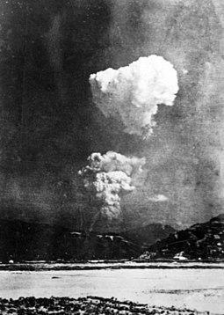
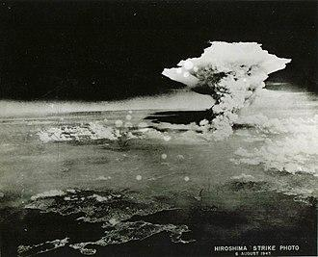
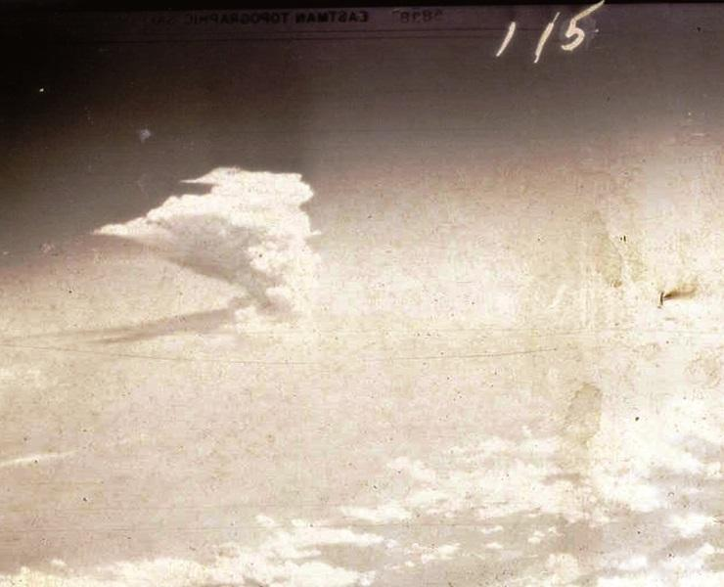
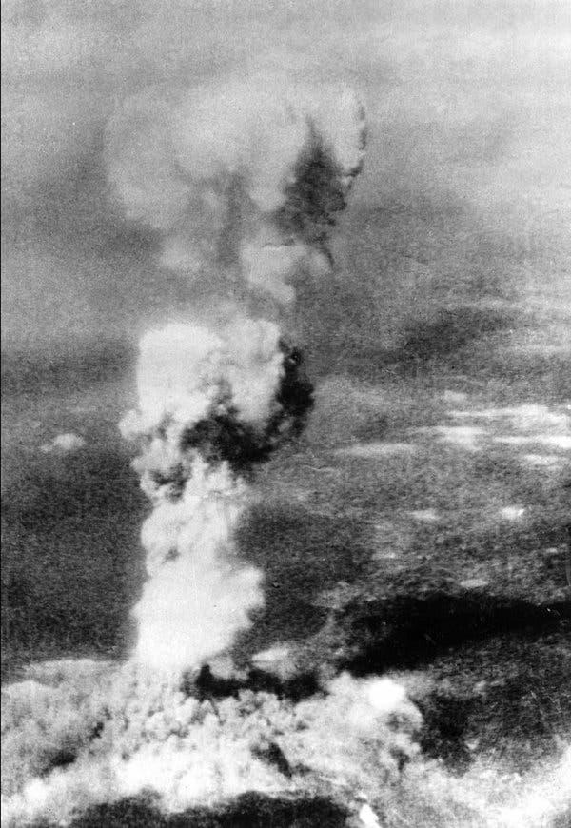
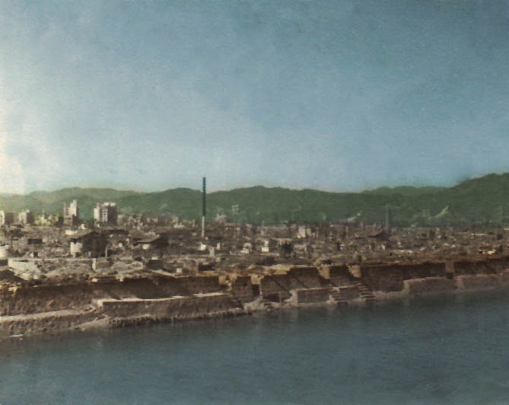
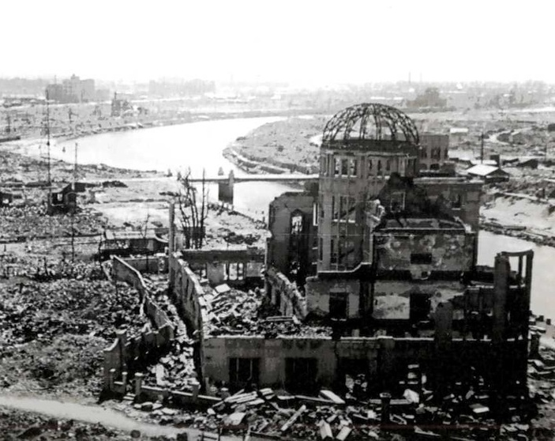
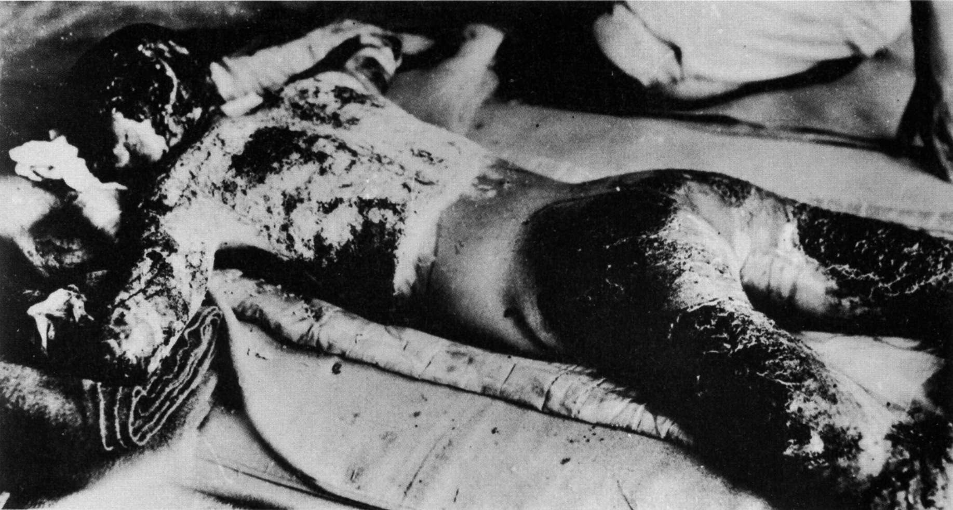
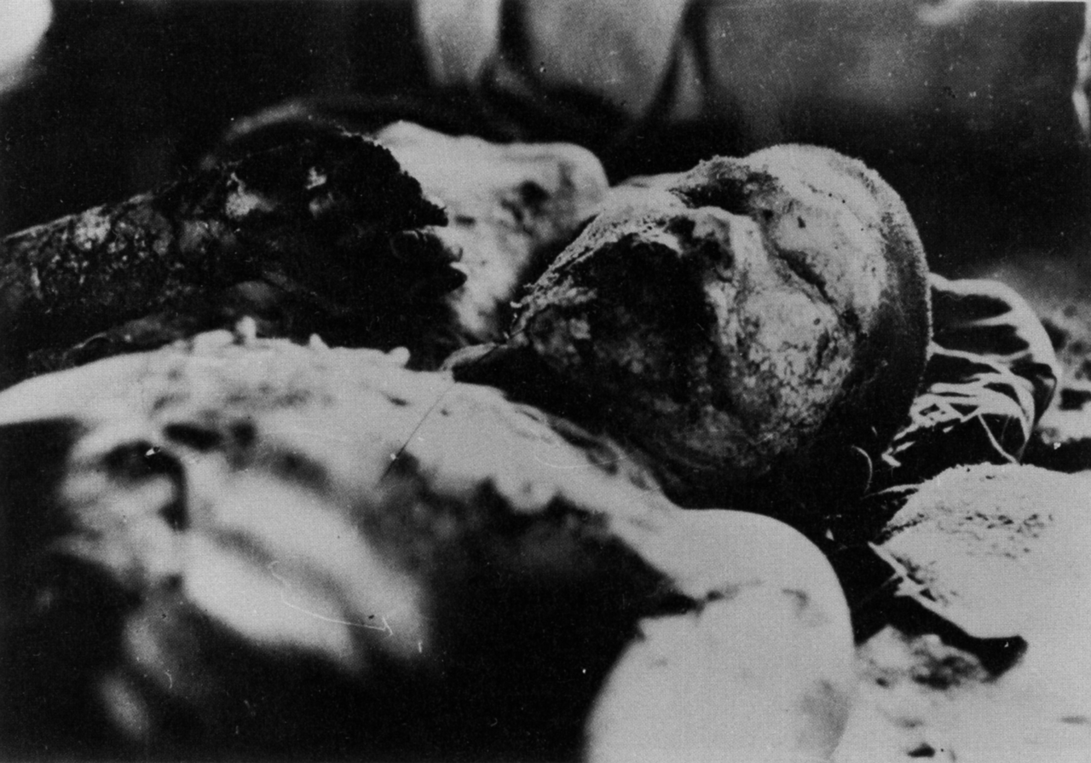
Atomic Bombing of Hiroshima

Slide 14
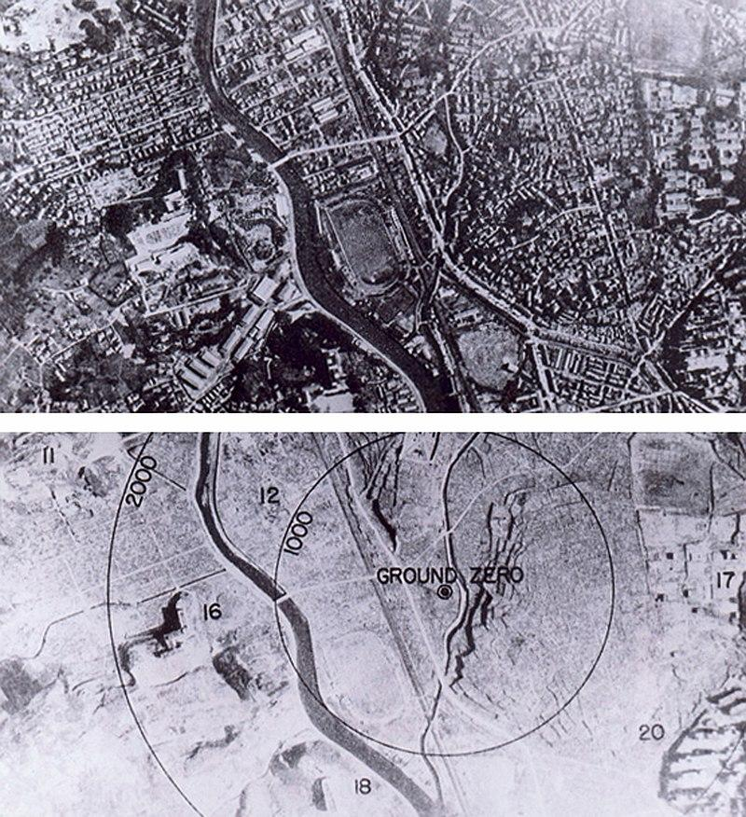
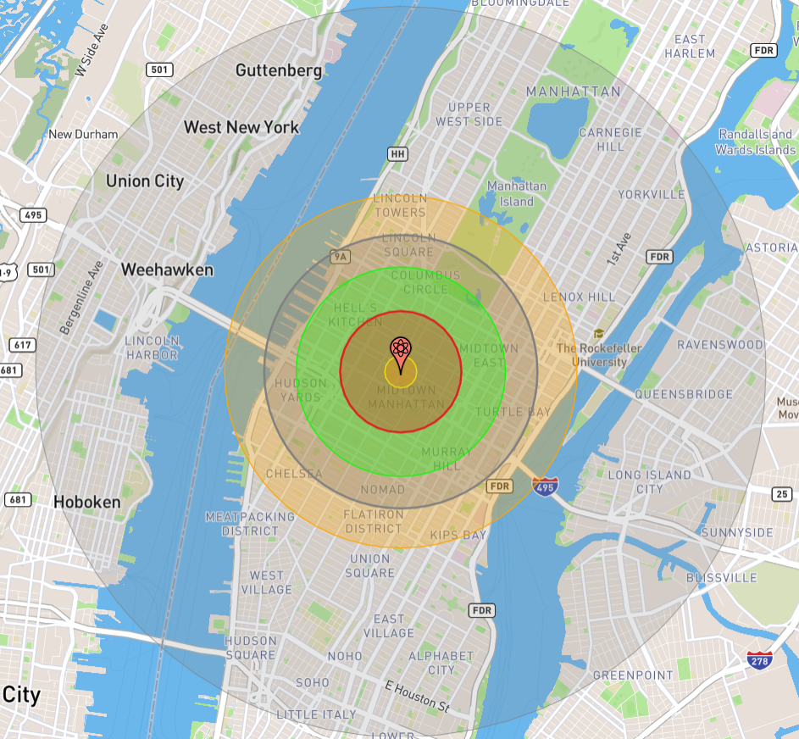
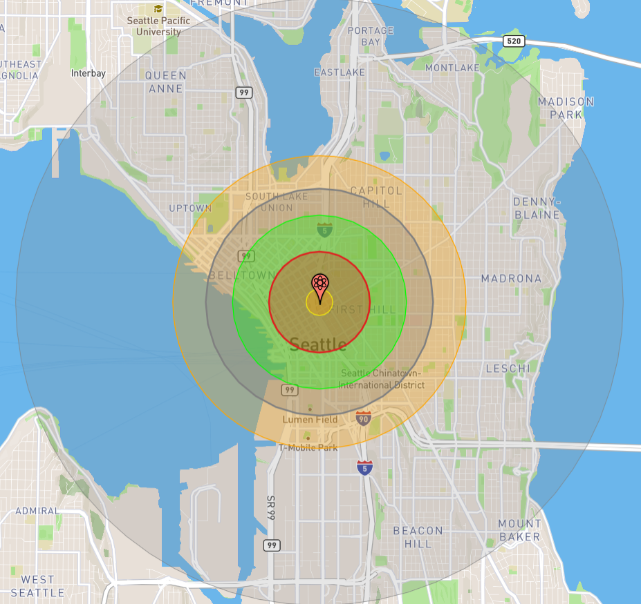
The Atomic Bombings
Nagasaki
On August 9th, 1945, the B-29 bomber Bockscar flew to Kokura, Japan, the intended target for the bomb. Kokura however was clouded by clouds and smoke from a firebombing at Yahata the previous day. These conditions saved Kokura from an atomic bombing.
The secondary target, Nagasaki, was flown to and at 11:01 Japanese time, the plutonium bomb known as “Fat Man” was released after a break in the clouds, and detonated at 11:02 with a force of ~21 kilotons of TNT, or 21,000 tons of TNT. Total destruction occurred for 1 mile in all directions and fires spread ~2 mi south.
Over 80,000 people were killed in the attack and much of the valley was destroyed. Ironically, the explosion occurred over the Urakami Tenshudo Catholic Church, the largest Catholic Cathedral in Asia.
Nagasaki before and after
Blast compared to NYC and Seattle

Slide 15
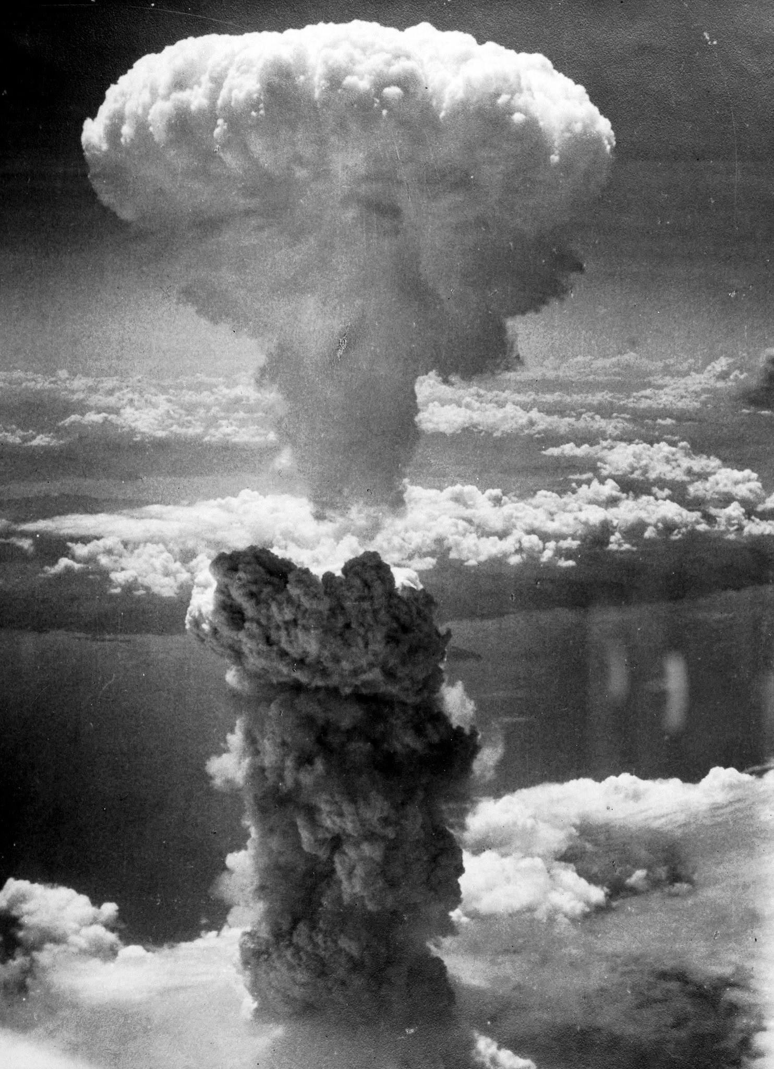
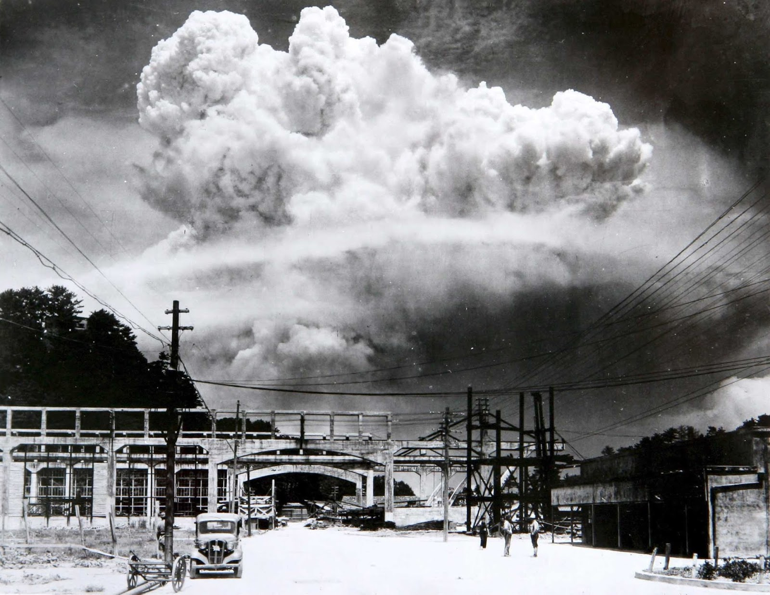
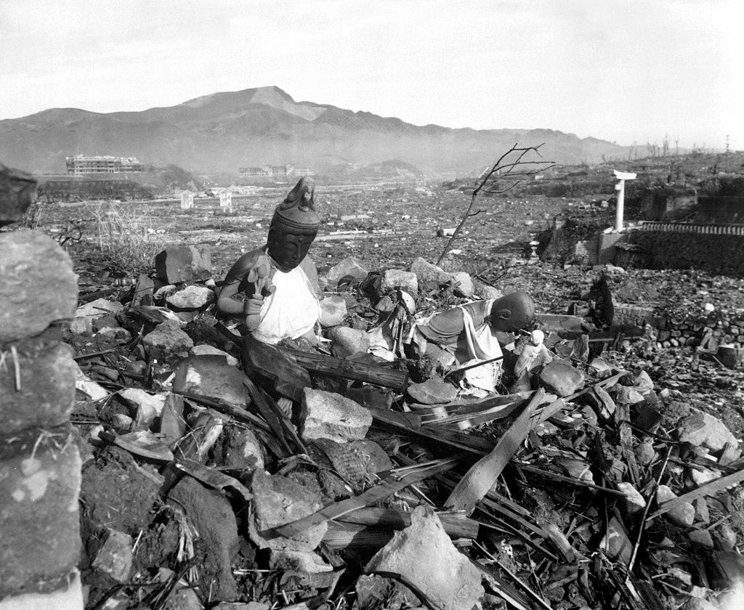
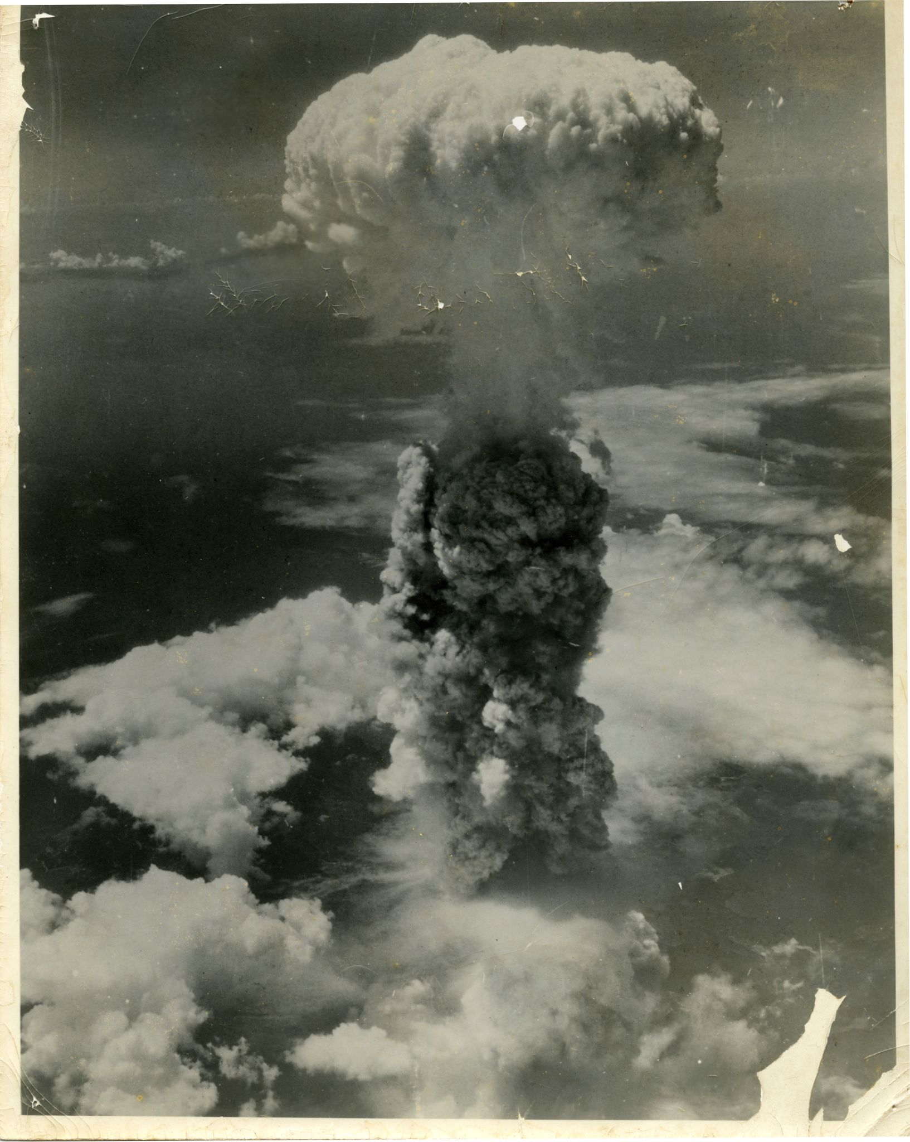
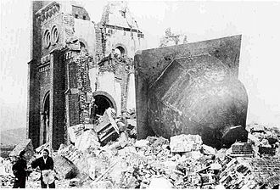
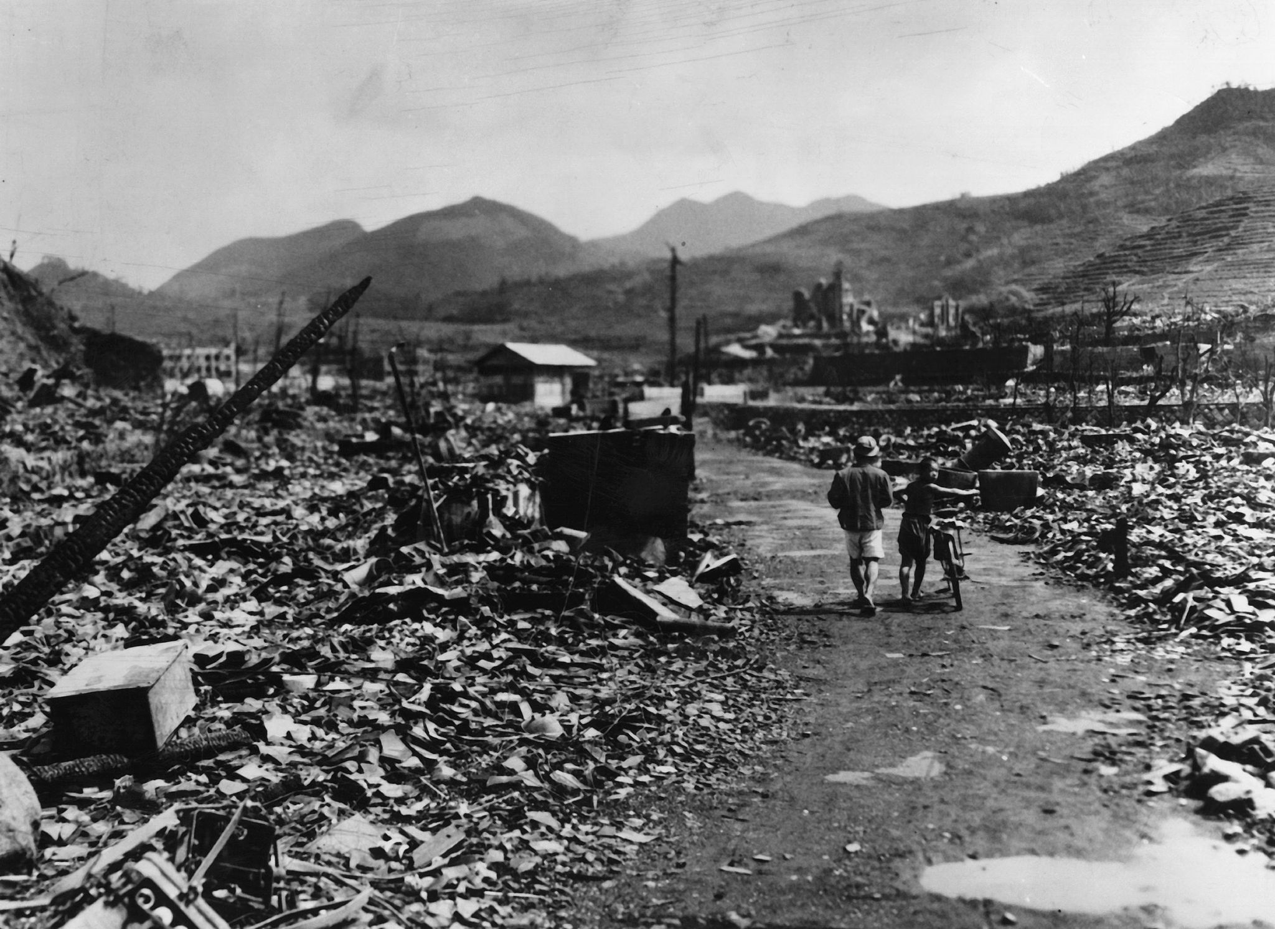
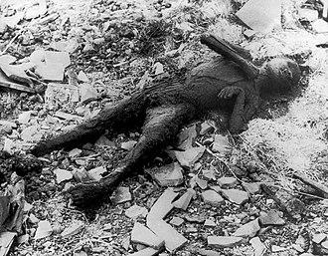
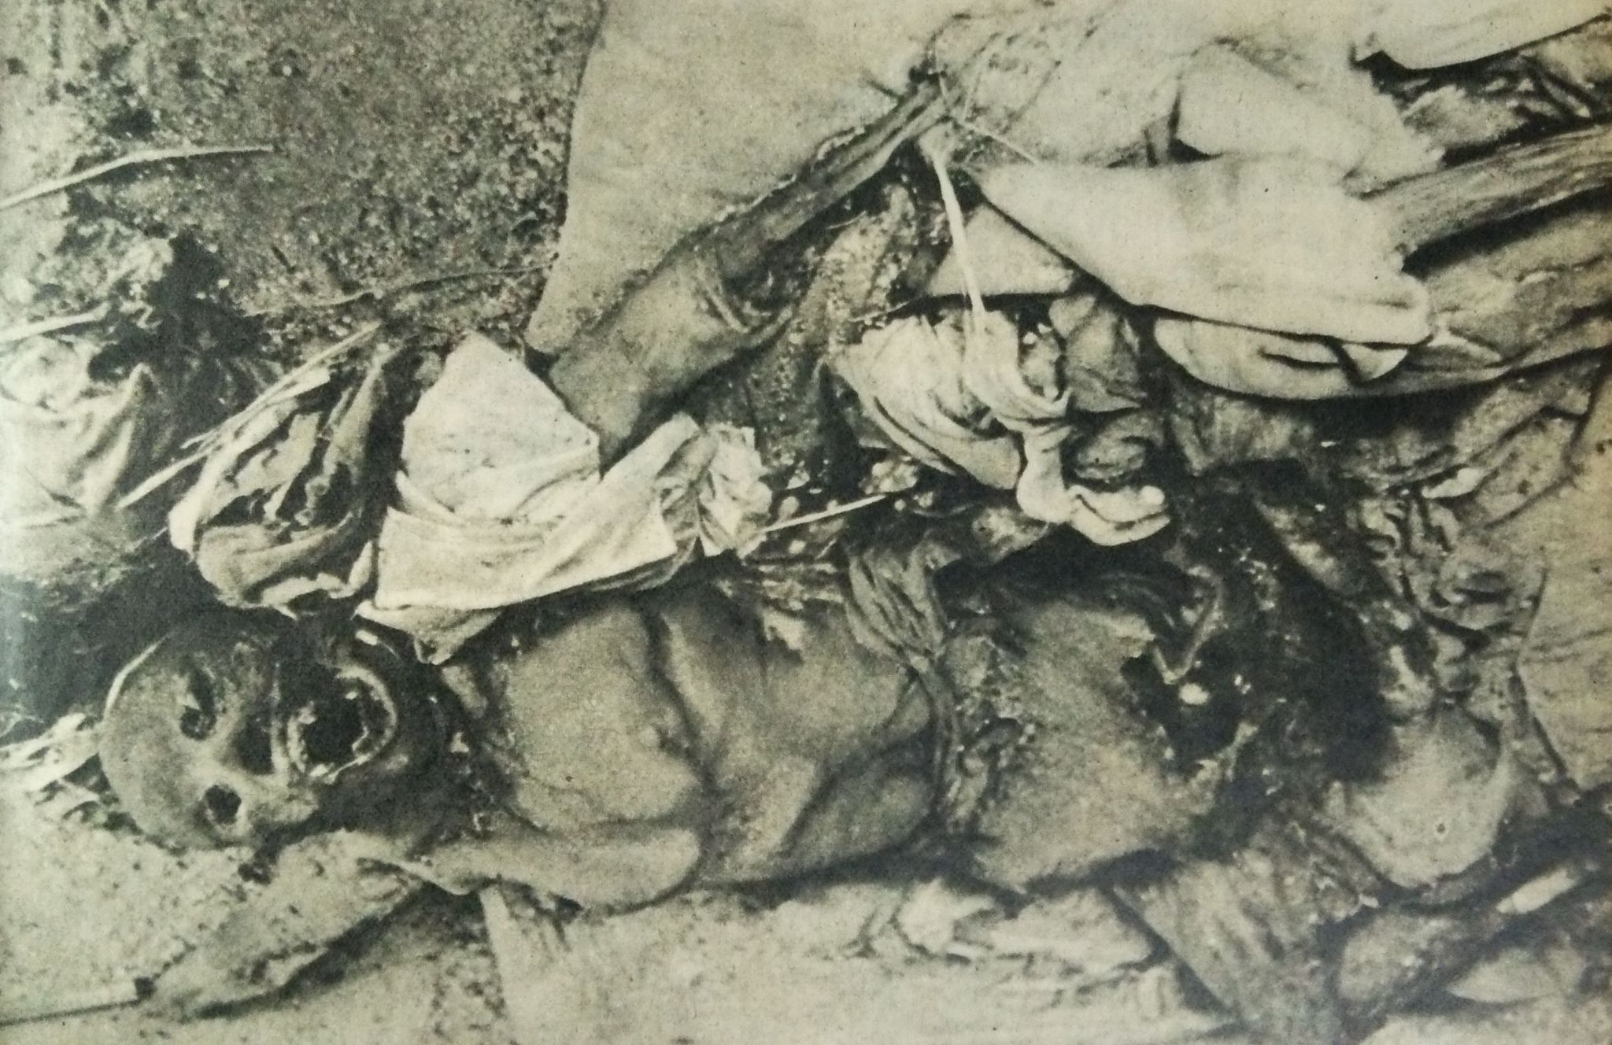
Atomic Bombing of Nagasaki

Slide 16
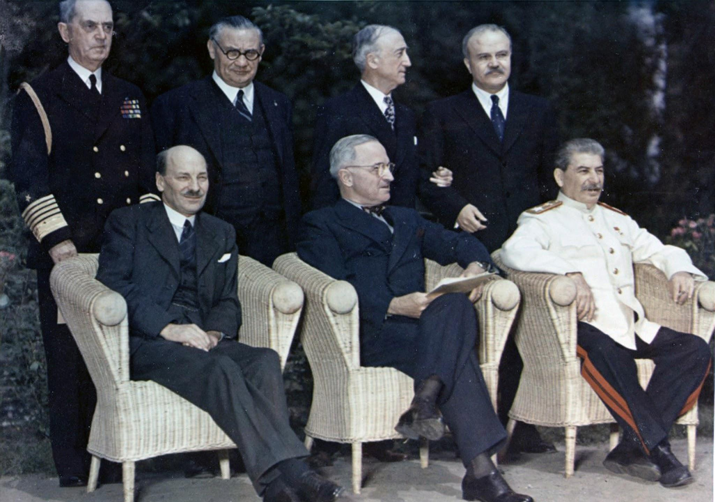
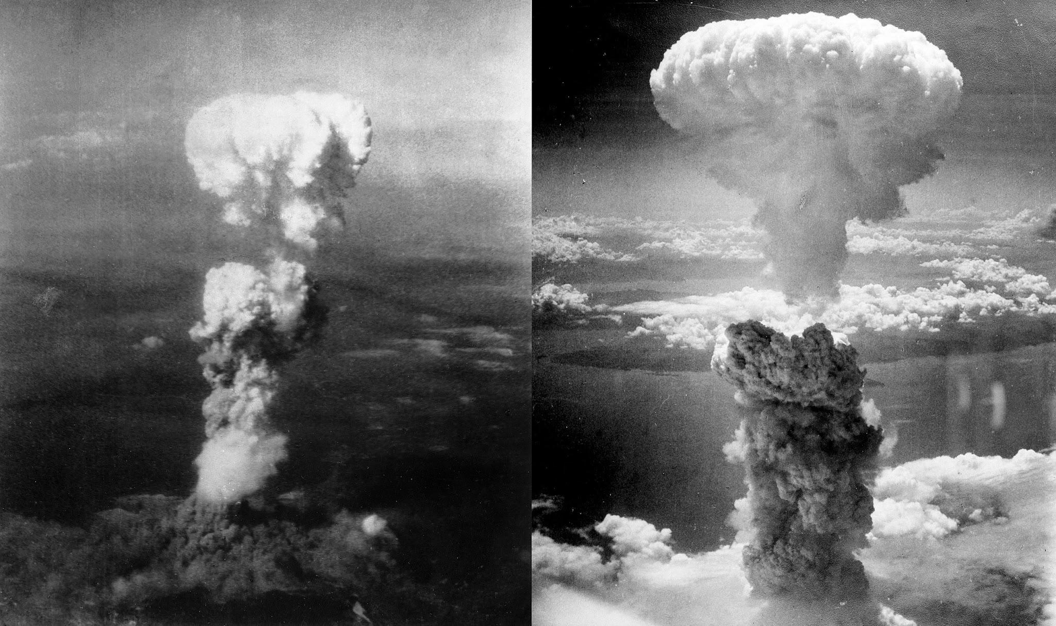
Why did we drop the A-bombs on Japan?
Preemptive Nuclear War
As the Second World War approached its end, FDR died in April of 1945 and the Nazis surrendered in May of 1945, the imperialists in the United States and United Kingdom were already looking to subvert the diplomacy made with the USSR during the war and was preparing to fight a war with the Soviet Union following WW2, and to use the end of WW2 to do so.
Hiroshima and Nagasaki were bombed with nuclear weapons to test them on a civilian center. Cities like Tokyo or Osaka were ash at that point, but an untouched city like Hiroshima would provide the US with a civilian center to assess the impacts of an atomic weapon on.
Leslie R. Groves, the director of the Manhattan Project, ordered a post-attack assessment report, which confirmed Hiroshima was chosen because it was “relatively untouched by previous bombing, in order that the effect of a single atomic-bomb could be determined.”

Slide 17
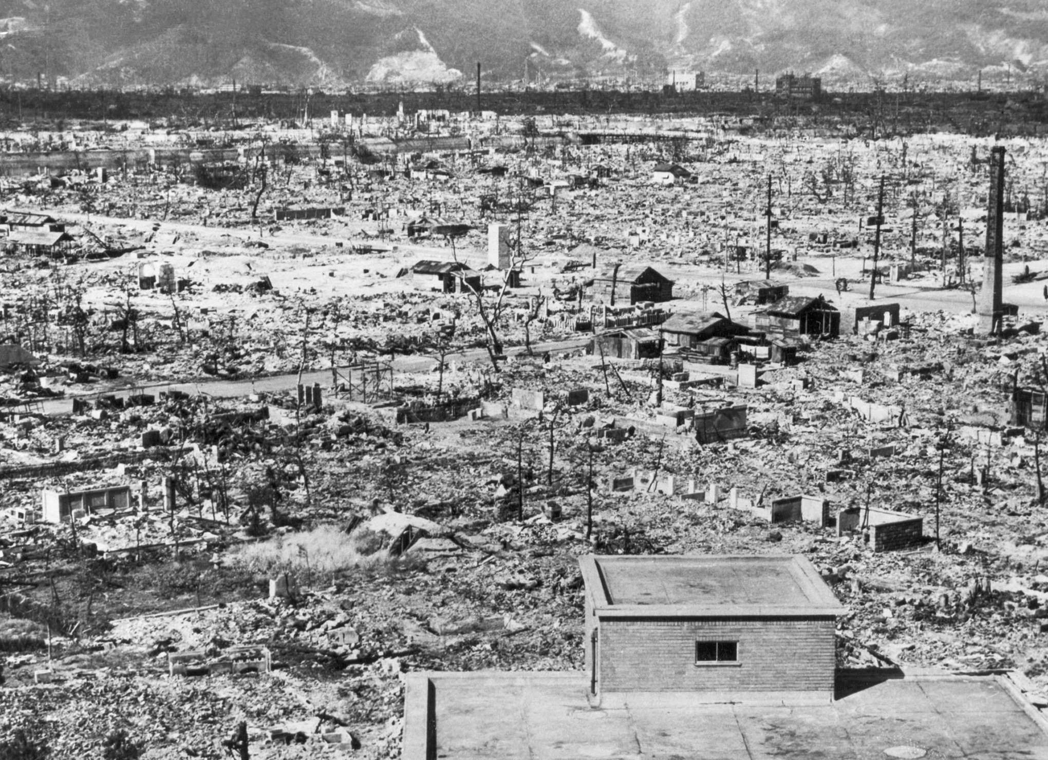
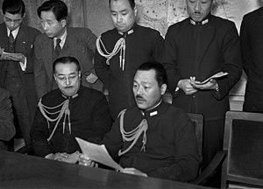
Why did we drop the A-bombs on Japan?
No Military Significance, No US-led Victory
The military significance of Hiroshima and Nagasaki was very low. In Hiroshima, there was the Second General Army Headquarters and Chugoku Military Police Headquarters and only ~7k-20k troops were killed in this attack. Nagasaki had Mitsubishi factories, including arms manufacturing, but only ~9,000 troops were killed in this attack.
Neither bombing brought about the Japanese surrender, even with atomic blackmail following Hiroshima and Nagasaki. Nor did they noticeably impair what was left of the Japanese war machine.
Japan was trying to figure out a way to surrender to the Soviets before Hokkaido was invaded and the foundation of Japan was broken. They were losing the war and had suffered catastrophic incendiary bombing in 67 cities. Losing 2 more to big bombs rather than thousands of smaller ones didn’t seem to make much difference at that point.

Slide 18
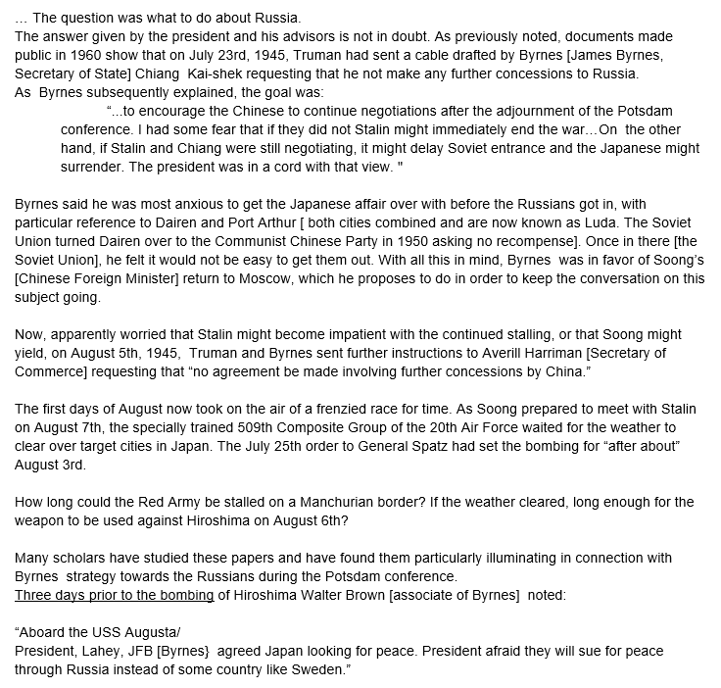
The Decision to Use the Atom Bomb
Gar Alperovitz

Slide 19
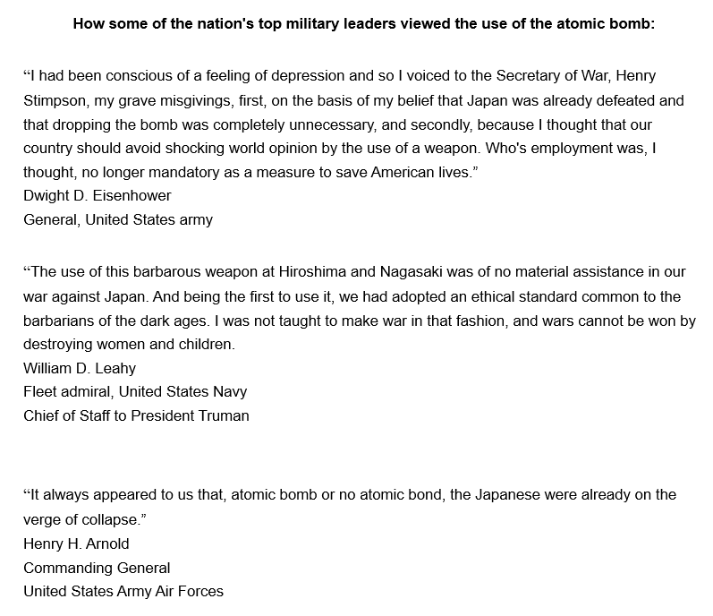
The Decision to Use the Atom Bomb
Gar Alperovitz

Slide 20
Discussion & New Members Introductions

Slide 21
New Member Introductions
What is your name, pronouns and state (or country/territory)?
Where do you work? Is it unionized?
How did you find out about the People’s School?
What do you think about tonight's class?

Slide 22
Atomic Aftermath & The Present Day Nuclear Threat

Slide 23
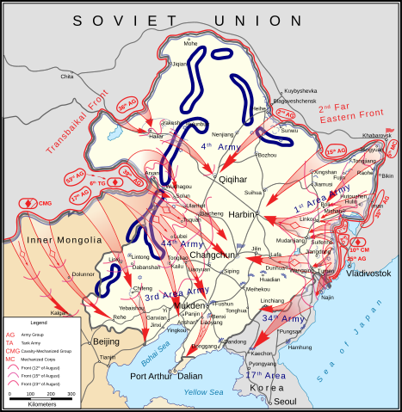
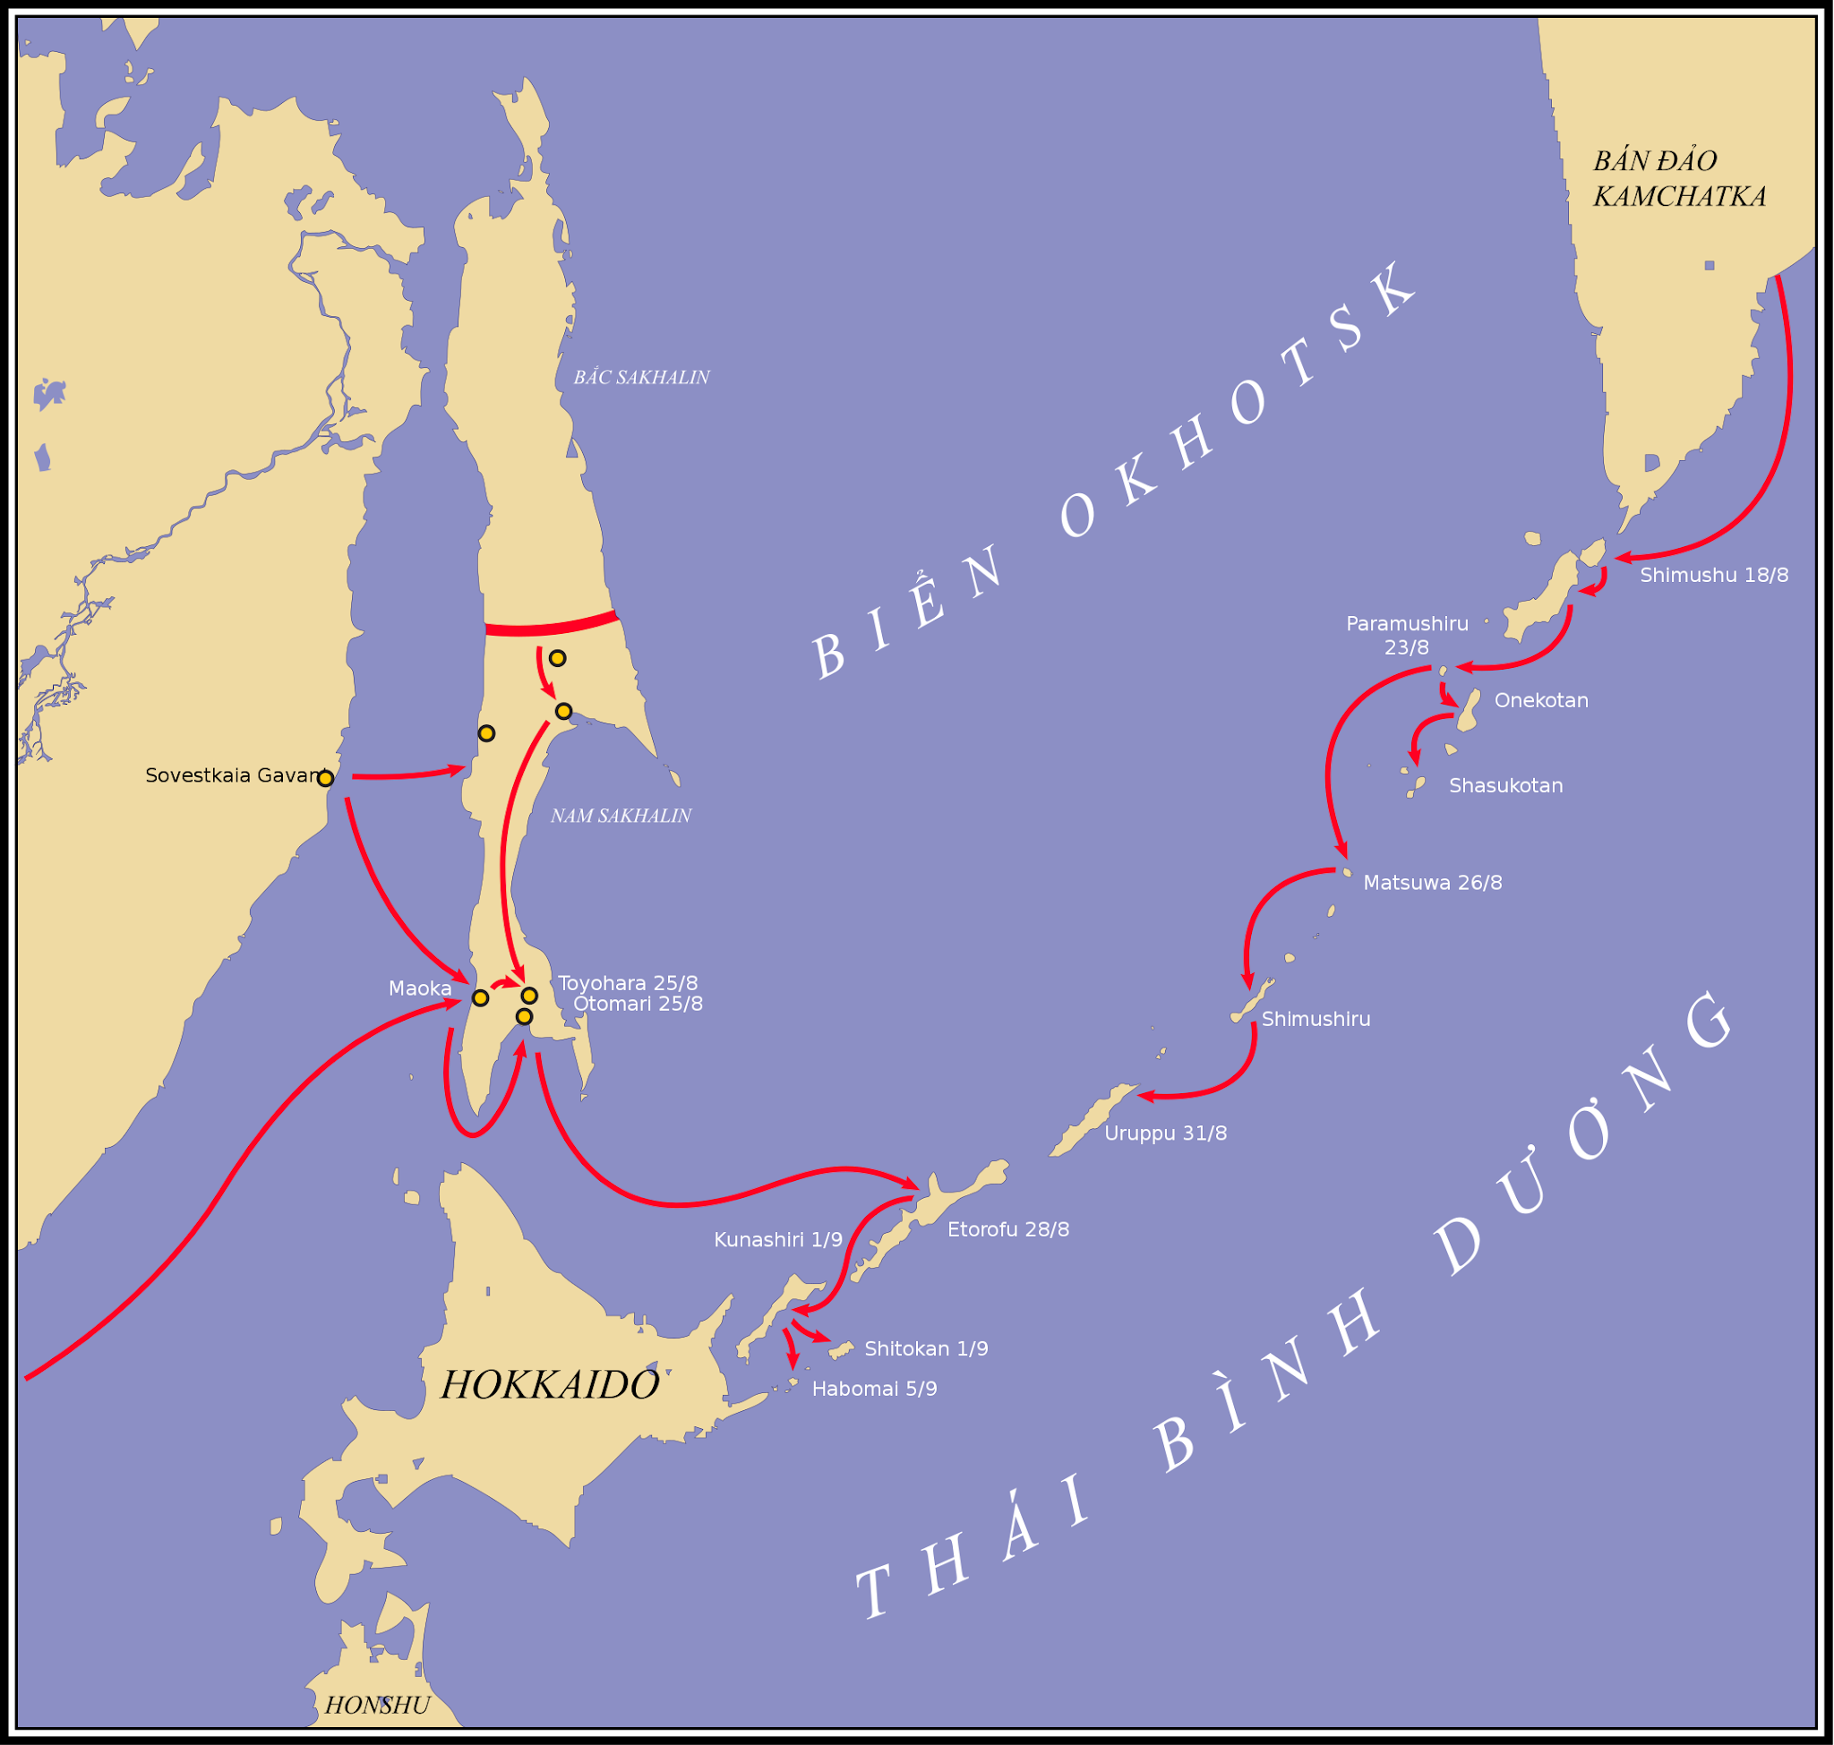
Soviet Victory in World War 2
Soviet Invasion Forced Japanese Surrender
As agreed to multiple times dating back to 1943, the Soviets declared war on Japan on August 7th, 1945 and on August 9th, 1945 the Khingan–Mukden, Harbin–Kirin, and Sungari Offensive Operations began in Manchuria. On August 11th, 1945, the Sakhalin Islands were invaded. On August 13th, Korea was invaded. On August 18th, the Kuril Islands were invaded. On September 2nd, 1945, Japan surrendered.
The Japanese leadership already afraid of a Soviet attack because:
The Japanese forces were all mostly focused south to deal with the other allies, and little was left in the north to defend against a Soviet invasion since they never had to.
The Soviet invasion was feared to be particularly brutal, seeing what they had done to defeat Nazi Germany in the west.
A Soviet invasion of Hokkaido would’ve broke the foundation of the Japan, according to the Japanese.
The Soviets were part of the allies, and could not be a mediator for surrender.

Slide 24
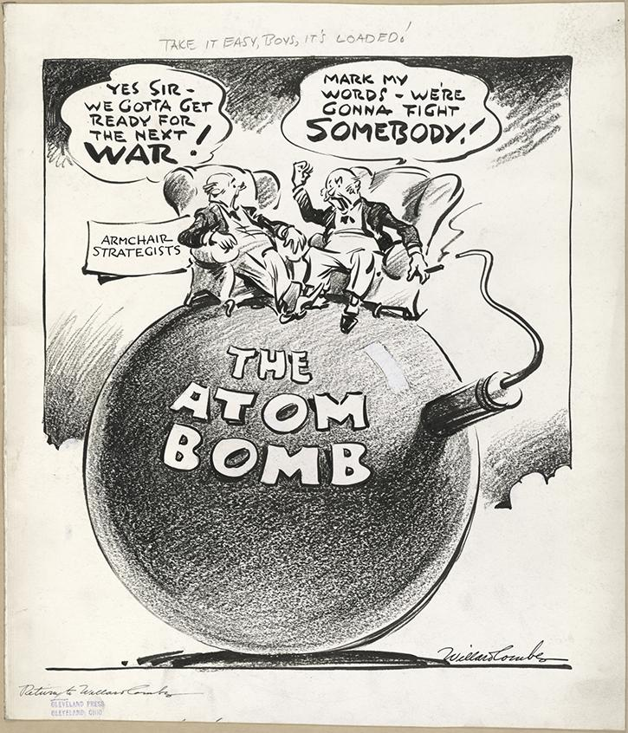
Dawn of the Atomic Age
How the Atomic Bombings Changed the World.
Trinity, Hiroshima and Nagasaki were shots heard around the world. The United States had invented and used a new type of weapon entirely, a weapon that could destroy whole cities or whole bases. They built it, tested it, used it on civilian centers and created a narrative that it ended the deadliest war in human history, and now, was the only nation in possession of a nuclear weapon. The United States had atomic monopoly, and therefore held significantly larger power on the world stage.
Luckily, atomic scientists did recognize the needs of the post-war world, and information from the Manhattan Project was successfully relayed to Soviet scientists who were already engaged in their nuclear program. In 1948, American atomic monopoly was shattered when the Soviets successfully tested RDS-1, a plutonium bomb with a force of ~21 kilotons of TNT like that used at Nagasaki, at a site in the Kazakh SSR.
This created Mutually Assured Destruction, and though the world has lived in fear of nuclear war between the US and USSR or Russia/China, the lack of atomic monopoly has ensured that no nuclear weapon was used on another nation since 1945. Nagasaki is still the last atomic bombing in war.
RDS-1

Slide 25
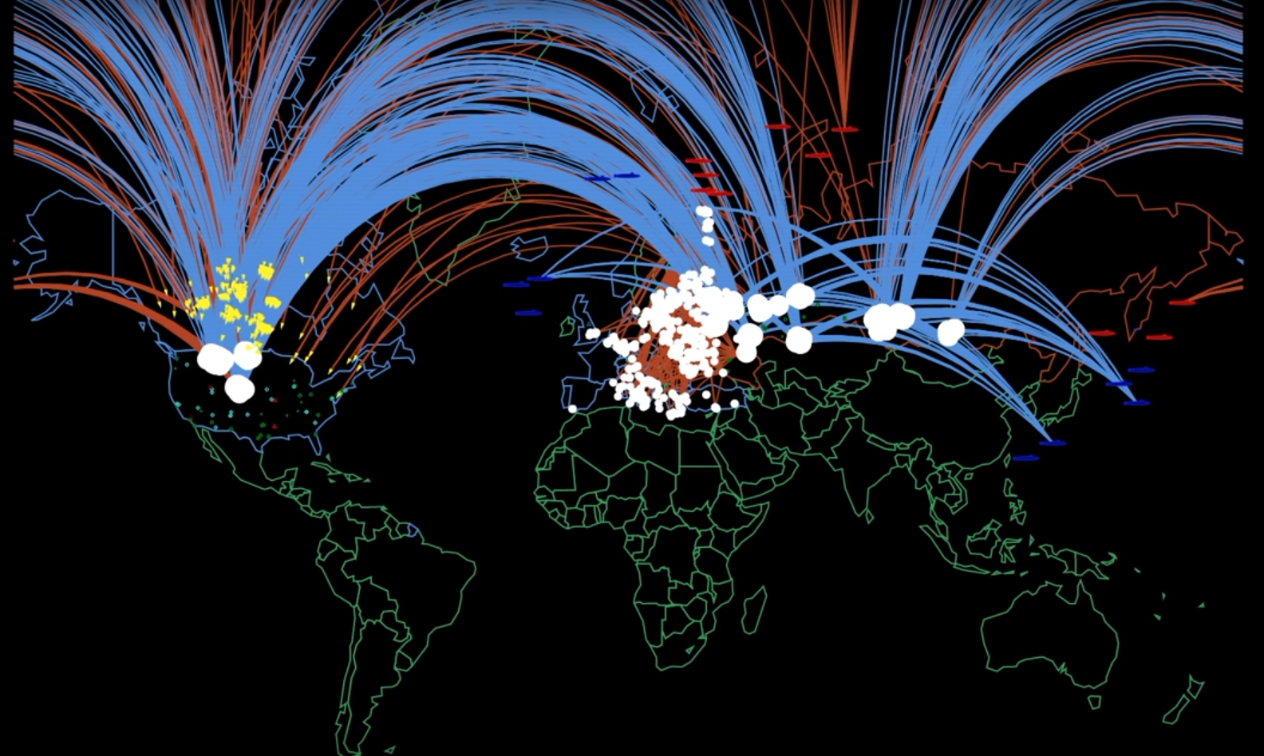
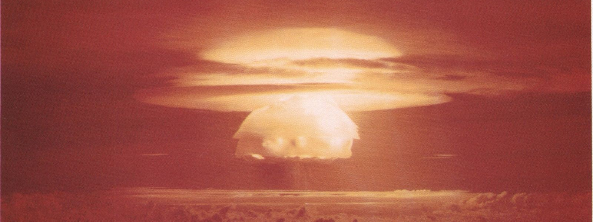
Present Day Nuclear Threat
An URGENT Need to Stop Nuclear War
Humanity is very lucky to have not seen an offensive nuclear attack since Nagasaki. We’ve seen the world come to the brink of nuclear warfare in 1962 with the International Missile Crisis. We’ve seen a lot of nuclear close calls and nuclear blackmail, but we’ve never used the bomb on eachother since 1945.
Today the situation is deteriorating and the United States and NATO are becoming recklessly closer to a Third World War with Russia and China. The United States has nuclear weapons in Germany, Netherlands, Belgium, Italy and Turkey. The Russian Federation has nuclear weapons in Belarus. Recently Russia suspended participation in all nuclear arms treaties by Feb 2023, and Putin claimed US officials were considering restarting American nuclear tests, which they had been according to multiple US outlets as far back as 2019.
With depleted uranium rounds being used in the War in Ukraine, suggestions of providing nuclear weapons to Ukraine, the imminent situation with Taiwan and the Middle East and US possibly looking to restart nuclear testing, the threat of nuclear war is the closest it has been since 1962. This, combined with fascism and militarism arising again, makes the work of anti-imperialism and anti-fascism the most important task of every person, and the ultra-left and liberal efforts to divide the anti-imperialist movement so criminally disgusting. The ultra-left is objectively aiding western imperialism. We say STOP NUCLEAR WAR and STOP NATO!
Per the Bulletin of Atomic Scientists, we are still online 90 seconds to Midnight. Midnight being nuclear war and destruction.

Slide 26
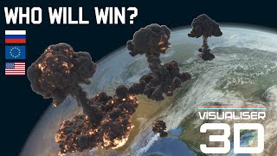
Nuclear War Simulation - *This video may not be accurate, only meant to show you the destruction of nuclear war*

Slide 27
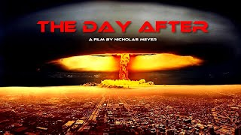
Scene from “The Day After”

Slide 28
Book References:
List of Book References:
Hiroshima - John Hersey I Was There - William D. Leahy Speaking Frankly - James F. Byrnes All in one Lifetime - James F. Byrnes Prompt and Utter Destruction - J. Samuel Walker Hiroshima Nagasaki - Paul Ham Journey To The Missouri - Toshikazu Kase Racing the Enemy - Tsuyoshi Hasegawa American Prometheus: The Triumph and Tragedy of J. Robert Oppenheimer - Kai Bird and Martin J. Sherwin Bomber Offensive - Arthur Harris Henry L. Stimson: The First Wise Man - David F. Schmitz Memoirs of Harry S.Truman

Slide 29
Discussion & Wrap Up

Slide 30
Announcements
We are looking for content submissions for Vol IV 2024 of New Masses! It is in production and we are excited to receive comrades’ art, poetry or prose! Send any submissions to info@partyofcommunistsusa.net and kamryns@johnreedcenter.net. Please send it ASAP!
The Peoples School for Marxist-Leninist Studies regained control of the original PSMLS YouTube channel we lost due to wreckers in 2022. SInce regaining control, we are re-uploading all our videos posted on the other channel since then. Check them out to see what we were talking about back then and make sure to like, share and subscribe to both channels!
PCUSA cell chairs need to be calling the people in their cell and reminding them of the PSMLS classes each week.

Slide 31
Volunteers Needed!
We are in need of volunteers for the staff of the People’s School! Here’s a few roles we need filled:
People to help manage posting on our social media and podcast platforms
Video Editors, Audio Editors, Graphic Designers, Artists, Narrators
Facilitators, Web Controls, Moderators
We will train you for these positions! No experience is fine!
Email info@peoplesschool.us if you’re interested, and we will get you into the roles we need you in.

Slide 32
PSMLS Propaganda
peoplesschool.us/media & peoplesschool.us/store
Materials to help promote the school!

Slide 33
https://aafc.us.org/
The Asian American Friendship Congress (AAFC) is an organization dedicated to struggling against racism and negative perception of Asian peoples.
We recognize that the prejudice experienced by Asian Americans and Pacific Islanders (AAPI) is exacerbated by the corporate elites to create a wedge between working AAPI people and the rest of the American population. We aim to educate the American people on AAPI history in order to demystify prejudices, stereotypes, and negative perceptions of the AAPI community. We also hope to foster closer bonds between the American people and the nations of East Asia and Southeast Asia. The AAFC seeks to normalize relations with these emerging Asian economies, including the Democratic People’s Republic of Korea and the People’s Republic of China.
The AAFC also seeks to promote and preserve the diverse cultures which Asian immigrants have brought to our shores. These rich cultural aspects include cuisine, music, art, and languages

Slide 34
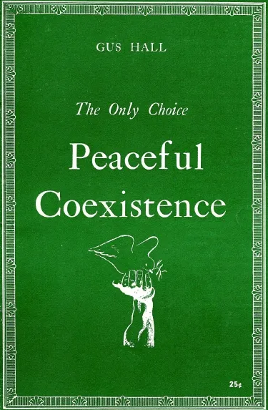
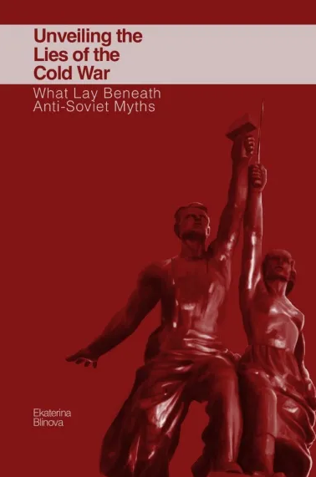
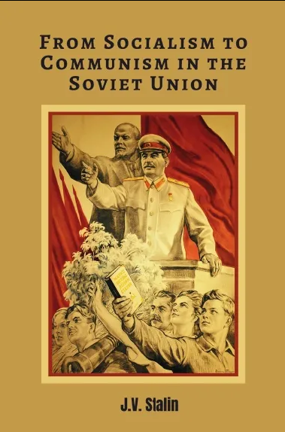
New Outlook Publishers
newoutlookpublishers.store
Relevant Releases
Latest Releases

Slide 35
New Outlook Publishers - Volunteers Needed!
newoutlookpublishers.store
New Outlook Publishers is looking for Volunteers!
NOP is looking for assistance in the following areas:
Formatters
Cover Artists
Please reach out to scottp@johnreedcenter.net if interested and attend the next New Outlook Publishers staff meeting on August 28th 2024 at 8 PM EST.

Slide 36
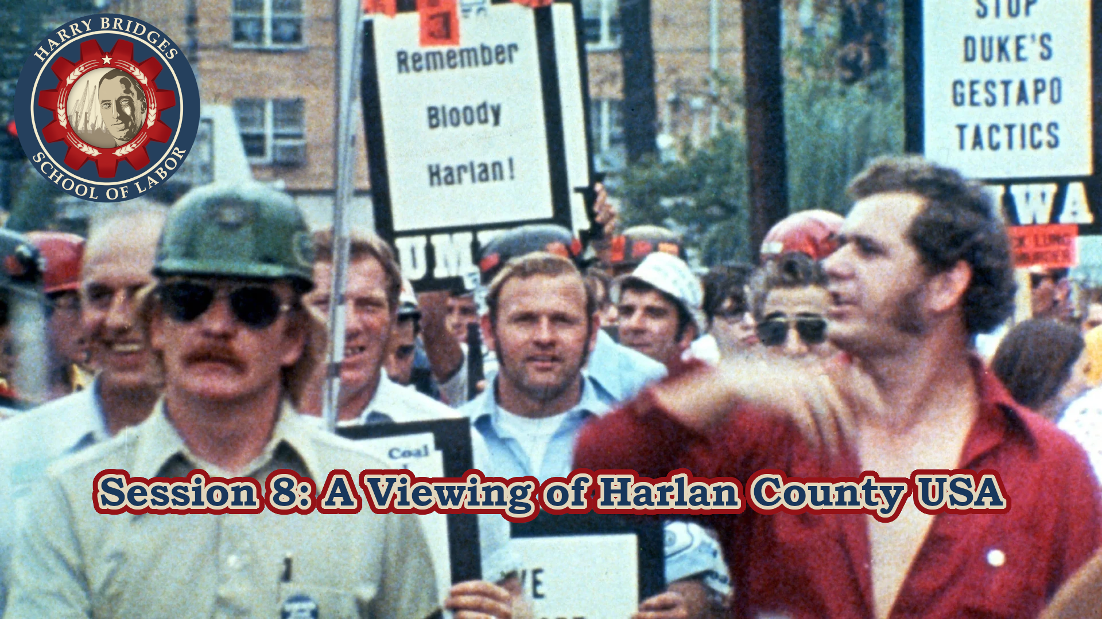
Next month’s session will take place on Wednesday August 7 at 9pm EDT/6pm PDT and Saturday August 10 at 7pm EDT/4pm PDT.
The topic will be: A Viewing of Harlan County USA

Slide 37
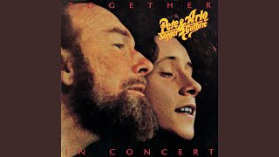
May There Always be Sunshine - Pete Seeger

