Slide 1

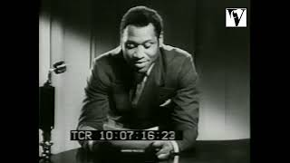
My Song Goes Forth by Paul Robeson

Slide 2
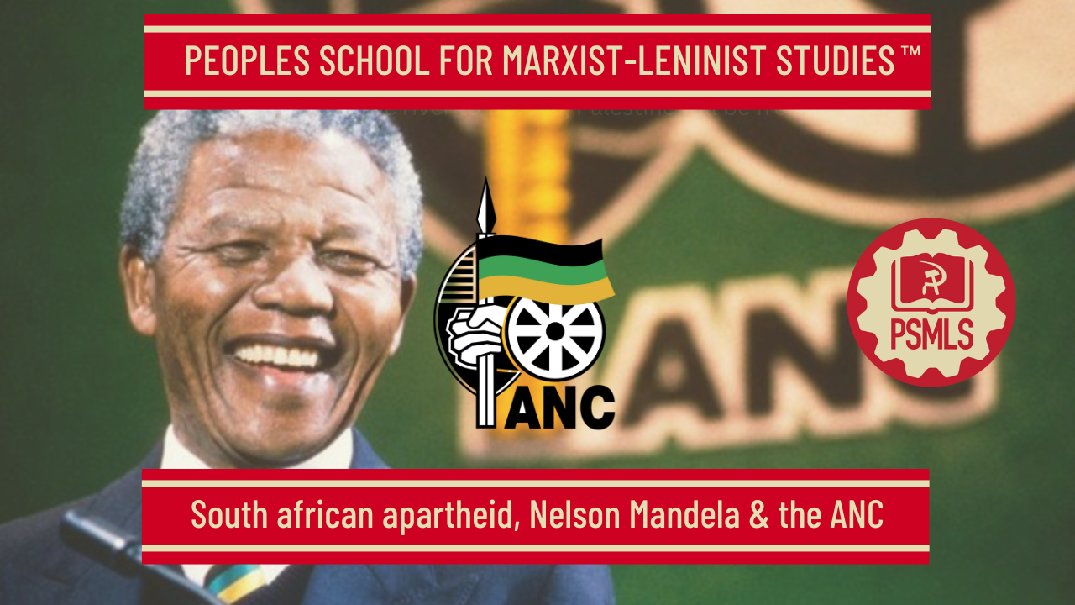
PSMLS 2/24/26

Slide 3
What we’ll be learning today:
South Africa as a colony and commonwealth
Political forces within South Africa
CPUSA’s support, parallels to Black liberation movement in USA

Slide 4
Life Under Apartheid

Slide 5
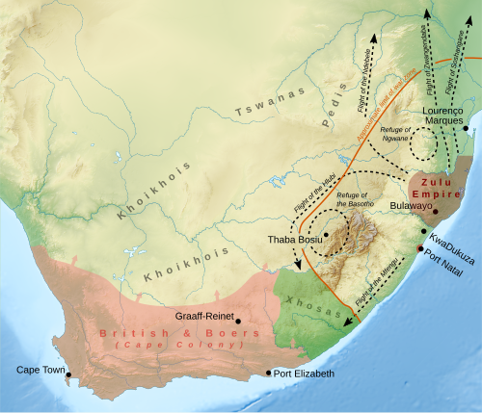
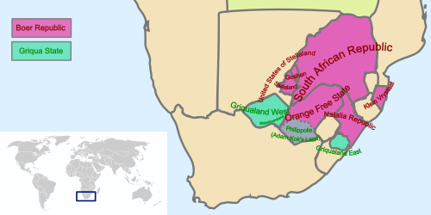
Boer Wars Formation of South Africa
Originally the area now known as South Africa was settled by various tribes such as the Zulu, Xhosa, Ndebele, Swazi, Sotho, Tswana, Pedi, Tsonga, and Venda.
Eventually settled by Dutch and English settlers as various independent republics
These would be conquered by the British during the Boer Wars and united into the Republic of South Africa.

Slide 6
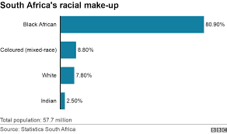
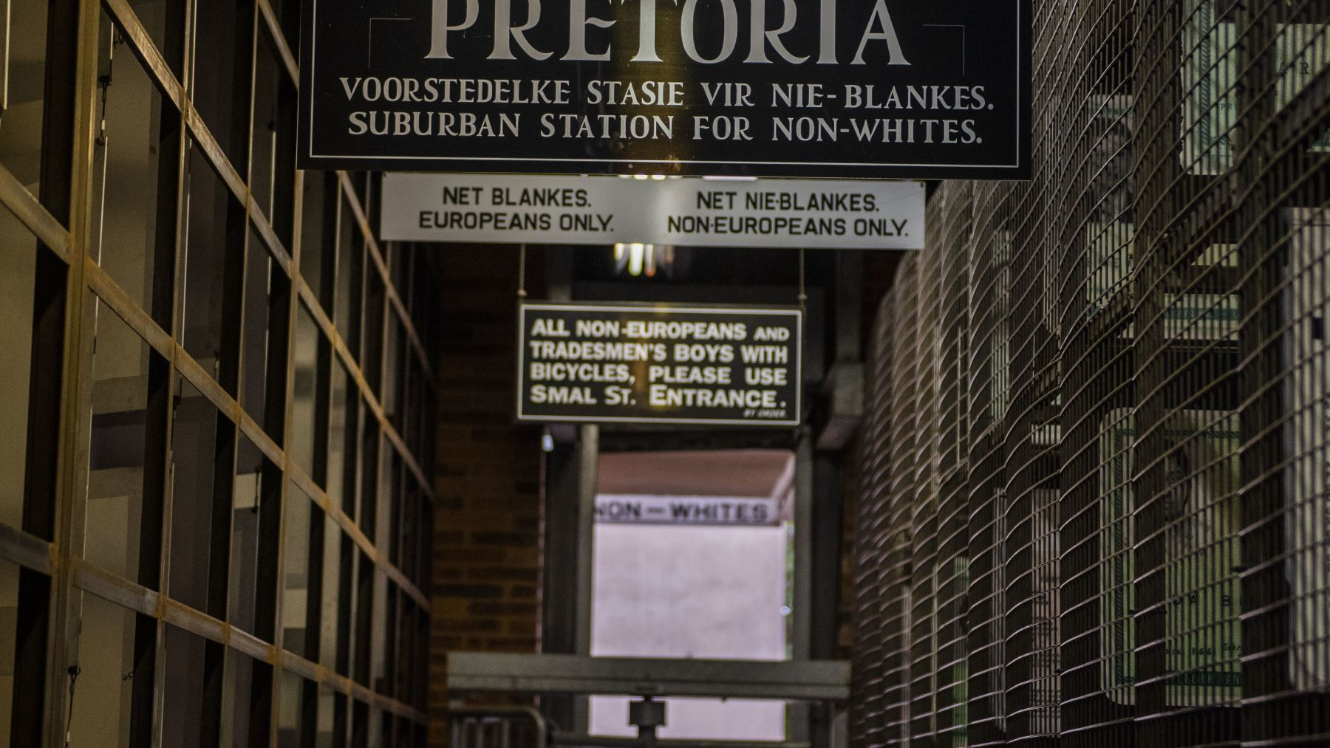
What is Apartheid?
Petty Apartheid vs. Grand Apartheid
Petty Apartheid: Similar to American Segregation in the South, a series of laws designed to separate “races”
Prohibition of mixed marriages
Population Registration Act: separated South Africans into 4 distinct groups with additional subgroups
> Whites
> Indians
> Coloured
> Blacks
Grand Apartheid: Bans where one can live and work based on race
Blacks were forced onto “homelands” where they were only allowed to leave for work
Designed to keep a permanent pool of migratory workers that White South Africans could extract wealth from

Slide 7
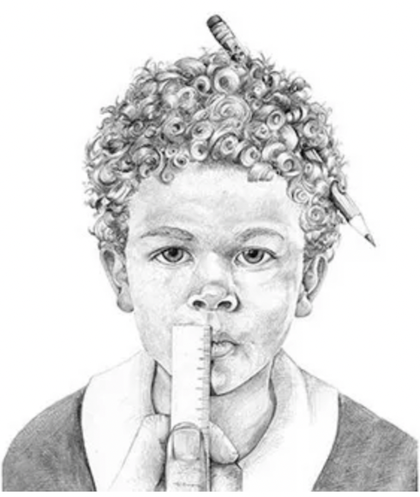
How were people separated?
Minor officials would administer tests to determine a person’s category. These included the pencil test, in which a pencil was shoved into the subjects' curly hair and the subjects made to shake their head, examining the shapes of jaw lines and buttocks, and pinching people to see what language they would say "Ouch" in.
Different members of the same family found themselves in different race groups.
The test documented what language(s) they spoke, their occupation, whether they had paid 'native' taxes in the past, who they associated with, and even what they ate and drank.
Goal was to maintain economic and lifestyle differences

Slide 8
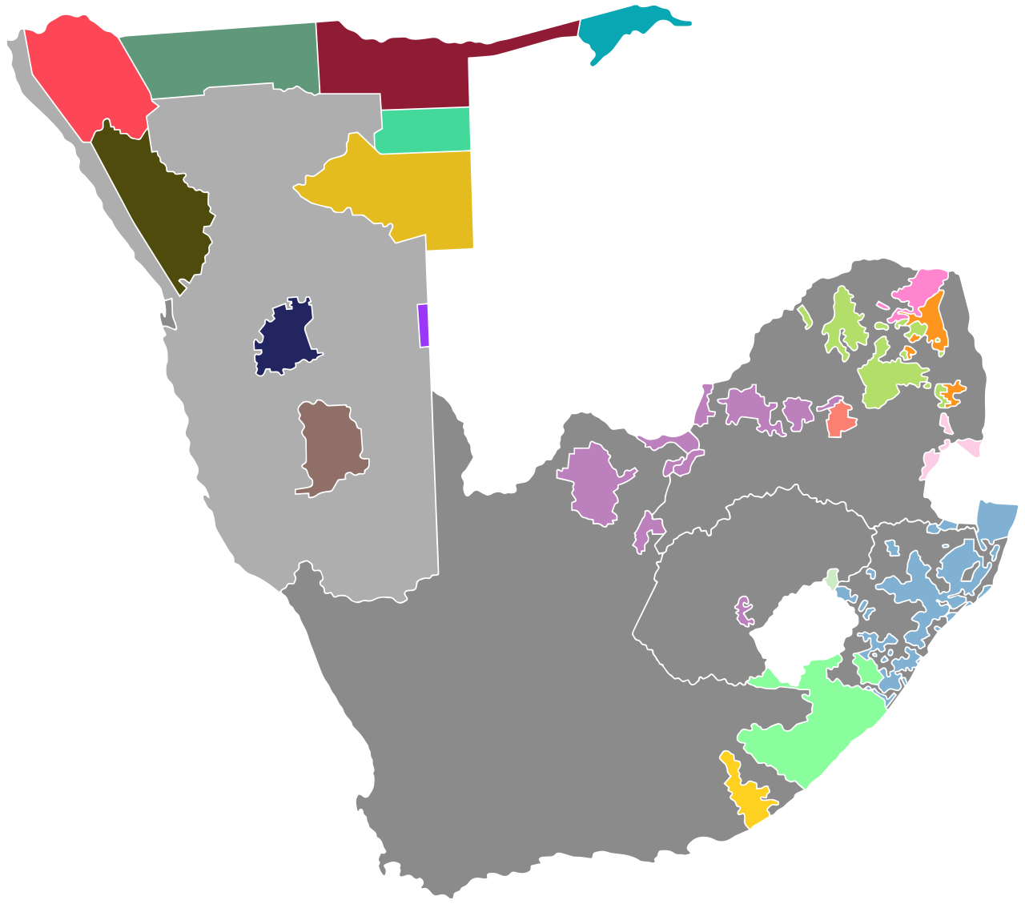
South African “Republics”
Nominally, South Africa was a republic made up of 20 independent “bantustans” (homelands)
  Each Bantustan was reserved for a specific race
  13% of all land in South Africa was reserved for Blacks
Thus, the Indians, Coloured, and Blacks were not citizens of South Africa and had their SA citizenship taken away.
This was the foundation of South Africa’s Grand Apartheid Strategy

Slide 9
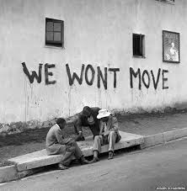
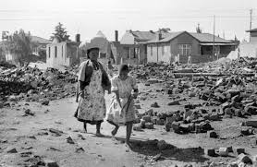
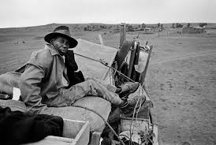
Forced Removal & Separation
Under Apartheid all public and private amenities were separated such as beaches, buses, hospitals, schools and universities.
Signboards such as "whites only" applied to public areas, even including park benches
Black, Asian, and Indian South Africans were provided with services greatly inferior to those of whites.
Each bantustan was responsible for its own police, school, hospitals, and public amenities
  On average, a Black child received 1/13 the funding for a white child

Slide 10
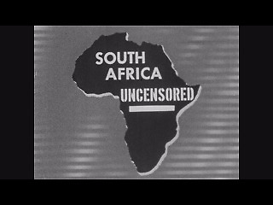
Viewing of South Africa Uncensored
Created by The Council on African Affairs
Narrated by Paul Robeson
From the website of the National Museum of African American History & Culture
https://nmaahc.si.edu/object/nmaahc_2012.79.1.5.1a
Time Stamps:
11:55 - 14:49

Slide 11
Discussion

Slide 12
Political Forces in South Africa

Slide 13
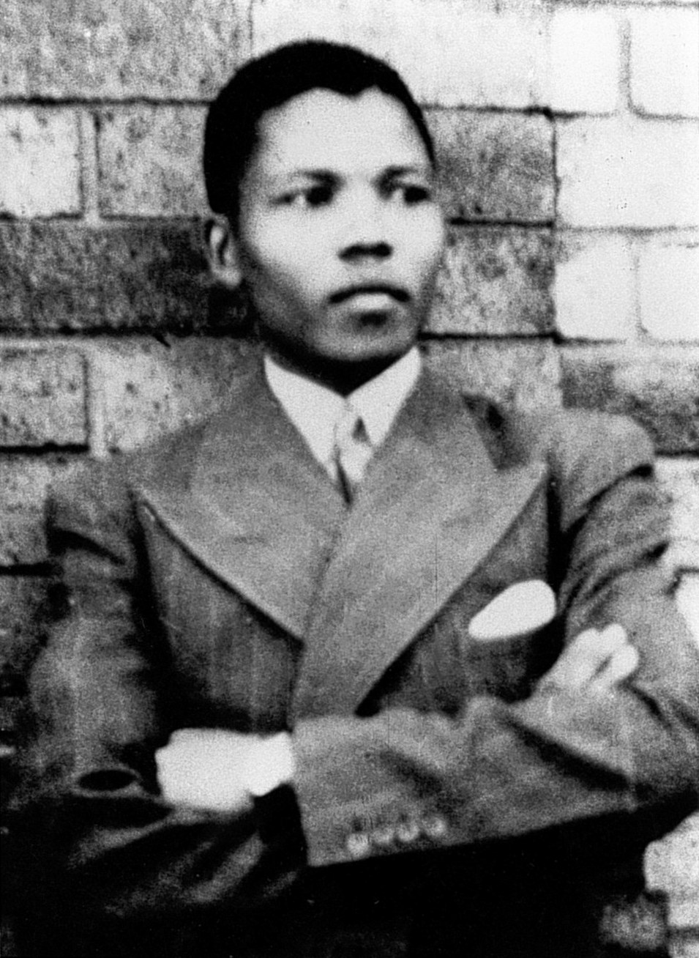
Nelson Mandela - The Father of the Nation
When apartheid is finally dead and buried and gets an epitaph in the form of a few lines in the encyclopedias, the 1980s will bring to mind not Pieter Botha's reforms but the image of Nelson Mandela, his boundless devotion to the ideals of freedom and his almost holy self-sacrifice. In the torture-chambers he has not only remained the leader of his people; his influence has been growing steadily owing to some secret laws of justice that always prove righteous. Political prisoners are as silent as the dead. Yet their silence is more eloquent than any words. Their suffering and courage, and their firm belief in victory and in the triumph of justice add to the spiritual strength of the people and show them the right path. Prison increases the attractiveness of the personality and ideas of a man convicted in an unfair trial. He becomes a hero, a martyr—and against this all power is useless. Attempts to stifle the voice of a popular leader through imprisonment, exile and other punishments have always produced the opposite effect. At all times the people have recognized as their leaders those who value conscience and truth more than anything else.

Slide 14
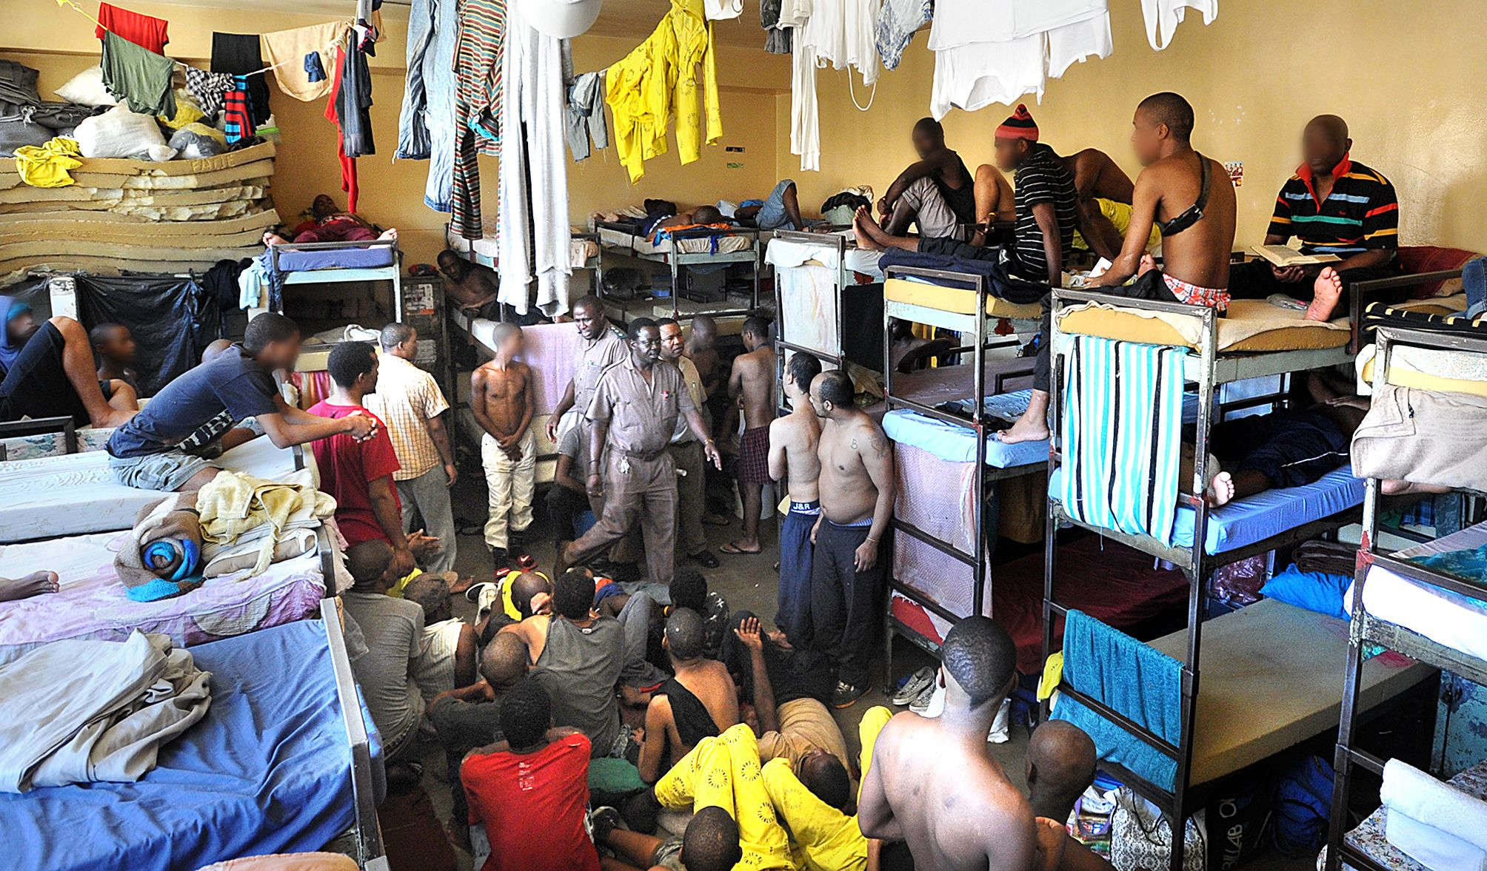
Nelson Mandela - The Father of the Nation
In almost every African country the colonialists filtered the black political leaders of the future through the prison cells. Nelson Mandela occupies a special place among them. His sentence—life imprisonment plus five years—might seem to have blasted all hopes of freedom and to have dealt a fatal blow to the anti-apartheid movement. In the horrible prison on Robben Island, where political prisoners were forced to quarry stone, and later on in the tough-regime Pollsmoor prison, Mandela remained a kind of shadow leader of the entire black population. Mandela's voice has not been heard for many long years.
In the remand center of Pollsmoor, detainees are often more than 70 in a cell designed for 19
Nevertheless, black South Africans are proud of him because during the toughest times, when the racist hysteria was at its height, he dared to hurl defiance at apartheid's machine of repression, because in the darkest period of South Africa's recent history he sowed the seeds of hope which have sprouted so luxuriantly today.

Slide 15
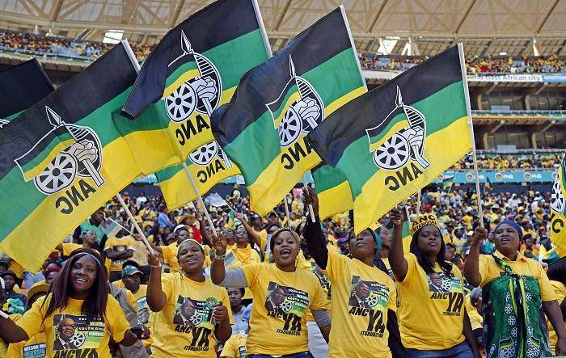
Birth of the ANC
Called the South African Native National Congress until 1923, the ANC was founded as a national discussion forum and organised pressure group, which sought to advance black South Africans’ rights at times using violent and other times diplomatic methods. Its early membership was a small, loosely centralised coalition of traditional leaders and educated, religious professionals, and it was staunchly loyal to the British crown during the First World War. It was in the early 1950s, shortly after the National Party’s adoption of a formal policy of apartheid, that the ANC became a mass-based organisation. In 1952, the ANC's membership swelled during the uncharacteristically militant Defiance Campaign of civil disobedience, towards which the ANC had been led by a new generation of leaders, including Nelson Mandela, Oliver Tambo, and Walter Sisulu. In 1955, it signed the Freedom Charter, which – along with the subsequent Treason Trial – cemented its Congress Alliance with other anti-apartheid groups.

Slide 16
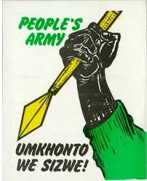
The ANC and the Communists Go Underground
At the turn of the decade, a series of significant events in quick succession changed the course of the movement. First, in 1959, a group of dissidents broke away from the ANC to form the rival Pan Africanist Congress, objecting to the ANC's new programme of multi-racialism as embodied in the Freedom Charter. This was one of two significant splits in the ANC on the basis of its racial policies – in 1975, the so-called Gang of Eight was expelled for objecting to the ANC's 1969 decision to open its membership to all races. The second major shift came when in March 1960, following the Sharpeville massacre, the ANC was banned, marking the beginning of a period of escalating state repression. Forced underground, the ANC and South African Communist Party (SACP) founded Umkhonto we Sizwe (MK), which was to become the ANC's military wing. Announcing the beginning of an armed struggle against apartheid, MK embarked upon a sabotage campaign.

Slide 17
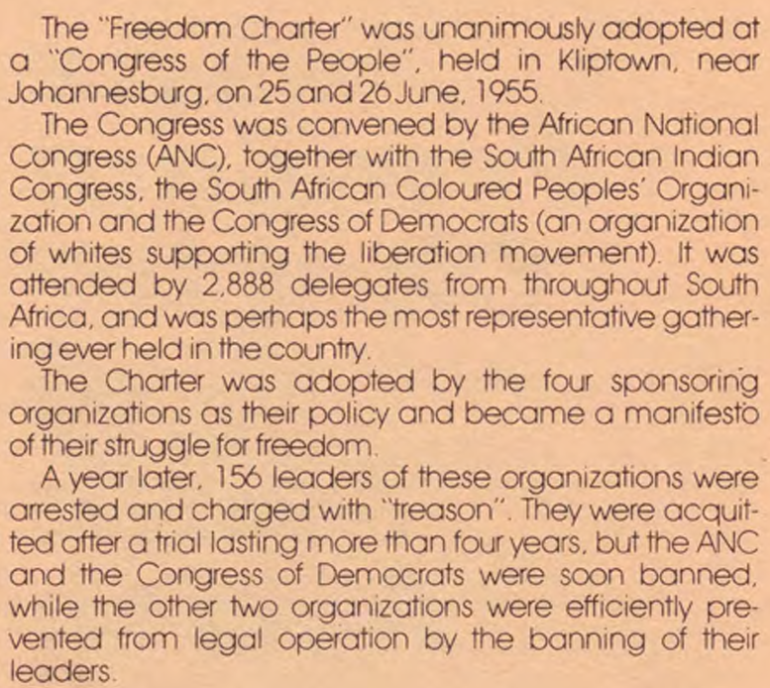
International Pressure: Increased global sanctions and isolation in the 1980s weakened the regime.
Negotiation (1990–1994): Following intense internal revolt and economic decline, the NP, led by F.W. de Klerk, unbanned liberation movements (ANC/PAC) and released Nelson Mandela, leading to the first democratic elections in 1994.

Slide 18
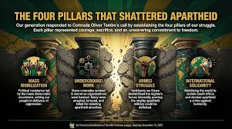
The ANC Wins Power
By 1965, pursuant to the imprisonment of many of its top leaders in the Rivonia Trial and Little Rivonia Trial, the ANC was forced into exile. It remained in exile until it was unbanned in 1990. For most of this period, the ANC was led by Tambo, headquartered first in Morogoro, Tanzania, and then in Lusaka, Zambia, and primarily supported by Sweden and the Soviet Union. Its exile was marked by an increasingly close alliance with the SACP, as well as by periods of significant unrest inside MK, including the Mkatashinga mutinies in 1983–84. Throughout these years, the ANC's central objective was the overthrow of apartheid, by means of the "Four Pillars": armed struggle; an internal underground; popular mobilisation; and international isolation of the apartheid regime. The ANC was unbanned on 2 February 1990, and its leaders returned to South Africa to begin formal negotiations. Following his release, Mandela was elected president of the ANC at its 48th National Conference in 1991. Pursuant to the 1994 elections, which marked the end of apartheid, the ANC became the majority party in the national government and most of the provincial governments, and Mandela was elected national president. The ANC has retained control of the national government since then.

Slide 19
The History of the Communist Party in South Africa
The history of communism in South Africa began with the formation in 1921 of the Communist Party of South Africa (CPSA). The party was entirely white, as was the majority of organized labor—its main constituency. The CPSA attempted to fight for equality of black and white workers, but white labor refused to desegregate, and the party’s support among Africans was practically nonexistent. In 1928, the Communist International (Comintern), of which the CPSA was a member, sent it an instruction to work for an “independent native republic.” This slogan helped the party to attract a black membership, but resulted in much infighting. The CPSA’s position strengthened during World War II, but in 1950, after Afrikaner nationalists came to power, the party was banned. It re-emerged in 1953 as the underground South African Communist Party (SACP). Since then, the party has worked closely with the African National Congress (ANC). Many of its cadres were simultaneously ANC members. In 1955, communists helped to formulate the Freedom Charter, the ANC’s overarching program. In 1960, the SACP launched the armed struggle against apartheid. The ANC took the nascent liberation army under its wing in 1963. In the early 1960s, many party members, including Nelson Mandela, were arrested or forced into exile. The party had a deep ideological influence on the ANC: from 1969, its ideas on South Africa as a colony of a special type and on the National Democratic Revolution (NDR) have become part of all ANC programs. After the end of apartheid, communists occupied important positions in all ANC governments.

Slide 20
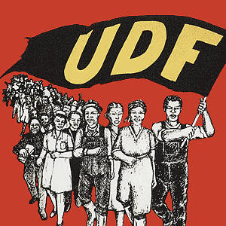
Other Political Forces in South Africa
COSATU/FOSATU - Powerful labour unions in South Africa that organized widespread strikes and stay-aways, particularly in the 1980s, severely impacting the economy.
United Democratic Front - South African popular front that existed from 1983 to 1991. It comprised more than 400 public organizations including trade unions, students' unions, women's and parachurch organizations. The UDF's goal was to establish a "non-racial, united South Africa in which segregation is abolished and in which society is freed from institutional and systemic racism."
Afrikaner Resistance Movement - a white supremacist separatist group aiming to establish a Boer state.

Slide 21
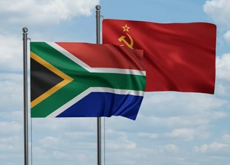
Support from the USSR
The Soviet Union played a huge role in supporting anti-apartheid in South Africa. The Communist Party of South Africa (CPSA), established in 1922, was a member of the Communist International (Comintern).
After the Sharpeville Massacre and the banning of the ANC and Pan Africanist Congress (PAC), more formal relations began to be established between anti-apartheid movements and the USSR’s official agencies.
The USSR provided significant funding, military training, and arms to the African National Congress (ANC) and South African Communist Party (SACP) to combat the apartheid government.
USSR backed movements such as SWAPO in Namibia and the MPLA in Angola, creating direct friction with the South African government, which intervened in these regions to prevent these national liberation movements from taking hold.

Slide 22
Discussion

Slide 23
CPUSA’s Support & Parallels to Black Liberation Movement in USA

Slide 24
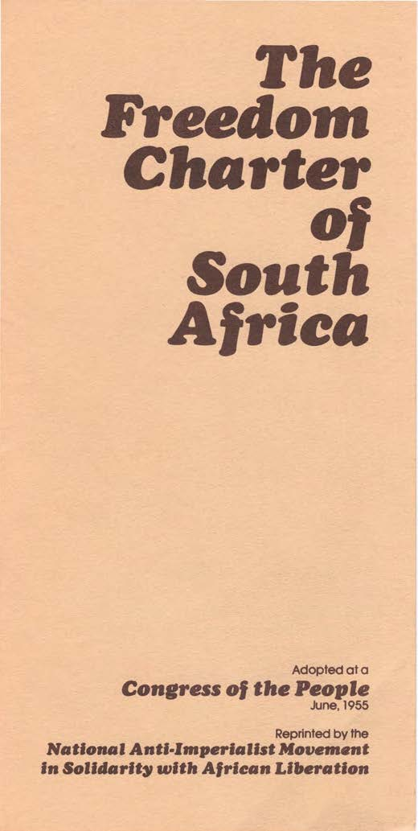
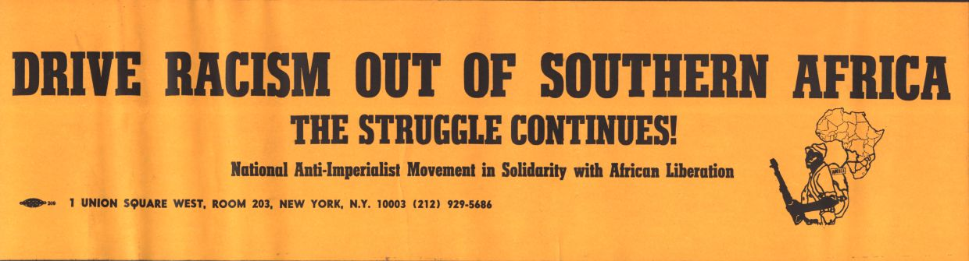
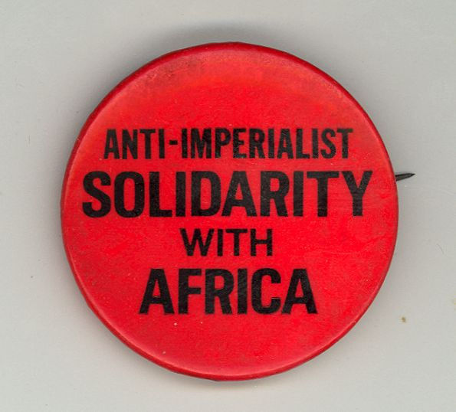
National Anti-Imperialist Movement Solidarity with South African Liberation (NAIMSAL)
NAIMSAL was founded in the early 1970s by the Communist Party USA (CPUSA), more specifically Henry Winston, in order to support South African liberation movements such as the African National Congress (ANC) and the South African Communist Party (SACP).
Used to unite the anti-racism struggle in the U.S. with the struggle against imperialism in Africa.
NAIMSAL held protests, conferences, and campaigns across the U.S.

Slide 25
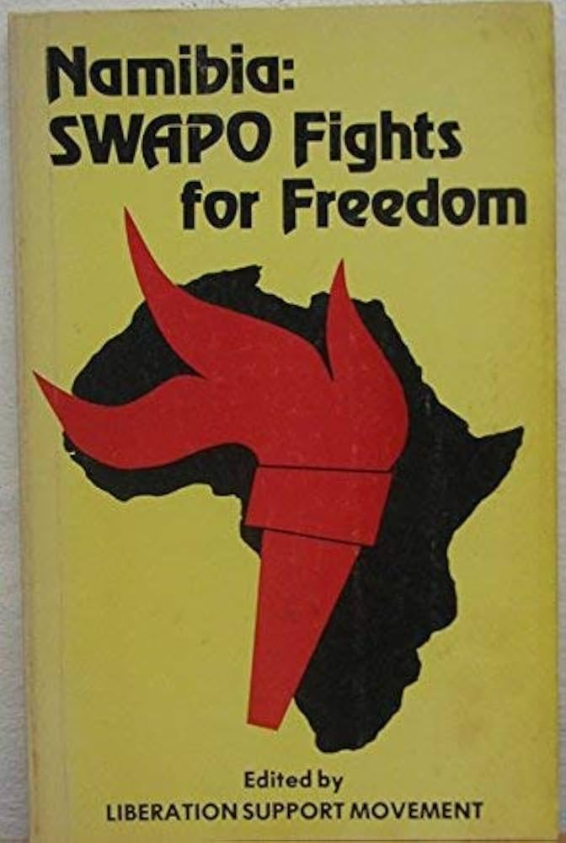
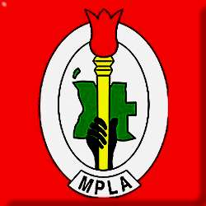
National Anti-Imperialist Movement Solidarity with South African Liberation (NAIMSAL)
Also supported other liberation movements such as, the South West Africa People's Organization (SWAPO) in Namibia, the People's Movement for the Liberation of Angola (MPLA) in Angola, and the Zimbabwe African National Union/Zimbabwe African People's Union (ZANU/ZAPU) in Zimbabwe.
Socialist activists such as, Charlene Alexander Mitchell, and other organizations such as, the National Alliance Against Racist and Political Repression (NAARPR).
Operated until the early 1990s where it fought against Apartheid, white minority rule in Rhodesia, and U.S. corporate exploitation in South Africa.

Slide 26
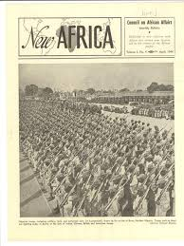
Council on African Affairs (CAA)
Founded in 1937 in the United States, it emerged as the leading voice of anti-colonialism and Pan-Africanism in the United States and internationally.
Paul Robeson served as the CAA's chairman for most of its existence while W. E. B. Du Bois served as vice-chair and head of the Africa Aid Committee.
The CAA articulated and promoted a fundamental connection between the struggle of African Americans and the destiny of colonized peoples in Africa, Asia and elsewhere in the world.
It publicized the connections between their campaigns in Africa and its larger critique of colonialism and capitalism via its monthly bulletin New Africa.
Most significant work took place in relation to South Africa. It supported striking black miners and helped direct worldwide attention to the African National Congress's struggle against the Union of South Africa government and its policy of imposing racial apartheid.

Slide 27
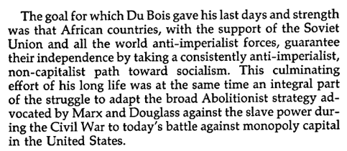
DuBois’s Original Meaning of “Pan-African Solidarity”
“Pan-African Solidarity” as explained by W.E.B. DuBois is focused on uniting people of African descent globally, both those in Africa and the global diaspora, to fight together against colonialism, racism, and exploitation of Africans and African descendants.
In 1900 with a strong focus on World War I, DuBois organized Pan-African Congresses to help expose the struggles of Africans to the international stage.
DuBois criticized the atrocities of European Colonial rule and sought for self-determination and equality for Africans.
He urged for Black people around the world to unify and share an identity that emphasized and represented a common history and destiny.
Believed in the economic self-reliance and global empowerment of African peoples.
Strategy for a Black Agenda by Henry Winston p. 16

Slide 28
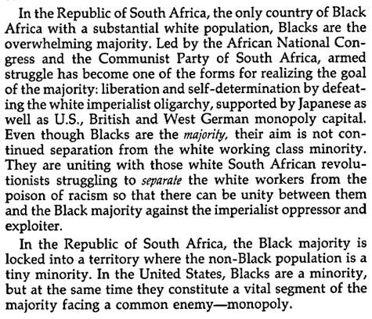
DuBois’s Original Meaning of “Pan-African Solidarity”
Strategy for a Black Agenda by Henry Winston p. 17

Slide 29
Viewing of South Africa Uncensored
Created by The Council on African Affairs
Narrated by Paul Robeson
From the website of the National Museum of African American History & Culture
https://nmaahc.si.edu/object/nmaahc_2012.79.1.5.1a
Time Stamps:
17:36 - 21:06 (end)

Slide 30
Discussion & New Members Introductions

Slide 31
New Member Introductions
What is your name, pronouns and state (or country/territory)?
Where do you work? Is it unionized?
How did you find out about the People’s School?
What do you think about tonight's class?

Slide 32
Discussion & Wrap Up

Slide 33
Announcements
PCUSA Cell Chairs need to call members of their cells to remind them about attendance.
The next issue of New Masses (2026) has begun production. If you have art you want us to feature, email it to info@partyofcommunistsusa.net.

Slide 34
Volunteers Needed!
We are in need of volunteers for the staff of the People’s School! Here’s a few roles we need filled:
People to help manage posting on our social media and podcast platforms
Video Editors, Audio Editors, Graphic Designers, Artists, Narrators
Web Controls, Moderators
Email info@peoplesschool.us if you’re interested and try to attend our next staff meeting if possible.

Slide 35

View From Left Field
https://viewfromleftfield.libsyn.com
The Old PSMLS Youtube is now the Youtube of View From Left Field, a podcast of analysis and discussion of current events from a progressive perspective.
Like the Youtube videos and subscribe with 5 star ratings on your podcast platforms.

Slide 36

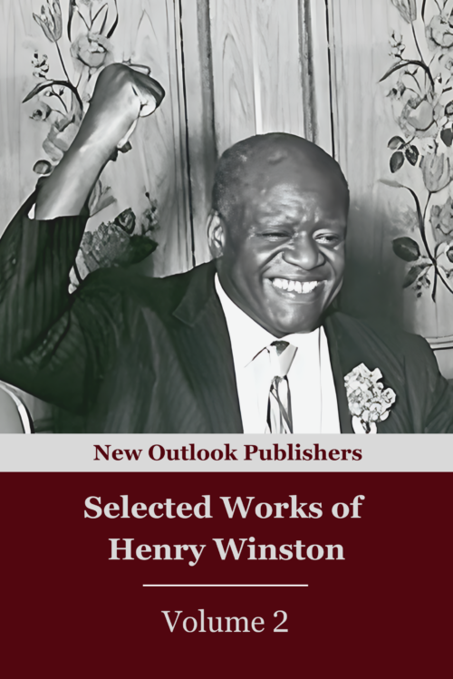
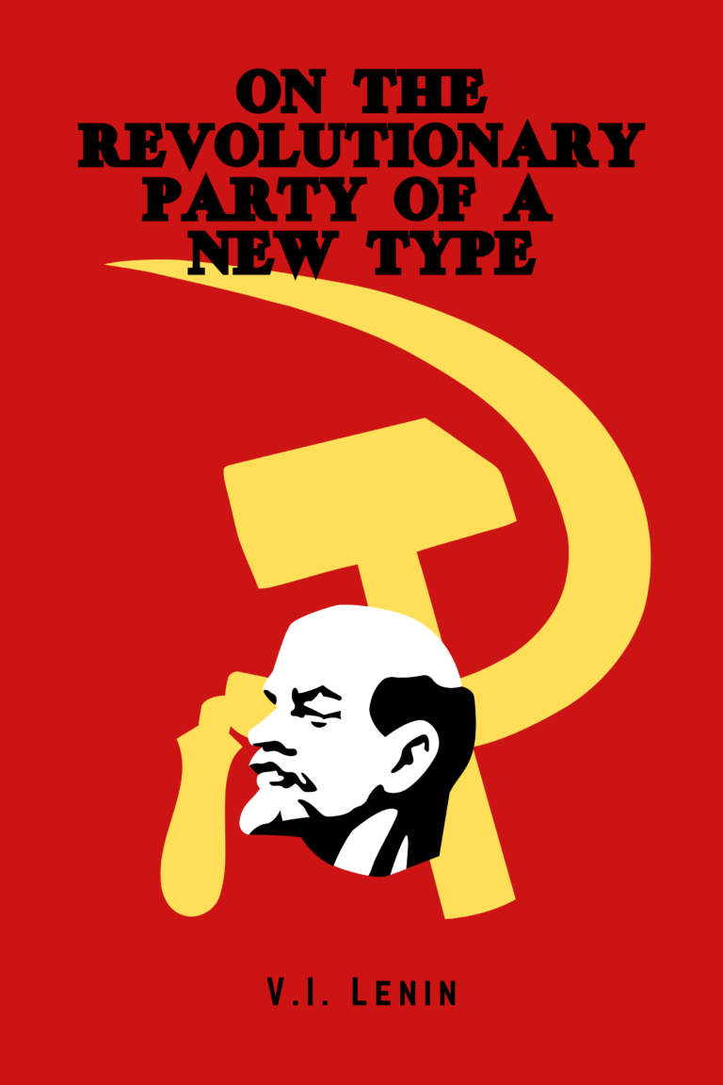

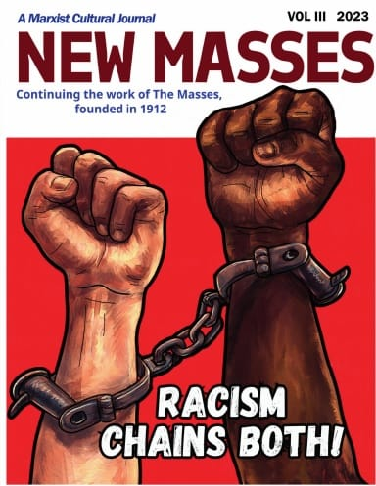
New Outlook Publishers
newoutlookpublishers.store
Relevant and Latest Releases

Slide 37



Harry Bridges School of Labor
luel.us/laborschool/
The Harry Bridges School of Labor is a monthly class covering a variety of topics aimed at building class consciousness among union members. For class schedule and other information, please visit the website at luel.us/laborschool.

Slide 38
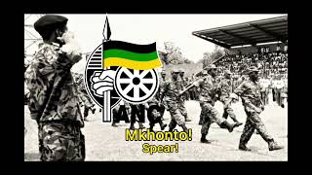
Hamba kahle Mkhonto - South African Anti-Apartheid Song

