Slide 1

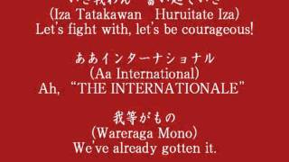
Click Insert -> Click Video -> Past Youtube link to song you want -> select song when it pops up
The Internationale (Japanese Version)

Slide 2
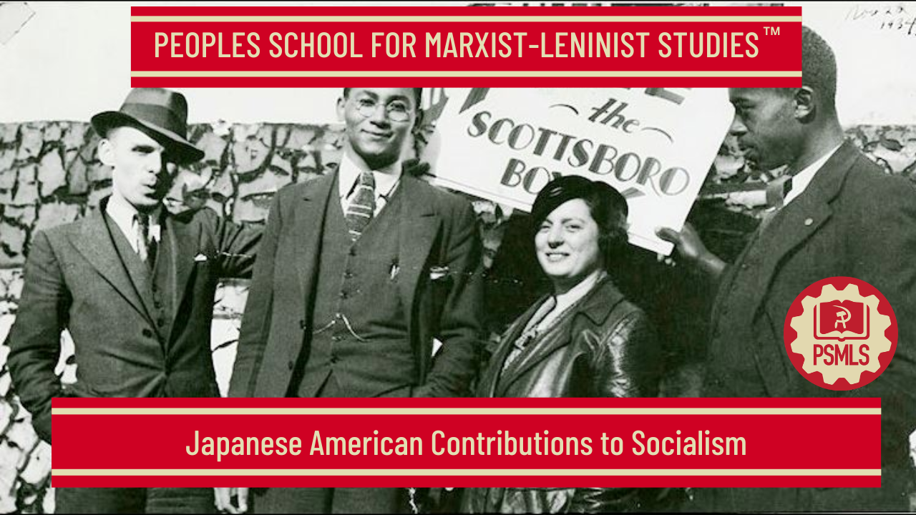
PSMLS 05/26/2026

Slide 3
What we’ll be learning today:
Background on Sen Katayama
Background on Karl Yoneda
Highlighting more AAPI Activism

Slide 4
Sen Katayama: Trade Union Pioneer, International Anti-War Hero, and Foundational Bolshevik Leader

Slide 5
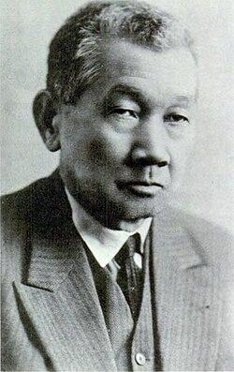
Karl Yoneda on Sen Katayama
The following are excerpts from The Heritage of Sen Katayama, an article written by Karl G. Yoneda for Red Star Publishers, which was intended to “give an insight into Katayama’s unique participation, guidance and leadership in the world revolutionary movement. It is full of experiences and lessons which should be known and shared by all, in order to illuminate our path to socialism.” Sen Katayama’s contributions to the Marxist-Leninist revolutionary movement in the United States, Mexico, Canada and Japan, as well as to the oppressed peoples in colonial and semi-colonial countries, are manifold and almost beyond imagination.
He is remembered by veterans of the movement in North America, Europe and Asia as a staunch anti-war fighter since 1900 and later as one of the founders and co-workers of the Communist Parties of the USA, Mexico and Canada. At the same time, he is renowned in Japan as “the father of Japan’s labor movement,” one of the organizers of the Communist Party of Japan, and as an advisor to the oppressed peoples in Asia, Africa and other sections of the world.

Slide 6
Proletarian Origins
Sen Katayama was born on December 3, 1859, on a farm in the village of Hadeki, Okayama Prefecture, Japan. For generations male members of his family were village headmen, but his father abandoned family, farm and position to become a Buddhist priest. From the 8th century, when serfs’ resistance to slave conditions is first recorded, Japan had numerous peasant uprisings and “rice riots.” No mention of specific women’s actions is made until 1866, when housewives of the Nishinomiya ghetto near Kobe started one of the biggest “rice riots,” demolishing rice warehouses, pawnshops, demanding lower rice prices, etc.—a movement which spread to Osaka and Tokyo. Katayama’s birthplace and adjacent villages were no exceptions to the ferment. Major demands were for lower taxes and abolition of feudal regulations, including the village headman system. During a revolt in 1873, his brother was removed as village headman and imprisoned for participating in the uprising. His uncle was also arrested and fined. This left its mark on the young Katayama, who was then 14 years old and had to become the sole support for his mother and himself. He worked as a wood chopper, farm-helper, straw product maker and charcoal producer. At the same time, having an overpowering desire to attain a formal education, he attended classes in the village private school and became a grammar school teacher at the age of 18. Four years later he went to Tokyo to acquire a higher education. There, while working as a printer under appalling conditions of exploitation, he continued his studies. In later years, his experiences as a farm worker and printer were to give Katayama a keen understanding of the problems faced by workers.

Slide 7
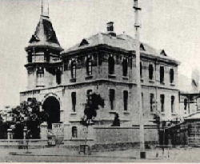
The First Trade Union in Japan
After studying and working in the U.S. for more than 12 years Sen Katayama returned to Japan in 1896. He found that Japan’s military victory in the Sino-Japan War (1894-95) had made Japan not only the imperial ruler of Korea and Formosa but a new upcoming capitalist nation, with intolerable working conditions in the iron, machine, textile and shipbuilding factories that had mushroomed throughout the land. He started Kingsley Hall in Tokyo, patterned upon observations made in England, and also set up an orientation program for those desirous of migrating to the U.S. Many Issei (Japan born) who came here in that period were briefed by him. However, sensing the urgency of organizing workers, Katayama, together with newspaperman F. Takano, tailor H. Sawada and shoemaker T. Jo, formed the Brotherhood of Labor in 1897. Significantly, the latter three and several others had headed a group in San Francisco in 1890 which had studied the American Federation of Labor program so they could establish unions in Japan. The first trade union in Japan came into being on December 1, 1897, when over 1,100 iron workers were formally organized into the Iron Workers Union with Katayama elected its paid secretary.
The inaugural meeting of the Ironworkers' Union was held at the Seinen Hall in Kanda-Mitoshirochô

Slide 8
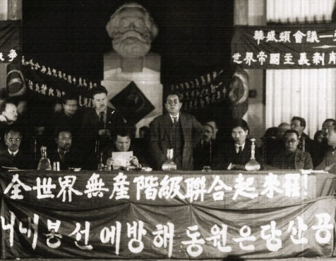
“I Will Be the Bleeding Mouth from Which the Gag has Been Snatched. I Will Say Everything”
Katayama began to publish a monthly, Labor World, in Japanese and English simultaneously. The tone and spirit of the Japanese labor movement at that time was reflected in his papers statement of principles: “The people are silent. I will be the advocate of this silence. I will speak for the dumb; I will speak for the despairing silent ones; I will interpret stammering; I will interpret the grumblings, murmurings, the tumults of the crowds, the complaints, the cries of men who have been so degraded by suffering and ignorance that they have no strength to voice their wrongs. I will be the word of the people. I will be the bleeding mouth from which the gag has been snatched. I will say everything.” (Sen Katayama, The Labor Movement in Japan, p. 39, Chicago, 1918.) The labor movement in Japan made tremendous strides; many unions were organized and countless strikes conducted with the help and encouragement of Katayama. The lasting title “Father of the Japanese Labor Movement” was bestowed on him as a result of these activities.
Sen Katayama Speaking at the First Congress of Communist and Revolutionary Organizations of the Far East in Moscow, 1922

Slide 9
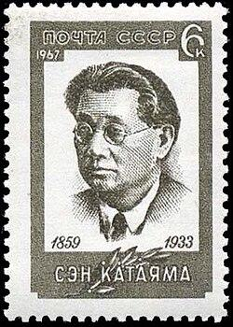
Organizing Japanese Immigrants in the US for Peace
The call for delegates to the Sixth Congress of the Second International, scheduled for August 1904 in Amsterdam, reached Japan in December of 1903. Japanese socialist groups considering Katayama to be the most qualified among them, designated him as their representative.
On the way to Amsterdam, Katayama arrived in Seattle in January 1904. There he met not only with local Japanese socialists, but leaders of the Socialist Party of America (SPA), and under its auspices plunged into a speaking tour on “The Socialist and the AntiWar Movements in Japan.” While audiences on the Pacific Coast were predominantly Japanese workers, meeting halls everywhere were packed; the response was beyond expectations; his anti-war message was especially well received. After the official declaration of the Russo-Japan War on February 10, 1904, Lenin wrote “An Appeal to the Russian Proletariat” which ended with the slogan “Long Live the Japanese Social Democrats Who Are Protesting the War!”
Postage stamp issued in the USSR in 1967, with a portrait of Sen Katayama

Slide 10
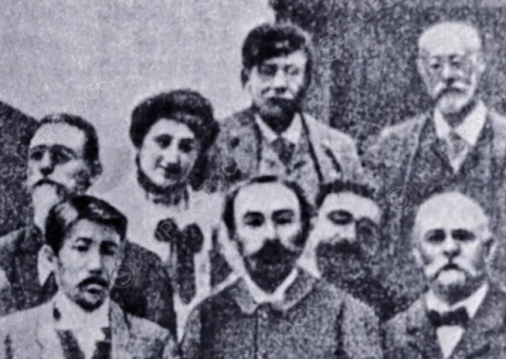
Establishing a Global Reputation as an Anti-War Socialist
May 1904 found Katayama in Chicago attending a national convention of the SPA: “I have never shaken hands nor conversed with so many people as at the Socialist Party banquet where 500 invited guests and 400 party delegates, including many known socialist leaders as Debs,... The M.C. asked me to say a few words which were received with tremendous enthusiasm. It was a remarkable sight to see so many nationalities including Russians, Poles, Africans and others gathered under the same roof with one principle—Socialism.” With great enthusiasm Katayama went on to Amsterdam to participate in the Second International Congress proceedings. George Plekhanov, a Russian delegate, and he were chosen co-vice chairmen. Upon being introduced to the assemblage, they shook hands, each pledging to fight against the Russo-Japan War. After Katayama’s address, which he delivered in English, was translated into German by Clara Zetkin and into French by Rosa Luxemburg, everyone stood and applauded for several minutes. Thus was his international anti-war reputation established. It was to continue not only throughout his lifetime but to this day.
Depiction of Some Members of the 1904 Amsterdam Congress

Slide 11
Return to Socialist Activity in Japan
Upon returning to Japan in January 1906, Katayama became part of the mainstream of its socialist activity. With his assistance a required government permit was obtained and the Japan Socialist Party (JSP) was activated in February. During its one year existence before the Japanese government ordered it to dissolve, the JSP was confronted with two different ideologies—Katayama’s group advocated use of the electoral process, whereas Kotoku— an avowed anarchist—and his followers asserted that only “direct action” would bring successful overthrow of the bourgeoisie. In spite of the imperial government’s constant repressive actions, Katayama went on speaking tours, during which he never failed to advise those in attendance to “read and study the books of Marx and Engels.” The effective agitation and propaganda carried on by Katayama and his group resulted in 6,000 Tokyo streetcar engineers and conductors going on strike. The strikers won their demand for a year-end bonus. Soon after, police arrested Katayama and over 150 others on the charge of “inciting workers to strike.” During the ensuing trial, the prosecutor characterized Katayama as “a tiger with sheepskin and the most dangerous person in Japan.” He received the heaviest jail term— five months. By the year 1914, subjected to persistent government persecution in Japan, Katayama decided to come to the U.S. “to appeal to comrades abroad to help Japan’s socialist movement.” Leaving his second wife and three children behind, he landed in San Francisco, residing in the home of long time friends, Mr. and Mrs. S. Oka. Yasuko, his 15-year old daughter, later joined him.

Slide 12
The World-Shaking Impact of the Bolshevik Revolution
News of the 1917 Russian revolution was to bring inspiration and encouragement to millions throughout the world and Katayama was no exception. The impact of the October Revolution was so great that the word “Bolshevik” became popular among vast numbers of working people and hated by the ruling class. When the U.S., Japan and their allies sent troops into Siberia for counter-revolutionary intervention against the first workers’ and peasants’ government, Katayama took an active part in protest meetings, strongly condemning the piratical action of the imperialist powers. At every opportunity, Katayama wrote and spoke out in support of the peoples’ struggles in the colonial and semi-colonial countries under the yoke of Japanese as well as U.S. imperialism, taking special interest in the Korean independence and Chinese revolutionary movements: “Deeply we sympathize with Koreans in their brave and heroic struggle for their national independence. Present is an age of national independence everywhere... Now, if the assertion of mine is right, then I ask you, the Koreans in America and in other countries, to consider whether your nationalistic aspirations and narrow agitation are advisable or not. Is there a sure hope for attaining it soon? Is it not wise to make a common cause for freedom with the Japanese working people and the working masses of the world? In that case you may not readily get help from American capitalists and Christians, but then you will get sure support from fifteen million Russian Bolsheviks and their Soviet government and the entire new International.”

Slide 13
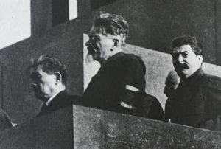
The Unifier
Miraculously escaping the infamous 1920 Palmer raid dragnet, he stayed in seclusion for four months at the Atlantic City home of K. Naito, where he started to write his autobiography. Returning to New York despite difficult underground conditions, he remained active and helped in the unification of the various U.S. Communist groupings into a single Communist Party. During the course of the unity movement, Katayama was appointed to serve on the American Section of the Communist International (CI or Comintern). In March of 1921 he went to Mexico to help strengthen its Communist Party and establish closer ties with the CI and in July was instrumental in the unification of Canada’s two Communist groups. Meeting Lenin was an honor and privilege and Katayama had that rare opportunity, shaking hands with him on December 21, 1922, at the Ninth All Soviet Union Congress which Katayama had been invited to address. They met again in January 1922, when he presented an Asian delegation to Lenin, who was aware of the conditions and problems of each delegate’s country and told them there must be unity among the Asian proletariat to successfully fight Japanese imperialism.
Standing on Lenin’s Tomb at the Red Square in Moscow (From Left to Right: Katayama, Rykov, and Stalin; Year Unknown)

Slide 14
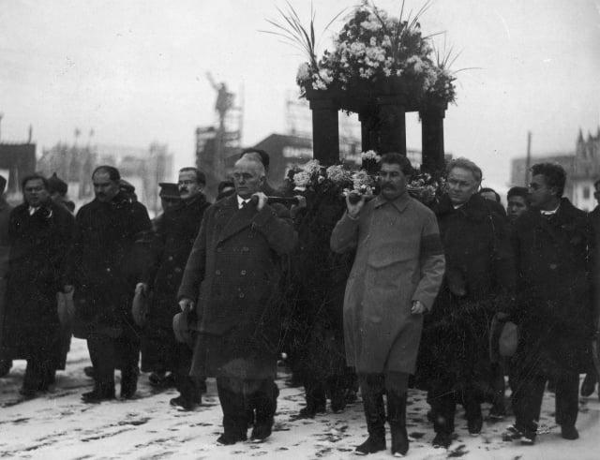
A Leading Bolshevik
At the Sixth CI Congress, held July-August 1928, Katayama had the honor of reading the “Declaration of the Comintern on the Chinese Revolution” which called upon the international proletariat to rally behind the revolutionary struggle of the Chinese workers and peasants. He joined other Congress delegates in the overwhelming rejection of Trotsky’s appeal against his expulsion from the Communist Party of the Soviet Union. Katayama had previously written an article on Trotsky, denouncing him as a power hungry petty-bourgeois counter-revolutionary, whose anti-Soviet actions would aid none but the Social Democrats and imperialist nations. His 70th birthday banquet was held in Moscow, December 1929, and yet another Soviet honor—membership in the Bolshevik Veterans Club—was bestowed upon Katayama. He kept more than 50 speaking engagements throughout the Soviet Union during 1930 and continued writing his autobiography. When he became gravely ill in 1931, his daughters and a half-brother from the U.S. were at his Kremlin hospital bedside. On recovery, he joined the campaign of the International Red Aid (IRA—founded in 1924 with Katayama’s help) to save the lives of the Scottsboro Nine. At the Eighth Congress of the IRA in 1932, he was elected its vice chairman.
Funeral of Japanese communist leader Sen Katayama, Moscow, USSR, 1933, with some of his Pallbearers being Kalinin, Stalin, Wilhelm Pieck, Bela Kun and Sanzo Nosaka

Slide 15
A Man Who’s Whole Long Life Was Devoted to the Proletariat
Just a month short of his 74th birthday, on November 5, 1933, Sen Katayama’s life came to an end. The next day, the CI issued a long obituary, which said in part: “He was an out-and-out Bolshevik, a man the whole of whose long life was entirely and wholeheartedly devoted to the proletarian fight, to the cause of the toilers and oppressed of the whole world, to the cause of the emancipation of humanity from the bloody yoke of capital, to the cause of Communism.... Whilst in America during the world war, Katayama exposed the war and all its imperialist inciters. In the U.S. he gathered together the forces of the proletarian international. On the outbreak of the October Revolution he was wholeheartedly on the side of the Bolsheviks. In 1919 he founded the first Japanese Communist group in the U.S.A. He propagated Communism among the Japanese and American proletarians and, as a true disciple of Lenin, organized revolutionary demonstrations and strikes.... This is why he always called so passionately and persistently for the defense of the Chinese people, of the Chinese Soviet, for aid for the oppressed peoples of Korea and Formosa, for the unity of all peoples of the Far East against predatory Japanese imperialism. For this reason, too, he agitated wholeheartedly, in word and writing, against the counterrevolutionary warmongering against the country of victorious Socialism.” At his funeral on November 9th, 150,000 Soviet officials, CI leaders, Red Army soldiers, workers and others came to pay homage to their beloved comrade and working class hero—Sen Katayama. Among the 14 prominent pallbearers were Kalinin, Stalin, Wilhelm Pieck, Bela Kun and Sanzo Nosaka (who was presently chairman of the CPJ). His ashes were placed in a Kremlin wall niche alongside other fallen comrades.

Slide 16
Discussion & New Members Introductions

Slide 17
New Member Introductions
What is your name, pronouns and state (or country/territory)?
Where do you work? Is it unionized?
How did you find out about the People’s School?
What do you think about tonight's class?

Slide 18
Background on Karl Yoneda

Slide 19
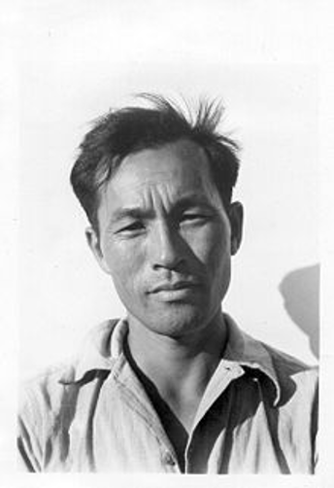
Karl Yoneda- Revolutionary Prospects
Karl Yoneda was born in Los Angeles in 1906 as the second generation of Japanese immigrants from Hiroshima Prefecture.
When he was seven, his family decided to move back to their native village near Hiroshima. Karl spent his formative years in Japan, during which the country was transitioning into a modern, industrialized colonial empire.
By the early 1920s, labor unions and a variety of socialist, communist, and anarchist activists, were mounting public demonstrations as well as protesting Japan’s rising militarism.
"Growing up," he wrote, "I was never physically strong, but I was as tenacious and stubborn as a mule. I never gave in to disease or the adversity that befell me."
Karl organized his first strike while still in high school. At 16, he made his way to Beijing, where he studied for two months with the blind Ukrainian anarchist and Esperanto teacher, Vasili Eroshenko.

Slide 20
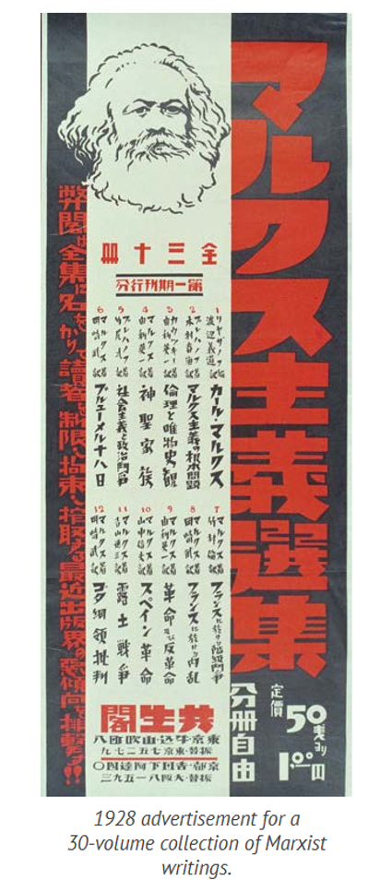
Karl Yoneda-Without a Nation
In 1926, to avoid being drafted into the Imperial Japanese Army, he boarded a freighter for San Francisco. Upon arriving, immigration officials classified him a kibei-nisei—born in the United States and educated in Japan—and locked him up at the Immigration Detention Center on Angel Island for two months. After his release, he went to Los Angeles, where he found work as a dishwasher and window washer.
As the American Federation of Labor (AFL) excluded people of color at the time, he joined the Japanese Workers’ Association, serving as their publication director.
Changing his first name from Goso to Karl in honor of Karl Marx, he also began working with the communist-affiliated Trade Union Educational League, organizing migrant field workers in the Central Valley and Fresno

Slide 21
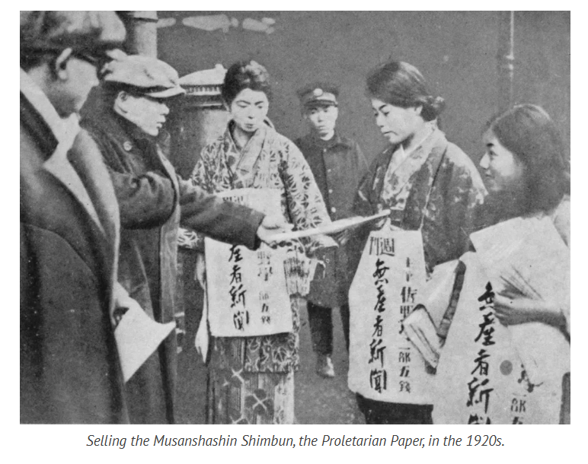
Karl Yoneda-The Party Press
In 1931, while at a Los Angeles demonstration calling for unemployment insurance in the midst of the Depression, Karl was severely beaten and thrown into jail by the police department’s notorious “Red Squad.”
As an underground worker, he helped to print, edit, and distribute thousands of anti-fascist leaflets and pamphlets destined for Japan. From 1933 to 1936 Karl edited the Rodo Shimbun, official organ of the Japanese section of the American Communist Party, in which he wrote frequent editorials against Japanese militarism.
The Japanese government not only banned the sale and distribution of the Rodo Shimbun in Japan, but kept surveillance of Karl's activities.

Slide 22
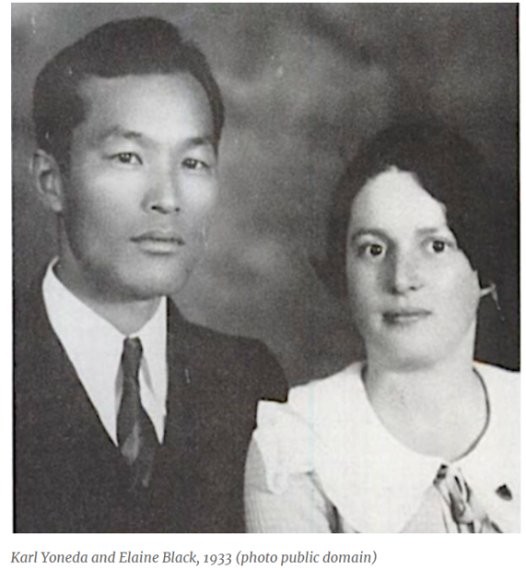
Karl Yoneda-Elaine Black, Comrade, Partner
During this time, Yoneda met a Jewish woman and fellow activist, Elaine Black.
A year later, after Elaine was assigned to the ILD offices in San Francisco, Karl showed up at her office, having taken a job in the city as editor of Rodo Shimbun, a Communist Party Japanese-language publication.
Defying California’s “Anti-Miscegenation Law” against mixed race couples, the couple moved in together in the city’s Japantown.
In the fall of 1934, Karl made California history as the first Japanese American to campaign for the state Assembly, running unsuccessfully on a platform of racial equality, unemployment insurance, and a living wage. Shortly before election day, the Red Squad arrested him during a campaign speech, charging him with vagrancy and making sure the newspapers highlighted his immoral living arrangement with the Tiger Woman.
In 1935, concerned their “shacking up” together was a political liability, Karl and Elaine boarded a train for Seattle, where they could be legally wed. To avoid being charged with violating the Mann Act, which criminalized transporting someone across state lines for immoral behavior, they rode in separate train cars.

Slide 23
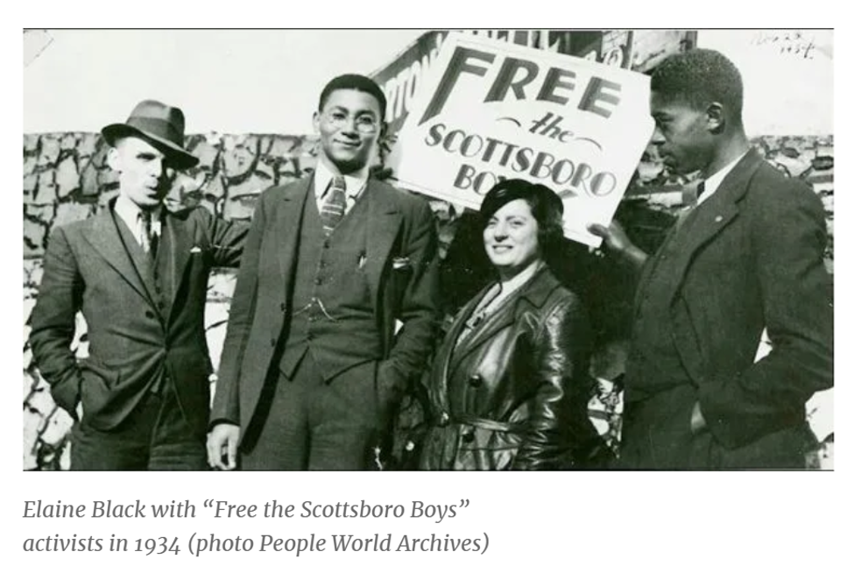
Elaine Black- Red Diaper Baby, Fellow Firebrand
For the remainder of the 1930s, Karl and Elaine pursued their political activism, with Karl forming a union for cannery workers in Alaska, and the two of them picketing Japanese cargo ships on the San Francisco docks that were being loaded with scrap iron for making Japanese military armaments.
Elaine grew up on New York City’s Lower East Side, the daughter of Jewish immigrants, Mollie and Nathan Buchman. Marxist activists, the Buchmans fled their native Russia after Nathan was drafted into the Czar’s army. In 1920, the family relocated from New York to Southern California.
After being accidently caught up in a brutal sweep by the Red Squad, an outraged Elaine took a job with the ILD and joined the Communist Party, adopting the last name Black, initially as an alias when questioned by police. Conservative newspapers labeled her “The Tiger Woman.” Fellow activists dubbed her “The Red Angel” for her tireless work among striking workers, providing them with food, lodging, and bail money.

Slide 24
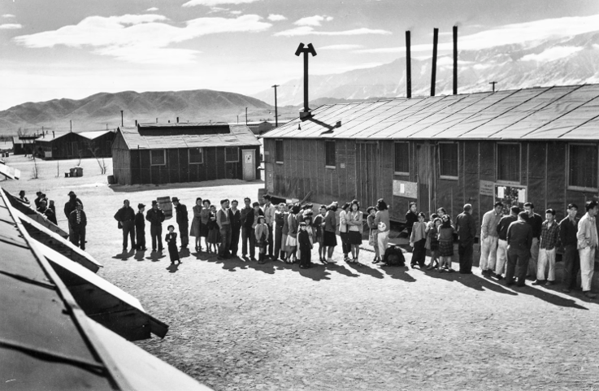
Karl Yoneda - First, Fight Fascism
In need of a steady income during the Depression, Karl became a longshoreman. In 1939, Elaine gave birth to their son Tom. A few months later, she made an unsuccessful run for the San Francisco Board of Supervisors, calling for low-cost housing, free childcare for working women, and civil rights.
Then came Pearl Harbor. Two months after the attack, President Roosevelt, bowing to xenophobia, racism, and baseless fears of spies, signed Executive Order 9066, leading to the incarceration of 110,000 people of Japanese descent, both American citizens and immigrants, living on the west coast.
Surprisingly, Karl and Elaine initially joined others—many of them Japanese Americans—in publicly supporting Roosevelt’s order. As Communists, they felt that the need to fight fascism outweighed other concerns
Manzanar War Relocation Center, 1943-44 (photo by Ansel Adams, Library of Congress)

Slide 25
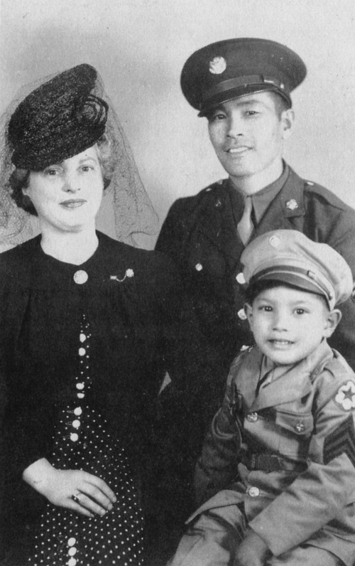
Karl Yoneda- Incarceration and War
Karl and his two year-old son Tommy were sent to the camp at Manzanar. Elaine had to fight her way in, becoming one of only seven Caucasians interned there. Karl initiated a petition at the camp to permit young Nisei—men born in the U.S. to immigrant parents—to volunteer for military service. After eight months at Manzanar—during which they received regular death threats from a small group of pro-Japan fascists known as the Black Dragons—Karl was accepted into the army, and Elaine and Tommy were allowed to return to San Francisco.
Karl enlisted in the U.S. Army on December 7, 1942, a year to the date of the Japanese attack on Pearl Harbor. At the time, he was incarcerated along with his wife and three-year-old son in Manzanar, one of ten concentration camps holding 110,000 Japanese Americans during the war
Karl was assigned with other Nisei to the psychological warfare team of Military Intelligence Service, whose motto was “Go For Broke.” Deployed to India, Burma, and China, he drafted and edited propaganda to be scattered among Japanese troops and transmitted over radios, often deep behind enemy lines.

Slide 26
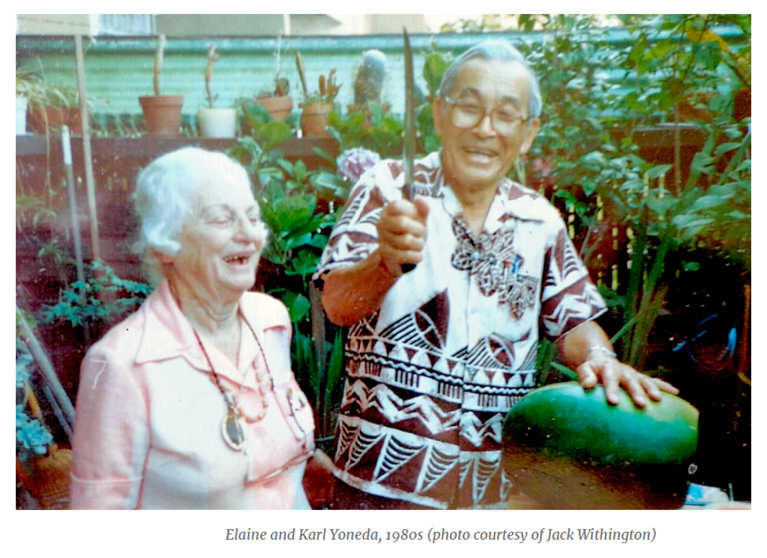
Karl and Elaine Yoneda-Devoted, Lifelong Communists
After serving in the war, Yoneda continued to work in ports, farms, and warehouses. He joined the Port Workers and Warehousemen Union and continued advocacy for worker’s rights through the post-war and red scare years, unwaveringly.
The Yonedas remained engaged activists, traveling to Tokyo as delegates at a nuclear disarmament conference, participating in numerous anti-Vietnam protests, and writing articles and lecturing on labor history. In recognition of their 50th anniversary together in 1983, San Francisco’s Board of Supervisors saluted them for dedicating their lives to fighting for the betterment of other people’s lives.
Elaine died in 1988, a day after taking part in a San Francisco demonstration for peace in Nicaragua with Jesse Jackson. Karl died eleven years later.

Slide 27
Discussion

Slide 28
Highlighting More AAPI Activism

Slide 29
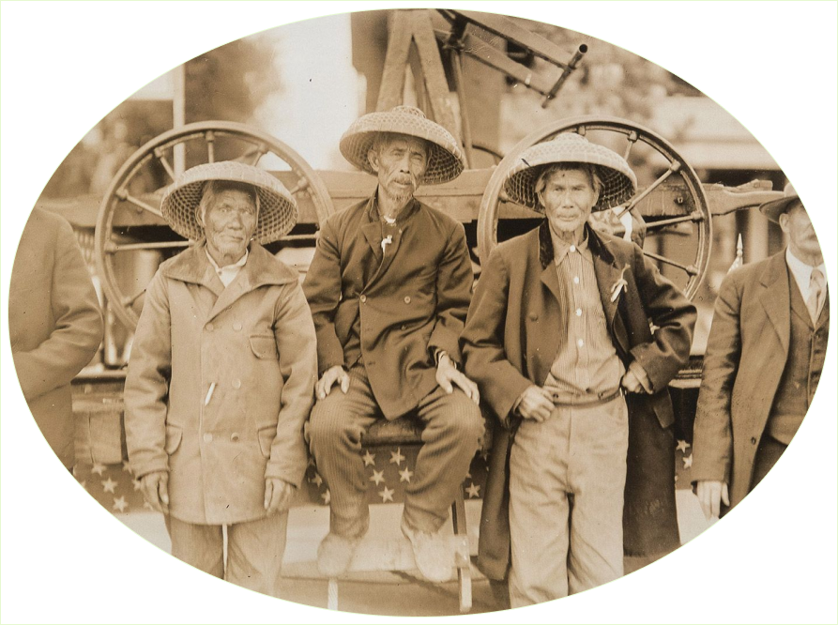
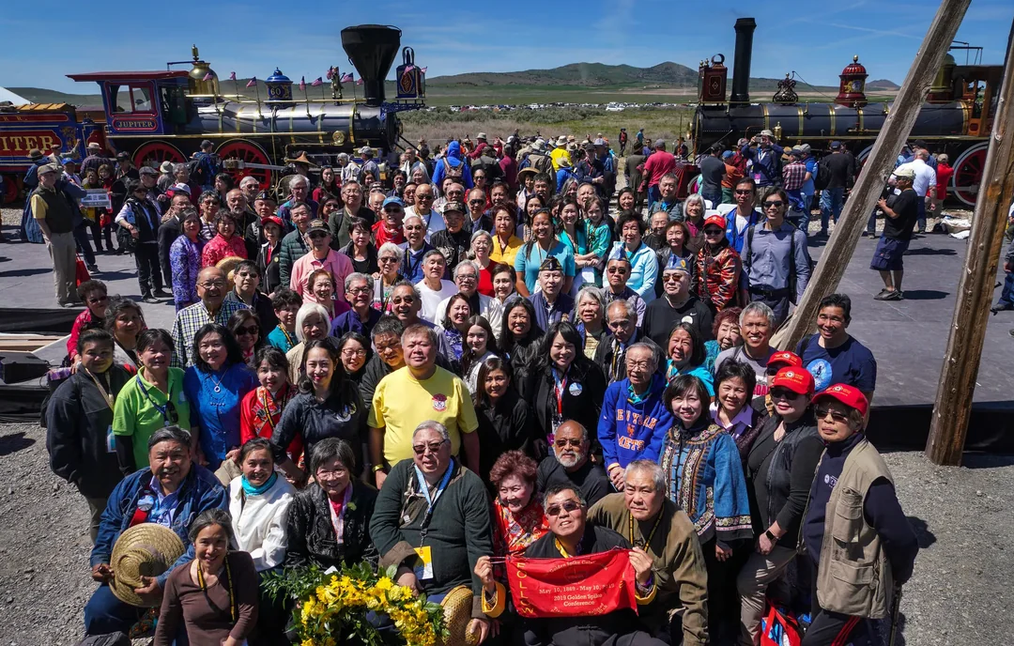
Members of Chinese-American communities, including descendants of railroad workers at a ceremony in Utah to celebrate the anniversary of the completion of a railroad in 1869.

Slide 30
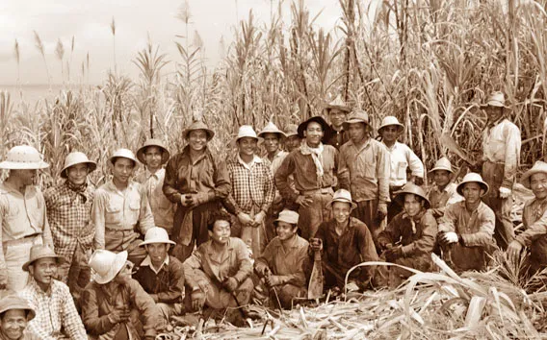
Filipino Workers on American Plantations
Following the Spanish-American War and the annexation of the Philippines by the United States in December 1898, thousands of Filipino immigrants known as Sakadas (plantation workers) worked on Hawaiian plantations and California farmlands. They came mostly from the provinces of Ilocos and Cebu to replace the Japanese workforce who intended to leave the Hawaiian plantations.
Although the Sakadas came to Hawaii as American Nationals, they were not given full rights as American citizens and were the first Filipino Americans to experience racial discrimination and cultural oppression. Many Filipino farm workers also experienced discrimination and repression.

Slide 31
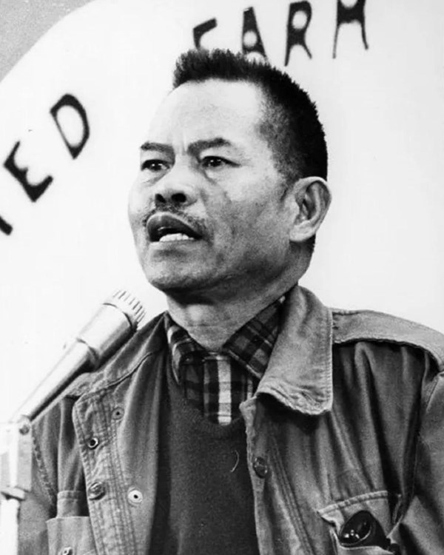
Filipino Activist Larry Itliong
In the 1930s, Filipinos and many other workers on the American plantations started getting organized. Among them was activist Larry Itliong, whose first experience organizing was shortly after he arrived in the US in 1930. By 1933, he organized farmworkers in California’s Salinas Valley. Itliong emerged as a leader in the Filipino American community of “Manongs” – respected elder workers who were crucial in shaping the labor movement.
In 1959, Itliong organized for a newly chartered union in the AFL-CIO, the Agricultural Worker’s Organizing Committee (AWOC). It was largely Filipino but included Mexican, Arab, Black, and white workers within its ranks.

Slide 32
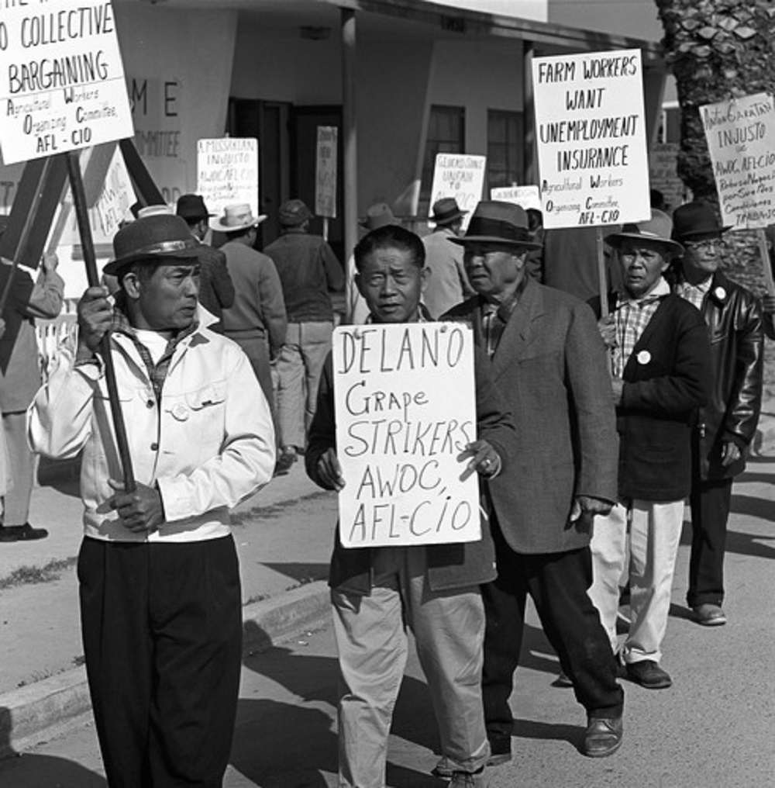
United Farm Workers and the Delano Farmworkers Grape Strike
In 1965, Itliong and the AWOC led 1,500 Filipino farmworkers on a strike against the grape growers of Delano, California. But a successful strike required the support of Mexican farmworkers, as grape growers could easily replace the striking workers. Many were represented by the National Farm Workers Association (NFWA). César Chávez, a leader of the NFWA, was hesitant to join the strike as he believed that the Mexican farmworkers needed more time to be organized. However, Itliong convinced him to bring the NFWA to join forces with the AWOC. Together, they commenced the massive 1965–1966 grape strike and boycott.

Slide 33
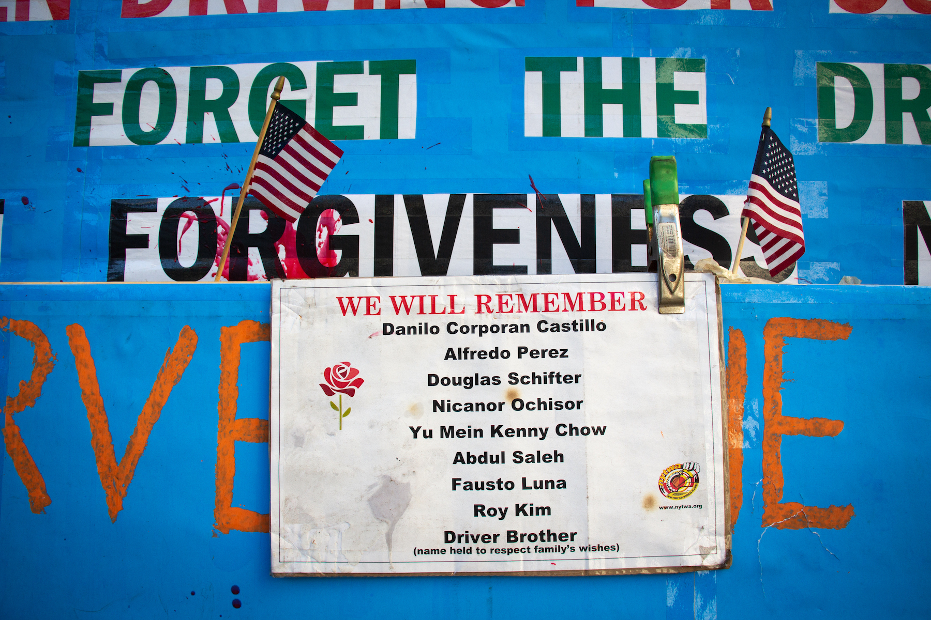
2021 Taxi Driver Strike
In 2021, workers of the New York Taxi Workers Alliance went on strike outside of City Hall, after crushing debts led to 9 drivers taking their own lives. The city’s first relief plan provided minimal assistance and no loan guarantees.
To own and operate a taxi, drivers must purchase one of a limited number of city-issued medallions. For decades these medallions were worth hundreds of thousands of dollars. Although drivers had to take out loans to afford them, most thought the investment was worth it.
The city was complicit in marketing the medallion as “better than a stock” and a pathway to the American dream, leading taxi drivers to believe a medallion was an investment worthy of such a high risk.

Slide 34
2021 Taxi Driver Strike
Predatory lenders targeted the taxi workforce, which is made up of many people of color in a sector long seen as a path to the middle class for immigrants.
The protestors at City Hall came to the United States from Bangladesh, China, Côte d’Ivoire, Haiti, India, Myanmar, Nepal, Pakistan, Romania, Taiwan and Tibet.
In the early 2000s, the city’s Taxi and Limousine Commission allowed private lenders to inflate the price of taxi medallions, which brought in revenue for the city government in addition to making money for banks and credit unions. Medallions reached a high of $1 million in 2014 before the bubble burst and prices crashed. Thousands of drivers were left with debt that far outweighed the new value of their medallions.

Slide 35
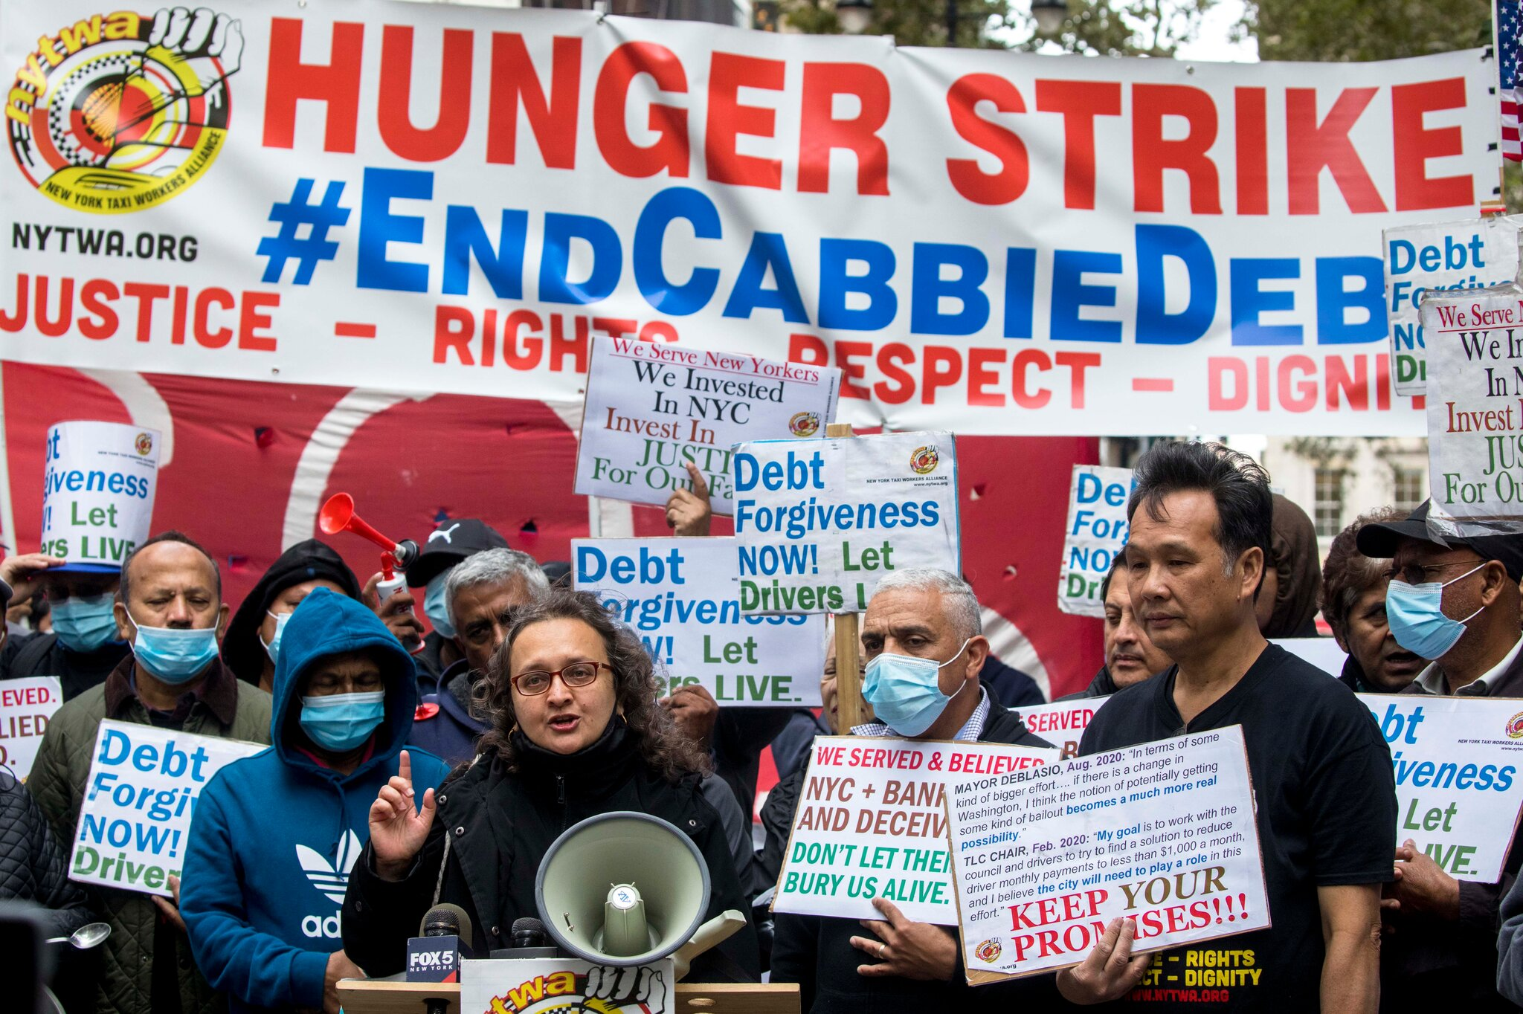
2021 Taxi Driver Strike
On September 19, drivers set up an encampment outside City Hall and mounted a 24-hour vigil to protest the city’s first relief plan, which provided minimal assistance and no loan guarantees. More drivers would join in the next two weeks, along with some local officials, including Queens state
assemblyman Zohran Mamdani. A month later, the hunger strike began. The hunger strikers subsisted on water with electrolytes, Gatorade, and coconut water — and, toward the end, vegetable and chicken broth. Other drivers passed by for rallies or to show solidarity; many slept in their cars to maintain a presence at the 24-hour protest.

Slide 36
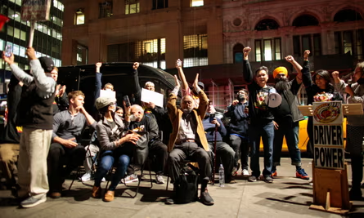
2021 Taxi Driver Strike
After 46 days of picketing and 15 days of hunger strike, members of the New York Taxi Workers Alliance won. When the final deal was accepted, in a unanimous vote by 300 drivers, the hunger strikers broke their fast with avocados and dates. The agreement was made with Marblegate, the largest medallion loan-holder, with more lenders following suit.
The TLC agreed to a city-backed guarantee to lower the monthly payments of taxi medallion owners to a maximum $170,000 – far less than the average medallion debt of around $600,000, according to the New York Taxi Workers Alliance. The city also guaranteed rescue loans in the event of default.

Slide 37
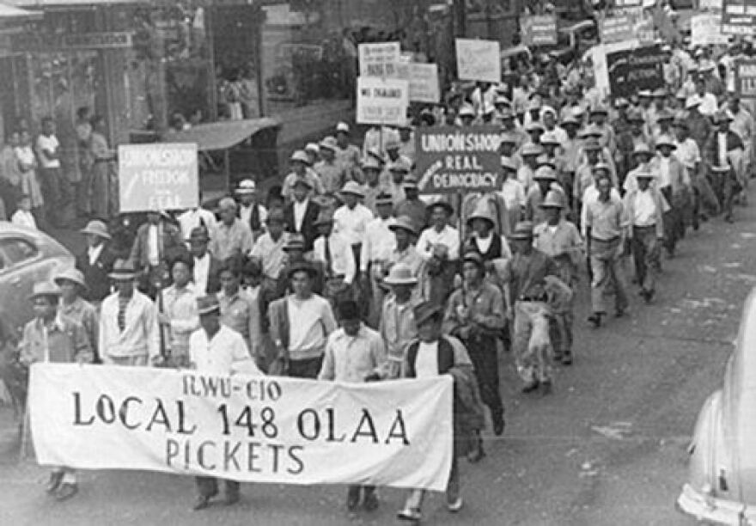
Meet the Labor Heroes of Hawaii

Slide 38
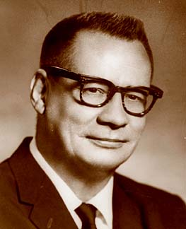
Jack Hall
Originally from the Mainland US, Hall moved to Hawaii in 1938.
Came to Communism after seeing the horrific conditions in East Asia by Western Imperialism
Instrumental in organizing a section of the International Longshoreman’ and Warehouse Union (ILWU) in Hawaii
Became Hawaiian Regional Director of ILWU in 1944

Slide 39
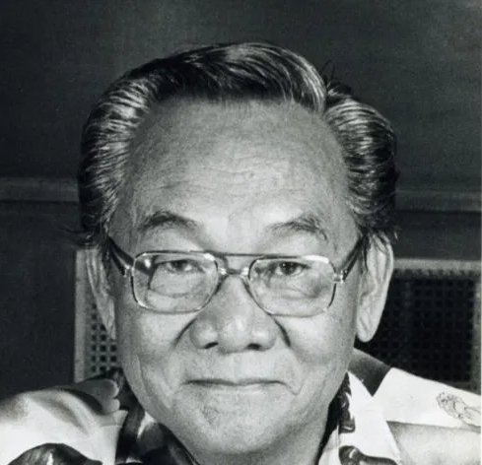
Carl Damaso
Filipino-American who organized and served as President of the ILWU Local 142 which led the 1946 Sugar Strike
Instrumental in breaking down the racial lines that divided workers and focused on organizing Filipino as well as workers of all ethnicities into one union.

Slide 40
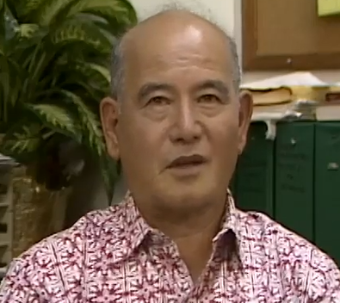
Yasuke Arakaki
Japanese American Labor Organizer
Studied at California Labor School, studied and applied strike strategies and knowledge on auxiliary strike resources such as organizing soup kitchens for striking families on Hawaii
A leading organizer of the Olaa Sugar Company

Slide 41
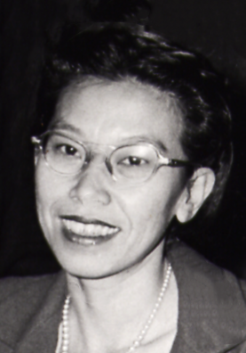
Ah Quon McElrath
Born Leong Yuk Quon to Chinese immigrants in Hawaii
Central Committee member of the CPUSA and social worker for ILWU
Labor recruiter and organizer during the 1946 Sugar Strike
Was part of the “Hawaiian Seven” who were tried during the McCarthyist purges for Communist Affiliation

Slide 42
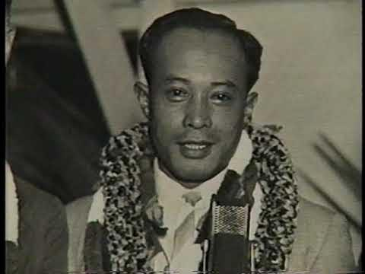
Harry Kamoku
Hawaiian-Chinese Labor Leader
Involved in 1934 Westcoast Waterfront Strike
Led organizing efforts of Native Hawaiian Dockworkers with the ILWU in 1937
Played a pivotal role in organizing the strikes against the Inter-Island Steam Navigation Company that were repressed by Hawaiian Police in what was called the Hilo Massacre of 1938

Slide 43
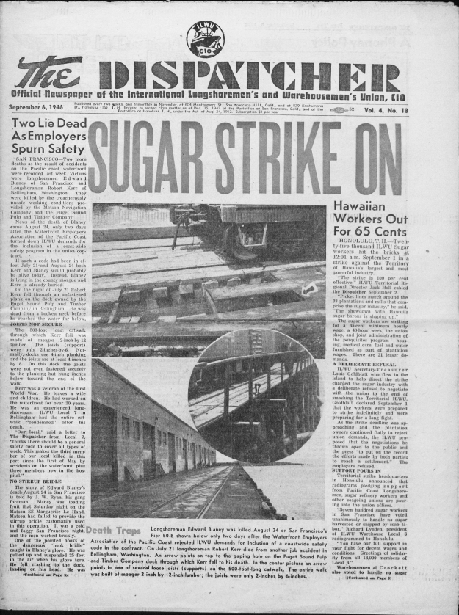
Strike that Transformed Hawaii
Strike began on 1st September 1946 and lasted 76 days
33 out of 34 Sugar Plantations came to a halt
Workers from various ethnic backgrounds organized by the ILWU
In total 76,000 people went on strike against the sugar monopolies

Slide 44
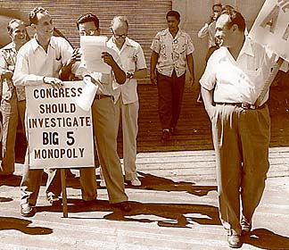
Previous strikes and labor organizings included: the Japanese Strikes in 1909 and 1920 and the failed labor struggles of the Filipino workers in 1920, 1924, and 1937.
These failures shared a common denominator: they were all organized on ethnic lines.
Hawaiian plantation owners exploited ethnic differences among workers
the workers organized regardless of race or nationality, maintained unity on democratic lines, and supported each other with mutual aid

Slide 45
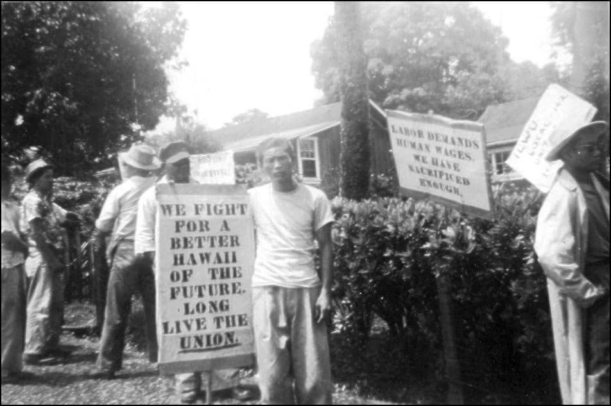
After 79 days of unified struggle, the workers, organized by ILWU, secured their demands of better housing, better pay, shorter work weeks, pensions, and more.
The strike changed the whole social structure of Hawaii from a semi-feudal style society to a democratic one
The lesson here is that workers of all races, ethnicities, genders, religions, etc. are stronger together and that the only way to strike a blow at corporate oppression is through unity.

Slide 46
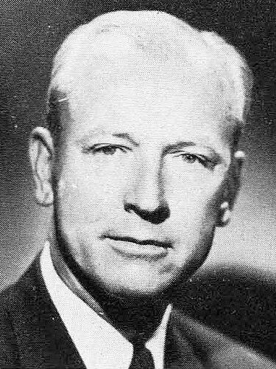
Labor Movement Following 1946 Sugar Strike
In 1949, the ILWU again struck against the Big 5 Sugar monopolies of Hawaii when dockworkers began the Great Hawaiian Dock Strike for 177 days for wage parity with mainland dockworkers
In 1953, Jack Hall and others are arrested under the Smith Act for Communist Affiliations
  ILWU organizes a 4 day general strike in protest
In 1954, organized labor in coalition with the Communist Party of Hawaii and the Democratic Party successfully overthrows the monopoly control when the Republican Party overwhelmingly loses elections. This had a huge impact in democratizing Hawaii and removing the sugar oligarchy, this election became known as the “Hawaiian Democratic Revolution of 1954”
Democratic John Burns, Governor of Hawaii after “Hawaiian Democratic Revolution of 1954”

Slide 47
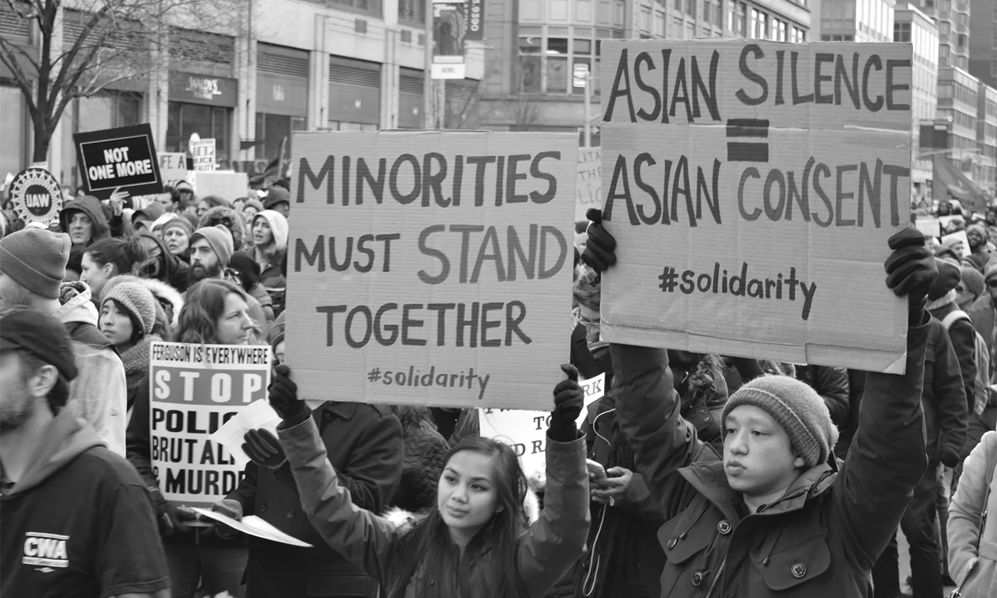
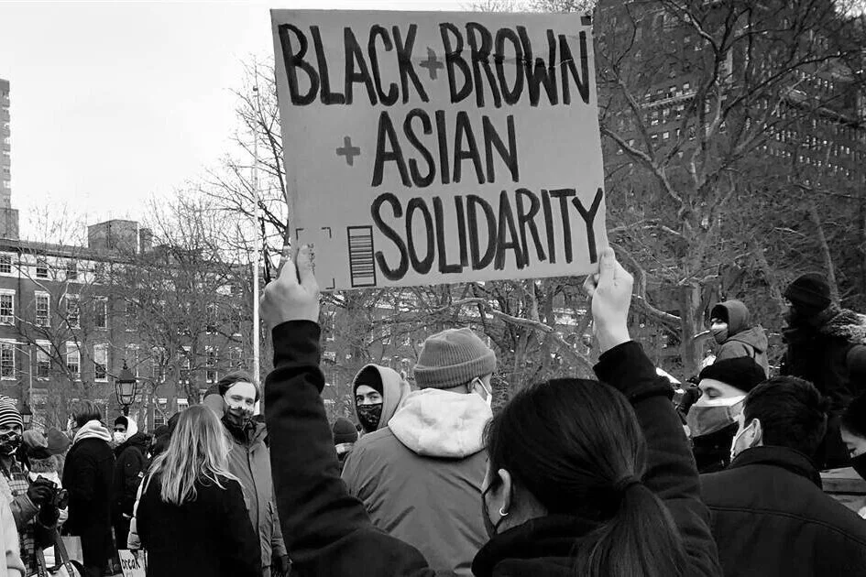
In Conclusion
Asians in the United States have suffered oppression in the forms of anti-immigration laws specifically targeting Asians, the internment of Japanese-Americans during WWII, their exploitation as laborers, and through xenophobia and tokenism promoted by capitalists.
Despite this, Asian-Americans have played an integral role in building the United States and fighting for labor rights and civil liberties. Especially in the case of the Sugar Strike and Delano Grape Strike, the collaboration and solidarity with people of different ethnic backgrounds was essential to the success of the strikes.

Slide 48
Discussion & Wrap Up

Slide 49
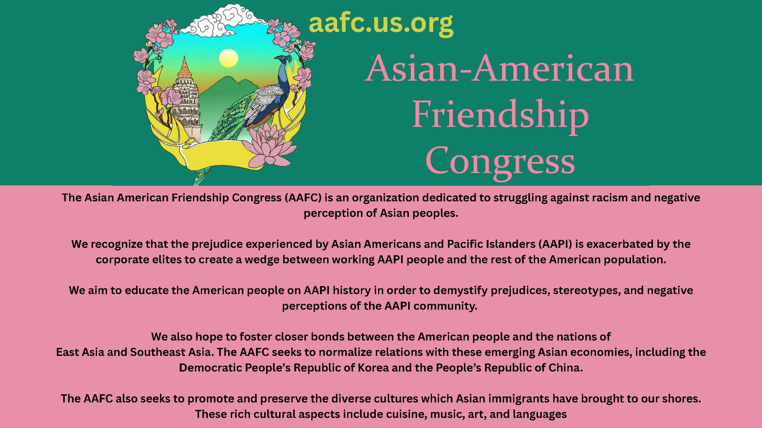
AAFC Announcement Slide

Slide 50
Announcements
PCUSA Cell Chairs need to call members of their cells to remind them about attendance.
PCUSA Cell members are reminded attendance at the Continuing Education class of Jones-Foster every first Wednesday of the month is required.
The next issue of New Masses (2026) has begun production. If you have art you want us to feature, email it to info@partyofcommunistsusa.net.

Slide 51
Volunteers Needed!
We are in need of volunteers for the staff of the People’s School! Here’s a few roles we need filled:
People to help manage posting on our social media and podcast platforms
Video Editors, Audio Editors, Graphic Designers, Artists, Narrators
Web Controls, Moderators
Email info@peoplesschool.us if you’re interested and try to attend our next staff meeting if possible.

Slide 52


Slide 53

View From Left Field
https://viewfromleftfield.libsyn.com
The Old PSMLS Youtube is now the Youtube of View From Left Field, a podcast of analysis and discussion of current events from a progressive perspective.
Like the Youtube videos and subscribe with 5 star ratings on your podcast platforms.

Slide 54

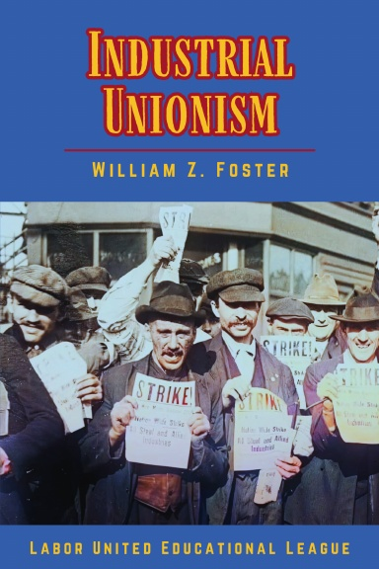
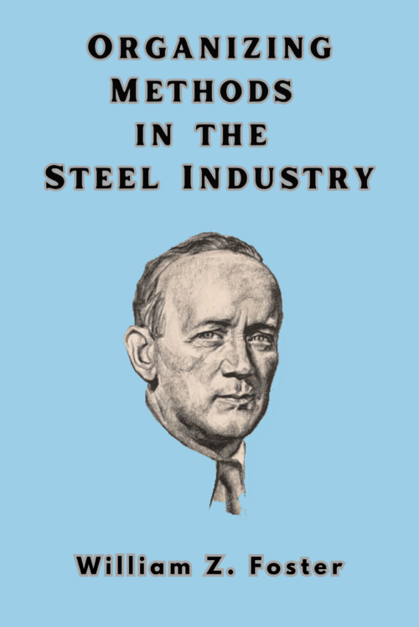
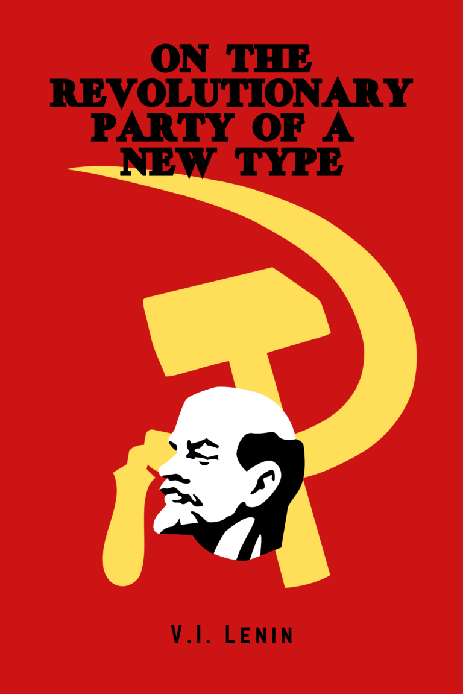

New Outlook Publishers
newoutlookpublishers.store
Relevant and Latest Releases

Slide 55


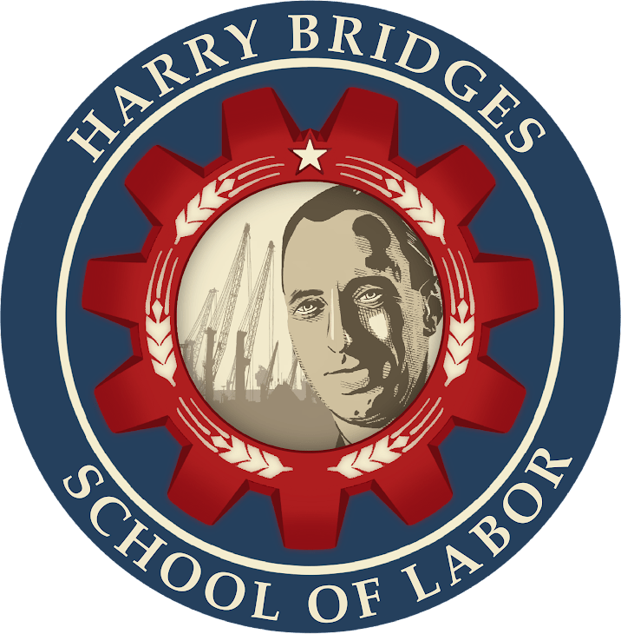
Harry Bridges School of Labor
luel.us/laborschool/
The Harry Bridges School of Labor is a monthly class covering a variety of topics aimed at building class consciousness among union members. For class schedule and other information, please visit the website at luel.us/laborschool.

Slide 56
The Internationale (Japanese Version)

