Slide 1

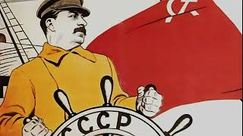
The Internationale

Slide 2
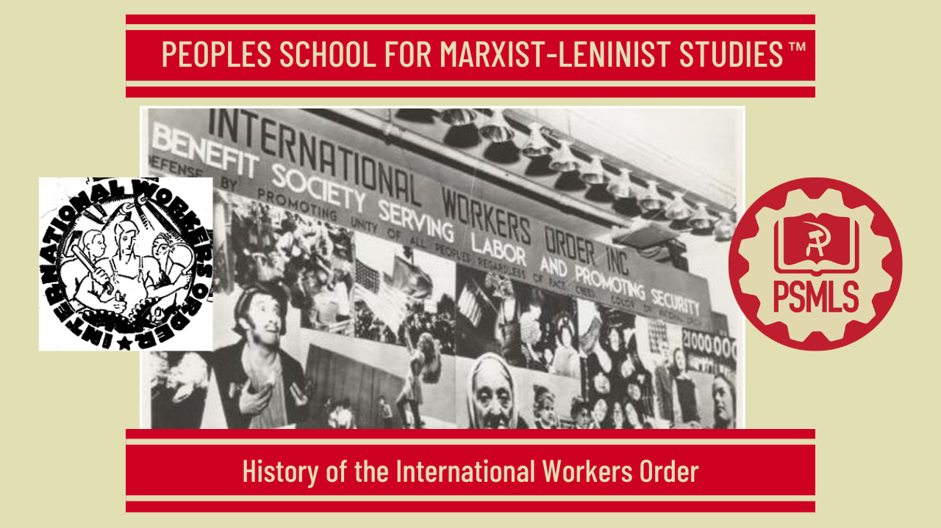
PSMLS 8/25/26

Slide 3
What we’ll be learning today:
Formation and History of the I.W.O.
Role of the I.W.O. During WWII
Mutual Aid, The I.W.O.’s Departure and Lasting Legacy

Slide 4
Formation and History of the I.W.O.

Slide 5
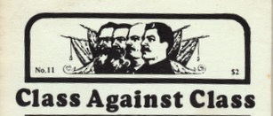
The Origins of the I.W.O.
The International Workers Order began with a split of the Workmen's Circle, a Jewish mutual benefit society of social democratic character. Principle functions of the organization included the provision of unemployment, sickness, and life insurance as well as a setting for the discussion of social problems. This was a byproduct of the Third Period ideology of the Communist movement, summed up by the slogan "Class Against Class" -- in which parallel organizations of revolutionary “purity” were being built as a general principle. It was, however, the end of a long and frustrating effort at winning the Workmen's Circle to a new line through the process of internal politics -- an effort which was thwarted at every turn by the Right majority of the organization. There had long been a Left and a Right Wing inside the Workmen's Circle organization. The 1920 Newark Convention of the Workmen's Circle stated that the organization was a working class fraternal organization but it had nevertheless decided to contribute thousands of dollars to reactionary organizations and newspapers to the outrage of the Communist members and fellow-travellers within the group.

Slide 6
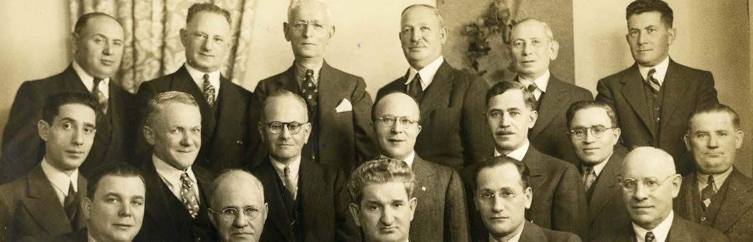
Stifling the Left-wing
The Feb. 1922 nominating conference, at which a new National Executive Committee was to be nominated, brought the Left Wing of the Workmen’s Circle into formal existence. Nearly 200 delegates attended this conference, which was dominated by the Socialists, who prevented a single representative of the Left from joining the Credentials Committee. A spontaneous walkout of Left Wing delegates was the result. In May 1922 the Workmen's Circle held its 22nd Convention at Toronto. This convention was attended by 26 Left Wing delegates out of a total of 138, who battled over two resolutions of the Executive Committee: one against the Soviet Union for its judicial action against the Socialist Revolutionaries and other coup-plotters, as well as a second resolution formulated against the Workers Party of America and its Yiddish language organ, the Freiheit.
Workmen's Circle Branch 45 Photographs -
Rauh Jewish Archives at the Heinz History Center

Slide 7
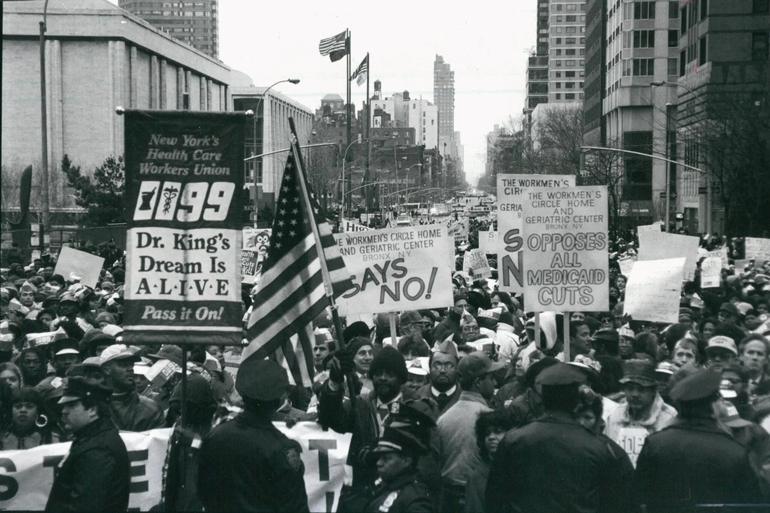
Resisting a Split
A "Protest Convention" was held on June 2, 1922, in response to the resolutions of the 22nd Convention. This was attended by 338 delegates, representing 235 branches of the organization from 23 states. In addition to passing resolutions, this Protest Convention elected a committee of 15 called the Left Action Committee. On June 11, 1922, the National Executive Committee of the Workmen's Circle struck back, dissolving the Left Wing-dominated Boston District Committee. On July 2, 1922, Lotker was expelled from the New York Committee, and on July 22 the NEC transferred Left Wingers Linden and Rsnik from Pittsburgh to the status of "members at large." Similar treatment was meted to Reingold in Cleveland. When elections to the National Board of Directors approached in 1922, the Left Wing found itself in a majority position in Minnesota, Missouri, Virginia, Texas, and Ontario. The National Executive Committee therefore dissolved 5 state organizations and various Left Wing branches, and divided other branches favorable to its regime, thereby ensuring a greater majority for themselves. Despite these actions, the Left Wing resisted splitting the organization, continuing its fight within the Workmen's Circle organization through 1925.
In recent years, the Workers Circle has fought for fairly mainstream causes like a $15 hourly minimum wage and an end to voter suppression. Its work has had almost nothing to do with Israel.

Slide 8
Inter-Organizational Struggle
The 1925 Convention of the Workmen's Circle was attended by about 1,000 delegates, of whom approximated 1/4 supported a program of the Left Wing calling for the Workmen's Circle to become a class struggle organization and to stop its persecution of the Left Wing. The Left Wing fought for days to win the right to read its 10 minute declaration to the Convention. This declaration stated that "to our shame, the Workmen's Circle, our Order, lately has become and out-and-out toll and weapon in the hands of the reactionary element in the Jewish working class movement." One of the Left Wing's chief projects within the Workmen's Circle revolved around the establishment of Jewish Workers' Children's Schools, akin to the Socialist Sunday Schools and intended as "an antitoxin to the bourgeois poison daily injected into the children's minds in the public schools, the movies, and other places." The Right came to see these schools as a propaganda arm of the Left Wing movement and moved to attack them. On Dec. 20, 1925, a conference of Workmen's Circles branches on the schools was addressed by the Right, which called for an entirely new model for the schools, replacing local school organizations with administrations elected by centralized conventions. The December 1925 conference turned down this restructuring, which was answered by the calling of a second conference, this one more closely packed by the central leadership. This conference prompted a walkout of over 100 Left Wing participants, who vowed not to accept the restructuring. As a result, 18 out of 24 schools in New York City were expelled from the Workmen's Circle. These expelled schools came together as the "Non-partisan Jewish Workers' Children's Schools" -- an organization which grew to encompass 83 schools by the time of their affiliation with the International Workers Order.

Slide 9
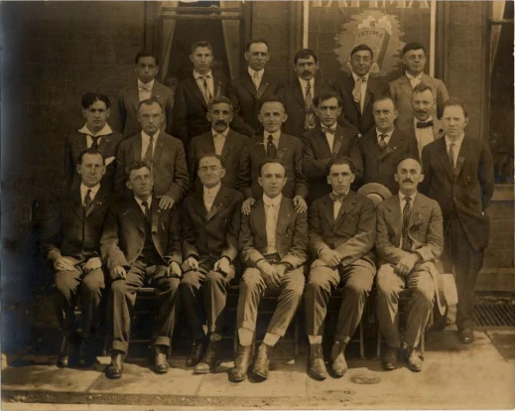
The Left-Wing Alliance
A "National Protest Conference" was called in protest of the 1925 Convention. At total of 191 branches were represented at this gathering, which was in session for two days. The conference organized itself into a "Left Wing Alliance" and declared that it would fight "against the terror of the Right Wing machine" and "for the non-party [i.e. non-Socialist Party] character of the Workmen's Circle." Aid to the childrens' school movement was pledged. The National Executive Committee of the Workmen's Circle responded to the organization of the Left Wing Alliance predictably, expelling 64 branches with a membership of close to 15,000. This put the Executive Committee of the Alliance in a difficult situation. Rather than the "suicide" of a premature split, the Executive Committee instructed its branches to comply with various requests of the NEC to resign from the Alliance or be expelled. A split was averted by the Alliance backing down and peace movement resulted, as pressure was built up on the NEC. To this end, a Special Conference was called by the Providence, RI City and District Committee on Oct. 30, 1926, whereby branches would withdraw from the Alliance en masse and be reinstated as branches of the Workmen's Circle. This gathering was attended by representatives of 188 branches. However, the NEC of the Workmen's Circle did not even attend the gathering. Rather than instantly reinstating branches, as promised, the NEC instituted a lengthy process for reinstatement drawing out the process over months and even years, so as to demoralize the Left Wing.
Members of the Minneapolis Workmen’s Circle c.190

Slide 10
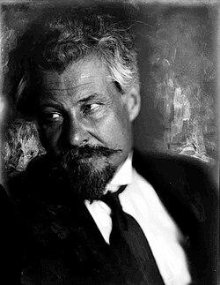
An Instrument of Capitalist Politics
The 1929 Convention of the Workmen's Circle attempted to eliminate the Left Wing from participation. The gathering was addressed by a guest speaker, Victor Chernov, leader of the Right faction of the Russian Socialist-Revolutionary Party. It was charged that a physical attack was made on the reporter of the Communist Party's Yiddish daily, the Freiheit. The convention renewed the two controversial Toronto resolutions of 1922 and formally approved the action of the NEC in suppressing the Left Wing movement in the Workmen's Circle. As a result of this reactionary campaign the National Conference of Minority Groups of the Workmen's Circle was called for Oct. 11th 1929. The Conference was attended by 193 delegates, representing 108 branches and 23 minority factions of branches. These delegates unanimously decided to leave the Workmen's Circle and build a new explicitly working class order. A manifesto issued by the conference declared: "The time has come when everyone who takes the interests of the workers seriously must shake off the dust of the Workmen's Circle. The Workmen's Circle, originally organized under the banner of the class struggle, writing into its program the abolition of the capitalist order...has been transformed in the past few years into an instrument of capitalist politics. There was not one single important occasion in the life of the Jewish workers in the last 7 or 8 years when the leadership of the Workmen's Circle did not line up with the enemies of the working class. The counterrevolutionary physiognomy of the Workmen's Circle is most clearly expressed in its attitude toward the Soviet Union, the only proletarian state in the world, the pride and crown of achievement of all class conscious workers throughout the entire world."
Victor Chernov - a Russian revolutionary, politician, and theorist who was a principal founder and leader of the Socialist Revolutionary Party

Slide 11
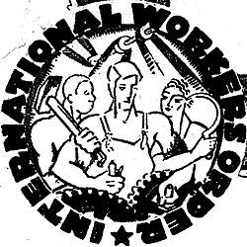
The Birth of the I.W.O
The 1929 National Conference initially sought to join an already-existing "Independent Workmen's Circle" organization. While 7 of the 9 members of the National Executive Committee of the Independent Workmen's Circle were in favor of the Left Wing affiliating, the two remaining members, including the Acting Secretary, attempted to use doctors' examinations as a pretext for exclusion. The NEC majority attempted to depose the Acting Secretary in response, but the opponents of the Left Wing in the Independent Workmen's Circle took to the courts, winning an injunction to block the amalgamation. A court-supervised "Injunction Conference" was held on January 12, 1930, to formally decide the matter of the Left Wing's admission to "The Independent." This gathering defeated the motion by a vote of 48 to 45, however, thereby ending the plan of amalgamation.
Incorporation papers for the IWO were filed on March 28, 1930, which the organization recognized as its date of birth. About 5,000 Left Wing members of Workmen's Circles left to found this new organization.

Slide 12
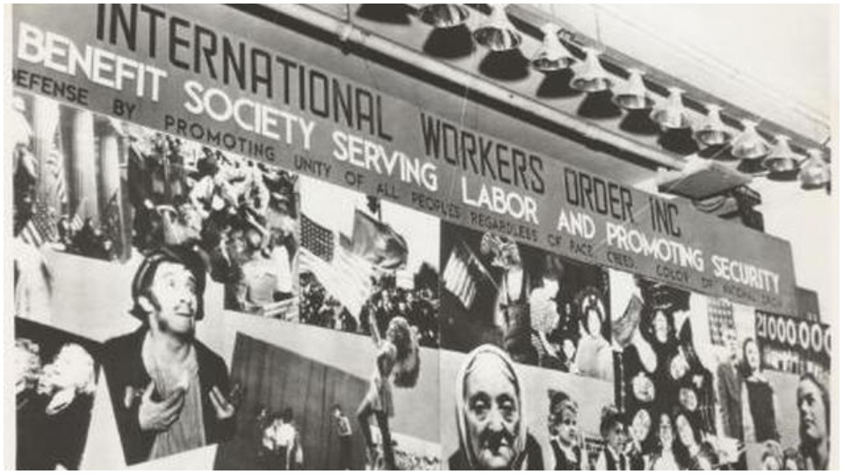
Taking an Active Part in Class War
Excerpt from The First Convention of the International Workers’ Order, Inc. by R. Saltzman:
The manifesto, which the first convention published, declared that the International Workers’ Order is an integral part of the working class movement and in that year the members, the branches, and the leading sections have by their activities shown that they are which they professed to be. The Order has actively taken part in the mass struggles. Not only has the Order endorsed the Unemployment Insurance Bill, but the branches and the members have collected signatures for the bill, they have participated in the unemployed demonstrations and the hunger marches. A large portion of the branches and district committees have participated in the election campaign, led by the Communist Party. In a certain measure the branches have participated in the anti-war demonstrations. In New York and in other centers the members of the Order were quite a large part of the May Day demonstration. We can say that we have not sufficiently participated in these activities, that we could have taken a greater part in these struggles, that we could have drawn in more members, more branches. But on a whole, the Order has taken an active part in the class war.
A large billboard at the headquarters of the IWO in New York, 1930s. The banner reads: "International Workers Order, Inc. - Benefit Society Serving Labor and Promoting Security - Defense By Promoting Unity of All Peoples Regardless of Race, Creed, Color, or National Origin." | Gotham Center for New York City History

Slide 13
Discussion & New Members Introductions

Slide 14
New Member Introductions
What is your name, pronouns and state (or country/territory)?
Where do you work? Is it unionized?
How did you find out about the People’s School?
What do you think about tonight's class?

Slide 15
Role of the I.W.O. During WWII

Slide 16
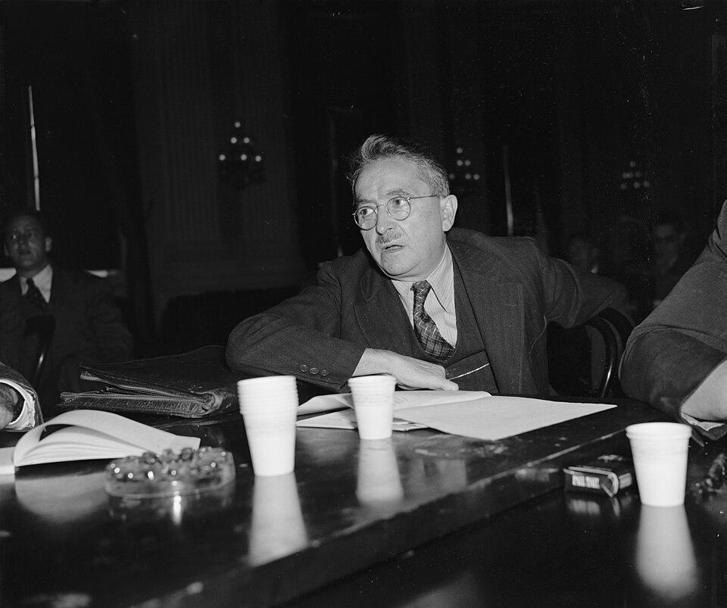
Leading Up to World War II
By the Third Convention that took place from the 6th of May to the 11th of May 1935, the IWO had found a new secretary by the name of Max Bedacht. Bedacht was a German-born American Revolutionary socialist. He was a political activist and journalist who had helped establish the American Communist Party (CPUSA).
Membership during this time had grown to 67,000 members in 1935, and by 1938, it had grown to over 141,000 members. During the organisations years leading up to the Second World War, they had established 225 branches in 31 states and 80 cities.
Bedacht testifies before the Dies Committee, October 16, 1939

Slide 17
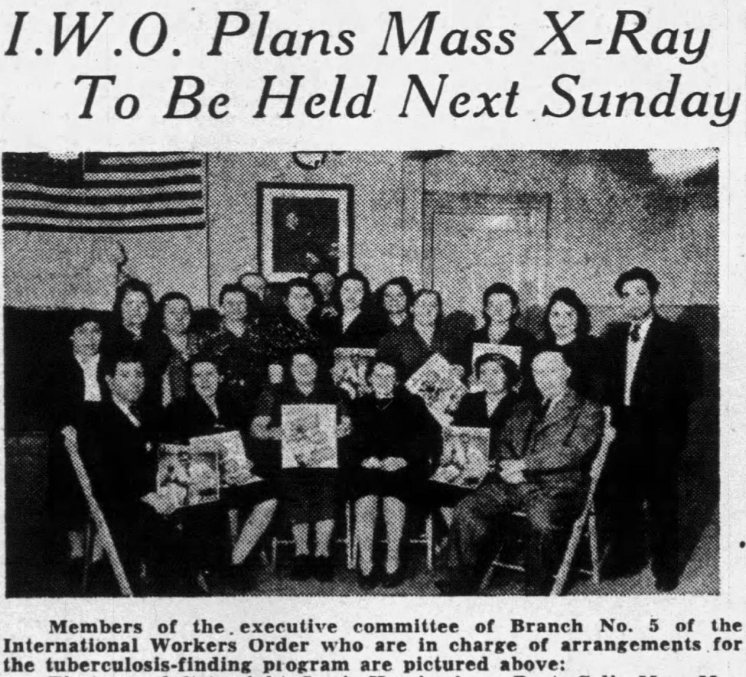
Benefiting the Community
The IWO in the years immediately following WW2 had a network of outlets to benefit the working class, including providing low-cost health insurance, life insurance, medical & dental clinics.
As could be imagined, such an open and equitable society attracted masses of the working class from every background, race, and gender. Non-Marxists and non-Party members were frequently utilising these services offered.
A mass public health x-ray session was sponsored by the IWO in Paterson, NJ in April 1943

Slide 18
The Assistance to Minority Groups
Anti-racism was central to the IWO mission. The IWO made a concerted effort to reach out to an interracial constituency, a revolutionary course in the 1930’s & 40’s. Most other benefit societies remained racially segregated, and private insurance companies charged African Americans inordinately higher rates for inferior coverage, leaving them at a disadvantage if the time came to utilise the policies they signed up for.
The tangible struggle against racism and discrimination was central to the IWO’s mission. Lodges held meetings in members’ native languages like Slovak, Italian, Yiddish, Spanish, Arabic, “and the like,” while also providing the health benefits, dental coverage, and payments for disability and accidental death discussed earlier.

Slide 19
The Assistance to Minority Groups Continued
Both the Communist Party USA and the IWO also offered ways for the many Slavic immigrants to resist the siren calls of “whiteness”. During this time, developing a more Western identity was seen as a key component to Eastern Europeans assimilation and acculturation to the American way of life, distancing themselves from fellow working class people of African, Asian, and other non-white Western European origin.
The IWO also recruited Spanish-speaking workers, Mexican and Puerto Rican, as well as Japanese, Chinese, Brazilian, Greek, and Arab-speakers, among others. A Syrian man in Detroit wrote “the IWO with plans to organise the Order among the 40,000 Arabic speakers in his city.” The FBI, in dismay, confirmed his efforts as an Arabic lodge was up and running by December 1945.

Slide 20
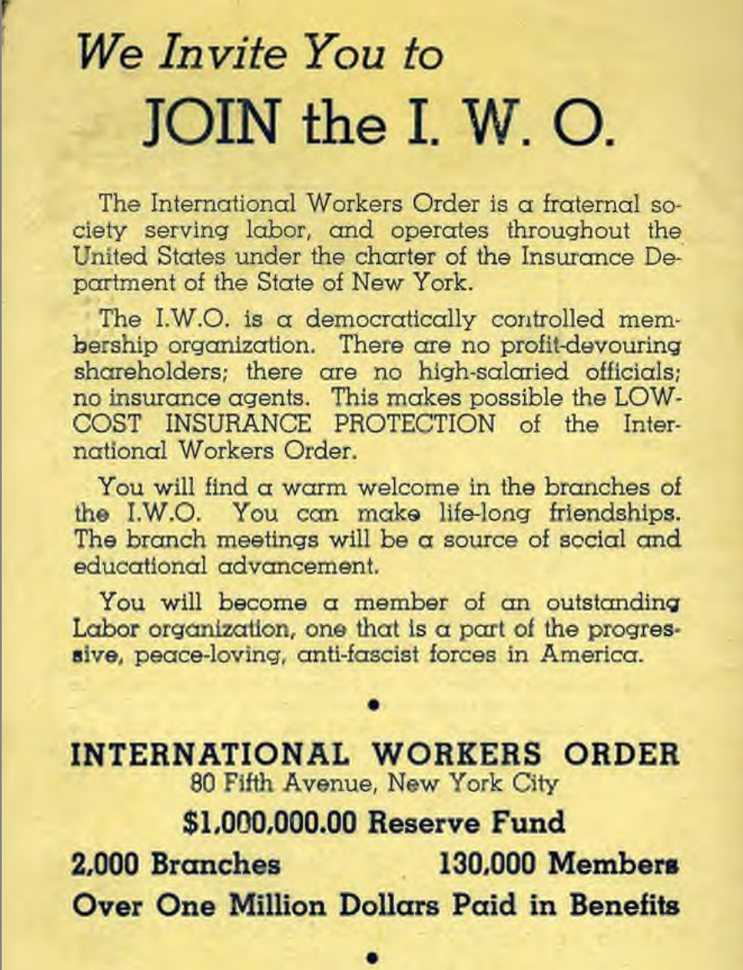
During Wartime
As World War II approached, membership in the IWO continued to climb. At the end of September 1941, the organization claimed a membership of 155,000 and assets approaching $1.9 million.
According to the testimony of IWO General Secretary Max Bedacht, these members had organized into over 19,000 branches and generated an income for the organization of over $1 million per year.
Flyer inviting people to join the IWO during the 1930s & 40s.

Slide 21
Occupied Slavic Nations
With World War II waging in the European Theatre, the American Slav Congress coordinated with Slavic countries occupied by the Third Reich.
The IWO had special sections for the Bulgarian and individual South Slavic groups.
The Bulgarians were well represented at the second congress of the American Slav Congress assembled (with some 2,500 delegates) in Pittsburgh during September 23-34, 1944. The South Slavs comprised a majority, they met in an atmosphere of jubilation over the victories of the advancing Soviet armies in East Europe. The speakers stressed that the Congress represented fifteen million Slavs.

Slide 22
Discussion

Slide 23
Mutual Aid, I.W.O.’s Departure and Lasting Legacy

Slide 24
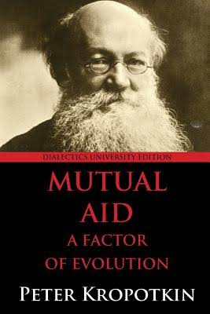
Mutual Aid
US’s nonprofit system today is the result of defunded welfare programs and increased reliance on corporate funding during the Reagan administration. This “neo-liberalization of social services” transformed charity into an industry where professionalism, maintaining tax-exempt status, and uplifting the needs of corporate donors and capitalist foundations fueled the work.
Now, the nonprofit system encourages social movements to follow capitalist models, is monitored and influenced by state and corporate entities, and is generally focused on employing educated workers to do the helping profession rather than mass activist organizing.
Conversely, mutual aid organizers are attuned to the needs of the collective over any other stakeholder, and the lines between those offering and receiving assistance are blurred. The term mutual aid was coined by Russian anarchist philosopher Peter Kropotkin in a collection of anthropological essays published in the late 19th and early 20th centuries countering prevailing theories of social Darwinism.
Kropotkin asks, who are the “fittest” in the theory of “survival of the fittest,” and postulates that in both the animal and human worlds, the most successful survivors are often the ones who mutually support their communities for the prosperity of the species as a whole.

Slide 25
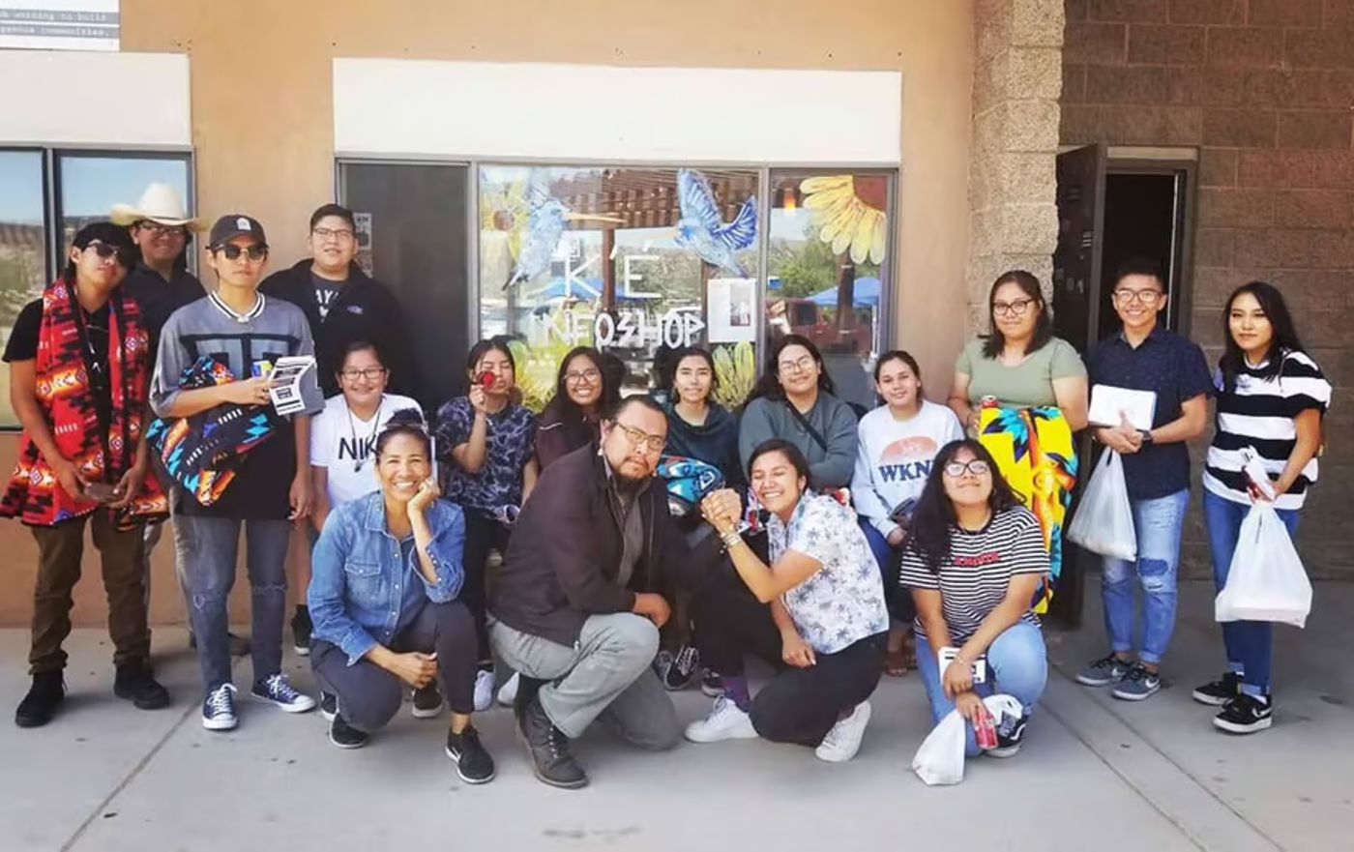
K’é (pronounced Keh) means Friendship, Peace, Relationship
Humans have been participating in mutual aid long before it had a name. Indigenous and non-Western societies often prioritize collectivism and reciprocity over individual survival and continue to do so in the face of colonial oppression.
Although every organization is different, a large number of mutual aid groups offer assistance around food because food is an essential part of collective survival and wellbeing of the community.
When existing systems fail to meet those essential needs in crisis, mutual aid delivers those needs to the community. The community itself is the most important component of mutual aid, as is empowering said community to have agency in their collective survival and wellbeing. Mutual aid is about mobilizing communities to address a shared injustice and working together to collectively find solutions.
“Indigenous Peoples have long-established practices of caring for each other for our survival, particularly in times of crisis. Mutual Aid is nothing new to Indigenous communities.”- Diné organizers, Kauy Bahe, Radmilla Cody
Window Rock, AZ.—the seat of the Navajo Nation—the K’é Infoshop is one such group, and has been supplying elders, families, and the immunocompromised with food and medical supplies.

Slide 26
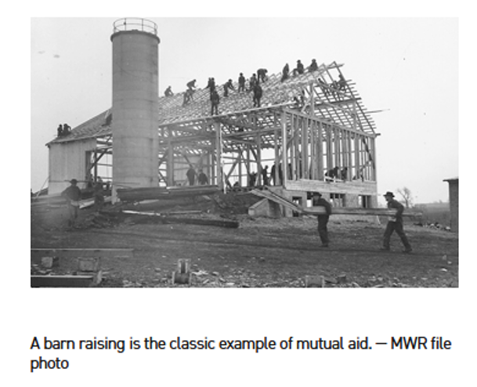
Fraternal Orders’ and Mennonite Mutual Aid
In the late 19th and early 20th centuries, approximately one in three men were involved in fraternal organizations, such as the Freemasons and Rotary Club. These groups were wildly diverse, though many offered health care, medical “lodges,” and labor union support.
Churches, of course, also have a long history of aiding their communities. For instance, in the wake of the Great Depression and World War Two, the Mennonite community across denominations in the US created Mennonite Mutual Aid (MMA) which offered legal and financial assistance for medical care and death and burial logistics.

Slide 27
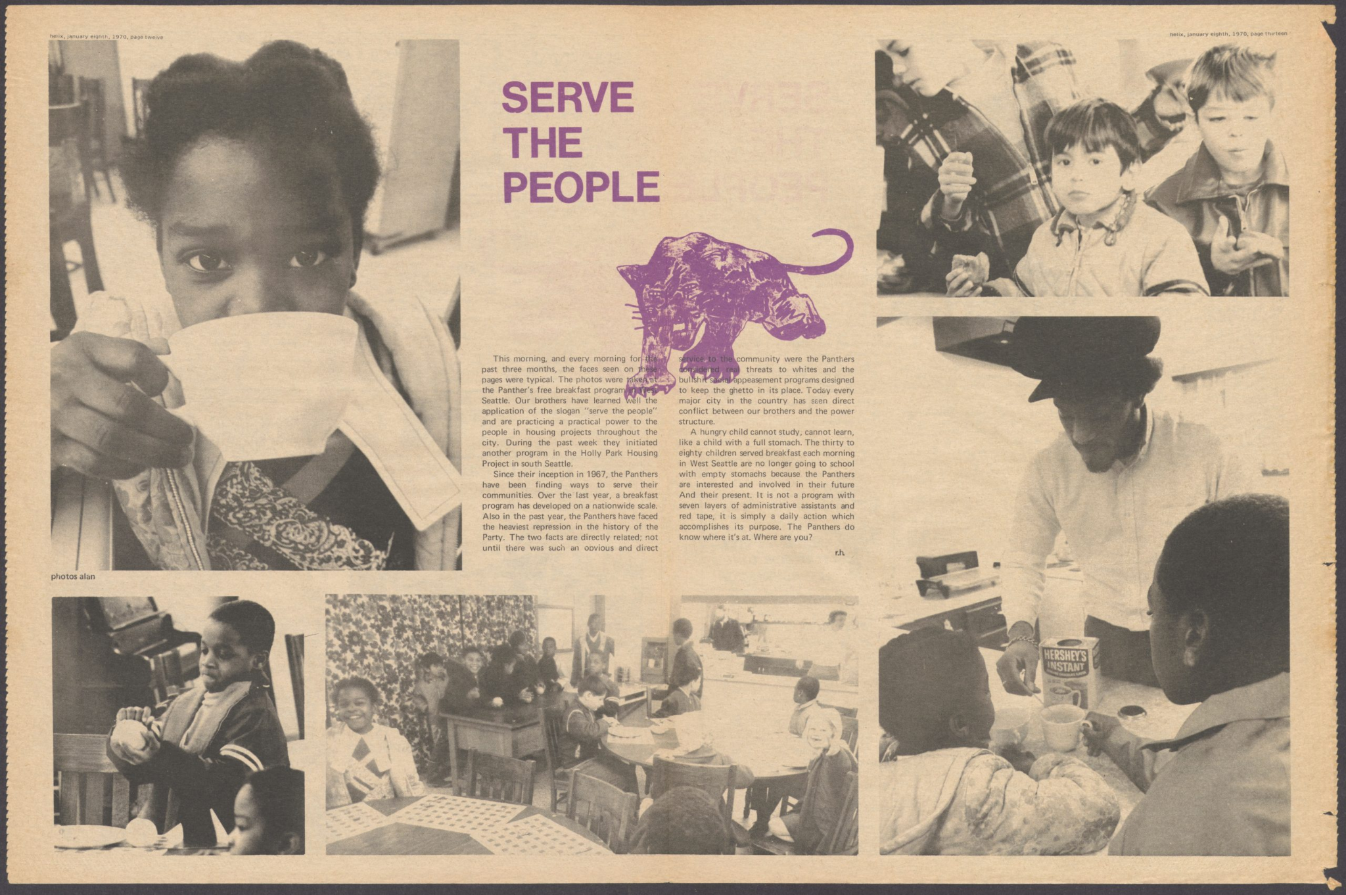
Breakfast for Children Program
The Party’s Survival Programs were directly addressing issues of hunger, class oppression, and racism while increasing the community’s political consciousness.
The first official Free Breakfast for School Children program began in January 1969 in Oakland, California. The premise was simple: children would do better in school if they had a nutritious breakfast before classes began. What started as an experiment at one local church blossomed into a nationwide initiative as communities took notice and came in droves, with some host sites serving over a thousand children each week.
FBI Director J. Edgar Hoover wrote in a 1969 memo to all field offices: “The BCP represents the best and most influential activity going for the BPP and, as such, is potentially the greatest threat to efforts by authorities to neutralize the BPP and destroy what it stands for”.

Slide 28
Mutual Aid: Organizational Structure and Approaches
Many contemporary charities have eligibility requirements for those receiving services based on sobriety, religious affiliation, income level, citizenship status, and more that arbitrarily assign deservingness to certain people and actively deny that food and shelter are essential human rights.
For many mutual aid organizers, the very concept of “charity” is antithetical to mutual aid principles. “Solidarity not charity” has become the unofficial rallying call of mutual aid organizers.
While many mutual aid organizers find that charity encourages an “us vs. them” mentality, solidarity reflects a collective, systemic struggle as a rallying point for all involved in organizing.
Referring, among other things, to the destruction of indigenous foodways and forced dependency on government rations, Indigenous Mutual Aid asserts that the US government and present-day settler nonprofits do not appropriately seek to repair the harm done by colonialism but instead feed into the concept of the “white savior.”
Because mutual aid encourages organizers to rethink and resist the way traditional social services operate, many mutual aid groups have difficulty designing leadership, decision-making, and funding models. Mutual aid groups are often most successful when lots of people come together and make decisions for the collective whole, but this is much easier said than done, especially when most of us are used to hierarchy and careerism.
Most mutual aid groups will follow a horizontal decision-making structure. This means that there are frequently no leaders, directors, CEOs, etc.

Slide 29
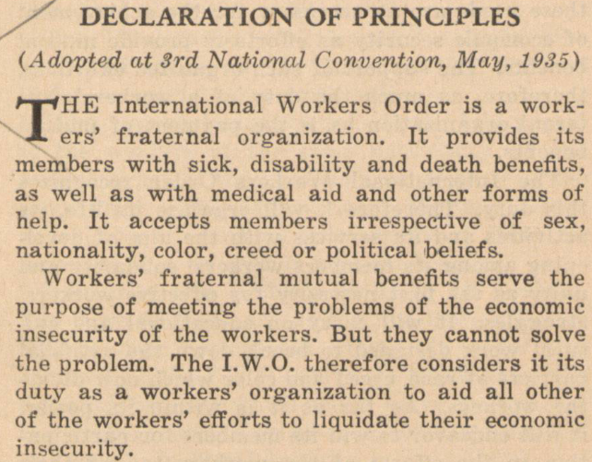
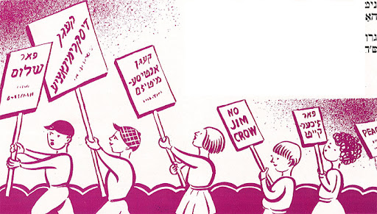
Mutual Benefits of the International Workers Order

Slide 30
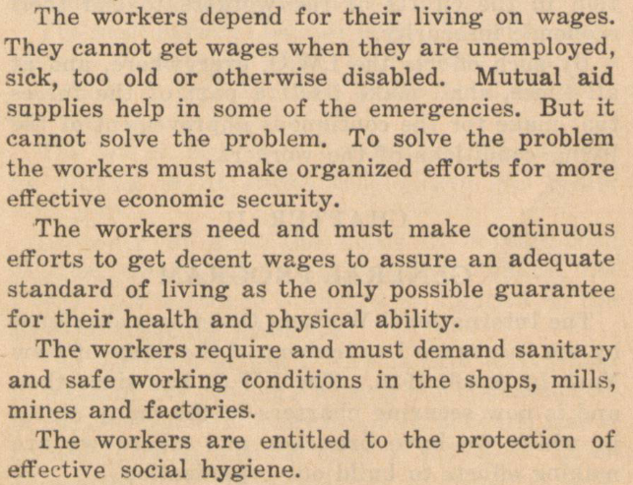
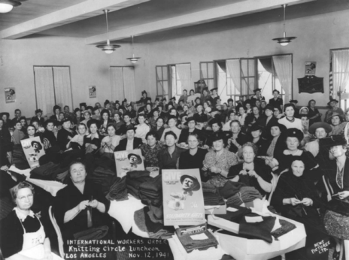
Life of the International Workers Order
Members of the International Workers Order’s Knitting Circle at a luncheon at the L.A. Cooperative Center, November 12, 1941. The women are knitting scarves, socks, and blankets to send in care packages to groups fighting the Nazis in Europe. | Shades of L.A. Collection / Los Angeles Public Library.

Slide 31
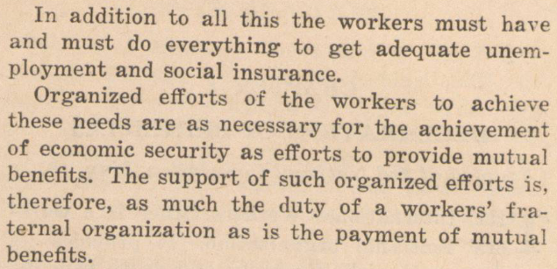
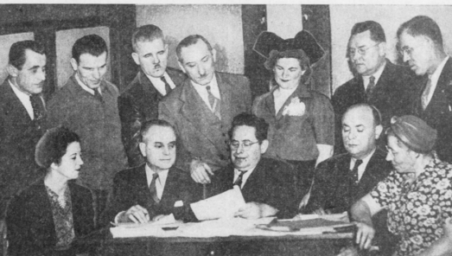
Life of the International Workers Order
Illustrating the diversity of the IWO, this picture shows the Romanian, Italian, Jewish, Ukrainian, Serbian, Hungarian, Finnish, Polish, Carpatho-Russian, Russian, and Czechoslovakian Sections of one IWO subcommittee in Detroit in 1943.

Slide 32
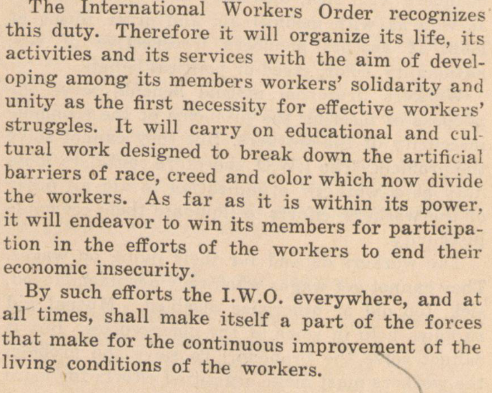

Life of the International Workers Order

Slide 33
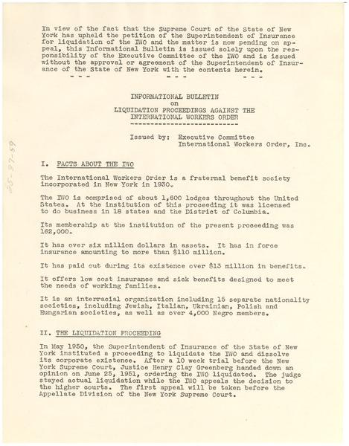
Conservatives' hostility to the Order soon resurfaced. Dies's Un-American Activities Committee in 1939 issued a report condemning the IWO as "possibly
one of the most effective and closely knitted organizations among the Communist 'front' organizations." Support for Communist candidates for office (including Bedacht, who in 1934 ran for Senate in New York), participation in "leftwing
strikes" and its "foreign and radical elements" were held to prove the IWO's menace to society.
In 1947, the IWO and all of its nationalities societies included 188,000 members, only about 10 percent belonged to the Party, but in the incipient Red scare, any association with Communists was suspect.
Destruction of the International Workers Order

Slide 34
Repression from 1944-1950
In 1944, the HUAC began to publicly call out the International Workers Order as a communist affiliated organization
The Special Committee said the IWO was a “huge patronage machine furnishing positions for a host of Communist functionaries, who serve as the party's controlling commissars within the organization”
In 1947, the US Attorney General placed the IWO on its list of subversive organizations.
The New York State Insurance Department moved to liquidate the IWO in 1950 on charges that its large cash reserves “would be surrendered to the Soviet Union by the IWO in the event of war.”
Destruction of the International Workers Order

Slide 35
From the start of the organization, foreign-born members were vulnerable to government suppression. In 1932 Rubin Saltzman of the Jewish section warned members that the Dies Bill stipulated deportation of a foreign-born resident who"believes in, advises, advocates or teaches the overthrow by force or violence the Government of the United States." Saltzman saw this measure as "the highest mark of vicious anti-foreign born legislation." He urged IWO members to act to defeat this "white terror legislation" sponsored by Texas congressman Martin Dies, later chair of the House Un-American Activities Committee.
Deportation of Members

Slide 36
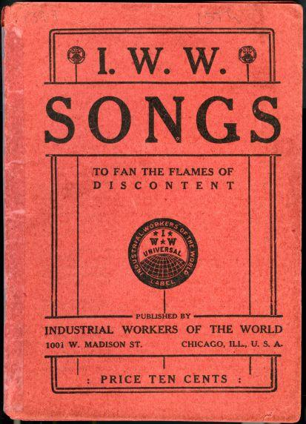
For foreign-born members, a high percentage of the Order's Italian, Greek, Romanian, and Slavic societies, the hysteria escalated. In 1947, Milgrom warned of INS "terrorization of the Yugoslav-American community of Farrell, Pennsylvania," where IWO members were threatened with denaturalization and deportation.
Other members in Gary, Indiana, were threatened with deportation for IWO membership and singing from the Little Red Songbook in the city's Croatian Glee Club.
Serbian Society leader Nick Baltich alerted headquarters that member Ljubice Pribicevich had been told by the INS (Immigration and Naturalization Services) that she could not get her citizenship papers until she resigned from the IWO. A Slovak in Passaic, New Jersey, was similarly threatened, and his alarmed wife burned their policies and dues books.
Deportation of Members
Seditious literature used by radicals for inciting riots and general mayhem- and sing-alongs with neighbors

Slide 37
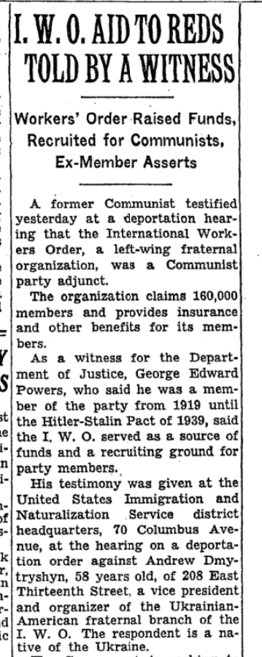
Many IWO officials lost their bouts with the INS and were expelled from the country. Such was the fate of Henry Podolski, who had taken the helm at the Polonia Society after Bolesław Gebert resigned and returned to Poland after a thirty years absence, one step ahead of deportation.
The IWO noted Podolski was targeted for removal even as the government welcomed eastern European"displaced persons" with records of wartime fascist collaboration. The Statue of Liberty was once again enlisted, with the Committee in Defense of Henry Podolski asking, "Shall we tear down the statue of Liberty and build concentration camps?"
The Order labeled Podolski a victim of the "deportation delirium" and "a fearless fighter for democratic rights." If Podolski were removed from the
country, the IWO suggested, the equally subversive Declaration of Independence should be shredded.“ Andrew Dmytryshyn, vice president of the Ukrainian Society, was also deported in a "mass murder of civil liberties.
Deportation of Members

Slide 38
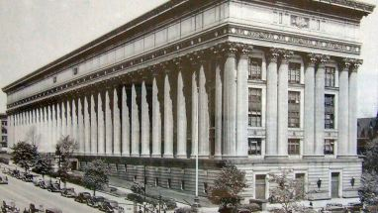
School boards contributed to the IWO's harassment: in New York and elsewhere the JPFO and other IWO societies were barred from using public schools for meetings, children's programs, and events.
The JPFO noted that New York was basing its ban on the attorney general's list, which would "deprive thousands of Jewish families in the City of New York the right to supplement the general education of their children with an after-school secular, progressive Jewish education." Pointing out that the superintendent of after-school programs himself admitted that there had never been any reports of JPFO schools teaching anything subversive, and that the board of education's president had defended "traditional civil freedoms" In rejecting an earlier attempt to ban the schools, the Order urged Mayor William O'Dwyer and the board to continue standing up to the Red-baiting "hysteria."
Suppression in Education
The State Education Building located at: 89 Washington Avenue Albany, NY 12234
JPFO president Saltzman argued that the textbooks used in schools as well as the children's magazine Jungvar (Youth) "offer concrete evidence and proof of the healthy spirit and program of our schools," and urged the board to defend "the principle of freedom of education" and not "fall victim to slanders and the spirit of Inquisition." When the city nevertheless banned the JPFO from using public schools, the JPFO's National School Committee appealed to the state commissioner of education, again noting that its classes had always been inspected by the city and no complaint of anything "subversive" had ever been received. Such appeals were unavailing.

Slide 39
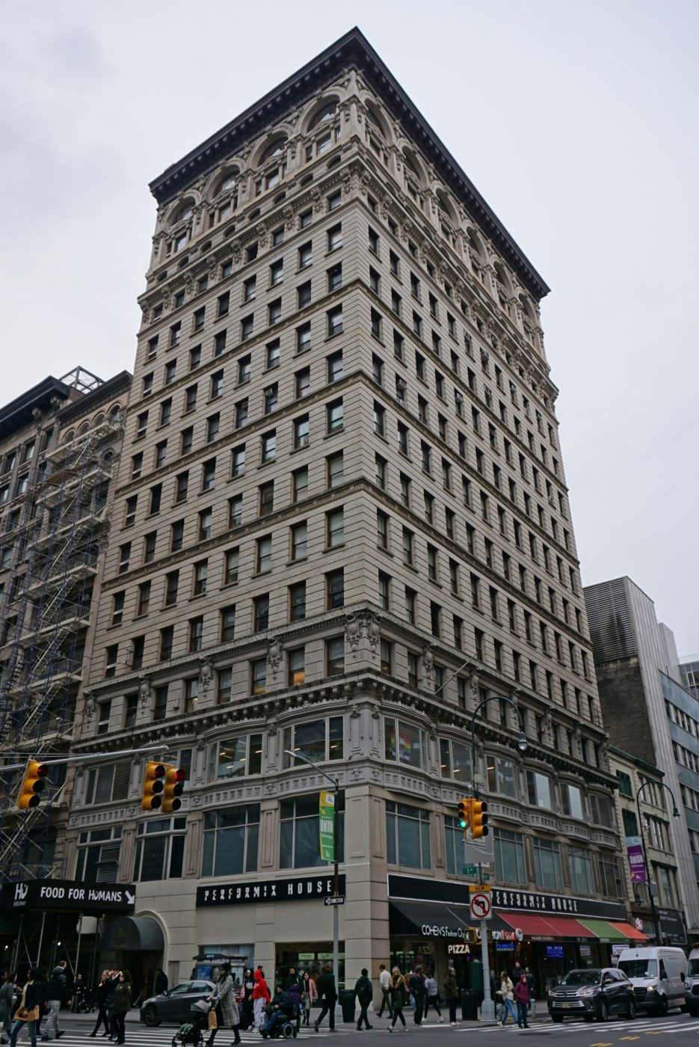
Disbanding
In 1951, the State of New York took legal action against the IWO on the grounds of being too close to the Communist Party USA.
This case dragged out for 4 years against the backdrop of McCarthyism in the United States.
Even during these tough times for the IWO, they were still providing necessary services and were still thousands of members strong.
In 1954, the International Workers Order finally came to an end when it was disbanded by the order of the State of New York.
Destruction of the International Workers Order
Located at 80 Fifth Avenue for its entire lifetime, from 1930 until 1954, this progressive mutual-benefit fraternal organization was a pioneering force in the U.S. labor and civil rights movements.

Slide 40
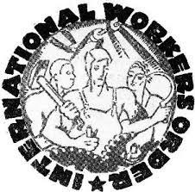
The IWO continued the legacy of the language federations of before and furthered the solidarity between the working class of the different ethnic/cultural communities of the US.
The removal of the services provided through IWO, it highlighted the necessity for better insurance coverage for the working class, especially ethnic communities.
Camp Kinderland, originally ran by the IWO, survived McCarthyism and still operates as a Jewish summer camp today.
It has been suggested that the mutual aid concept behind the IWO could be applied to Gig Economy workers since they have no employer provided benefits.
Legacy of the International Workers Order

Slide 41

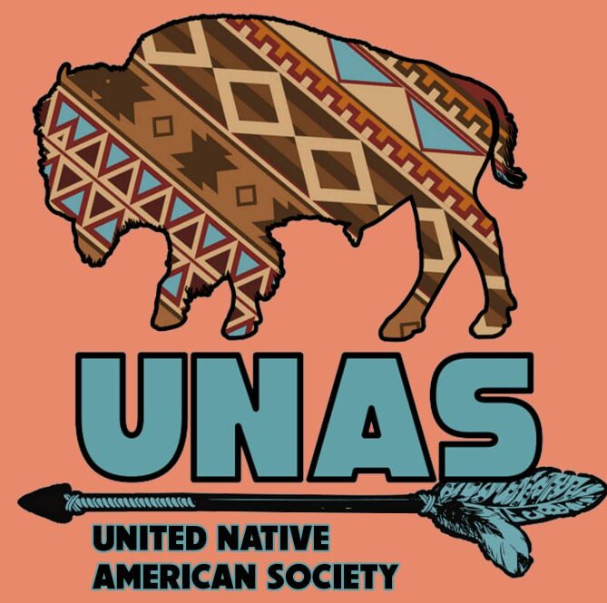
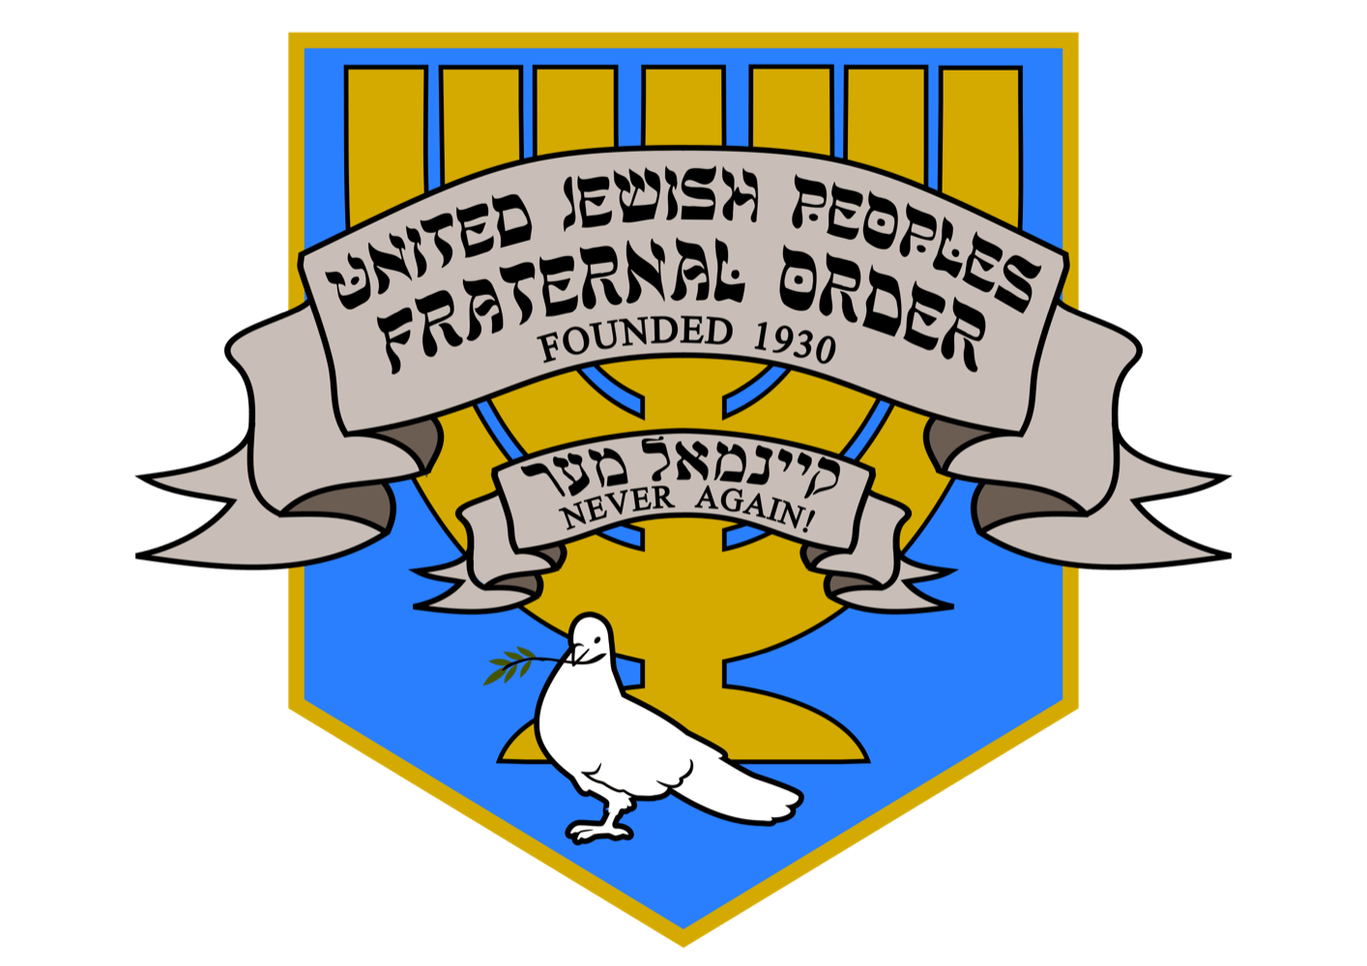
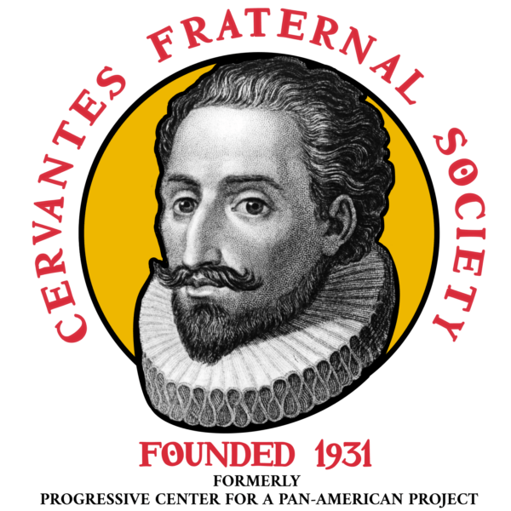
Legacy of the International Workers Order
Asian-American Friendship Congress.
United Native American Society.
United Jewish People’s Fraternal Order.
Cervantes Fraternal Society

Slide 42



Legacy of the International Workers Order
Irish-American Connolly Council
Peoples Anti-Racist Coordinating Committee
And Italian mass org soon to come…
American Slav Congress

Slide 43
Discussion & Wrap Up

Slide 44
Announcements
PCUSA Cell Chairs need to call members of their cells to remind them about attendance.
PCUSA Cell members are reminded attendance at the Continuing Education class of Jones-Foster every first Wednesday of the month is required.
The next issue of New Masses (2026) has begun production. If you have art you want us to feature, email it to info@partyofcommunistsusa.net.

Slide 45
Volunteers Needed!
We are in need of volunteers for the staff of the People’s School! Here’s a few roles we need filled:
People to help manage posting on our social media and podcast platforms
Video Editors, Audio Editors, Graphic Designers, Artists, Narrators
Web Controls, Moderators
Email info@peoplesschool.us if you’re interested and try to attend our next staff meeting if possible.

Slide 46

View From Left Field
https://viewfromleftfield.libsyn.com
The Old PSMLS Youtube is now the Youtube of View From Left Field, a podcast of analysis and discussion of current events from a progressive perspective.
Like the Youtube videos and subscribe with 5 star ratings on your podcast platforms.

Slide 47

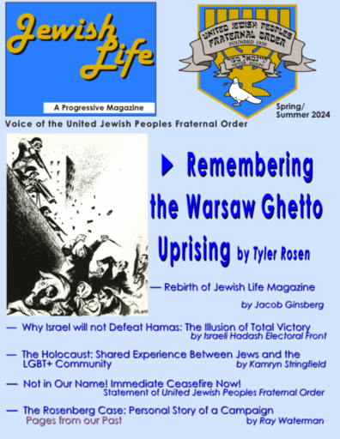


New Outlook Publishers
newoutlookpublishers.store
Relevant and Latest Releases

Slide 48



Harry Bridges School of Labor
luel.us/laborschool/
The Harry Bridges School of Labor is a monthly class covering a variety of topics aimed at building class consciousness among union members. For class schedule and other information, please visit the website at luel.us/laborschool.

Slide 49
