Slide 1

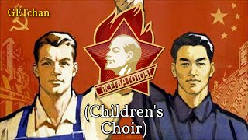
Moscow–Beijing (Sino-Soviet Friendship Song)

Slide 2
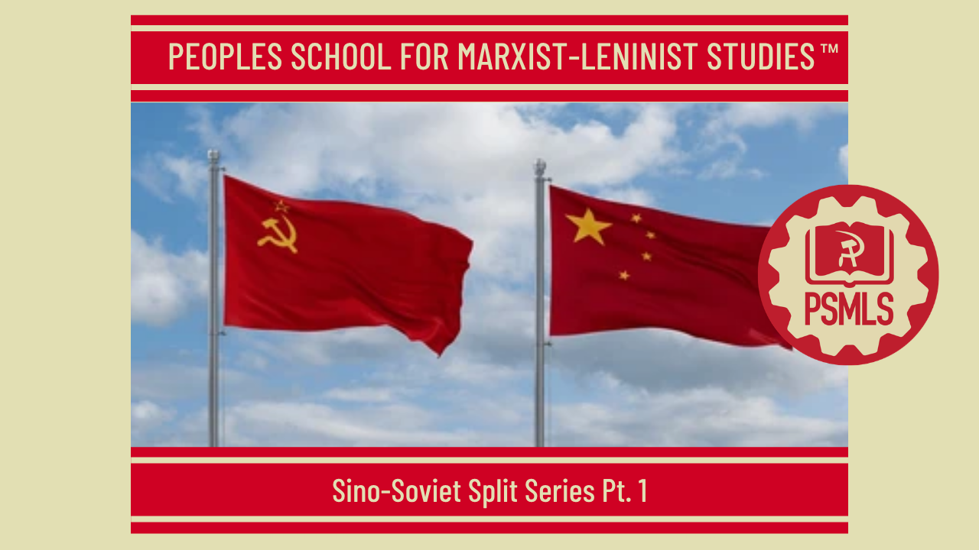
PSMLS 9/15/26

Slide 3
What we’ll be learning today:
Direct lead-up to the split
What is the Sino-Soviet Split?
Long-term effects of the Sino-Soviet Split

Slide 4
Direct Lead-Up to the Split

Slide 5
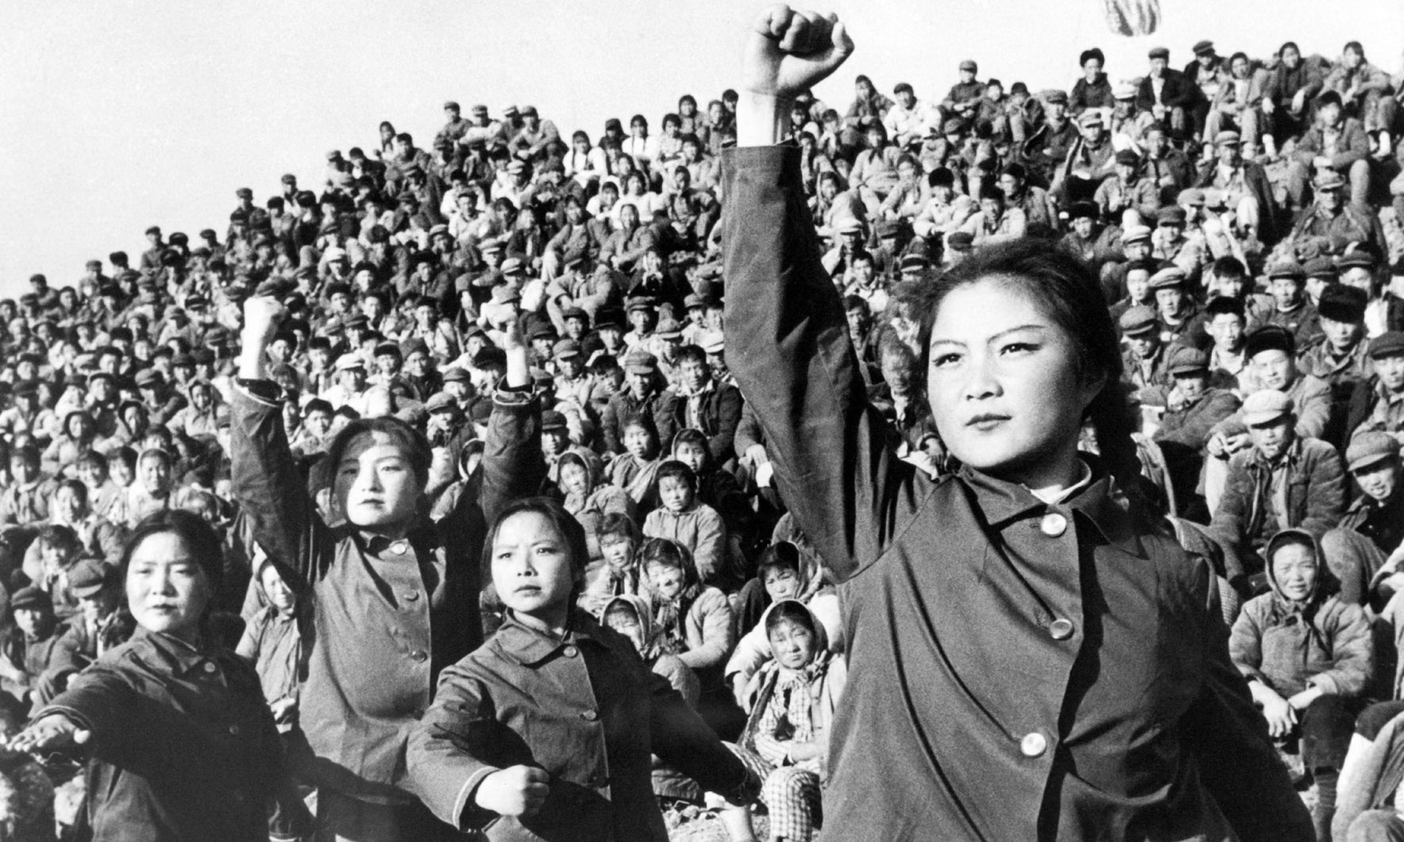
The Rupture Of Sino-Soviet Relations
The year 1960 was a turning point in Sino-Soviet relations. It marked the beginning of a new period when the key positions in the CPC were taken by forces which imposed a nationalistic policy on the People’s Republic of China. Its implementation led to a radical revision of China’s foreign policy, the departure of her Communist Party from the principles of proletarian internationalism, the rupture by Peking leaders of the relations of friendship and co-operation with the Soviet Union and other socialist countries, and an open political struggle against them. The renunciation by the CPC leadership of the Leninist principles of foreign policy of a socialist state was inseparably linked with the internal processes of China’s development. It was the direct result of the growth of anti-socialist tendencies in China, the imposition of anti-Marxist, anti-Leninist views on the Communist Party, the departure of Peking leaders from the path of socialist construction. On the other hand, the home situation in China in that period was characterised by an exacerbation of the class struggle, because the great setbacks in economic development caused by the disastrous voluntaristic policy of the “big leap” and the setting up of people’s communes undermined the positions of socialism in China and gave the anti-socialist forces an opportunity for a counter-offensive.
Chinese red guards during the cultural revolution in 1966

Slide 6
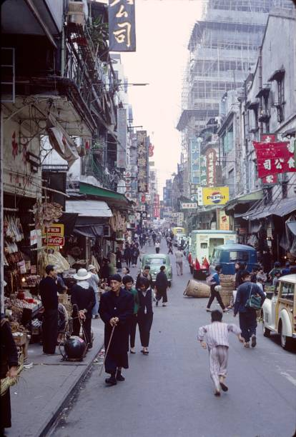
China’s Home Situation In The Early 60s
The situation which had taken shape in China toward the early 60s was characterised by a sharp deterioration of the economic conditions. The failure of attempts by CPC leaders to overcome economic backwardness within a brief space of time by voluntaristic methods, and thereby to provide the internal prerequisites for making their nationalistic aspirations and claims to leadership come true, became strikingly obvious to everybody. China’s economy was completely disorganised. Her industrial and agricultural production fell sharply. By 1962 her gross industrial output had reduced almost by half as compared with 1959. The total grain harvest fell by one-third. A large proportion of her productive forces was destroyed. According to expert estimates, the total value of main production assets in industry reduced at least by 33 percent, in agriculture by 25-30 percent. The CPC leadership had to take emergency measures to check the further decline of production. For this purpose, the 9th plenary meeting of the CPC Central Committee held in January 1961 decided to curtail the scope of capital construction and to adjust the rates of development. This implied massive suspension of work at enterprises built mostly in the “big-leap” years, complete closure of “backyard” blast furnaces, and from the middle of 1961, termination of capital construction in industry and the transport services.

Slide 7
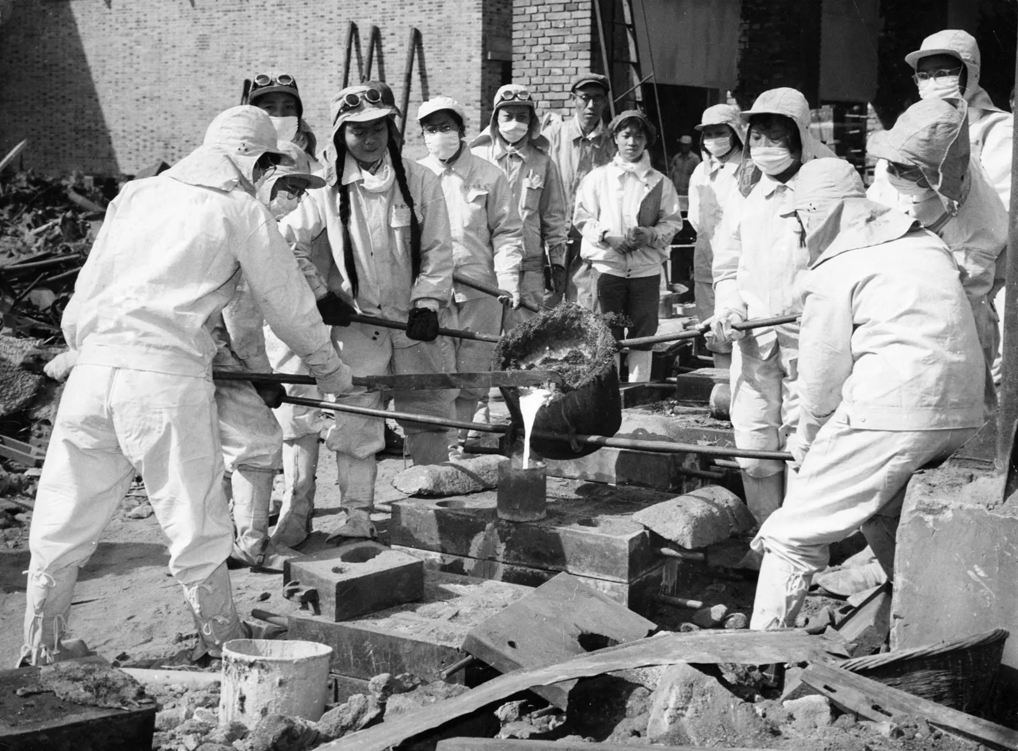
Economic Difficulties Under the CPC
The failure of the “big leap” resulted in unprecedented difficulties in food and consumer goods supplies to the population. Rationing and special coupons were introduced for the purchase of many goods and later rations of grain, fats, sugar were sharply diminished. In 1962 and later years an adult person’s monthly ration was 150-200 grams of meat, 100-150 grams of vegetable oil. The annual ration of cotton fabrics was 2-3 metres per person. The emergency measures taken by the CPC leadership to deal with the consequences of the “big leap” produced a definite effect. By the end of 1962 the economic situation leveled off to a certain extent. Nevertheless, the curtailment of heavy industry, the growth of military spending, the policy of developing natural economy could not secure any appreciable progress. Of course, many difficulties in China’s economic development were due to objective causes. Suffice it to recall that China, with her huge population accounts for only 4 percent of the world industrial output the people’s government inherited from pre-revolutionary times primitive agriculture, backward industry, poverty, and economic dislocation. The difficulties inevitable under such conditions were multiplied tenfold by mistakes of Mao Tse-tung and his followers, their renunciation of fraternal cooperation with the socialist countries, disregard for the laws of economic development.
Women steel workers of the Chunghua Metallurgical Plant in Shanghai pouring molten steel into sand molds - 1959

Slide 8
Departure From The Leninist Principles Of Socialist Foreign Policy
In the period of setting up people’s communes, the Maoists kept repeating that communism could be built within a matter of years (“three years of stubborn work 10,000 years of happiness,” etc.), now they went to the other extreme, putting off the attainment of this goal to an indefinite future. It was asserted in Peking that “the final victory of socialism cannot be achieved within the lifetime of one or two generations. It can be achieved in full within the lifetime of five to ten generations or even after a longer period of time”. Thus, the nationalists in the CPC admitted their complete inability to cope with the breath-taking tasks of socialist construction, to lead the struggle of the Chinese working people for the final victory of socialism in their country. This did not mean, however, that Chinese leaders had given up their nationalistic ambitions and claims to leadership. After their setbacks in the economic field they went about searching for new ways to attain their old objectives. They concentrated on foreign policy, seeking to prod a world revolution by war, to involve the world’s leading powers — the USSR and the USA — in a mutually annihilating military conflagration and to build on their ruins “a new brilliant civilisation” where China would dominate thanks to the overwhelming numbers of her population. It was declared in Peking that it was foolish to speak of building communism as long as imperialism existed and was relatively strong in the main regions of the world. Chinese leaders attacked the policy of peaceful coexistence pursued by the socialist countries in an effort to aggravate international tensions. At the same time, they sought to secure success for their policy at a minimum of risk for China herself, trying to keep away, insofar as possible, from the dangers involved in this policy.

Slide 9
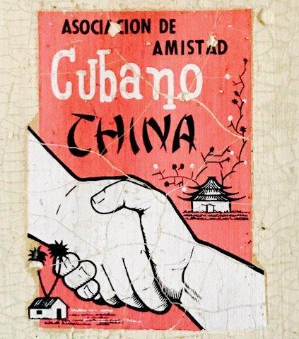
The CPC Splits from the USSR on the World Stage
China’s foreign policy during this period was directed at frustrating the policy of peaceful coexistence, aggravating international tensions, bringing nearer a “decisive military battle with imperialism”. The departure of Peking leaders from the agreed common line of the socialist countries on the international scene became particularly glaring in the autumn of 1962 during the Caribbean crisis. At a time when Cuba was faced with a grave danger of invasion by US troops and the world was on the brink of a thermonuclear war, Chinese leaders made undisguised attempts to provoke a large-scale international conflict. In the first stage of the crisis, between October 23 and 28, 1962, when the international situation was extremely tense, and it was particularly imperative to come out in a united front against the aggressive actions of American imperialism, CPC leaders abstained from active measures to support Cuba, as it was done by the USSR and other countries. Chinese leaders preferred to take up a wait-and-see attitude so as to say the last word whatever the outcome of the crisis. After October 28, 1962, when the tension diminished, and a trend was in evidence toward ending the crisis, a clamorous campaign suddenly flared up in the PRC ostensibly in token of her determined support for the Cuban people’s struggle while Chinese propaganda emphasised quite unequivocally that the Soviet stand allegedly caused damage to Cuba.

Slide 10
“The Ideas of Mao Tse-tung are the Only Truth”
The policy of Chinese leaders toward the national liberation movement assumed a strikingly obvious anti-Soviet character. Peking propaganda sought to play down the role of the Soviet Union on the international scene, to undermine its unity with countries waging a national liberation struggle against imperialism. While deliberately belittling the importance of the Great October Socialist Revolution for the development of the national liberation movement in the colonies and dependent countries, CPC leaders went out of their way to circulate the thesis on the first priority importance of the ideas of Mao Tse-tung for the success of this movement. A textbook of history published by the Hofei Teachers’ Training Institute in 1961 said: “The ideas of Mao Tse-tung are a new development of Marxism-Leninism in the conditions of revolution in the colonies and semi-colonies. The ideas of Mao Tse-tung are the only truth which has brought liberation to the Chinese people, as well as the only truth with the aid of which the peoples of the colonial and semicolonial countries will liberate themselves. Therefore, the ideas of Mao Tse-tung are of exceedingly great importance not only for China, they also have universal significance for the world communist movement and the national liberation movements of the peoples of Asia, Africa and Latin America.” The Marxist-Leninist parties regard the collapse of the colonial system under the pressure of the national liberation movement as a historical phenomenon, second in importance to the formation of the world socialist system. Revising this assessment, Chinese leaders began to describe the national liberation movement as the main factor of struggle against imperialism, to play down the role of the world socialist community and the revolutionary movement of the working class in the capitalist countries.

Slide 11
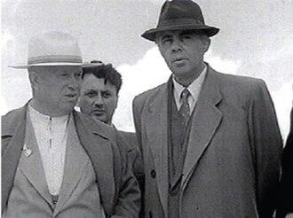
The Albanian Problem
Since the early days of their breaking with the CPSU and other fraternal parties, Albanian leaders had been a mouthpiece and instrument of the splitting policy of Mao Tse-tung and his group. Numerous statements by Albanian leaders, articles in the Albanian press abounded in crude attacks on the CPSU and the Soviet Government. Statements by Albanian leaders in defence of the integrity of Marxism-Leninism, all their arguments adduced to show their independent views on the key issues of today had been fully borrowed from Peking leaders. The setting up of the anti-Soviet alliance of Chinese and Albanian leaders, their union in a single opportunist bloc spearheaded against the CPSU was one of the first results of the practical implementation of the Peking leaders’ splitting policy within the socialist camp and the world communist movement. The splitters would not have dared to oppose the CPSU so brazenly, to oppose themselves to the entire world communist movement, if they had not been encouraged and fully supported by Peking. From the very outset this support was not only ideological but also material. Already the first anti-Soviet statements by the splitters at the 1960 Meeting of the Communist and Workers’ Parties were generously rewarded by Chinese leaders. Later, this sort of encouragement camouflaged with the false slogans of “international fraternal assistance” became regular.
1959- Nikita Khrushchev with Enver Hoxha, an Albanian politician, revolutionary, and communist political theorist who was the leader of Albania from 1944 until his death in 1985

Slide 12
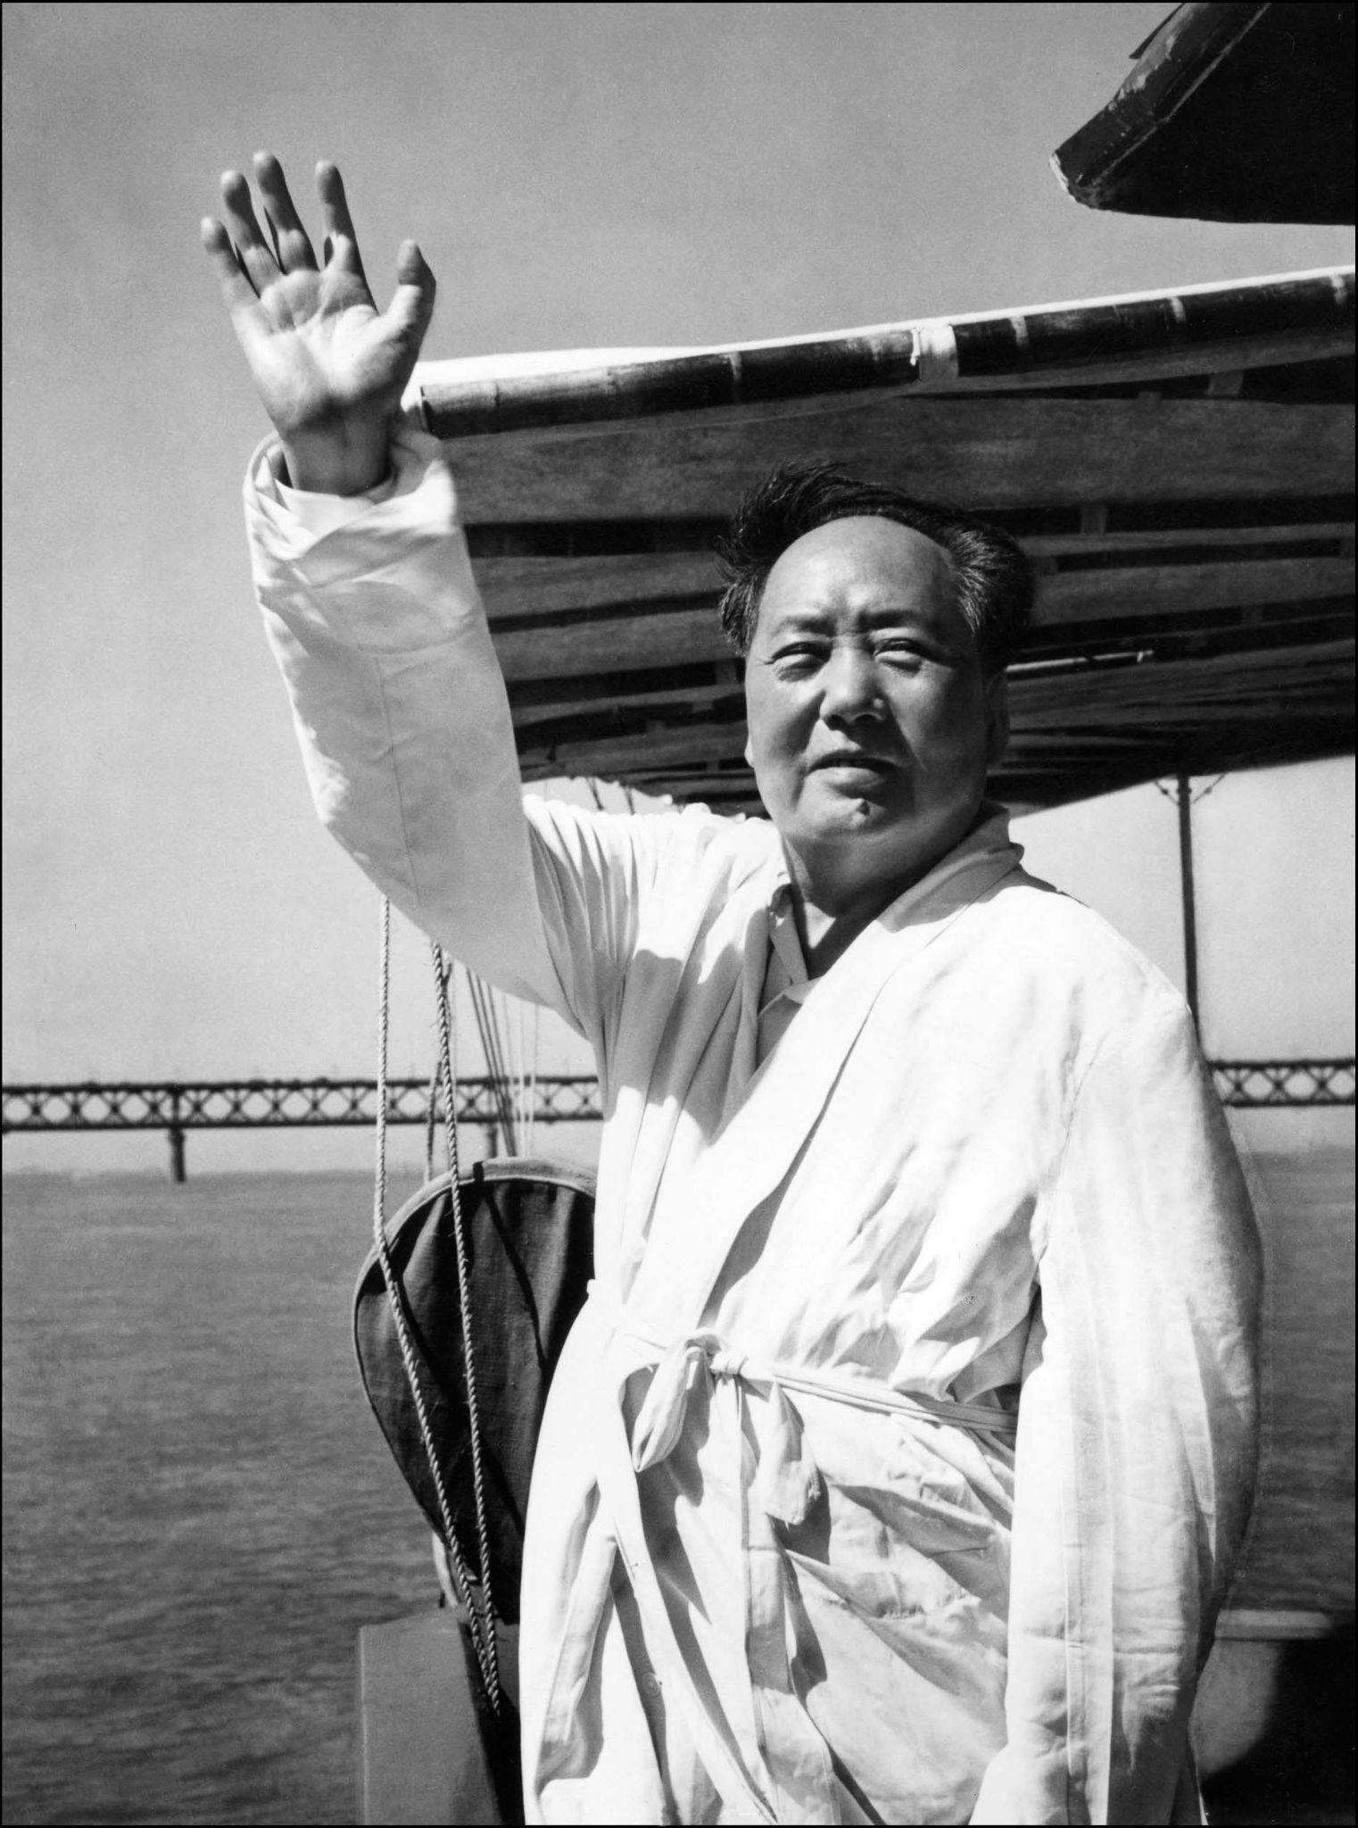
Such Absurdities
Peking began to set up at a feverish pace various splitting groups within the world communist movement. The louder and the more scandalous the curses such groups made against the CPSU, the fouler and the more cynical their anti-Soviet fabrications, the greater was the support they received from Peking. In the Chinese press and official statements by CPC leaders, leaders of dissentient groups were extolled as “great” and “staunch” Marxist-Leninists. On every occasion bombastic greetings interspersed with hypocritical epithets and fulsome praises were sent to them from Peking. In return, the dissenters took servile oaths of life-long allegiance and gratitude to Mao Tse-tung for his solicitude and support. Stepping up their attacks on the CPSU Peking leaders accused it of a striving for “dictatorship” in the communist movement, a desire to impose its will on other parties. These slanderous accusations graphically showed how far CPC leaders had departed from the views they professed a short time ago. Indeed, only three years before, Jenmin Jihpao wrote: “The imperialists, referring to the fact that the socialist camp is led by the Soviet Union, accuse the Communist parties of all countries of being dependent on Moscow or slander the Communist Party of the Soviet Union on account of its alleged control of the Communist parties of other countries. Such absurdities do not deserve as much as a laugh from the Communists.
Mao Zedong’s ‘world-record-breaking’ swim in the Yangtze River in the 1960s signalled the return of the “Great Helmsman”. Other state leaders have since tried to use the sport as a demonstration of power, with varying results

Slide 13
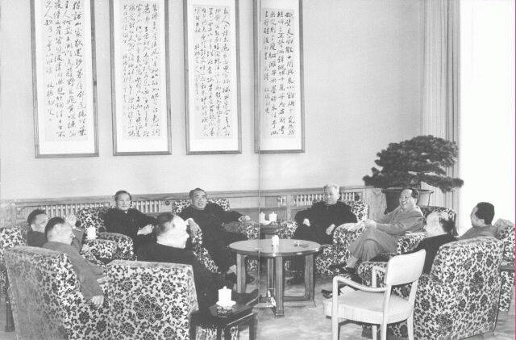
Attempts to Re-Unify
In a situation of stepped-up splitting activities by Peking leaders, the CPSU Central Committee undertook new efforts to end open controversy. The party persistently sought to restore the relations of unity and cohesion between the CPC and the international communist movement, to normalise and strengthen Sino-Soviet relations. On January 3, 1963, in a discussion with the Chinese Ambassador Pan Tzu-li held at the CPSU Central Committee, the Soviet side re-emphasised that the CPSU was seeking to restore friendly Sino-Soviet relations and was prepared to do everything necessary to this end. On January 7, 1963, the CPSU Central Committee appealed in Pravda for strengthening the unity of the communist movement to secure the triumph of peace and socialism. Pravda emphasised that differences between individual communist parties on this or that question had no deep-going roots in the social system of the socialist countries, had no objective foundation but were primarily subjective in character. “Therefore,” Pravda wrote, “there is everything for overcoming the differences successfully. It is necessary to be guided by the supreme goals and interests of the international communist movement and seek ways towards rapprochement, ways towards cooperation and unity.”
April 1960 meeting of the Political Bureau of the CPC Central Committee

Slide 14
Methods of Internal Struggle
However, the statement made at the Congress on January 18 by the representative of the CPC showed that its leadership had no interest in ending open controversy. The leader of the CPC delegation clung to the old positions of Chinese leaders and repeated attacks against the CPSU on questions at issue, including the assessment of the Caribbean crisis, the Sino-Indian border conflict, etc. The statement by the Chinese representative showed that CPC leaders wanted to turn the subject in such a way as to guard themselves against criticism while continuing their splitting activities and their attacks on the CPSU and other Marxist-Leninist parties. Chinese leaders confirmed their negative attitude to the proposal for ending open controversy in a Jenmin Jihpao editorial of January 27, 1963. This article, for the first time in the official Chinese press, contained direct slanderous attacks on the CPSU leadership and rejected the proposal of the CPSU Central Committee supported by the fraternal parties. The Communist Party of the Soviet Union has never denied the usefulness of fruitful discussions within the ranks of Communists who are pursuing the same goals. Without comparing different opinions and points of view the successful development of the revolutionary movement is impossible. No differences or discontent with the behaviour of this or that party, however, can justify methods of struggle detrimental to the interests of the international communist movement. The deeper and the wider a party’s understanding of the objectives and tasks of the international working class, the more energy it should display to secure that differences, however grave, be discussed in a quiet and businesslike way, without interfering with fruitful work, without disorganising the revolutionary activities of the international working class.

Slide 15
Discussion

Slide 16
Discussion & New Members Introductions

Slide 17
New Member Introductions
What is your name, pronouns and state (or country/territory)?
Where do you work? Is it unionized?
How did you find out about the People’s School?
What do you think about tonight's class?

Slide 18
What is the Sino-Soviet Split?

Slide 19
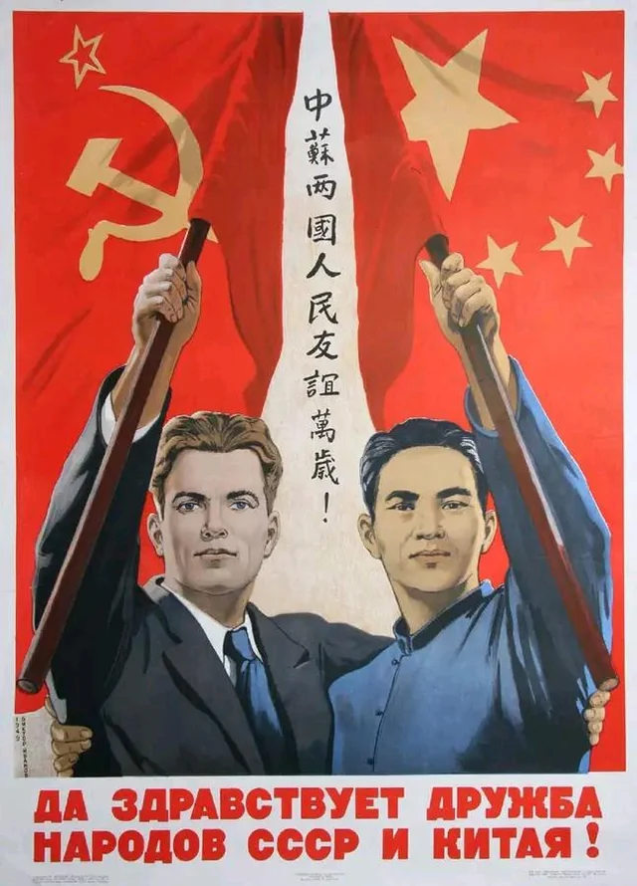
Explanation
The term "Sino-Soviet Split" refers to the gradual worsening of relations between the Soviet Union and the People's Republic of China, and between their respective Communist Parties. Graduating from words to deeds, the conflict was expanded from an ideological one between two political parties to a conflict between nation states as relations between the USSR and the PRC were severed and, in 1969, their troops clashed across their common border.
“Long live the friendship of the peoples of USSR and China”

Slide 20
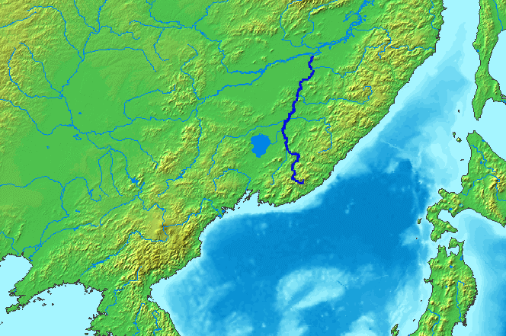
Sino-Soviet Tensions Mount Along the Ussuri River
The Sino-Soviet tensions along the Ussuri River border in 1969 marked a significant escalation in the already strained relationship between the two communist superpowers. Rooted in ideological differences and historical grievances, the conflict was exacerbated by China's Cultural Revolution and Moscow's withdrawal of support.

Slide 21

Sino-Soviet Tensions Mount Along the Ussuri River
The dispute came to a head with skirmishes over a small, disputed island, Damansky (Zhenbao), which led to armed clashes resulting in casualties on both sides. Despite the lack of strategic importance of the island, the incidents symbolized deeper issues of national pride and political rivalry.

Slide 22
Sino-Soviet Tensions Mount Along the Ussuri River
In response to the border violence, the Soviet Union increased its military presence along the border, hinting at the potential for nuclear confrontation. Diplomatic efforts, including a meeting between Soviet and Chinese leaders, ultimately failed to resolve the underlying tensions, although they temporarily halted the fighting. The aftermath of the conflict reshaped international relations, as the United States seized the opportunity to foster closer ties with China, shifting the global balance of power.

Slide 23
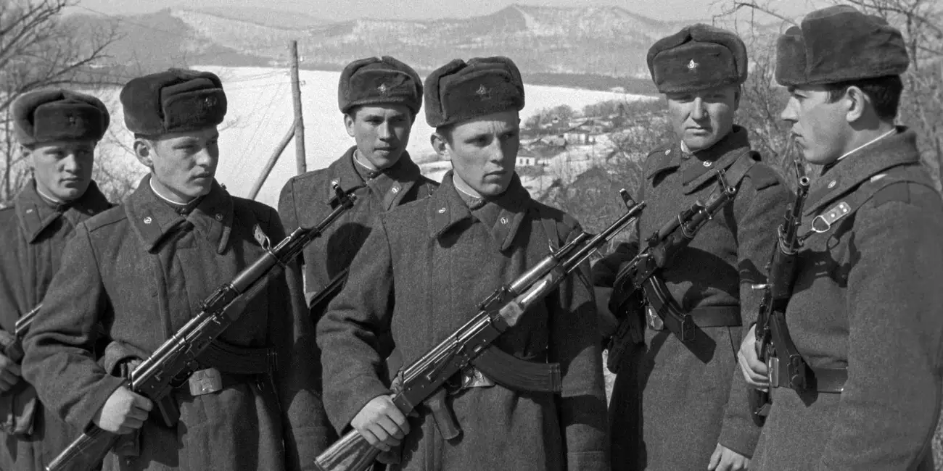
Sino-Soviet Tensions Mount Along the Ussuri River
This period of heightened animosity and subsequent rapprochement significantly influenced the trajectory of the Cold War, leading towards a tripolar international system that ultimately contributed to the collapse of the Soviet Union and the end of the Cold War.
Despite the lack of strategic importance of the island, the incidents symbolized deeper issues of national pride and political rivalry.
Red Army troops at Damansky Island

Slide 24
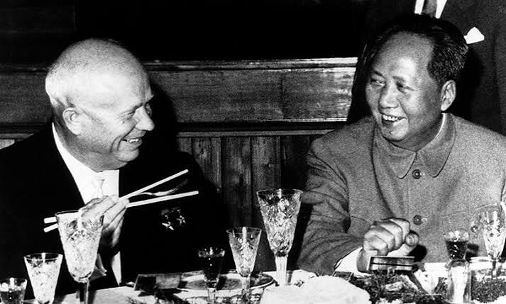
Sino-Soviet Schism
The border dispute between China and the Soviet Union was the culmination of a growing antagonism between the two communist superpowers that began in the late 1950’s. The schism’s roots were many: ideological differences, conflicts of national interests, the clashing personalities of Nikita S. Khrushchev and Mao Zedong, Moscow’s withdrawal of atomic and economic aid, Mao’s opposition to Khrushchev’s “peaceful coexistence” policy, and Beijing’s grievances against czarist Russia’s imperialism in the nineteenth century at China’s expense.
Soviet and Chinese Premiers Khrushchev and Mao - 1959

Slide 25
Sino-Soviet Schism
Antagonism became particularly intense during the three years leading up to the armed clashes of 1969. Domestically, China was going through the convulsions of its Cultural Revolution. In the highly charged atmosphere of this revolution numerous incidents exacerbated the hostile attitude of Beijing toward Moscow. One potentially troubling concern was the unstable border between China and the Soviet Union, a border that had never been fully and exactly demarcated.

Slide 26
Sino-Soviet Schism
In the 1960’s numerous border incidents were reported, particularly along the Amur and Ussuri Rivers in 1967 and 1968. These incidents culminated on March 2, 1969, in a fight for a tiny island in the Ussuri River called Damansky by the Soviets and Zhenbao by the Chinese. Located about 250 miles north of Vladivostok, the island was uninhabited and of no economic or military significance. The Chinese claimed the island on the grounds that the border ran down the middle of the river and that Zhenbao was on their side of the line. The Soviets insisted that the island was on their side of the border.

Slide 27
Sino-Soviet Schism
The March 2 skirmish took place on Damansky Island as a result of what the Soviets termed an ambush by Chinese troops. Some three hundred Chinese frontier guards and regular soldiers crossed the ice and opened fire on a group of Russian soldiers who confronted them. A two-hour battle ensued, leading to the deaths of some thirty Russian border guards and an unknown number of Chinese soldiers. Both sides claimed victory although both withdrew from the island after the battle. Moscow was outraged and accused Beijing of aggression. A flurry of protests and propaganda followed from both sides.

Slide 28
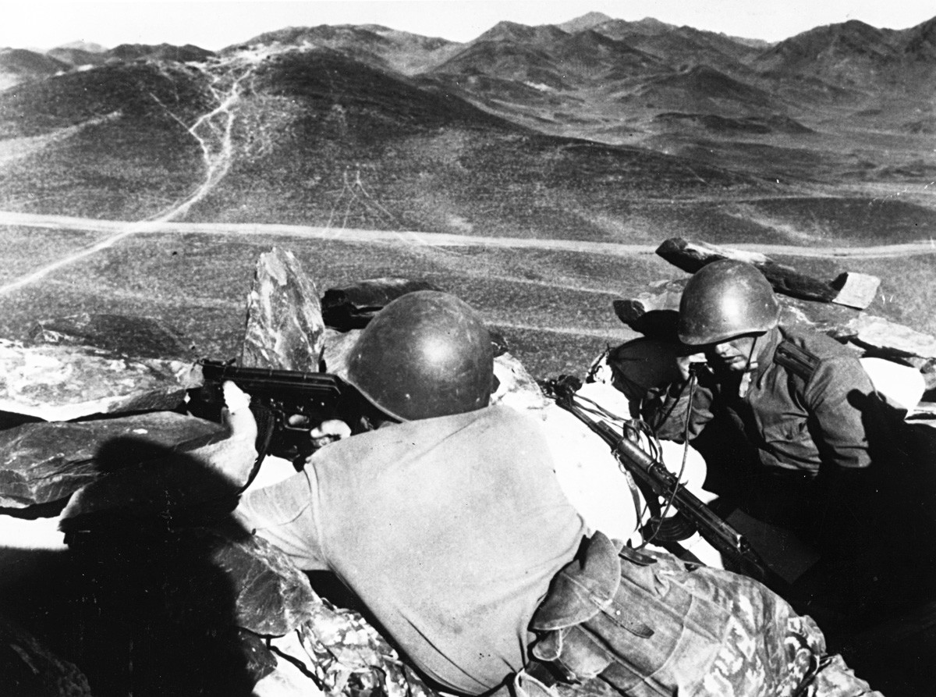
Sino-Soviet Schism
Another battle followed on March 15. The forces, and the casualties, were greater. Beginning mid-morning, the nine-hour battle involved exchanges with mortar and artillery fire. The Russians suffered about sixty casualties (dead and wounded), and the Chinese forces, which numbered around two thousand at the start of the battle, lost several hundred to injury or death.

Slide 29
Sino-Soviet Schism
Possession of Damansky Island never was an objective of either side. The initial Chinese assault was intended to discredit the Soviet Union before the world’s communists and to bolster Mao’s image against his domestic enemies. Moscow’s retaliation on March 15 as well as all subsequent Soviet-initiated actions were designed to punish the Chinese for their initial actions on March 2 and to deter them from further actions. Over the course of the following months a flurry of accusations and counterclaims increased the tension between the two states. Border incidents increased all along the boundary between China and the Soviet Union.

Slide 30
Sino-Soviet Schism
Prior to the fighting in March the prospect of a war between the two communist states had been remote. That changed in the spring and summer of 1969. Both states, particularly the Soviet Union, began a steady build-up of military forces along the border. In addition, Moscow increased Soviet forces along the entire length of the Soviet-Mongolian and Chinese-Mongolian border. The Soviet Union was clearly the stronger power militarily and was determined to use its power to coerce the Chinese into a settlement of their border and other differences. The border incidents initiated by Moscow were part of its strategy of coercive diplomacy.

Slide 31
Sino-Soviet Schism
Coercive diplomacy had a nuclear dimension. While building up militarily, Moscow hinted that it was prepared to initiate a nuclear attack on China. Such a threat was conveyed by Victor Lewis, a Soviet news correspondent in London. Rumors coming from Moscow also suggested the possibility of a Soviet air strike against the Chinese nuclear testing site at Lop Nor in Sinkiang, China’s southwestern province. It is highly unlikely that Moscow was actually prepared to initiate a preemptive nuclear strike against China, but the threat was clearly intended to pressure the Chinese.

Slide 32

Sino-Soviet Schism
On August 18 an official with the Soviet embassy in Washington questioned a U.S. diplomat about what the American reaction would be in the event of a Soviet attack on China’s nuclear facilities. The Americans’ reaction was negative. Moscow also sounded out its Warsaw Pact allies on the possibility of a Soviet nuclear strike.
Soviet Embassy in Washington DC

Slide 33
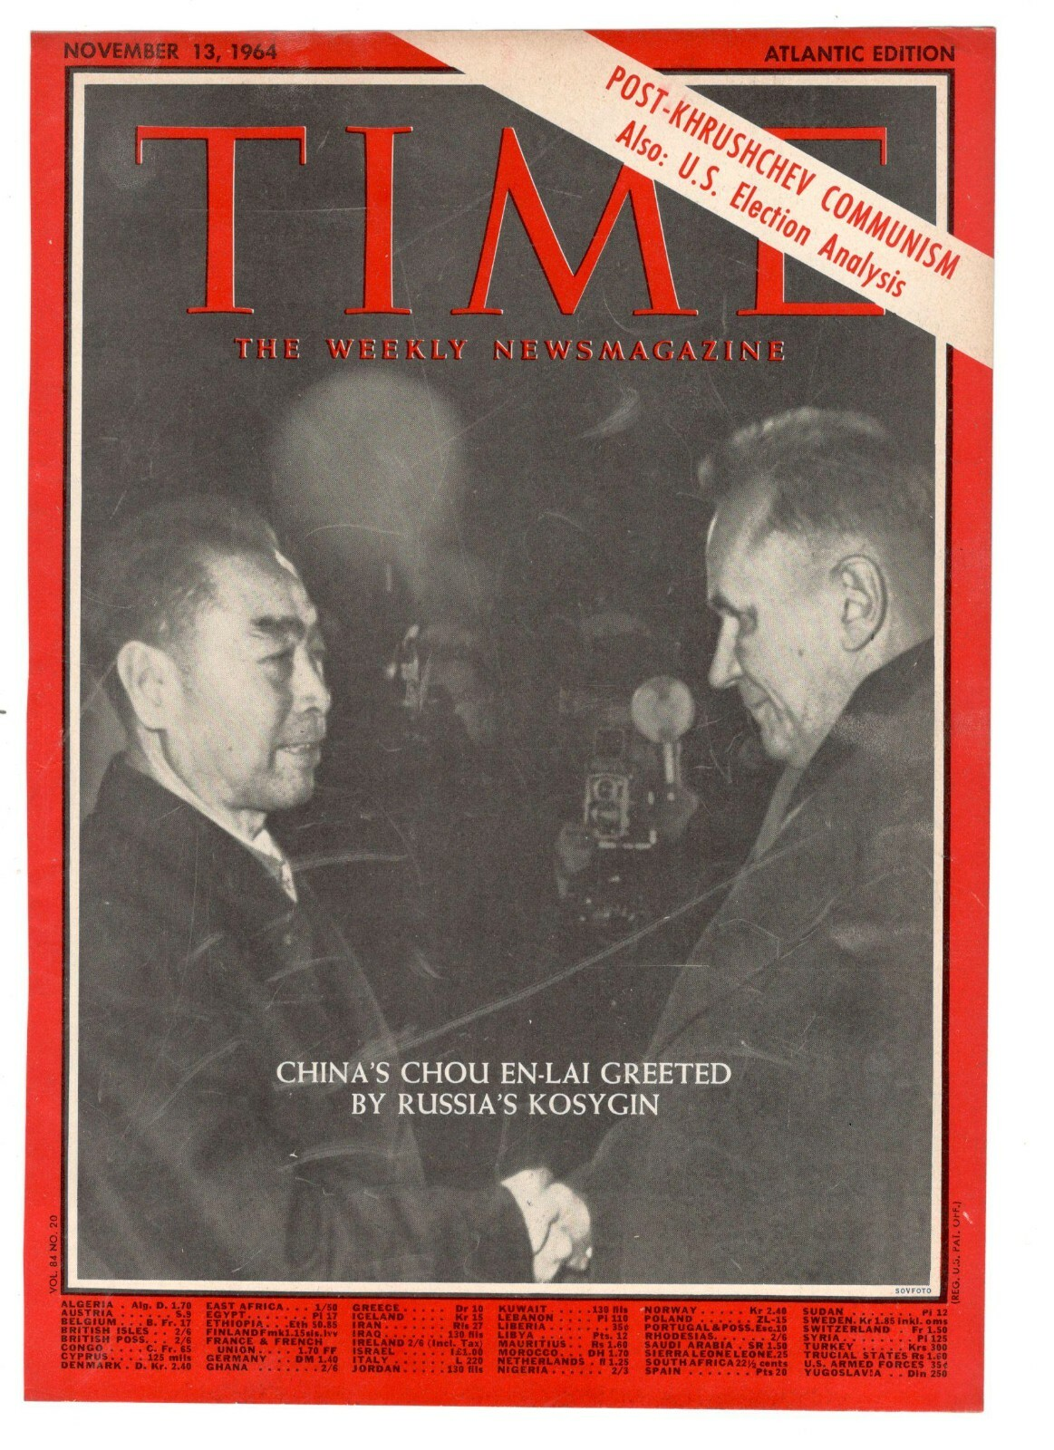
Sino-Soviet Schism
Reluctantly the Chinese agreed to a meeting at the prime ministerial level between Aleksey Kosygin and Zhou Enlai. They met in Beijing in September but did not reach a formal agreement. Authoritative sources reported that they did agree to cease armed provocations, resume border negotiations, restore diplomatic relations, and improve economic relations. The September negotiations failed to resolve fundamental differences, but on October 20, the two countries met again in Beijing, agreeing to disagree on the “border” matter. From that point on border incidents ceased to be a major factor in Sino-Soviet animosity.

Slide 34
Sino-Soviet Schism
The biggest beneficiary of the border incidents in 1969 was neither China nor the Soviet Union but the United States. As the fissure in Sino-Soviet relations widened, Washington saw an opportunity to alter the global balance of power by fostering a Sino-American entente. In Washington the significance of the March, 1969, events took some weeks to become apparent, but both President Richard M. Nixon and his national security adviser, Henry Kissinger, quickly moved to improve ties with China. The diplomacy for this policy had to be subtle because of the bitter history of Sino-American relations that, at the time, went back to the Korean War of the early 1950’s.

Slide 35
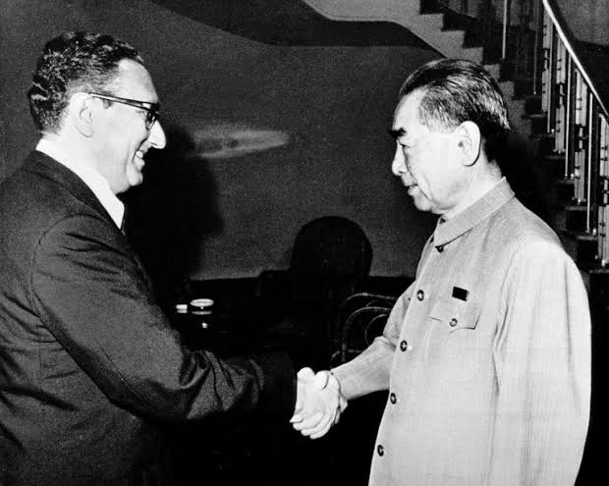
Sino-Soviet Schism
Slowly but relentlessly the United States cultivated China. Restrictions in trade and travel to the People’s Republic were eased. Third-party governments were advised confidentially to inform the Chinese of Washington’s desire for better relations. China responded positively. By the end of 1969, Nixon and Kissinger concluded that Beijing had made a strategic decision to seek a rapprochement with the United States.
Henry Kissinger with Zhao Enlai - 1971

Slide 36
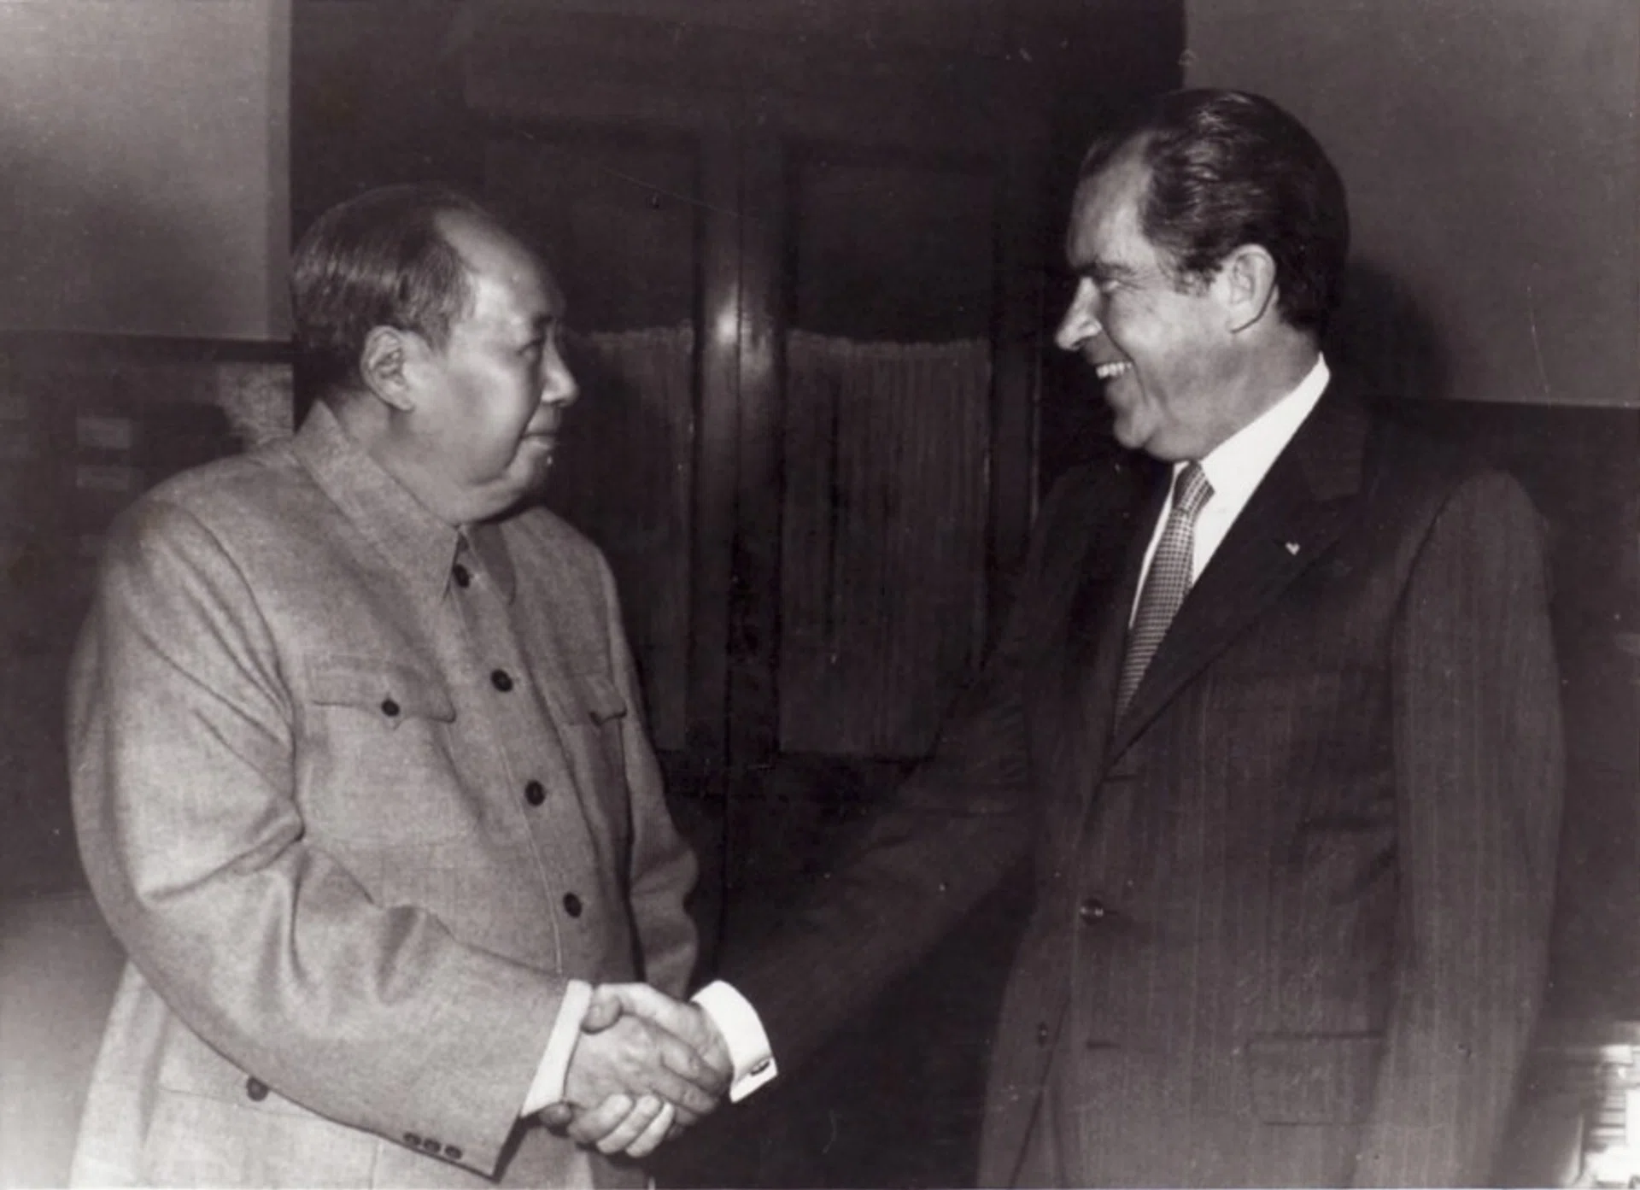
Sino-Soviet Schism
Slowly but relentlessly the United States cultivated China. Restrictions in trade and travel to the People’s Republic were eased. Third-party governments were advised confidentially to inform the Chinese of Washington’s desire for better relations. China responded positively. By the end of 1969, Nixon and Kissinger concluded that Beijing had made a strategic decision to seek a rapprochement with the United States.
In 1971, Kissinger made a secret visit to China to arrange a visit by Nixon in 1972 to meet with Mao. The detente that was formalized between the two countries was not a military alliance. Politically, however, the alliance changed global politics and contributed to the end of the Cold War some two decades later.

Slide 37
Discussion

Slide 38
Sino Soviet Split- Global Implications and Response

Slide 39
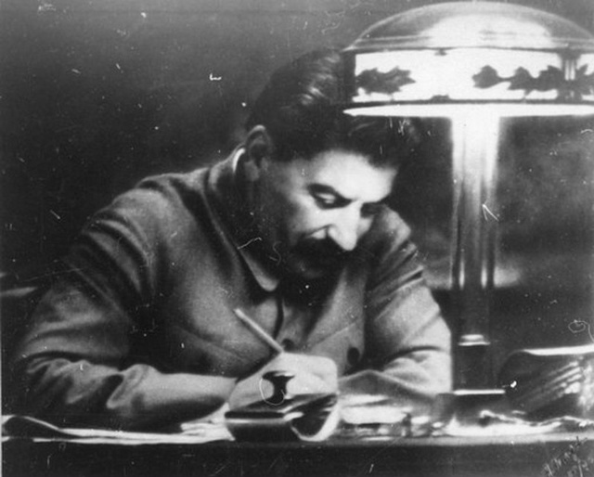
Study guide- Discussion Questions
“Experience is the hardest kind of teacher. It gives you the test first and the lesson afterward.”― Oscar Wilde
Discussion Questions
What causes do the Korean Workers Party (KWP) suggest about the split?
What post-split problems do the KWP identify?
What are their suggestions for how best to respond and which are the most effective?
How would a modern Communist Party respond? Differently, or similarly? Explain.

Slide 40
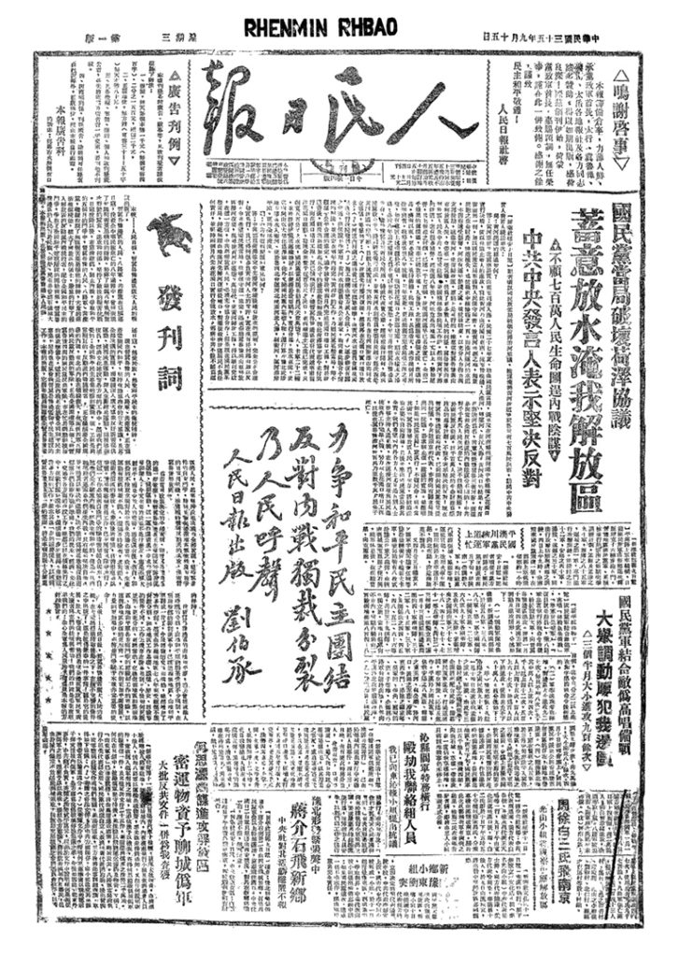
Korean Workers' Party
Thwart the Manoeuvres to Split the International Communist Movement
April 22, 1964
Renmin Ribao
The official newspaper of the Communist Party of China
Renmin Ribao (人民日报, People’s Daily) is the official organ of the Central Committee of the Communist Party of China, and the central newspaper of record for the modern Chinese state. Since its founding in 1946, Renmin Ribao has published the official policies and viewpoints of China’s central government and has been the voice of the upper echelons of power in the People’s Republic of China.
Korean Workers' Party
Thwart the Manoeuvres to Split the International Communist Movement
April 22, 1964
https://www.marxists.org/history/international/comintern/sino-soviet-split/other/kwp1964.htm

Slide 41
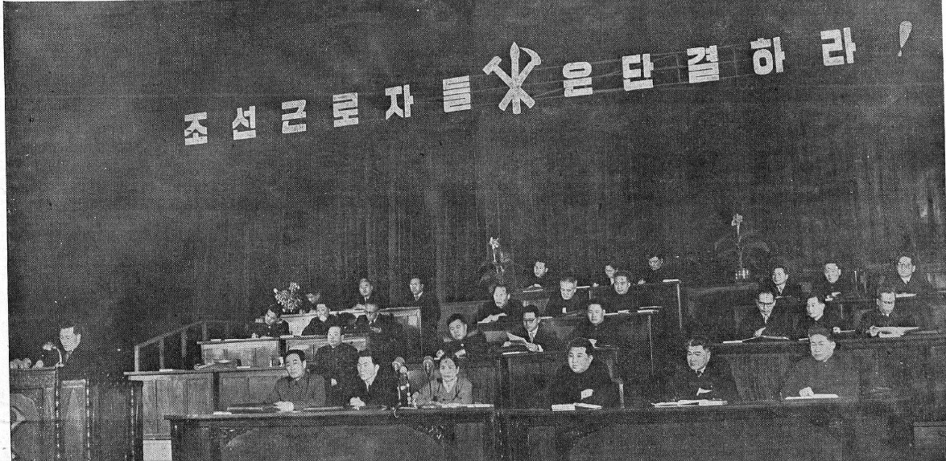
The entire situation is developing in a direction more favourable to the revolutionary people of the world.
The anti-imperialist revolutionary struggle of the broad masses is rising to ever greater heights while the position of imperialism continues to decline.
Nevertheless, the international communist movement is faced with a great obstacle because of the activities of certain people who have sunk into the slough of revisionism.
Owing to these people, a situation which cannot but worry many has arisen in the socialist camp and the international communist movement.

Slide 42
This is a brazen plot to split the socialist camp.
It was they who first brought the differences into the open before the enemy and slandered and vilified the fraternal Parties, declaring that they did so “for the sake of the international communist movement”, but when other fraternal Parties maintain their point of view, they brand this as “dogmatism,” and “sectarian activities”.
To shift the responsibility for the splitting activities on to others, to bedeck themselves with hypocritical phrases about unity and solidarity and to go ahead with mobilization work for splitting — this is precisely the true content of the campaign they are now waging.
Owing to such activities by these people, heedless of the consequences, the unity of the socialist camp and the international communist movement is faced with danger.
It is by no means accidental that the imperialists are jubilant and fan the flames.

Slide 43
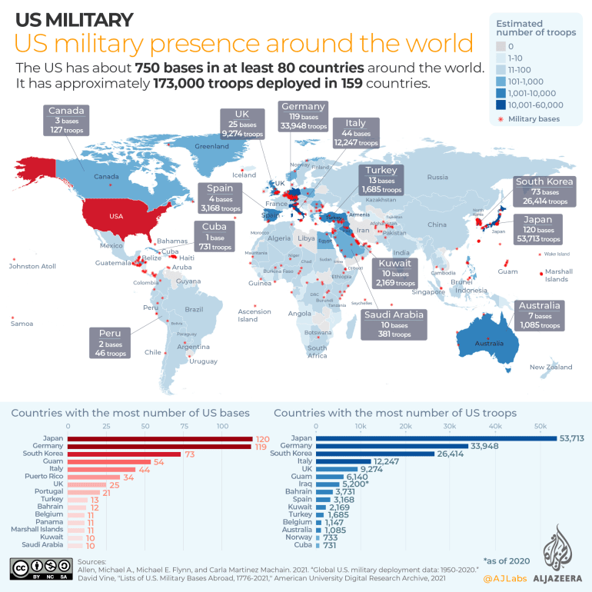
We Korean Communists are waging a severe struggle against U.S. imperialism, face to face, and therefore are resolutely against the machinations to split up.
We oppose a split and earnestly desire unity.
In the socialist camp and the international communist movement there is not only unanimity of thinking and aim but also a basis which guarantees united action through collective effort.
Our Party has always held that all Communist and Workers’ Parties must adhere to the revolutionary principles of the Declaration and the Statement and the principles guiding the relations among fraternal Parties for the sake of the unity of the socialist camp and the international communist movement.

Slide 44
Our Party has maintained from the very beginning…
Attempting to isolate and exclude their class brothers, they have launched every attack against those who refuse to follow them and who hold on to the revolutionary stand. They have done so in the past, and are still doing so.
Today, socialism is a world system, and therefore it is not a single country but the entire socialist camp which is the base of world revolution. It follows that to defend the socialist camp means to defend the camp as a whole, and not just one or a few of the socialist countries.
To safeguard the unity of the socialist camp, therefore, means to adhere to the revolutionary principles, to consolidate our class alliance for the common interest, but not to follow a certain person, regardless of principles.

Slide 45
It is only by strengthening its economic independence that any socialist country can consolidate its political dependence.
With ulterior motives they censure the building of an independent national economy. Their clamour for the so- called “economic integration” is an attempt to control and dominate economic construction in other countries.
This is to ignore the sovereignty of others and an attempt to arrogate to oneself in every possible way all the advantages of the socialist camp and reduce the economy of other countries to the status of an appendage. It is a manifestation of typical national egoism. All these machinations designed to weaken the socialist camp and disintegrate the international communist movement must be resolutely opposed.
Those who persist in splitting activities are departing farther and farther from the internationalist stand. They are undermining the international unity of the working class and the unity of the international working class with the oppressed nations.

Slide 46
Today the flames of the powerful anti-imperialist revolutionary struggle are blazing brightly in Asia, Africa and Latin America.
This struggle is destroying the imperialist positions, and impelling the world revolution forward. It has become a tremendous force in defence of peace. Only those who have departed from the revolutionary stand fight shy of this struggle and try to discredit its significance.
The awakened peasantry of many countries in these areas has taken part in the revolution under the leadership of the working class and a series of countries have won victory in the revolution.
The current situation demands that all the Communist Parties and Communists ponder deeply and adopt the correct stand in the interest of the socialist camp and the international communist movement and for the sake of the cause of peace, democracy, national independence and socialism.

Slide 47
The principle of centralism is a norm applicable to life within each individual Party.
This principle cannot be applied to relations among fraternal Parties. To prattle about the principle of centralism means, in the final analysis, to lead the differences of views to the point of an organizational split and give full play to big nation arrogance and domination, appointing oneself the holder of the central post.
Genuine unity demands that all Communist Parties and Communists make a resolute stand against these activities and reject the manipulation of the socialist camp and the international communist movement by any individual.
The socialist camp and the international communist movement are not the plaything of any one person or any one Party. So long as more and more Communist Parties and Communists rise to fight against the arbitrariness of certain persons, the phenomenon mentioned above can be reversed.
If all the Parties and Communists who want to maintain unity combine their efforts in the struggle, the splitting machinations will definitely prove bankrupt.

Slide 48
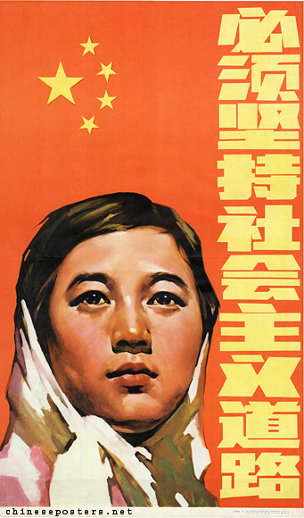
A Communist must not, under any circumstances, abandon his principled stand, but must always maintain his independent character.
If a Party sets store by unity and the socialist cause, it should not submit to external pressure, give up its in dependence and blindly follow another Party. To speak and act as others do without a sense of in dependence on one’s own part will not help strengthen the unity of the communist movement; nor is it loyal to internationalism.
On the contrary, it would cause losses to the revolutionary work of one’s own people and the international working class and weaken the genuine internationalist unity of the socialist camp and the international communist movement.
Communists are fighters for the cause of revolution, who pay no regard to all kinds of persecution, adulation and demagogy. The honour of the Communists, and the confidence the masses have in them, are founded on the fact that they fight unswervingly for truth and for their faith in the revolution.

Slide 49
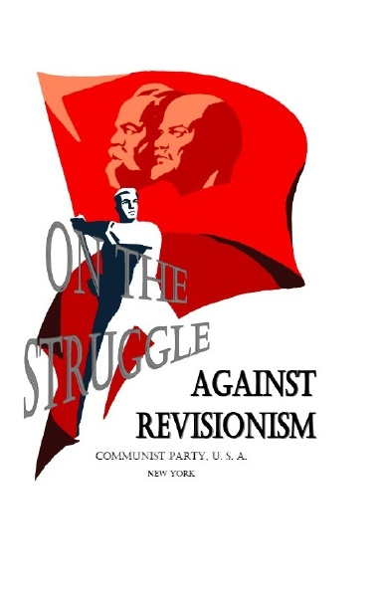
The revisionists continue to try to create confusion and splits in the ranks of the international communist movement.
Without the struggle against revisionism, the purity of Marxism-Leninism cannot be safeguarded; nor can genuine unity of the socialist camp and the international communist movement be ensured.
At the same time, great-power chauvinism which indulges in high-handedness and imposes revisionism upon others must be flatly rejected.
Great-power chauvinism is a dangerous poison which undermines unity and solidarity. Only by eliminating it can voluntary unity be realized.

Slide 50
Criticism should be freely conducted on the basis of facts, in a fair way and on an equal footing; it should be conducted in accordance with principle and in a comradely manner.
The wrongful practice of carrying on polemics one-sidedly and making groundless attacks on others while trying to suppress their correct opinion and to isolate and ostracize them must not be permitted.
When criticism is practised on a wide scale, people will see who is right and who wrong and the latter will be bankrupted and the purity of the ranks of the international communist movement will be ensured.
Only in this way will it be possible to defend the unity of the socialist camp and the solidarity of the international communist movement, based on Marxism-Leninism, and to develop the communist movement on a sound basis.
The international meeting of fraternal Parties can, however, only succeed when it is held on the basis of the principles of independence, equality and comradely consultation and after full preparations have been made.

Slide 51
Communists all over the world must raise higher the revolutionary banner of Marxism-Leninism.
All Marxist-Leninist parties must unite. Communists of all countries must unite.
The working class of all countries must closely unite. The working class and oppressed nations of the world must unite. The Marxist- Leninist parties and the Communists must resolutely uphold the unity of the socialist camp and the international communist movement. They must closely unite with the revolutionary people of the world and carry the revolution through to the end.
No matter what underhand games the revisionists may stoop to, the Marxist-Leninist parties and genuine Communists of all countries will under all circumstances successfully withstand all tests and, holding high the banner of proletarian internationalism, they will continue to march forward courageously and carry the revolution through to the end. No force can hold back the forward march of the revolution.

Slide 52
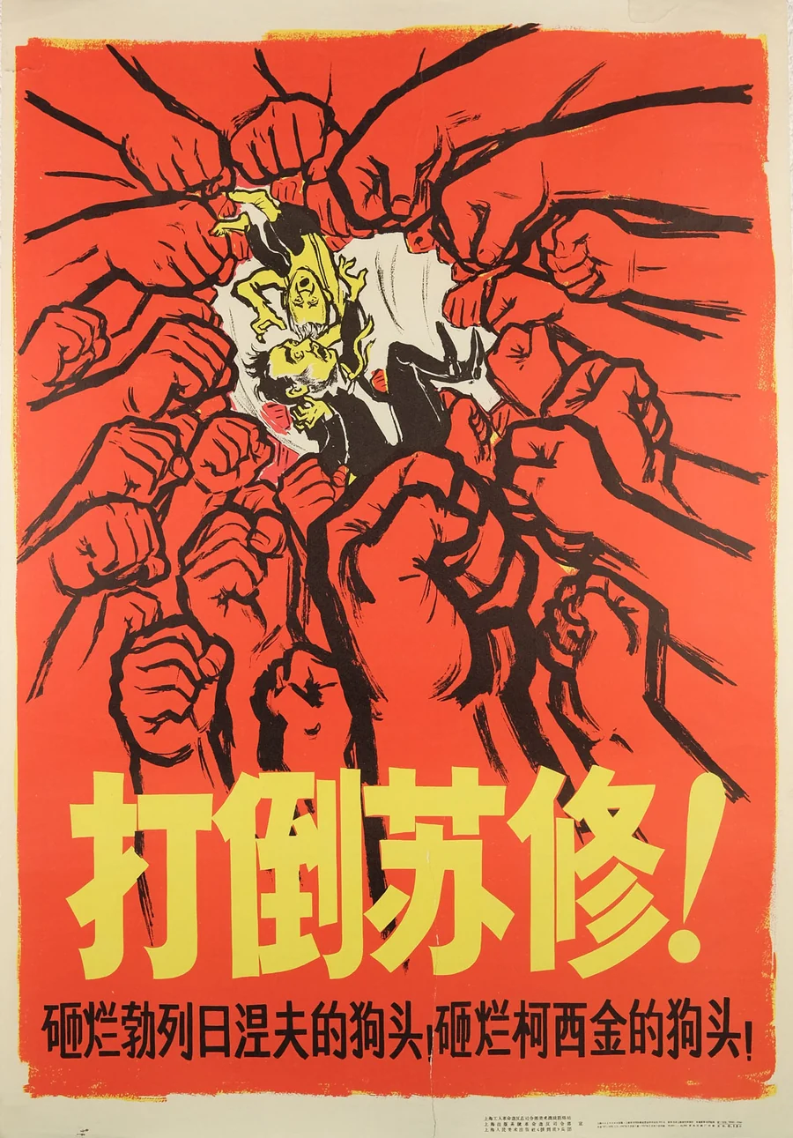
The Korean Communists have persistently opposed revisionism
As in the past, our Party will remain faithful to the principles of Marxism-Leninism and proletarian internationalism, and the revolutionary principles of the Declaration and Statement of the meetings of representatives of the Communist and Workers’ Parties and will indomitably fight against imperialism and revisionism and for the defence of the unity of the socialist camp and the international communist movement.
Defeat the splitting machinations, defend unity!
Working class of the world, unite!
The working class and the oppressed nations of the world, unite!
Defeat Soviet Revisionism!

Slide 53
Discussion & Wrap Up

Slide 54
Announcements
PCUSA Cell Chairs need to call members of their cells to remind them about attendance.
The next issue of New Masses (2026) has begun production. If you have art you want us to feature, email it to info@partyofcommunistsusa.net.

Slide 55
Volunteers Needed!
We are in need of volunteers for the staff of the People’s School! Here’s a few roles we need filled:
People to help manage posting on our social media and podcast platforms
Video Editors, Audio Editors, Graphic Designers, Artists, Narrators
Web Controls, Moderators
Email info@peoplesschool.us if you’re interested and try to attend our next staff meeting if possible.

Slide 56

View From Left Field
https://viewfromleftfield.libsyn.com
The Old PSMLS Youtube is now the Youtube of View From Left Field, a podcast of analysis and discussion of current events from a progressive perspective.
Like the Youtube videos and subscribe with 5 star ratings on your podcast platforms.

Slide 57

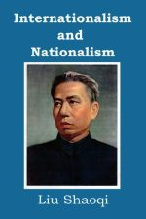
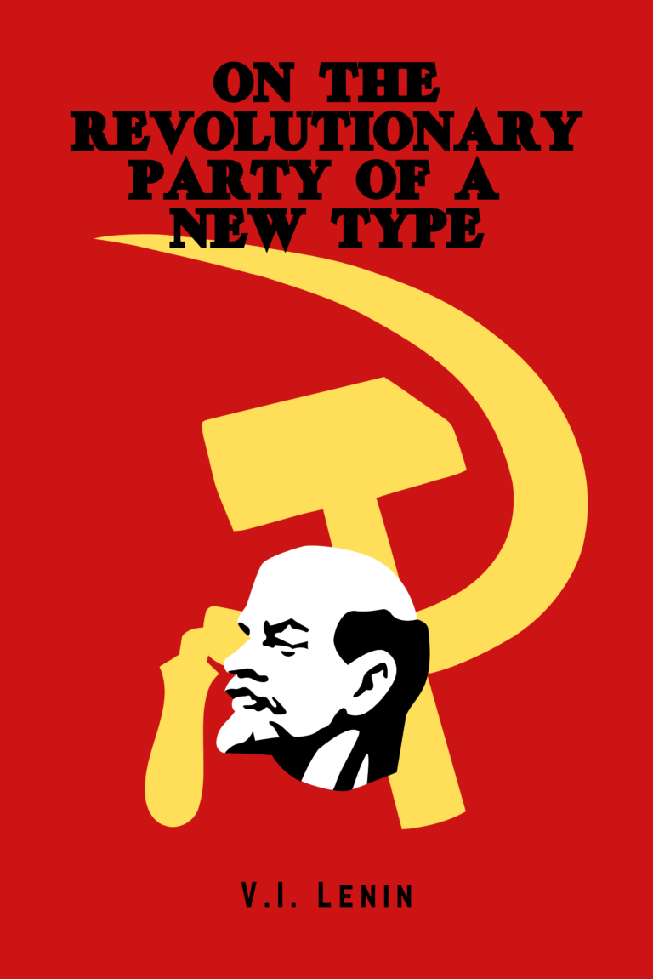
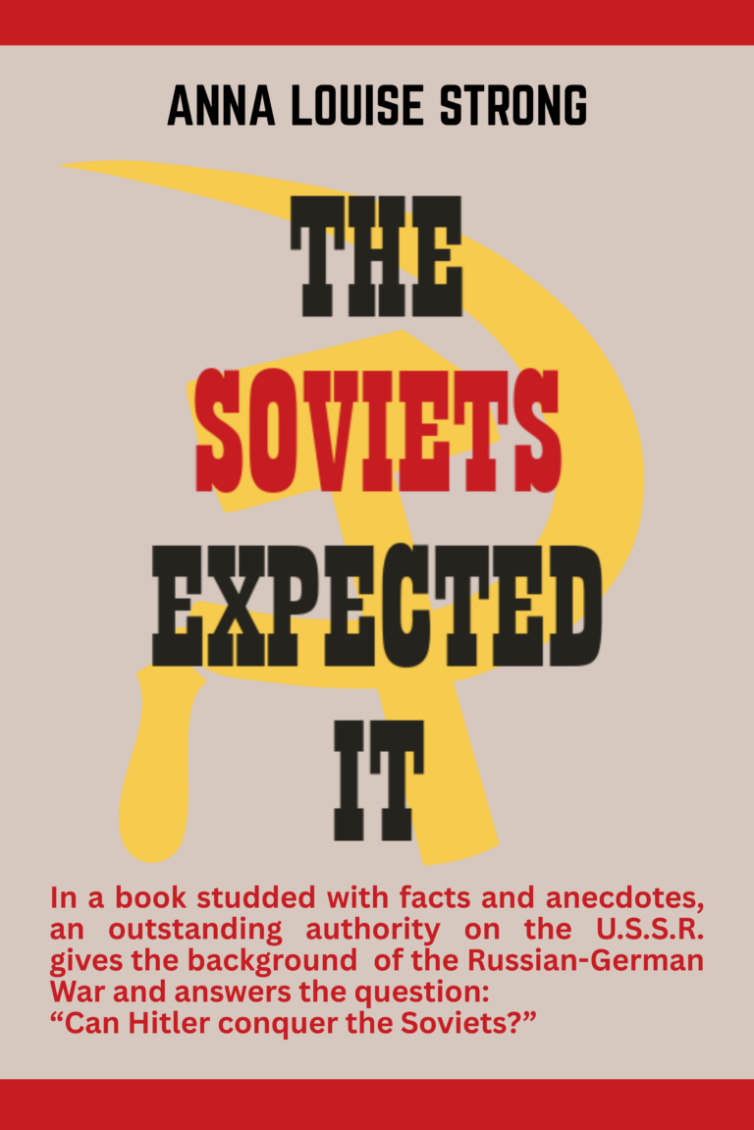
New Outlook Publishers
newoutlookpublishers.store
Relevant and Latest Releases

Slide 58
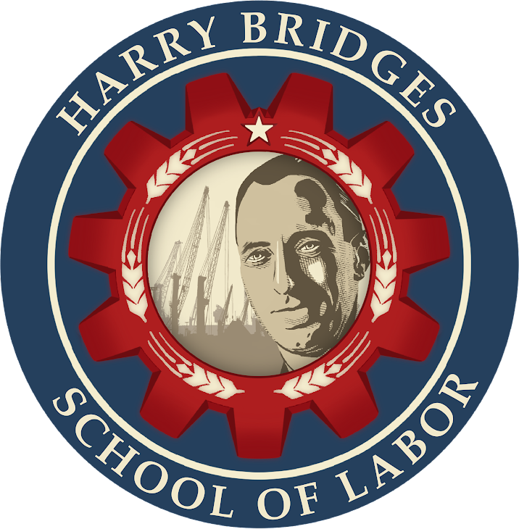

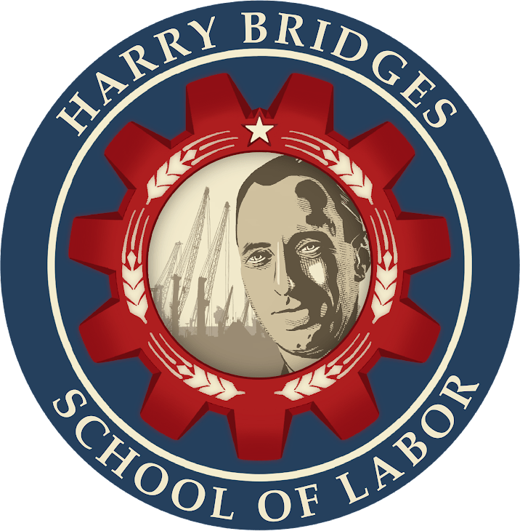
Harry Bridges School of Labor
luel.us/laborschool/
The Harry Bridges School of Labor is a monthly class covering a variety of topics aimed at building class consciousness among union members. For class schedule and other information, please visit the website at luel.us/laborschool.

Slide 59
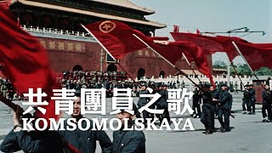
Komsomol Song (Chinese version)

