Slide 2
Ultra-Leftism
PSMLS 01/03/23 - 01/05/23

Slide 3
What we’ll be learning today:
What is ultra-leftism and who are the ultra-leftists?
Different types of ultra-leftists and the Marxist-Leninist critiques of them.
Reading from Lenin’s “Left-Wing Communism: An Infantile Disorder”

Slide 4
What is Ultra-Leftism?

Slide 5
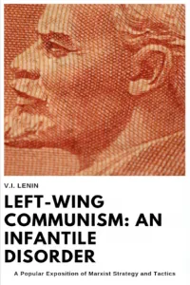
What is Ultra-Leftism?
Ultra-Leftism is a term coined by Marxist-Leninists to describe various left-wing ideologies, both allegedly communist and not, that ascribe to more radical positions and are too extreme in their actions.
Ultra-Leftism’s primary policy is that of sectarianism; the incorrect policy, or correct policy incorrectly applied, which tends to isolate the Communists from the masses, leaving them to few in number, a “sect”. (From Marxists Glossary)
Also known as Left Wing Communism, as in the title of Lenin’s work on the subject, Left Wing Communism: An Infantile Disorder, published in June of 1920

Slide 6
What is Ultra-Leftism?
Ultra-Leftism is a Left-Wing deviation from Marxism-Leninism.
The Marxist Glossary by L. Harry Gould describes Left-Wing Deviation as:
“An overestimation of the power of the capitalists, i.e., an absence of faith in the capacity of the workers for successful struggle against capitalism, resulting in failure to organize and lead the struggle, and hence “adventurism” and the “superman” leaps in the sphere of policy.”

Slide 7
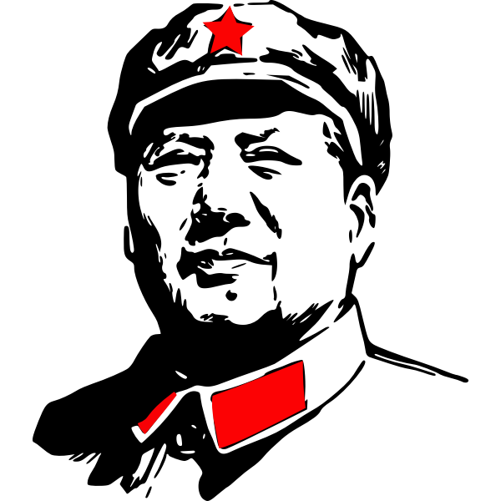
What is Ultra-Leftism?
Examples of Ultra-Leftist ideologies include:
Anarchism/”Anarcho-Communism”/
Anarcho-Syndicalism/Etc
Maoism/”Marxism-Leninism-Maoism”/
Gonzalo Thought
Trotskyism
New Leftism

Slide 8
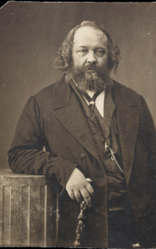
What is Ultra-Leftism?
History of Ultra-Leftism - Origins: 1850’s-1920’s
The first ultra-leftist ideology was anarchism, which was not Marxist and was built on individualism, anti-statism, spontaneity and idealism. Modern Anarchism first came to being in the mid 1800’s with the ideas of philosophical anarchism, individualism and mutualism emerging. Marx gave these ideas critique in his time.
The term ultra-leftist originated in the 1920’s Dutch and German Workers Movement describing anti-Bolshevik forces that were also affiliated with anarchists.
Ultra-Leftism was born of left-wing opposition in the Communist Parties in the 1910’s and 1920’s combined with the pre-existing anarchist movements.
Mikhail Bakunin, a collectivist-anarchist philosopher who disagreed with Marxism.

Slide 9
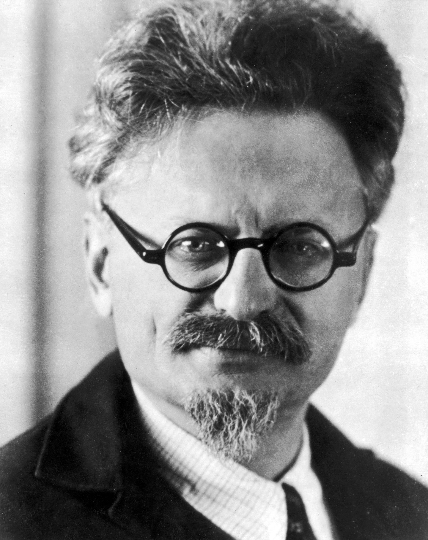
What is Ultra-Leftism?
History of Ultra-Leftism - Trotsky and the Left Opposition
In 1923, Leon Trotsky formed the “Left Opposition” of the Russian Communist Party (Bolshevik). It was partially in opposition to “socialism in one country” and in support of Permanent Revolution, the idea of worldwide revolution all at once.
There was also a Right Opposition led by Nikolai Bukharin, which was a right-wing deviation. The Left and Right Oppositions both united to form the United Opposition in 1926, and both opposed the Stalin leadership and economic policy until the United Opposition was expelled at the 15th Party Congress in 1927 after Trotsky was expelled. Bukharin was later expelled in 1929.
The Trotskyist current affected the world communist movement, causing splits in parties all around the world and engendering anti-Sovietism in the communist movement. The International Left Opposition was formed by Trotsky in 1930, and later became the “Fourth International” rejecting the Bolshevik led Third International.

Slide 10
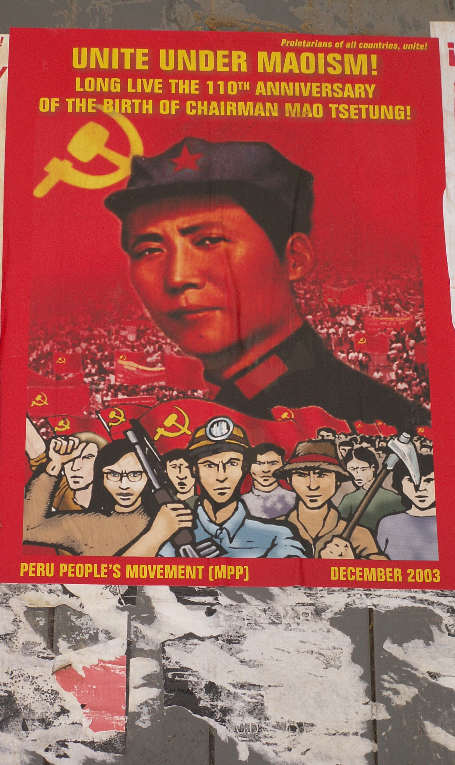
What is Ultra-Leftism?
History of Ultra-Leftism - Maoism
Maoism came about as a result of Mao’s deviations from Marxism-Leninism, mostly post 1949. Mao rejected the term Maoism, the term was used mostly after his death. Maoism has prevailed as an ultra-leftist current in the world especially since Mao’s death in the 1970s. Some of the left deviations of Maoism from Marxism-Leninism are:
Three Worlds Theory - The idea that the Soviet Union was “social imperialist” and was part of the 1st world with the United States, the 2nd world was their imperialist satellites and the 3rd world was the rest of the world including China.
Peasantry as the Revolutionary Vanguard - The idea that rather than the urban-proletariat, the peasantry is the revolutionary vanguard.
New Democracy - The idea that every colonial country would have its own unique path to socialism and socialism in China would be different than in the Soviet Union.
China itself took a capitalist right wing turn after Mao’s death, but many Maoist Parties and Insurgency Groups exist around the world today as a result of Mao’s deviations.

Slide 11
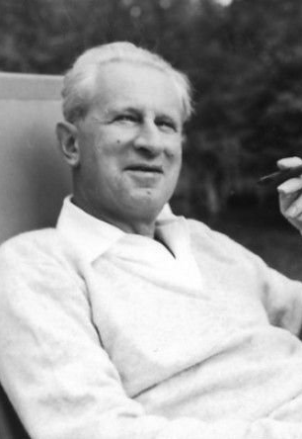
What is Ultra-Leftism?
History of Ultra-Leftism - New Leftism
Herbert Marcuse is considered the father of the New Left. He attended the Institute of Social Research, what would later become the Frankfurt School, and was a leading proponent of critical theory.
Critical Theory is a school of thought that deviates from the Marxist theory by combining Marxian analysis with other forms of sociological or philosophical traditions. Although initially modernist, it gave rise to postmodernist thought.
The New Left was essentially founded on critical theory and a rejection of the class struggle and the focus on the labor movement to instead focus solely on the social issues of race, gender, sexuality etc. Maoism and Anarchism also played a role in New Left movements.
Examples of New Left organizations include Students for a Democratic Society, the Black Panther Party, Young Patriots, Young Lords, Brown Berets, American Indian Movement, the Weathermen, the Hippie Movement, Subversive Action, Kommune 1, the Situationalist International, the Workers Party of Brazil, the United Red Army, Japanese Red Army and even to some extent, modern movements such as BLM.

Slide 12
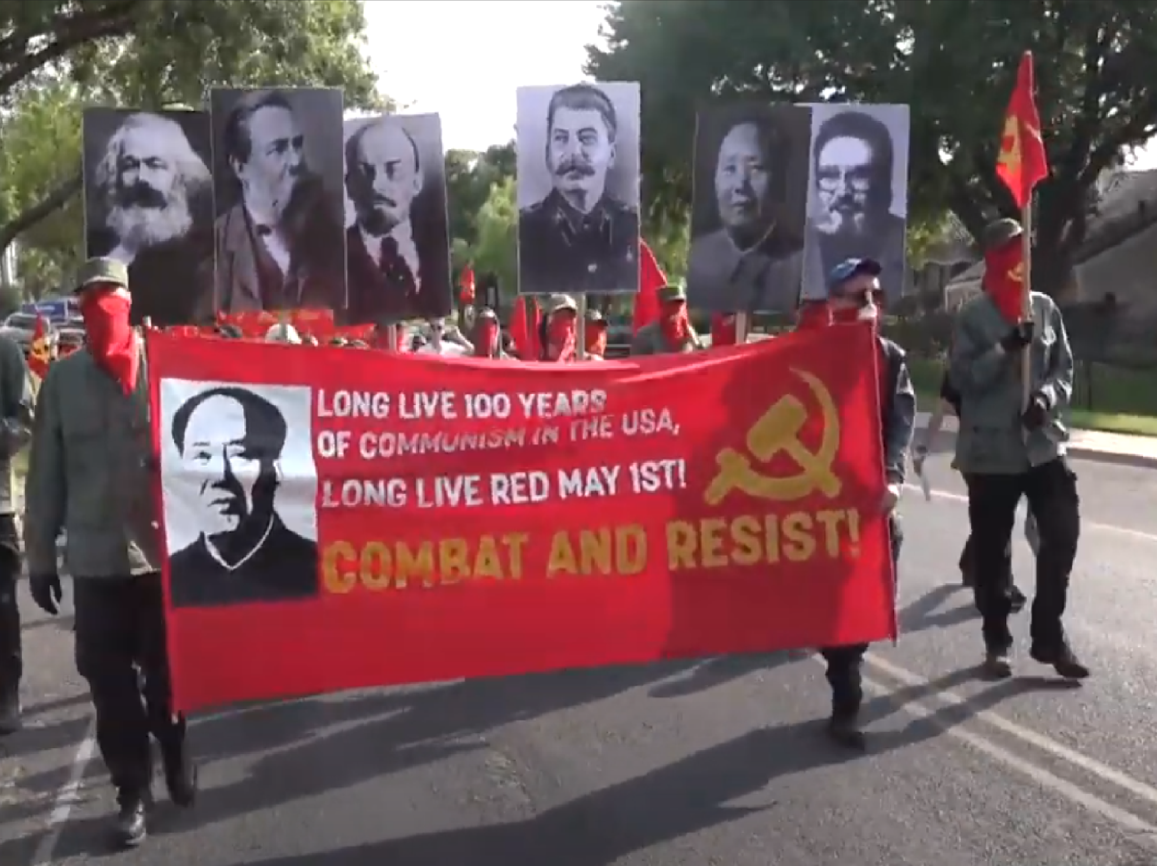
What is Ultra-Leftism?
History of Ultra-Leftism - Ultra-Leftism in the Current Day
The longstanding effects of the New Left, McCarthyism, CoIntelPro, the Sino-Soviet Split and the Counter-Revolution in the USSR, as well as the actions of right deviationists in the world communist movement, have resulted in a prevalence of ultra-leftism in much of the western left.
In the United States, the most widespread form of ultra-leftism is anarchism, which shows itself in the form of spontaneous attacks on police, right-wing forces & communists, individualism and unbridled sectarianism, decentralization and spontaneous riots as seen in the 2020 Uprisings against Police Brutality. “Antifa” is another example of rising anarchist activity under a bastardized version of the original communist Antifascistiche Aktion, which clashes with fascists in the streets of American cities, but does nothing to stop the rise of fascism politically.
Maoism in the United States today is not as strong as anarchism or new leftism, but it can be seen in militant maoist groups such as the Red Guards, who follow the thought of Chairman Gonzalo from Peru, and who have physically attacked socialist groups in the last few years, such as the Party for Socialism and Liberation in Austin TX.
New Leftism has an astounding influence on modern social justice groups like Black Lives Matter, Landback and some LGBT+ groups. Critical Race Theory and New Left Feminism have been pushed much as of recently, both products of Critical Theory.

Slide 13
Discussion
Have you seen an example of ultra-leftism in present day?
To what extent can we work with the different denominations of ultra-leftists? When should we not?

Slide 14
Left-Wing Communism:
An Infantile Disorder

Slide 15
Left-Wing Communism: An Infantile Disorder
Left-Wing Communism: An Infantile Disorder, was published in June of 1920 and was published in Russian, German, English and French.
It was distributed to each delegate of the 2nd World Congress of the Communist International.
In this text, Lenin talks of the international significance of the Bolshevik revolution, criticizes the 2nd International for not seeing it, points out the eras of the Bolshevik revolution and how it succeeded and then critiques the left elements of the CPSU and the German Communist Party as well.

Slide 16
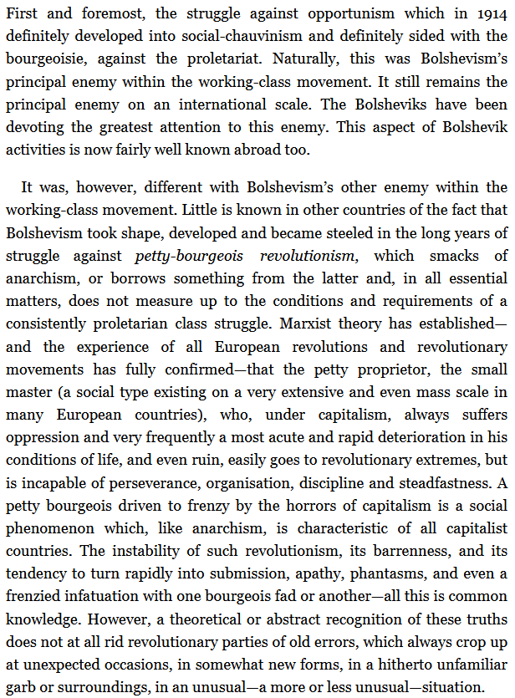
Left-Wing Communism: An Infantile Disorder
Chapter 4: The Struggle Against What Enemies Within The Working Class Movement Did The Bolsheviks Become Strong and Steeled?

Slide 17
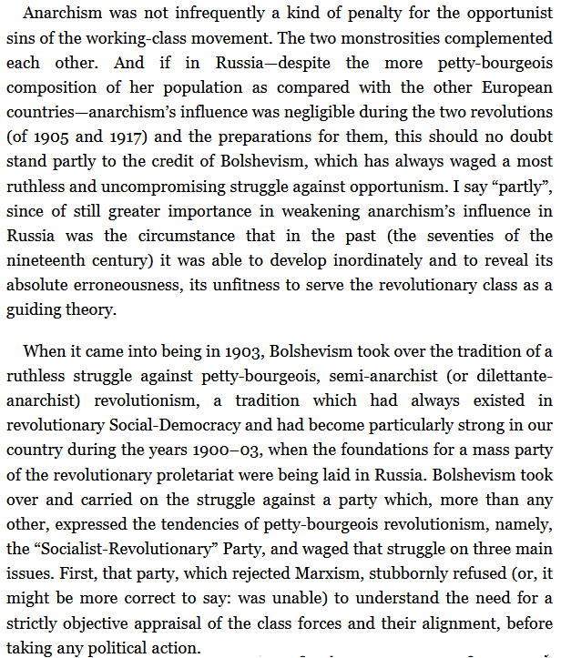
Left-Wing Communism: An Infantile Disorder
Chapter 4: The Struggle Against What Enemies Within The Working Class Movement Did The Bolsheviks Become Strong and Steeled?

Slide 18
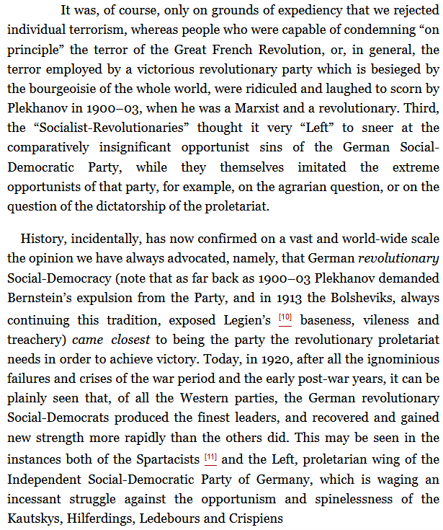
Left-Wing Communism: An Infantile Disorder
Chapter 4: The Struggle Against What Enemies Within The Working Class Movement Did The Bolsheviks Become Strong and Steeled?

Slide 19
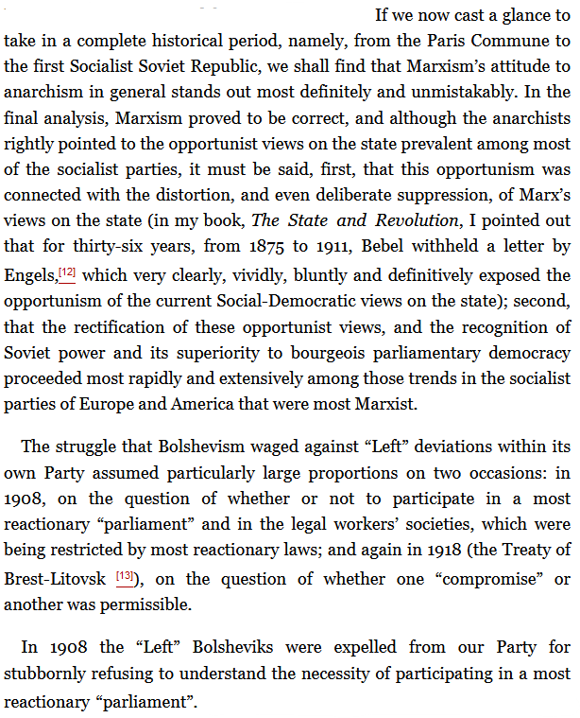
Left-Wing Communism: An Infantile Disorder
Chapter 4: The Struggle Against What Enemies Within The Working Class Movement Did The Bolsheviks Become Strong and Steeled?

Slide 20
Discussion
How are the left-wing communists of Lenin’s time similar to or different than ours?
How can we apply what Lenin is saying here to today?

Slide 21
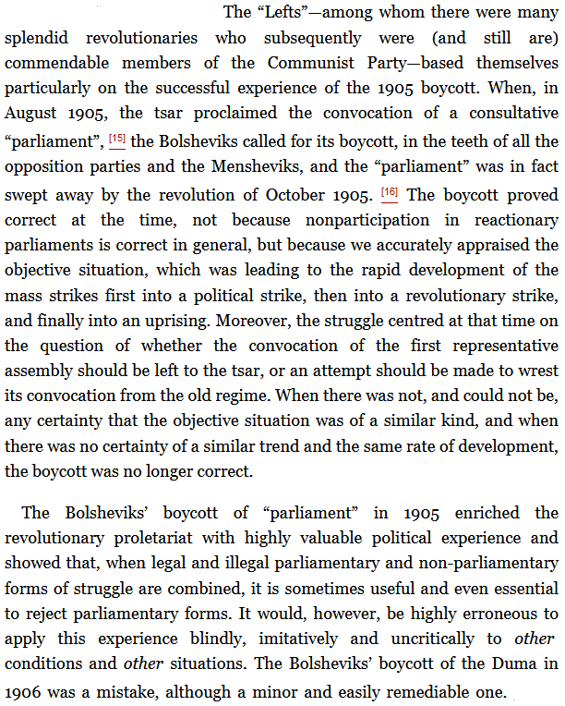
Left-Wing Communism: An Infantile Disorder
Chapter 4: The Struggle Against What Enemies Within The Working Class Movement Did The Bolsheviks Become Strong and Steeled?

Slide 22
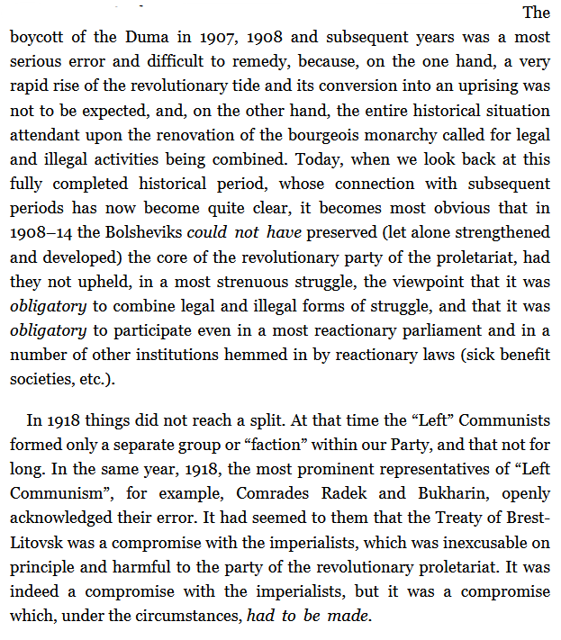
Left-Wing Communism: An Infantile Disorder
Chapter 4: The Struggle Against What Enemies Within The Working Class Movement Did The Bolsheviks Become Strong and Steeled?

Slide 23
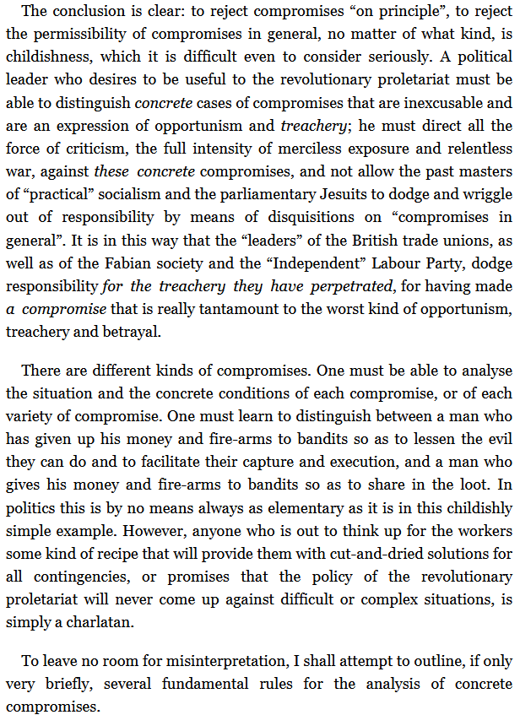
Left-Wing Communism: An Infantile Disorder
Chapter 4: The Struggle Against What Enemies Within The Working Class Movement Did The Bolsheviks Become Strong and Steeled?

Slide 24
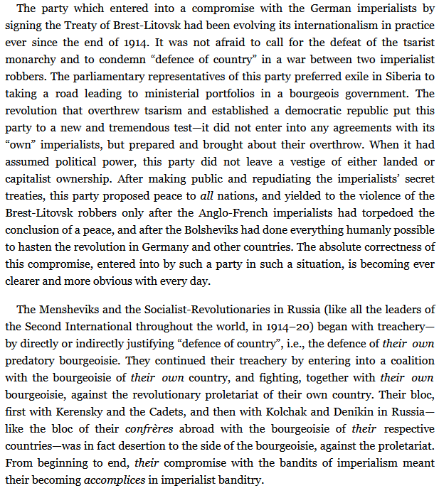
Left-Wing Communism: An Infantile Disorder
Chapter 4: The Struggle Against What Enemies Within The Working Class Movement Did The Bolsheviks Become Strong and Steeled?

Slide 25
Discussion
How and when do we compromise with the bourgeois today?

Slide 26
New Member Introductions
What is your name, pronouns and state (or country/territory)?
Where do you work? Is it unionized?
How did you find out about the People’s School?
What do you think about tonight's class?

Slide 27
Volunteer Positions & Help Needed
Audio Editors, Video Editors, Graphic Designers
People to Manage Uploads to Podcast Platforms
Facilitators, Web Controls, Moderators
Art Submissions
Email info@peoplesschool.us to volunteer or submit art

Slide 28
Upcoming Classes
Class from Indigenous People’s Commission of the PCUSA
Tactics and Skills Class: Political Organizing
80th Anniversary of the Victory at the Battle of Stalingrad
2 Classes from the Peace and Solidarity Commission of the PCUSA
Class from the Black Liberation Commission of the PCUSA
International Working Women’s Day Class w/ Women’s Commission of PCUSA

Slide 29
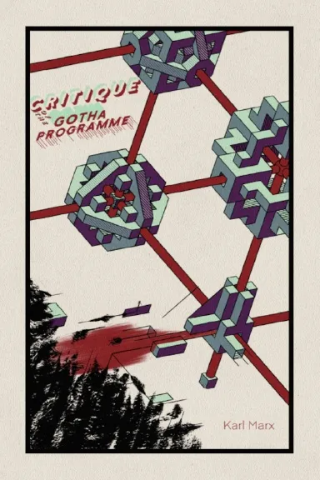
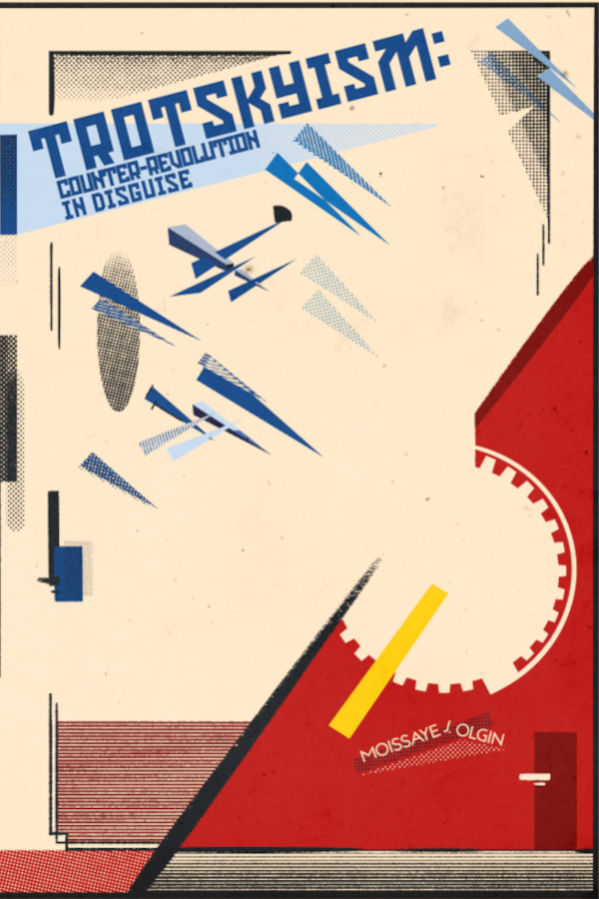
New Outlook Publishers
Newest Releases:
Related to Class:

