Slide 1
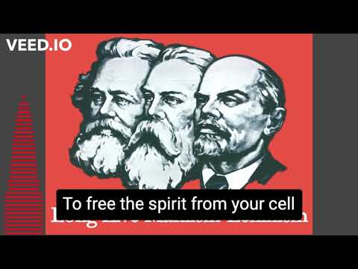

Slide 2
Broken Rainbow (1985)
PSMLS 01/10/23 - 01/12/23

Slide 3
What we’ll be learning today:
The focus of the Documentary showcases the events that took place during the 1980’s when US federal government implemented a controversial policy on the relocation of over 10,000 Navajo inhabitants from their homeland. The material factors involved surrounding the involuntary relocation. Highlighting the founding and establishment of Tribal governments for the intent of facilitating the expropriation of mineral wealth by large corporations from Indigenous Lands. The use of the US state apparatus wielded by Monopoly Capital in creating tensions between neighboring tribes to gain access to previously unavailable mineral wealth.

Slide 4
What we’ll be watching today:
Detailed Overview:
In the years of the 1980’s, ending in 1990– Over 10,000 Navajos were forcefully relocated from the area known as Big Mountain in Northeast Arizona. In the 1980s, Peabody Coal Corporation successfully campaigned to open an additional coal mine near the Big Mountain area, representing the largest coal deposit in the US at the time. The coal deposit in the area was estimated to be worth over $1 trillion or $2.7 trillion adjusted for inflation. However, the rise of natural gas production during the Shale Revolution in 2005 to 2010 has since reduced demand for coal dramatically for the past 10 years, and resulted in the last Peabody coal mine closing in 2019.

Slide 5
Part 1: The Reasons for Relocation and its Effects.

Slide 6
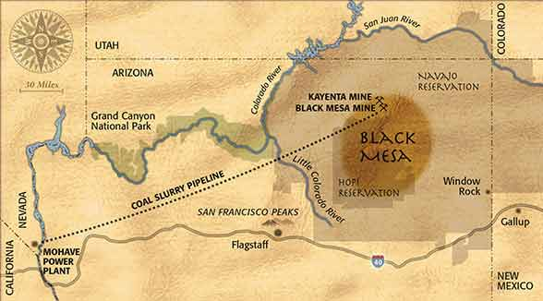
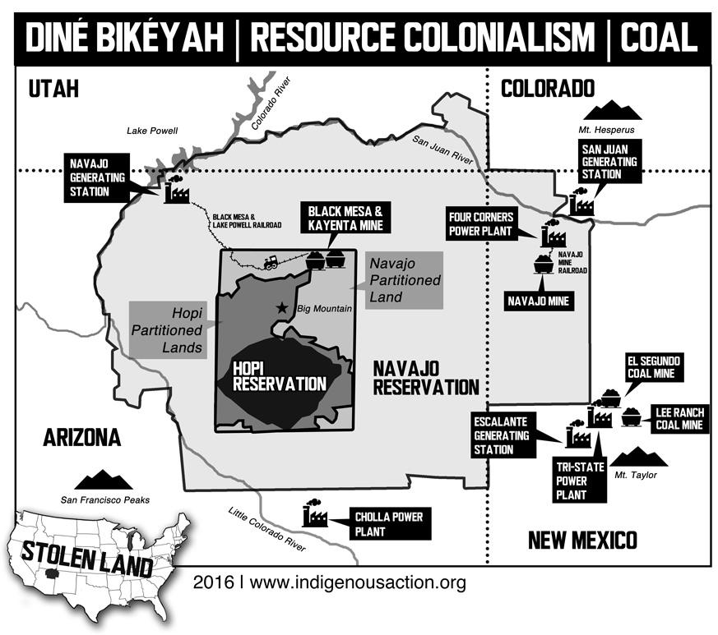
A rural Navajo man’s experience of sudden transition to life under the capitalist mode of production.
The material interests as the cause of creating a federal relocation policy for over 10,000 Navajo people.
Other Examples: Currently the San Carlos Apache and their fight against the Construction of a Copper Mine. Another more famous resistance is Standing Rock.
Notes:
Add videos to tabs before presentation to avoid adverts.
https://youtu.be/W5z8OgMfXXc
Please Pause at 08:07

Slide 7
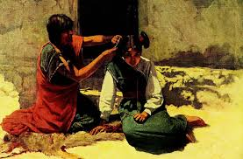
Brief History on people and culture of the Hopi and Navajo.
Interviews with Big Mountain inhabitants and way of life.
Notes:
https://youtu.be/W5z8OgMfXXc?t=538
Add videos to tabs before presentation to avoid adverts.
Please Pause at 15:30

Slide 8
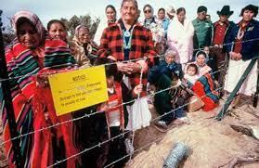
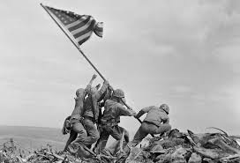
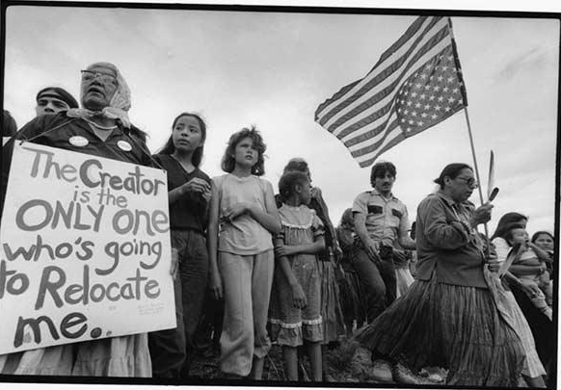
Notes:
https://youtu.be/W5z8OgMfXXc?t=1099
Please Pause at 23:40

Slide 9
Discussion

Slide 10
Part 2: American Indian Movement and Native Activism.
Notes:
Start:
https://youtu.be/W5z8OgMfXXc?t=2360
Pause at 41:34
Start:
https://youtu.be/W5z8OgMfXXc?t=2544
Pause at 53:30
Skip to 54:53
https://youtu.be/W5z8OgMfXXc?t=3293
Pause at 1:00:38
Skip to 1:01:11-1:06:01
https://youtu.be/W5z8OgMfXXc?t=3671

Slide 11
Party of Communists USA
Policy and Party Line
The full rights of First Nations Indigenous Peoples of North America:
To be officially recognized as distinctive independent nationalities with full sovereignty over their respective lands.
Recognition and expansion of treaty rights.
Reserve for the right to self-determination and national separation.
Complete jurisdiction and control of legal powers on matters of criminal law and justice.
To the creation or expansion of land bases on the basis of historical territorial homelands for current and future generations.
Cultural revitalization and cultivation initiative programs.
Reclamation and ownership of Heritage, Religious, Sacred, Ancestral and other culturally significant sites.
The right to use their respective Languages, Religions, Customs, Traditions, and the Sanctity of Religions.
Full jurisdiction of natural resources, fishing/hunting, and mineral rights.
Full monetary compensation of the total value of previous and current resource extraction and appropriation at the behest of monopoly capitalism.
Restoration and clean-up for industrial pollution sites and environmental damages from the current and past government and capitalist activities.
Full monetary compensation and healthcare assistance for victims of industrial pollution sites.
End of economic Trade restrictions for exports and imports.
End the violence against Indigenous women and girls.
Release of all political Indigenous prisoners.

Slide 12
New Member Introductions
What is your name, pronouns and state (or country/territory)?
Where do you work? Is it unionized?
How did you find out about the People’s School?
What do you think about tonight's class?

