Slide 1
SKILLS AND TACTICS:
POLITICAL ORGANIZING
PEOPLES SCHOOL FOR MARXIST -LENINIST STUDIES

Slide 2
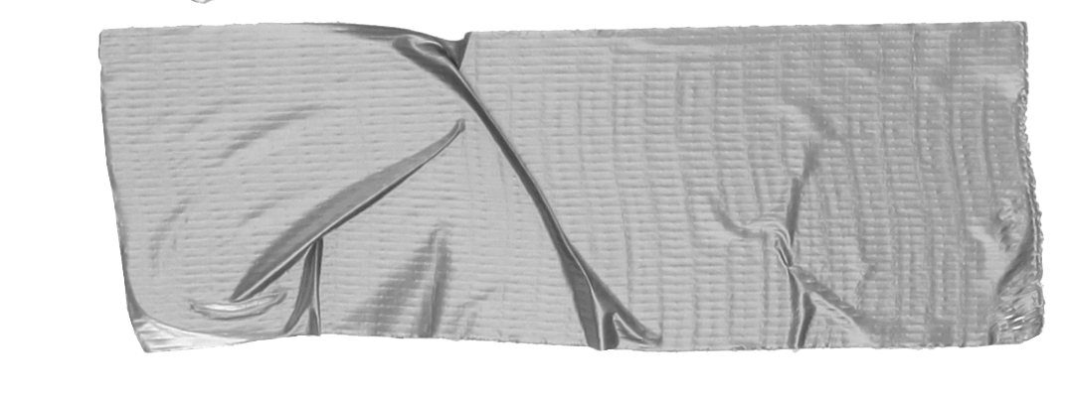
WHAT DOES POLITICAL ORGANIZING MEAN?
A Group that reaches out to people to create a mass movement
A Group rallying around a particular issue Roe versus Wade
A Group reporting on local politics Attending City Councils, report in newsletters
A Group supporting candidates Phone banks, participate in events, mailings

Slide 3
“THE THREE-LEGGED STOOL”
This a realistic policy that is neither sectarian, nor set in stone, nor part of the current “two-party” machine that dominates the US political process.
Running our own candidates where and when feasible.
Running with other forces in a formation that is independent of the “two-party” system, wherever possible.
Where appropriate, supporting local progressives who are pro-labor, pro-worker, anti-racist and anti-war who run in primaries of other parties (to reach more workers).
“THE THREE-LEGGED STOOL”
Article XI of the PCUSA Program
PAUSE

Slide 4
“The workers took part in elections, …they contested with the bourgeoisie in every post.
“And so it happened that the bourgeoisie and
the government came to be much more afraid
of the legal than of the illegal action of the
workers’ party, of the results of elections than
those of rebellion.”
Tip
Are you registered to vote?
If so, have you voted?
In the pledge to follow Marxist-Leninism teachings, it is your duty to become a voter for the working class.
Frederick Engels, The Origin of Family, Private Property, and the State

Slide 5
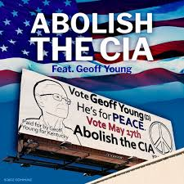
GEOFF YOUNG - 2022 PLATFORM
- Prevent a Nuclear War
- Get Big Money out of Politics
- Medicare-for-ALL
- Abolish the CIA - Abolish AFRICOM
- Impeach the 6 crooked “Justices” who voted to overturn Roe v. Wade
- Legalize all drugs
- Tax Millionaires & Billionaires
- Impeach President Biden for risking World War 3 with Russia & China
- End all Economic Sanctions against all Countries and Individuals
PAUSE
Example
Both MPD and WREE participated in the planning sessions of Geoff Young’s campaign which met most every Saturday.

Slide 6
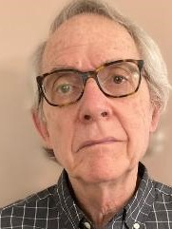
THE GOOD, THE BAD, AND THE UGLY
MEET ED
FROM
STATEN IS., NY
TRIUMPHS
Joined the Liberal Party of NY
Rose up the ranks to the State Committee
Ran twice for the NY Assembly
Ran for Borough President
A Democratic candidate, in danger of losing his
election to an anti-union Republican motivated Ed, drawing support from his union’s central labor council, campaigned door to door, aka “ Labor to Neighbor”. His son confiscated Republican leaflets along their route. The Democrat won.
One of the co-founders of the Working Families Party. Created the infrastructure, fulfilled the NY State petition requirements, gained enough members to support candidates and to attract allies.
A founding member of our Party, and one who has spent decades engaged in politics, now shares his experiences and recommendations for a productive and mind-stretching foray into “politics”.

Slide 7
HIJACKED
The Working Families Party was popular enough to gain some unwanted attention. Big unions funded the Party and then pressed for their own candidates to be selected disregarding the Party’s concerns. Eventually Ed resigned, and, at a meeting, requested that the state committee resign, which they did, effectively ending the Party.
SABOTAGED
As a Liberal Party candidate, his one-issue platform was NO to the nuclear home port being sponsored for Staten Island. This was a hot issue, and, Democrats, fearing votes for him would significantly decrease the chances of the Democratic candidate winning, Blacklisted Ed, so that no newspaper would run his press releases or report on his speeches.

Slide 8
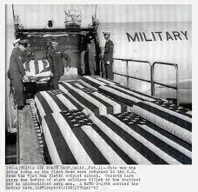
KNOWLEDGEABLE ADMINS-FOR ‘NUTS AND BOLTS’
THE PROPER SLOGAN CAN WIN ELECTIONS
A COMMITTED CAMPAIGN COMMITTEE
COMMITTED WORKERS AND SUPPORTERS
FLEXIBLE STRATEGISTS TO SEIZE OPPORTUNITIES
A SOBERING MOMENT
THERE ARE MANY REASONS TO ENTER POLITICS
FOR ED, IT WAS ACCOMPANYING A FALLEN SOLDIER HOME FROM VIETNAM
LESSONS LEARNED ALONG THE WAY
PAUSE

Slide 9
“The franchise (suffrage) has been transformed by the workers from a means of deception,…
Into an instrument of emancipation.”
“It provided a means, second to none, of getting in touch with the masses…forcing all parties to defend their views and actions…”
Frederick Engels, The Origin of Family, Private Property, and the State

Slide 10
In preparing for the elections to the Duma in 1912, Lenin wrote that “to every party at all worthy of the name, a platform is something that has existed long before the elections; it is not something specially devised ‘for the elections,’ but an inevitable result of the whole work of the party, of the way the work is organized, and of its whole trend in the given historical period.” Our “election platform can be expressed in three words:
“For the Revolution!”
What area of “politics” would motivate you to participate in? Join groups focusing on local issues?
Volunteer to “campaign” for candidates?
How do you see yourself taking action? Register to vote?
Compile a guide of your representatives?
Begin attending City Councils and reporting on their activity in a newsletter?
PAUSE

Slide 11
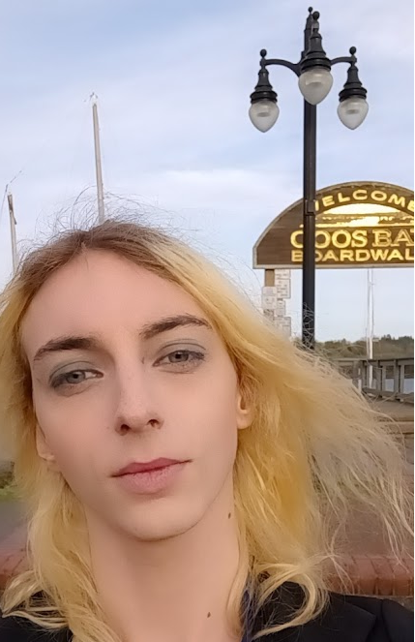
Kamryn - Write-in Candidate
Platform for Coos Bay City Council: Labor and Economy
● A public housing plan that will both accommodate the homeless in Coos Bay and traveling workers. The funding will come from city budget reforms and taxes.
● Affordable housing, with a rent cap of no more than 20% of average income. ● Vacation rentals be taxed at 20%, and funds go directly to public housing.
● Coos Bay city staff and public workers be unionized.
● Increase in Coos Bay minimum wage to $15/hr. Will go to Salem to tell our state reps to make the minimum wage equal state-wide and to raise it.
Moratorium on evictions and foreclosures due to current economic issues for low-income Americans.
● Creation of a Labor Board for Coos Bay City Government to allow direct representation for the labor movement. ● Bringing industry to Coos Bay that is both good for our workers and is as environmentally friendly as possible. This includes renewable energy and some careful development of our port. No fossil fuels or other harmful industries.
● Approach conversation with other local governments and people on the topic of the bay area consolidation and overall economic future with optimism and cooperation.
.

Slide 12
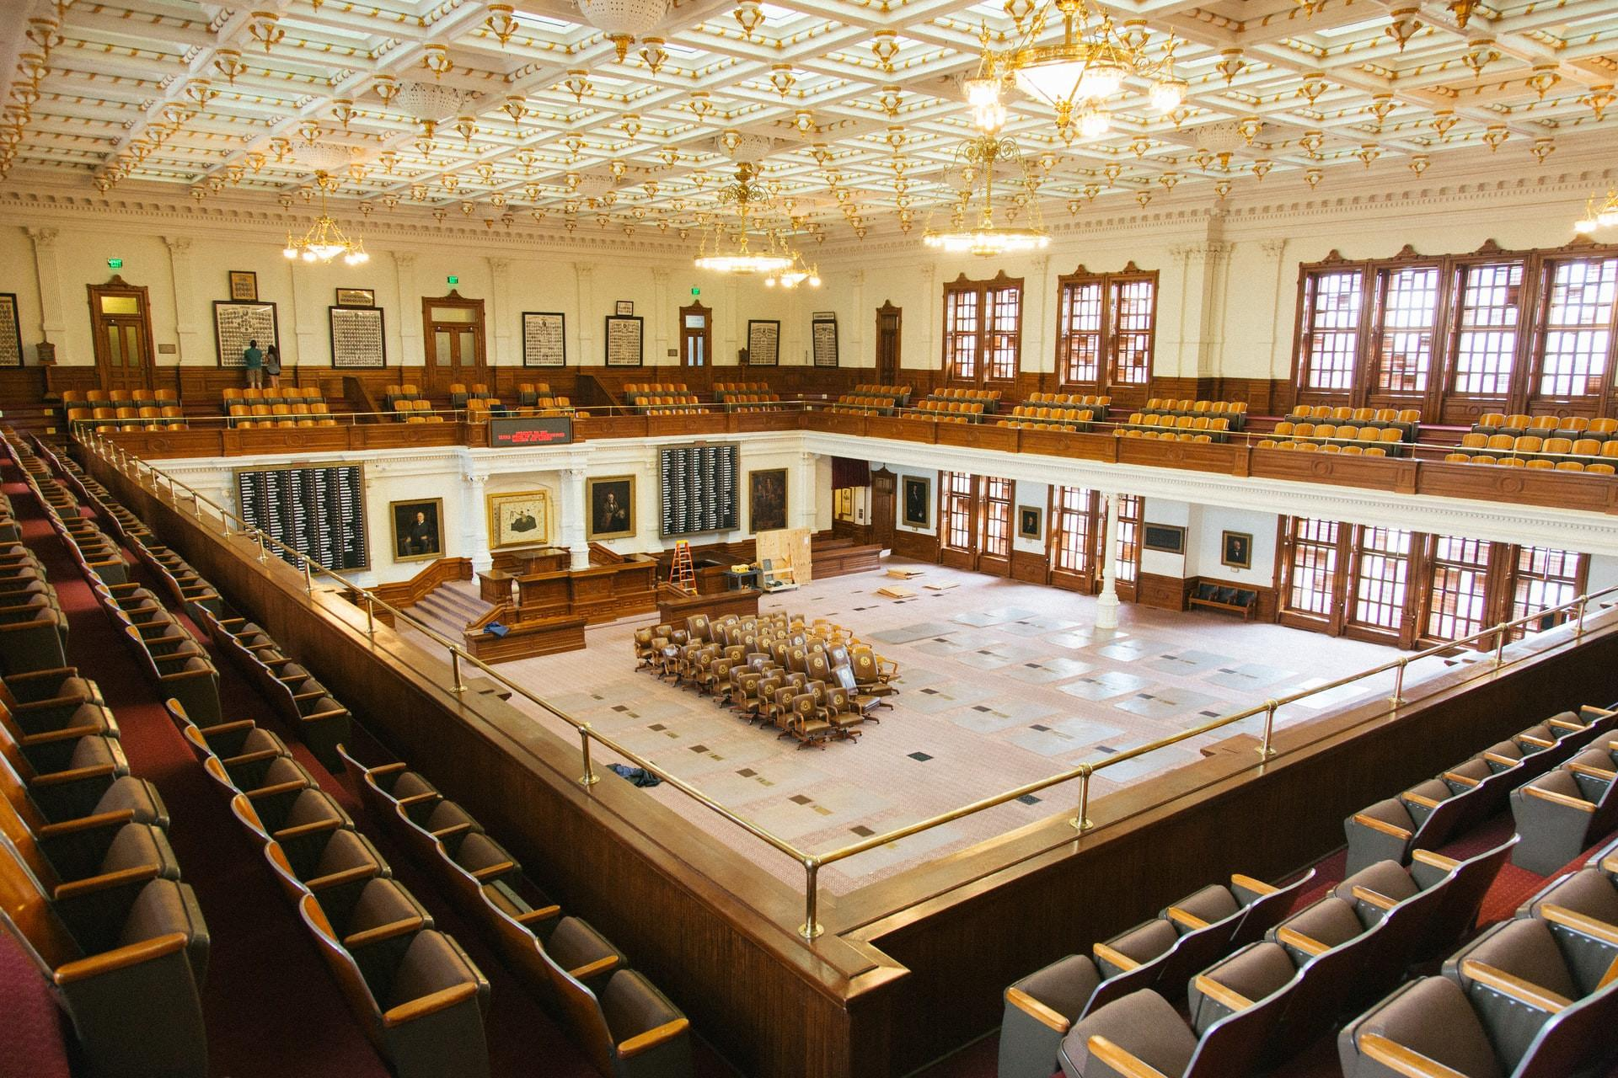
RESOURCES
MASS ORGANIZATIONS FOCUSED ON ELECTORAL ACTIONS
- ANYONE CAN JOIN -
MOVEMENT FOR A PEOPLES DEMOCRACY
MPD
Movementforpeoplesdemocracy.us
WOMEN FOR RACIAL & ECONOMIC EQUALITY
WREE
Wreeusa.com
CIVIL RIGHTS CONGRESS
Tip
The Legislative & Electoral Commission is where Strategy and Tactics are determined, and where policies are reviewed to ensure current policies reflect current situations.
One must be a Party Member to join.

Slide 13
LEGISLATIVE COMMISSION
+ Candidates are to reach out or be directed to the electoral subcommittee.
+ Potential candidates must become cadre before being eligible to run.
+ Platform presented during assessment will be reviewed. Any changes that need to be made based on the profile developed during phase two will be added.
+ The town/city, district, and state as well as the position the candidate is running for should be of paramount concern.
+It is recommended that inexperienced party members run in local elections.
Legislative Commission Chair
PAUSE

Slide 14
“TAKE AWAYS”
:
Engage in “Politics” Turn deception into emancipation
The Slogan is Everything From “Peace, Bread and Land” to “Peace, Bread and Jobs”
What’s next?

Slide 15
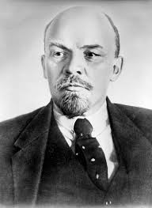
“COMMUNISTS IN ALL COUNTRIES SHOULD:
exist for the purpose of changing - in all spheres of life - the old socialist, trade unionist, syndicalist, and the parliamentary type of work into a new type of work, the communist.
…In Western Europe and in America, the communist must learn to create a new, uncustomary, non-opportunist, and non-careerist parliamentarianism: the Communist parties must issue their slogans; …[and] to take the bourgeoisie at its word and utilize the machinery it has set up, the elections it has appointed,
and the appeals it has made to the people. [We must} take the
opportunity to explain Bolshevism in a way that was never
possible outside of election times. It is very difficult…,
but it can and must be done, for the objectives of communism
cannot be achieved without effort.”
Lenin, “Left-Wing” Communism, an Infantile Disorder”

Slide 16
QUESTIONS
Do you consider the strengthening of third parties, especially those parties that continually attack capitalist candidates’ contradictions during the campaign periods, to be worth the time and effort of socialists and communists?
Do you consider the possibility of significant electoral successes could aid in the struggle towards socialism and assist in the elimination of capitalism?
Relate
Make big numbers digestible by putting them in the context of something familiar

