Slide 1
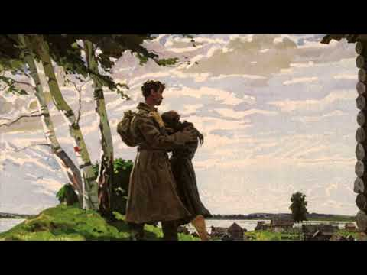
День победы - Victory Day

Slide 2
Fascism in the Present Day
PSMLS 01/24/23 - 01/26/23

Slide 3
What we’ll be learning today:
Examining fascism as it stands in the present day in different countries in Europe, Asia and South America.
Examining fascist movements nowadays in the United States, and where they stand in regards to gaining power.
Reading from Dimitrov’s “The Fascist Offensive and the Tasks of the Communist International” to understand what we must do as Communists to resist the re-emergence of fascism.

Slide 4
Preface: Fascism in the Last Century

Slide 5
Fascism in the World Today
Preface
Fascism emerged as a major force in world politics in the 1920’s following World War 1 and the Bolshevik Revolution. The same force whom’s contradictions gave rise to socialism gave rise to fascism - imperialism.
The Treaty of Versailles and other post-war constructs dealt countries like Germany and Italy an economic blow that ravaged the working class of those countries. Unfortunately, due to many issues both inside and outside the socialist movements of those countries, the socialists failed to do in those countries what they had done in Russia in 1917.
The Fascists, whom in some cases used the word “socialist” to describe themselves, grew and used nationalism and scapegoating of groups of oppressed peoples and leftists, rather than class struggle, to gain support from the working class. At the same time, they used ruthless terrorism and political sabotage against the socialist and progressive-liberal forces to suppress their opposition.
They quickly grew in power, wiped out opposition and gained state power. In many cases, imperialists in the countries of the fascists handed them this power, and neighboring imperialists appeased them…

Slide 6
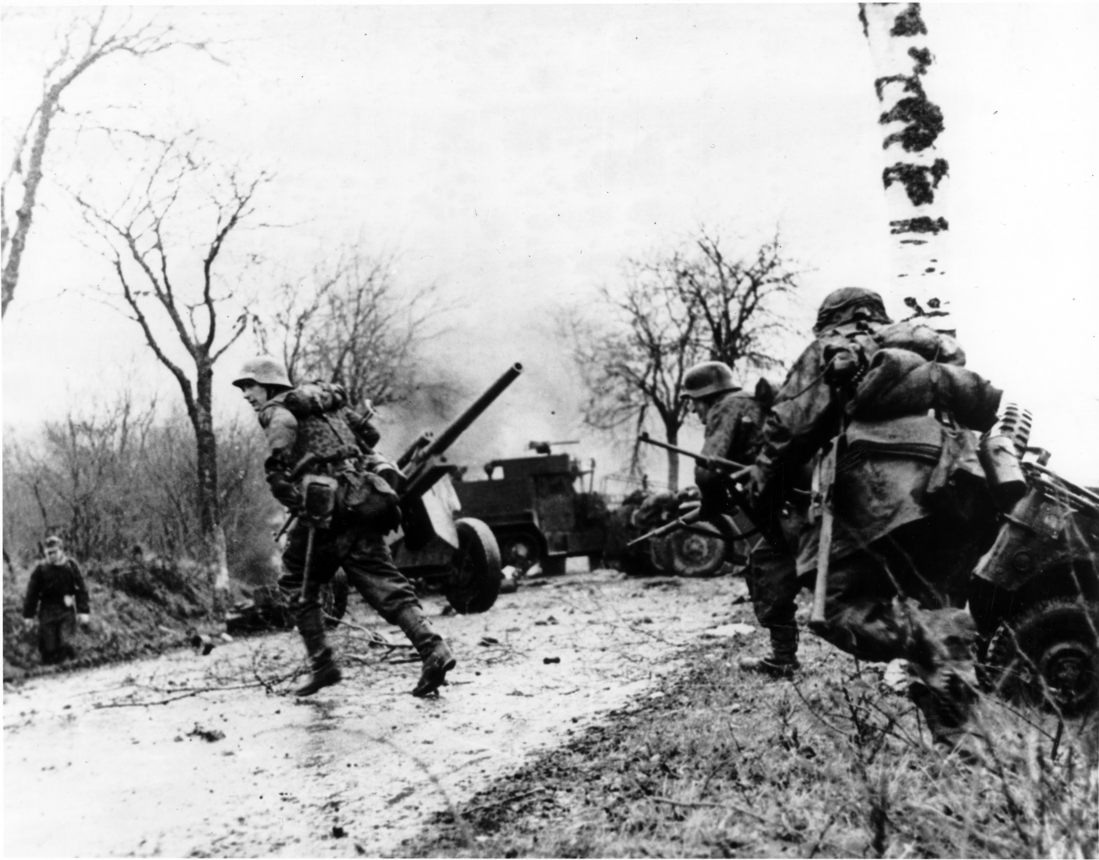
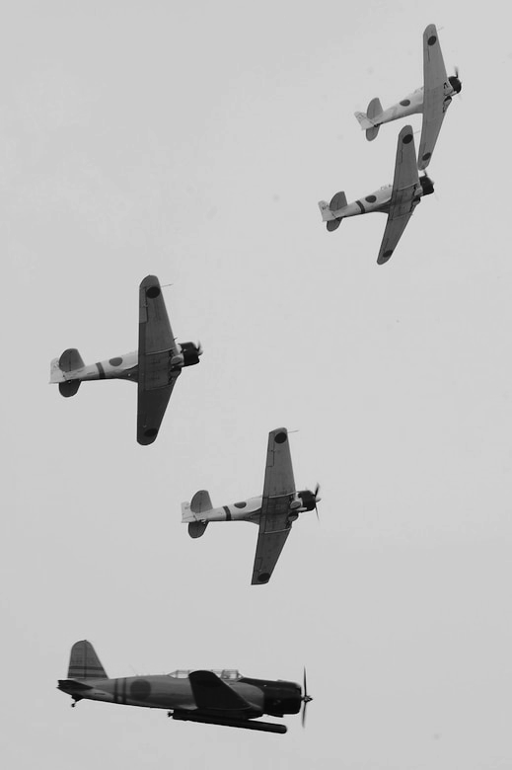
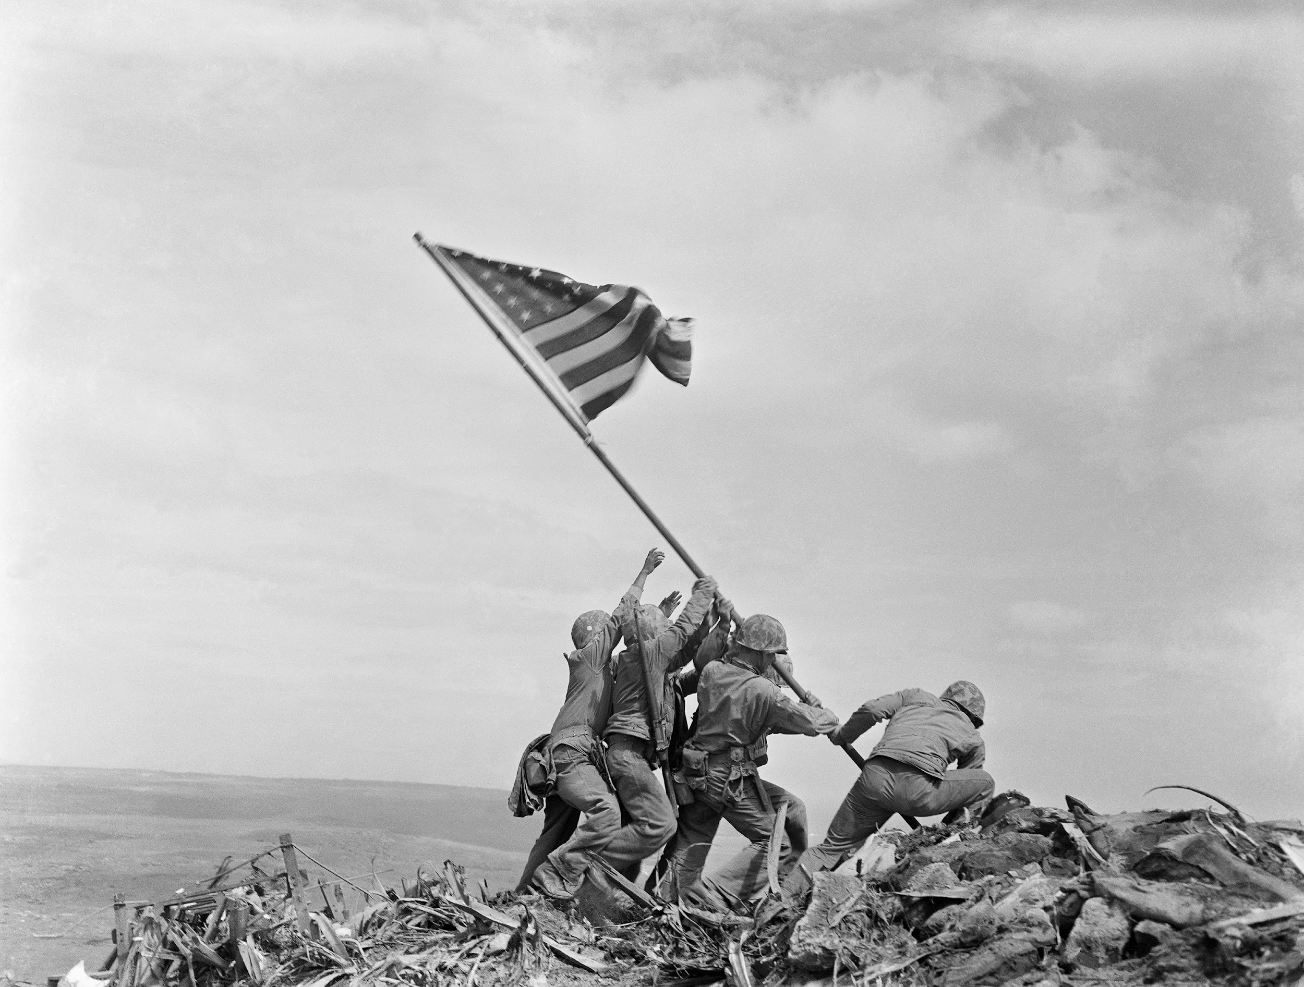
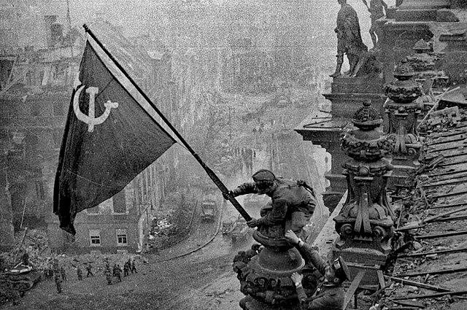
Fascism in the World Today
Preface
In the 1930’s and 1940’s, the world saw the terrifying brutality of fascism during the fascist onslaught that was WW2. The fascists of Nazi Germany, Fascist Italy, Imperial Japan, Vichy France and more unleashed their violence on the people’s of Europe, Asia and Africa, taking anywhere between 35-60 million lives.
Luckily for the time, the Axis Powers (the fascist alliance of WW2) were defeated in 1945, primarily due to the USSR’s monumental fight for their existence in what they call “The Great Patriotic War” that took over 20 million Soviet lives, but also due in part to the fighting of the other Allied Powers (the anti-fascist alliance of WW2) as well as millions of partisan fighters from several countries.
Fascism did not go extinct, however…

Slide 7
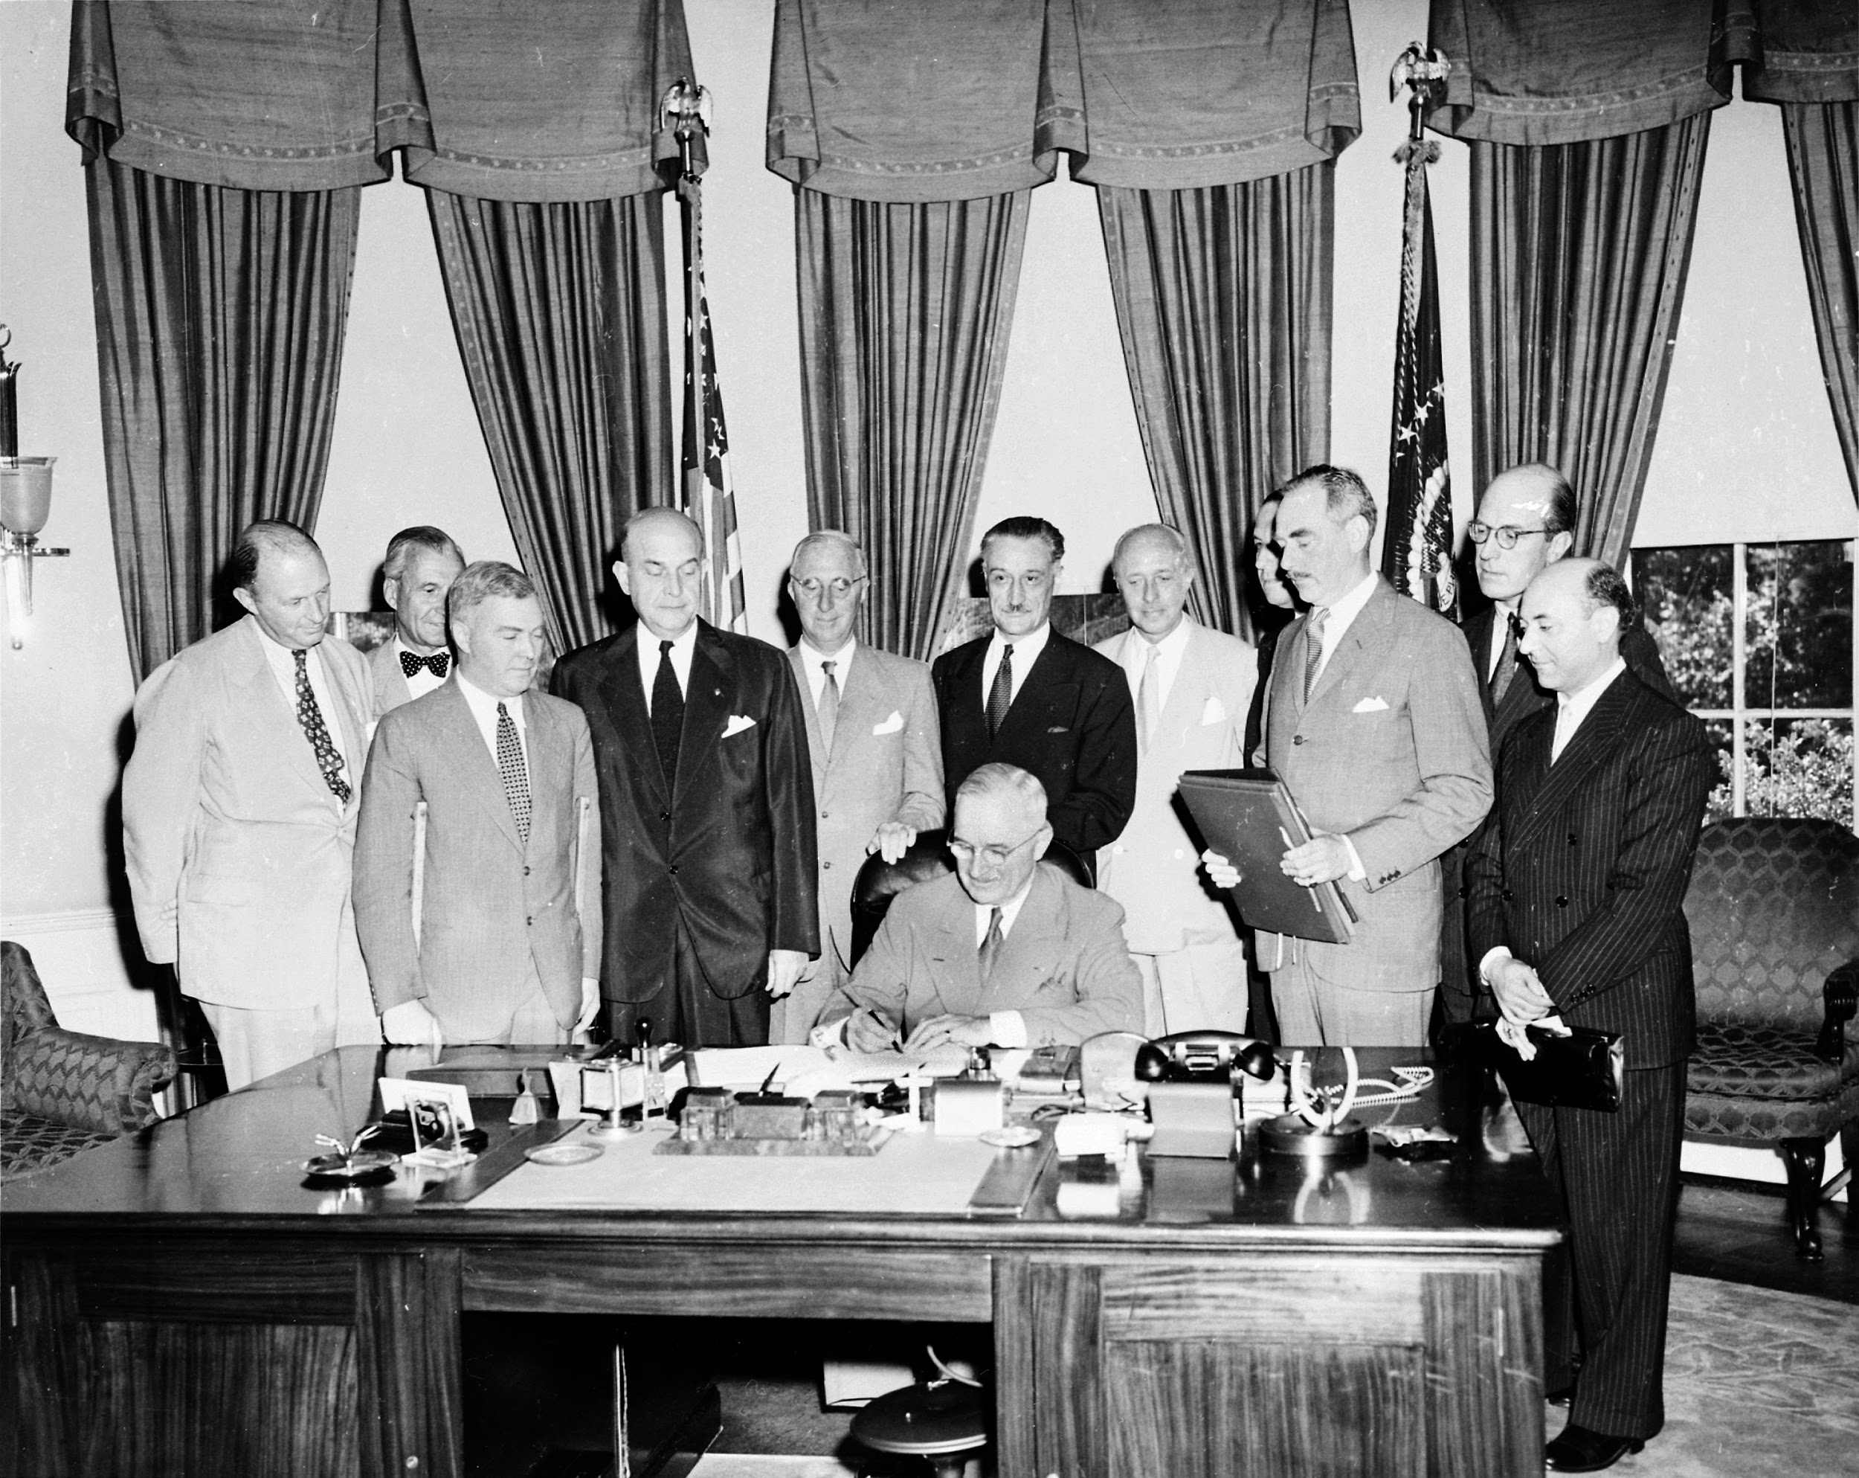
Fascism in the World Today
Preface
Following the Second World War, the surviving imperialist powers of the west - led by the United States - created NATO and resuscitated European fascism, taking fascists into their countries and keeping them at the ready for potential conflict with the Soviet Union throughout the Cold War.
As the Cold War went on, the United States expanded their support for fascists to Latin America, such as in Chile with Pinochet and in Brazil with Branco, as well as the Middle East, where the US supported Zionism in Israel and a variety of fascistic, Islamic extremist forces, such as Saudi Arabia and the Mujahideen.
It must be understood that the USA is NOT a fascist state, it is a capitalist empire that props up fascism around the world to serve its interests and wipe out revolutionary socialist movements.
Signing of the North Atlantic Treaty in 1949. NATO was integral in rehabilitating Nazis and resuscitating fascism.

Slide 8
Fascism in the World Today

Slide 9
Fascism in the World Today
Fascist Countries vs Countries with Fascists
Let us understand from the start that there is a critical distinction between a state which is verifiably fascist, such as Ukraine for example, and countries that have fascists in them, even a few in power. Both deserve the attention of anti-fascists, but the nature of fascism in these countries has an impact on how to combat them.
Ukraine, for example, is verifiably a fascist country. The people in power in Ukraine are among the most reactionary, most chauvinistic, most imperialist elements of western finance capital and have actually gained and consolidated power. Beyond that, they’ve incorporated neo-nazi militias into their military, banned all opposition parties and honored the Banderite fascists of Ukraine’s past. This fascism must be crushed at once.
A country like Russia, on the other hand, has fascists in it for sure. However, they hold no significant power in the country, the Communist Party isn’t banned and is the 2nd largest party in Russia, and the country has led a special military operation since February 2022 to denazify the aforementioned fascist Ukraine, a move that was initially promoted by Russian communists. Therefore, while anti-fascists in Russia should by all means resist any Russian fascism, Russia does not deserve the attention of the world’s anti-fascists in the same way as Ukraine at this time.

Slide 10
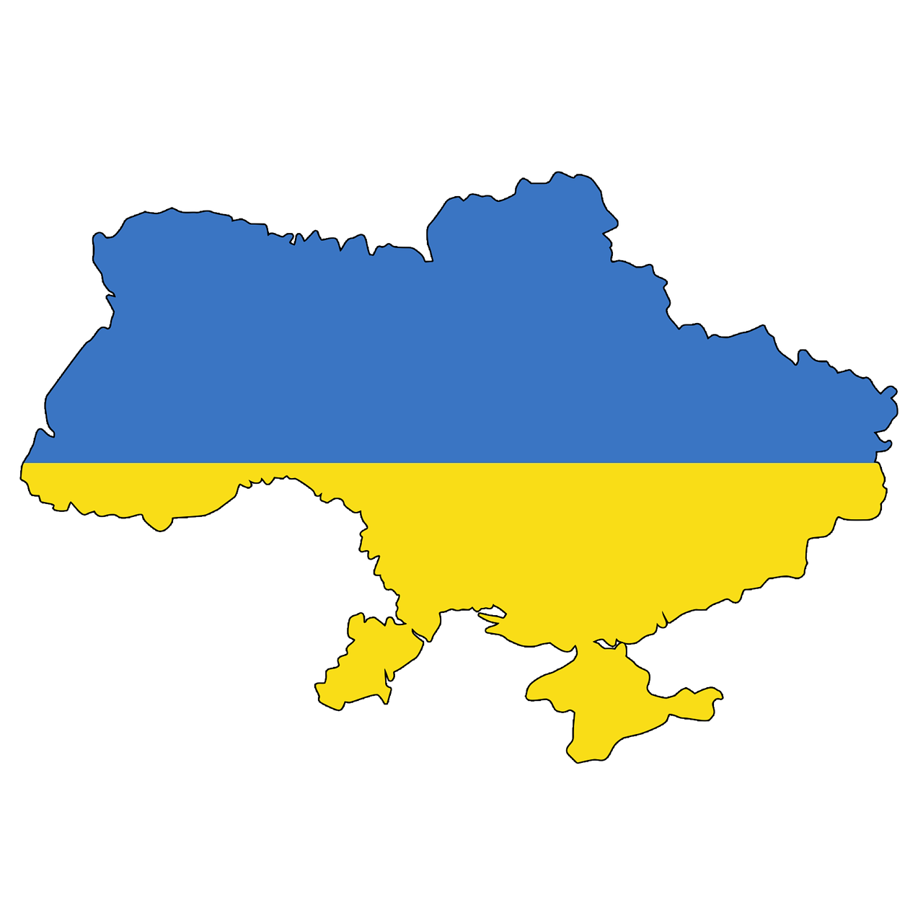
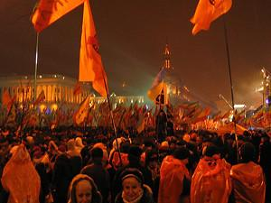
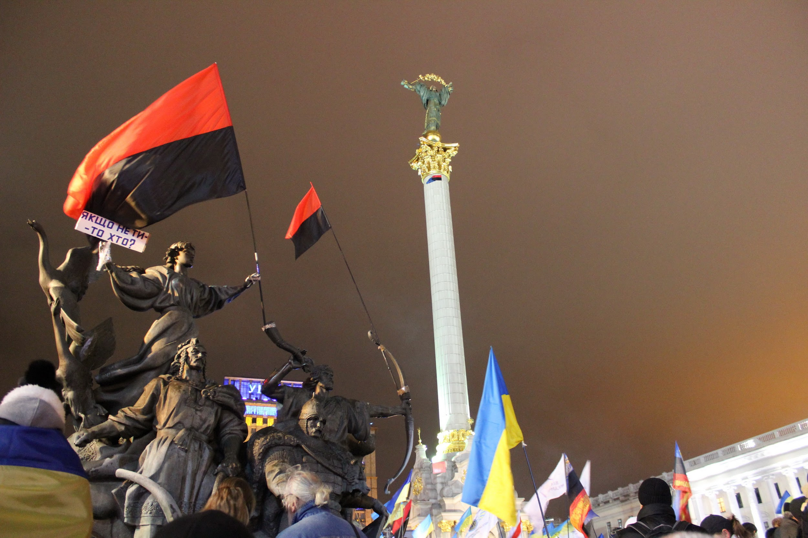
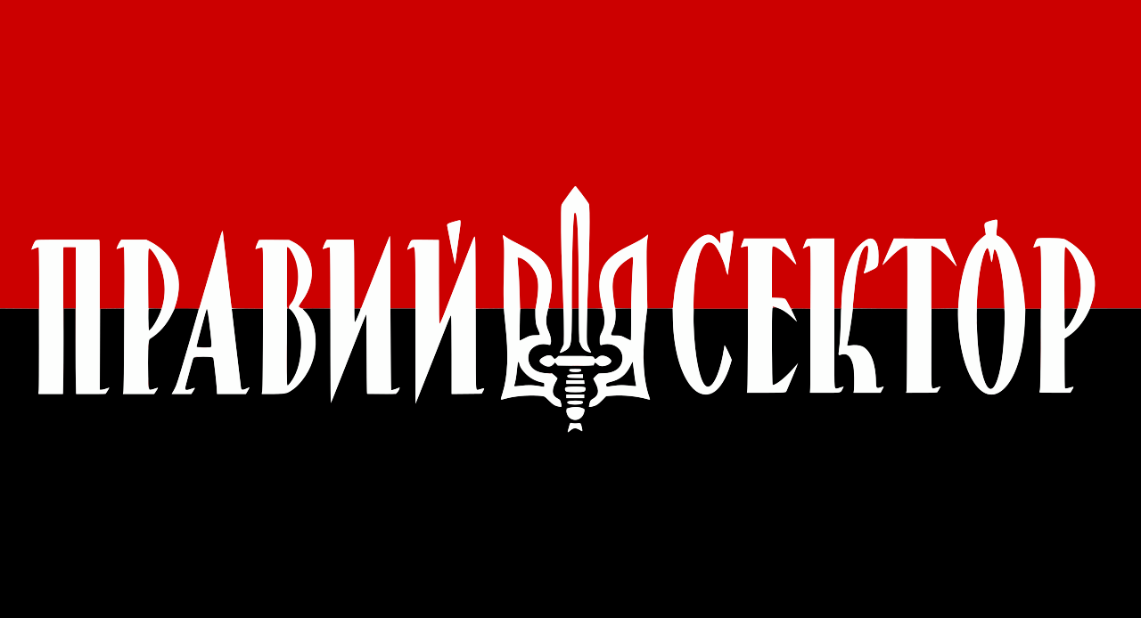
Fascism in the World Today
Ukraine
Ukraine is a country that has only existed since 1991. It was formerly a part of the Soviet family which was destroyed by the counter-revolutionary forces of Gorbachevists and Yeltsinists. It existed as a capitalist democracy for ~23 years between 1991 and 2014. During this time, it struggled with western-backed color revolution (Orange Revolution of 2004), rising nationalism and its relationship with the Russian Federation and the EU.
In 2013, the Euromaidan began, which were a series of protests, mostly organized by Ukrainian fascists. They took issue with the pro-Russian president Viktor Yanukovych and his administration's rejection of an economic relationship with European imperialism and closer ties with Russia. These protests culminated in an undemocratic fascist coup in Ukraine, which ousted Yanukovych and began a series of events which would further exemplify the fascism of Ukraine.
Left: Map and flag of Ukraine | Right: Orange Revolution of 2004
Flags of the fascist “Right-Sector” fly during the Euromaidan, 2014

Slide 11
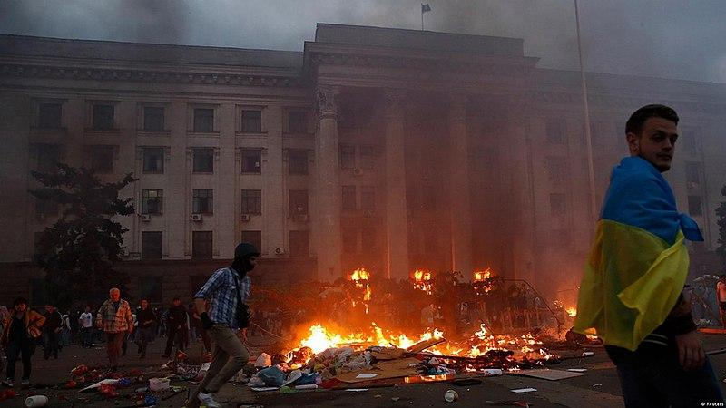
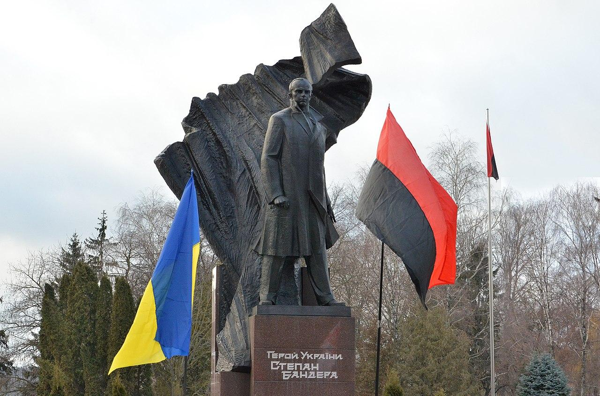
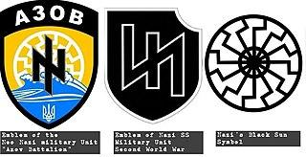
Fascism in the World Today
Ukraine
Following the fascist seizure of power in 2014, the Eastern Regions of Ukraine - which are predominantly Russian-speaking - sought separation. Russia annexed Crimea in March of 2014. On May 2nd, 2014, the Trade Union building in Odessa was lit aflame and 42 people died at the hands of Ukrainian fascists.
Stepan Bandera and other Ukrainian fascists from the 20th Century were officially granted “Heroes of Ukraine” and their imagery pervaded much of Western Ukraine post-2014. Bandera is responsible for the deaths of thousands of Ukrainians, Russians and Poles.
In the Donbass region, for 8 years the people suffered a war on them by the government of Ukraine. The National Guard absorbed the neo-nazi Azov and Donbass battalions, and allowed them to carry out brutal warfare on civilians in the Donbass. At least 365 civilians were murdered by Ukraine between 2016 and 2021. In 2021, Russia began to build its forces on their border with Ukraine, and in 2022, they recognized the two republics in the Donbass, the Lugansk People’s Republic and Donetsk People’s Republic, and invaded Ukraine with the expressed goal of denazification. This war is still continuing.
Trade Union Building in Odessa on fire, May 2nd 2014.
Left: Monument of Stepan Bandera erected in fascist Ukraine
Right: Comparison between Azov and Nazi SS symbols.

Slide 12
Fascism in the World Today
Sources for Further Research-Ukraine
8 Years Before Documentary by The Revolution Report - On YouTube
Ukraine of Fire Documentary by Oliver Stone - On YouTube
Ukraine: The Everlasting Present by Global Tree Pictures - On YouTube
Fighting Fascism in Ukraine by N. Butyaev of RCWP - On website and in The Communist 2022

Slide 13
Discussion

Slide 14
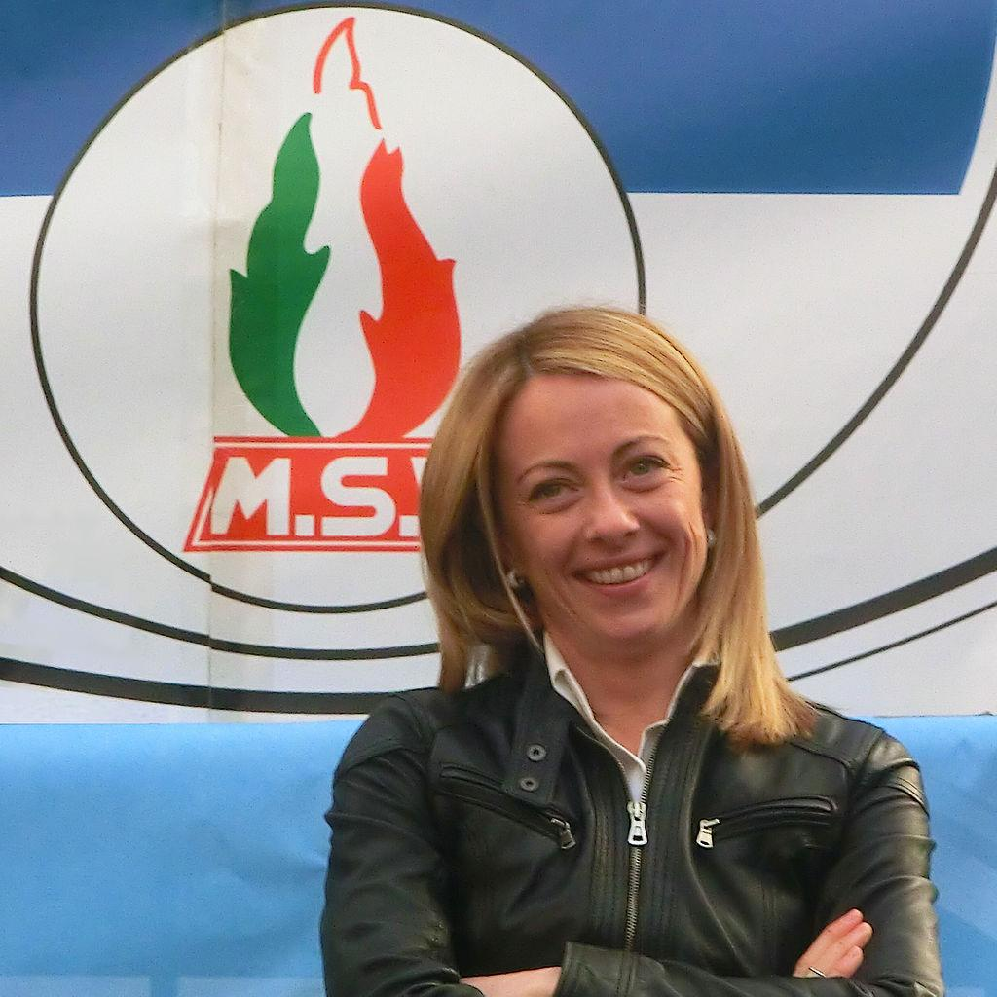
Fascism in the World Today
Fascism in Other Foreign Countries
Italy
While there is a general lack of other countries that are verifiably fascist and can be called “fascist states”, there are a number of countries in which rising fascist movements should be cause for alarm and could result in the establishment of more fascist states. Here are a few notable examples:
In July of 2022, following a government crisis which led to the fall of the Draghi government, President of Italy Sergio Mattarella dissolved the Italian parliament and called for new elections, which led to a snap election in September. In that election, the neo-fascist Brothers of Italy party won an absolute majority of all the seats in the Italian Parliament, and their leader, Giorgia Meloni, was elected prime minister of Italy.
This party has consistently shown admiration for Italian fascism, Mussolini and the fascist Italian groups of the latter half of the 20th century. Their members have publicly performed the fascist salute, and the manager of the party actually said in 2019 that “We must be free to be able to define ourselves as fascists.” This is an evolving crisis deserving the attention of world anti-fascists especially considering the history of fascism in Italy, its birthplace. Italy and their fascists support Ukraine.

Slide 15
Fascism in the World Today
Sweden
Japan
The Swedish Democrats are a far-right, nationalist party that was originally started out of Swedish Nazism in the 1980s and 1990s, though the party supposedly rejects fascism and nazism today. However, their ideology and party platform is based on Nordic Nationalism, Xenophobia, Islamophobia and Euroscepticism.
In the General Election of October 2022, the SD was allocated chairmanship of four parliamentary committees for the first time in the Riksdag, and The Moderate Party’s Kristersson Cabinet (executive branch) must get confidence and supply from them (confidence in motions, supply of budget - form of parliamentarianism based on the Westminster system). For the first time in history now holds direct influence over the government. In July 2022, NATO signed an accession protocol to allow Sweden into the military coalition, and the Swedish Government and Swedish Democrats have been supportive of fascist Ukraine since the invasion.
There has been a re-emergence of nationalism and militarism in Japan as of late, as in 2022 following the assassination of Japanese prime minister Shinzo Abe, the current prime minister Fumio Kishida called for the amendment of Japan’s pacifist constitution and a rearmament of Japan. This coincides with renewed nationalism and tone-deaf patriotism about Japan’s role in WW2, as well as anti-Korean xenophobia. The “Rising Sun” flag has been seen more again in Japan as of late, such as at the 2022 World Cup and at Japanese protests. Japan supports Taiwan and Ukraine.
The Rising Sun Flag, flown by fans at the 2022 World Cup (Center flag)

Slide 16
Fascism in the World Today
Brazil
On January 8th, 2023, only 2 years and 2 days after the January 6th putsch in the United States, supporters of fascist former president Jair Bolsonaro performed a putsch at the government buildings in the capitol of Brazil, following the inauguration of Lula Da Silva, who was imprisoned by Bolsonaro on ‘corruption’ charges and was released recently, ran for president and won. Lula denounced the supporters as nazis and fascists. Bolsonaro was in Miami, Florida.
Jair Bolsonaro’s governance was one of assault on the Amazon rainforest, including the indigenous people living in it, as well as Christian Nationalism and militarism. He praised the 1964 US-backed fascist coup in Brazil which installed a military junta in Brazil. In December 2008, Bolsonaro said that "the error of the dictatorship was that it tortured, but did not kill". He has repeatedly remarked about how leftists, homosexuals, women and indigenous people should be beaten, tortured and shot, and has been connected with multiple assassinations of political opponents.
For now, it seems Bolsonaro has accepted the election results and tried to distance himself from the putsch, but there is still a rising fascist movement in Brazil that still supports him. Brazil has a history of being a fascist country before and could become one again, bringing fascism back to Latin America for the first time since the reign of Augusto Pinochet in Chile in the 1970’s (also US-backed). Bolsonaro supports Ukraine.
Bolsonaro supporters invading the Brazilian National Congress

Slide 17
Discussion

Slide 18
Fascism in the USA Today

Slide 19
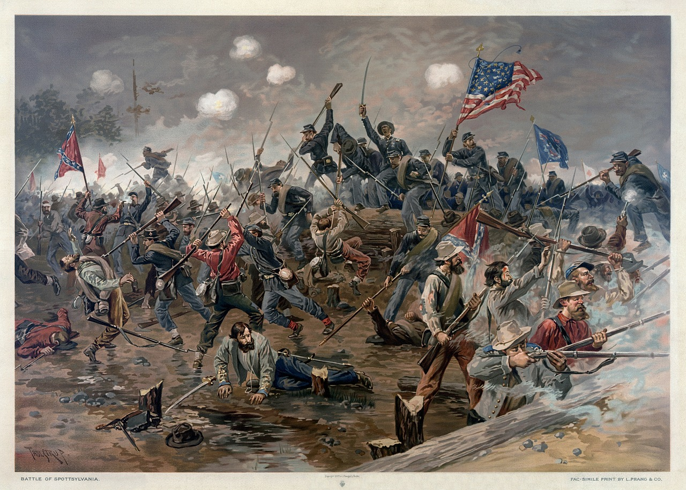
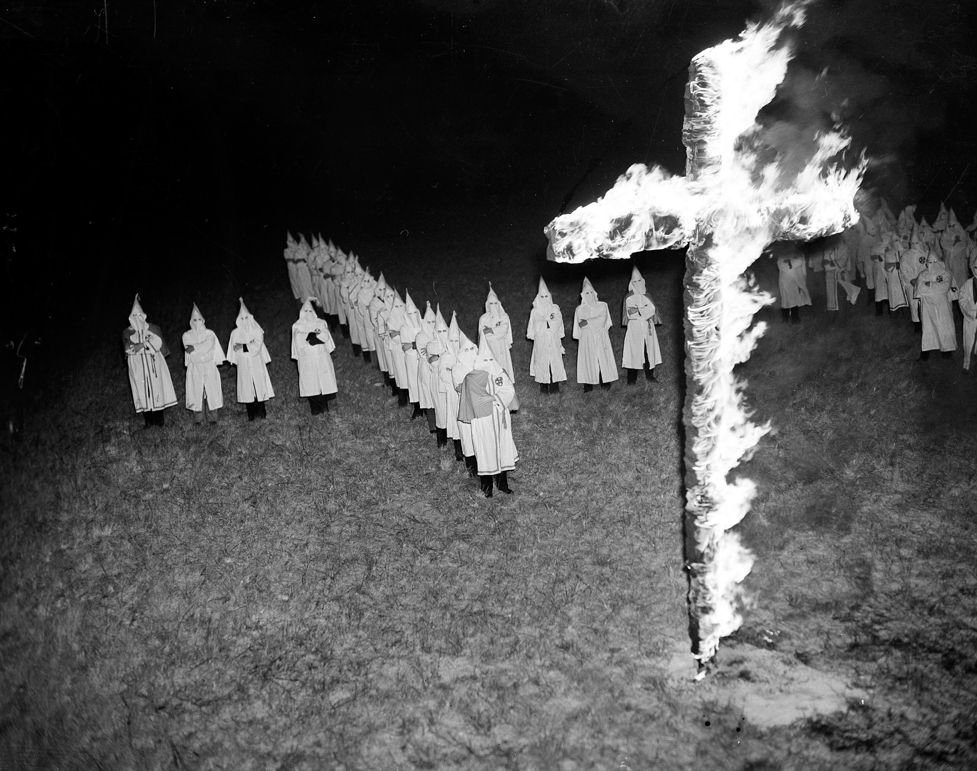
Fascism in the World Today
Brief History of American Fascism
It is important to understand that American fascism is different than Nazi fascism in that American fascism is a lot more based on Christian-Nationalism, white supremacy and a sense of pride in America’s colonial and imperial history.
American fascism truly came to being in the 1920’s when fascism was being invented in Europe, but it had its roots what can be considered proto-fascist movements of the Confederate States of America (which The Union defeated in the Civil War), the Ku Klux Klan, the “One Hundred Percent-Americans” and more.
America’s westward expansion and accompanying genocide of the indigenous people in North America was very inspirational for German fascists later on. Then, as WW1 came and went and American imperialism was becoming a powerhouse and American businessman were making deals worldwide, millionaires like Henry Ford and JP Morgan funded, aided and praised the Nazis and provided them with breakthroughs in their transportation, concentration camps and weaponry.
Depiction of a battle in the American Civil War
Ku Klux Klan gathered for a cross burning in the early 1900s.

Slide 20
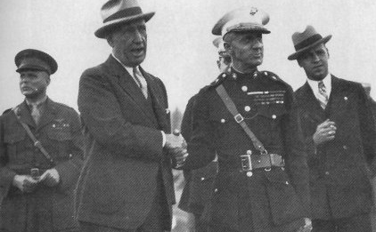
Fascism in the World Today
Brief History of American Fascism
When fascism was coming into existence formally in Europe in Italy, Germany and Spain, fascist movements were attempting to establish themselves in America.
The most notable example of a planned seizure of power by fascists in the United States during this time was that of the Business Plot of 1933, which was organized by American fascists who wanted to overthrow Franklin Delano Roosevelt and install a fascist regime in the United States friendly to the Axis Powers. It was foiled by Smedley Butler among others, and a coup was never attempted.
The “America First Committee” was formed in 1940 with the main policy being that of Isolationism from the war in Europe, thus avoiding American war against fascism. They reached around 800,000 members at one point in 1940. Luckily however, because of the attack on Pearl Harbor and the German declaration of war on the United States, their popularity quickly dwindled and they were dissolved on December 11th, 1941.
Smedley Butler with associates in the 1930s
Logo of the America First Committee

Slide 21
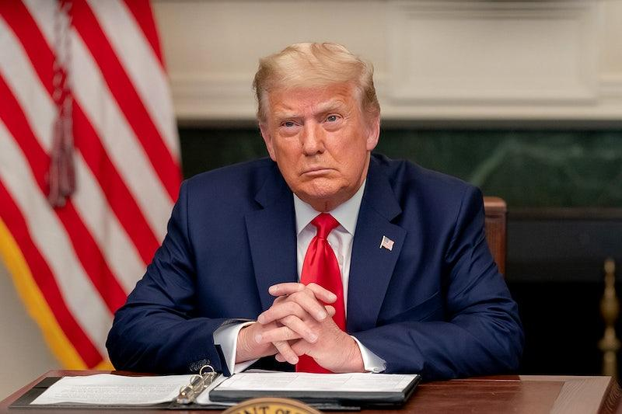
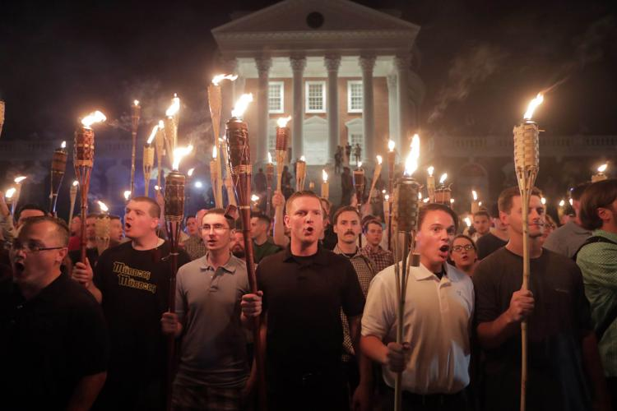
Fascism in the World Today
American Fascism in the Present Day
Since the end of World War 2, different Neo-Nazi, White Supremacist and Christian Nationalist groups and movements have sprung up and gone out of existence. The Aryan Brotherhood is the most notable example, usually formed of imprisoned white Americans who have joined into it as a racist gang. They’re more focused on operating like a criminal gang than a political force however.
Since 2016 and the campaign and presidency of Donald Trump, a borderline fascist who championed xenophobia, transphobia, racism, islamophobia and even the “America First” slogan in addition to the regressive, rebirth myth of “Make America Great Again”, fascist groups have emerged in America and a rising fascist movement has been visible for a few years.
In 2017, for example, American fascists marched with tiki torches in Charlottesville VA shouting “Jews Will Not Replace Us” and “Blood and Soil” the night before the “Unite the Right” rally there. The next day, anti-fascists clashed with them and the night ended with an American woman named Heather Heyer being killed by a fascist who crashed his car at high speed into a crowd of protesters. Donald Trump denounced the event, but blamed both sides and said there were good people on both sides too.
Former US President Donald Trump
American fascists hold lit tiki torches in Charlottesville VA in 2017

Slide 22
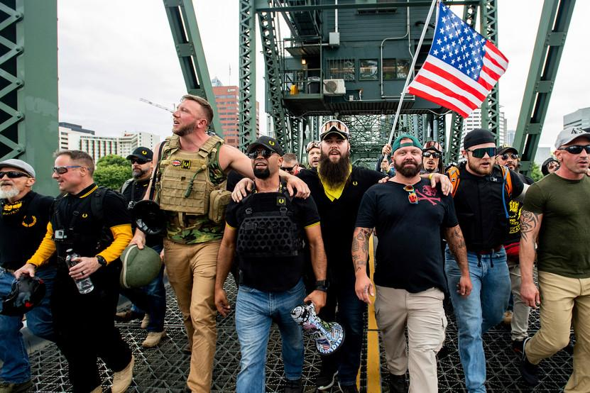
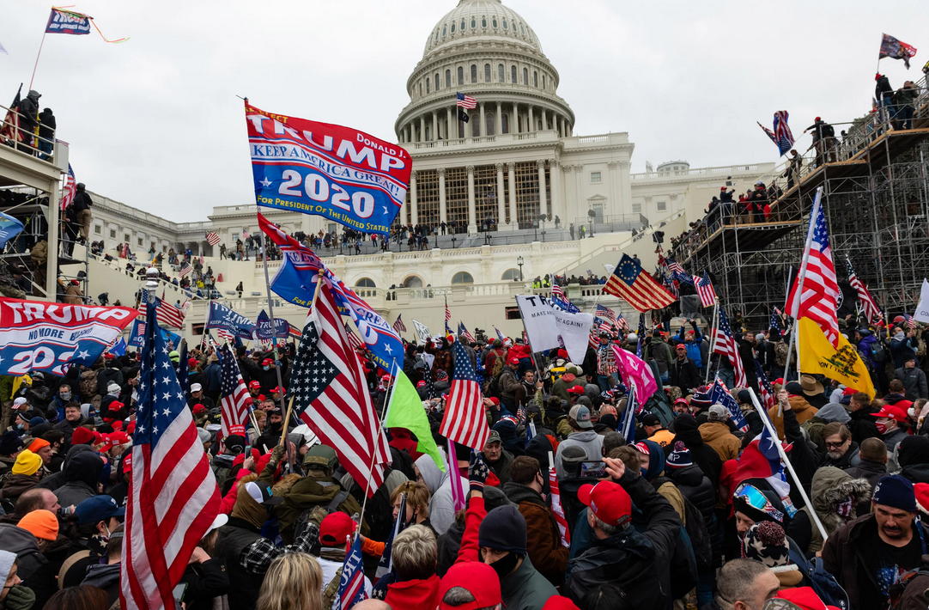
Fascism in the World Today
American Fascism in the Present Day
Other notable events involving violent fascists in the last fews years include clashes between fascist street militias such as Proud Boys, Patriot Prayer, Patriot Front, Threepercenters and Oathkeepers and (mostly anarchist) anti-fascists in Portland OR, Berkeley CA, Oregon City OR and more since at least 2017. Fascists groups have also planned and attempted attacks on LGBT+ events such as the pride event in Coeur D’Alene, Idaho in 2022 where Patriot Front members were busted armed to the teeth in the back of a U-Haul ready to assault the event.
When the 2020 US General Election came and the results were that Joseph Biden would become the next president of the United States, Trump and his supporters immediately rejected the election results, spread misinformation that the election was stolen and openly organized online the January 6th, 2021 putsch at the US Capitol Building in Washington DC. This was a fascist show of power that is unrivaled in the history of the United States. Many disparate fascist groups were in attendance (some even antifa-jacketing or fed-jacketing eachother), some protesters wore shirts saying “6MWE” meaning “6 Million [Jews] Wasn’t Enough”, and at the end of the day, 2 officers lie dead at the hands of protesters while only 1 protester was killed by police forces in the capitol building.
Proud boys march before clash in Portland, OR
Crowds outside the US Capitol Building
on January 6th, 2021

Slide 23
Fascism in the World Today
American Fascism in the Present Day
The status of the American Fascist movement as of this moment is that it does not have any significant power in the United States, however that does not mean it is not gaining power and consolidating it. At least 2 January 6th putsch participants have been elected to Congress in 2022, and violent fascists have ran successfully for positions all the way from School Boards and City Councils to State Representatives and Senators. It is also worth noting that a significant section of the Republican Party, or GOP (Grand Ole Party), has defended the January 6th putsch, as well as other fascist actions, individuals and policies.
Right-wing candidates for 2024’s Presidential Election have all given varying degrees of alarming statements about their views and thoughts for the future of this country. Former President Donald Trump quietly walked away from the putsch but recently mentioned suspending articles of the constitution with regards to elections based on his claim of the 2020 election being fraudulent. Ron DeSantis is another frontrunner candidate who has championed anti-LGBT+ laws, is very anti-communist and would be just as bad if not worse than Trump. “Ye”, also known as Kanye West, is a celebrity running for president who was close to Trump during his presidency, and recently made very overtly pro-Hitler and pro-Nazi remarks on the fascist talk show InfoWars with Alex Jones.
Whether a fascist revolution occurs in America by legal means such as it did for Hitler in the 1930’s or through a violent coup d'etat like Chile in 1973 remains to be seen yet, but what can be said is that a semi-organized American fascist movement is rising and with the United States of America already holding economic hegemony over a lot of the world and upholding a massive military empire that spans the globe, anti-fascists of the world must rise to the task of stopping fascism in America and it is the most important task we have.

Slide 24
Discussion

Slide 25
What Dimitrov Tells Us To Do

Slide 26
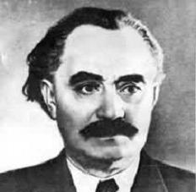
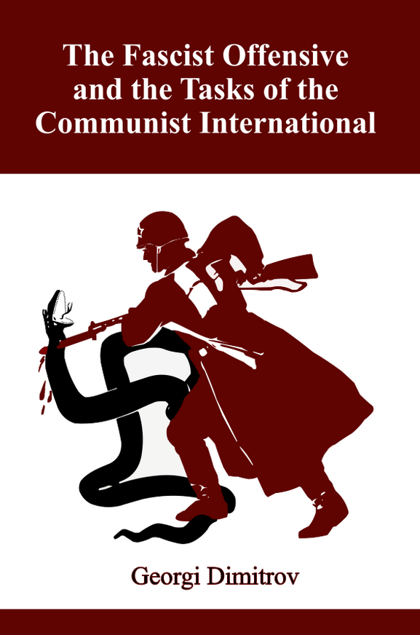
Fascism in the World Today
The Fascist Offensive and the Tasks of the
Communist International
Georgi Dimitrov was born in 1882 in Kovachevtsi in the Principality of Bulgaria. They later moved to Sofia, the capitol and largest city in Bulgaria. His brother joined the Bolsheviks, but was exiled by the Tsarist Empire to Siberia, where he died. Another brother was a trade unionist who died in the First Balkan War. Despite this, he became a tarde unionist and got involved in the Bulgarian labor movement, and then joined the Bulgarian Social Democratic Worker’s Party, which became the Bulgarian Communist Party in 1919 with the Bolshevik Revolution.
By 1932, he was given lead over the Central European section of the Comintern. At this point, European fascism was almost in full swing. In 1934, Joseph Stalin gave him lead over the Comintern and tasked him with promoting the United Front in Europe, which he did. In August 1935, he gave his Tasks of the Communist International [against the Fascist Offensive] at the 7th Comintern Congress. He stayed as head of the comintern until it was dissolved in 1943 in the midst of World War 2 and cooperation with the Allied powers. His United Front tactics and leadership of the comintern was integral in defeating the first wave of fascism in the world, and thus is why we go to him on the question of how to deal with fascism today.
Georgi Dimitrov
Book available at newoutlookpublishers.store

Slide 27
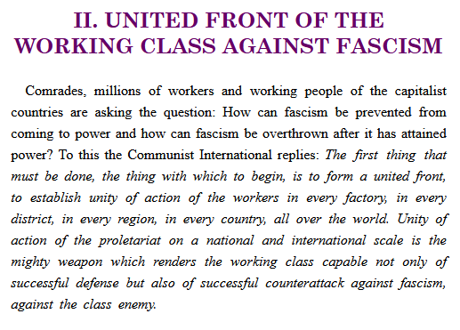

Slide 28
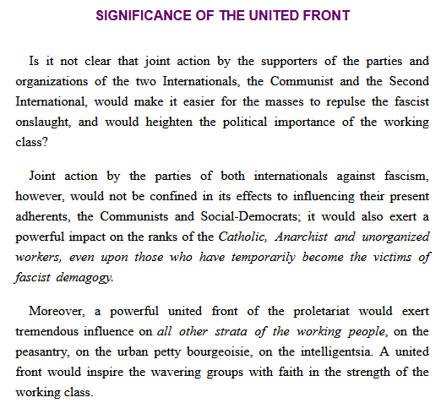

Slide 29
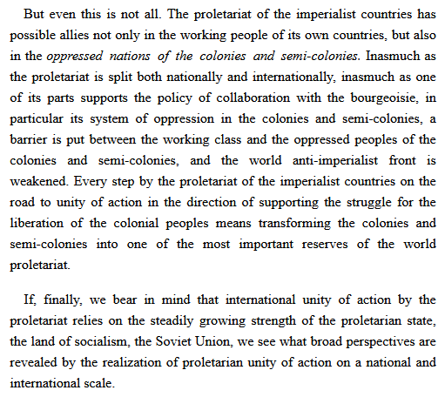

Slide 30
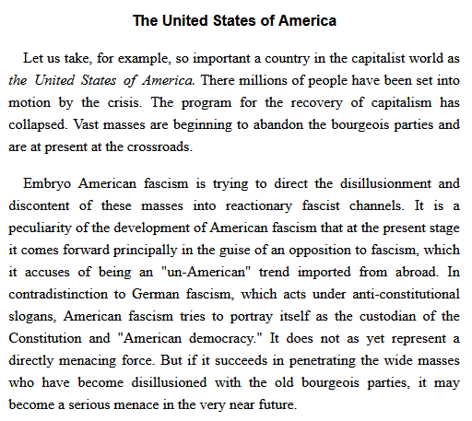

Slide 31
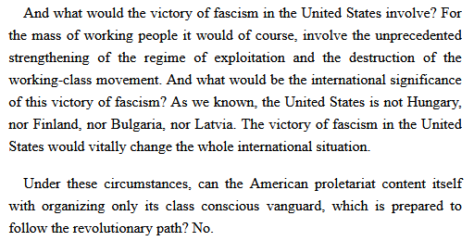

Slide 32
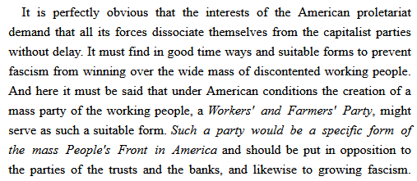

Slide 33
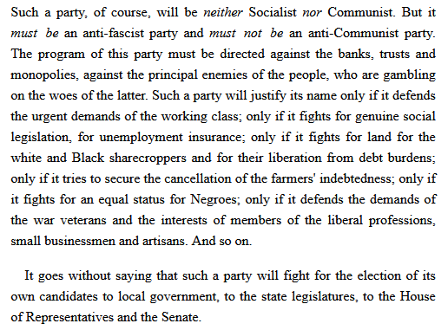

Slide 34
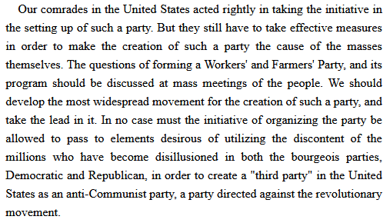

Slide 35
Discussion

Slide 36
New Member Introductions
What is your name, pronouns and state (or country/territory)?
Where do you work? Is it unionized?
How did you find out about the People’s School?
What do you think about tonight's class?

Slide 37
Volunteers Needed!
We are in need of volunteers for the staff of the People’s School! Here’s a few roles we need filled:
People to help manage posting on our social media and podcast platforms
Video Editors, Audio Editors, Graphic Designers, Artists, Narrators
Facilitators, Web Controls, Moderators
Email info@peoplesschool.us if you’re interested and try to attend our next staff meeting on Feb 2nd if possible.

Slide 38
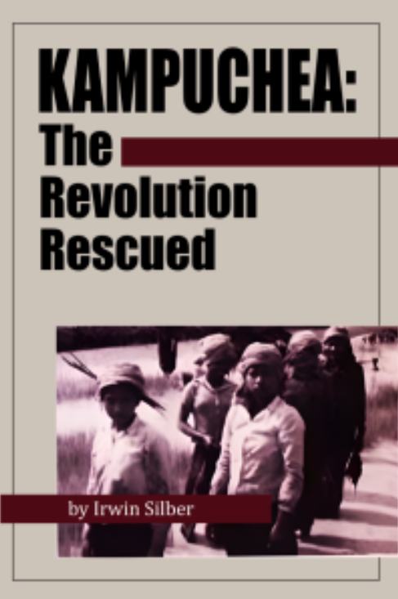
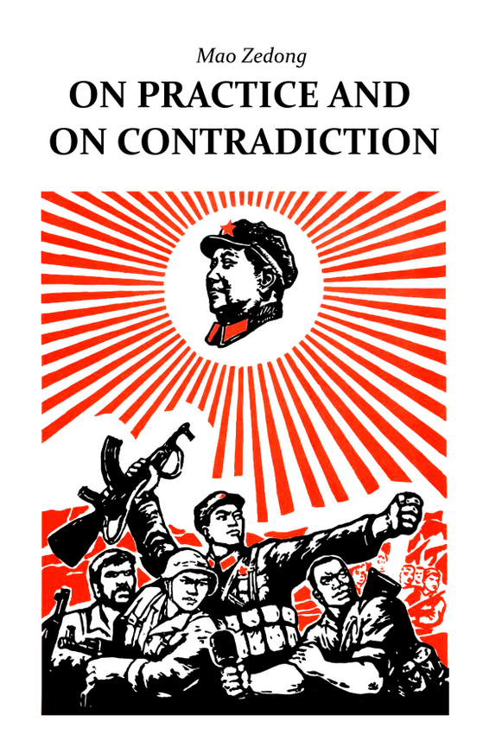
New Outlook Publishers
newoutlookpublishers.store
Related to Class | Latest Releases

Slide 39
Legal Drive
Last year we were attacked and sabotaged by wreckers that tried to steal the PSMLS and destroy the PCUSA.
They failed, but they will be held accountable and there are still things they took from us that we’ve not got back, like videos, imagery and audio. That is why we still need donations to the legal drive.
To donate, go to partyofcommunistsusa.net/donations/
Put “For legal funds” in the details box and try to donate on Tuesday or Thursday so it is easier for us to sort through. It will go to the legal fund. Anything helps!

Slide 40
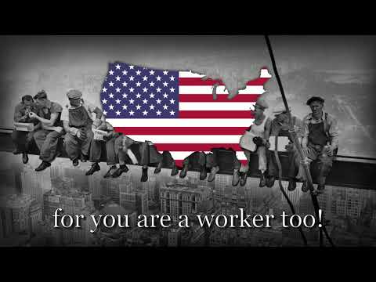
Einheitsfrontlied - Song of the United Front

