Slide 1
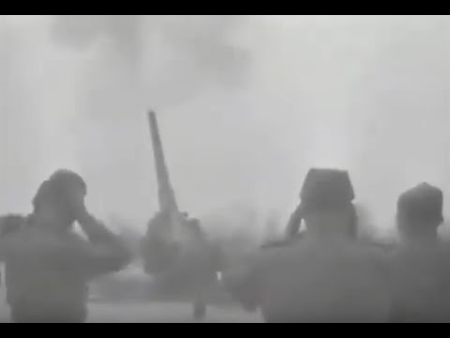
Священная война - The Sacred War

Slide 2
80th Anniversary of the Victory at the Battle of Stalingrad
PSMLS 01/31/23 - 02/02/23

Slide 3
What we’ll be learning today:
The timeline of the Battle of Stalingrad, and how the victory turned the tide of the whole war.
The significance of Stalingrad to us as Marxist-Leninists and anti-fascists.
Watching a short part of the documentary series “The Unknown War” about the Eastern Front and Stalingrad.

Slide 4
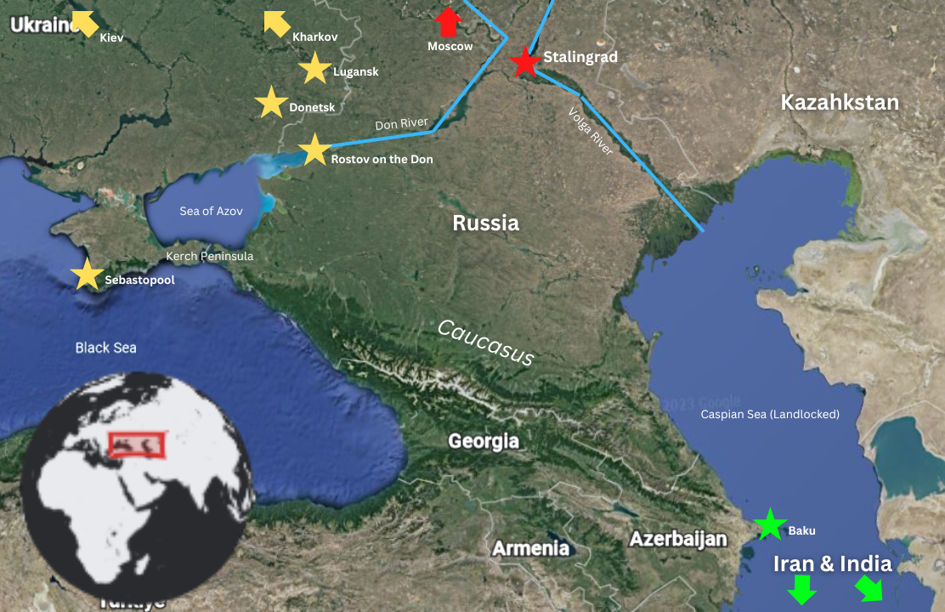
Map of the Region

Slide 5
Timeline of Stalingrad:
Prelude

Slide 6
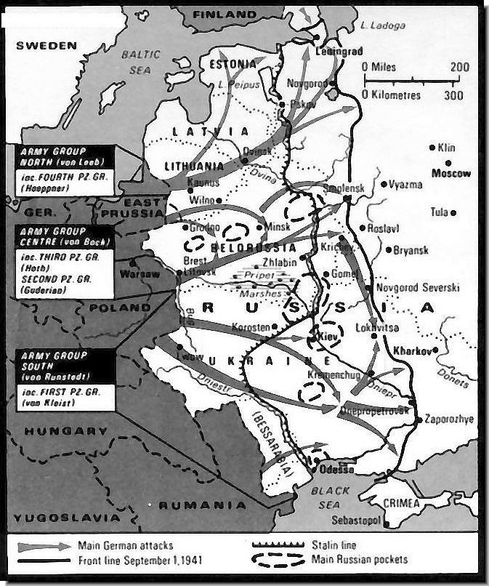
Prelude to Stalingrad
Invasion of USSR begins on June 22nd, 1941 -
Operation Barbarossa
3.8 million soldiers on an 1800 miles long front
Germany had three objectives: Leningrad, Moscow and Kiev.

Slide 7
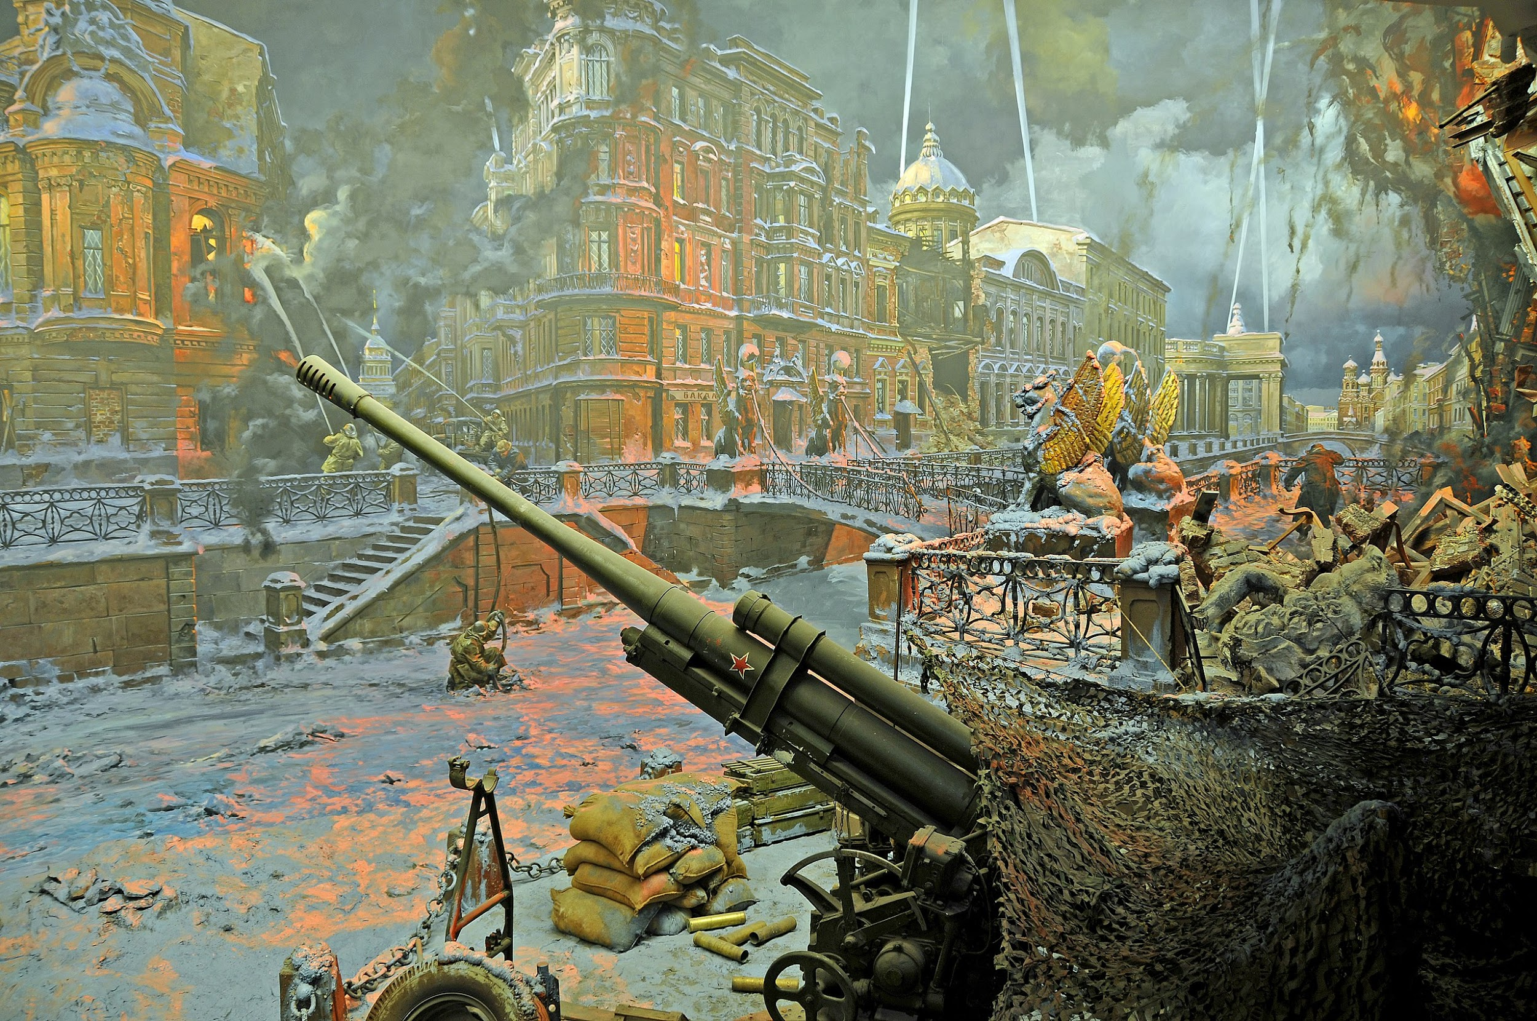
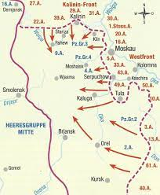
Prelude to Stalingrad
In September the Wehrmacht surrounded Leningrad
By November, Wehrmacht was at Moscow's doorsteps.
In December, Red Army launches counter-offensive pushing Nazis back 200 miles.

Slide 8
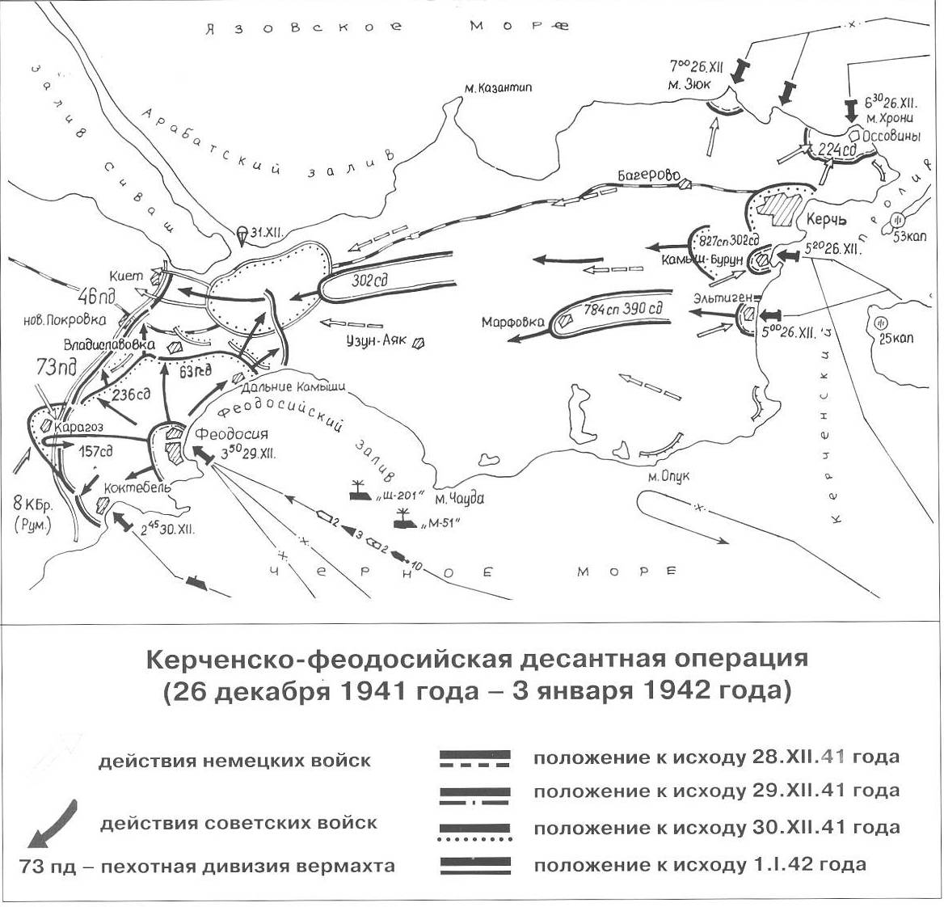
Prelude to Stalingrad
The whole of Crimea was in German hands by the fall of 1941
The Red Army landed 40k troops in the Kerch peninsula by the end of Dec 41.
In May 42 they suffered a disastrous defeat and retreated toward Russia.

Slide 9
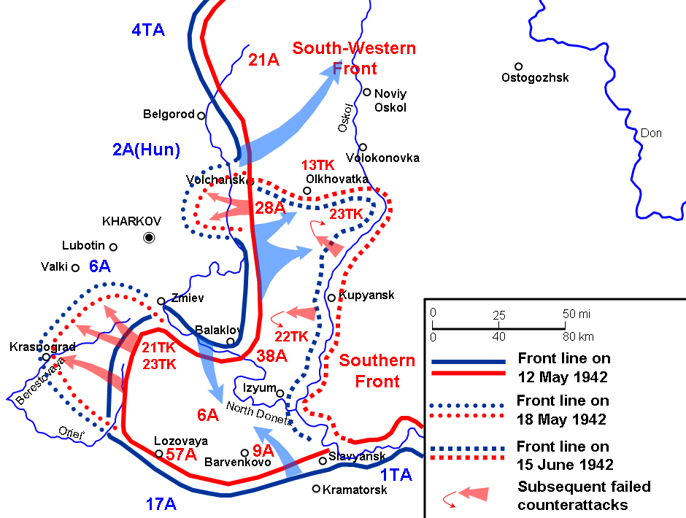
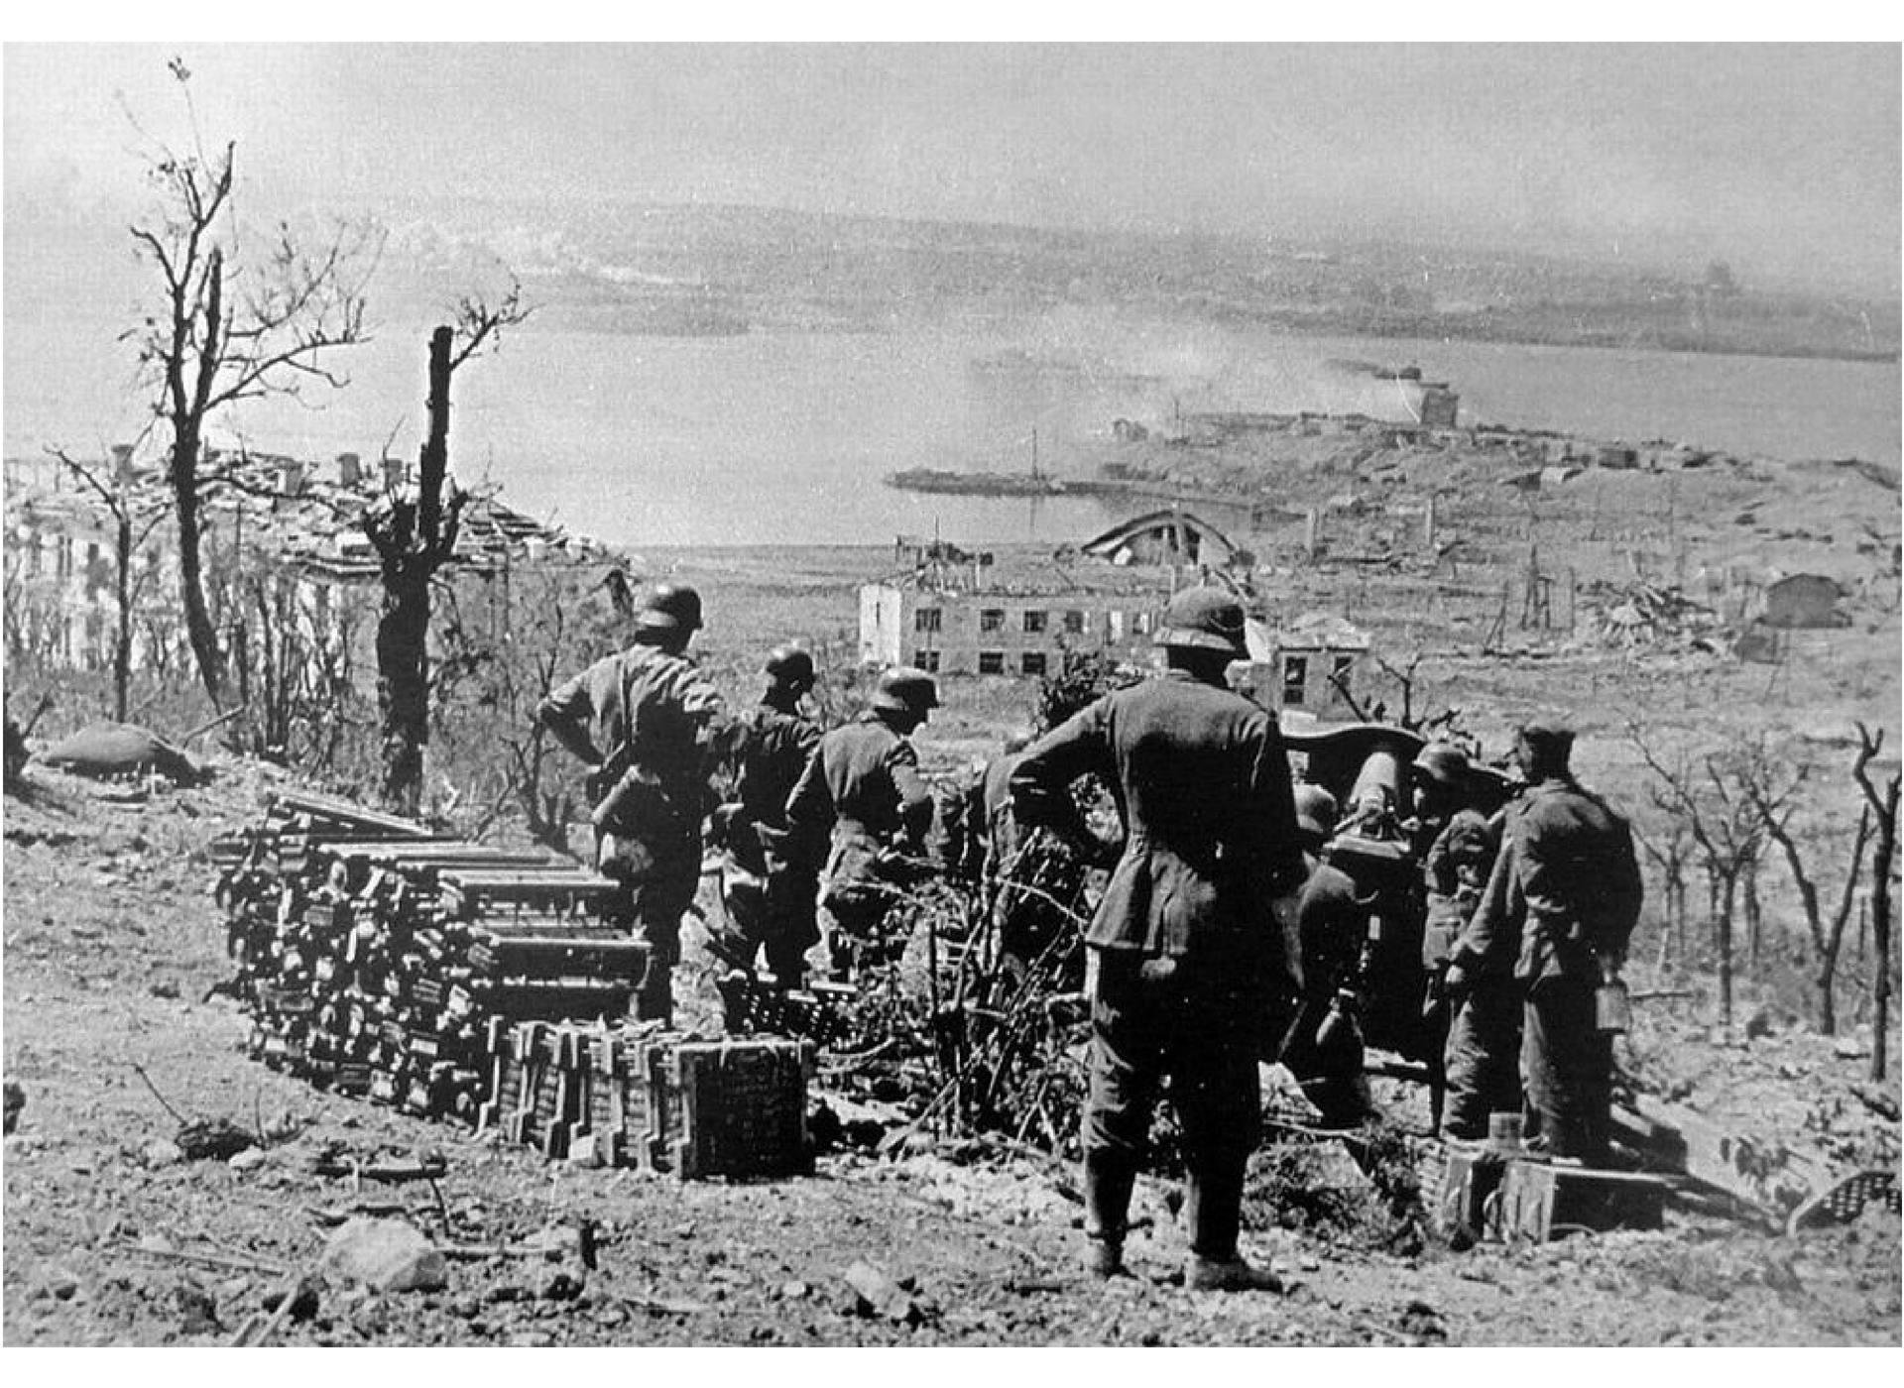
Prelude to Stalingrad
The Red Army suffered another defeat at Kharkov, which opened the Donbass to the Wehrmacht.
Finally the fortress of Sebastopol on the Black Sea in Crimea fell in June 42.
This was the Dark Summer of 1942, with 3 defeats in a row.

Slide 10
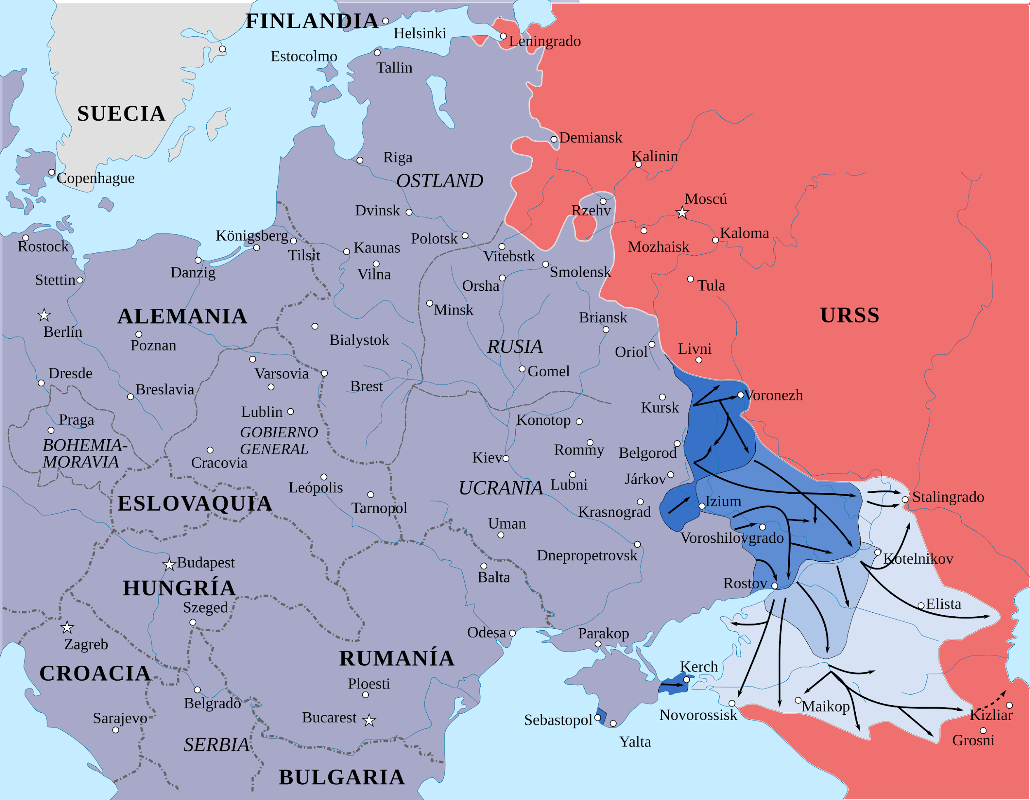
Prelude to Stalingrad
Hitler was now ready for Operation Blau:
Pushing to the Don and the Volga
Conquer Stalingrad
At the same time push toward the Caucasus and the Baku oil fields by the Caspian Sea.
Hitler believed it would bring Turkey into the war on Germany's side and also open the door to Iran, Iraq and ultimately India.

Slide 11
Discussion

Slide 12
Timeline of Stalingrad:
The Battle

Slide 13
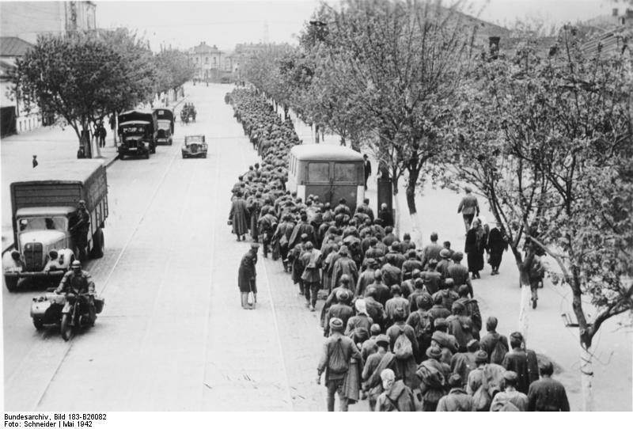
Battle of Stalingrad
The big German summer offensive began on June 28th, 1942 over a wide front.
The Donbass was overran and Lugansk fell on July 19th. Then Rostov by the Sea of Azov fell on July 24th.

Slide 14
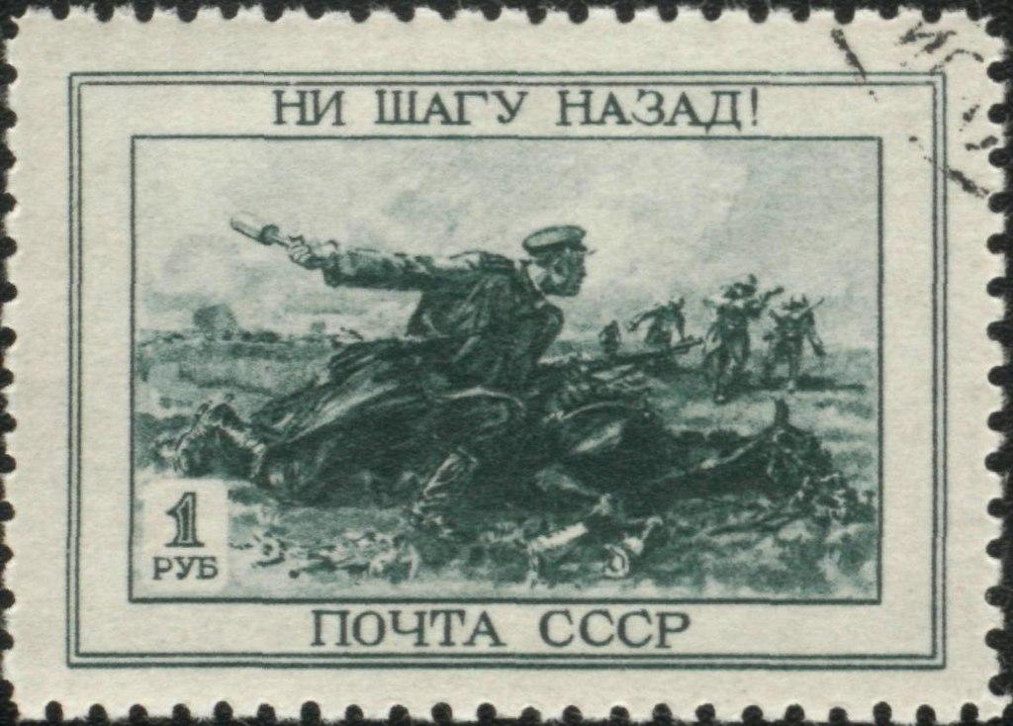
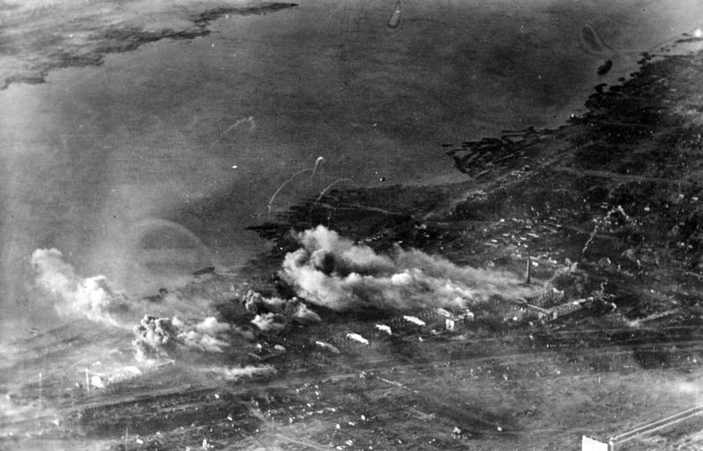
Battle of Stalingrad
Stalin then issued Order #227, known as "Soviet soldiers, not a step back!"
It energized the Red Army: "every soldier must be ready to die the death of a hero rather than neglect the duty to his country"
Thus began the Battle of Stalingrad
“Not One Step Back!”

Slide 15
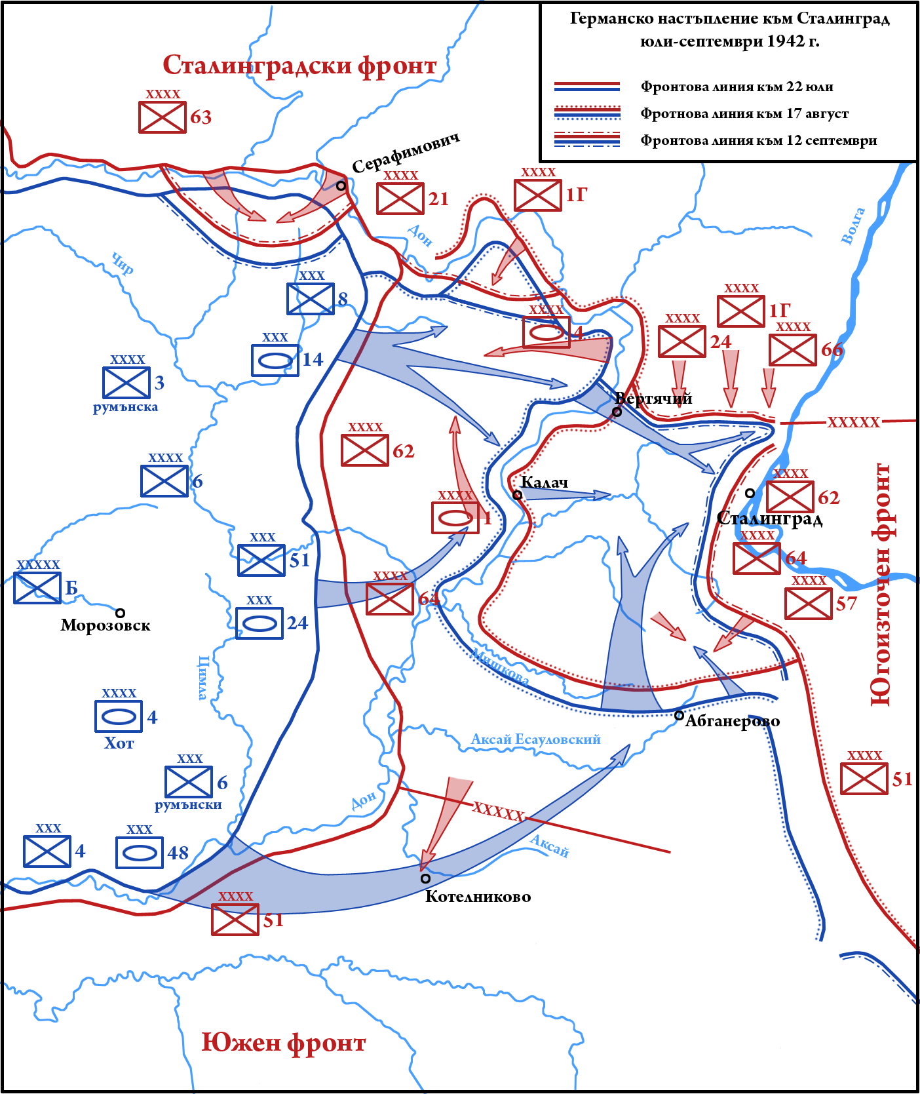
Battle of Stalingrad
Broadly speaking it may be divided into 8 stages.
1. July 17th, 1942-August 4th, 1942
The Red Army fought inside the Don Bend and slowed down the Germans, preventing them to capture Stalingrad in one sweep.

Slide 16
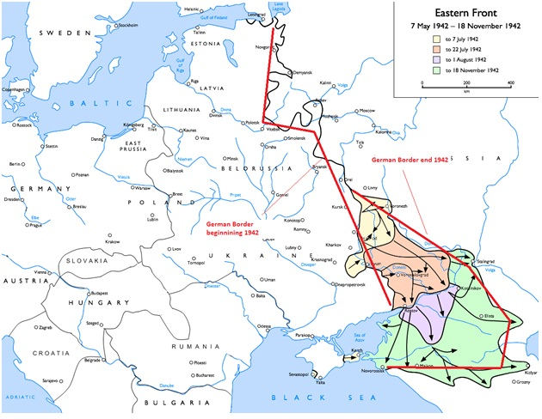
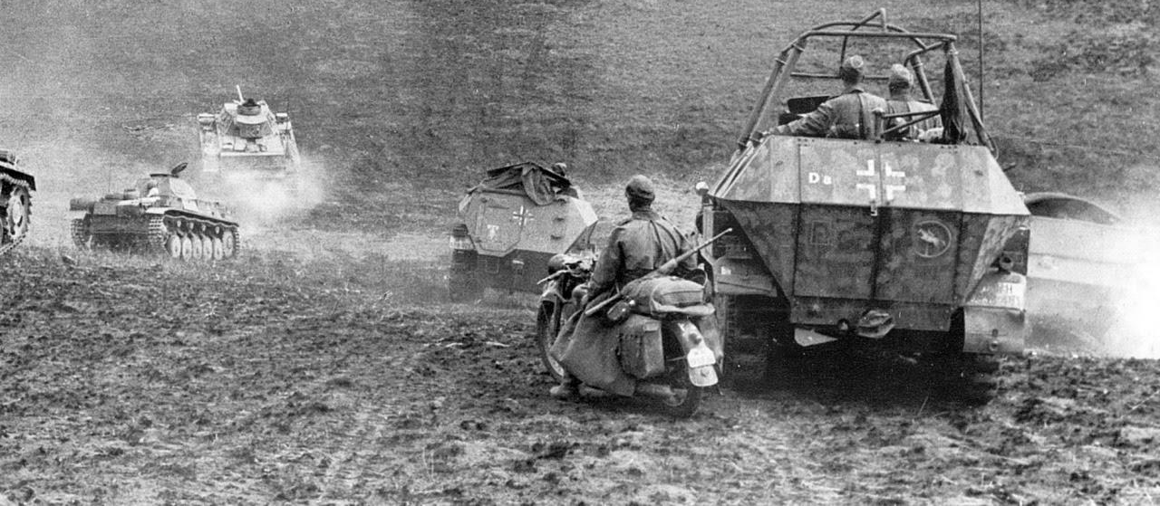
Battle of Stalingrad
2. August 5th, 1942-August 28th, 1942:
German 6th army conquers the whole inside of the Don bend and moves toward Stalingrad from 3 directions: south, west and north-west.
3. August 19th, 1942-September 3rd, 1942:
Intense fighting between the Don and the Volga. The German made it to the Volga just north of Stalingrad.

Slide 17
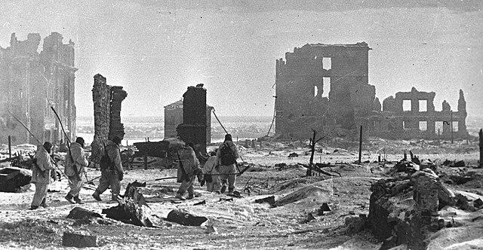
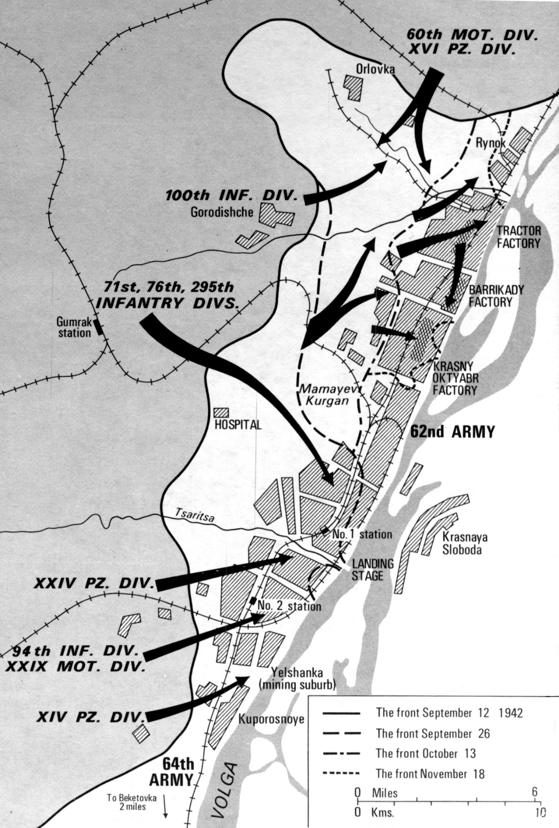
Battle of Stalingrad
3a. August 23rd, 1942
Hitler rounded up every single bomber of his entire Luftwaffe (air force) and ordered the leveling
of the whole city, killing 40k civilians.
4. September 4th, 1942-September 13th, 1942
Germans were able to squeeze the Red Army from the north and the south. The 62nd army of General Chuikov was now surrounded and isolated from the rest of Soviet forces, with its back on the western bank of the Volga.

Slide 18
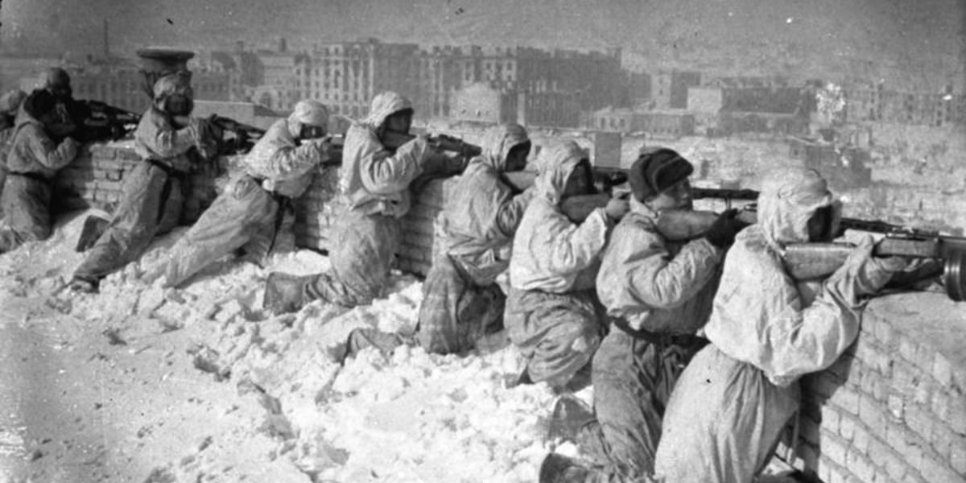
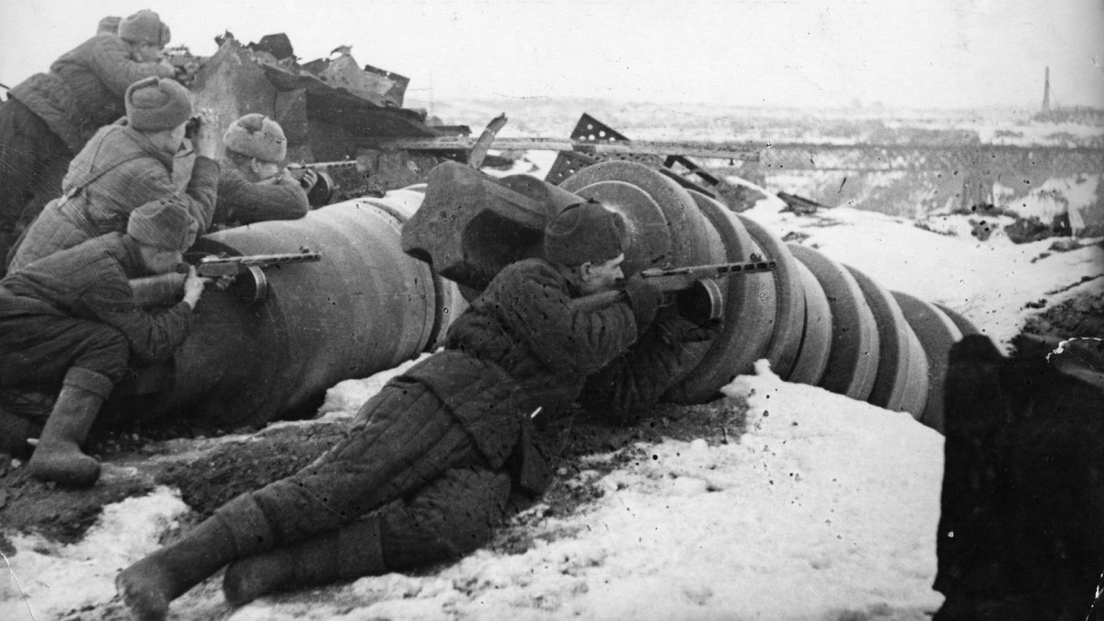
Battle of Stalingrad
5. September 14th, 1942-November 18th, 1942:
The historical legendary stage of the battle of Stalingrad.
The stage that set the defense of Stalingrad as one of Mankind's greatest feat of heroism, if not the greatest. A special place in History belongs to the Rodimtsev Division.

Slide 19
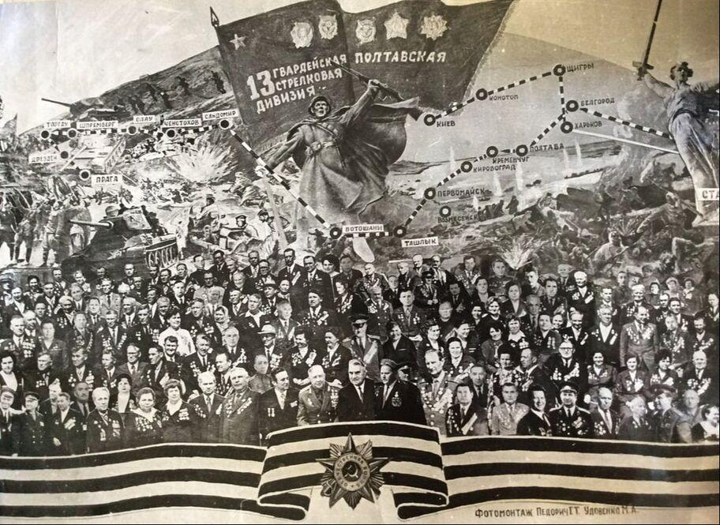
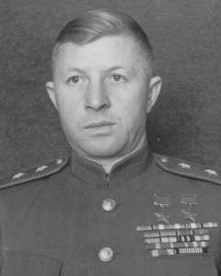
Battle of Stalingrad
5. September 14th, 1942-November 18th, 1942:
Alexander Rodimtsev commanded the 13th Guards Rifle Division, 10000 men strong. It entered battle on September 14th and was ordered to clear the center of Stalingrad and to occupy Mamaev Kurgan hill, which overlooks the entire city.
Within 24 hours of crossing the Volga, 3k Guardsmen had already died in combat.
It can be said that Rodimtsev's Guardsmen saved Stalingrad. Out of 10k 13th Guardsmen who crossed the Volga, only around 300 survived.

Slide 20
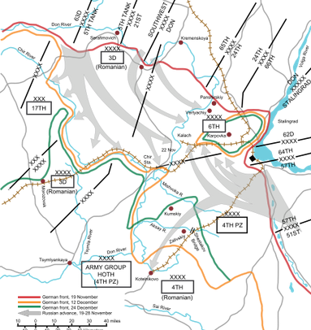
Battle of Stalingrad
6- November 19th, 1942 to December 11th, 1942:
Stalin, Zhukov and Vassilevsky conceived a master plan.
The Red Army launched a counter offensive that destroyed Italian, Romanian and German troops outside Stalingrad and trapped the 6th army into a cauldron. It was the beginning of the end for Hitler's crack army.

Slide 21
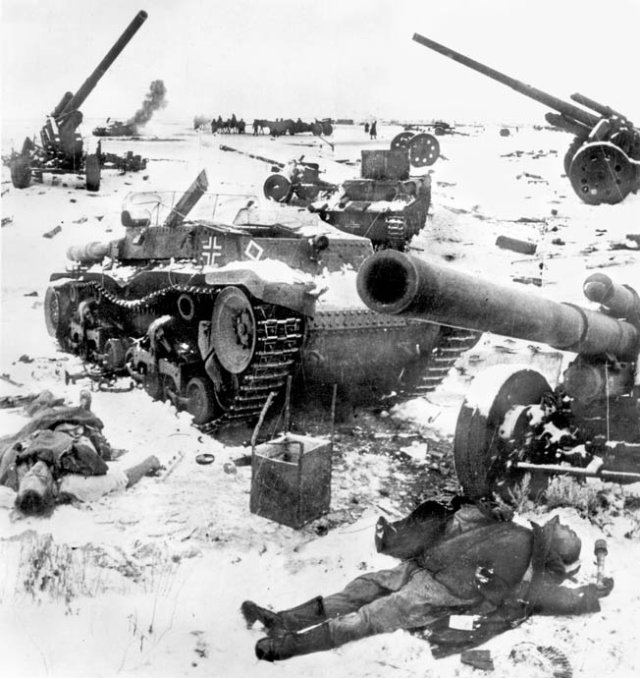
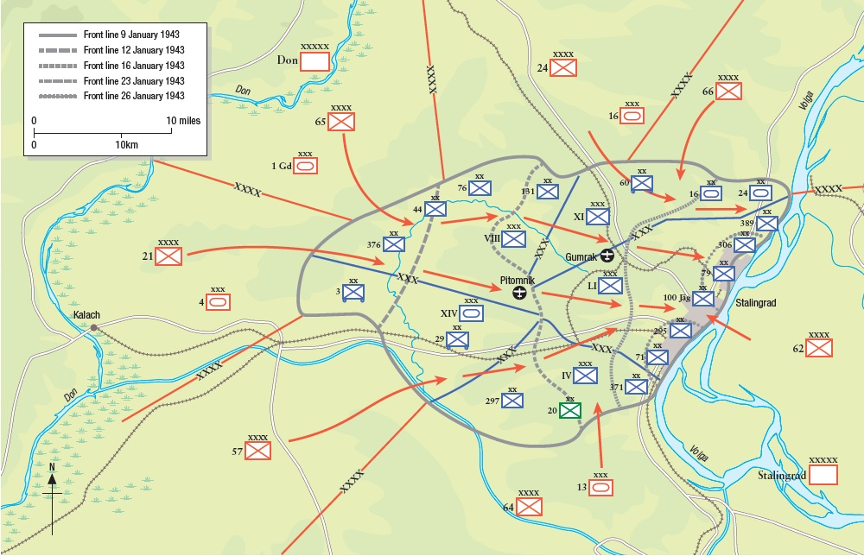
Battle of Stalingrad
7. December 12th, 1942-January 1st, 1943:
The failed attempt of the Wehrmacht to rescue the encircled 6th army, the enlargement of the ring around Stalingrad and the final destruction of Italian Alpini troops in the Don region.
8. January 2nd, 1943-February 2nd, 1943:
The agony of the 6th army and its final liquidation inside the Stalingrad cauldron. On January 8th, Rokossovsky offered Paulus a capitulation. It was rejected.

Slide 22
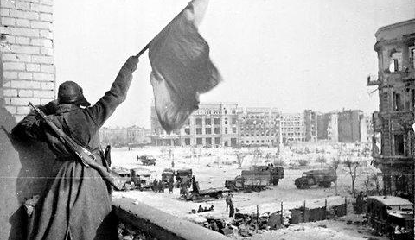
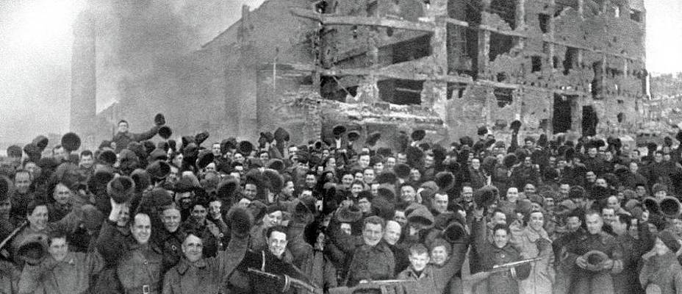
Battle of Stalingrad
8. January 2nd, 1943-February 2nd, 1943:
On Jan 10th the Red Army unleashed 7000 guns and mortars on the Germans who suffered enormous casualties.
Another offer at surrender was rejected on the 17th. Final assault began on the 22nd. Some German troops surrendered in groups.
On the 30th, Paulus asked Hitler by radio for permission to surrender. The response was no, Field marshal Paulus capitulated the next day, and what remained of the 6th army surrendered on February 2nd.

Slide 23
Discussion

Slide 24
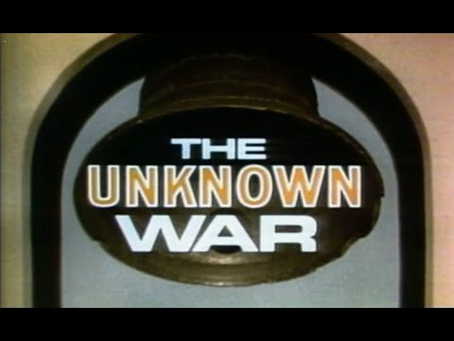
The Unknown War (1978)- Part 5 Defense of Stalingrad

Slide 25
Discussion

Slide 26
New Member Introductions
What is your name, pronouns and state (or country/territory)?
Where do you work? Is it unionized?
How did you find out about the People’s School?
What do you think about tonight's class?

Slide 27
The Unknown War (1978)- Part 6 Survival of Stalingrad

Slide 28
The Unknown War (1978)- Part 6 Survival of Stalingrad

Slide 29
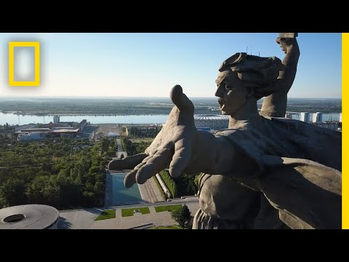
The Story Behind Europe's Tallest Statue: The Motherland Calls

Slide 30
Discussion

Slide 31
Volunteers Needed!
We are in need of volunteers for the staff of the People’s School! Here’s a few roles we need filled:
People to help manage posting on our social media and podcast platforms
Video Editors, Audio Editors, Graphic Designers, Artists, Narrators
Facilitators, Web Controls, Moderators
Email info@peoplesschool.us if you’re interested and try to attend our next staff meeting on Feb 2nd if possible.

Slide 32
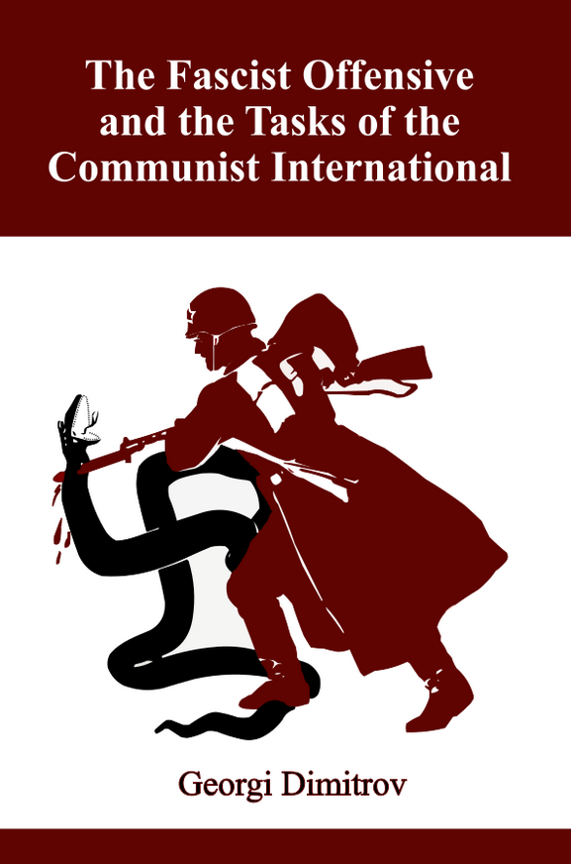
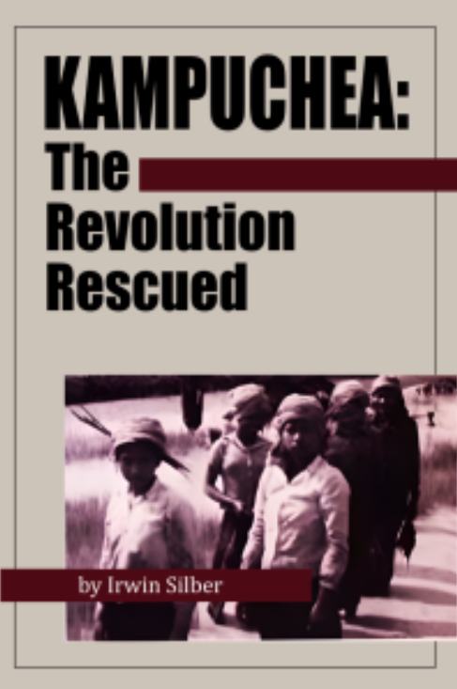
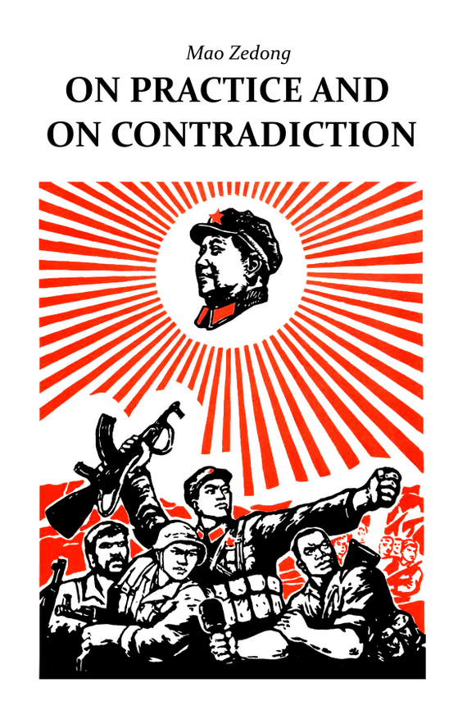
New Outlook Publishers
newoutlookpublishers.store
Related to Class | Latest Releases

Slide 33
Legal Drive
Last year we were attacked and sabotaged by wreckers that tried to steal the PSMLS and destroy the PCUSA.
They failed, but they will be held accountable and there are still things they took from us that we’ve not got back, like videos, imagery and audio. That is why we still need donations to the legal drive.
To donate, go to partyofcommunistsusa.net/donations/
Put “For legal funds” in the details box and try to donate on Tuesday or Thursday so it is easier for us to sort through. It will go to the legal fund. Anything helps!

Slide 34
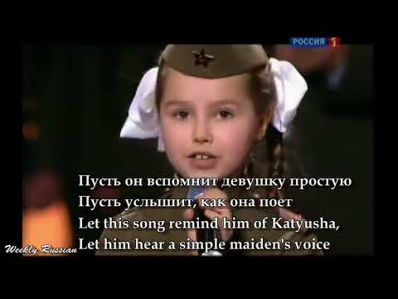
Катюша - Katyusha

