Slide 1
Multipolar New World Order Coming to be is background of West’s war on Russia & China
Economies of BRICS nations & others abandoning use of USD
Multiple non-western multinational organizations dominating international affairs
BRICS
Shanghai cooperation organization
Eurasia Economic Union
China’s Belt and Road Initiative
Alba
Notes:
‹#›

Slide 2
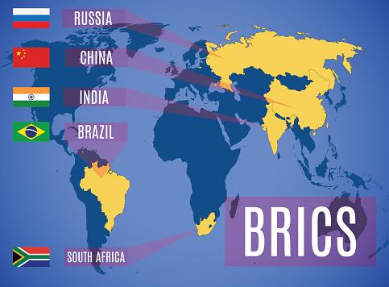
r
Notes:
‹#›

Slide 3
BRICS
Brazil, Russia, India, China, South Africa
Spans four continents
26% of world land surface
41% of world population
BRICS payment system in development since 2015—alternative to SWIFT
-- > 12 countries seek membership, incl. Argentina, Iran, Algeria, Saudi Arabia
Eu has declined against all BRICS currencies in 2022
Notes:
‹#›

Slide 4
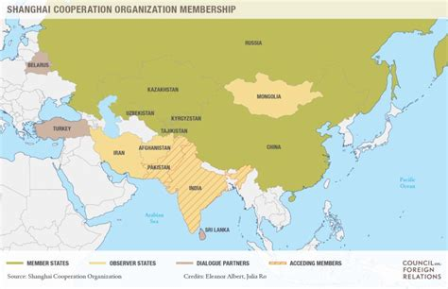
Notes:
‹#›

Slide 5
Shanghai cooperation organization
Include nearly all of Asia, plus part of E. Europe
3 ½ billion people
Unites 20 states, with 5 more applying
China, Russia, Kazakhstan, Kyrgyzstan, Tajikistan formed Shanghai Five in 1996
= China & five former Soviet states
Uzbekistan joined to form SCO 2001
India, Pakistan joined 2017
Iran, Belarus applying
Copyright 2014 by Robert Gallagher
Notes:
‹#›

Slide 6
Russia Offers SWIFT Alternative to Trade Partners
Moscow’s alternative is offered to 18 members & partners of the SCO in a bid to exclude the USD & Eu & boost settlements in national currencies.
“In order to ensure uninterrupted cooperation between our banks, we suggest that members of the organization join the Russian financial messaging system,” Economic Development Minister Maxim Reshetnikov said in an address to the SCO
Copyright 2014 by Robert Gallagher
Notes:
‹#›

Slide 7
BRICS and SCO show that an alternative world order is coming to be.
BRICS needs to call for an international conference to form a new monetary system to replace the Bretton Woods system.
Copyright 2014 by Robert Gallagher
Notes:
‹#›

Slide 8
Europe: From Gladio to Ukraine

Slide 9
Operation Gladio
Formed in 1956, Operation Gladio was the name for clandestine “stay behind” armies of fascists that were stationed in NATO countries as well as other countries considered neutral at the time (Switzerland, Greece, etc.)
These were built in the event of a “Soviet invasion” of Western Europe but would also be used to intimidate and kill members of the left that were projected to win in Parliament. After the counter-revolution in the Soviet Union in 1991, Gladio forces shifted eastward to oppose Russia in particular.
These armies would then go on to carry out terrorist attacks against civilians and blame it on the left so the population would lose confidence in the left as well as look to the current state for greater protection.

Slide 10
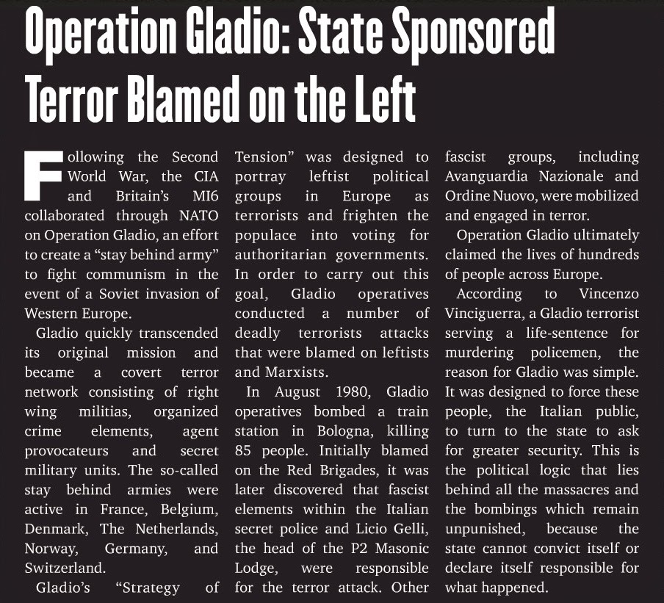

Slide 11
NATO's Drive Eastward
West Germany would be the last country to join NATO in 1955 until Spain in 1982.
After the counter-revolution of the USSR, starting in 1999, 14 countries would join NATO over the next 21 years. Fascists militias from World War II were reactivated when these countries joined NATO.
Estonia, Latvia, and Lithuania all share a border with Russia. The only countries separating the rest of NATO from Russia are Belarus and Ukraine.
NATO’s eastward expansion violates the promise made to Gorbachev not to expand past their 1991 border.

Slide 12
US-backed Coup in Ukraine
The US had a strategic advantage to undermining the government in Ukraine and installing one that was anti-Russian.
Joe Biden and other top US officials were mentioned in a leaked phone call between Victoria Nuland and Geoffrey Pyatt regarding Ukraine and the best way to manipulate the situation.

Slide 13
Biden's Involvement
President Joe Biden has personally been involved with the ongoing conflict in Ukraine since at least 2014 along with Hunter Biden. When his son was to be investigated, he saw to it that the Ukrainian prosecutor was fired otherwise the then Obama administration would pull up to a billion dollars in loan guarantees from Ukrainian president Petro Poroshenko.
"'You’re not getting the billion'. I’m going to be leaving here in, I think it was about six hours. I looked at them and said: ‘I’m leaving in six hours. If the prosecutor is not fired, you’re not getting the money'...Well, [SOB], he got fired. And they put in place someone who was solid at the time." - Biden at the House of Foreign Relations

Slide 14
Democrats Fully Support War
Democrats have been the most vocally supportive of the proxy war in Ukraine.
Many of them including AOC, Bernie Sanders, and “the squad” vote yes on massive bills to send billions of dollars to Ukraine
Near the end of October, the Progressive Caucus released a letter urging Biden to seek diplomacy with Russia which was later retracted and clarified that they still support sending military aid to Ukraine.
Ilhan Omar called those seeking an end to the war “dangerous propagandists”, Bernie when confronted asked, “who's paying you?”

Slide 15
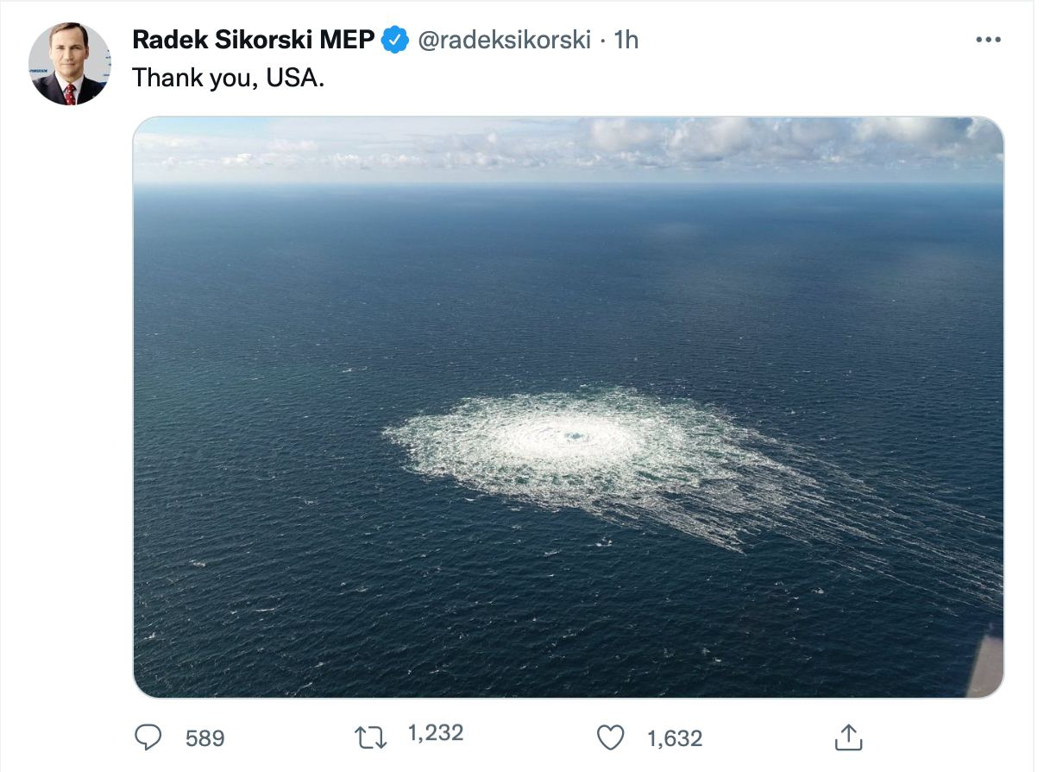
Europe's Energy Crisis
Nord Stream 2 was an effective way to get gas to Germany and therefore the rest of Europe.
This proves problematic for the US during the Russian Special Military Operation. If Europe is able to continue receiving gas from Russia, American influence would be lost and countries would forge closer ties to Russia.
NATO would end up blowing up both of the Nord Stream pipelines to retain control.
Currently, Europe is without an alternative plan for the winter and many people will suffer as the US attempts to keep control
Norway may open its own pipeline to Germany (Baltic pipe)

Slide 16
Mass Demonstrations
Many citizens in Europe have protested against the current hold US imperialism has on their countries. (pictured: demonstration in Prague, Czech Republic)
These demonstrations have criticized their countries’ involvement in NATO.
Americans too are feeling the effects of the US proxy war in Ukraine as over half of the population do not want us funding a war.

Slide 17
Pyotr Simonenko
“As we believe, the war of Donbass against the Kiev regime should be considered as national liberation struggle, in essence, a war for independence from the ruling fascist regime, for the right of the people to speak their native Russian language and not to follow the anti-Russian course imposed by the United States.
Hence, on the basis of Marxist theory, the military conflict in Ukraine should not be considered as an imperialist war in a literal sense of the word, and moreover in view of Russia, it is considered as the struggle against an external threat to national security and fascism.” - First Secretary of the Communist Party of Ukraine Pyotr Simonenko at the XXII Meeting of Communist and Workers’ Parties, Havana, Cuba, October 2022

Slide 18
Ukraine's Attempt to Provoke NATO
On November 15th a missile landed in Poland killing two farmers. Ukraine would go on to blame Russia for the attack while the next day, Poland and the US would admit the missile did not come from Russia. Zelensky would go on to double down and deny the missile came from Ukraine.
The situation caused many NATO countries to call for Article 5 (collective defense), but was quickly de-escalated as the truth about the matter came out.

Slide 19
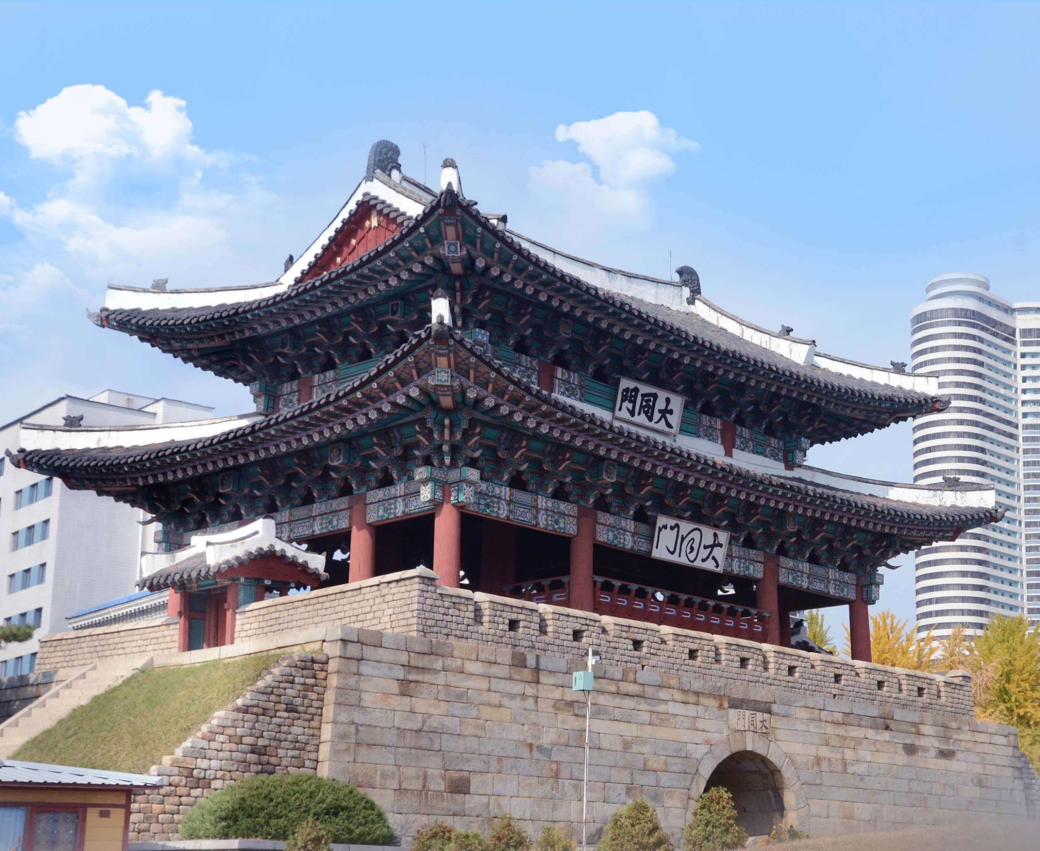
The Mutlipolar World - East Asia

Slide 20
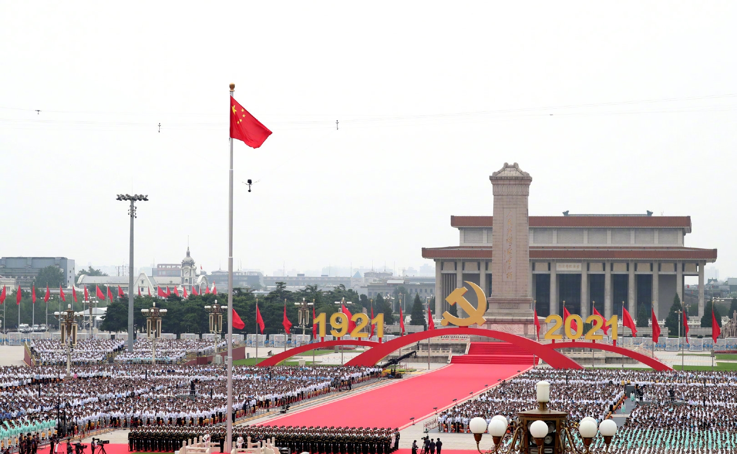
Section I - China

Slide 21
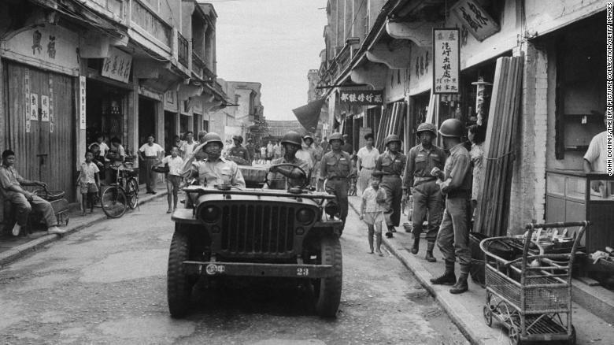
Taiwan
Despite nominally recognizing the “One China” policy, the US has long supported Taiwan separatist elements.
The US even considered using nuclear weapons against China during the 1958 Taiwan Strait crisis.

Slide 22
Taiwan (cont’d)
Recently, US-China tensions over Taiwan have only escalated.
The US has sold billions of dollars worth of weapons to Taiwan.
The number of American military personnel in Taiwan nearly doubled in 2021, and American warships continue to pass through the Taiwan Strait.
US Speaker of the House Nancy Pelosi’s recent trip to Taiwan was a provocation that has only worsened the situation.
American think tanks like the American Enterprise Institute are now calling for providing nuclear weapons to Taiwan as a “deterrent”.
“Advanced semiconductors are the petroleum of the digital age”

Slide 23
People in Taiwan protesting Pelosi’s visit

Slide 24
Taiwan (cont’d)
All of these aggressions are part of an attempt by the US to halt the rise of China while it still can.
In October, the Biden administration blocked China from importing semiconductors, “the petroleum of the digital age”.
Taiwan controls a major portion of the global semiconductor industry, which is part of why the US is trying to drive a wedge between it and mainland China.

Slide 25
Xinjiang - Intro
As part of its continued attempt to demonize the PRC, Western media has also invented the narrative of the “Uyghur genocide” in Xinjiang.
This misinformation states that the Uyghurs, who reside primarily in Xinjiang province, have been rounded up into concentration camps by (predominantly Han) Chinese in an act of genocide.
Ultimately, the sources most commonly cited for this myth are the CIA-cutout Radio Free Asia and Adrian Zenz, whose stated motivation is that he believes he is “led by God” to oppose the CPC.

Slide 26
Xinjiang – cont’d
In reality, the Muslim Uyghurs have been the target of ongoing attempts at radicalization by anti-China forces, including the US.
The CPC was obliged to respond amidst the resulting sharp untick in acts of terrorism in China with a program for deradicalization.
In the next slide, United States Army Colonel Lawrence Wilkerson makes this clear when he explains why the US has remained in Afghanistan, which borders Xinjiang province.

Slide 27
“Why the US Is Still in Afghanistan”

Slide 28
Xinjiang – UN Human Rights Council Rejecting Debate
In a promising indication that internationally the flimsy narrative of the Uyghur genocide is being seen through, the UN Human Rights Council rejected a motion to hold a debate on China’s policies in Xinjiang.
This is a rare occurrence, with the motion being only the second motion to be rejected in the entire history of the UN Human Rights Council.

Slide 29
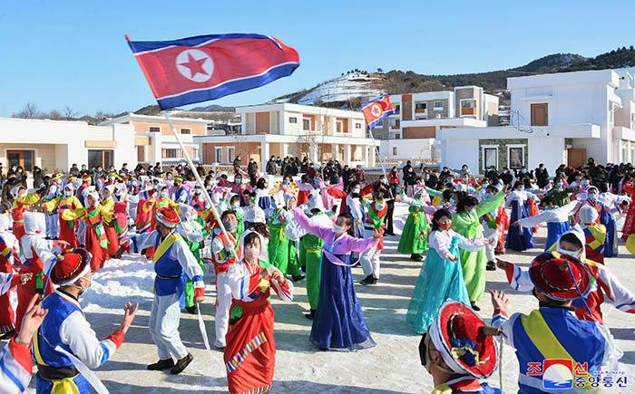
Section II - DPRK

Slide 30
DPRK vs South Korea
Recently the DPRK (North Korea) has come under fire yet again in the Western media for their nuclear tests and missile launches.
What is not mentioned is the imperialist aggressions which have necessitated the DPRK’s nuclear deterrent.
What is not mentioned is the imperialist aggressions which have necessitated the DPRK’s nuclear deterrent.

Slide 31
DPRK vs South Korea
In October 2022, the US and South Korea conducted the largest joint air drill in the history, which has been termed Operation Vigilant Storm.
This operation emerged after a series of escalations in military activity in occupied Korea, which also included the “Ulji Freedom Shield” field mobile drills as well as large-scale joint naval exercises.

Slide 32
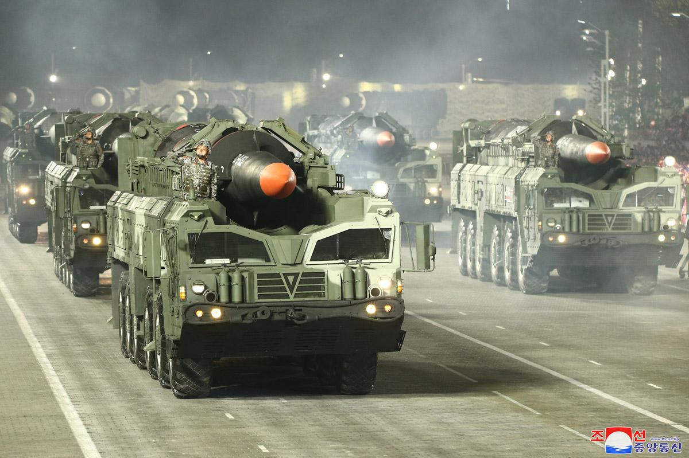
DPRK vs South Korea
At this point, the forces of occupied Korea are openly talking about practicing pre-emptive strikes against the DPRK.
These actions have been sharply condemned by the Foreign Ministry of the DPRK, which has stated that the “U.S. nuclear war scenario against the DPRK has entered the final stage.”

Slide 33
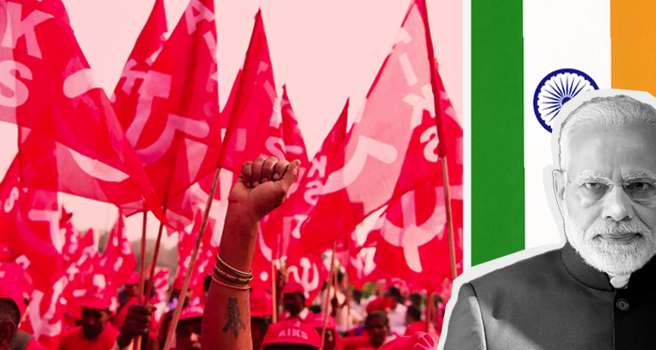
Section III - India

Slide 34
India - Background
Privatization and neoliberal economic policies have accelerated in India ever since the counterrevolution in the Soviet Union in 1991.
The impact on the Indian peasantry has been particularly severe, with hundreds of thousands of peasants committing suicide in the last 15 years because competition with multinational corporations has left them unable to continue making a living.

Slide 35
India – Three Black Farm Laws
Recently, the ruling Hindu Nationalist Bharatiya Janata Party (BJP) under Narendra Modi had enacted the Three Black Farm Laws, which sank India’s agricultural sector deeper into neoliberalism.
The laws removed price controls on crops, facilitated private monopoly control of the agricultural market, and reduced other state interventions which protected the livelihood of India’s peasantry.

Slide 36
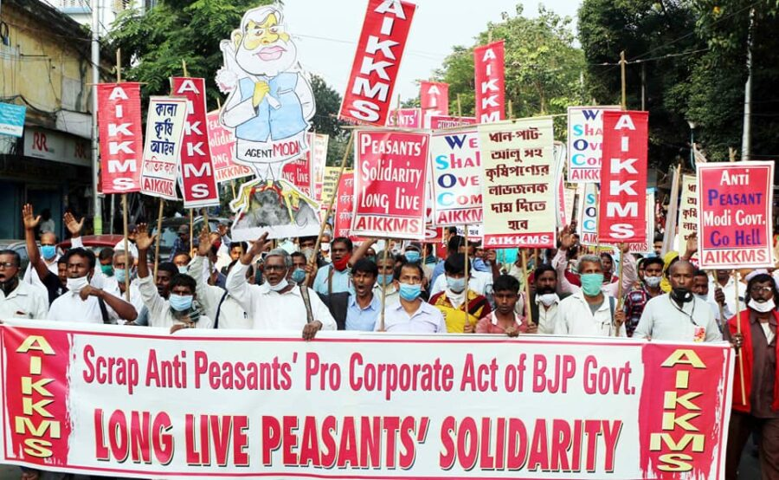
India – The Peasant Movement
The peasants and allied workers have responded with protests at an unprecedented scale against the Three Black Farm Laws.
The All-India Kisan Khet Mazdoor Sanghathan (AIKKMS), associated with the Socialist Unity Center of India (Communist), has taken a leading role in organizing the peasants to fight back.

Slide 37
India – Tentative Victory and the Future
Despite immense struggle from the BJP government, Modi capitulated in November 2021, announcing that the Three Black Farm Laws would be withdrawn.
This has been a great victory for the Indian peasant movement and a sign of a shift in power towards the masses, but there is still much work to be done.
Class consciousness has flourished in India through the struggle, but the workers and peasants will need to maintain unity in the face of the inevitable growing fascist threat as capitalism continues to decay.

Slide 38
Q&A

