Slide 1
The Middle East and its relationship to the grand Geopolitical Struggle
Israel and its relationship to Palestine, Lebanon, Syria, and Iran
Arab Nationalism and national liberation
The supposed “War on Terror”
Arab Spring(particularly in Egypt, Lebanon, and Syria)
Saudi Arabia and its proxy conflicts with Iran as well Yemen Crisis
Iran’s historical relationship with the West
The move towards realignment of the Gulf States away from the West and toward BRICS

Slide 2
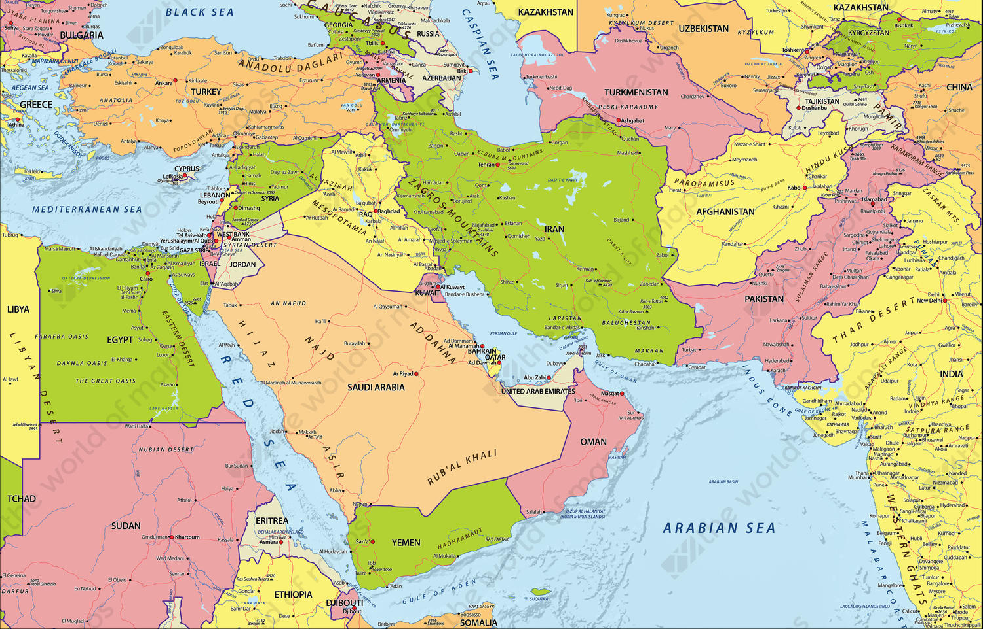

Slide 3
Though an interesting history for the Middle East and for giving some context for the current situation in the Middle East, it is sufficient to say that the Ottoman Empire created a relative unity in Southeast Europe and the Middle East from the 14th century until its dissolution in the early 20th century.
From 1878 to the end of the first World War, the rapid decline of the Ottoman Empire was due to its imperial rivalries with the Western European powers and with the Russian Empire.
After losing WW1 alongside the German led Central Powers, the lands of the former Ottoman Empire were divided up among the Triple Entente, particularly by the British Empire.

Slide 4
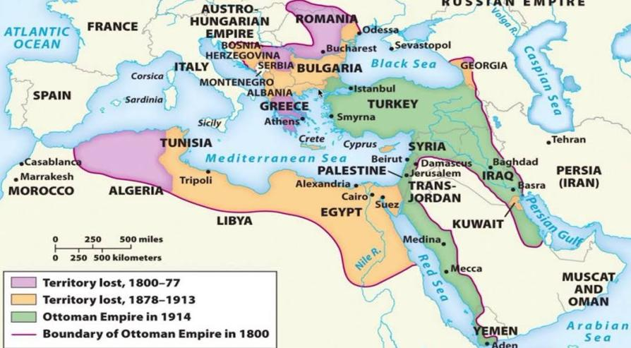
Decline of the Ottoman Empire

Slide 5
Israel
In 1917, Arthur Balfour issued the Balfour Declaration which would lay the foundations for the creation of the British Mandate of Palestine
After the Great Depression, dissatisfaction without answers and the lack of organizing from the Communists in Germany led the masses to the Nazi movement which scapegoated Jewish people for the loss of the German Empire. The pogrom known as Kristallnacht(Night of broken glass) as well as the systematic genocide of 6 million Jews and the mass exodus of millions more further intensified the Zionist sentiment in the Jewish European populations.
In 1948, the British Mandate of Palestine formally ended. With the British out of Palestine, the State of Israel had free reign to expand into Palestinian land.
Though initially a refuge for persecuted Jewish Europeans, the idea of Zionism would be taken advantage by Western Imperialists in their pursuit of a loyal stronghold in the Middle East and the Suez Canal.

Slide 6
Gamal Abdul Nasser and Arab Nationalism
Nasser led Egypt from 1956 to his death in 1970.
Nasser’s main goal was to unite the Arab world(Middle East and North Africa) under a common language, cultural, and historical identity.
Nasserism is sometimes called Arab Socialism. The ideology adopts certain aspects of Marxism such as national liberation, anti-imperialism, and nationalization of key industries. It however rejects class struggle and abolition of private ownership over the means of production. It also integrated principles of Islam while rejecting a sectarian state in favor of a Muslim(Sunni,Shia,Alawite) republic that encompasses the whole Arab world.
Nasserism as well as its related but competing ideology, Ba’athism plays a strong role in National Liberation movements in the region even today.

Slide 7
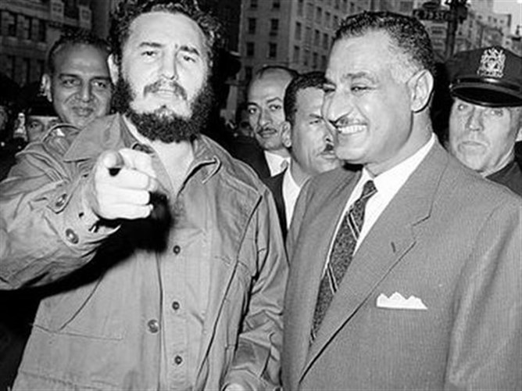
Gamal Abdul Nasser with Fidel Castro in New York, September 28th 1960

Slide 8
Iranian National Liberation
Iranian National liberation sentiments became popular with frustration against the Shah Mohammad Reza Pahlavi who led the Imperial State of Iran from 1941-1979.
Under the Shah, Iran was a neo-colony dominated by British and U.S. petroleum interests.
In 1951, Mohammad Mosaddegh led a revolt which overthrew the Shah. The goal was to nationalize Iranian Oil industry. Under Mosaddegh, the Tudeh Party(The pro-Soviet Iranian communist party) reached its apex and had great influence over society and politics.
In 1953, that all ended when a CIA and MI6 backed coup overthrew the Mosaddegh government.
After the coup, the Shah was more authoritarian and cracked down on the Tudeh Party.
In 1979, Iran underwent another Revolution. This time overthrowing the Western aligned Shah for the Islamic Republic of Iran under the Ayatollah Ruhollah Khomeini and succeeded by Ali Khamenei who still leads Iran today

Slide 9
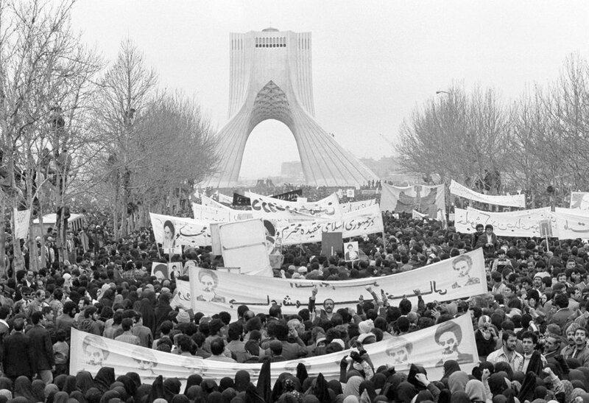
Hundreds of thousands of supporters of Ruhollah Khomeini and the Iran Revolution: February 8th 1979

Slide 10
After Iran Revolution of 1979
Since the Revolution of 1979, the U.S. and its allies continue to wage war against Iran whether economic sanctions, proxy wars such as the 8 year long Iran-Iraq war of 1980, and information wars.
A year after the National Liberation of Iran, the Iran-Iraq war broke out over the Shatt-al-Arab river disputes. The war was initiated when the then CIA friendly Saddam Hussein invaded Iran. The result of the war was an estimated 1-2 million dead on both sides and a combined cost of $1.2 trillion. This war was devastating to the new Iranian republic.
Despite Iran’s adherence to the Joint Comprehensive Plan of Action(aka Iran Nuclear Deal) and the allowance of the International Atomic Energy Agency’s(IAEA) surveillance of Iranian nuclear production, the US backed out of the deal in 2018. To this day, the US continues to sanction Iran and calls for tougher sanction despite the deal to lift sanctions with Iranian compliance with the JCPOA.

Slide 11
Undermining Iran
In January 2020, tensions between the US and Iran increased after the assassination of Iranian General Qasim Soleimani by the US during Soleimani’s visit to Iraq.
In 2021, a chain wave of protests that continue to this day began in Iran. In 2021, the protests were over economic hardship the country faced while under sanctions by the international community. In September 2022, protests broke out after the death of Mahsa Amini who was detained by police. The protests started out as a legitimate frustration against Iranian Morality Police but immediately had the support of the U.S. state department calling for demands for regime change and a return to a pre-1979 Shahdom.
Unsurprisingly, these protests began and gained momentum just weeks after Russian President Putin and Iranian Ayatollah Khamenei met in Tehran to strengthen strategic alliances.

Slide 12
“War on Terror” and the Arab Spring
After decades of destabilization efforts by the US in the middle east, the Wahhabist terrorist organization Al Qaeda, which was a group in the CIA backed Mujahideen to overthrow the Saur Revolutionary government in Afghanistan, committed the September 11th attacks in 2001. Though Al Qaeda had direct ties to the Saudi kingdom, no war broke out between the US and its ally. Instead, the US began campaigns in Afghanistan which was under the control of the Taliban, another group in the CIA-backed Mujahideen. The War on Terror as it was dubbed was declared on what President Bush called the Axis of Evil(the non-alignment movement). The wars which spread into Syria as a civil war, the ongoing Yemeni crisis, the Arab Spring which toppled leaders like Libya’s Muammar Qaddafi, etc has led to a cost of upward of $21 trillion and estimated lives lost at over a million.

Slide 13
“Saudi Arabia and its shift toward China and Russia
Though Saudi Arabia has long been a loyal ally to the US, Israel, and the NATO European states. As of 2022, developments that have seemingly come from left field are threatening the US hold on the Unipolar “rules based” order. As of March 2022, the Saudi government has made strides towards the Russian-China alignment by accepting trade deals in the Chinese Yuan. Saudi Arabia, along with Turkey, Egypt and the United Arab Emirates, have expressed interest in joining the economic cooperation Bloc called BRICS(Brazil, Russia, India, China, and South Africa).

Slide 14
Discussion

Slide 15
Peace and Solidarity
Latin America

Slide 16
Latin America in the 20th century – Fascism, Neoliberalism and the Washington Consensus
In the 20th Century, the US has backed over 50 coups. In 1973, Chillan President Salvador Ellende was overthrown by a fascist led, CIA-backed coup that put in the dictator Pinochet. Countries in Latin America were put into economic turmoil through American imperialism, oil crisis, and suppressing popular worker and socialist movements which led to neoliberal policies through the IMF and free market capitalist ideology. Organization of American States, was founded in 1948 to suppress Soviet alliances in Latin America While communist movements had been suppressed by the US and its fascist allies in Latin America, from the early 2000s, there was a socialist’s leaning, “Pink Tied” movement that criticized the policies of the US and elected social democratic parties.

Slide 17
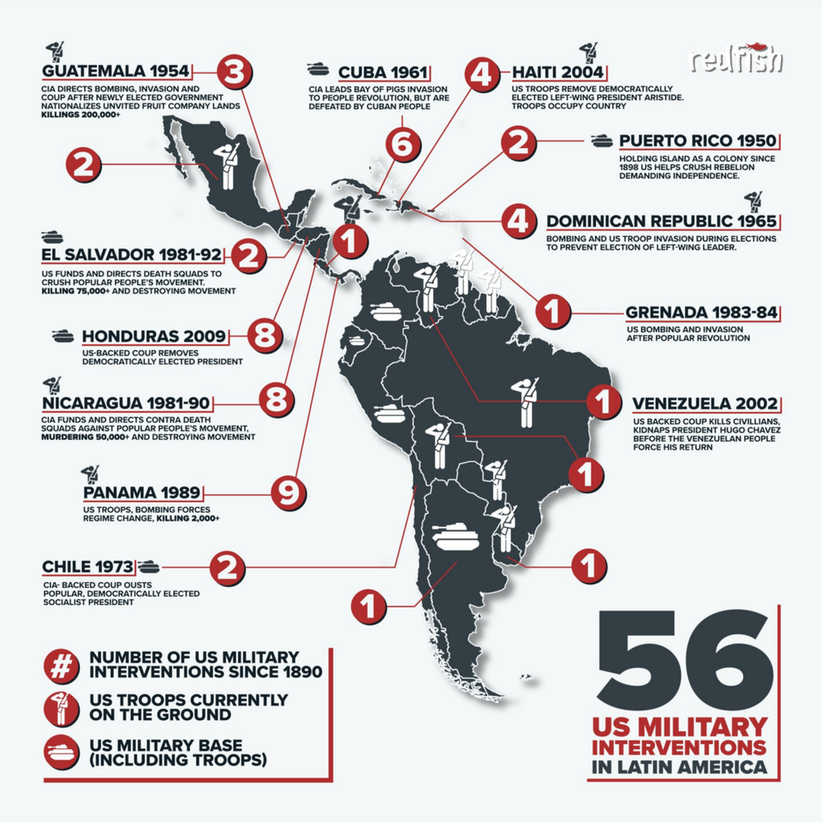
A Brief History of American backed coups
U.S. declared war on Spain in 1898 and captured the Philippines, Puerto Rico, and Cuba.
The United States often used military intervention to force the small nations of Central America and the Caribbean to repay loans owed to banks in Europe or the United States.
The United States occupied Cuba, the Dominican Republic, Nicaragua, Honduras, and Haiti on various occasions during the late nineteenth and early twentieth centuries.
Panama Canal—finished in 1914
Occupied Nicaragua from 1912 to 1931.

Slide 18
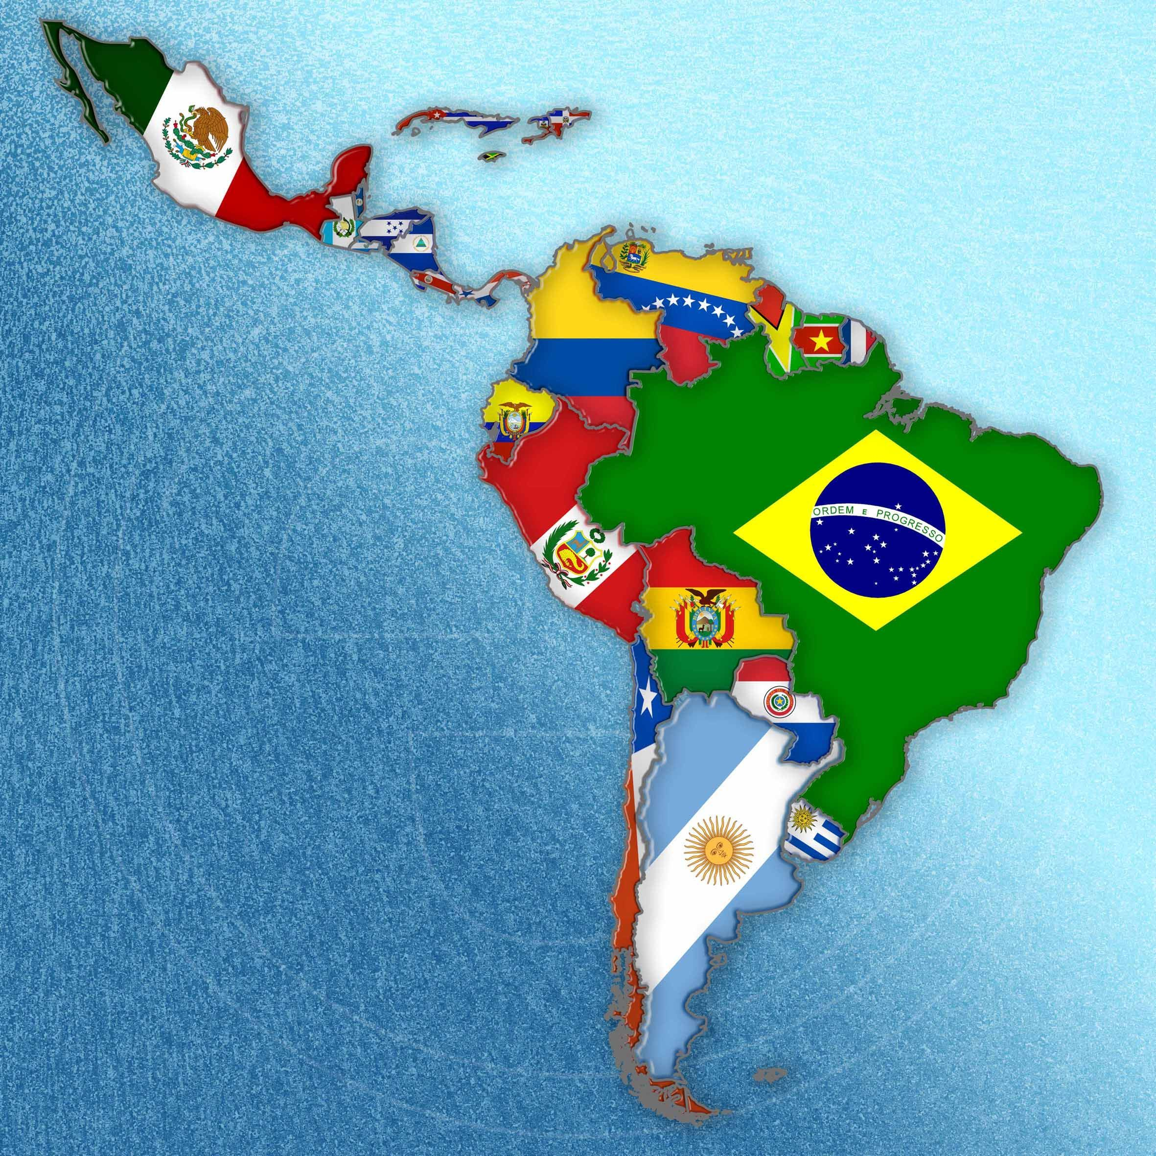
The countries of Latin America and their fights for Peace and Solidarity

Slide 19
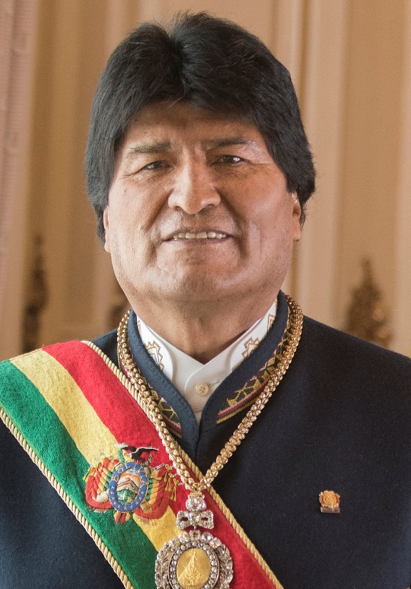
Bolivia
Unions representing the cocaleros (coca growers) of Morales’s home region, Cochabamba, set up MAS in 1998; their aim was to get indigenous and union leaders elected to Congress. Unions representing the cocaleros (coca growers) of Morales’s home region, Cochabamba, set up MAS in 1998; their aim was to get indigenous and union leaders elected to Congress. Morales elected in 2005, immediately Morales passed a law redistributing thousands of square miles of land deemed unproductive or illegally held to peasants. He placed the natural gas, oil, telecommunications and electricity industries under state control. And he continually raised the minimum wage. Bolvia under Morales has increased its per capita income by 3 folds and reduced the Bolvia’s gini coefficient ( a metric to measure inequality) by 19%.

Slide 20
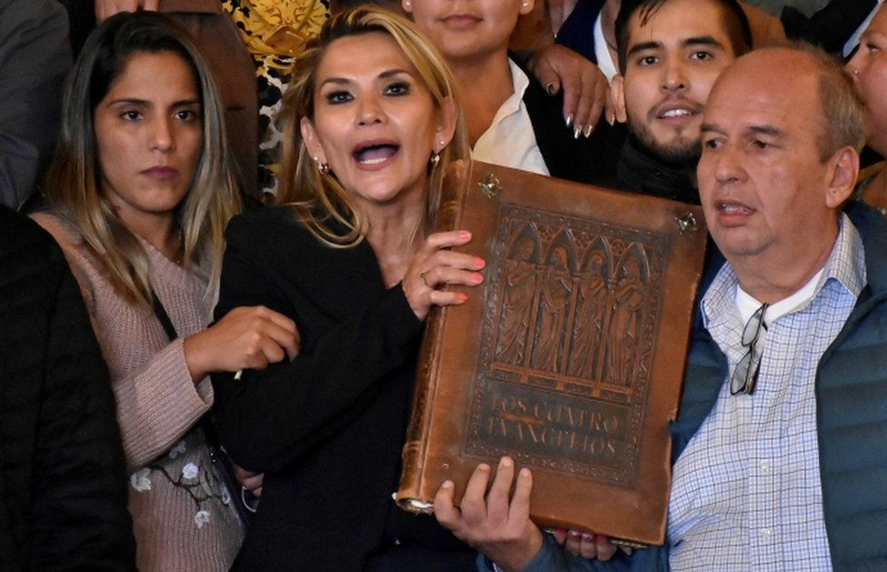
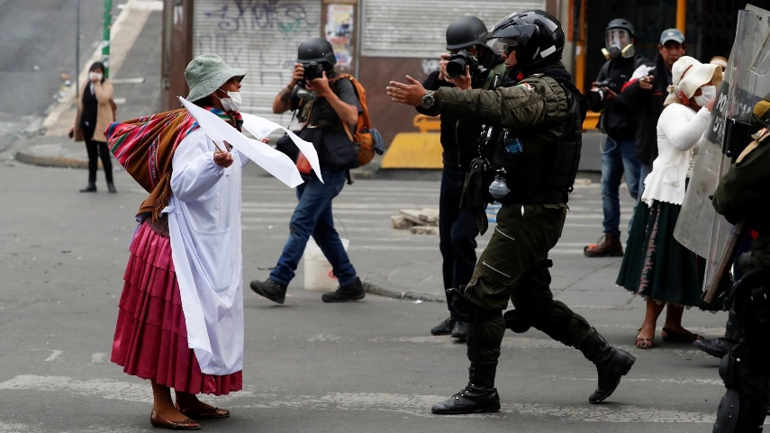
Bolivia
In 2019, Morales was forced to flee the country to Mexico after reactionary forces ( with ties to the American DOJ ) enforced a coup on claims of voter fraud. The opposition senator Jeanine Anez, proclaimed herself ‘interim president’. During the fascist’s coup, violence against the organized indigenous people and coca plant growers.
Senkata and Sacaba Massacres murdered over 20 people and injured almost 200.
Morales and the MAS party (Movimiento Al Socialismo) was so popular that due to social unrest and organizing, the MAS Party won the elections after the coup. Morales is back in Bolivia as an active member of his party.

Slide 21
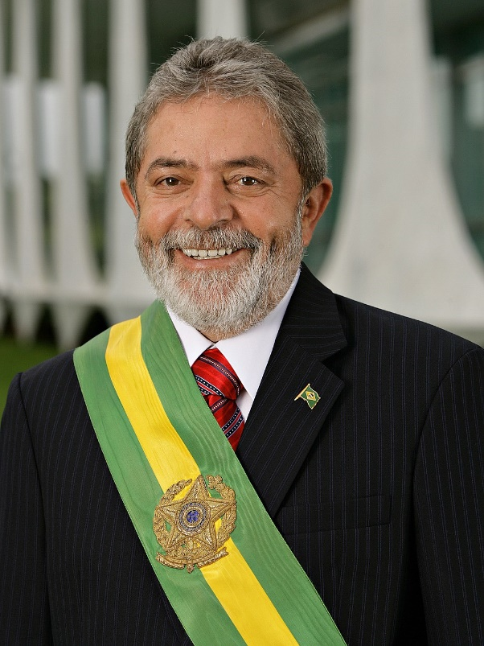
Brazil
Lula Des Silvia was president from 2003-2010 and created programs that lifted 20 million people out of poverty, programs to feed, educate, and employ Brazilian citizens were created. Since Lula has been out of power unemployment has skyrocketed, poverty has increased, and Brazil has over 680,000 deaths due to the Covid pandemic. Lula’s party, The Worker’s Party is a social democratic party. For the gains it made in Lula’s first presidency they were all dismantled or removed. US DOJ backed “anti-corruption” campaign to oust Lula and his Worker’s Party. Many WP members were sentenced to prison which included Lula.

Slide 22
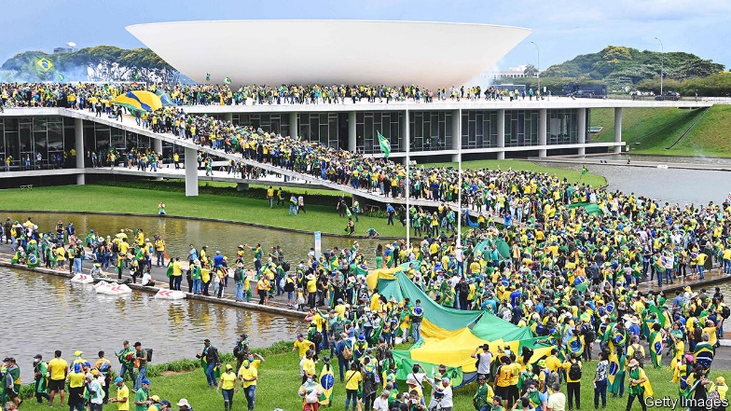
Brazil
Lula couldn't run in 2017 against Jair Bolsonaro despite his popularity due to charges of corruption led by Brazil and American judicial influences, he was later exonerated from this. Lula won against Bolsonaro in the 2022 election, but he has strengthened relationships with the US and does not appear to be pushing against the US and NATO’s involvement in Ukraine. On 8 January 2023, following the defeat of then-president Bolsonaro in after Lula was inaggurated, a mob of his supporters attacked Brazil's federal government buildings in the capital, Brasilia. The mob invaded and vandalized the many government buildings in the capital including the presidential palace.

Slide 23
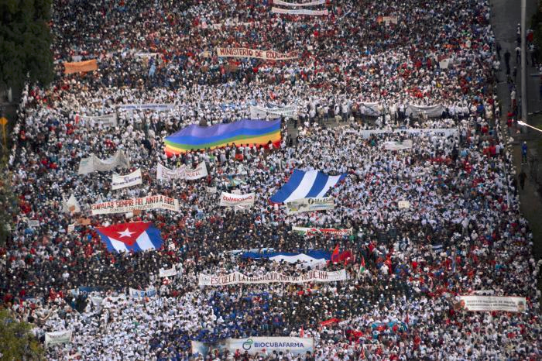
Cuba
After the fall of the Soviet Union in the 90s, Cuba suffered from a lack of resources due to an embargo caused by the US. Cuba maintains a very democratic, Communist run government with a progressive constitution. The new code enacts sweeping advances in the rights of women, LGBTQ people, children, elderly people, and people with disabilities. Cuba and the Communist Party of Cuba has pushed solidarity, anti-imperalist movements in latin America and around the world. Coup attempts through color revolutions but have all failed. Russia and Cuba both recognize their mutual solidarity against American imperialism. Talks to increase military spending and even a Russian military base on the island.

Slide 24
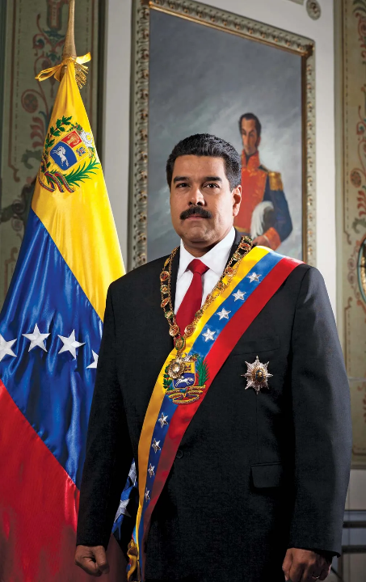
Venezuela
The election of Hugo Chavez in 1999 marked a turn for Venezuela against American hegemony and IMF austerity. Nationalized oil created antagonism with the US. America failed attempts to overthrow government under Maduro after claims of “voter fraud.” Military operations failed as well in 2019. US Sanctions continue to hurt Venezuela’s economy. Venezuela has stood in favor of Russia’s war in Ukraine. Venezuela is one of Cuba’s strongest allies supplying the Cuban people and government with petroleum in exchange for medical resources and doctors.
Notes:
https://www.vox.com/2020/5/11/21249203/venezuela-coup-jordan-goudreau-maduro-guaido-explain - The Stupid Bay of Pigs
The beginning of the Bolivarian revolutionary process, with the election of President Chávez and the adoption of the Constitution of the Bolivarian Republic of Venezuela, intensified the class struggle but also created conditions for the displacement of the hegemony exercised by the CTV union and the search of trade union unity, from the regrouping of the very diverse occupational factors supporting the revolutionary process. The National Union of Workers (UNETE), linked to the WFTU (World Fed Trade Union) and which supports the revolutionary process from a position of class independence, is born under these dynamics.
Maduro made moves to protect himself. He moved the European headquarters of PDVSA, Venezuela’s state-owned oil and natural gas company, from Lisbon to Moscow
https://www.ndtv.com/world-news/ukraine-crisis-venezuela-assures-strong-support-to-russia-2797942 – strong support for Russia
But also sides with US https://english.elpais.com/international/2022-03-17/between-russia-and-the-us-how-venezuela-is-playing-both-sides-in-the-ukraine-conflict.html

Slide 25
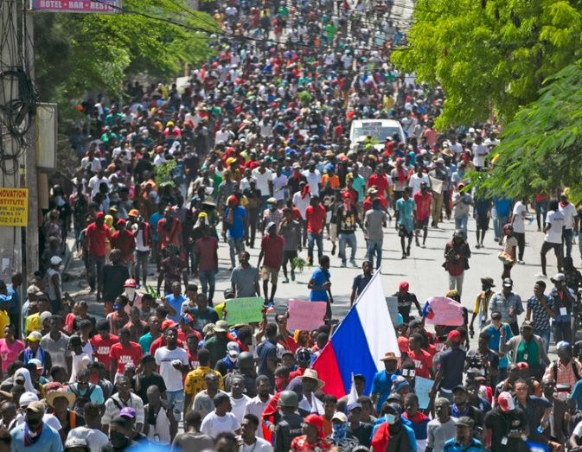
Haiti
The country has gone from being forced into debt after winning their independence in 1804 from its French colonizers to American soldiers suppressing labor strikes in order to keep the country under American hegemonic rule. Haiti is one of if not the most exploited country from imperialism 1986, Haiti had a People’s Uprising but wasn’t able to accomplish much in governmental leadership due to constant imperialist pressure and crippling debt. Since the United States, OSA, and UN have put corrupt puppet dictators in place that act against the interest of the country’s people, an example would be the former president Moise, who was assassinated in 2021. General Strikes and working power in 2021-2022 have forced imperialism harder on the Haitian public right-wing parliamentary gangs, backed by western capital were created to enforce workers into these conditions. Haiti continues dealing with increasing parliamentary groups funded by imperialist capital or “gang” violence as another cholera outbreak has left over 70,000 hospitalized since October.

Slide 26
Columbia, Ecuador, Peru
Columbia The incoming president, Gustavo Petro has said Colombia will stop granting new licenses for oil exploration and will ban fracking projects, even though the oil industry makes up almost 50% of the nation’s legal exports. He plans to finance social spending with a $10 billion a year tax reform that would boost taxes on the rich and do away with corporate tax breaks.
Ecuador
Right Wing president Guillermore Lasso was elected in 2021.
National strikes in July 2022 against Lasso’s austerity measures
Peru
December 7th, 2022, democratically elected Peruvian President Pedro Castillo issued a decree dissolving the republic’s congress, held by a right-wing majority, along with calling to draft a new constitution. President Castillo was arrested by authorities on charges of inciting rebellion and conspiracy, and promptly impeached from office. A the Vice President was sworn in on Dec 8th, 2022 and remains president while Castillo remains in jail.
Notes:
https://lis-isl.org/en/2022/06/25/ecuador-lasso-contra-las-cuerdas/
This popular uprising, which, as we said, is in a way a continuation of the massive protests that took place in October 2019, when the government of Lenín Moreno tried to impose austerity measures very similar to those of Lasso. Three years ago the Ecuadorian people managed to force the government to cancel the cuts. However, at that time the congress was taken over and the central government was forced to move its offices from the capital of Quito to Guayaquil, in addition to the fact that the slogans had evolved from canceling the cuts to the complete ouster of the government. The popular insurrection had made a breakthrough and Moreno’s fall seemed a matter of time. Faced with this scenario, the CONAIE decided to accept talks with Moreno and rejected the popular will that demanded the president’s head. We see a similar trend today. Lasso is increasingly cornered and has begun to lose the trust of the establishment itself, which sees its privileges and profits at risk and urgently needs to find a way out of the crisis. As an example of this, the media itself, always an advocate of the Ecuadorian bourgeoisie, began to express that they would not take a dim view of the “institutional” solution proposed by Correismo, which tries to channel and control the mobilization process through electoral means.

Slide 27
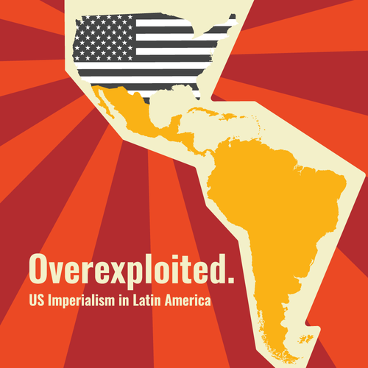
USA - Imperialism Today
The US has 76 bases in Latin America, a strong Air force, marine, and CIA agents (Guantanamo Bay). Yet America has failed in its efforts to suppress leftist movements. Bolivia (2019 coup), Venezuela (2002,2020), Cuba (2021) The Biden administration tries to influence South America through other mean. Continuing the Trump administrations policies like recognizing an alt-president in Venezuela, chastising Bolivia for trying to hold those responsible for the recent coup and repression legally accountable.
Notes:
SOUTHCOM, Southern Command, which is composed of the 12th Corps of the Air Force (it has 396 warplanes, 32600 men, with an additional reserve of 17700 men and 214 combat aircraft), the 2nd Marine Expeditionary Force (it has 47000 marines, provisioned to fight autonomously for 60 days), the 2nd Marine Division (20000 men), 2nd Air Division Marines (400 combat aircraft), the 2nd Group Support Force (landing, maintenance, etc.) and the Southern Army "USARSO" (That operates from Fort Sam Houston in Texas, the base is composed by 1800 men, but it can mobilize tens of thousands of men from reservists and the national Guard). In addition, SOUTHCOM has intelligence agencies, including CIA agents, consisting of around 250 and 300 interrogators operating at Guantanamo Bay, Cuba.
https://inthesetimes.com/article/biden-blinken-latin-america-imperialism-greg-grandin

Slide 28
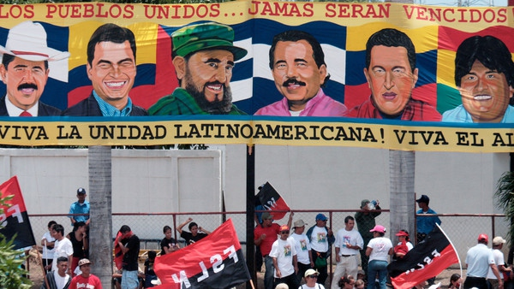
Latin America fights back
BRICS and Bolivarian Alliance for the People of Our America (ALBA) are some examples of economic alliances that are pushing against America’s neoliberal hegemony. Russia has supplied an alternative to military arming for a lot of Latin American countries creating opposition and preventing the US from its military coups. China has created economic relationships with Latin American countries.
Notes:
BRICS - Brazil, Russia, India, China, South Africa agreement of these countries to not trade with USDs but with their own currency. Other Countries like Argentina would like to join.
ALBA was started from Venezuela and Cuba to help through mutual aid , medical support and petroleum
https://www.fmprc.gov.cn/eng/zxxx_662805/202206/t20220623_10709037.html
BRICS - 41% of world population with 3.14 billion people, 24% of global GDP , Total combined area of 29.3% of the total land surface of the world , 16% of world trade. Start financial institutions like the New Development Bank, The Euro has declined against all BRICS currencies during 2022.

Slide 29
ALBA - Alianza Bolivariana para los Pueblos de Nuestra América (Bolivarian Alliance for the Peoples of Our America)
Founded initially by Cuba and Venezuela in 2004, it is associated with socialist and social democratic governments wishing to consolidate regional economic integration based on a vision of social welfare, bartering and mutual economic aid. ALBA was aimed at the exchange of medical and educational resources and petroleum between the two nations. Cuba dispatches doctors for Venezuelan petroleum. Now there are ten member countries are Antigua and Barbuda, Bolivia, Cuba, Dominica, Grenada, Nicaragua, Saint Kitts and Nevis, Saint Lucia, Saint Vincent and the Grenadines and Venezuela. TeleSur – news agency was founded by ALBA Ecuador and Honduras have left after right wing governments came into power

Slide 30
Discussion

Slide 31
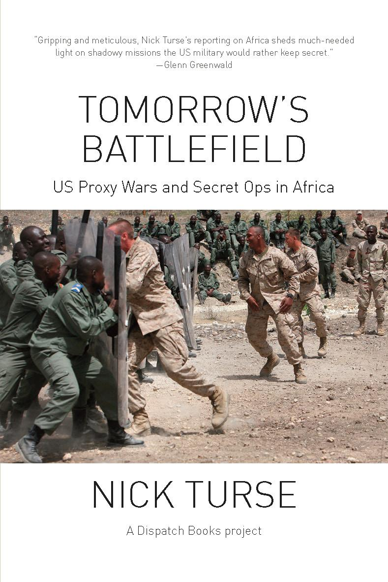
Africa is the battlefield of tomorrow, today.
-Brig. Gen. James Linder
AFRICOM
Why is Africa so important globally?
9/11 and the Shift to Africa
Why Proxy wars?
France and other old colonial nations still want a piece of the pie
The new cold war

Slide 32
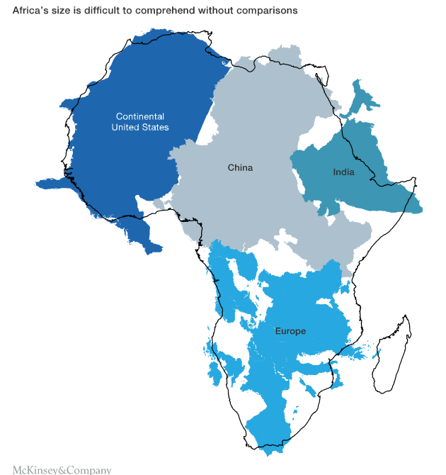
Importance of Africa
Africa is the battlefield of tomorrow, today.
-Brig. Gen. James Linder
1.2 Billion people live in Africa; second only to Asia in population.
The continent roughly has the same landmass as the continental US, Europe, China, and India.
Africa is growing economically faster than any other continent.
700 doing business in Africa have revenue greater than $500M annually.
There have been 214 coups attempted in Africa since 1950. Sudan alone has had 17 attempted coups.

Slide 33
Importance of Africa continued
Africa is the battlefield of tomorrow, today.
-Brig. Gen. James Linder
Africa is home to 30% of the world’s mineral reserves, 8% of the world’s natural gas and 12% of the world’s oil reserves. The continent has 40% of the world’s gold and up to 90% of its chromium and platinum. The largest reserves of cobalt, diamonds, platinum and uranium in the world are in Africa. It holds 65% of the world’s arable land and ten percent of the planet’s internal renewable fresh water source.
-UN Environment Program (UNEP)
China is Africa’s #1 trade partner. Bilateral trade between People’s China and Africa rose 35%, from 2020 to 2021, a total of $254 billion.
China’s Belt & Road initiative has helped develop the continent, and the majority of African countries are members.

Slide 34
9/11And the Shift to Africa
Africa is the battlefield of tomorrow, today.
-Brig. Gen. James Linder
From Chapter 2 of Tomorrow’s Battlefield
In 2000, a report prepared under the auspices of the US Army War College’s Strategic Studies Institute examined the “African security environment.” While it touched on “internal separatist or rebel movements” in “weak states,” as well as non-state actors like militias and “warlord armies,” it made no mention of Islamic extremism or major transnational terrorist threats. In fact, prior to 2001, the United States did not recognize any terrorist organizations in sub-Saharan Africa.
Shortly after the 9/11 attacks, a senior Pentagon official claimed that the US invasion of Afghanistan might drive “terrorists” out of that country and into African nations. “Terrorists associated with al-Qaeda and indigenous terrorist groups have been and continue to be a presence in this region,” he said. “These terrorists will, of course, threaten US personnel and facilities.

Slide 35
9/11And the Shift to Africa
Africa is the battlefield of tomorrow, today.
-Brig. Gen. James Linder
The commander of EUROCOM testified to congress that “the increasing strategic significance of Africa will continue to pose the greatest security stability challenge in the EUCOM AOR. The large ungoverned area in Africa, HIV/AIDS epidemic, corruption, weak governance, and poverty that exist throughout the continent are challenges that are key factors in the security stability issues that affect every country in Africa.”
In the fall of 2002, the US formed the Combined Joint Task Force - Horn of Africa and arrived to the area in December 2002.
In 2006, Sec. of State Donald Rumsfeld formed a planning team looking into the creation of AFRICOM. AFRICOM was recommended to President Bush, and it was authorized the day Rumsfeld stepped down from his position.
AFRICOM’s first major military operation was Operation Odyssey Dawn in 2011. Tomahawk cruise missiles were used to attack Libyan targets including their air defense systems.

Slide 36
Why Proxy Wars?
Africa is the battlefield of tomorrow, today.
-Brig. Gen. James Linder
It looks better
Has to compete with China and Russia for local support
AFRICOM is disguised to look as they only provide aid.
“Humanitarian Aid projects are extremely rewarding. The appreciation expressed by the locals is fantastic. Each successful project is a photo opportunity.” - Wayne Uhl, Army Corps of Engineers
AFRICOM headquarters are located in Germany and key logistics support hubs are in Spain, Aruba, and Greece.
The US can have others fight their wars
The “Ukraine Model” that we are more familiar with is how the Americans prefer war
Some other group is the “bad guy.”
No negative press in the US of American soldiers dying
Mercenaries and other private corporations can do things soldiers can’t.
AFRICOM provides military training, logistics, and intelligence to “friends” of the American cause.
AFRICOM modernizes airports for use of military planes and drones.
Africa has had 214 coup attempts since 1950 with about half being successful
Enabling terrorism while having a “war on terrorism” leaves the continent in a constant state of instability. This justifies the US and NATO to continue their operations.

Slide 37
France’s Continued Destruction
Africa is the battlefield of tomorrow, today.
-Brig. Gen. James Linder
In 2011, France helped in overthrowing Gaddafi in Libya
Tuareg mercenaries that fought for Gadaffi returned to their home in Mali. They decided to fight for independence in northern Mali. As a result, France deployed troops to Mali from 2013-2022.
The conflict has kept Mali in turmoil, and they had only 7.5% turnout in the last election in March 2020.
France deployed troops to Niger directly after deployment in Mali. Their soldiers are also actively positioned throughout the region in many of their old colonies.
The Movement against Slavery and Terrorism has accused France of supporting Boko Haram through aid and payment of ransom.
In August, Mali told the UN that France has been arming Islamist militants in their region and has entered into their airspace 50 times this year.
In October 2022, France staged a coup in Burkina Faso. The people of Burkina Faso have been protesting outside of the French embassy. The country banned Radio France International for airing terrorist propaganda. Russian flags are at the protests, and the people prefer a security partnership with Russia over France and the West. The Wagner Group, a Russian mercenary force, is involved in the region.

Slide 38
China and the New Cold War
Africa is the battlefield of tomorrow, today.
-Brig. Gen. James Linder
China is the world’s largest developing country, and Africa is the continent with the most developing countries.
China has been Africa’s largest trading partner for 12 consecutive years.
China and Africa’s shared past experiences, common goals, and similar challenges makes them excellent partners.
52 out of 54 African countries are involved with China’s Belt and Road Initiative.
China has established the Forum on China-Africa Cooperation (FOCAC) based on the Five Principles of Peaceful Coexistence. Mutual respect for territory and sovereignty, mutual non-aggression, mutual non-interference in internal affairs, equality and mutual benefit, and peaceful co-existence.
Many parts of Africa still have fond memories and respect for the USSR. Angola, Mozambique, and South Africa have seen the US as being on the wrong side of history for decades. Russia is looked at positively by many people in Africa.
Although extracting resources has always been a priority, western hegemony is under severe threat in Africa. BRICS and FOCAC are detrimental to the US’s

Slide 39
Discussion

