Slide 1
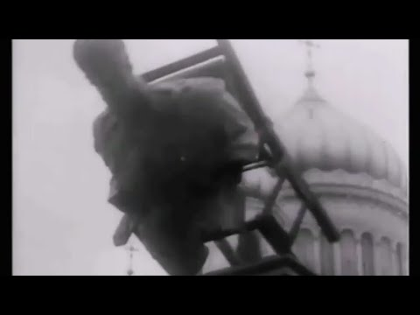
The Internationale

Slide 2
Overview of 1 Year of War in Ukraine
PSMLS 02/21/23 - 02/23/23

Slide 3
What we’ll be learning today:
Reading a timeline of events in the last year of the war in Ukraine
Reading Seymour Hersh’s article on the US sabotage of Nordstream 2.
Looking at statistics and maps about the war to better understand how the conflict is going for both sides.

Slide 4
Timeline: Pre-Conflict - Nordstream 2 Sabotage

Slide 5
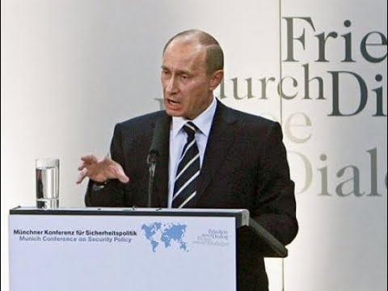
Timeline: Pre-Conflict - Nordstream 2 Sabotage
Pre-Conflict
February 10th, 2007: Vladimir Putin delivers a famous speech at the Munich Security Conference. Here is piece of that speech, which decried NATO expansion:

Slide 6
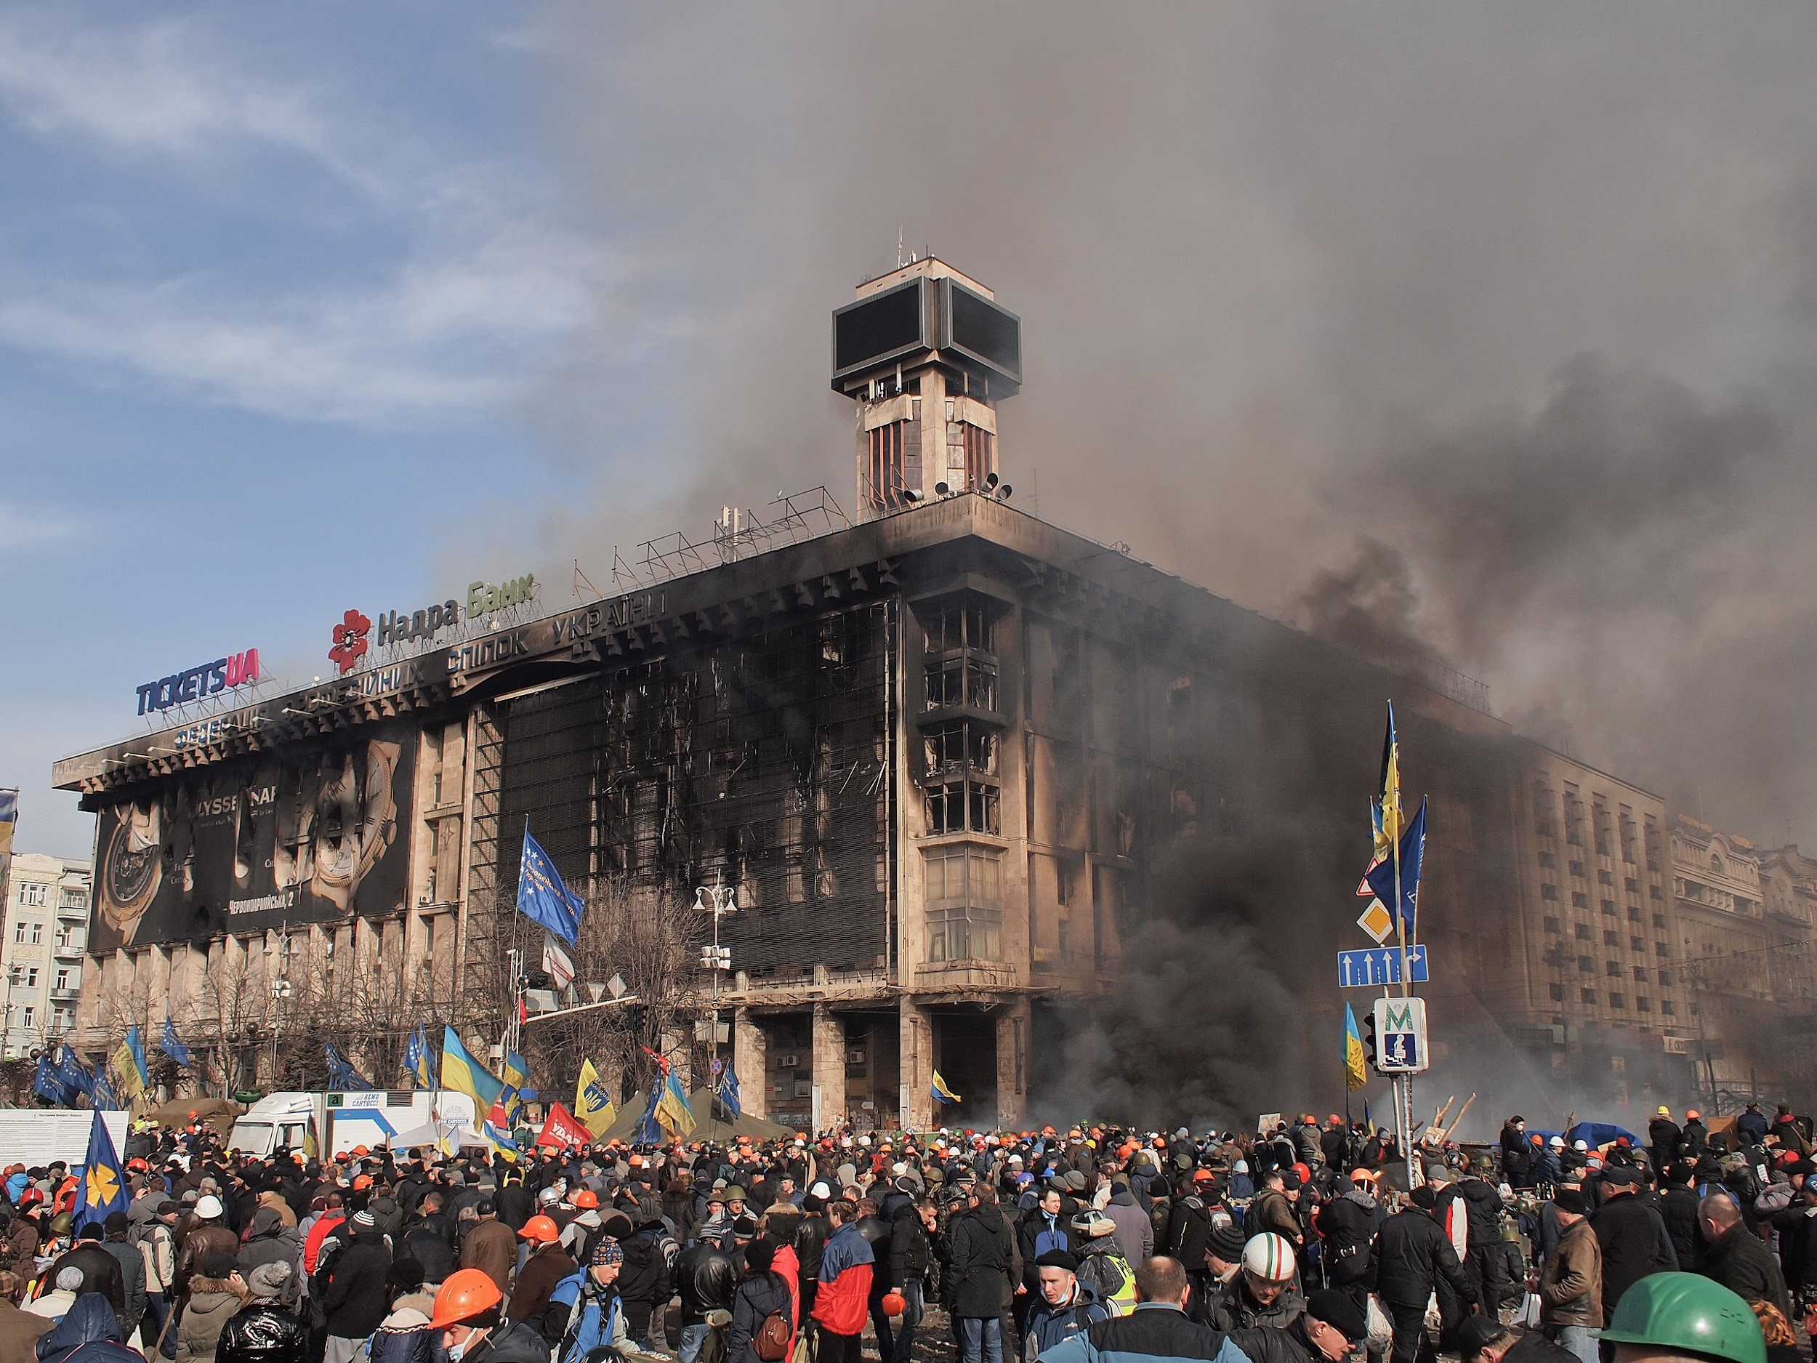
Timeline: Pre-Conflict - Nordstream 2 Sabotage
Pre-Conflict
2008: Ukraine applies to join NATO under
presidency of Viktor Yushchenko.
2010: Viktor Yanukovych wins presidency of Ukraine,
shelves joining NATO, works closer with Russia.
2013-14: Fascist “Euromaidan” coup takes place in Ukraine, Yanukovich ousted, fascist US-chosen regime takes power, Russian Federation annexes Crimea after referendum to join wins, Donetsk & Lugansk Peoples Republics are founded in the Donbass region.
2014-Present: War in Donbass as Fascist Ukraine carries out brutal war against the people of the DPR and LPR. This went on for 8 years without Russian intervention.
House of Trade Unions in Kiev, Ukraine on fire during the Euromaidan

Slide 7
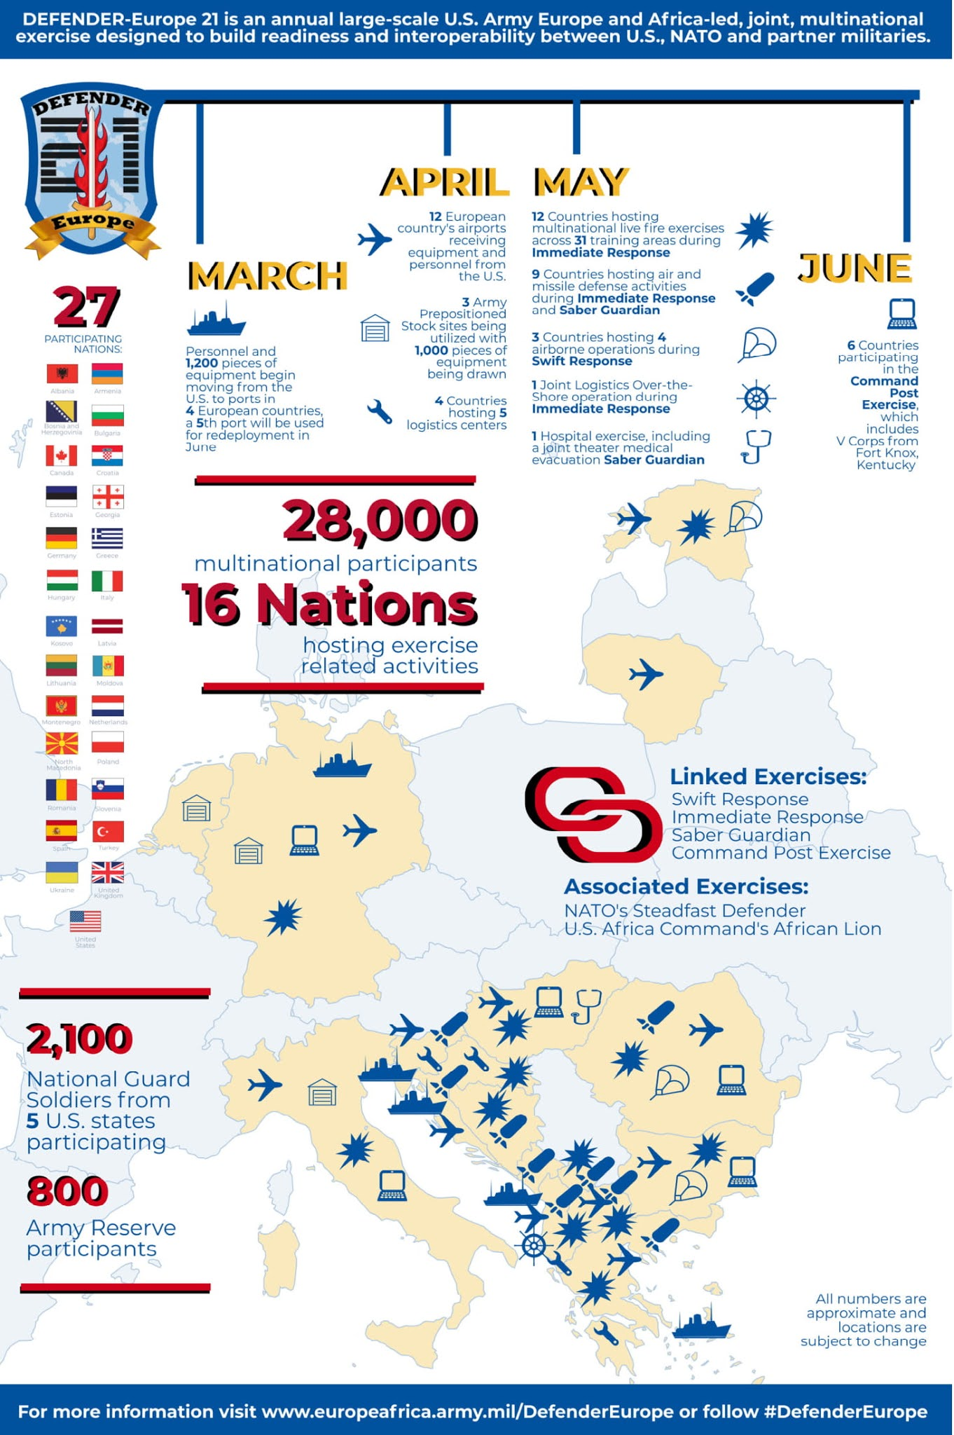
Timeline: Pre-Conflict -
Nordstream 2 Sabotage
Pre-Conflict
September 24th, 2020: New president Volodymyr
Zelenskyy approved Ukraine's new National Security
Strategy, "which provides for the development of the
distinctive partnership with NATO with the aim of
membership in NATO."
February 21st, 2021: Russian Defence Ministry
announced the deployment of 3,000 paratroopers
to the border for military exercises.
March 16th, 2021: NATO Military Exercise
“Defender Europe 2021” takes place as
28,000 troops from 27 nations conduct operations
in 30 training areas in 12 countries.

Slide 8
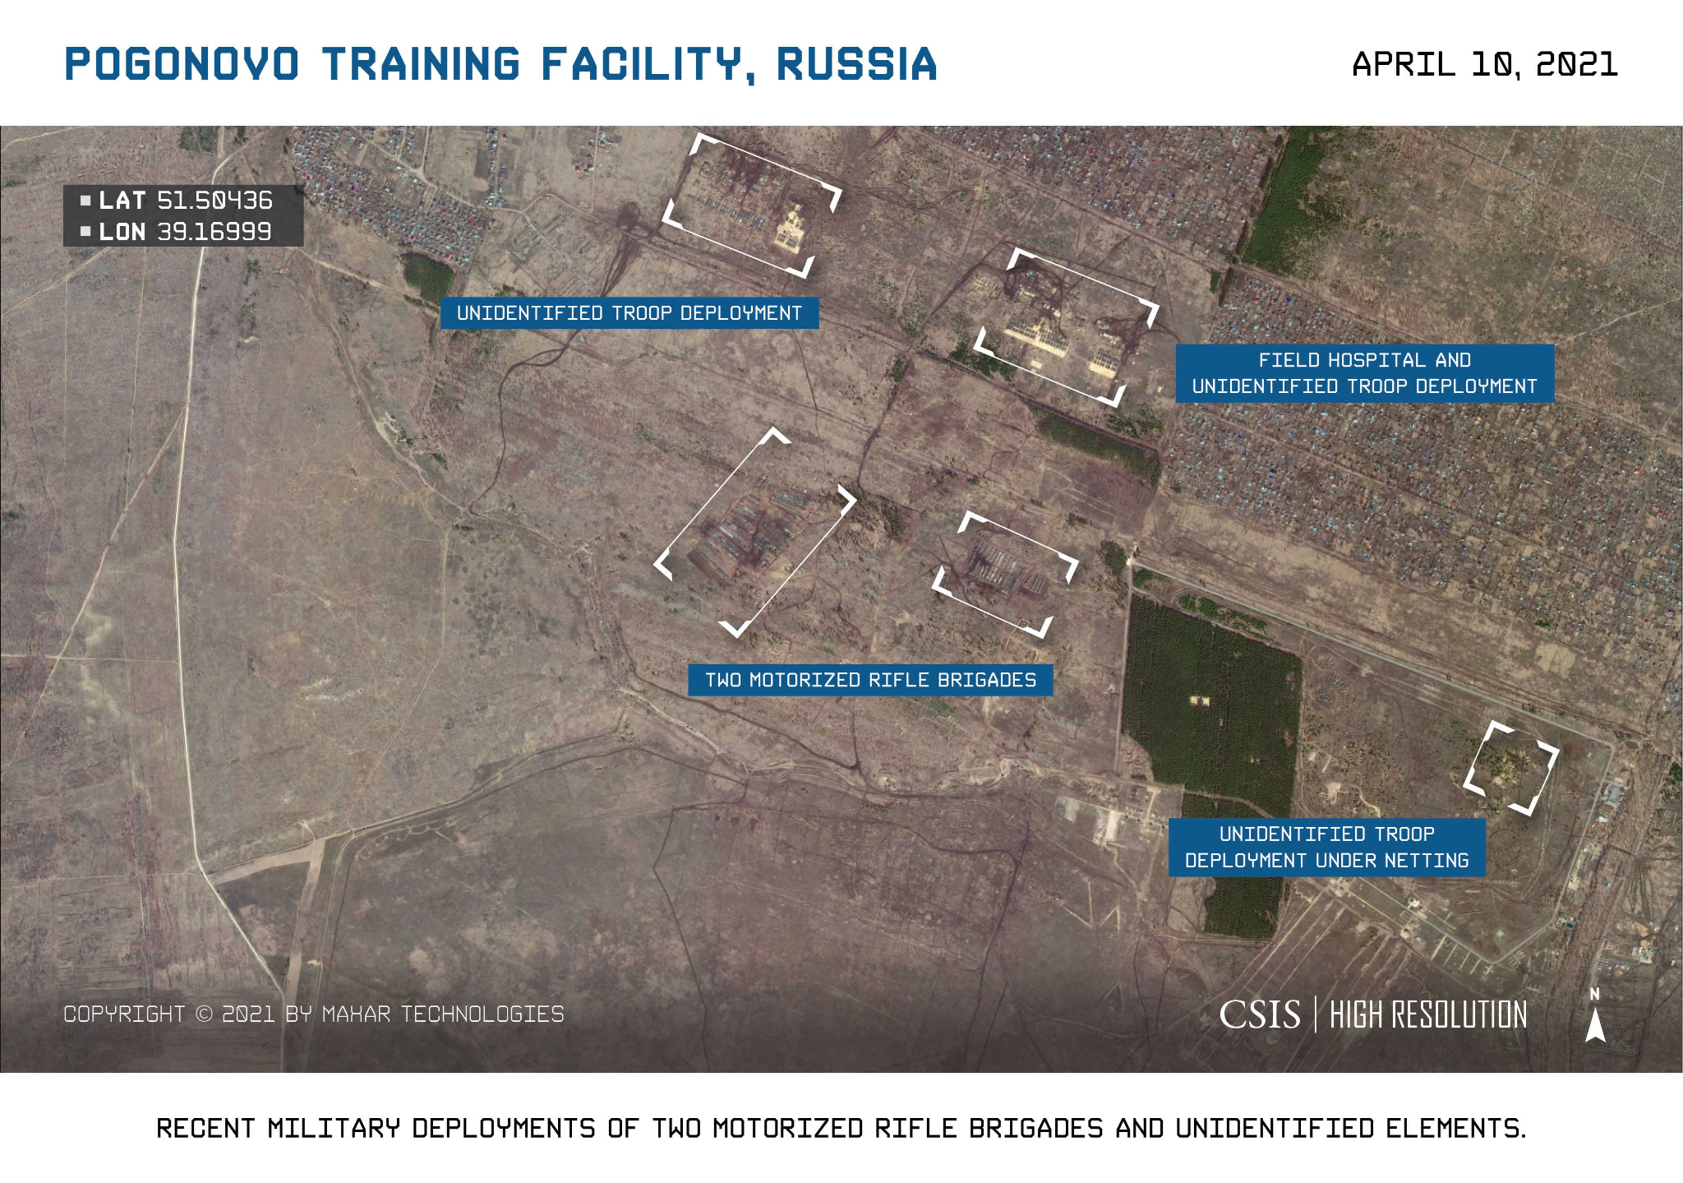
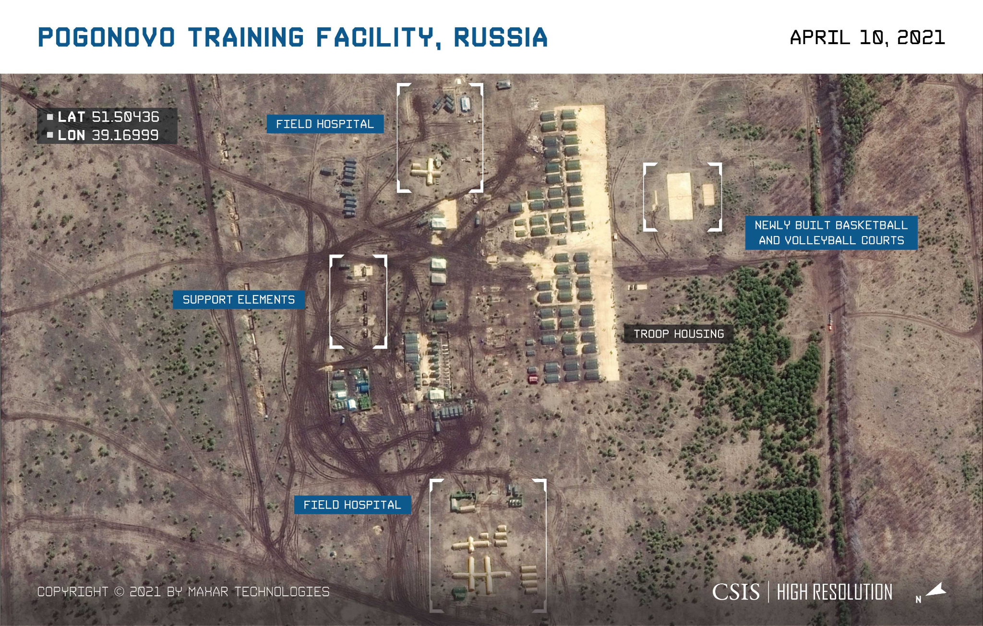
Timeline: Pre-Conflict - Nordstream 2 Sabotage
Pre-Conflict
March-April 2021: Unofficially reported Russian
buildup on border with Ukraine. April 14-15 saw a
naval confrontation between Ukrainian forces and
Russian KGB forces in the Sea of Azov
April 22nd, 2021: Russian Minister of Defence
Sergey Shoigu announced a drawdown of military
exercises, and multiple divisions return to their
bases, however military equipment is left there.
November 2021-January 2022: More reports again
of Russian military buildup near border with
Ukraine.

Slide 9
Discussion

Slide 10
Timeline: Pre-Conflict - Nordstream 2 Sabotage
February 2022
February 11th, 2022: Ukraine invokes provision III of the Vienna Agreement requesting explanation from Russia for military activities, US warns that a Russian invasion
could occur on the 16th and warned Americans to leave Ukraine.
February 21st, 2022: Russia recognizes the independence of the Donetsk and Luhansk People's Republics and orders troops to be sent into the 2 republics.
February 24th, 2022: At 4:00 Moscow time, Putin announced the special military operation in Ukraine with the expressed purpose of the denazification of Ukraine.

Slide 11
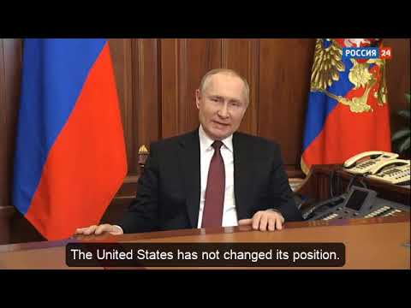
“On the special military operation”

Slide 12
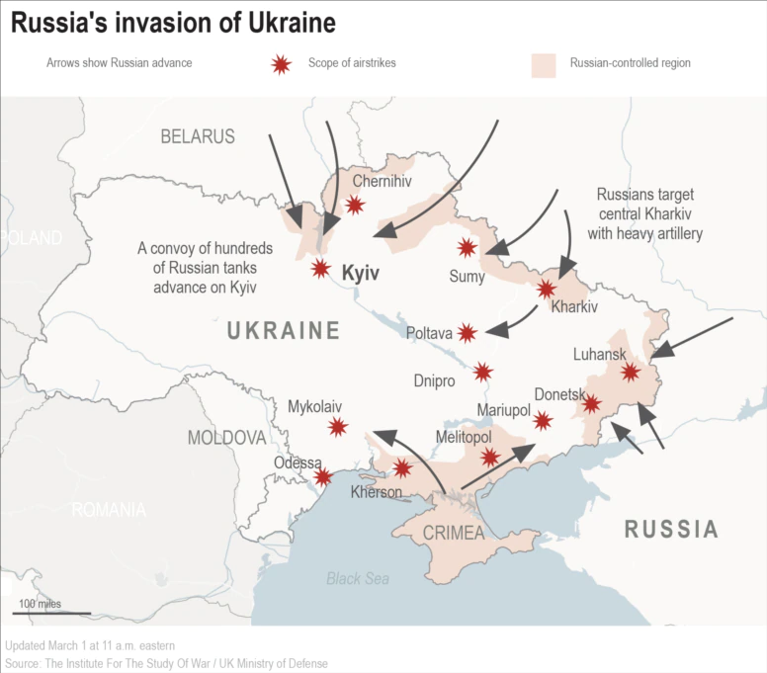
Timeline: Pre-Conflict - Nordstream 2 Sabotage
First stage: February to April
February 24th 2022: Shortly after the announcement,
missiles hit Kyiv, Kharkiv, Odessa and Donbass.
Russian troops invaded via Belarus, Crimea, the Black
Sea and near Kharkiv. Battle of Antonov Airport begins
and is won by Russia the following day.
February 25th, 2022 - March 29th, 2022:
Battles rage on the Northern and Southeastern front, accusations are lobbed at Russia of using cluster, vacuum and phosphorus bombings. NATO and US reject Ukraine’s call for a “no fly zone.”
March 29th, 2022 - April 7th, 2022: Russia and Ukraine have in-person negotiations in Instanbul, Turkey. The Russian Ministry of Defense then announces a reduction of military activity on the Kyiv and Chernihiv fronts, and by April 7th the redeployment to Southeastern Ukraine was underway. Russia is accused of committing a massacre in Bucha, however the evidence was not there and Russia accuses Ukraine of committing a false flag attack and staging the massacre.

Slide 13
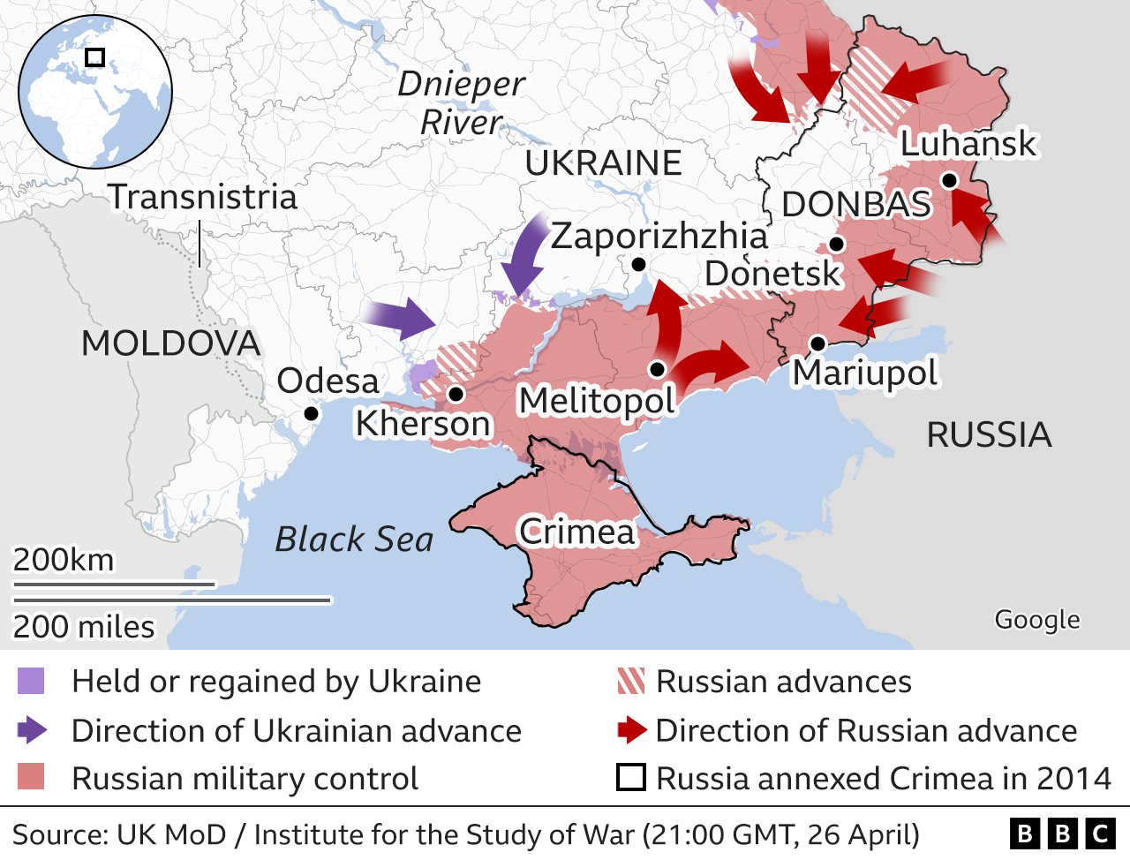
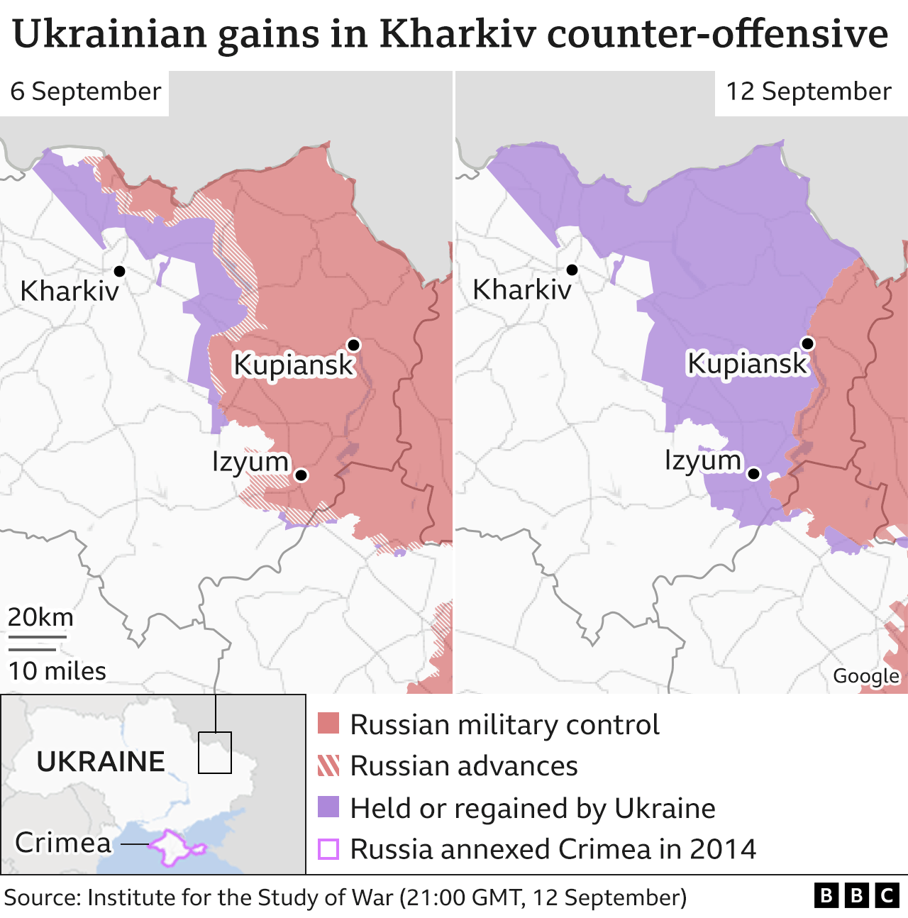
Timeline: Pre-Conflict - Nordstream 2 Sabotage
Second stage: April to September
NATO aligned countries send hundreds of artillery and weapons
to Ukraine from April on. This includes former Warsaw Pact
weaponry and a bit of western weapons as well, such as Stinger
missiles.
Battles are fought in Southern and Southeast Ukraine in the
Donbass region and near Odessa, as well as in the Black Sea
where the Russian cruiser Moskva was sunk by Ukrainian forces.
Russia occupies Kherson.
September 9th, 2022: Ukraine launches a counter-offensive in the
Kharkiv Oblast, which pushes Russia back to the banks of the Oskol
River.
September 23rd - 27th, 2022: Referendum in the 4 Ukrainian oblasts
of Lugansk, Donetsk, Zaporizhzhia and Kherson about joining the
Russian Federation, to which all 4 vote in favor.

Slide 14
Discussion

Slide 15
The US Sabotage of the Nordstream 2 Pipeline

Slide 16
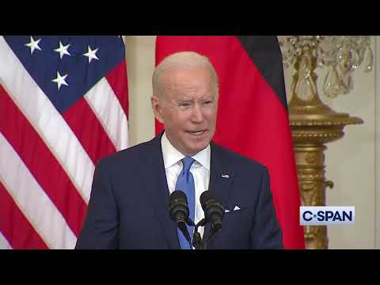
The US Sabotage of the Nordstream 2 Pipeline
Declarations of Intent
Multiple US politicians had made statements over the last year and before of the Nordstream 2 needing to be stopped in the event of a war with Russia. This is Biden, 2/7/22:

Slide 17
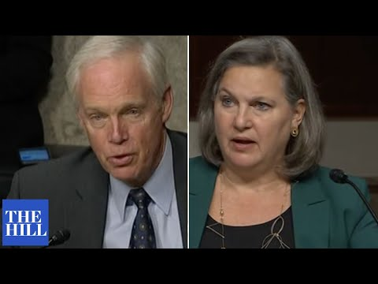
The US Sabotage of the Nordstream 2 Pipeline
Declarations of Intent
This is Under Secretary of State Victoria Nuland being questioned in a hearing by a GOP Senator Ron Johnson on December 7th, 2021 about stopping Nordstream 2:

Slide 18
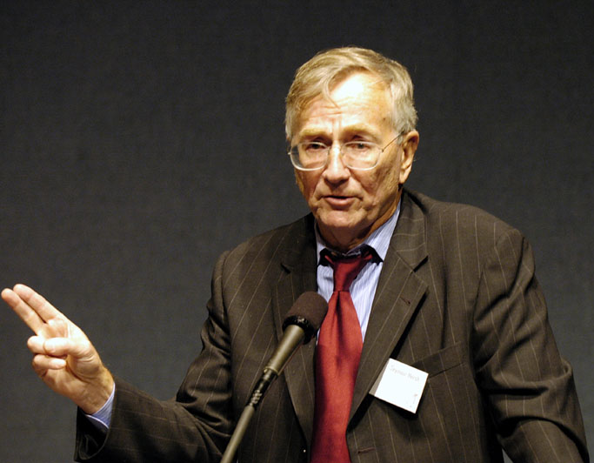
The US Sabotage of the Nordstream 2 Pipeline
About Seymour Hersh
Exposed My Lai massacre in Vietnam in 1969.
In the 70’s he covred Watergate and the US Secret Bombing of Cambodia
In 2004, detailed abuses of prisoners at Abu Ghraib prison in Iraq.
In 2013, he disputed claims of the Assad government being responsible for the Ghouta chemical attack
In 2015, he reported the US and Pakistan lied about the events surrounding the killing of Osama Bin-Laden

Slide 19
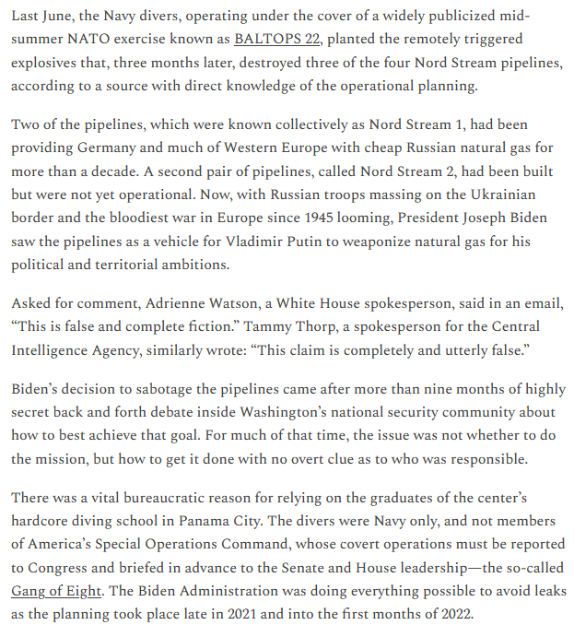
“How America Took Out the Nordstream 2 Pipeline”
By Seymour Hersh

Slide 20
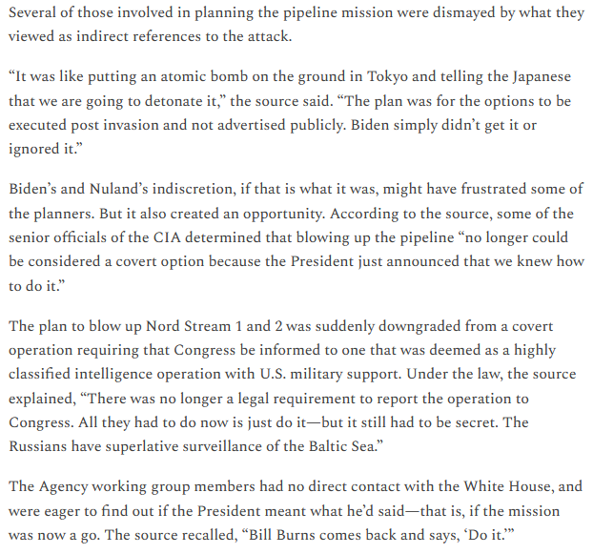
“How America Took Out the Nordstream 2 Pipeline”
By Seymour Hersh

Slide 21
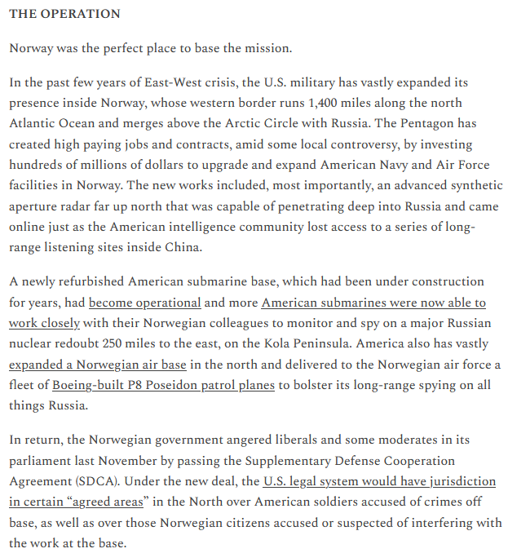
“How America Took Out the Nordstream 2 Pipeline”
By Seymour Hersh

Slide 22
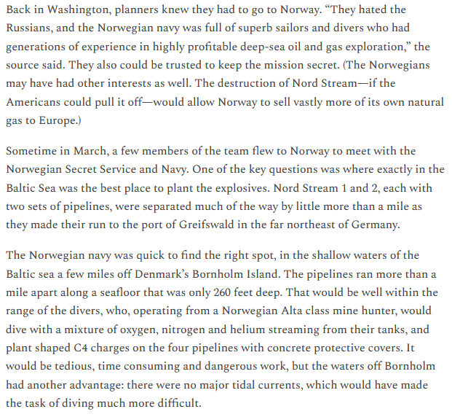
“How America Took Out the Nordstream 2 Pipeline”
By Seymour Hersh

Slide 23
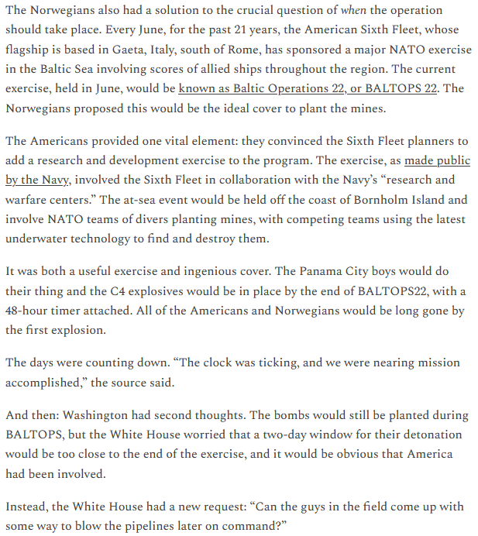
“How America Took Out the Nordstream 2 Pipeline”
By Seymour Hersh

Slide 24
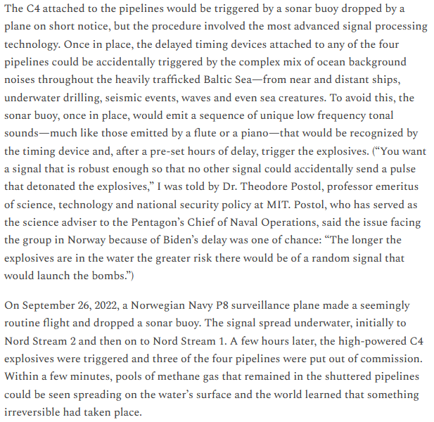
“How America Took Out the Nordstream 2 Pipeline”
By Seymour Hersh

Slide 25
Discussion

Slide 26
Next Week: Timeline from Nordstream 2 Sabotage - Present;
Statistics & Maps

Slide 27
New Member Introductions
What is your name, pronouns and state (or country/territory)?
Where do you work? Is it unionized?
How did you find out about the People’s School?
What do you think about tonight's class?

Slide 28
Volunteers Needed!
We are in need of volunteers for the staff of the People’s School! Here’s a few roles we need filled:
People to help manage posting on our social media and podcast platforms
Video Editors, Audio Editors, Graphic Designers, Artists, Narrators
Facilitators, Web Controls, Moderators
Email info@peoplesschool.us if you’re interested and try to attend our next staff meeting on March 2nd if possible.

Slide 29
New Outlook Publishers
newoutlookpublishers.store
Latest Releases

Slide 30
Legal Drive
Last year we were attacked and sabotaged by wreckers that tried to steal the PSMLS and destroy the PCUSA.
They failed, but they will be held accountable and there are still things they took from us that we’ve not got back, like videos, imagery and audio. That is why we still need donations to the legal drive.
To donate, go to partyofcommunistsusa.net/donations/
Put “For legal funds” in the details box and try to donate on Tuesday or Thursday so it is easier for us to sort through. It will go to the legal fund. Anything helps!

Slide 31
ДОНБАСС ЗА НАМИ - Donbass Is Behind Us!

