Slide 1
Anthem of the USSR sung by Paul Robeson

Slide 2
Black Communists of the 20th Century
PSMLS 02/28/23 - 03/01/23

Slide 3
During the initial formation of the American Communist Party in 1919 there were no black workers in the party. It consisted of predominantly whites.
The Socialist Party, which the founders of the Communist Party USA split from, did not do anything on the race question either.
Everything changed at the 4th Comintern Congress at which a thesis was passed which guided the Communist Party to focus on national liberation movements within their own country, most notably the struggle of African Americans and their struggles for self determination.
Self determination would present itself in the forms of the establishment of unemployment councils, the support of the creation of a Black Belt in the South, and running African American candidates in elections.
The Age of Proletarian Revolution (1919 - 1935)

Slide 4
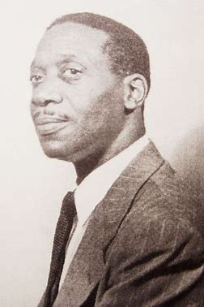
Born in Nebraska to former slaves in 1898 , Haywood is best known for his role in formulating the “Black Belt” thesis adopted by the 1928 Comintern. According to Haywood, African-Americans in the Deep South constituted an oppressed nation according to the Bolshevik definition, and as such were entitled to self-determination.
His answer to the two main trends of black liberation, the integrationalists like the NAACP, and the separatists like Marcus Garvey’s “Back to Africa” movement.
He saw that during times of economic distress like the 20s and 30s, separatist movements surged in popularity, and it was important to address the dual desires for autonomy and economic self-determination in in order to win the masses to the side of the Communist Party.
Harry Haywood - 1923 - 1959

Slide 5
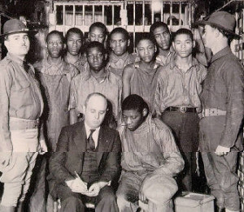
The Scottsboro Boys
A group of 9 black boys ranging from the ages of 13 to 20 were falsely accused of rape and were risking imprisonment.
The Communist Party, through the International Labor Defense, came to their defense in a battle for civil rights, the NAACP did not involve itself until 4 years later.
Samuel Leibowitz was the attorney that took on the boys’ case pro bono. He was their attorney the whole time.
The case lasted from 1930 through 1937.
The case was fought all throughout the legal system in United States until it was thrown out by the Supreme Court, resulting in the case being won by the defendants.

Slide 6
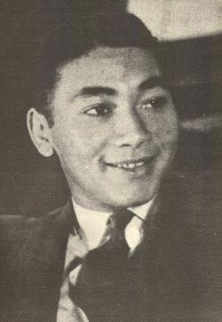
Angelo Herndon
An African American labor organizer who got his start working in the railroad industry.
Joined the Communist Party in 1930 and quickly helped build the Party up while organizing black and white workers in the South.
This led to his arrest by police in 1932.
Angelo was also defended by the International Labor Defense.
The state convicted Herndon but the ILD would continue to support him up until he left the party in the 1940’s.

Slide 7
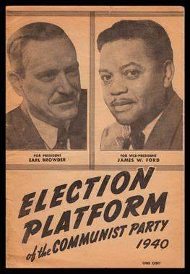
James W. Ford
The first African American to run as a presidential candidate in the United States.
He ran on the party ticket in the 1932, 1936, and 1940 elections running with William Z Foster and Earl Browder.
He Joined the Party in 1928 and would soon be a representative at important conventions at the time such as the League Against Imperialism and Colonial Oppression.

Slide 8
Discussion

Slide 9
Everything changed in 1935 during the 7th Congress of the Comintern when the policy changed from class against class to United Front against Fascism.
The conference deemed that the International Communist movement will now be focused on the fight against fascism with the rise of it across Europe such as in Nazi Germany, Mussolini’s Italy, and Imperial Japan.
The Anti Fascist Period (1935-1947)

Slide 10
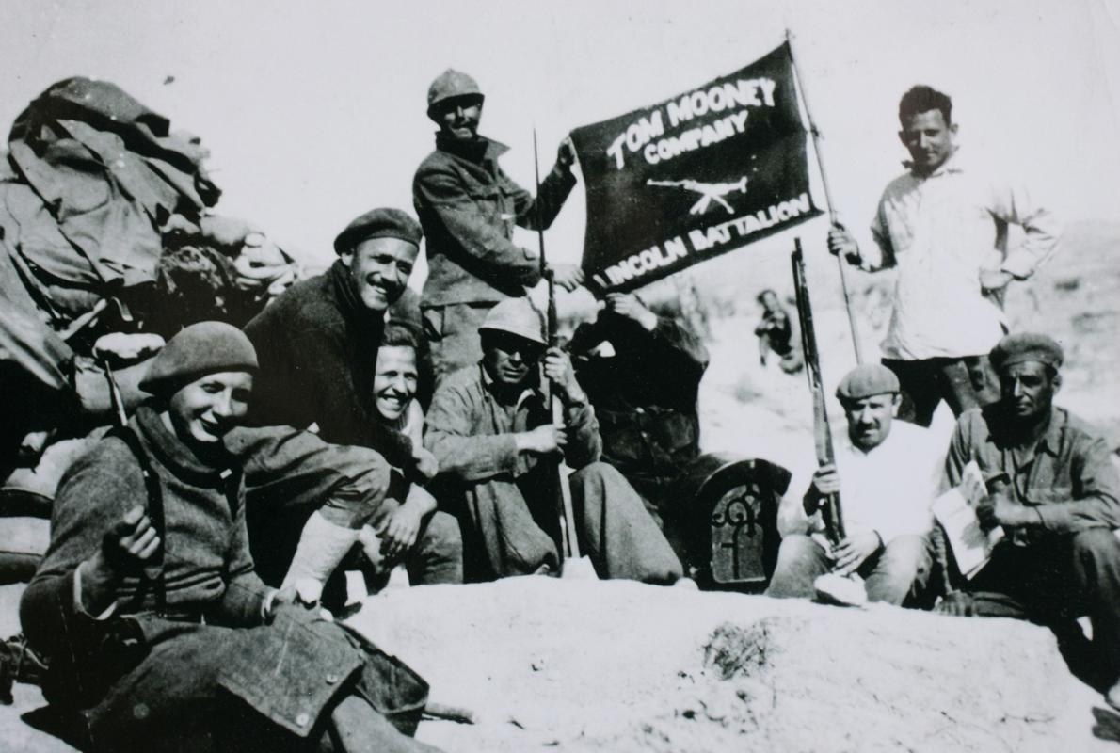
General Franco and other generals in Spain rose up against the New Republic in 1936 (Replaced the Spanish autocratic Monarchy).
The International Communist movement organized military brigades to go help the Republic (in a call of “No Pasaran” or “They shall not pass”). In the United States, the communists organized the Abraham Lincoln and George Washington Battalions.
Notable members of the Party, such as James W. Ford, became volunteers in the fight against Fascism in Spain.
The Fight against Fascism

Slide 11
Around this time, the Black Belt thesis went away because African Americans moved from the South to the North looking for employment.
The Mass Mobilization for the war effort ramped up around this time as well guiding Party policy in the fight against Fascism by supporting it.
The Fight Against Fascism (Cont.)
Notes:
Add a picture

Slide 12
The fight against Fascism in Europe saw the Communist Party join the war efforts to fight against the Axis powers and throughout the end of World War II.
Following the war against fascism the leadership of the Communist Party were sent to prison under the guise of the Smith Act.
The Party had to go underground during this time due to the McCarthy Period.
Paul Robeson testifying at the House Un-American Activities Committee - YouTube
The Post-War McCarthy Period (1947 - 1955)

Slide 13
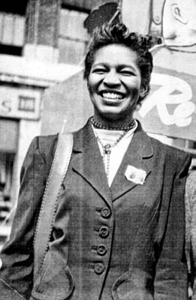
Claudia Jones
At the age of 18, Jones became a member of the Young Communist League (YCL)
Wrote on the behalf of the Scottsboro Boys’ legal defense for the YCL journal Weekly Review. Later she wrote for the Communist Party newspaper The Daily World.
Jones was arrested in 1948 and 1955. Since she never gained U.S. citizenship, Jones was deported from the United States to England where she immediately became involved in the various struggles of the West Indian community and other nationally oppressed groups.

Slide 14
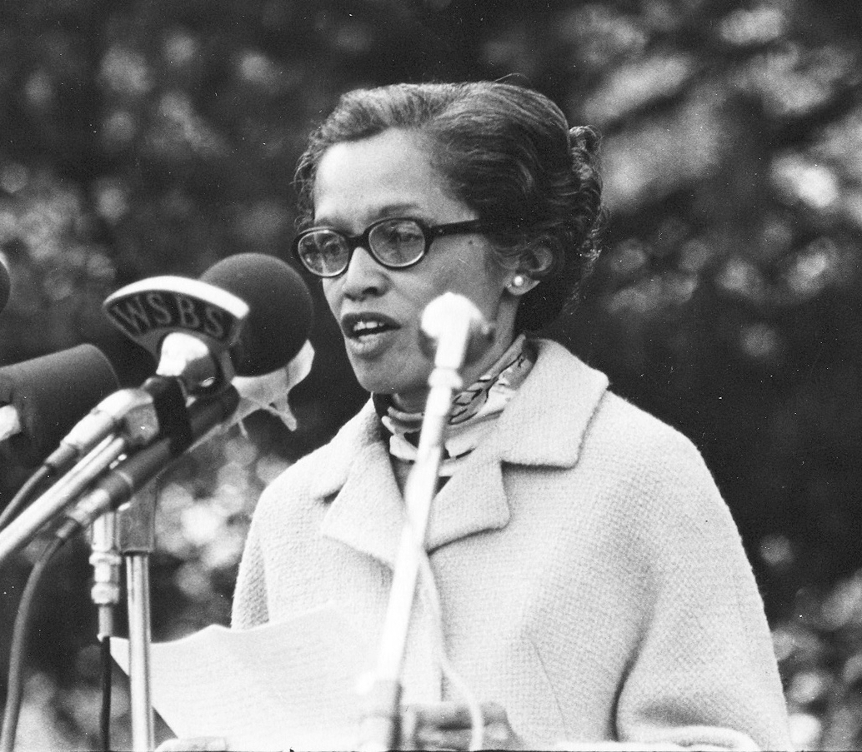
Esther Cooper Jackson
Jackson became a member of the staff of the Voting Project in Birminghan, Alabama, for the Southern Negro Youth Congress (SNYC).
For seven years as a prominent leader of SNYC, Esther Cooper Jackson worked with her husband, Louis and numerous others, conducting many campaigns promoting the rights of blacks and poor whites.
In New York of 1961, Jackson became managing editor of Freedomway.

Slide 15
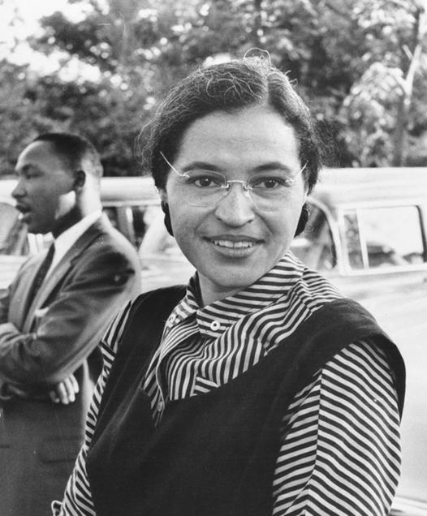
Rosa Parks
Parks became a NAACP activist in 1943, participating in several high profile civil rights campaigns.
On December 1, 1955, in Montegormy, Alabama Parks rejected the bus driver order to vacate a row of four seats in the “colored” section in favor of a White passenger, once the "White" section was filled
Attended CPUSA meetings with her husband.
Notes:
Come back to the part of attending CP meetings w/her husband.

Slide 16
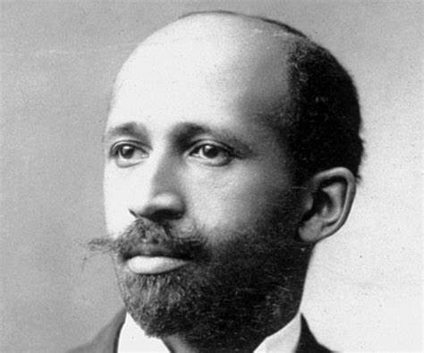
W.E.B. Dubois
The first African American in history to receive a Ph.D from Harvard University.
Founded the NAACP
Joined the Communist Party in 1961 at the age of 93. Gus Hall processed and accepted his application.
At the same time, he became a citizen of Ghana honored by socialist leader Kwame Nkrumah.
He would live out the rest of his life in Ghana until his death in 1963.
Dr. Martin Luther King Jr. Attended one of his speeches in 1958.
Awarded the Lenin Peace Prize in 1959.

Slide 17
Discussion

Slide 18
During this period, came the emergence of what’s called the New Left.
With the start of the War in Vietnam along with the ongoing Civil Rights Movement, we saw the return of the Communist Party from its underground period during the McCarthy Period.
Civil Rights Era (1956-1973)

Slide 19
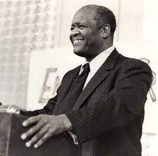
Henry Winston -
Joined LYC at the age of 19
World war II veteran
Arrested under the Smith Act. Went blind during his period of incarceration.
National Chair of the CPUSA from 1966 - 1986
Wrote Strategy for a Black Agenda. and Class, Race, Black Liberation
Winston died in 1986 in the Soviet Union
The giant industrial monopolies, the big banks and insurance companies, the financiers and landowners, all spawn racism and use it as one of their chief class weapons to maintain and defend their regime of exploitation and oppression, of enmity among peoples, of imperialist wars of aggression.
It follows that all democratic and antimonopoly forces, with the working class and Black liberation movement in the van, can effectively defend the interests of the vast majority of people only when they actively further the struggle against racism. This is an essential precondition for the development of a fighting alliance which will unite all democratic and antimonopoly [anticapitalist] forces in the country.
Marx wrote long ago that “labor in a white skin can never be free so long as labor in the black skin is branded.” This profound observation points up the fact that racism is the consciously employed weapon of the white imperialist oppressors, who use it to create division in the ranks of the working class. And Marx correctly suggests that white workers must take the lead in the struggle against racism. This is the path which can lead to unity of Black and white workers in struggle, which can achieve Black equality and a real improvement in the conditions of all workers.

Slide 20
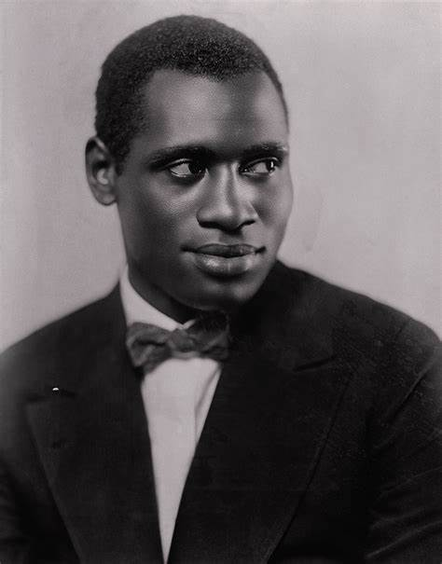
Paul Robeson
A former Football player and Lawyer who graduated from Columbia Law School, he became a Communist activist by the 1930’s.
He led the We Charge Genocide campaign in 1951 alongisde W.E.B. Dubois and William L Patterson.
He visited the Soviet Union in the 1930’s where he claimed “this is the first time I felt fully human.”
His passport was taken from him as a result of his political activities.
His right to travel was restored by 1958.

Slide 21
New Member Introductions
What is your name, pronouns and state (or country/territory)?
Where do you work? Is it unionized?
How did you find out about the People’s School?
What do you think about tonight's class?

Slide 22
Volunteers Needed!
We are in need of volunteers for the staff of the People’s School! Here’s a few roles we need filled:
People to help manage posting on our social media and podcast platforms
Video Editors, Audio Editors, Graphic Designers, Artists, Narrators
Facilitators, Web Controls, Moderators
Email info@peoplesschool.us if you’re interested and try to attend our next staff meeting on March 2nd if possible.

Slide 23
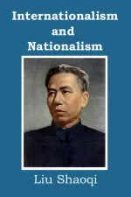
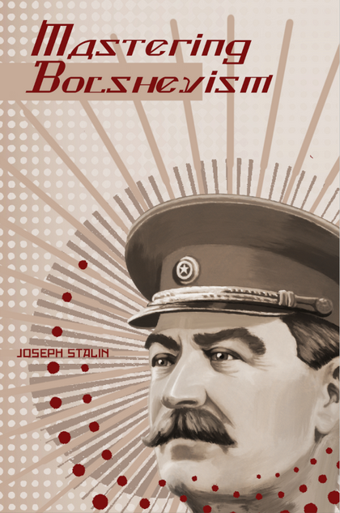
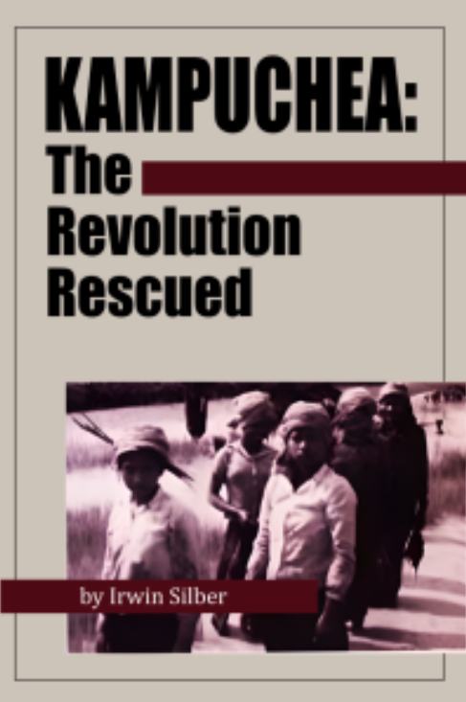
New Outlook Publishers
newoutlookpublishers.store
Latest Releases

Slide 24
Legal Drive
Last year we were attacked and sabotaged by wreckers that tried to steal the PSMLS and destroy the PCUSA.
They failed, but they will be held accountable and there are still things they took from us that we’ve not got back, like videos, imagery and audio. That is why we still need donations to the legal drive.
To donate, go to partyofcommunistsusa.net/donations/
Put “For legal funds” in the details box and try to donate on Tuesday or Thursday so it is easier for us to sort through. It will go to the legal fund. Anything helps!

Slide 25
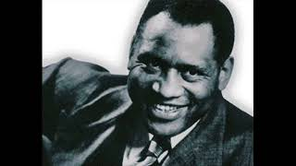
The House I Live In sung by Paul Robeson

