Slide 1
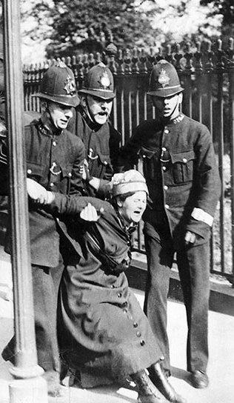
Women Union Activists in the 1900s
Capturing American History
that has been lost.

Slide 2
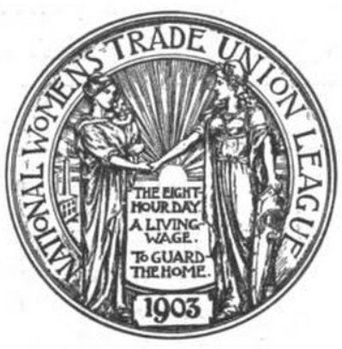
Why concentrate on the women’s involvement
in the American Union Movement?
Not only has the American Union Movement itself been downplayed, or eliminated from our textbooks, but women’s contributions are almost non-existent. This class will work on restoring our rightful place in American History.

Slide 3
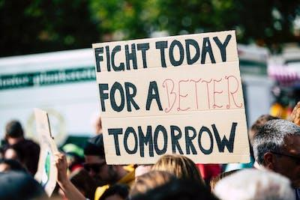
Fannie Sellins
Lucy Parsons
Emma Tenayuca
Elizabeth G.Flynn
Velma Hopkins
Jessie de la Cruz

Slide 4
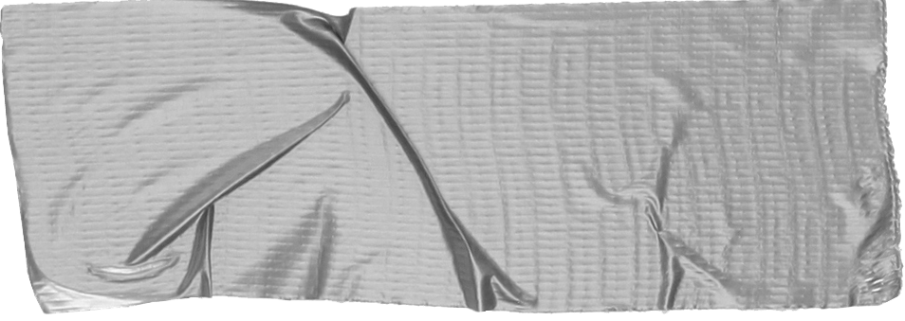
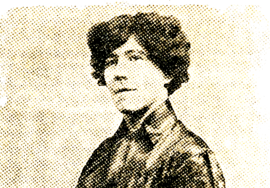
Fannie Sellins
Born - 1872 Murdered 1919
After the death of Fannie’s husband, she worked in a garment shop where she helped organize the United Garment Workers of America and in 1911 participated in a major strike.
Moving to Chicago, she became an Organizer for the United Mine Workers of America and was sent to work in the nonunion coalfields of West Virginia. There she was sent to prison for “inciting a riot”. She served six (6) months before she was pardoned by President Woodrow Wilson.
Tip
In this example, we’re leading off with something unexpected.
While the audience is trying to come up with a number, we’ll surprise them with the next slide.

Slide 5
Highlights
Worked with the miner’s wives to organize across ethnic barriers.
Recruited black workers, who originally came north as strike-breakers, into the United Mine Workers America.
Fannie Sellins was “a thorn in the side of the Allegheny Valley coal operators”. A marked woman, she could have “set her own price to move out of the valley, but she refused to betray the miners, or desert them”. The operators openly threatened to “get her”. Their opportunity came on August 26, 1919
August 26, 1919
During a tense confrontation between townspeople and armed company guards outside the Allegheny Coal and Coke company mine in Brackenridge on August 26, 1919, Fannie Sellins and miner Joseph Strzelecki were brutally gunned down. A coroner’s jury and a trial in 1923 ended in the acquittal of two men accused of her murder.

Slide 6
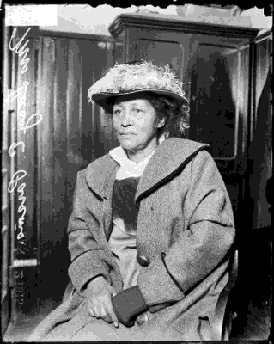
Lucy Parsons c. 1853 – March 7, 1942
HAYMARKET RIOT
On May 1, 1886, Lucy Parsons helped launch the world’s first May Day and the demand for the eight-hour work day. A new international holiday was born.
Parsons went on to help found the International Workers of the World, and worked tirelessly for equality throughout the rest of her life until her death in 1942 at the age of 89.
A protest rally, called by Albert, Lucy’s husband, a few days after May Day became known as the Haymarket Riot when seven Chicago policemen died in a bomb blast. No evidence has ever been found pointing to those who made or detonated the bomb, but Parsons and seven immigrant union leaders were arrested.
As the corporate media whipped up patriotic and law-and-order fervor, a rigged legal system rushed the eight to convictions and death sentences.
Lucy Gonzales started life in Texas, born into slavery. The path she chose after emancipation led to conflict with the Ku Klux Klan, painful personal losses, and many nights in jail. The white supremacy forces in Texas considered the couple, (her husband was white), dangerous and their marriage illegal, and soon drove them from the state.
When Lucy led the campaign to win a new trial, one Chicago official called her “more dangerous than a thousand rioters.”

Slide 7
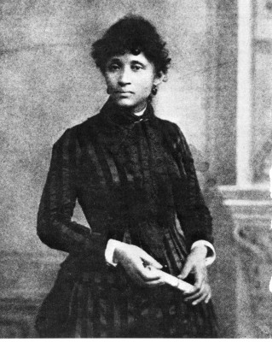
In February 1941, poor and living on a pension for the blind, the Farm Equipment Workers Union asked Lucy Parsons to give an inspirational speech to its workers. On March 7, 1942, fire engulfed the simple home of 89-year-old Lucy Gonzales Parsons ending a life dedicated to liberating working women and men of the world from capitalism and racial oppression. Federal and local lawmen arrived at the gutted Parsons home to make sure her legacy died with her. They poked through the wreckage, confiscated her vast library and personal writings, and never returned them.
HIGHLIGHTS
First she advocated a measure close to her heart when she called women “the slaves of slaves” and urged IWW delegates to fight for equality and assess underpaid women lower union fees.
In a longer speech, she called for the use of nonviolence that would have broad meaning for the world’s protest movements. She told delegates workers shouldn’t “strike and go out and starve, but to strike and remain in and take possession of the necessary property of production.”
Lucy was of Mexican American, African American, and Native American descent and born into slavery.

Slide 8
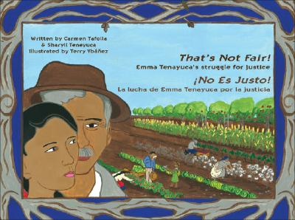
“I was arrested a number of times. I never thought in terms of fear. I thought in terms of justice.”
Meet Emma Tenayuca
From 1934-48, Emma supported almost every strike in San Antonio, writing leaflets, visiting homes of strikers, and joining them on picket lines. She joined the Communist Party and the Workers Alliance (WA) in 1936. Due to anti-Mexican, anti-Communist, and anti-union hysteria Tenayuca fled San Antonio for her safety but later returned as a teacher. She led a wave of strikes by women workers in Texas in the 1930s. During this time, the Great Depression had led to terrible hardship for many Americans. New Deal laws expanded the rights of workers to organize unions and demand better conditions. But it was leaders like Tenayuca who brought people together to fight for changes in their lives.

Slide 9
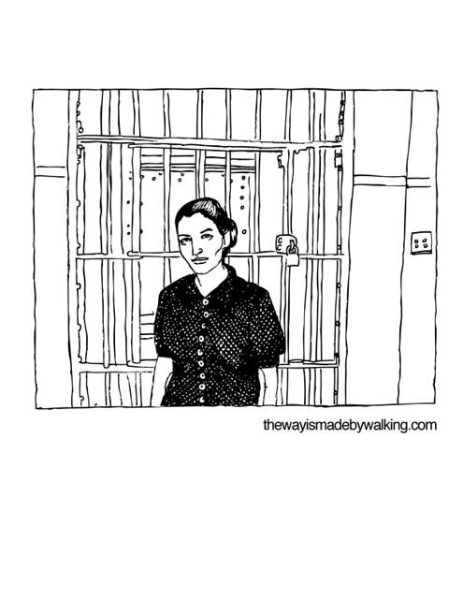
HIGHLIGHTS
Emma organized a protest over the beating of Mexican migrants by United States Border Patrol agents and was instrumental in the 1938 Pecan Shellers Strike in San Antonio.
In August of 1939, Tenayuca received death threats due to her involvement with the Communist Party and was blacklisted in San Antonio, forcing her to relocate to Houston, Texas, and eventually to San Francisco, California.

Slide 10
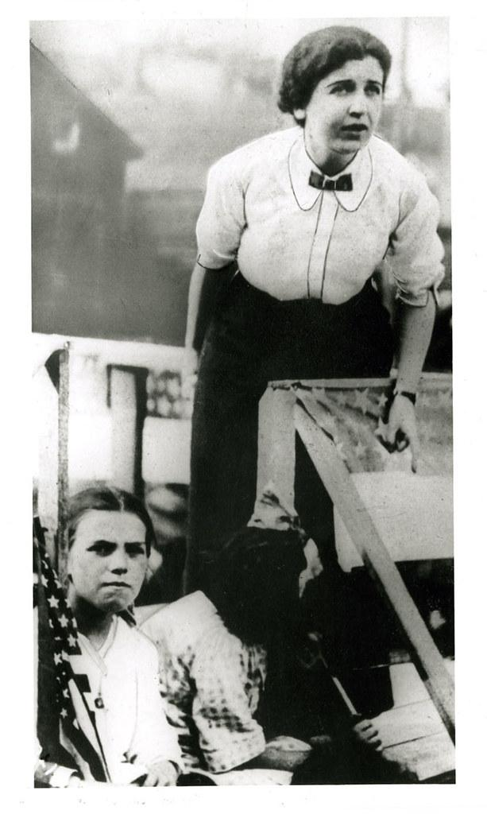
In 1912, Lawrence, Mass. was one of the textile capitals of the world. Half of all the city's residents over the age of 14 worked in the mills.
The giant Wood Mill was the largest cloth producing factory on the planet. It alone employed 40,000 workers. The workers came from more than 30 countries, spoke more than 45 different languages and they worked in hot, dangerous, deplorable conditions. Then, on January 12, 1912, some 25,000 workers walked off the job.
ELIZABETH GURLY FLYNN

Slide 11
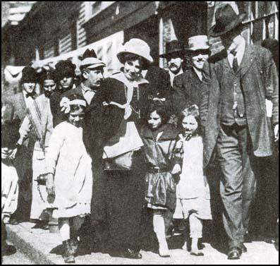
In 1907, Elizabeth Gurley Flynn became a full-time organizer for the Industrial Workers of the World and in 1912 traveled to Lawrence, MA during the Great Textile Strike. With the arrests of Joseph Ettor and Arturo Giovannitti Flynn at the end of January she became “the strike’s leading lady.”
She was a major organizer of the various trips by children of textile workers to supportive cities like New York. She called the children’s demonstrations “the most wonderful that I have ever seen. I have been in strikes and battles for free speech but I have never seen such an outburst of human brotherhood as I saw Saturday.”

Slide 12
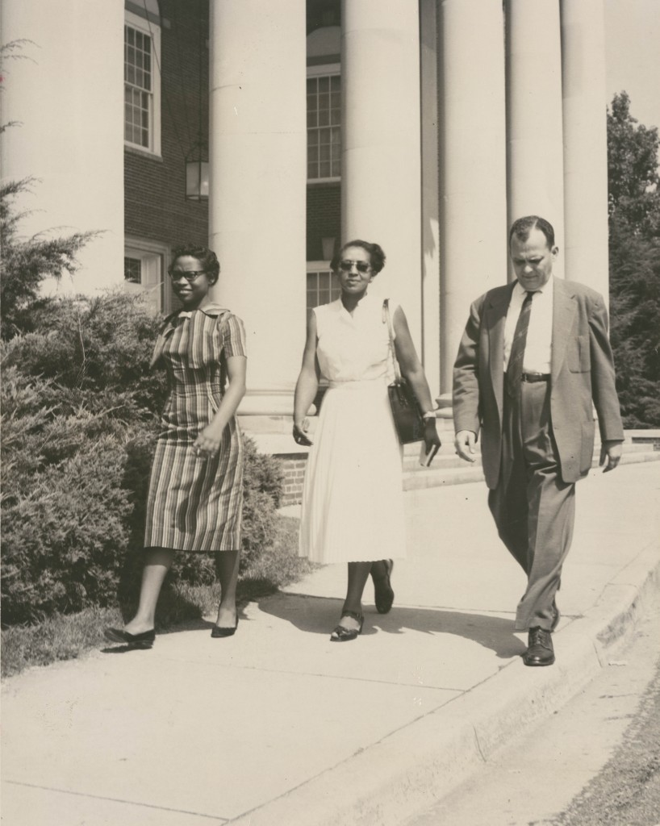
VELMA HOPKINS
“I know my limitations and I surround myself with people who I can designate to be sure it’s carried out. If you can’t do that, you’re not an organizer.”
Velma Hopkins helped mobilize 10,000 workers into the streets of Winston-Salem, NC, as part of an attempt to bring unions to R.J. Reynolds Tobacco Company. The union, called Local 22 of the Food, Tobacco, Agricultural and Allied Workers of America-CIO, was integrated and led primarily by African American women. They pushed the boundaries of economic, racial and gender equality.
Velma Hopkins, center, became active in the Civil Rights Movement. Here she is escorting the first black student to the newly desegregated R. J. Reynolds High School in North Carolina. Image: Digital Forsyth.

Slide 13
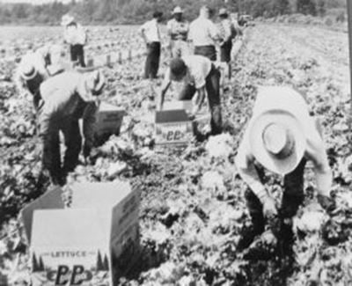
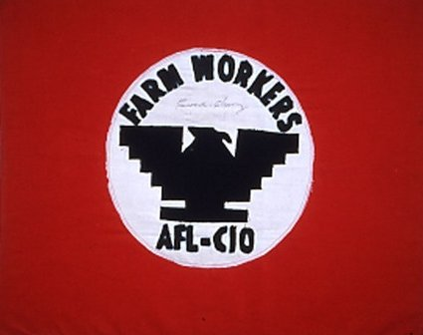
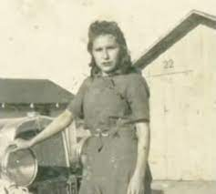
Jessie de la Cruz
A field worker since the age of five, Jessie knew poverty, harsh working conditions, and the exploitation of Mexicans and all poor people. Her response was to take a stand. She joined the United Farm Workers union in 1965 and, at Cesar Chavez’s request, became its first woman recruiter. She also participated in strikes, helped ban the crippling short-handle hoe, became a delegate to the Democratic National Convention, testified before the Senate, and met with the Pope. She continued to be a political activist until her death in 2013.
Helped ban the crippling short-handle hoe

Slide 14
WHAT DID THESE WOMEN HAVE IN COMMON?
WHAT DIFFERENT ATTITUDES
OR TECHNIQUES DID THEY USE?

