Slide 1
Dialectical Materialism
PSMLS 10/25/22-10/27/22

Slide 2
What We’ll Be Learning
The History of Dialectical Materialism
How Dialectical Materialism Works
Practical Application of Dialectical Materialism

Slide 3
Dialectics
Hegel formulated the main features of the original dialectical method.
Marx and Engels took the rational aspects of dialectics and “turned it on its head.”
Materialism
Roots trace back to ancient philosophers such as Democritus, Epicurus, etc.
Originally existed in a crude form as mechanistic materialism.
History of Dialectical Materialism

Slide 4
Hegelian dialectics places the ideal as primary, while Marxist dialectics places the material and objective as primary.
History of Dialectical Materialism

Slide 5
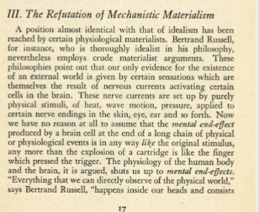
Marxism and Modern Idealism
John Lewis

Slide 6
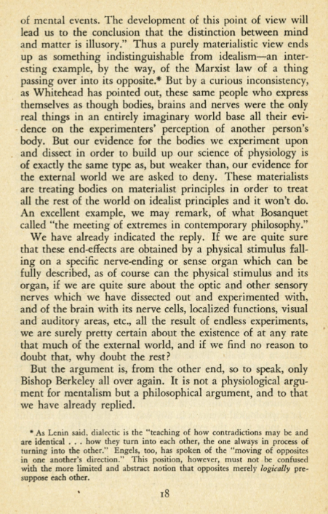
Marxism and Modern Idealism
John Lewis

Slide 7
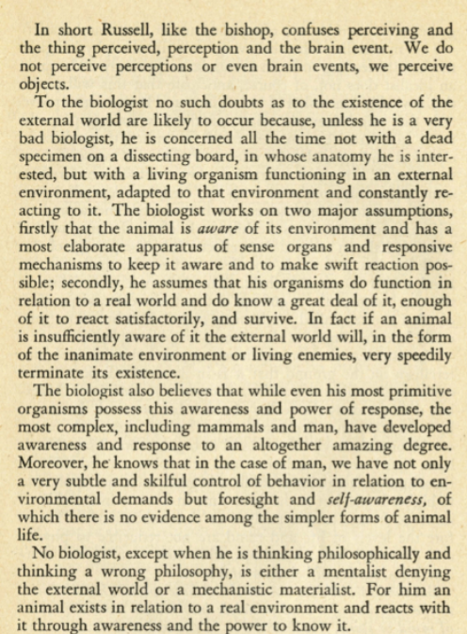
Marxism and Modern Idealism
John Lewis

Slide 8
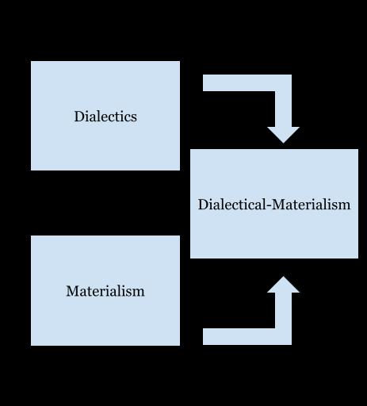
Marx and Engels took Dialectics and applied a materialist lens, creating Dialectical Materialism
History of Dialectical Materialism

Slide 9
Discussion

Slide 10
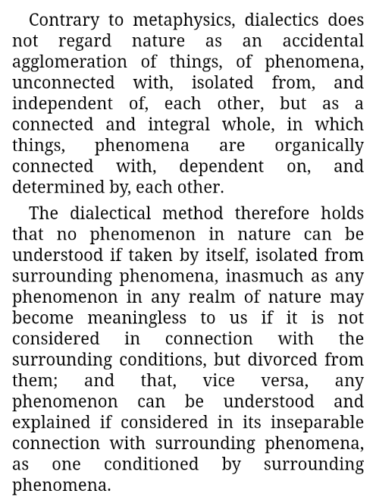
Dialectical and Historical Materialism
Joseph Stalin

Slide 11
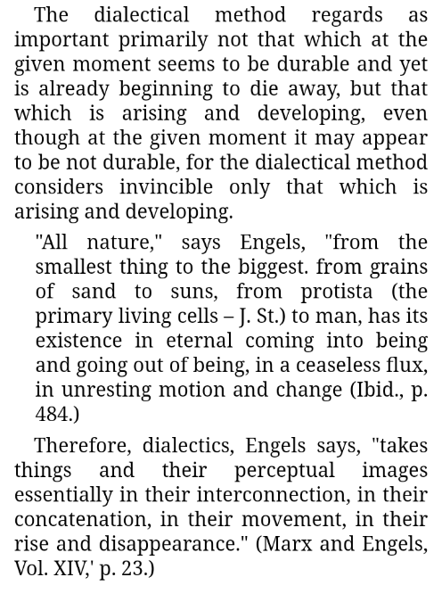
Dialectical and Historical Materialism
Joseph Stalin

Slide 12
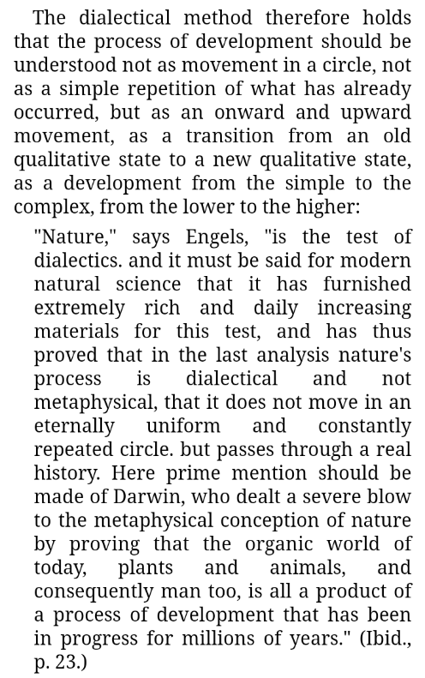
Dialectical and Historical Materialism
Joseph Stalin

Slide 13
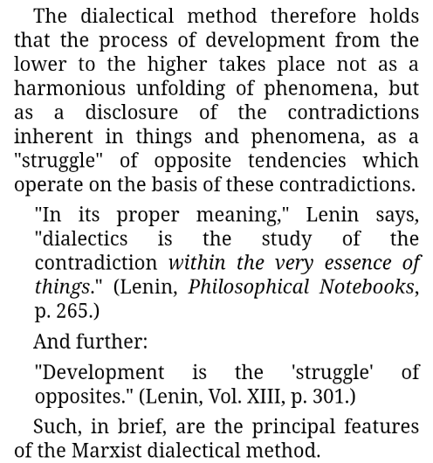
Dialectical and Historical Materialism
Joseph Stalin

Slide 14
Dialectical Materialism is a new mode of thinking and analysis, the proper application of which requires a total shift in the way we think of and interact with the world.
All things have both internal and external contradictions which influence their development. Of the two, internal contradictions are primary.
A dialectical relationship is a relationship between two things which are contradictory and influence the development of each other.
How Dialectical Materialism Works

Slide 15
Dialectical Materialism is not a simple idea, but a law of nature that guides the development of everything.
How Dialectical Materialism Works

Slide 16
Discussion

Slide 17
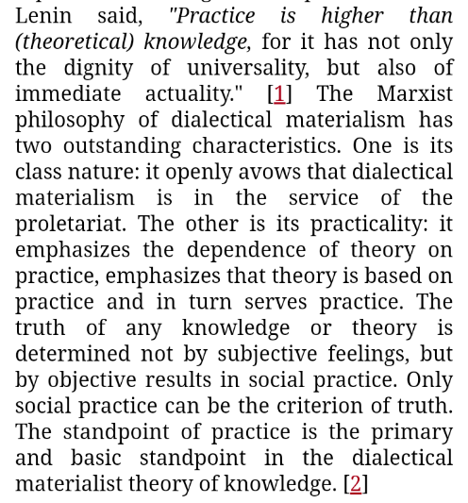
On Practice
Mao Tse-tung

Slide 18
The dialectical materialist method should be used to inform our analysis of various situations, looking at the objective whole with all its contradictions.
When analyzing a situation, we must first engage in the action of trying to change a thing, or study those who have, and then analyze the results.
In any analysis:
The objective reality must be primary.
That which is arising must be placed before that which is decaying.
We must understand things as a whole through their internal and external contradictions.
Practical Application of Dialectical Materialism

Slide 19
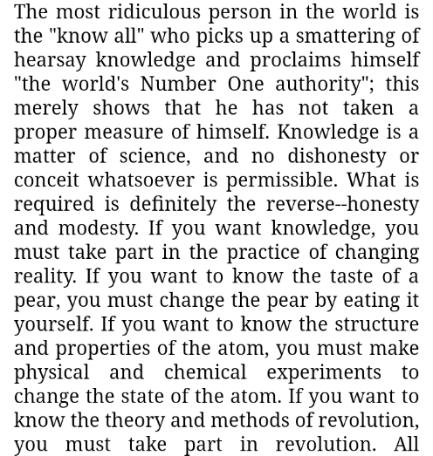
On Practice
Mao Tse-tung

Slide 20
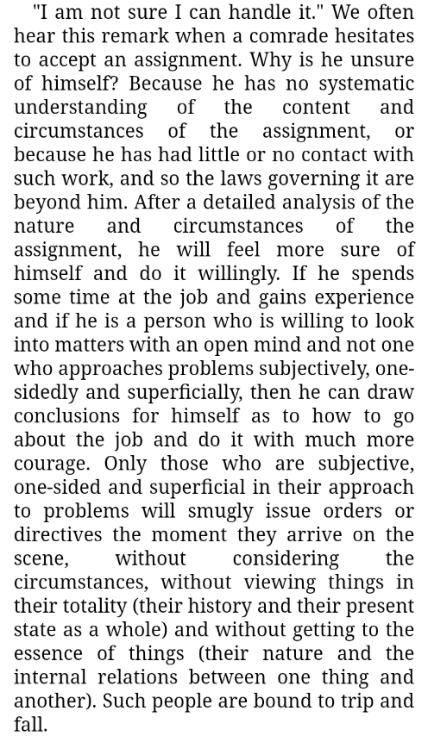
On Practice
Mao Tse-tung

Slide 21
Discussion

