Slide 1
The November Revolution
PSMLS 11/1/22-11/3/22

Slide 2
What We'll Be Learning
The October Revolution by Stalin
Reviewing Soviet Decrees and statistics
A short video on the history of the November Revolution

Slide 3
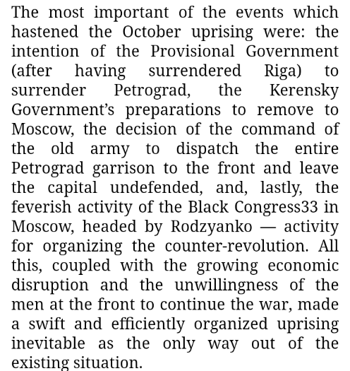
The October Revolution
JV Stalin

Slide 4
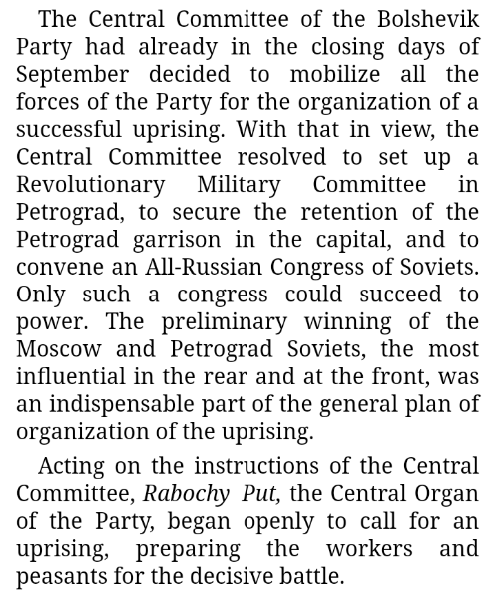
The October Revolution
JV Stalin

Slide 5
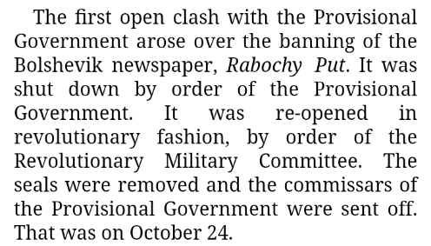
The October Revolution
JV Stalin

Slide 6
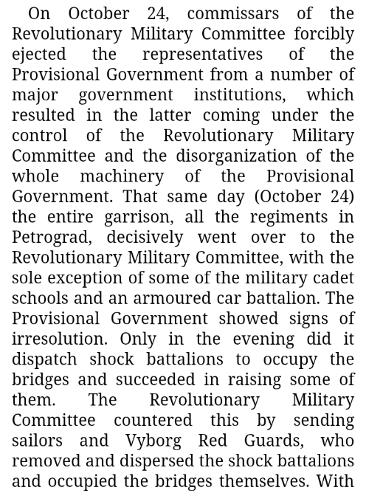
The October Revolution
JV Stalin

Slide 7
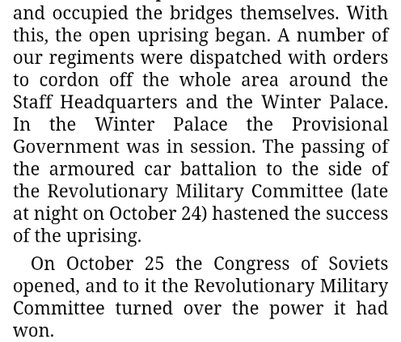
The October Revolution
JV Stalin

Slide 8
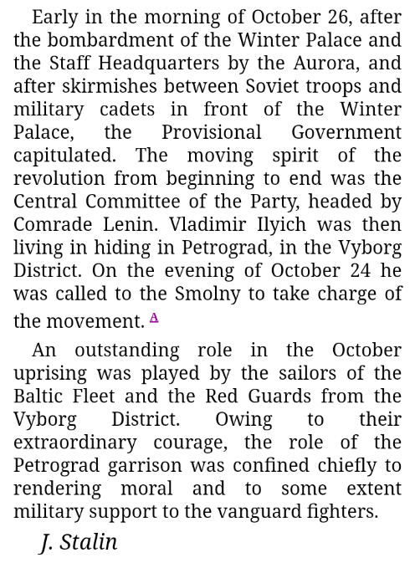
The October Revolution
JV Stalin

Slide 9
Q&A

Slide 10
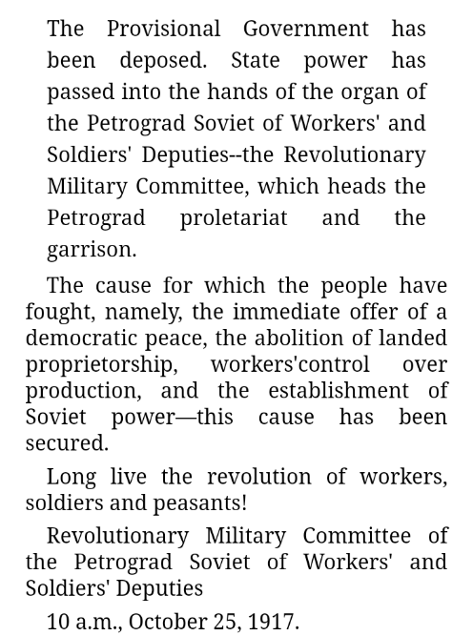
To the Citizens of Russia!
October 25/November 7

Slide 11
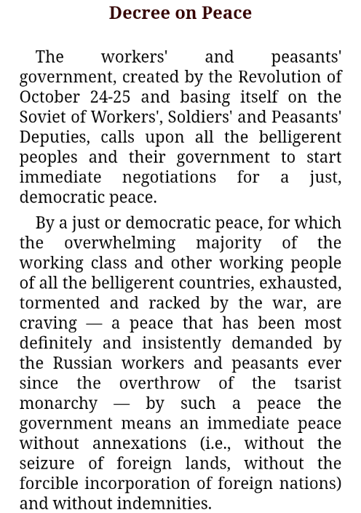
Decree on Peace
October 26/November 8

Slide 12
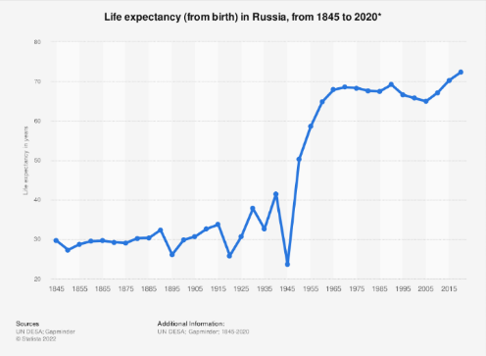
Life Expectancy in the USSR
Life expectancy increased under Soviet leadership, especially after WWII

Slide 13
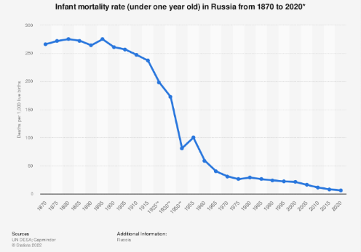
Life Expectancy in the USSR
Once the Soviets took power, not only did overall life expectancy increase, infant mortality rates plummeted.

Slide 14
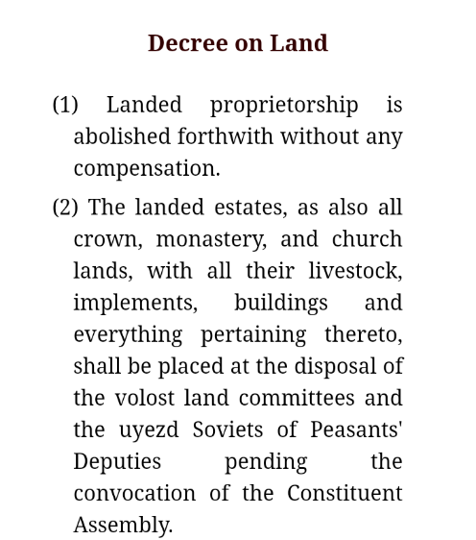
Decree on Land
October 26/November 8

Slide 15
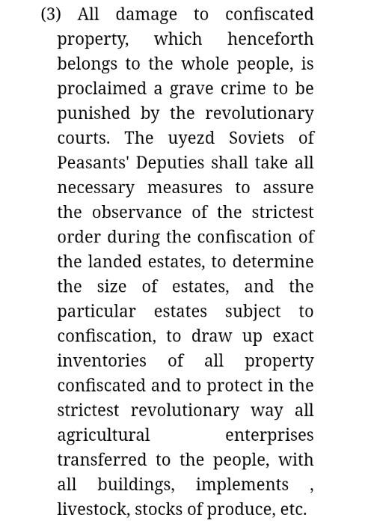
Decree on Land
October 26/November 8

Slide 16
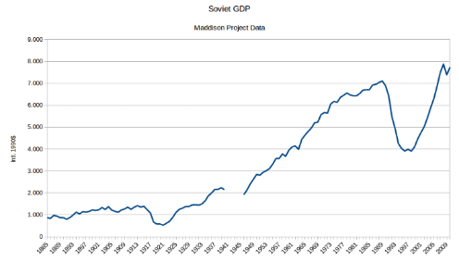
Economy in the USSR
The GDP of the USSR skyrocketed, not only that, but they industrialized in under a decade!
However, after the 1991 counter-revolution and the reintroduction of capitalism, the economy of Russia crashed.

Slide 17
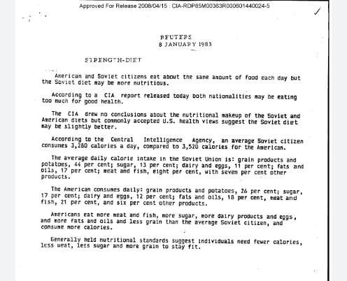
Economy in the USSR
While the USSR did suffer from famines due to various factors, even the CIA admitted that by the 1980s, their caloric intake was not only comparable to the west, but they had a better diet.

Slide 18
Q&A

Slide 19
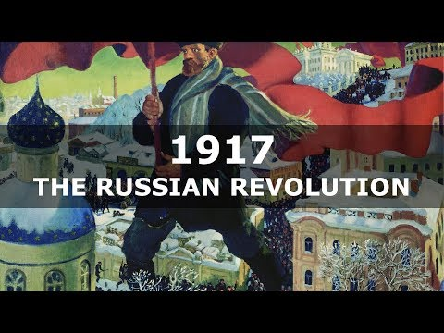
Brief History of October Revolution - TheFinnishBolshevik

Slide 20
Q&A

