Slide 1
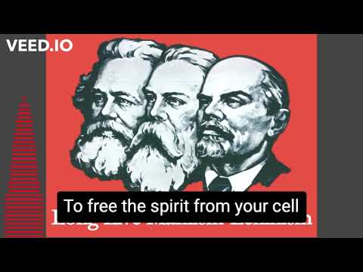
The Internationale

Slide 2
Political Economy
PSMLS 11/15/22 - 11/17/22

Slide 3
What we’ll be studying today
Reading from Value, Price and Profit by Karl Marx, and the Political Economy Textbook of the Academy of Sciences of the USSR republished by New Outlook Publishers in 2020.

Slide 4
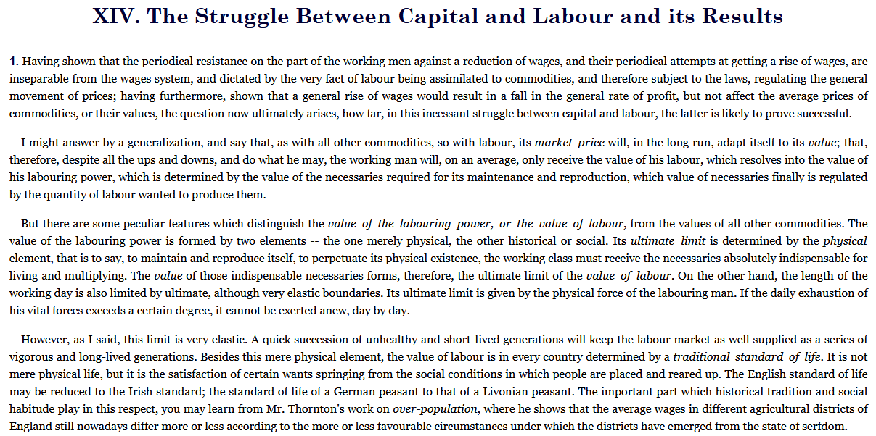
Value, Price and Profit by Karl Marx

Slide 11
