Slide 1
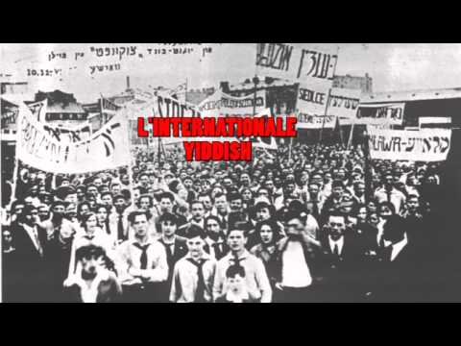

Slide 2
International Workers Order
PSMLS 11/28/22-12/1/22

Slide 3
What We’ll Be Learning
The History of the International Worker’s Order
Its Relation to the Communist Movement
Its downfall and the JPFO.

Slide 4
Origins of the International Workers Order

Slide 5
Der Arbeter Ring (The Workmen’s Circle)
Founded in 1900 by Eastern European immigrants, mostly Yiddish.
Social democrat, Jewish, mutual aid organization (this mutual aid is different from contemporary anarchistic mutual aid)
Dominated by members of the Socialist Party of America.
Was anti-Soviet, decrying Soviet judicial actions against the Socialist Revolutionary Party.
Was affiliated with the Yiddish newspaper “The Forward”
Origins of the International Workers Order

Slide 6
Split in The Workmen’s Circle
Factional disputes go back to 1922
In Feb ‘22, a new Executive Committee was made and Communists were prevented from getting on the Credentials Committee.
In May of ‘22, the 22nd Conference of the Workers Circle was held.
2 Executive Decisions angered left-wing members:
One against the Soviet Union
One against Workers Party USA and Yiddish Morgan Freiheit Paper
A Protest Convention was held in June of 1922
The National Executive Committee struck back and suppressed the Left-Wing faction, shutting down the Boston District Committee
On October 11th 1929, a National Conference of Minority Groups of the Workmen's Circle was held and attended by 193 delegates from all around the country.
The Left-Wing faction then made the decision to leave the Workmen’s Circle and start their own working class formation
Origins of the International Workers Order

Slide 7
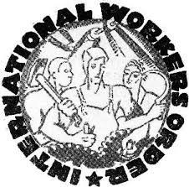
Establishment of the International Workers Order
Formed in 1930
Founded by open members of the Communist Party USA, Rubin Saltzman and William Weiner. Salztman became the first General Secretary, Weiner the first President
In the 1920’s, the Communist Party USA operated language federations, but they faltered as the decade went on. The IWO took its place, albeit not being part of the party itself.
They provided members with low-cost life insurance, published newsletters in different languages and held community events for the different ethnic and cultural groups.
The Order grew from ~3000-5000 members at formation to ~155,000 members by its peak in 1941.
Origins of the International Workers Order

Slide 8
Discussion

Slide 9
Life of the International Workers Order

Slide 10
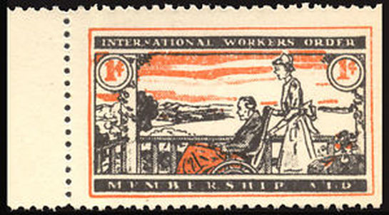
Insurance Programs
The IWO provided a very low-cost life insurance to its members initially.
In the 1940’s, they offered health insurance at the same low-cost.
The IWO operated medical and dental clinics.
Was the only insurance at the time for coal-miners that gave them the same benefits as other occupations.
Was also the only insurance that gave black Americans the same benefits as white workers.
Life of the International Workers Order

Slide 11
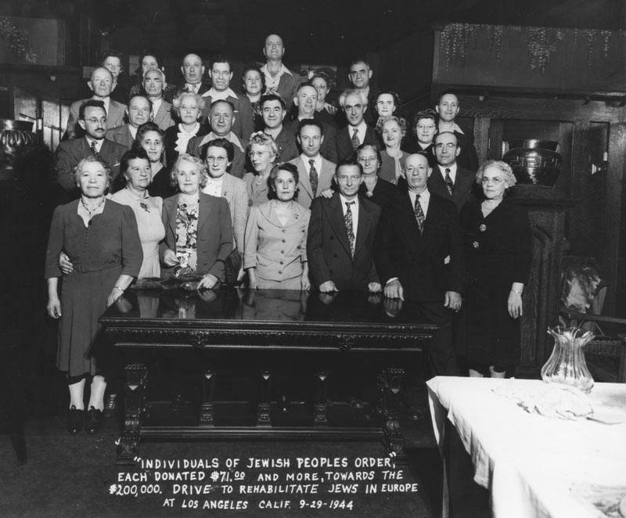
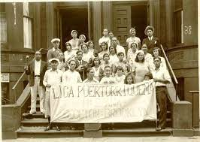
Sections of the IWO
The IWO was comprised of 15 sections:
Jewish People's Fraternal Order
English section
Czech Workers Society
Ukrainian-American Fraternal Union
Carpatho-Russian National Society
Hellenic-American Brotherhood
Serbian-American Federation
Russian American Mutual Aid Society
Slovak Workers Society; the Polonia Society
Rumanian American Fraternal Society
(Italian) Garibaldi American Fraternal Society
Hungarian Workmen's Sick, Benevolent, and Educational Federation
(Spanish) Cervantes Society Mutualista Obrera Puertorriqueña
Finnish American Mutual Aid Society
Life of the International Workers Order

Slide 12
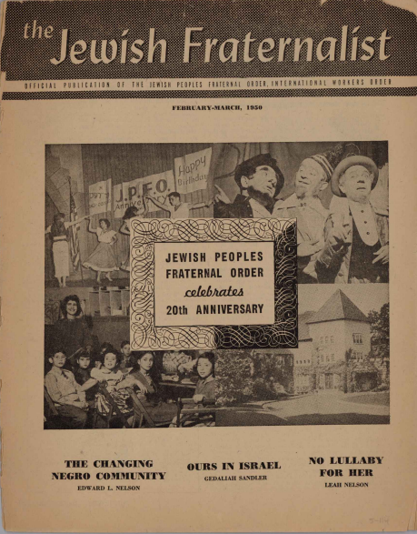
Jewish Peoples Fraternal Order
Started as “Jewish Section” of IWO, received the name of “Jewish People’s Fraternal Order” in 1944.
Was the most well-known and largest section of the IWO, holding ⅓ of the membership of the IWO.
Camp Kinderland was a notable Jewish summer camp in Massachusetts that was operated by the IWO.
Was expelled from LA Jewish Community because of McCarthyism and the old Worker’s Circle supporters.
After McCarthyism, the JPFO changed to the Jewish Cultural Clubs and Societies and dropped the mutual benefits aspect.
Operated the publication “The Fraternalist”
The United Jewish People's Fraternal Order is the 2022 Resurrection of the JPFO, initiated by the PCUSA.
Canadian Equivalent, UJFO, still exists today.
Life of the International Workers Order

Slide 13
Discussion

Slide 14
Destruction of the International Workers Order

Slide 15
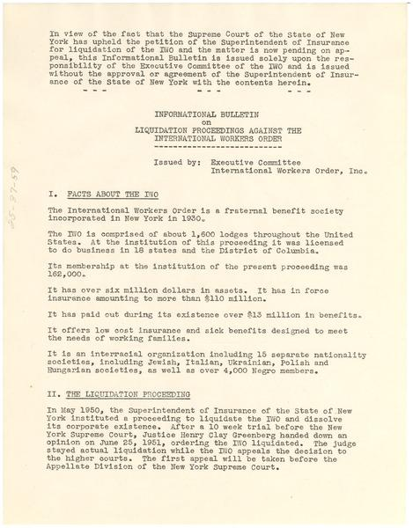
Repression from 1944-1950
In 1944, the HUAC began to publicly call out the International Workers Order as a communist affiliated organization
The Special Committee said the IWO was a “huge patronage machine furnishing positions for a host of Communist functionaries, who serve as the party's controlling commissars within the organization”
In 1947, the US Attorney General placed the IWO on its list of subversive organizations.
The New York State Insurance Department moved to liquidate the IWO in 1950 on charges that its large cash reserves “would be surrendered to the Soviet Union by the IWO in the event of war.”
Destruction of the International Workers Order

Slide 16
Disbanding
In 1951, the State of New York took legal action against the IWO on the grounds of being too close to the Communist Party USA.
This case dragged out for 4 years against the backdrop of McCarthyism in the United States.
Even during these tough times for the IWO, they were still providing necessary services and were still thousands of members strong.
In 1954, the International Workers Order finally came to an end when it was disbanded by the order of the State of New York.
Destruction of the International Workers Order

Slide 17
Legacy of the International Workers Order
The IWO continued the legacy of the language federations of before and furthered the solidarity between the working class of the different ethnic/cultural communities of the US.
The removal of the services provided through IWO, it highlighted the necessity for better insurance coverage for the working class, especially ethnic communities.
Camp Kinderland, originally ran by the IWO, survived McCarthyism and still operates as a Jewish summer camp today.
It has been suggested that the mutual aid concept behind the IWO could be applied to Gig Economy workers since they have no employer provided benefits.
Destruction of the International Workers Order

Slide 18
Discussion

