Slide 1
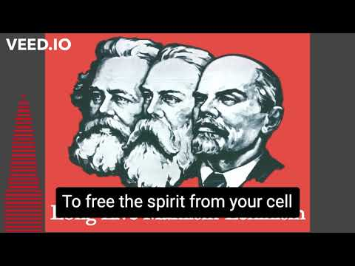

Slide 2
Political Outreach
PSMLS 11/8/22 - 11/10/22

Slide 3
What we’ll be learning:
The different forms of political outreach and why we do them
Methods used in political outreach; differences depending on form
How to conduct yourself when engaging in outreach

Slide 4
“Outreach” itself means simply the act of reaching out. That can be with a service or message or offer.
Politically, this could be reaching out to the masses, to other organizations or even to those in power on certain occasions, either by directly contacting them or via propaganda.
There are different forms of political outreach:
Community Outreach - Reaching out to your local community members with a call to action or a survey or to recruit them into an organization
Coalition Outreach - Connecting your organization with other political organizations that you might like to work with or stand in solidarity with
International Outreach - The party or organization you’re with making connections with other parties or organizations around the world that you’d work with or send greetings to
What is “Outreach”

Slide 5
Community Outreach is reaching out to the masses in your community. This could be for a variety of things, and propaganda will play a critical role in much of your outreach. A few different instances of community outreach would be:
Rallying community members to a call for action. This could be for a strike, a demonstration, a campaign, an election etc.
This will require posting propaganda for your call to action in places where many community members will see, both in the community itself and in online spaces where community members gather. Once community members are interested, keep in communication with them, interact professionally with them, keep them posted on any updates on the effort, and try to keep the motivation going.
Lack of communication, rudeness or inappropriate behavior, failing to give updates on the effort and burnout will all work to the detriment of what you’re doing.
Community Outreach
What is “Community Outreach”
A common example of this in bourgeois parties is “Get Out the Vote” events/campaigns

Slide 6
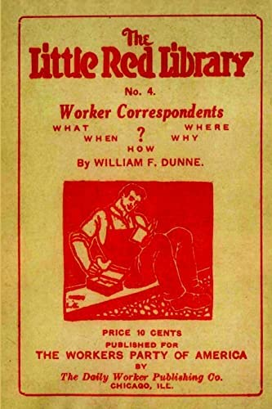
Surveying the opinion of the people in your community on an issue. This may be on rent costs or labor struggles or on homelessness or on any specific event that happened or policy enacted in your community.
This could be through an actual survey with questions to answer or by interviewing people for a publication or documentary.
This can be important for a campaign you’re waging on an issue or to use to agitate the masses more on an issue. Many working class people don’t always have a voice for themselves, so we should give them one.
When doing this, be professional and understanding. Don’t force an opinion out of someone, and don’t show up to an event uninvited to start interviewing people or passing out a survey (more on working w/ event hosts in coalition outreach).
Community Outreach
Examples of Community Outreach Continued
“Workers Correspondents” by William F. Dunne is an excellent book to reference for this work.

Slide 7
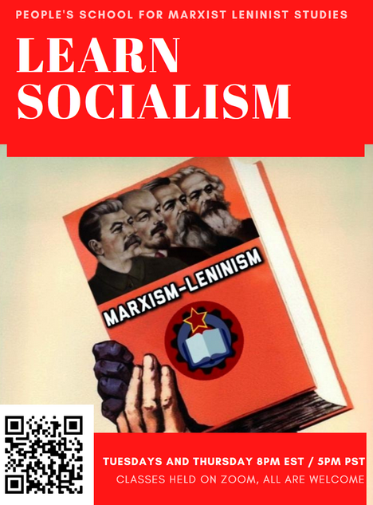
Establishing your organization in the community and recruiting community members to your organization.
By first establishing your organization in the community through events, tabling, propaganda and by generally having a presence, you can then easily recruit members from the community into your organization.
Of course this can be through getting folks to sign up on a sign-up sheet when you’re tabling, but this can also be through the use of propaganda that invites people to join your organization with a phrase like “Want to stop ____? Join _____!” or something along the lines of the classic “We Want You!” poster.
Once people are interested in joining, you will have to keep in communication with them the same as for a call to action, and you should take some time when possible to talk to the people you recruit and bond with them as a comrade. It is important to remember comrades does *not* equal friend, and you will certainly not agree with every community member, but it is the work you’re doing that matters. Be respectful and professional.
Community Outreach
Examples of Community Outreach Continued
This PSMLS Flyer is an example of propaganda inviting people to our school.

Slide 8
These forms of Community Outreach can and should be used in tandem with each other, but you should strategize when and how to do so

Slide 9
Q&A
Do you have any examples of Community Outreach?

Slide 10
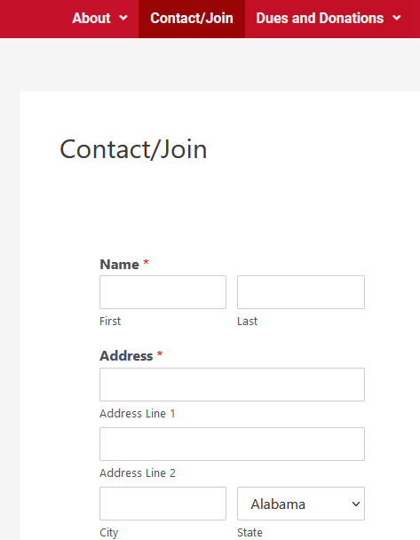
Coalition Outreach is organization to organization coordination. Coalition building is a key part of political work and has its own forms of outreach. It involves thorough communication with the organizations you want to work with and a disciplined manner of doing it. Here’s a few key points on how you go about coalition outreach:
Initially, reach out to the leaders of an organization you’re interested in working with, give them a brief introduction of yourself and your organization and how you’d like to work with them. This should be done professionally and respectfully, and should be an act of extending an olive branch and trying to build a relationship.
This may be in-person at an event, forum or at their office if they have one, or it may be done through online or telephone communication. You will have to be considerate of their time and availability, and understanding if they can’t talk to you that very moment or if it's not the time or place for it.
Once you’ve established contact, you will need to keep in communication with them and support them in the causes you’d like to build a coalition with them about. This will build your relationship with them and establish your org as an ally with them.
Coalition Outreach
What is “Coalition Outreach”
Most organizations have a page with either contact information, or a form to contact that org. Example is PCUSA.

Slide 11
In your work with other organizations, you should STICK TO THE SUBJECT AT HAND.
If you’re working with a shop that’s trying to unionize, you probably shouldn’t bring up issues of war and peace. If you’re trying to build a coalition with a group opposing police brutality and systemic racism, you should avoid talking about climate change and environmental policies. Working with an LGBT+ pride organization, you probably want to leave a conversation about the problems of rural America at the door.
Unless another issue ties in and is directly related to the subject at hand, avoid bringing it up. It’s not worth risking your coalition with that organization.
It helps to appoint a person within your organization as representative from your org to the another. That person should preferably be someone who shares in whatever struggle the 2 orgs want to unite on, and especially if that person already has experience with that organization and knows the people there. If there are pre-existing relationships, build on them.
The representative should try to attend most public meetings of the other organization, and convey any information that needs to be conveyed between orgs, and bring back whatever necessary information to report.
Coalition Outreach
Coalition Outreach Key Points Continued
Most organizations have a page with either contact information, or a form to contact that org. Example is PCUSA.

Slide 12
When the organization you’re working with has an important event like a congress or conference, have your org write up a greeting to send to the organization that acknowledges the work they do, congratulates them on that work and on their event, reiterates your organizations support for them, and thanks them for the relationship your two organizations share.
Share the relevant content of the organization you’re allied with and boost their campaigns. If possible, work with them to make their campaigns a joint effort, that way you can make coalition propaganda that strengthens your allyship with that organization.
When you have more than 2 organizations in your coalition, work with all of them to facilitate a meeting of the organizations involved and instigate inter-organizational coalition communication so that you’re all on the same page, and can use your different organizations strengths and weaknesses your collective advantage in the struggle you share with them.
Coalition Outreach
Coalition Outreach Key Points Continued
Most organizations have a page with either contact information, or a form to contact that org. Example is PCUSA.

Slide 13
Q&A
Have you any experience in coalition outreach or coalition building?

Slide 14
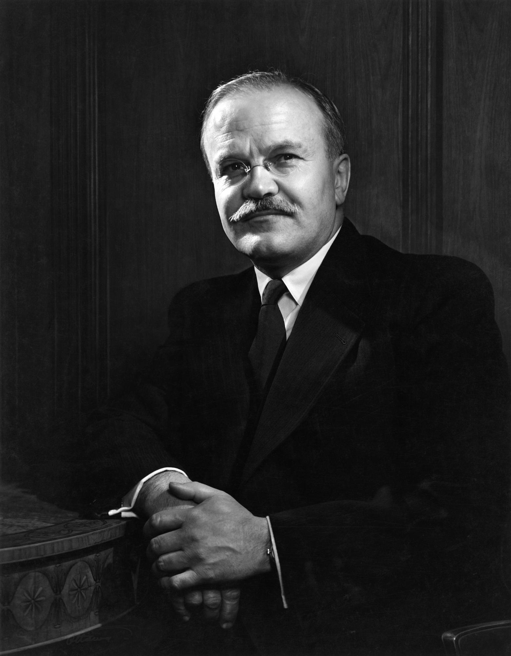
International Outreach is fostering connections internationally with foreign parties or organizations. This can be situationally, working to support an organization for a time, such as against fascism or imperialism, or generally, working to build an international coalition of organizations, such as the international communist movement. Here’s some ways in which that can be accomplished:
Someone in your organization is given the role of being an international secretary (or something of that nature). They will reach out to the offices of the foreign organizations and will begin conversations with the corresponding members of that organization, and will then try to facilitate a meeting of the two organizations to greet each other, discuss their relationship and how they will work with each other.
In a way, it is much like coalition outreach, but instead of being on a domestic, local level, it is on a global scale which makes it more logistically difficult, but somewhat more impactful. There are many times language barriers, timezone differences, internet access issues and more that must be overcome to do it.
International Outreach
What is “International Outreach”
Vyacheslav Molotov is a famous example of a communist who filled this role as Minister of Foreign Affairs of the USSR

Slide 15
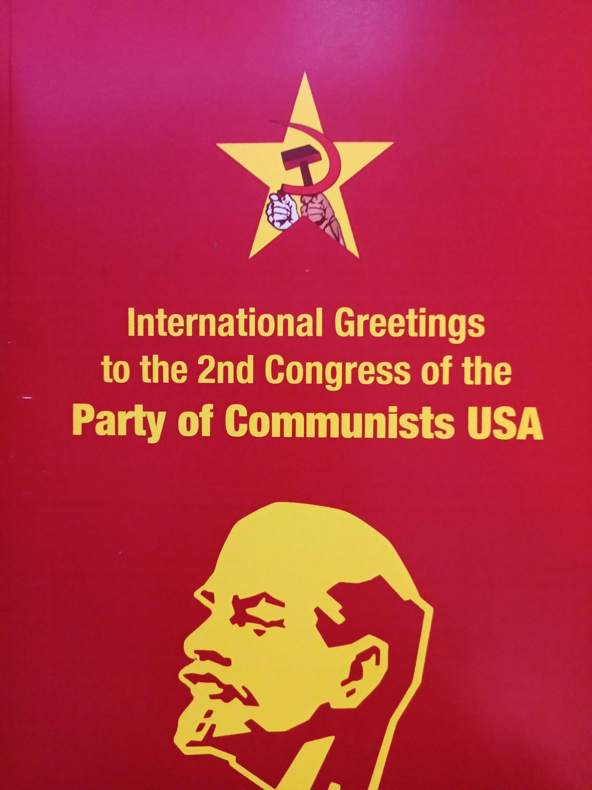
A member who speaks a foreign language and can translate between the two organizations may be asked to fulfill the role of translator. Ultimately, comrades learning foreign languages helps us tremendously in this regard.
Much like in coalition outreach, it is good to send greetings to the congresses and conferences of foreign organizations. Sometimes a group of representatives makes the international trip to a foreign event to give their remarks and stand in solidarity. Sometimes, all an organization can do at the time is send a written greeting, all of which can be compiled and published, which establishes the credibility of that organization internationally.
International Outreach
International Outreach Key Points Continued
The PCUSA, for example, compiled the greetings to its second congress and has sent its members abroad to different international events.

Slide 16
International Outreach is done with the utmost respect and professionalism. Conversations are to the point, appropriate and the results are incredibly significant. These are meetings that can ultimately influence politics all over the Earth.
International outreach is not usually something you do with a local org in your community. It is mostly done in nation-wide organizations that want to connect with foreign groups. With that said, the same tactics used in community outreach won’t be the same used in international outreach.
International Outreach
International Outreach Key Points Continued

Slide 17
Q&A
How do you think international outreach might be different in different situations?

