Slide 1
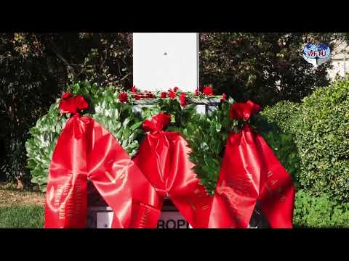
Credit for Video: https://www.youtube.com/watch?v=rA7uPPfGcp0&ab_channel=WFTUFSM

Slide 2
Overview of the Railroad Workers Struggle of 2022
PSMLS 12/13/22 - 12/15/22

Slide 3
What we’ll be learning today:
An explanation of the many terms used here and that we must understand to understand this struggle.
Background to the struggle; conditions of the railroad workers preceding any action.
Timeline of the 2022 Railroad Workers Struggle.

Slide 4
Terminology of the Struggle

Slide 5
Terminology
Unions Involved: There are twelve unions representing 115,000 workers involved in this labor dispute. They are:
The unions most frequently referenced in the news are SMART-TD and BLET. The Railroad Workers United (RWU) is not itself a Union. It is an activist group. It is, in their words, “an inter-union, cross-craft solidarity 'caucus' of railroad workers, and their supporters, from all crafts, all carriers, and all unions across North America.” Pushing for the nationalization of the rails.
the American Train Dispatchers Association
Brotherhood of Locomotive Engineers and Trainmen (BLET)
Brotherhood of Maintenance of Way Employees
Brotherhood of Railroad Signalmen
International Association of Machinists
International Brotherhood of Boilermakers
Mechanical Division of International Association of Sheet Metal, Air, Rail and Transportation Workers (SMART)
National Conference of Firemen & Oilers
International Brotherhood of Electrical Workers; Transport Workers; Transportation Communications Union (including Brotherhood Railway Carmen)
Transportation Division of SMART (including Railroad Yardmasters of America).

Slide 6
Terminology
Railway Labor Act: A federal labor law that governs the railway and airline industries. The aim of the act is to replace strikes with arbitration and mediation when railway carriers and unions cannot reach an agreement as to contract terms. It empowers the government to intervene using a National Mediation Board to broker an agreement between the two disputing parties. The act stipulates that all negotiation procedures must be exhausted before there can be a change to the status quo such as a strike. A strike is only permitted after all stipulated mediation procedures fail. The act also empowers the federal courts to issue injunctions to compel one or both parties to act as the court dictates, under penalty of fine or imprisonment.
Curiously, the RLA imposes fewer restrictions on strike conduct than the National Labor Relations Act. Under the RLA, secondary boycotts are allowed, as are intermittent strikes.
The act differentiates between “major” and “minor” disputes. A major dispute is the making or modification of an agreement, and striking over major disputes is allowed. A minor dispute concerns the interpretation and application of contract terms, and strikes are not allowed. Instead, a remedy through arbitration is expected.
In the event of a strike, a railway carrier may replace a striking worker with a scab. The carrier may not fire the striking worker except for reasons of misconduct. The carriers must also allow strikers to displace their replacements at the conclusion of the strike. If a railway employee crosses the picket line to work (perish the thought), and he is promoted by the carrier, he may keep his position at the strike's conclusion, regardless of seniority rules.

Slide 7
Terminology
The NCCC: The National Carrier's Conference Committee. A consortium of the five U.S. Class 1 railway carriers, and one Canadian carrier. They are: BNSF, CSX, Kansas City Southern, Norfolk Southern, Union Pacific, and Canadian National.
Tentative Agreement: A contract agreement made between the railway carrier bargaining unit and the bargaining unit from the union representing the workers. It is not yet an official agreement. The tentative agreement (TA) must be sent to the rank-and-file of the union for a ratification vote. If the majority of the membership vote to accept the TA, then it becomes the new union contract for a designated period of time (usually 2-4 years.) If the TA is voted down, then the representatives of the union and management must return to the bargaining table and make a new TA.
In the case of the railroads, the federal government may step in to propose a TA to be voted on. They may even use their powers to force unions to accept a rejected TA, as we have seen this previous week.

Slide 8
Terminology
Presidential Emergency Board: The President may create an emergency board to investigate and report on a dispute over the terms of a collective bargaining agreement. Under the Railway Labor Act, the President may exercise his discretion to create an emergency board when the labor dispute threatens “substantially to interrupt interstate commerce to a degree such as to deprive any section of the country of essential transportation service.”
Creation of an emergency board delays a strike, lockout or other form of self-help, generally for 60 days. The emergency board has 30 days to issue its report. Generally, emergency boards provide recommendations for settlement of the dispute. After the emergency board reports to the President, the parties to the dispute have another 30 day cooling off period to consider the recommendations of the emergency board and to reach an agreement.
If no agreement is reached at the end of the cooling off period, then the parties may engage in self-help, including strikes, lockouts and unilateral changes in terms and conditions of employment.

Slide 9
Terminology
Wildcat Strike: A strike undertaken by union members without the sanction or approval of the union's leadership. In the United States, wildcat strikes are illegal. While engaging in them does not typically result in legal trouble, it strips striking workers of their legal protections. They may be fired or otherwise penalized by their employers. A wildcat may become a legal strike if it is later sanctioned by union leadership. In addition, rank-and-file union members engaged in a wildcat may petition the National Labor Relations Board (NLRB) to decertify their union and remove the worker's association with them. The wildcat then becomes legal, as it no longer conflicts with the NLRA.
All that said, for certain industries there is the threat of actual legal consequences for pulling a wildcat strike. Postal workers may be jailed or fined for striking, as can Railway workers.
Class Collaboration: In the context of labor relations, this term describes working class organizations who abandon class struggle. For example, the leadership of a working class union who works with the bourgeois owners of a business to suppress worker's demands are engaging in class collaboration. It is a process of reformist which seeks to reconcile the irreconcilable differences between working and ownership classes.

Slide 10
Terminology
Scab: A slang term for a strikebreaker, also called a blackleg. A scab is a replacement worker hired by a company for the purpose of undermining and ultimately defeating a strike. Scab may also refer to that most lowly of class traitor, a union member that betrays their striking fellows and crosses the picket lines to go and work for the boss.
Robber Baron: A derogatory term for wealthy industrialists and businessmen. It refers to the wealthy oligarchs by two features. One, as a robber, who has stolen the surplus value generated by his workers to enrich himself. Two, as a baron, an unelected aristocrat who wields illegitimate power. There are not supposed to be any barons in a “representative democracy”. The term originally came to use in the 1860s and was used towards the industrialists at the time such as Rockefeller, Carnegie and the like. Modern robber barons include Warren Buffet, Jeff Bezos, and Elon Musk.
Labor Aristocracy: Typically refers to members of the proletariat in a developed country who benefit from imperialism and the exploitation of the proletariat of less developed countries and receive a higher standard of living as a result. It is a way of exporting poverty. Lenin said that companies in highly developed countries exploit workers in less developed countries where wages are very low and working conditions are very poor. The companies extract more profit that way. Then, they pay workers domestically a higher wage. This creates a domestic proletariat who is relatively satisfied with their standard of living and are less inclined to pursue revolution and overthrow the bourgeoisie. These workers are the labor aristocracy.

Slide 11
Terminology
Nationalization: The process in which a privately owned asset, such as a railway system, power grid or postal system, is changed into a publicly owned asset. Sometimes the former private owner is compensated for the loss of their property. In the U.S., the fifth amendment of the constitution is supposed to guarantee compensation for any property taken by the state. Sometimes no compensation is given and the state simply takes (or seizes, if you will) the property. This often happens after a successful Socialist revolution, as the property in question is being used to generate profit through the exploitation of others and is thus illegitimate.

Slide 12
Discussion

Slide 13
Background of the Stuggle

Slide 14
Background
Grievances of the workers:
Hi Viz Attendance Policy:
This punitive policy started with the BNSF Railway on February 1st 2022. Railroad workers start with a bank of “30 points” and if they miss a shift or call in sick they lose points. The number of points lost depends on what day of the week it is, how busy the rail yard is, and whether they miss multiple days in a row. It is possible for workers to lose all 30 points in just a few infractions, and they could lose up to 25 points in a single infraction. Workers originally wanted to strike over this policy with 17,000 workers rallying to prevent this from taking effect. A federal judge however blocked this multiple times calling the policy “arguably justified” but also “harsh.”

Slide 15
Background
Grievances of the workers:
Paid sick days
Railroad workers currently have 0 paid sick days. They are one of a very few number of union workers who receive 0 days of paid sick leave. The workers were asking for 15 days of paid sick leave in their contract, but this was a concession as the workers themselves believe sick days are a right and no one should be forced to work while sick. The house had legislated that the workers would receive 7 days of paid sick leave but the senate struck it down knocking that number back to the 0 that was placed in the PEB tentative contract.

Slide 16
Background
Grievances of the workers:
Precision Scheduled railroading
This is the policy that creates forced overtime and one man crews. Originally introduced by Hunter Harrison, this policy sets the railroads up to put the least number of workers on any given crew or job. This goes as low as one man crews, and then when there is an absence the worker at the site goes into “forced overtime.” “They will hold an employee over to cover the vacancy. 16 hours in a rail yard isn't just grueling, it's unacceptably dangerous. The potential for fatalities is glaringly real, made exponentially worse by fatigue.”

Slide 17
Background
Grievances of the workers:
Hybrid Discipline
The hybrid discipline policy is also a point of contention. The workers are asked to work at a completely unreasonable pace, then they are penalized when inconsistencies or errors are found in their work. This creates an unsafe environment where workloads are not set to reasonable standards and then employees are shamed and disciplined for not being able to meet these unreasonable expectations.

Slide 18
Background
A sum up of events up the Presidential Emergency Board:
This heart of these troubles begin with unexpected dates. One of the first large issues was the Precision scheduled railroading which began in 1993. The railway workers have spent many years trying to adapt to this, but time has proven the danger and long term inefficiency of this system.
Next, there is a bit of an odd nuance here because technically railroad contracts never expire due to the Railway Labor Act, they are just continually amended. For the sake of our discussion though, the Railroad union contract had “expired” in 2020. These negotiations began in earnest in 2021 when it was clear that the workers were demanding more than the railroad companies were willing to give them.

Slide 19
Background
A sum up of events up the Presidential Emergency Board: (Continued)
Our third major point of contention was the Hi-Viz attendance policy which went into effect February 1st of 2022. This was met with an immediate reaction from the workers and the unions demanding that the implementation would be cancelled or they were going to strike. By the end of February, this notion was shot down as a federal judge in Texas called this a “minor” dispute and would not qualify for a legal strike under the Railway Labor Act.
Negotiations continued throughout the summer over the contracts for the railway workers, but it imperitive that we understand by this point they had already been dealing with years of concessions. Mortality rates were rising due to PSR, Hi-Viz complaints were shut down by Federal courts, contracts were not meeting standards, and it was clear the time to strike was coming. By November, the first vote to strike was authorized as 8 of the 12 unions voted yes.
We'll learn more about what happened after this in the following timeline of events.

Slide 20
Discussion

Slide 21
Timeline of the Struggle

Slide 22
Timeline
June of 2022
07/12: BLET membership votes to authorize strike in near unanimous vote.
07/14: SMART-TD President announces initial strike authorization has been granted unanimously by effected General Chairpersons
07/15: President Biden issues Executive Order appointing “neutral” Presidential Emergency Board (PEB), issuing PEB triggers 60 day cooling off period

Slide 23
Timeline
August of 2022
08/16: PEB announces its recommendations, cooling off period to end 09/16
08/29: ATDA, IAM District 19, IBEW, TWU/TCU-BRC announces Tentative Agreements (Tas) based off PEB with NCCC

Slide 24
Timeline
September of 2022
09/11: BMWED, IBB, SMART-MD, announce TAs with NCCC
09/13: NCFO announces TA with NCCC
09/14: IAM District 19 members vote down TA, authorize strike; TWU/TCU-BRC members ratify TA; White House gets involved in negotiations of final 3 unions yet to agree to a TA with NCCC
09/15: BLET, SMART-TD, BRS announce TAs with NCCC
09/27: IAM District 19 announces 2nd TA, agreement to extend cooling off period 2 months
09/28: IBEW members ratify TA

Slide 25
Timeline
October of 2022
10/02: IAM Local 696 President, Reece Murtagh, issues letter condemning IAM District 19 agreement to extend cooling off period without rank-and-file input.
10/04: ATDA members ratify TA
10/07: TCU announces TA with CSX Intermodal based off PEB
10/10: BMWED members vote down TA, cooling off period ends 11/14
10/12: SMART-MD members ratify TA
10/13: NCFO members ratify TA
10/19: Twitter leak claims IAM Local 696 President Murtagh will run for District 19 President due to handling of negotiations
10/26: BRS members vote down TA; TCU members ratify TA

Slide 26
Timeline
November of 2022
11/05: IAM District 19 members ratify 2nd TA
11/06: BMWED extends cooling off period to line up with all unions
11/11: IBB members vote down TA
11/21: BLET members ratify TA; SMART-TD members vote down TA; in total 4 unions reject TA, while 8 ratify, though this is a majority of unions, the 4 who rejected make up the majority of railroad workers.
11/28: President Biden releases statement calling on Congress to ratify Tentative Agreement negotiated by his administration—against the democratic will of the railroad workers—without any alterations
11/29: It is announced that Congress with bring up the Tentative Agreement to vote on 11/30, with a separate vote to add 7 paid sick days.

Slide 27
Timeline
November of 2022: House of Representatives Vote
House of Representatives votes to force rejected TA on rail workers:
House of Representatives votes to add 7 paid sick days to TA:

Slide 28
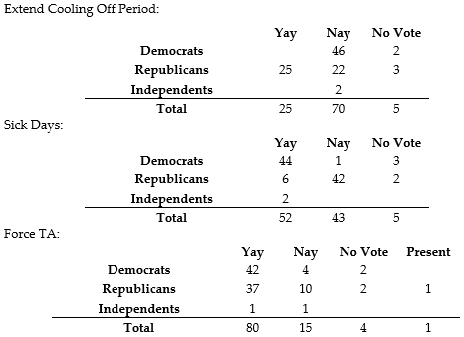
Timeline
December of 2022: US Senate Vote
12/01: Senate Votes on 3 bills, one to extend cooling off period, then sick days, final vote was to force the TA;
12/02: Biden signs bill forcing rejected TA on railroad workers

Slide 29
Discussion

Slide 30
New Member Introductions
What is your name, pronouns and state (or country/territory)?
Where do you work? Is it unionized?
How did you find out about the People’s School?
What do you think about tonight's class?

Slide 31
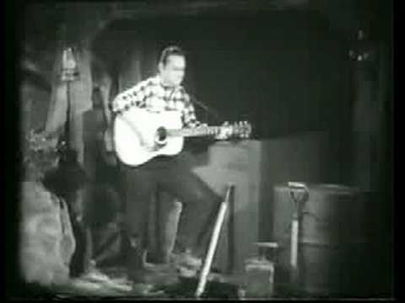
Credit for Video: https://www.youtube.com/watch?v=5pfVvqLM_e4&ab_channel=BIRDYKITTEN

