Slide 2
Counter Revolution in the USSR
PSMLS 12/20/22 - 12/22/22

Slide 3
What we’ll be learning today:
The history of what lead to the 1991 dissolution of the Soviet Union and how it affected the world communist movement.
Reading from “Socialism Betrayed” by Roger Keeran and Thomas Kenny.
Hearing from comrades who experienced witnessing the counter-revolution, and how it affected them and their work.

Slide 4
The Counter-Revolution
1985-1986

Slide 5
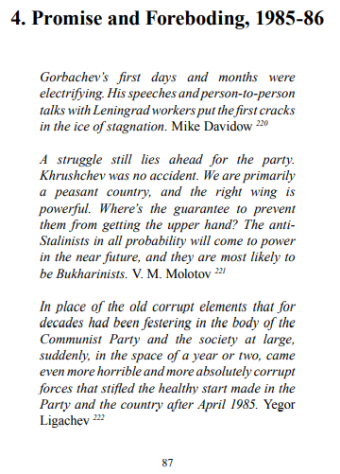
Socialism Betrayed

Slide 6
Socialism Betrayed

Slide 7
Socialism Betrayed

Slide 8
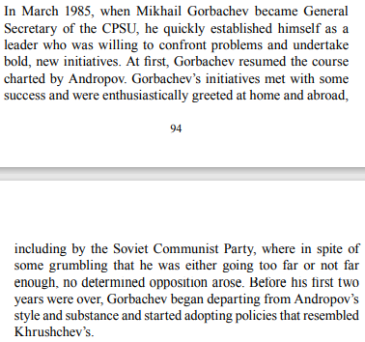
Socialism Betrayed

Slide 9
Socialism Betrayed

Slide 10
Discussion

Slide 11
The Counter-Revolution
1987-1988

Slide 12
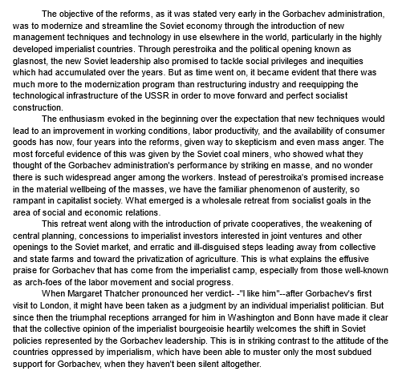
Brief Excerpt from Introduction to Sam Marcy’s “Perestroika”

Slide 13
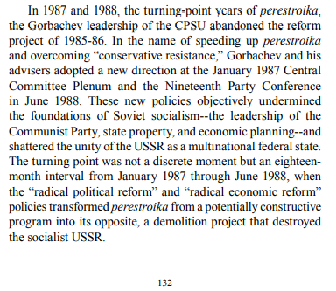
Socialism Betrayed

Slide 14
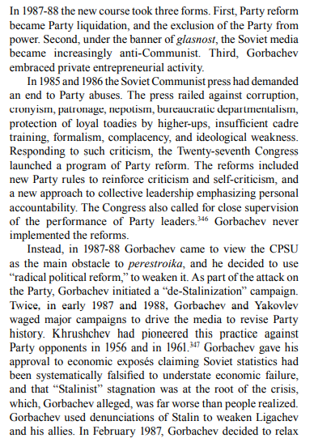
Socialism Betrayed

Slide 15
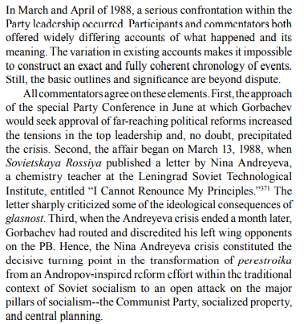
Socialism Betrayed

Slide 16
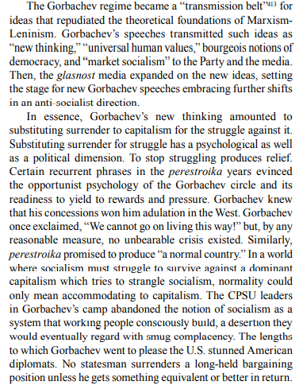
Socialism Betrayed

Slide 17
Discussion

Slide 18
The Counter-Revolution
1989-1991

Slide 19
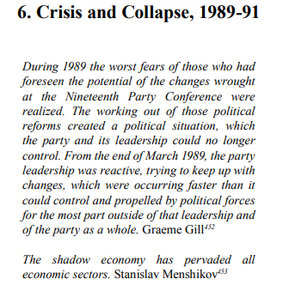
Socialism Betrayed

Slide 20
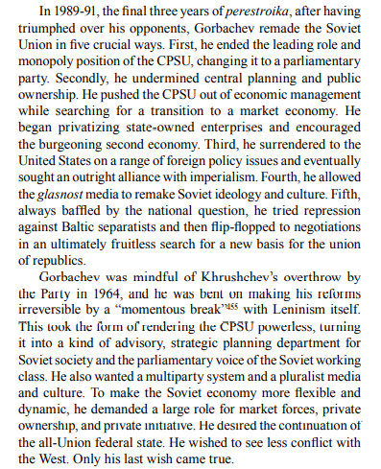
Socialism Betrayed

Slide 21
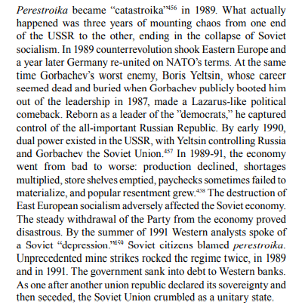
Socialism Betrayed

Slide 22
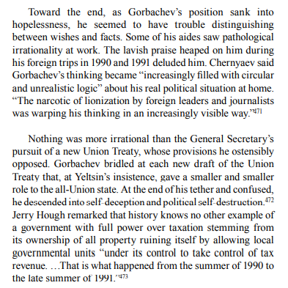
Socialism Betrayed

Slide 23
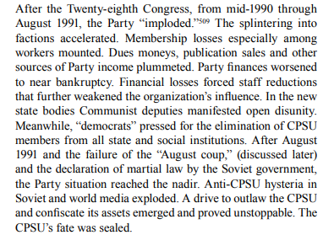
Socialism Betrayed

Slide 24
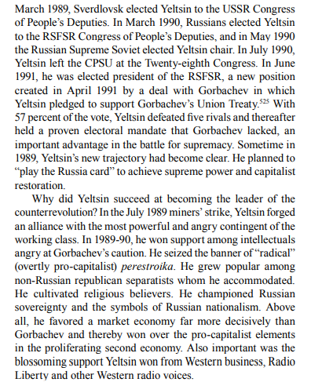
Socialism Betrayed

Slide 25
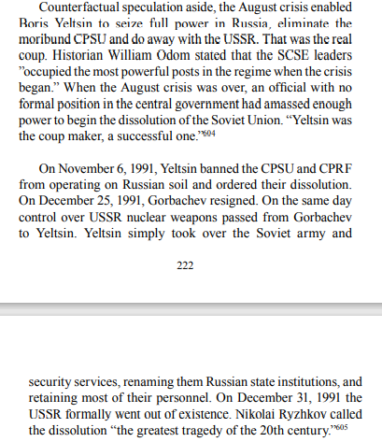
Socialism Betrayed

Slide 26
Discussion

Slide 27
New Member Introductions
What is your name, pronouns and state (or country/territory)?
Where do you work? Is it unionized?
How did you find out about the People’s School?
What do you think about tonight's class?

Slide 28
PSMLS 2022 Year In Review
Highlights of 2022:
Movies Shown:
North Star - 1943 film about Nazi invasion of Ukraine
Ukraine on Fire - Documentary about 2014 coup in Ukraine
Come and See - 1985 film about Belorussian partisan fighters in WW2
World at War - Documentary series about WW2
Key Narrations Released:
The Other Germany: The GDR
Trotsky the Traitor
For the Emancipation of Black People from Imperialism
The Communist Vol. 1, No. 1
Why Communism?
Guerilla Warfare
Key Classes from Each Month:
Music in the World Communist Movement - January
The present situation in Ukraine - February
International Working Women’s Day - March
Celebrating Lenin's Life & Legacy - April
May Day Celebration & Successes - May
LGBT+ Pride Month - June
The July 26th Movement - July
Hiroshima and Nagasaki - August
Soviet-Afghan War; Truth about Afghan History - September
60th Anniversary of the Cuban Missile Crisis - October
Political Economy - November
Overview of the Railroad Workers Struggle of 2022 - December

Slide 29
Peoples School for Marxist Leninist Studies
We wish all our comrades a great New Year for 2023!
What you can expect in the new year:
Thursday classes will be 9 pm EST/ 6 pm PST starting in January.
Classes on Ultra-leftism, Stalingrad, Indigenous Struggle and more!
Narrations of Organizing the Unorganized, Industrial Trade Unionism, Afghanistan - Washington’s Secret War etc!
More movie nights, commission presentations, and PSMLS reels.
Opportunities to volunteer at the People’s School!
Continuing collective education for everyone!

Slide 30
