Slide 1
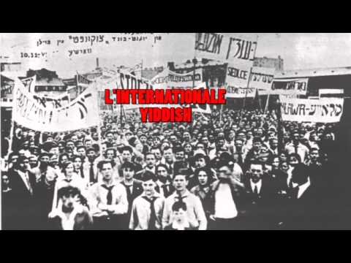

Slide 2
International Workers Order
PSMLS 12/6/22-12/8/22

Slide 3
What We’ll Be Learning
Reading from the newspaper of the JPFO
Discussing how the IWO reached people

Slide 4
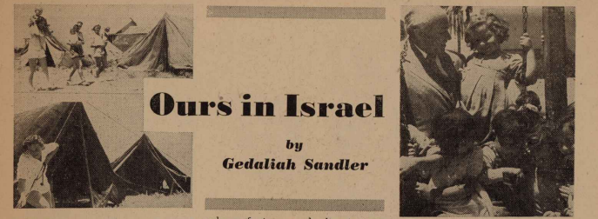
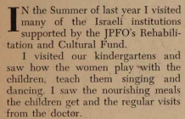
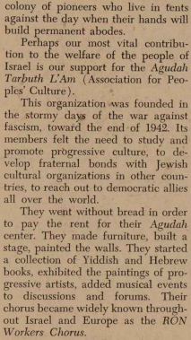
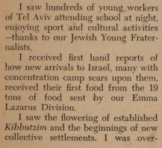
The Jewish Fraternalist, JPFO Newspaper
Feb-Mar 1950

Slide 5
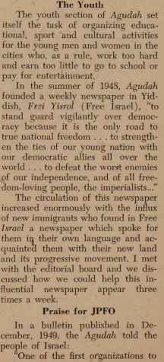
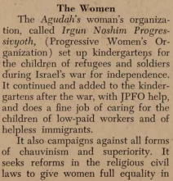
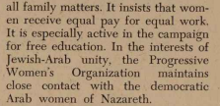
The Jewish Fraternalist, JPFO Newspaper
Feb-Mar 1950

Slide 6
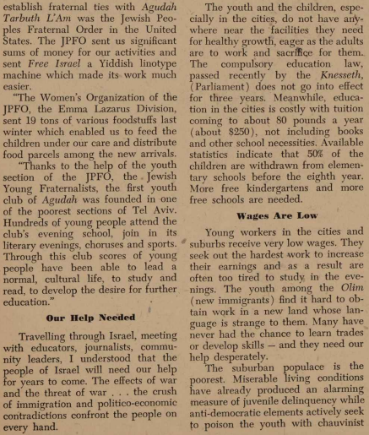
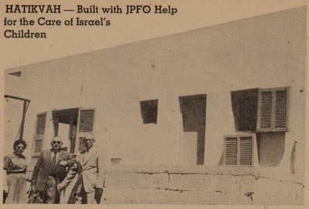
The Jewish Fraternalist, JPFO Newspaper
Feb-Mar 1950

Slide 7
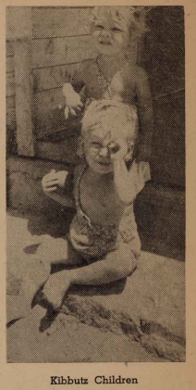
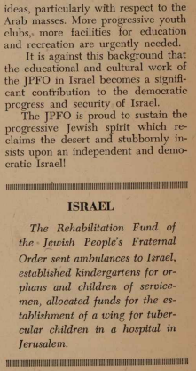
The Jewish Fraternalist, JPFO Newspaper
Feb-Mar 1950

Slide 8
Discussion

Slide 9
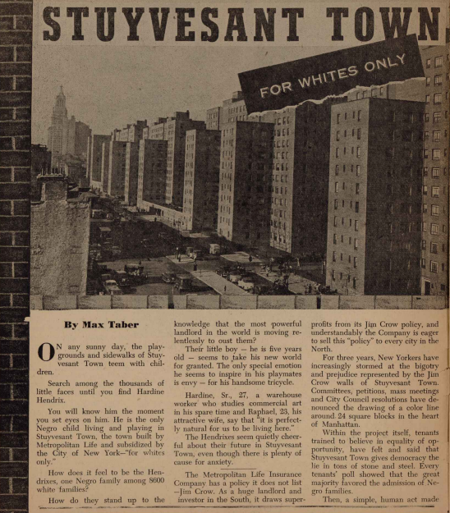
The Jewish Fraternalist, JPFO Newspaper
Feb-Mar 1950

Slide 10
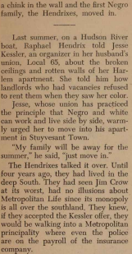
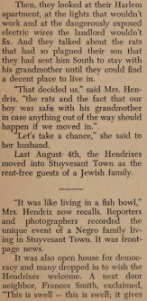
The Jewish Fraternalist, JPFO Newspaper
Feb-Mar 1950

Slide 11
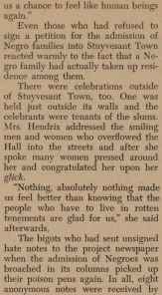
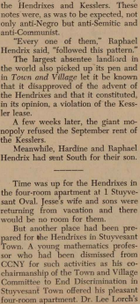
The Jewish Fraternalist, JPFO Newspaper
Feb-Mar 1950

Slide 12
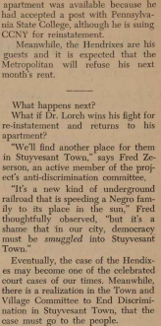
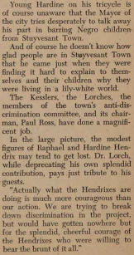
The Jewish Fraternalist, JPFO Newspaper
Feb-Mar 1950

Slide 13
Discussion

Slide 14
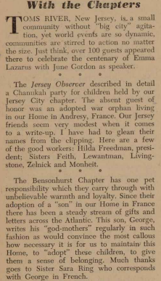
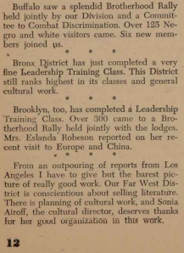
The Jewish Fraternalist, JPFO Newspaper
Feb-Mar 1950

Slide 15
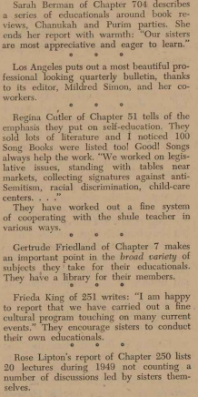
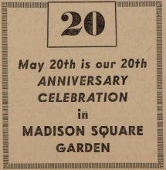
The Jewish Fraternalist, JPFO Newspaper
Feb-Mar 1950

Slide 16
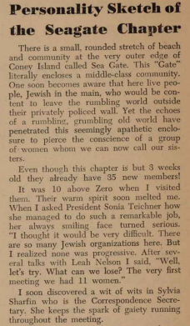
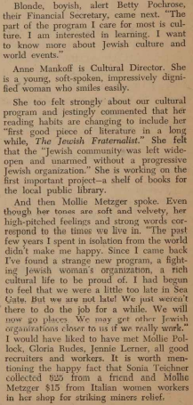
The Jewish Fraternalist, JPFO Newspaper
Feb-Mar 1950

Slide 17
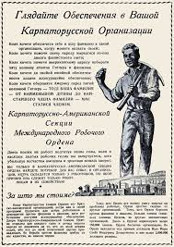
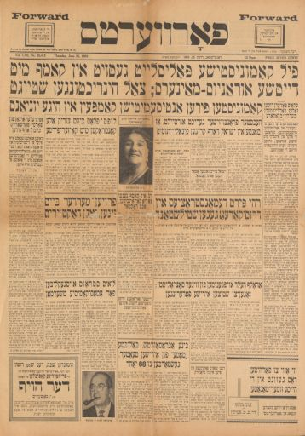
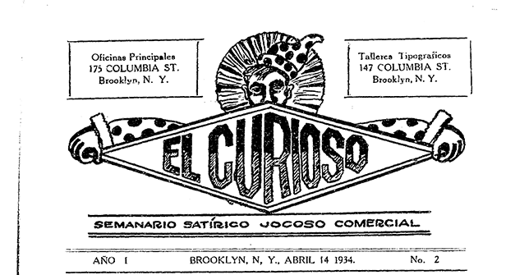
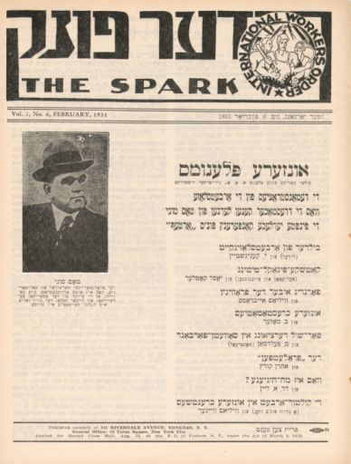
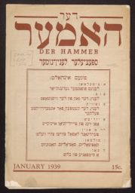
Other Newspapers
Carpatho Russian Paper
Daily Forverts - Jewish Publication
El Curiso - Satirical Spanish Publication
The Spark - Jewish Publication
Der Hammer - Jewish Publication

Slide 18
Discussion

Slide 19
