Slide 1
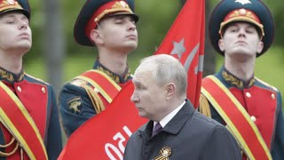
Sacred War (Dedicated to War in Ukraine)

Slide 2
Overview of 1 Year of War in Ukraine Part 2
PSMLS 03/07/23 - 03/09/23

Slide 3
What we’ll be learning today:
Continuing the timeline of events in the war from Sept 2022 to now
Looking at various statistics on casualties, equipment, subsidies, etc.
Observing maps of Russian vs Ukrainian controlled zones.
Discussing prospects for the war as it goes into its 2nd year.

Slide 4
October ‘22 - January ‘23

Slide 5
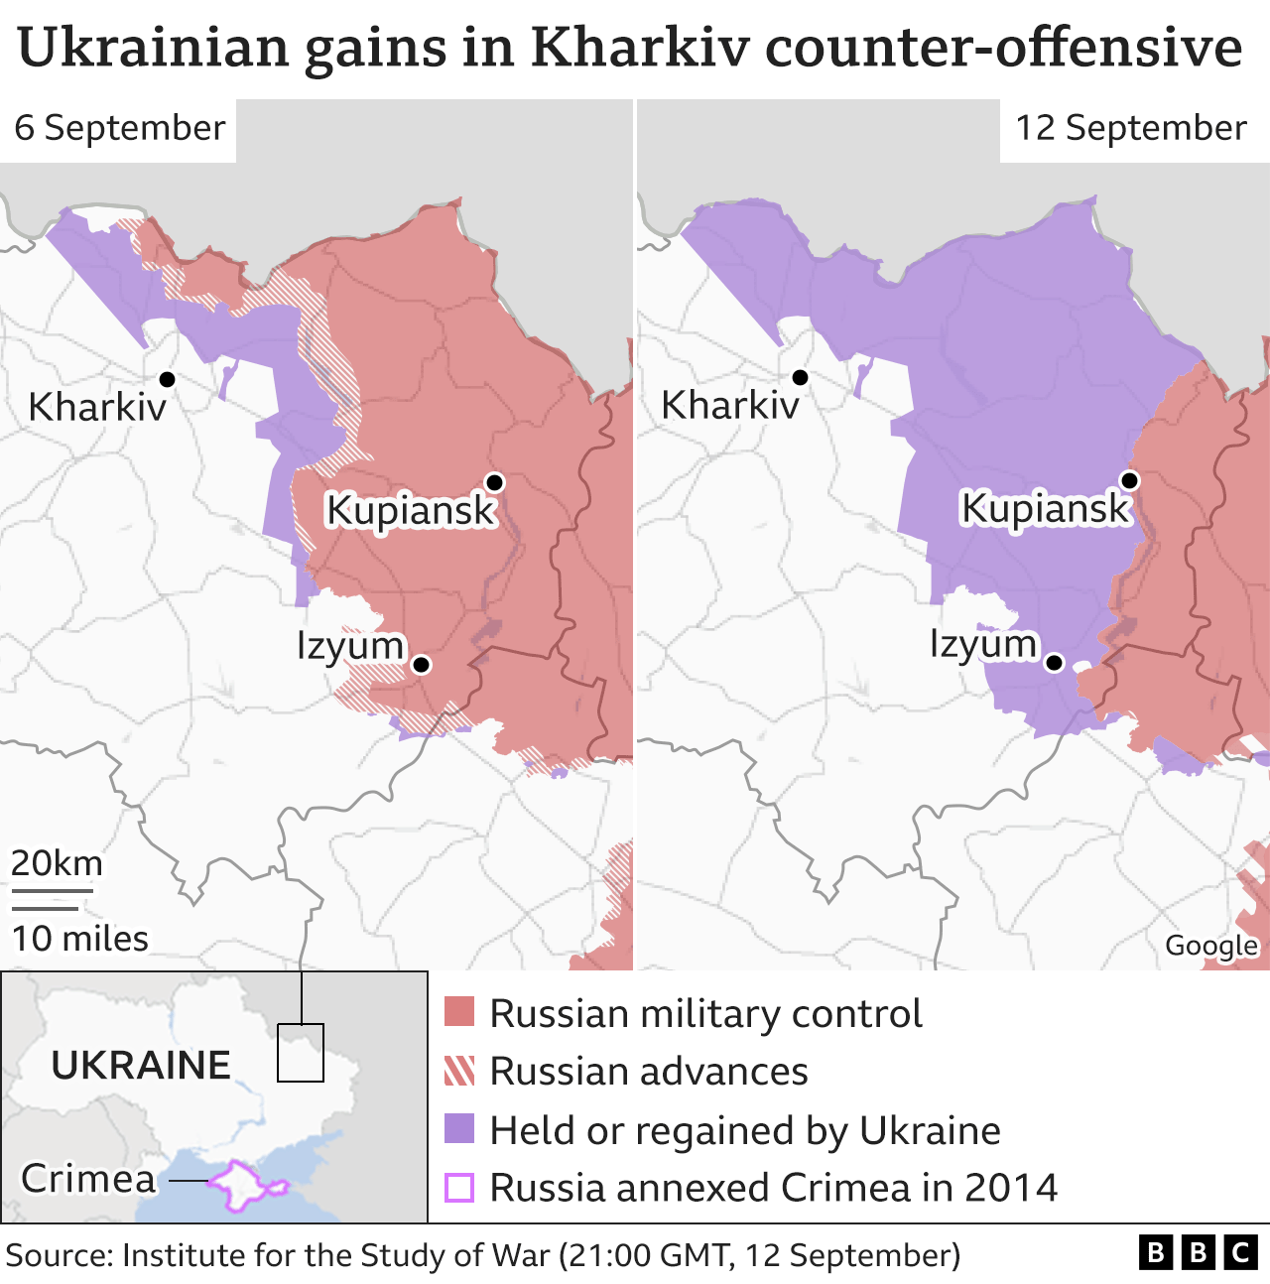
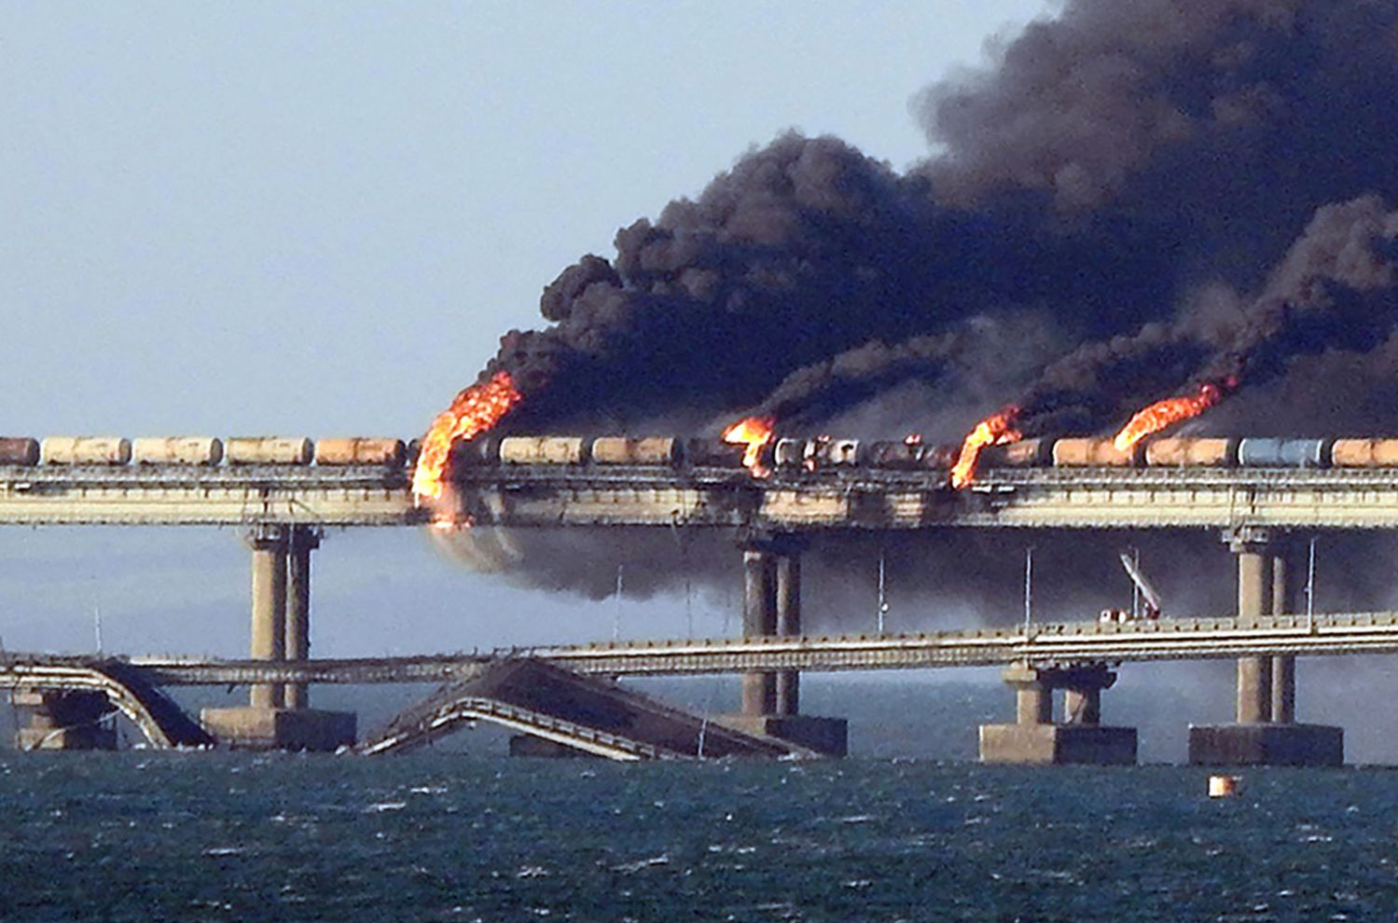
Timeline - October ‘22-January ‘23
Phase 3: September 12th-November 9th
In September and October of 2022, Russia was seemingly at a bad position in the war, due to:
American blame on Russia for the Nordstream sabotage, albeit foolish.
Fascist Ukraine’s successful counter-offensive in Kharkiv
Having been demonized and ostracized in the international community and receiving little help from other countries.
Ukrainian bombing of a Crimean bridge used by Russian forces on Oct 8th

Slide 6
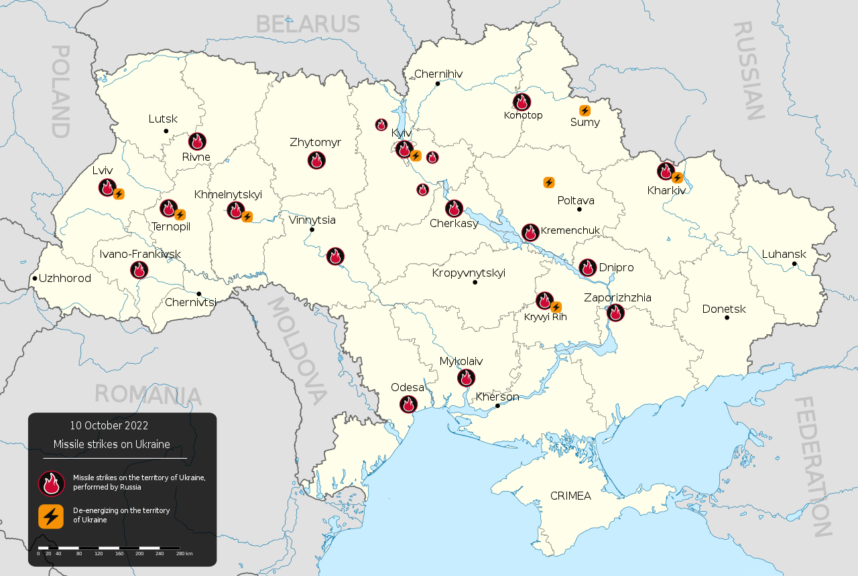
Timeline - October ‘22-January ‘23
October & November 2022
October 10th: Russia retaliates against Ukraine for the attack on the Crimean bridge by unleashing a missile barrage across all of Ukraine, including Kyiv. Attacks would continue through October and November.
October 12th: The United Nations passed Resolution ES-11/4 which encouraged nations not to recognize the democratic vote of the 4 regions - Zaporizhia, Kherson, Donetsk and Lugansk - to join the Russian Federation.
143 nations voted yes, including all of the west
35, including Cuba, Laos, Vietnam, India, Pakistan and China, abstained
5 voted no: The DPRK, Nicaragua, Belarus, Syria and Russia.
By AlexKozur - This vector image was created with Adobe Illustrator., CC BY-SA 4.0, https://commons.wikimedia.org/w/index.php?curid=124062723

Slide 7
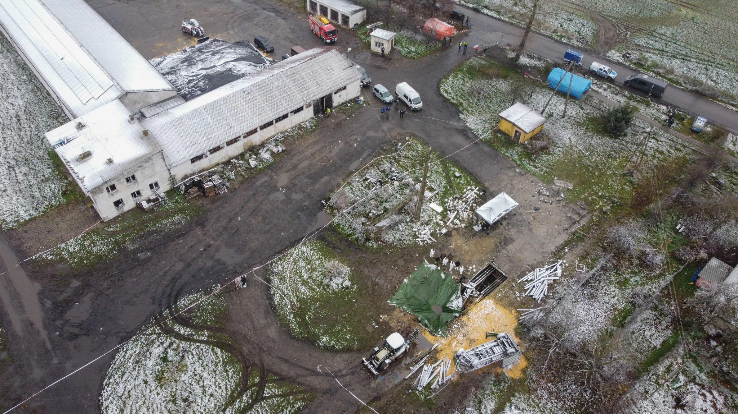
Timeline - October ‘22-January ‘23
Phase 4: November 10th-Present
November 15th: After 85-100 Russian missiles are fired at cities across Ukraine, a Ukrainian air defense missile accidentally hit Przewodów, Poland and killed 2 civilians.
Initially, Ukraine blamed the explosion on Russia, asked for a no-fly-zone over Ukraine, and continued to deny responsibility for the attack for days following the event.
NATO meetings were called for by Poland and other NATO states like Hungary, on the basis of Article 4 of the NATO charter.
The possibility of invoking Article 5 of the NATO charter was brought up if it was found to be an intentional Russian attack.
This would have meant the start of WW3.
Site of missile explosion in Przewodow, Poland. It was sealed off for a probe following the attack.

Slide 8
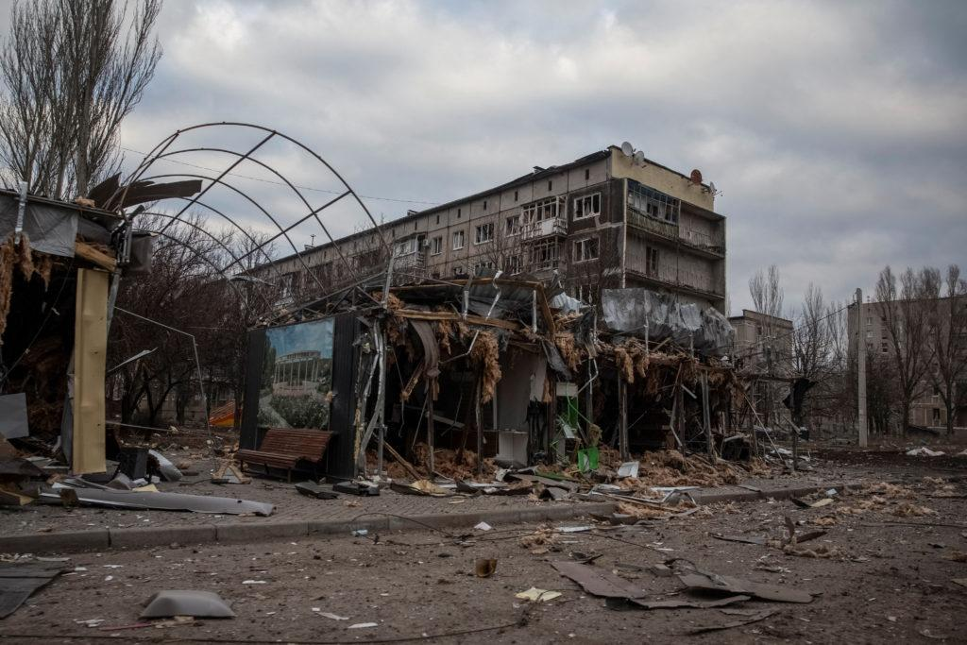
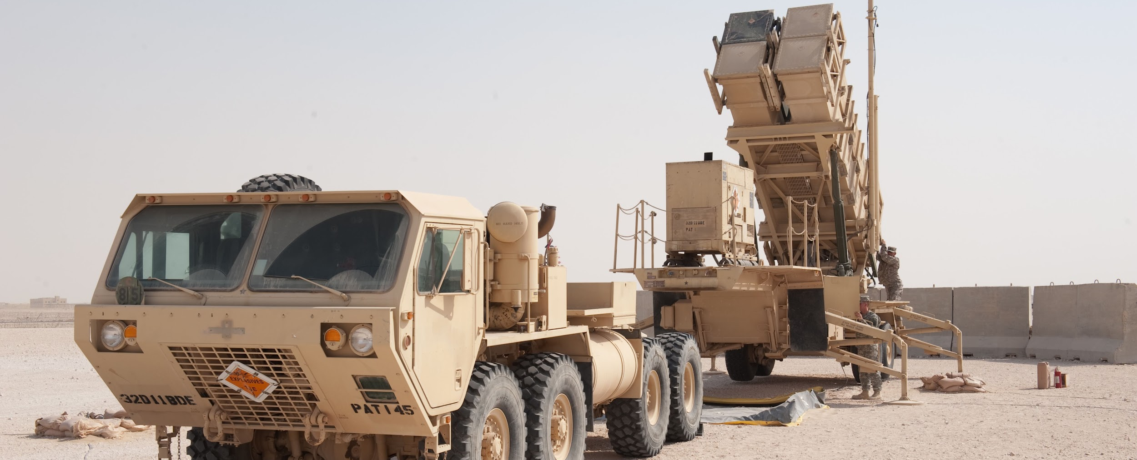
Timeline - October ‘22-January ‘23
November & December 2022
In the Battle of Bakhmut (Artyomovsk), which had been going on since the initial Russian assault in August, Russian forces were making minor advances and were starting to surround the city from both sides.
The conditions of the battle were brutal. It was approaching winter and much of the battle was now trench warfare.
By December, Bakhmut was becoming a meat grinder. Much of it lie in ruins and Russian and Ukrainian forces were constantly fighting, sometimes only 100 meters apart, street by street, similar to Stalingrad.
December 12th: Zelenskyy asked the G7 for tanks, artillery and long range weapons, to which the G7 agreed.
December 24th: Zelenskyy visited the US and met with Biden and addressed congress the same day the US announced a $1.8 billion aid package w/ Patriot missiles batteries.
An image of ruins in Bakhmut. Note that not all buildings were destroyed by Russia, and Ukraine participated in much of the destruction of the city.
US Patriot Missile System

Slide 9
Timeline - October ‘22-January ‘23
January 2023
January 13th: The city of Soledar was captured by Russian forces after fierce fighting in the Battle of Soledar. Ukraine denied the capture, but they were only defending the northwestern edge of the city. Soledar is just north of Bakhmut.
From January 14th on, many western nations announced they would send main battle tanks to Ukraine, a major escalation in the war:
UK announced it would send Challenger 2 tanks
France announced that they would send Leclerc tanks
Poland announced the same day that they would send 14 Leopard tanks to Ukraine regardless of German approval
Germany announced it would send 14 Leopard 2 tanks, in addition to the 88 already sent by various nations
The United States announced it would send 31 m1 Abrams tanks

Slide 10
Discussion

Slide 11
New Member Introductions
What is your name, pronouns and state (or country/territory)?
Where do you work? Is it unionized?
How did you find out about the People’s School?
What do you think about tonight's class?

Slide 12
February ‘22 - March ‘23

Slide 13
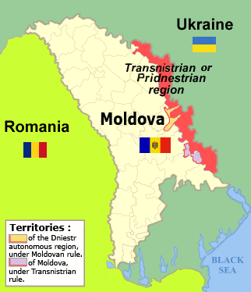
Timeline - February ‘23-March ‘23
February 2023
As the war approached its 1 year anniversary, it was becoming evident that this conflict is heating up to an international conflict.
Embargos and price ceilings on Russian petroleum imposed by the G7 went into effect this month.
On February 9th, Zelenskyy alleged Russia is planning a coup in Moldova.
On February 10th, 35 nations demanded Russia and Belarus be banned from the 2024 Olympics in Paris, and Ukraine said they would boycott if not.
On February 20th, Joe Biden visited Kyiv
On February 21st, Russia pulled out of the New START treaty with the United States
The Russian Ministry of Defense claimed that Ukraine was preparing to invade Transnistria

Slide 14
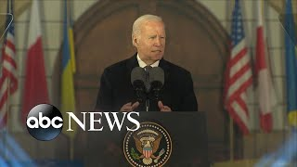
Timeline - February ‘23-March ‘23
February 2023
Biden gave a speech in Poland on February 21st, 2023. In it, he hypocritically accuses Russia of being hellbent on violence, starting wars and imposing their will on others, something the United States has done countless times since WW2, many times with Biden’s direct involvement.

Slide 15
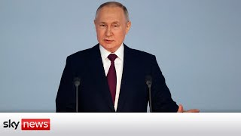
Timeline - February ‘23-March ‘23
February 2023
The same day, Putin gave a speech in the Kremlin about the war, in which he reiterates why the invasion happened, why Russia has taken the actions it has and where the war is at today.

Slide 16
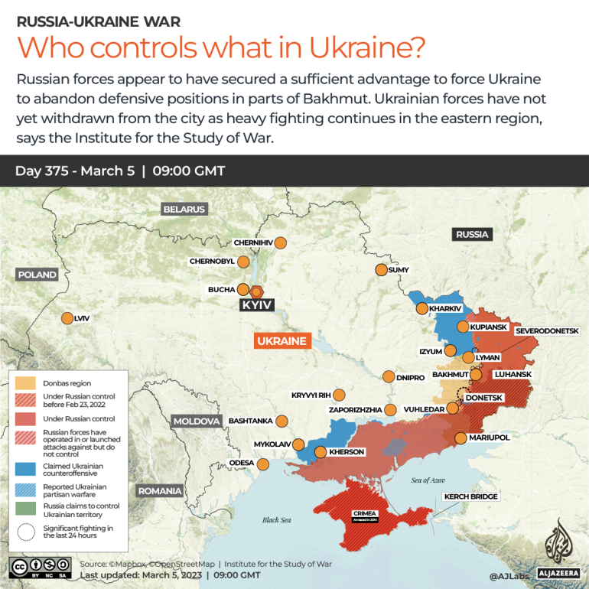
Timeline - February ‘23-March ‘23
March 2023 - Where things stand
On March 4th, Ukrainian forces began withdrawing from Bakhmut, beginning the end of the conflict and Russian victory, which will also allow Russia to make more gains in the west and take back territory lost in the counter-offensive.
Ukraine is reportedly planning to invade transnistria, which would open up a new front in the war and may draw in Moldova.
Ukrainian air force pilots are being trained in the United States on how to fly F-16 fighter jets.
China has proposed a peace plan which calls for a ceasefire and negotiations that would respect the sovereignty of nations and end cold war mentality. Ukraine has said it awaits details. Biden and Blinken doubt China’s sincerity about the plan, and China has not taken a definitive stance on the conflict as of yet.

Slide 17
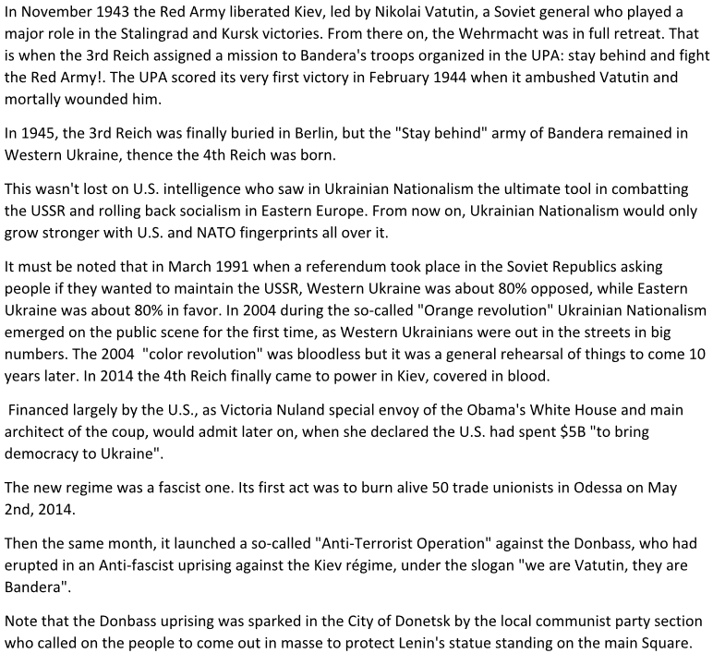
Article wrote by Cde Christian CA for Daily Worker USA

Slide 18
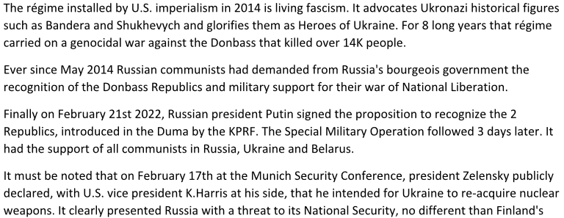
Article wrote by Cde Christian CA for Daily Worker USA

Slide 19
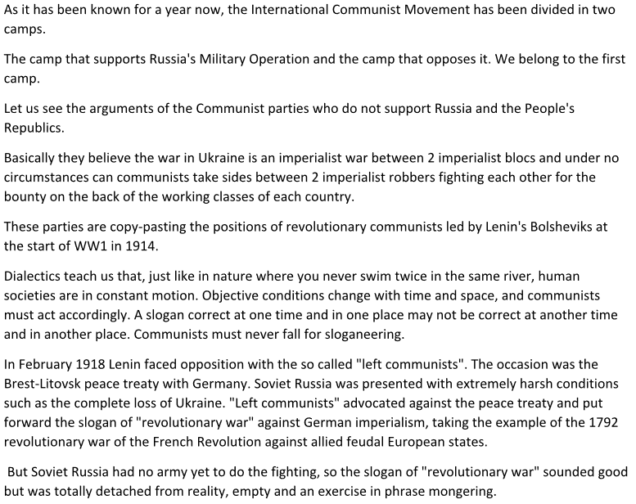
Article wrote by Cde Christian CA for Daily Worker USA

Slide 20
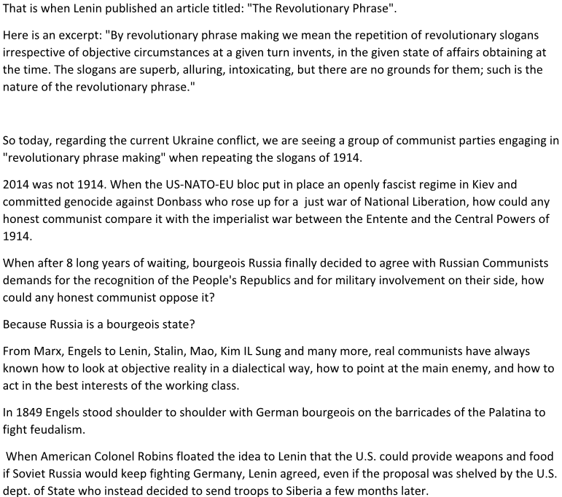
Article wrote by Cde Christian CA for Daily Worker USA

Slide 21
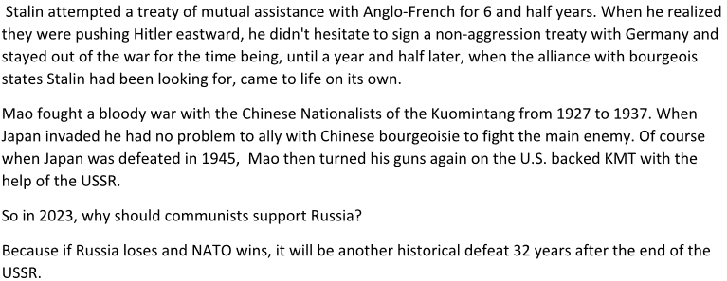
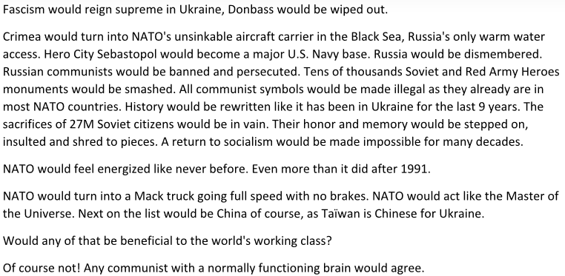
Article wrote by Cde Christian CA for Daily Worker USA

Slide 22
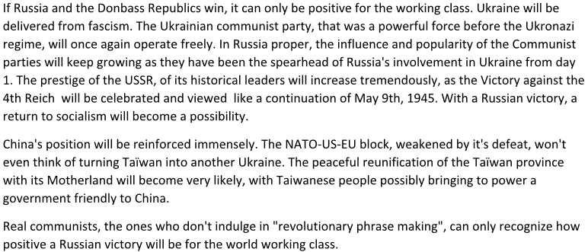
Article wrote by Cde Christian CA for Daily Worker USA

Slide 23
Discussion

Slide 24
Maps and Statistics

Slide 25
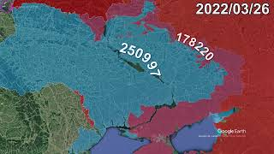
Map of War in Ukraine Every Day for First Year

Slide 26
Statistics: Personnel and
Casualties
Stats are from Statista (NATO stats are as of ‘22)
Total Estimated Personnel:
Russia - 1.3 million
Ukraine - 500,000
NATO - 5.4 million
Active Soldiers:
Russia - 830,900
Ukraine - 200,000
NATO - 3.4 million
Reserve Forces:
Russia - 250,000
Ukraine - 250,000
NATO - 1.3 million
Paramilitary Units:
Russia - 250,000
Ukraine - 50,000
NATO - 738,700
Casualty Stats from WIkipedia
(Sources on website)
Russian Military Losses:
Russian Reporting - 5,937 killed
BBC Russia and “Mediazona” - 32k killed
US Estimate - 200,000 killed
Ukraine Reporting - 153,770 killed
Ukraine Military Losses:
Russian Reporting - 61,207 killed
US/EC Estimates - 100,000+ killed
Ukraine Reporting - 13,000+ killed
Civilian Losses:
UN Reporting - 8,101 killed
DPR/LPR Reporting - 1,252 killed
US Estimate - 40,000 killed
Ukraine Reporting - 9k - 16,502 killed

Slide 27
Statistics: Equipment and
Foreign Aid
Estimated value of weapon deliveries to Ukraine from January to November 2022, by country - from Statista (Top 10)
United States - $18,182,200,000
Germany - $4,127,890,000
United Kingdom - $3,509,480,000
Poland - $2,183,500,000
Canada - $1,207,000,000
Netherlands - $837,050,000
Sweden - $484,570,000
Italy - $470,840,000
Latvia - $299,640,000
Turkey - $275,000,000
Alleged military aid to Russia
China - Navigation systems and fighter jet parts (Forbes)
Iran - Aircraft, drones, ballistic missiles and oil (Washington institute)
DPRK - Artillery shells and rockets (US Intelligence, no presented evidence)
Stats are from Statista (NATO stats are as of ‘22)
Total Aircraft:
Russia - 4,182
Ukraine - 312
NATO - 20,723
Total Helicopters:
Russia - 1,531
Ukraine - 113
NATO - 8,485
Total Armored Vehicles:
Russia - 151,641
Ukraine - 37,000
NATO - 115,855
Total Military Ships (Naval Power)
Russia - 598
Ukraine - 38
NATO - 2,049
Nuclear Weapons:
Russia - 5,977
Ukraine - 0
NATO - 6,065

Slide 28
Discussion

Slide 29
Volunteers Needed!
We are in need of volunteers for the staff of the People’s School! Here’s a few roles we need filled:
People to help manage posting on our social media and podcast platforms
Video Editors, Audio Editors, Graphic Designers, Artists, Narrators
Facilitators, Web Controls, Moderators
Email info@peoplesschool.us if you’re interested and try to attend our next staff meeting on March 2nd if possible.

Slide 30
New Outlook Publishers
newoutlookpublishers.store
< Related to Class!
Russel “Texas” Bentley is an American anti-fascist fighter that volunteered to help fight the UkroNazis in the Donbass. This is his account of that struggle. You can’t get this anywhere else!

Slide 31
Legal Drive
Last year we were attacked and sabotaged by wreckers that tried to steal the PSMLS and destroy the PCUSA.
They failed, but they will be held accountable and there are still things they took from us that we’ve not got back, like videos, imagery and audio. That is why we still need donations to the legal drive.
To donate, go to partyofcommunistsusa.net/donations/
Put “For legal funds” in the details box and try to donate on Tuesday or Thursday so it is easier for us to sort through. It will go to the legal fund. Anything helps!

Slide 32
Donbass is Behind Us

