Slide 1
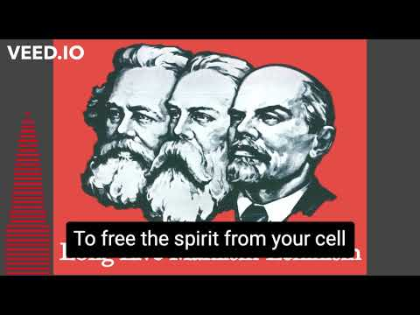

Slide 2
The Leninist Path to Coalition Building
PSMLS 03/14/23 - 03/16/23

Slide 3
What we’ll be learning today:
Sectarianism and its consequences
Lessons from History: The Farmer-Labor Party and the LaFollette Movement
The People’s Front and the need for building a broad coalition against fascism

Slide 4
Section 1: Sectarianism and its Consequences

Slide 5
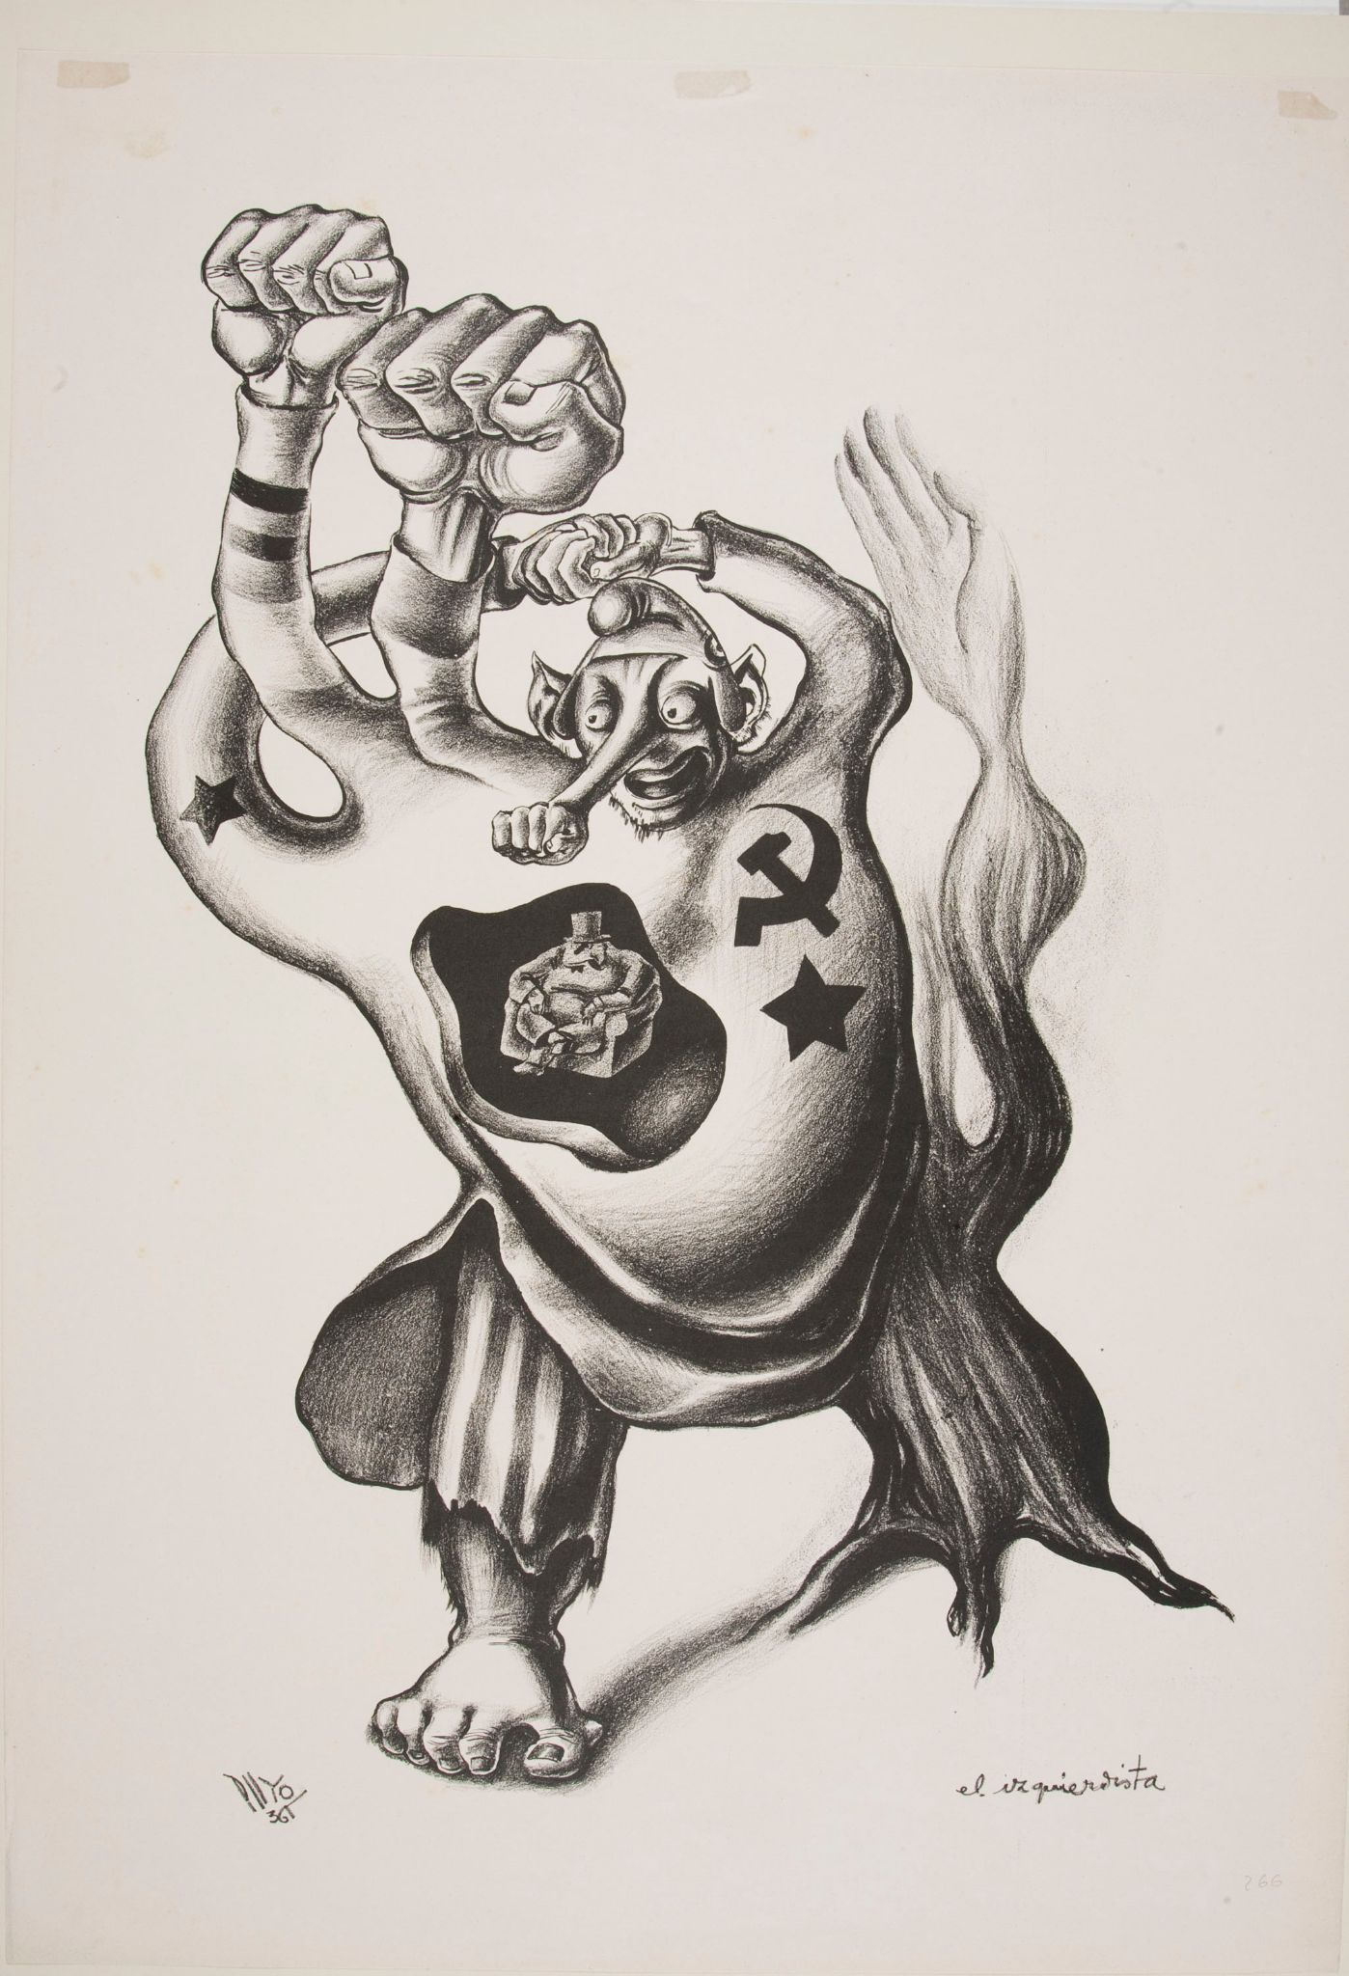
Sectarianism and its Consequences
Sectarianism, within the context of the Communist movement, means refusal to work with groups that do not meet a narrow standard of ideological or moral “purity”.
Sectarianism is an error that is primarily associated with ultraleft tendencies, as opposed to right opportunism. Both objectively serve the forces of reaction and the bourgeoisie.
The consequences of sectarianism have been observed time and time again within the Communist movement. Sectarianism means isolation from the masses and the irrelevance of the Communist party within the working class movement.
The Ultra-Leftist, Ramon Puyol, 1936

Slide 6
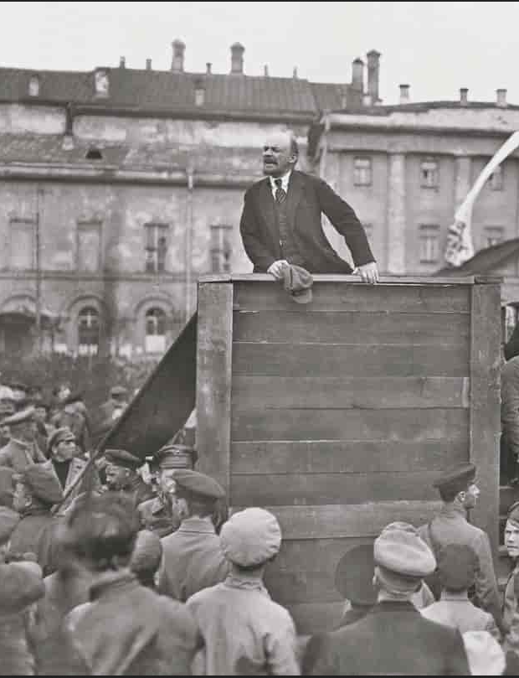
Sectarianism and its Consequences
Lenin recognized the dangers of sectarianism and denounced it in his classic polemic “Left-Wing Communism: An Infantile Disorder”.
One of the forms of sectarianism which he observed at the time was the refusal of certain Communist groups to work within reactionary trade unions, as is described in the following passage.
V. I. Lenin

Slide 7
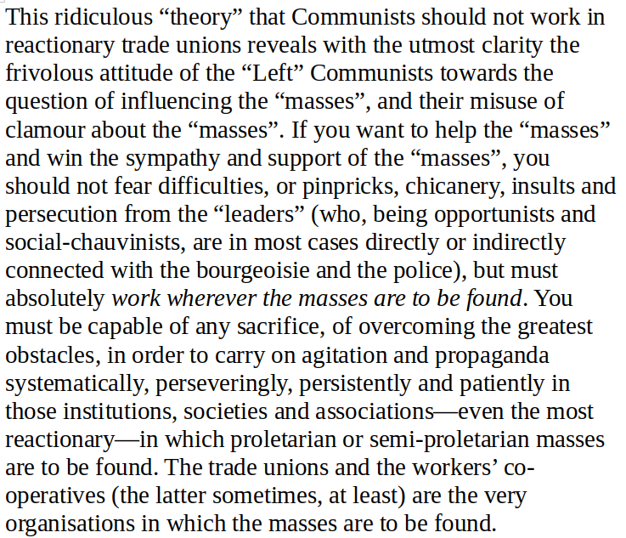
From “‘Left-Wing’ Communism: an Infantile Disorder” by V. I. Lenin, Chapter 6: “Should Revolutionaries Work in Reactionary Trade Unions?”

Slide 8
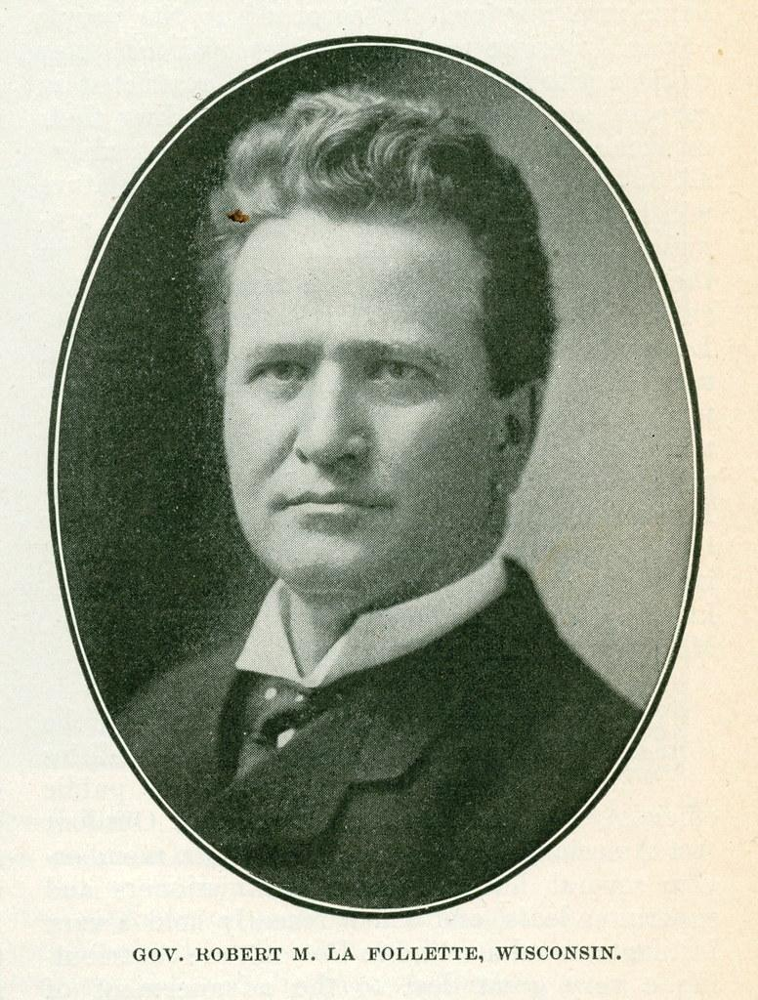
Comrade William Z. Foster clearly emphasizes how today we should be working with all people in a coalition on an issue, and bring unity to that coalition - not bring disunity to the coalition.
Robert M. LaFollette’s presidential campaign in 1924 attracted much support from American farmers, workers, and petty bourgeoisie. However, the LaFollette movement was not a revolutionary movement and contained many reactionary tendencies, such as white chauvinism.
The Communist Party USA, then called the Workers Party, made the mistake of not affiliating with the LaFollette campaign through its mass organizations. This meant that the Party was largely isolated and irrelevant from the largest farmer-labor movement in America at the time.
The consequences of the Communist Party USA’s failure to fully engage with the LaFollette Movement in the 1920s serve as a warning for the present day.

Slide 9
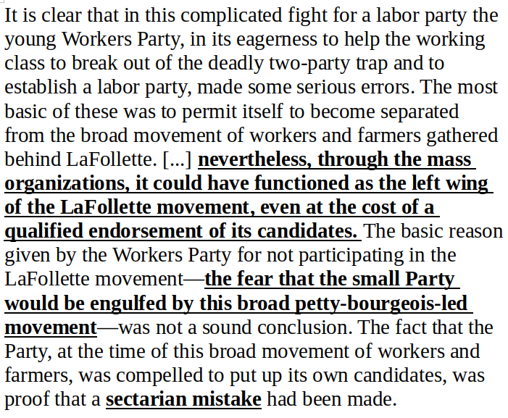
Again, the fight to unify Communist work in coalitions is exemplified in Comrade Foster’s “‘History of the Communist Party of the United States” by W. Z. Foster, Chapter 15: “The Communists and the LaFollette Movement”

Slide 10
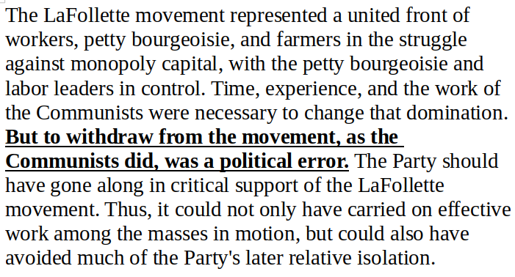
From “‘History of the Communist Party of the United States” by W. Z. Foster, Chapter 15: “The Communists and the LaFollette Movement”, continued

Slide 11
Discussion

Slide 12
Section 2: Coalition Building - the building of a united people’s front against fascism

Slide 13
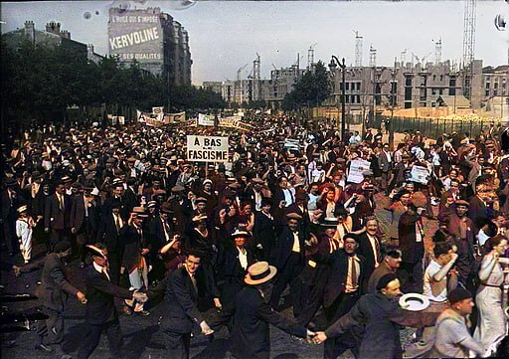
The People’s Front Against Fascism
The 7th Congress of the Comintern, the international Communist organization led by the Soviet Union, was held in 1935 amidst the encroaching threat of fascism.
The Congress recognized that the changing conditions required a turn away from its previous policy of “class against class” to the development of a People’s Front (or Popular Front) against fascism.
The Communist movement must now respond to a similar situation in the world today, where fascism is experiencing a resurgence amidst a deepening global crisis of Capitalism.
The fascist movement today is led by NATO and its proxy states, as exemplified by the current Ukrainian regime.
The French Popular Front protesting fascism in Paris, 1934, Colorized

Slide 14
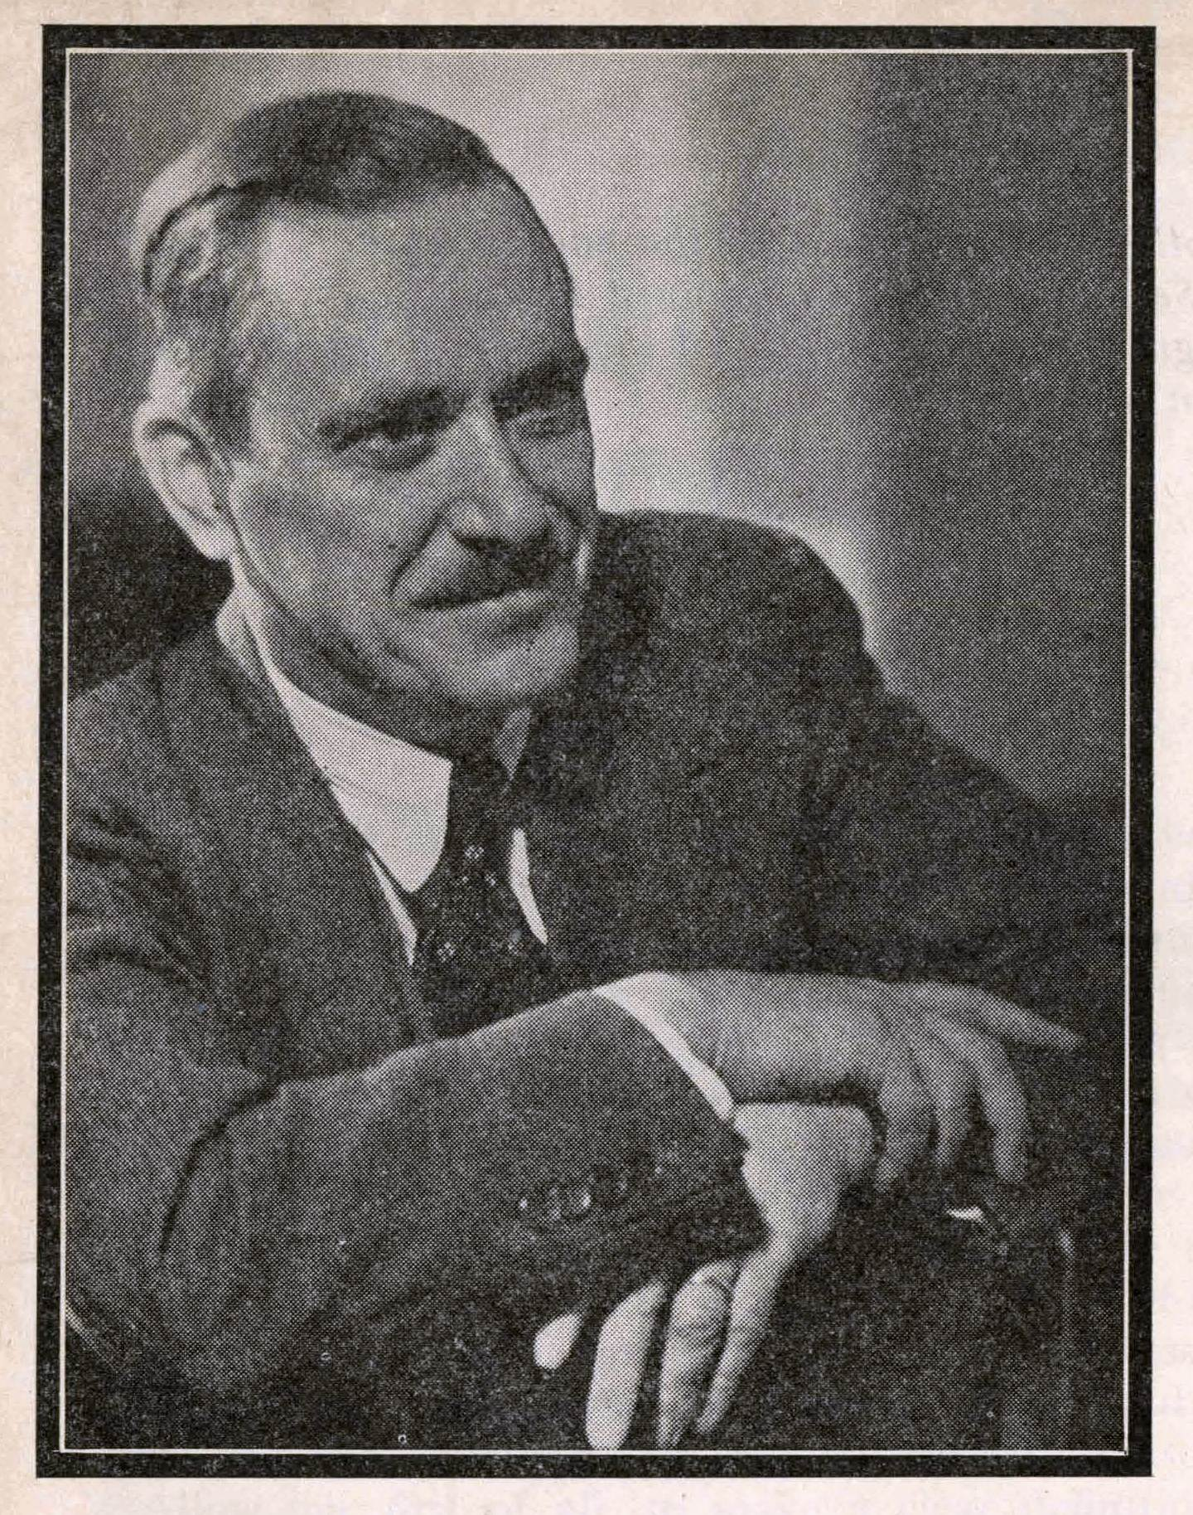
The People’s Front Against Fascism, continued
The Communist Party USA, as a member organization of the Comintern, dutifully followed the new line set about by the Congress.
Earl Browder was the Chairman of the CPUSA at the time.The next passage is from his text “People’s Front” written in 1938. It explains the necessity of unity among all anti-fascist forces in the fight against fascism.
Earl Browder

Slide 15
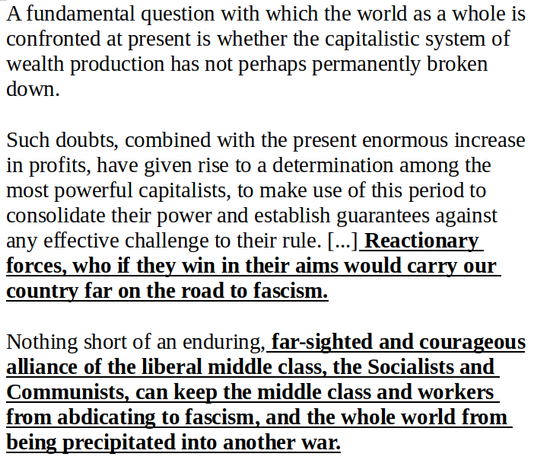
From “‘The People's Front” by Earl Browder, Chapter 10: “The People’s Front can Defeat Reaction”

Slide 16
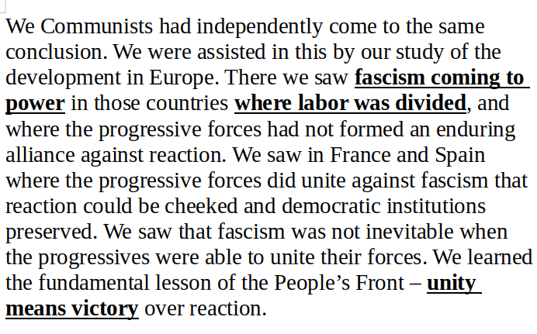
From “‘The People's Front” by Earl Browder, Chapter 10: “The People’s Front can Defeat Reaction”

Slide 17
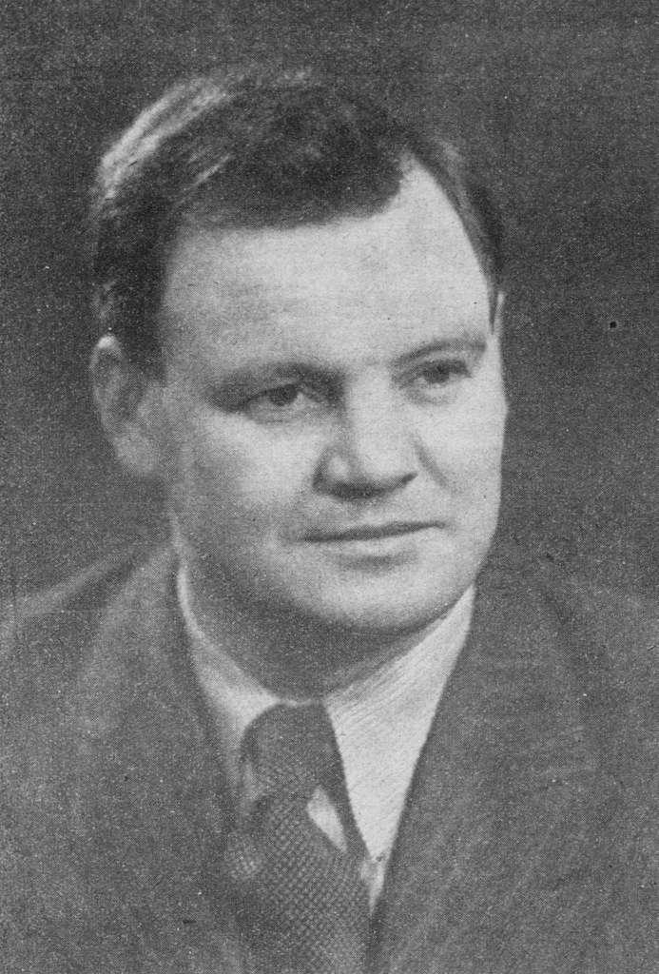
The “Outstretched Hand”
87 years ago, the secretary general of the French Communist Party Maurice Thorez extended his hand to Catholics and to the right, in the name of national unity in the face of the fascist threat. This speech of the "outstretched hand" foreshadows the victorious alliance that will allow the Popular Front to come to power.
The speech still resonates today as if it had just been delivered. With nine days of legislative elections which promise to be decisive, Maurice Thorez, Secretary General of the French Communist Party, amazed when he launched on April 17, 1936 the policy of the "outstretched hand" towards Catholics and the right in the name of the union nation against the fascist threat. For the PCF, which had campaigned since its foundation in 1920 on a "class against class" line, fighting both the right and the socialists, this was a major turning point.
Maurice Thorez

Slide 18
The “Outstretched Hand”, cont.
What does Thorez say in this historic speech? “A wind of distress is blowing over our beautiful country. For five years now, the economic crisis has been raging in industry, agriculture, commerce and public and private finance”, he attacks, in terms that seem very contemporary to us. For this persistent crisis, he blames "the 200 families who dominate the economy and politics of France" and "the dictatorship of the banks". Here again, there is no need to emphasize the proximity to the revolt against the liberal oligarchy expressed by the massive protests that are raging across France lately.
Then the communist leader denounces the false alternative offered by the far-right leagues, inspired by Italian fascism and Nazism, which tried to seize power on February 6, 1934. But the most astonishing thing about the speech is at the end of it. “We extend our hand to you, Catholic, worker, employee, craftsman, peasant, we who are atheist people because you are our brother and like us you are burdened by the same worries. We extend our hand to you, national volunteer, veteran who has joined the Cross-of-Fire, because you are a son of our people, you suffer like us from disorder and corruption, because you want, like us, to stop our Motherland from slipping into ruin and catastrophe.”

Slide 19
Discussion

Slide 20
Section 3: The Popular Front in Practice

Slide 21
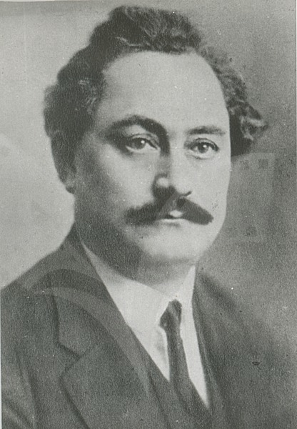
The Comintern on the People’s Front Period
Our final passage is from a history of the Communist International (Comintern).
The passage describes how the policy of the People’s Front (coalition building) was put into action during the period of the War Against Fascism (World War II).
Georgi Dimitrov, General Secretary of the Executive Committee of the Comintern from 1935 to 1943

Slide 22
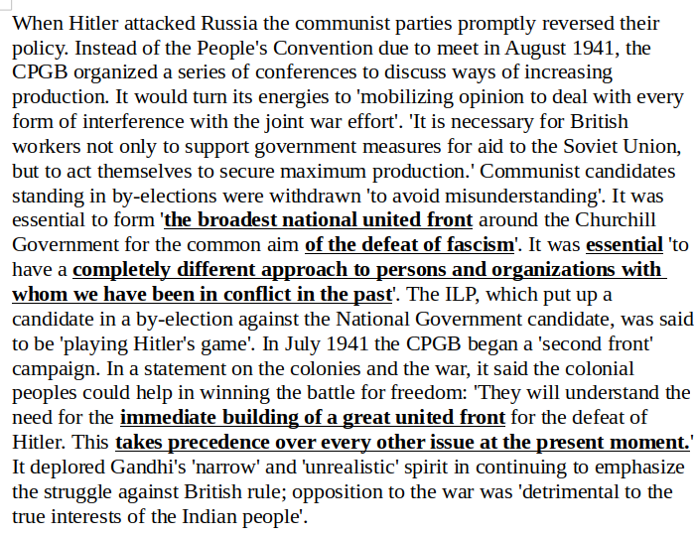
From “‘The Communist International, Volume III:1929-1943” p. 471

Slide 23
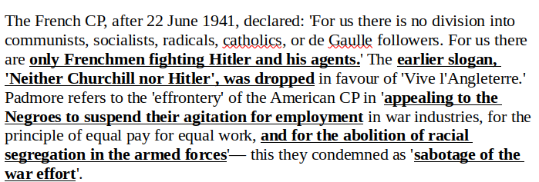
From “‘The Communist International, Volume III:1929-1943” p. 471

Slide 24
Discussion

Slide 25
New Member Introductions
What is your name, pronouns and state (or country/territory)?
Where do you work? Is it unionized?
How did you find out about the People’s School?
What do you think about tonight's class?

Slide 26
Volunteers Needed!
We are in need of volunteers for the staff of the People’s School! Here’s a few roles we need filled:
People to help manage posting on our social media and podcast platforms
Video Editors, Audio Editors, Graphic Designers, Artists, Narrators
Facilitators, Web Controls, Moderators
Email info@peoplesschool.us if you’re interested and try to attend our next staff meeting on March 2nd if possible.

Slide 27
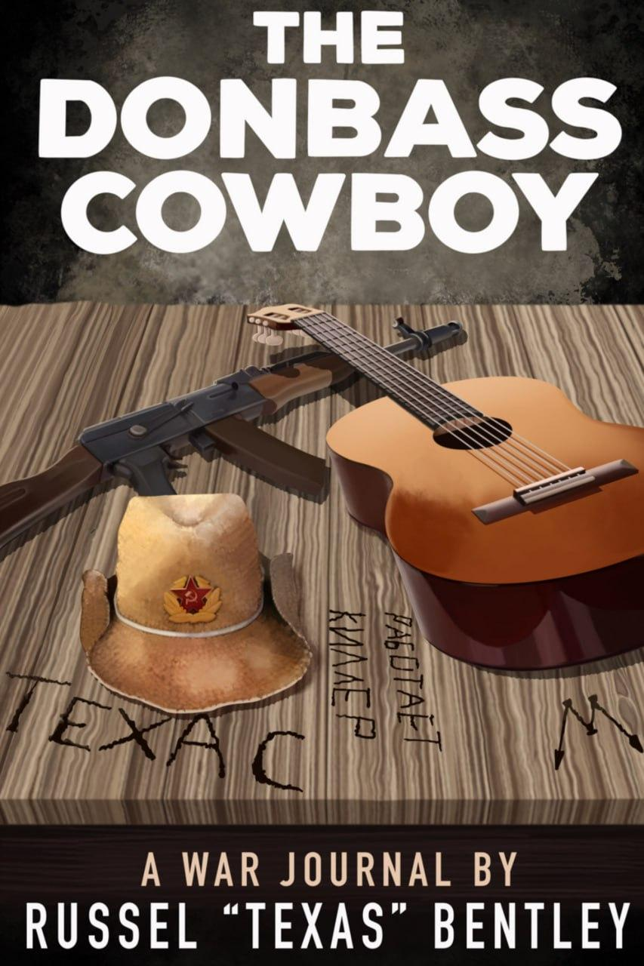
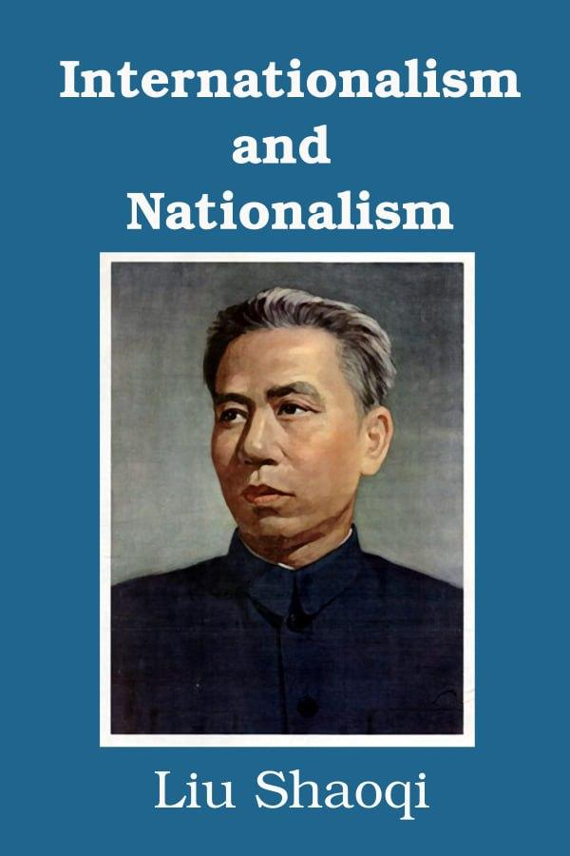
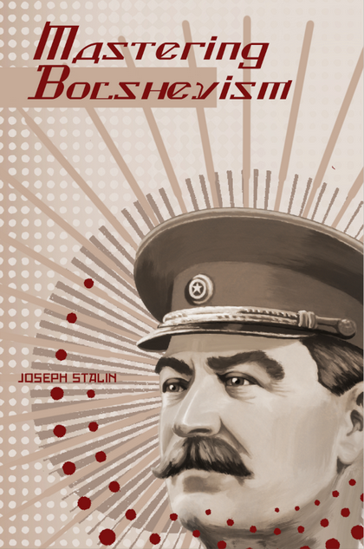
New Outlook Publishers
newoutlookpublishers.store
Latest Releases

Slide 28
Legal Drive
Last year we were attacked and sabotaged by wreckers that tried to steal the PSMLS and destroy the PCUSA.
They failed, but they will be held accountable and there are still things they took from us that we’ve not got back, like videos, imagery and audio. That is why we still need donations to the legal drive.
To donate, go to partyofcommunistsusa.net/donations/
Put “For legal funds” in the details box and try to donate on Tuesday or Thursday so it is easier for us to sort through. It will go to the legal fund. Anything helps!

