Slide 2
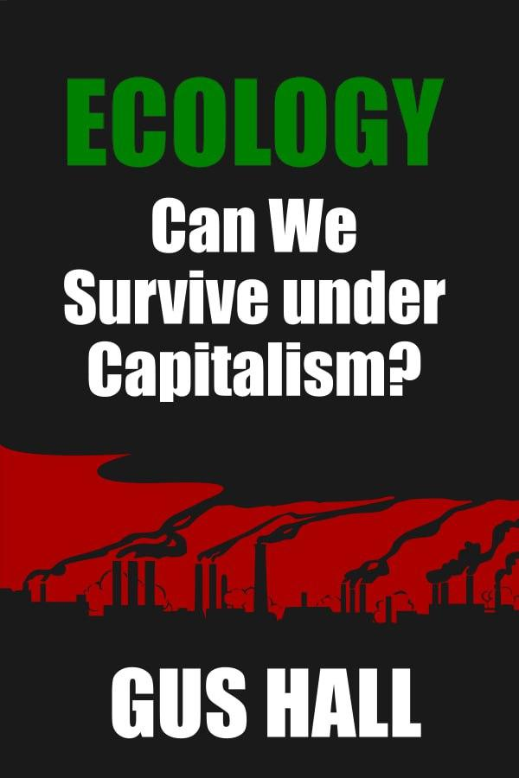
“Ecology: Can We Survive Under Capitalism?” By Gus Hall
PSMLS 04/04/23 - 04/06/23

Slide 3
What we’ll be learning today:
Can we survive under capitalism?
How should communists approach the climate crisis?
Capitalism, not “technology”, is driving the climate crisis
Why a centrally planned economy is necessary for saving the environment

Slide 4
Historical Context and Introduction

Slide 5
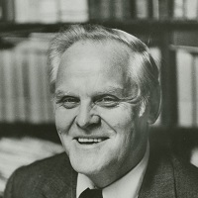
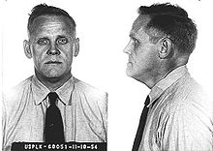
Author: Gus Hall
Born in 1910 and raised in a working class family
Parents were early members of the CPUSA
Helped lead the “Little Steel” strike of 1937. Rose through party leadership afterwards
Fought in WWII, US Navy 1942-1946. Honorably discharged
Indicted under the Smith Act during the Red Scare. Imprisoned from 1949-1951, 1951-1959
General Secretary of the CPUSA 1959-2000

Slide 6
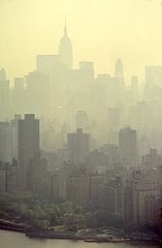
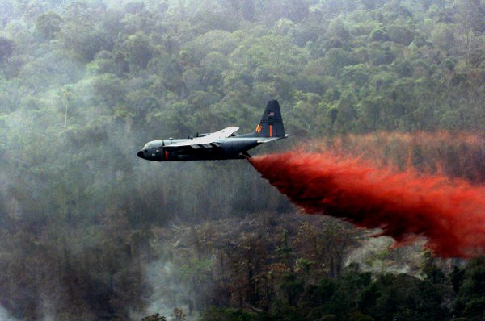
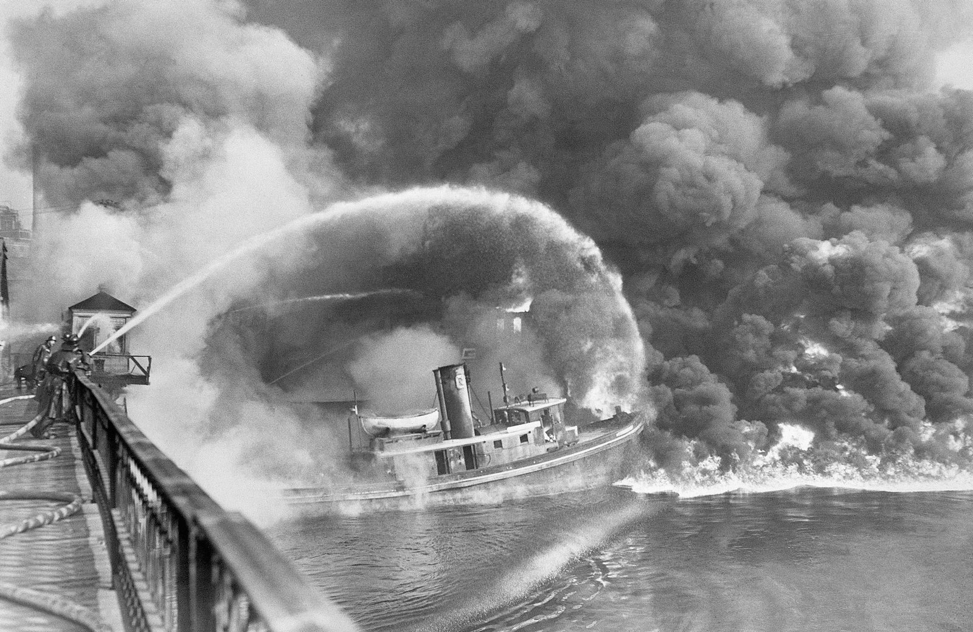
America and the environment in 1972
“Silent Spring” by Rachel Carson published in 1962. Often credited with sparking the environmentalist movement
1969: Fire on the Cuyahoga River
Major air and water quality regulations did not exist until late 1972
Vietnam War: agent orange deliberately used to destroy the environment in Vietnam. Also causes cancer and birth defects
Greenhouse effect NOT yet a widespread concern until ~1988

Slide 7
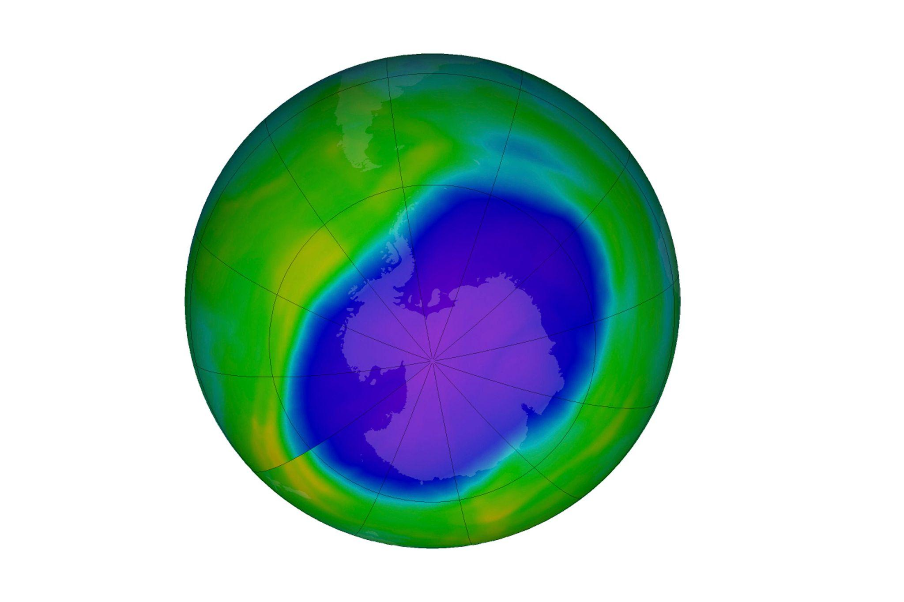
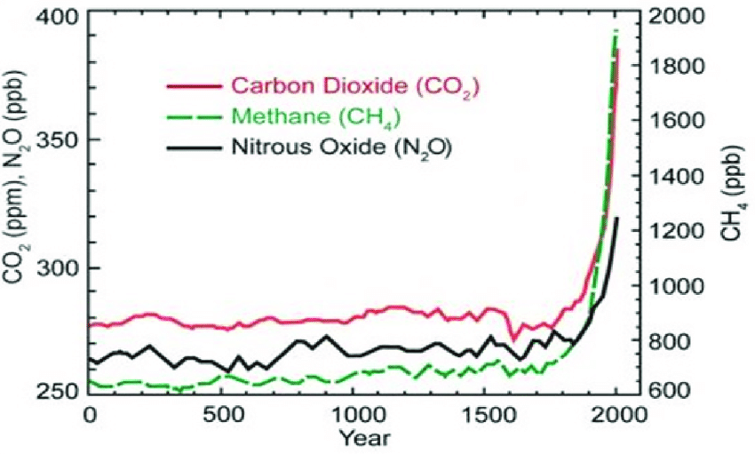
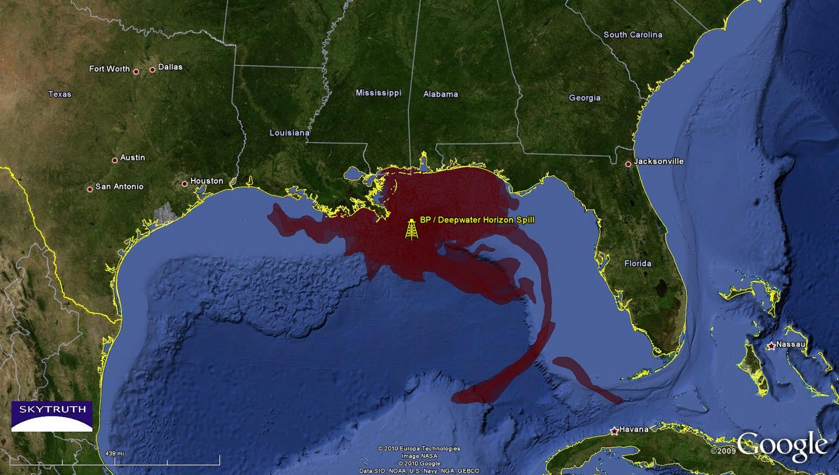
Environment: 1972 - Today
1983: Olin Corporation becomes first corporation forced to pay healthcare costs for victims, +10 years after EPA creation
Ozone hole discovered in 1985, CFC still produced until 1993, other ozone depleters will not be fazed out until 2030
1988: Runaway greenhouse effect gains national publicity
1989: Exxon-Valdez spill
1996: Lead removed from gasoline 25 years after EPA mission began
2010: Deepwater Horizon spill. Some consider it to be the worst environmental disaster in US history. No major regulations passed in response, unlike with previous disasters
2022: NOAA estimates climate changed fueled disasters caused $165 billion in damages that year
PFAS (forever chemicals) found to cause cancer, used in countless products. Practically unregulated to this day, issue underplayed by the government
2023: Train derailments release toxic chemicals, gaining national publicity with East Palestine, Ohio derailment

Slide 8
Introduction
Pollution and environmental deterioration are often ascribed to the negative effects of science and technology, and remedies are seen only in that area. The Communist leader ascribes these new dangers of extinction basically to the unplanned, anarchic system of capitalism and to the profit motive of monopoly. He gives the discussion a class dimension, showing that workers suffer the most, both at the place of work and at home. While urging immediate remedies, he holds that socialism provides the solution, as shown in the countries which have made the turn to the new social system.
Our nation is being poisoned with the ultimate threat of extinction by pollution and destruction of our environment, the main factor in which is the plunder of our natural resources. Everybody appears agreed on this. There is a widespread tendency to blame this dangerous situation on science and technology. But the real source of the problem must be sought elsewhere. It lies in the very nature of the social system under which we are forced to live.
The main impulse of our social system is the quest for profit. The result is unplanned, anarchic production, which allows the pollution and indiscriminate plunder of our natural resources. The ones responsible are the monopolies, the corporations, who have made enormous profits while they pollute and destroy our environment. It is estimated that hundreds of billions of dollars will be needed just to remedy the pollution and destruction wrought by the monopolies and their predecessors.

Slide 9
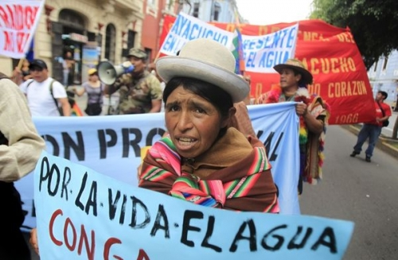
Introduction
The major victims are the working people, who suffer from the effects of pollution every minute of their lives.
The irony of the situation is that the only remedies now being proposed will bring additional profits to the corporations, through producing the means of halting the pollution and destruction of the environment. But the working people must pay for this by an addition to their tax burden and by a hike in the prices of commodities produced under the new conditions.
The only ultimate solution, of course, is the creation of a planned society in which the quest for profits has been abolished and the results of our science and technology are used for the benefits of the masses of the people of our nation…
This does not mean that the people can do nothing to halt the deterioration of our environment now. United effort by all the victims, the vast majority of the people, can force the federal, state and local governments to wrest from the monopolies reparations for the vast damages already done, to see to it that the costs of the remedies come out of the profits of the monopolies, and to guarantee that none of the costs of the remedies are foisted on the people through increased prices for commodities produced under the new conditions…

Slide 10
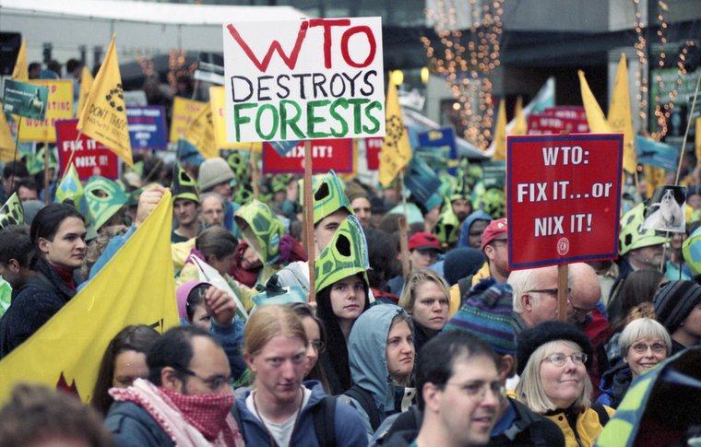
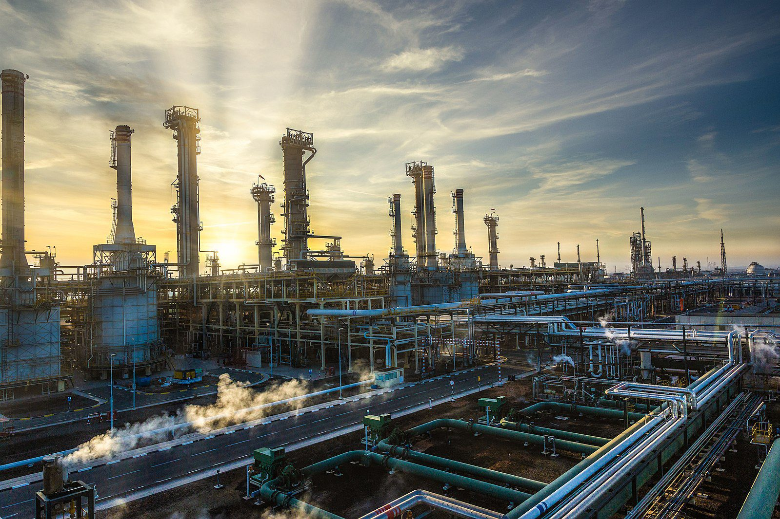
Introduction
Pollution and the need to preserve a livable environment have become an issue in the class struggle. The pollution is heaviest where workers work and live. In keeping with their inherent nature, capitalist corporations refuse to take any responsibility for the pollution which they originate. They go to any lengths to cover up their guilt. The corporations are for doing something about the pollution if it does not in any way affect their rate of profit. When questions of their responsibility are raised they respond by threatening to close down the plants and move to new locations. Or they demand tax gifts in order to protect profits.
Pollution has become a new factor in runaway shops. Industry's first response to pressure on cleaning the environment is to create a job scare and a political crisis. They react to this pressure as they have reacted to union organization and to strikes.
The new levels of science and technology always fire the boilers of a transition. But they also have always provided tools of combat.
The boilers of the changeover have developed a heavy head of steam. Science and technology have taken a qualitative leap: With the new technology has come a qualitative leap in the means of destruction. Human society has come to a crossroads. It can now provide abundance for all or it can now destroy every living thing. Nuclear, chemical and bacteriological stockpiles can now kill every living thing 100 times over. For the first time the human race is forced to consider the difficult question: How can it proceed with social

Slide 11
Introduction
progress, with the transition to a higher social order without a nuclear disaster? The struggle against nuclear war of course must be placed in an overall framework. Human society will not accept a status quo. It is rejecting values and priorities based on exploitation and private profits. It will not accept imperialist oppression as a way of life. The struggle for social progress will go on. The transition to a new economic and social system will not wait. This struggle must now be joined with the struggle against a nuclear war. This only adds a new dimension to the crisis quality of the moment.
The struggle against both nuclear and environmental disaster are closely linked. The root causes are the same. The line up of class and political forces on both sides are the same. They are critical problems peculiar to this moment of transition.

Slide 12
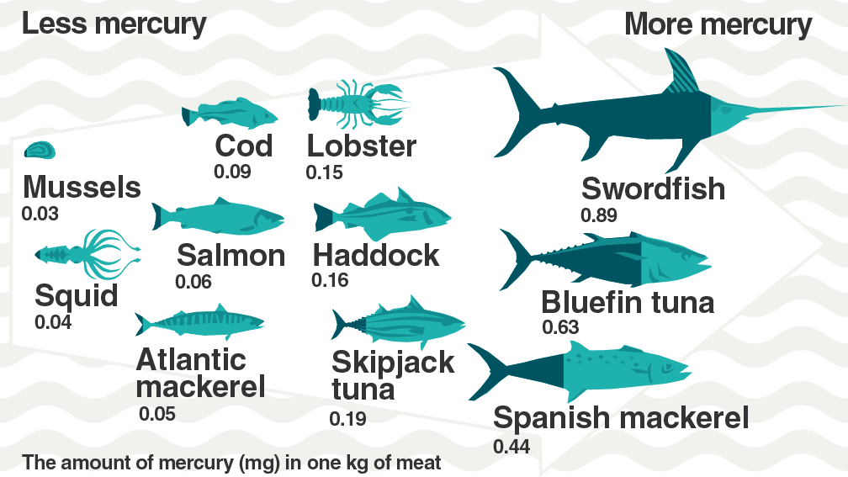
2. The Eggs and the Chickens are Being Destroyed
Industries have poured mercury wastes into the lakes and rivers for decades. But we are only now seeing the cumulative effects of that pollution in the poisoned fish that have become inedible. Mercury pollution went unnoticed until it began to kill human beings as a poison. How long it has been the cause of sickness and, indirectly, the cause of death no one knows. And if mercury pollution were totally stopped its poisoning would not only continue, but would escalate for the next thousand years. No one has come up with any proposals on how to gather up the mercury that now lies in the bottom of rivers and lakes. Each year it will poison more fish.
Up to a year or two ago all scientists assumed that the discard of industrial mercury would sink into the soil of river and lake bottoms and lie there in a harmless state. No one suspected it would be transformed into a killer poison that would enter nature's food chain and kill human beings because the process was not evident to the human eye. No one had any idea of its effects on the soil, plants, animal or on human beings.
Now there is a growing concern about lead and other elements in the food chain.
The most critical processes accumulating death are unseen and many more are unknown. And the most criminal are the deadly processes known but deliberately covered up and hidden from the public by corporation executives and government officials.

Slide 13
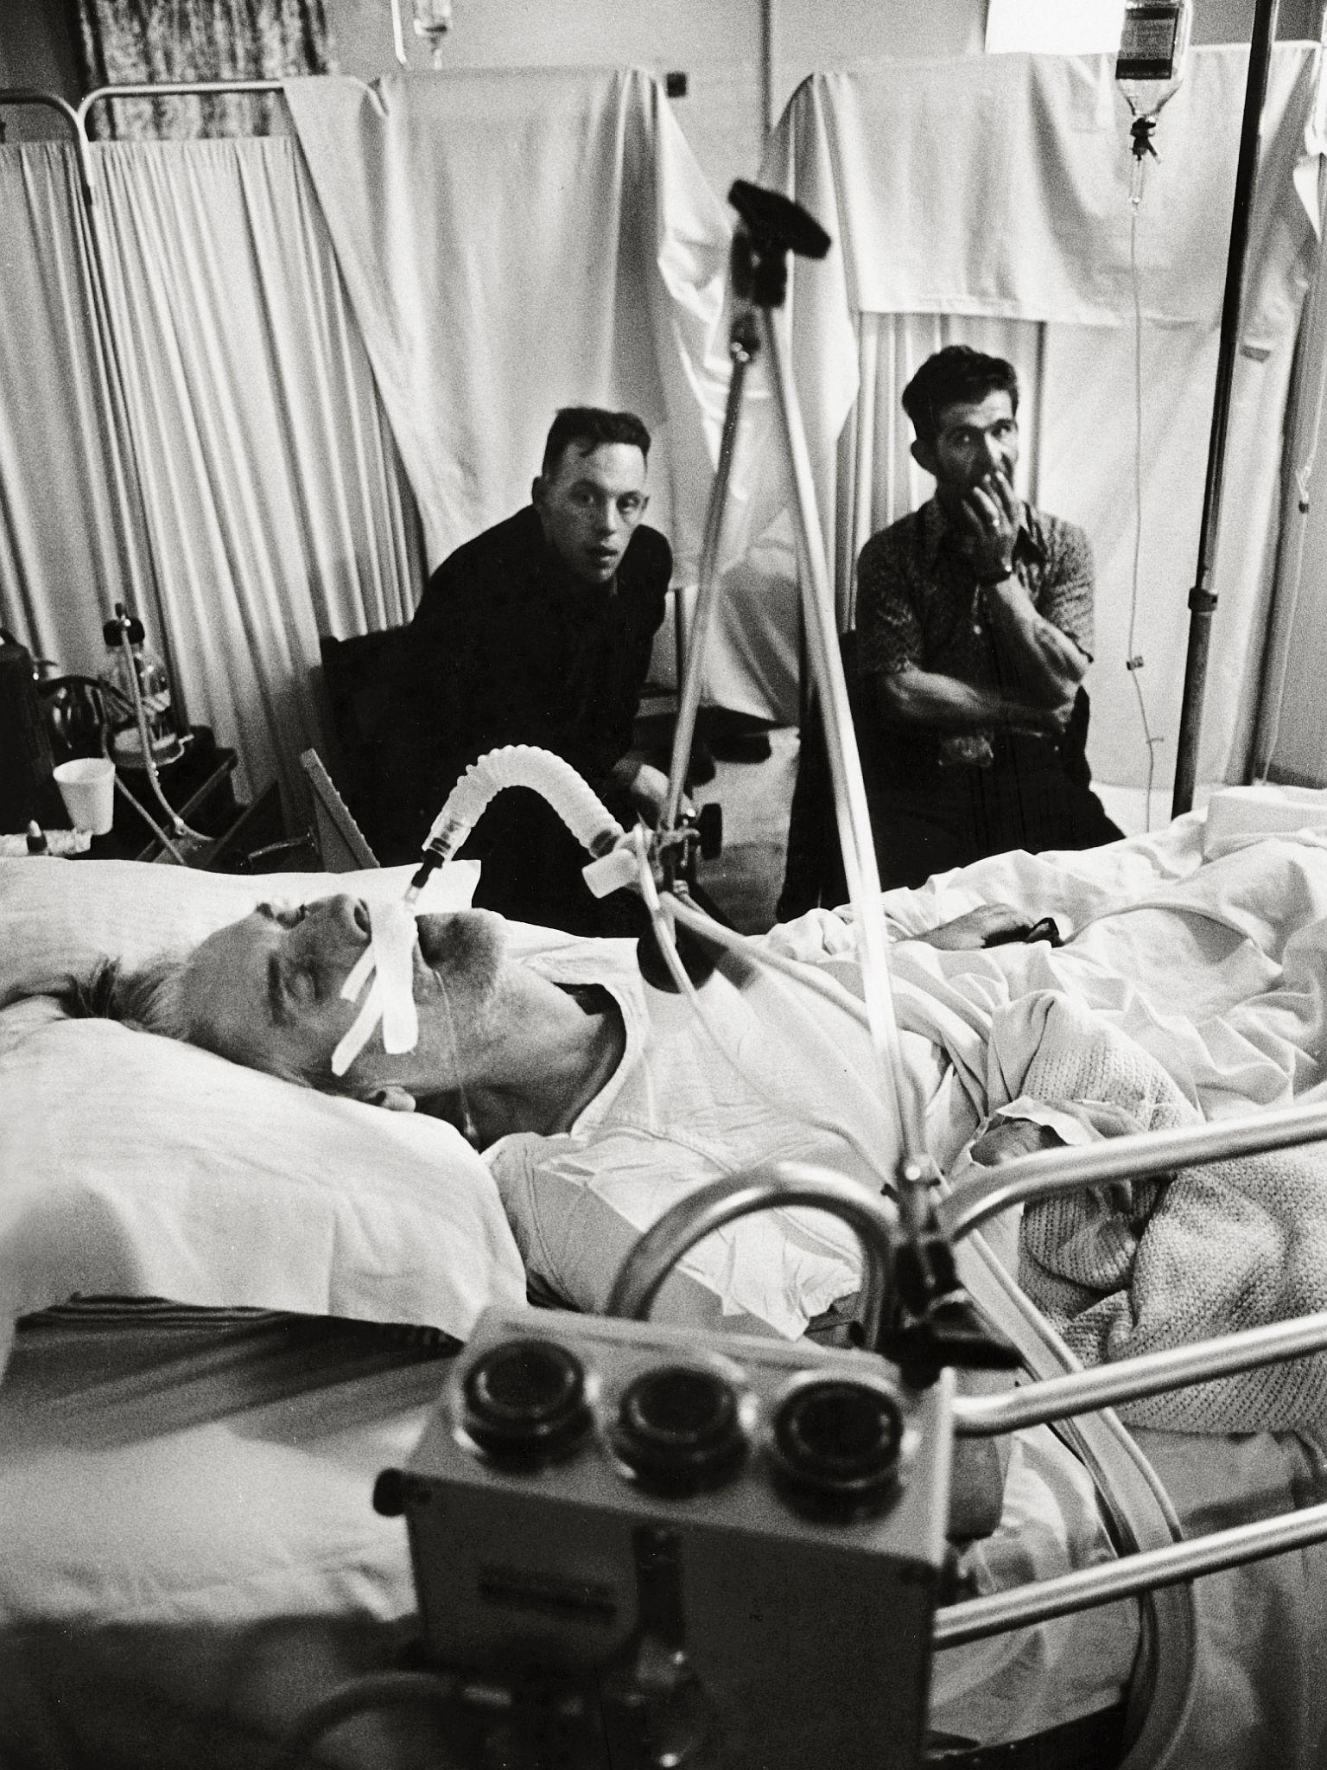
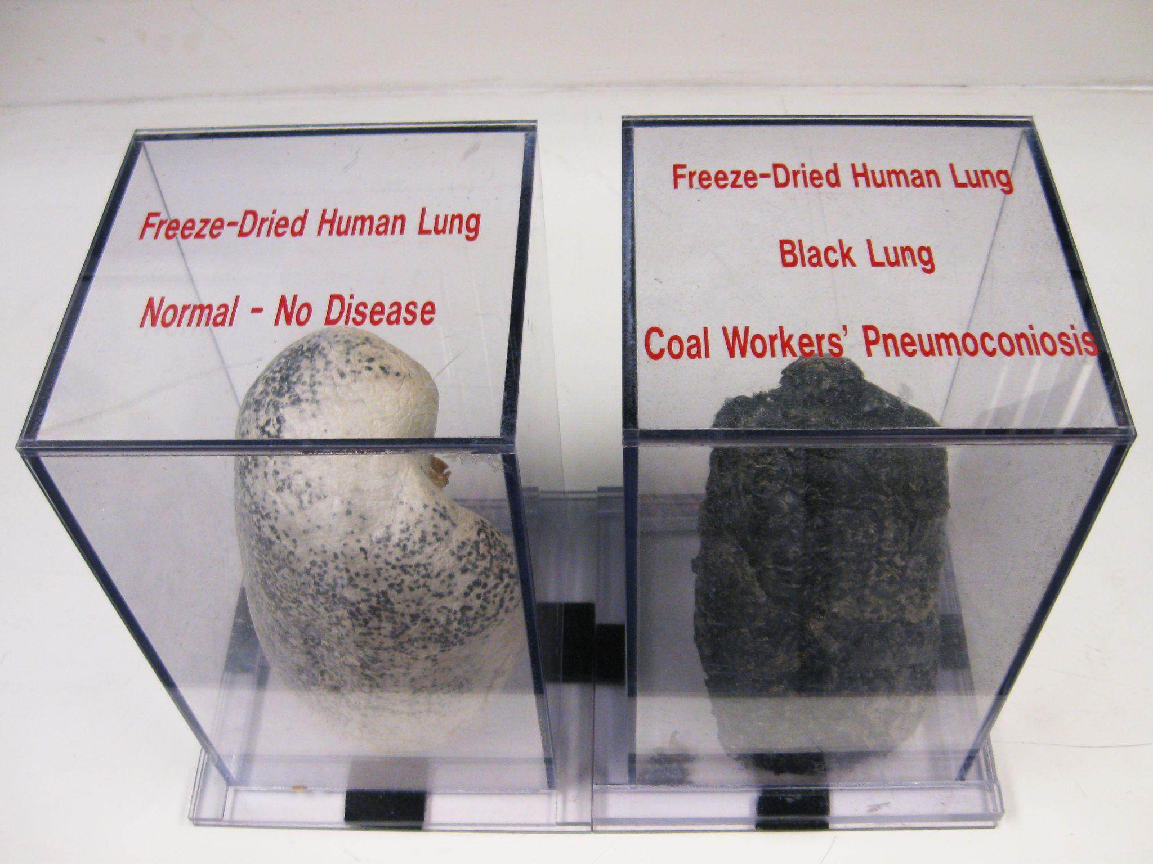
3. The Oldest Crime
The problem of overall environment has focused attention on the oldest and most brutal of all of capitalism's crimes. It is the mass murder that has been going on in the factories and mines for over a hundred years. The number of victims runs into the millions. The crime is hidden behind the biggest of all lies, the "death certificates" signed by medical authorities bought off by corporations.
This mass murder, because it takes place within the industrial processes, has always been acceptable to capitalist society as necessary and normal. Workers' lives have always been expendable for the corporations. Sixty die from industrial accidents every day. Thousands are maimed and crippled. This, industry cannot deny. In spite of the overwhelming evidence to the contrary, the coal companies still try to deny that the black lung disease, from which hundreds of thousands of coal miners have died, is related to the unhealthy conditions in their coal mines. Corporations in other industries are no different. On the scale of profits, human lives are worthless...
"And, in the same State of West Virginia, probably the most dramatic evidence of lack of concern on the part of the Government, has been the situation with the mine workers. Let's just review that question for a moment. In the State of West Virginia we have 30,000 miners employed in coal mines. We know approximately 80 per cent of them will die of Black Lung, pneumoconiosis. Eighty per cent of the miners who go down into the pit will die of this disease. Possibly the other 20 per cent will die from falling rock, cave-ins, and the like. Now that's a staggering figure.

Slide 14
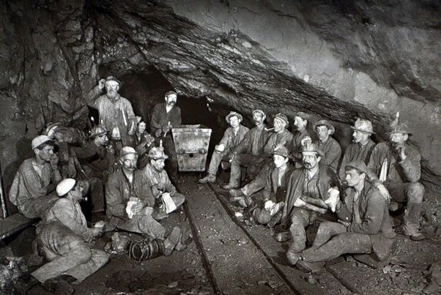
3. The Oldest Crime
"The State of West Virginia did not even have Black Lung as a compensable injury, and it was virtually impossible to collect compensation for it."
Another worker observed how socialism reacts to such problems:
"In examining this book on which American law is based, I was really amazed to see that they list a worrisome chemical, being used in our oil refineries, with a standard of 225 parts per million, under the Walsh-Healy Act. And they cite, in this very book that's part of American law, that the Russian standard is 25 parts per million. Now I don't know who's correct; whether the Russians are correct or the Americans are correct. However, I say, if there has to be an error, let the error be on the side of the worker, instead of on the side of the boss. Two hundred and twenty-five parts per million as opposed to 25 parts per million? I say, let's have the lower level, and if it's over-safe, fine, because once you've been exposed to the higher level, it's irreversible."
The standards are dramatic comparisons of the two social systems, one motivated by private corporate profits, the other by concern for human beings.

Slide 15
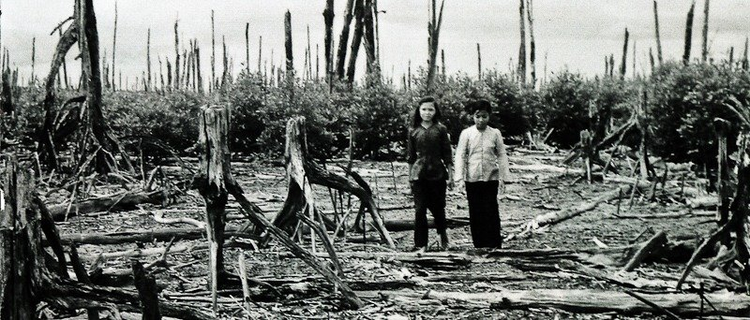
4. “Kill Every Living Thing”
The realization that the human race faces a critical challenge from pollution brings with it a rising consciousness about other crises and dangers. In Vietnam, indeed in all Indochina, the United States is hard at work trying to do there what pollution threatens to do to the world. The orders at My Lai were not at cross purposes with the U.S. military policy for all of Indochina. Millions of tons of napalm have burned the flesh off the bones of hundreds of thousands of living human beings. The aerial bombardment has never differentiated between military and civilian villages. The death toll of civilians is in the millions. This is the result of a policy of "kill every living thing that moves" and "destroy everything that grows."
There is a chemical called [Agent Orange]. It is used in the United States for killing weeds. When some of this killer chemical was blown by the winds into a flock of sheep and goats in Nevada, 60 per cent of the offsprings were born dead or deformed. The rest died. In 1968 in this same area 6,400 sheep died because the winds carried a whiff of nerve gas being tested by the army. About 45 per cent of the land area in South Vietnam has now been sprayed with [agent orange] that is 13 times more powerful, more concentrated than that permitted in the United States. It has now been proved that these chemicals produce human cancer, possibly for generations, in an escalating spiral. Is there a more heinous crime in all of history? The fires of these crematoriums will burn for generations to come.

Slide 16
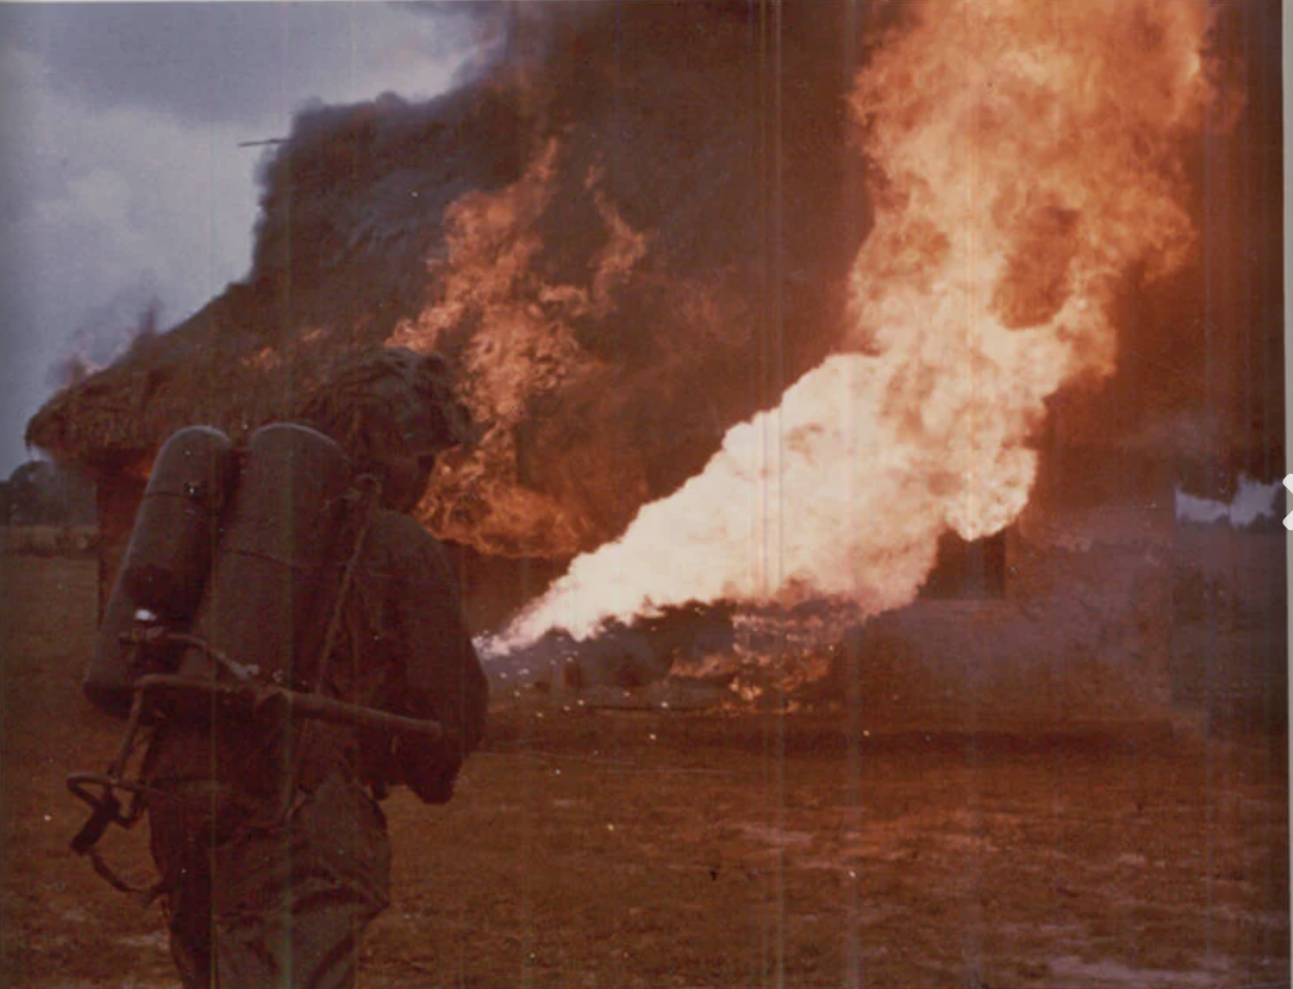
4. “Kill Every Living Thing”
This is as deliberate and premeditated as the atomic bombing of Hiroshima and Nagasaki. It is no less a crime than the death camps of Hitler fascism. Hiroshima, Buchenwald, My Lai-they are all offsprings of a morality that is generated by the very nature of capitalism. In the struggle to end the destruction of the environment the people are going to have to fight against the same class having the same morality…
There is another similarity between the policy of destroying the people and the lands of Indochina and the destruction of the environment. The people of the United States are against both policies, but the policies continue. The lesson is obvious. A more militant struggle must be waged. An essential part of that struggle is the need to expose the roots of the social system that bears these evils. We must indict the creator of misery and murder and not limit ourselves to the immediate horror.

Slide 17
Key Takeaways
The food we eat is being poisoned by capitalist pollution. The ecosystems that produce that food are also being destroyed by capitalism
Workers suffer the most from pollution. Since the beginning of capitalism, their workplaces have been full of deadly pollution. Now that the wider environment is deteriorating, workers are forced to live in the most polluted areas
Imperialism is driven by the same powers/system that destroys the environment. Vast environmental destruction is always a by-product of imperialism. Imperialists often deliberately poison the environment as thoroughly as possible to achieve their goals

Slide 18
Discussion

Slide 19
A Solution is Impossible Under Capitalism

Slide 20
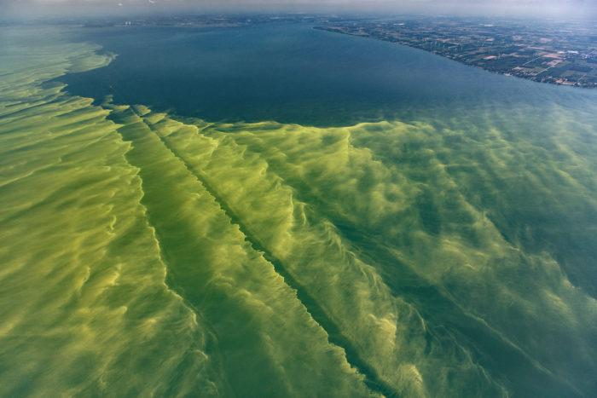
5. The Roots of the Problem
Countless books on pollution are flooding the market. Many of them describe the effects, but most, if not all, sidestep and avoid coming to grips with the central problem. Without defining the real cause there can be no basic solutions.
Many point the accusing finger at "the new technology." Their "solutions" are simple. Technology got us into this mess and technology will get us out also. This, of course, is no solution. Technology is what people make of it. Technology is an instrument. It can be harnessed and used either for positive or for negative results. It can be controlled and used for social good. Or it can be controlled and used to pile up private profits. So technology in the abstract is neither the cause nor the cure for the problems of the environment.
Speaking about the problems of environmental pollutions, U Thant, the Secretary-General of the United Nations, sought the source "in the explosive growth of human population, in the poor integration of a powerful and efficient technology with environmental requirements, in the deterioration of agricultural lands, in the unplanned extension of urban areas, in the decrease of available space and growing danger of extinction of many forms of animal and plant life." (UN Document E/4667, 1969.)

Slide 21
5. The Roots of the Problem
Such a statement while descriptive, reflects only part of the truth. It is true there is a "poor integration of a powerful and efficient technology." But the real question is why is there such a "poor integration"? How must society rearrange its structure to guarantee "good integration" of efficient technology with the needs of human progress?
The New York Times editorially (February 9, 1971) inadvertently came one step closer to the core of the problem when it stated:
"A corporate manager has his attention focused on the profit targets and production schedules. He has a natural resistance to taking into account environmental costs, some of which may be invisible, incalculable or very long-term.
"What is involved is a conflict of values. Nixon proposes many excellent environmental measures but he often talks the old fashioned language of the profit-first businessman."
What is important is that the "resistance" is inherent within capitalism. What neither U Thant nor the New York Times says (each for one's own reasons) is that the "corporate manager" with his "profit targets" is an inseparable feature of capitalism. As long as we have capitalism we are going to have "corporate managers" who are going to "resist" taking into account the environmental risks.

Slide 22
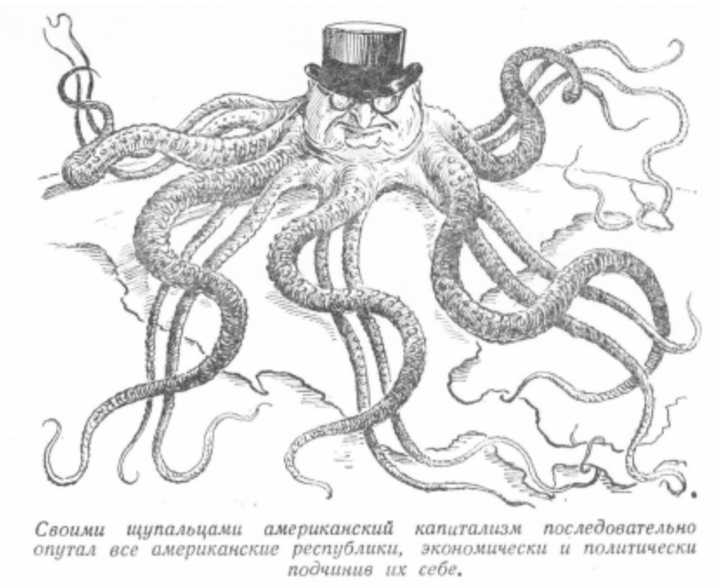
5. The Roots of the Problem
"Corporate managers" under capitalism cannot be separated from the "profits-first businessman." These managers are going to continue doing so, especially where the risks and hazards are "invisible and incalculable" to the people. That is the very nub of the dilemma. Corporate managers will resist, government officials will "play ball" with them, and the "invisible," "incalculable" processes leading to a point of no return will grind away.
What is involved is a conflict of values. What is important? Profits for a few already rich, or an environment in which life on this planet can continue?
There is a basic concept, a fundamental approach-an attitude that underlies corporations' responses. It is a response, a sense of values that is devoid of any social responsibility. Any entrepreneur who might dream of deviating from the rules of profit knows that this is the path of suicide. If he is to survive he must play by the rules set by the system. The root of the problem is not to be found in the evilness of individuals
Corporate response reveals its true colors when there is public pressure against an industry polluting the environment of a city. Time after time they say, "You force us to spend money on ending the pollution and we will move our industry out of the city." Time after time, they say in effect, "Take it or leave it! You have a choice of clean air, clean water, and no jobs. Or polluted air and water, shorter lives, and possible jobs"...

Slide 23
5. The Roots of the Problem
That is not only the attitude of one corporation. It is the basic approach of capitalism-of all corporations to any problem that is in any way an obstacle to making more profits.
A leading executive of Reynolds Metals is quoted as saying, "It's cheaper to pay claims than it is to control fluorides." (Reynolds Metals, V. Lanpert, 9th Circuit, 1963.) This puts a price tag on the life of every American. For the corporations the issue is not whether people live or die as a result of their pollution-but rather what is the cheapest way to continue the destruction of the environment. The fines leveled by government bodies against corporate polluters is a joke. What is a $50 or $100 fine to a corporation that deals in billions of dollars? These fines, in fact, become licenses to continue polluting.
In 1970, 13 corporations, including such giants as Dupont and Texaco were convicted for polluting New York Harbor. They were fined only $750 each…
There are other problems reflecting the same anti-human sense of values by corporations. The monopoly corporations in a basic sense dominate all governmental bodies. This domination has now been extended to problems of pollution control. A Colorado hearing on pollution of a stream was presided over by the so-called Pollution Control Director of the brewery that was polluting the stream under investigation.

Slide 24
5. The Roots of the Problem
There are anti-pollution boards in most of the 50 states. But a check shows that at least 35 such boards are dominated by representatives of the corporations who are the main polluters.
The most influential member of the Los Angeles Harbor Anti-Pollution Board is an executive of an oil corporation that is the biggest polluter of the harbor area.
Their presence on these boards is not accidental. The official rationale is that they bring with them "expertise and familiarity with pollution problems." The other excuse is that they should be on these boards "because of their civic importance." It is clear to anyone that their "expertise" as polluters is in covering up the polluted tracks of the corporations they represent. Their "expertise" is the expertise of a wolf in a flock of sheep. There is a clear case of conflict of interest between what these boards should do and what they actually do, as a result of having the representatives of the polluters sit on them. They have become a cover for the polluters. They divert the concern over pollution to dead-end corners and endless "studies" and "discussions."
We have examples of what happens to people who take their "civic responsibilities" seriously. In New York, Mr. John Burns was an Assistant District Attorney. In 1970 he went after General Motors for polluting the Hudson River. He was doing a very good job. Because he was doing a good job he was summarily fired by the U.S. Attorney General.

Slide 25
6. Irresponsibility of Government
Criminal conspiracy and destruction of the environment are not limited to corporations. They extend to the very top governmental bodies. The crime on the governmental level is covered up by demagogic speeches about ecology and calling for "earth days." The Nixon-Agnew gang was the first to use the ecology demagogy on a wide scale. It thought it could make meaningless speeches about clean air and clean water, and involve youth in a meaningless movement. But the strategy backfired. Youth quickly discovered collecting discarded cans and bottles, while not without merit, was not tackling the problem at its source. There is an important lesson to be learned here: the mass can move very quickly from revulsion at the effect to condemnation of the cause. We are witnessing the same educational process that took place in the peace movement…
Earlier Nixon made a big point about ecology in his State of the Union address. But, as usual, when the Nixon Administration introduced the bills that would become law, seven key words were inserted at every point into every law dealing with the environment. This was done at the insistence of the Administration spokesman. The seven words are "taking into account the practicability of compliance." These words pulled the rug from under all anti-pollution government bodies. They also pulled the rug from under the power of the courts to deal with environmental pollution. This clause makes Nixon's anti-pollution bills a farce.

Slide 26
6. Irresponsibility of Government
It is the loophole through which even the biggest polluters can crawl. This is Nixon's good deed to big business, which on February 10, 1971, complained that anti-pollution boards were setting air and water standards "which are unachievable with present available technology" and "at economically tolerable costs." (New York Times, February 11, 1971.) In plain, simple words, the corporations said they are not going to do anything to safeguard the environment if it affects their drive for maximum profits…
The government and the monopoly corporations have become ever more entwined in carrying out these designs of capitalism. They cannot be separated from the policies of aggression in Vietnam. They cannot be separated from the policies of exploitation, of racism, of high taxes, prices, rents. They have the same basic class interests. Through struggle the government can be forced to make concessions. Through struggle the corporations can be made to make concessions. But as is the case with wages or victories against racism-so it is in the struggle for a clean environment.
The anti-pollution offensive has not gotten off the ground yet. Congress passed a bill appropriating six million dollars to investigate-not pollution, but whether the concept in any way is hurting big business.

Slide 27
6. Irresponsibility of Government
In their efforts to win workers to their position, employers are using the workers' fear of losing their jobs. They say that if the pressure continues they will have to close down plants. This is the same propaganda they have used against trade unions and against paying local taxes.
Cleaning and safeguarding the environment will create more jobs. Workers will be needed to manufacture the new equipment. Workers will be needed to run the equipment. Researchers and specialists will find employment in this new field.
The solution to problems brought on by new technology is not going back to the "good old days." Such ideas only create illusions and apathy because they are myths.
The task is to update human society so it measures up to the new level of technology. Going back to the "good old days" is a form of "cop out."

Slide 28
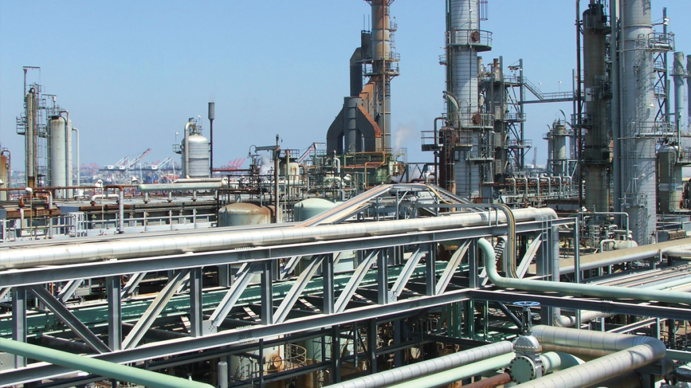
7. A New Problem
What we are facing in the environment crisis is not just another problem, but a qualitatively different one. The basic solutions are not to be found in old concepts, or even stopgap measures, as important as they are. New problems require a radically new approach.
Throughout history, science and technology have broken through old social and political frameworks. The then existing social systems became roadblocks to further progress. The present break-through in science and technology has created a more formidable obstacle than a roadblock. It has brought with it the serious danger of wiping out all forms of life on this planet…
To move on remedial action, however, opens a key question for consideration. How can human society continue to use the benefits of the technological breakthrough while placing a permanent and a continuous control over the negative features resulting from these processes? Economic and social processes in a human society have definite structural forms. In the United States we are dealing with the crisis of the environment as it is related to the system and structure of capitalism.
Therefore the most fundamental question facing the people of the United States is whether controls can be placed on the negative effects of the technological revolution while permitting capitalism to continue as an economic and social structure.

Slide 29
7. A New Problem
There is no question about the need for an organized movement to force even stopgap measures against the pollution of the environment. Mass actions can influence the action of governmental bodies. The exposés of Ralph Nader and his task force are an example of the possibilities open in this area. Their proposals can cut down on some forms of the pollution. They can even postpone the disaster. But Nader and his associates limit themselves to first aid and are not physicians.
In a fundamental sense, the question remains: Can human society avoid an environmental point of no return while life and production remain organized along capitalist lines?...
It is this same drive for profits that is now in irreconcilable contradiction with the ability of human society to continue to survive on this planet. As the drive for private profit has destroyed human life through various forms, it has launched a new killer environmental disaster. The human race faces the challenge: Will it be capitalism or survival?
This contradiction is rooted in the intrinsic characteristics of capitalism. The big corporations have taken over the benefits of the technological breakthrough because they are profitable. There are no profits in the control of the negative features resulting from these new technological processes. Capitalism has never been concerned with human problems, including human life. Why should anyone think capitalism is going to change now? One can judge a social system by its history.

Slide 30
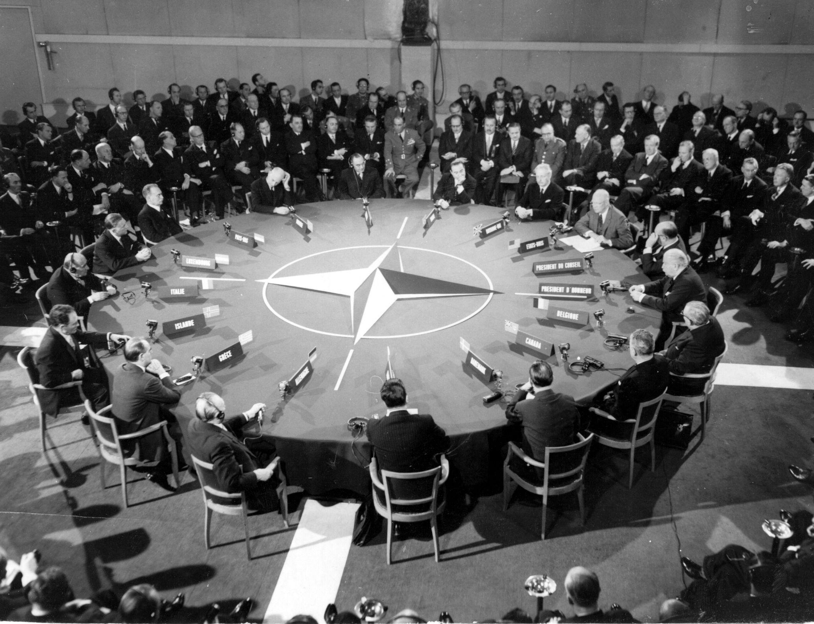
7. A New Problem
Capitalists, particularly of the Wall Street variety, frequently attempt to cover up the human devastation caused by their system by concealing their deeds with pious pronouncements. Such was the scheme in Vietnam where genocide was carried out while Washington attempted, unsuccessfully, to persuade the American public that it had the lofty aim of "self-determination." Now the Pentagon Papers confirm that merciless war was to be waged against the entire population while the public was to be told that the pure-hearted generals were motivated by altruism.
Fascism is inherent in capitalism. Fascism is a brutal enforcer in a capitalist private profit system. When people threaten the ability of monopoly corporations to continue making their profits the system of capitalism moves to suppress such movements. Fascism in Germany, in Italy, were structures to advance the ability of the big monopolies to make maximum profits. In that drive they murdered tens of millions of people, among them six million Jews. A system responsible for such crimes will not be concerned with the pollution of the environment.
Racism is the basis for a special system of oppression and exploitation. In the United States the basis for the special exploitation of Black Americans, Chicanos, Puerto Ricans and Indian Americans is racism. Racism is an instrument of corporate profits. Individual rich Americans are richer because Black Americans are forced to work for lower wages.

Slide 31
7. A New Problem
They are richer because white workers who are influenced by racism keep the working class split and therefore are forced to work for less wages than would be the case if the working class was united. In human terms, racism is a brutal killer. It is genocide. In slum neighborhoods 111.1 babies of every 1,000 live births die at birth. This is five times greater than the national average in the United States. It is 15 times greater than such deaths in affluent areas in our country. This is racism in human terms. The incidence of tuberculosis in the slums of Boston is six and one half times the rate that it is in the city as a whole. This is racism. In some slum areas the death rate is larger than the birth rate. In spite of the struggles and partial victories this basic system of racist genocide continues. In 1950 the "non-white" infant mortality rate was 62 per cent greater than among white Americans. Now, 20 years later, it is nearly 90 per cent greater…
The federal government spends more money on instruments of death than the total sum that is spent by the federal, state, county and city governments on health, hospitals, education, old age and retirement, public assistance, unemployment and social security, housing, agriculture and community development projects all put together. Is it not an illusion to expect such a system to spend money and be concerned about improvement of the environment?

Slide 32
7. A New Problem
Under pressure, the corporations will maneuver. They will retreat, but they will only seek for new ways to hide the pollution of the environment from the public. This is not because of the evil in man, but rather it is because of the inherent nature of capitalism as an economic and social system…
Capitalist production is planless. It is anarchy. Each corporation is motivated only by how it can squeeze out the maximum profits. General Motors is a $25-billion private empire. It accepts no social responsibilities-human or environmental. Science, production and technology have now reached a level where such problems as the environment cannot be left to the mercy of individual corporations who have no social consciousness.
In the final sense, the present level of human activity produces problems that can be resolved only by a social structure that can plan and guide the activity so that benefits go to all the people.

Slide 33
Key Takeaways
Corporations, not technology, are responsible for the climate crisis. They have the most power in our society, and it is in their interest to continue polluting
The government operates in lock-step with the corporations. We cannot rely on the government alone to regulate pollution
Fascism, racism, imperialism, and the environmental crisis are all driven by the same underlying system. Those who wield violence against the working class have no social consciousness. Thus we can expect the fight to save the environment to be just as difficult as the struggle to end fascism, imperialism, and racism

Slide 34
New Member Introductions
What is your name, pronouns and state (or country/territory)?
Where do you work? Is it unionized?
How did you find out about the People’s School?
What do you think about tonight's class?

Slide 35
Discussion

Slide 36
Centralized Planning:
A Lasting Solution

Slide 37
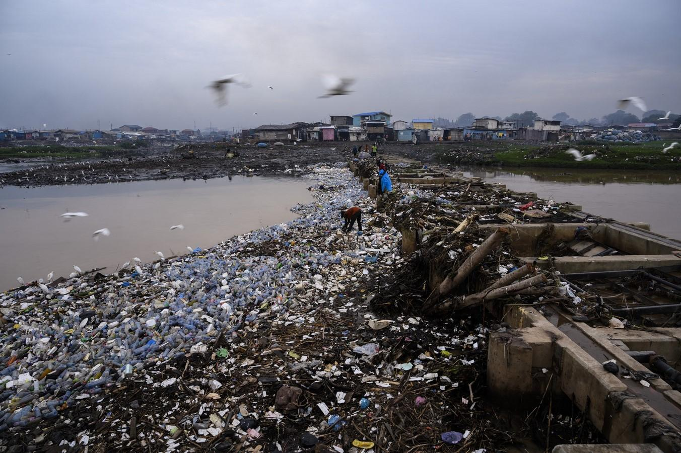
8. Socialism and the Environment
Socialism corrects the basic flaw of capitalism. It sets human society on a new path. The means of production, factories, mines and mills become the property of the people. They operate and produce only to fulfill human needs. They are not motivated by private profits. This is the foundation for a new set of priorities-for new values. This then is the framework in which all questions are determined. If a process does not serve the common good, it does not take place. A clean environment is for the common good. It is therefore pursued.
Under capitalism there is a contradiction between the drive for profits and cleaning the environment. Under socialism this contradiction is eliminated. Saving the environment becomes a social necessity. Under capitalism, the main pressure on the production processes is maximum private profit. Capitalism cannot function any other way. The environment is a casualty of these pressures. Under socialism this pressure is totally eliminated. It is replaced by a pressure to do only that which is in the best interests of all in society. This pressure guarantees that no process will take place that endangers a continuation of life on this planet.
What is involved is "a conflict of values." The values of capitalism are geared to supporting a system of exploitation and private profit for the few already rich. They are values that justify exploitation, oppression, racism, and imperialist wars of aggression. It is these values that are the obstacles in the struggle for a liveable environment…

Slide 38
8. Socialism and the Environment
We may now ask: How are socialist societies doing on problems of pollution? Is the environment better? Is it being polluted?
In a basic sense the answer is yes-they are doing much better, but with some weaknesses. Most important-the laws, the approach, the sense of values, the priorities given to saving the environment are on a high level in all of the socialist states. A violation of environmental laws is treated as a serious crime. There may be some weaknesses in research. They will have to increase research in the areas of the detection of pollutants, their effects and the means of prevention…
Socialism, motivated by doing only that which serves society as a whole, has values and priorities that make the preservation of the environment a part of the overall human activity…
Moscow is one of the largest industrial cities in the world. Not so many years ago the air around it was one of the dirtiest in the world. World pollution specialists agree that Moscow is now the cleanest big industrial city in the world. Since 1948 the air is 83 per cent cleaner. There are no smoking apartment house chimneys. There is no heating either by oil or coal. Moscow has a city-wide heating system. The system burns only gas…

Slide 39
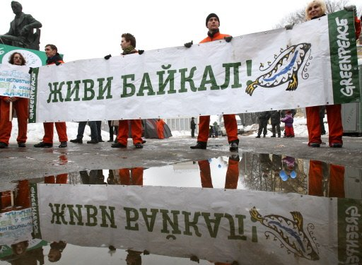
8. Socialism and the Environment
Achievement in this area is not confined to such cities as Moscow. It spreads over the entire Soviet countryside and undoubtedly the most dramatic story is that of Lake Baikal. What happened there at the earth's most ancient and deepest lake was told, not by a Soviet publication, but by Farley Mowat in the Boston Globe.
The lake, Mowat wrote, contains almost a fifth of all the free fresh water in the world. Its depth is more than a mile, the waters "fantastically clean," and Baikal has more than a thousand species of plants and animals that are found nowhere else.
Mowat continues:
"In 1962, the economic planners in Moscow decided to build five gigantic cellulose and wood-chemical plants on Lake Baikal. In 1964 work on the first two began.
"At this juncture something truly remarkable occurred. Pravda and Izvestia, having proudly announced the birth of the gigantic new production complex at Baikal, were inundated by letters of outrage. As the two plants neared completion the intensity of the storm strengthened.
"An elderly, much respected Moscow writer described what followed:

Slide 40
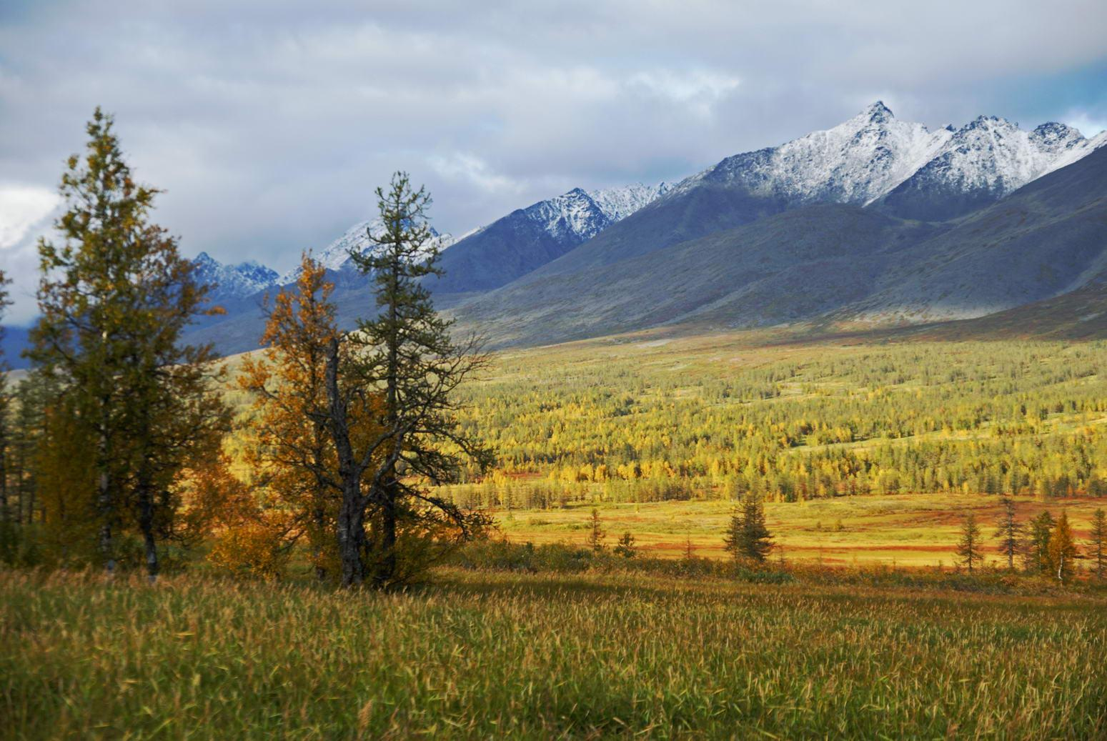
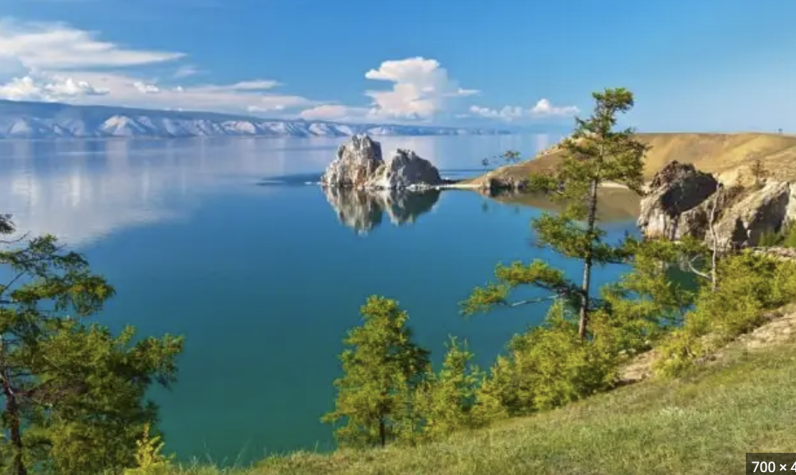
8. Socialism and the Environment
" 'The word Baikal became a rallying cry even to people who knew very little about it except its name. They were acute enough to see that finally the high priests of progress through production had to be brought to their senses. . . .
" 'For a while the authorities who had designed the cellulose combine tried to drown out the protest .... There were some threats . . . . The plants were completed and began operations .... Within three months there were reports of fish dying in Baikal and even of people getting sick from eating fish caught in the Angara. The fight of the people to save the lake became more furious and then, quite suddenly the authorities gave in. The plants were closed.'
"To the Western mind the scope of the victory seemed staggering. In 1967 the Presidium of the Supreme Soviet of the USSR voted to make the entire Baikal region-the lake and thousands of square miles of surrounding territory-into a national park.
"Extensive reclamation projects are underway to restore tributary streams and riverbeds. New fish hatcheries are being built. All wildlife ranging from wolves to wild flowers are now under complete protection. By 1970 the seal population had increased to 45,000 and even the very rare Barguzin sable was staging a remarkable comeback."

Slide 41
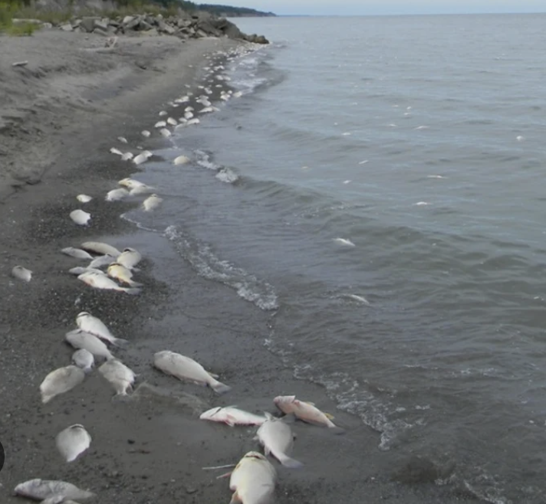
8. Socialism and the Environment
The struggle to end the pollution around Lake Baikal is an example of both the difficulties and the seriousness with which a socialist government approaches this problem. The Soviet government issued its basic directives for cleaning the lake in 1969. Evidently the directives were not carried out fast enough. On September 24, 1971 both the Central Committee of the Communist Party and the Soviet Government issued directives demanding speedier action and full compliance. The new directives called for "speed in drafting and implementing the organization of the protected zone." The protected zone includes the drainage basin, in which are situated the mining and timber lands in the Lake Baikal region. The old pulp mills were given until 1972 to establish full pollution controls. The new pulp mills were instructed not to start operations until "appropriate treatment facilities were ready."
The directives set 1973 as the year by which the cities along the rivers that flow into Lake Baikal were to have full waste-treatment devices. Electric power stations are prohibited from raising the water temperature in the rivers on which they operate by no more than seven degrees Fahrenheit.
Compare this to the futile efforts to save dying Lake Erie. Lake Erie is now listed as dead. It is not being cleaned up. If all of the pollution was stopped today it would take 50 years to give it new life. It took 50 years to kill it. In 1920 the commercial catch from Lake Erie was 33 million pounds of white fish, blue pike, and lake trout. By 1960 commercial fishing had to close shop. You swim in Lake Erie at your own great risk…
The basic difference between the two systems is that in the socialist countries the battle for a liveable environment is being won; the tide has been turned.

Slide 42
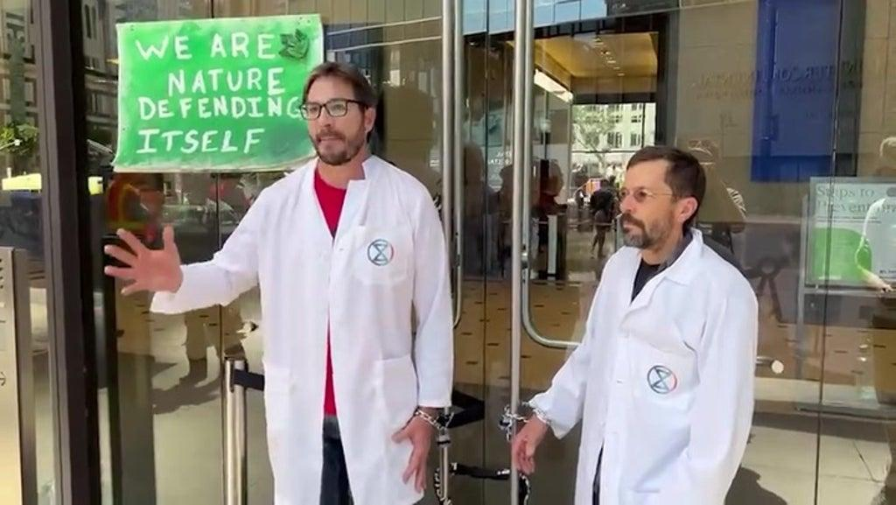
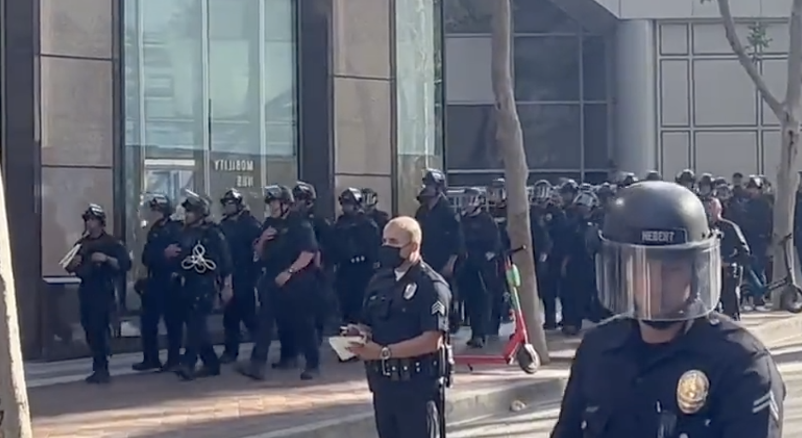
9. Toward a Solution
As of now in the leading capitalist countries-the United States, West Germany, England, Japan and France-the battle is being lost. There are some victories here and there, but the basic processes leading to an environmental crisis continue to escalate.
While the ultimate solution to the grave problem of pollution and destruction of our environment can come only with the replacement of the capitalist system by a socialist society, the masses of the American people cannot put aside action until that stage in the development of our country arrives. The monopolies are continuing to commit their crimes against our environment, despite the massive protests of the American people. And the federal government is determined to help the corporations commit these crimes while claiming it is opposed to this plunder…
It is obvious from this that the American people cannot depend on Washington to do the job, that the immediate struggle against pollution must be accelerated. Although the ultimate solution cannot be achieved at once, partial victories can be won against the rapacity of the monopolies.
But such victories will require the united effort of the masses of Americans. The key factor will be leadership of the struggle by the organized working class, the most powerful single element for progress in our society.

Slide 43
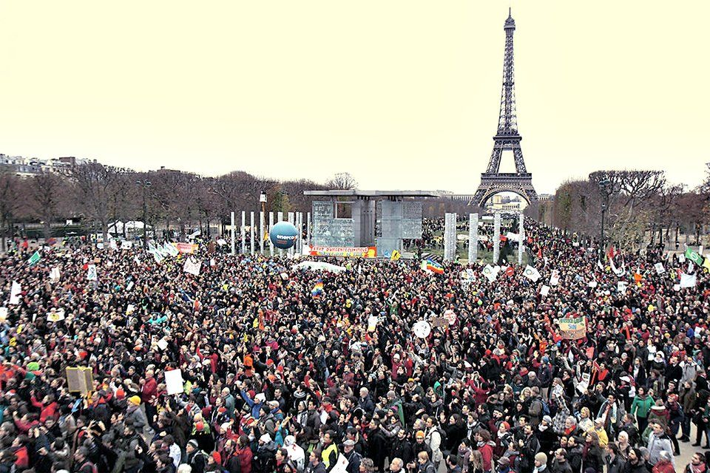
9. Toward a Solution
Masses who after all are the power of any revolution do not, as a rule, set their directions through academic studies. They reach conclusions through experiences, through the medium of struggle. The struggles are for reforming the old system. They are not convinced that the old system is beyond repair. This is true in the struggle to save the environment. What is new, however, is that the knowledge of the point of no return gives this struggle an unusual urgency.
Masses are not going to wait and see if it works. Those of us who know that capitalism cannot basically be reformed, must work with and for people who have not yet come to that conclusion. We must be the organizers, the leaders of these movements. We must give these struggles the benefit of our deeper understanding.
The immediate goals of the struggle must be a demand for federal laws-without the Nixon clauses that make them meaningless.
The demand must be for laws with provisions through which the people, workers, the people in the ghettos, trade unionists, can be the enforcers.
The demand must be for the nationalization of industry that violate anti-pollution laws.
The demand must be for laws that guarantee that the cost of all anti-pollution measures comes from corporate profits.

Slide 44
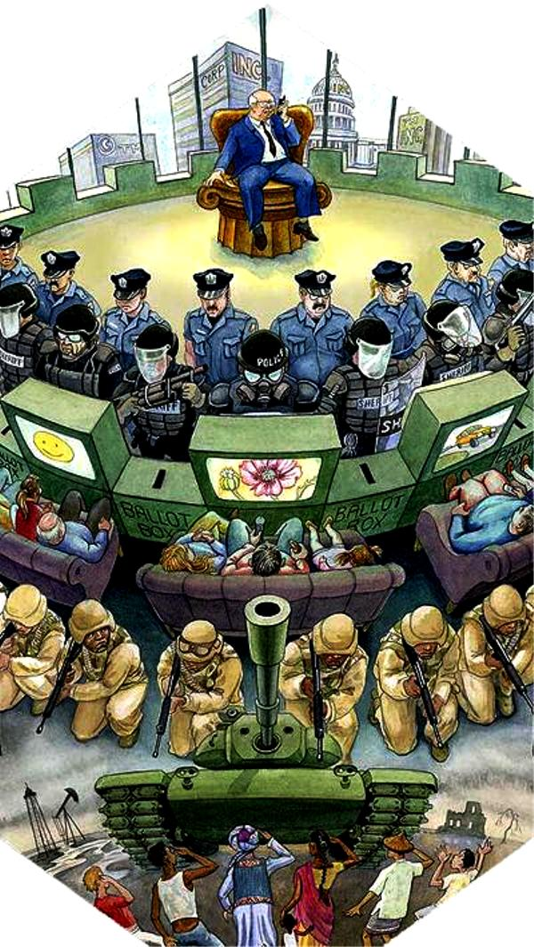
9. Toward a Solution
The power of environmental control must be with the people…
When we deal with the problems rooted in capitalism we are not dealing with the evil intent of individuals. We are dealing with the evils of a social and economic system. All social and economic systems are propelled by inner laws. Because of the cause and effect factors of these laws it is possible to foresee the general direction of development. It is these inner laws of development that mold the structure of society. They dictate the order of priority and the values. The capitalist class is both the product and the perpetuator of the system that rests on these laws. They will continue as long as capitalism continues. Based on our understanding of these inner laws of capitalist development, as well as our study of past experiences we are forced to conclude that capitalism as a social and economic system will be increasingly in sharper contradiction with the needs of society as they are measured by the explosive potential that is present in the new level of science and technology. The struggle to save the environment cannot be separated from this overall challenge that a decaying, outdated system presents to the human race…
Capitalism is in its very essence a system through which a small minority class exploits the majority to further enrich itself from the profits that come from exploitation.

Slide 45
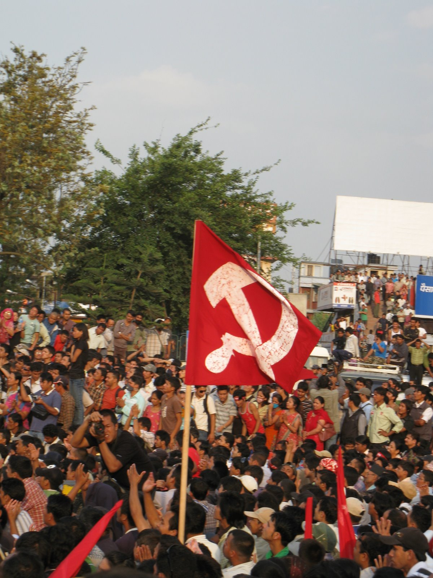
9. Toward a Solution
The basic solution is to put an end to a system that perpetuates exploitation for private profits. The basic solution is to destroy capitalism and build in its place a system that does not permit exploitation for private profit-socialism.
If you are convinced of the need for mass action, for struggle-to cut back, to hold back, and to do away with a social system that breathes and lives on the destruction of its environment, including the human race-join in removing it from the scene. Join in replacing it with a social structure that exists only to serve all humankind-socialism.
The social forces that carry out a revolutionary transition never arrive on the scene from the blue. They are never hatched in some isolated hot house. They mature, they become conscious of their historic mission and their collective power, in the struggles around the immediate grievance they face in their daily lives. The tens of millions who are in the struggle against pollution are not yet ready to save the environment by fighting for socialism. This they will learn through the experiences of struggle against specific acts of pollution. But even this does not take place spontaneously. Experiences of struggle open up the mind to ideas, to concepts. Marxism-Leninism is a social science. It is the science of the revolutionary transition. It embodies the basic essence, the wisdom, the might that comes from all of human revolutionary experience.

Slide 46
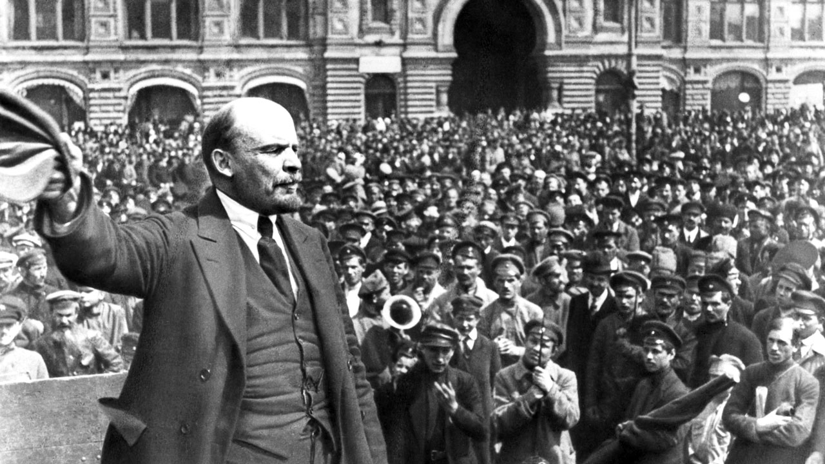
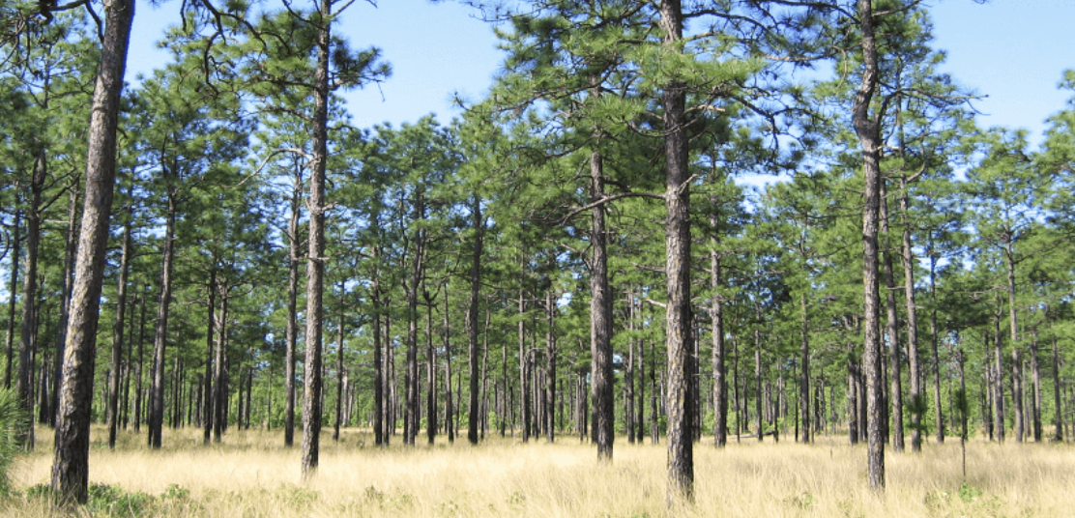
9. Toward a Solution
Marxism-Leninism is the theory of the historic transition.
The experience that comes from the struggle around the daily needs and grievances, combined with a study of the nature of the social and economic system, and its class forces, transforms the fighters for reforms into fighters for the revolutionary transition to socialism. Thus the forces of transition are hatched and matured in the struggles for immediate needs. With the help of a science, Marxism-Leninism, the processes can be greatly speeded up.
It is hoped that this booklet will be a factor in helping the millions who are getting the experiences of struggle in the movements against pollution to become a new force in the transition from capitalism to socialism.

Slide 47
Summary
The workers have always been the victims of pollution at the hands of capitalists. This gets continually worse, and today threatens to destroy all life
Human technology has advanced to the point that it can either be used to advance society to a new stage, or destroy the entire planet
The internal laws of capitalism determine the nature of society today. The values of the capitalist class are highly individualistic. They are in contradiction with the welfare of the majority, and are incompatible with collective survival
Adapting human society to become balanced with the ecosystem poses a massive challenge. Socialist societies are doing a better job at this than capitalist societies. While there are still difficulties under socialism, the internal laws of that system make it POSSIBLE to exist sustainably
Marxism-Leninism is the science of revolutionary transition from capitalism to socialism. The masses will learn through struggle that a comprehensive assault on capitalism is the only way to permanently solve the climate crisis. We must do what we can to accelerate this learning

Slide 48
Discussion

Slide 49
Volunteers Needed!
We are in need of volunteers for the staff of the People’s School! Here’s a few roles we need filled:
People to help manage posting on our social media and podcast platforms
Video Editors, Audio Editors, Graphic Designers, Artists, Narrators
Facilitators, Web Controls, Moderators
Email info@peoplesschool.us if you’re interested and try to attend our next staff meeting on May 4th if possible.

Slide 50
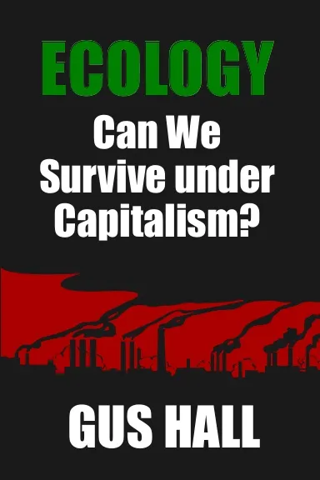
New Outlook Publishers
newoutlookpublishers.store
Latest Releases

Slide 51
Legal Drive
Last year we were attacked and sabotaged by wreckers that tried to steal the PSMLS and destroy the PCUSA.
They failed, but they will be held accountable and there are still things they took from us that we’ve not got back, like videos, imagery and audio. That is why we still need donations to the legal drive.
To donate, go to partyofcommunistsusa.net/donations/
Put “For legal funds” in the details box and try to donate on Tuesday or Thursday so it is easier for us to sort through. It will go to the legal fund. Anything helps!

