Slide 1
National Anthem of the Union of Soviet Socialist Republics

Slide 2
Marxism and the National Question
J.V. Stalin
PSMLS 04/11/23 - 04/13/23

Slide 3
What we’ll be learning today:
Introduction
Marxist-Leninist definition of a nation
Class nature of national liberation struggles
False solutions put forth by the Austrian Second International Social Democrats and Bundists
Marxist-Leninist Solution

Slide 4
Introduction

Slide 5
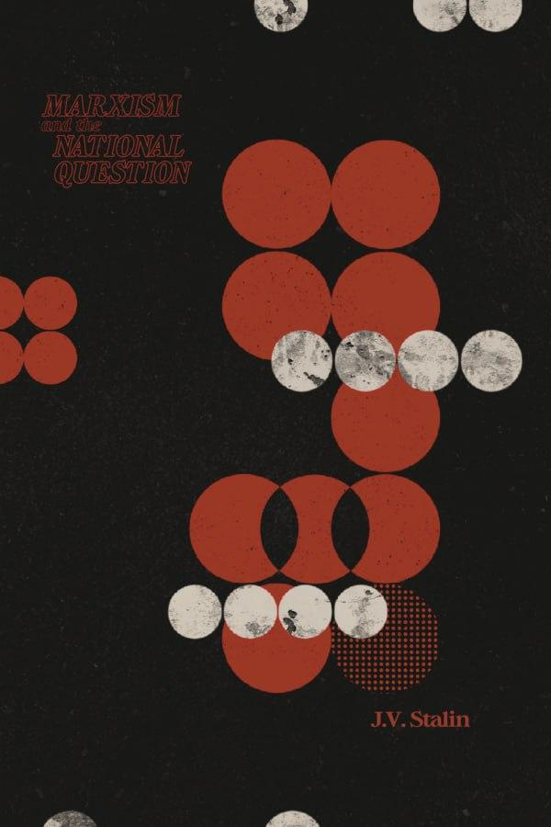
Written at the end of 1912 and early 1913, Stalin wrote Marxism and the National Question (originally the National Question and Social-Democracy), this pamphlet was written seven years after the 1905 Revolution betrayed by the liberal Cadets and the following counterrevolutionary attacks of the Tsarist regime due to the fissure of the Bourgeois Democratic movement led by the Proletariat. This served as lesson that while coalitions with bourgeois groups was necessary, that it was equally necessary for the Proletariat to maintain the role of the leadership of Democratic and National Liberation Struggles
Historical Background

Slide 6
Cultural-National Autonomy: The theory of national sovereignty put forward by the Austrian Social Democrats asserting that autonomy should be on the basis of culture and language rather than definite political boundaries.
Regional Autonomy: Theory put forward by the Bolshevik faction of the Russian Social Democrats that asserted that a territory with defined boundaries and made up of a cultural and linguistic group or set of groups that differs from the broader state be given political sovereignty that allows the free cultural and linguistic development for said groups.
Key Terms
Right of Nations to Self-Determination: The policy set forward by the Communists that states that a national group within a defined boundary has the right to determine their own destiny. This can be through secession if determined by the majority or by regional autonomy if they wish to remain within the State Union. It should be stated that while the Communists would not get in the way of Right to Self-Determination, the Party would agitate among the masses for a solution that serves the Proletariat the best. For example: if secession would free the Nation from national oppression within a bourgeois democratic state but put the National Proletariat under the control of an anti-democratic (Fascist, feudal, etc) ruling class, Communists may agitate for Regional Autonomy within the Union.

Slide 7
Marxist-Leninist Definition of Nation

Slide 8
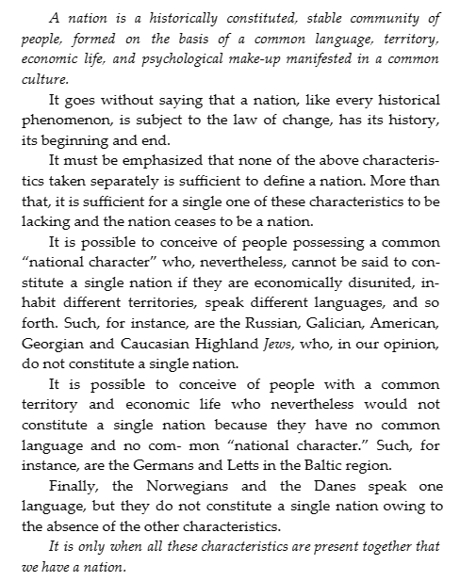
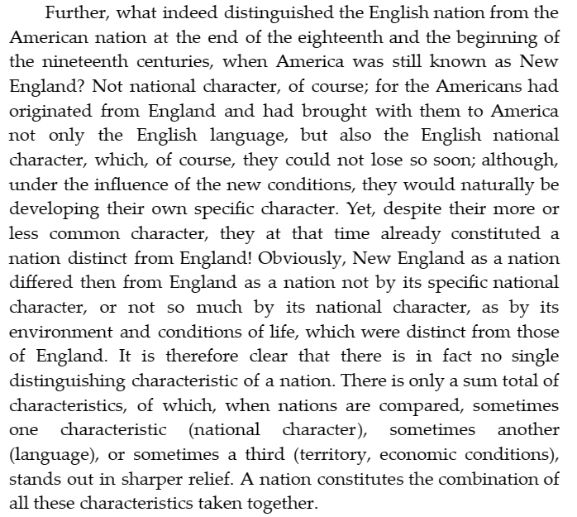

Slide 9
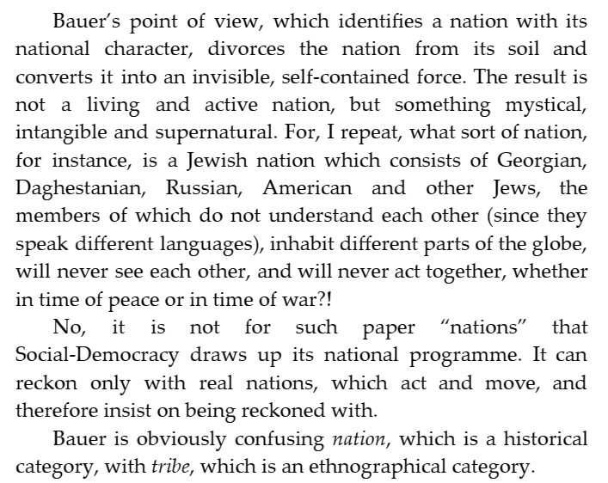

Slide 10
Discussion

Slide 11
Class Nature of National Liberation Struggles

Slide 12
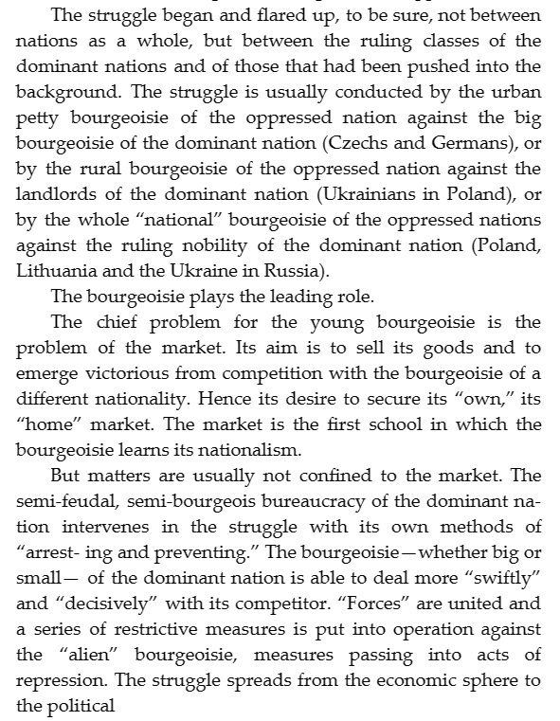
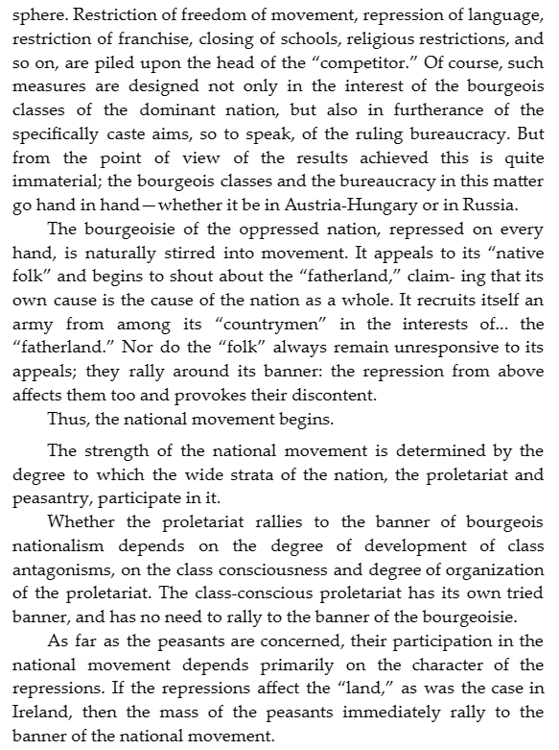

Slide 13
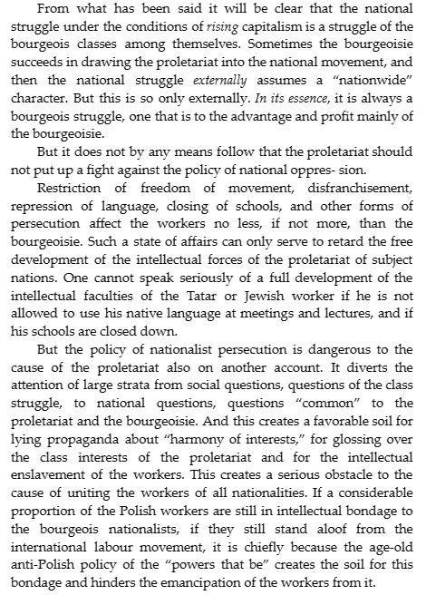
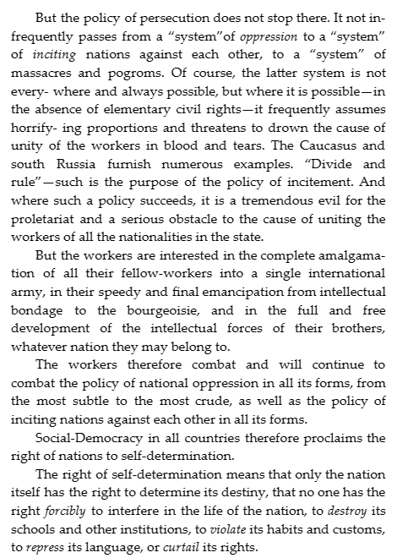

Slide 14
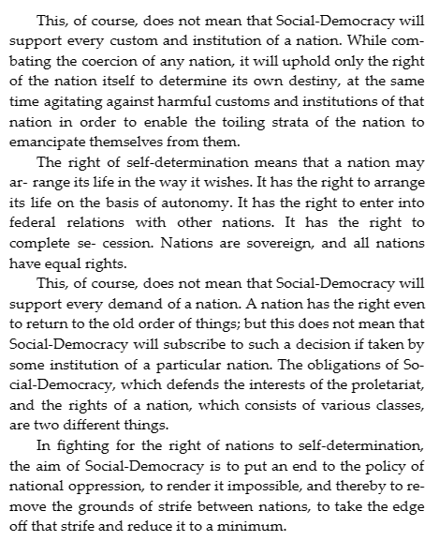
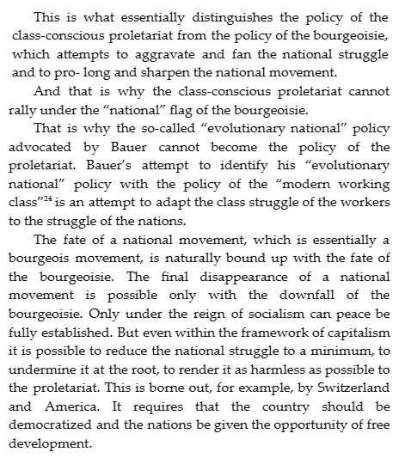

Slide 15
Discussion & New Members

Slide 16
New Member Introductions
What is your name, pronouns and state (or country/territory)?
Where do you work? Is it unionized?
How did you find out about the People’s School?
What do you think about tonight's class?

Slide 17
False Solution: National-Cultural Autonomy (nationalist separatism)

Slide 18
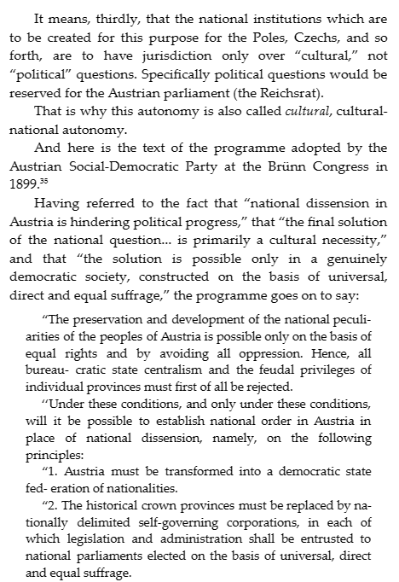
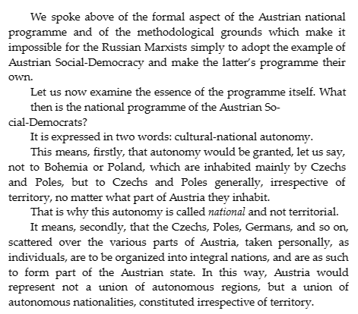

Slide 19
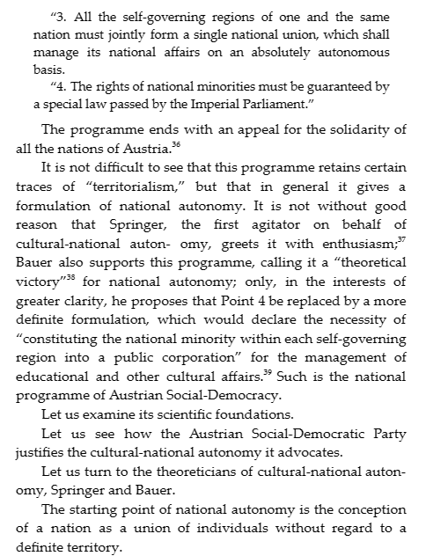
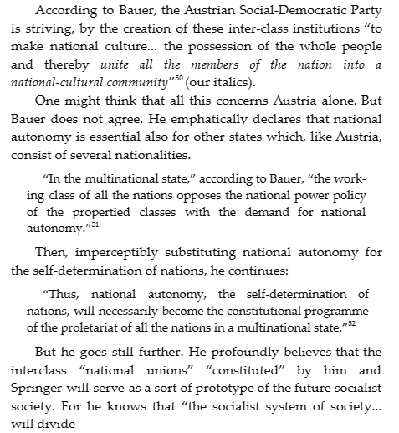

Slide 20
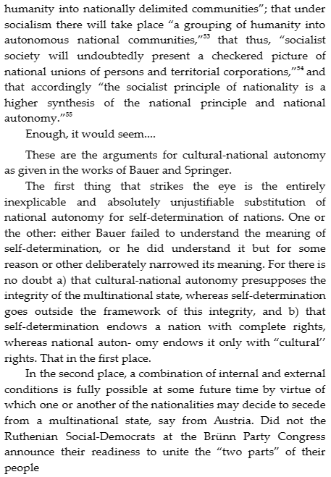
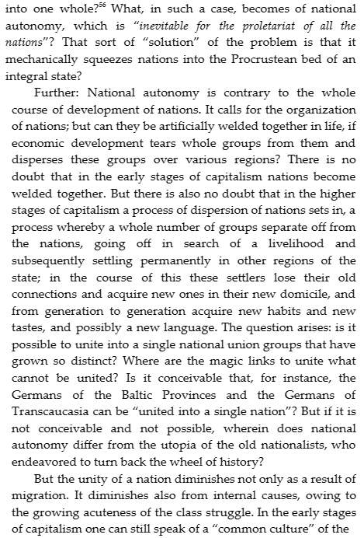

Slide 21
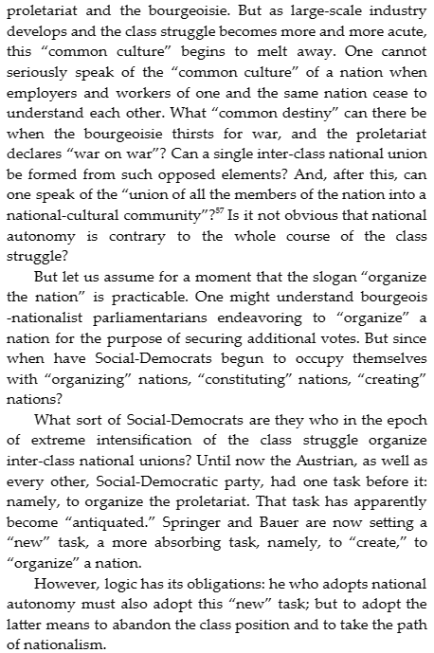
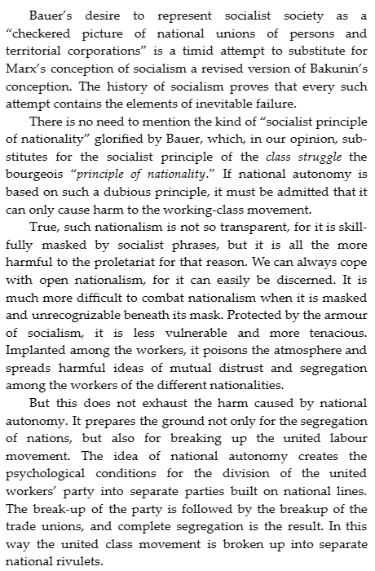

Slide 22
Discussion

Slide 23
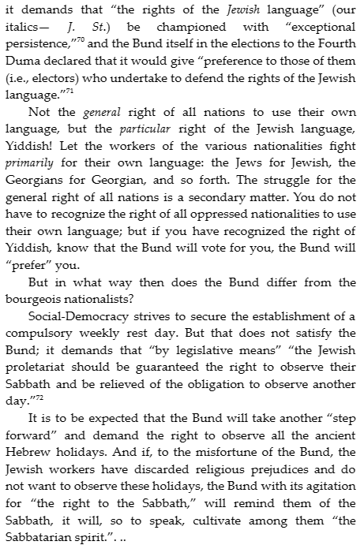
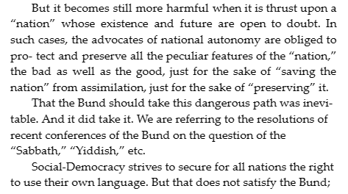

Slide 24
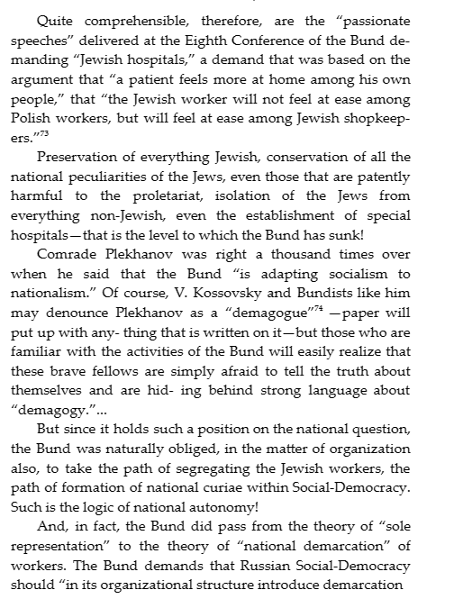
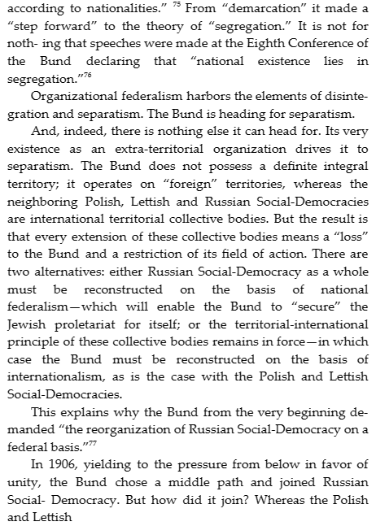

Slide 25
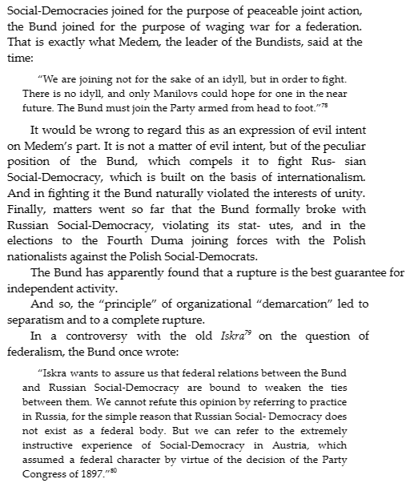
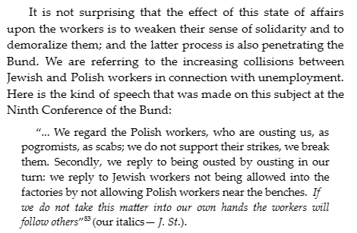

Slide 26
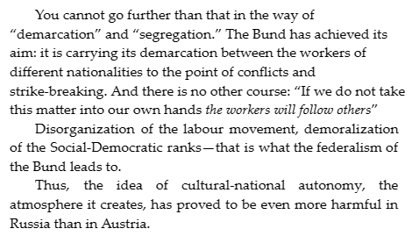

Slide 27
Marxist-Leninist Solution: Right of Nations to Self-Determination

Slide 28
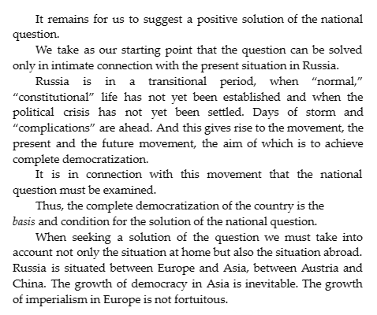
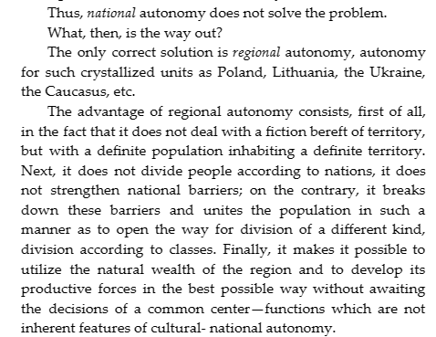

Slide 29
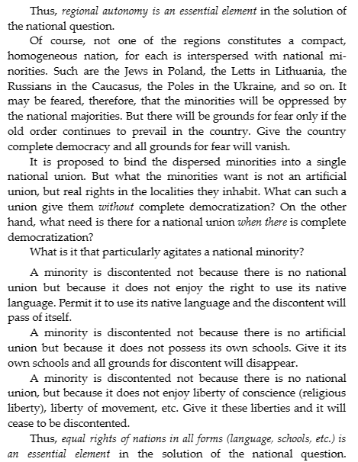

Slide 30
Volunteers Needed!
We are in need of volunteers for the staff of the People’s School! Here’s a few roles we need filled:
People to help manage posting on our social media and podcast platforms
Video Editors, Audio Editors, Graphic Designers, Artists, Narrators
Facilitators, Web Controls, Moderators
Email info@peoplesschool.us if you’re interested and try to attend our next staff meeting on March 2nd if possible.

Slide 31
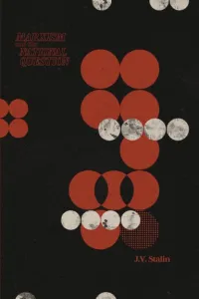
New Outlook Publishers
newoutlookpublishers.store
Latest Releases

Slide 32
Legal Drive
Last year we were attacked and sabotaged by wreckers that tried to steal the PSMLS and destroy the PCUSA.
They failed, but they will be held accountable and there are still things they took from us that we’ve not got back, like videos, imagery and audio. That is why we still need donations to the legal drive.
To donate, go to partyofcommunistsusa.net/donations/
Put “For legal funds” in the details box and try to donate on Tuesday or Thursday so it is easier for us to sort through. It will go to the legal fund. Anything helps!

Slide 33
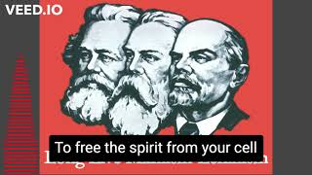
The Internationale - The New Singers, 1933

