Slide 1
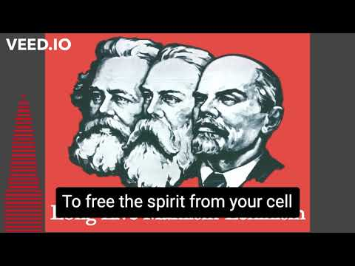

Slide 2
Ultra-Leftism in Our Time
PSMLS 04/18/23 - 04/20/23

Slide 3
What we’ll be learning today:
Brief history of how the ultraleftist trend emerged.
About the emergence of an ultraleftist pole in the world communist movement which tries to split the movement on disagreements.
Contemporary examples of this ultraleftist trend.
What we can do to combat this trend and unify the communist movement.

Slide 4
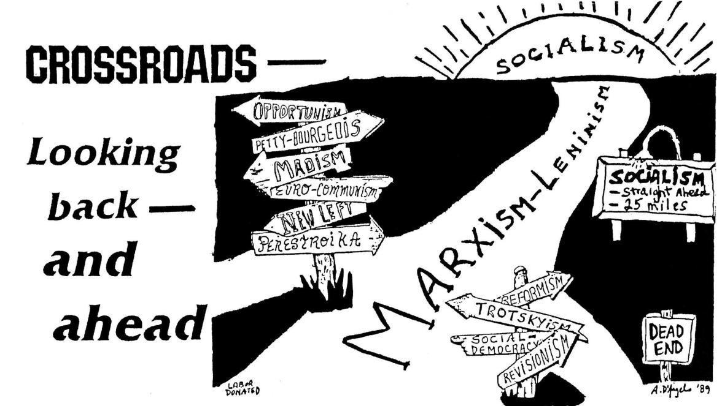
Walking the Tightrope of
Marxism-Leninism
What is the “Tightrope”?
The Party of Communists USA promotes the theory of “walking the ideological tightrope of Marxism-Leninism”, and not falling to the right, towards reactionaries, reformism, revisionism, and not falling to the left, to ultra leftism and left deviationism. Both of which lead to the death of a revolutionary movement.
Ultra-Leftism is manifested in individualism, sectarianism, anti-leadership, spontaneity and an underestimation of the power of the ruling class with an overestimation of the working class. Anarchists, Maoists, Trotskyists, and New Leftists are all examples of ultra-leftists.

Slide 5
Brief History of Ultra-Leftism

Slide 6
Roots of Ultra-Leftism
Anarchism
The first ultra-leftist ideology was that of Anarchism, which arrived on the philosophical scene in the early 1800’s with the works of Bakunin, Proudhon, Kropotkin and more, simultaneously with and in conflict with Marxism. They were expelled from the First International, but remained a current in the ultra-left to this day.
Anarchists reject all states, including socialist ones, and engage in spontaneous, accelerationist activity, including terrorism. They also uphold mutual aid as a tactic for sharing resources in the community.
Anarchists are also highly individualist, and only operate in collectives in a loose, undisciplined sense. They reject democratic centralism and either rely on consensus or everyone doing what they want and nobody being able to criticize tactics.
“We believe that the Anarchists are real enemies of Marxism. Accordingly, we also hold that a real struggle must be waged against real enemies. Therefore, it is necessary to examine the "doctrine" of the Anarchists from beginning to end and weigh it up thoroughly from all aspects.” - J.V. Stalin, Anarchism or Socialism

Slide 7
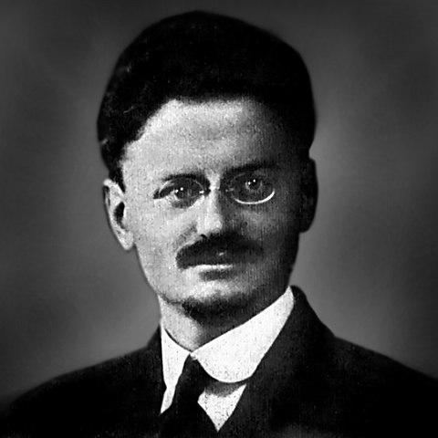
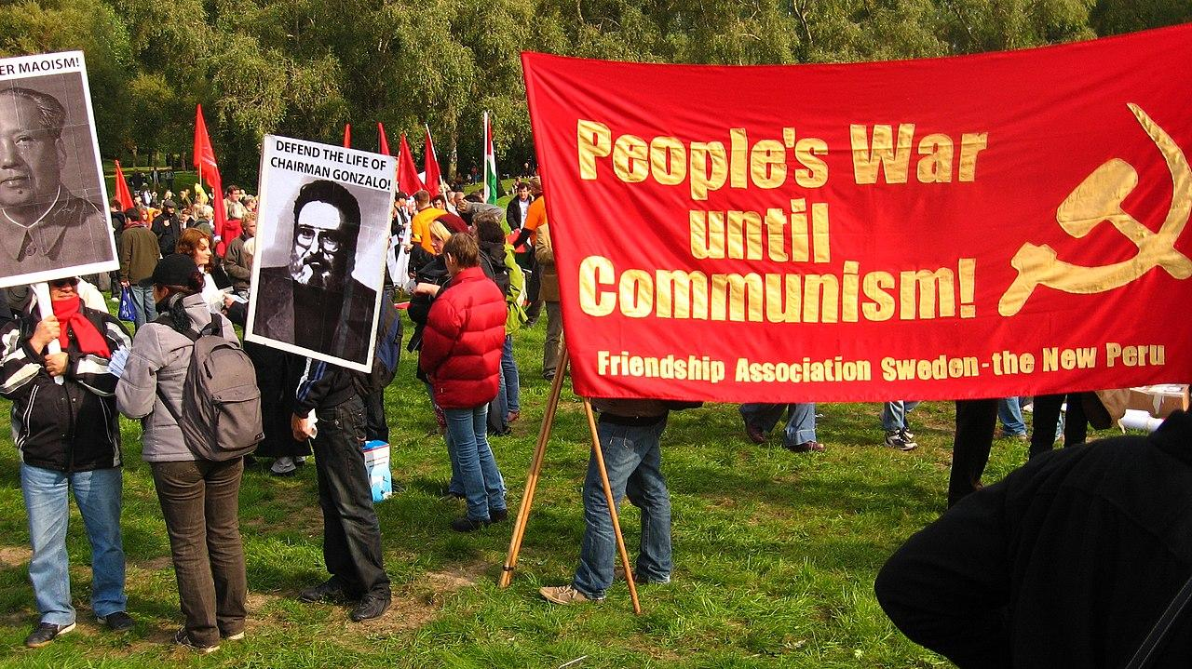
Roots of Ultra-Leftism
Trotskyism
Trotskyism was the one of first left deviations from the Communist movement. In the 1920’s, the “Left Communist” faction of the Communist Party of the Soviet Union, led by Leon Trotsky, were expelled from the CPSU in 1927, where they began the United Opposition, which eventually included the Right Opposition, led by Bukharin.
The International Left Opposition was founded in 1930, which became the “Fourth International”, and Trotskyism served as an anti-Soviet force in the world for decades to come.
Maoism
Maoism came about in the late 60’s and into the 70’s as another anti-Soviet force in the world communist movement following the Sino-Soviet Split and Mao’s death. Maoist insurgents have served as armed counter-revolutionaries against the USSR and Maoist groups in the US have attacked various other communist formations.

Slide 8
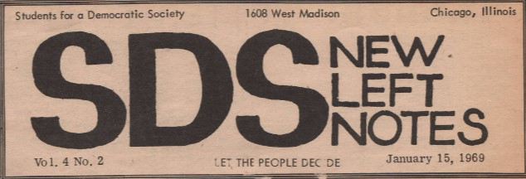
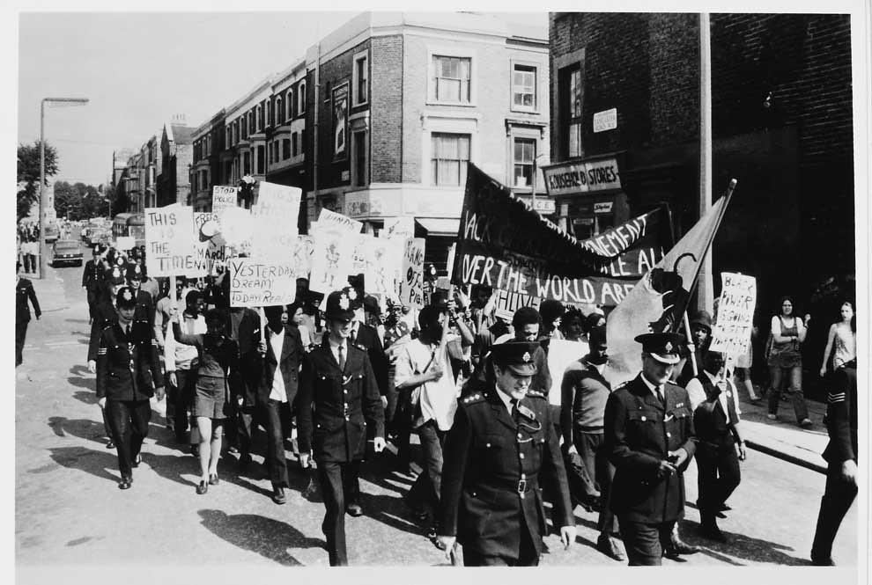
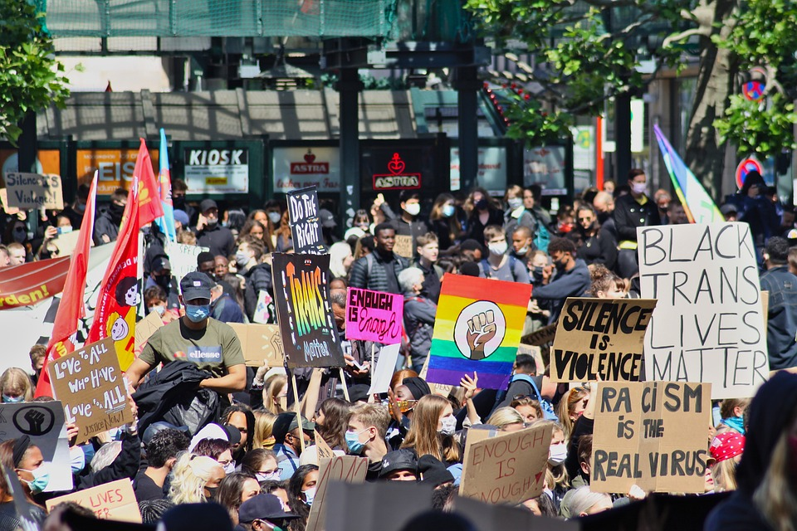
Roots of Ultra-Leftism
New Leftism
Following the weakening of the American communist movement following McCarthyism and the anti-communist repression of the 1940’s, 50’s and 60’s, the New Left was born out of philosophers in the Columbia University and the Frankfurt School, such as C Wright Mills and Herbert Marcuse respectively.
New Leftism was essentially founded on critical theory and a rejection of the class struggle and the focus on the labor movement to instead focus solely on the social issues of race, gender, sexuality etc without a class lens. Maoism, Trotskyism and Anarchism also played a role in New Left movements.
Examples of New Left organizations include Students for a Democratic Society, the Black Panther Party, Young Patriots, Young Lords, Brown Berets and even to some extent, modern movements such as BLM.

Slide 9
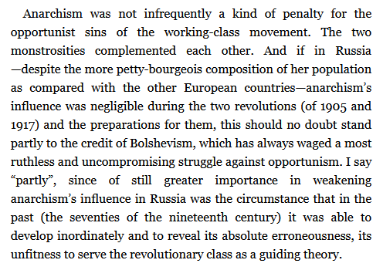
Left-Wing Communism: An Infantile Disorder
V.I. Lenin

Slide 10
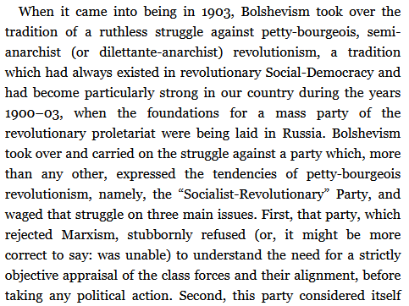
Left-Wing Communism: An Infantile Disorder
V.I. Lenin

Slide 11
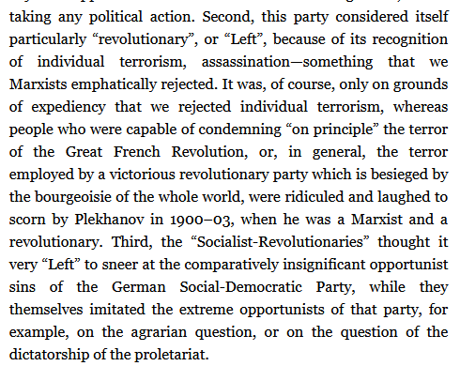
Left-Wing Communism: An Infantile Disorder
V.I. Lenin

Slide 12
Discussion

Slide 13
Today’s Ultra-Leftist Pole

Slide 14
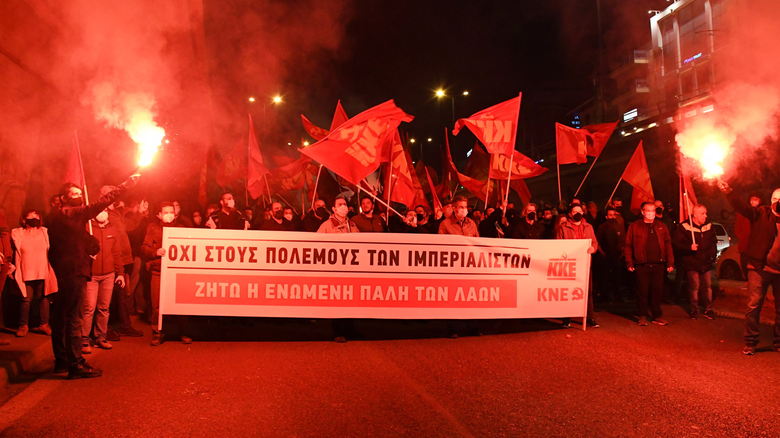
A New Trend
Left in Form, Right in Essence
As of recent, a trend has emerged in the world communist movement again which is a left, sectarian deviation that seeks to divide the world communist movement, and objectively, regardless of intentions, helps Western Imperialism.
Much of it has centered on opposing the nations opposed to Western Imperialism, such as Russia, China and Iran, as being imperialist or fascist themselves.
Historically, the Ultra-Left stood against the Soviet Union, Vietnam, China, the DPRK, socialist Afghanistan and more. The USSR specifically was accused of being “social imperialist” similarly to Russia being called imperialist today.
Especially with the 2022 invasion of Ukraine, a worldwide struggle in the communist movement has intensified.

Slide 15
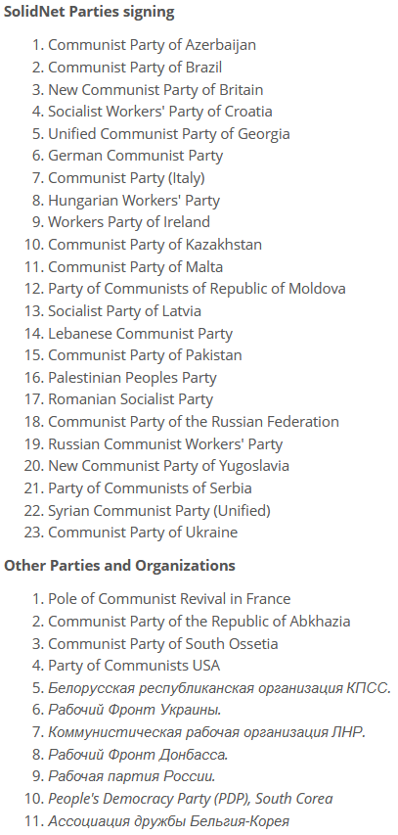
A New Trend
Dividing the World Communist Movement
Some parties have took the position on the Ukraine war that it is an inter-imperialist conflict and that communists should not be supportive of the Russian Special Military Operation, despite the fact that the Communist Parties of Russia, Ukraine and the Donbass have all been pushing for such an operation since the fascist coup of 2014. They do not recognize fascism in Ukraine as the main danger.
These parties have sought to undermine the Russian Communist Parties and the Ukrainian Communist Parties in their publications, in their party work and on the international stage, such as in Havana Cuba in 2022.
These parties are all mostly Western Communist Parties that have divorced themselves from the history of the Soviet Union and do little to oppose NATO imperialism nowadays.
Parties which signed onto the pro-Donbass statement in Havana Cuba in 2022, which have been attacked by ultraleftist parties

Slide 16
A New Trend
Wreckage, Sabotage and Factionalism
These parties have stoked factionalism in the parties they opposed and aligned themselves with wreckers of the parties they oppose. This includes the wreckers that tried, and failed, to destroy the PCUSA in 2022.
These forces sabotage party infrastructure by stealing not only websites and information, but also by attempting to steal entire organizations connected to the parties, such as wreckers attempted to do with the PSMLS.
This shows a break with any true sense of Bolshevism. Instead of pushing for the line they think is correct through the proper channels at the proper time, and instead of following Democratic Centralism, they decide to leave a party and inflict as much damage as possible during and after their departure. Their life is dedicated more to the destruction of the party than the destruction of capitalism.

Slide 17
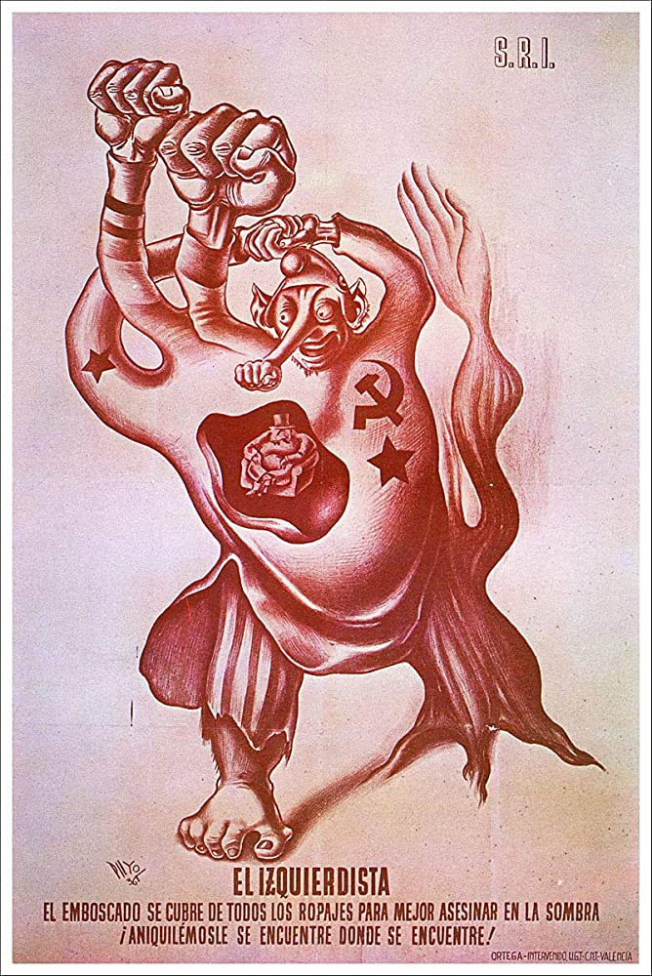
A New Trend
Objectively Aiding the Imperialists
The effect of this left deviation in the current communist movement is that the world communist movement is weakened.
The parties involved in the most urgent struggles - such as in Russia, Ukraine, Eastern Europe, the Middle East, Africa and here in the Belly of the Beast, the United States itself - are attacked, and the forces of NATO imperialists and Ukraine fascists go unopposed as Russia gets a tongue-lashing from Western communist parties and the Donbass endures a fascist onslaught.
Historically, it has never been rare for ultra-leftist groups to objectively stand by Western imperialists in their time. Trotskyists conspired with German, Spanish and Japanese fascists against the USSR and communists in Spain, and many later became neo-conservatives. Maoists fought on the same side as US-backed forces in many areas during the Cold War against the USSR and existing socialist states, and supported Pinochet. These ultra-leftists are objectively aiding western imperialism to oppose Russia, as well as Syria, Serbia, Iran and China.

Slide 18
Discussion and New Members Introduction

Slide 19
New Member Introductions
What is your name, pronouns and state (or country/territory)?
Where do you work? Is it unionized?
How did you find out about the People’s School?
What do you think about tonight's class?

Slide 20
How do we combat this trend?

Slide 21
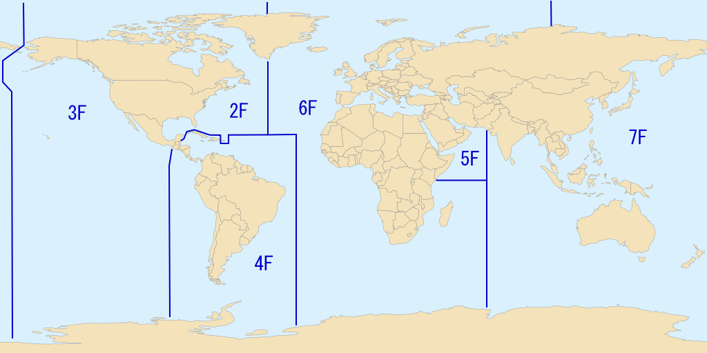
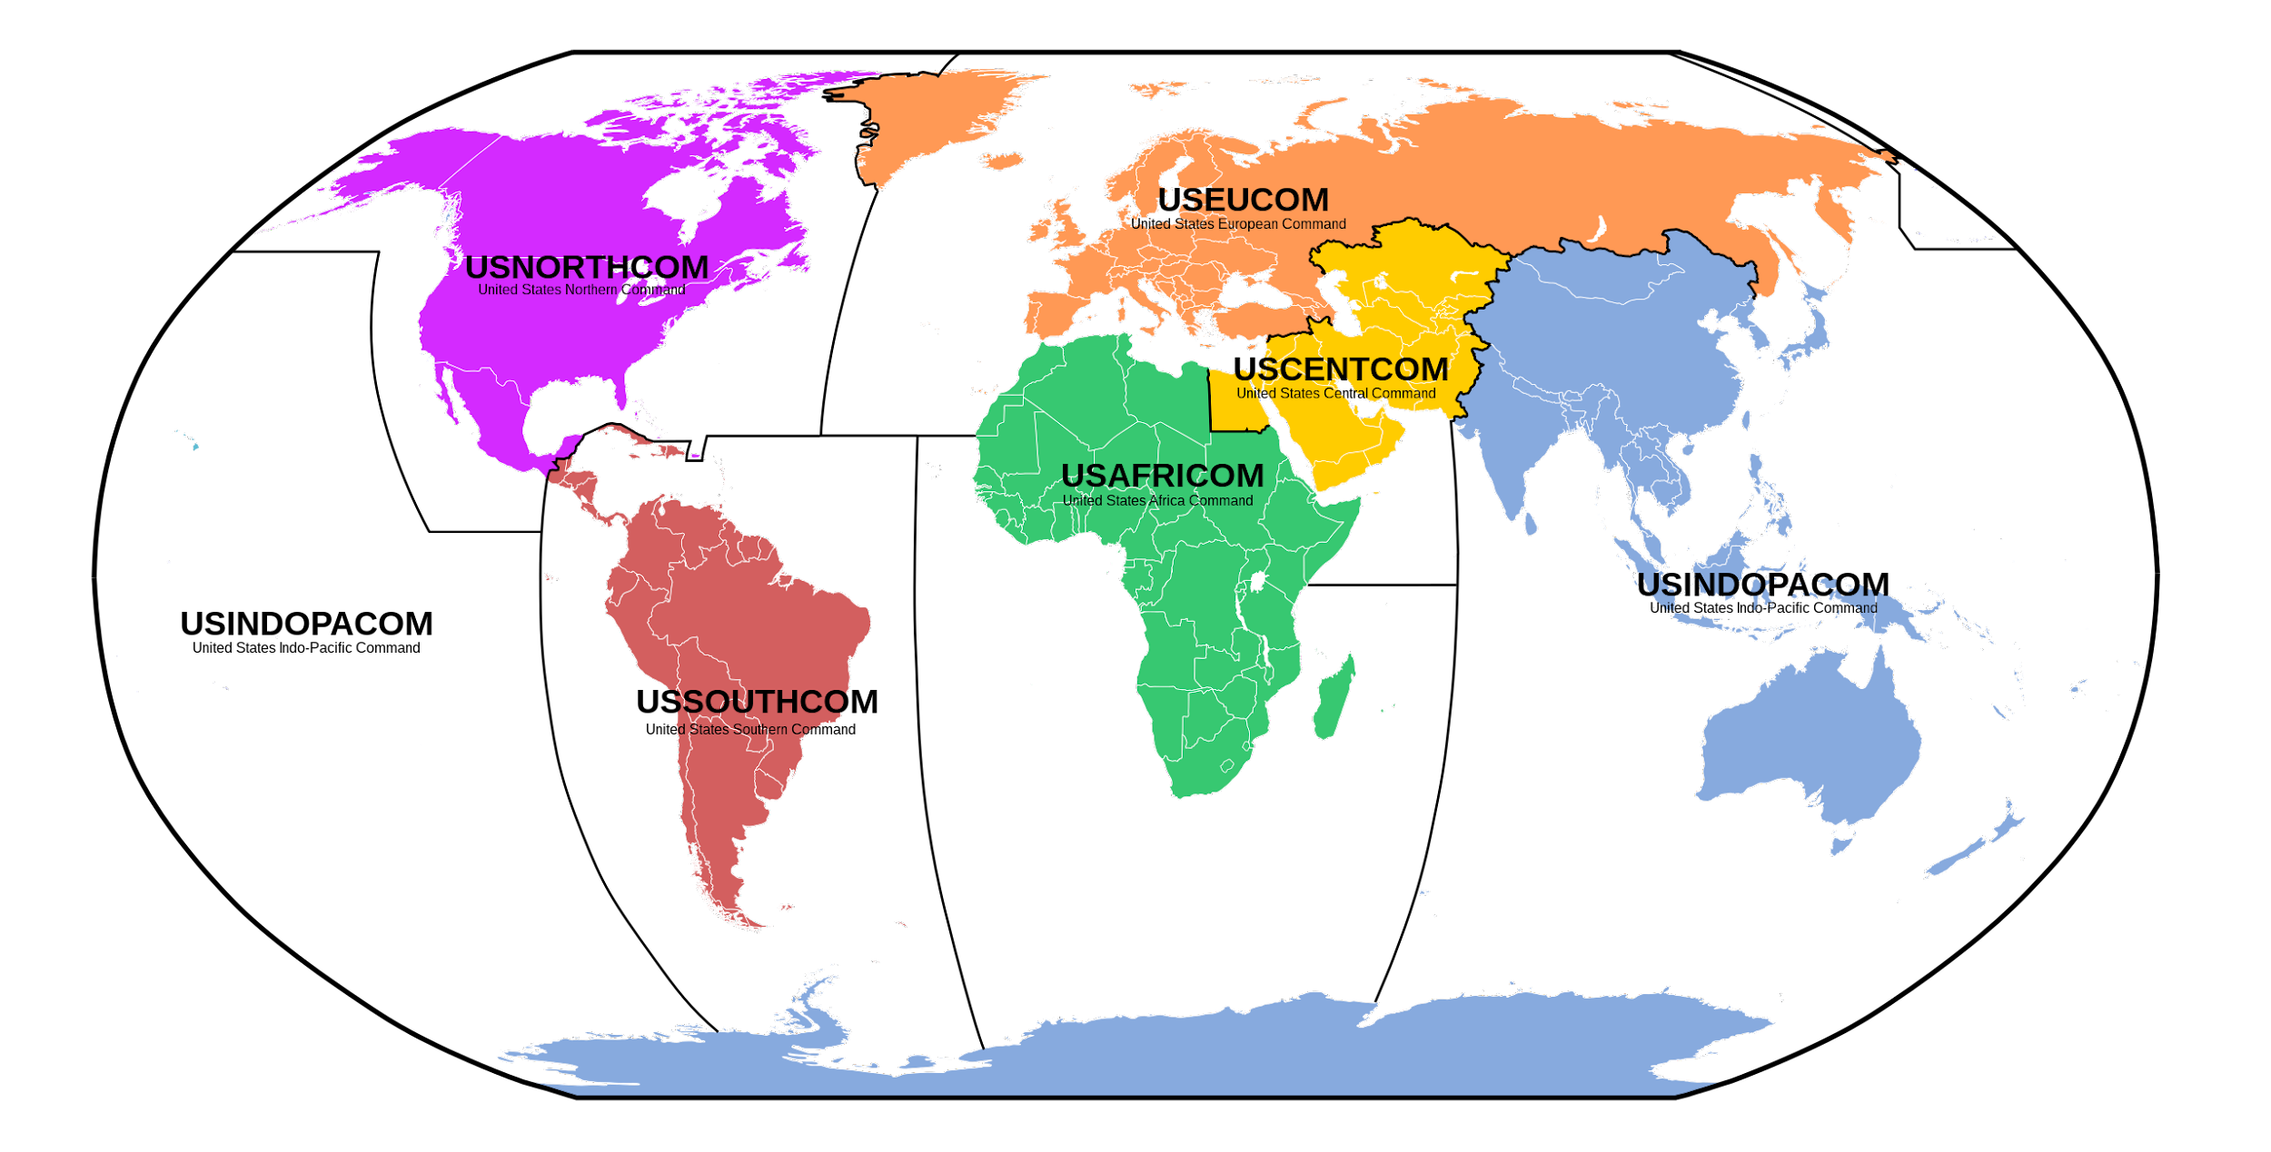
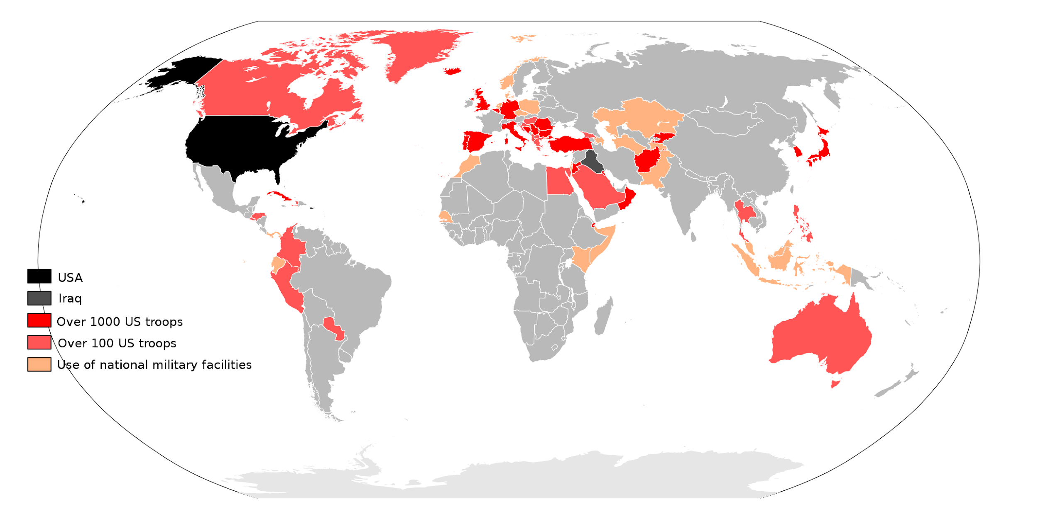
How to Fight Back
Solidarity Against Western Imperialism
The greatest threat to life on Earth as it stands right now, and the biggest obstacle to the socialist revolution is not “Russian Imperialism” or “Chinese Imperialism”, but rather Western Imperialism; the imperialist hegemony of the United States.
Western Imperialism is killing this planet whilst resuscitating fascism, monarchies and militarism across the globe to fight for its interests. It has placed naval fleets in every ocean, bases on every continent, planes in every sky and propaganda into nearly every cyberspace. Russia, China, Iran, Cuba and more have been encircled.
Therefore, we stand resolutely with those nations and organizations fighting Western Imperialism, especially including those fighting fascist Ukraine. We know we’re on the right side.
Naval Fleets
Combat Command Zones
US Military Bases

Slide 22
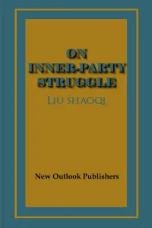
How to Fight Back
Discipline, Security and Democratic Centralism
We need to safeguard our parties from the wreckage and sabotage that these forces hope to inflict on us. We do that be becoming more disciplined with party procedure and party work, which strengthens the party and better secures us from attacks.
We need to maintain strict security measures and be careful with who we let into our orbit and what people's intentions are. Anarchists and Trotskyists have been purged from Communist formations before, and purging ultra leftist elements now is not a bad thing.
Comrades also need to have a FIRM commitment to Democratic Centralism. The test of which is not whether you can say you’ll follow it when you come in, but whether you do when something doesn’t go your way. Bolsheviks follow Democratic Centralism, wreckers break it.

Slide 23
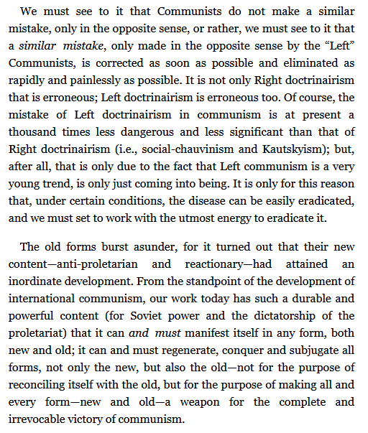
Left-Wing Communism: An Infantile Disorder
V.I. Lenin

Slide 24
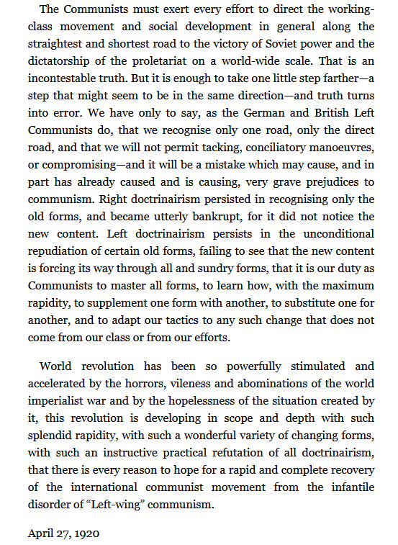
Left-Wing Communism: An Infantile Disorder
V.I. Lenin

Slide 25
Support our Legal Drive!
Last year we were attacked and sabotaged by wreckers that tried to steal the PSMLS and destroy the PCUSA.
They failed, but they will be held accountable and there are still things they took from us that we’ve not got back, like videos, imagery and audio. That is why we still need donations to the legal drive.
To donate, go to partyofcommunistsusa.net/donations/
Put “For legal funds” in the details box and try to donate on Tuesday or Thursday so it is easier for us to sort through. It will go to the legal fund. Anything helps!

Slide 26
Discussion

Slide 27
New Member Introductions
What is your name, pronouns and state (or country/territory)?
Where do you work? Is it unionized?
How did you find out about the People’s School?
What do you think about tonight's class?

Slide 28
Volunteers Needed!
We are in need of volunteers for the staff of the People’s School! Here’s a few roles we need filled:
People to help manage posting on our social media and podcast platforms
Video Editors, Audio Editors, Graphic Designers, Artists, Narrators
Facilitators, Web Controls, Moderators
Email info@peoplesschool.us if you’re interested and try to attend our next staff meeting on May 4th if possible.

Slide 29
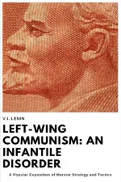
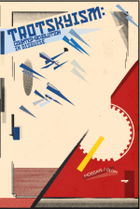
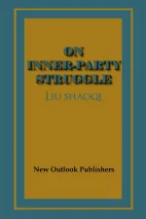
New Outlook Publishers
newoutlookpublishers.store
Related to Class

