Slide 1
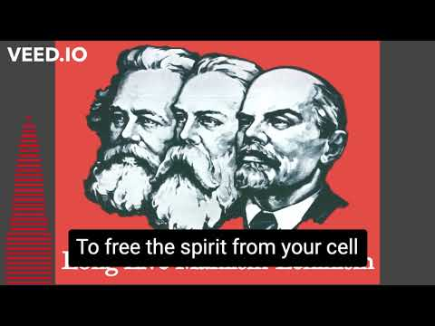

Slide 2
International Workers Day
PSMLS 04/25/23 - 04/27/23

Slide 3
What we’ll be learning today:
The struggle throughout the 19th century leading up to the 8 hr work-day
The 1886 Haymarket Affair, as well as similar events in Milwaukee.
The trials of the Haymarket martyrs and the actions following.
The Communist legacy of May Day since then.

Slide 4
Struggle for the 8 Hr
Work Day

Slide 5
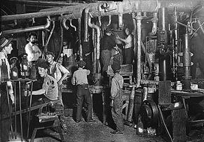
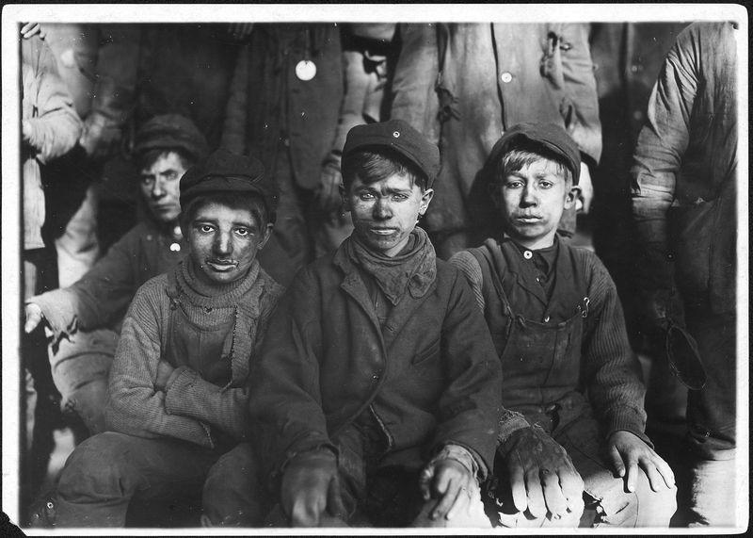
Struggle for 8 Hour Work Day
Labor before the 8 hour work day
With the industrial revolution of the 18th century, industrial exploitation of labor rose exponentially.
The conditions of laborers at the time of the early 19th century were highly exhaustive, exploitative and unsafe.
Workers were often forced to work as many as 16 hour work days and had up to 6 day work weeks.
Child labour was also common and many children were forced to work in dangerous jobs for low wages, and many even had to resort to prostitution.

Slide 6
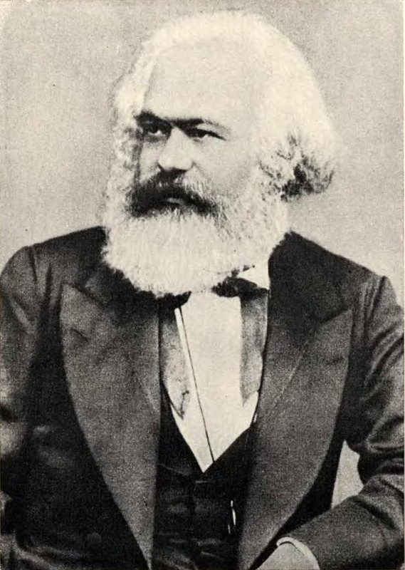
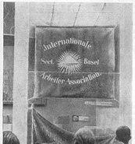
Struggle for 8 Hour Work Day
Marx & the International Workingmen's Association
Karl Marx was a fierce opponent of the capitalist exploitation of the workers. Beyond writing about capital and at length about how the exploitation manifested and what alternative system was possible, he was a founder of the International Workingmen’s Association, or the First International.
In addition to many voices calling for such as far back as 1817, the First International proposed 8 hours as the legal limit of the working day at their Geneva Convention in 1866. Marxists were one of the leading forces in the early push for an 8 hour work day.

Slide 7
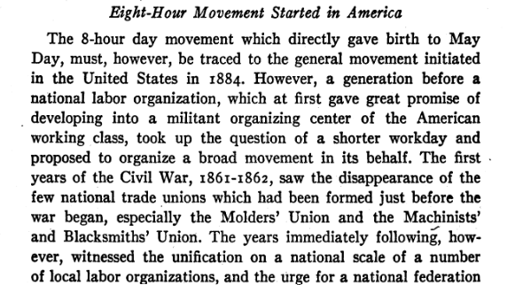
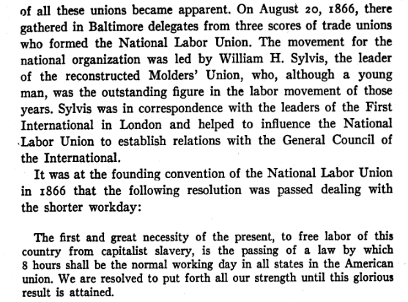
History of May Day by Alexander Trachtenberg

Slide 8
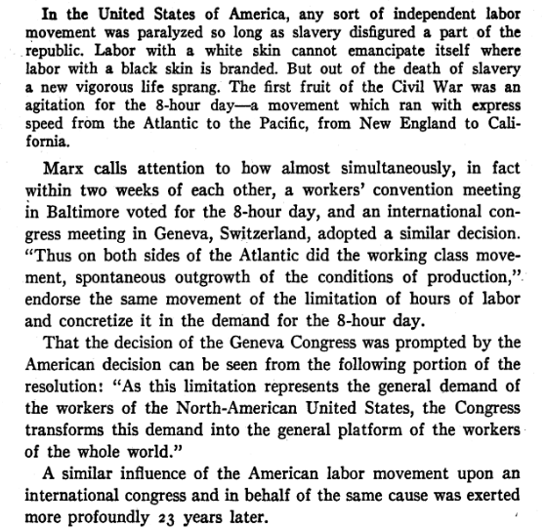
History of May Day by Alexander Trachtenberg

Slide 9
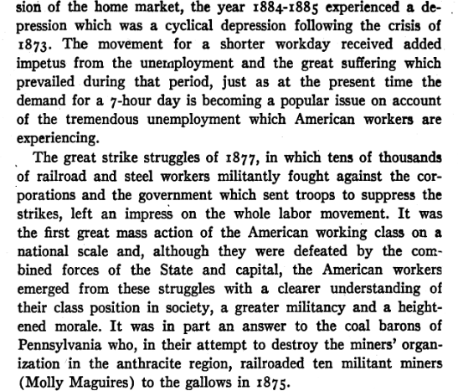
History of May Day by Alexander Trachtenberg

Slide 10
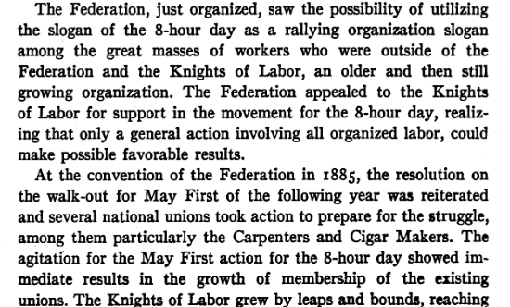
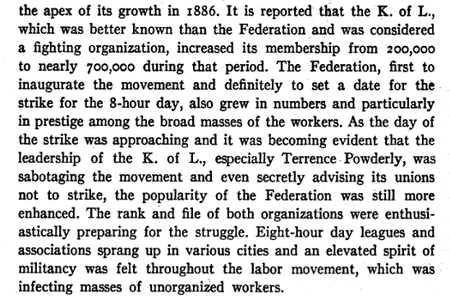
History of May Day by Alexander Trachtenberg

Slide 11
Discussion

Slide 12
1886 Haymarket Affair

Slide 13
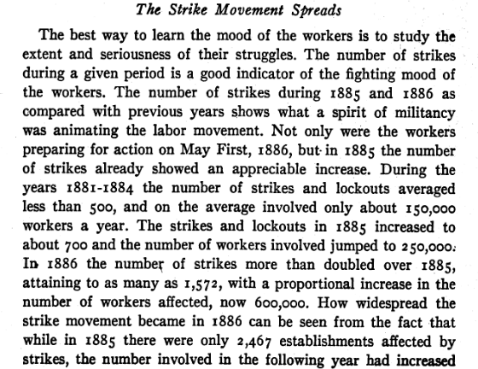
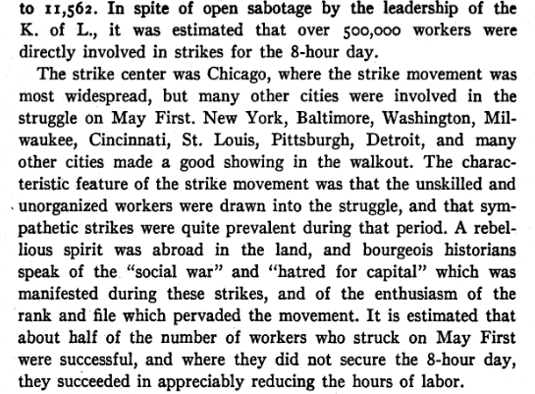
History of May Day by Alexander Trachtenberg

Slide 14
The Haymarket Trial (Short Clip from a Documentary)

Slide 15
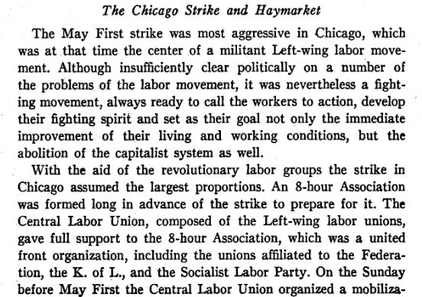
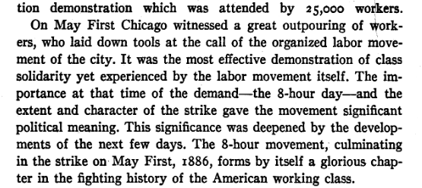
History of May Day by Alexander Trachtenberg

Slide 16
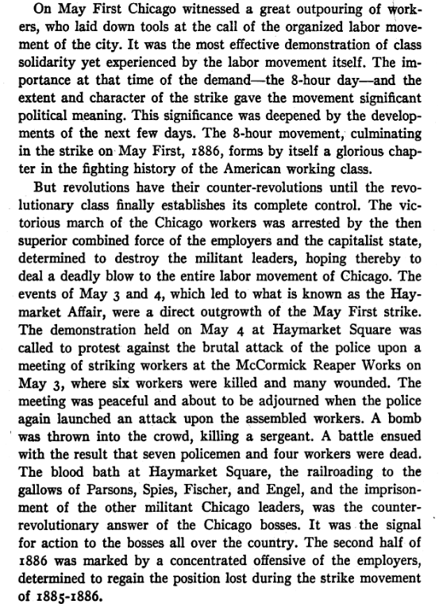
History of May Day by Alexander Trachtenberg

Slide 17
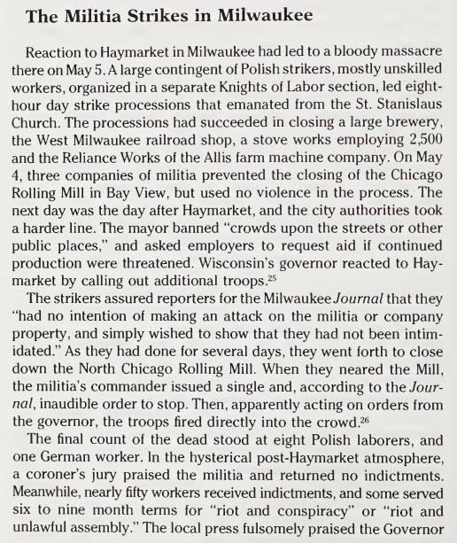
May Day:
A Short History
by Philip S. Foner

Slide 18
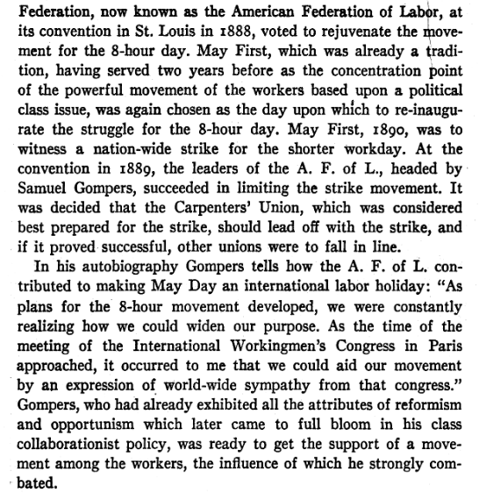
History of May Day by Alexander Trachtenberg

Slide 19
Discussion

Slide 20
New Member Introductions
What is your name, pronouns and state (or country/territory)?
Where do you work? Is it unionized?
How did you find out about the People’s School?
What do you think about tonight's class?

Slide 21
Aftermath of Haymarket;
Communist Legacy of May Day

Slide 22
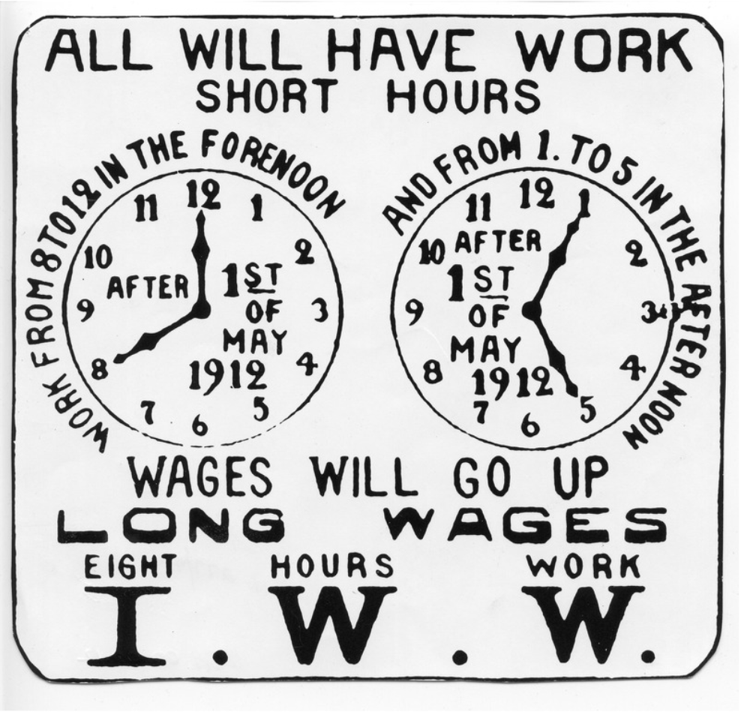
Aftermath of Haymarket
8 Hour Work Days Implemented
8 hour work days were not immediately implemented across the board. In 1898, United Mine Workers of America won an eight hour work day.
In 1900, the Building Trades Council in San Francisco declared workers would only work 8 hours a day.
By 1912, Teddy Roosevelt included an 8 hour work day on his presidential platform, and World War 1 made workers strike more for the 8 hour work day, leading to the Adamson Act in 1916, which instituted 8 hour workdays in rail industries.
In 1937, the Fair Labor Standards Act of FDR’s New Deal instituted the 8 hour day in a number of industries.

Slide 23
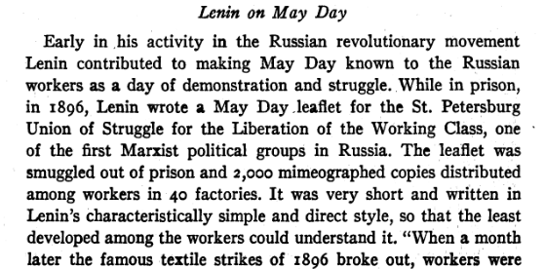
History of May Day by Alexander Trachtenberg

Slide 24
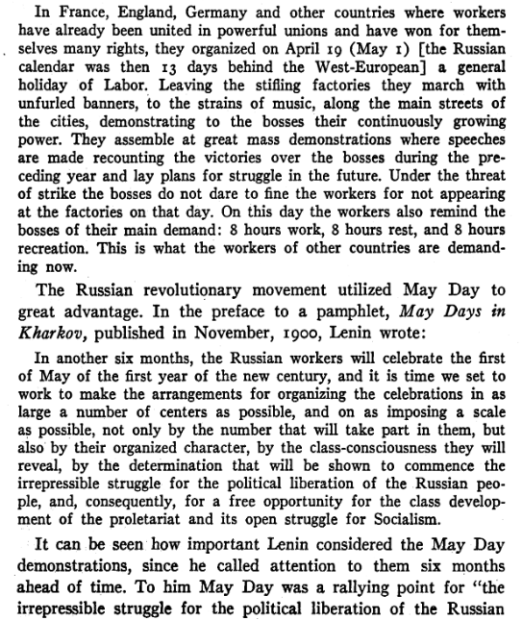
History of May Day by Alexander Trachtenberg

Slide 25
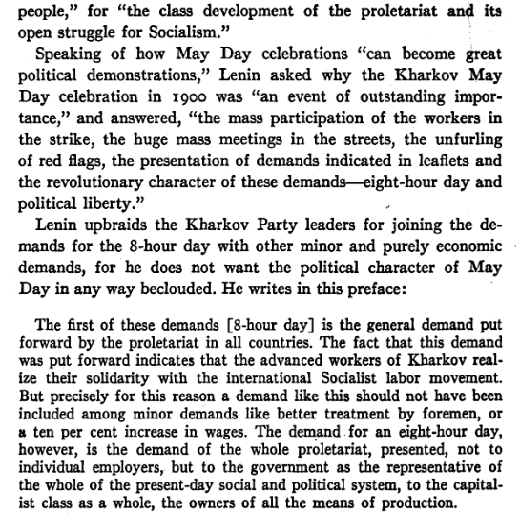
History of May Day by Alexander Trachtenberg

Slide 26
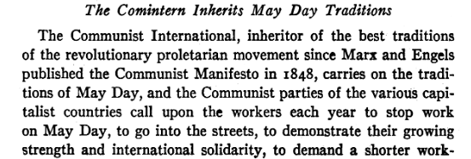
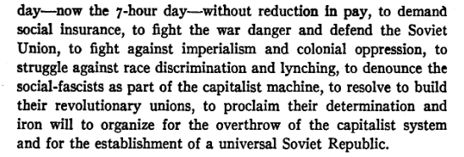
History of May Day by Alexander Trachtenberg

Slide 27
Discussion

Slide 28
Volunteers Needed!
We are in need of volunteers for the staff of the People’s School! Here’s a few roles we need filled:
People to help manage posting on our social media and podcast platforms
Video Editors, Audio Editors, Graphic Designers, Artists, Narrators
Facilitators, Web Controls, Moderators
Email info@peoplesschool.us if you’re interested and try to attend our next staff meeting on May 4th if possible.

Slide 29
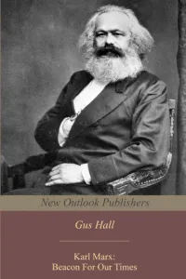
New Outlook Publishers
newoutlookpublishers.store
Spotlight - Marx

Slide 30
Legal Drive
Last year we were attacked and sabotaged by wreckers that tried to steal the PSMLS and destroy the PCUSA.
They failed, but they will be held accountable and there are still things they took from us that we’ve not got back, like videos, imagery and audio. That is why we still need donations to the legal drive.
To donate, go to partyofcommunistsusa.net/donations/
Put “For legal funds” in the details box and try to donate on Tuesday or Thursday so it is easier for us to sort through. It will go to the legal fund. Anything helps!

Slide 31
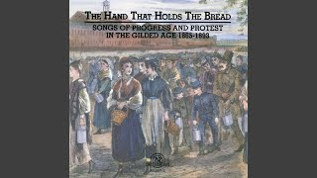
Eight Hours by Cincinnati University Singers (Song from struggle for 8 hours)

