Slide 1
Sacred War

Slide 2
Victory in Europe Day - May 8th
PSMLS 05/02/23 - 05/04/23

Slide 3
What we’ll be learning today:
The events of the Battle of Berlin
The surrender of Nazi Germany - Victory Against Fascism in Europe
Watching the Victory Day parades, both old and recent.

Slide 4
Battle of Berlin

Slide 5
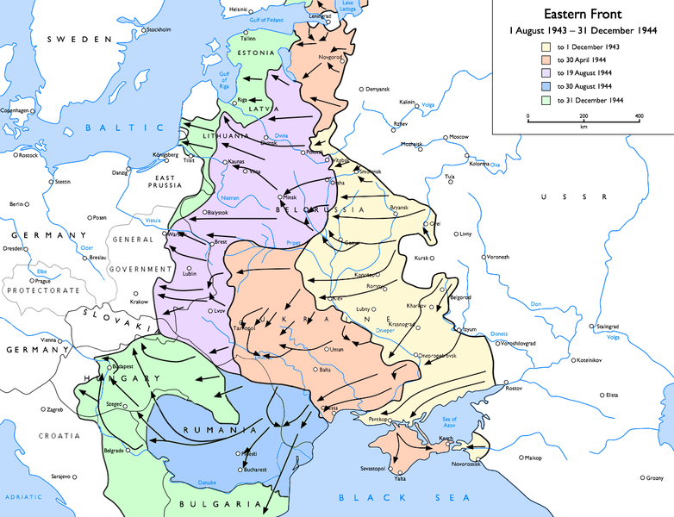
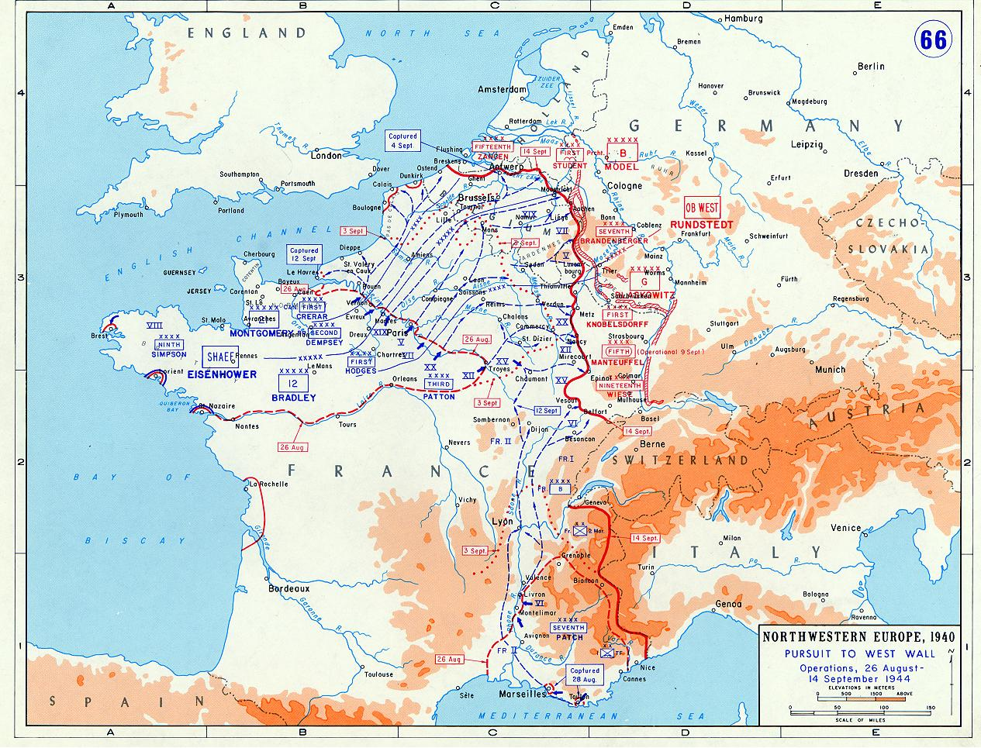
Battle of Berlin
Prelude
In the Great Patriotic War, Stalingrad was the turning point against the Axis powers. It was there that the Nazi military was defeated and their retreat westward began.
Between February of 1943 and April of 1945, the Soviet Union continued to repel the Axis powers and take more territory to the west.
In July of 1943, Fascist Italy was defeated by Allied Powers and Italian Partisans, and Germany was left as the one major Axis power in Europe.
The next year, the Allies made landing in northern France on D-Day and soon France was liberated and Nazi Germany found itself being squeezed to death by the Allies on both sides.

Slide 6
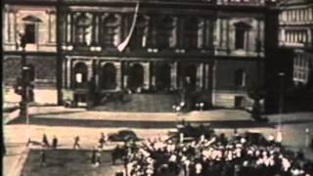
The Unknown War - The Battle of Berlin

Slide 7
Discussion

Slide 8
The Unknown War - The Battle of Berlin

Slide 9
End of Nazi Germany

Slide 10
The Unknown War - The Battle of Berlin

Slide 11
Victory Day Parades

Slide 12
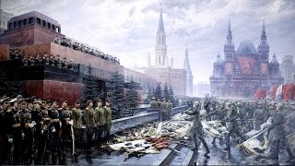
Victory Day Parade of 1945

Slide 13
Victory Day Parade of 1945

Slide 14
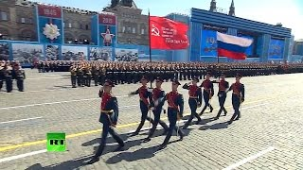
Victory Day Parade of 1945

Slide 15
New Member Introductions
What is your name, pronouns and state (or country/territory)?
Where do you work? Is it unionized?
How did you find out about the People’s School?
What do you think about tonight's class?

Slide 16
Volunteers Needed!
We are in need of volunteers for the staff of the People’s School! Here’s a few roles we need filled:
People to help manage posting on our social media and podcast platforms
Video Editors, Audio Editors, Graphic Designers, Artists, Narrators
Facilitators, Web Controls, Moderators
Email info@peoplesschool.us if you’re interested and try to attend our next staff meeting on May 4th if possible.

Slide 17
New Outlook Publishers
newoutlookpublishers.store
Latest Releases

Slide 18
Legal Drive
Last year we were attacked and sabotaged by wreckers that tried to steal the PSMLS and destroy the PCUSA.
They failed, but they will be held accountable and there are still things they took from us that we’ve not got back, like videos, imagery and audio. That is why we still need donations to the legal drive.
To donate, go to partyofcommunistsusa.net/donations/
Put “For legal funds” in the details box and try to donate on Tuesday or Thursday so it is easier for us to sort through. It will go to the legal fund. Anything helps!

Slide 19
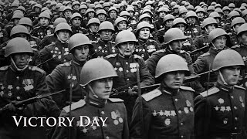
Den Pobedy - Victory Day

