Slide 1
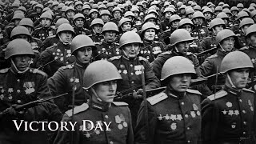
Victory Day - Den Pobedy

Slide 2
History of Ukrainian Fascism
PSMLS 05/09/23 - 05/11/23

Slide 3
What we’ll be learning today:
The history of fascist groups and individuals in Ukraine in the 20th century and 21st.
The establishment of Ukraine as a fascist state and the genocide in the Donbass
Ukrainian fascism today and how it appears on the battlefield.

Slide 4
Introduction

Slide 5
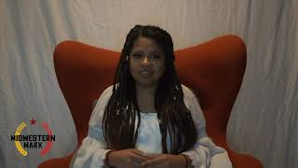
Fascism in Ukraine, explained by Kayla Popuchet, for PSMLS and Midwestern Marx

Slide 6
Origins of Ukrainian Fascism
1917-1959

Slide 7
Origins of Ukrainian Fascism
Ukronazism is Nazism with Ukrainian characteristics.
In the history of Ukronazism, 3 names come to the forefront and are intrinsically linked to its development: Symon Petliura, Stepan Bandera and Roman Shukhevych.
In fact it's not a coincidence that portraits of these 3 were all over the Maïdan color revolution that overthrew the legal government of Ukraine in 2014.

Slide 8
Origins of Ukrainian Fascism
Symon Petliura and the Ukrainian People’s Republic
The February 1917 revolution in Petrograd put an end to 350 years of tsarism in less than a week. With the collapse of tsarism, a movement of national liberation instantly developed in Ukraine, and autonomy within Russia was quickly proclaimed.
There were two wings in this movement: the bourgeois nationalist wing and the proletarian internationalist wing represented by Ukrainian Bolsheviks who stood shoulder to shoulder with their Russian comrades. In the Ukrainian national liberation the class struggle was at center stage. After the October Revolution, things came to a head. The bourgeois nationalist Ukrainians could not accept Soviet power that was in control of Russia and proclaimed its independence.

Slide 9
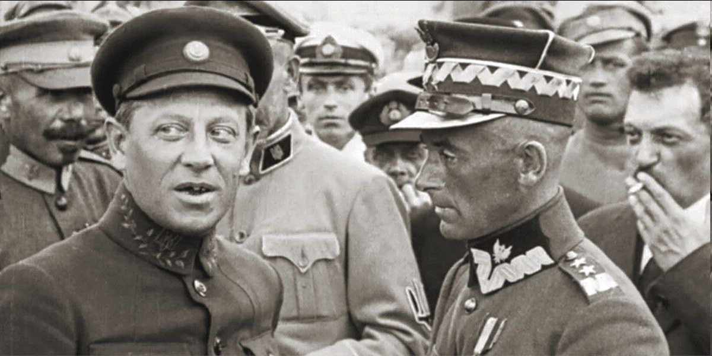
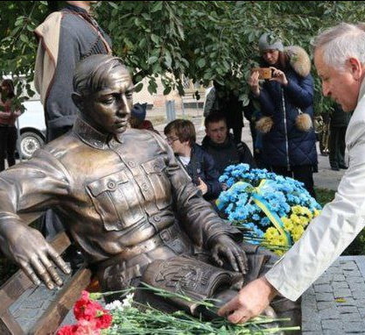
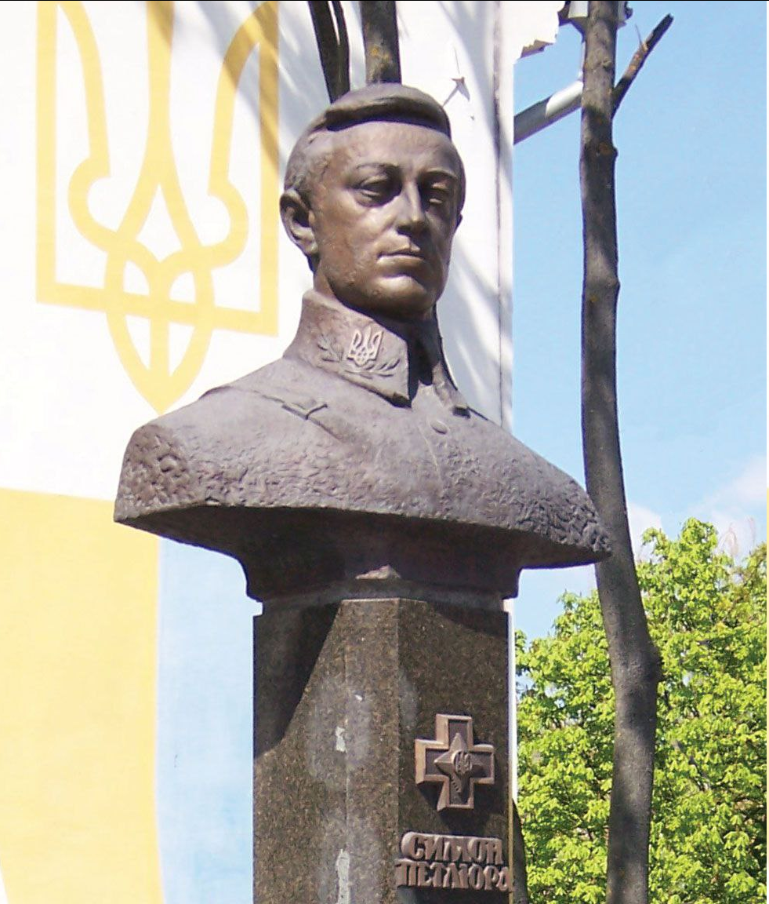
Origins of Ukrainian Fascism
Symon Petliura and the Ukrainian People’s Republic
A so called Ukrainian People's Republic was created in Kiev, led by Symon Petliura, a notorious anti-communist and anti-semitic. The Ukrainian People's Republic adopted the blue-yellow flag and the trident; both symbols of the current Ukronazi régime.
Petliura's army murdered tens of thousands of Ukrainian jews. Petliura's régime fought against the Russian SSR and the Ukrainian SSR. In the summer of 1920, Petliura allied with Poland when it launched a war against Soviet Russia. Poland was able to conquer parts of Western Ukraine namely Galicia, including Lvov the stronghold of Ukrainian nationalism. The Ukrainian People's Republic was defeated by the Ukrainian and Russian SSR's who united in the USSR in 1922. Petliura went into exile and ended up in Paris. In 1926, a Jew whose family Petliura had murdered in Odessa, likely working for the Soviet GPU, assassinated him in the streets of Paris.

Slide 10
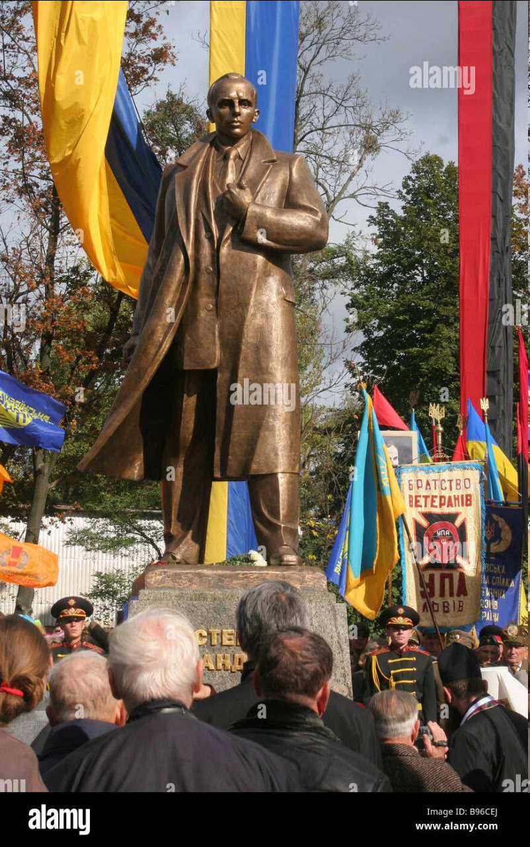
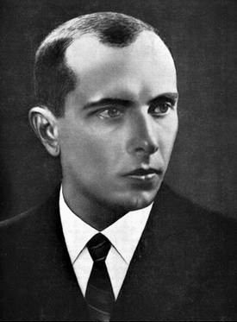
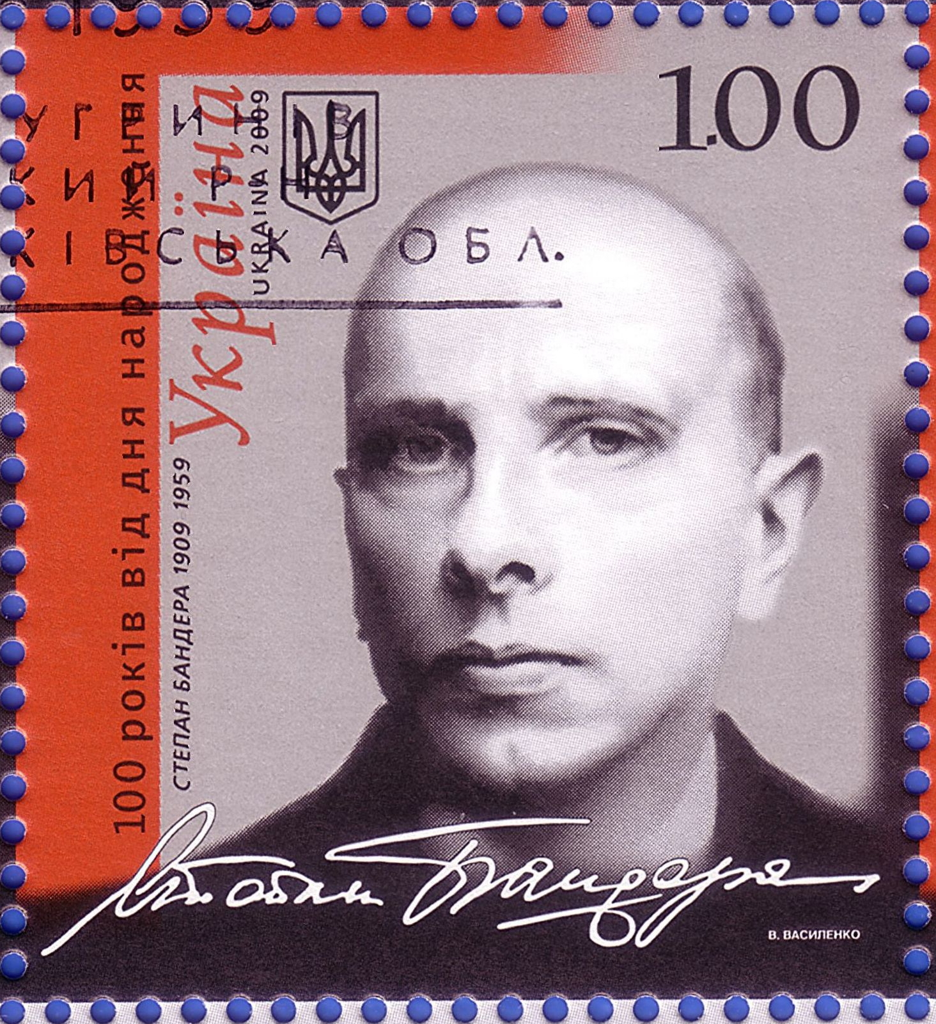
Origins of Ukrainian Fascism
Stepan Bandera
Stepan Bandera was born in Galicia and did his studies somewhere else... in Lvov. In 1929 at age 20, Bandera joined the just founded Organization of Ukrainian Nationalists (OUN) and quickly climbed up the ladder to become its leader by 1933.
The OUN ideology was similar to Italian fascism and German nazism. It was "integral nationalism", held the nation as supreme, based on biological characteristics. It romanticized violence, and believed that a charismatic iron fist leader embodied the "national will", such as the Duce or Führer. Like Hitler, the OUN believed in the right of a chosen people to dominate others, copying the Nazi slogan "Deutschland über alles" (Germany above all). Bandera proclaimed the superiority of Ukrainian blood.
Prior to Hitler's invasion of the USSR, Bandera negotiated with the Wehrmacht the formation of 5th column battalions inside the USSR, to prepare the terrain for the onslaught. One of them was the Nachtigall battalion.

Slide 11
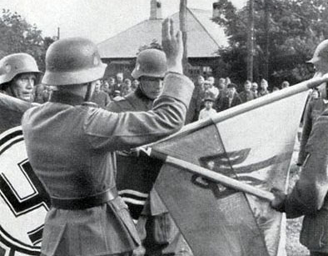
Origins of Ukrainian Fascism
Stepan Bandera
Shortly after the invasion Bandera unleashed the Lvov anti-jewish pogroms under the protection of the Wehrmacht: they were called the "Petliura days", to avenge Symon Petliura's assassination by a Jew in Paris, 15 years before. These pogroms by Bandera's OUN resulted in the murder of close to 10k Jews in June and July 1941 in Lvov.
With the arrival of German troops Bandera proclaimed an independent fascist Ukrainian state under the leadership of Hitler. That did not fit into the Führer's plans: fascist yes, but independent no. So Bandera was put under house arrest and later transferred into a Hilton prison in Germany. There he was kept in reserve for further use. In the meantime Bandera's OUN supporters kept busy following the Wehmacht in its eastward progression.
The Lvov pogroms were just a prelude for things to come. In September 1941 Kiev fell and the Holocaust began shortly after: 33k Jews were machine gunned in 48 hours outside of Kiev at Babi Yar. 1200 were in charge of rounding up the Jews, marching them up to the killing fields and machine-gunning them. Out of these 1200, 300 were Germans the rest were western Ukrainians, partisans of Bandera's OUN.
The WW2 Holocaust of the Jews was inaugurated in Ukraine and mostly by Ukrainians, followers of Bandera.
In 1942 the OUN founded the Ukrainian Insurgent Army UPA, whose main feat was to murder 100k poles, mosty old men, women and children in Galicia and Volhynia, in such a barbarian butchering fashion that even Wehrmacht officers found it disgusting.

Slide 12
Origins of Ukrainian Fascism
Stepan Bandera
Bandera was released from his Hilton prison in 1944 as Hitler urgently needed his help in fighting the advancing Red Army. After the 3rd Reich's defeat, Bandera was exfiltrated by British intelligence to Munich, inside the American zone of occupation. A true return to his origins, as Munich was the headquarters of the Nazi party.
From there Bandera continued to direct anti-Soviet operations inside Ukraine. He operated under the protection and support of the newly created CIA, to whom he represented a highly valuable asset in the fight against the USSR. Finally in October 1959, the KGB caught up with Bandera in Munich and handed him a one way ticket to go meet his Führer.
Bandera is a Hero of the current Ukronazi régime. His statues and monuments are everywhere in western Ukraine. Stamps have been issued in his honor. His birthday is a national holiday. The former president of Ukraine Poroshenko has mounted a .50 cal machine gun on the bed of his pick-up which he then baptized "Banderamobile". Bandera's red over black flag is seen everywhere in Ukraine and flies over half the graves in military cemeteries. The song "Our mother is Ukraine, our father Bandera" is almost like a national anthem. It is sung in the parliament and taught in kindergarten.

Slide 13
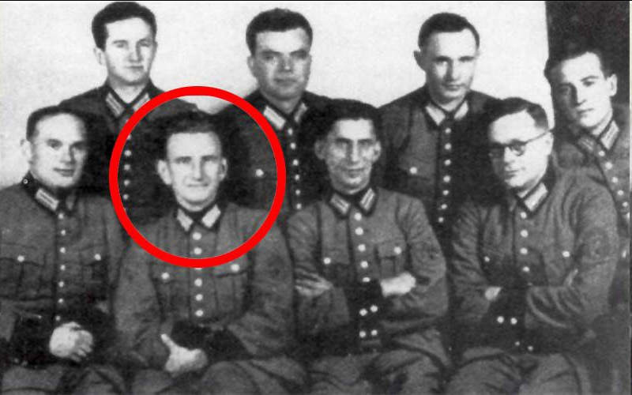
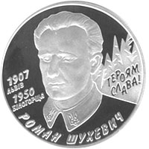
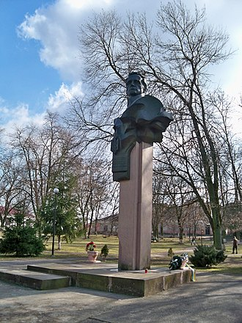
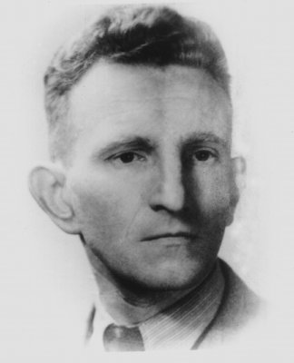
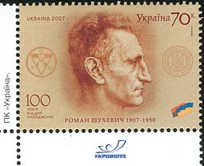
Origins of Ukrainian Fascism
Roman Shukhevych
If Stepan Bandera was the Adolph Hitler of Ukronazism, Roman Shukhevych was its Heinrich Himmler. Shukhevych was born in Lvov of course. He did his studies at Lvov Polytechnic, the very same university attended by Bandera. Shukhevych joined the OUN in 1929. He wasn't an ideologue like Bandera, he was a man of action, a field commander.
He was well versed in terrorist activities, assassination was his thing. He assassinated a Polish chief of police and tried but failed, to assassinate the Soviet consul in Lvov. With the help of German intelligence, Shukhevych organized armed subversion against Czechoslovakia, preparing its take over by the 3rd Reich in 1939. With such credentials, the Wehrmacht found him very useful, and made Shukhevych commander of its Nachtigall battalion, a 5th column unit, to serve as special operations inside the USSR, prior to the Barbarossa invasion of June 1941.

Slide 14
Origins of Ukrainian Fascism
Roman Shukhevych
Nachtigall wore standard German uniforms, but with blue-yellow ribbons on their shoulders. They were the first to enter Lvov and supervised the June and July 1941 massacres of Jews by civilian followers of the OUN. In 1942, Shukhevych led Nachtigall in anti-partisan and anti-Jews operations in Belarus, killing thousands. He was promoted supreme commander of the Insurgent Ukrainian Army, UPA, in August 1943, just on time for the Galicia and Volhynia massacres of 100k Poles.
In February 1944, Shukhevych's UPA scored a major symbolic victory: it ambushed and mortally wounded Red Army general Nikolaï Vatutin, the hero of the battles of Stalingrad and Kursk, the liberator of Kiev. Vatutin, posthumously made Hero of the USSR, holds a special place in the heart of the Russian and Donbass people. When Donetsk and Lugansk erupted in uprising against the Ukronazi régime in 2014, it was under the slogan: "they are Bandera, we are Vatutin!".
Unlike Bandera, Shukhevych remained in Western Ukraine after the 3rd Reich's defeat. He kept fighting the Red Army and the NKVD in the hills and forests of Galicia until March 1950, when he was finally killed in combat at the age of 42. Like Bandera, Shukhevych is a hero to the current Ukronazi régime who renamed Kiev's Nikolaï Vatutin Avenue into Roman Shukhevych Avenue. Shukhevych statues, coins and stamps litter today's Ukraine. His bust holds a prominent place in the office of Ukraine's military Commander-in-Chief, Valery Zaluzhny. Lvov's largest stadium bears the names of Bandera and Shukhevych.
One of the most popular songs in Ukraine is "Chervona Kalyna" which served as the anthem of the UPA. Chervona Kalyna won Eurovision 2016. Eurovision is a yearly song contest held in Europe, in which 52 countries participate. Chervona Kalyna was played in concert by Pink Floyd (minus Roger Waters obviously) in April 2022, in support of the Zelensky régime.

Slide 15
Discussion

Slide 16
Reemergence of Ukrainian Fascism
1995-2014

Slide 17
Reemergence of Ukrainian Fascism
Following the Counter-Revolution in the USSR, Ukraine became “independent” once again and nationalism began to fester.
By 1995, the neo-nazi Social-National Party of Ukraine was formed, which later became Svoboda.
The events of the 2004 Western-backed Orange Revolution further empowered Ukrainian fascists and they grew more and more into the 2010s.

Slide 18
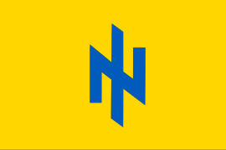
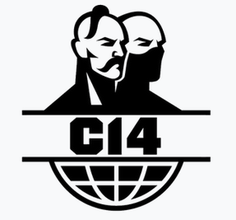
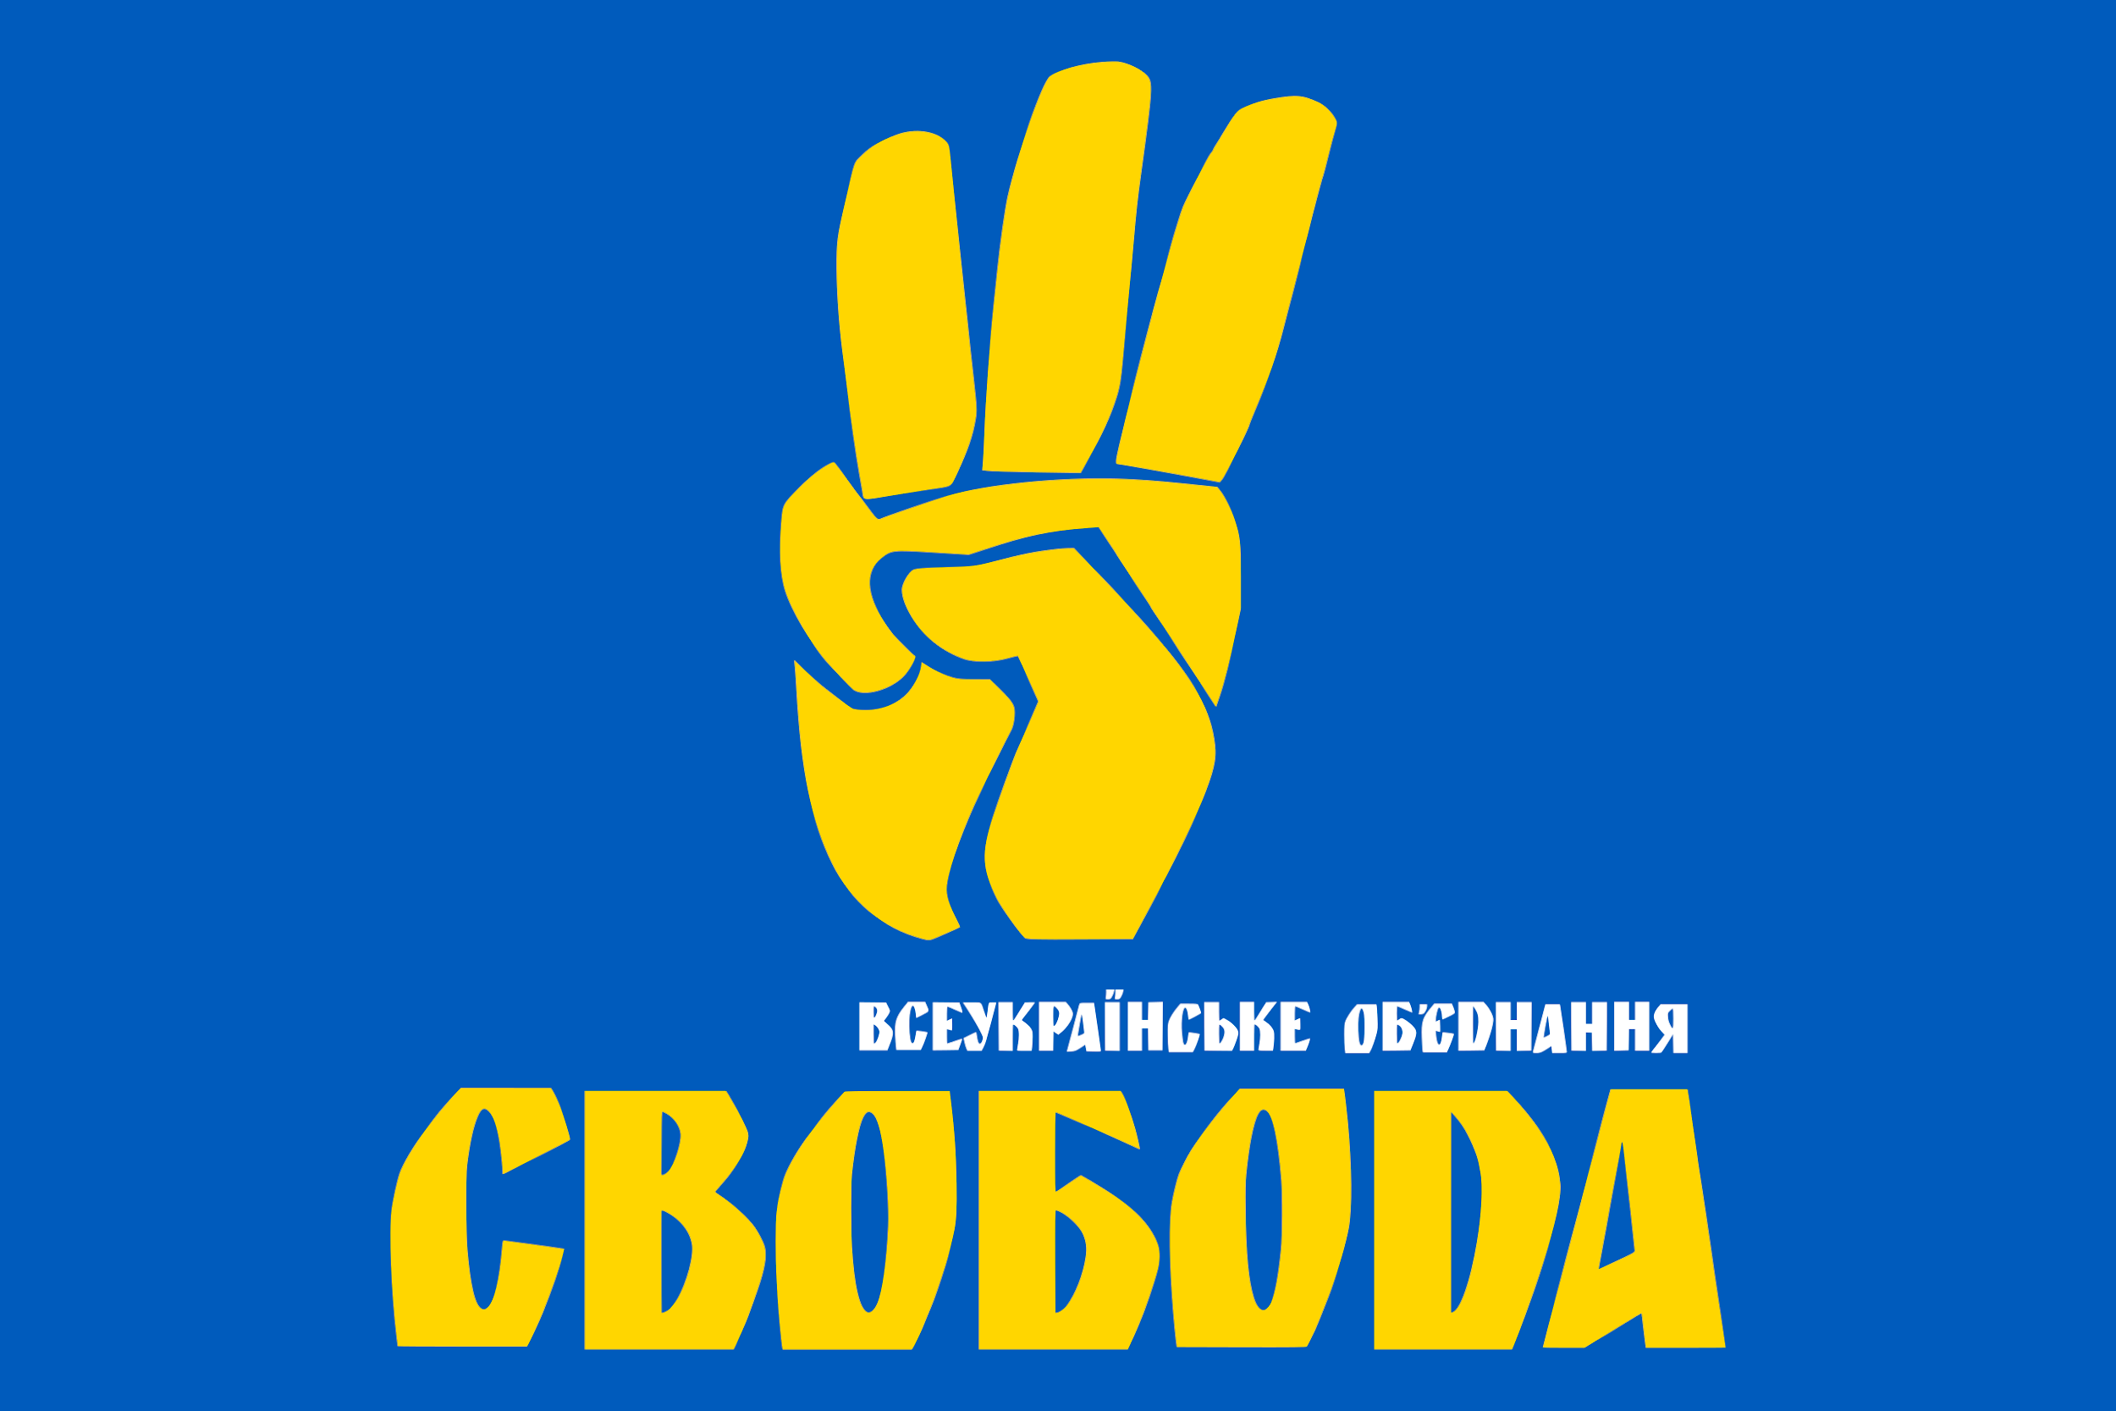
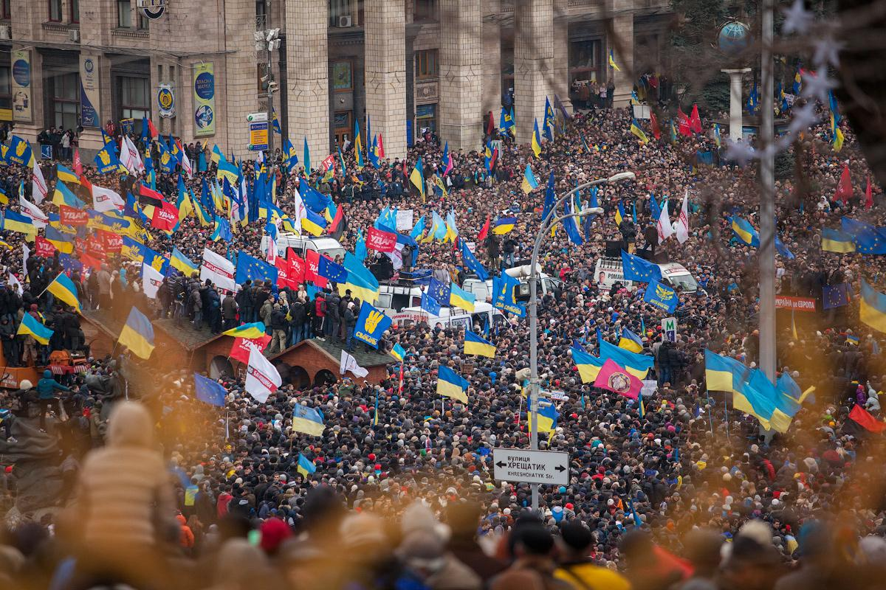
Reemergence of Ukrainian Fascism
Svoboda
In 2004, the year of the Orange Revolution, the Social-National Party of Ukraine became the “All-Ukrainian Union ‘Freedom.’” Freedom translates to Svoboda in Ukrainian. Though supposedly expelling neo-nazi elements and distancing from fascism in 2004, the Ukronazi nature of Svoboda would be continually shown.
From 2009-2014, it was a member of the ultranationalist Alliance of European National Movements. Its youthwing, C14, was a neo-nazi paramilitary organization. Svoboda was involved heavily in the Euromaidan protests and fascist “Revolution of Dignity” and was popular enough to secure 10.45% of the vote in the 2012 Elections.

Slide 19
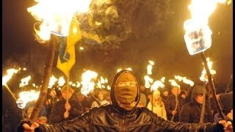
Report on Svoboda torch-light rally by BBC, c. 2014

Slide 20
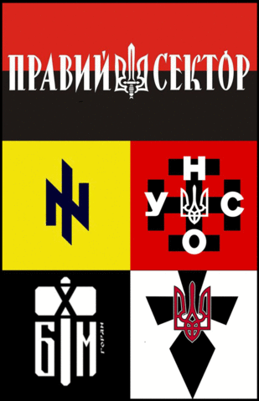
Reemergence of Ukrainian Fascism
Right Sector
Another prominent Ukronazi group is the Right Sector. Starting in Nov 2013, at the start of Euromaidan, this coalition of fascist Ukrainian forces included the Trident (Tryzub), the Ukrainian National Assembly- Ukrainian National Self-Defense (UNA–UNSO), Social-National Assembly, its Patriot of Ukraine paramilitary wing, White Hammer, and the Sich Battalion (paramilitary wing of Svoboda).
The Right Sector was heavily involved in Euromaidan, the killings of trade unionists in Odessa, and the genocide in Donbas. Despite Right Sector and Svoboda not achieving much in recent elections, they are heavily involved in the military activities of Ukraine.

Slide 21
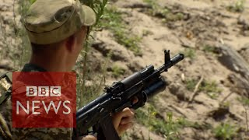
Report on Right Sector by BBC, c. 2015

Slide 22
Discussion and New Members Introductions

Slide 23
New Member Introductions
What is your name, pronouns and state (or country/territory)?
Where do you work? Is it unionized?
How did you find out about the People’s School?
What do you think about tonight's class?

Slide 24
Fascist Ukraine
2014-Present

Slide 25
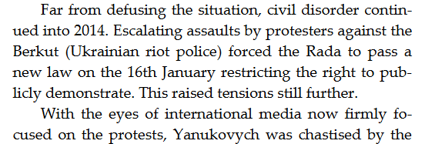
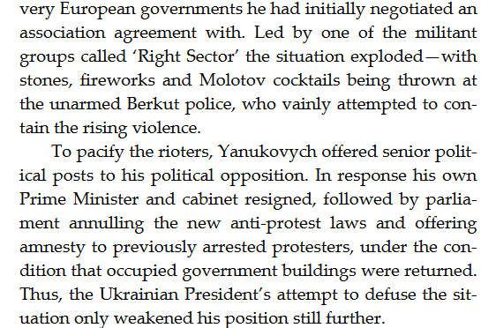
Donbass Cowboy
by Russel Texas Bentley
Prelude to War

Slide 26
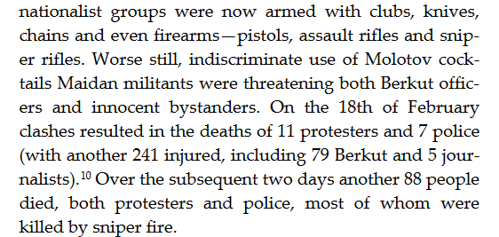
Donbass Cowboy
by Russel Texas Bentley
Prelude to War

Slide 27
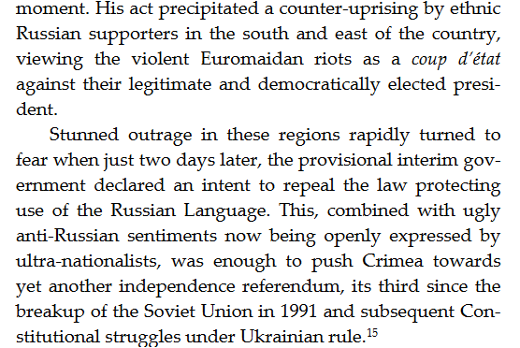
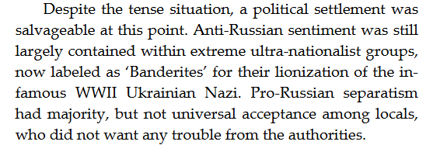
Donbass Cowboy
by Russel Texas Bentley
Prelude to War

Slide 28
Donbass Cowboy
by Russel Texas Bentley
Prelude to War

Slide 29
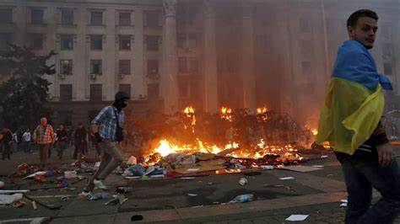
Maidan and Odessa Clashes
In 2014 the parliament dismissed Yankovich after protest that were triggered in wake of his refusal to sign the EU-Ukraine trade pact and led to the February 21st agreement later to be broken by the opposition in which Maidan supporters in the parliament implemented a interim president Oleksandr Turchynov against the Constitution of Ukraine.
Another important development was the passage of a law later reversed by the interim president of changing the status of the Russian language which triggered unrest leading to clashes between trade unionist and rioters in the city of Odessa that resulted in the tragic deaths of 40-50 people in the Trade Union building.

Slide 30
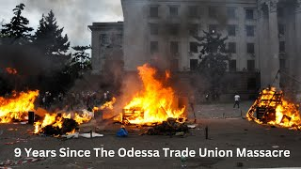
From 8 Years Before by The Revolution Report - Odessa Massacre

Slide 31
8 Years Before by The Revolution Report

Slide 32
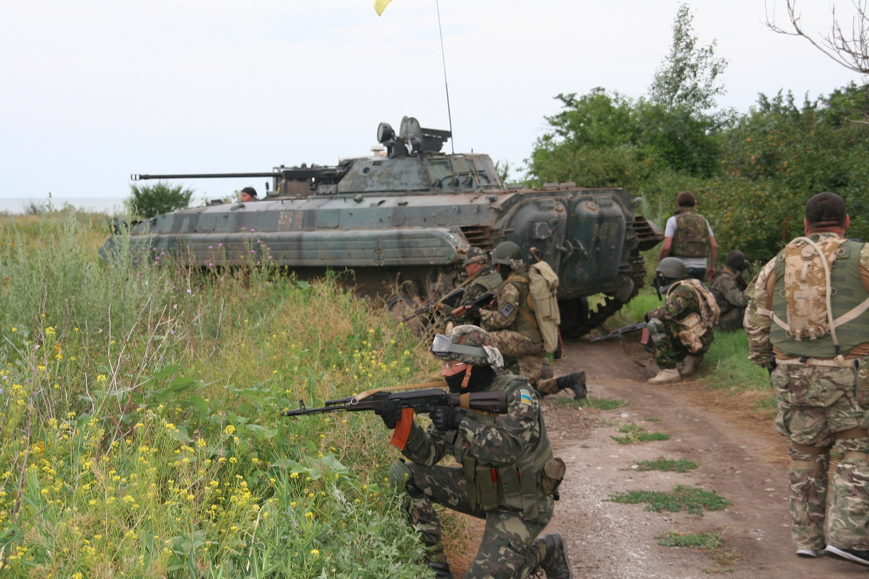
War in Donbas
The war in Donbas raged for 8 years as the separatist, Russian-speaking regions faced an onslaught by fascist Ukraine. The warfare took the form of trench warfare, building bunkers, using artillery etc.
There were several ceasfires brokered between the 2 forces through the Minsk Agreements, but again and again, the Ukraine fascists attacked and fighting resumed.
It was not until 2022 that the Donetsk People’s Republic and Lugansk People’s Republic were recognized by Russia and the Russian Federation came to their assistance with the Special Military Operation to Denazify Ukraine, which is still continuing to this day.

Slide 33
Ukraine: An Everlasting Present by Global Tree Pictures - Zelenskyy

Slide 34
Discussion

Slide 35
Volunteers Needed!
We are in need of volunteers for the staff of the People’s School! Here’s a few roles we need filled:
People to help manage posting on our social media and podcast platforms
Video Editors, Audio Editors, Graphic Designers, Artists, Narrators
Facilitators, Web Controls, Moderators
Email info@peoplesschool.us if you’re interested and try to attend our next staff meeting on June 1st if possible.

Slide 36
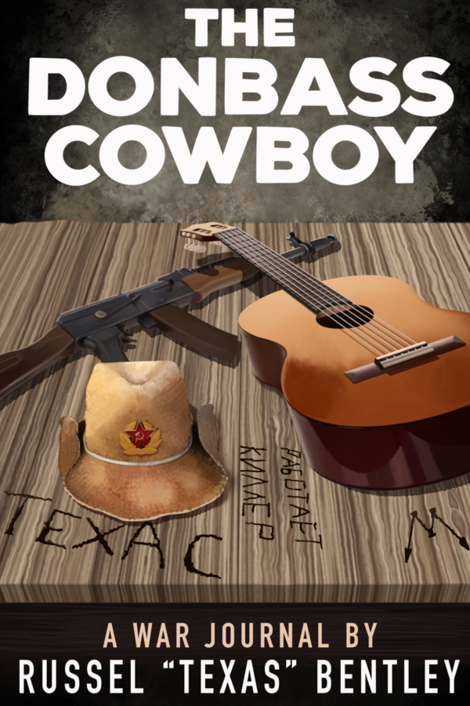
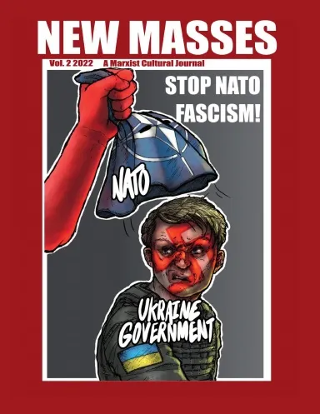
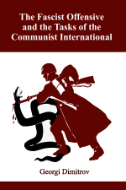
New Outlook Publishers
newoutlookpublishers.store
Related to Class

Slide 37
Legal Drive
Last year we were attacked and sabotaged by wreckers that tried to steal the PSMLS and destroy the PCUSA.
They failed, but they will be held accountable and there are still things they took from us that we’ve not got back, like videos, imagery and audio. That is why we still need donations to the legal drive.
To donate, go to partyofcommunistsusa.net/donations/
Put “For legal funds” in the details box and try to donate on Tuesday or Thursday so it is easier for us to sort through. It will go to the legal fund. Anything helps!

Slide 38
Donbas is Behind Us

