Slide 1
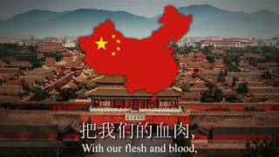
March of the Volunteers - Anthem of the People’s Republic of China

Slide 2
PSMLS 06/06/23 - 06/08/23

Slide 3
What we’ll be learning today:
A brief history of China’s struggle against Japanese and Western imperialism
A brief summarization of the Chinese Civil War as a prelude to this issue over the island of Taiwan.
About American aggression towards China and the present build up to a war with the People’s Republic of China.

Slide 4
Introduction

Slide 5
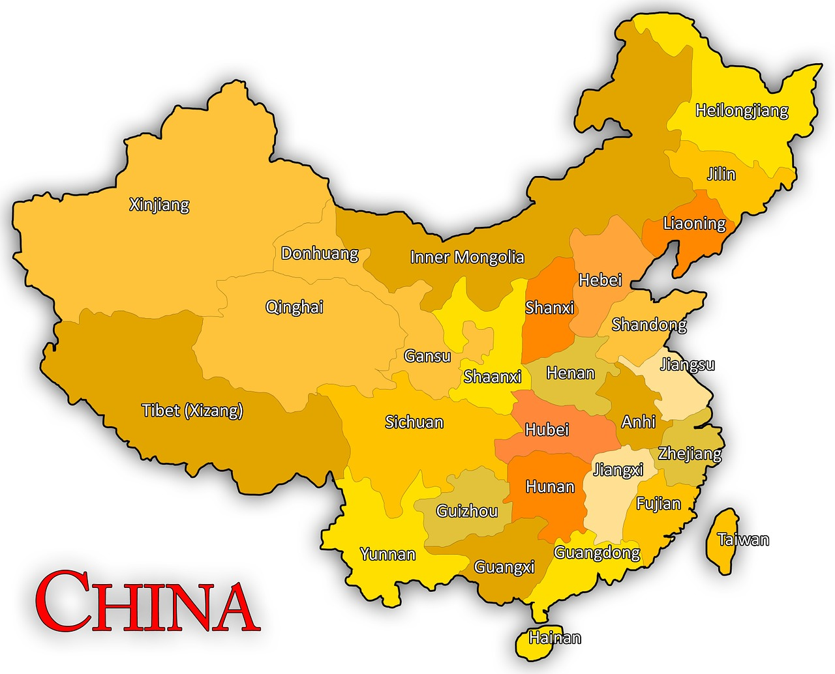
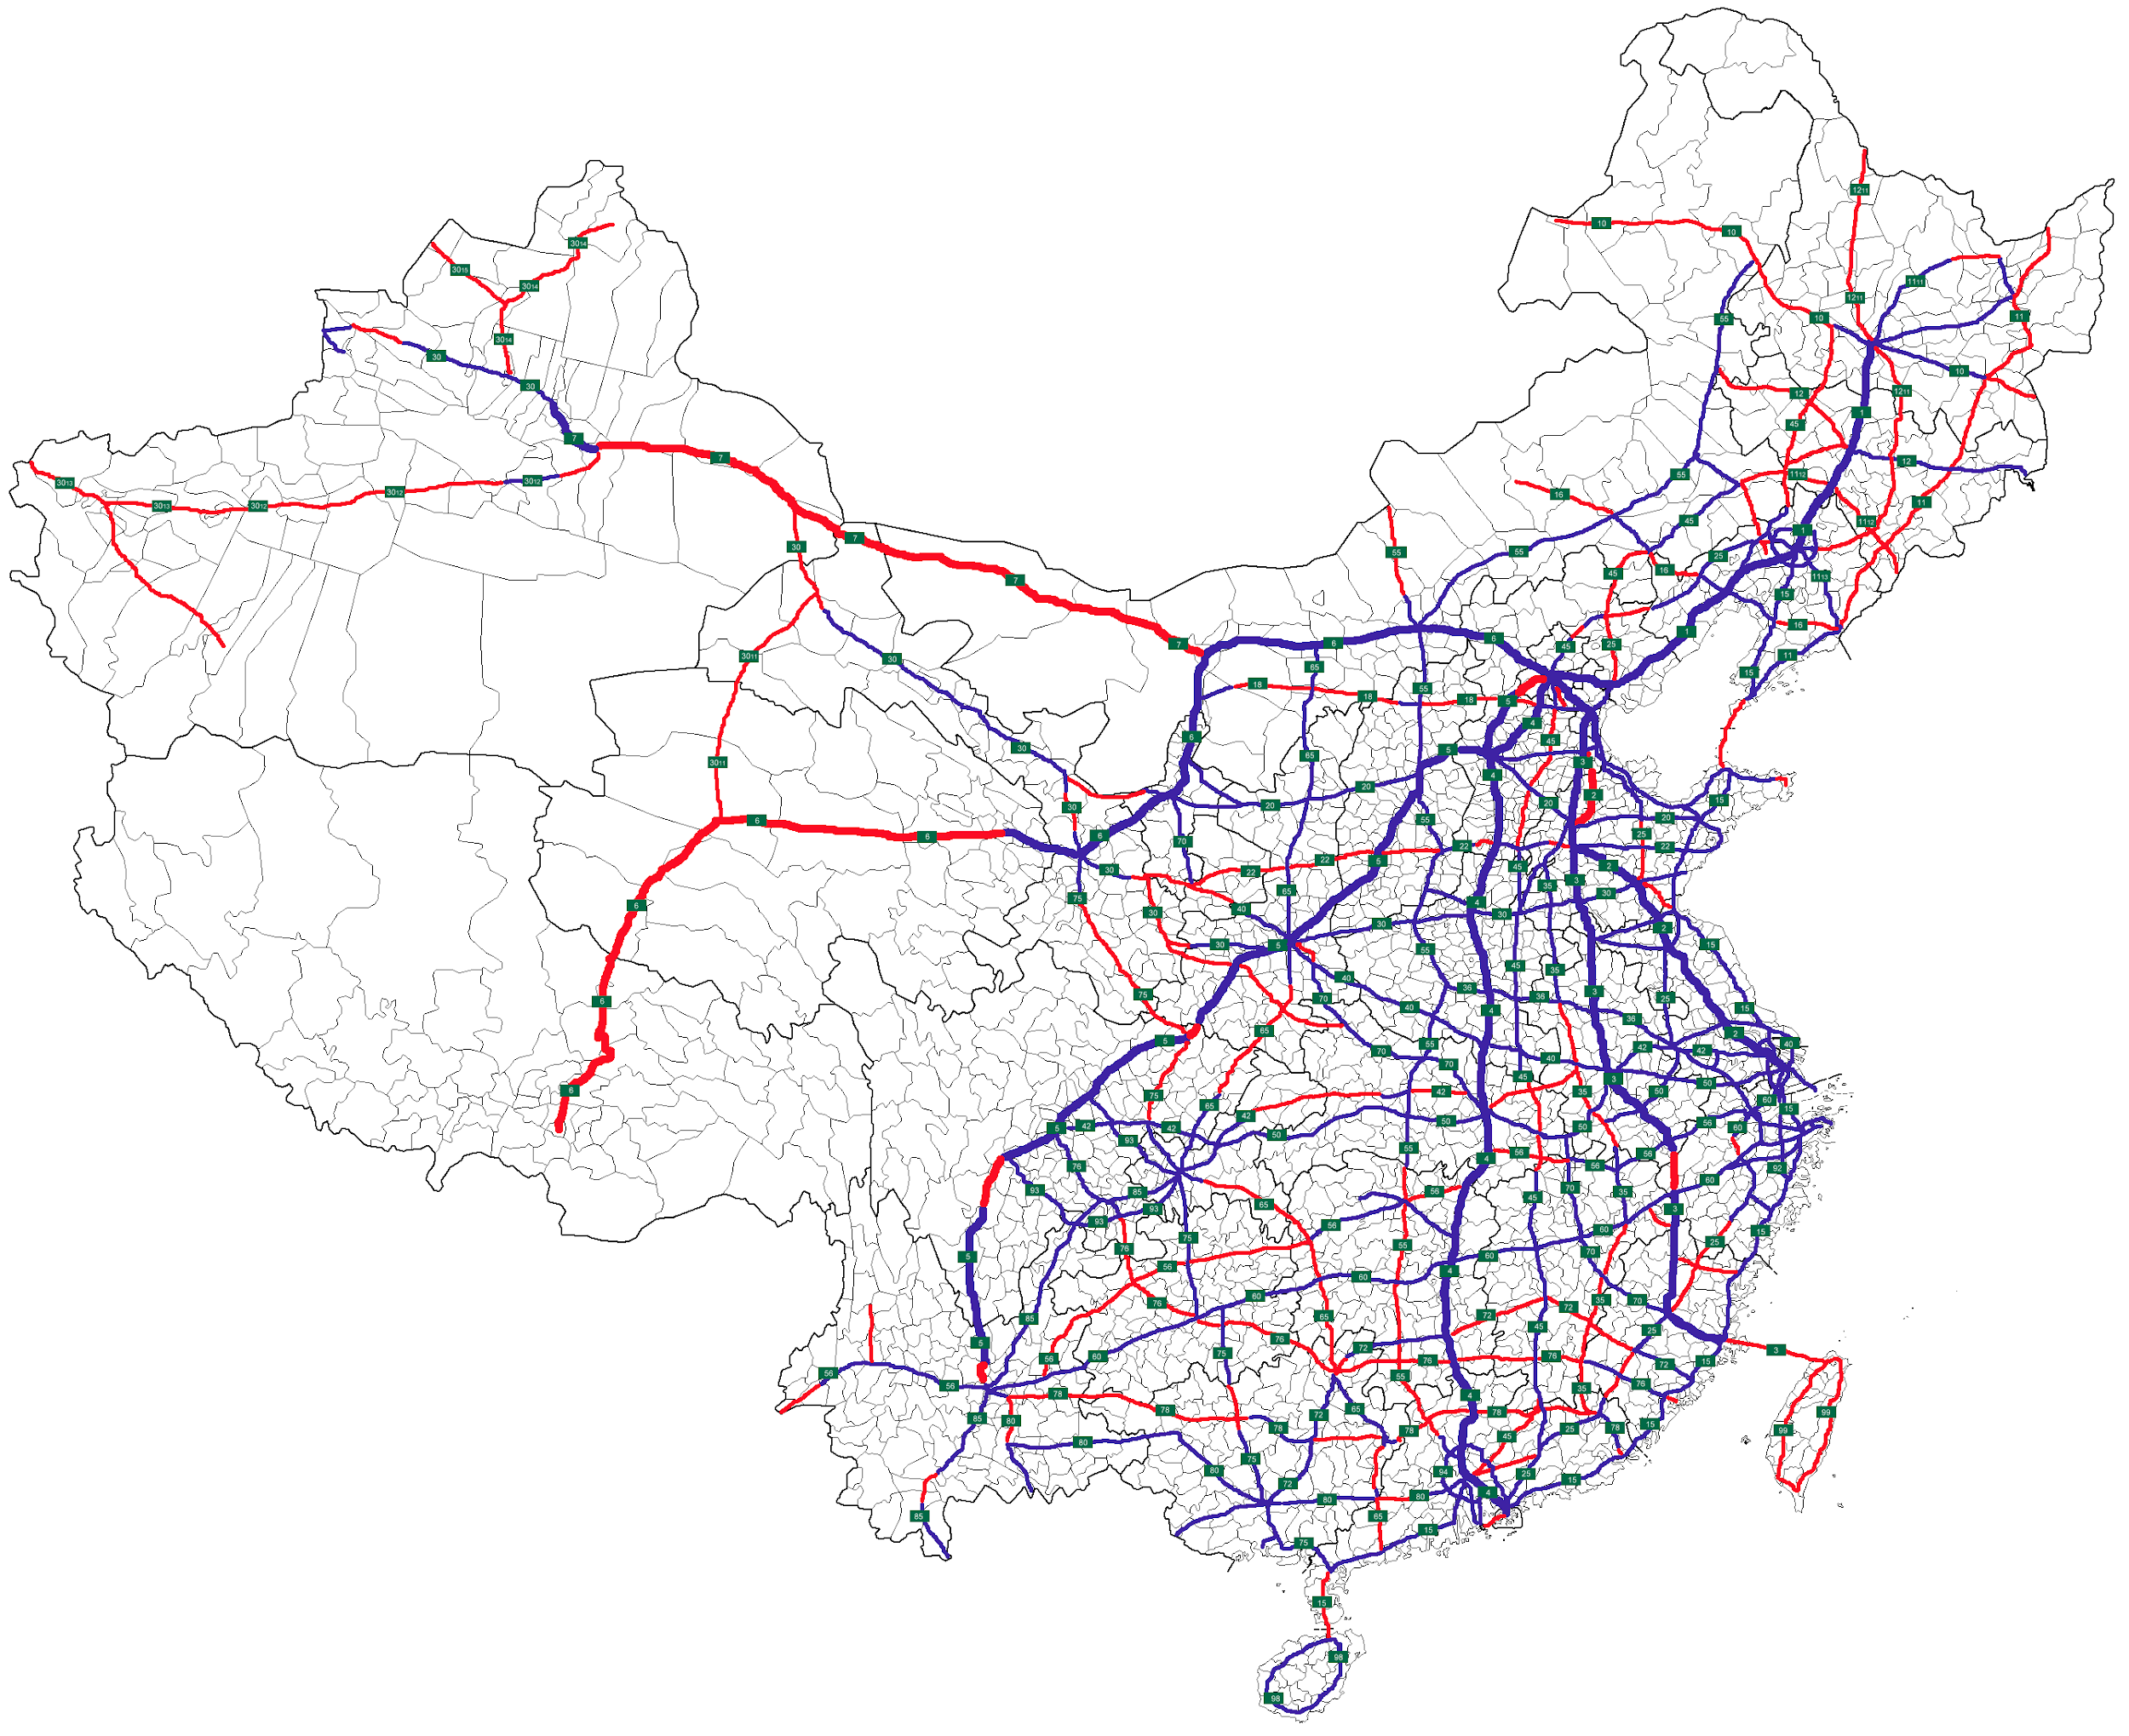
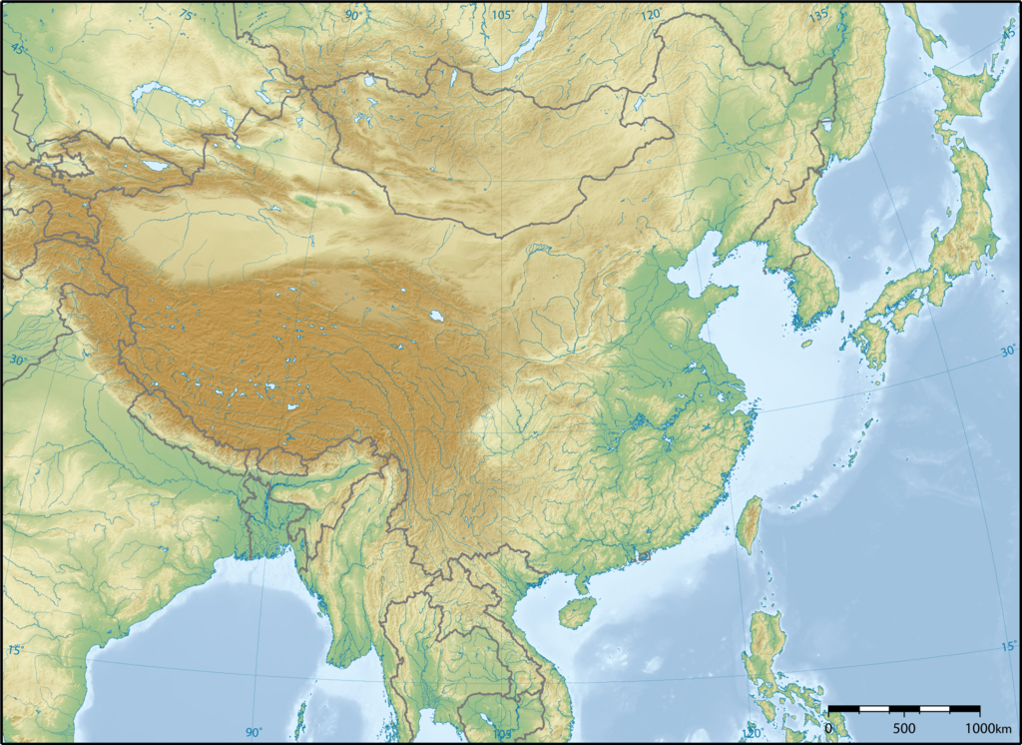
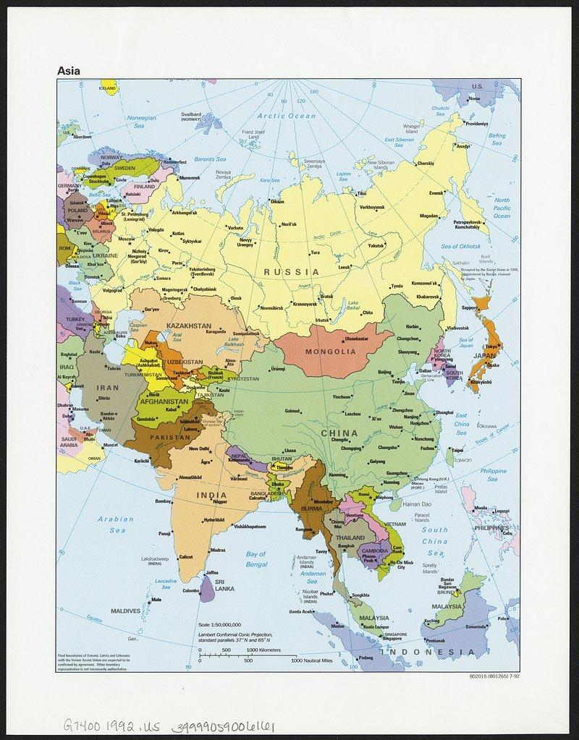
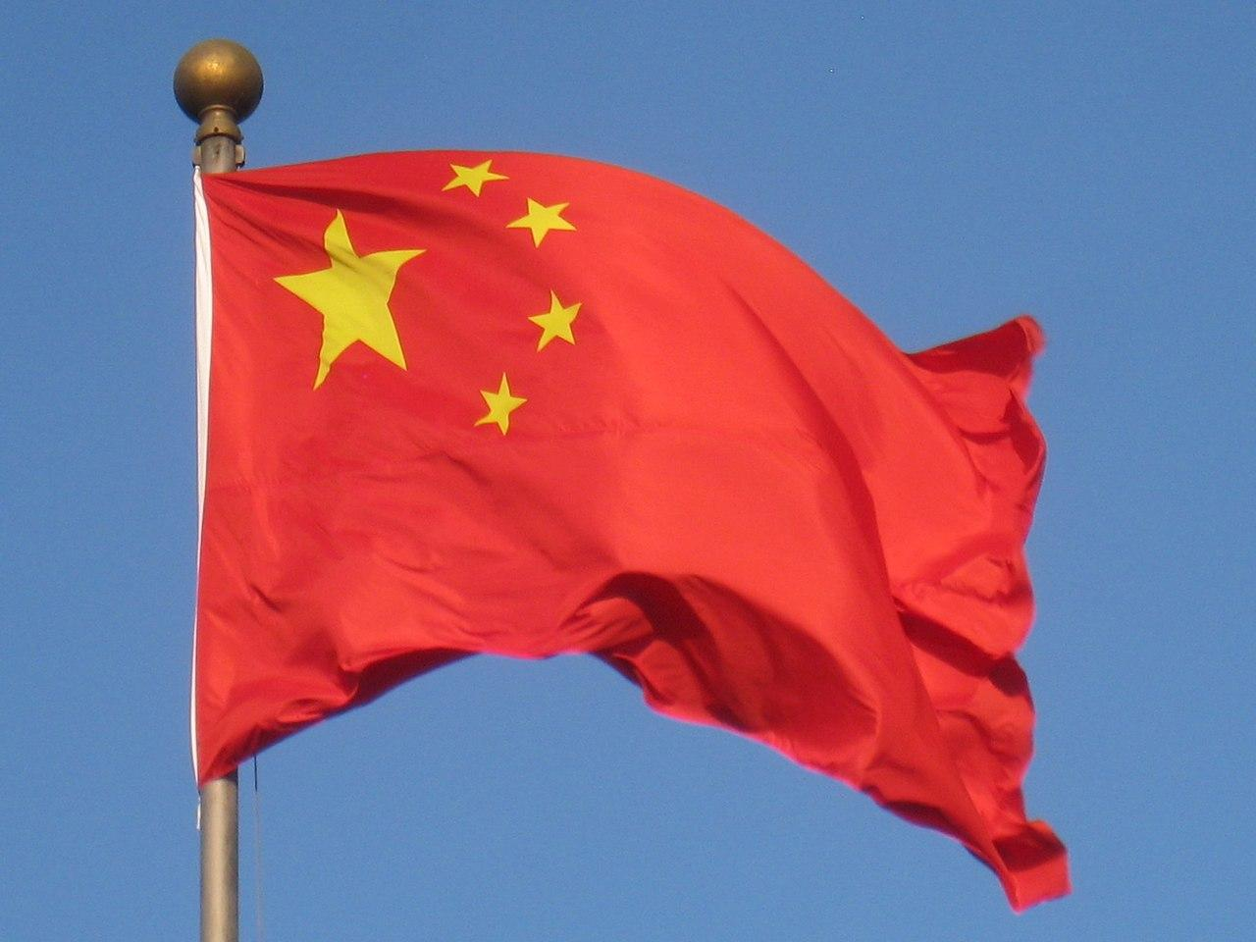
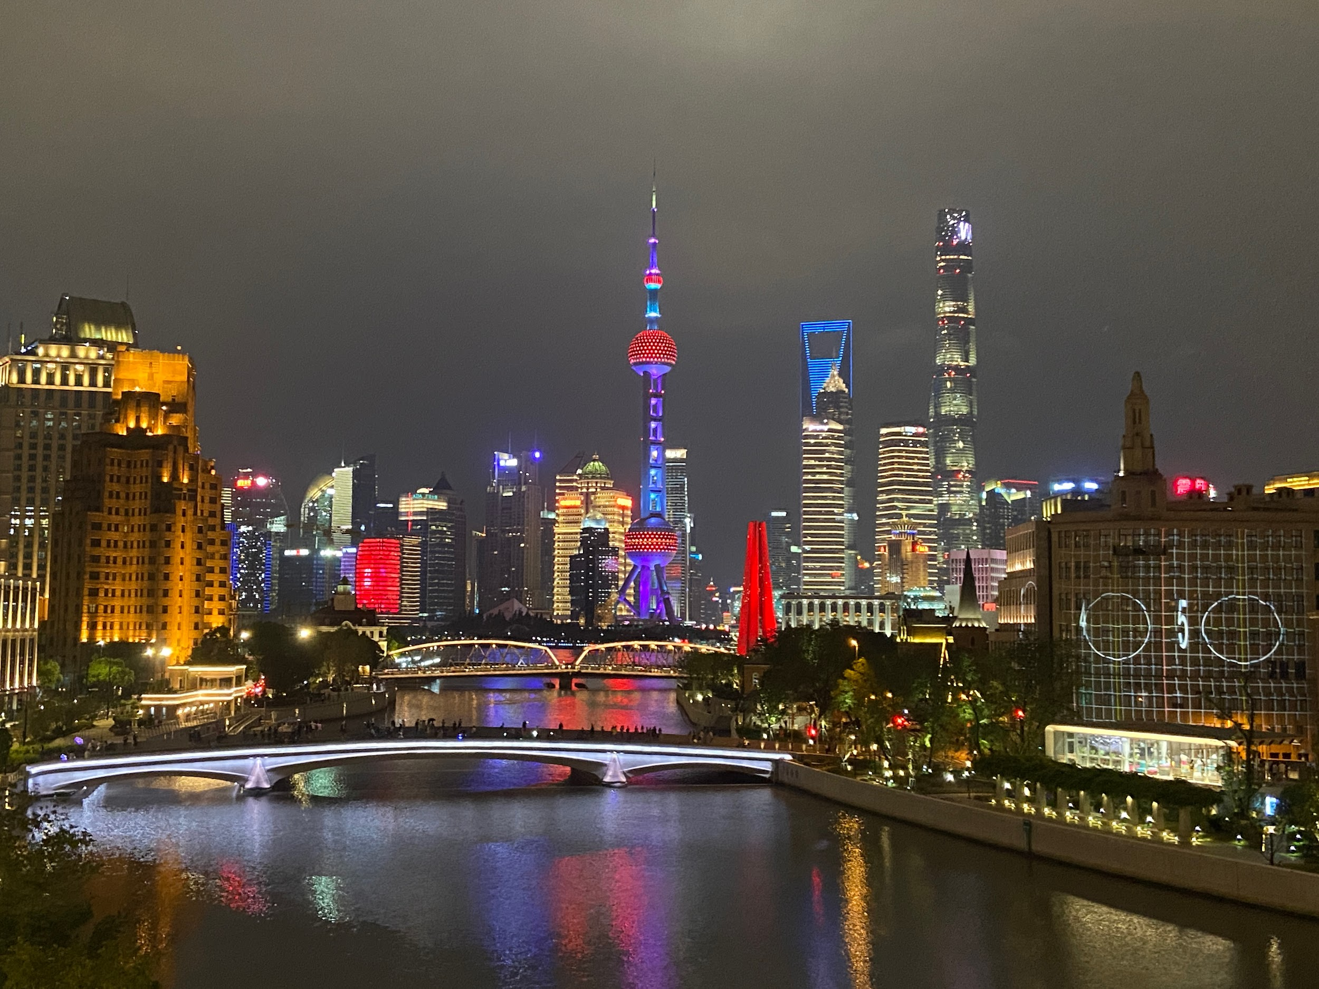
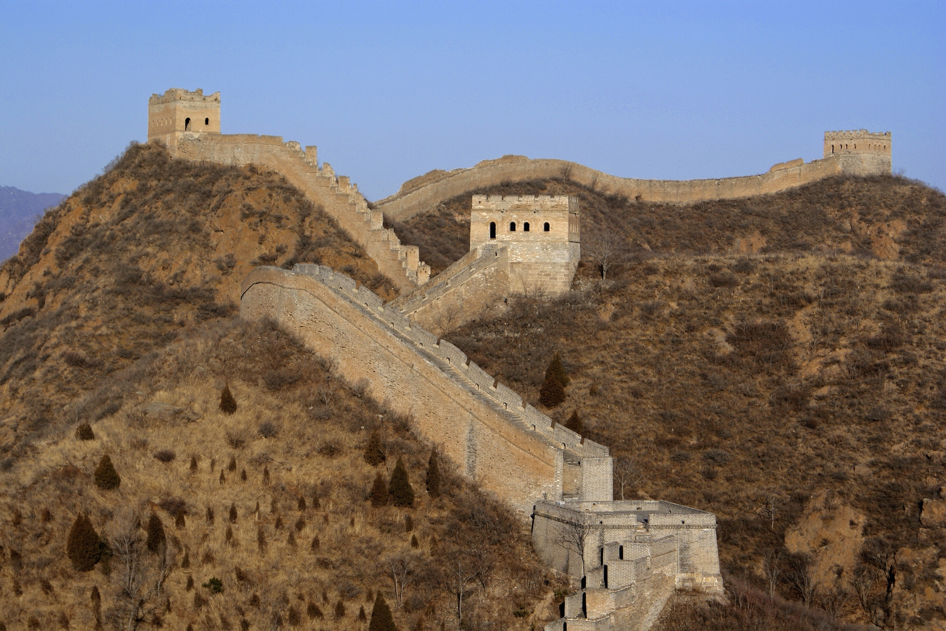
China Basic Information
Shanghai
China, currently the People’s Republic of China (PRC), is a nation in East Asia on the Western rim of the Pacific, which has existed as the PRC since 1949, but the area itself had previously seen thousands of years of feudal states under several dynasties.
Today, ~1,450,000,000 people live in the PRC, making it the most populated country in the world. China’s largest city is Shanghai, with ~25 million people. The capital is Beijing. China borders Korea, Vietnam, Laos, Myanmar, India, Bhutan, Nepal, Pakistan, Afghanistan, Tajikistan, Kyrgyzstan, Kazakhstan, Russia, Mongolia, the East China Sea, the South China Sea and the Pacific Ocean the most of any country, crossing 5 time zones
Famous Great Wall of China
Rural China

Slide 6
Historical Background 1895- 1949

Slide 7
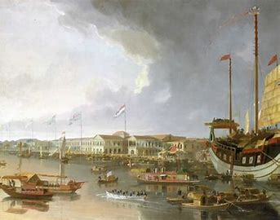
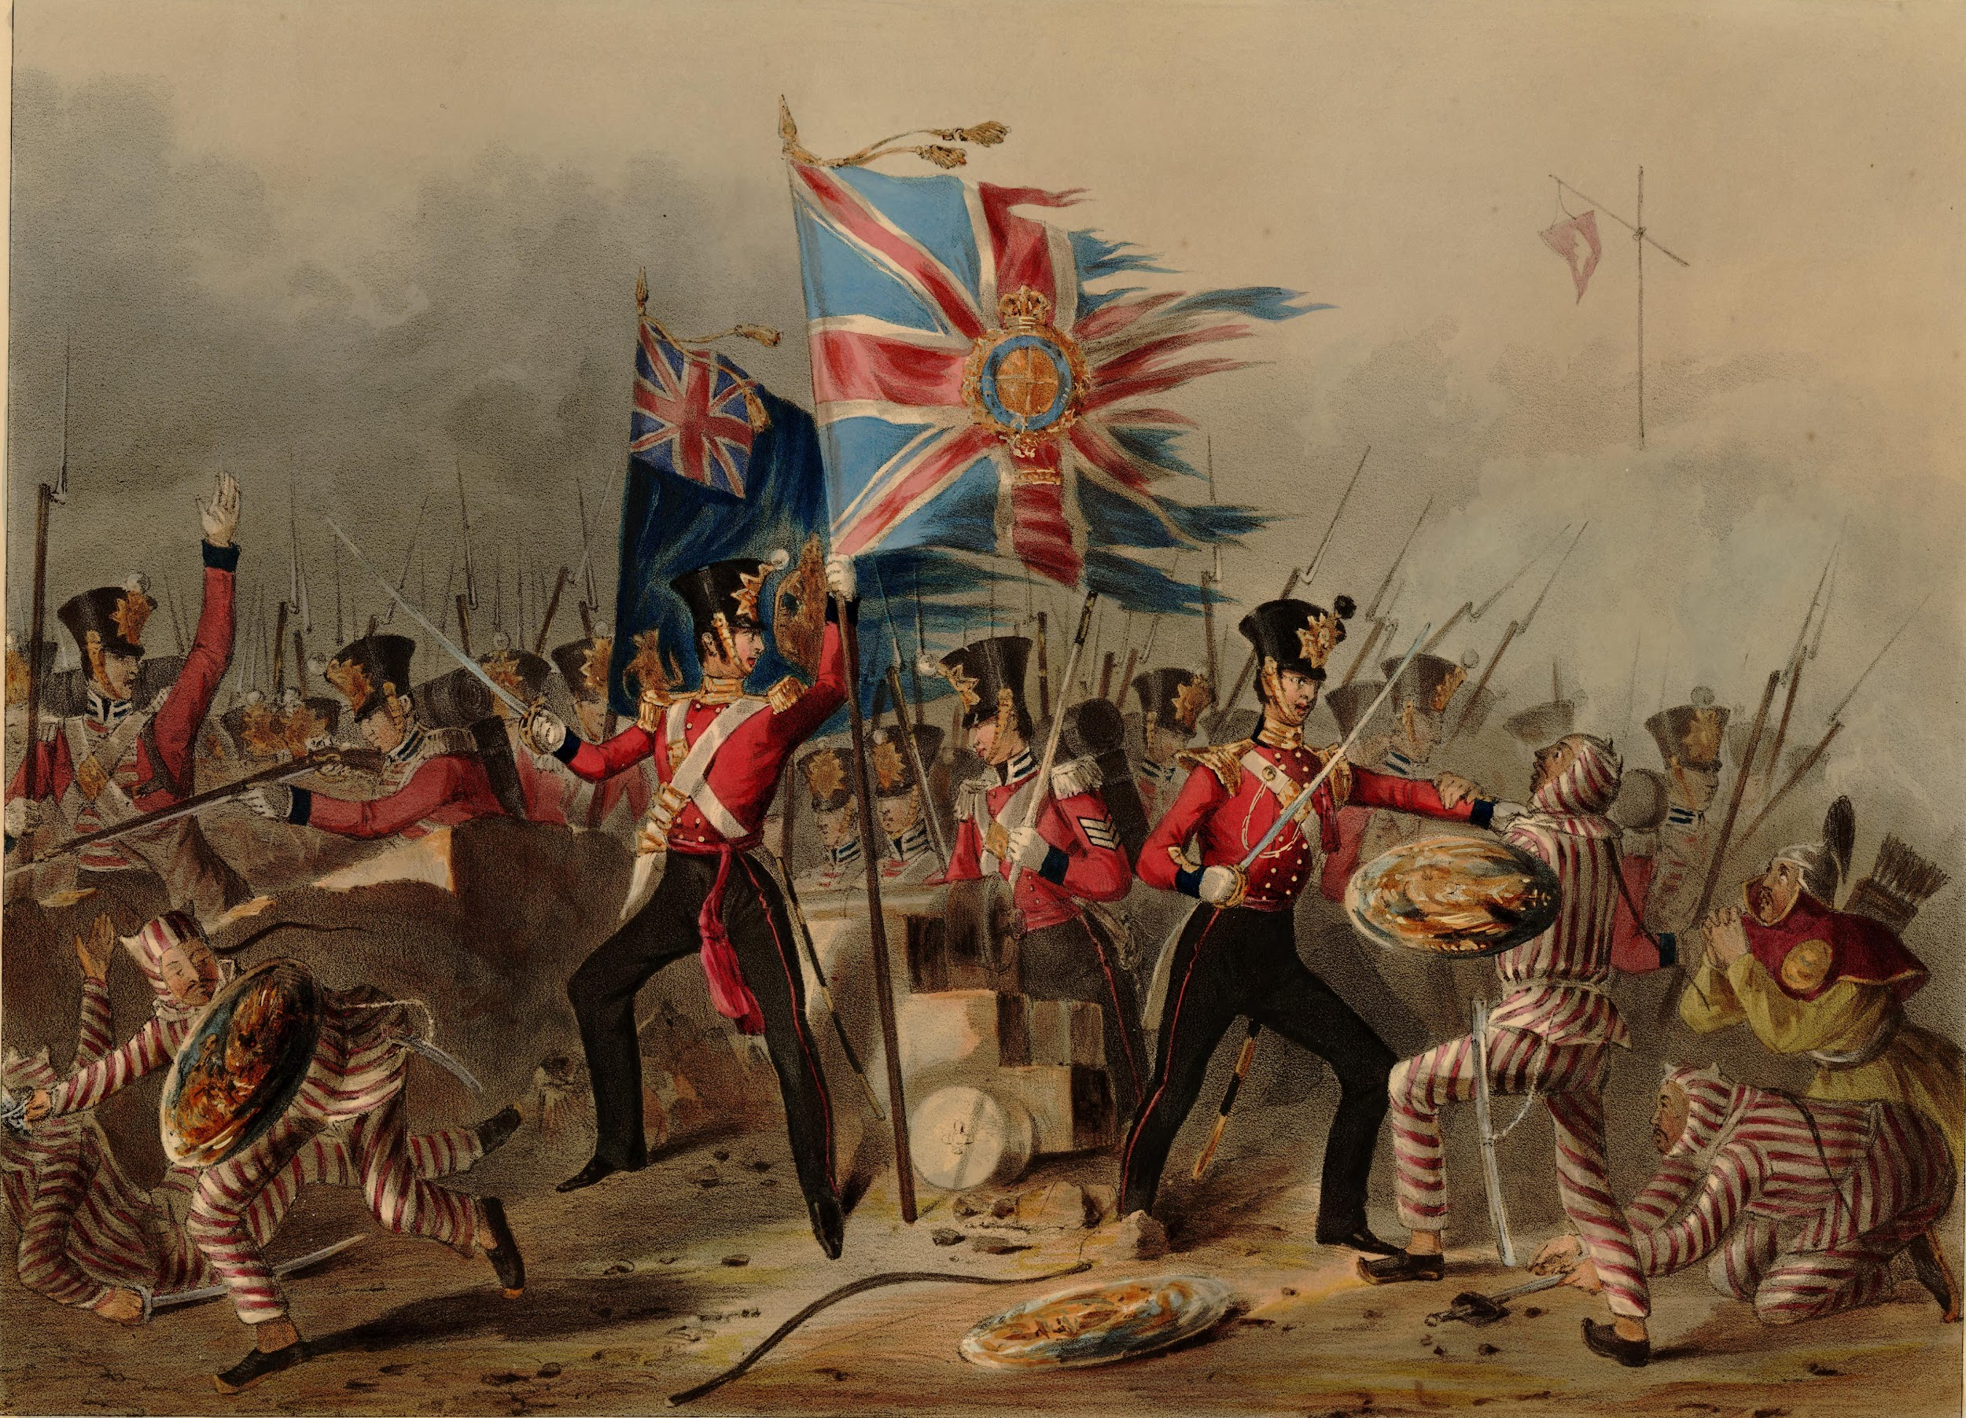
Background
Prelude
At the turn of the 17th century, China was among the world's biggest economies. It is estimated that a third of the worlds silver wound up in the hands of the Chinese.
The British devised strategy to recover their huge trade deficit there and had come about ways of turning this drug, Opium, that previously in the 6th or 7th century, was used by Turkish traders as a oral remedy for pain or a tool of assasination, was now converted into chandu for smoking.
It was sold to private merchants through the East India company due to a ban passed by emperor Yongzheng which was the prohibition of consumption and for Jianqing prohibited the sale and importation.
The new product reached respectively 2000 chest in 1793, 10,000 chest in 1820 and 40,000 chest in 1838 leading to the famous seizure of 1,400 tons of drugs in Canton. This led to the development to the 1838 of the Canton raids and subsequent war. This was the century of humiliation for China.

Slide 8
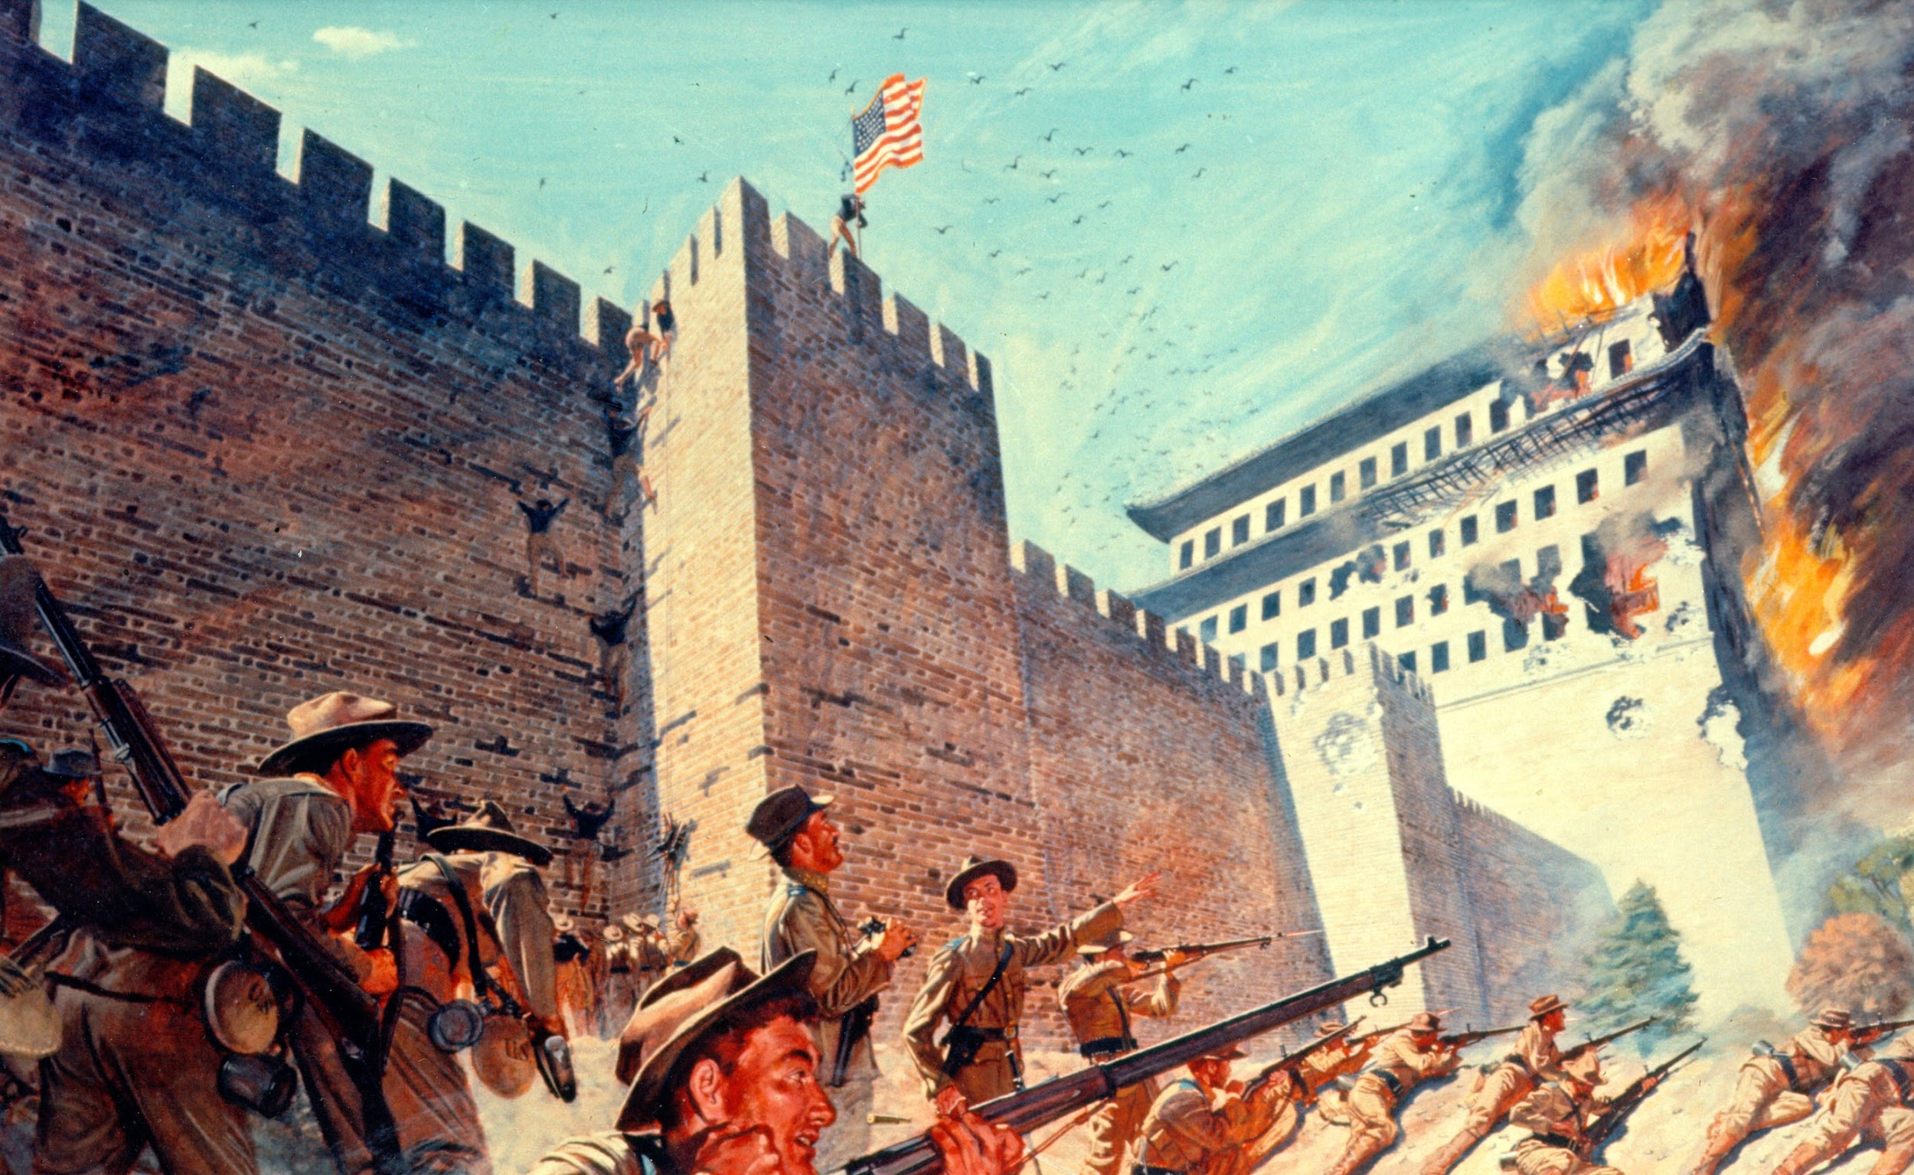
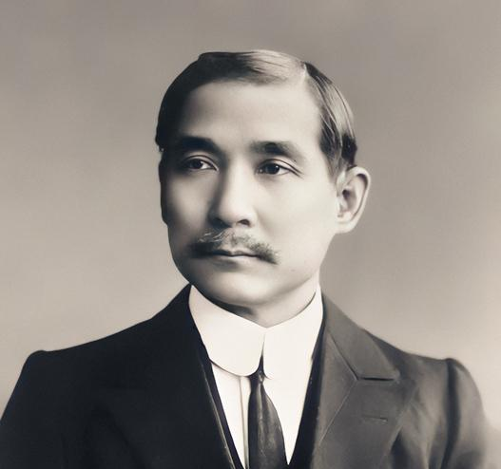
Background
Prelude - Awakening
The much weakened Chinese nation had been opened up to unlimited exploitation as we enter the 1890s. The Boxer Rebellion in 1900 was an uprising against Western, Russian and Japanese imperialism and saw the United States intervene militarily against China for the first major time, just as US imperialism was taking off.
The mounting discontent against the foreigners spawned the first Guangzhou uprising led by Zheng Shiling and Sun Yat Sen, which was smashed by leaks of membership records to the Qing authorities.
While in exile Sun Yat Sen formulated the three popular principles under the then common union. The Chinese took great inspiration from the actions of the Russians writing in the publications of “The People”.
“The revolutionary storm in Russia shook the world like a mighty peal of thunder… Now the whole world knows the strength of the Russian Socialist party, Russia can show us the way in our own revolution”

Slide 9
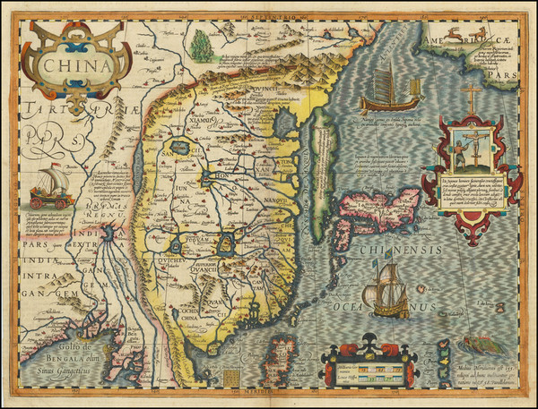
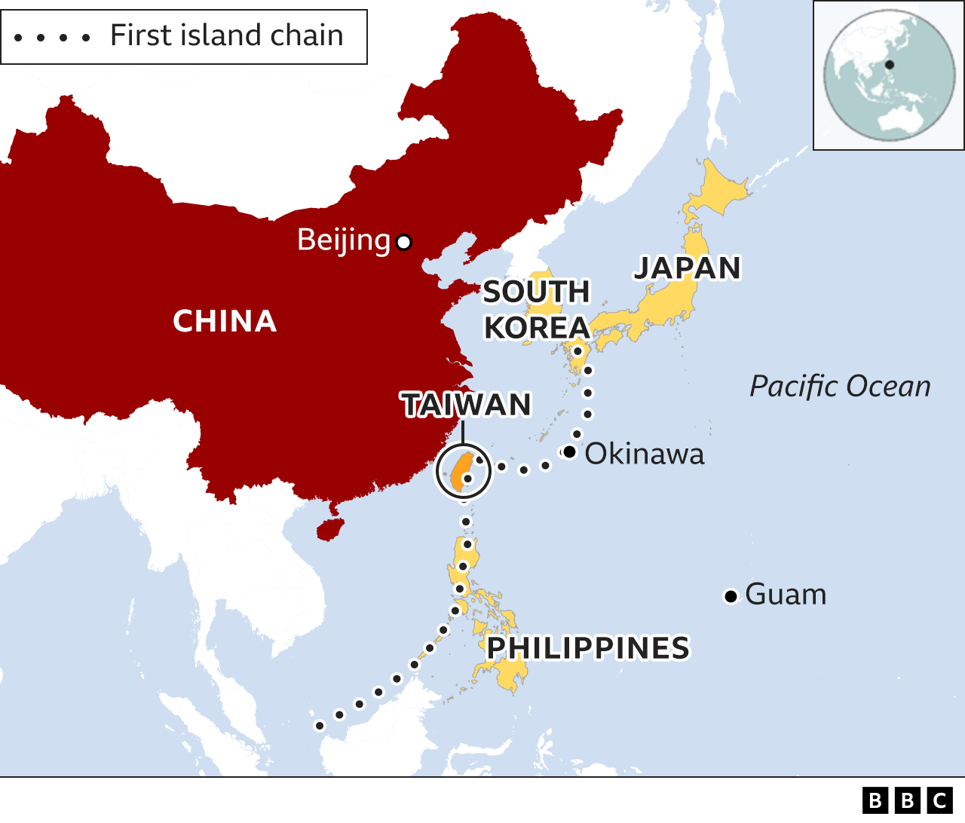
Background 1895-1949
Taiwan or Formosa?
Taïwan is an island in the Western Pacific ocean about the size of the U.S. state of Maryland. It sits 81 miles Southeast of China, and 160 miles north of the Philippines. To the north east is Japan, to the south west is Vietnam. Taïwan is about halfway between both countries.
Around 1540, Portuguese explorers sailed by Taïwan, were struck by its beauty, and named it "Formosa", meaning beautiful. Officially, Chinese gave the island its name of Taïwan around 1680. Thru the centuries both names were used, but Formosa was the primary name used until the late 1960's.
After 1895, Taīwan became a colony of the Japanese Empire. That lasted for 50 years until 1945 when Japan was defeated in WW2. The history of Taïwan in the 20th century is intrinsically linked to the history of the Chinese Revolution.

Slide 10
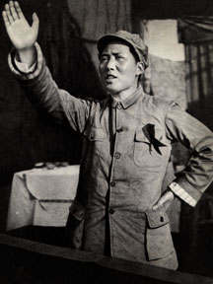
Background 1895-1949
1st Chinese Civil War
The 1st Chinese Revolutionary Civil War began in 1921, when the just founded Communist Party of China began to fight against feudal war lords, side by side with the Kuomintang (KMT), a bourgeois democratic type party.
In 1927 the KMT split into a left leaning wing, friendly to the CPC and an anti-communist wing, led by Chiang Kaī-shek. The right wing of the KMT took over and proceeded to slaughter communists in Shangaī. And so ended the 1st Revolutionary Civil War.
Mao Tsé-tung came up with the brilliant idea of withdrawing to the country side where the CPC was strong, forming a peasant based revolutionary army, and establishing Soviet bases in remote areas of China.

Slide 11
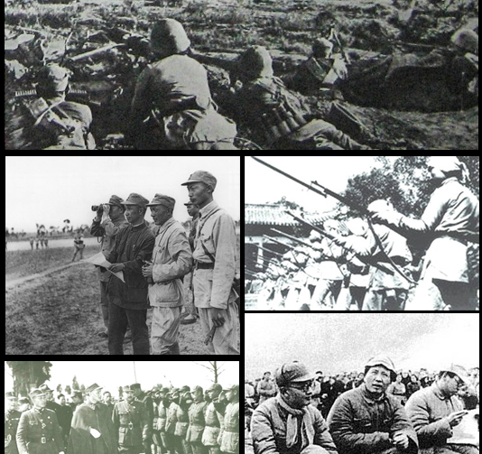
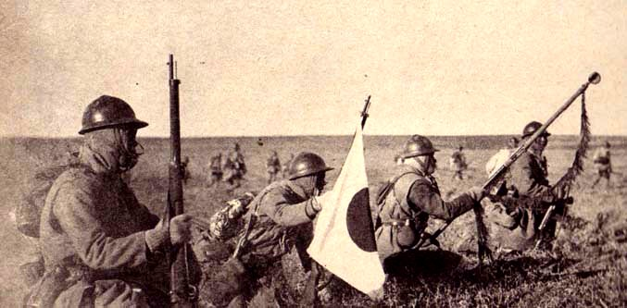
Background 1895-1949
2nd Chinese Civil War & Japanese Invasion
Thus began the 2nd Revolutionary Civil War. It lasted 10 years from 1927 to 1937, and culminated in 1934-35 with the Long March, when 2 Chinese Red Armies embarked on a 12,500Km journey toward the North West of China, by Mongolia and the USSR.
To this day, the Long March remains one of most daring military feats in History. In 1937, imperialist Japan invaded China on a full scale. Decision was made by the CPC, in accordance with the Komintern and its Anti-fascist Popular Front policy, to ally with the KMT and Chiang Kaī-shek.
The 2nd Revolutionary Civil War ended and the War of Resistance to Japanese Aggression began. It lasted 8 years from 1937 to 1945, when Japan was defeated by the United States in alliance with the USSR.

Slide 12
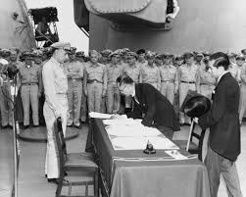
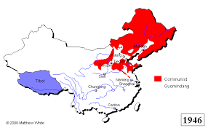
Background 1895-1949
KMT and PLA during and after WW2
Japan surrendered on Sept 2nd, 1945. Under the treaty of surrender, provision was made for the return of Taïwan to the legal government of China, which at the time, was the Republic of China (ROC), led by the Kuomintang and Chiang Kaī-shek.
After the liberation of China from the Japanese yoke, following the advice of Stalin, Mao Tsé-tung attempted peace with the KMT, but that proved impossible.
During the Anti-imperialist war, the Chinese Red Army, now called the People's Liberation Army (PLA), had grown into a formidable force controlling huge swaths of China. The Soviet Red Army provided the PLA with all the weapons it had taken from the Japanese Imperial Army. In the meantime, the U.S. Truman administration proceeded frantically to arm the KMT.

Slide 13
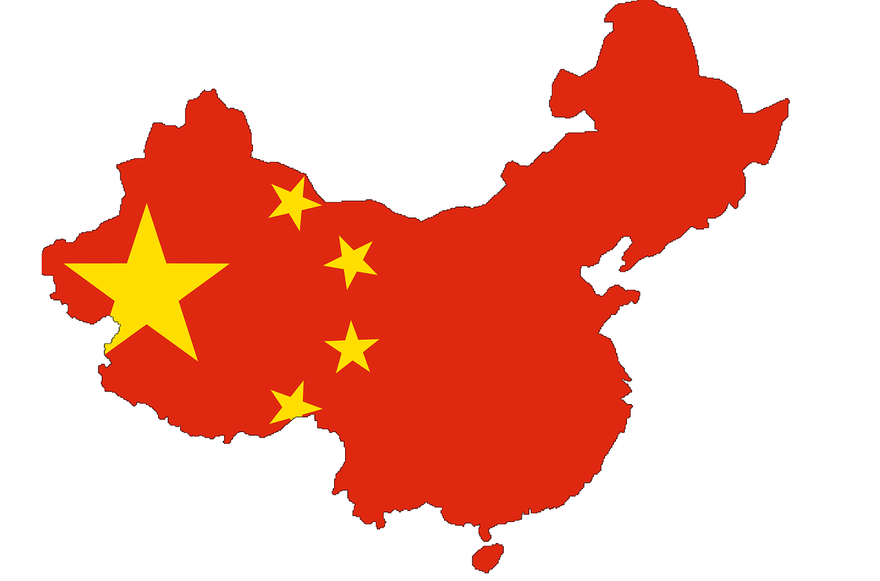
Background 1895-1949
3rd Chinese Civil War
The 3rd Revolutionary Civil War officially began in July 1946, less than a year after Japan's surrender. The PLA, backed by 500M Chinese peasants and workers, went from victory to victory, and vanquished the KMT by the fall of 1949.
The People's Republic of China was proclaimed on October 1st, 1949 and all Chiang Kaī-shek was left with, was Taïwan and the Tibet, plus a few small pockets of China.

Slide 14
Discussion

Slide 15
Historical Background 1949-2010

Slide 16
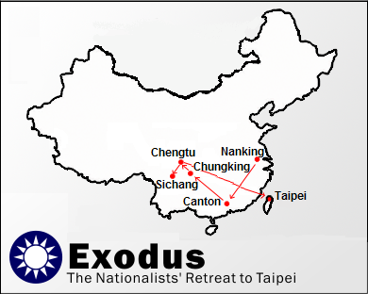
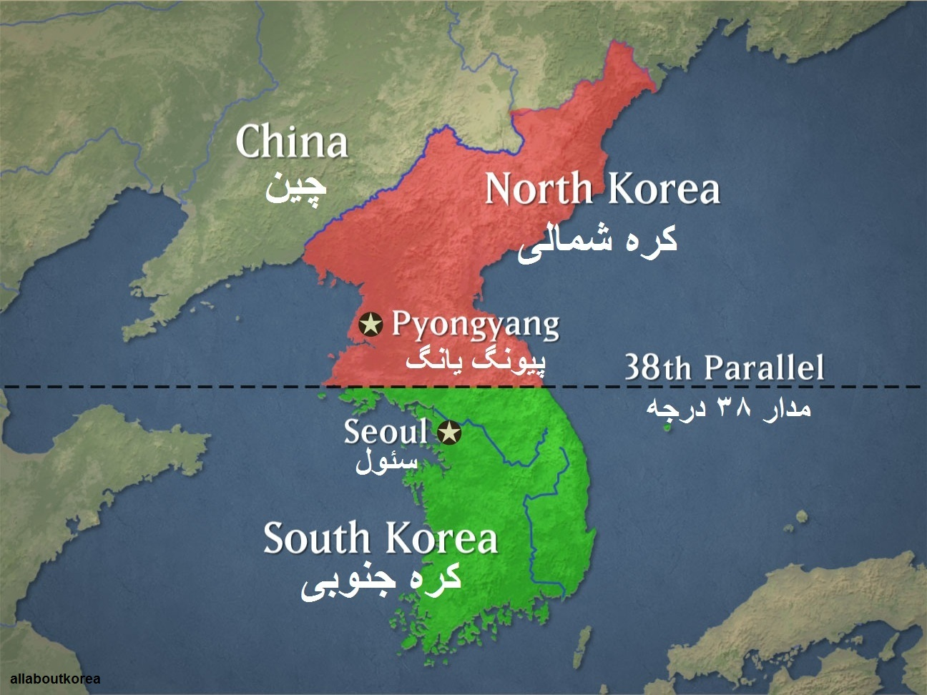
Background 1949-2010
Kuomintang flees to Taiwan
By December 1949, the KMT had withdrawn its forces to the island of Taïwan, around half a million soldiers, followed by 2M civilians.
Beginning in 1950, the PLA prepared for its final battle against the KMT's stronghold of Taïwan. The PLA had no navy in 1950, only sailing ships called junks. It had thousands of junks that would cross the Taïwan Straight and carry troops to liberate the island.
1950 was a year of extreme tensions in South East Asia. In the North East, on the Korean peninsula, the newly created Democratic People's Republic of Korea was facing a puppet régime, armed to the teeth by the U.S.

Slide 17
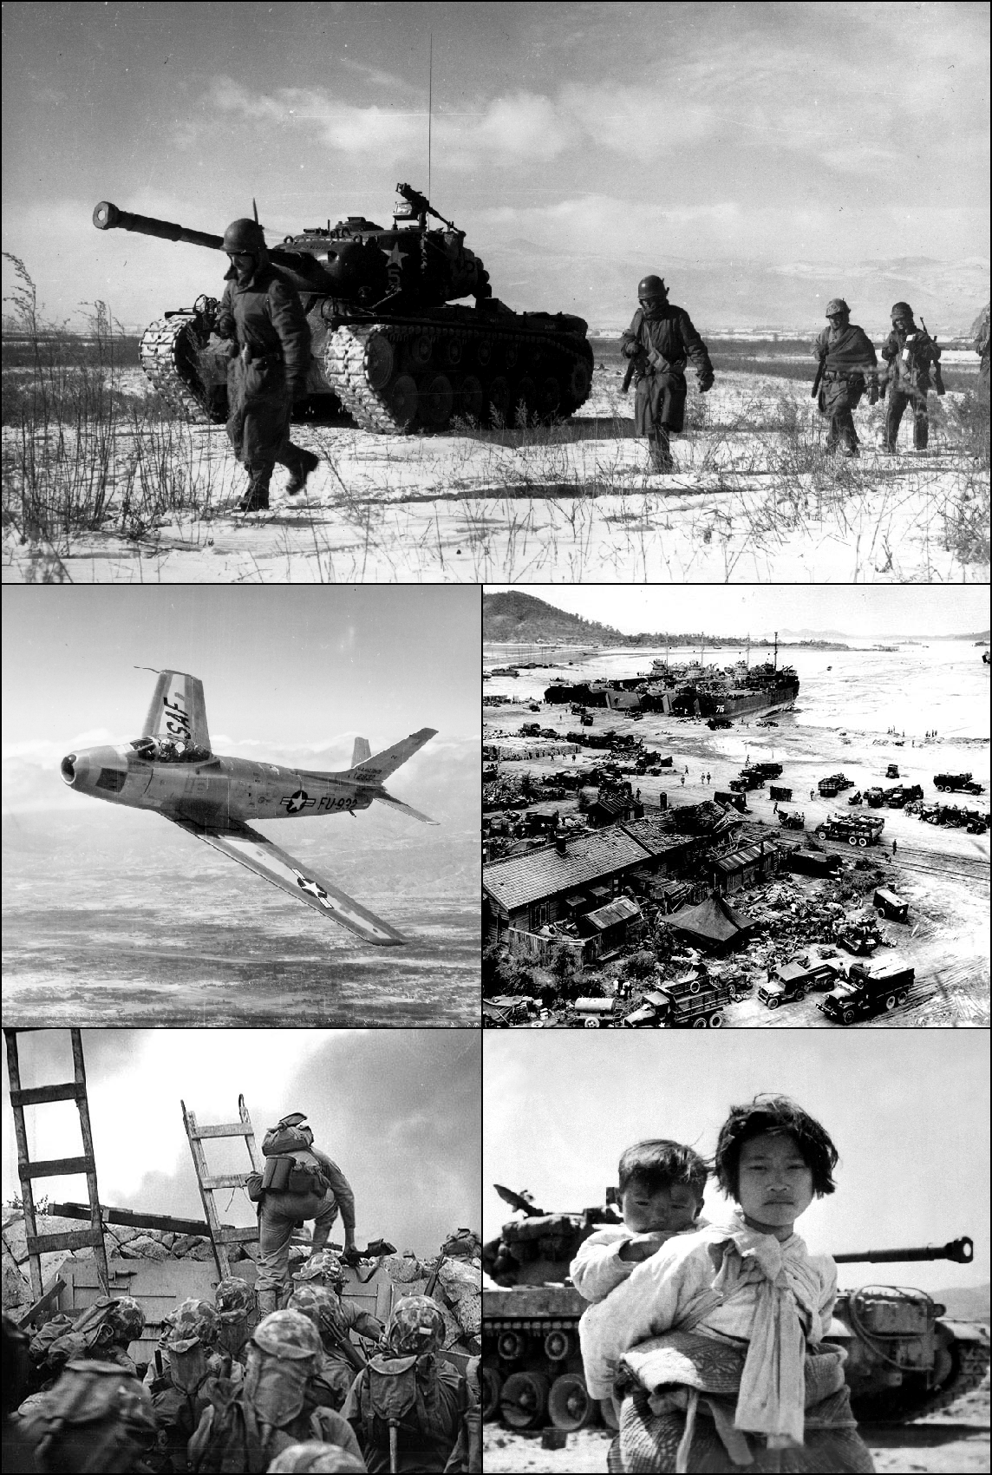
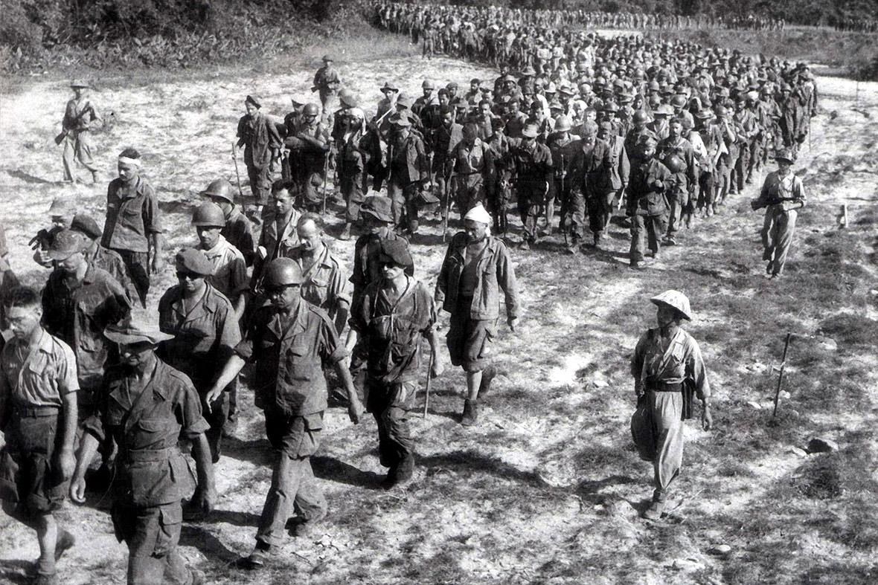
Background 1949-2010
US Aggression on 3 fronts
In the South West, war was raging between French colonialism and the Democratic Republic of Vietnam, led by the Viet Minh. The USSR and the PRC supported revolutionary Vietnam, the U.S. supported colonialist France.
In June 1950, war broke out in Korea between the DPRK and the southern puppet régime. The U.S. immediately hurled its forces against the DPRK, together with other imperialist states, notably the UK, Canada, and Australia.
At the very same time, Truman sent the U.S. 7th Fleet to the Taïwan Straight, to block the PLA's planned liberation of the island. There is nothing PLA's junks could have done against American aircraft carriers, battleships and fighter jets.
The PRC found itself facing the 3 daggers of U.S. imperialism: to its head with Korea, to its belly with Taīwan, to its feet with Vietnam.

Slide 18
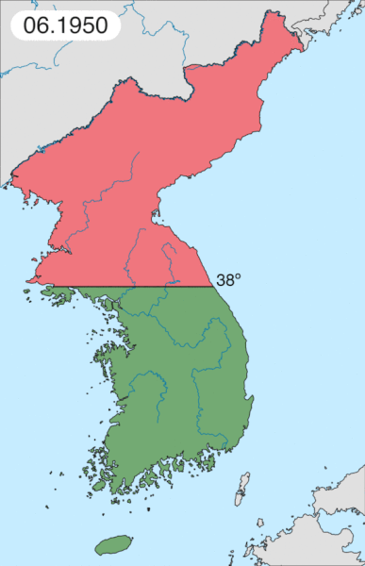
Background 1949-2010
Korean War
In October 1950, merely one year after the Revolution's Victory, Mao Tsé-tung sent 300k PLA soldiers across the Yalu river into North Korea, responding to the requests of Stalin and Kim Il-sung to come to the rescue of the Korean People's Army, that was battling alone the superior war machine of U.S. imperialism.
The Korean war, known in the DPRK as the Fatherland Liberation War, lasted until July 1953, when an armistice was signed, not a peace treaty.

Slide 19
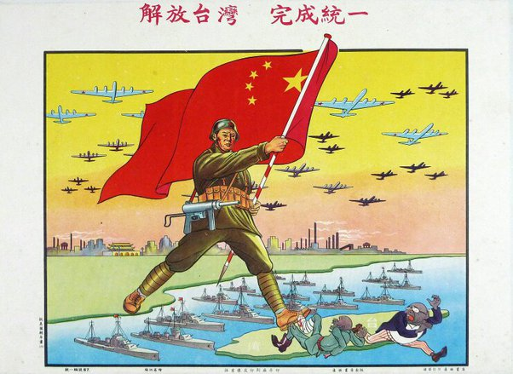
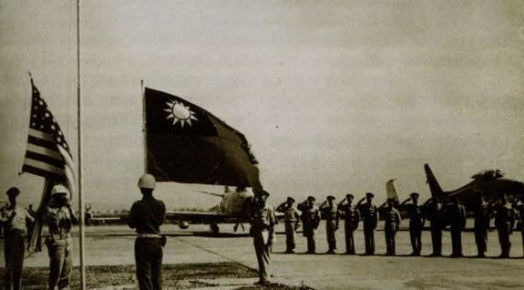
Background 1949-2010
Taiwan Strait Crises
Armed confrontations erupted between the PLA and the KMT's Nationalist Army in 1954-55, known as the 1st Taïwan Strait Crisis.
Then again, 3 years later in August 1958, during the 2nd Taïwan Straight Crisis, a much more serious one, where even the use of nuclear weapons was put on the table by the infamous evil American warmonger, John Foster Dulles. U.S. imperialism began to supply the KMT régime with advanced weapons and Khrushchev warned Eisenhower against starting WW3.
The events of 1958, remembered as the Formosa Crisis, were the last major military clashes to be recorded between the PRC and the Nationalist régime.
Then 13 years later, in 1971, the PRC scored a decisive victory on the political and diplomatic front: for the first time since the Revolution, it was recognized by the United Nation as the sole, legal, representative of China. Chiang Kaī-shek's régime was expelled from the UN.

Slide 20
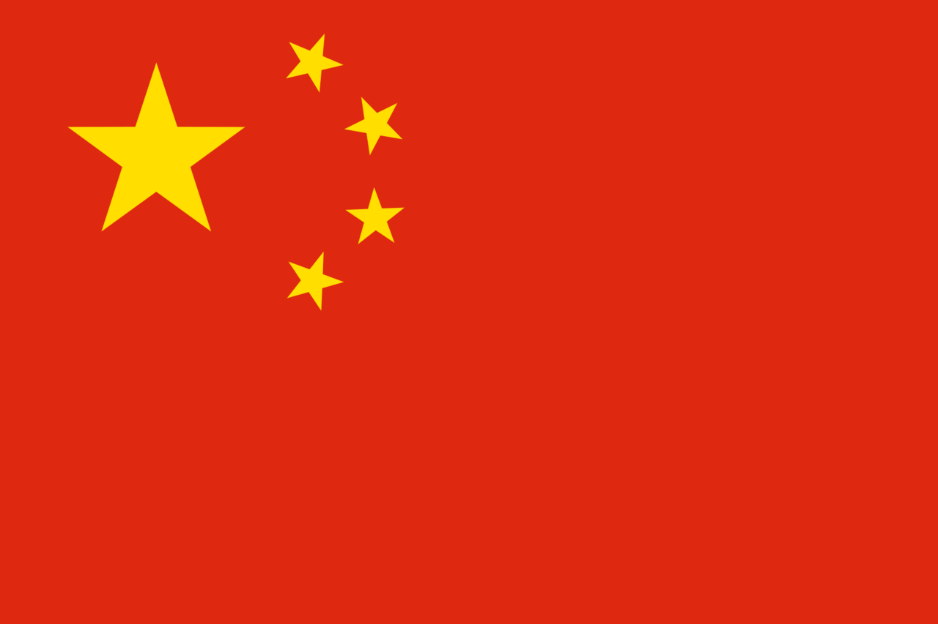
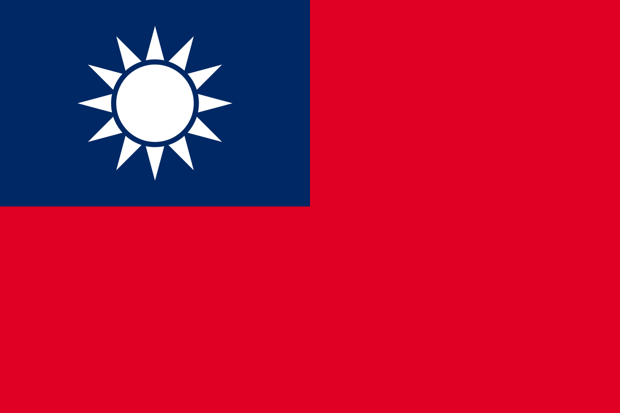
Background 1949-2010
The UN and Two Chinese Governments
It must be noted that ever since its creation after WW2, the UN has a Security Council whose mission is to ensure international peace and security.
The UNSC is composed of 15 members, 5 of which are permanent: the U.S., the UK, France, the USSR (Russia after 1991) and China, the 5 victors of WW2. Naturally, from its founding in 1945 until October 1st, 1949 , that is during the 3rd Revolutionary Civil War, the Republic of China, led by the KMT, was the representative of China.
After the proclamation of the People's Republic of China and the flight of the KMT to the island of Taïwan, there were two Chinese governments. One government controlled 13K square miles of Chinese territory and 8M Chinese people. The other government controlled 3.7M square miles of Chinese territory and 552M Chinese people.

Slide 21
Background 1949-2010
The UN and Two Chinese Governments
According to the UN, a government that controlled 99.99% of the country's surface and 99.98% of its population was not allowed to represent that country in an international body, concerned with peace and security of the entire planet.
It was utter absurdity. For that reason, in January 1950, Stalin decided to boycott the UN Security Council when it refused to recognize the PRC, and give it a seat as permanent member, instead of the ROC. From now on the USSR would no longer participate to the deliberations of the UNSC, as long as the Chinese Nationalists were not unseated.
In June 1950, the USSR was tricked. The UNSC voted for sending troops to Korea and the USSR wasn't present to block the resolution by using its absolute veto power. Therefore, an illegal multinational military intervention in Korea was launched under UN mandate. In August 1950, the USSR returned to the UNSC.
So in 1971, the UN recognized the PRC and expelled the ROC. The "One China" policy was established officially. This was all happening in the middle of a major Chinese-Soviet rift that began about 10 years earlier, mostly apparent after the 22nd congress of the CPSU in 1961, and the Chinese-Indian war of 1962. None of this was lost on the U.S. State Department in the late 60's, especially on Henry Kissinger, Nixon's right hand.

Slide 22
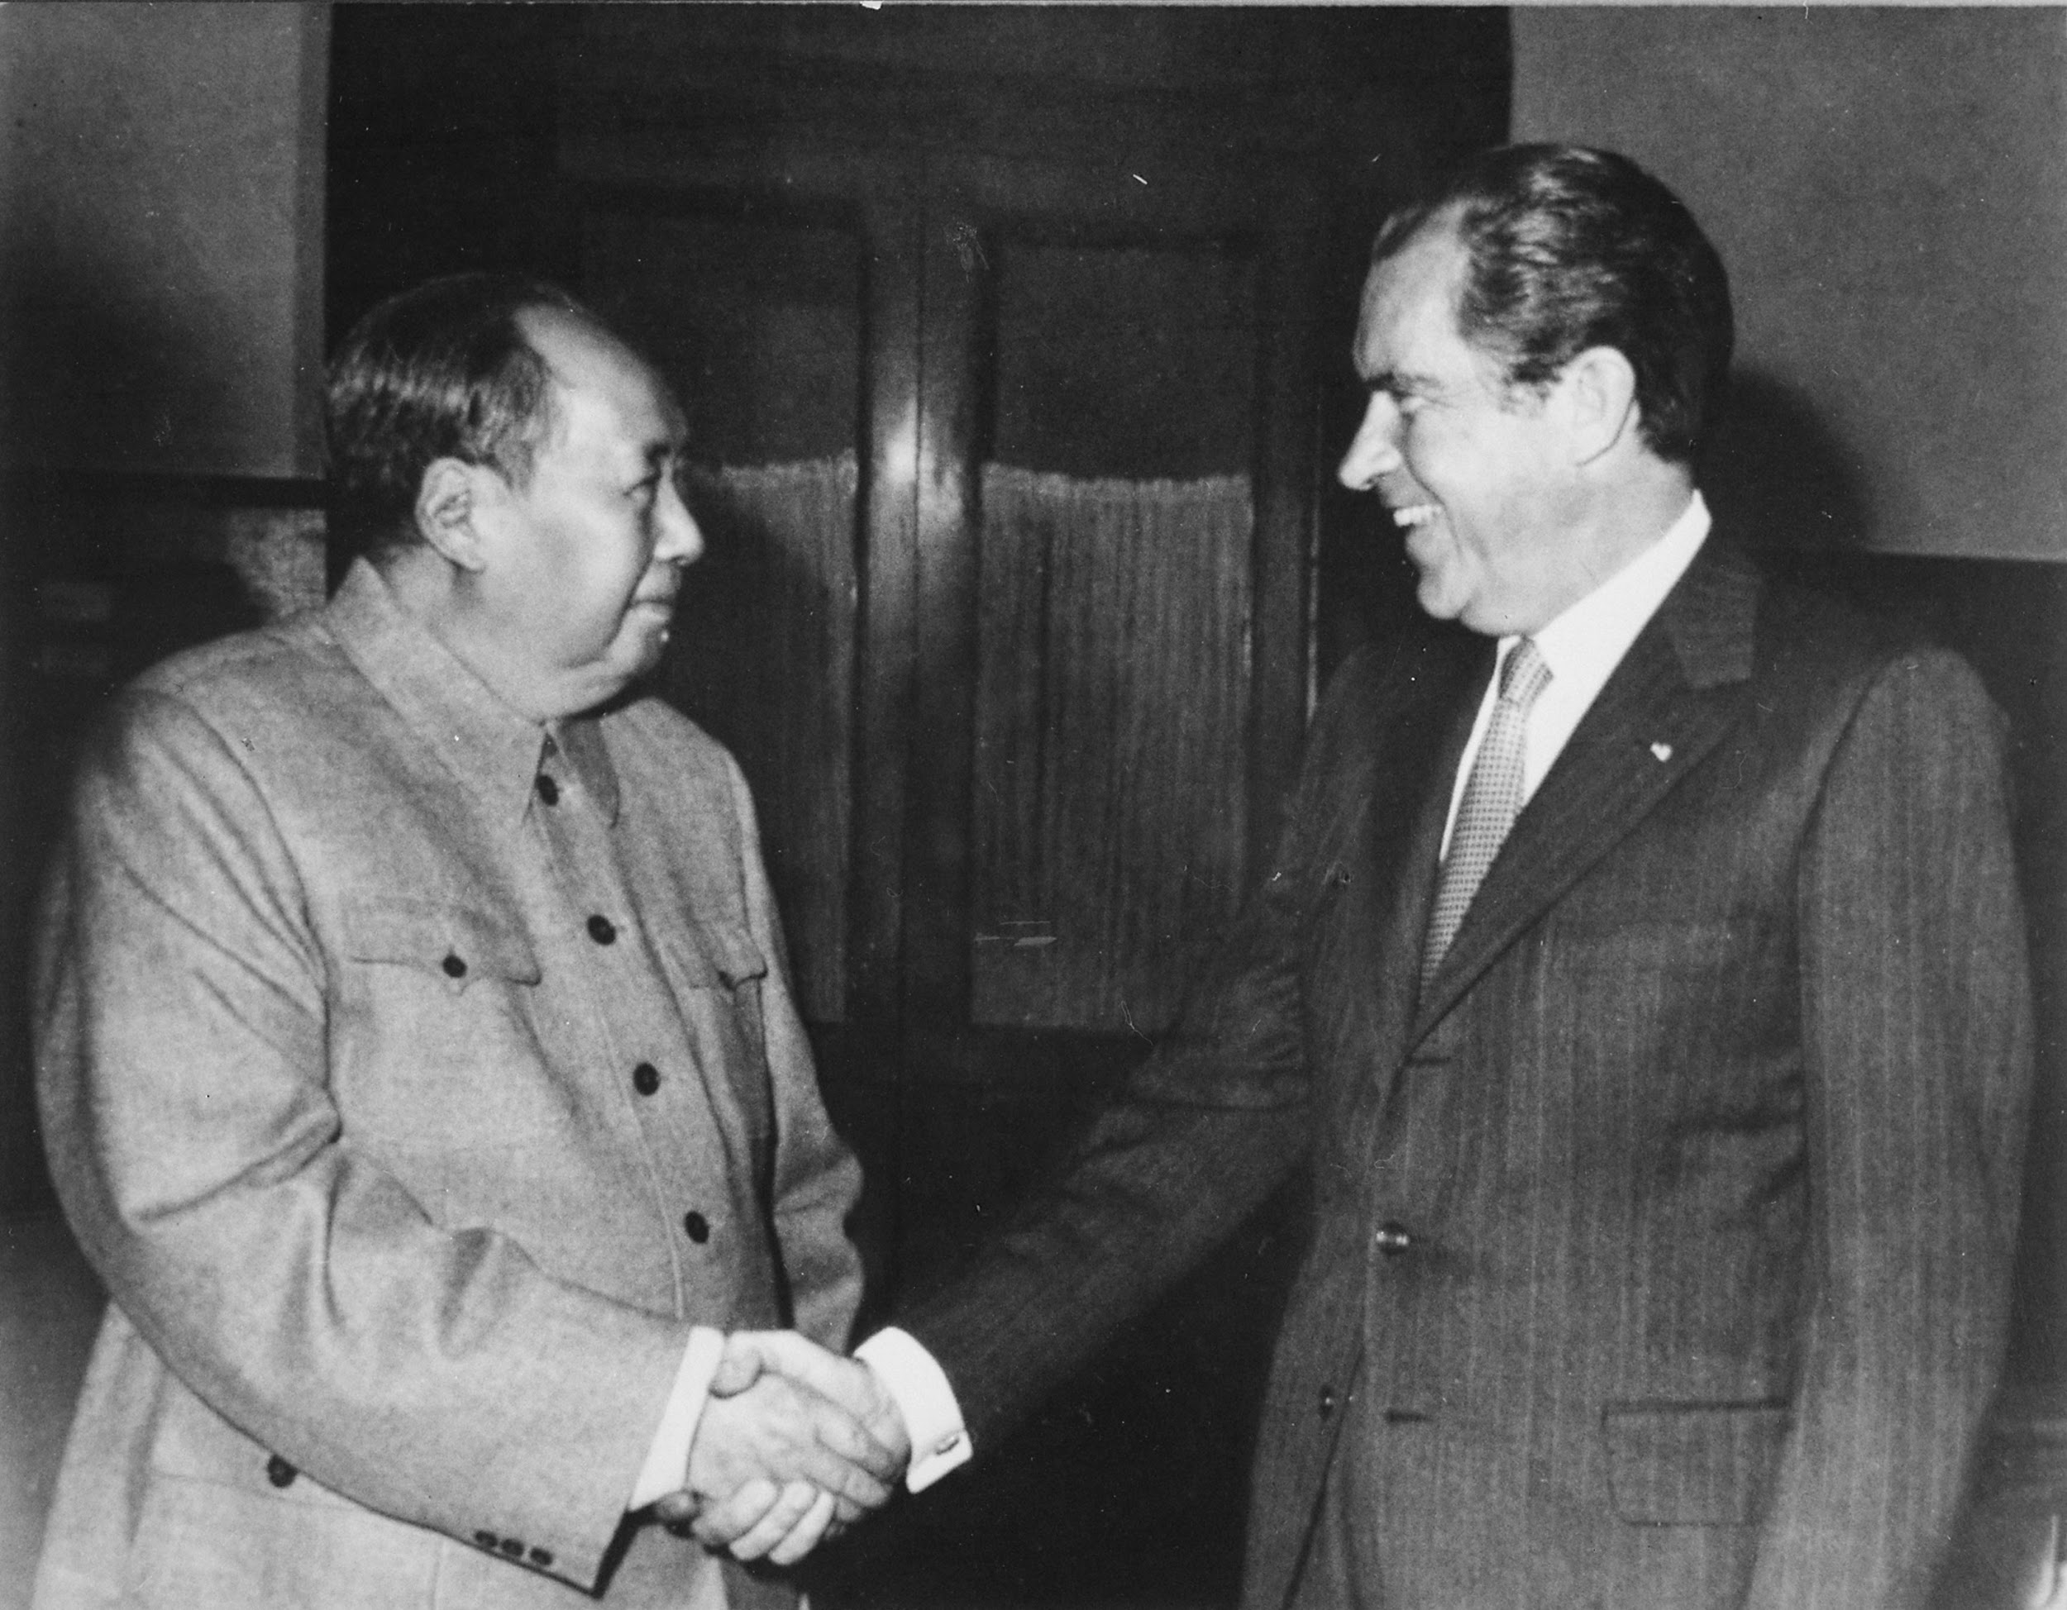
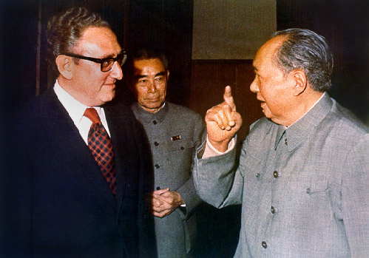
Background 1949-2010
Sino-Soviet Split and US Meddling
The Chinese-Soviet split is one of the main reasons that pushed Kissinger to normalize relations with the PRC, in order to drive a wedge deeper between the 2 socialist giants. In 1972, Nixon went to China and met with Mao Tsé-tung and Chou Enlaï.
Even though the U.S. accepted the PRC's membership into the UN, it still pushed for "2 China" and it wasn't until 1979, under president Carter, that the US officially recognized the PRC as the sole legitimate government of China.
Officially, 1979 marked the end of the "2 China" policy for the U.S. It must be noted that among the Western countries, the U.S. were the last to recognize the PRC except for Ireland and Portugal. Under president De Gaulle, France was the first Western country to recognize the PRC in 1964.

Slide 23
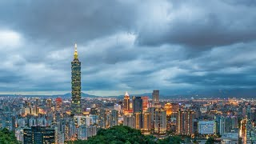
One-China principle and the Taiwan question - CGTN

Slide 24
Discussion and New Member Introductions

Slide 25
New Member Introductions
What is your name, pronouns and state (or country/territory)?
Where do you work? Is it unionized?
How did you find out about the People’s School?
What do you think about tonight's class?

Slide 26
The Present Situation
Building a War

Slide 27
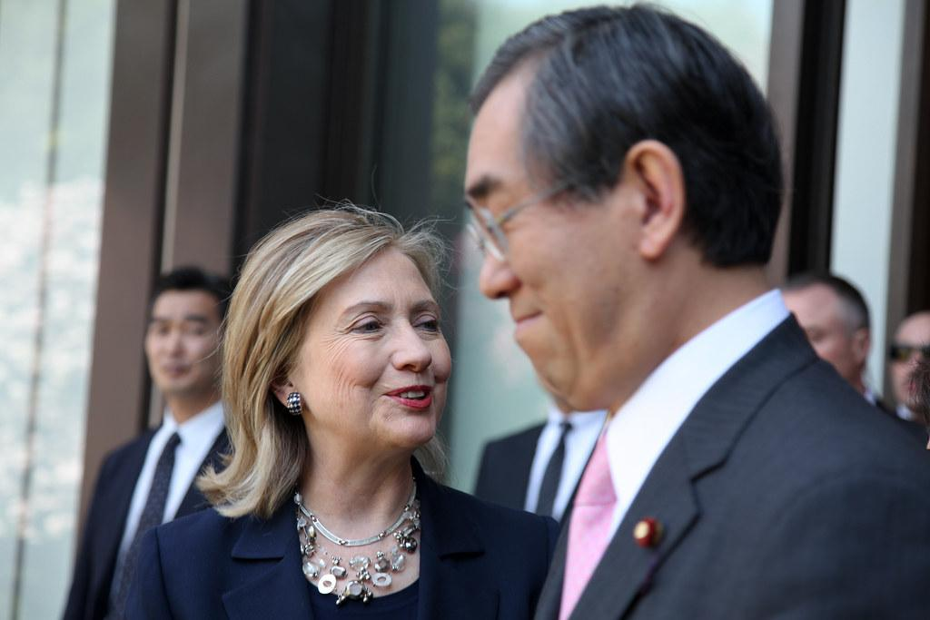
Present Situation
America’s Pacific Pivot
The United States was mostly bogged down in the Middle East, as well as deeply involved with interventions in Latin America, Eastern Europe and Africa at the turn of the 21st Century.
Despite the United States sending most of its manufacturing to the PRC and ending up in billions of dollars in debt to China, the imperialists in the Obama Administration decided in the late 2000’s to begin a “Pacific Pivot”, or a strengthening of forces and relationships with “allies” in the Asia-Pacific region to envelop China, as well as Russia, the DPRK and more.
Neoliberal Hillary Clinton wrote about the pioneering of this policy in October 2011, with a foreignpolicy.com piece entitled “America’s Pacific Century”, which admitted :
“maintaining peace and security across the Asia-Pacific is increasingly crucial to global progress, whether through defending freedom of navigation in the South China Sea, countering the nuclear proliferation efforts of North Korea, or ensuring transparency in the military activities of the region's key players.”

Slide 28
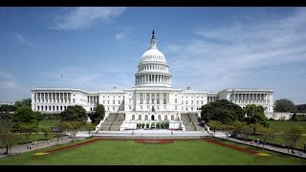
Oliver Stone’s Untold History of the United States - Episode 12

Slide 29
Oliver Stone’s Untold History of the United States - Episode 12

Slide 30
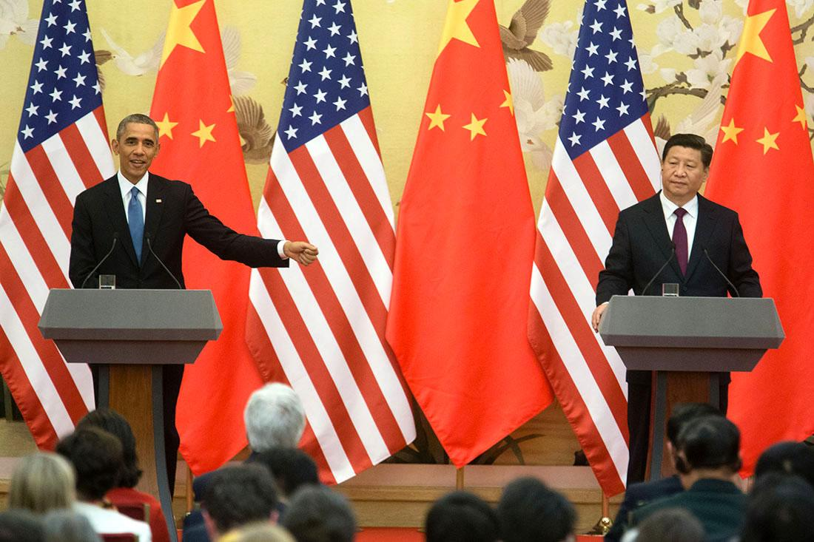
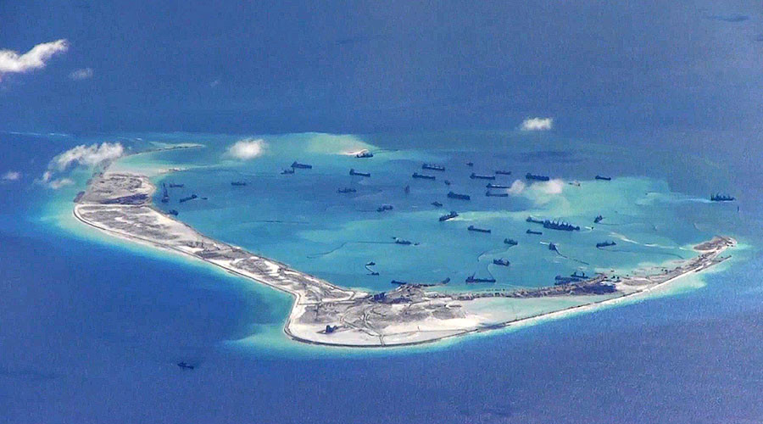
Present Situation
2009-2017 Relations under Obama Admin
The sales of weapons to Taiwan and a meeting between the Dalai Lama and Obama angered the PRC, but they continued to try working diplomatically with the Obama Administration and compromised on a few issues such as putting sanctions on the DPRK.
While the Obama Administration continued to carry out the Pacific Pivot, and militarily and economically build US presence in the Asia Pacific Region, it still stuck to the “One China Policy” and Obama met with Xi Jinping in 2013 in one of the most important summits between an American and Chinese leader since Nixon.
In 2015, the United States warned China to halt any further militarization in the South China Sea after US reconnaissance allegedly found evidence of military buildup on the islands built by China’s land reclamation project.

Slide 31
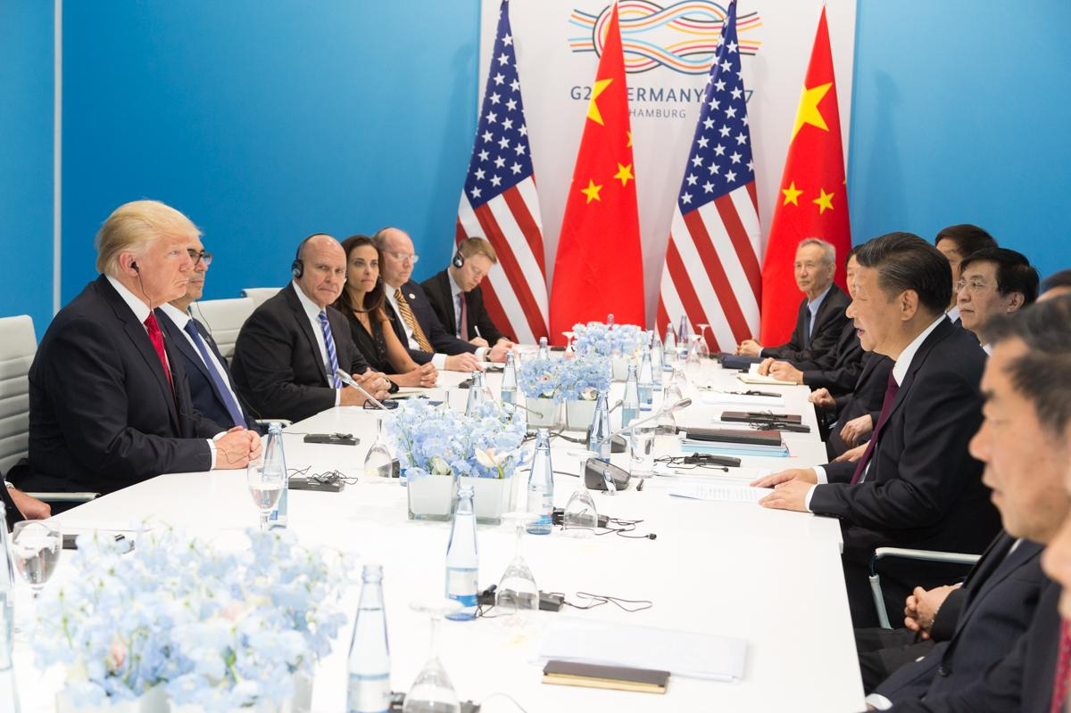
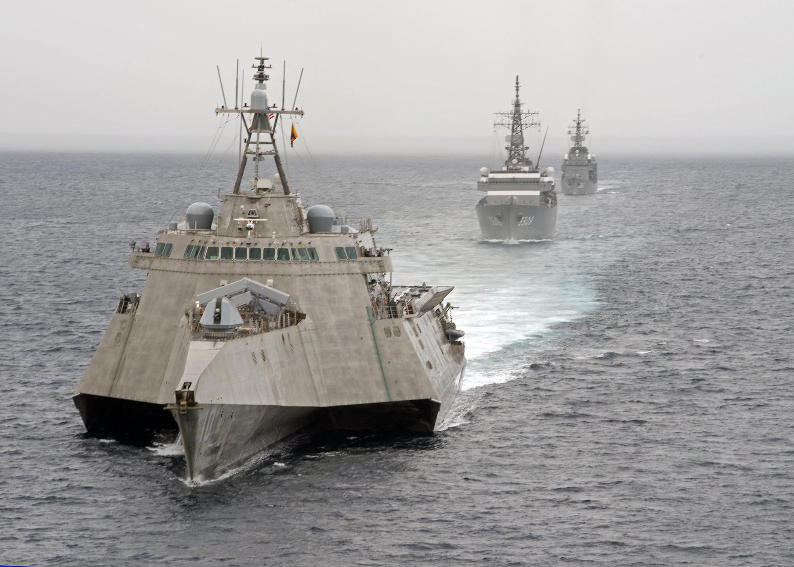
Present Situation
2017-2021 Relations under Trump Admin
Trump’s Administration saw more hawkish and reckless actions against China, first by speaking with Tsai Ing-Wen, the then leader of Taiwan, as president-elect before ever speaking with Xi Jinping, and then questioning the One China Policy.
Trump later reassured the PRC about his support for the One China Policy, but as his administration went on:
Chinese businessman were arrested in the United States (Huawei executives)
Chinese-made drones were removed from service in the US
1.8 Million Dollars were given to Taiwan in military aid
A massive media campaign in support of “Hong Kong Protests” occurred
Lies about a “Uyghur Genocide” were spread
Military drills near China and People’s Korea were continued.
The Coronavirus pandemic gave way for more manufacturing consent against China, as claims about a “Chinese Lab Leak” were spread by Western Media and the PRC was blamed for the worldwide pandemic.

Slide 32
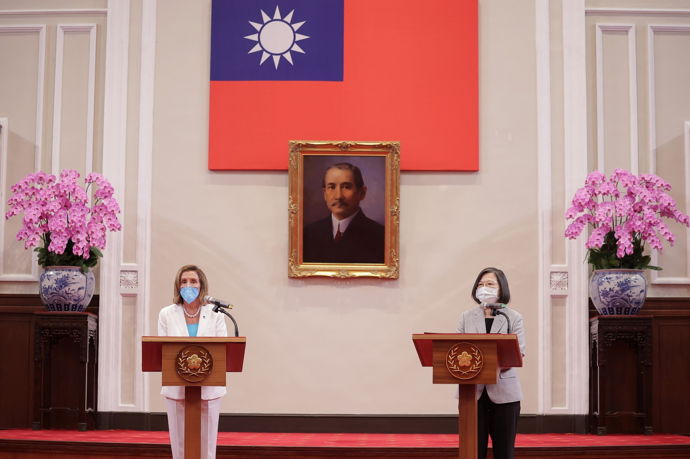
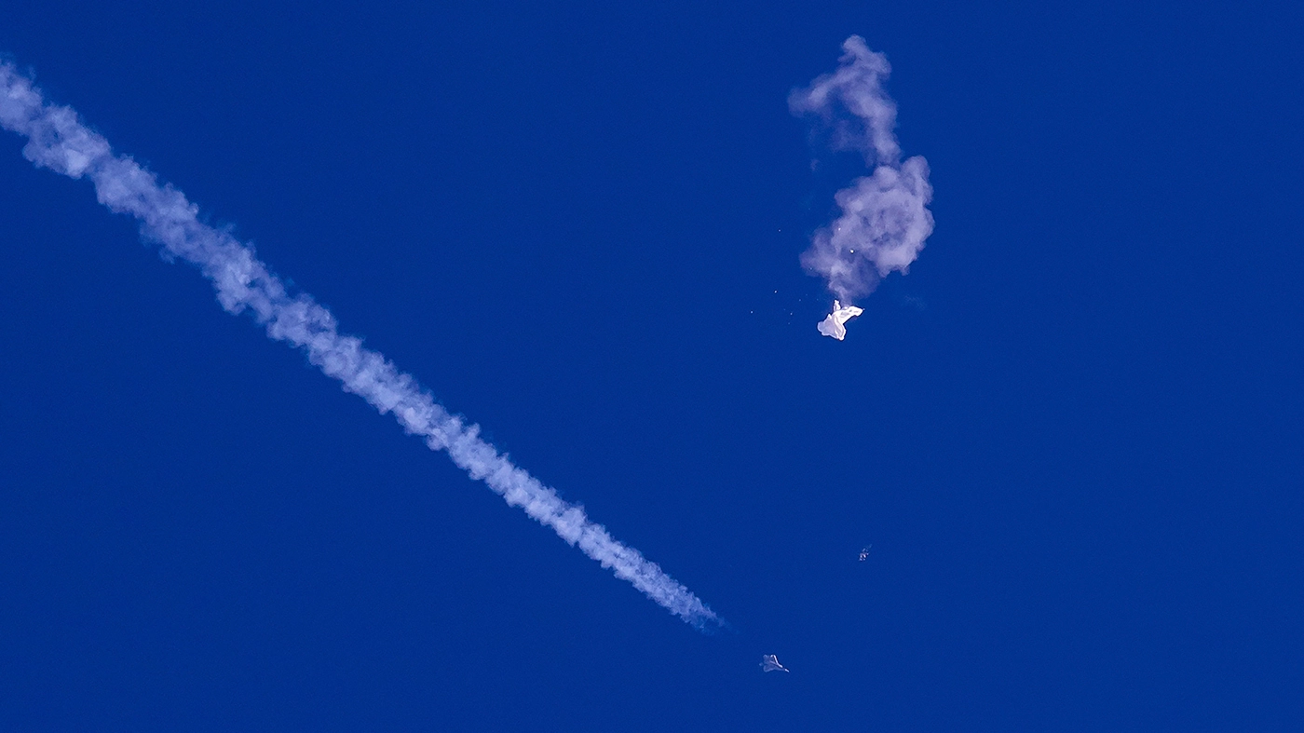
Present Situation
2021-Present Relations under Biden Admin
The Biden Administration has seen the most reckless actions towards China of the United States so far. The People’s Republic of China and the United States have had more incidents with each other militarily by ever before and since the start of the Russo-Ukrainian War, US officials have been much bolder about threats of war with China, even threatening a Third World War
In July 2022, Nancy Pelosi went and met with Tsai Ing-Wen in Taiwan, which was condemned by China and even unpopular among the islands residents. As a result, China severed all engagement with activities that were being worked on with the United States. Since, China has attempted encircling Taiwan in drills and the United States has sent the Pacific Fleet in between the island and mainland multiple times.
Other major incidents include the February 2023 shootdown of a Chinese weather balloon called the “Chinese Spy Balloon” by a US F-22 Raptor after it flew across the continental United States. More recently, US and Chinese Naval Ships nearly collided in the South China Sea as tensions escalate.

Slide 33
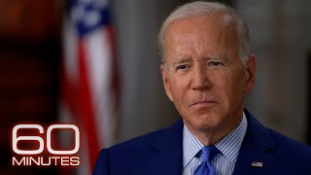
Biden stating US Troops will be Deployed to Taiwan in Case of Chinese Invasion

Slide 34
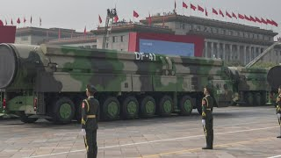
US Air Force General Predicting War with China by 2025

Slide 35
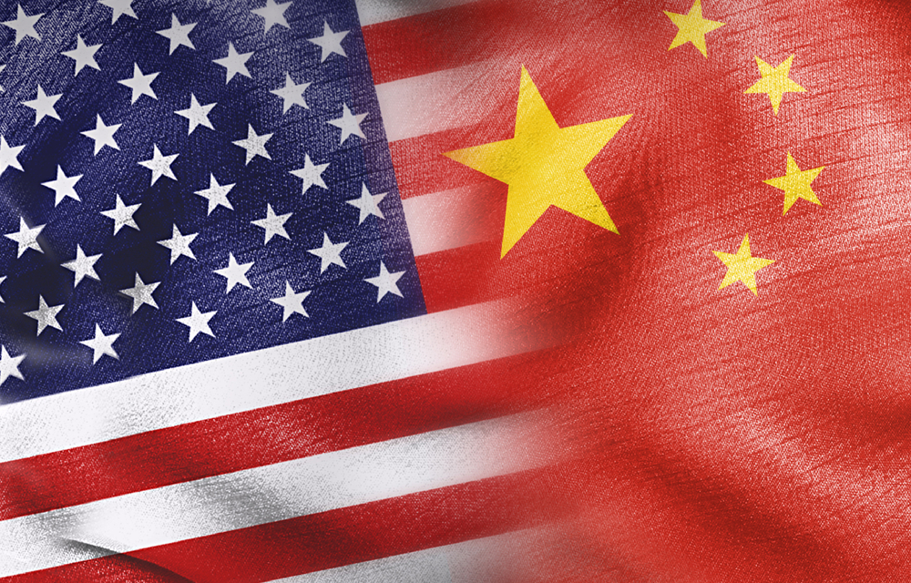
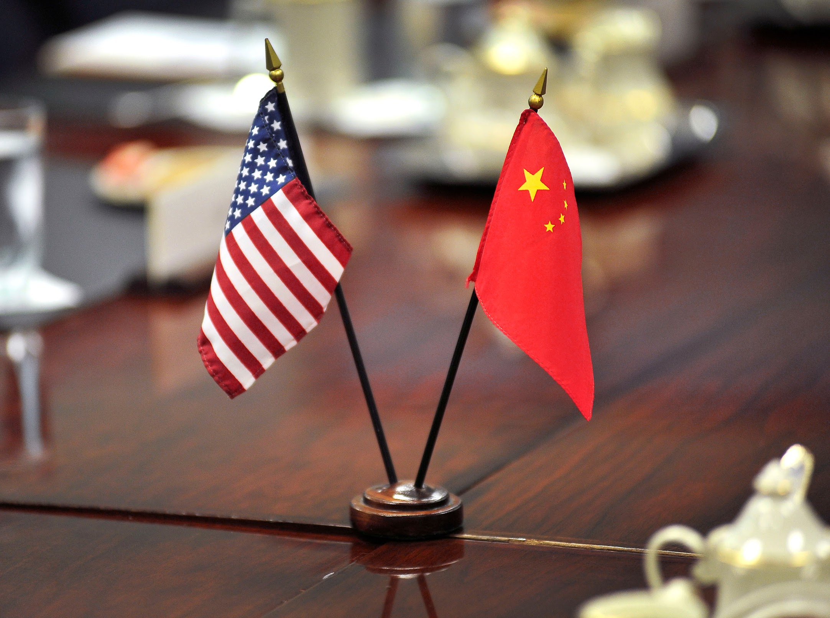
Present Situation
What can happen from here
The United States and People’s Republic of China are the closest to war that they’ve been since the Korean War. The United States is being more provocative than ever before in the Asia Pacific Region, diplomatic relations are falling through and regional adversaries of China such as Japan and South Korea are militarizing themselves like never before too.
The United States and People’s Republic of China could go to war any day at this point with all this escalation, but peaceful reunification with Taiwan and cooling of relations with the United States is also just as likely. The latter is most ideal.
China also still owns over a 1 trillion dollars of the United States debt that it could call in, which could wreck the US economy like never before and this could be enough to make the United States hesitant to act militarily. The United States would also undoubtedly end up in more debt if it fought a war on two fronts: against Russia in Ukraine and China in the Pacific.
We must stand with the PRC against American Imperialism at all costs, and strive for a peaceful solution to this crisis.
Stop WW3! Stop NATO! End the Sanctions and Drills! Stand with China!

Slide 36
Discussion

Slide 37
Announcements
The PCUSA Arts and Culture Commission is looking for content submissions for Vol III 2023 of New Masses! Send any submissions to info@partyofcommunistsusa.net and kamryns@johnreedcenter.net
The PCUSA Women’s Commission is preparing a webinar for children and families this November, and could use any assistance w/ the event.
LUEL has started the Harry Bridges School of Labor! Their classes are Saturday at 7 pm EST/4 pm PST.

Slide 38
Volunteers Needed!
We are in need of volunteers for the staff of the People’s School! Here’s a few roles we need filled:
People to help manage posting on our social media and podcast platforms
Video Editors, Audio Editors, Graphic Designers, Artists, Narrators
Facilitators, Web Controls, Moderators
Email info@peoplesschool.us if you’re interested and try to attend our next staff meeting on July 6th if possible.

Slide 39
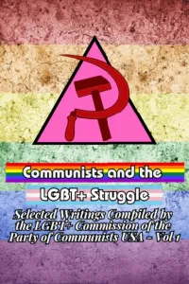
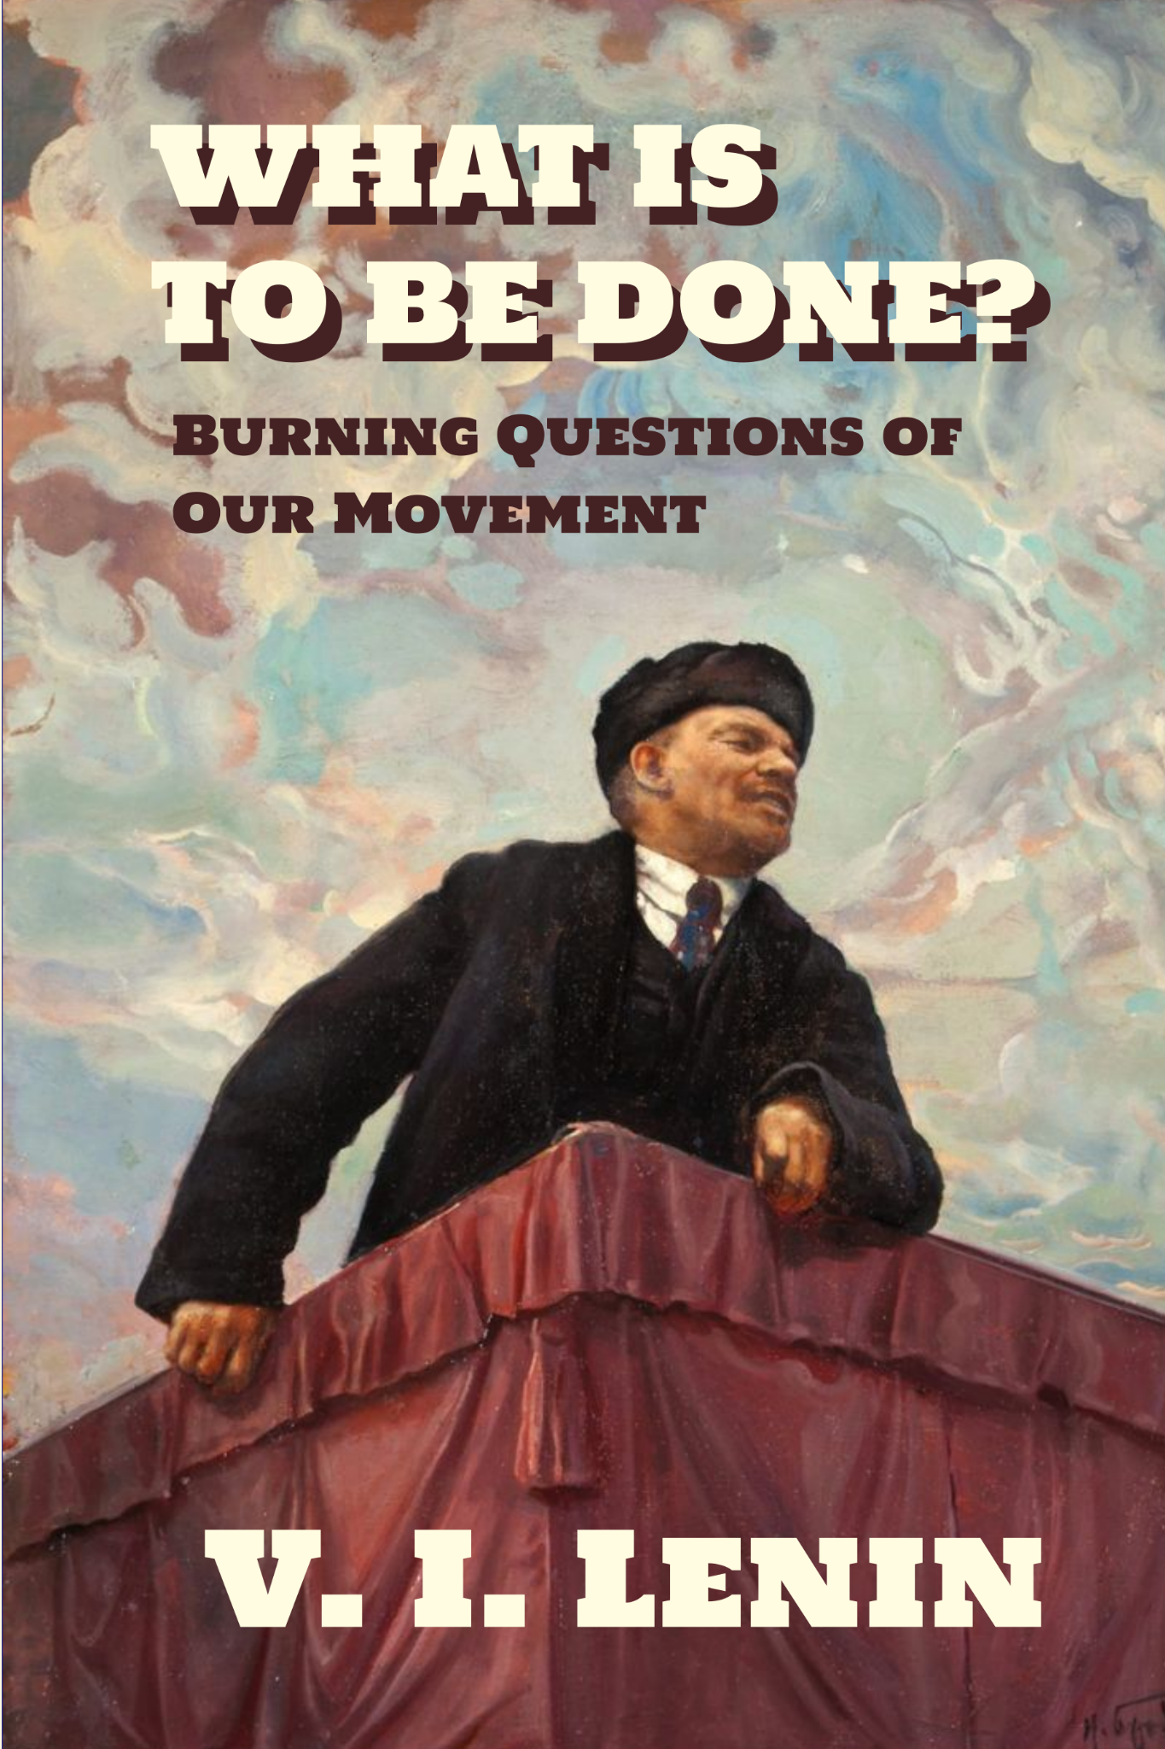
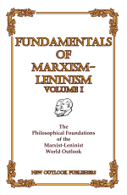
New Outlook Publishers
newoutlookpublishers.store
Latest Releases

Slide 40
Legal Drive
Last year we were attacked and sabotaged by wreckers that tried to steal the PSMLS and destroy the PCUSA.
They failed, but they will be held accountable and there are still things they took from us that we’ve not got back, like videos, imagery and audio. That is why we still need donations to the legal drive.
To donate, go to partyofcommunistsusa.net/donations/
Put “For legal funds” in the details box and try to donate on Tuesday or Thursday so it is easier for us to sort through. It will go to the legal fund. Anything helps!

Slide 41
March of the Volunteers - Anthem of the People’s Republic of China

