Slide 1
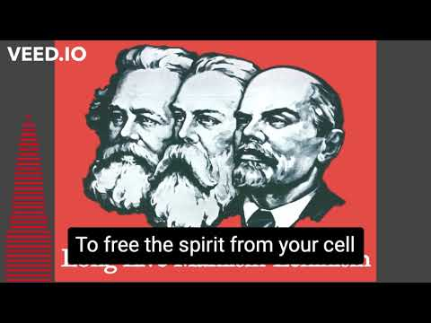
The Internationale - 1933 American Version by “The New Singers”

Slide 2
https://us06web.zoom.us/meeting/82457251871
PSMLS 06/13/23 - 06/15/23

Slide 3
What we’ll be learning today:
Anti-Soviet and McCarthy Era “Red Scare” that led to the Rosenberg’s arrest and trial.
Who were the Ethel and Julius Rosenbergs, their trial, and their execution by Washington.
The implications of the trial and the struggle to reopen the case.

Slide 4
The Atom Bomb Hoax and the start of the Cold War

Slide 5
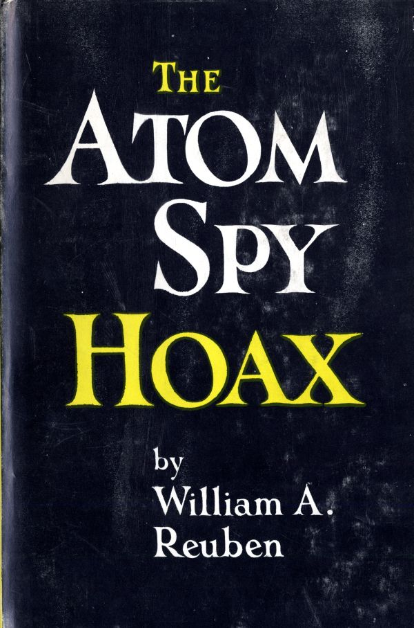
This Section will be taken from this book
From The Atomic Bomb Hoax by William A. Reuben
At a few minutes past eight o'clock on Monday morning, August 6, 1945, the greatest single act of destruction in history took place, with the explosion of the atom bomb over Hiroshima.
The scientists who had created the bomb all agreed on four things.
There was no "secret" of the atom bomb.
Other countries would be able to manufacture the bomb independently, probably within three to five years.
It was impossible to develop defenses for atomic warfare.
Therefore, it was mandatory to establish conditions under which cooperation, not rivalry, in atomic power would prevail.

Slide 6
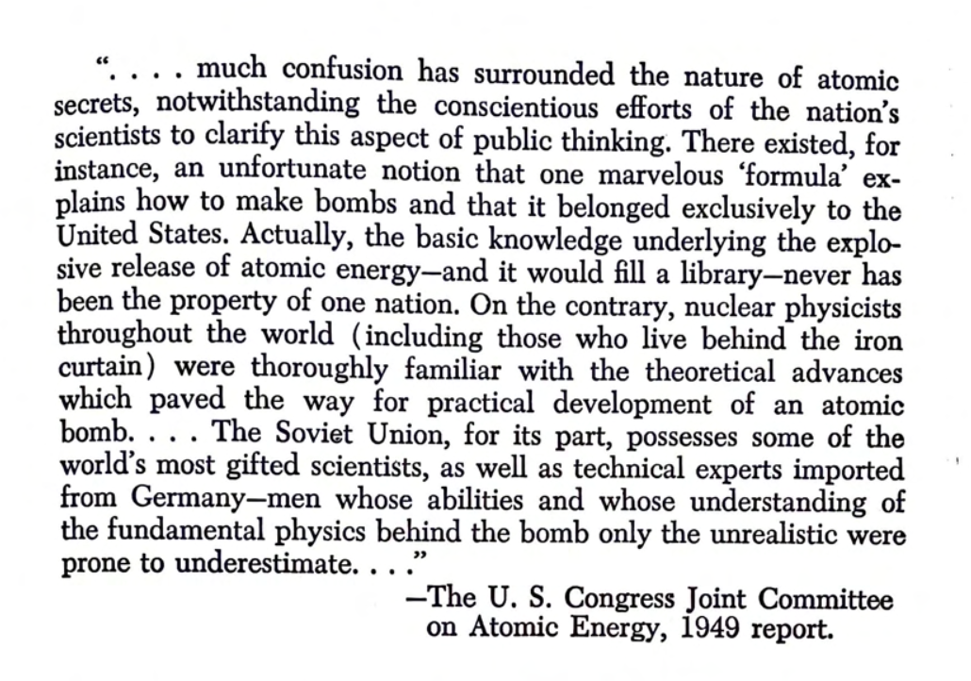
Not just the scientific community was saying this but congress as well.
The entire American press (in 1945) was virtually in unanimous agreement that there was no "secret” to the bomb. Practically all information media agreed with the scientists, and government officials that science, industrial capacity and "know-how" were the only elements needed to smash the atom for destructive as well as useful purposes; that the Soviet Union would develop the atom bomb in three to five years.

Slide 7
The Communist Hysteria and the House of Un-American Activities
The year 1948 was as crucial as any other in United States history. It meant that, finally, after almost four years, the American people would have a chance to register, formally, at the polls, their satisfaction or dissatisfaction with the interpretation Harry S. Truman had placed upon Franklin D Roosevelt's policies. It meant that they would be able to indicate whether they found the Fair Deal an adequate substitute for the New Deal they had voted for in 1944. It meant much more, too, for with the formation of a third party, the Progressive Party with former Vice President Henry Wallace running for president, the American people could express themselves as supporting the policies of a political party which contended that peaceful co-existence between the United States and the Soviet Union was possible.
But above all what it meant-the real threat represented by the Progressive Party was that, for the first time since Roosevelt's death, the American people would have a chance to register, by their votes, a protest to the Cold War.
The year 1948 wrought many changes in American life. The Un-American Activities Committee was more responsible than any other government agency for these attempts to transform the traditional American concepts of government. The Committee had already accused Dr. Edward Condon, and the first American by the Committee to be accused as an “atom spy.” But 1948 was an election year, the charges on Dr. Condon were modified to fit the formation.
The New York Times for March 1, shows how the a-bomb spy hunt first began to be used for political partisan interests:
''A House subcommittee on Un-American Activities denounced Dr. Edward U. Condon, head of the National Bureau of Standards, as ‘one of the weakest links in our atomic security’ and an associate ‘knowingly or unknowingly of alleged Soviet espionage agents.’ He had been closely connected with development of the atomic bomb. Dr. Condon, the subcommittee said was recommended for the directorship of the Bureau of Standards by Henry A. Wallace.
“The subcommittee said: We further recommend that the full committee address a communication to the President of the United States calling his attention to the fact that the situation as regards Dr. Condon is not an isolated one, but that there are other government officials in strategic positions who are playmg Stalin's game to the detriment of the United States."

Slide 8
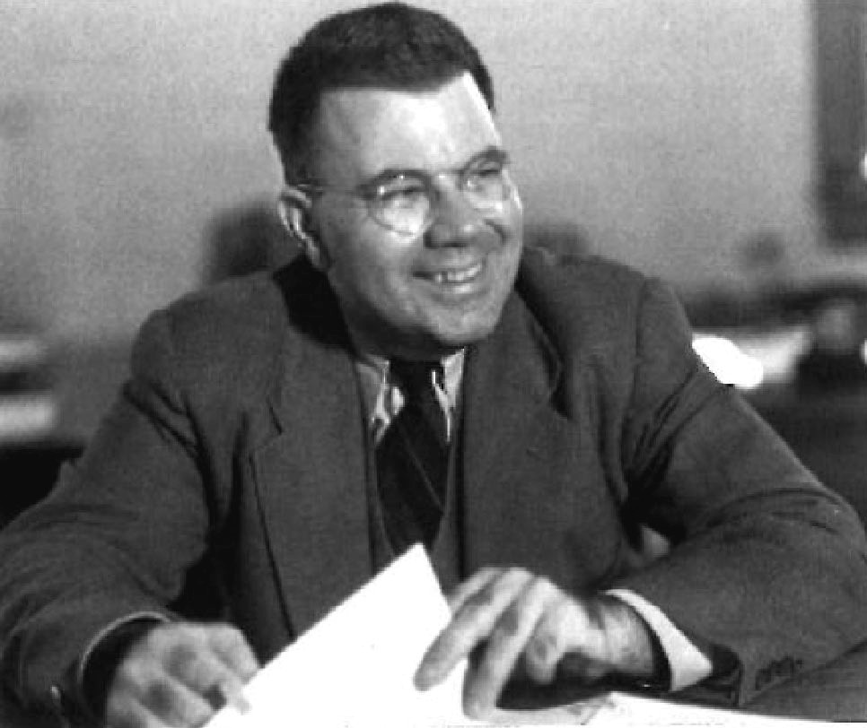
The House of Un-American Activities First attacks Dr. Edward Condon
As for evidence to support its serious charges the sub-committee offered none. As for innuendo making a link between Soviet espionage and the Progressive Party, the subcommittee offered the following:
"On November 5, 1945, Dr. Edward U. Condon was appointed Director of the National Bureau of Standards. Dr Condon was recommended by Henry A. Wallace, who was then Secretary of Commerce. The Bureau of Standards is a Bureau in the Department of Commerce.''In this country (the Communists) haven't gotten as far as they have in Czechoslovakia, but they have got pretty far, because they got a man as Vice President of the United States, and he is now their candidate for President, and he is the same man who recommended Dr. Condon as Director of the Bureau of Standards
The clearest proof that the Un-American Activities Committee intended to try its case in the headlines- apart from its persistent refusal for five years, until 1952, to permit Dr. Condon to testify before it, is in the fact that six days before the issuance of the subcommittee's report, the Department of Commerce's loyalty board had given Condon a loyalty clearance and had held unanimously that "no reasonable grounds exist for believing that Dr. Condon is disloyal to the Government of the United States."
The House of Un-American Committee’s all out campaign to make “Communism” and espionage synonymous was launched immediately after the Atomic Energy Committee had reported that its investigation had showed that Dr. Edward U. Condon’s loyalty was “unquestionable,” and by clear implication, the Committee’s five-month smear campaign of Dr. Condon was without any foundation in fact.
The Committee achieved on its inclusive basis of producing its frauds, lies, and failure to deliver anything of substance from the “spy” investigations. But it’s atom bomb espoinage investigation did remain in the headlines for the election year throughout.
It is, perhaps, not inappropriate to note the some Americans might not have been displeased about the Committee’s sentionalized investigations into Soviet Atomic espionage. There may not be any clearly visible connection, but in 1948 peacetime defense spending was larger than ever before and the profits of U.S. corporations were the highest in the history of the world.
Edward Condon

Slide 9
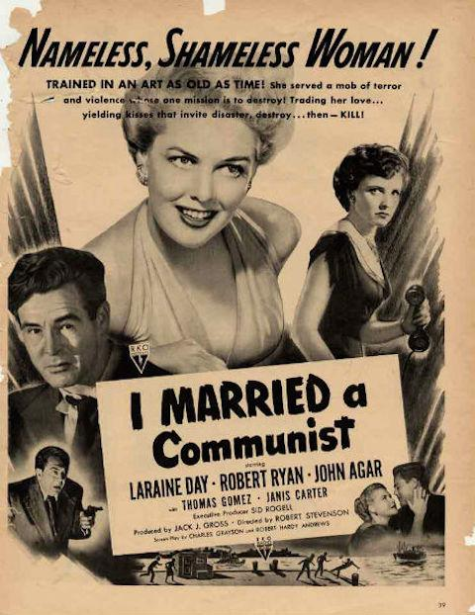
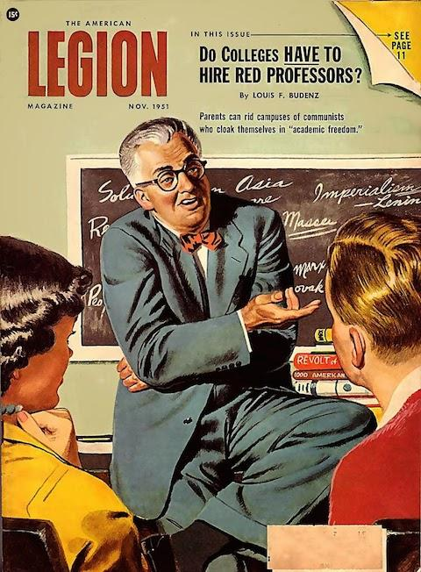
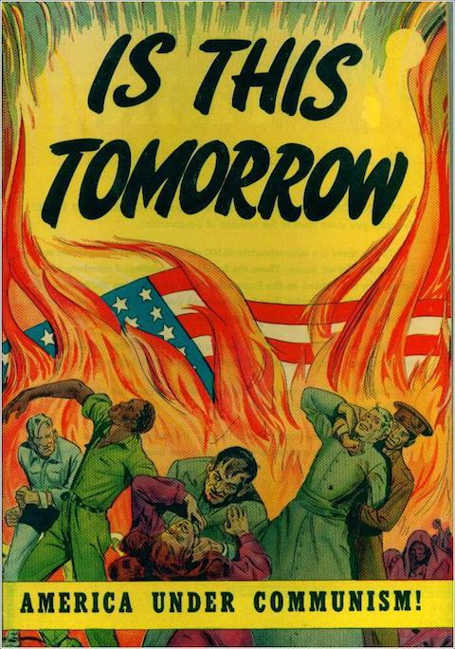
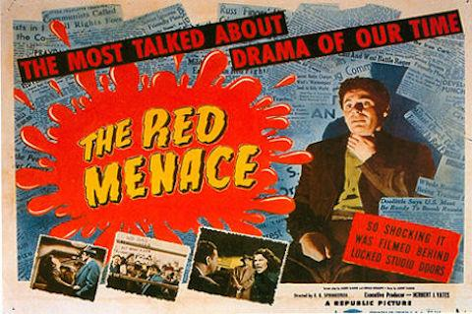
The Communist Hysteria
But, in 1949, exactly one concession was made to the clearly expressed will of the American electorate indicated in the 1948 elections: the "atom" part of the spy hunt was temporarily deemphasized. However, with three "Communist spy" trials, the Eleven leaders of the Communist Party, Judith Coplon and Alger Hiss hogging the front pages of the nation’s press throughout 1949, a new kind of semantics was established in America: Such terms as "Red,” "traitor" and "spy" became so interchangeable in our lexicography that, by the end of the year, few Americans were able to tell them apart.
Corporations, trade associations and business organizations published·advertisements and booklets and sponsored innumerable radio and TV programs dealing with the "Red spies." American universities sponsored endless studies, projects and lectures that invoked just about every corpus of man's knowledge save economics, perhaps to explain the emotional and psychological drive of "Communists." Churchmen of all faiths conducted from their pulpits an examination of the "menace." The film, radio and the TV industry finally found one issue around which their aims could join forces without conflict. The program or the dealing with "Communist intrigue” and with "Soviet spies.” They refurbished their old war scripts, changed German names to Russian, and were in business. Children's so-called comic books found a new kind of villain: the “Red” spy, anti-Communist and anti-Soviet literature became a major industry for magazines and books, with uncountable articles and volumes written about "Reds" and "traitor" and “spies" during the critical first nine months of 1949.

Slide 10
USSR has the Atomic Bomb and America Refuses Peace
On September 23, 1949, the President of the United States and the Prime Ministers of the United Kingdom and Canada simultaneously released identical statements announcing that "within recent weeks" an atomic explosion had occurred in the Soviet Union.The election returns of 1948, returning Truman to office on a progressive platform, showed clearly that the American people had far greater interest in real issues, such as housing, civil rights legislation, anti-inflation measures and a means of ending the Cold War, than they did in shadow campaigns against "atom spies."
But, as had been true in the Fall of 1945 in the discussions concerning the problems surrounding the United States' possession of the atom bomb, there was no chance for reasoned debates on the matter, for the militarists, politicians and financiers came up with a startling discovery which provided, like a deus ex machina, a resolution of the problems that had arisen after three years of the Cold War. This provided the sort of headlines that made unthinkable an end to the Cold War. It justified increased spending for military purposes and scotched the effectiveness of Soviet peace bids. It produced a further argument, which indicated that it was impossible for the West to be able to trust the Soviet Union. After three full years of Cold War "defense" spending, signs began to appear of an impending drop in employment. Thus, despite three and a half years of Cold War with its enormous "defense” spending, despite the Marshall Plan, the Truman Doctrine and the North Atlantic Treaty, something more was needed.
In January 31 1950, Truman announced the order of the Atomic Energy Commission to continue to develop the hydrogen bomb, despite the scientific community plea the President Truman to “break away from the stubborn deadlock,” and push for peace with the USSR. The USSR’s response was also to to push for peace. But President Truman and General Dwight Eisenhower would not allow peace talks. As for the attitude of the Truman Administration, a dispatch datelined Washington and appeared on February 16 in the New York Times headline:
PRESIDENT VETOES MISSION TO STALIN FOR PRESENT TIME
"The President said he might again, someday essay a mission for peace to Moscow. But now is not the time nor would any act of showmanship help the end of the Cold War.”
This was indicated fairly explicitly by the chief of the New York Times Washington Bureau, James Reston, who on September 24, the day after the announcement was made about the Soviet bomb, reported: "The immediate concern in Washington is not that the Russians will make atomic war on the West but that they will now launch a new particularly deceptive peace offensive in the United States and Europe, and in the United Nations”
The headline under which this dispatch appeared may help to explain what Cold War profiteers were really afraid of. It said:“WASHINGTON IS WARY OF A 'PEACE OFFENSIVE’ ”

Slide 11
The Communist Hysteria and the House of Un-American Activities
It is undoubtedly true that the convictions in these three cases provided an apparent basis for Americans to believe in the existence of a Communist conspiracy bent on pilfering defense secrets for Russia. However, it is even more obviously true that this concept was established, not as a result of direct proofs offered in court, but by implications.
And it is also evident that the impressions resulting from a solid year of headlines about the "Communist spy" cases were totally different from any issues that were raised, disputed and settled inside a courtroom.
Within twelve months of Truman's "within recent weeks" announcement, the Communist "Eleven," Alger Hiss, Judith Coplon were convicted; Senator Joseph R. McCarthy emerged as a national figure; the Korean War began; Ethel and Julius Rosenberg and Morton Sobell and five others were arrested as "atom spies"; and, with the passage of the McCarran Act, anyone in America could be put behind the barbed wire of a detention camp for being, in the eyes of the FBI, a "probable" espionage conspirator.
Considering the fact that this total transformation of public opinion was achieved on the basis of unsupported charges and unsubstantiated newspaper headlines, it should not be difficult at all for us to comprehend that the next logical development in these proceedings would be taken almost as a matter of course: the production of the “atom spy" or "a-spies" who had given, as the headline writers and spy-hunters were fond of phrasing it, the atom bomb to Stalin.
While the "Communist-spy" trials, as the majority of press was soon to lump the trials of Judith Coplon, Alger Hiss and the eleven Communist Party leaders were going on, The Un-American Activities Committee kept up its work. This work to be in the vanguard of a drive to convince the American people not only that there were atomic "secrets" which could be stolen but that all "Reds” which before long would become interchangeable with anyone who opposed McCarthy or the Committee or who had ever supported the New Deal were agents of Moscow, engaged in either sabotage or spying.

Slide 12
Discussion

Slide 13
The Trial of Julius and Ethel Rosenberg

Slide 14
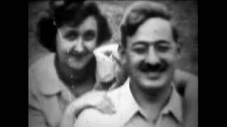
Can the Rosenberg Case be Reopened (1975)

Slide 15
Article from Jewish Affairs - the Communist Parties Jewish Magazine

Slide 16
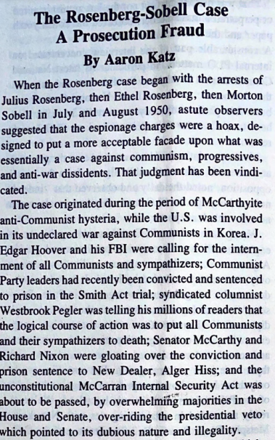
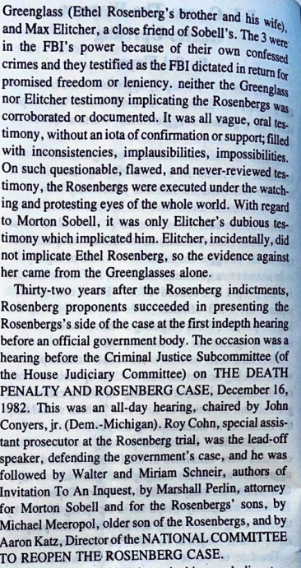
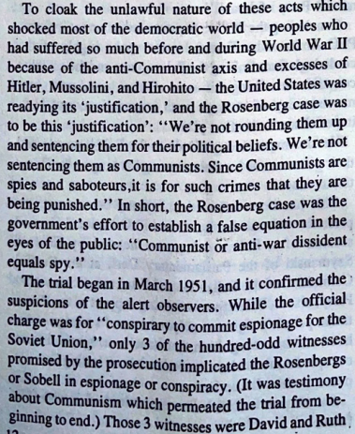
The Rosenberg-Sobell Case A Prosecution Fraud

Slide 17
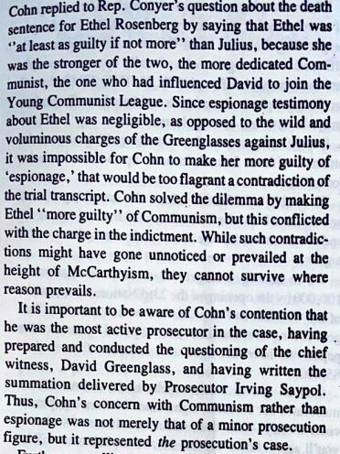
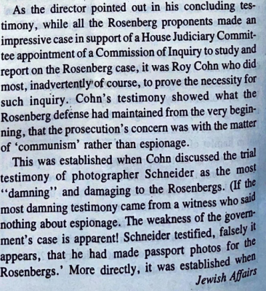
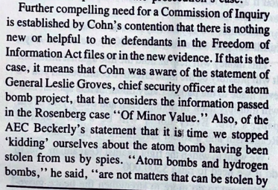
The Rosenberg-Sobell Case A Prosecution Fraud

Slide 18
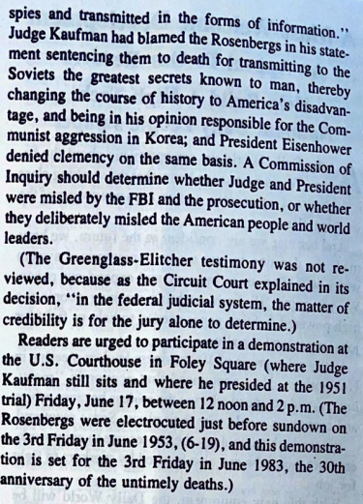
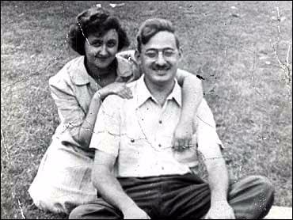
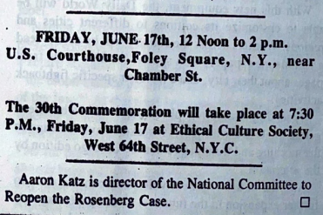

Slide 19
Discussion and New Members Introductions

Slide 20
New Member Introductions
What is your name, pronouns and state (or country/territory)?
Where do you work? Is it unionized?
How did you find out about the People’s School?
What do you think about tonight's class?

Slide 21
The Movement around Reopening the Case

Slide 22
Can the Rosenberg Case be Reopened (1975)

Slide 23
Reopening the Case
Even before the execution took place, there was an organization trying to use everything in their power to prevent the execution: National Committee to Secure Justice in the Rosenberg Case (NCSJRC) The committee waged a ruthless grassroots campaign to challenge the evidence in the case and prevent the death sentence.
Actions of the campaign included: mass protests, letter campaigns, clemency petitions, fundraisers for legal fees and child care for the Rosenberg's two young sons, and the creation and distribution of publications to present new evidence to raise questions about the legitimacy of the Rosenberg trial and death sentence. (From Robert F Wagner Labor Archives).
Following the execution, some of the committee focused on Martin Robell, who was another defendant in the case. Most of the committee went dormant and the activism around the Rosenbergs was not picked up again until the 1970’s by the children of the Rosenbergs themselves.

Slide 24
Reopening the Case
In 1973, Michael and Robert Meeropol, formed the National Committee to Reopen the Rosenberg Case (NCRRC). The first major campaign was to get information released by the FBI under the Freedom of Information Act. In 1975, over a hundred thousand files were released regarding the Rosenberg case.
Also in 1975, an event, The Julius & Ethel Rosenberg Case: Reopening the Past in Light of the Present, was held at the Santa Monica Civic Auditorium. Many people showed up to this event and were eager to hear the presentations from this committee and learn more about the Rosenberg case. However, a tear gas canister was used on the event attendees and everybody was forced to clear out of the theatre. First responders showed up questionably fast and told people the event was over, and to go home.
Some went home, but many others stayed and the event continued. The tear gassing was carried out by the National Socialist (Nazi) Liberation Front, a clearly fascist attack, possibly in tandem with law enforcement, on a civil rights event.

Slide 25
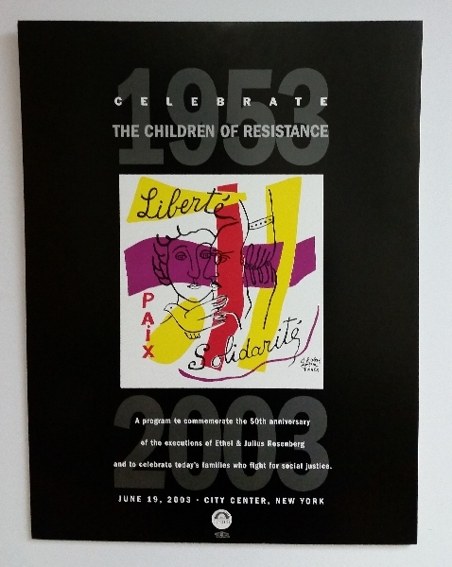
Reopening the Case
The activism of the group continued through the rest of the 20th Century and into the 2000’s. Most of which was still focused on obtaining more information through FOIA and continuing to use publications to challenge the execution of the Rosenbergs, no matter how much time has passed since their murder.
On the 50th Anniversary of the murder, an event was held in NYC called “Celebrate the Children of Resistance” and was put on by the Rosenberg Fund for Children, created to show the same support to the children orphaned by repression that was shown to the children of the Rosenbergs. The event featured many children who had the same things happen as the Rosenbergs, and it was clear that the children of the Rosenbergs were fighting political repression on a wider basis than before.
The movement around the Rosenbergs continues to this day, but seems to be less overt than it was before. We, as Communists, must struggle on this case even today, and bring Julius and Ethel justice, and bring an end to the deadly repression of those who oppose US imperialism and support anti-imperialist countries.

Slide 26
UJPFO DRAFT SAMPLE LETTER TO CONGRESS MEMBERS
This letter is only to be sent out to select members of the US house and Senate after vetting with UJFPO executive members.
Honorable …………
(Address to be added)
Dear Senator (or Congressman/woman)
This June 19th marks the 70th anniversary of the execution of Ethel and Julius Rosenberg, who were convicted on false charges of supplying the Soviet Union with documentation to enable them to produce an atomic bomb. We believe, as do many Americans, that the entire proceedings regarding their trial were corrupt and that their fate was planned.

Slide 27
Firstly, although the claim against them was espionage, they were tried in New York State Supreme Court, with the charge against them being “conspiracy to commit espionage”. This was since there was no death penalty under the U.S. Penal statutes, and N.Y. State had a death penalty. Also, as to the jury selection, at that time trial juries in New York were selected only from a pool of registered voters. Since the Jewish population in New York City was at least 20% of the city, there should have been at least some Jewish people selected for the trial. However, the prosecution knew that there could be some sympathy for the Rosenbergs, who were dedicated and loving parents of two young boys, and that there was still much anti-Semitism among the non-Jewish population, the prosecution, along with the approval of the judge, to ensure that there were no Jews on the jury.

Slide 28
Further, the whole atmosphere of the trial was clouded by the ongoing anti-Communism of post war America, fueled by right wing McCarthyism, and the fact that the Rosenbergs were members of the Communist Party fed right into the prosecution’s case. Although the evidence at the trial was scant and questionable, the prosecution easily convinced the jury that they were guilty because they were Communists.
To this date, the U.S. Government files of this case have been deemed “classified” and although part of these files were declassified and released, the entire file has not. Currently, all the participants in this event have long since deceased, and there is no reason to continue to refuse to release the entire file.
We are therefore seeking, in the cause of justice, that you make a formal request to the U.S. National Archives and Records Administration to so declassify the entire Rosenberg file, and let all Americans see the truth.

Slide 29
Discussion and Wrap Up

Slide 30
Announcements
The American Peace and Information Center (APIC) is having a webinar on Saturday, June 17th at 1 pm EST/10 am PST on Uranium Weapons: Their History, Effects and Recent Deployment to Ukraine, feat. Dr. Chris Busby.
The PCUSA Arts and Culture Commission is looking for content submissions for Vol III 2023 of New Masses! Send any submissions to info@partyofcommunistsusa.net and kamryns@johnreedcenter.net
LUEL has started the Harry Bridges School of Labor! Their classes are Saturday at 7 pm EST/4 pm PST.

Slide 31
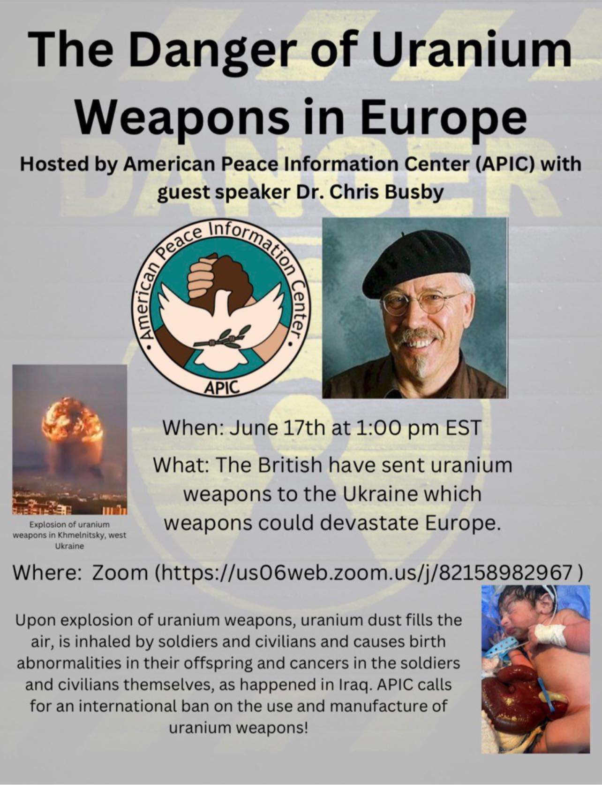

Slide 32
Volunteers Needed!
We are in need of volunteers for the staff of the People’s School! Here’s a few roles we need filled:
People to help manage posting on our social media and podcast platforms
Video Editors, Audio Editors, Graphic Designers, Artists, Narrators
Facilitators, Web Controls, Moderators
Email info@peoplesschool.us if you’re interested and try to attend our next staff meeting on July 1st if possible.

Slide 33
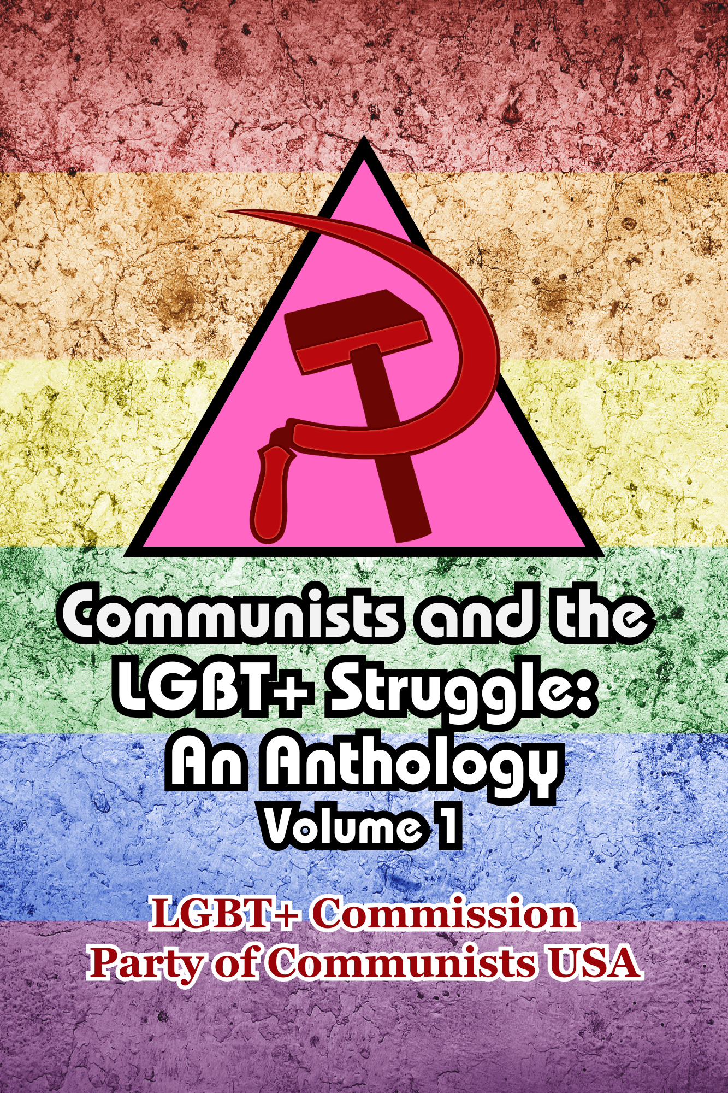
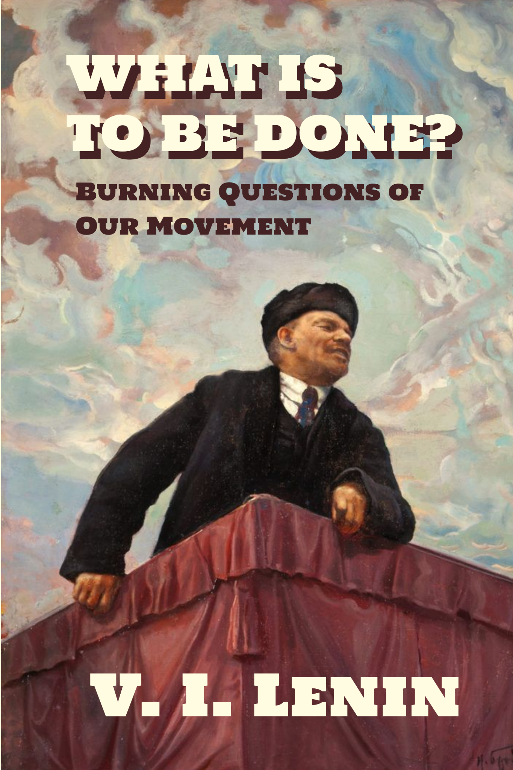
New Outlook Publishers
newoutlookpublishers.store
Latest Releases

Slide 34
Legal Drive
Last year we were attacked and sabotaged by ultraleft wreckers that tried to steal the PSMLS and destroy the PCUSA. They failed, but they will be held accountable and there are still things they took from us that we’ve not got back, like videos, imagery and audio. That is why we still need donations to the legal drive.
To donate, go to partyofcommunistsusa.net/donations/
Check the box that says “PSMLS Legal Funds” and try to donate on Tuesday or Thursday so it is easier for us to sort through. It will go to the legal fund. Anything helps!

Slide 35
The Internationale - 1933 American Version by “The New Singers”

