Slide 1
The Internationale - 1933 American Version by “The New Singers”

Slide 2
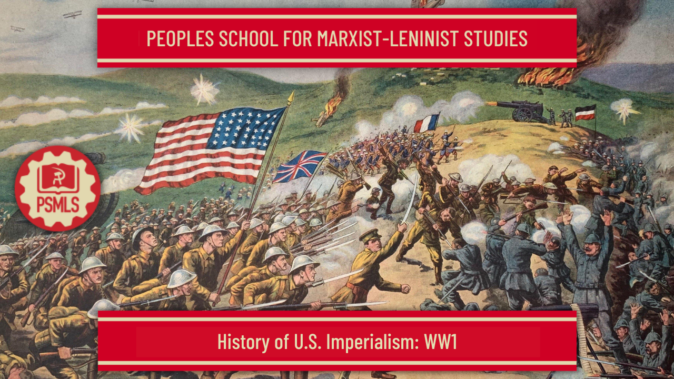
PSMLS 06/20/23 - 06/22/23

Slide 3
What we’ll be learning today:
The imperialist nature of WW1 and how Communists at the time reacted to it
The United States intervention in WW1 and how it furthered US Imperialism
What the United States did in the “Interwar Period” and how it set up post-WW1 institutions and programs that served its interests

Slide 4
The Great War: WW1

Slide 5
The Untold History of the United States - World War 1

Slide 6
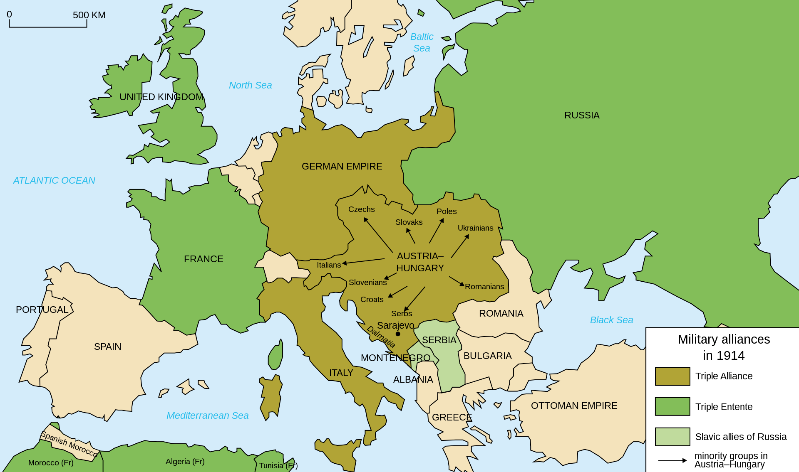
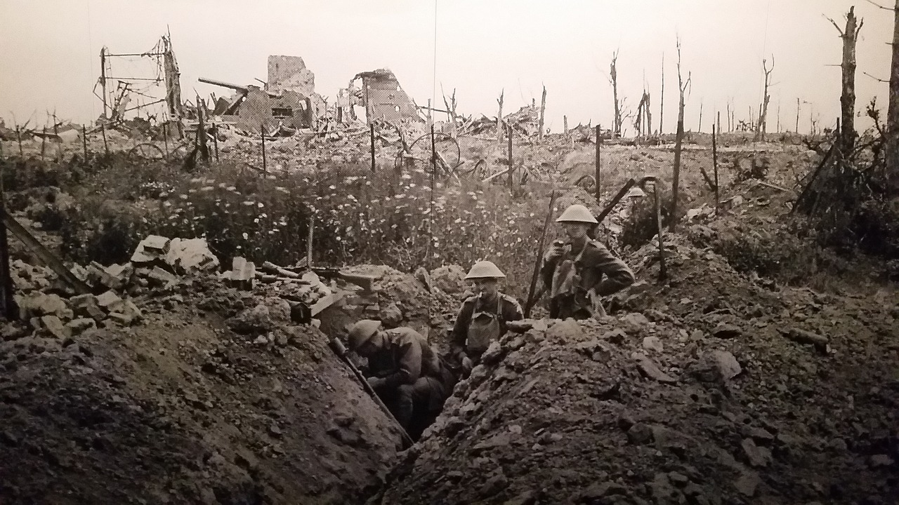
The Great War - World War 1
“The War to End All Wars”
World War 1 was the great clash of imperialist powers of the Earth, and spanned Eurasia, Africa, the Indian Ocean, Pacific Ocean and Atlantic Ocean and resulted in a loss of ~20 million people, with a further ~20 million injured. At the time, this was one of the deadliest conflicts in human history.
It last 4 years, 3 months and 2 weeks between July of 1914 and November of 1918. It officially began on July 28th, 1914, when Austria declared war on Serbia following the assassination of Archduke Franz Ferdinand, and began shelling Belgrade. Russia then mobilized in support of Serbia.
Germany then moved to begin their Schlieffen Plan, invading Belgium on August 4th, then continuing into France throughout August. Russia then attacked German forces in East Prussia. German and British/French Colonial Forces clashed in Africa and Oceania.

Slide 7
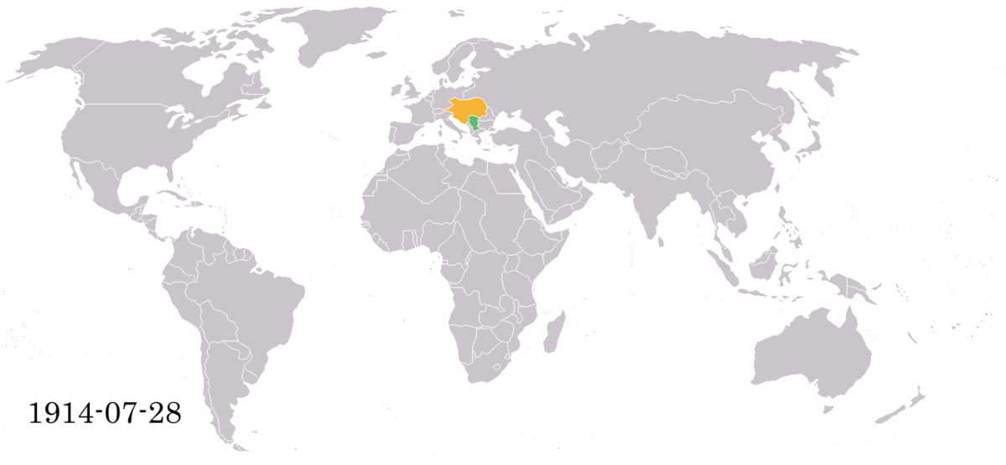
The Great War - World War 1
1914-1916
As WW1 went on, the conflicting powers found themselves in tug-of-war struggles at the frontlines in Europe, in the trenches and in the waters off of Europe. From 1914-1917, neither British/French nor German forces made any significant advancements. Battles such as at the Marne, Verdun and Somme were mostly meat grinders that showed no results. Battles were underway in Eastern and Southern Europe, as well as the Middle East with the Ottoman Empire. In 1915, Serbia was occupied and Italy changed sides.

Slide 8
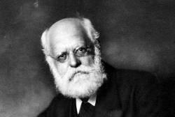
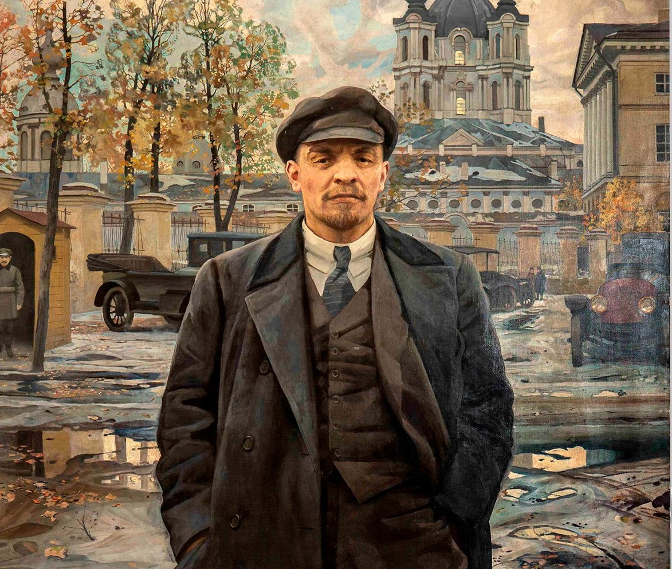
The Great War - World War 1
The Split in the World Communist Movement
When World War 1 was looming, the Social Democratic forces in the Second International in Europe decided to support their own respective imperialist governments in the war.
This was sharply criticized by the Bolsheviks, who *at the time* recognized that this Great War specifically was an inter-imperialist conflict, and that the correct policy of the Socialists was to oppose the war and use the situation as an opportunity to agitate the masses against imperialism and take power. Lenin said in 1916:
“There you have an excellent Marxist formulation, one that fully coincides with our own and fully exposes the present-day Kautsky, who has turned from Marxism to defence of social-chauvinism. It is a formulation (we shall have occasion to revert to it in other articles) that clearly brings out the principles underlying the Marxist attitude towards war. War is the continuation of policy. Hence, once there is a struggle for democracy, a war for democracy is possible. National self-determination is but one of the democratic demands and does not, in principle, differ from other democratic demands. “World domination” is, to put it briefly, the substance of imperialist policy, of which imperialist war is the continuation. Rejection of “defence of the father land” in a democratic war, i.e., rejecting participation in such a war, is an absurdity that has nothing in common with Marxism. To embellish imperialist war by applying to it the concept of “defence of the fatherland”, i.e., by presenting it as a democratic war, is to deceive the workers and side with the reactionary bourgeoisie.”

Slide 9
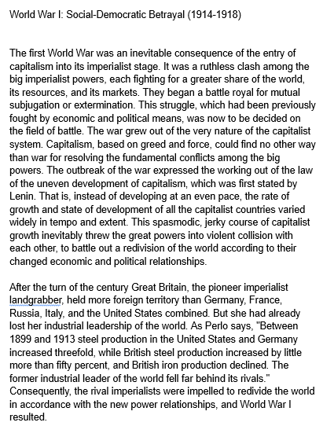
History of the CPUSA - William Z Foster - WW1: Social-Democratic Betrayal

Slide 10
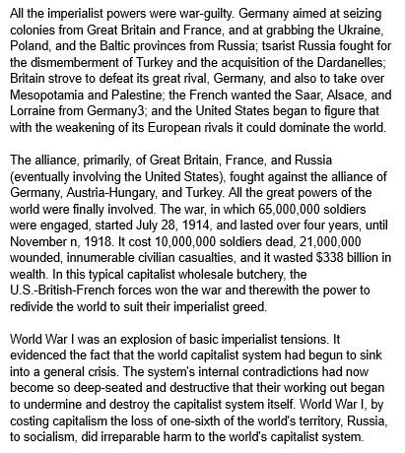
History of the CPUSA - William Z Foster - WW1: Social-Democratic Betrayal

Slide 11
Discussion

Slide 12
American Intervention

Slide 13
The Untold History of the United States - WW1

Slide 14
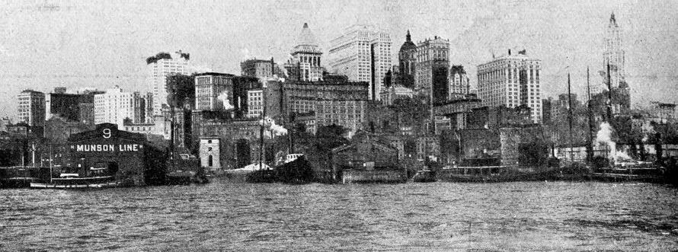
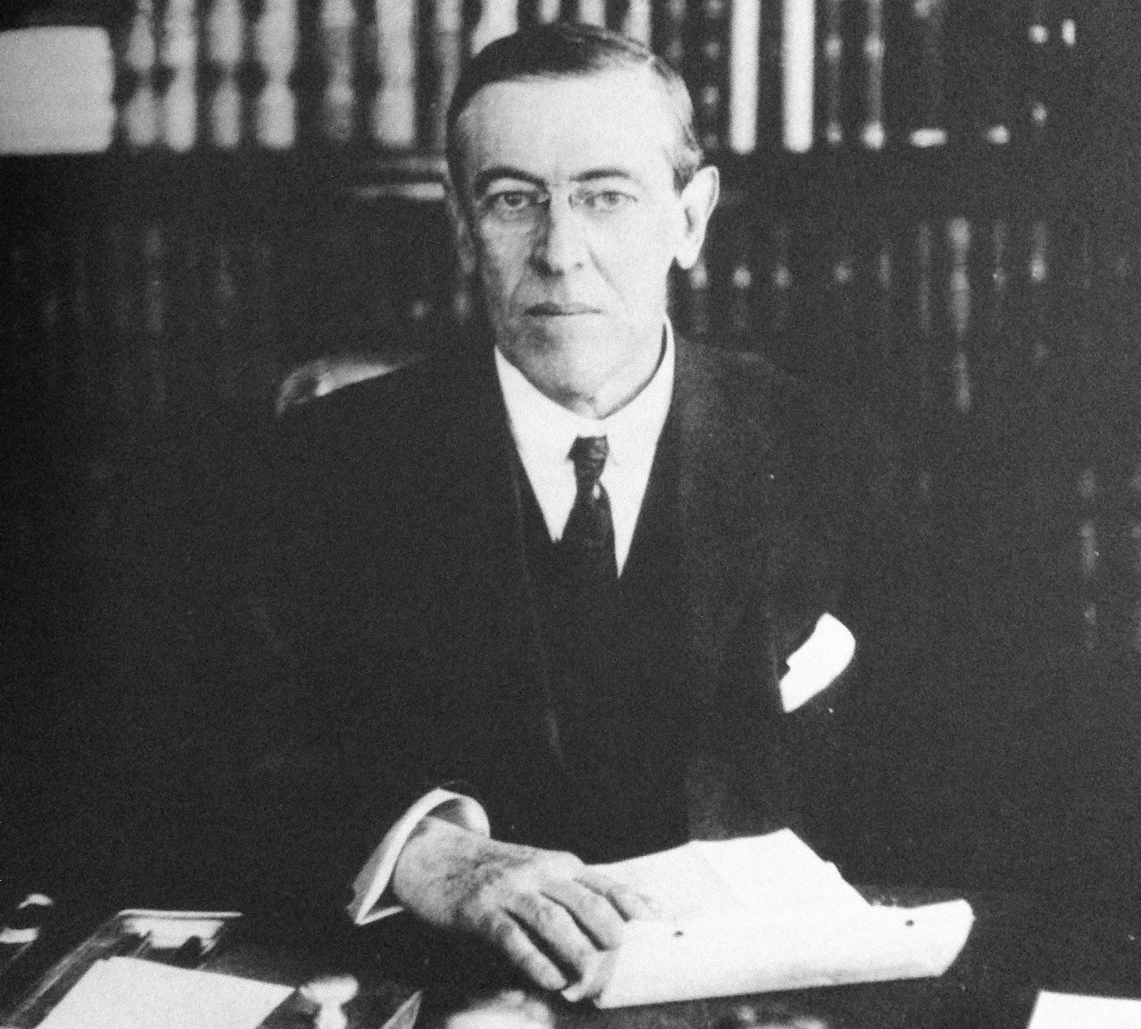
American Intervention in the First World War
What it did for American Imperialism
The United States of America, prior to the 1910’s, had relatively no interest in military interference in Europe. It was more concerned with what it could obtain control over in the Americas, Pacific and Africa. There was a general sentiment of just letting Europe fight their own wars.
The First World War presented American imperialism with many benefits:
The United States could profit off of the war to begin with by selling arms to the allies and create European reliance on the United States. Exports grew from $2.4b in 1913 to $6.2b in 1917.
The United States could be involved in, potentially even lead, the talks and treaties following the war, creating institutions and programs to benefit itself & create hegemony.
The United States could use the war and the concurrent Bolshevik revolution to crack down on the working class with the Espionage and Sedition Acts and more.

Slide 15
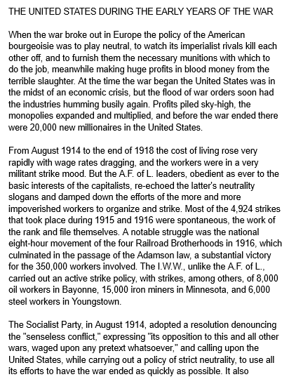
History of the CPUSA - William Z Foster - WW1: Social-Democratic Betrayal

Slide 16
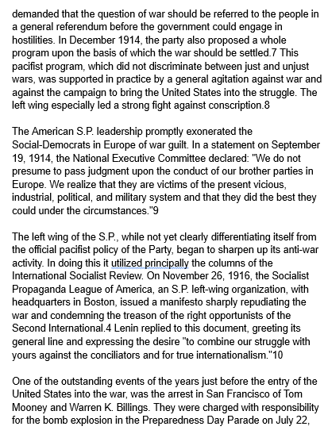
History of the CPUSA - William Z Foster - WW1: Social-Democratic Betrayal

Slide 17
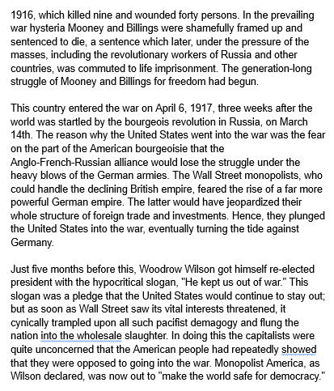
History of the CPUSA - William Z Foster - WW1: Social-Democratic Betrayal

Slide 18
Discussion & New Members Intros

Slide 19
New Member Introductions
What is your name, pronouns and state (or country/territory)?
Where do you work? Is it unionized?
How did you find out about the People’s School?
What do you think about tonight's class?

Slide 20
The Interwar Period

Slide 21
The Untold History of the United States - WW1

Slide 22
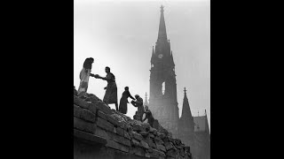
The Untold History of the United States - WW1

Slide 23
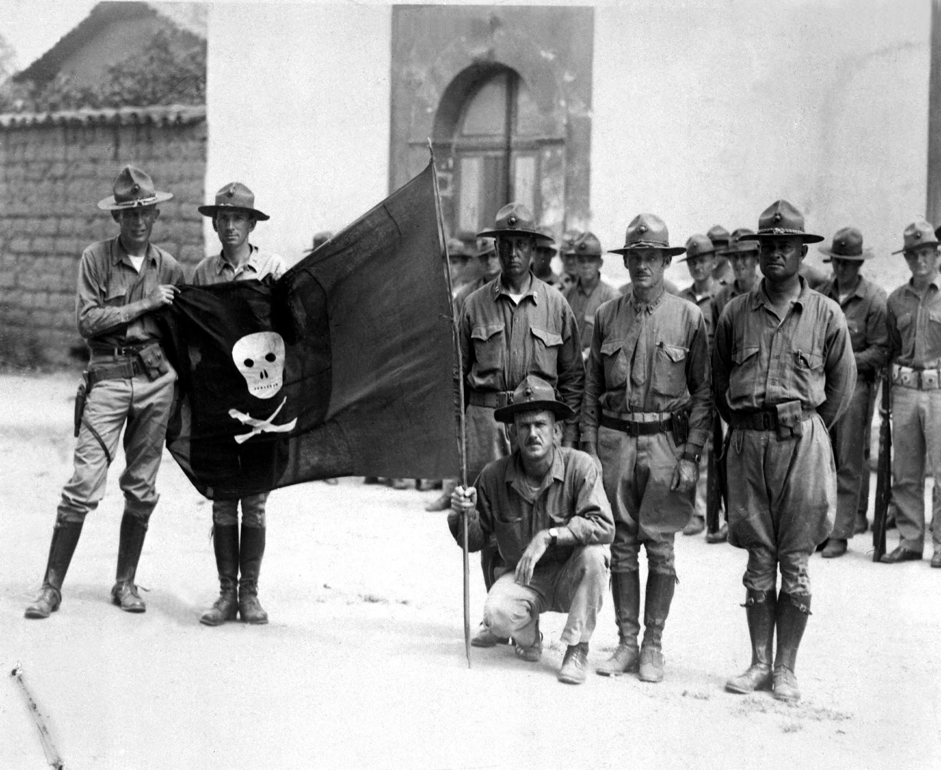
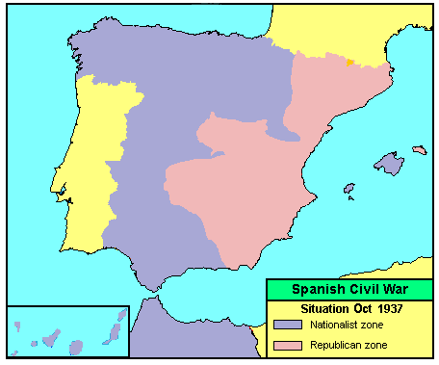
The Interwar Years
American action in the Interwar years
Following the end of WW1, the United States intervened in the Russian Civil War, and 13,000 Americans were sent to the Arkhangelsk and Vladivostok regions. However, following this, there is a period of time from 1920-1942 in which America is generally thought to be “isolationist.”
This isn’t entirely correct. The United States continued its intervention in Nicaragua and, in the rest of the world, had established a leading presence as a world power and held some economic hegemony over Europe. We continued to be imperialist, but the full-blown wars weren’t actively occurring.
It is worthwhile to note where we did not intervene. We refused to aid Spanish Republicans against the fascist forces of Francisco Franco, backed by the Nazis and Italian fascists. Roosevelt later called this a mistake. We also did not intervene against Italy in Africa or Japan in China. We didn’t intervene where it would’ve helped people, we did where our interests were at stake.

Slide 24
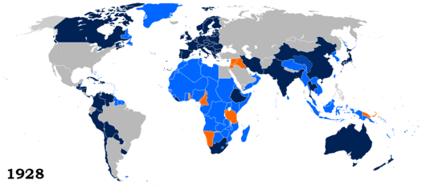
The Interwar Years
The “League of Nations”
In the Treaty of Versailles, the League of Nations was founded, as it was envisioned by Woodrow Wilson. It was the first intergovernmental worldwide organization, and was supposedly aimed at world peace and democracy. Most of post-war Europe joined the League of Nations, as did parts of the Americas, Africa, Asia and Oceania.
Despite being the idea of an American president, the Senate of the United States voted against joining the league, and the United States never did. Weimar Germany joined in 1926, and the Soviet Union joined in 1934.
The League never actually intervened militarily in any conflict and Germany, Italy, Japan and Spain were never expelled for their aggressions (though they did leave the league in the 1930s). The only country ever to be expelled was the Soviet Union for the Winter War, which was the last act of the league.

Slide 25
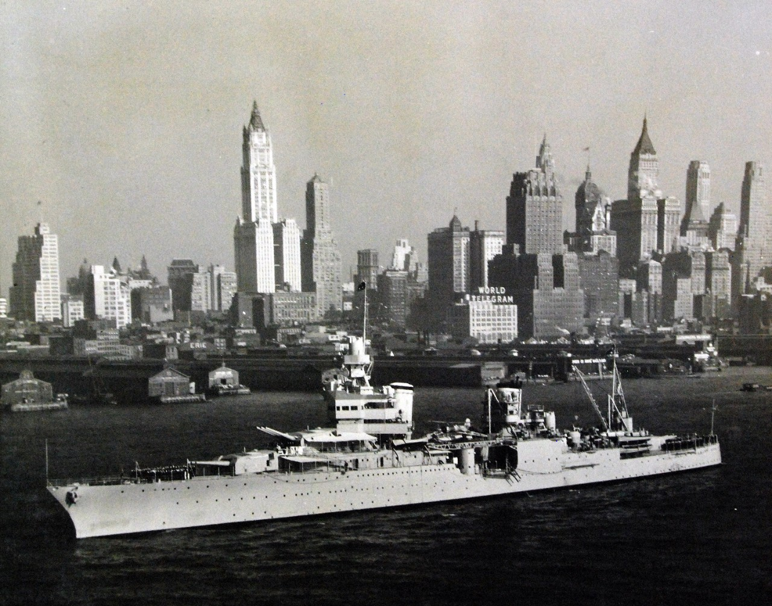
The Interwar Years
U.S. Imperialism in 1939
Prior to World War 2, the United States was a world power. The intervention in World War 1 and diplomatic overtures of Wilson allowed US imperialism and economic hegemony to extend to Europe and opened the door for further imperialist action in Europe.
However the United States did not yet have as much reach and power as it would following WW2. In the interwar years, the United States was more paranoid of the Soviet Union than Nazi Germany, and American businessman such as Ford, J.P. Morgan and more aided the Nazis and American fascists planned to take over in 1933, but were thwarted. The fascist war on the world in 1939 would eventually draw the US in, but the US would make the most out of the war and American imperialism would grow exponentially.
To be continued in History of U.S. Imperialism: WW2

Slide 26
Discussion and Wrap Up

Slide 27
Announcements
The PCUSA Arts and Culture Commission is looking for content submissions for Vol III 2023 of New Masses! Send any submissions to info@partyofcommunistsusa.net and kamryns@johnreedcenter.net
LUEL has started the Harry Bridges School of Labor! Their classes are Saturday at 7 pm EST/4 pm PST.
The Historical Music Committee of the Arts and Culture Commission, needs more audio recordings of Internationale, especially of higher pitched voices. Send to remyb@johnreedcenter.net
Follow PSMLS Social Media on Facebook, Twitter, Instagram, TikTok, Reddit, Telegram, YouTube, Rumble and more! All can be found at peoplesschool.us.

Slide 28
Volunteers Needed!
We are in need of volunteers for the staff of the People’s School! Here’s a few roles we need filled:
People to help manage posting on our social media and podcast platforms
Video Editors, Audio Editors, Graphic Designers, Artists, Narrators
Facilitators, Web Controls, Moderators
Email info@peoplesschool.us if you’re interested and try to attend our next staff meeting on July 1st if possible.

Slide 29
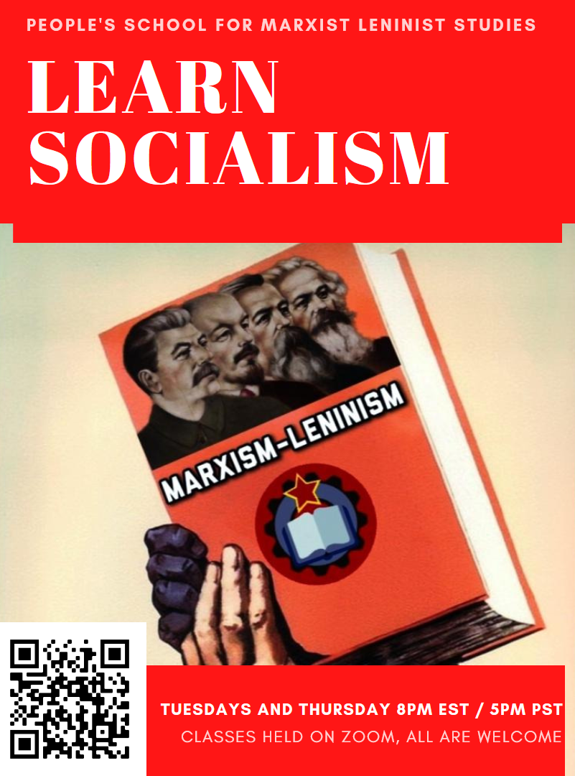
PSMLS Propaganda
peoplesschool.us/media
Materials to help promote the school!

Slide 30
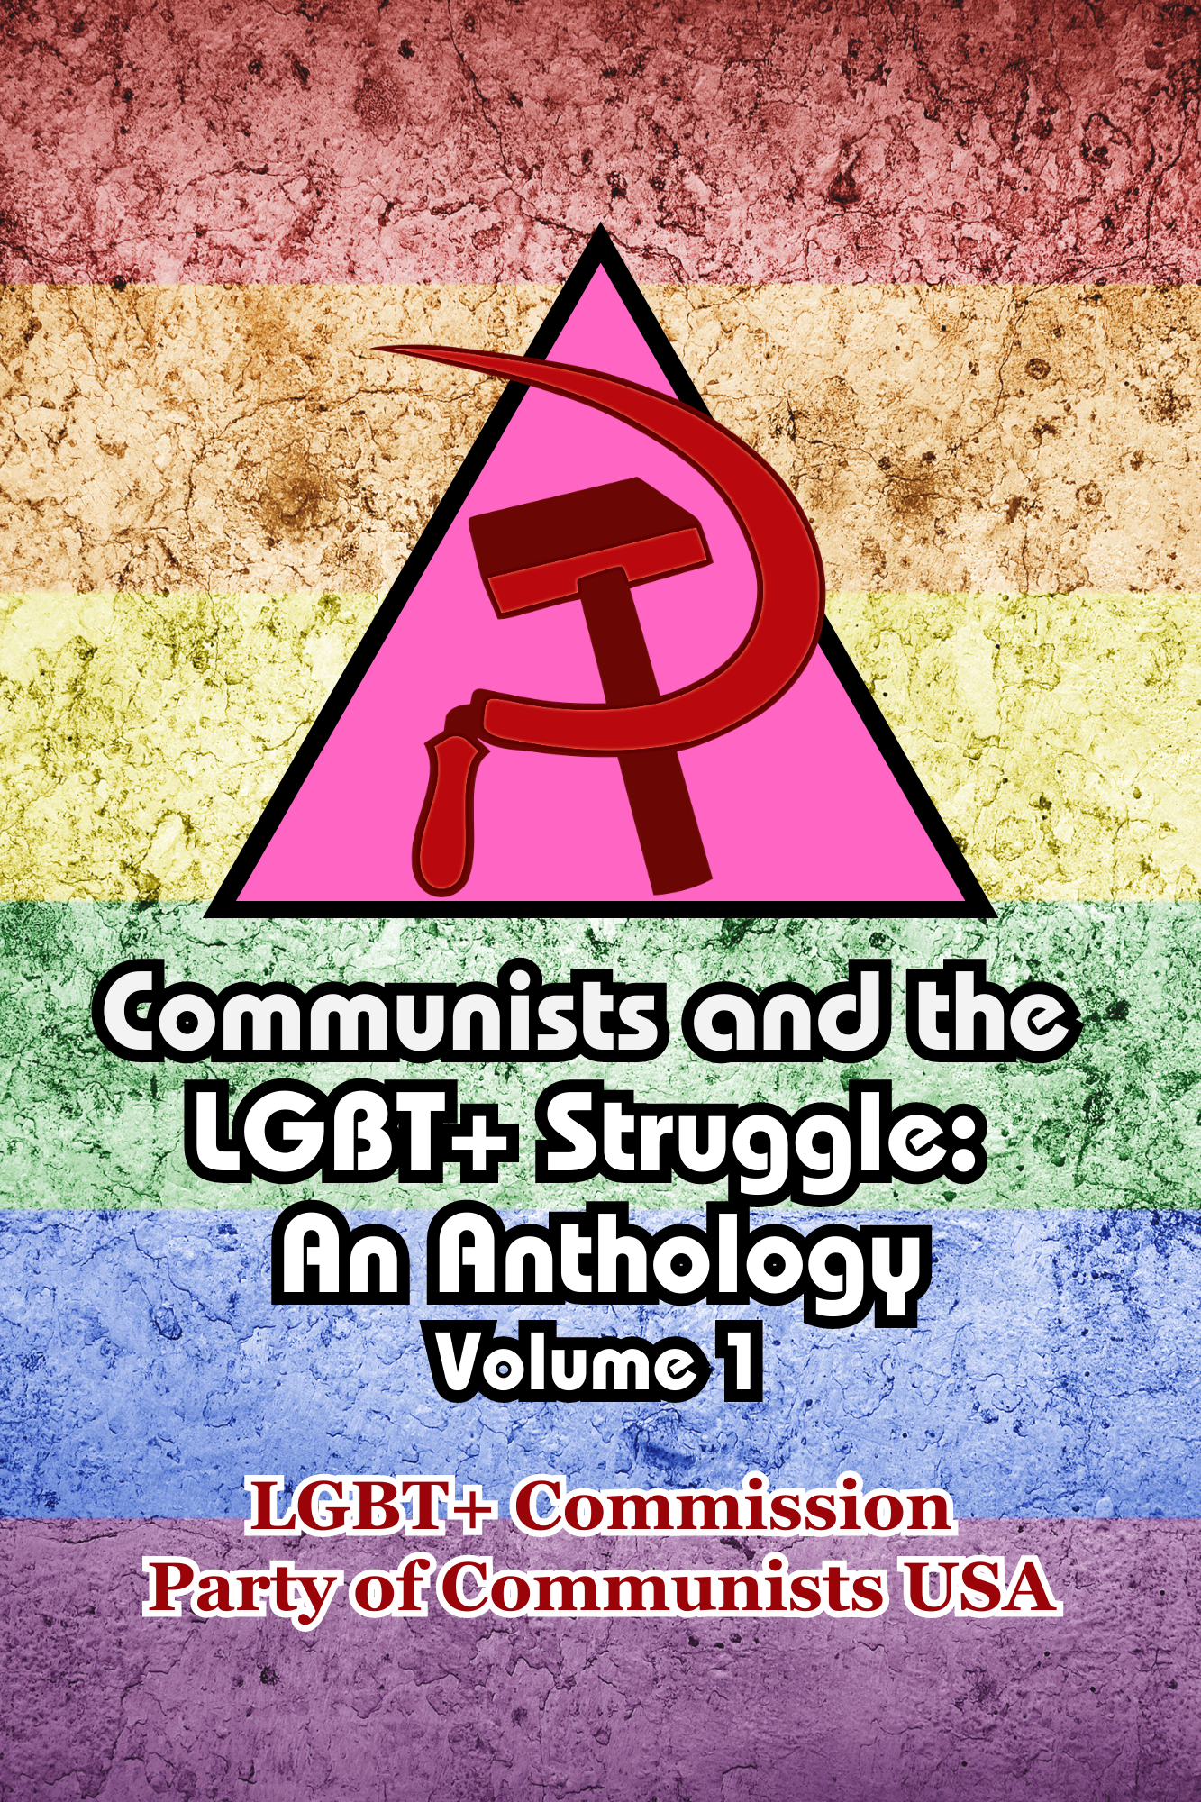
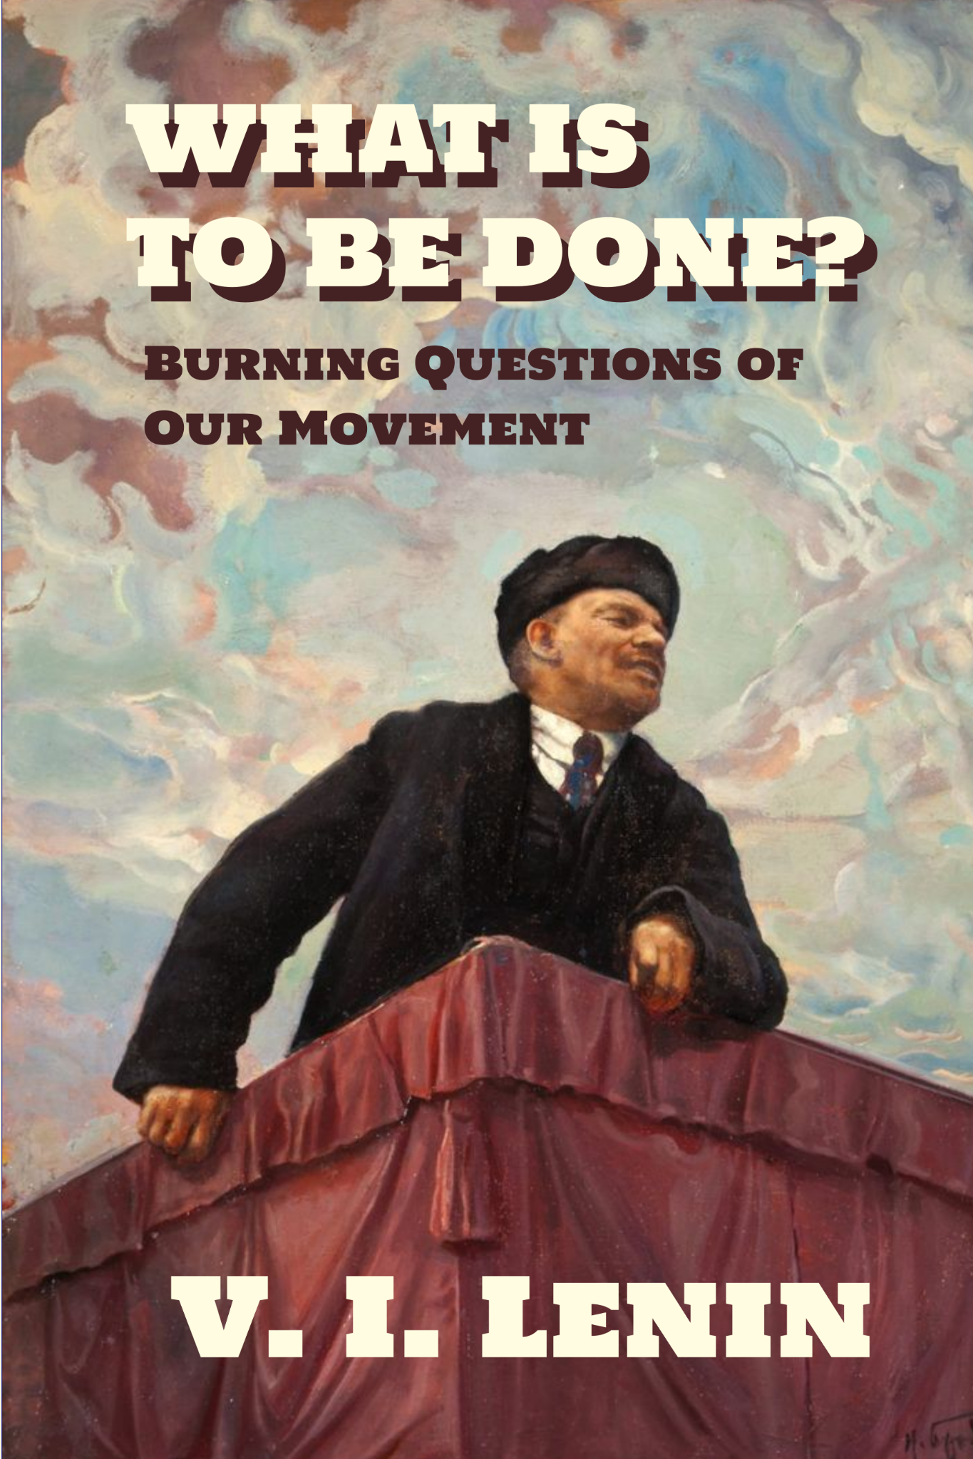
New Outlook Publishers
newoutlookpublishers.store
Latest Releases

Slide 31
Legal Drive
Last year we were attacked and sabotaged by ultraleft wreckers that tried to steal the PSMLS and destroy the PCUSA. They failed, but they will be held accountable and there are still things they took from us that we’ve not got back, like videos, imagery and audio. That is why we still need donations to the legal drive.
To donate, go to partyofcommunistsusa.net/donations/
Check the box that says “PSMLS Legal Funds” and try to donate on Tuesday or Thursday so it is easier for us to sort through. It will go to the legal fund. Anything helps!

Slide 32
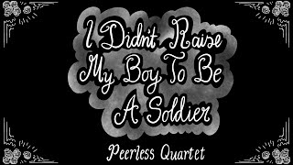
I Didn’t Raise My Boy To Be A Soldier - Peerless Quartet, 1914

