Slide 1
الدولية - Iraqi Internationale

Slide 2
PSMLS 03/28/23 - 03/30/23

Slide 3
What we’ll be learning today:
Context about the recent history of Iraq, and US involvement in their affairs.
The protests of 36,000,000 (thirty six million) people around the world to the US invasion of Iraq in 2003.
The history of the US-led invasion of Iraq, and the 9 years of war that followed.
The aftermath of the Iraq war, continued US intervention in Iraq and the Middle East and where Iraq is today.

Slide 4
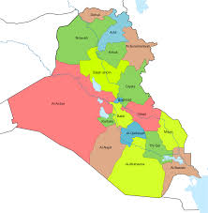
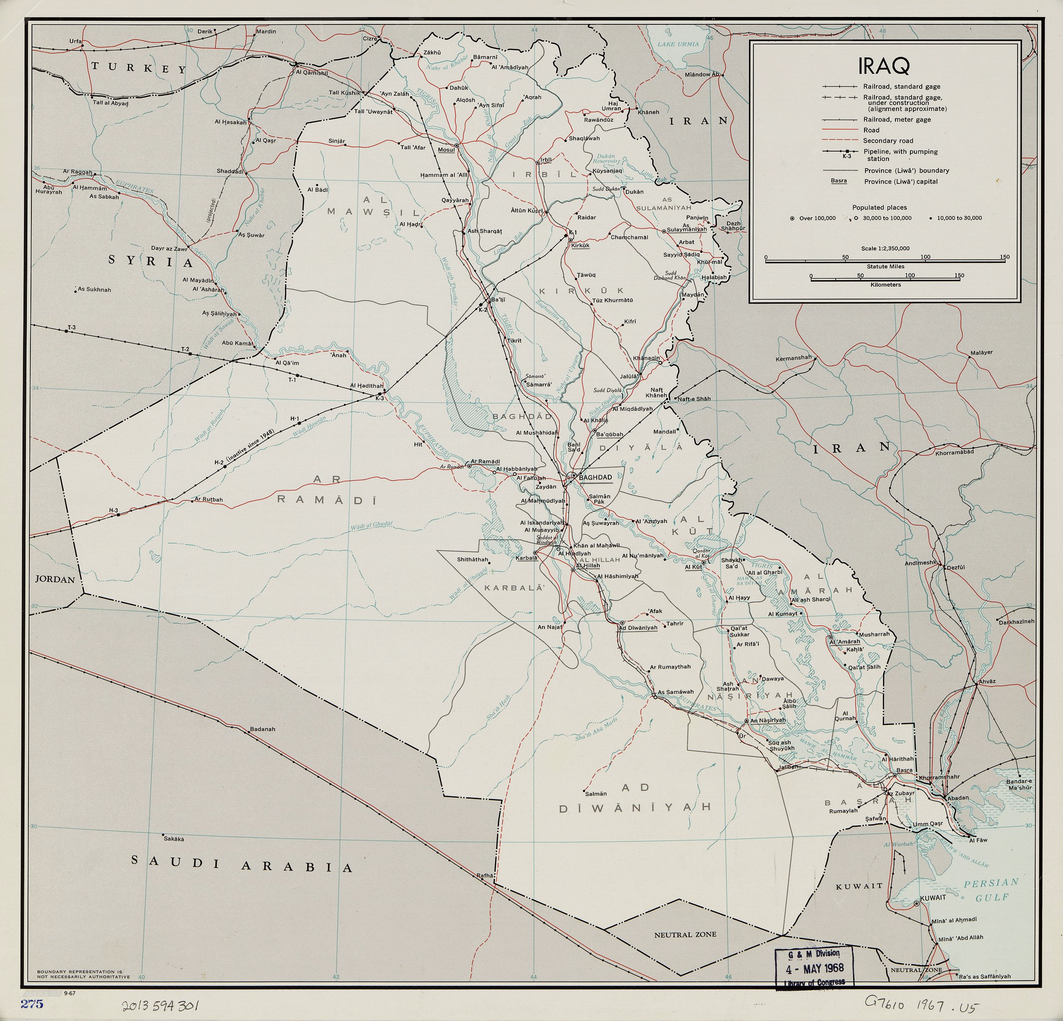
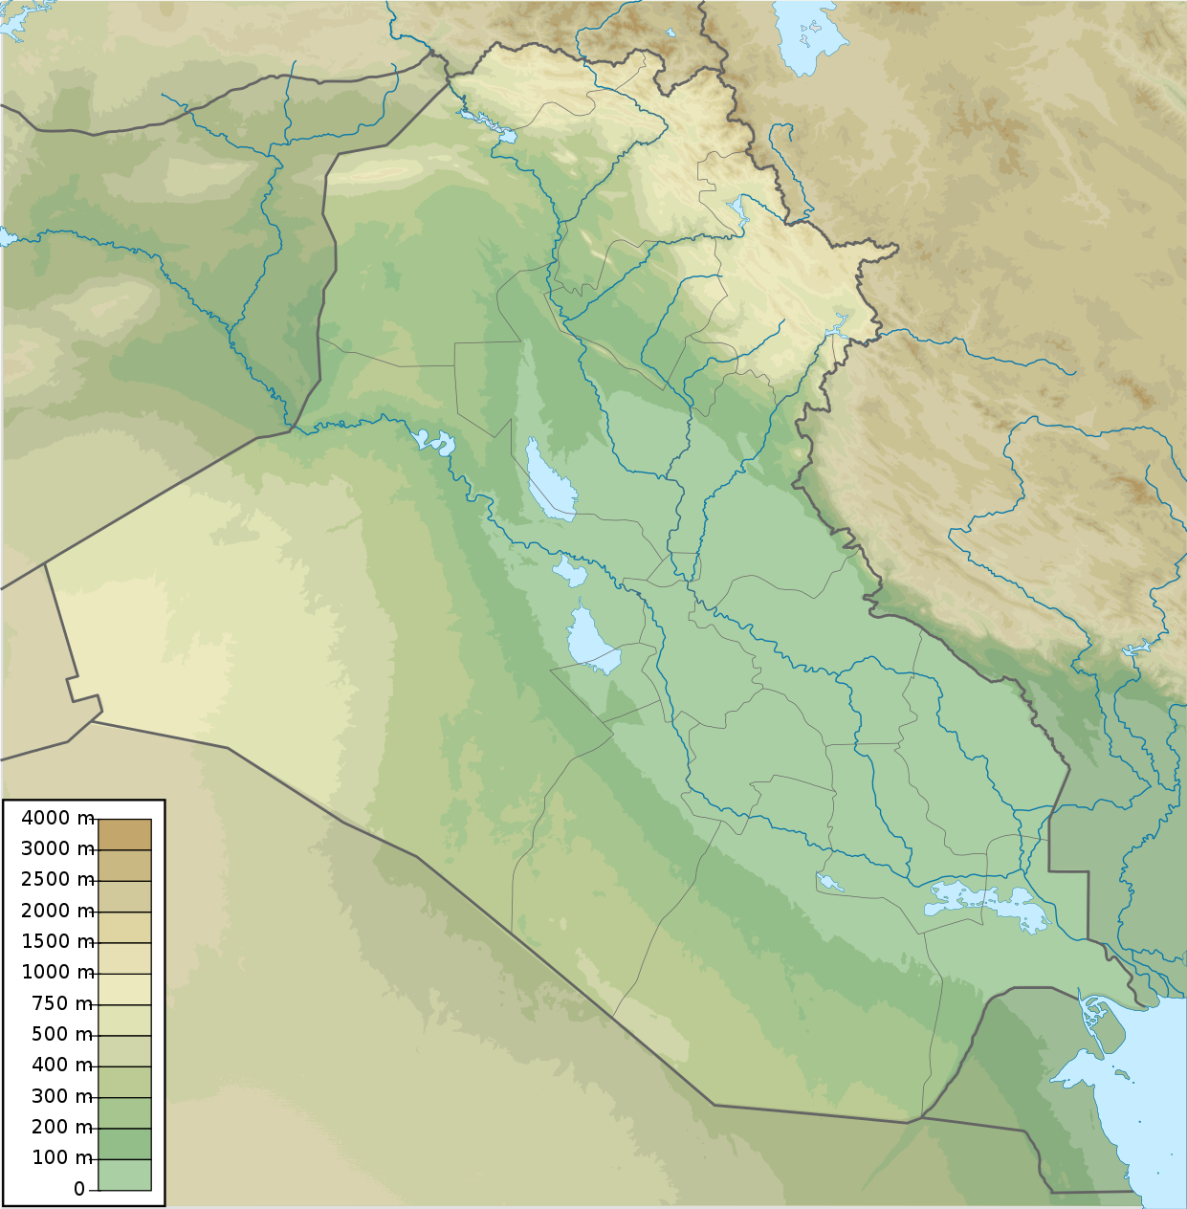
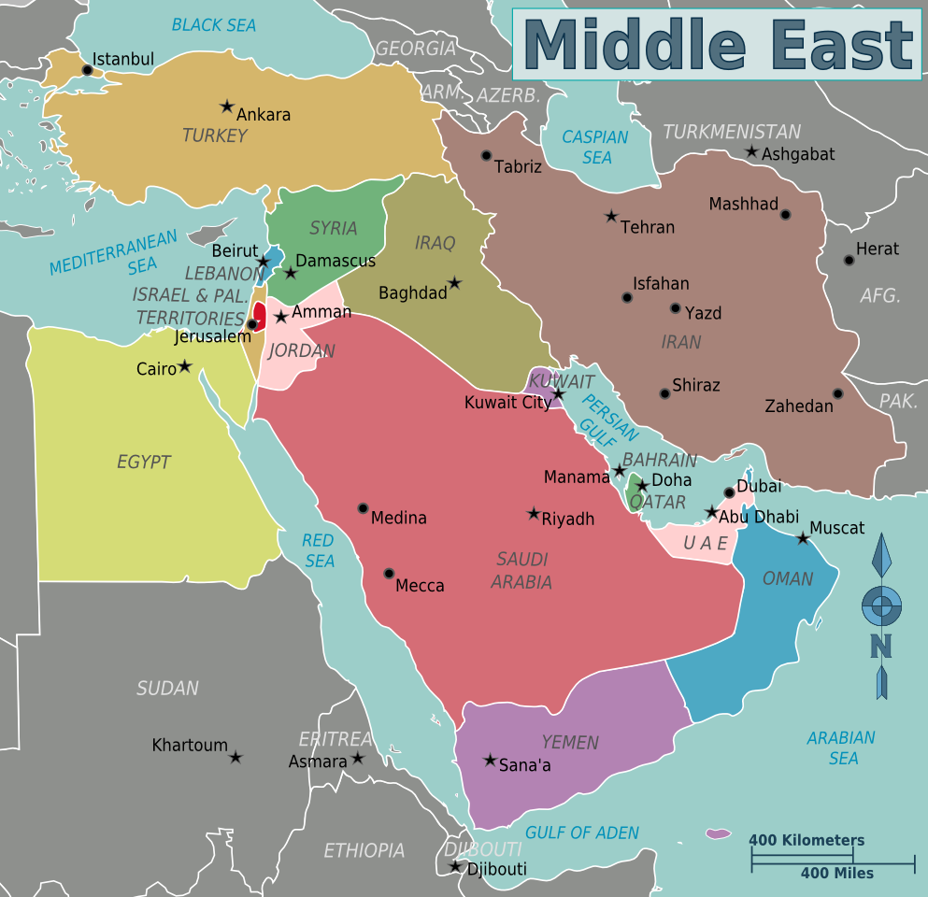
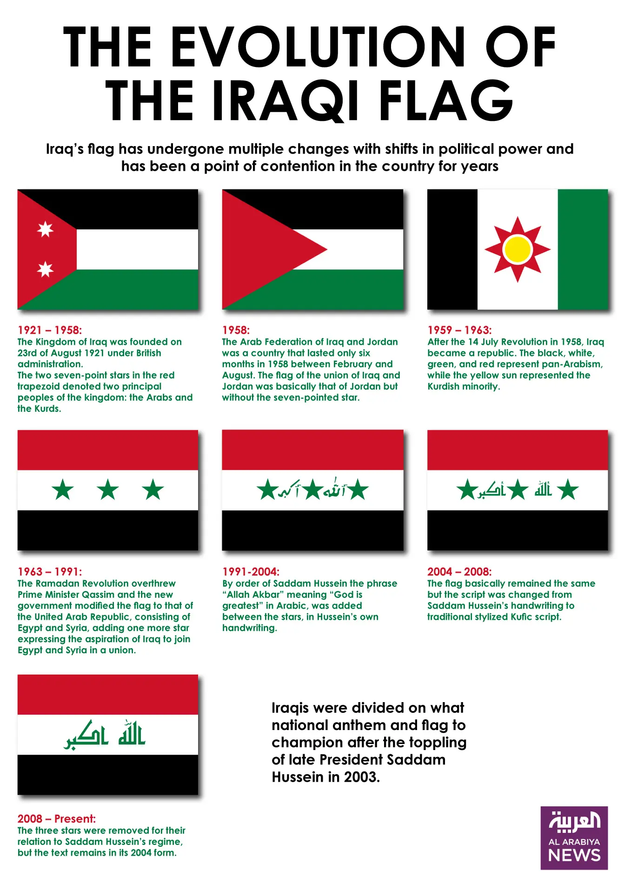
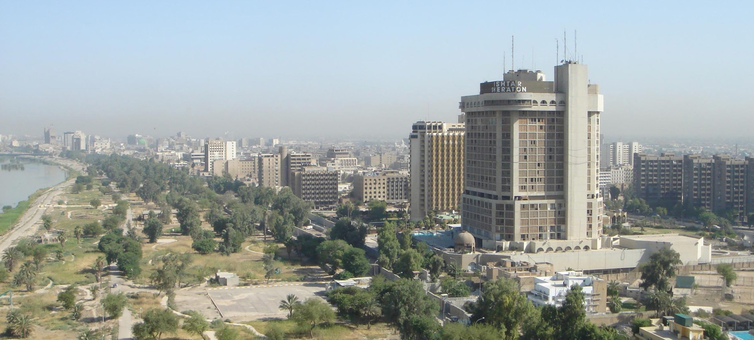
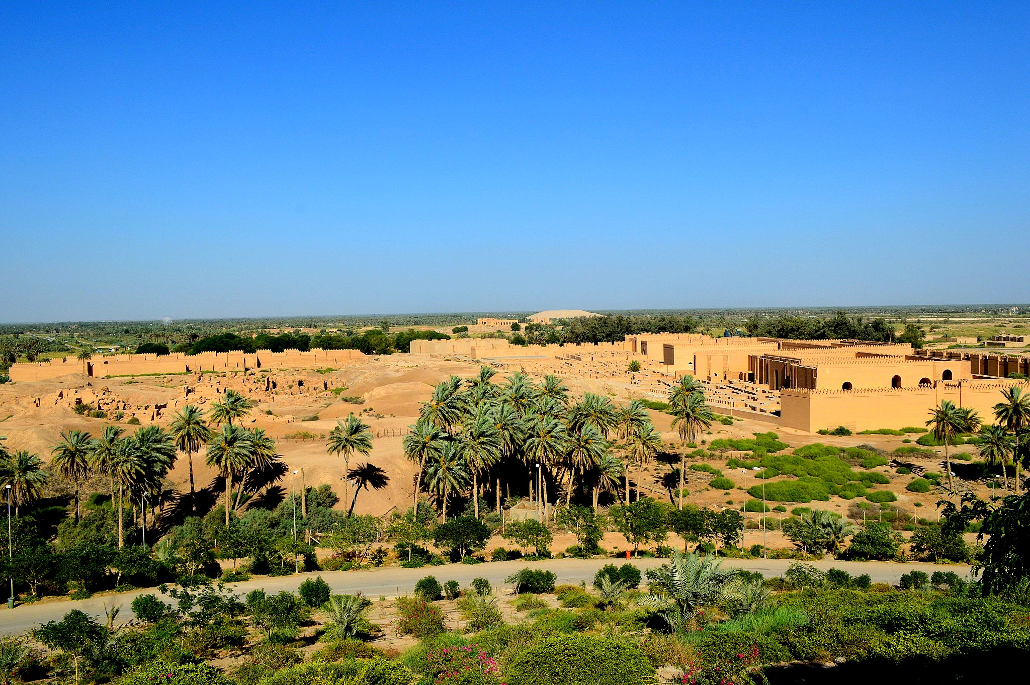
Iraq Basic Information
Baghdad
Iraq is a nation in West Asia or the Middle East, which has existed independently since 1932, when the Kingdom of Iraq was founded and British colonial rule came to an end after years of struggle by the Iraqi people.[1]
Today, ~45,209,423 people live in Iraq. In 2003, Iraq’s population was ~27,070,000.[2] Iraq’s largest city and capital is Baghdad, which has ~10,750,719 people today, more than 1.5 million more than New York City today. In 2003, the population of Baghdad was ~5,615,224. [3] Iraq borders Iran, Turkey, Syria, Jordan, Saudi Arabia, Kuwait and the Persian Gulf.
Rural Iraq

Slide 5
Prelude: Iraq from 1968-2002

Slide 6
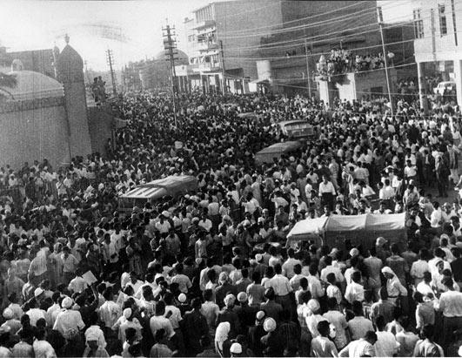
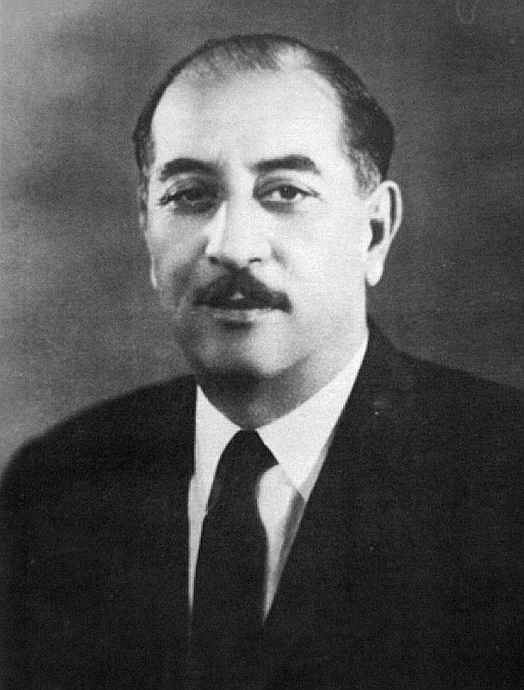
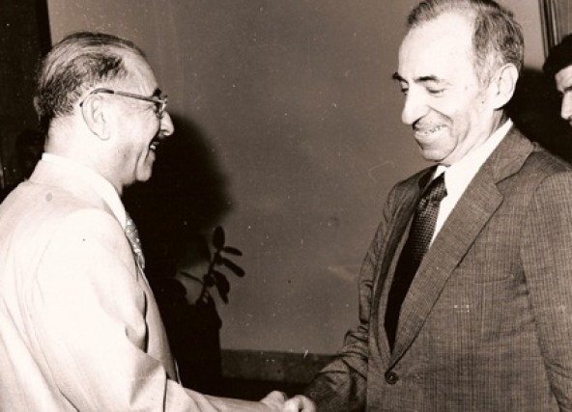
Prelude: Iraq from 1968-2002
In 1958, the Kingdom of Iraq was ended and the Monarchy overthrown in the 14 July Revolution by “The Free Officers” who were Pan-Arab Nationalists and opposed to western imperialism.[4]
In 1963, the Arab Socialist Ba’ath Party of Iraq seized power in Iraq, overthrowing The Free Officers. Following this, the Ba’athists hunted down Iraqi Communists that belonged to the Iraqi CP and killed around 5,000 of them.[5]
In 1968, the leader of Ba’athist Iraq, Abdul Rahman Arif, was overthrown by the Ba’ath Party in the 17th July Revolution and was exiled to Turkey. From there, Ahmed Hassan al-Bakr was installed as president and all other parties in Iraq were banned, beginning Ba’athist Iraq.[6]

Slide 7
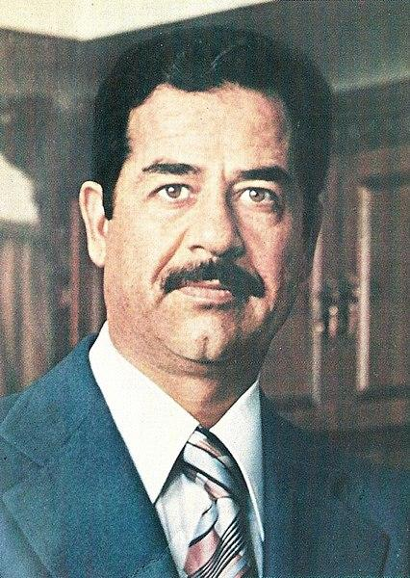
Prelude: Iraq from 1968-2002
By 1975 Ba’athist Iraq nationalized its oil industry[7], in turn angering the United States, whom Arif was trying to work closer with.
On July 16th, 1979, Saddam Hussein took control of the offices of president, leader of the Ba'ath Party and chairman of the Revolutionary Command Council.[8]

Slide 8
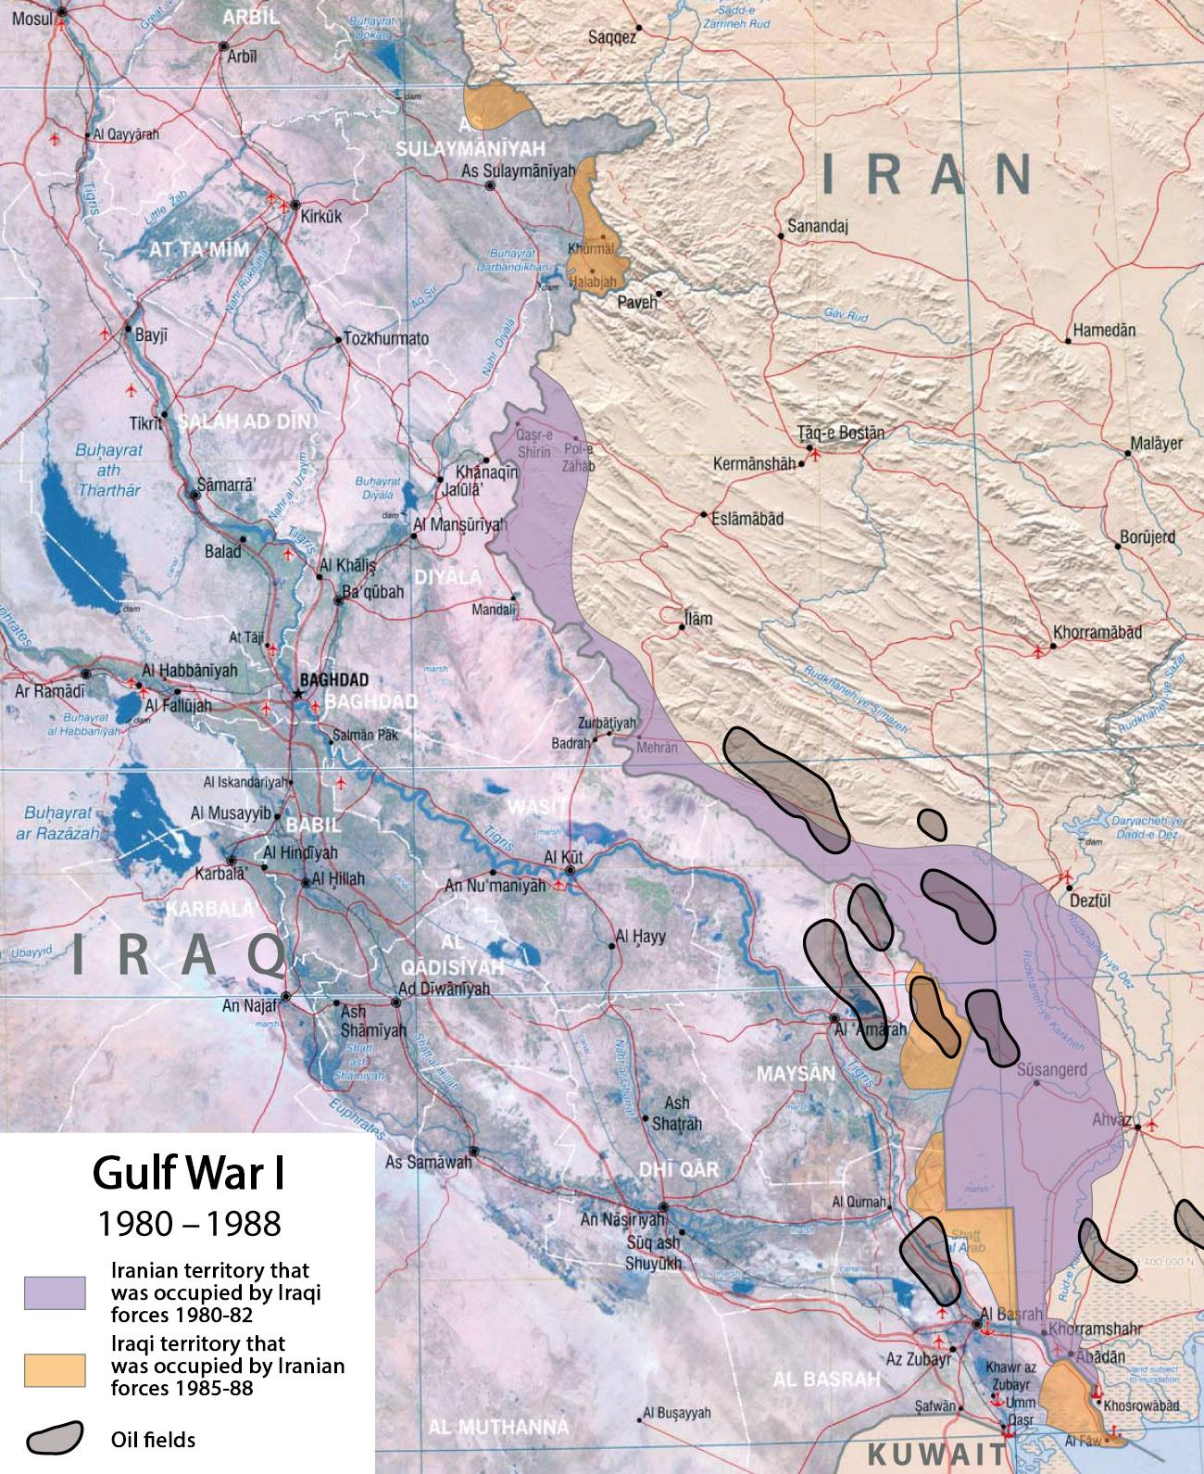
Prelude: Iraq from 1968-2002
Iran-Iraq War
On September 22nd, 1980, Iraq launched an invasion of Iran. This was for many reasons, including:
The Ayatollah Khomeini was exiled from Iraq in 1978, and after the Iranian Revolution, called for Iraqis to overthrow the Ba’athist Government of Iraq.
Saddam also wanted to expand Iraq to include the oil-rich areas of Khuzestan in Iran.[9]

Slide 9
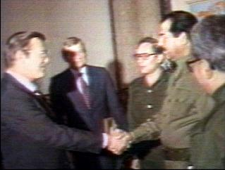
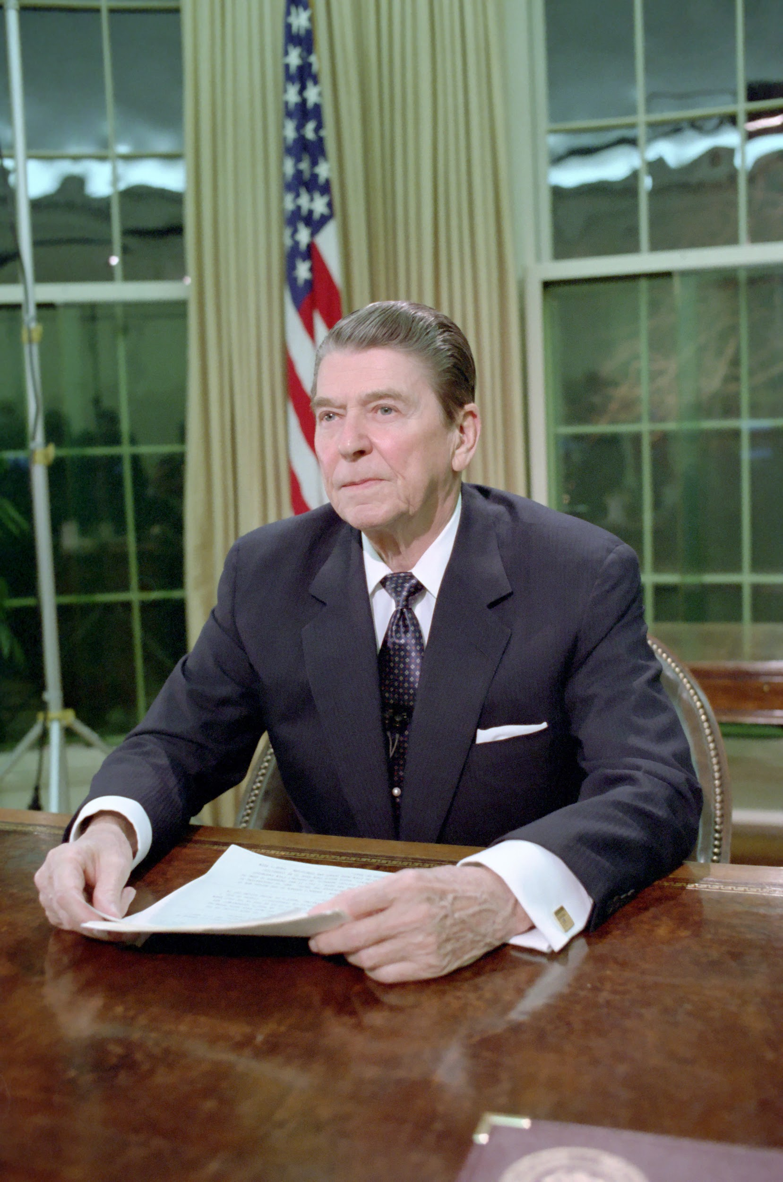
Prelude: Iraq from 1968-2002
Iran-Iraq War
The war lasted from 1980-1988, cost 1-2 million lives, and both sides failed to get what they achieved. Iraq made no territorial gains by the end of the war, and Iran failed to see Iraq’s government toppled.[10]
The United States funded both sides of the war. It sent helicopters and cluster bombs to Iraq, then gave millions of dollars in food credits to Iraq to buy weapons from the USSR and France. Reagan also sent Donald Rumsfeld to meet with Saddam and give assurances of US support in December 1983.[11]
The United States gave covert support to Iran through the infamous Iran-Contra affair in which the United States sold weapons to Iran and used the revenue to fund the Counter-Revolutionaries (Contras) in Nicaragua.[12]

Slide 10
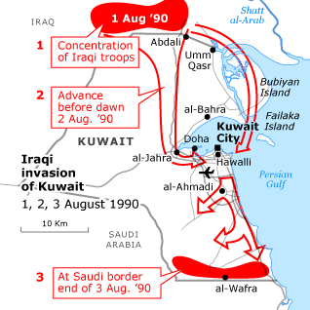
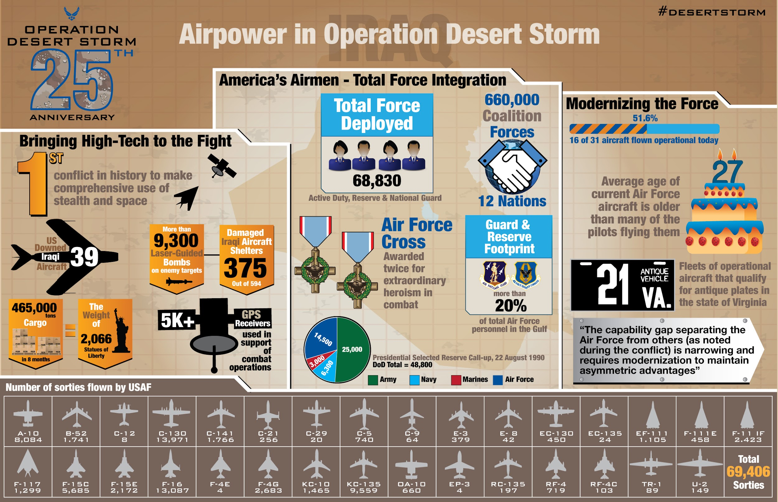
Prelude: Iraq from 1968-2002
Gulf War
Iraq launched another invasion on August 2nd 1990, this time on Kuwait, who purposefully increased their oil output following the Iran-Iraq War, and only brought it down once Saudi Arabia told them to. Venezuela then increased their output.
Saddam demanded Kuwait pay Iraq back for what Iraq saw as stolen oil, and when Kuwait did not respond, the invasion began. Many nations including in the west, Arab world and even the USSR condemned the unjustified invasion. [13]
Despite helping Iraq in the 80’s the US turned on Iraq for its own imperialist reasons in 1991. From August ‘91 to January ‘92, coalition forces including the United States, Kuwait, Saudi Arabia, the United Kingdom, France, and Egypt, as well as 29 other nations and the Mujahideen, built up their forces in what was known as Desert Shield. Military action was undertaken on January 17th, 1991, in “Operation Desert Storm”, beginning with a ruthless aerial bombing campaign. Desert Storm lasted 7 weeks and ended in coalition victory.[14]

Slide 11
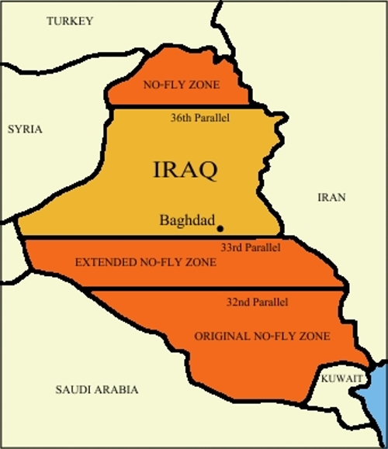
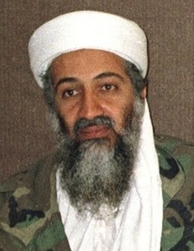
Prelude: Iraq from 1968-2002
The 1990’s, Al-Quaeda and September 11th
The ‘91 war in Iraq ended with a “Coalition Victory” in that the Iraqis were expelled from Kuwait, no-fly zones were set up in Iraq and strengthened US power in the Middle East. [13] Iraq lost ~20,000 servicepeople and over 3,000 civilians[15], many due to daytime air raids which killed hundreds of civilians [16]. There was also the February “Highway of Death” war crime that took the lives of 800-1000 Iraqis, some of which had surrendered. [17] Operation Desert Fox followed in 1998, bombing Iraq again.
In another part of the middle east, the group Al-Quaeda was formed out of the Mujahideen, the same one that received billions of dollars from the CIA to fight the Soviets in the 1980’s. Osama Bin-Laden was a leader in Al-Quaeda, and angered by US action in the region in the 90’s, issued his first religious fatwa for American troops to leave Saudi Arabia in 1996, which they had been in since Desert Shield. [18]
In 1998, he issued his 2nd fatwa against American support for Israel and presence in the Middle East since 1991.[19] He then orchestrated a massive terrorist attack against the United States in 2001, which was known as 9/11. [20]
Despite the fact that neither Iraq nor Saddam Hussein had anything to do with 9/11, Al-Quaeda or Osama Bin-Laden, 9/11 had a profound impact on Iraq as the United States used the attack to justify an entire imperial campaign in the Middle East, and by September 12th, Bush already instructed counter-terrorism czar Richard Clarke, to look into Iraq’s connection to 9/11, and Bush admin officials said there were “no good targets in Afghanistan, let’s bomb Iraq.”[21]

Slide 12
Discussion

Slide 13
The US Invasion of Iraq
2003-2011

Slide 14
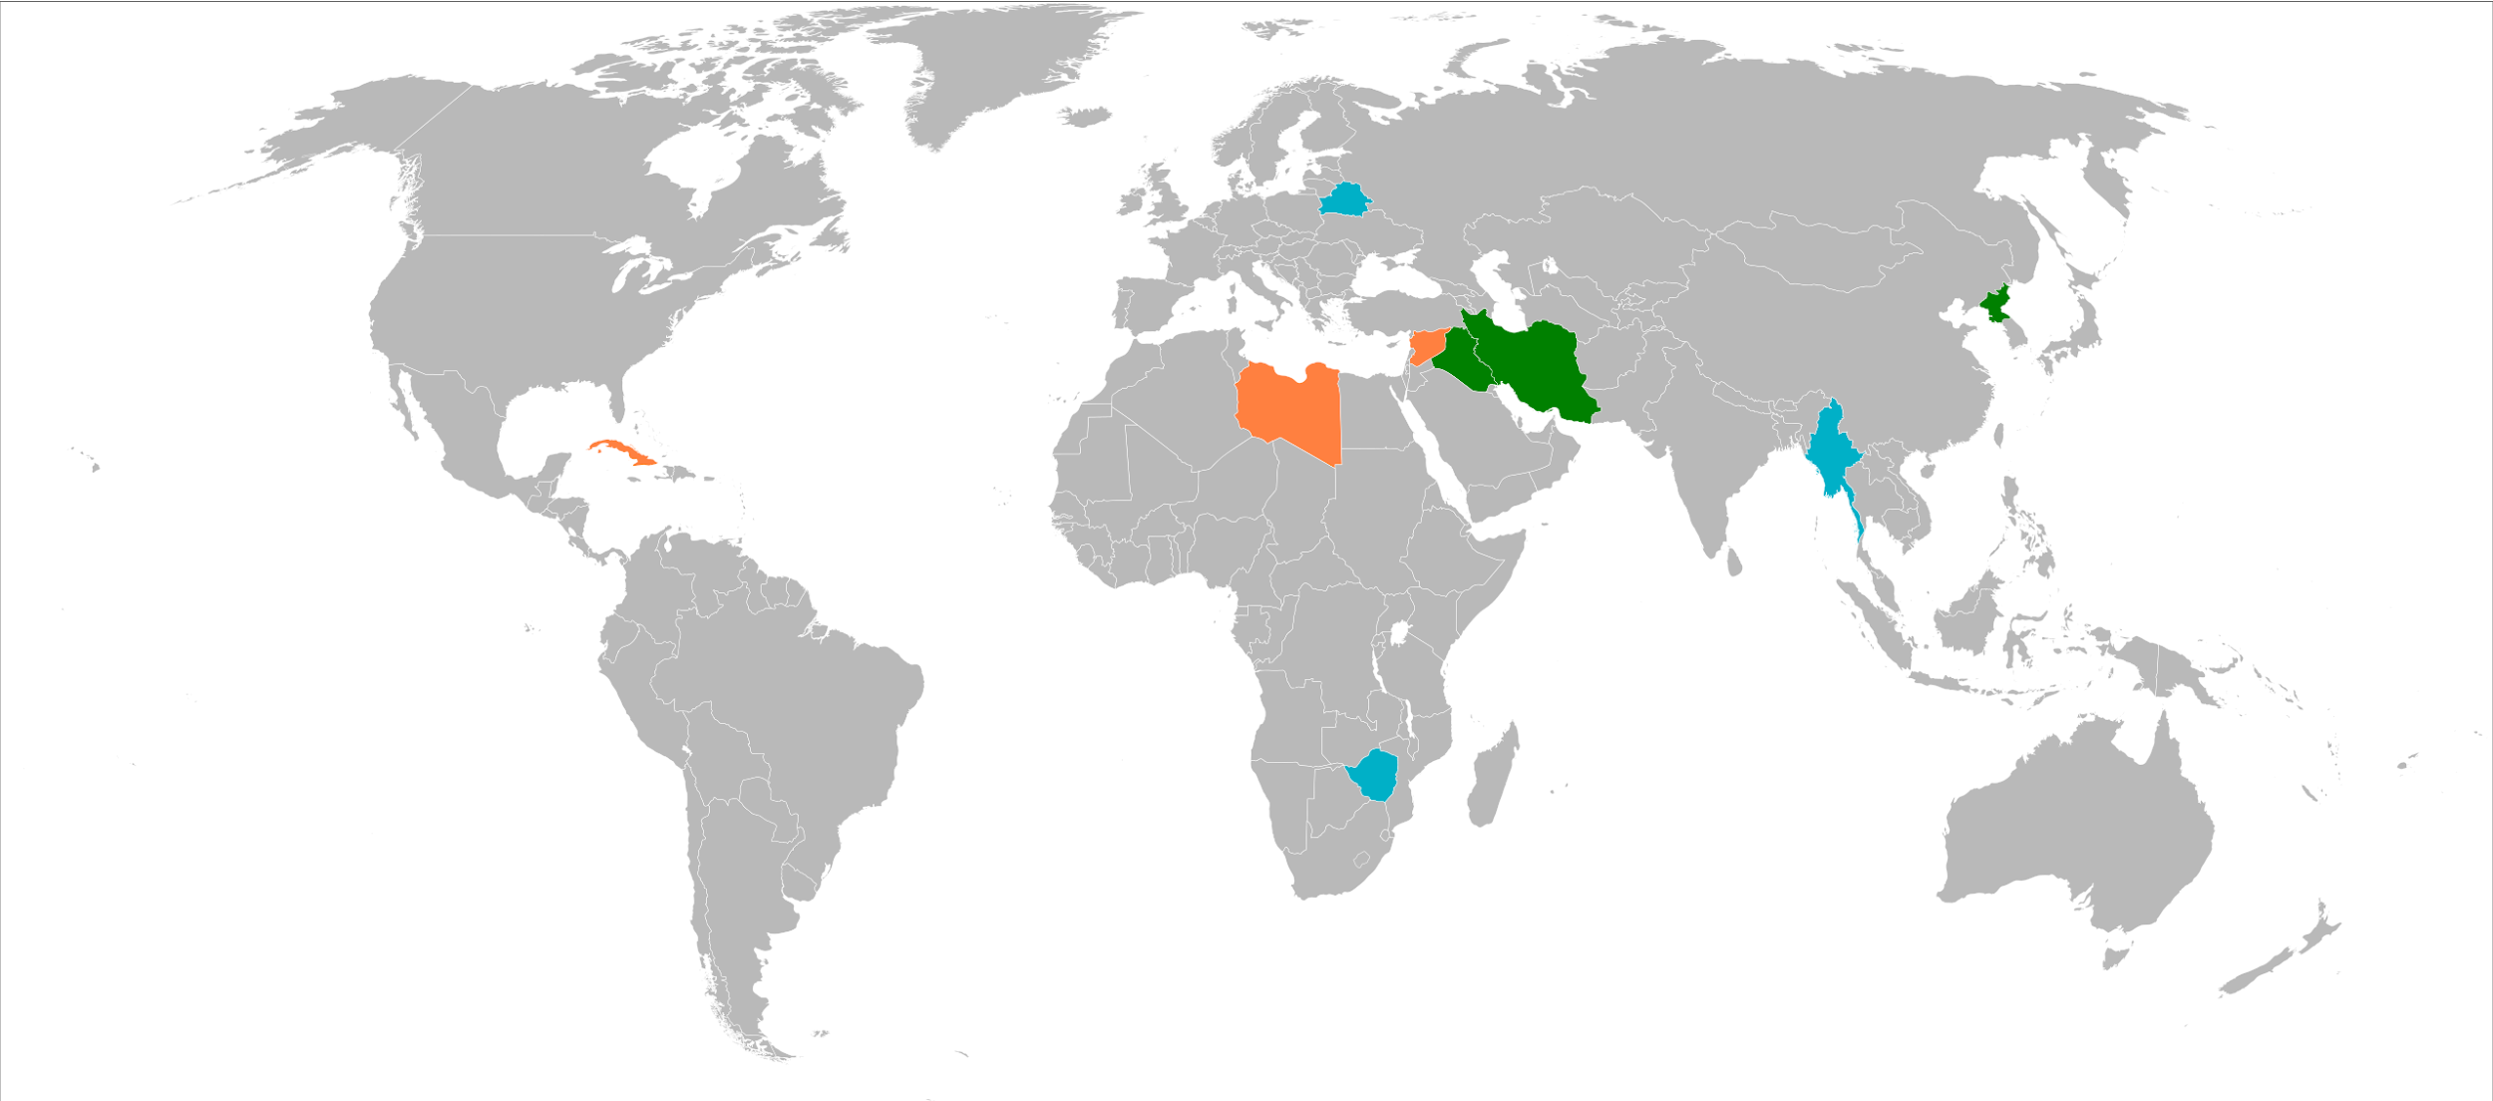
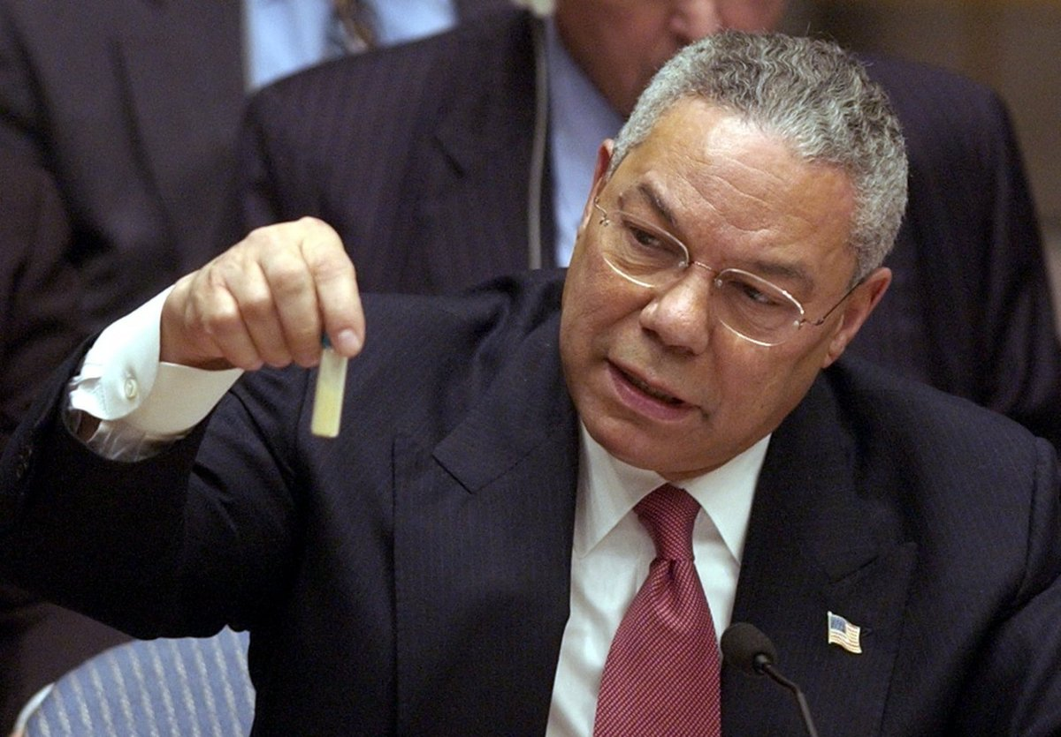
US Invasion of Iraq 2003-2011
Manufacturing Consent
In the climate of fear created after the 9/11 attacks, the US government used the opportunity to declare a global war on “terror” and the “axis of evil” and pump out false propaganda designed to justify an invasion of Iraq to the American people and international community.
Over 60 former and current military officials were paraded onto mainstream cable news networks and newspaper publications to peddle lies about Iraq, were given talking points by the CIA, and were paid between $500-$1000 per appearance.[1]
The main lie that was pushed was that Iraq was building Weapons of Mass Destruction. Colin Powell famously presented this lie on February 5th, 2003 in front of the UN.[2]
Countries Bush and his admin deemed the Axis of Evil
Colin Powell holds up a vial of white powder symbolizing anthrax that Saddam Hussein supposedly had.

Slide 15
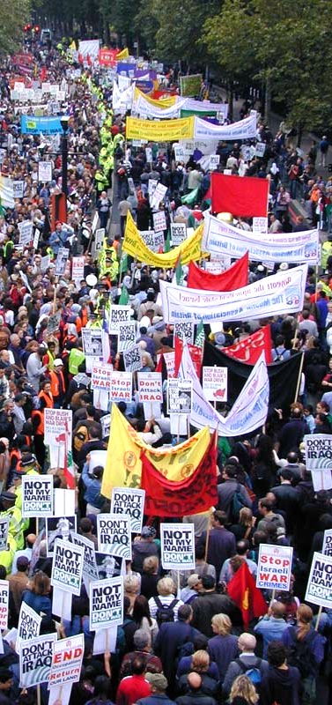
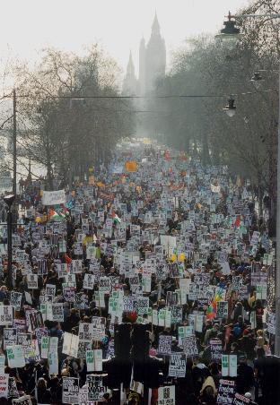
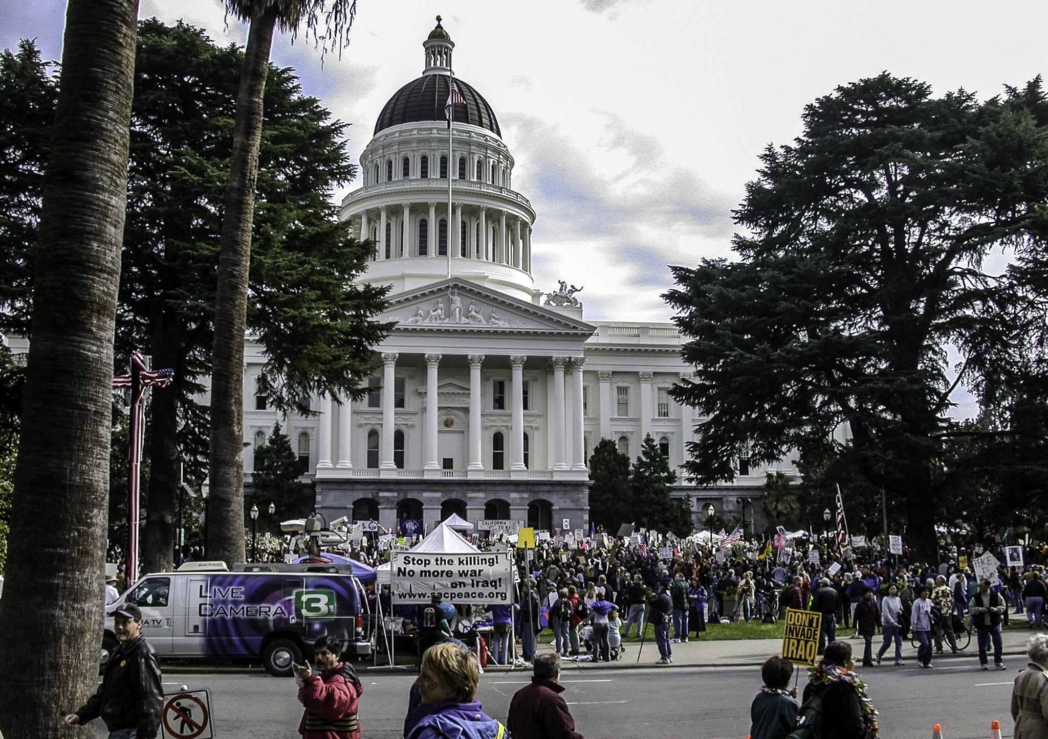
US Invasion of Iraq 2003-2011
Protests
From January 2003 to March 2003, ~36 million people around the world protested an impending US invasion of Iraq.
The largest day of protest came on February 15th, 2003, when millions marched in over 800 cities around the world, including:
3-4 million in Spain
3 million in Rome
2 million in London
half a million in France
half a million in Germany
half of million in the United States
smaller protests happening in Russia, Greece, India, South Korea, South Africa, Kenya
1 million on the streets of Baghdad, Iraq itself.
It stood as the largest protest in human history until the Indian Farmers Protest in 2020 [3][4]

Slide 16
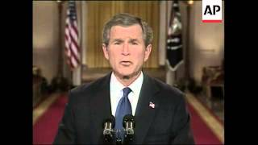
US Invasion of Iraq 2003-2011
Invasion - 48 Hour Ultimatum - 3/17/03

Slide 17
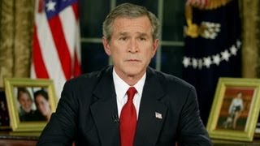
US Invasion of Iraq 2003-2011
Invasion - Bush Announces Invasion - 3/19/03

Slide 18
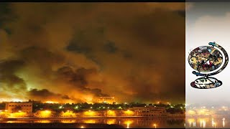
US Invasion of Iraq 2003-2011
Invasion - Shock and Awe - 3/19/03

Slide 19
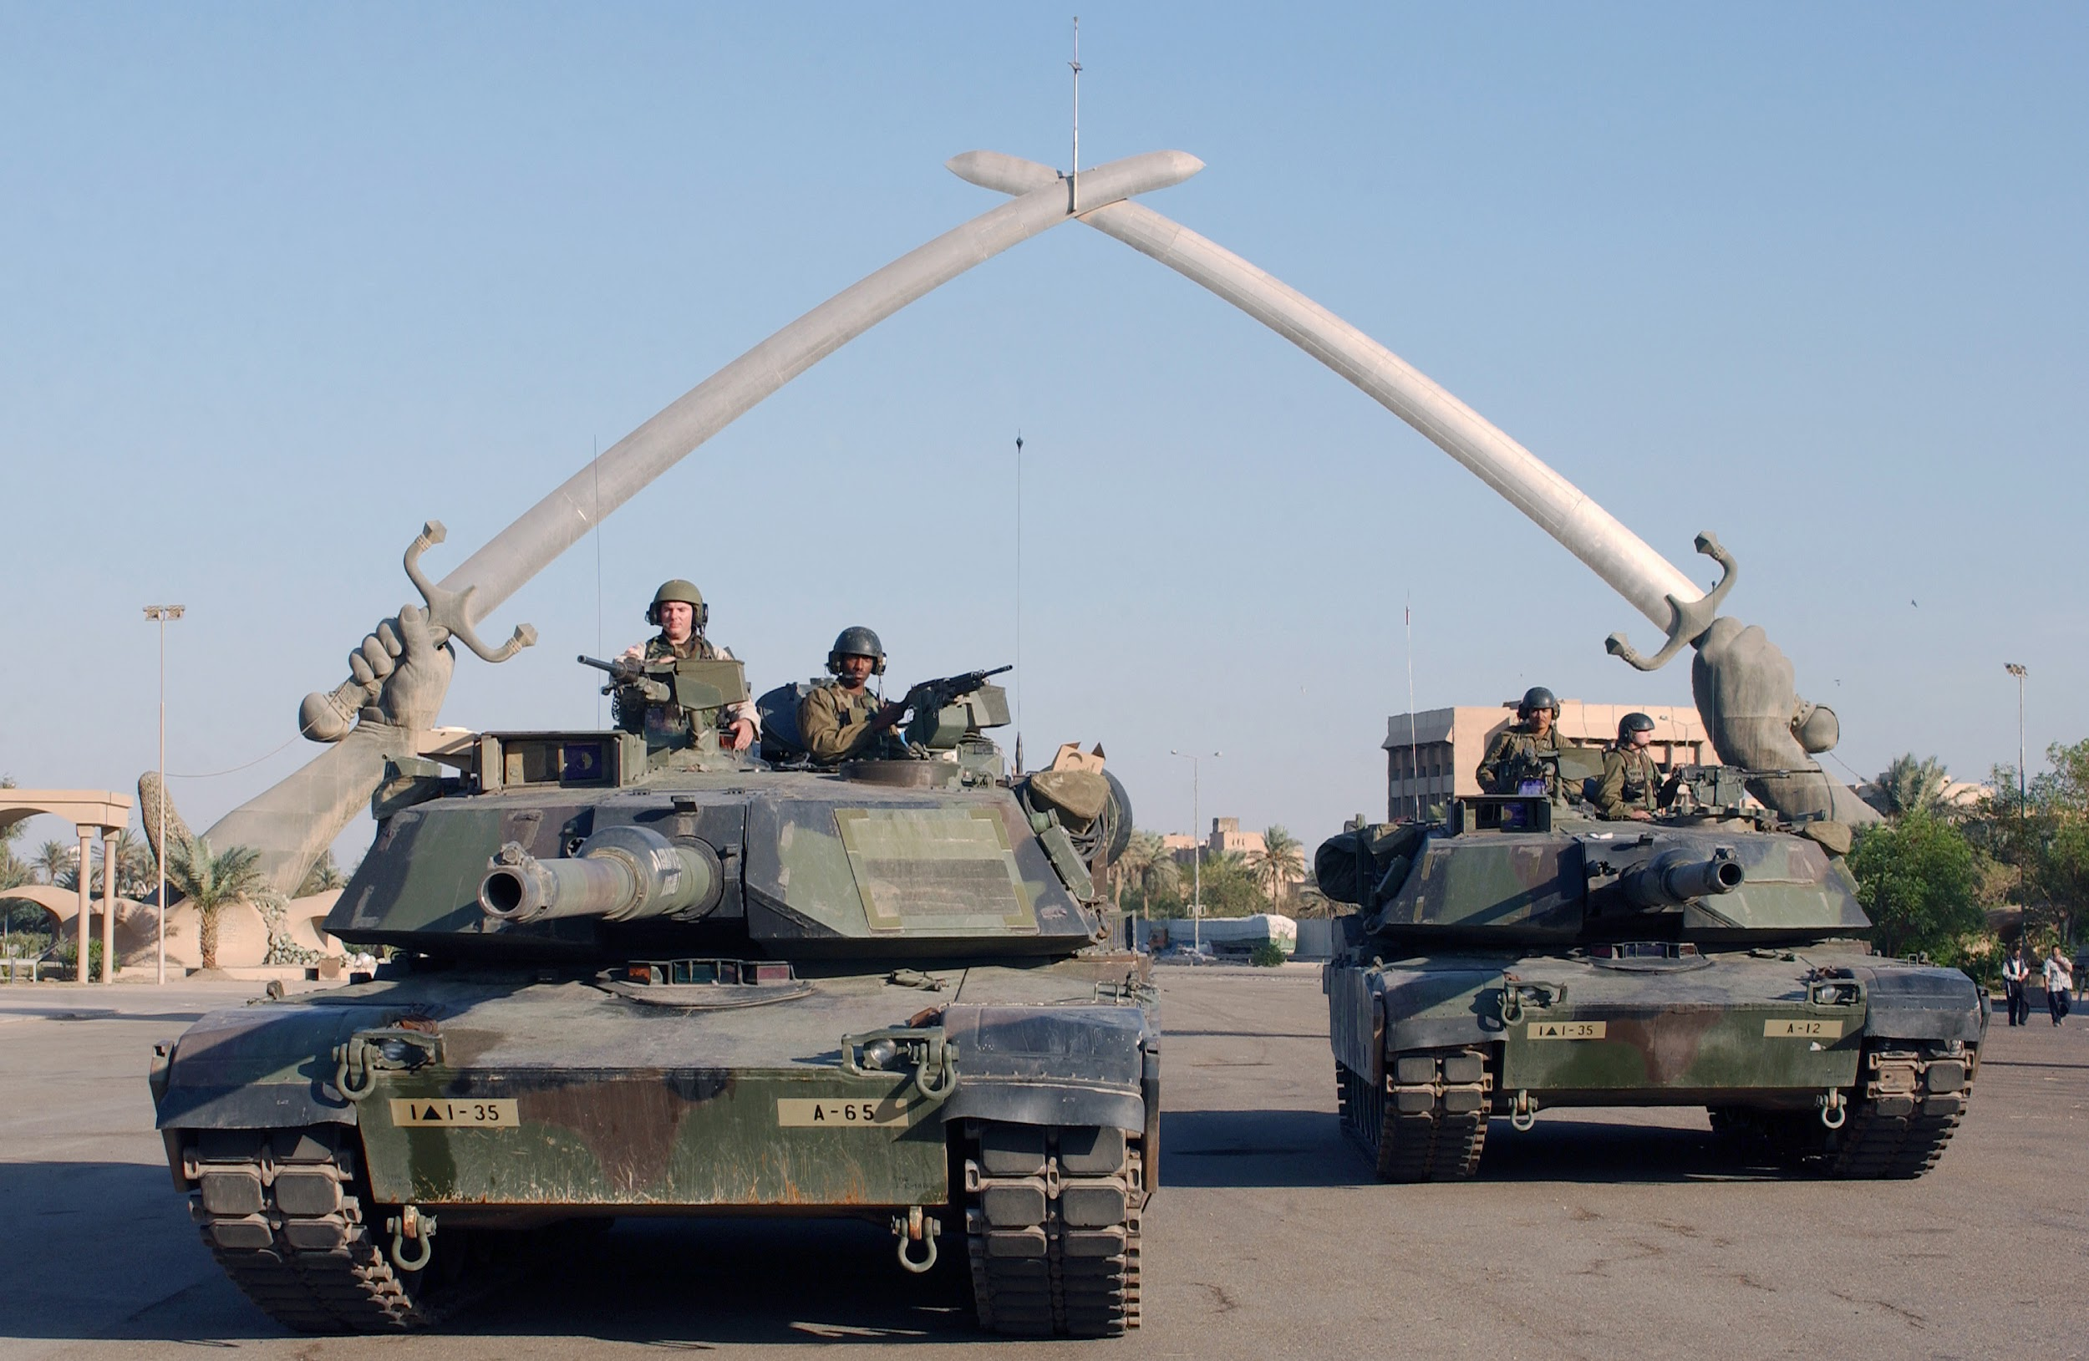
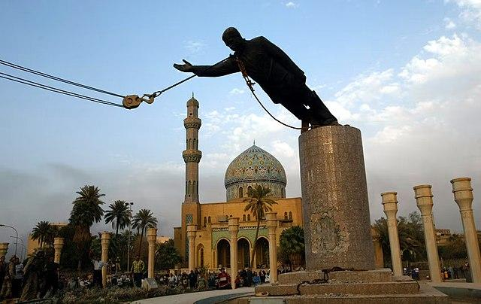
US Invasion of Iraq 2003-2011
Invasion - March, 20th 2003 - May 1st, 2003
March 19th - First casualty of the war at Doro Farm, where a 2000 lb Bunker Buster bomb killed 1 civilian and injured 14 others.
March 20th - The first attacks from coalition forces begin in Baghdad, and in Basra by the British 2 days later. The bombing campaign, carried out by B2 Stealth Bombers, “Shock and Awe” begins, taking the lives of 6,700 civilians from March 20th to April 9th .[5]
March 20th-April 9th - Bombing and ground campaigns rage as American forces assault Baghdad and British forces assault Basra. The US accuses Russia and Syria of supplying weapons to Iraq, which are promptly denied by both countries. Basra is captured on April 6th, the 1st coalition victory.
April 9th - US forces capture Baghdad, Saddam Hussein’s statue is toppled and major looting begins in the capitol, including of government buildings, hospitals, the Iraqi National Museum and more. Tikrit is the last town to be captured 4 days later.
May 1st - After the coalition victory, Bush announces from the USS Abraham Lincoln that the war is over and “Mission Accomplished” [6]

Slide 20
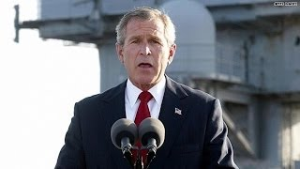
US Invasion of Iraq 2003-2011
Invasion - Mission Accomplished - 5/01/03

Slide 21
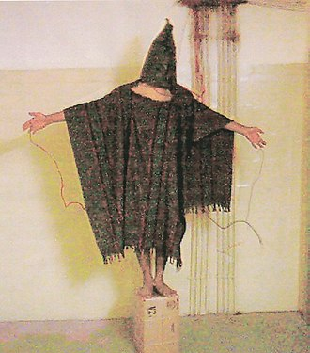
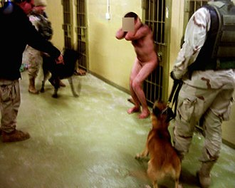
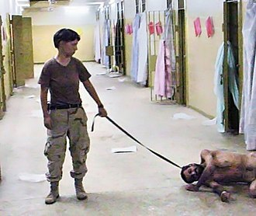
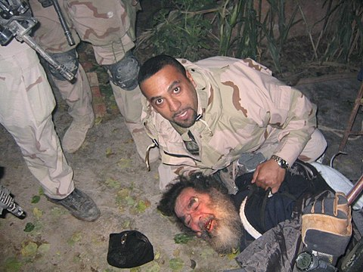
US Invasion of Iraq 2003-2011
Insurgency - May 1st, ‘03-February 22nd, ‘06
Following the “Coalition Victory” in May of 2003, the war shifted into an insurgency, as Iraqi insurgents including Ba’ath loyalists, Sunni Al-Quaeda in Iraq and the Shia Mahdi Army and others resisted US-led occupation of Iraq.[7]
In June of 2003, reports started to come out from Amnesty International and others that gruesome torture and abuse of prisoners was happening at Abu Ghraib Prison in Abu Ghraib Iraq.
In April of 2004, CBS News’ 60 Minutes, as well as Seymour Hersh, brought this to the world's attention.
Bush and Rumsfeld apologized for the abuses, but stated it was not indicative of US-policy. Human Rights Watch, Red Cross and Amnesty International rebuked that this was part of a pattern seen with Guantanamo Bay and Afghanistan prisons.
Only 2 soldiers involved were held accountable and imprisoned. Abuses included waterboarding, rape, bondage, beatings, humiliation and murder. 63 detainees were murdered.[8]
December 13th, 2003: Saddam Hussein is captured by United States military forces in “Operation Red Dawn”, named after the Cold War film.
[9]

Slide 22
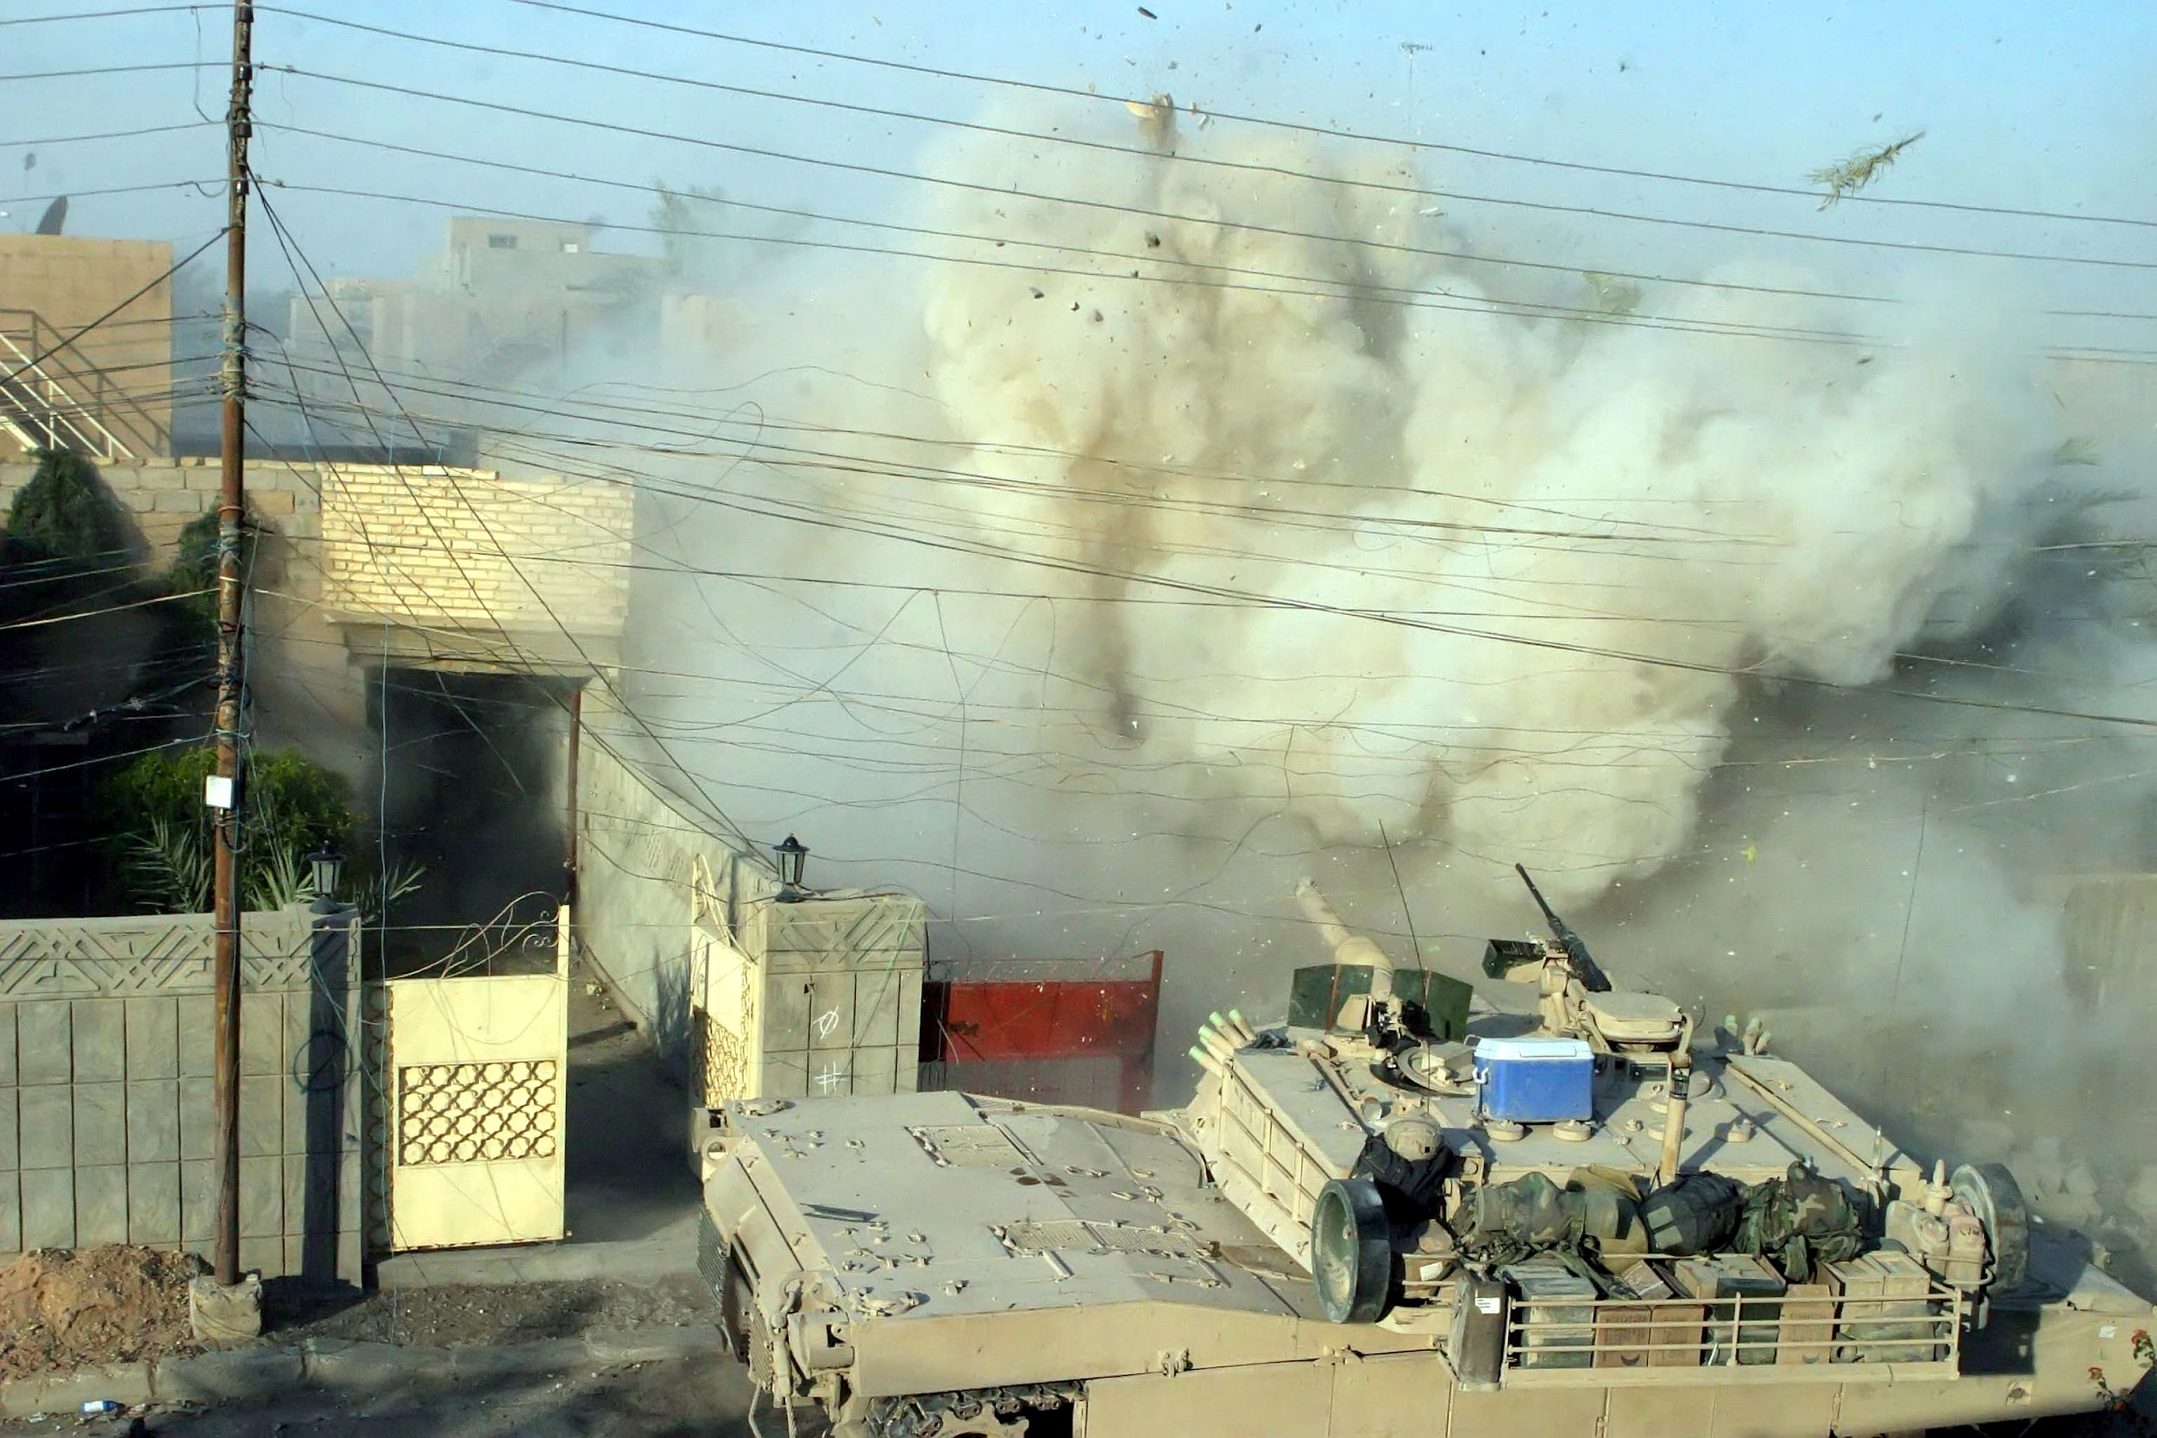
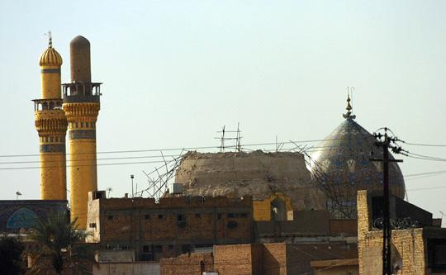
US Invasion of Iraq 2003-2011
Insurgency - May 1st, ‘03-February 22nd, ‘06
In 2004, chaotic fighting between the Coalition Forces and insurgents was underway in Fallujah, Abu Ghraib, Najaf, Samarrah and Mosul. The First and Second Battles of Fallujah were incredibly ferocious, close-quarters battles that also utilized a lot of indiscriminate airstrikes that killed many civilians. The Coalition Forces suffered their first major defeat in the First Battle, then won in the Second Battle.[9][10][11]
The Second Battle of Fallujah was the bloodiest battle of the War in Iraq and was the bloodiest battle the US had been in since the Battle of Hue City in the Vietnam War, with 1200-2000 Iraqi insurgents killed, 800 Iraqi civilians and 107 Coalition soldiers. This lasted until Nov 2004, and afterward the insurgents quickly took hold again. White phosphorus was also illegally used in the battle. [11]
2005 would see the first Iraqi elections since the start of the war, and voters approved a new Iraqi constitution. Saddam Hussein was also put on trial, convicted of crimes against humanity by Iraqi courts and hanged in December of 2006. It would also see the formation of the “Sons of Iraq”, a Sunni group sponsored by the US and with relation to Al-Quaeda in Iraq. Many members of the group would later become ISIS.[9][12]
On February 22nd, 2006, the Shi’ite al-Askari Shrine was bombed. The perpetrators are still unknown. The US alleged that Al-Quaeda in Iraq did it, who denied involvement. The Iranian President and Hezbollah leader claimed the United States and Israel were behind the attack to stoke a civil war in the Iraq, which it did between Sunnis and Shi’ites, which then allowed for continued US involvement.[13]

Slide 23
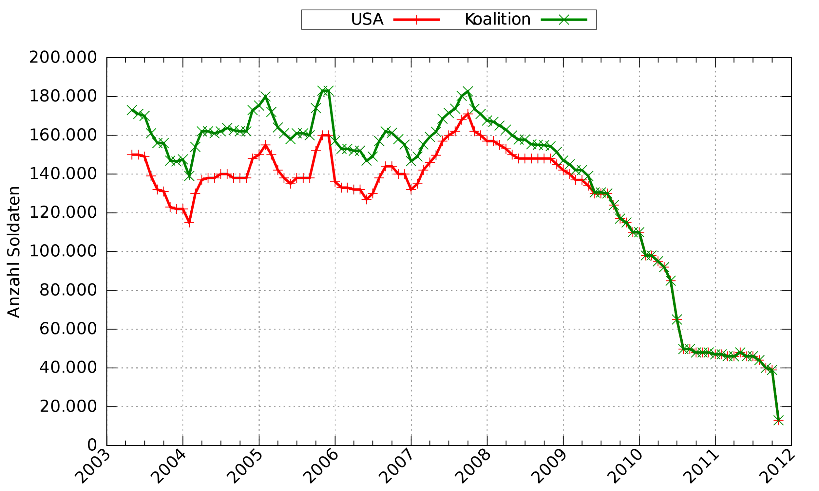
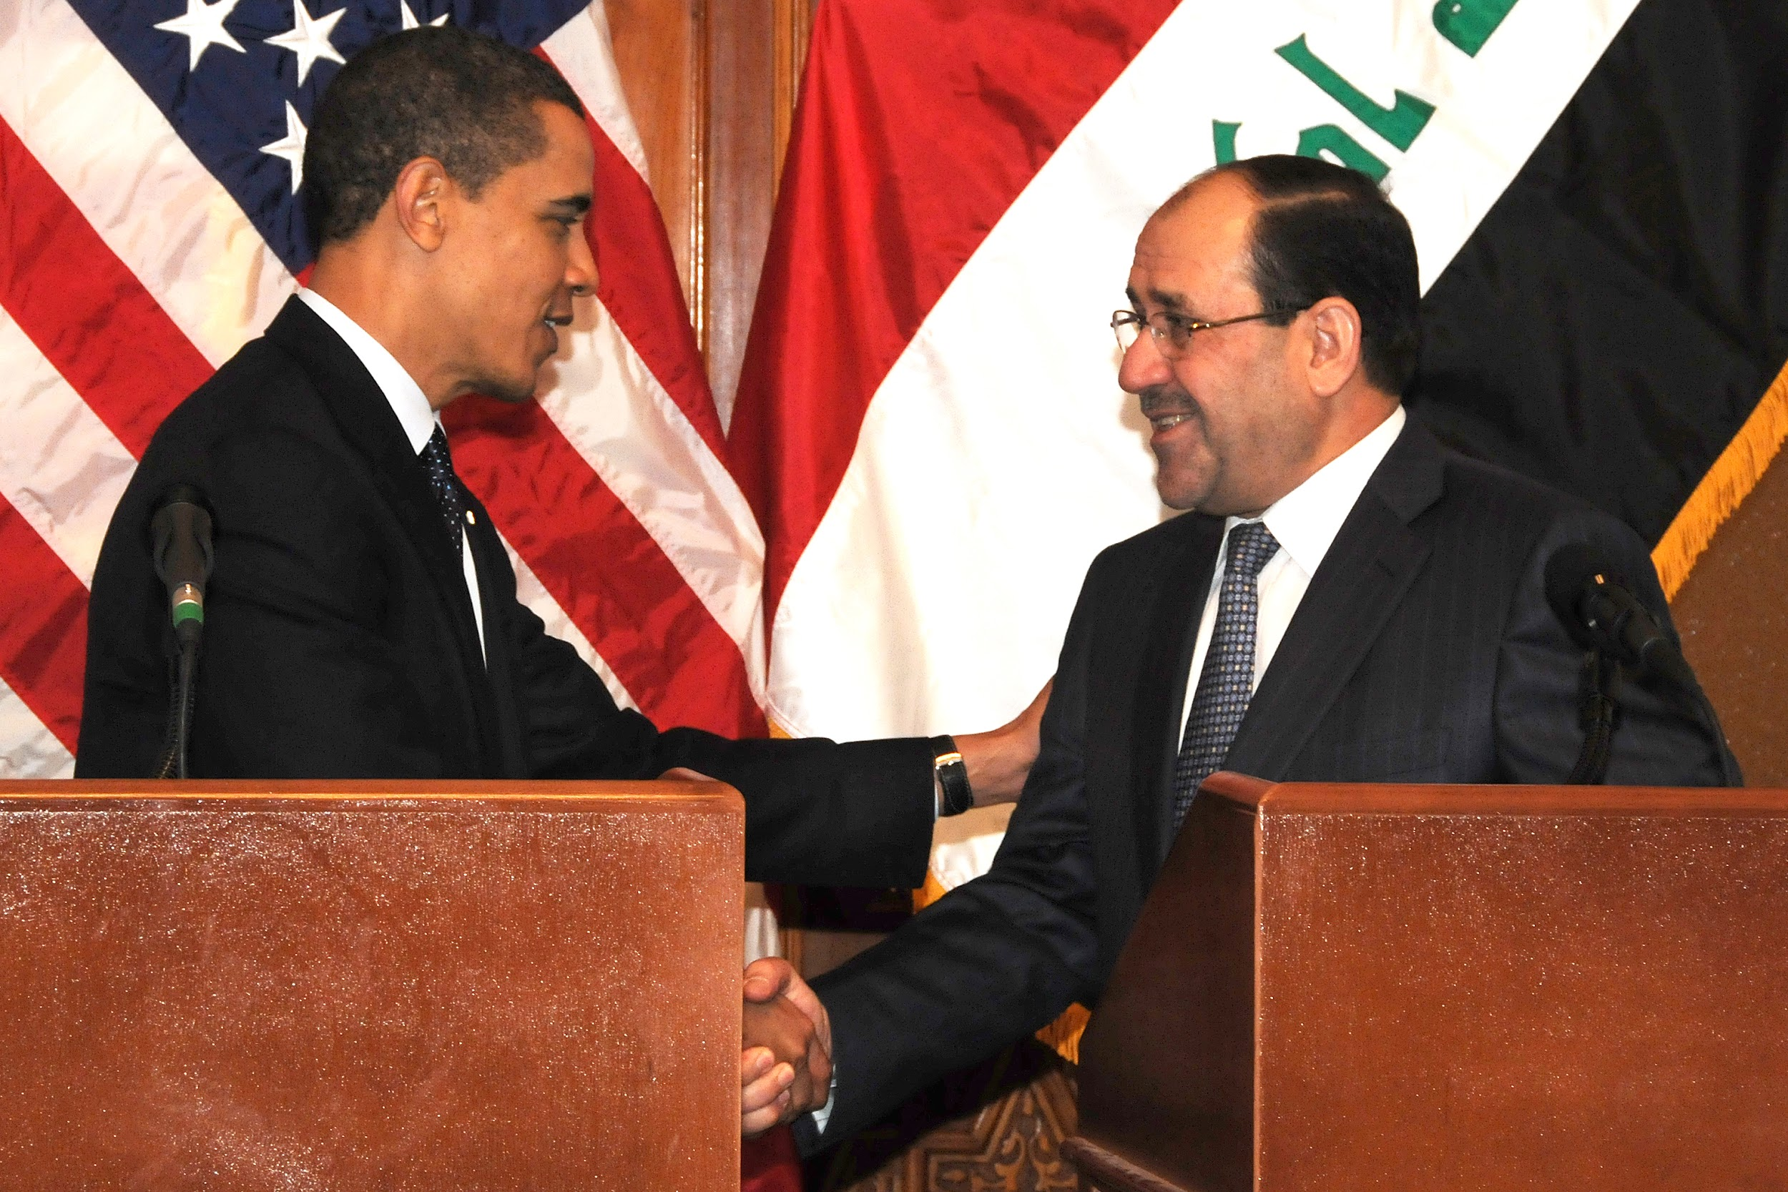
US Invasion of Iraq 2003-2011
Civil War - February 22nd ‘06-December 16th ‘11
In September 2006, a Third Push on Fallujah is mounted and the Great Sunni Awakening occurs in August, in which the Sons of Iraq gain influence in the city councils. Control of Fallujah is transferred to the Iraqi Provisional Authority in 2007.[12]
On January 10th, 2007, Bush announced a increase of 20,000 US soldiers in Iraq “to put down sectarian violence in Iraq.” A Bloomberg poll released on January 18th revealed that 60 percent of Americans opposed the troop surge. Bush’s approval rating had been the highest of any president ever after 9/11, up to 92%. His approval rating in early February 2007 was 32%, and in July of 2008, was at a record low of 22%.[14]
Elections in the US occurred in 2008, and Bush had served 2 terms. US Senator Barack Obama, who ran on saying Afghanistan was the “good war” that we should fight and Iraq was the “dumb war” that should be ended, and who flexed his opposition to the war over Hillary Clinton and Joseph Biden, who both voted for the war, won the presidency and was inaugurated on January 21st, 2009.
On August 18th, over a year after Obama took office, American combat operations in Iraq ended and troop presence was gradually drawn down as the war approached its December 2011 deadline set by the Bush Administration. In October of 2010, WiliLeaks published almost 400,000 classified documents on the Iraq War, which revealed over 66,000 civilian casualties out of around 109,000 total Iraqi casualties.[15]

Slide 24
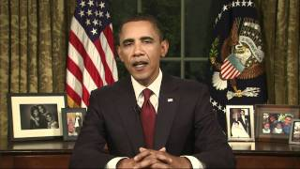
US Invasion of Iraq 2003-2011
Invasion - Ending the War - 8/31/10

Slide 25
Discussion

Slide 26
New Member Introductions
What is your name, pronouns and state (or country/territory)?
Where do you work? Is it unionized?
How did you find out about the People’s School?
What do you think about tonight's class?

Slide 27
Results of Iraq War and Continued US Intervention
2011-2023

Slide 28
Results of War and Continued
US Intervention 2011-2023
Profits
The biggest winners of the war were the oil and arms industries that secured $182 billion in contracts from the US government to cover everything from private military to “rebuilding” Iraq.
The Financial Times wrote in 2013 that
“No one has benefited more than KBR, once known as Kellogg Brown and Root. The controversial former subsidiary of Halliburton, which was once run by Dick Cheney, vice-president to George W. Bush, was awarded at least $39.5bn in federal contracts related to the Iraq war over the past decade. Two Kuwaiti companies – Agility Logistics and the state-owned Kuwait Petroleum Corporation – are the second and third-biggest winners, securing contracts worth $7.2bn and $6.3bn respectively. The US hired more private companies in Iraq than in any previous war, and at times there were more contractors than military personnel on the ground.”[1]

Slide 29
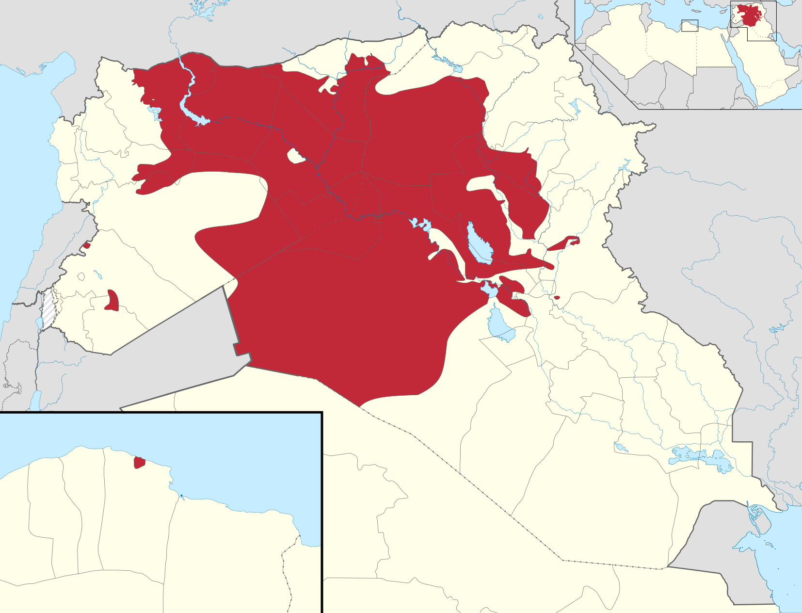
Results of War and Continued
US Intervention 2011-2023
Rise of ISIS, Second Iraqi Insurgency
The Iraqi Military left behind by Obama was not able to stop an insurgency in 2013 by a emergent group, the Islamic State of Iraq and Syria (ISIS), which was made of members from the Sons of Iraq formation before that the US aided.
The United States initially fueled ISIS and other groups, such as the Nusra front, by funding the Syrian rebel groups and generally aiding any groups hostile to the Syrian Government in the Syrian Civil War, beginning in March of 2011.[2]
A WikiLeaks provided classified email from Hillary CLinton in 2013 said
“We need to use our diplomatic and more traditional intelligence assets to bring pressure on the governments of Qatar and Saudi Arabia, which are providing clandestine financial and logistic support to ISIL and other radical Sunni groups in the region,”[3]
In 2014, ISIS took large swaths of Iraq and Syria and multiple large cities in the Northern and Western Iraq Offensives.

Slide 30
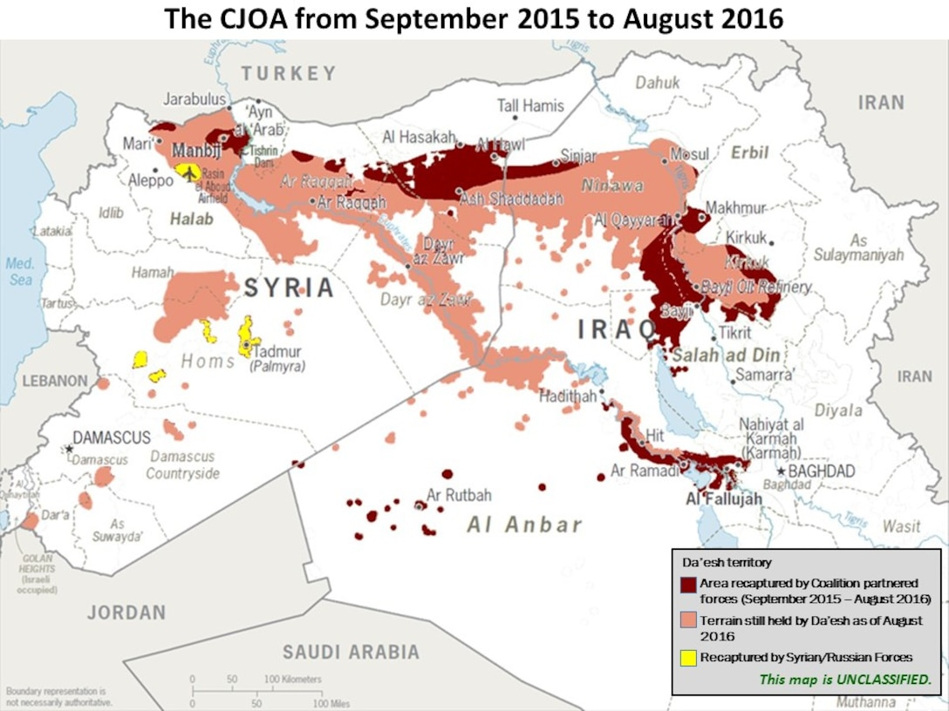
Results of War and Continued
US Intervention 2011-2023
US Intervention in Iraq 2014-2021
On June 15th, 2014, Barack Obama ordered Operation Inherent Resolve, the redeployment of the American military to Iraq less than 3 years after withdrawing, to fight ISIS. This was done at the request of the Iraq puppet government installed by the US.
This war lasted more than 7 years, and costed the lives of over 35,000 civilians, of which over 6,000 died at the hands of Coalition Forces.[4]

Slide 31
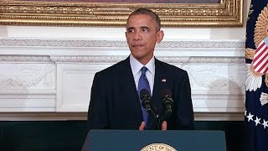
Results of War and Continued
US Intervention 2011-2023
Intervention - Operation Inherent Resolve - 8/7/14

Slide 32
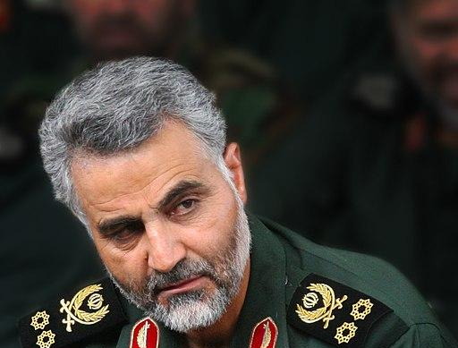
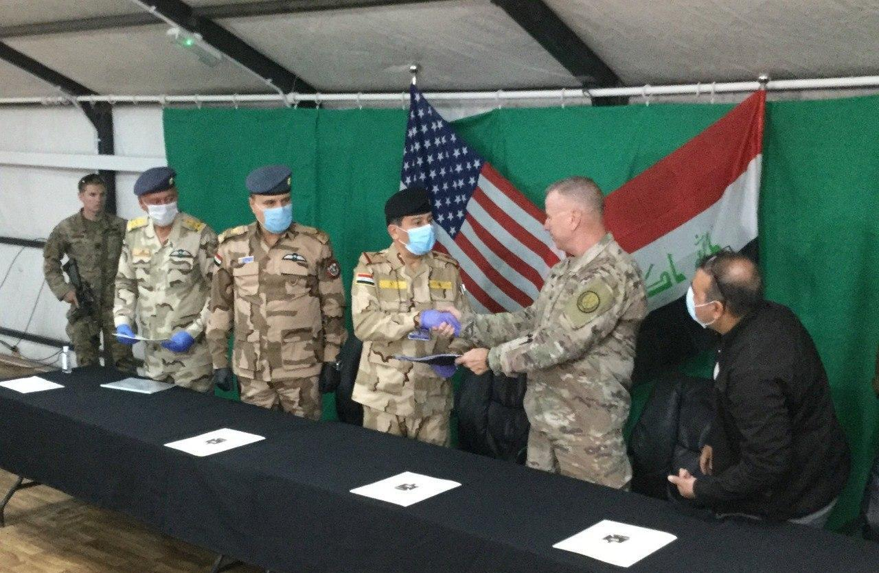
Results of War and Continued
US Intervention 2011-2023
US Intervention in Iraq 2014-2021
In the 2017 Mosul Airstrike under the new Trump Administration, over 200 civilians were killed, making it the deadliest airstrike since the 2003 invasion.
In 2018, ISIS began to lose territory in Iraq, and troop numbers were beginning to drop. On December 31st, 2019, angry Iraqi protesters attacked the US embassy in Baghdad, which Trump blamed on Iran.
4 days later, the United States, after using Saudi Arabia to lure Iranian Major General Qasem Soleimani into Baghdad, assassinated him in Operation Martyr Soleimani. Iran responded a few days later with a missile attack on an airbase in western Iraq that had US forces stationed there. This incident nearly brought the United States and Iran to war.
On February 10th, 2020, the United States began to withdraw its troops from 15 military bases in Iraq. On December 9th, 2021, the United States formally ended its combat mission in Iraq again, but left 2,500 troops that are still there to this day.[4]

Slide 33
Results of War and Continued
US Intervention 2011-2023
Intervention - Ending Combat Mission - 7/26/21

Slide 34
Discussion

Slide 35
Volunteers Needed!
We are in need of volunteers for the staff of the People’s School! Here’s a few roles we need filled:
People to help manage posting on our social media and podcast platforms
Video Editors, Audio Editors, Graphic Designers, Artists, Narrators
Facilitators, Web Controls, Moderators
Email info@peoplesschool.us if you’re interested and try to attend our next staff meeting on April 6th if possible.

Slide 36
New Outlook Publishers
newoutlookpublishers.store
Latest Releases

Slide 37
Legal Drive
Last year we were attacked and sabotaged by wreckers that tried to steal the PSMLS and destroy the PCUSA.
They failed, but they will be held accountable and there are still things they took from us that we’ve not got back, like videos, imagery and audio. That is why we still need donations to the legal drive.
To donate, go to partyofcommunistsusa.net/donations/
Put “For legal funds” in the details box and try to donate on Tuesday or Thursday so it is easier for us to sort through. It will go to the legal fund. Anything helps!

Slide 38
الدولية - Iraqi Internationale

Slide 39
Sources

Slide 40
Sources for First Section
All Wikipedia sources have further sources available on the website.
https://en.wikipedia.org/wiki/Iraq
https://worldpopulationreview.com/countries/iraq-population
https://worldpopulationreview.com/world-cities/baghdad-population
https://en.wikipedia.org/wiki/14_July_Revolution
https://en.wikipedia.org/wiki/Iraqi_Republic_(1958%E2%80%931968)
https://en.wikipedia.org/wiki/17_July_Revolution
https://www.nytimes.com/1975/12/09/archives/vationalizing-of-oil-completed-by-iraq-iraq-completes-nationalizing.html
https://en.wikipedia.org/wiki/Ba%27athist_Iraq
https://en.wikipedia.org/wiki/Iran%E2%80%93Iraq_War
https://www.britannica.com/event/Iran-Iraq-War#ref344821
https://www.npr.org/templates/story/story.php?storyId=4859238&t=1573287420836
https://nsarchive2.gwu.edu/NSAEBB/NSAEBB210/
https://en.wikipedia.org/wiki/Gulf_War
https://en.wikipedia.org/wiki/Gulf_War_air_campaign
https://www.pbs.org/wgbh/pages/frontline/gulf/appendix/death.html
https://www.hrw.org/reports/1991/gulfwar/INTRO.htm
https://web.archive.org/web/20160104222225/http://www.comw.org/pda/0310rm8ap2.html
https://web.archive.org/web/20011031024057/http://www.pbs.org/newshour/terrorism/international/fatwa_1996.html
https://www.pbs.org/newshour/updates/military-jan-june98-fatwa_1998/
20. https://en.wikipedia.org/wiki/September_11_attacks
21. https://www.youtube.com/watch?v=0Q8qAtimsEE

Slide 41
Sources for Second Section
All Wikipedia sources have further sources available on the website.
Untold History of the United States, O. Stone & P. Kuznik, 2013, pg 522
https://www.newyorker.com/news/daily-comment/colin-powells-fateful-moment
https://www.wsws.org/en/articles/2003/02/summ-f17.html
https://slate.com/news-and-politics/2020/12/india-farmer-protests-modi.html
https://aoav.org.uk/2014/baghdad-shock-awe/
https://en.wikipedia.org/wiki/Timeline_of_the_2003_invasion_of_Iraq#May_1
https://en.wikipedia.org/wiki/Iraqi_insurgency
https://en.wikipedia.org/wiki/Abu_Ghraib_torture_and_prisoner_abuse#Casualties
https://en.wikipedia.org/wiki/Timeline_of_the_Iraq_War#December
https://en.wikipedia.org/wiki/First_Battle_of_Fallujah
https://en.wikipedia.org/wiki/Second_Battle_of_Fallujah
https://en.wikipedia.org/wiki/Sons_of_Iraq#Anbar_Awakening
https://en.wikipedia.org/wiki/2006_al-Askari_mosque_bombing
https://news.gallup.com/poll/116500/presidential-approval-ratings-george-bush.aspx
https://wikileaks.org/irq/

Slide 42
Sources for Third Section
All Wikipedia sources have further sources available on the website.
https://www.ft.com/content/7f435f04-8c05-11e2-b001-00144feabdc0
https://www.theguardian.com/commentisfree/2015/jun/03/us-isis-syria-iraq
https://thegrayzone.com/2016/10/11/hillary-clinton-isis-saudi-arabia-qatar-wikileaks-emails/
https://en.wikipedia.org/wiki/American-led_intervention_in_Iraq_(2014%E2%80%932021)#Timeline

