Slide 1
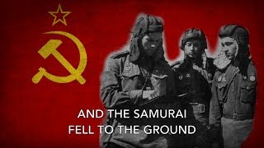
Tri Tankista - Song of the Soviet Tankmen

Slide 2
PSMLS 07/11/23 - 07/13/23

Slide 3
What we’ll be learning today:
Briefly about the events in between the battles of Stalingrad and Kursk.
The Battle of Kursk, the largest tank battle in history, and the significance of it to this day.
Relating the Great Patriotic War to today’s war in Ukraine.

Slide 4
Prelude

Slide 5
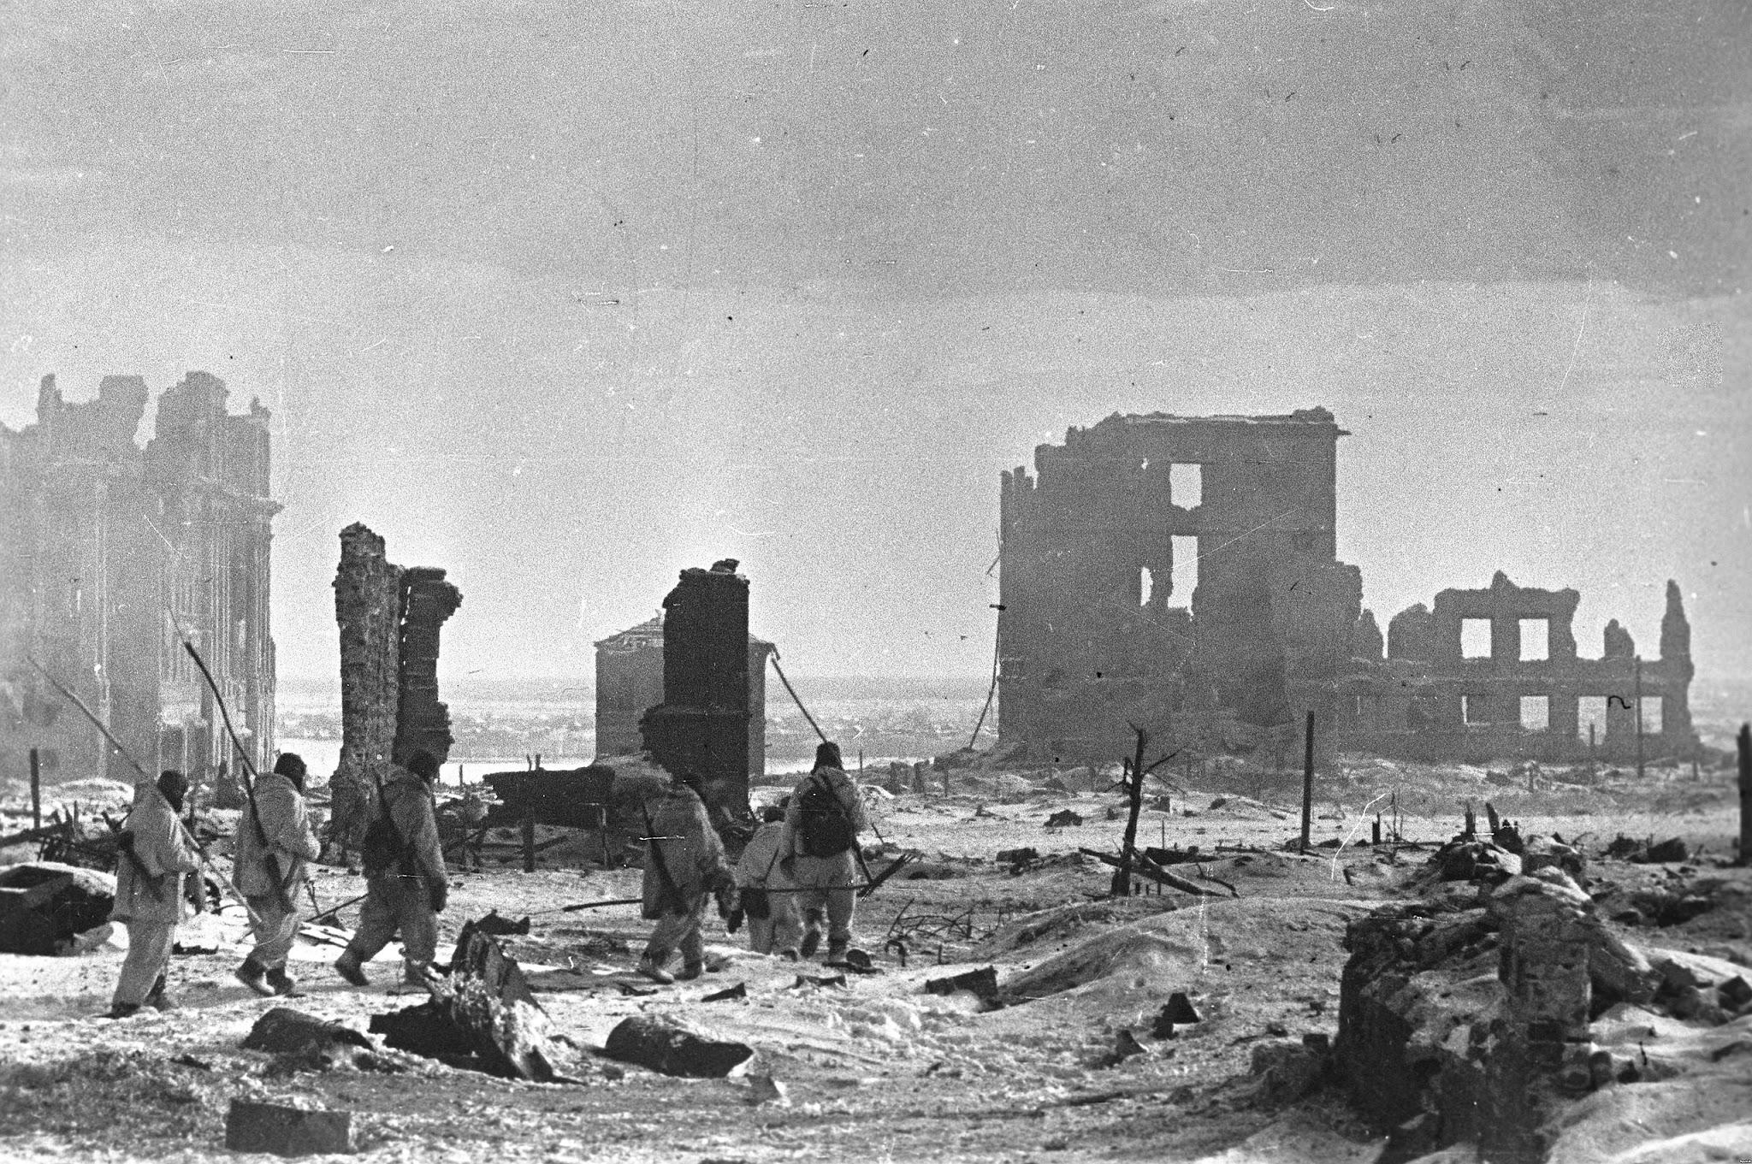
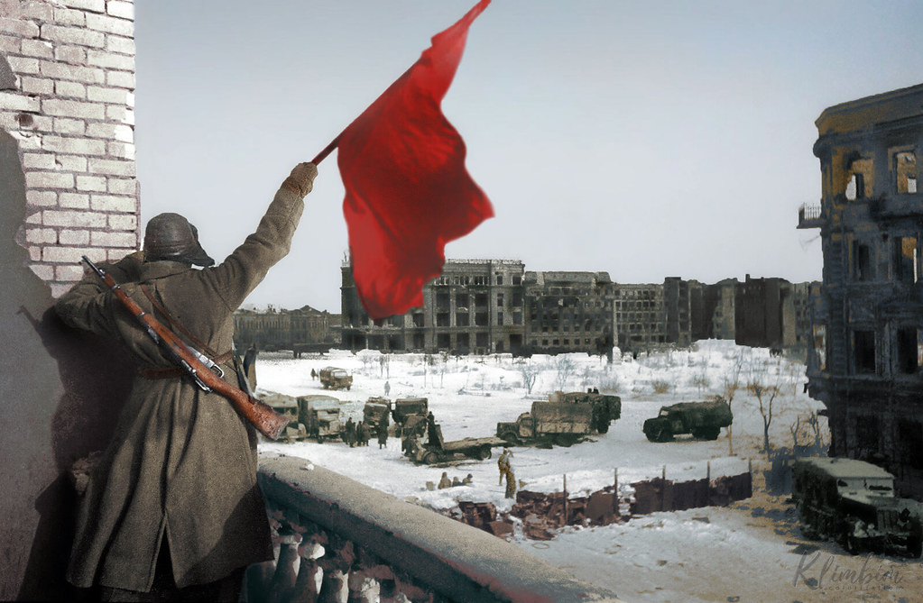
Prelude
Victory at Stalingrad!
In the dark summer of 1942, Hitler had launched Operation Blau in Ukraine and Southern Russia, whose objective was the seizure of the Caucasus oil fields and the control of the Lower Volga around Stalingrad down to the Caspian Sea.
Operation Blau resulted in the Battle of Stalingrad, where the Wehrmacht's elite 6th Army was annihilated. The Red Army routed German forces in the Caucasus who had to retreat hurriedly to the Crimea to avoid complete destruction.
After the Victory at Stalingrad, the Red Army launched a general offensive in the South and achieved important success on a front of 1500 km, but fell short of accomplishing its most ambitious goals, due to German surprising resilience after its defeat at Stalingrad, as proven by the Red Army's failure to hold Kharkov.

Slide 6
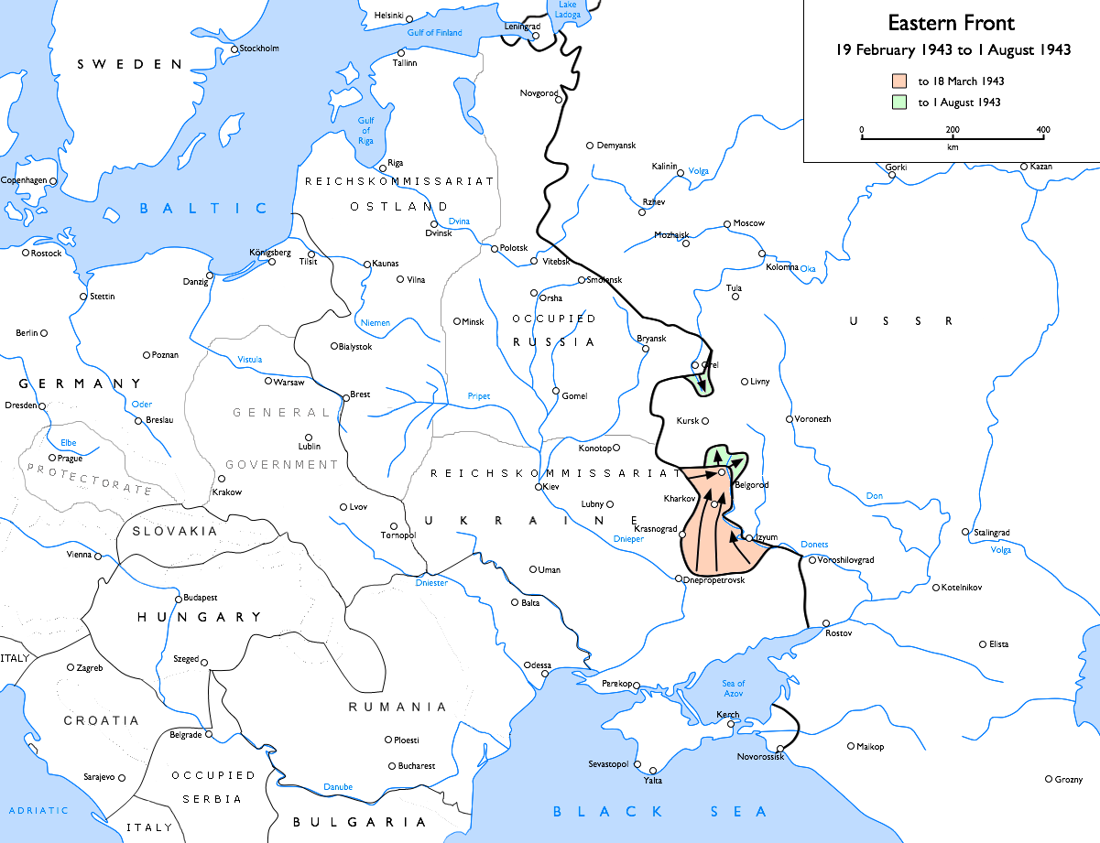
Prelude
Eyeing Kursk
The Soviet winter offensive ground to a halt with the advent of the "Rasputitsa", the snow melting season, when Russia, Belarus and Ukraine turn into "Marshal Mud".
Starting in the early spring of 1943, the Red Army remained on the defensive. One peculiar aspect of the front line, was the existence of a huge bulge, pointing to the west and centered around the town of Kursk, about halfway between Orel to the north, and Kharkov to the south, both cities in German hands.
This particularity of the front line presented the Wehrmacht with the ideal perspective of enveloping the Kursk salient with a pincer maneuver toward the South from Orel and toward the north from Kharkov.

Slide 7
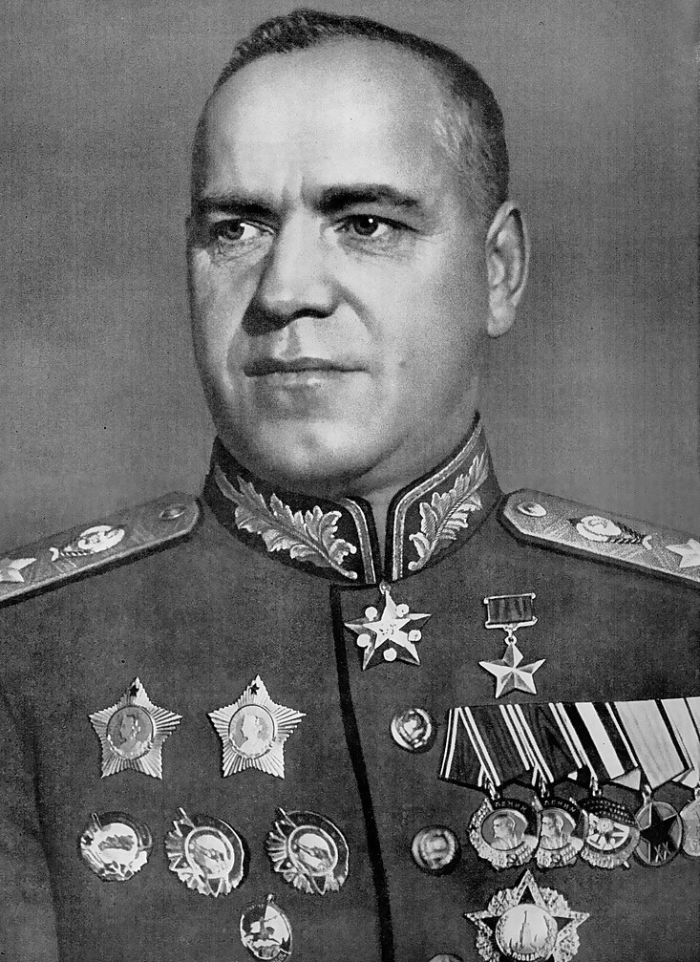
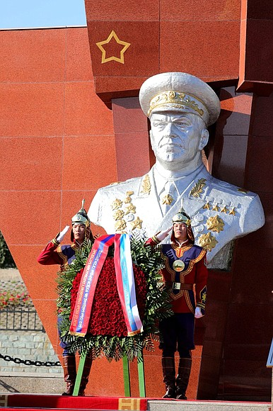
Prelude
Predicting German Offensive
This wasn't lost on Zhukov who could predict the intentions of the German High Command. In April 1943 he suggested to Stalin the possibility to prepare for and absorb the German attack and then launch a powerful counter-offensive.
Zhukov was pushing the right buttons with Stalin, who, after consulting with the Front Commanders to put to the test Zhukov's position, fully agreed with the Marshal's plan.
In the month of May, Soviet intelligence totally confirmed German intentions and preparations. In the spring of 1943 Germany began energetic preparations for the offensive, code name Operation Citadel. Total mobilization was proclaimed and the Wehrmacht received 2 million more men than in 1942.
Altogether Germany had 6.3 million POW's and foreign slave labor in its war industry. Improved versions of its best tanks, Tiger and Panther panzers were developed. The Wehrmacht put 71% of its forces on the Eastern Front, 4.8 million soldiers, plus 500k allied troops for a total of 5.3million soldiers. Facing them were 6.4 million Red Army's troops. For Operation Citadel, the Wehrmacht concentrated 900k men, 2.7k tanks, 10k guns, and 2k planes.

Slide 8
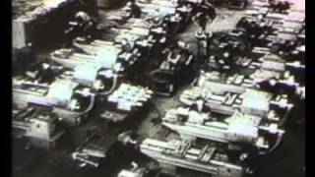
The Unknown War - The World’s Greatest Tank Battle

Slide 9
The Battle of Kursk:
Operation Citadel

Slide 10
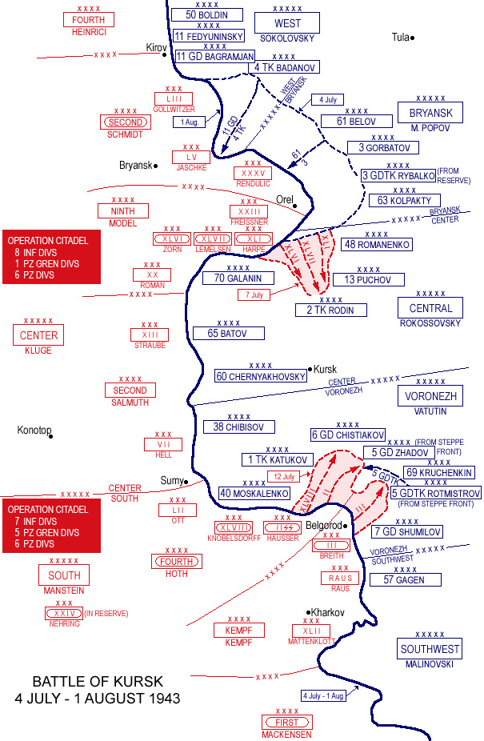
Battle of Kursk
Kursk Salient
The Kursk salient was located at the junction of German Army Group Center, around the city of Orel and German Army Group South around the city of Kharkov. The 9th army of Group Army Center, that would attack from the north, was commanded by General Walter Model. The 4th Panzer Army of Group Army South, that would attack from the south, was commanded by Marshal von Manstein.
3 elite SS divisions were part of Group Army South:
The 1st SS Panzer division Leibstandarte Adolf Hitler which was Hitler’s bodyguard troops.
The 2nd SS Panzer division Das Reich, that used the Wolf Angel symbol, the one that Azov Ukronazis are using today.
The 3rd SS Panzer division Totenkopf, “Death Head”, whose symbol is also widely used today by Ukronazi troops in the current war.

Slide 11
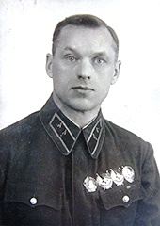
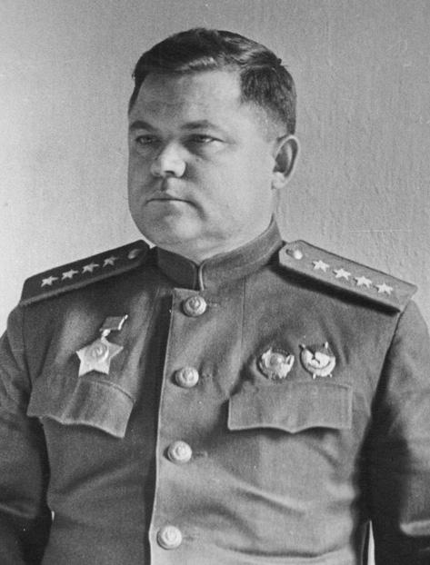
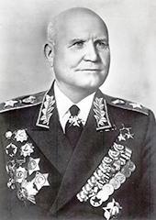
Battle of Kursk
Soviet Defenses
Hitler’s objective was to smash Soviet defenses with a tank avalanche.
Inside the salient were 1.3 million Red Army men, 20k guns and mortars, 3.6k tanks. 2 armored colossus were waiting to collide head on. The Soviet plan was to annihilate the enemy in both the regions of Orel and Kharkov, and to liberate the Ukraine up to the Dniepr river as well as the Donbass.
Konstantin Rokossovsky commanded the Central Front to the north of the salient facing Model’s 9th army. Nicolai Vatutin commanded the Voronezh Front to the south facing Manstein’s 4th Panzer army. Then Ivan Konev commanded the Steppe Front, kept in reserve. The whole Red Army Kursk operation was directed by 2 Marshals of the USSR : Georgy Zhukov and Alexander Vasilevsky.
Rokossovsky
Vatutin
Konev

Slide 12
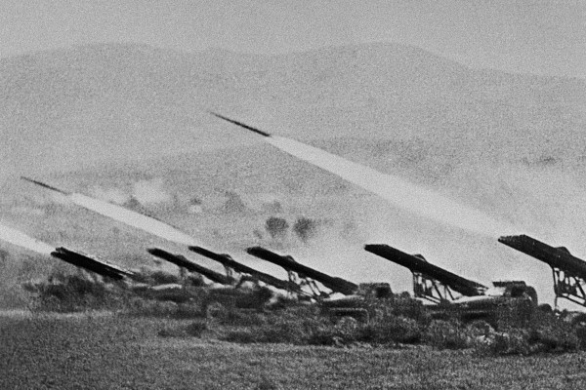
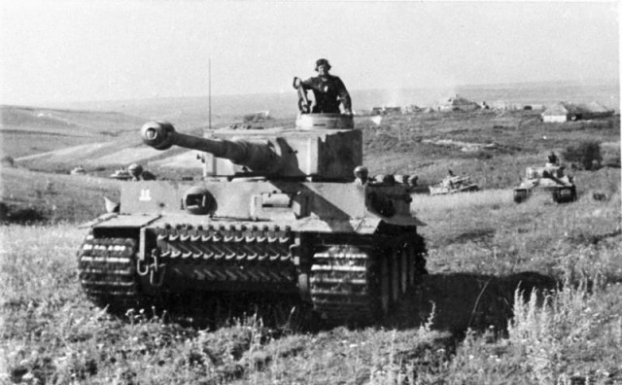
Battle of Kursk
The Gods of War
German soldiers were captured who gave the day and time of the start of Citadel: it was July 5th, at 03:00.
That was the time Vatutin and Rokossovsky chose to unleash an avalanche of Katyushas and artillery, “The Gods of War”, on the enemy’s battle dispositions. This shelling caused considerable confusion and great casualties on the Germans, and disrupted their initial assault.
The Wehrmacht attacked Rokossovsky’s Central Front at 05:30 and Vatutin’s Voronezh Front at 06:00. And a savage battle began, the 1st day of which Germans had lost 25k men and 200 tanks. By the 2nd day, the SS divisions in the South had advanced 4 miles into Vatutin’s Front, and after one week only 9 miles.

Slide 13
The Unknown War - The World’s Greatest Tank Battle

Slide 14
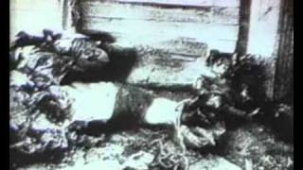
The Unknown War - The World’s Greatest Tank Battle

Slide 15
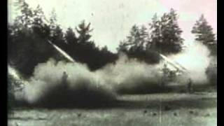
The Unknown War - The World’s Greatest Tank Battle

Slide 16
Discussion

Slide 17
Battle of Kursk:
Soviet Counter-Offensive

Slide 18
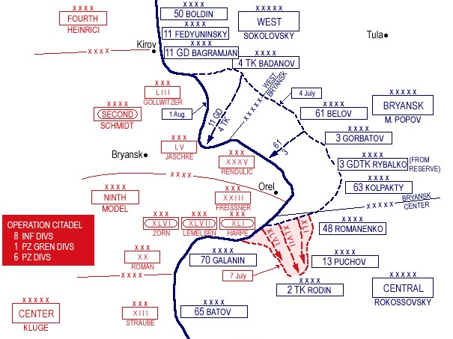
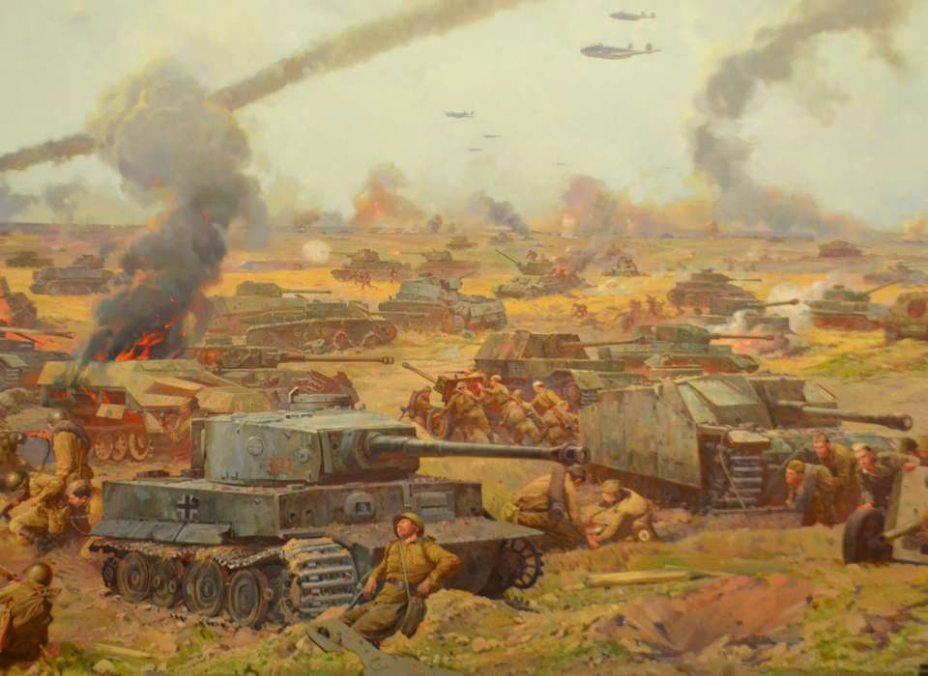
Battle of Kursk
Operation Kutuzov
On July 12th, Zhukov released his reserves and switched the Red Army into counter-offensive mode.
That day, Soviet T-34s hit German Panther and Tiger panzers head on, and the tide of the battle turned in favor of the Red Army. Operation Citadel was a failure.
By July 16th the Wehrmacht was in full retreat in the South, pursued by Vatutin’s troops, joined by Konev’s Steppe Front 2 days later.
The Red Army's counter-offensive was given the code name Operation Kutuzov, after the Russian general who beat Napoleon in the Patriotic War of 1812.

Slide 19
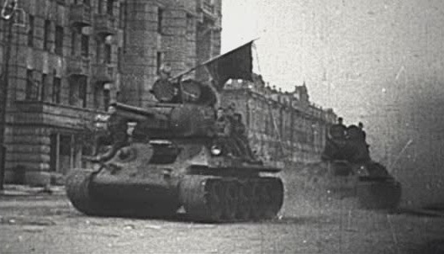
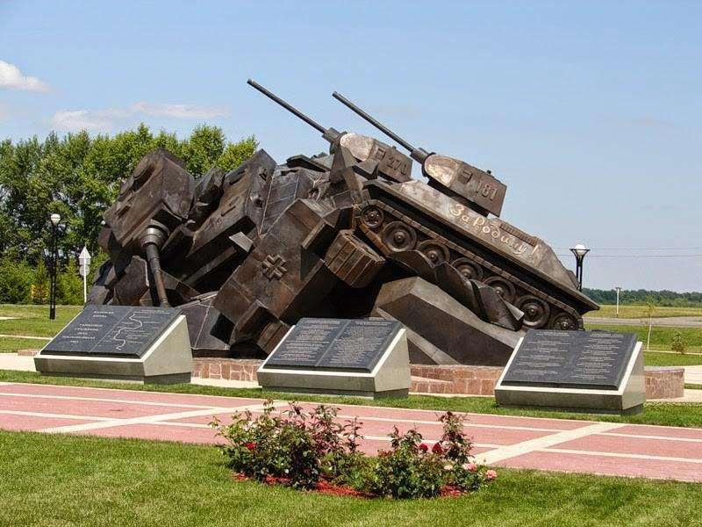
Battle of Kursk
Victory at Kursk!
In the North, around the city of Orel, the Nazi High Command ordered its troops to fight to the last man. In that region, Soviet partisans operating behind German lines made life a living hell for the Wehrmacht, blowing up railways, attacking garrisons, ambushing road convoys. In retaliation the Nazi fury knew no bounds, old men, women and children were slaughtered like cattle, entire towns and villages burned to ashes. Orel was finally liberated on August 5th.
On that same day in the South, Konev’s men cleared Belgorod of the last Nazis. So on August 5th, 1943 two ancient Russian cities were liberated after intense fighting. The Steppe Front kept pushing South, and Konev’s troops entered Kharkov on August 23rd.
That ended the Battle of Kursk and Operation Kutuzov. The savage battle that began July 5th, lasted 50 days.

Slide 20
The Unknown War - The World’s Greatest Tank Battle

Slide 21
The Unknown War - The World’s Greatest Tank Battle

Slide 22
Discussion & New Members Introductions

Slide 23
New Member Introductions
What is your name, pronouns and state (or country/territory)?
Where do you work? Is it unionized?
How did you find out about the People’s School?
What do you think about tonight's class?

Slide 24
Battle of Kursk: Significance

Slide 25
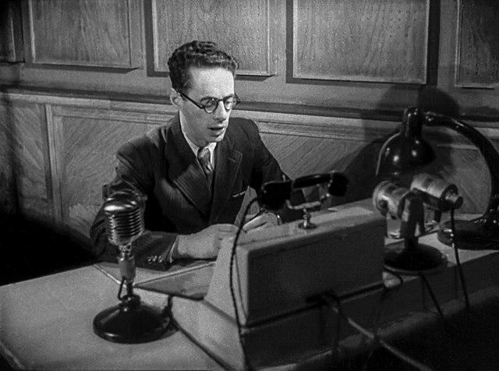
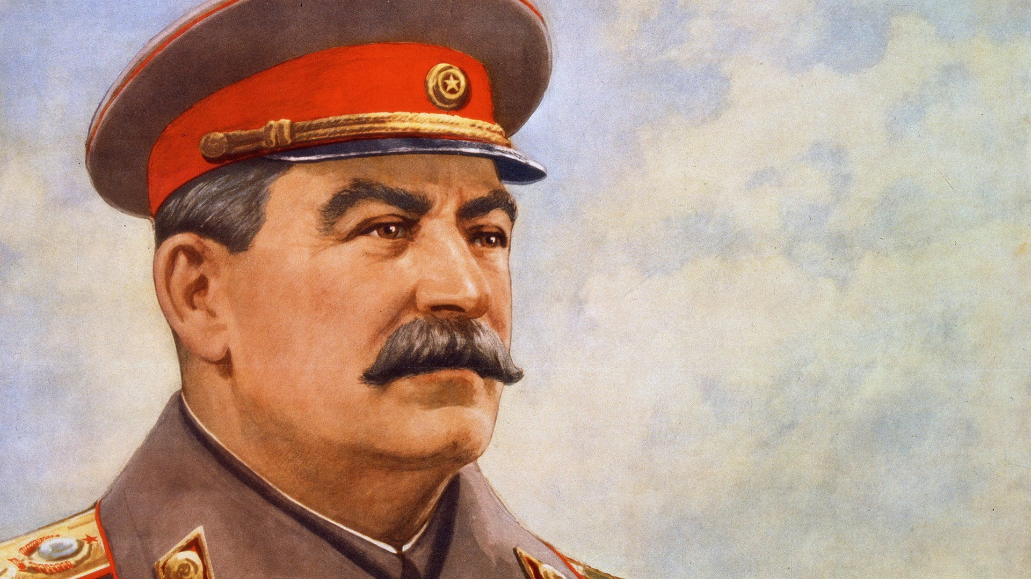
Battle of Kursk
Victory Salute!
To mark the victories at Orel and Belgorod, a salute of 12 salvoes of 120 guns was fired in Moscow. This was the first Victory salute of the Great Patriotic War. There would be 300 such salvoes ordered by Stalin in the remaining years of the war.
The deep voice of Yuri Levitan, Moscow Radio’s star announcer, now uttered for the 1st time phrases that were to become like sweet and familiar music during the next 2 years:
“Tonight at 24 o’clock on August 5th, the capital of our country, Moscow, will salute the valiant troops that liberated Orel and Belgorod with 12 artillery salvoes from 120 guns. I express my thanks to all the troops that took part in the offensive. Eternal glory to the heroes who fell for the freedom of our country. Death to the German invaders.
The Supreme Commander-in-Chief, Marshal of the Soviet Union, Stalin.”

Slide 26
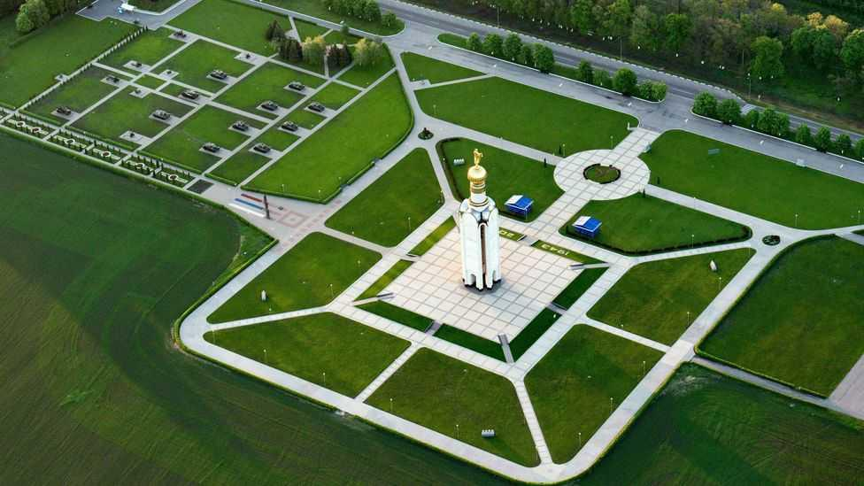
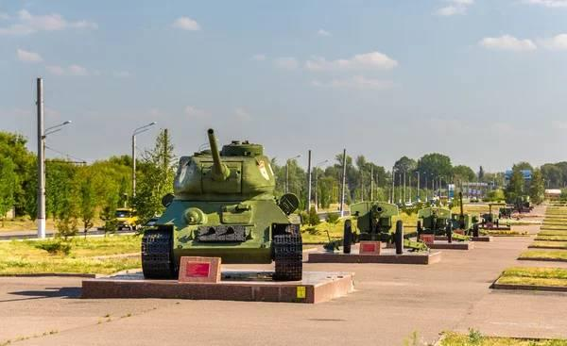
Battle of Kursk
Turning the Tide Definitively
With only some slight variations in the wording, this was to become the consecrated text which Russia was to hear over the radio more than 300 times before the final victory over Germany and Japan.
There was nothing fortuitous or arbitrary in the Russian decision to celebrate the Victory at Kursk with those first Victory salvoes and fireworks. The Russian Command knew that by winning the Battle of Kursk, Russia had, in effect, won the war. In retrospect it can be said that if the Battle of Stalingrad was the political-psychological turning point of the whole war in the east, the German defeat at the Battle of Kursk was its military turning point.
The Wehrmacht suffered a defeat from which it never recovered. After Kursk the Nazi Command was compelled to abandon its offensive strategy and go over to the defensive along the entire German-Soviet front. This meant that the backbone of the German Army had been broken. The strategic initiative was now unequivocally in the hands of the Red Army. This finally turned the tide of the war.

Slide 27
The Unknown War - The World’s Greatest Tank Battle

Slide 28
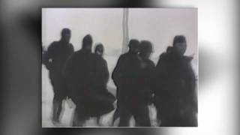
The Unknown War - The World’s Greatest Tank Battle

Slide 29
Discussion & Wrap Up

Slide 30
Announcements
THE KONONOVITCH BROTHERS NEED US, SHARE THIS ARTICLE:
https://dailyworkerusa.com/stop-the-kiev-regimes-calls-for-the-murder-of-the-kononovitch-brothers/
The PCUSA Arts and Culture Commission is looking for content submissions for Vol III 2023 of New Masses! Send any submissions to info@partyofcommunistsusa.net and kamryns@johnreedcenter.net
The Peoples School for Marxist Leninist Studies has began posting videos on our TikTok channel @peoplesschool! Please subscribe to the channel and like and share our content!

Slide 31
Volunteers Needed!
We are in need of volunteers for the staff of the People’s School! Here’s a few roles we need filled:
People to help manage posting on our social media and podcast platforms
Video Editors, Audio Editors, Graphic Designers, Artists, Narrators
Facilitators, Web Controls, Moderators
Email info@peoplesschool.us if you’re interested and try to attend our next staff meeting on Aug. 3rd if possible.

Slide 32
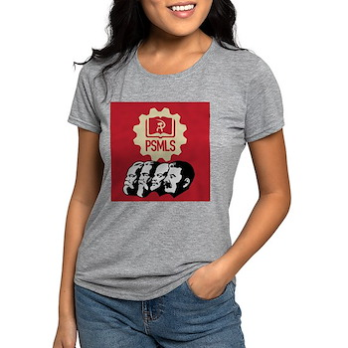
PSMLS Propaganda
peoplesschool.us/media & peoplesschool.us/store
Materials to help promote the school!

Slide 33
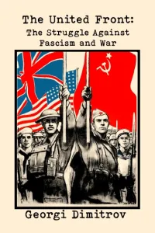
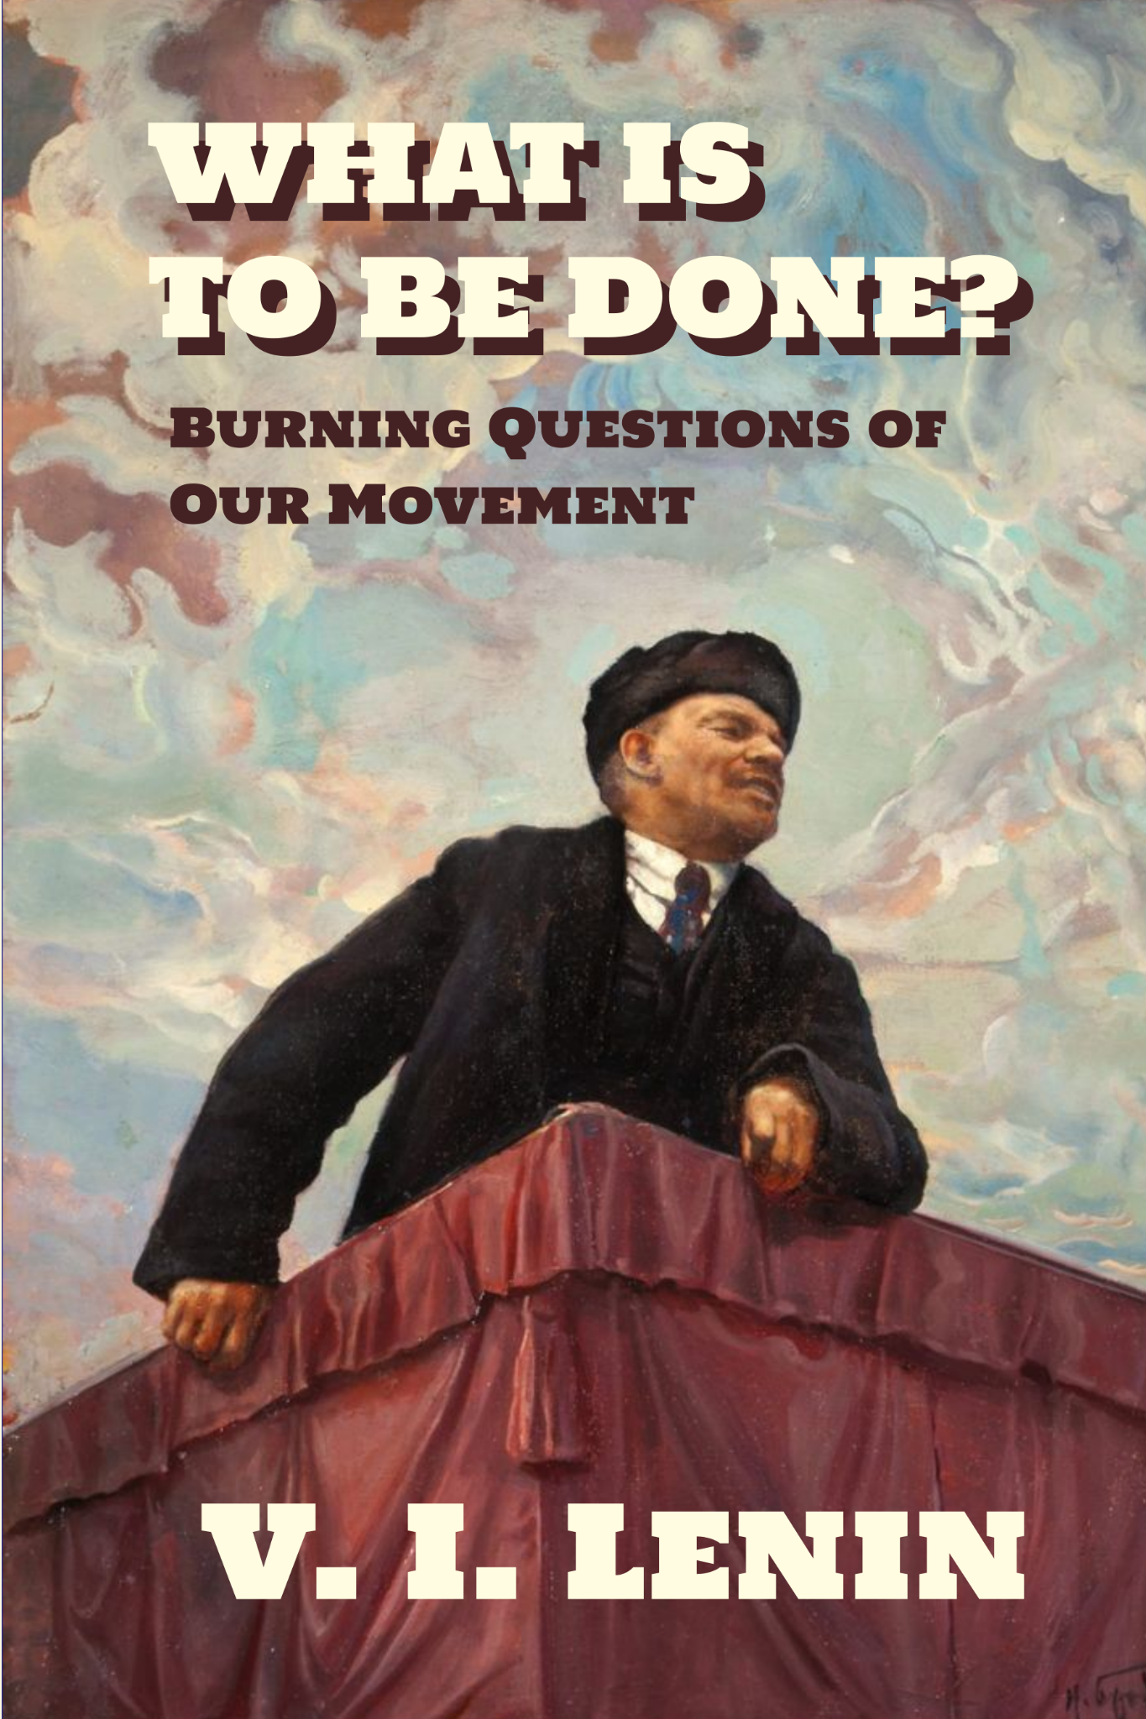
New Outlook Publishers
newoutlookpublishers.store
Latest Releases

Slide 34
Legal Drive
Last year we were attacked and sabotaged by ultraleft wreckers that tried to steal the PSMLS and destroy the PCUSA. They failed, but they will be held accountable and there are still things they took from us that we’ve not got back, like videos, imagery and audio. That is why we still need donations to the legal drive.
To donate, go to partyofcommunistsusa.net/donations/
Check the box that says “PSMLS Legal Funds” and try to donate on Tuesday or Thursday so it is easier for us to sort through. It will go to the legal fund. Anything helps!

Slide 35
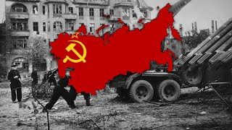
Katyusha

