Slide 1
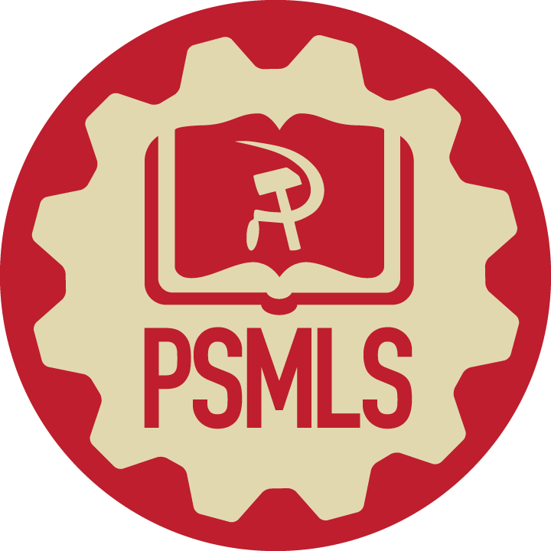
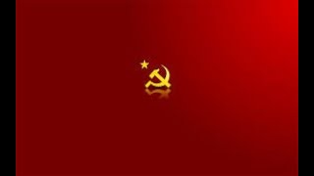
Bella Ciao - Red Army Choir Version

Slide 2
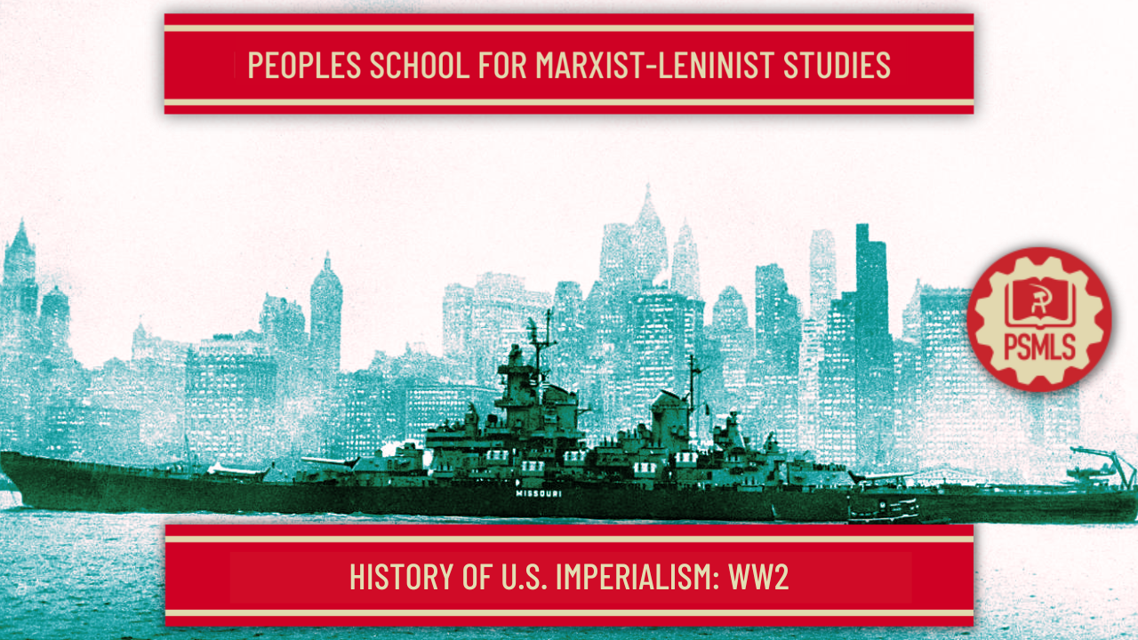
PSMLS 07/18/23 - 07/20/23

Slide 3
What we’ll be learning today:
The Collaboration between American Capitalists and Nazi Germany
American Imperialism during WW2 and the Progressiveness of the American intervention in WW2 despite it.
American Imperialism immediately following WW2, including NATO, CIA, Marshall Plan, Bretton Woods, Stay-Behind Ops and more.

Slide 4
Series Recap

Slide 5
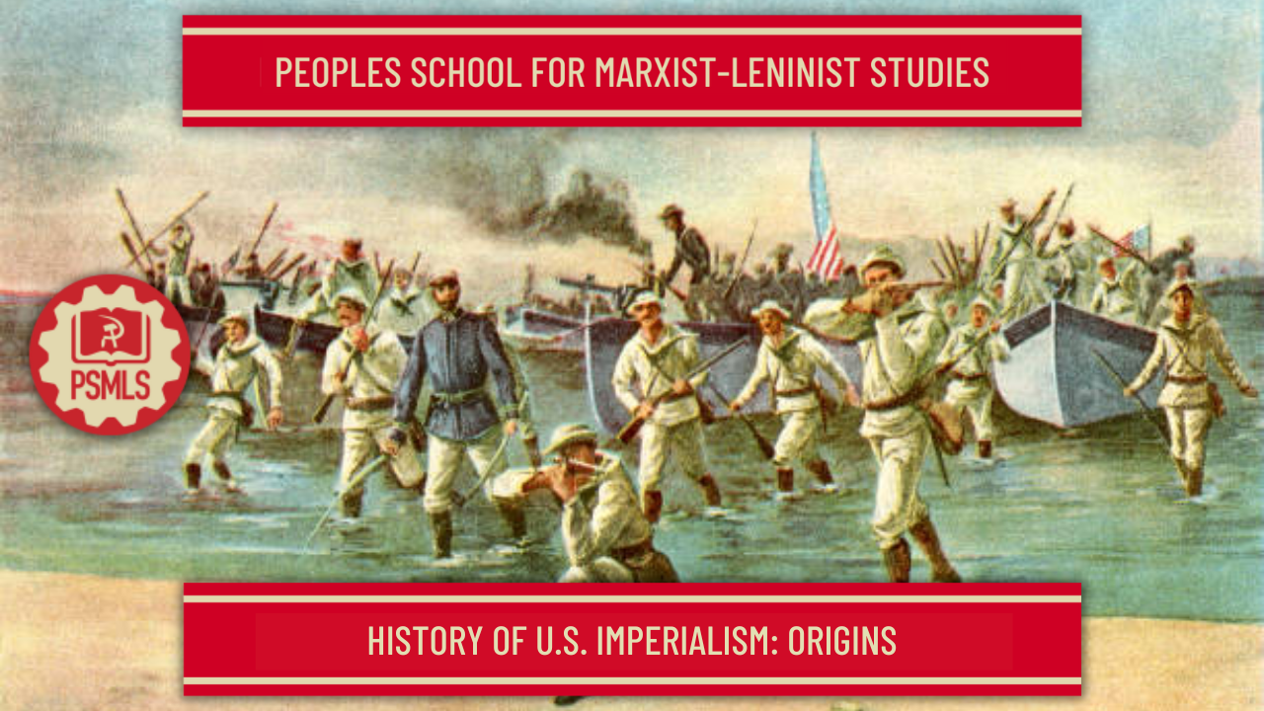
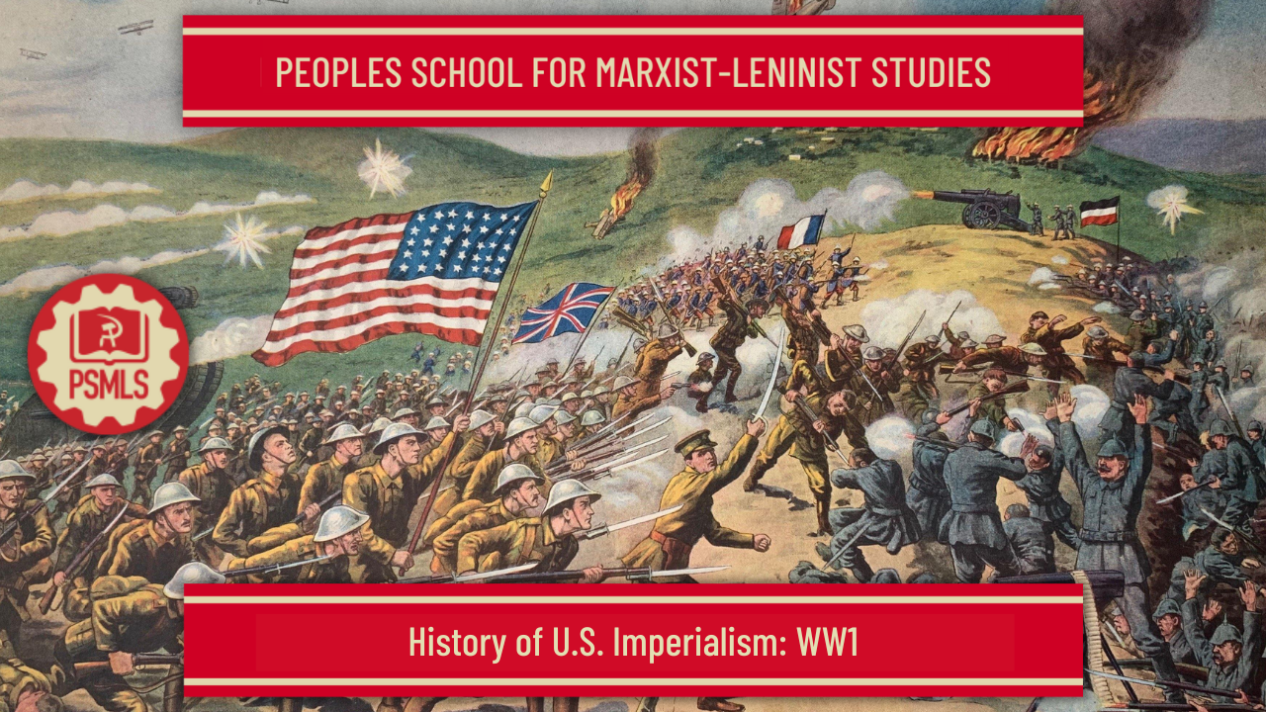
American Collaboration w/ Nazi Germany
History of US Imperialism: Origins
In May, we covered the origins of American imperialism, starting with the development of American capitalism into imperialism by the end of the 19th century, and covering the massive launch of American Imperialism with the Annexations of Hawaii and Samoa, the Spanish-American War of 1898, the US Intervention in the Chinese Boxer Rebellion, the Philippine-American War and the Banana Wars.
History of US Imperialism: WW1
In June, we covered the role of American imperialism in the great inter-imperialist war of World War 1, and how the United States became a massive power in the world with the war and built institutions after the war which served to benefit the United States at the expense of the European working class. It also explored the interwar period, and the US interventions in the Russian Civil War and ongoing occupation of Nicaragua contrasted with the neglect towards the Spanish Civil War and other pre-WW2 fascist conflicts, such as Italy’s invasion Ethiopia or Japan’s invasion of Manchuria.

Slide 6
American Collaboration w/ Nazi Germany

Slide 7
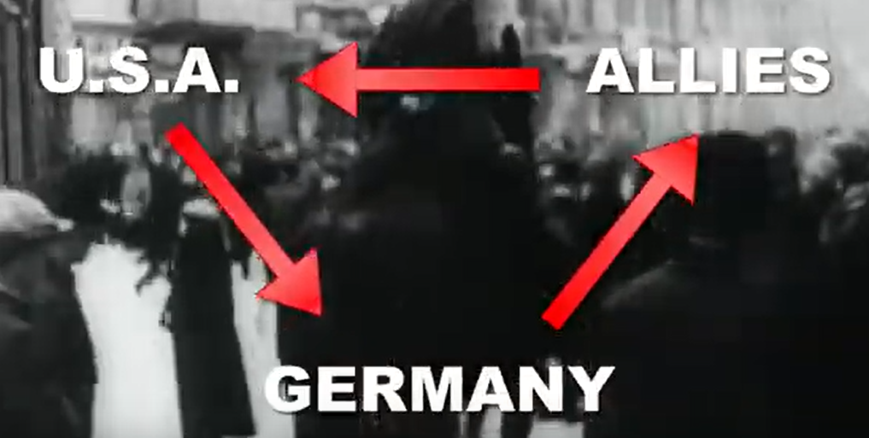
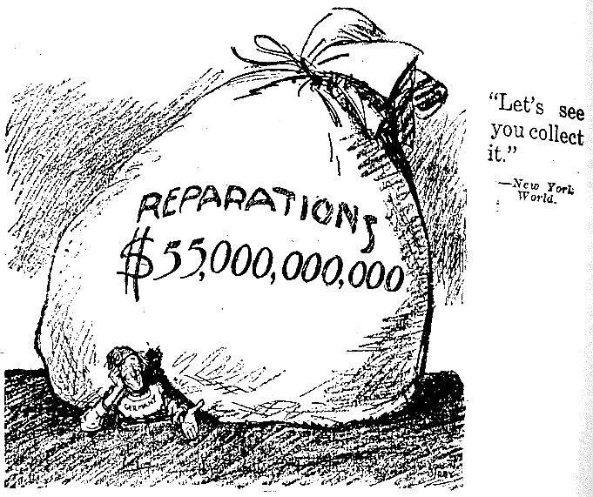
American Collaboration w/ Nazi Germany
German War Reparations Fuels Nazism
Following WW1, the American imperialists set up many policies and institutions internationally. Besides the League of Nations (which it never entered), the plan for war reparations from Germany to the British and French were established, as well as the Bank of International Settlements.
Britain and France had to pay their debts to the United States for US aid and intervention in WW1. When Germany was unable to pay its debts, it relied on the United States for loans to do so, which worked to some extent from the implementation of the Dawes Plan in 1924 until the Wall Street Crash of 1929. The Great Depression had international affect.
While German industry began to prosper again, the German people were left with a severe economic crisis in the 1930’s which could’ve easily gave way to a socialist revolution, but instead gave way to Nazism, as Adolf Hitler takes power in 1933.

Slide 8
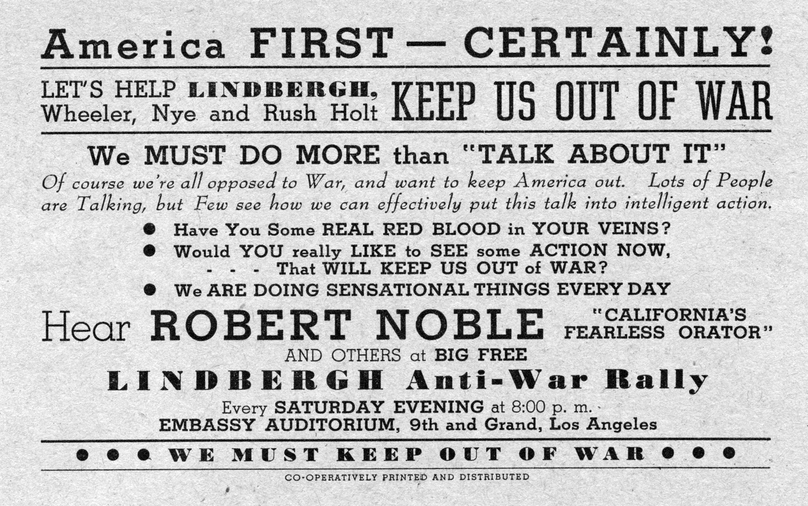
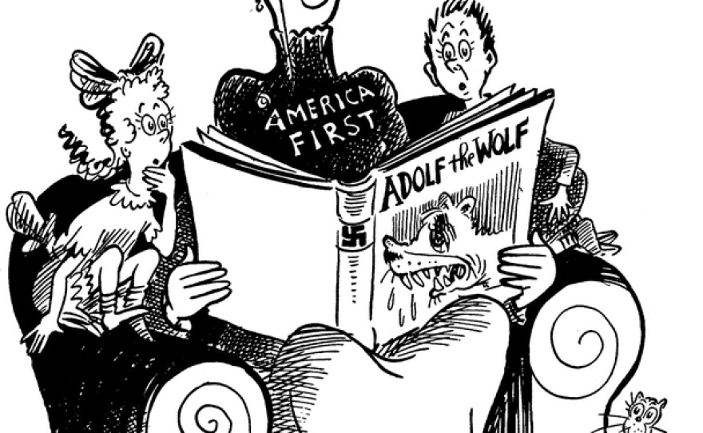
American Collaboration w/ Nazi Germany
Isolationism, America First & Nazi Inspiration
Adolf Hitler’s idea of Lebensraum was partially inspired by American “Manifest Destiny” and his treatment of non-Aryans was inspired by American treatment of African Americans and Indigenous Americans, as well as US Immigration Policy.
Many Americans found themselves in support of Nazi Germany from the start, and organized an organization called the “America First Committee.” It preached isolationism and non-interventionism in WW2 against the Axis Powers and was dissolved 4 days after Pearl Harbor.
Notable members of the AFC include Henry Ford, Charles Lindberg, Robert E. Wood (Retired US general and heads of Sears at the time), and more. Communists were involved, but left and denounced the organization as a Nazi Front following Operation Barbarossa in June 1941.

Slide 9
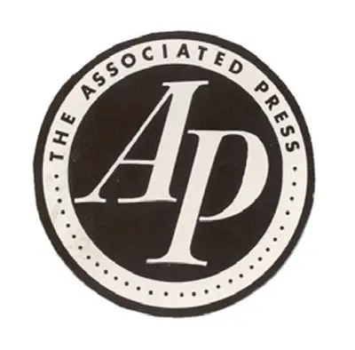
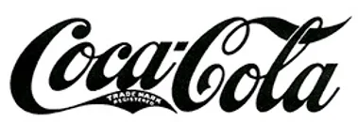
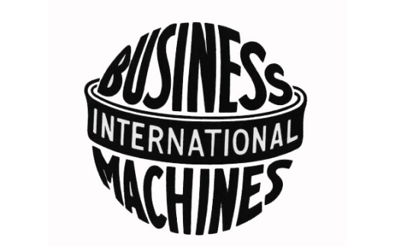
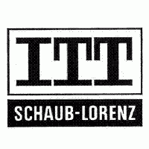
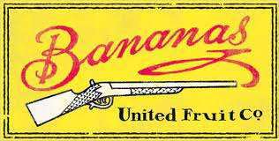
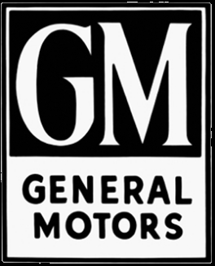
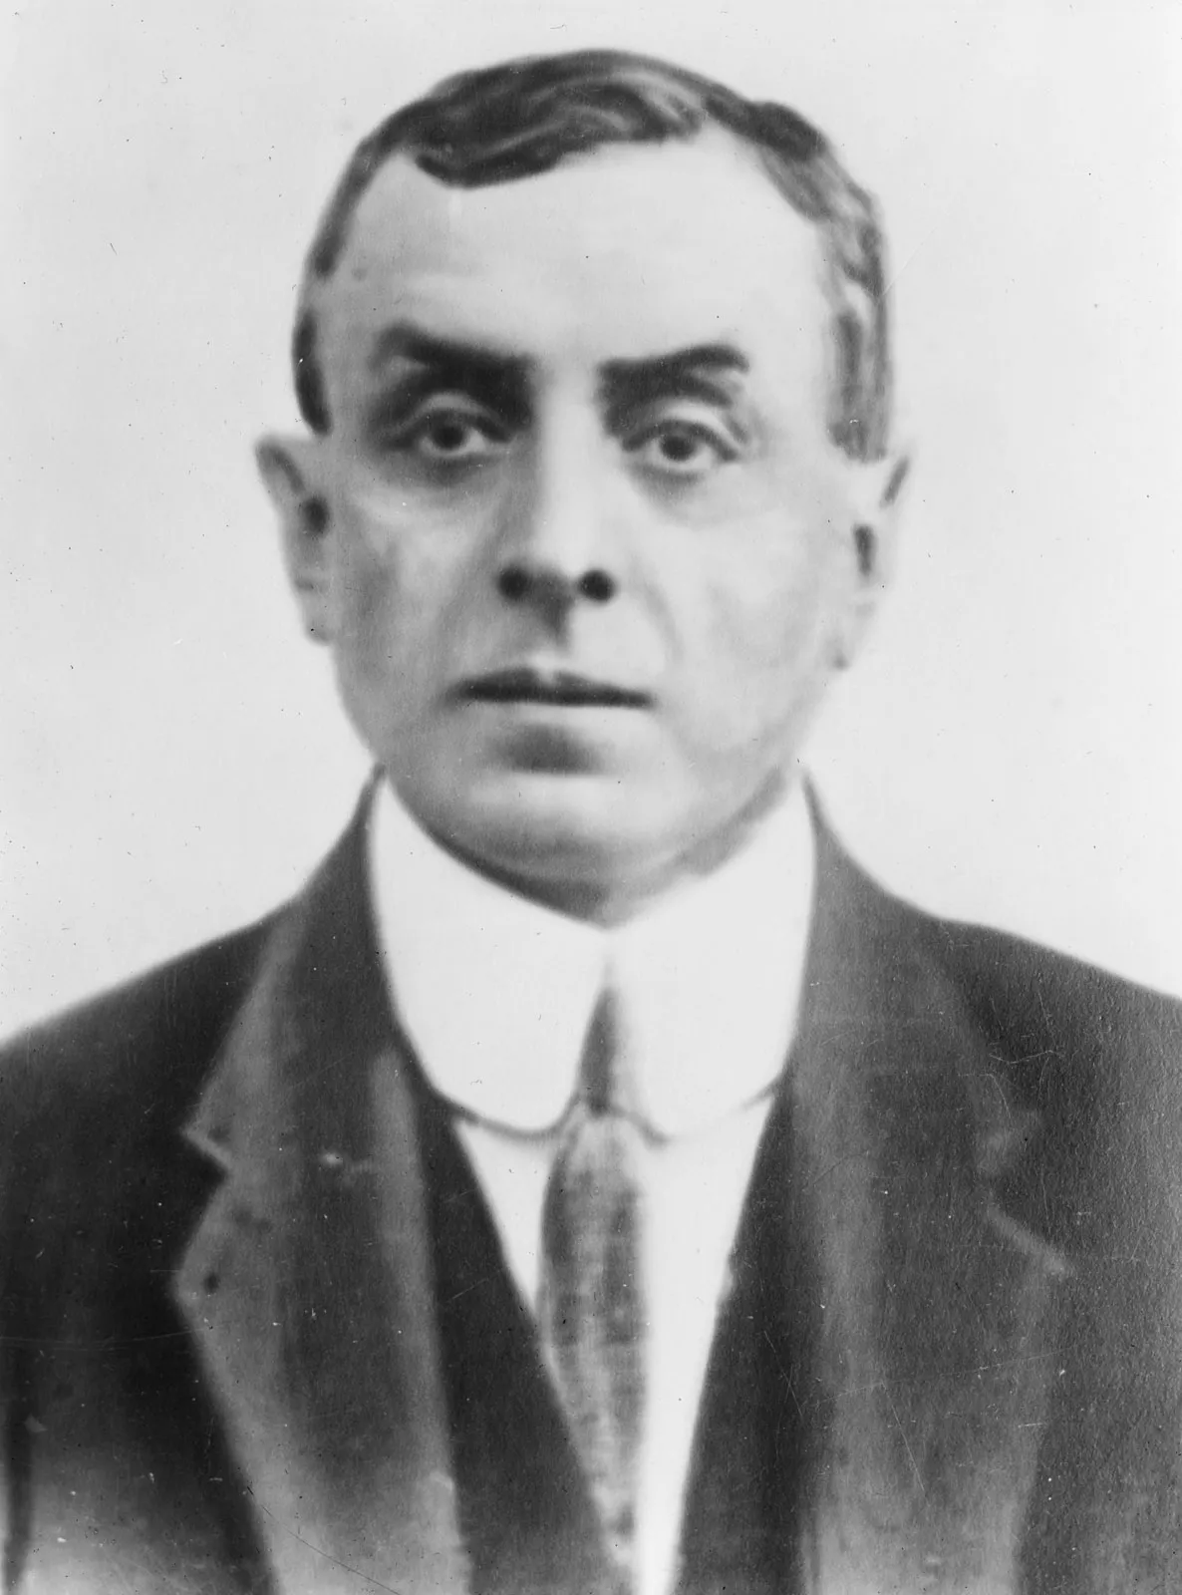
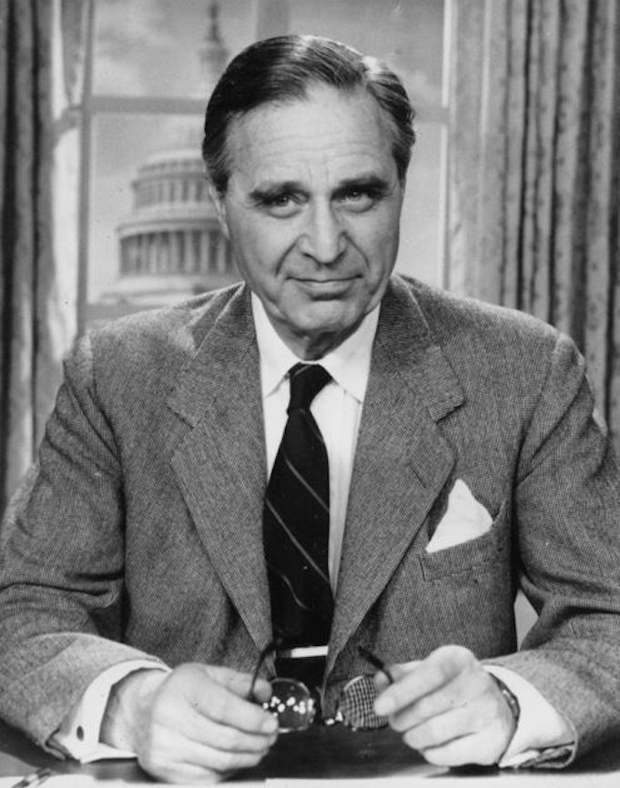
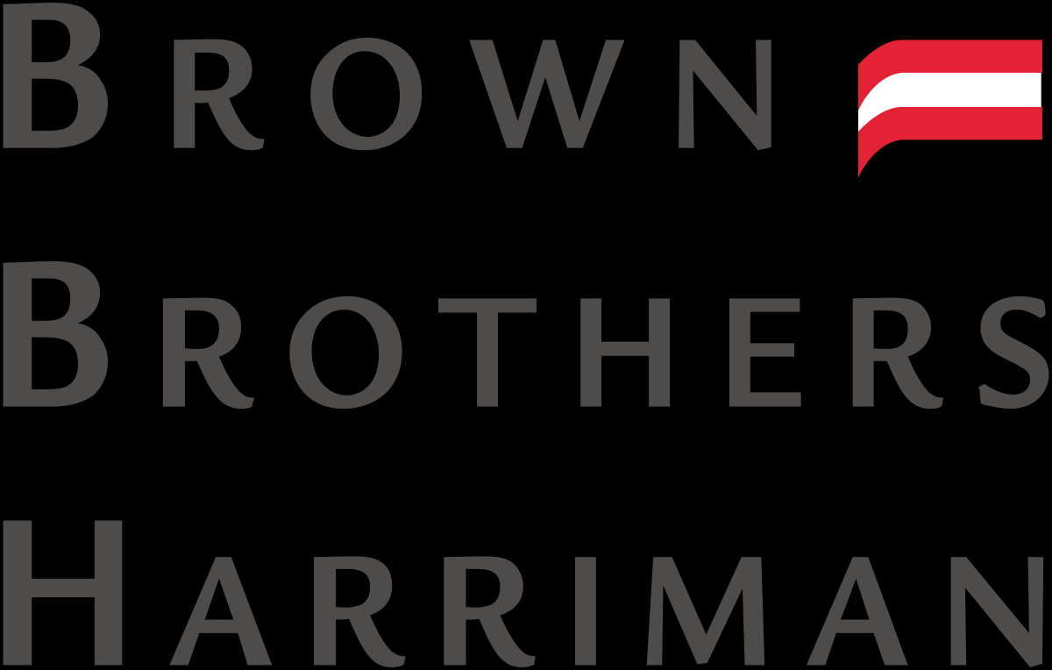
American Collaboration w/ Nazi Germany
American Business Dealings with Nazis
Many American companies, collaborated with Nazi Germany before the Second World War, including: Ford, Associated Press, Coca Cola, Gilette, Kraft, JPMorgan, Chase Bank, Union Banking Corporation International Business Machines Corporation (IBM), International Telephone And Telegraph Corporation (ITT), General Motors, General Electric, Alcoa, Standard Oil, Dupont, Eastman Kodak, Westinghouse, Pratt & Whitney, Douglas Aircraft, United Fruit, Singer, International Harvester and a number of Hollywood Film Studios, all only those that we know of.
Fritz Thyssen, a Nazi coal and steel magnate, had his wealth protected by Brown Brothers Harriman Investment Firm, through the holding company, Union Banking Corporation in an account managed by Prescott Bush (father of George H. W. Bush and grandfather of George W. Bush). In ‘41, Union Banking Corp was seized under the Trading with the Enemy Act, but the shares were returned after the war to Bush and other American shareholders.

Slide 10
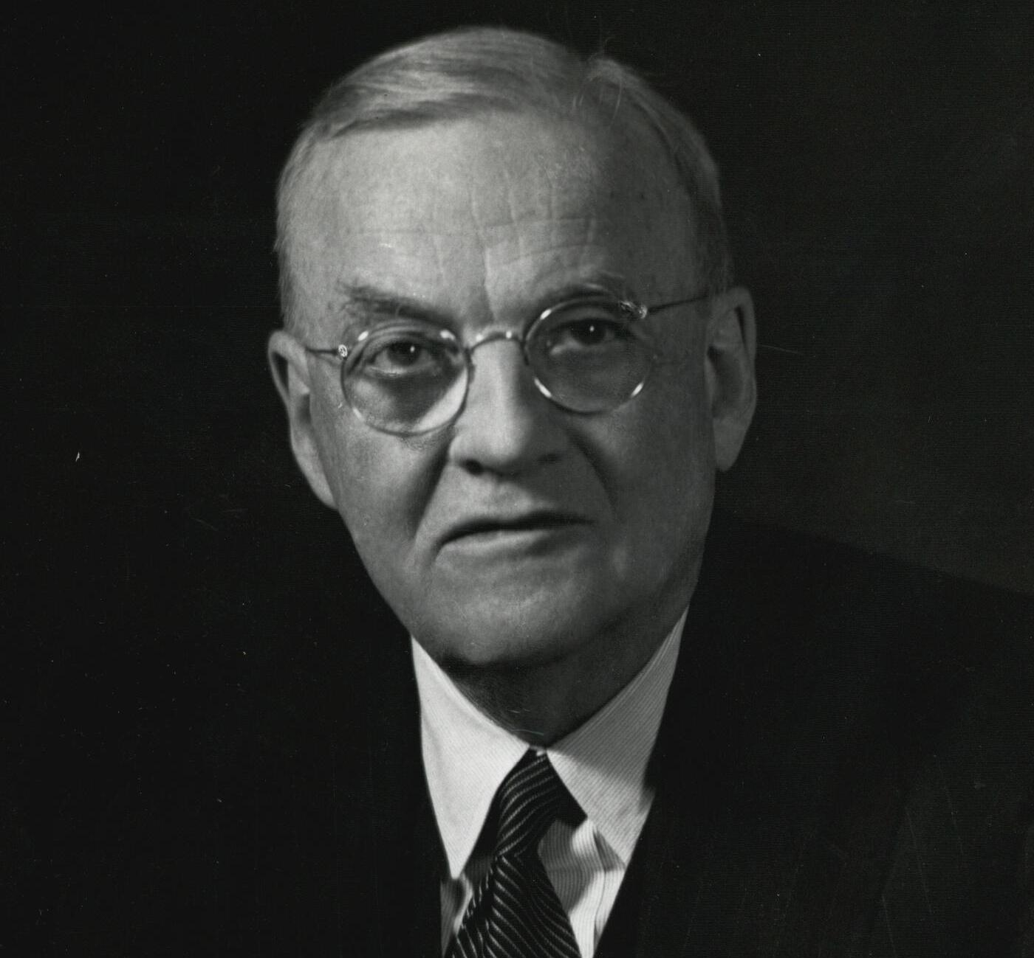
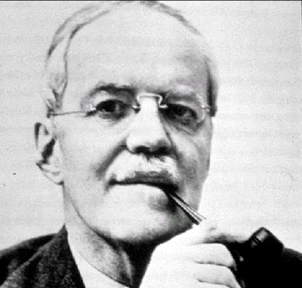
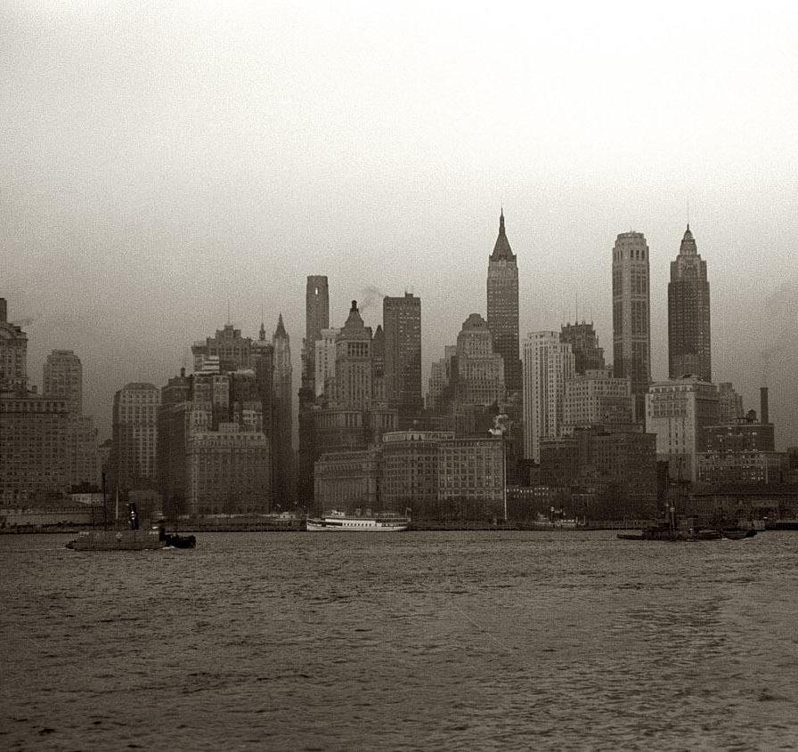
American Collaboration w/ Nazi Germany
American Imperialism and Nazi Germany
The law firm Sullivan & Cromwell LLP whose managing director, who would later be Secretary of State, John Foster Dulles, and as a partner, Allen Dulles, had served many clients of these corporations and institutions. One of which was the Bank for International Settlements in Switzerland, which continued to deal with Germany after the start of the war and received most of the gold stolen by the Nazis during this period. American Thomas McKittrick, head of the institution, managed this.
American monopoly capitalists were supporting Nazism. For the US imperialists, war was great business and they played both sides of the war, aiding the Allies and Axis Powers.
This doesn’t mean the role the US then played in aiding the defeat of Nazi Germany, Fascist Italy and Imperial Japan was not progressive or justified. The United States was, as it still is, a bourgeois democracy and an imperialist country, that stood up and did the right thing militarily in WW2.

Slide 11
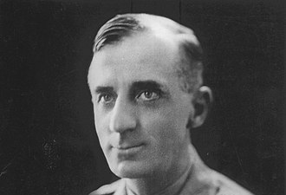
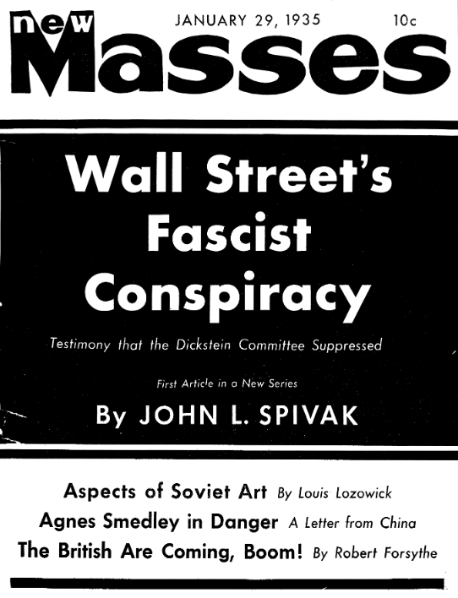
American Collaboration w/ Nazi Germany
Attempt at Fascism in America
The fascism that the business interests of America were interested in was no limited to foreign nations. The possibility of a fascist coup against Franklin Delano Roosevelt was considered and somewhat planned.
The Business Plot of 1933 or the “Wall Street Putsch” was a plan to overthrow FDR and install Smedley Butler, who became an anti-imperialist retired general, as its leader. When Butler was approached about it, he and others testified to the McCormick-Dickstein Committee and foiled the plot. The unredacted version was actually revealed in a 1935 New Masses article by John L. Spivak.

Slide 12
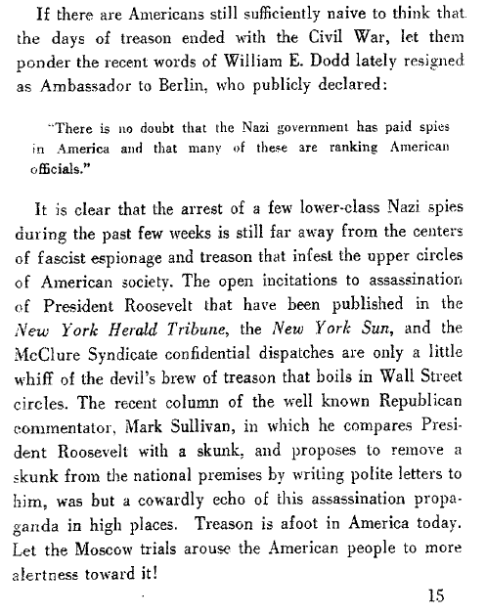
Traitors in American History: Lessons from the Moscow Trials
Earl Browder

Slide 13
Discussion

Slide 14
The United States in World War 2

Slide 15
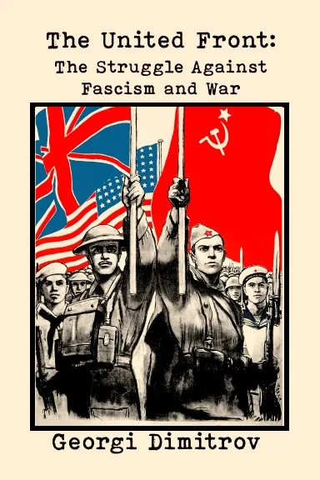
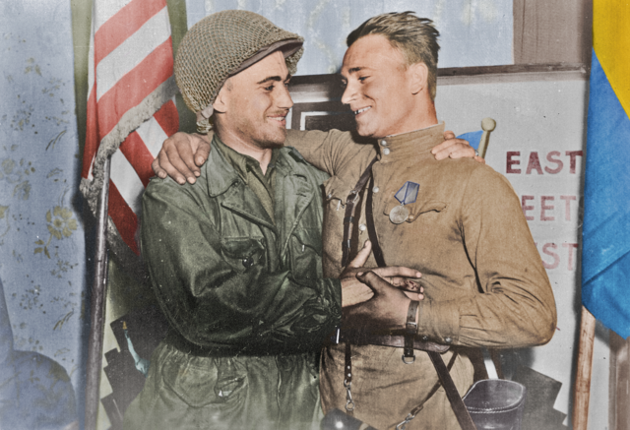
The United Front Policy During WW2
Dimitrov’s United Front leads to Allied Victory
In 1935, Georgi Dimitrov, the then General Secretary of the Executive Committee of the Communist International, brought the communist movement the anti-fascist United Front Policy. This called for Communists of the world to make anti-fascist their primary task, unite with Communists and non-Communists in the struggle against fascism and defend bourgeois democracy against fascism. He said:
“There is no more imperative duty than that of influencing public opinion and governments with the aim of ending the ostrich-like policy of hiding the head in the sand when confronted with unbridled fascist intervention. There is no more vital task than that of supporting by deeds the peace policy of Soviet democracy which aims at stopping fascist intervention, curbing the aggressors and defending the independence of the democratic rights and liberties of the people.”
This policy continued and intensified into WW2. The United States recognized the Soviet Union under Roosevelt, and after Operation Barbarossa, signed a Mutual Assistance Treaty with the Soviet Union and began shipping $11 billion in munitions and aid to the USSR under the Lend-Lease Program. Once the United States entered the war following the attack at Pearl Harbor, the United States definitively became allied with the Soviet Union in the war against fascism. Roosevelt and Stalin met many times and agreed on peaceful coexistence in victory. The Western Front, opened initially in Africa and then in France, was crucial in aiding the defeat of Nazism. Imperialists like Truman had other ideas for a post-war world.

Slide 16
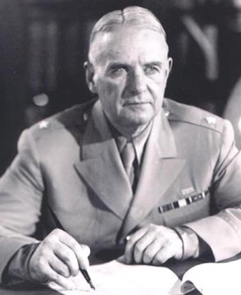
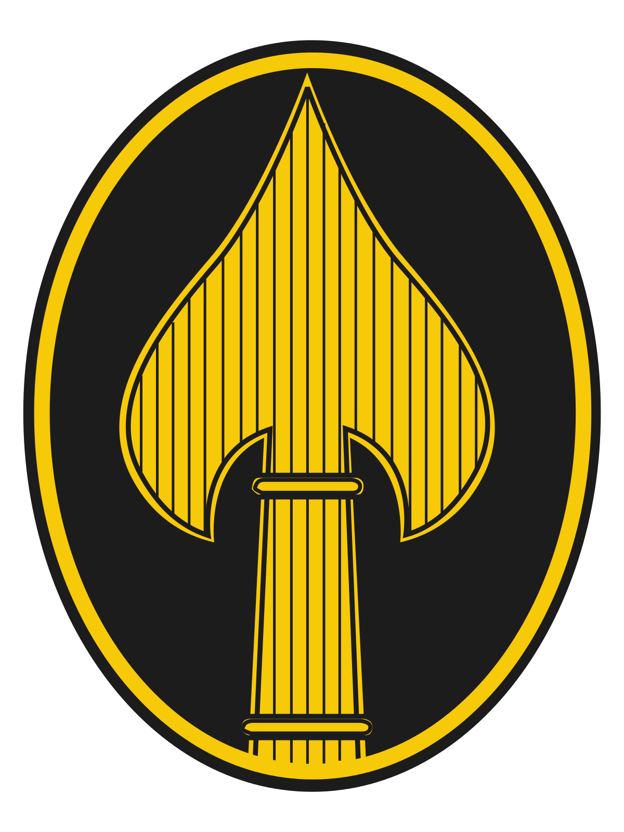
Office of Strategic Services (OSS)
OSS, the Ironic Predecessor to the CIA
The OSS was the intelligence agency of the United States during WWII. It was a first attempt at centralizing any military intelligence-gathering. It lasted from 1942 - 1945, dissolving shortly after the end of the war. However much of its functions were taken over by the CIA and INR. Functions of the OSS included spying to collect intelligence, organizing anti-Nazi resistance groups in Europe and providing training to anti-Japanese guerilla troops in Asia.
The OSS played a role in training KMT forces in China, guiding Allied forces in Burma against the Japanese Army and training, arming and supplying the Viet Minh in French Indochina (Vietnam.) OSS operatives managed to penetrate Nazi Germany by training German and Austrian individuals for missions inside Germany. Some of these agents included exiled communists and Socialist party members, labor activists, anti-Nazi POWs, and German and Jewish refugees.
Operations in Switzerland provided extensive information on German air defenses, submarine production, and weapons including secret efforts in chemical and biological warfare. Switzerland's station also supported resistance fighters in France, Austria and Italy, and helped with the surrender of German forces in Italy in 1945.

Slide 17
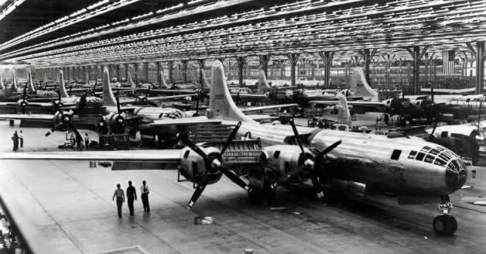
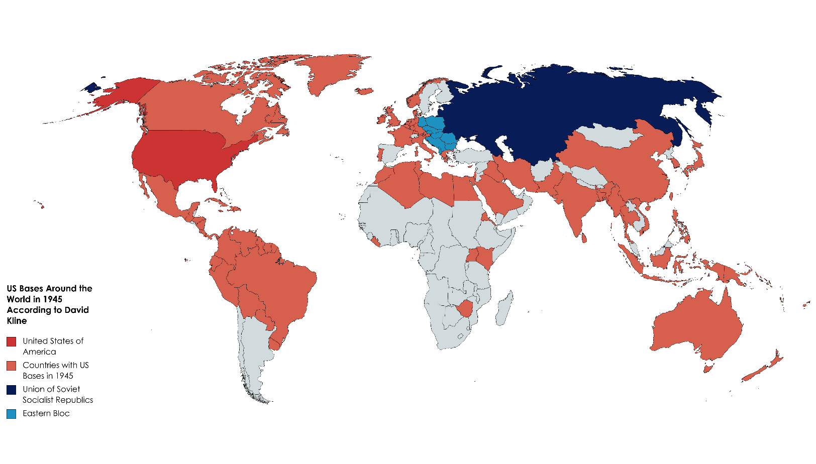
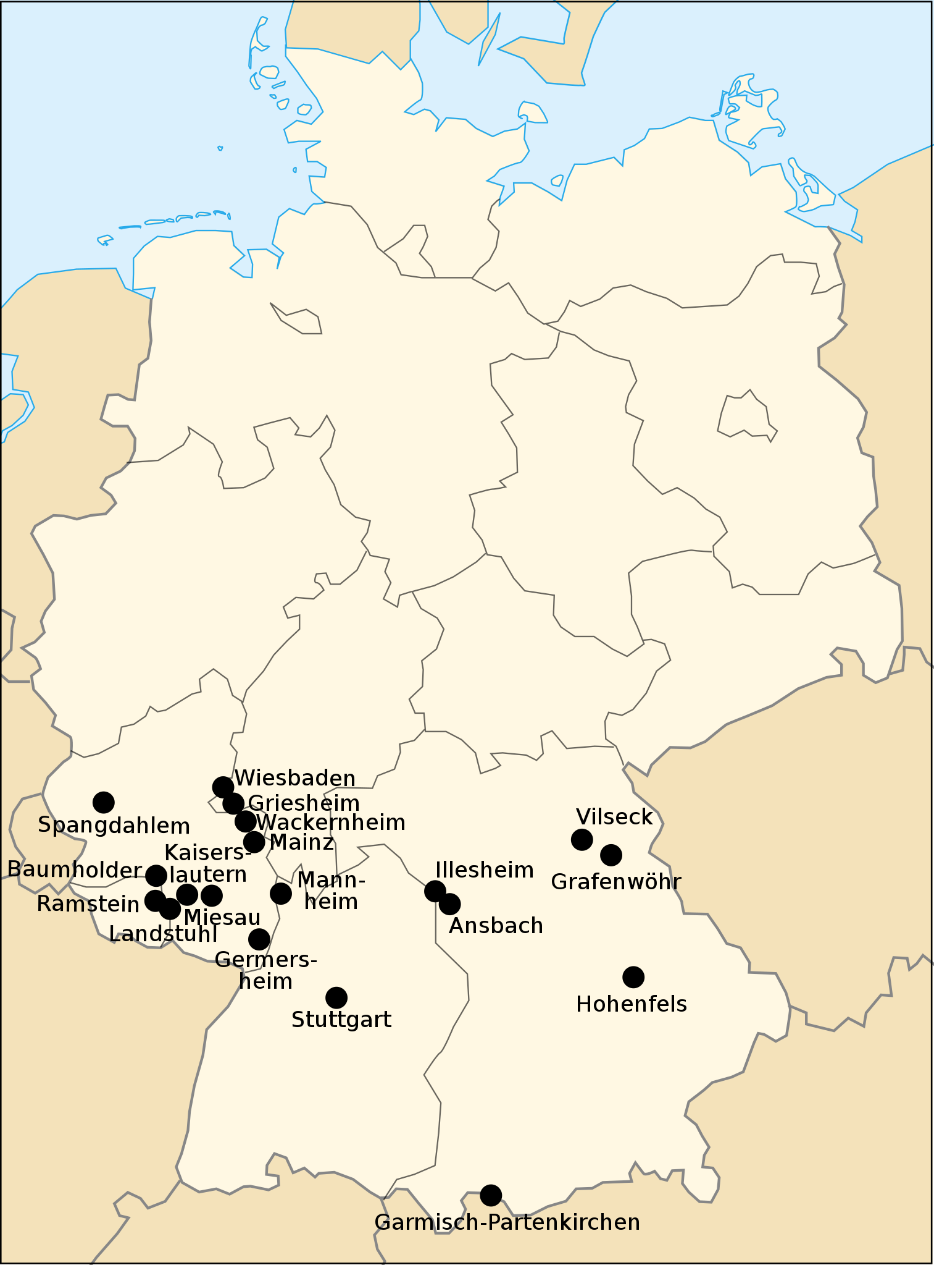
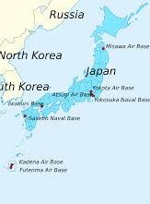
US Imperialism During WWII
Imperialists Still Gain from War
Despite the United States allying with the Soviet Union and working in a United Front against the Axis Powers, the imperialists still gained from the war and would ultimately determine post-war policy, not Roosevelt or the Soviets.
The United States received $7.8 Billion from Lend-Lease, American industry boomed, several businesses profited from both sides of the war, the military occupations in Europe and the Pacific allowed for further occupation and the setting up of US military bases and economic satellites, including of the former Axis Powers, and not a single factory was destroyed in the US.
Harry Truman, who would only shortly later botch Solaunch the Cold War, said “If we see that Germany is winning we ought to help Russia, and if Russia is winning we ought to help Germany, and that way let them kill as many as possible although I don't want to see Hitler victorious under any circumstances.” After the 1944 Vice-Presidential Election shafted Henry Wallace for Truman last second, Truman took over in FDR’s death and changed the end of the war by using atomic monopoly against the Soviets.

Slide 18
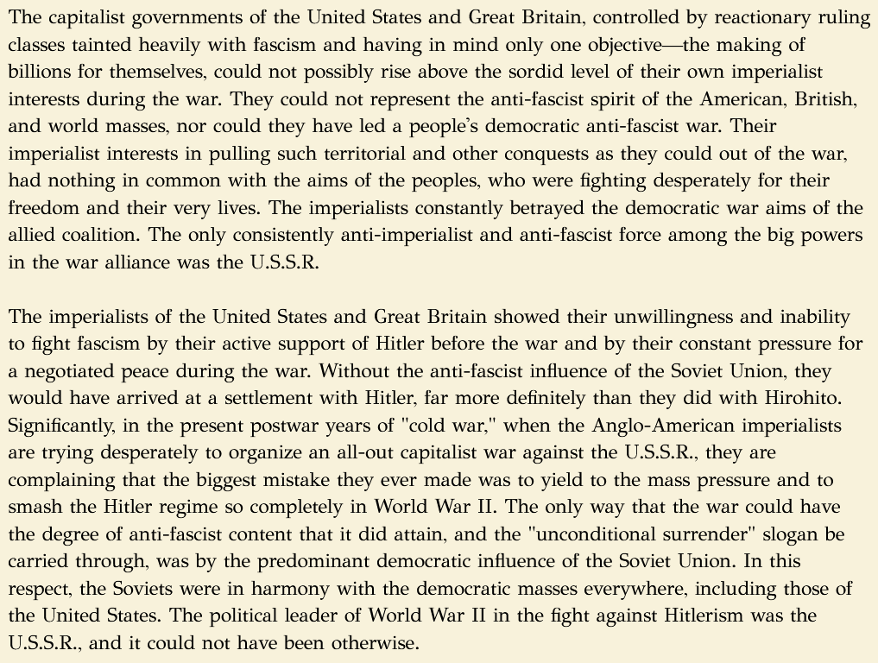
History of the CPUSA by William Z Foster
Chapter Twenty-Eight: World II: The Peoples' Anti-Fascist War (1941-1945)

Slide 19
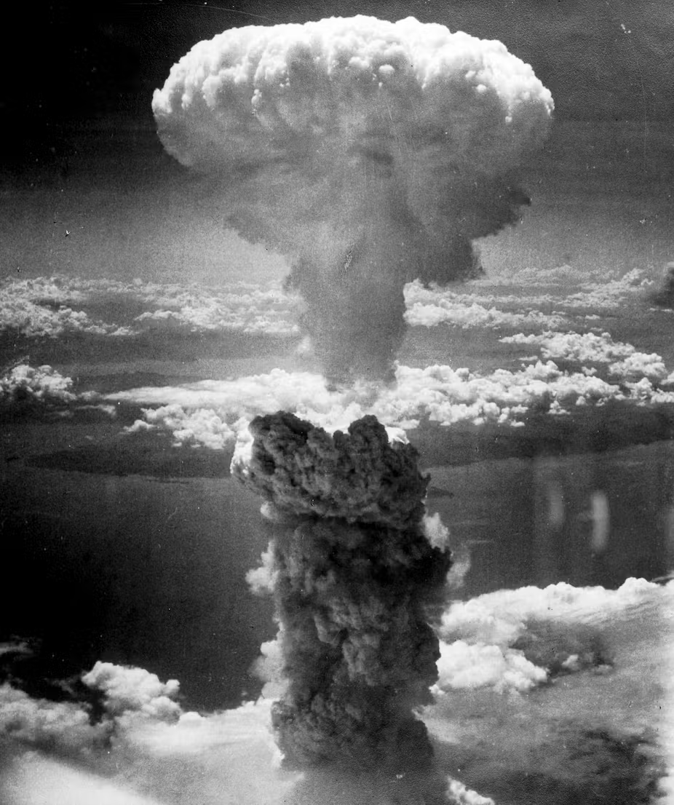
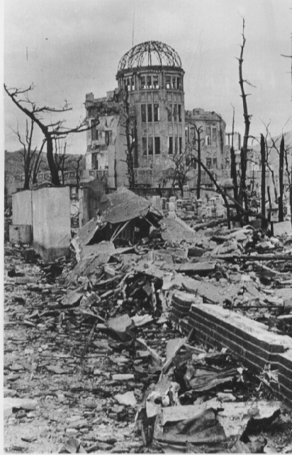
The Truth about the Atomic Bombs
The Atomic Bombings of Hiroshima and Nagasaki
On August 6th and 9th, the US dropped nuclear bombs on the Japanese cities of Hiroshima and Nagasaki. An estimated 129,000 - 226,000 civilians died as a result. On August 15th, Japan declared an unconditional surrender. The most common narrative in the US justifies the bombings by claiming that this was the only way to end WWII without an invasion which would have cost thousands of American and Japanese lives.
However, historical evidence from American and Japanese archives shows that Japan would have surrendered in August regardless if nuclear bombs were used. President Truman and his closest advisors were well aware of this. Allied intelligence reported that Soviet entry into the war would force the Japanese to surrender, stating, “If at any time the USSR should enter the war, all Japanese will realize that absolute defeat is inevitable.”
On August 8th, the USSR invaded Japanese-occupied Manchuria and ousted the Kwantung Army. Realizing they could not fight a war on two fronts, especially with the threat of Soviet takeover, Japan surrendered. Admiral William Leahy, Truman’s Chief of Staff even wrote in his memoir “the use of this barbarous weapon at Hiroshima and Nagasaki was of no material assistance in our war against Japan. The Japanese were already defeated and ready to surrender …. In being the first to use it we had adopted an ethical standard common to the barbarians of the Dark Ages.”

Slide 20
Discussion & New Members Introductions

Slide 21
New Member Introductions
What is your name, pronouns and state (or country/territory)?
Where do you work? Is it unionized?
How did you find out about the People’s School?
What do you think about tonight's class?

Slide 22
Post-War Imperialist Activity

Slide 23
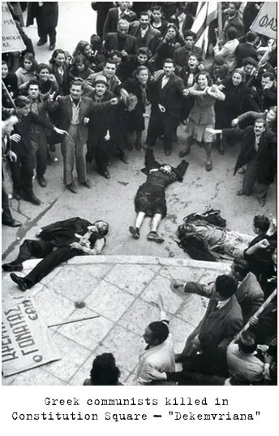
Greek Civil War and Towards Policy of Containment of the USSR
Greece, Launching Pad of Cold War
In October 1944, after the axis were defeated in Greece by the Greek Communist Party and the National Liberation Front (EAM), the British intervened on the side of King George II and the fascist paramilitary groups such as Organization X.
From December of that year to February 1945, the mass killing of National Liberation Front members and Communists called the Dekemvriana took place. This conflict, though ended in 1945, started back up as a full scale Civil War from 1946 to 1949 with the British, under Churchill, and Americans, under Truman, supporting the side of reaction both financially and militarily.
On March 12, 1947 the Truman Doctrine was announced to Congress. The Truman Doctrine was adopted as the Cold War policy of Containment of the Soviet Union.
Protesters killed by British Army and Greek Monarchist Police

Slide 24
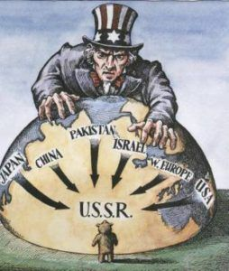
Marshall Plan and Containment
What was the Marshall Plan?
Formally called the European Recovery Act of 1948, the Marshall Plan was a program to contain the Soviet Union by providing $13 Billion ($138 billion today) for reconstruct the war ravaged Europe. The Marshall Plan was an extension of the Truman Doctrine. The Plan was stated to rebuild post-War Europe but in practice, it gave grants and loans to Europe to buy U.S. goods.
It was signed into law on April 3rd, 1948 by Harry Truman after being passed by the 80th Congress of the United States. The Soviets rejected this Plan, Molotov walked out of the Paris talks and Eastern European states were advised to and did reject the plan as well.

Slide 25
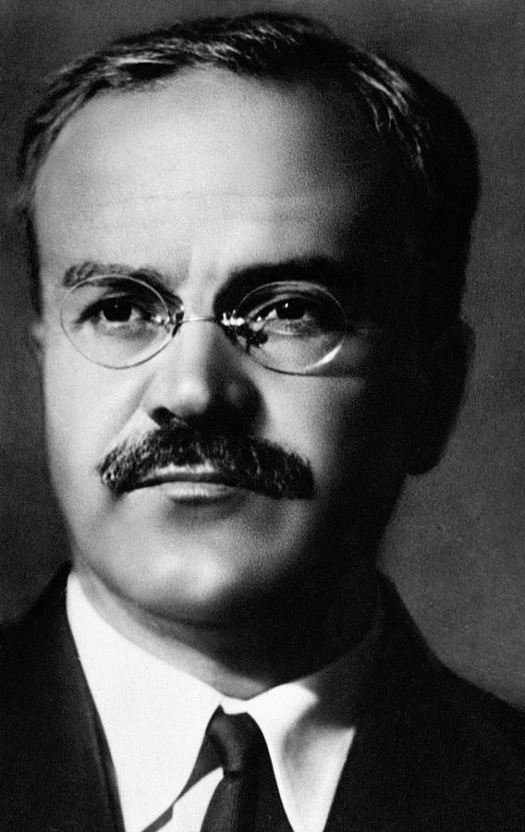
Marshall Plan and Containment
V.M. Molotov on the Marshall Plan
“Everybody is familiar with the stir raised in Europe over the Marshall plan. This plan is advertised as the factor of salvation for the post-war recovery of Europe’s economy. To listen to certain British or French statesmen, without American credits under the Marshall plan, economic recovery in the European countries is impossible. However, the American dollars which floated this year into the pockets of the European capitalists under the United States credit plan did not produce any real revival of industry in the countries of capitalist Europe. And they cannot produce that revival, since the American credits are not being given in order to restore and expand the industries of the European countries which compete with the United States but in order to provide a broader market for American goods in Europe and to place these countries in economic and political dependence on the capitalist monopolies which dominate the United States and on their aggressive plans, in disregard of the interests of the European peoples themselves. In contradistinction to this, the post-war recovery and expansion of industry in the U.S.S.R. are not dependent upon any capitalist country and entirely serve to satisfy the needs of its own people.”
- V. M. Molotov in 31st Anniversary of the Great October Socialist Revolution
V. M. Molotov
Minister of Foreign Affairs 1939 t0 1949 and 1953 to 1956

Slide 26
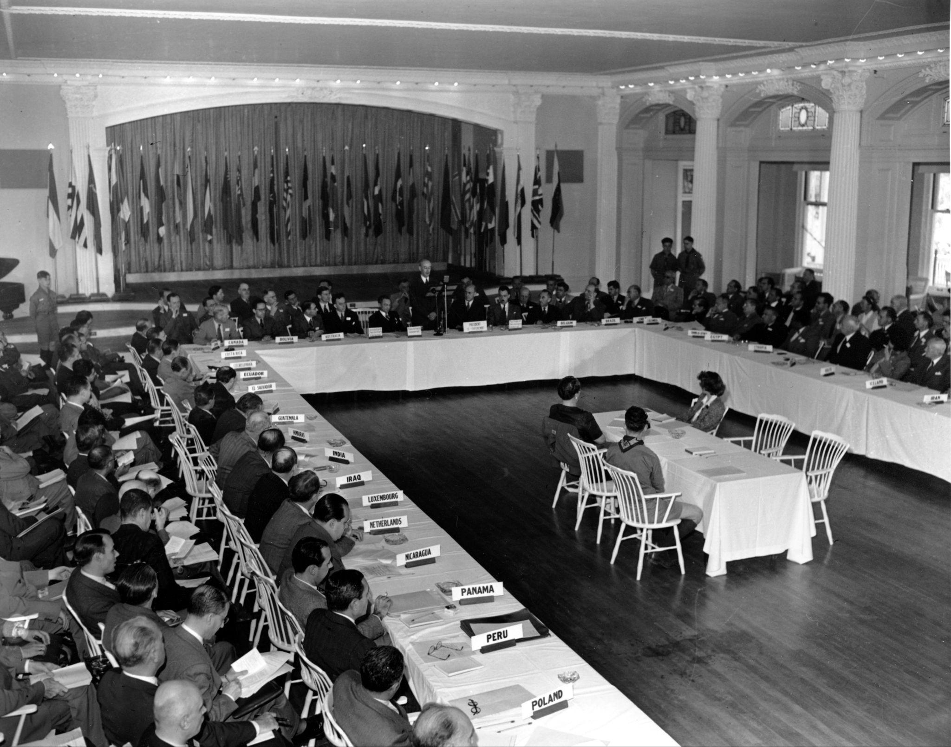
Bretton Woods Conference
Creating American Hegemony
From July 1st to July 22nd 1944, The United Nations Monetary and Financial Conference met in Bretton Woods, New Hampshire. The Conference was attended by 44 nations to discuss the post-war economic order.
The main results of the conference were the creation of the organizations: International Monetary Fund created by Special Assistant to US Secretary of Treasury Harry Drexel White and the economist John Maynard Keynes's International Bank for Reconstruction and Development(later changed to the World Bank).
The goal was to create a gold backed currency and exchange rate. Since the US dollar was the strongest of the participant Nations, the US dollar would become fixed to the price of gold and all other currencies would exchange via the US dollar. Effectively, this created an international trade system dominated by the United States

Slide 27
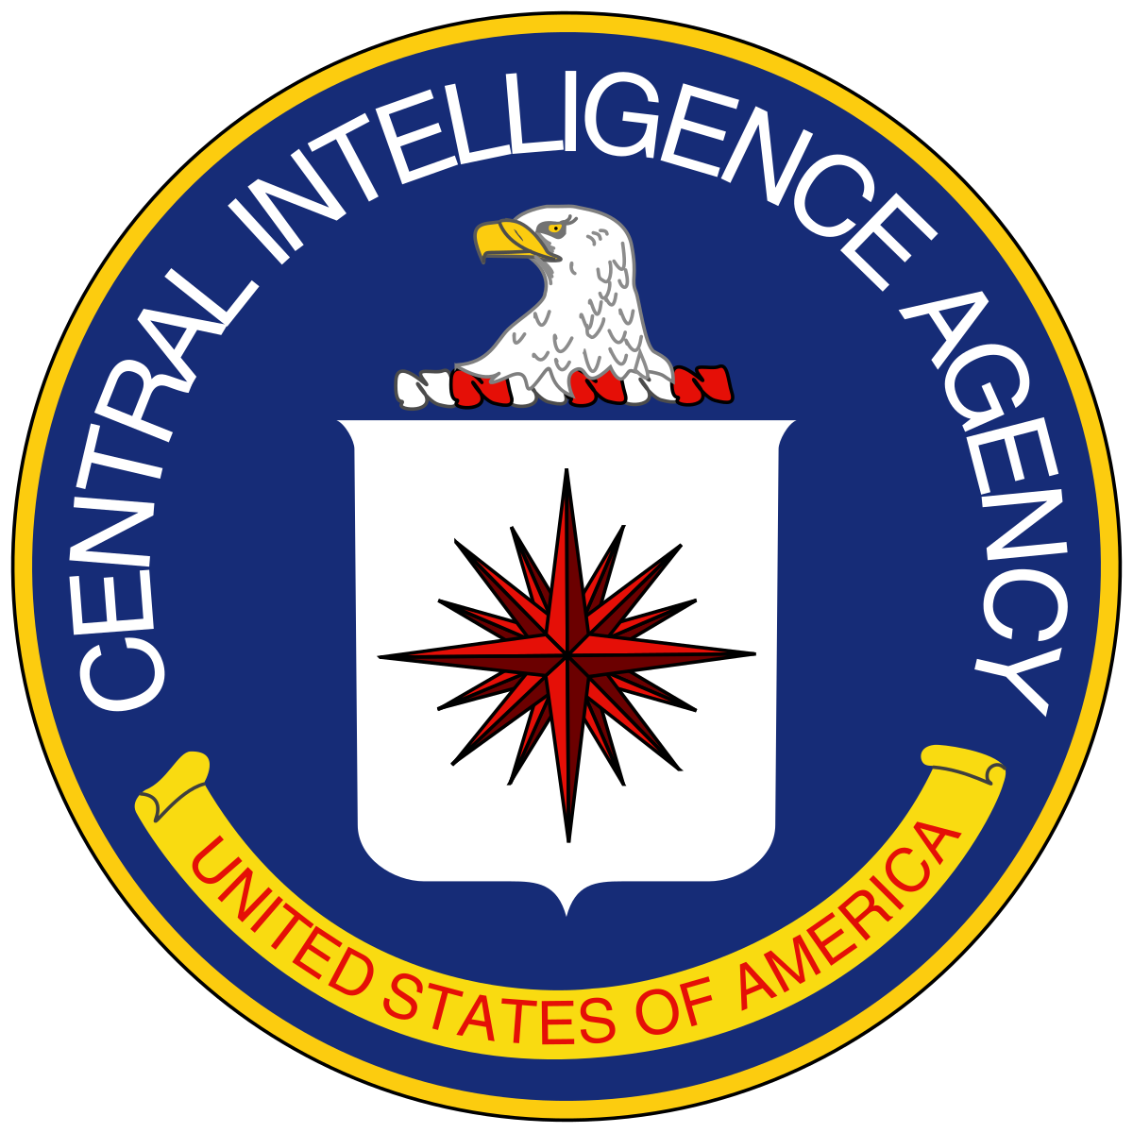
Creation of CIA, NATO, and the Stay-Behind Operations
Creation of the CIA
The Central Intelligence Agency (CIA), which succeeded the Office for Strategic Services (OSS), was created with the passage of the National Security Act of 1947. The CIA was created with the aims of centralizing intelligence in order to gain information on foreign militaries, to sabotage enemy military infrastructure, and to bring political change that favored US foreign policy.
The CIA was given additional permission to use any actions necessary to carry out its objectives. This even caused Truman himself to rebuke the operational role of the CIA in a op-ed for the Washington Post in Dec. 1963, writing “I never had any thought that when I set up the CIA that it would be injected into peacetime cloak and dagger operations.”

Slide 28
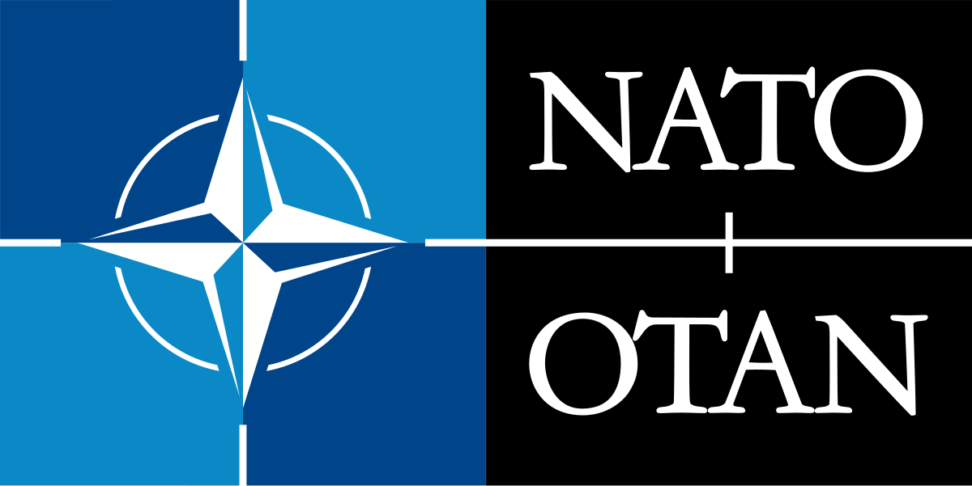
North Atlantic Treaty Organization (NATO)
Creation of NATO
The North Atlantic Treaty Organization was a collective military agreement that formed in 1949 as a generalization of the Treaty of Dunkirk and the Treaty of Brussels. NATO became a military alliance between Western Europe, US, and Canada to continue the Truman Doctrine of containment of the USSR.
Founding members included Belgium, Canada, Denmark, France, Iceland, Italy, Luxembourg, the Netherlands, Norway, Portugal, the United Kingdom, and the United States.
NATO brought into leadership former Nazi military leaders such as General Adolf Heusinger, General Wolfgang Altenburg, General Johannes Steinhoff as well as others. NATO claimed to be a security pact to protect against attacks by the Soviet Union but has not dissolved to this day, 32 years after the Counterrevolution of 1991 that systematically dismantled the USSR.

Slide 29
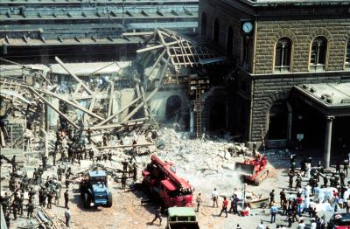
Stay-Behind Operations
Resuscitating Fascism
Stay-Behind Operations were plans coordinated between NATO, CIA, and the British Secret Intelligence Services (SIS also known as MI6)
These Operations coordinated fascist networks in order to cause disorder and destroy socialism in Eastern Europe. A couple of notable stay-behind operations conducted were Operation Gladio and Operation Aerodynamic.
Operation Gladio was the name of all operations in Italy that conducted false flag operations to delegitimize Communist organizations as well as to arm, fund, and provide intelligence to neo-Nazi and neo-Fascist groups such as the New Order, National Vanguard, and others who committed terrorist attacks on Communists throughout the 1960s to 1980s.
Bologna Train Station after bombing on April 2nd 1980 by neo-Fascist Nuclei Armati Rivoluzionari group.

Slide 30
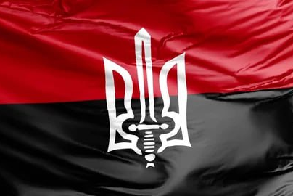
Operation Aerodynamic
Aiding Ukrainian Fascists Early On
A declassified CIA document from July 13th 1953 stated “The purpose of Project AERODYNAMIC is to provide for the exploitation and expansion of the anti-Soviet Ukrainian resistance for cold war and hot war purposes. Such groups as the Ukrainian Supreme Council of Liberation (UHVR) and its Ukrainian Insurgent Army (OUN), the Foreign Representation of the Ukrainian Supreme Council of Liberation (ZPUHVR) in Western Europe and the United States, and other organizations such as the OUN/B will be utilized”
This series will be continued with History of U.S. Imperialism: Dawn of the Cold War in August.
Flag of the Banderite Nazi Organization of Ukrainian Nationalists Flag

Slide 31
Discussion & Wrap Up

Slide 32
Announcements
THE KONONOVITCH BROTHERS NEED US, SHARE THIS ARTICLE:
https://dailyworkerusa.com/stop-the-kiev-regimes-calls-for-the-murder-of-the-kononovitch-brothers/
The PCUSA Arts and Culture Commission is looking for content submissions for Vol III 2023 of New Masses! Send any submissions to info@partyofcommunistsusa.net and kamryns@johnreedcenter.net
The Peoples School for Marxist Leninist Studies has began posting videos on our TikTok channel @peoplesschool! Please subscribe to the channel and like and share our content!

Slide 33
Volunteers Needed!
We are in need of volunteers for the staff of the People’s School! Here’s a few roles we need filled:
People to help manage posting on our social media and podcast platforms
Video Editors, Audio Editors, Graphic Designers, Artists, Narrators
Facilitators, Web Controls, Moderators
Email info@peoplesschool.us if you’re interested and try to attend our next staff meeting on Aug. 3rd if possible.

Slide 34
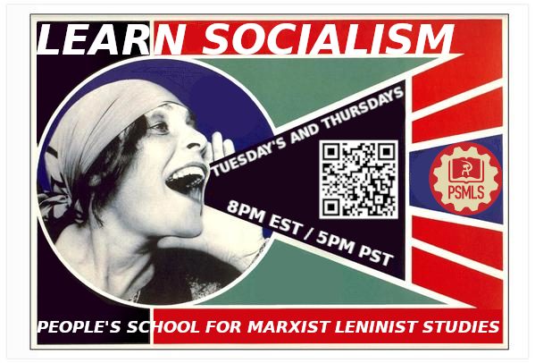
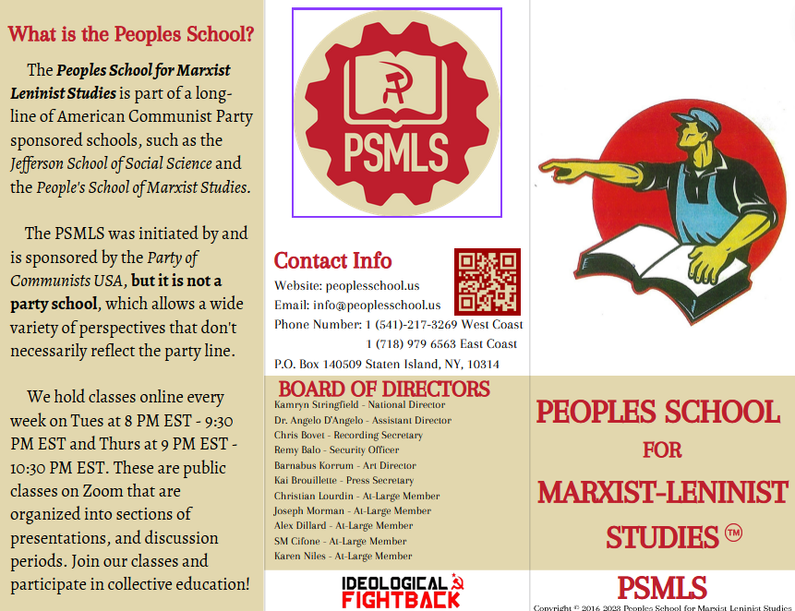
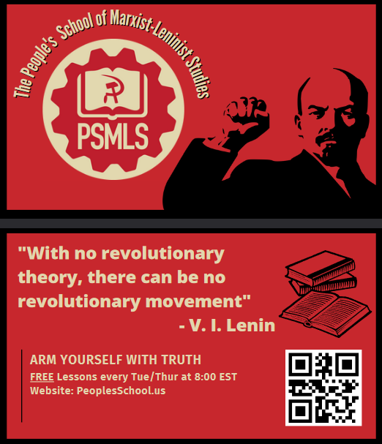
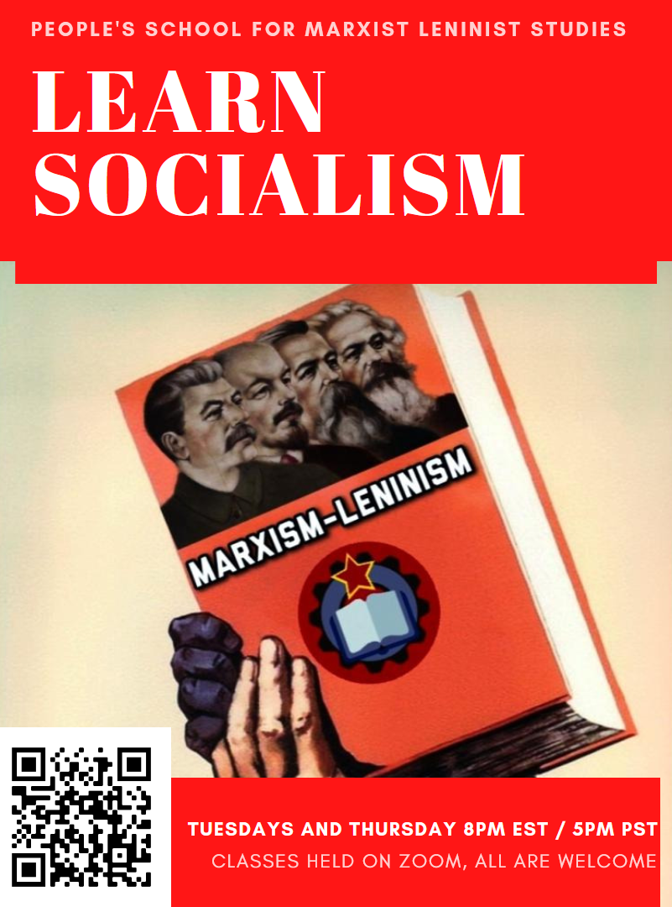
PSMLS Propaganda
peoplesschool.us/media
Materials to help promote the school!

Slide 35
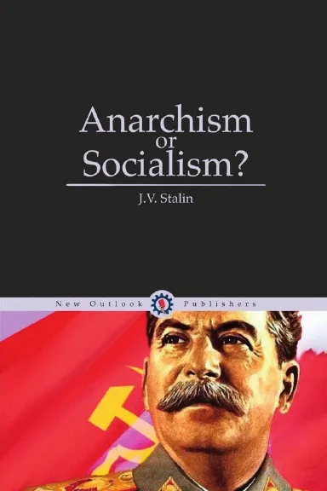
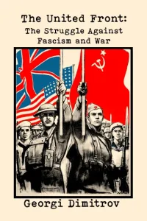
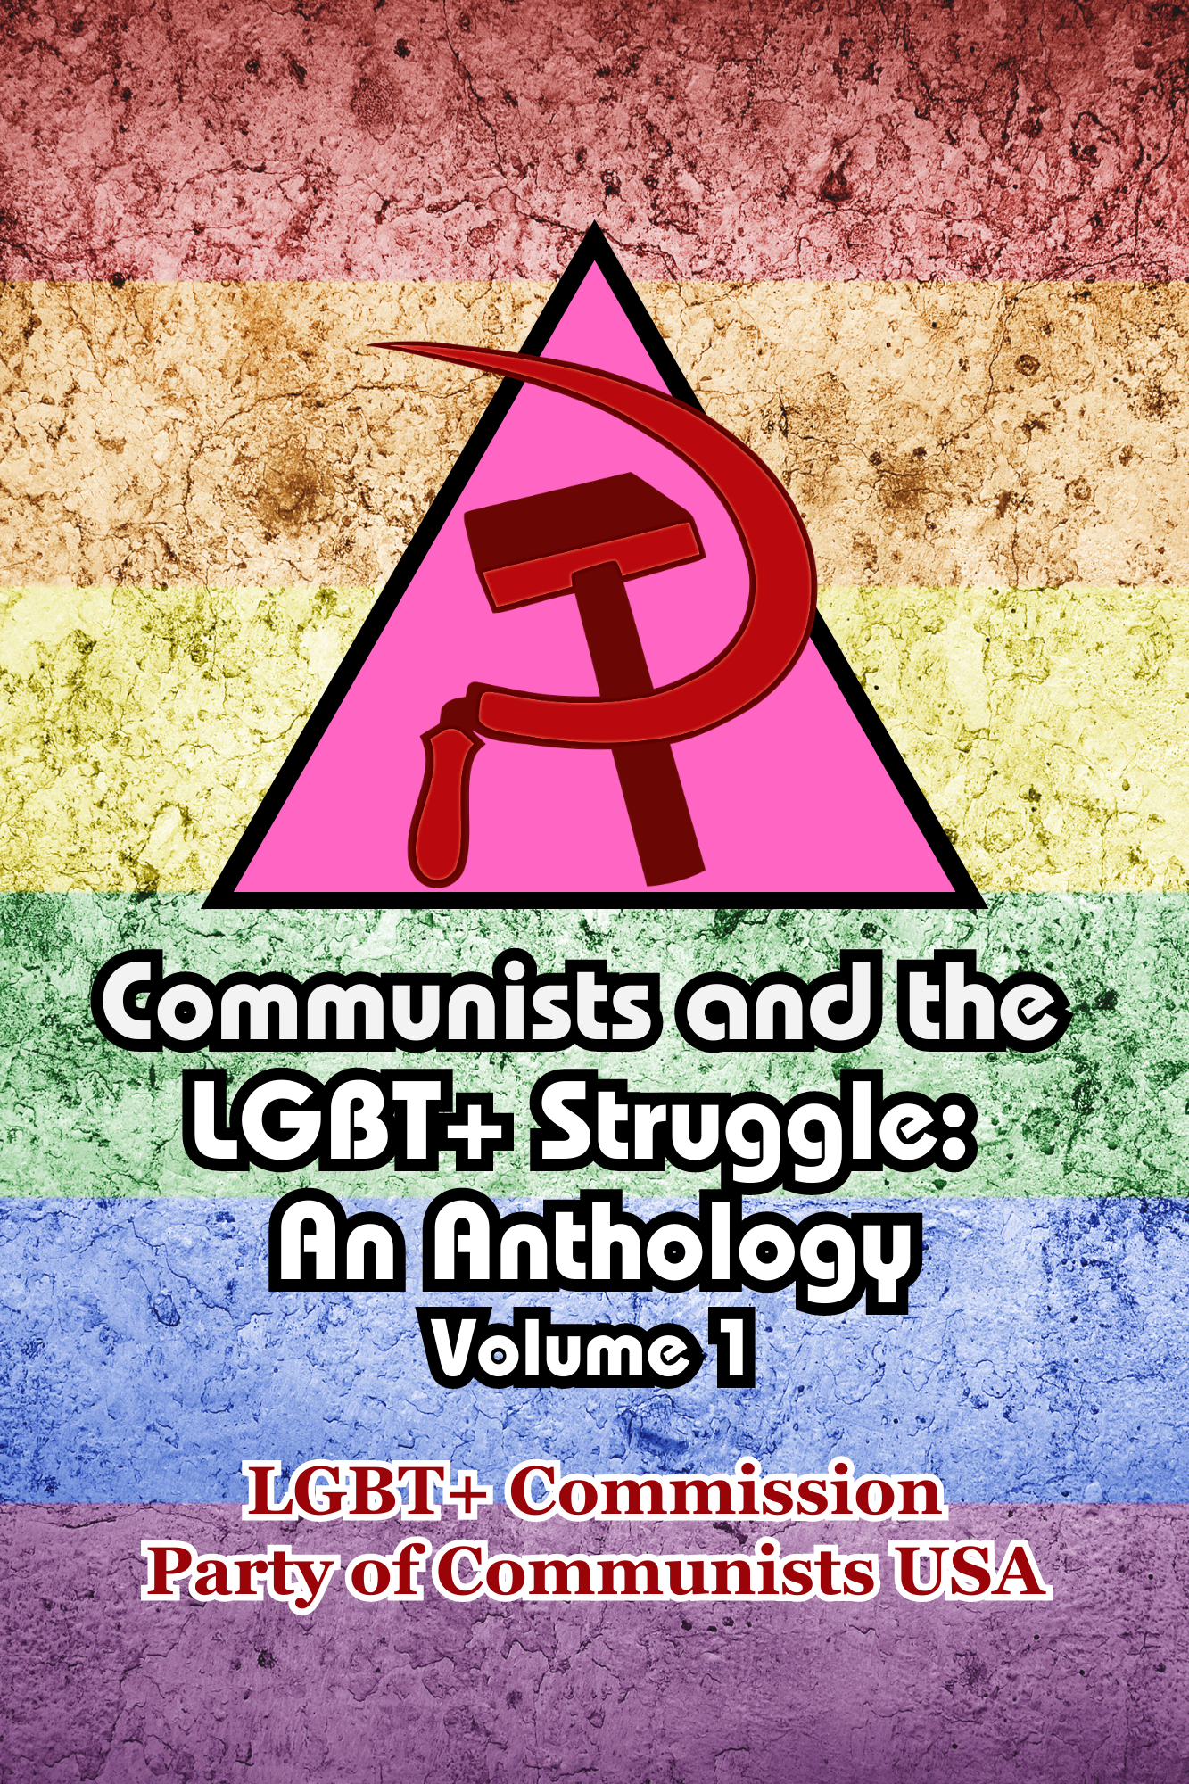
New Outlook Publishers
newoutlookpublishers.store
Latest Releases

Slide 36
Legal Drive
Last year we were attacked and sabotaged by ultraleft wreckers that tried to steal the PSMLS and destroy the PCUSA. They failed, but they will be held accountable and there are still things they took from us that we’ve not got back, like videos, imagery and audio. That is why we still need donations to the legal drive.
To donate, go to partyofcommunistsusa.net/donations/
Check the box that says “PSMLS Legal Funds” and try to donate on Tuesday or Thursday so it is easier for us to sort through. It will go to the legal fund. Anything helps!

Slide 37
Einheitsfrontlied - Song of the United Front

