Slide 1
Hasta Siempre Commandante - Farewell, Che Guevara

Slide 2
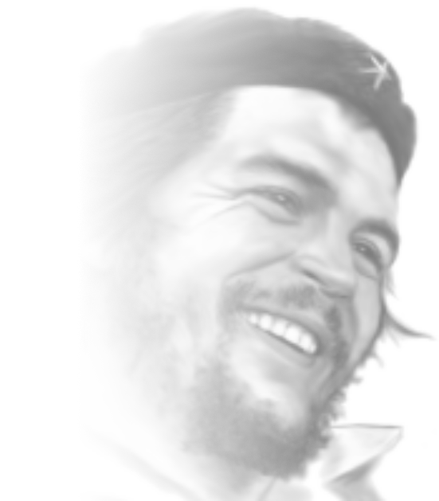
THE LIFE
AND DEATH OF
ERNESTO “CHE” GUEVARA
June 14th, 1928 - October 9th, 1967
PSMLS 07/25/23 - 07/27/23

Slide 3
What we’ll be learning today:
Who he was as a person, where he came from & the politics of the time.
His introduction to Marxism, his time in Guatemala & Mexico and Meeting Fidel
His involvement in the Cuban Revolution and the politics of the Republic of Cuba
The activities of Che around the world preceding his assassination in Bolivia in 1967

Slide 4
Ernesto Guevara
Notes:
w

Slide 5
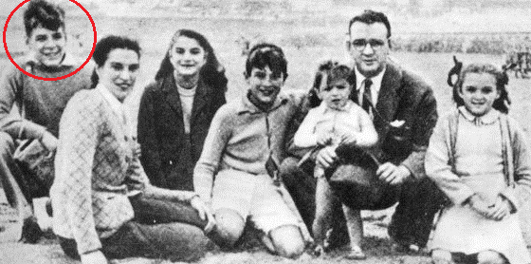
Who was he?
His parents were upper-class immigrants from Spain. He had hints of Irish in him
Early on, he developed an "affinity for the poor" having been educated on leftist works. His father supported the republicans during the Spanish Civil War - 1936-1939
Born in Argentina - June 14th 1928
He suffered from severe asthma as a kid but never let it stop him
Eventually achieved the rank of Major in Fidel’s armed resistance

Slide 6
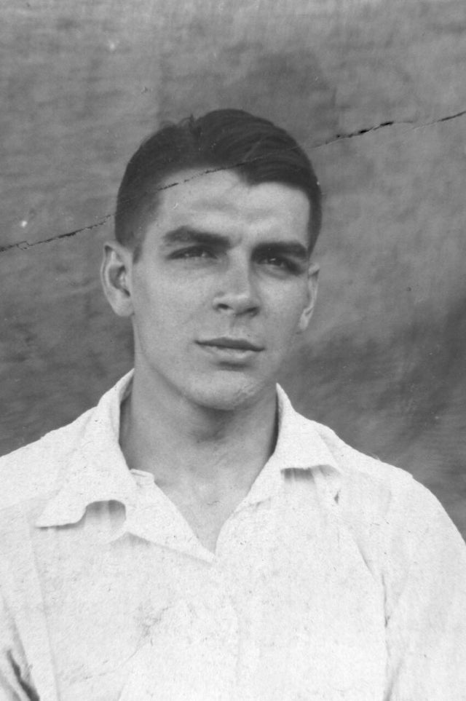
While generally pleasant and charming, he was known to be strong in his conviction and would often speak his mind, bluntly if need be
His father (Ernesto Guevara Lynch) once mentioned that: “In his blood flows the blood of Irish rebels.”
In 1948 he studied medicine in Buenos Aires. Also had a undying passion to explore.
Read everything from Nietzsche’s Idea of Death, Jawaharlal Nehru, Marx-Lenin, Ciro Alegria Bazan, Jorge Icaza, H. G Wells, the Buddha & more
Favorite subjects were: Philosophy, math, engineering, political science, sociology, history, and archaeology
A later declassified CIA document would note Che as: “Quite well read, and fairly intellectual for a Latino”. -1958

Slide 7
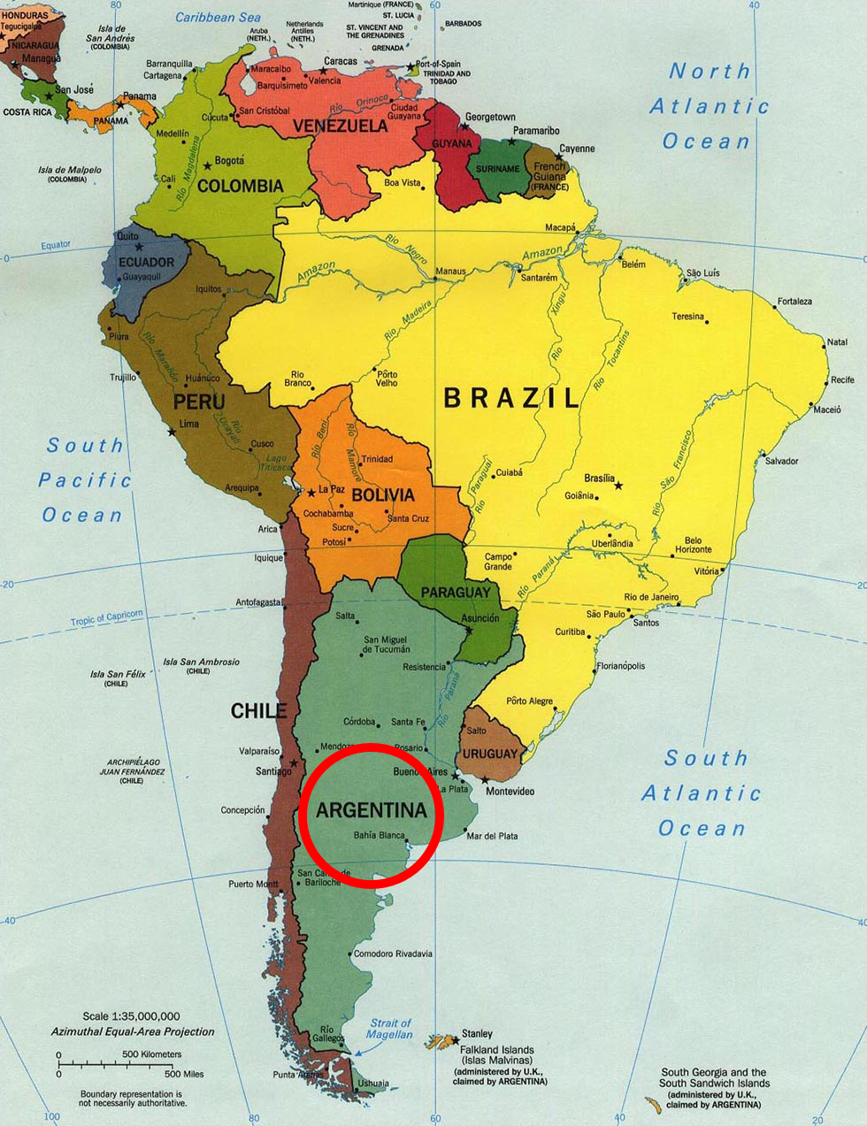
Latin America at the Time
BRAZIL 1935 Communist Uprising. Led by Luis Carlos Prestes. Between 23-27th of November 1935
VENEZUELA The Military Dictator Perez Jimenez was forced out on January 1958
COLOMBIA 1948 to 1958 was La Violencia - A 10 year civil war between the Conservative Party and the Liberal Party. Begun with the assassination of Jorge Eliecer on April 9th 1948
PERU In a coup on October 2th, 1948, General Manuel A. Odria became president. At first he appease the Oligarchs but then later shifting to support the poor and lower classes
BOLIVIA By 1967 the CIA funded the Bolivian Dictatorship to hunt and later murder Che
CHILE By 1920 had a system working for the rich. 1924 was a military coup led by Luis Altamirano
By 1925 another coup would then oust Altamirano. He was arrested but died of old age in 1938
Pinochet
URUGUAY Gabriel Terra couped the General Assembly in 1933 and governed by decree

Slide 8
Latin America at the Time
ARGENTINA
1930 saw the coup of Yrigoyen by Jose Felix Uriburu
A 1934 coup by General Arturo Rawson toppled the democratically elected government of Ramon Castillo
GUATEMALA
United Fruit Company & US Involvement
Saw a Communist threat from Mexico
1944-1954 Che witnessed and experienced the Guatemalan Revolution
The civil war from 1954/60 to 1996
The laws passed by Arbenz
Harry Truman authorized toppling Arbenz in 1952 with the help of the dictator Anastasio Somoza Garcia
MEXICO
The Zapatistas - A force of the Mexican Revolution from 1911 to 1920, who fought against the Nationalists

Slide 9
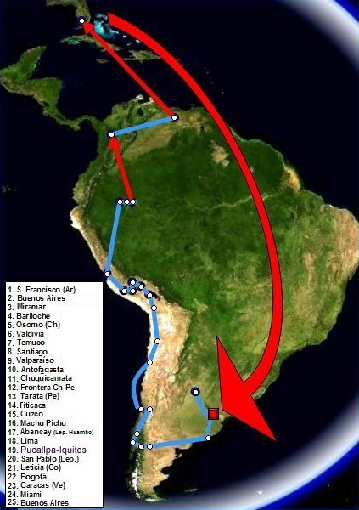
The Death of Ernesto and the Birth of Che
His first road trip, Ernesto makes it to Florida
He sees what US Capitalism is doing to his native people (Camplight Story)
He let nothing stop him, even selling his suitcase to make it all the way
What he witnessed in Guatemala during the 50’s had solidified his Left leanings and would shortly after explain his devotion to Marxism-Leninism
Spent some of his time traveling, curing the impoverished or those “out of reach”, for free
His socio-political awakening has very much to do with his face-to-face contrast with poverty, exploitation, illness and suffering. -Carlos M. Vilas

Slide 10
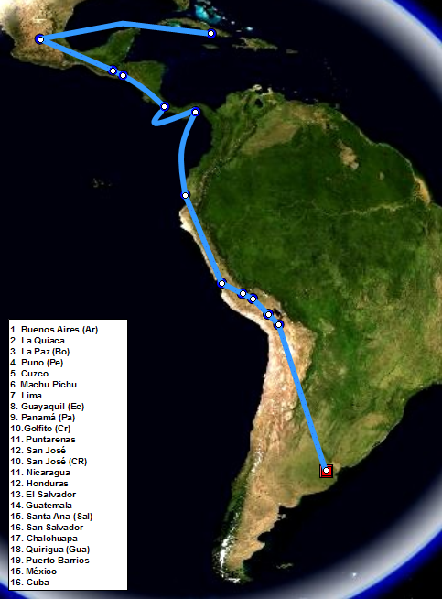
The Death of Ernesto and the Birth of Che
Che’s journey which led him to Cuba
His 2nd road trip

Slide 11
Discussion

Slide 12
Becoming a Communist
Notes:
w

Slide 13
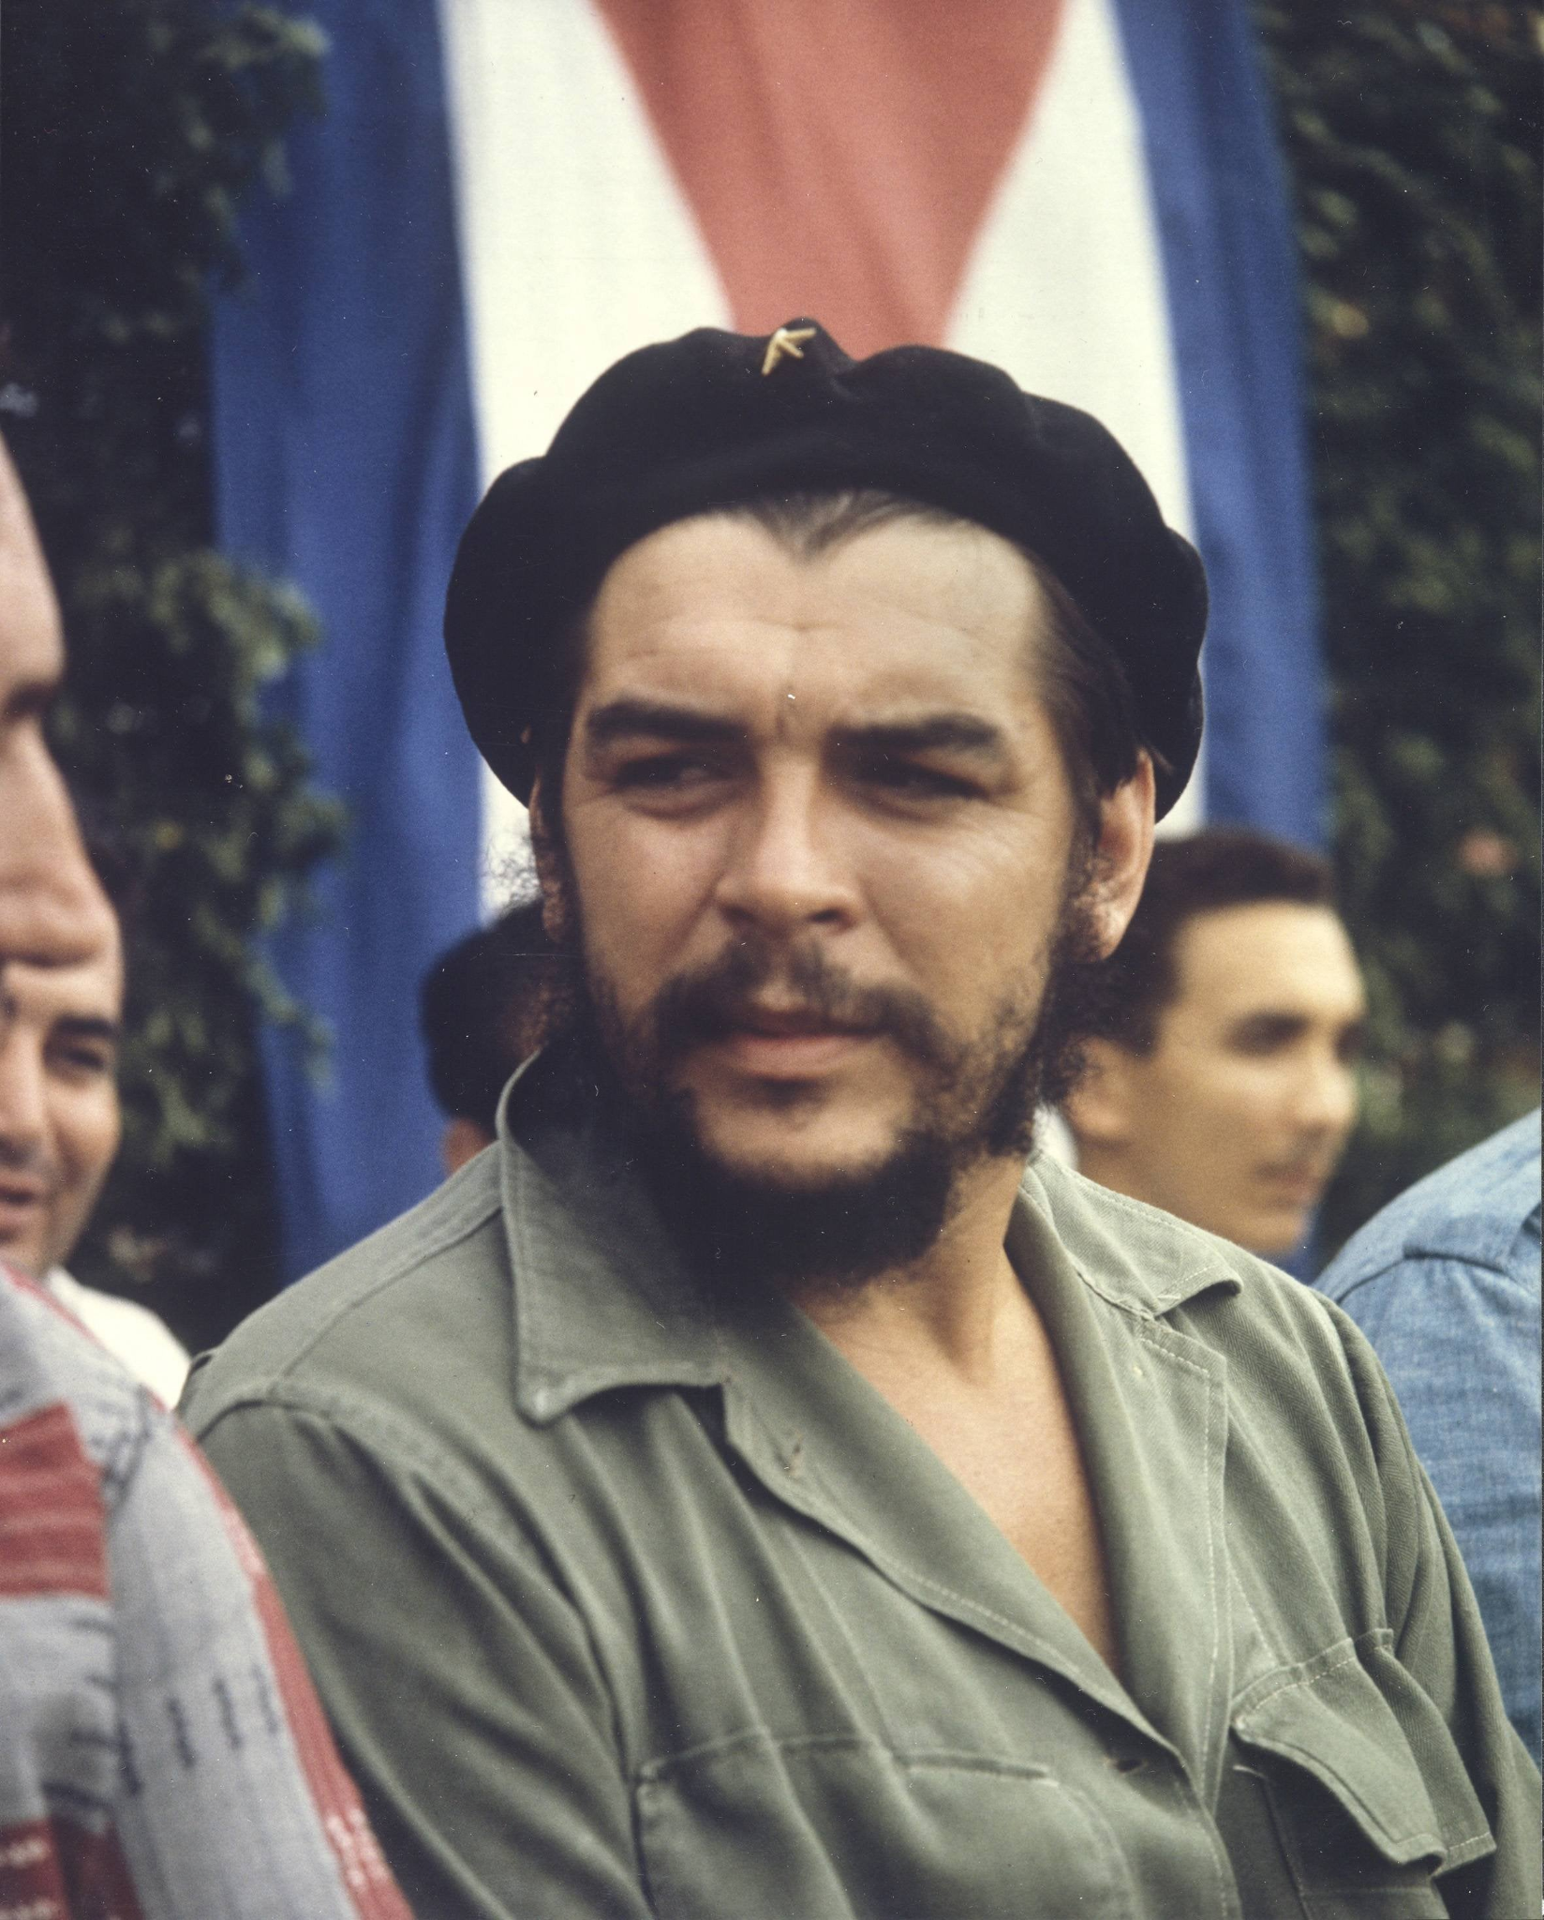
Meeting Fidel
Joined the Guatemalan Youth League but was annoyed by its inaction
Was never formally a member of a communist party and did what he did out of duty and humanity
His repeated calls to resist marked him for death from the state but found safe passage to Mexico
There he met an exiled revolutionary lawyer named Fidel Castro and the two quickly connected politically
It was in Guatemala which finally convinced him of the necessity for armed struggle and for taking the initiative against imperialism
Without much thought, he joined Fidel as his number 3 to land and Liberate Cuba despite not being Cuban. This was seen as highly respected but odd at the time
Che’s conviction strengthened that Marxism, achieved through armed struggle and defended by an armed populace, was the only way to rectify capitalist conditions

Slide 14
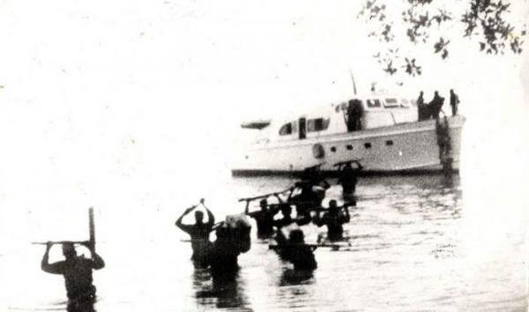
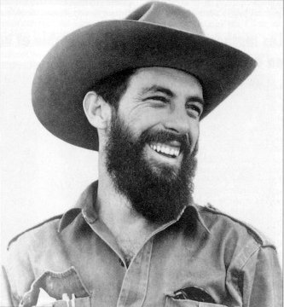
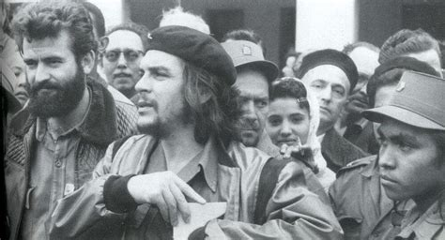
The Cuban Revolution
After sailing from Mexico on December 2, 1956 the yacht Granma landed, albeit, noticed by Batista’s troops. The yacht was designed to house 12 people. It carried 82
Of the 82 that originally landed, under gunfire and bombings, only around 6 would live to see Havana; Including Che, Fidel, Raul, & Camilo Cienfuegos
It was at this landing that Che, although a doctor, chose the path of a gun when under fire, he had to pick between his aid packet or his rifle. Che had come into his own
It took Che nearly two weeks of an asthma-ridden hiking (alone) in the Sierra Maestra to reach the rally point after the botched landing. During which, he crossed many Batista patrols and impassable ravines undetected

Slide 15
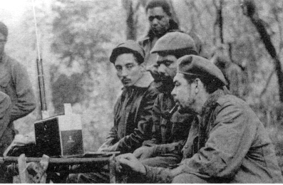
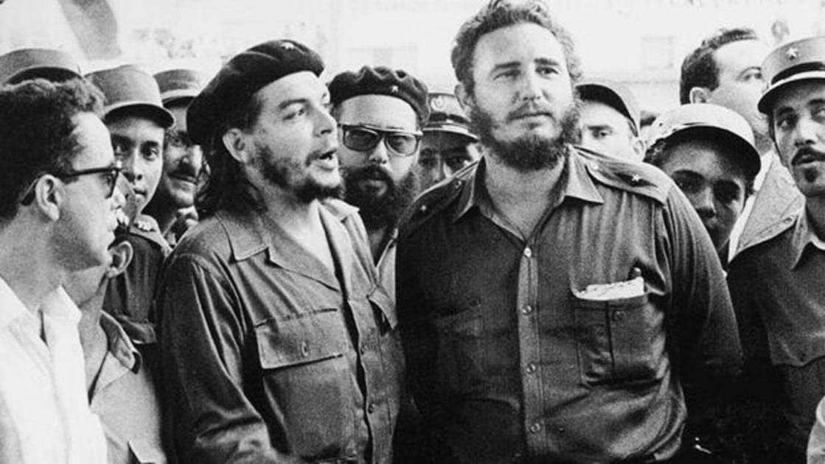
While being smart and independent, Che knew what his role was. Once when he lost his rifle, Che was scolded by Fidel and lost command of a column
Being a true revolutionary, Che took the punishment without a single thought of revenge
Everyone would consult Fidel before any major decision went out. Che was vital for hearing the needs of the men and passing it on to Fidel
It was his (Che) commitment to Marxism and the good leadership of Fidel which was the core to the movement working. It should be a standard all Marxists should have today
Che eventually made the rank of Major, and commanded a whole front of the revolution, leading the charge on Santa Clara. Raul (Fidel’s Brother) commanded the 2nd front and Fidel the other
One act of betrayal too large, or one more desertion could have easily caused the movement to die but it was Che (In my opinion) that was the glue that held it all together
“If you tremble with indignation at every injustice then you are a comrade of mine”. - Che Guevara

Slide 16
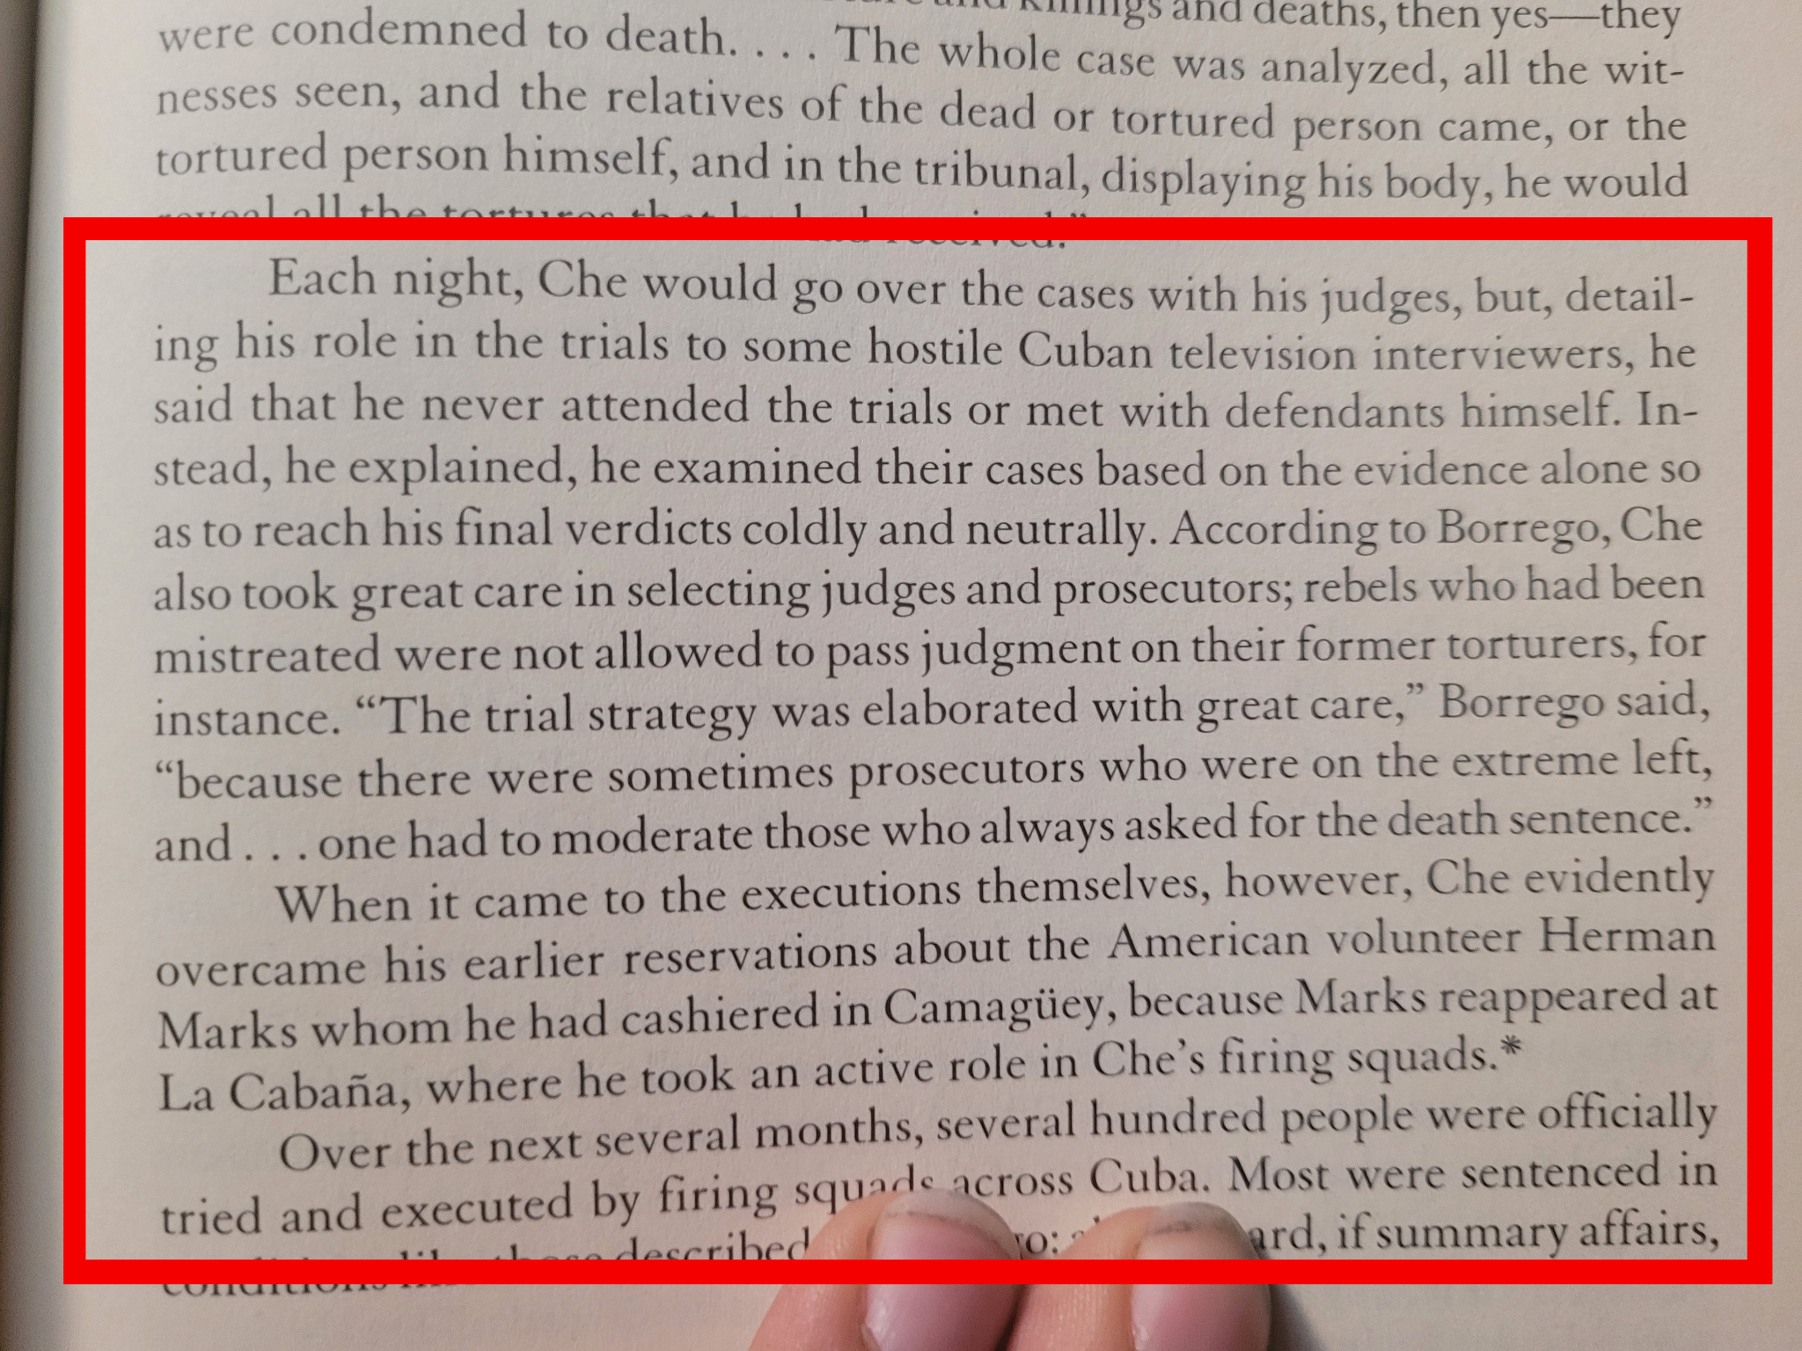
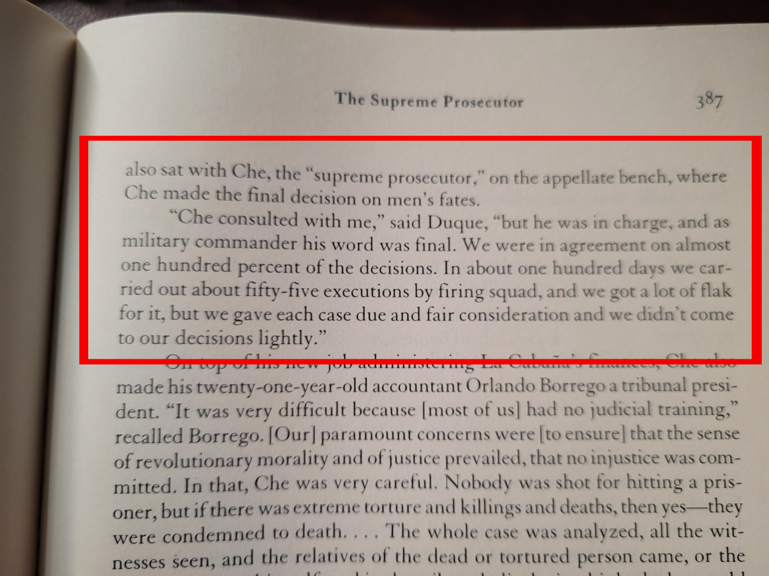
The “Butcher” of La Cabana

Slide 17
Discussion and New Members Introductions

Slide 18
New Member Introductions
What is your name, pronouns and state (or country/territory)?
Where do you work? Is it unionized?
How did you find out about the People’s School?
What do you think about tonight's class?

Slide 19
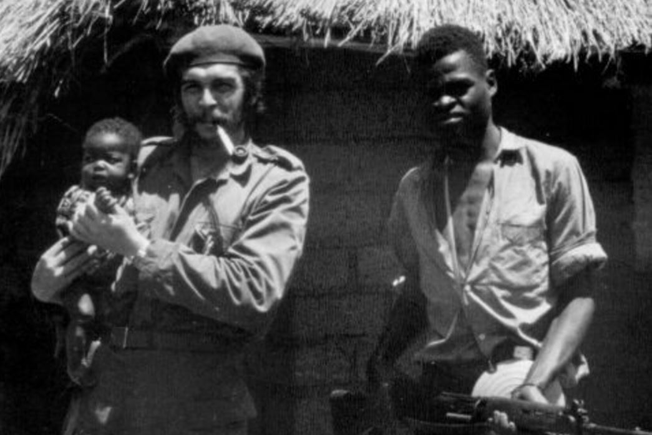
Che in the Congo
Che met MPLA leader Agostinho Neto in January 5th 1965
Cuban troops acted as a strategic reserve for key areas
Che thoughtb that Africa was Imperalism’s weak link
Che showed “The same respect to black people has he did to whites.” -Freddy Llanga, Che’s Swahili interpreter
Wanted to export revolution by instructing local fighters in Marxist Ideology
He wanted to stay and fight till death but Castro ordered him back
He later changed his mind stating: “There is no will to fight, the rebel leaders are corrupt. In a word… there was nothing to do”.
“One can not liberate a country that does not want to fight”. -Che Guevara on the Congo Conflict.

Slide 20
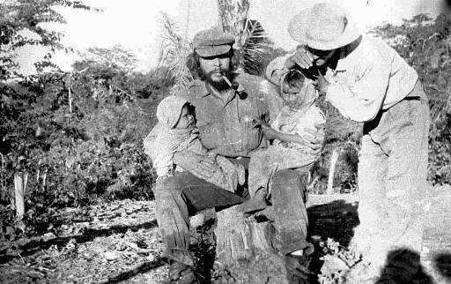
Bolivia & Adventurism
Che never liked or cared (Unlike) Fidel to govern a people. His duty for the cause was to help others rise up
Some of his policies as the minister of the bank were criticized
Feeling like he had done everything he could for the people of Cuba, he secretly asked for permission to help an eventual successful uprising in Angola
Against good dialectical theory, Che then went to aid the peasants of Bolivia. Due to various reasons, US meddling, and virtually no support from the local Communist Party, his efforts in Bolivia proved futile
He was then ambushed & captured near the Yuro Arvine. The Bolivian troops who captured Che were shocked to find out they had indeed gotten the infamous, elusive Che
Wanted to launch an insurgency in his native Argentina.

Slide 21
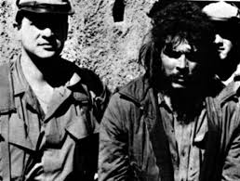
Bolivia & Adventurism
A local school teacher asked to see Guevara earlier that day. A 22 year old woman named Julia Cortez later stated that: “I found Guevara to be an agreeable looking man with a soft and ironic glance, and found myself unable to look him in the eyes because his gaze was unbearable, piercing and so tranquil.”
Che held his head high and De Guzman (his executioner) stated: “He looked everyone straight in the eyes and only asked for something to smoke. I took pity and gave him a small bag of tobacco for his pipe. Che smiled and thanked the officer
Upon some US consultation, he was promptly executed in a small house in which he was being held
After some seconds of contemplation, Che, being a slave to his convictions, shouted at his executioner to: “Shoot coward, you’re only going to kill a man!” before being shot six time in the Chest. Later autopsies would confirm Che died from drowning due to blood in his lungs

Slide 22
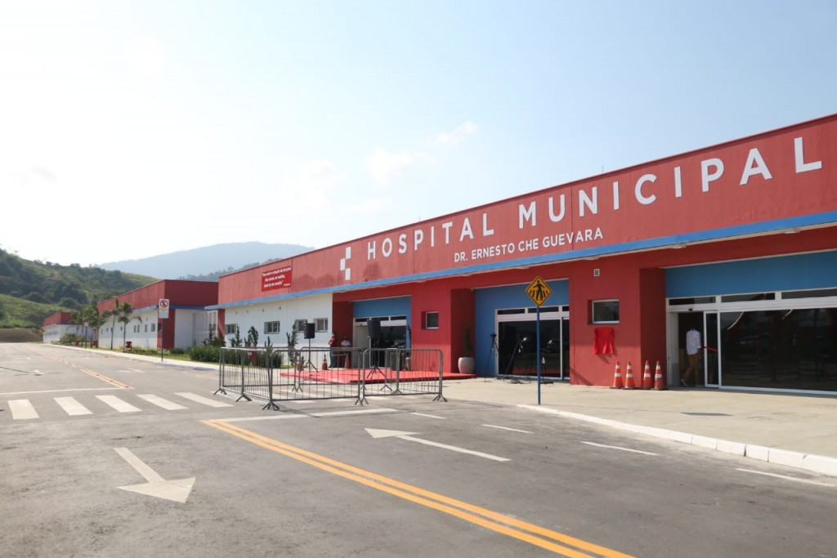
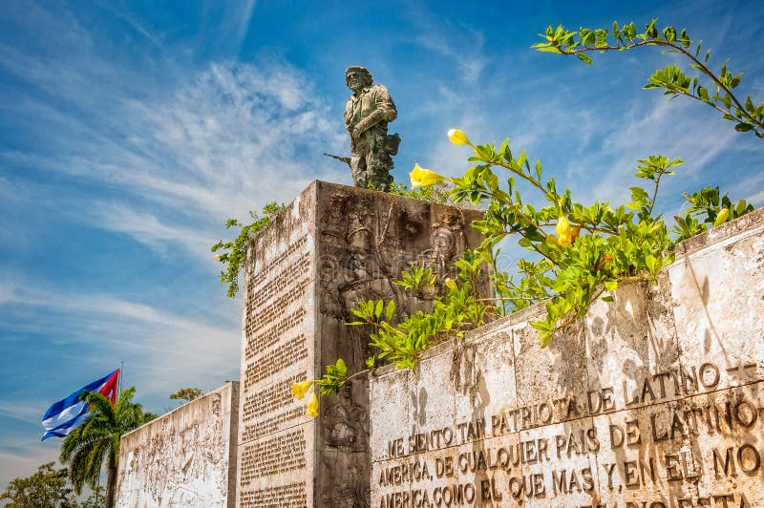
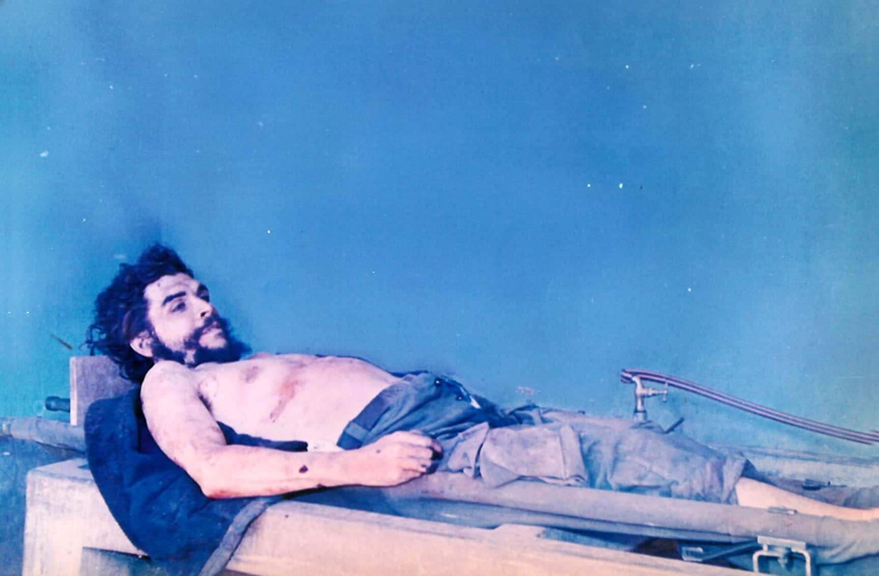
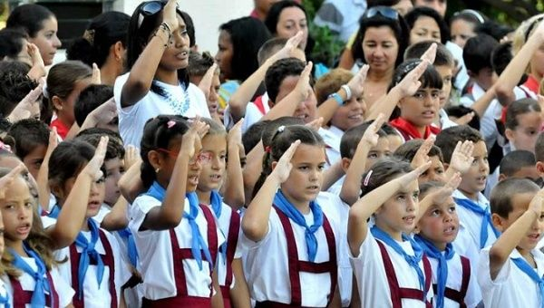
In Memory…

Slide 23
Discussion and Wrap Up

Slide 24
Announcements
THE KONONOVITCH BROTHERS NEED US, SHARE THIS ARTICLE:
https://dailyworkerusa.com/stop-the-kiev-regimes-calls-for-the-murder-of-the-kononovitch-brothers/
The PCUSA Arts and Culture Commission is looking for content submissions for Vol III 2023 of New Masses! Send any submissions to info@partyofcommunistsusa.net and kamryns@johnreedcenter.net
The Peoples School for Marxist Leninist Studies has began posting videos on our TikTok channel @peoplesschool! Please subscribe to the channel and like and share our content!

Slide 25
Volunteers Needed!
We are in need of volunteers for the staff of the People’s School! Here’s a few roles we need filled:
People to help manage posting on our social media and podcast platforms
Video Editors, Audio Editors, Graphic Designers, Artists, Narrators
Facilitators, Web Controls, Moderators
Email info@peoplesschool.us if you’re interested and try to attend our next staff meeting on Aug. 3rd if possible.

Slide 26
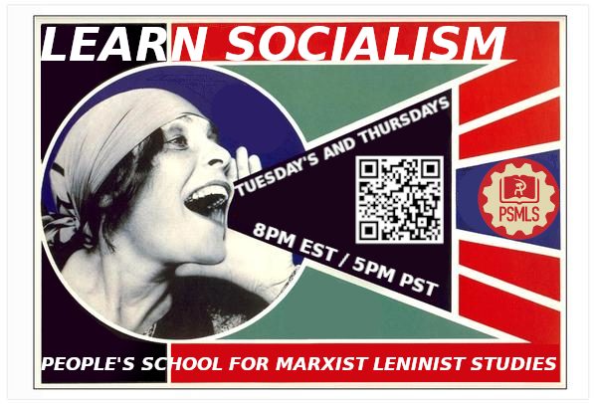
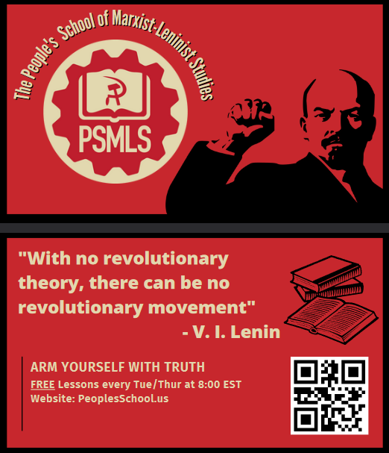
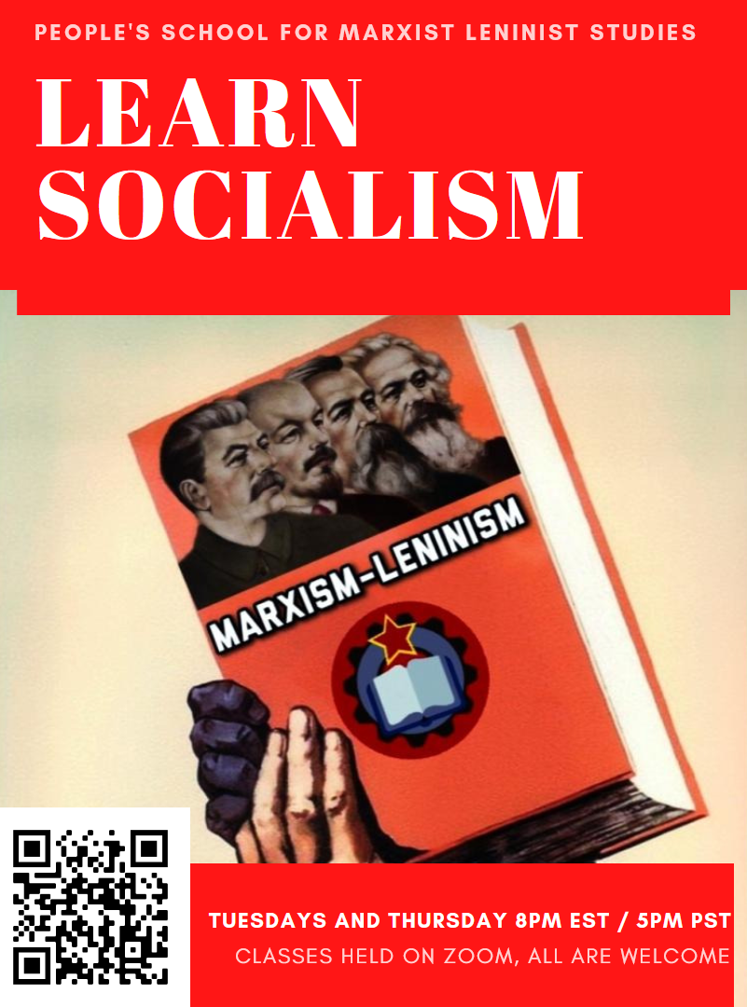
PSMLS Propaganda
peoplesschool.us/media
Materials to help promote the school!

Slide 27
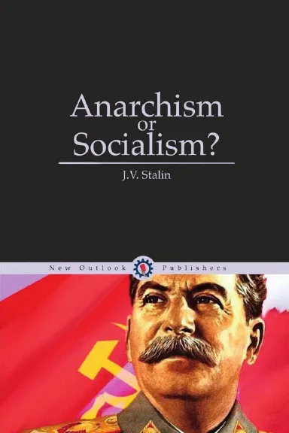
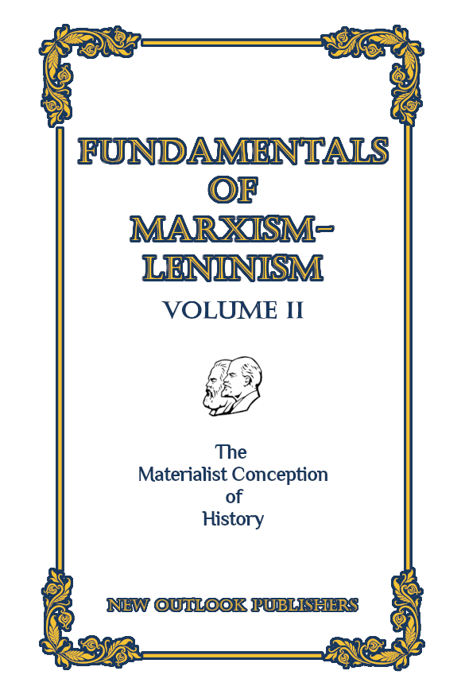
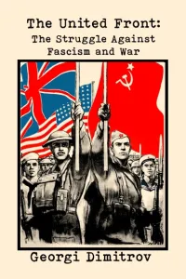
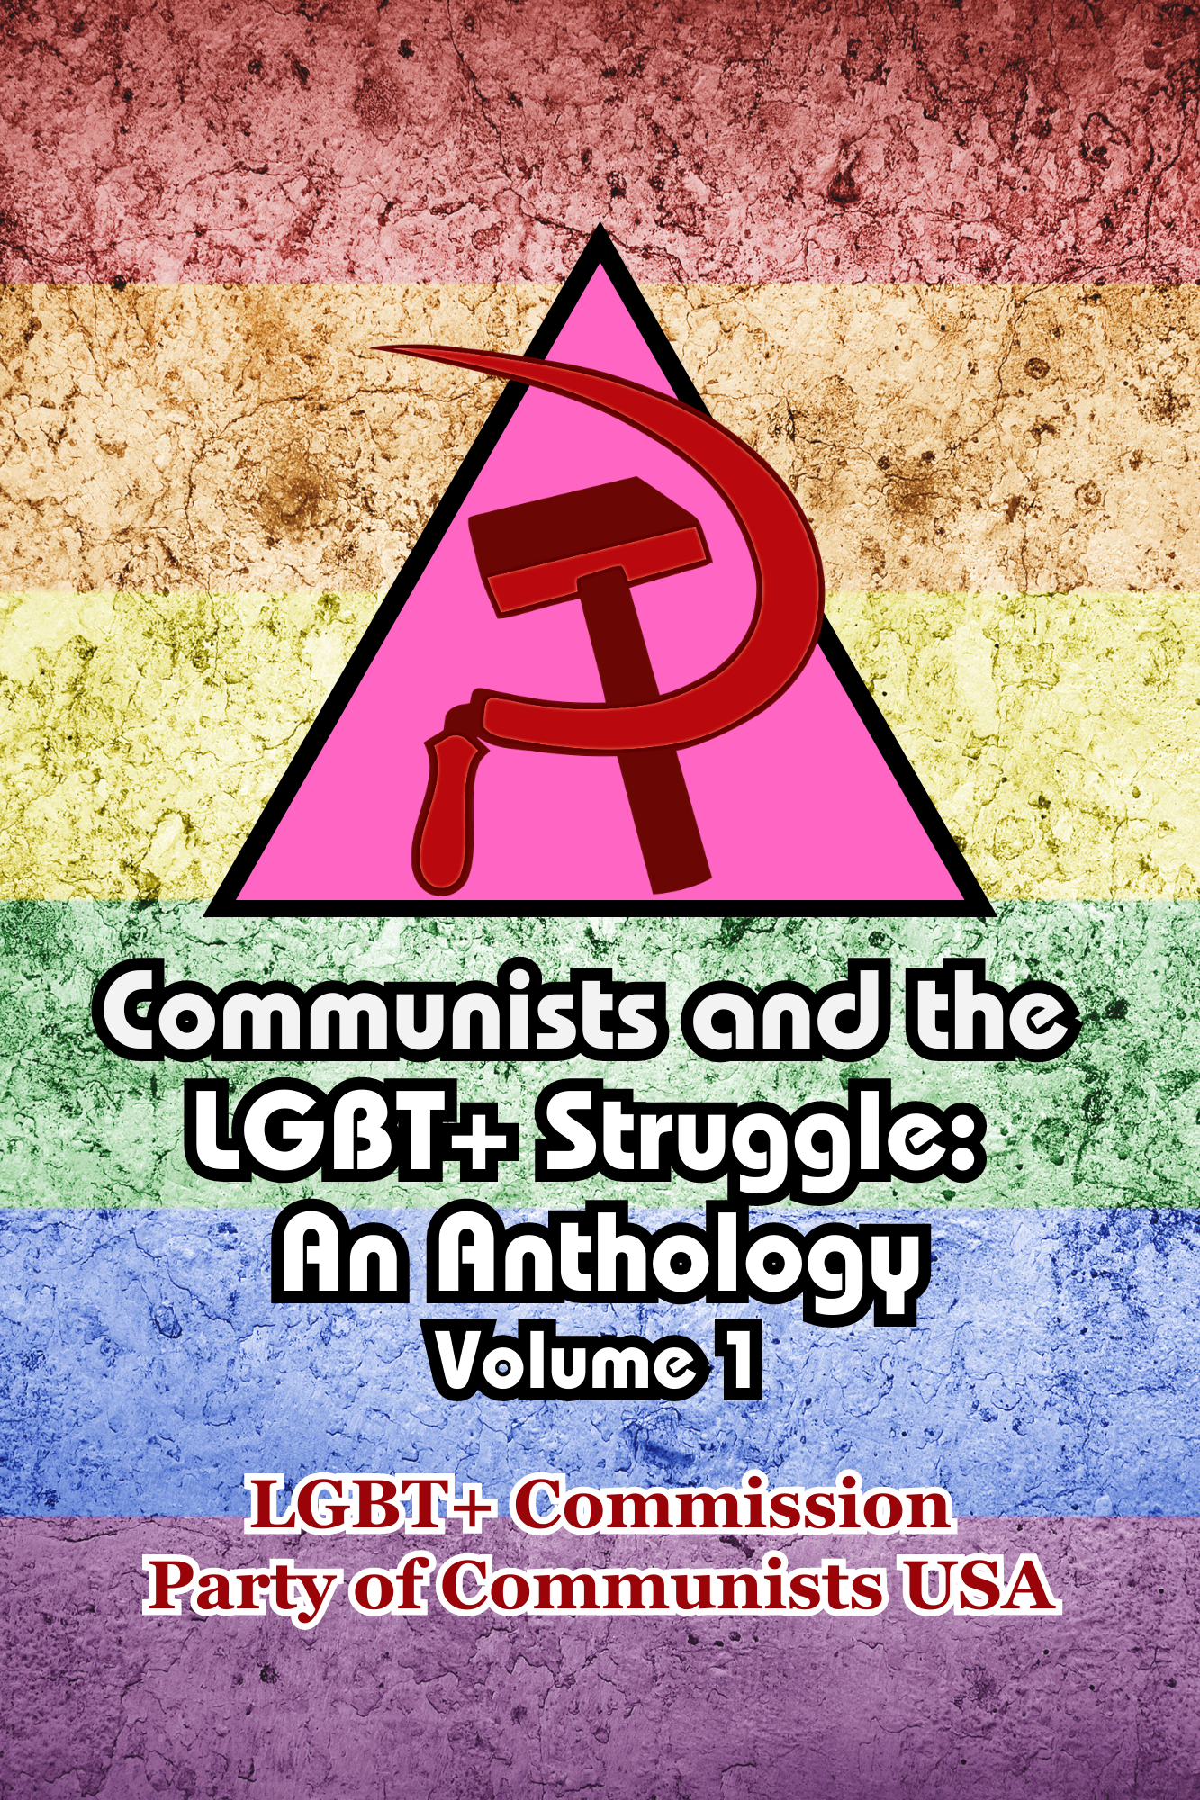
New Outlook Publishers
newoutlookpublishers.store
Latest Releases

Slide 28
Legal Drive
Last year we were attacked and sabotaged by ultraleft wreckers that tried to steal the PSMLS and destroy the PCUSA. They failed, but they will be held accountable and there are still things they took from us that we’ve not got back, like videos, imagery and audio. That is why we still need donations to the legal drive.
Support the GoFundMe for the legal drive at https://www.gofundme.com/f/legal-fund-to-defend-against-wreckers. Anything helps!

Slide 29
Hasta Siempre Commandante - Farewell, Che Guevara

