Slide 1
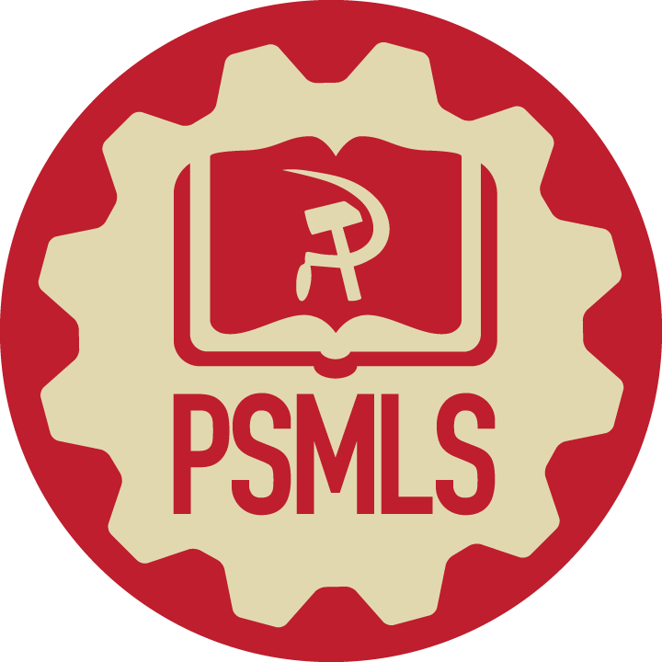
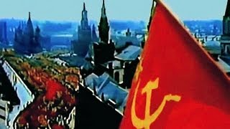
National Anthem of the Soviet Union - 1984 Daily Broadcast Version

Slide 2
PSMLS mm/dd/yy - mm/dd/yy

Slide 3
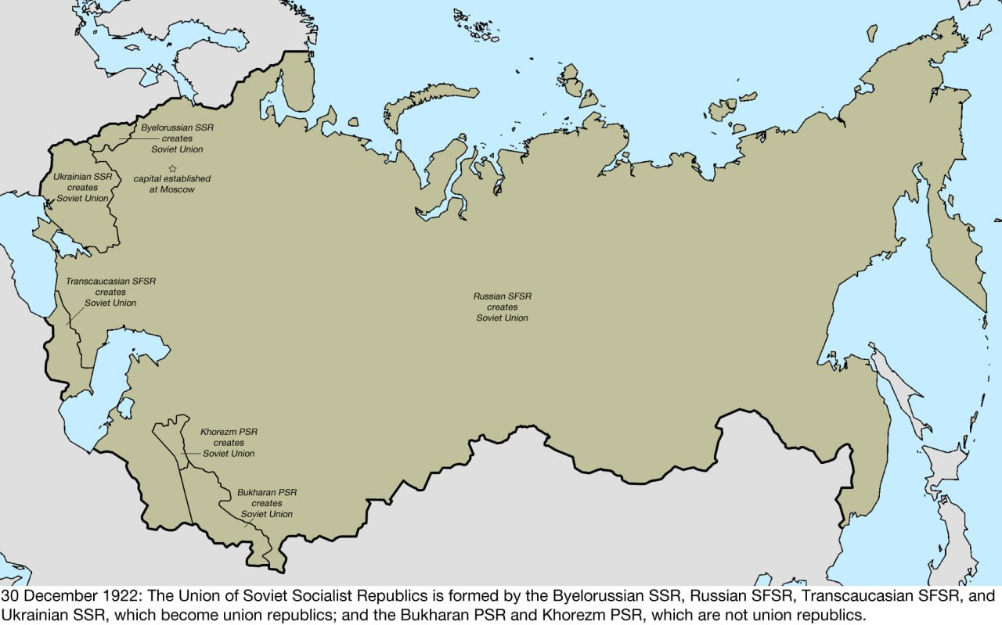
What we’ll be learning today:
Belorussian SSR
Kazakhstan SSR
Transcaucasian SFSR
Ukrainian SSR

Slide 4
Belorussia - Similar but Different

Slide 5
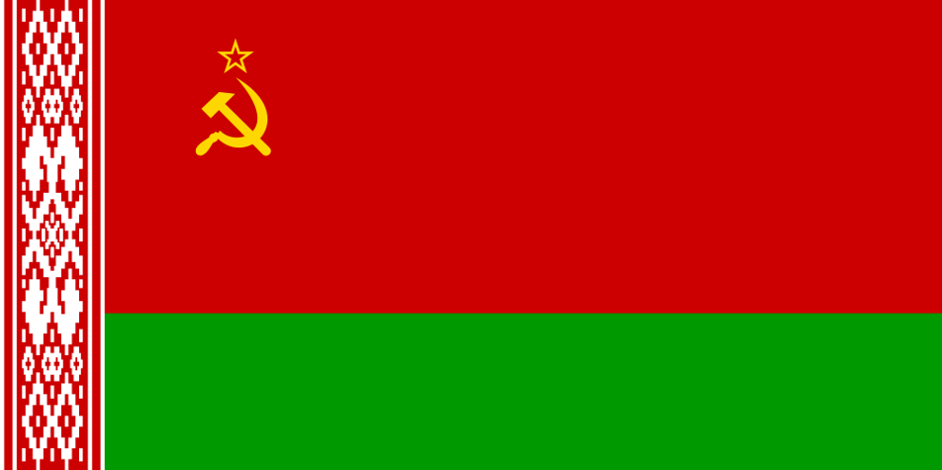
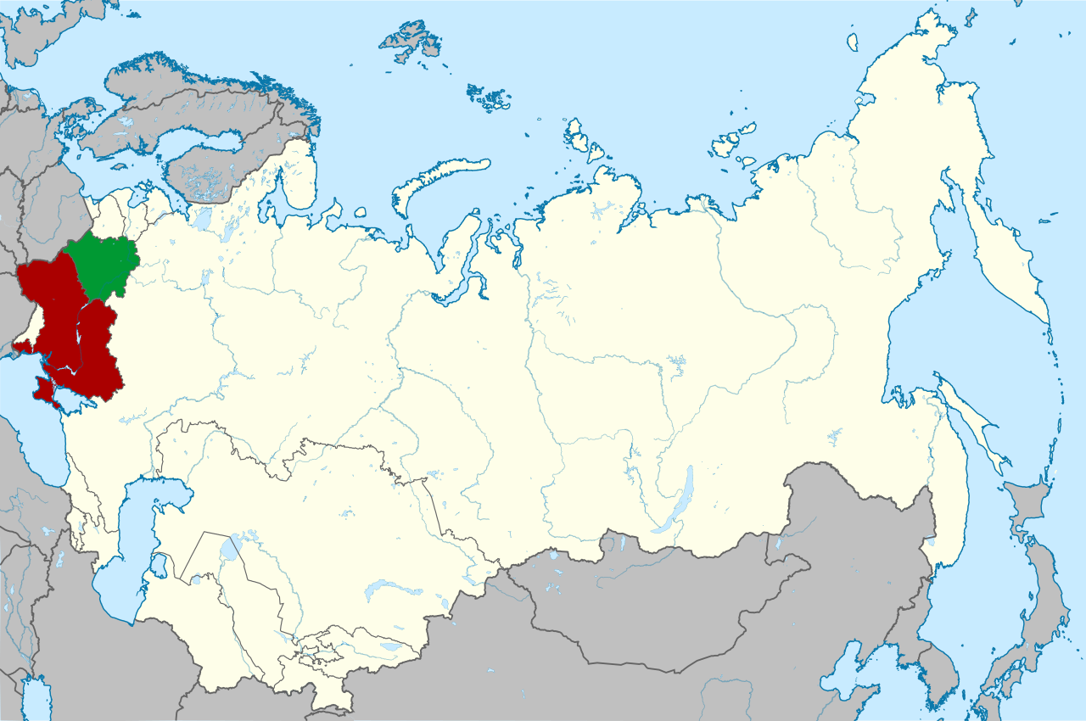
“White Russians”
●Belorussia was a country that bordered Russia to the NW and had a diverse cultural makeup of Jewish and Russian backgrounds.
●“Belorussia is to Russia as Portugal is to Spain; next door on the West, smaller, with similar but distinct language and people” - Soviet But Not Russian

Slide 6
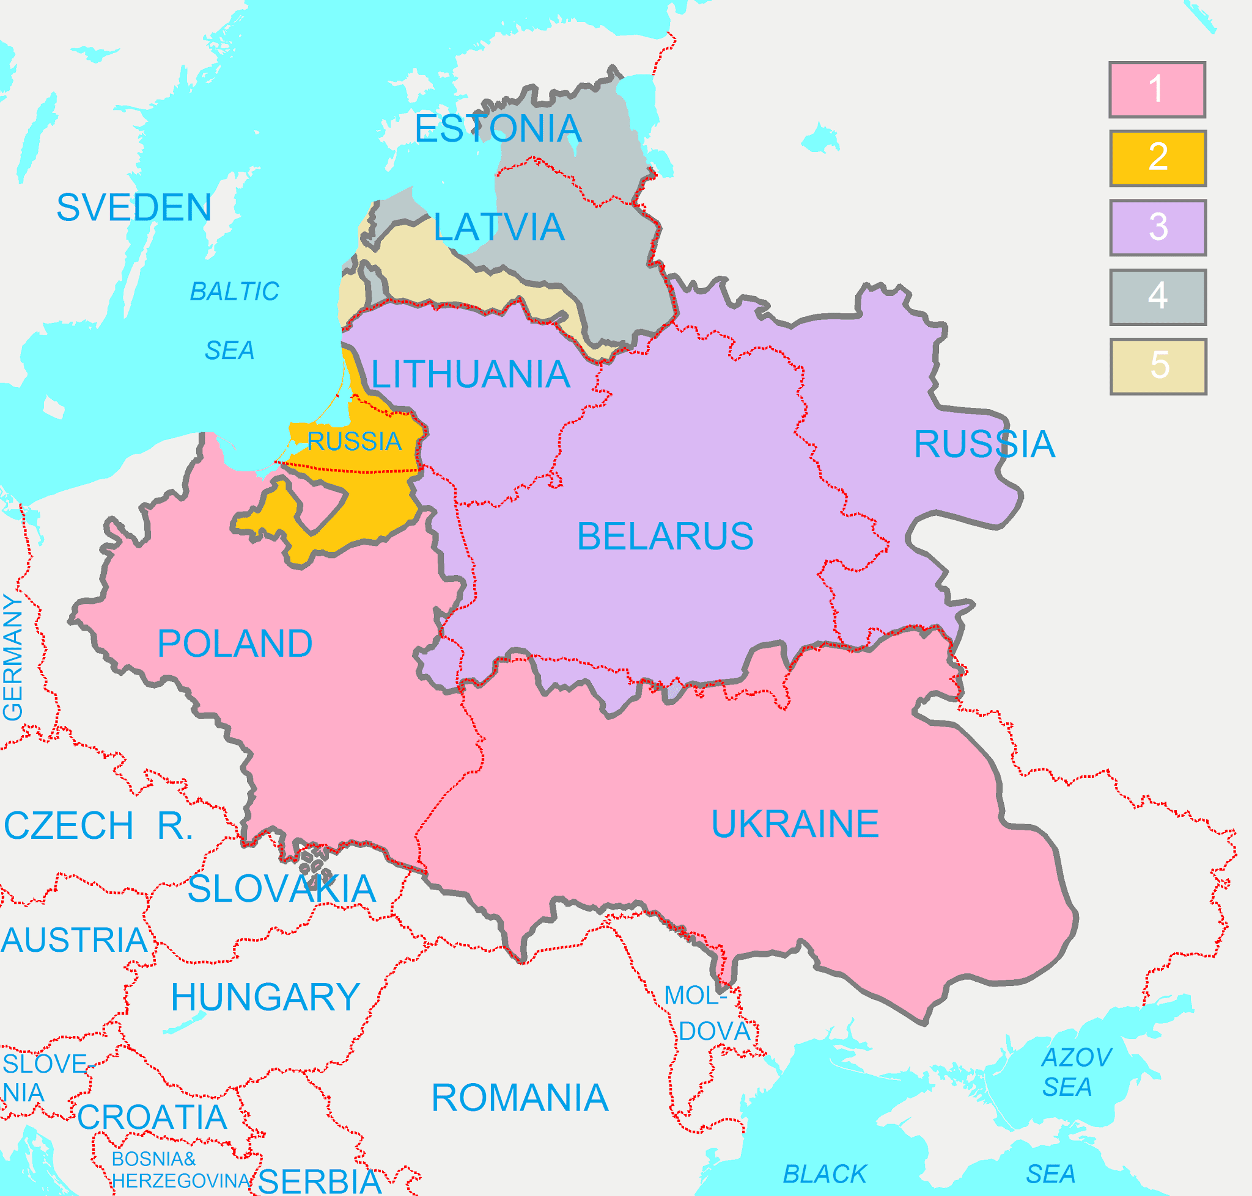
“Colonials of Semi-Colonials”
Belorussians were mostly peasants under Polish landowners who were also under Russian rule until the Bolshevik Revolution.
Never developed enough to become an empire in history. They were a part of the Polish-Lithuanian Commonwealth until 1795.

Slide 7
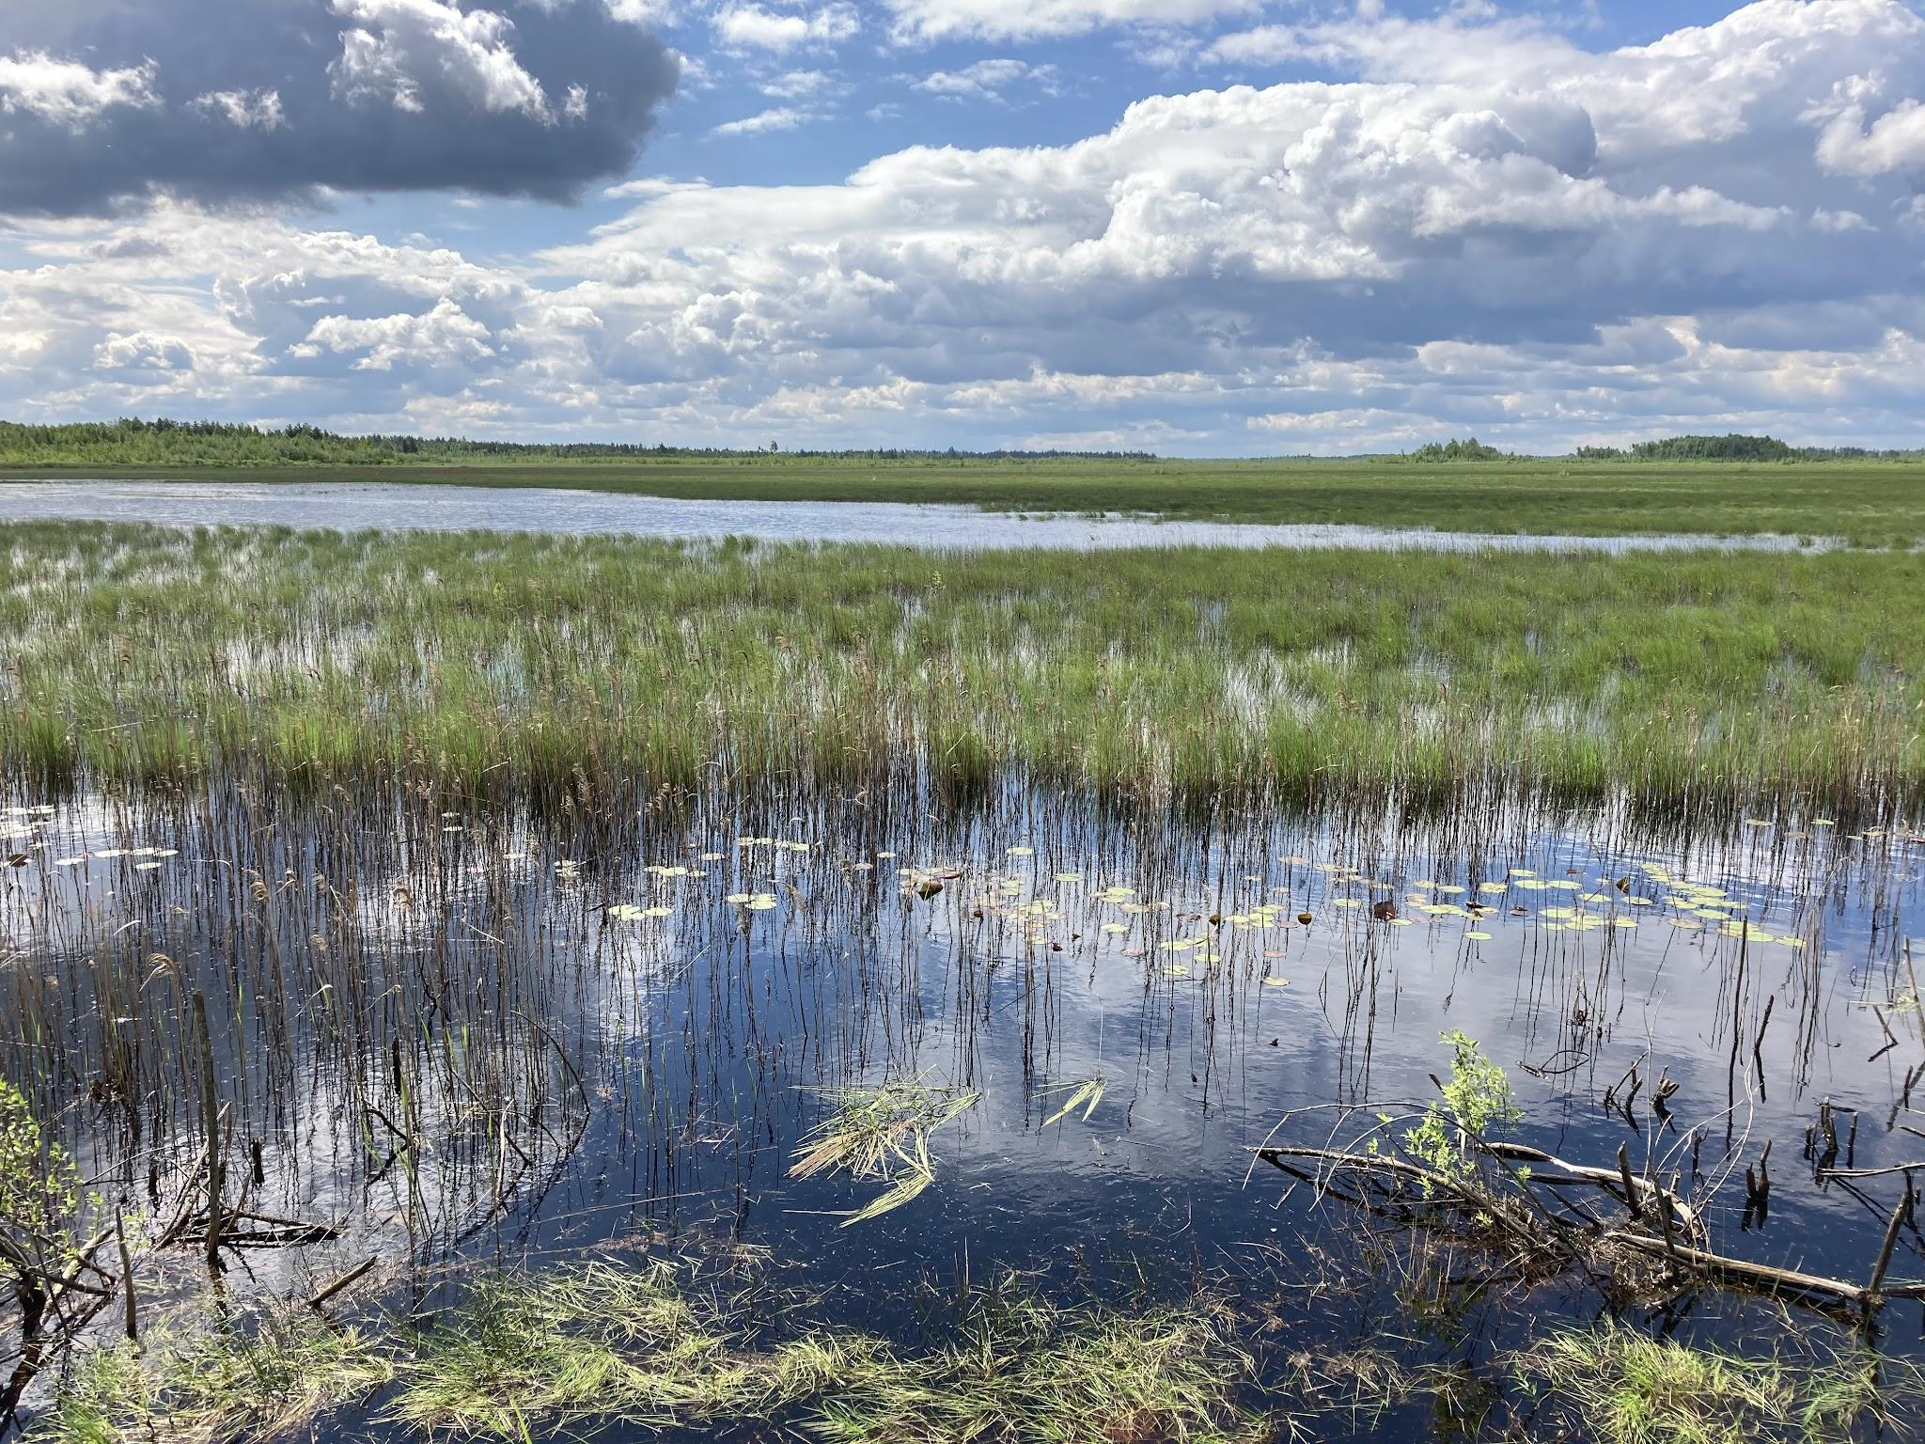
The People of the Marshes
●Belarussia was similar in size to Minnesota (90,000 sq. miles)
●The meteoric makeup of the area was very humid, frequent heavy rain and damp. The marshes would often flood from the rain and cover 1/5th of the entire territory.
●Many of the peasants lived in the marshy land since nobles took the more favorable land for themselves

Slide 8
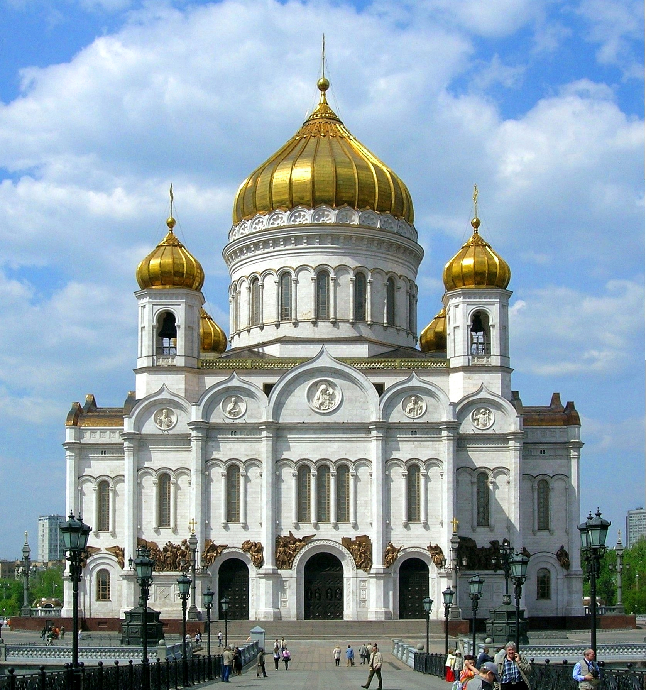
The People of the Marshes cont’d
“During spring floods they go from island to island in canoes driven by sail or paddle or pulled across shallows by long-horned oxen. In summer they cannot travel at all. Only when winter freezes the marshes is there firm travel over the snow” - People of the USSR
On religion, the Belorussians consisted mostly of Orthodox Christians even when the Lithuanian king had stated in 1569 upon the acquisition of Poland that citizens would embrace Roman Catholicism

Slide 9
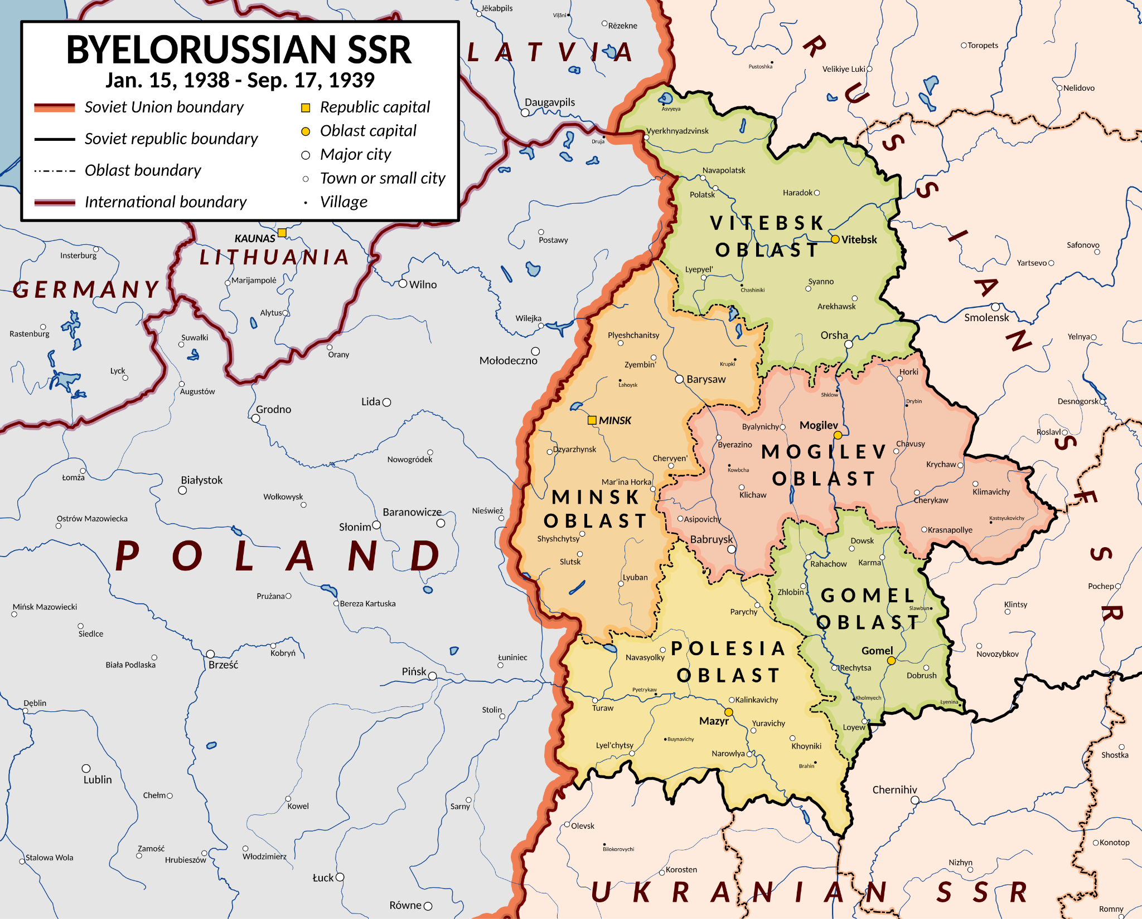
Belorussian Soviet Socialist Republic
●On November 7th, 1917, workingmen in Minsk created a soviet government for White Russia.
●It wasn't until January 1, 1919 that they became a separate republic after reclaiming the land from driving Germany out.
●The land in possession of peasants doubled from 15 million acres to 35 million after the expropriation from previous tsars and nobles
●By 1937, the area of cultivated land grew to 10 million, doubling the harvest yield.

Slide 10
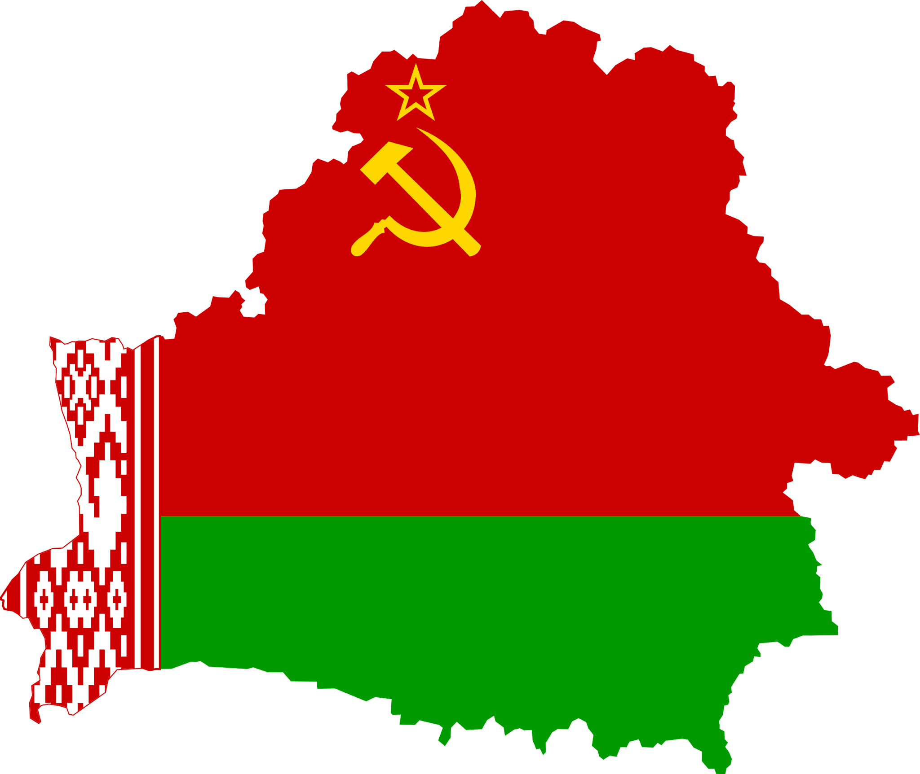
Soviet Advancements
●Under the Soviet leadership, White Russia was able to utilize the swamps to power the country. By 1939, the country was producing 500,000 kilowatt hours of energy.
●White Russia had a national library of around 2 million volumes available to all citizens.
●“Hospital Town” outside of Minsk provided care to all the rural districts of the country.
●Promoting or advocating for race discrimination was a punishable crime

Slide 11
Discussion

Slide 12
Kazak Autonomous Soviet Socialist Region / Kazak Socialist Soviet Republic

Slide 13
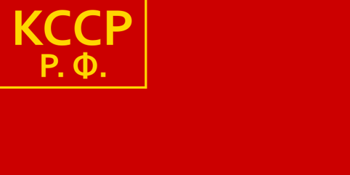
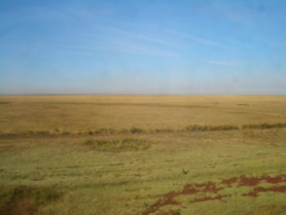
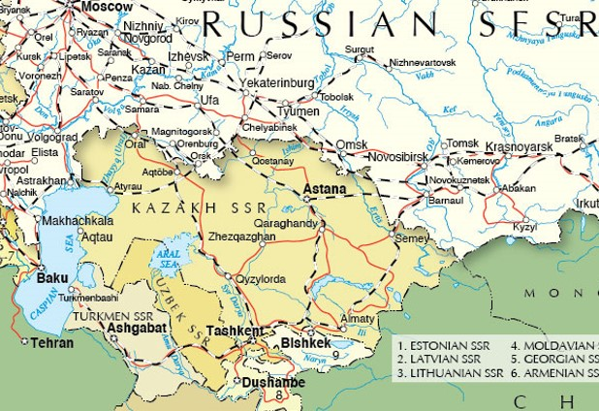
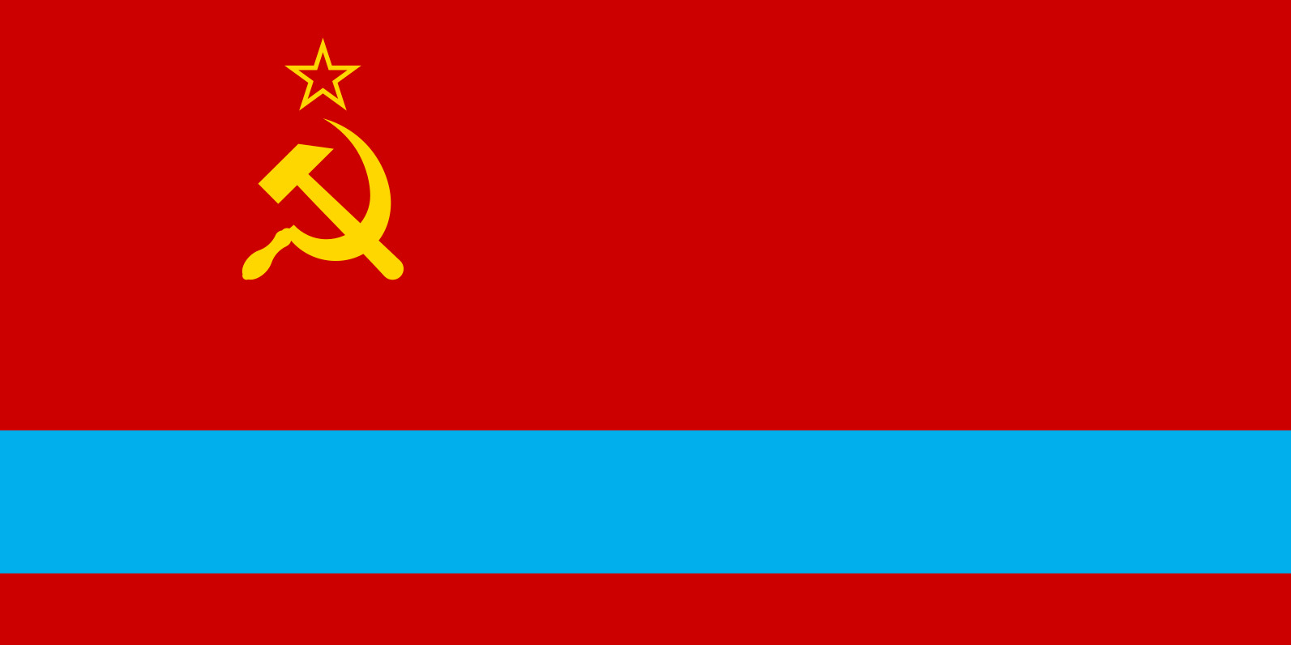
The Kazakh Soviet Socialist Republic
The Region is filled with steppes and nomadic people and cultures

Slide 14
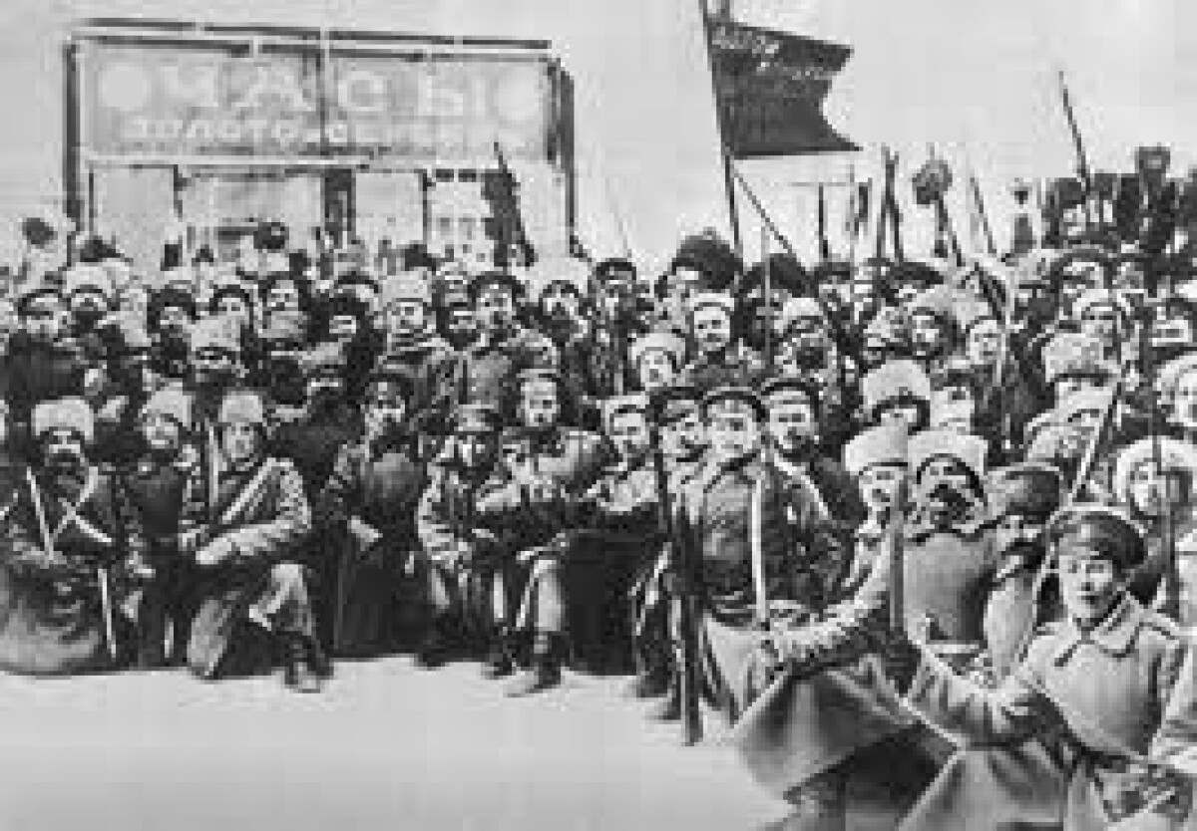
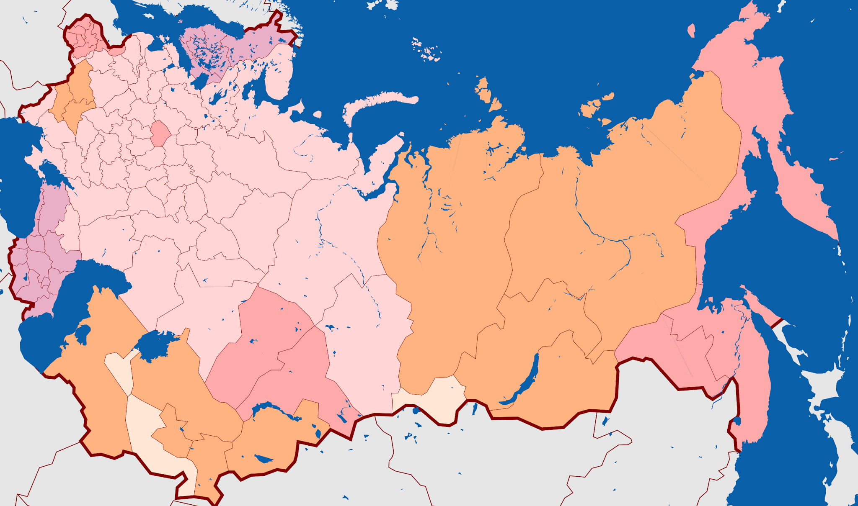
The Kazakh People Under Tsarist Russia
Given the weak development of capitalist relations under Tsarist Russia, Kazakhstan was a heavily exploited region where Russian and English capital penetrated for raw materials and minerals.
This oppression was hard on the indigenous people of modern Turkmenistan, Uzbekistan, and Tajikistan. These people were of various religions but mainly Muslim.
Despite being Russian citizens, the people of these regions were easily oppressed by the religious Tsarist monarchy.
The Kazakh people under the feudalistic, pseudo capitalist society were considered lower class people given the worst working conditions and improvisation.

Slide 15
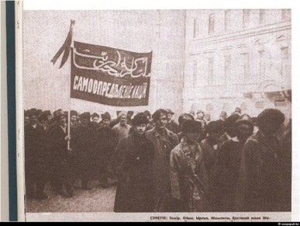
Islam and the Revolution
As mentioned earlier the people of the region of Kazakhstan were greatly oppressed under Tsarist russia and this includes the Muslim faith.
The Muslim Communist Party played an important role working with the Reds in Turkestan, the region of Kazakhstan and Central Asia in helping to defeat the Whites and the counter revolution.
Many military deputies in the region during the civil war were of the Muslim faith. By 1918, this region was starting to stabilize and formed soviets with many Muslims taking leading roles.
While many Muslims joined the Bolsheviks in supporting a socialists revolution, there were those that sided with reactionary nationalist Islamic forces that supported the region to become a pan-Turkish or Pan-Islamist nation.

Slide 16
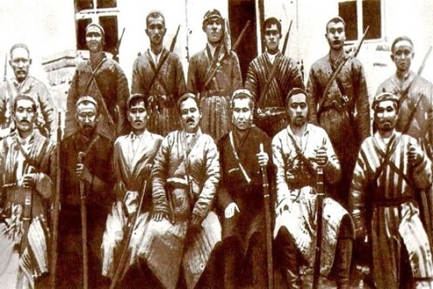
The Alash Party and the Bolshevik Revolution
After the Bolshevik Revolution in 1917 and the Civil War against the White Russian army that took base in central Asia, Kazakhstan was established as a separate nation under the nationalist Alash party.
The Alash party created a secular government that resembled the bourgeois Duma government of Russia in February 1917.
Despite the Alash party’s rule of the state of Kazakhstan, the Bolshevik party of Turkestan, supported by the Red guard of the military garrisons in the region suppressed the counter revolution.
When the Whites were defeated in 1920, the Alash party which pulled a lot of its support from reactionary Muslim forces and the bourgeois of the region that represented the economic ties to Tsarist Russia and British imperialism were also defeated.
Many Alash members were given amnesty after their defeat to join the revolutionary government of Kazakh, Kyrgyz. Some after given amnesty tried to undermine the newly formed socialist government.

Slide 17
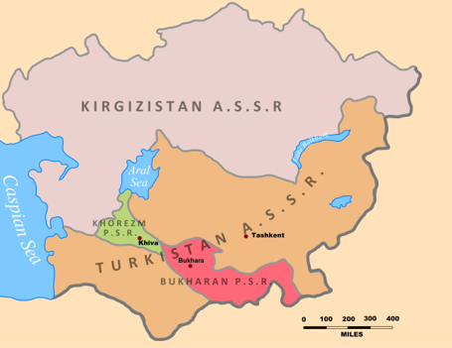
Soviet Power and the Turkestan SFSR
Before the Kazakh Autonomous Region was established in 1922, political delegations that happened during the Civil War in the steppe region of central Asia and the Turkestan region. April 30, 1918, the 5th Regional Congress of Soviets of Turkestan were held. Over 120 representatives of the local indigenous population – Uzbeks, Kazakhs, Turkmens and Tajiks-took part in its work.
The region was divided because of the contradictions between the peoples who inhabited it. Reactionary, religious and bourgeois forms of ideology backed by a foundations of “pan-Turkism” and “pan-Islamism” endangered the socialist revolution all together. The region needed to be partitioned in a way to give autonomy to all the different people and cultures.
In 1920, the Turkestan Commission led by the Bolshevik Party adopted a resolution proposing the administrative regrouping of Turkestan in accordance with the ethnographic and economic conditions of the region. It identified three main groups of people that could become the basis for new national units in the TASSR: Uzbeks, Kazakhs, and Turkmens.
The party finally chose the path of creating new Soviet Nations and, accordingly, national-state autonomies that separated Turkestan and the Kazakh Steppe region.

Slide 18
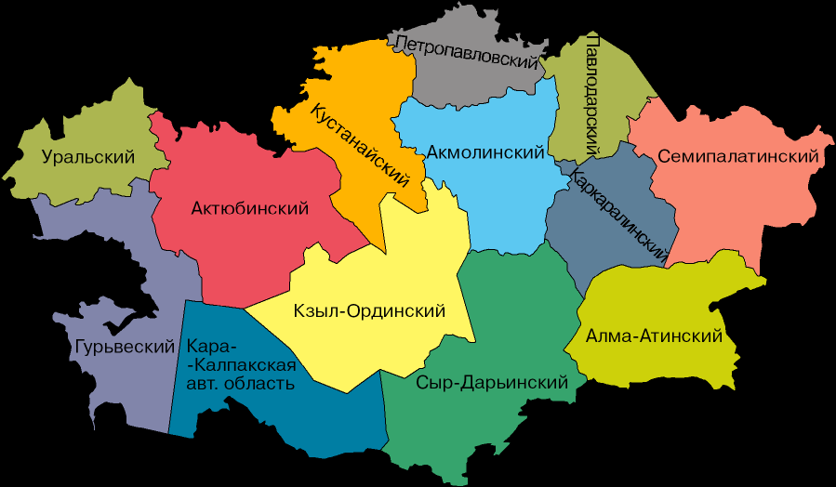
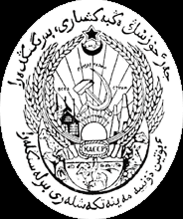
The Forming of the Kazakh ASSR
It was the Bolsheviks who were at the origins of the creation of the Kazakh autonomous region and the Soviet national statehood in 1936.
In 1920, the Kazakh ASSR (Kazakh Autonomous Soviet Socialist Republic) was formed. The constitutional congress of the Kazakh ASSR Soviets was held in Orenburg which became the capital of the autonomous region.
On August 26, 1920, the Decree on the formation of the Kazakh Autonomous Soviet Socialist Republic came into effect. On October 4, 1920, the Constituent Congress of the KazASSR Soviets was finalized. The Congress adopted the "Declaration of Workers’ Rights of KazASSR". The Declaration served as the Constitution. It secured broad political rights for the workers of Kazakhstan to this day.
The regions was finally brought into the Soviet Union in 1922 when it was officially formed.

Slide 19
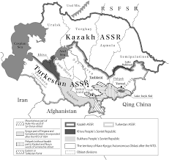
Kazakh ASSR in the Soviet Union
Industrialization of the region skyrocketed. Reactionary elements of religious laws were outlawed like polygamy, bride-buying, unilateral divorces by only men were all outlawed. Women-oriented schools were established, and women were encouraged to participate in public life.
The Bolshevik approach was strictly and fundamentally aimed at helping the development of the region in its current ethnopolitical material conditions. Representatives of indigenous peoples were appointed to administrative and party posts in the Kazakh ASSR.
The Soviet government decided to translate the alphabet of the Asian peoples of the USSR into Latin writing systems in order “not only to introduce a westernized alphabet in the interests of the future global Soviet country, but also to break cultural and historical ties with the former heritage, primarily Arabic and Turkish. ”
The first Five-Year Plans, help transform the steppe region that ran on nomadic or semi-nomadic farms into a completely new society with new industries, a new working class and urban culture.

Slide 20
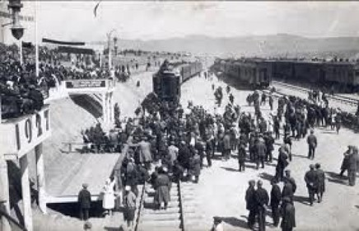
The Kazakh Soviet Socialist Republic
The Kazakh Soviet Socialist Republic joined the Soviet Union as a state from the Autonomous Region in 1936.
Industry became the predominant branch of the economy of Kazakhstan, the share of its products in the mid-30s began to prevail and in 1939.
Kazakhstan took the second place in the production of non—ferrous metals, the third—in coal and oil production, and the fifth-in electricity generation in the Soviet Union.
All this allowed it to become one of the major arsenals of the Soviet Union during the great Patriotic war of 1941-1945. Almost from scratch, from 1926 to 1940, a completely new industrial district was created in the face of Soviet Kazakhstan
The KSSR was the last state to leave the USSR in 1991, for four days it was the entire soviet union before it left as well.

Slide 21
Discussion & New Members Introductions

Slide 22
New Member Introductions
What is your name, pronouns and state (or country/territory)?
Where do you work? Is it unionized?
How did you find out about the People’s School?
What do you think about tonight's class?

Slide 23
Transcaucasian Socialist Federative Soviet Republic

Slide 24
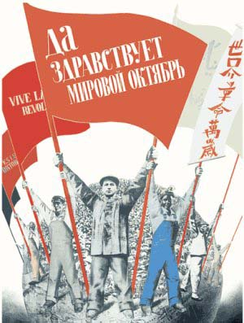
Transcaucasian Socialist Federative Soviet Republic
●The Caucuses were originally a part of the Russian Empire. It is separated from modern Russia by the Caucasus Mountains.
●As the Russian Empire began to be dissolved, Georgia, Armenia, and Azerbaijan declared their independence.
●Armenians, Azerbaijanis, and Georgians had been in opposition for many years with race riots breaking out in larger cities where ethnic groups converged.
●To combat this, Lenin proposed that the three Soviet republics be united, and it was finalized March 12, 1922. The Transcaucasian SFSR became a founding member of the USSR on December 30, 1922.
After the 1936 Constitution was signed, the three regions were individually elevated to republics of the USSR.
Long Live World October

Slide 25
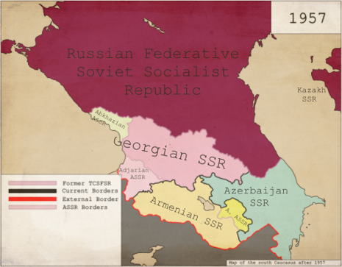
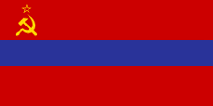
Transcaucasian Socialist Federative Soviet Republic
Transcaucasian Socialist Federative Republic
Armenian SSR
Azerbaijan SSR
Georgian SSR

Slide 26
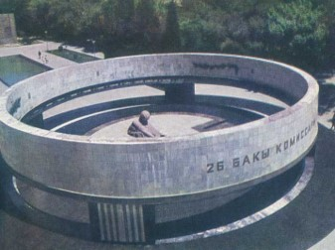
Transcaucasian Socialist Federative Soviet Republic
Revolutionary leaders:
Georgia: Joseph Stalin
Azerbaijan: Meshadi Azim-bek-ogly Azizbek
Armenia: Stepan Shaumian
During the Communist Intervention in 1918, the British
seized Baku, Azerbaijan and Azizbek and Shaumian
were shot and killed. A monument was erected in their
memory and it became tradition for newlyweds to leave
a piece of their wedding bouquet at the monument.

Slide 27
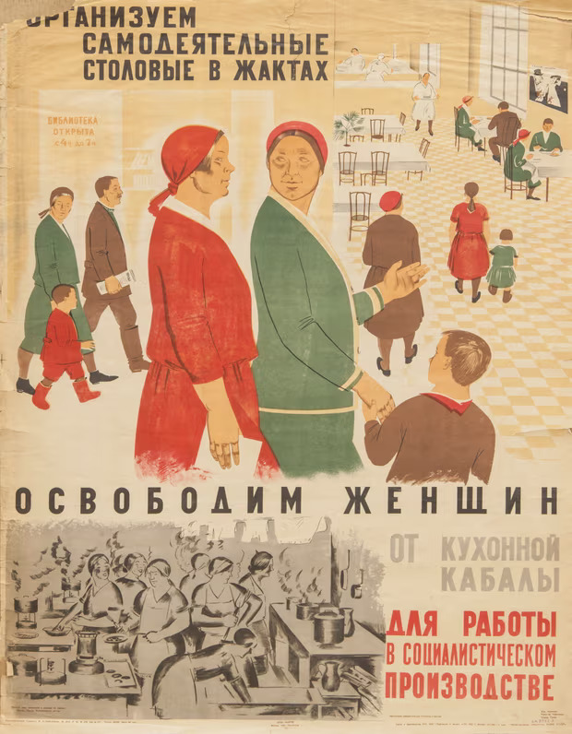
Excerpts from Soviet, But not Russian
Professor David Lange from the University of London was the leading authority on Georgia. He wrote in his book A Century of Russian Impact on Georgia, “If we compare the position of Georgia and adjoining Soviet republics with that of Turkey and Persia, the remarkable improvements in the health and general standards of living look even more striking.
Employment of women in qualified work is an extremely common phenomenon in Georgia. Industrial workers and peasants are by and large better off than in most places in European Russia. The sharp contrast between the dynamic economic and industrial system and the excellent cultural facilities of Georgia, on the one hand, and, on the other, the chronic instability of some modern countries of the Middle East, or the deplorable backwardness and stagnation of others, leaves little room for denying the positive side of Russia’s impact on Georgia.
Georgia is at present well insured against drifting back into the vicious circle of ignorance, poverty, and disease, and is able to stand on her own feet economically and industrially in this highly competitive modern age.”

Slide 28
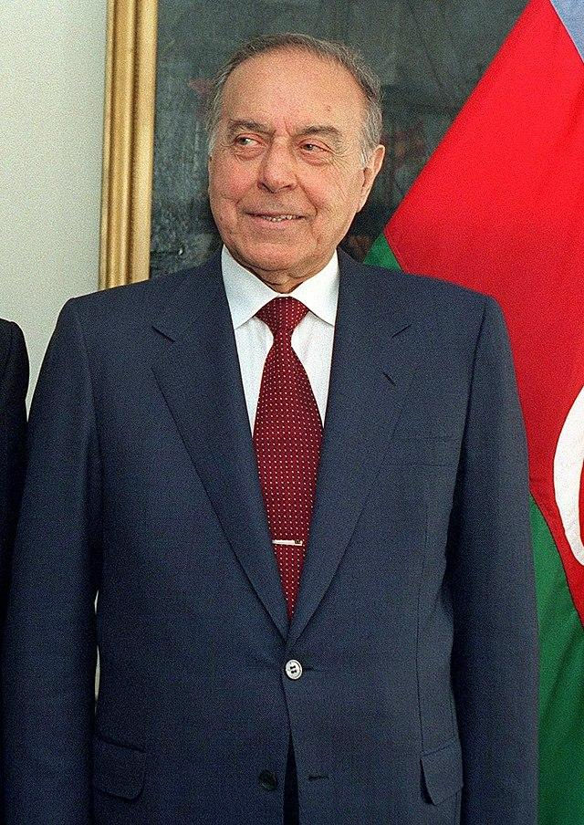
Excerpts from Soviet, But not Russian
“When Brezhnev died suddenly, his successor, Andropov, amazed the West by bringing [an] Azerbaijani, Geidar Ali Rza ogly Ali(ev) into the Political Bureau where he was named the first deputy premier of the Soviet Union. (The amazement stems from the fact that Western scholars, journalists, and politicians had apparently hypnotized themselves into believing that the Muslim peoples in the USSR are treated like blacks in the US.)
Aliev is entirely a product of Soviet times. Born in 1923, the son of a worker, he graduated in history from the University of Azerbaijan, itself founded after the Revolution…. Aliev’s duties have not, however, been associated with ethnic matters. His first job under Andropov was to turn around the lagging Soviet railroad industry. At this writing, [In 1985] he is in charge of consumer-goods industries, which the Cherenko administration has pledged to boost. He has also been sent to Syria to discuss the future of the Near East and Soviet arms aid.”

Slide 29
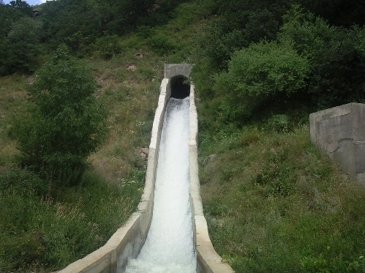
Excerpts from Soviet, But not Russian
“One admires the Armenians for their ability to wrest a living from soil so unbelievably rocky and arid. They say: "stone is our bread" — it makes Maine look like prime farmland. But they do wrest a living; today the Armenians live well, extremely well.
Little more than one-seventh of Armenia is arable land, by far the lowest proportion in any Soviet republic — it is the smallest of them to begin with — little larger than Vermont. What is arable can only be if irrigated, as Armenia has no rain to speak of. Fortunately. Armenia has an immense mountain lake. Sevan, which irrigates 250,000 acres— an extraordinary engineering feat for its day. Six dams, each also producing hydropower, one below the other, were built between 1930 and 1962. But before the last went into service, it was realized that the 17 irrigation canals were drawing so much water the lake would be destroyed. So a tunnel was drilled 30 miles through hard rock to bring it the water of a river separated from it by mountains nearly 10,000 feet high. This remarkable effort, one of the world's earliest great environmental- protection projects, took only six years.”

Slide 30
Discussion

Slide 31
History of the Ukrainian SSR 1917 - 1922

Slide 32
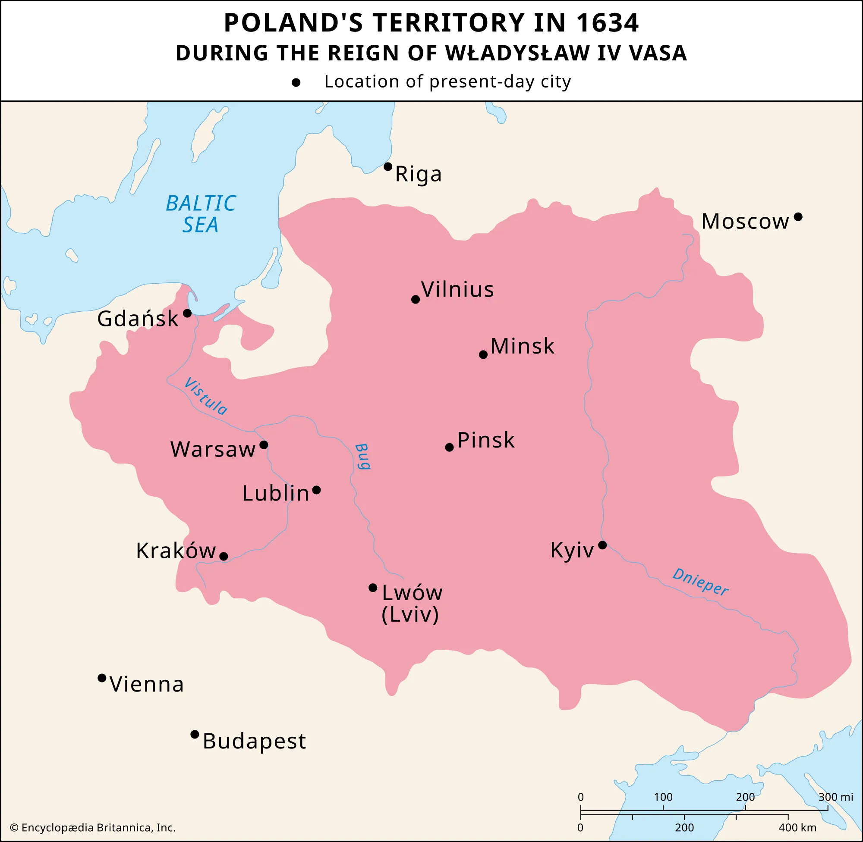
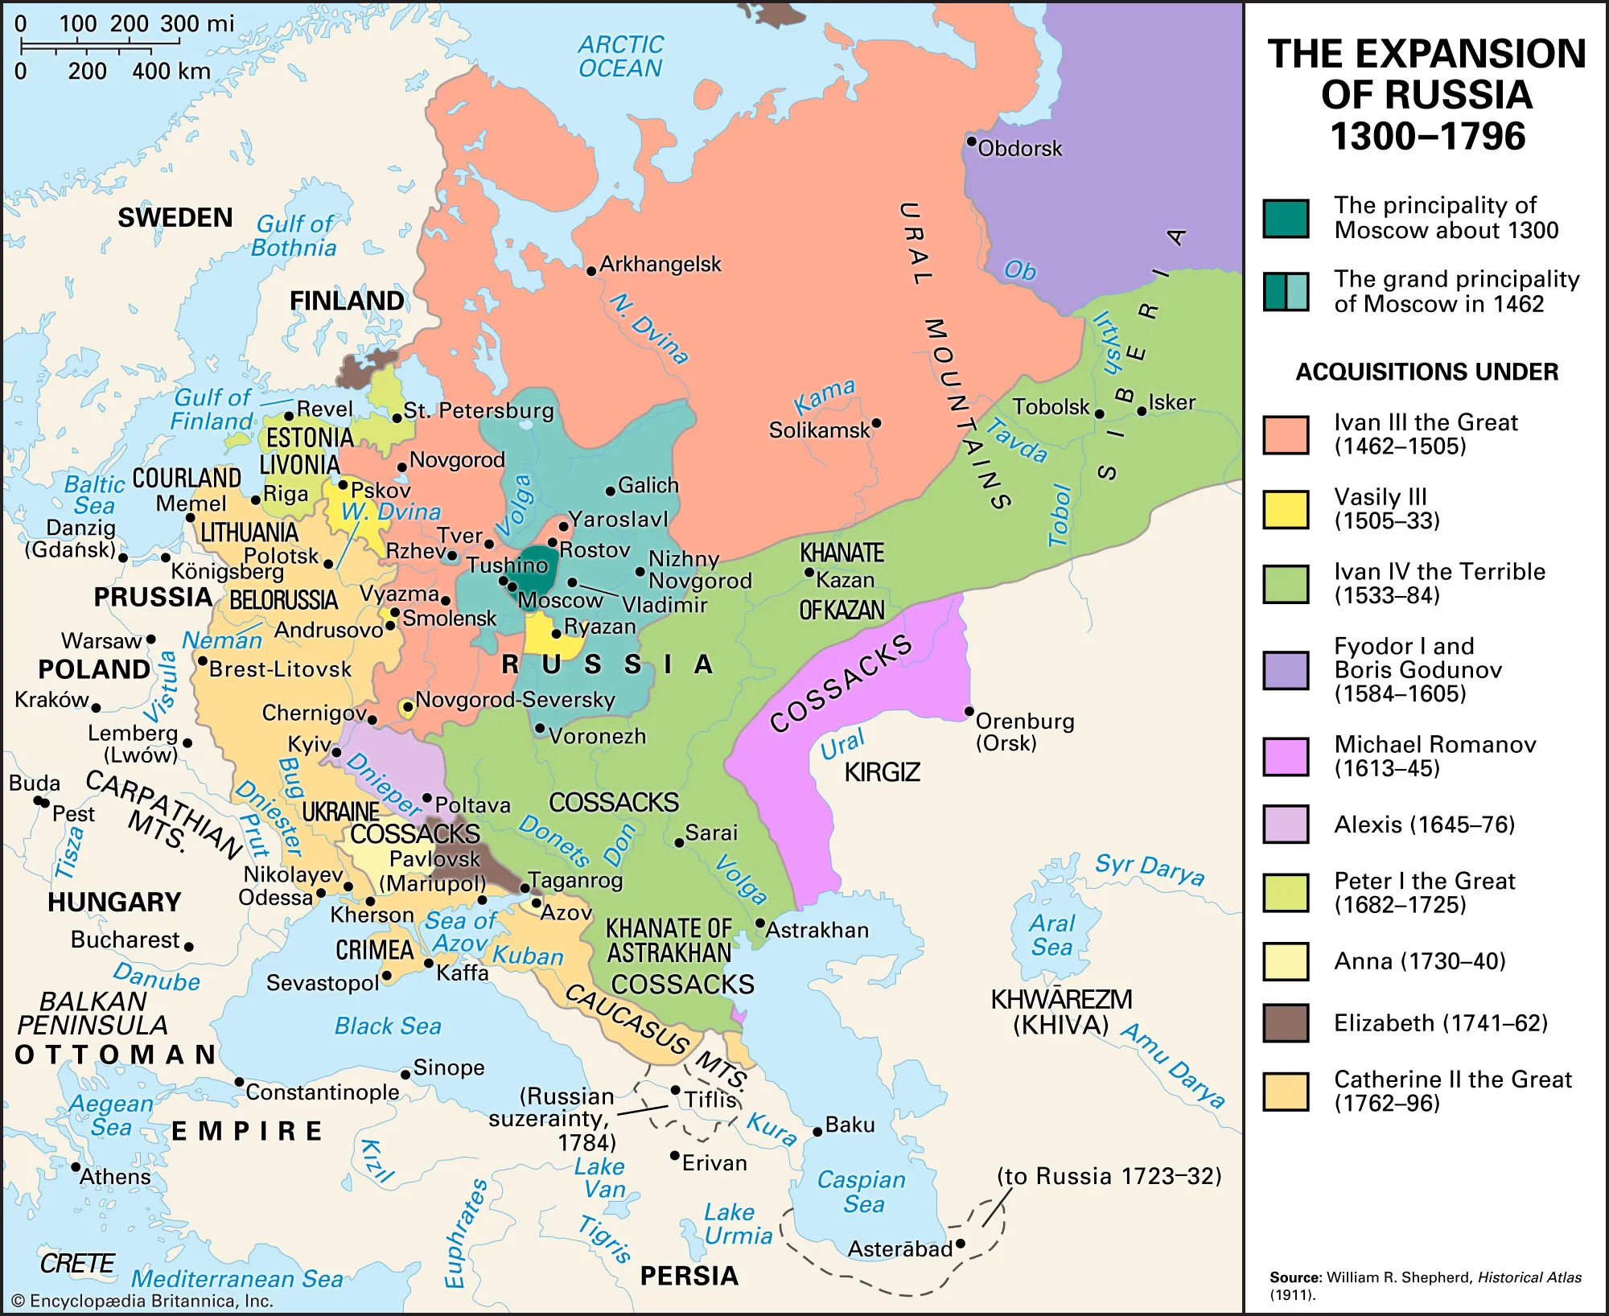
Pre-October 1917 History
Tsar Peter began a campaign of “Russofication” that continued until the Communist Revolution. Other times Ukraine was split between Russia, Poland, Lithuania, Hungary, and Crimea.
Some autonomy in the Russian empire, but was ultimately taken away when Tsaress Catherine took the crown.

Slide 33
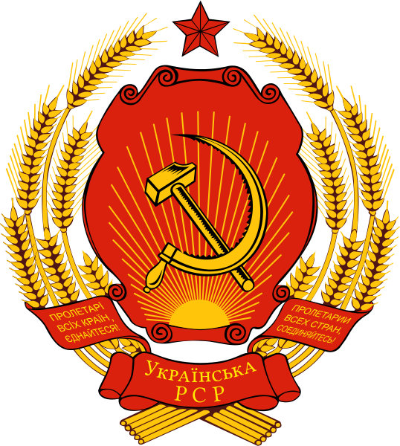
Immediate effect of the October Revolution
2 republics declared with abdication of tsar, the Ukrainian People's Republic in Kiev and the Ukrainian Soviet Republic in Kharkov.
Ukrainian Soviet Republic founded December 24-25 1917. It was named as either the Republic of Soviets of Workers', Soldiers', and Peasants' Deputies or the Ukrainian People's Republic of the Soviets.
Start of civil war around this time against nationalists in Kiev, who had support of Central Powers.
Dissolved in 1918 after the signing of Brest-Litovsk with last session in city of Taganrog.

Slide 34
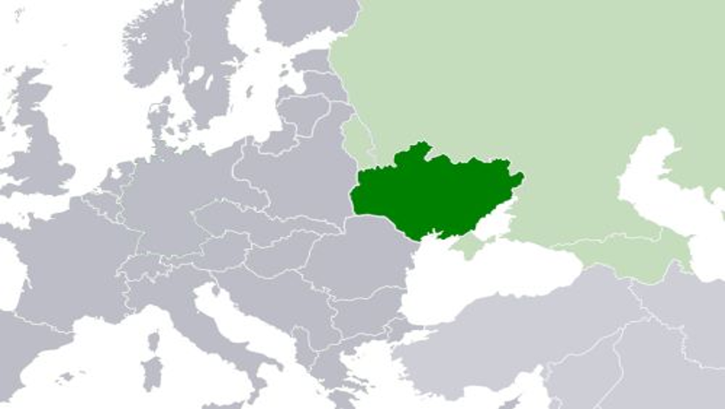
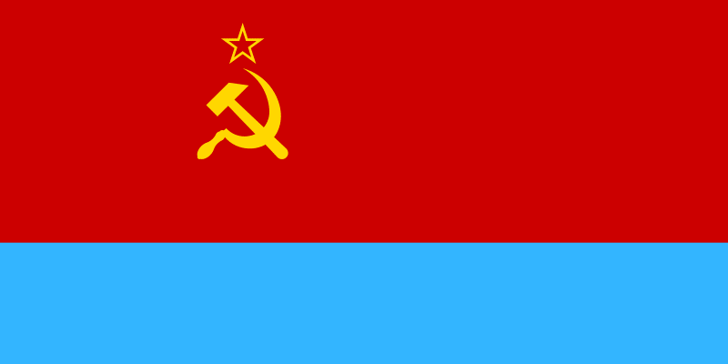
From 1917-1922
1919 – Nationalist-held Kiev was the spot of pogroms.
When the October Revolution occurred, the Soviets and soldiers of Kiev voted 2 days later to support the revolution
1917 – Takeover by nationalist Central Rada government. Only way to survive was through German support. Germans withdrew with end of Great War, and Directory took power. Under the leadership of a tsarist general, Skoropadsky.
Rada attacked peasants who sought to split up landlord lands, so when Germans withdrew, Communists defeated the nationalists in civil war.
Communists returned to power in February 1919 with the liberation of Kharkov. Formation of second Soviet Ukranian government that was dissolved during the fighting against the Whites and the Nationalists in 1919-1920
Third Ukranian SSR formed on December 21, 1919. Ended up getting most territory of Ukraine with the Polish-Soviet Peace treaty of Riga.
December 30, 1922 – Ukraine SSR is one of the founding members of the USSR.

Slide 35
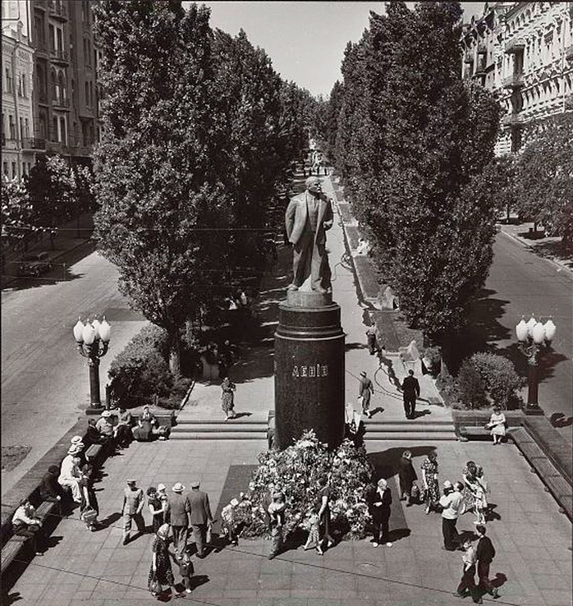
Ukrainian SSR in the USSR
West Ukraine was ruled by Poland until the Great Patriotic War. Any education of the Soviet Union in Poland was suppressed, Ukrainians in Poland were “required to look West”.
First “Machine and Tractor Station”, a central service place where cooperative farms could get tractors and farm machinery formed around Odessa in 1930. First of its kind and copied throughout USSR.
Occupied by Nazis during Great Patriotic war. Liberated 1944.

Slide 36
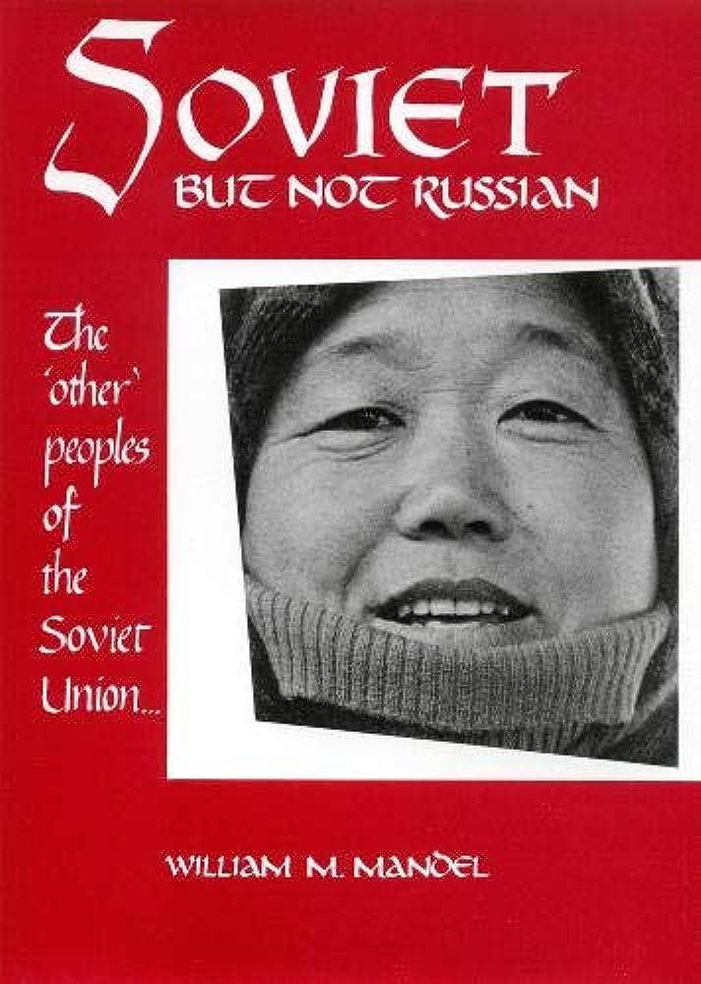
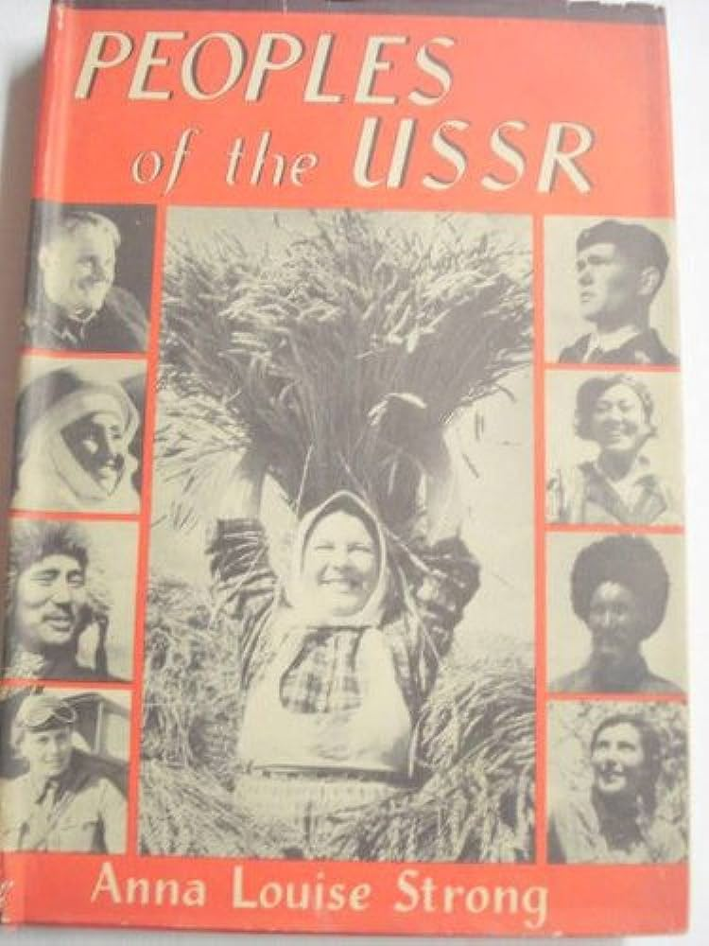
Sources
●Mandel, William. Soviet but Not Russian: The Other People of the Soviet Union. https://archive.org/details/SovietButNotRussian/page/n111/mode/2up
●Strong, Anna Louise. Peoples of the USSR. https://archive.org/details/PeoplesUSSR/page/n39/mode/2up

Slide 37
Discussion & Wrap Up Introductions

Slide 38
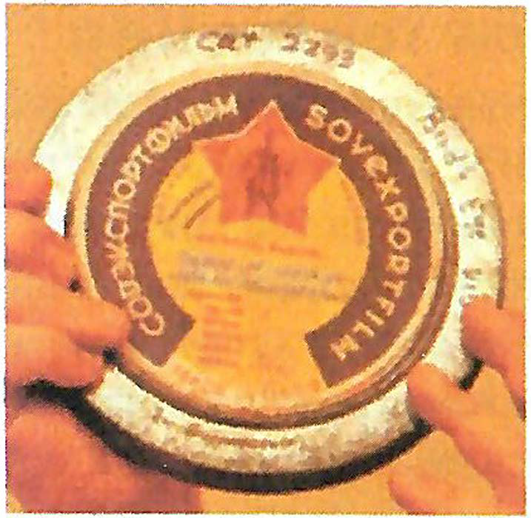
USFSP Film Archive Project
At the end of 2008, various comrades regained possession of a cache of films that used to be the film library of the Berkeley, CA branch of the Soviet-American Friendship Society. The collection consists of about 300 films on a variety of topics. They are in Russian with English subtitles, and represent the Soviet Union speaking of itself, in its own voice.
The U.S. Friends of the Soviet People (USFSP) agreed to take possession of these films in 2009 and raise the funds and perform the work to digitize the collection, and to distribute its contents both via recorded media (like DVDs) and via the Internet.
We are beginning to release these on the Youtube channel of the Party of Communists USA. We need donations to complete this work since it is not cheap to digitize the films.
You can donate at the US Friends of the Soviet People Website: https://usfriendsofthesovietpeople.info/donations/

Slide 39
Announcements
THE KONONOVITCH BROTHERS NEED US, SHARE THIS ARTICLE:
https://dailyworkerusa.com/stop-the-kiev-regimes-calls-for-the-murder-of-the-kononovitch-brothers/
The PCUSA Arts and Culture Commission is looking for content submissions for Vol III 2023 of New Masses! Send any submissions to info@partyofcommunistsusa.net and kamryns@johnreedcenter.net
The Peoples School for Marxist Leninist Studies has began posting videos on our TikTok channel @peoplesschool! Please subscribe to the channel and like and share our content!

Slide 40
Volunteers Needed!
We are in need of volunteers for the staff of the People’s School! Here’s a few roles we need filled:
People to help manage posting on our social media and podcast platforms
Video Editors, Audio Editors, Graphic Designers, Artists, Narrators
Facilitators, Web Controls, Moderators
Email info@peoplesschool.us if you’re interested and try to attend our next staff meeting on ______ if possible.

Slide 41
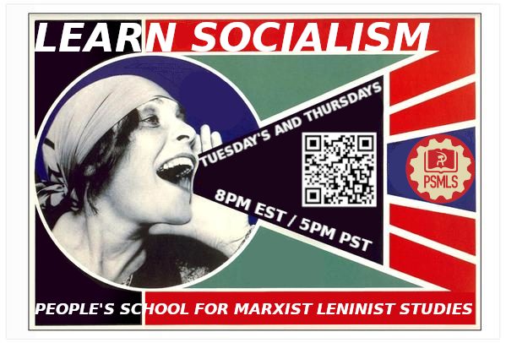
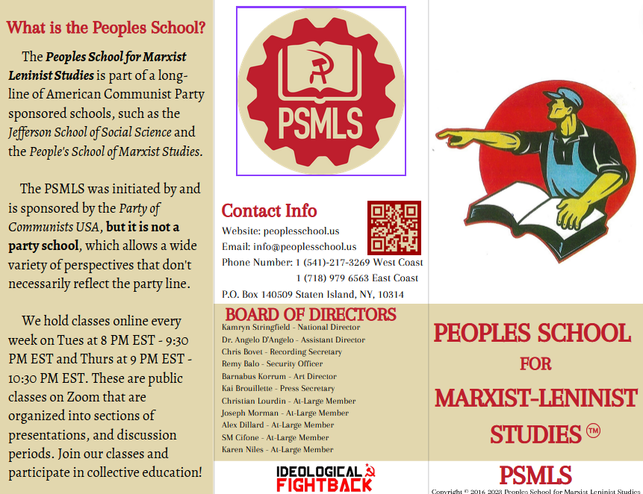
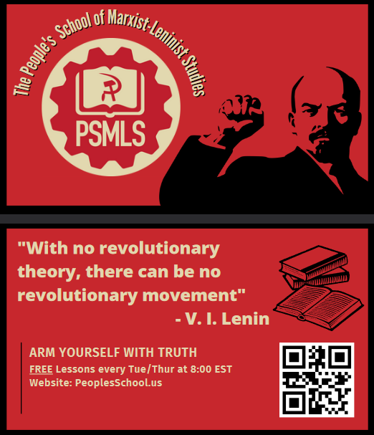
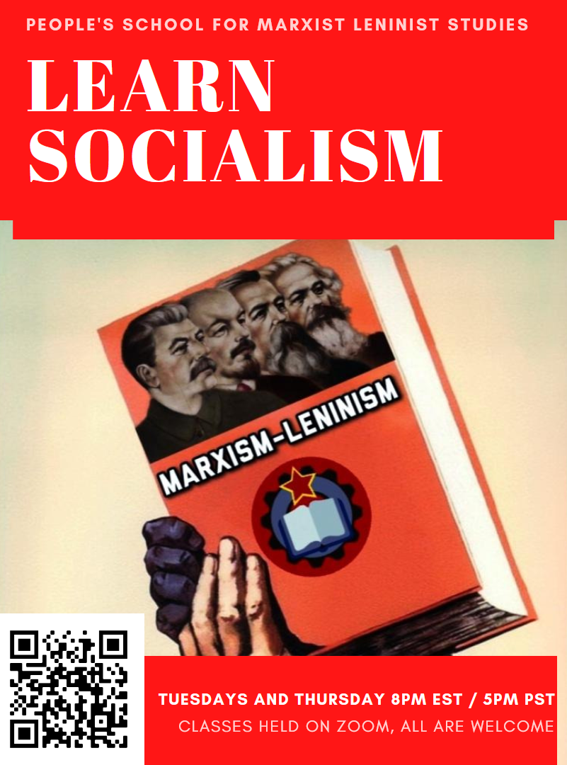
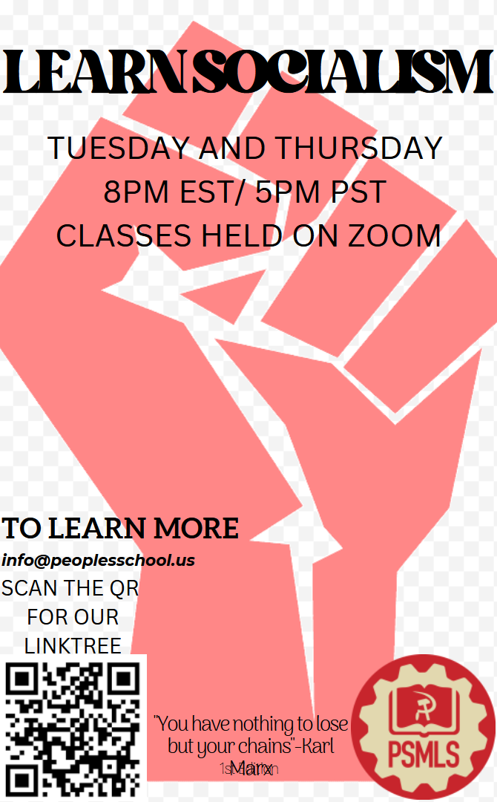
PSMLS Propaganda
peoplesschool.us/media
Materials to help promote the school!

Slide 42
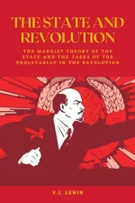
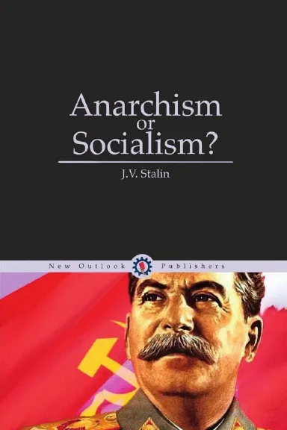
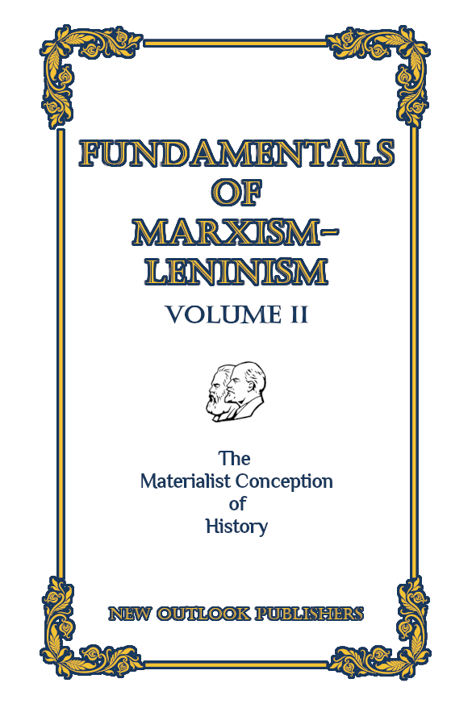
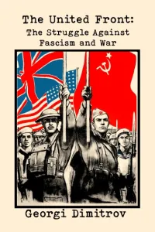
New Outlook Publishers
newoutlookpublishers.store
Latest Releases

Slide 43
Legal Drive
Last year we were attacked and sabotaged by ultraleft wreckers that tried to steal the PSMLS and destroy the PCUSA. They failed, but they will be held accountable and there are still things they took from us that we’ve not got back, like videos, imagery and audio. That is why we still need donations to the legal drive.
Support the GoFundMe for the legal drive at https://www.gofundme.com/f/legal-fund-to-defend-against-wreckers. Anything helps!

Slide 44
National Anthem of the Soviet Union - 1984 Daily Broadcast Version

