Slide 1
L’ Internationale - Sung in the original French language.

Slide 2
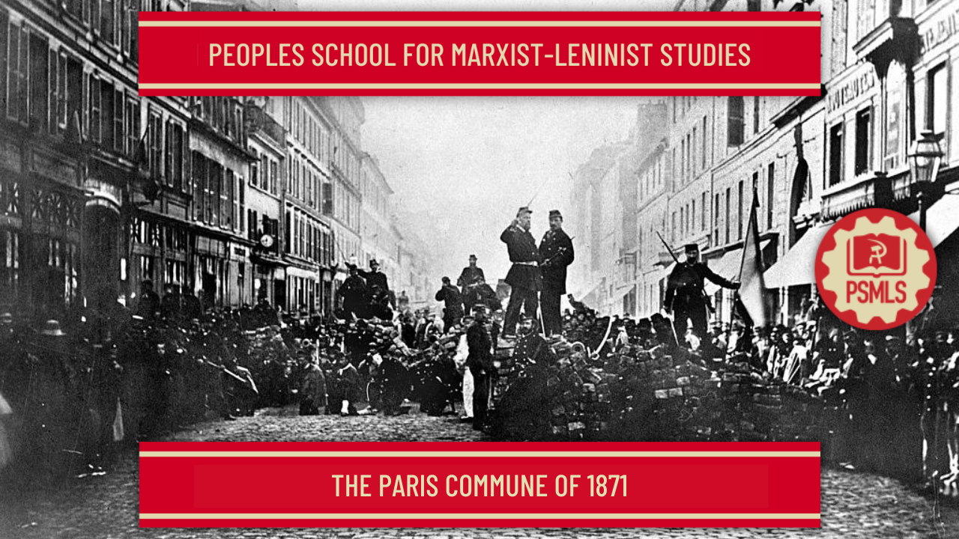
PSMLS 05/23/23 - 05/25/23

Slide 3
What we’ll be learning today:
The significance of the Paris Commune at the time and today – both for the Communist movement and the general Working Class.
Why the Paris Commune came about in its historical context. Timeline of events of the Paris Commune.
The role of Proletarian Patriotism in the Commune.

Slide 4
Section 1: Historical Context and Timeline of the Paris Commune

Slide 5
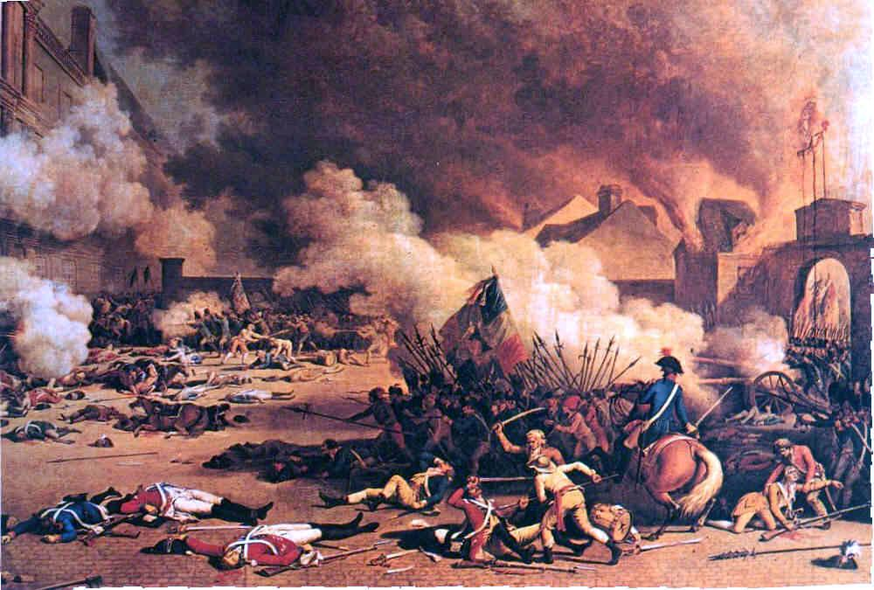
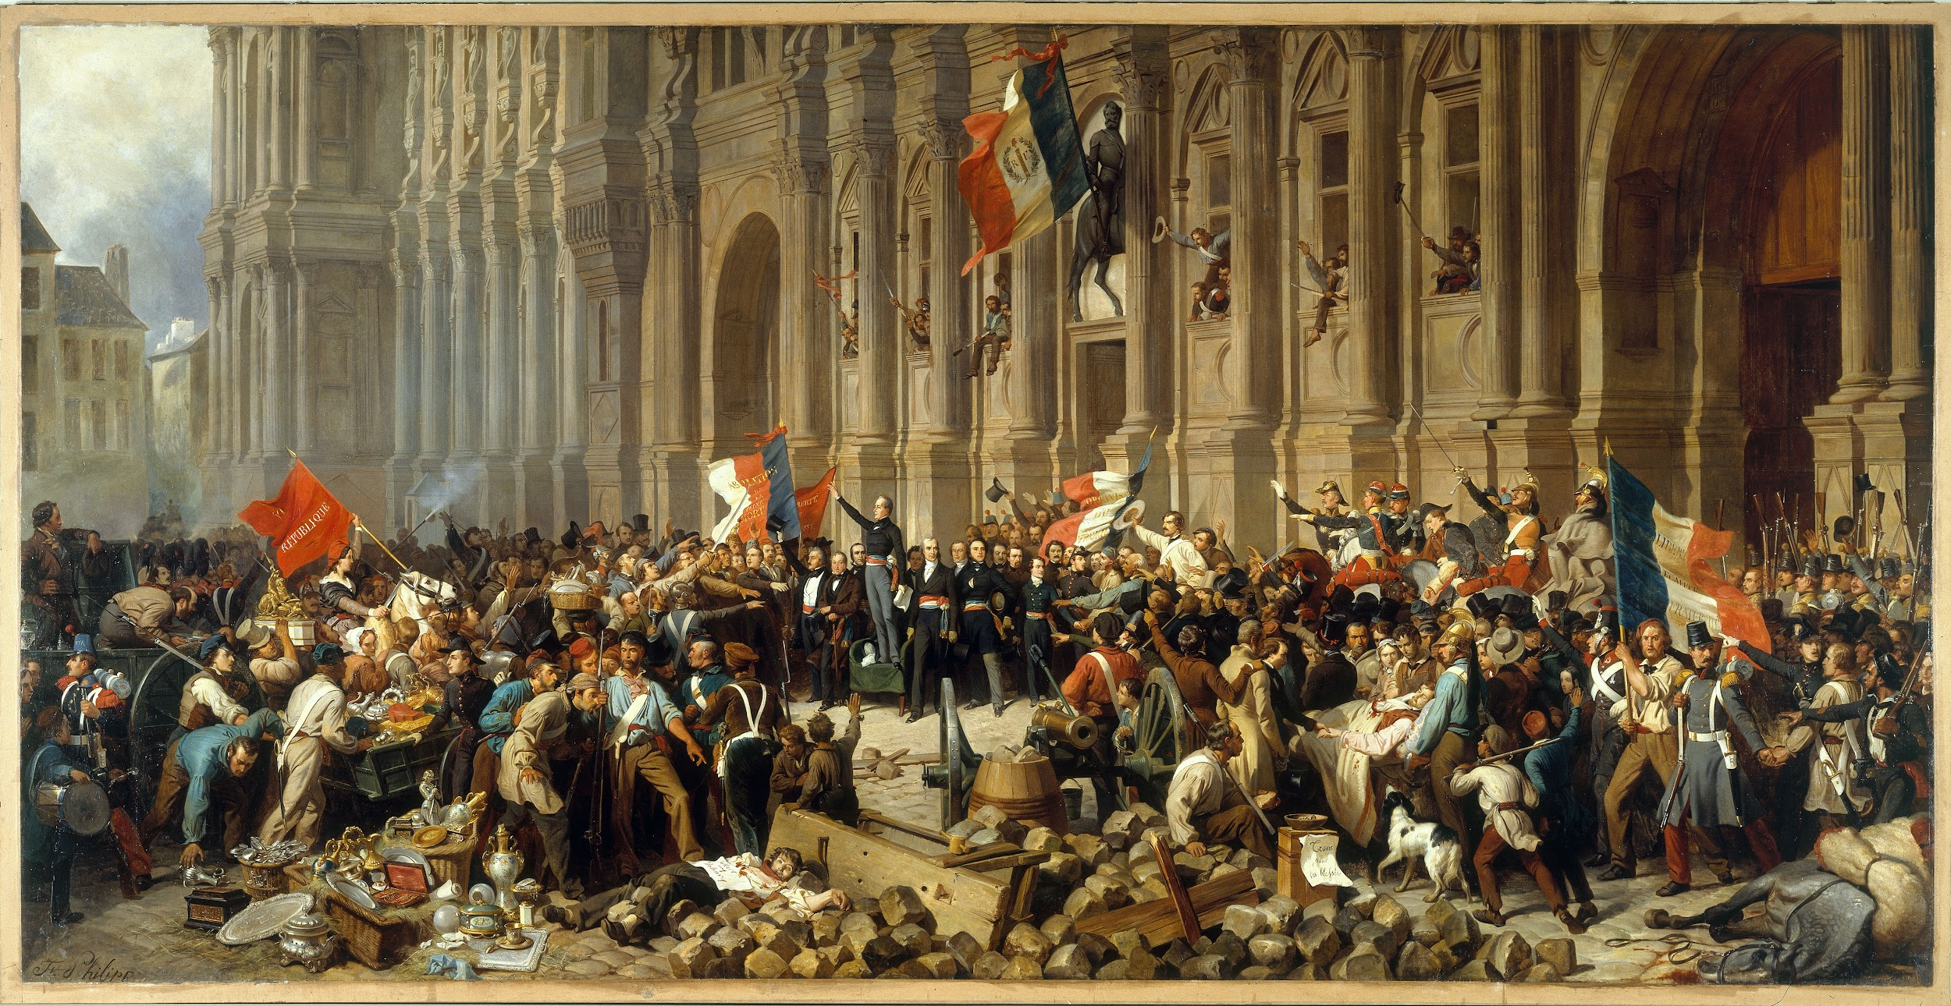
Historical Context of the Paris Commune
The 18th Century ended with the French Revolution, which was a revolt against monarchy and feudalism. The whole 19th century was a century of insurrection in France, each one getting stronger than the previous.
The first Proletarian Revolution occurred in June 1848 in Paris, a prelude to the Paris Commune. It lasted only one week. Marx drew many lessons from the Revolution of 1848, and would later compare it to the Paris Commune in 1871.

Slide 6
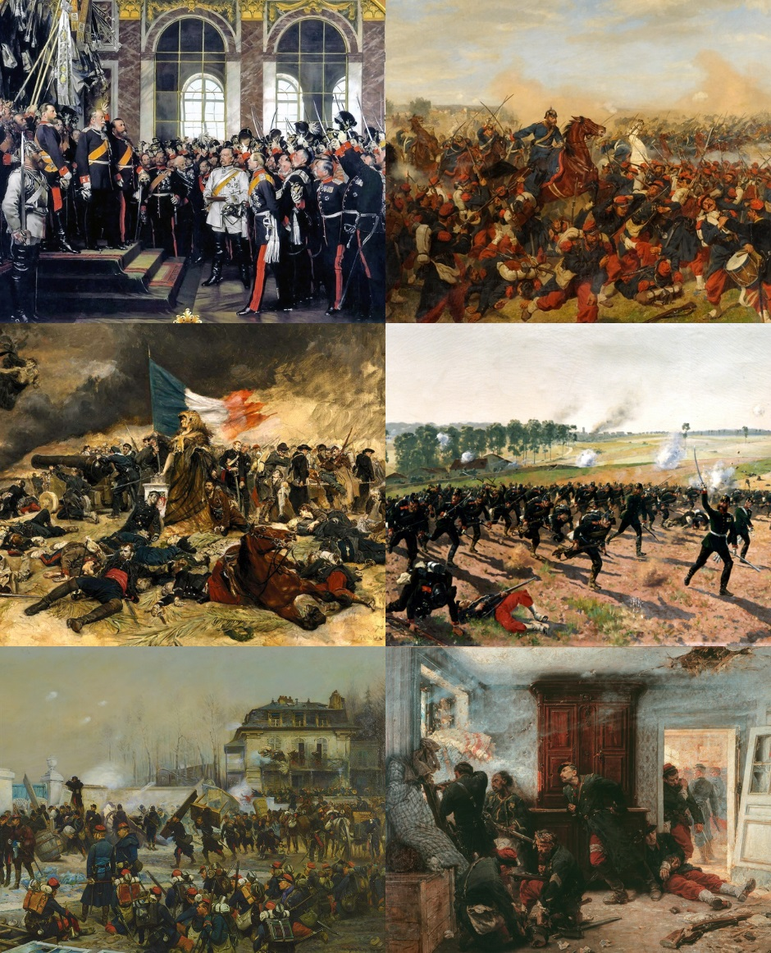
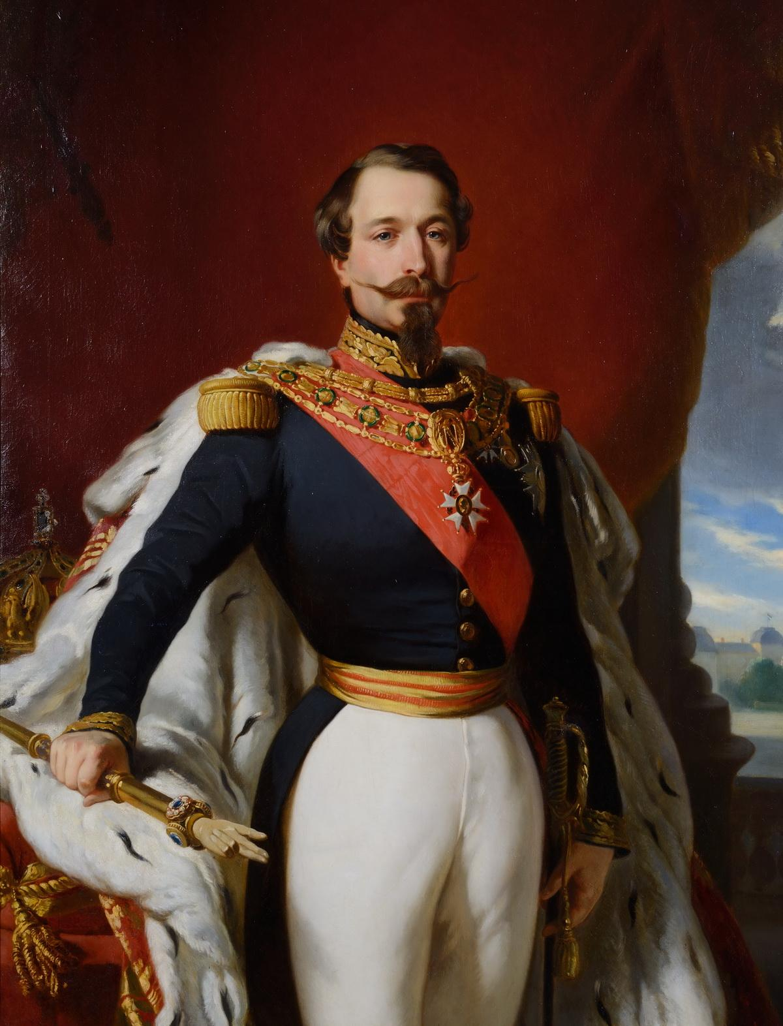
Historical Context
of the Paris Commune
Franco-Prussian War – Started in 1870, it was a war between the Second French Empire and the Kingdom of Prussia (Now known as Germany.) The French bourgeoisie were losing and ready to capitulate to Prussia.
Napoleon III went to war because of the rising struggle of the working class – strikes and militancy. He was trying to copy Napoleon I – first as tragedy, then as farce (Napoleon III being the farce).

Slide 7
Timeline of the Paris Commune
At the news, the Paris proletariat sprang up into action, overthrew the 2nd Empire, and as usual handed power to the bourgeoisie who proclaimed the republic (the 3rd one) on September 4th, 1870. (As a side note, the 3rd Republic lasted 70 years until WW2. It began with a German invasion, and it ended with another German invasion.)
September 1870 marked the end of the 2nd empire and the end of emperors once and for all, but as normal, the workers spilled their blood in the streets and the bourgeois republicans grabbed state power. The red flag flies on top of barricades, but the tricolor blue-white-red flies on top of parliament.

Slide 8
Timeline of the Paris Commune
On the night of March 18th, 1871 the bourgeois government sent the regular troops to disarm the National Guard (also called “the Federates"). Women workers who were the first awake gave the alarm to their men sleeping and the National guard rushed to confront the soldiers. Most of them fraternized with the Federates and turn their guns against their own officers. On the spot, the Federates executed the general who commanded the bourgeois army.
What was left of the bourgeois so called national army retreated in panic, 12 miles outside Paris to the city of Versailles and the bourgeois government, feeling all naked, followed them quick and in a hurry. It abandoned Paris and left it to the armed workers who took the power in their hands: they proclaimed the Commune!

Slide 9
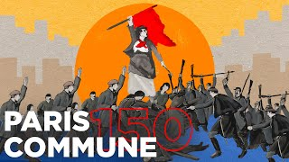
Video on Paris Commune

Slide 10
Discussion

Slide 11
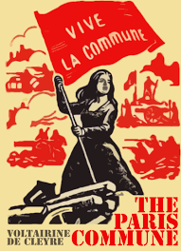
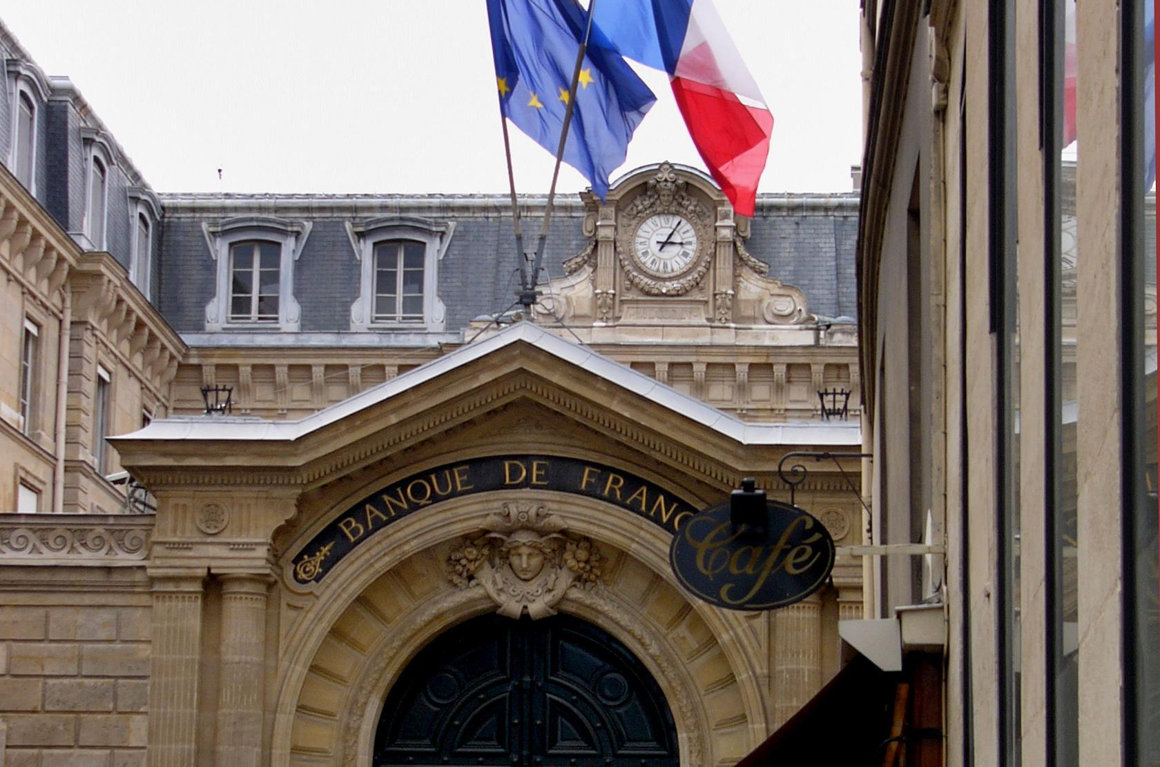
Timeline of the Paris Commune
From that day they became known as "Les Communards", but they made a mistake which would turn out to be fatal later. They did not pursue the fleeing bourgeois army to wipe them off. Mistakenly, they let the regular army regroup in Versailles under the bourgeois government headed by Thiers.
Another huge mistake by the Communards was to leave the Bank of France. They stopped at the gates of it. All the gold of France was there to take. The Bank of France paid Thiers army and government with that gold.

Slide 12
Timeline of the Paris Commune
This naïveté was criticized by Marx and didn’t get lost on Lenin 50 years later. (During the October 1917 uprising, one of the first missions of the Red Guards and the Military Revolutionary Committee was to secure at once Kerensky government’s gold.)
Communards showed to be naïvely good hearted toward the enemy. When Communards took bourgeois army prisoners they would just release them, even letting them keep their weapons. On the other end, every Communard taken by Thiers's soldiers was summarily executed, many of them even tortured.
Thiers negotiated with Bismarck, the leader of Prussia, and begged him to release Louis Napoleon's captive soldiers so they would join the fight against the Commune. Bismarck agreed if Thiers would give him some French territory. Of course Thiers made the deal, and handed Bismarck two french provinces bordering Germany: Alsace and Lorraine.

Slide 13
Timeline of the Paris Commune
Thiers was able to rebuild his army patiently over two months and finally launch his offensive. On May 21st, 1871 the bourgeois army was able to breach the gates of Paris and enter the City. The whole of Paris Proletariat, men, women and children, took to the streets and build barricades all over the city. The combat lasted for 8 days and 8 nights. These last 8 days are known as "La Semaine Sanglante", the bloody week. Communards took their last stand on Sunday May 28th at the Père Lachaise cemetery where they fought hand to hand in between the graves.
For over 100 years, on the last Sunday of May, a march takes place to the wall, to honor the memory of the Paris Communards who, as Karl Marx said, "stormed the heavens". That annual march is known as "La Montée au Mur", the climb to the wall. When Lenin had to decide of a national anthem for the Soviet Republic, he spontaneously chose L'Internationale. Lenin's wish was to be buried wrapped in a red flag of the Commune that was kept for 50 years and made it to Russia. Very few Communards survived to old age, hoping for a revenge before they passed away. But some did, and finally in October 1917 they got their revenge. Now, the last Communards could die in peace.

Slide 14
Discussion and New Members Introduction

Slide 15
New Member Introductions
What is your name, pronouns and state (or country/territory)?
Where do you work? Is it unionized?
How did you find out about the People’s School?
What do you think about tonight's class?

Slide 16
Section 2: Analysis of the Paris Commune

Slide 17
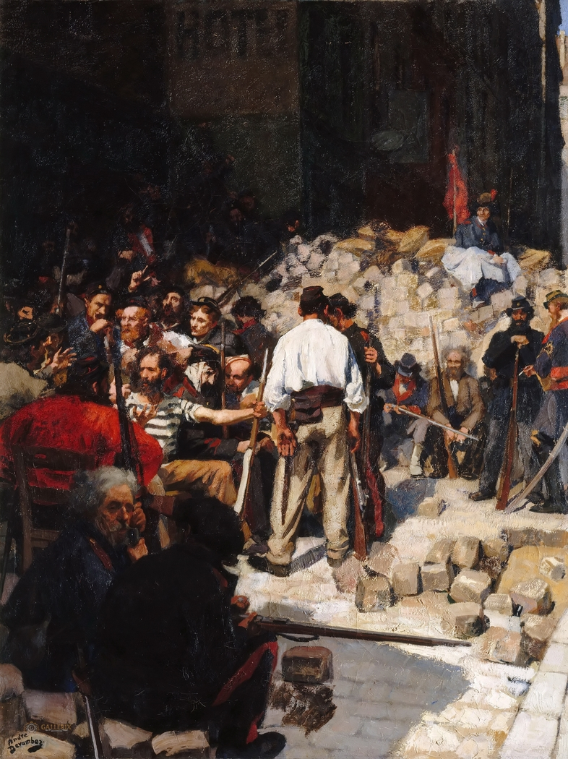
Analysis of the Paris Commune
The Paris Commune provided an example of a socialist experiment for the first time, and showed that the bourgeois could be overthrown, at least from a city such as Paris, however it also revealed issues with what actions are taken once revolution happens. The hesitancy to act further and pursue the bourgeois or take the Bank of France ultimately meant the end of the Paris Commune.
Engels analyzed the Paris Commune extensively on its 20th anniversary in 1891.

Slide 18
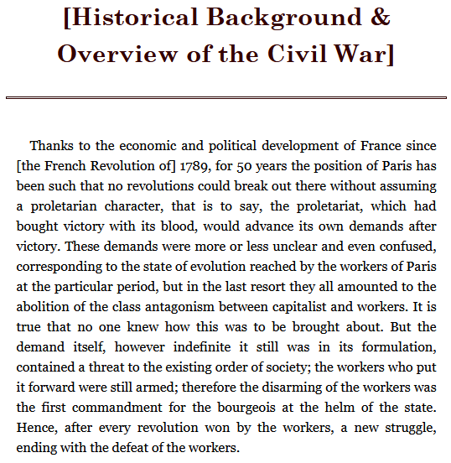
The Civil War in France by Karl Marx and Frederick Engels

Slide 19
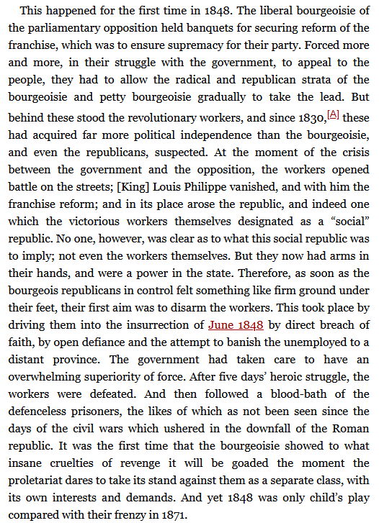
The Civil War in France by Karl Marx and Frederick Engels

Slide 20
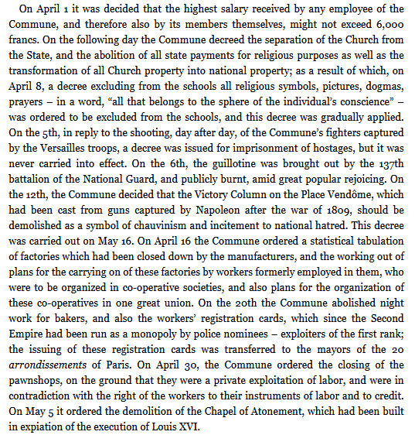
The Civil War in France by Karl Marx and Frederick Engels

Slide 21
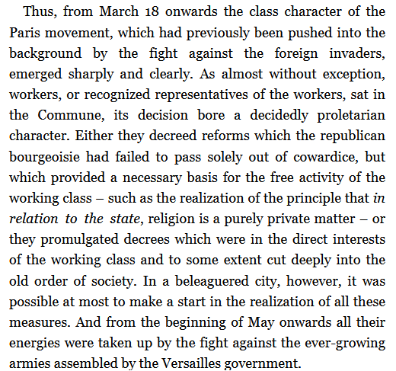
The Civil War in France by Karl Marx and Frederick Engels

Slide 22
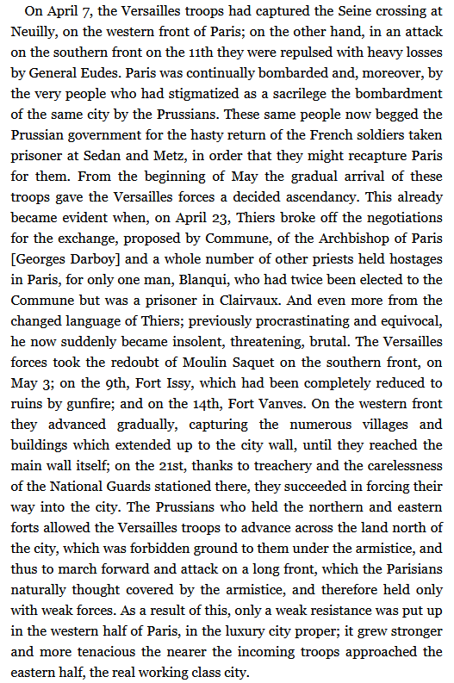
The Civil War in France by Karl Marx and Frederick Engels

Slide 23
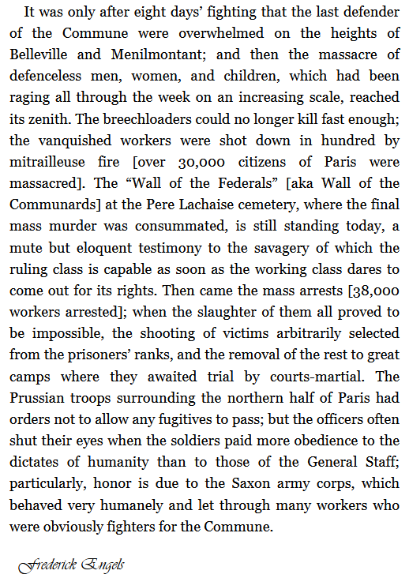
The Civil War in France by Karl Marx and Frederick Engels

Slide 24
Section 3: The Commune and Proletarian Patriotism

Slide 25
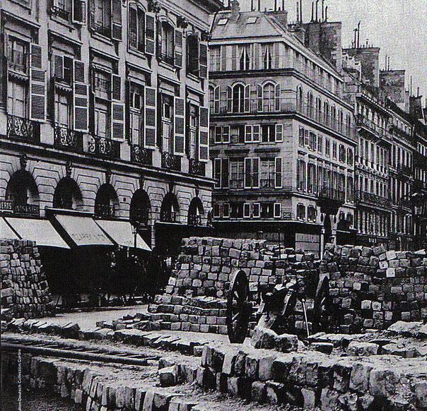
The Commune and Proletarian Patriotism
Marx pointed out a fatal mistake of the Commune, namely rushing to insurrection pushed by proletarian patriotism and revolutionary socialism with a foreign army at your door steps.
Therefore we must know and understand these historical events, namely the Franco-Prussian war that occurred 8 months prior to the Commune.
The first International was founded in 1864, meaning it had been in existence already 6 years at the time of the Franco-Prussian war and had accumulated precious experience regarding workers uprisings.
Marx wrote 3 addresses of the International about that war. The first two are short, the third one is long and became a famous work known as “The Civil War in France”.

Slide 26
The Commune and Proletarian Patriotism
In July 1870, Louis Napoleon (Napoleon the 3rd), trying to bring back the chauvinist glory of Napoleon the 1st, and brandishing the false “patriotism” of oppressor classes, launched a war of aggression against Prussia (Germany).
Marx, in the his first address of July, warned French workers against falling in the trap of chauvinism and false “patriotism” and asked them to show support to German workers who defended their country. Napoleon was swiftly defeated by the Prussians, and taken prisoner on September 2nd.
Upon hearing the news, French workers rose up in Paris and overthrew Louis Napoleon’s Empire, handing power to the bourgeoisie who proclaimed the republic and formed a government of “national defense”.
That is when Marx wrote the 2nd address of the International on September 9th.

Slide 27
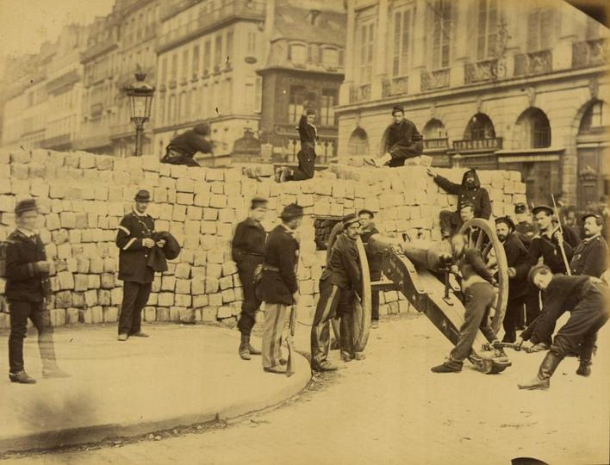
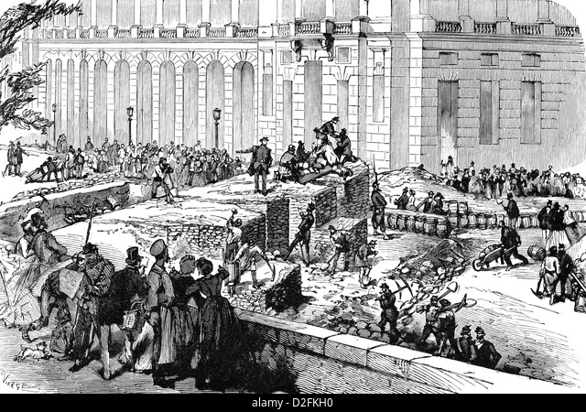
The Commune and Proletarian Patriotism
In it, he said that Germany had gone from a war of defense to a war of conquest when it crossed the border and marched toward Paris.
He warned the French proletariat that doing an uprising when Prussians soldiers were at the gate would be “desperate folly”. Marx warned French workers not to be “swayed by the national souvenirs of 1792”. That was the time when French people rose in masse to save the 1st republic, under attack by all feudalists of Europe.
Marx warned against a mechanical application of the 1792 slogan “the fatherland in danger”, to the Franco-Prussian war of 1870, that fighting the Prussians on behalf of the bourgeoisie would be madness. Marx ended the 2nd address with “Vive la République”, long live the republic, even though he knew it was a bourgeois republic.

Slide 28
The Commune and Proletarian Patriotism
The bourgeois government of alleged “national defense” turned out to be a government of “national treason”. In Paris, the National Guard was created to defend the city. It was composed of workers.
Now the proletariat was armed, and that became the nightmare of the bourgeois government who was more concerned about fighting the workers than fighting the invaders. Paris was besieged for 4 months by the Prussian army. The treasonous government signed a shameful peace with Bismarck. Prussians troops paraded in Paris and that enraged the proletariat who could not accept defeat.
A Frenchman loves his country and it was impossible to be light-hearted when it was threatened. The reaction of Parisians was one of outrage and the people of Paris called the surrender “a monstrous trickery”. Determined not to bow to their enemies, the National Guard of Paris organized the seizing of numerous cannons, moving them to specific parts of the city, namely Montmartre, which was the highest point in the city.

Slide 29
The Commune and Proletarian Patriotism
The bourgeoisie didn't care to fight the Prussians, but rather was getting ready for war against Paris workers and attempted to disarm them. That is the day the proletariat overthrew the bourgeoisie and proclaimed the Commune.
Here Is the Commune proclamation of March 18th by the Central Committee of the National Guard: “the proletarians of Paris, in the midst of the defeats and betrayals of the ruling class, have come to understand that they must save the situation by taking the conduct of public affairs into their own hands...” That clearly shows the intricate connection of revolutionary socialism and proletarian patriotism.
Before the Commune, Marx was against an insurrection and wanted workers to hold their horses, wait for peace and foreign troops to leave the gates of Paris, or else it might turn into another massacre, such as the June 1848 slaughter of the Paris proletariat.
But from the moment that Parisians workers launched their insurrection, triggered by their disgust of the bourgeoisie’s betrayal of the nation and its attempt to disarm the National Guard, Marx gave the proletariat his full support, praising the Communards “storming heaven”: “history has no like example of like greatness!”.

Slide 30
Discussion

Slide 31
Volunteers Needed!
We are in need of volunteers for the staff of the People’s School! Here’s a few roles we need filled:
People to help manage posting on our social media and podcast platforms
Video Editors, Audio Editors, Graphic Designers, Artists, Narrators
Facilitators, Web Controls, Moderators
Email info@peoplesschool.us if you’re interested and try to attend our next staff meeting on June 1st if possible.

Slide 32
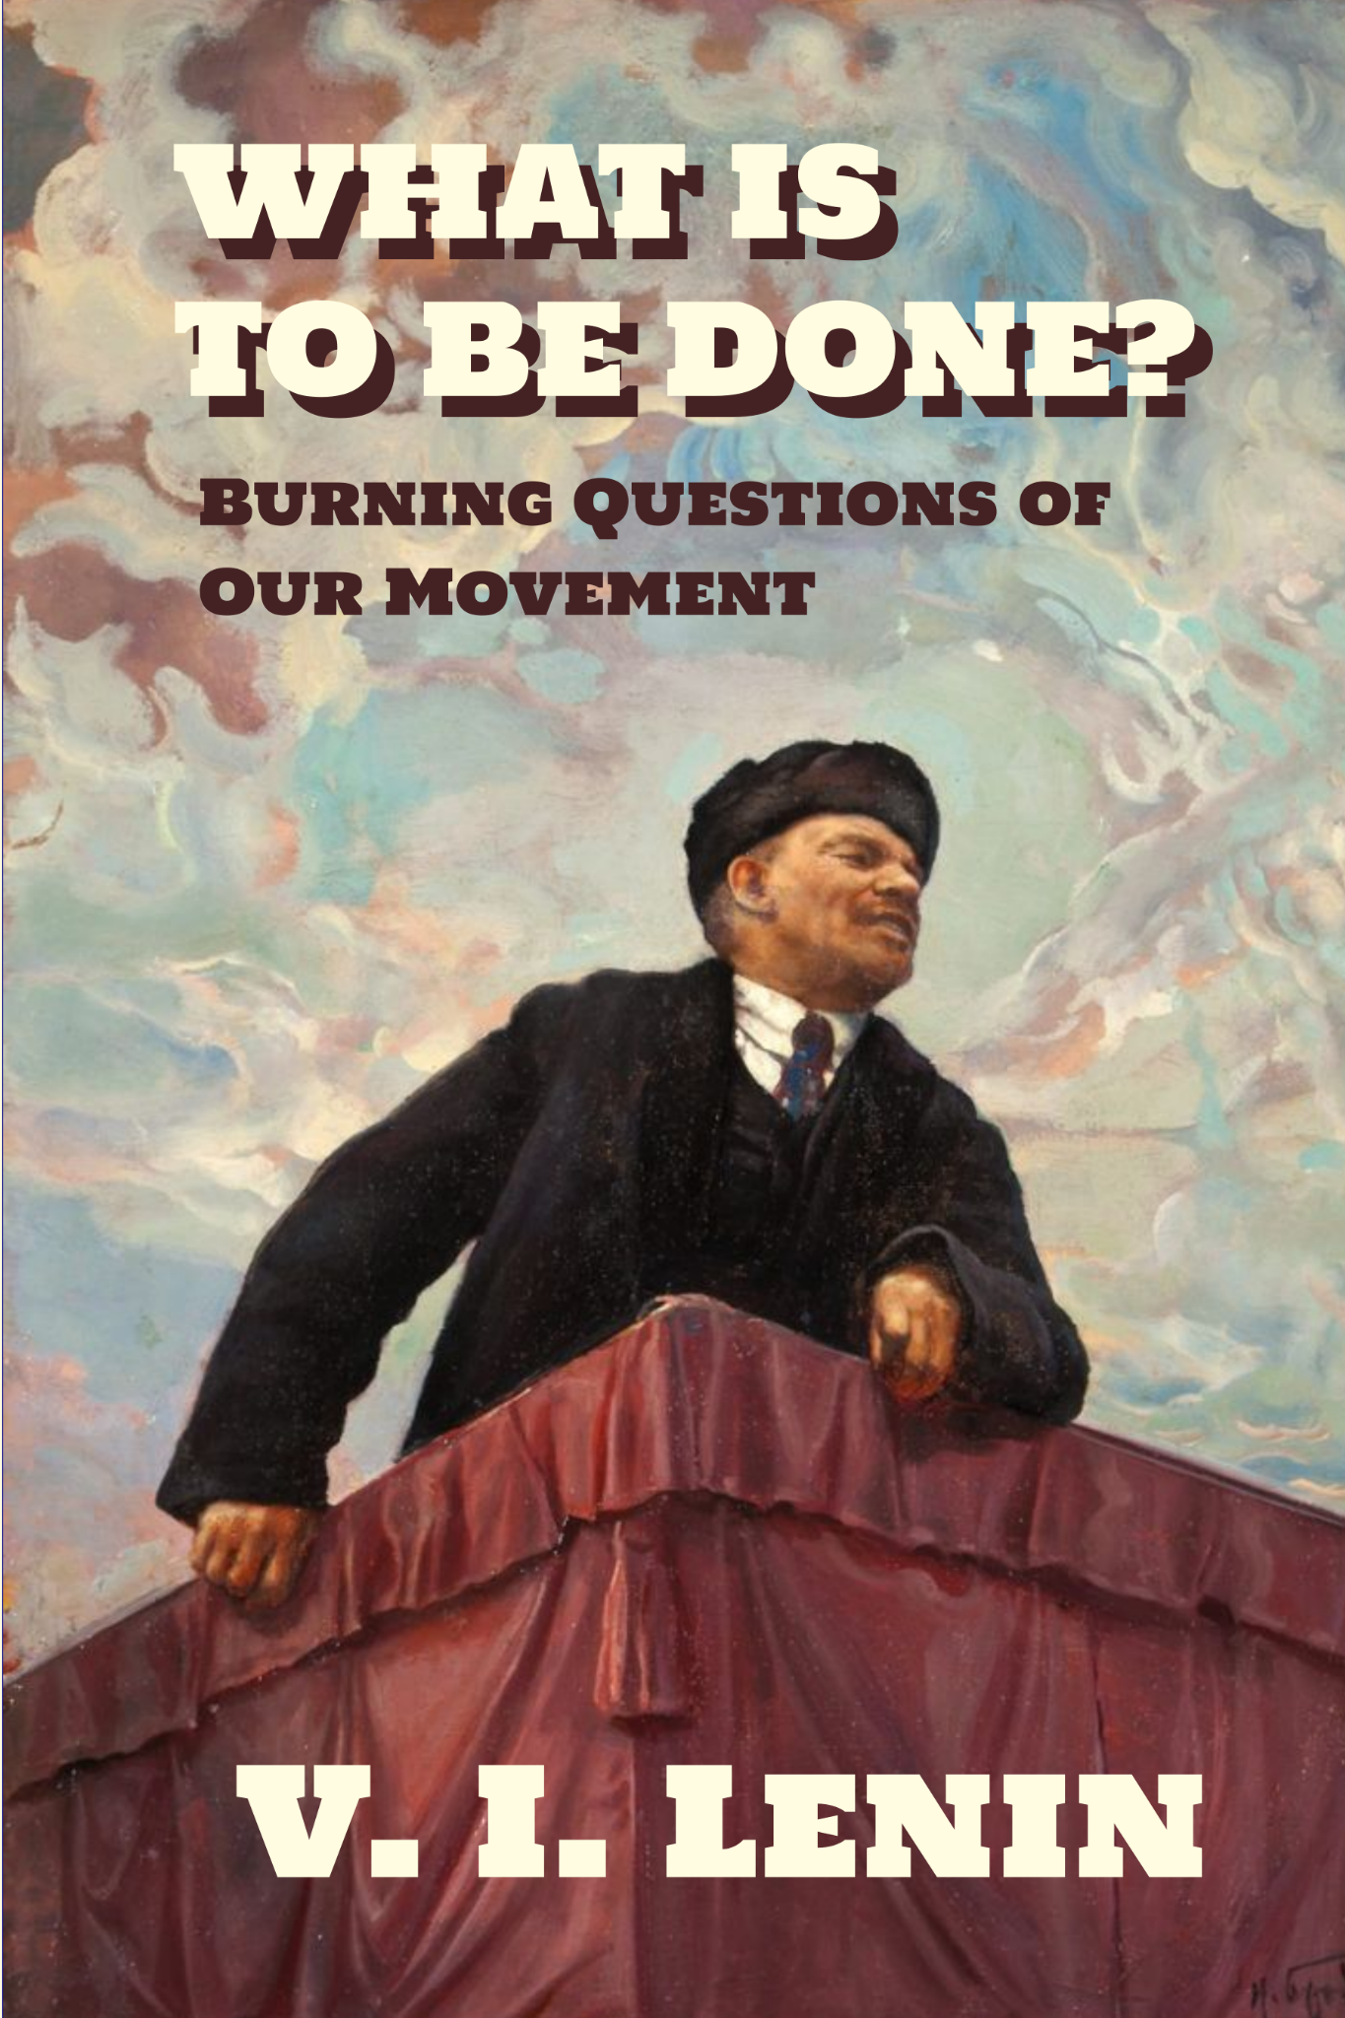
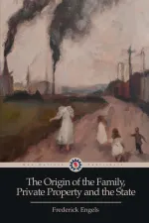
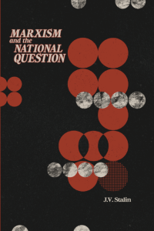
New Outlook Publishers
newoutlookpublishers.store
Latest Releases

Slide 33
Legal Drive
Last year we were attacked and sabotaged by wreckers that tried to steal the PSMLS and destroy the PCUSA.
They failed, but they will be held accountable and there are still things they took from us that we’ve not got back, like videos, imagery and audio. That is why we still need donations to the legal drive.
To donate, go to partyofcommunistsusa.net/donations/
Put “For legal funds” in the details box and try to donate on Tuesday or Thursday so it is easier for us to sort through. It will go to the legal fund. Anything helps!

Slide 34
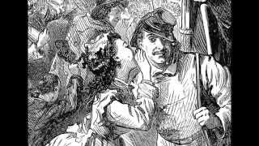
Le temps des cerises | The time of cherries

