Slide 1
The Internationale - 1933 American Version by “The New Singers”

Slide 2
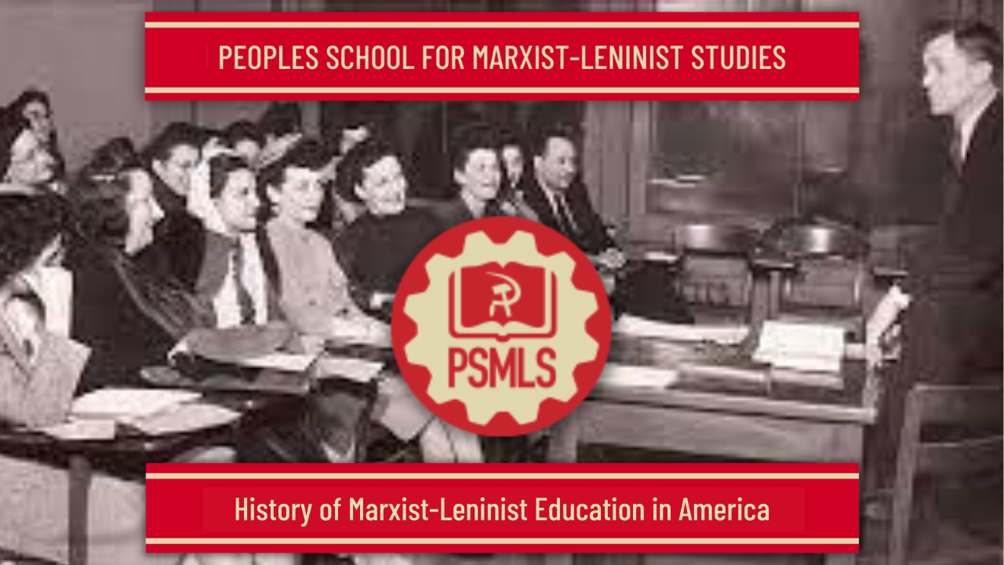
PSMLS mm/dd/yy - mm/dd/yy

Slide 3
What we’ll be learning today:
The history of Marxist-Leninist, party sponsored schools in the United States, from the early Workers Schools to our Peoples School today.

Slide 4
Precursors to the PSMLS

Slide 5
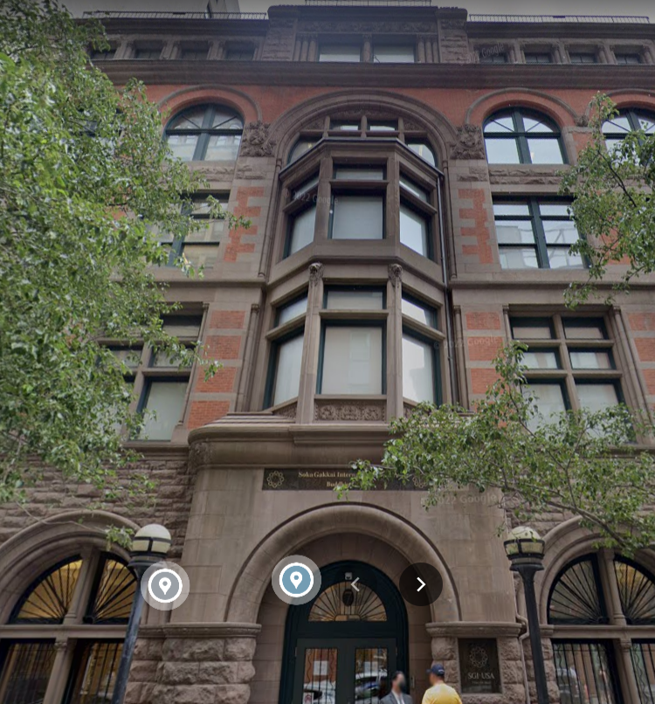
Earliest Communist Schools in the US
Schools of “Social Science”
One of the earliest attempts at a socialist oriented school was at the end of the 19th century, in 1899, with the College of Social Science, initiated by the Christian socialist “Social Reform Union” in Boston, Massachusetts. There was also a Karl Marx School started at the same time in Boston.
In 1901, the Socialist Party of America was founded, and the Workmen’s Educational League, later known as the Socialist Educational League, was formed in New York City, NY. None of these schools gained much traction at the time and failed to leave much impact on the socialist movement, but they would serve as an impetus to build more impactful and more attended socialist schools in the United States. The Finnish Socialist Federation of the SPA also started the Work People’s School in Duluth, Minnesota in 1907, but by the 1910’s, the school was taken over by the IWW. Operations ceased in 1941.
However in 1906, the SPA formed the Rand School of Social Science at the People's House, 7 East 15th Street, New York City. The school existed for 29 years before being dissolved in 1935 after a split in the Socialist Party in 1936. The formation of the school was made possible by a $200,000 endowment by widowed lumber heiress Caroline A. Rand. It survived mob attacks and a raid by New York’s Lusk Committee which sought to prosecute the school under the espionage act for Scott Nearing’s anti-war pamphlet “The Great Madness”, but factionalism in the SPA brought its downfall.
7 East 15th Street, New York City

Slide 6
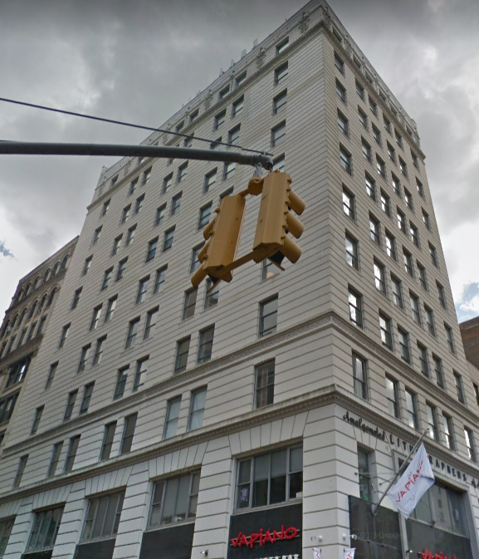
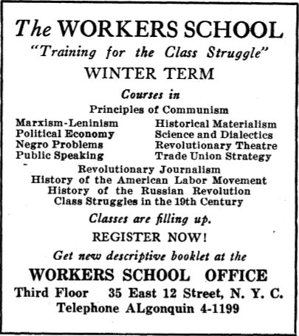
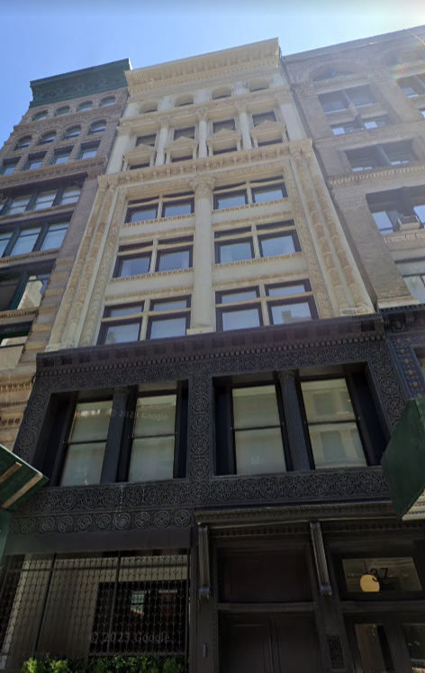
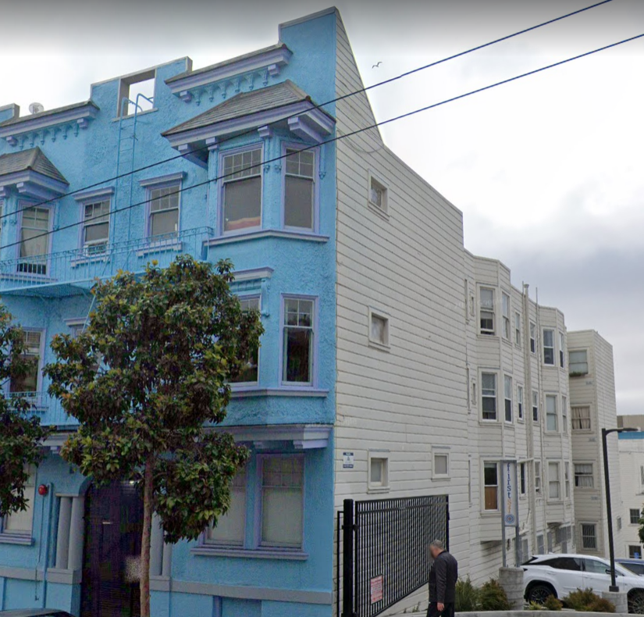
Other institutions, some calling themselves “Workers Schools”, would be set up by the CPUSA under Earl Browder in the 1930’s in other major cities of the United States.
Sometime in the 1930’s, the Abraham Lincoln School of Social Science was established in Chicago, Illinois by William L. Patterson of the CPUSA, and was aimed at educating thousands of black Americans coming in from the South during the Great Migration.
In 1934, the San Francisco Workers School was established and operated similarly to schools in New York and Chicago. It was located at 121 Haight Street, San Francisco. In 1940, under pressure from federal and state authorities for its communist teachings, it became the Tom Mooney Labor School (also known as California Labor School) which lasted until 1957. The Los Angeles People's Educational Center was established as an LA extension in 1944-1948.
Other schools included the Pacific Northwest Labor School in Seattle WA, Samuel Adams School in Boston MA, George Washington Carver School in Harlem, NY, Highlander School in Appalachia, Tom Paine School of Social Sciences in Philadelphia PA and the Pittsburgh Labor School in Pittsburgh PA.
Workers Schools
In the October of 1923, the Communist Party USA established the New York Workers School at 48–50 East 13th Street, New York City, though it would twice move. It was seen as the historical successor of the Rand School, since the CPUSA came about as a split from the Socialist Party of America in 1919.
The school obviously taught its students about Marxist-Leninist theory and history, but also handled problems of the time and even offered language and “Citizenship and Naturalization” classes for their immigrant students, as the CPUSA established many fraternal organizations amongst different groups of immigrants.
The Workers School suffered a split of its own when the Lovestoneites left the CPUSA in 1929, where they formed the New Workers School, and the first director of the Workers School, Bertram Wolf, left with them. He was succeeded in the WS by Abraham Markoff and Will Weinstone as directors. The NY Workers School was merged into the Jefferson School of Social Science in 1944.
48–50 East 13th Street
35 East 12th, NY
121 Haight St,
San Francisco CA

Slide 7
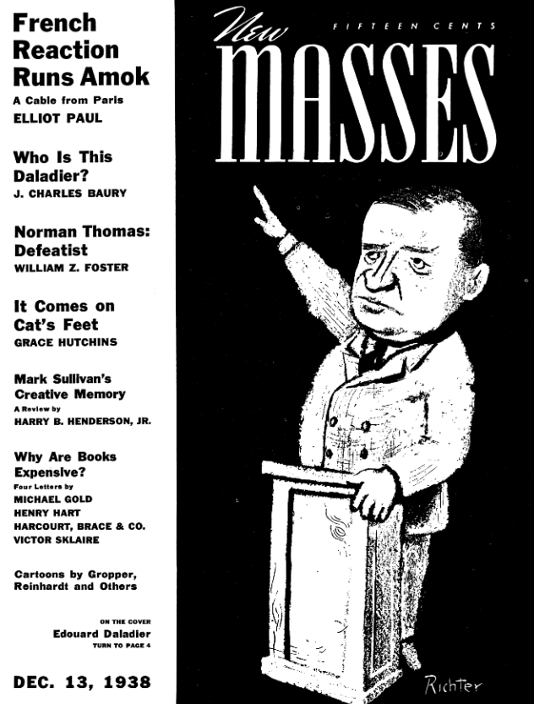
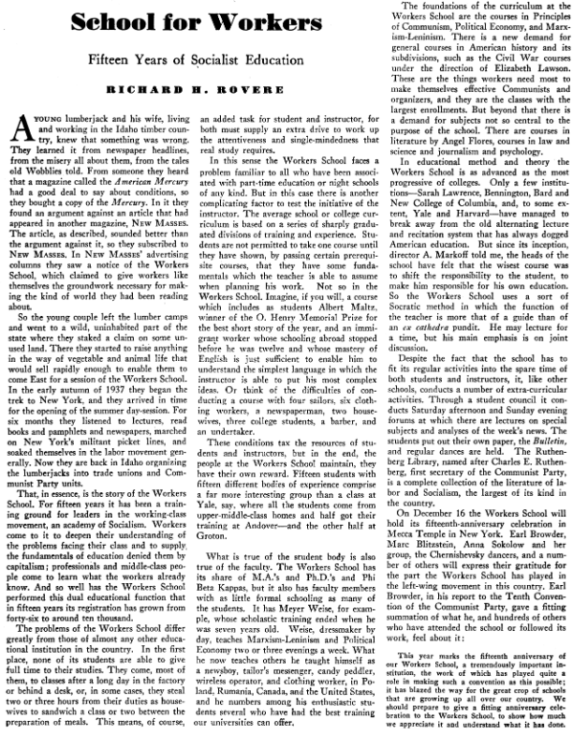
New Masses, Dec 13th, 1938

Slide 8
New Masses, Dec 13th, 1938

Slide 9
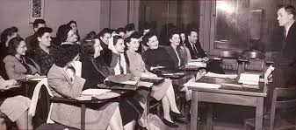
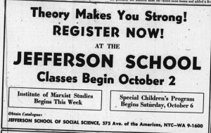
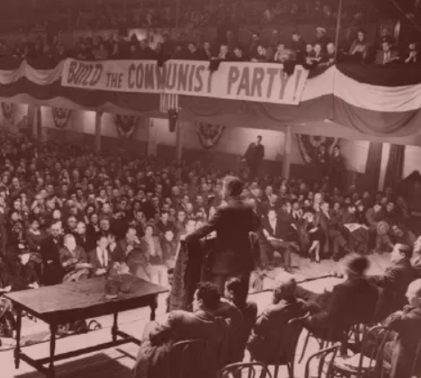
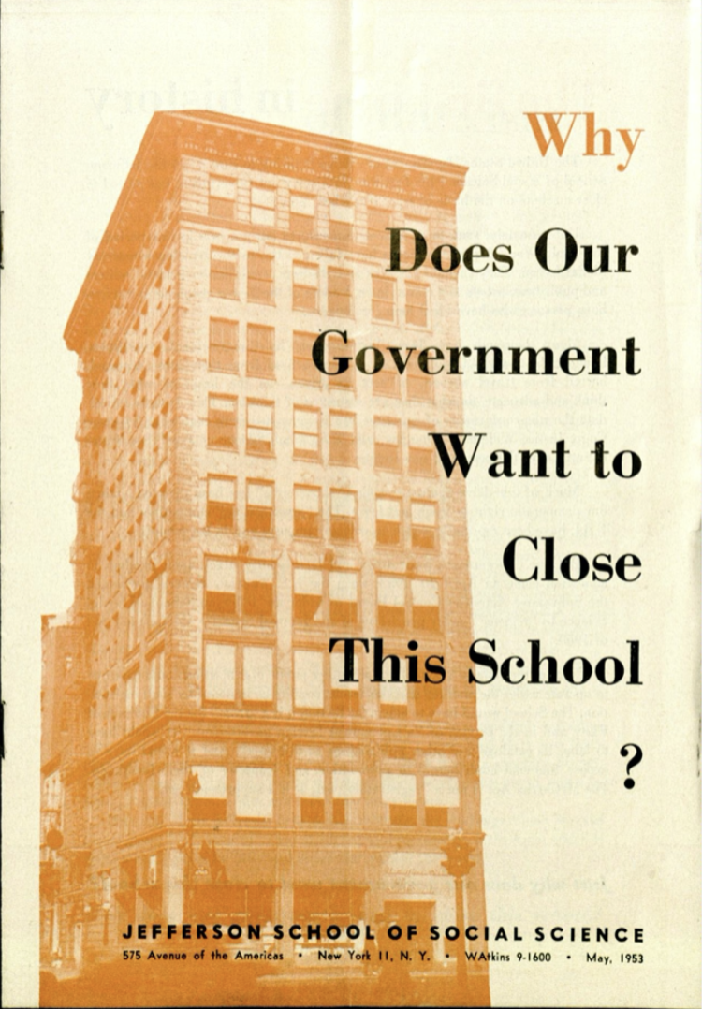
Jefferson School of Social Science
The Jefferson School of Social Science was established by the CPUSA in 1943. As the New York Worker’s School merged into the Jefferson School of Social Sciences in 1944, the school had a greater emphasis on community outreach and education rather than solely training party members. This was because the CPUSA was in the Popular Front era and sought to integrate itself more among the masses.
It was located at 575 Sixth Avenue in the Manhattan borough of New York City. It was a 9-story building, which was built around 30,000 volumes of books. On the first floor, there was a cafeteria for comrades to eat at. The school covered much of the same subjects as its predecessor, but also included non-political and artistic classes, such as on creative writing or personal beauty on a budget. It had 1 Director, Howard Selsam.
In 1947/1948, the school’s membership was at its peak with around ~5,000 members. It was subject to legal battles and anti-communist oppression during the McCarthy era and its operations terminated in 1956.

Slide 10
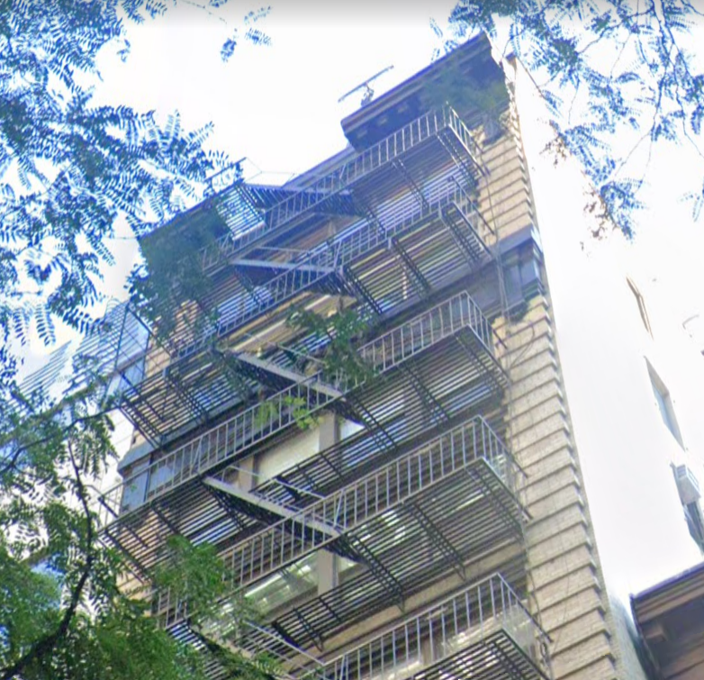
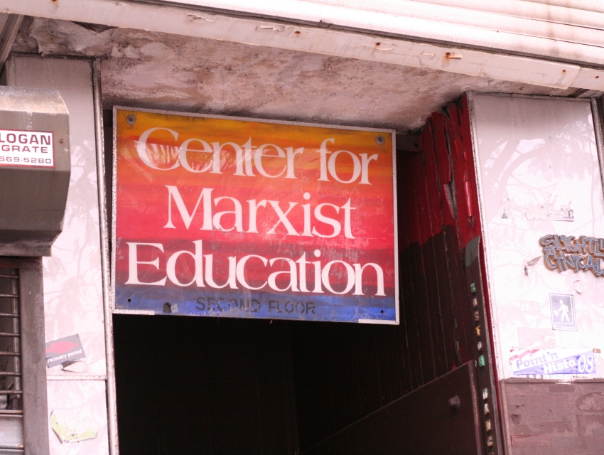
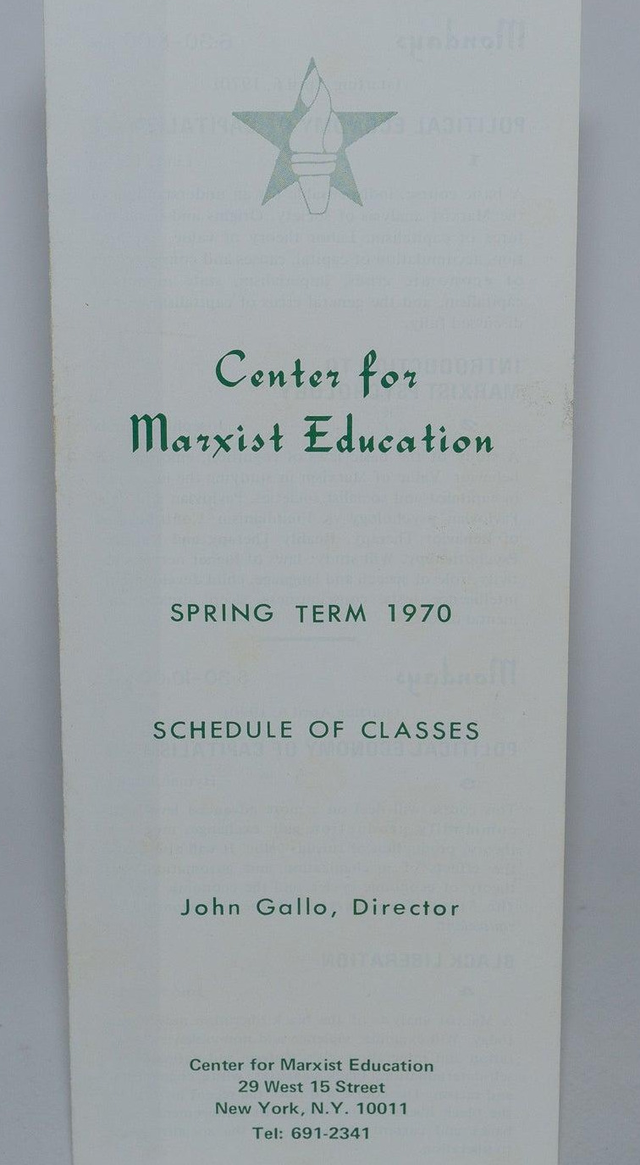
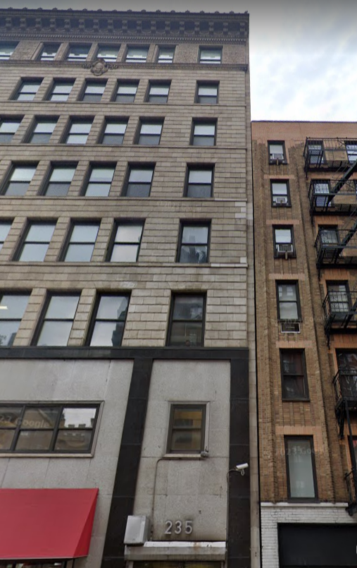
Center for Marxist Education &
Peoples School for Marxist Studies
Party Sponsored School of the 1970’s & 1980’s
Following the closure of the Jefferson School in 1956, and after the tumultuous years of the 1960’s in the communist movement, the Center for Marxist Education (CME) was established in 1970 at 29 W 15th St, 7th Floor, New York, NY. The building had a cafeteria similar to the Jefferson School, and the school offered extension courses.
As early as July 1970, the CME was designated by the US Attorney General as a “CPUSA Front Organization”, but was unable to shut it down. The first director was John Gallo, and notable members included Dr. Angelo D’Angelo, Jarvis Tyner, Phillip Bonosky, Herbert Aptheker and even former director of the NY Workers School, Will Weinstone. It ran intermittently due to lack of resources.
In the 1980’s, the school was changed to the People’s School for Marxist Studies (PSMS), located at 235 W 23rd St, New York, NY. The PSMS was a center for pro-Soviet, anti-Trotskyite education in the American left. Much like the CME before it, the People’s School used extension courses to reach those outside Manhattan. These were schools operated by the CPUSA, but as we know the CPUSA took a revisionist turn into the 2000’s and as the PCUSA was founded to continue the legacy of the old CP, a continuation of the party-sponsored education was needed.

Slide 11
Discussion
What takeaways do you have about these predecessors of the PSMLS?

Slide 12
Formation of the PSMLS

Slide 13
Formation of the PSMLS
Peoples School for Marxist-Leninist Studies
The Peoples School for Marxist-Leninist Studies was established at the first Party of Communists USA congress in 2014, continuing the long-line of party sponsored Marxist-Leninist education in the United States. Its first National Director was PCUSA General Secretary Angelo D’Angelo.
At its inception, the PSMLS offered different courses for a price on different subjects of Marxist-Leninist theory and history. Extension courses became unnecessary and the PSMLS became quite possibly the first national, online school for Marxist-Leninist studies in the US.
Being brought back in a new era of instant global communication via the internet meant students could be reached anytime, anywhere via free teleconference call classes. This would become the medium for the classes for years until 2021, when the PSMLS started having classes on Zoom, a popular virtual meeting platform that gained prominence at the start of the 2020’s. You can find classes on our Youtube as old as 2018.
Old logos of the PSMLS

Slide 14
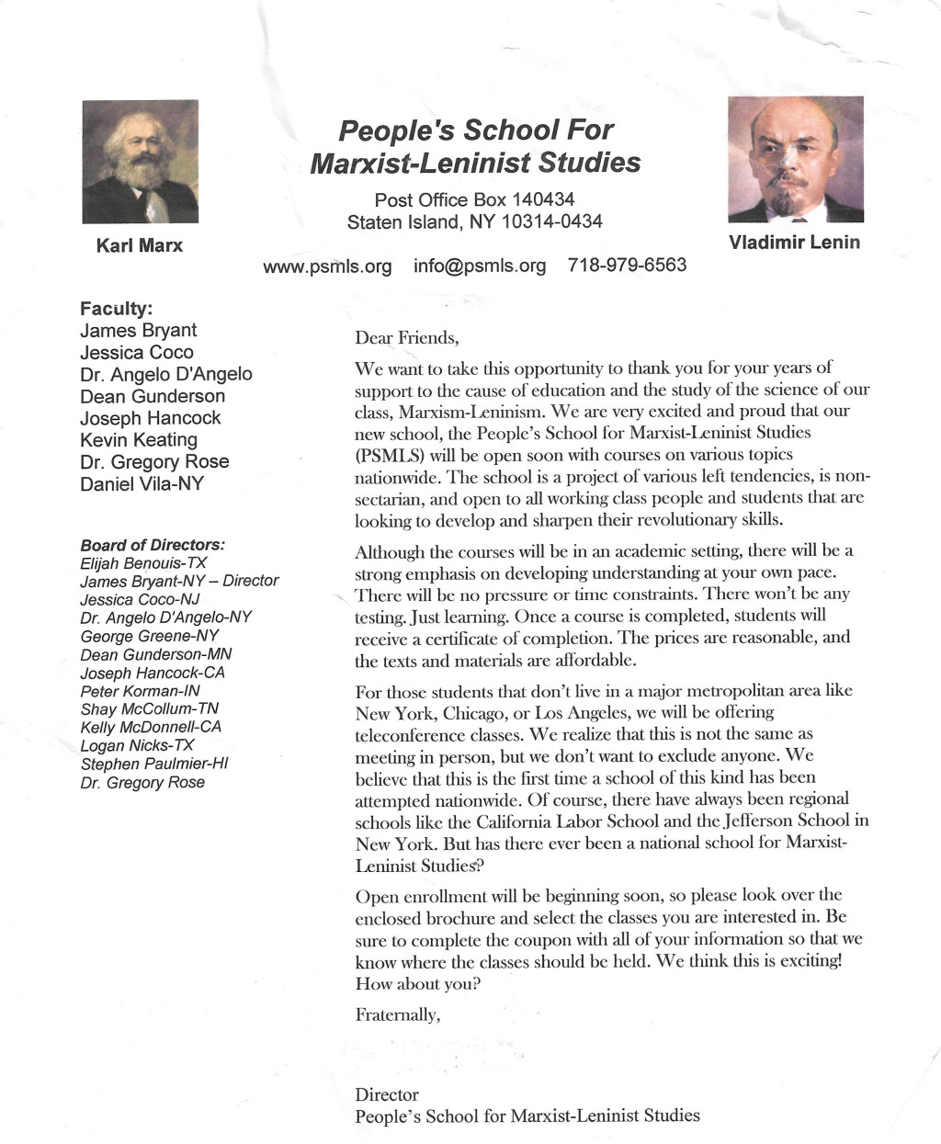
Announcement of the PSMLS, circa 2015-2016

Slide 15
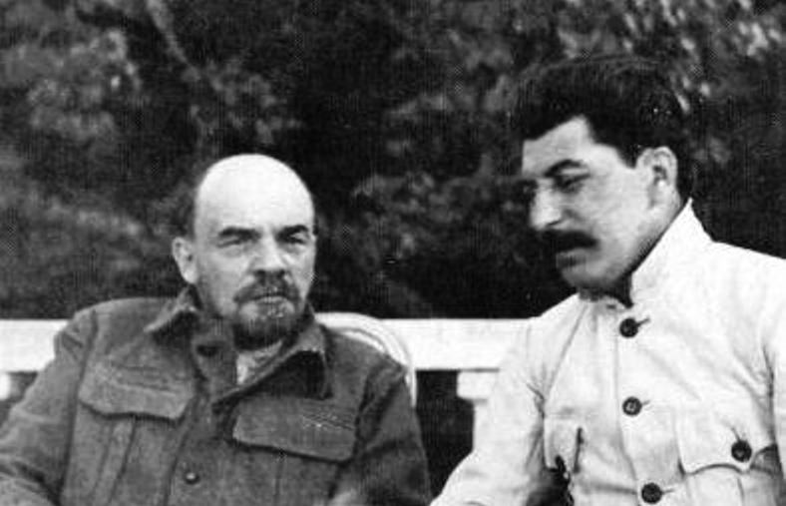
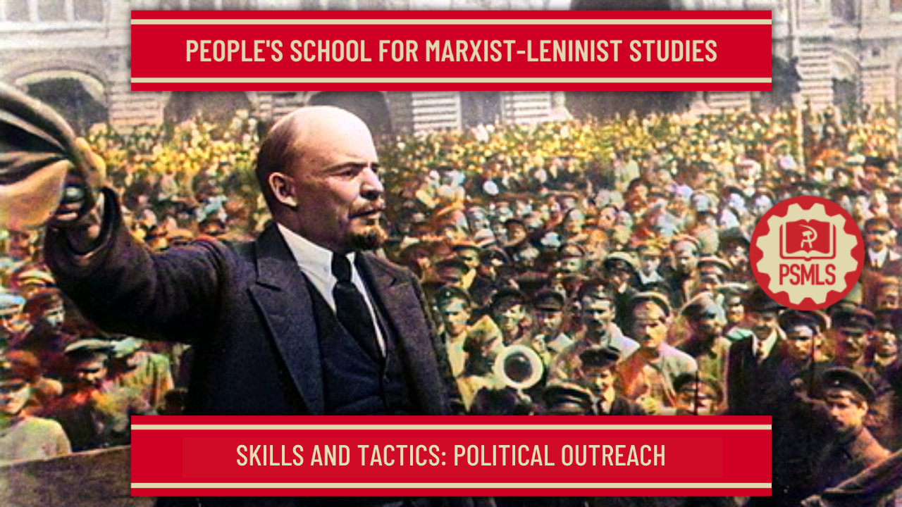
Peoples School for Marxist-Leninist Studies
Marxist-Leninist Education for the 21st Century
The new PSMLS was crucial at a time of intense revisionism in the Communist movement and the ideology taught by the school was, and is, pro-Lenin and pro-Stalin and upholds the socialist states of the 20th & 21st century, including the USSR, Cuba, China, Vietnam, DPRK, etc.
For this, the PSMLS has spent much time teaching with Lenin’s texts and Stalin’s texts, as well as old CP texts, and members of the PSMLS even did the work of translating texts into English that hadn’t been translated, like Ludo Martens text “Stalin and the Great Purges” and the Luis Corvalán’s text “Czechoslovakia 1968.” No other so-called “communist” or “marxist” school is doing all this in the present day.
The PSMLS has also had classes on new present-day issues such as the LGBT+ Struggle and Animal Rights, as well as on current events, such as the 2021 Capitol Hill Putsch, the 2022 Special Military Operation in Ukraine, the 2022 Railroad Strike and the 2023 East Palestine Rail Disaster. Since 2022, the PSMLS has also had multiple classes on practical tactics and skills communists should learn.

Slide 16
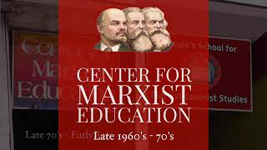
What is the PSMLS? - PSMLS Clip on YouTube

Slide 17
Peoples School for Marxist-Leninist Studies
Over the Years
The longest serving National Director of the PSMLS was Dr. Angelo D’Angelo. The position has been delegated to other PCUSA members since then. The current National Director is Kamryn Stringfield, who resides in Eugene, OR.
PSMLS courses are now free and public. They are mandatory for PCUSA members, who are required to attend 1 class a week or submit a 200-word essay if they miss that week’s class. This is to involve them in collective discussion and show that they can devote themselves to making it to regular meetings.
The PSMLS has seen the same factionalism arise as in other party-sponsored schools before, but has survived. In August of 2022, a small ultraleft faction of the PCUSA, including the then National Director, left the party and tried to hijack and steal the Peoples School for Marxist-Leninist Studies for their own splinter group.
This was resisted by loyal PSMLS members and the splinter group later stopped using the name “Peoples School for Marxist-Leninist Studies” and we are in the process as of this class’s dates of pursuing the group legally for what they did. A link for the GoFundMe for this legal drive will be included in the Wrap Up of tonight's class.

Slide 18
Discussion & New Members Introductions
Question for our older members:
When did you begin attending PSMLS classes and what do you remember about the PSMLS at that time?

Slide 19
New Member Introductions
What is your name, pronouns and state (or country/territory)?
Where do you work? Is it unionized?
How did you find out about the People’s School?
What do you think about tonight's class?

Slide 20
Present Day and Future for PSMLS

Slide 21
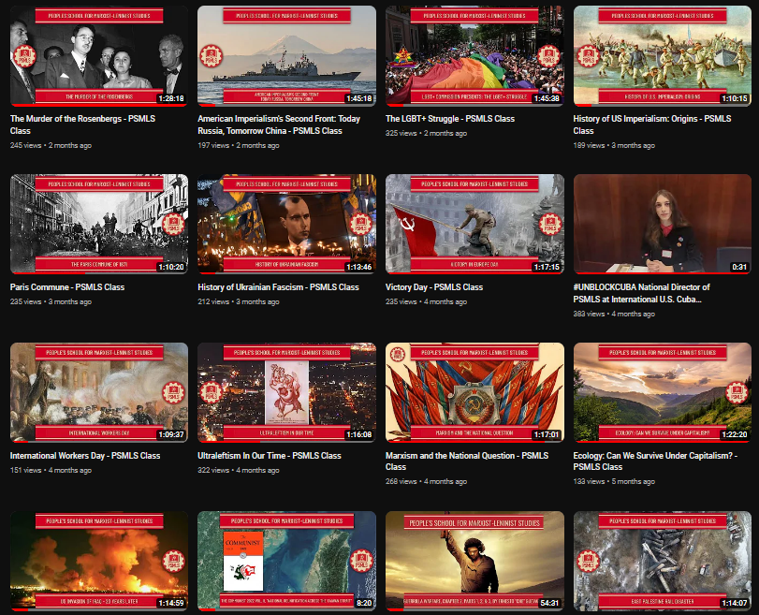
Present Day and Future for
PSMLS
State of the Peoples School
The Peoples School for Marxist-Leninist Studies is growing and learning. We are limited by our resources and our staff capacity but we are committed to this school and to bringing the masses party-sponsored education 51 weeks a year.
Last year, the PSMLS began using formal presentation PowerPoints that are made available on the peoplesschool.us website. At the start of 2023, we began making videos of the slideshow presentations on YouTube and have begun making videos on the social media platform TikTok to reach more people as well. These are developments that we need people to volunteer to help us with and that we seek to continue.
The Peoples School is also trying to use social media more than ever before to spread the message of Marxism-Leninism and anti-imperialist solidarity on Facebook, Instagram, X, Threads, YouTube, Reddit, TikTok, Telegram, Rumble and more.

Slide 22
PSMLS Structure:
BoD and Staff
Board of Directors
Like the party-sponsored schools of before, the PSMLS is ran by a Board of Directors, with both specified positions and at-large members. The National Director is Kamryn Stringfield and the Assistant Director and Security Officer is Nick Anderson. Andrea Busco is Art Director, Tyler Lyons is Recording Secretary and Kai Brouillette is Press Secretary. S.M. Cifone is our New Outlook Publishers Representative. At-large BoD members include Dr. Angelo D’Angelo, Chris Bovet, Joseph Mormon, Christian Lourdin and Shruti Singh. The PSMLS BoD meets every month and evaluates the school’s work and passes motions for the school.
Staff
The PSMLS Staff is the group of volunteers that help to facilitate the functions of the Peoples School and help with the creation of PSMLS content. This includes members of our Social Media Committee, narrators, video and audio editors, graphic designers, class facilitators, web controls, moderators and more. Staff members coordinate with each other through telegram and meet once a month every first Thursday at 8 pm EST in a public PSMLS Staff Meeting to similarly evaluate the school and recommend motions to the BoD. We encourage all PCUSA members and newcomers to volunteer for a position in the staff of the PSMLS, which is a task of monumental importance.

Slide 23
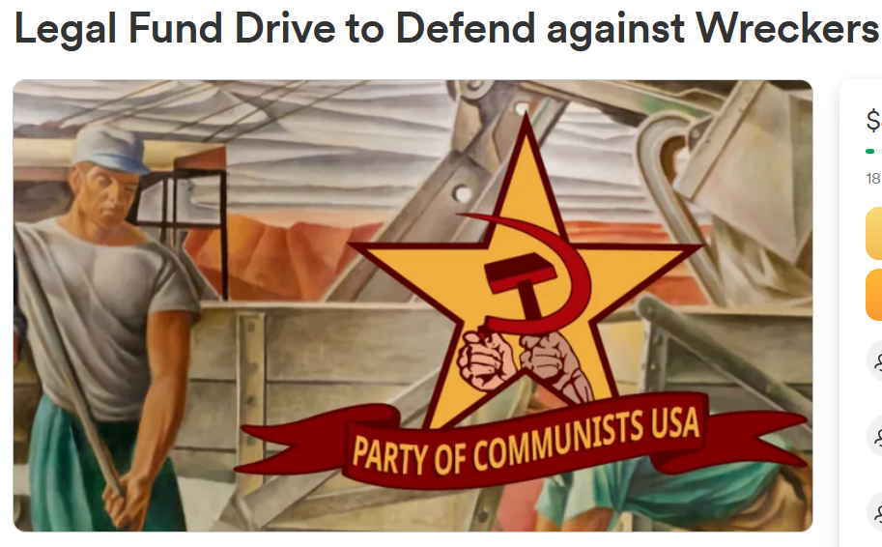
Current Needs of the PSMLS
The PSMLS needs VOLUNTEERS
Weekly classes, regular posts on social media and the creation of content for our video and podcast platforms takes a lot of work. We need comrades to step up and volunteer to assist the school. We would like to train comrades on how to perform these functions and more comrades helping means less work on all of our shoulders at this school!
The PSMLS needs PROMOTION
Include PSMLS literature and propaganda in your tabling events! Post up PSMLS flyers and stickers! Leave PSMLS brochures and business cards in key places like libraries and rest stops! Buy PSMLS merchandise and show it off! Share PSMLS posts and articles on your social media!
The PSMLS needs SUPPORT
We are in the midst of a legal battle against the wreckers that tried to steal our school. We need your monetary support to our fund drive more than anything. Donate, share the fund drive and stay tuned for updates. You can also support us by purchasing from New Outlook Publishers!

Slide 24
The Future of the Peoples School
What is to be done?
The main goal of the PSMLS right now is to improve our staff and grow our membership. Our needs have been expressed but we do have a few ideas for the future of the school besides that:
Brick and Mortar School
It would be ideal to establish a Brick and Mortar school in an area with many members in addition to our standard Zoom meetings now. Comrades may find that they learn better in an in-person collective environment and this will drive comrades to meet each other and strengthen their relationships with one another, fostering discussions and study that strengthen us as Marxist-Leninists and preparing them to overcome social anxieties to do party work.
More Online Content
It has been suggested before that the PSMLS host live streams discussing things from our Marxist-Leninist perspective, which is something we would like to do. We would also like to post more video content on TikTok and YouTube among other platforms. Potential content could include short clips, communist music and news. We would need dedicated volunteers for all of this.
More Webinars
In the past we’ve had many speakers, including Dr. Barry Lituchy, Carlos Garrido and more, that gave us a presentation on a certain subject and those webinars were very successful. We’d like to do more webinars with both domestic and international comrades and organizations.

Slide 25
Discussion & Wrap Up
A few questions for our students tonight:
What do you want to see the PSMLS do in the future?
What can the PSMLS do better that it is already doing?
What has the PSMLS done that you most enjoyed?

Slide 26
Announcements
THE KONONOVITCH BROTHERS NEED US, SHARE THIS ARTICLE:
https://dailyworkerusa.com/stop-the-kiev-regimes-calls-for-the-murder-of-the-kononovitch-brothers/
The PSMLS Staff meeting will be next week, on Thursday, October 5th, at 8 pm EST on the same Zoom link as this class. If you are volunteering for the PSMLS staff, have feedback for the school or just want to observe how a staff meeting operates then please feel free to attend the meeting!

Slide 27
Volunteers Needed!
We are in need of volunteers for the staff of the People’s School! Here’s a few roles we need filled:
People to help manage posting on our social media and podcast platforms
Video Editors, Audio Editors, Graphic Designers, Artists, Narrators
Facilitators, Web Controls, Moderators
Email info@peoplesschool.us if you’re interested and try to attend our next staff meeting on October 5th if possible.

Slide 28
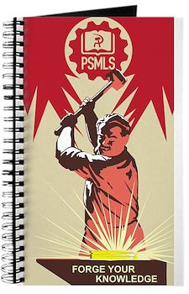
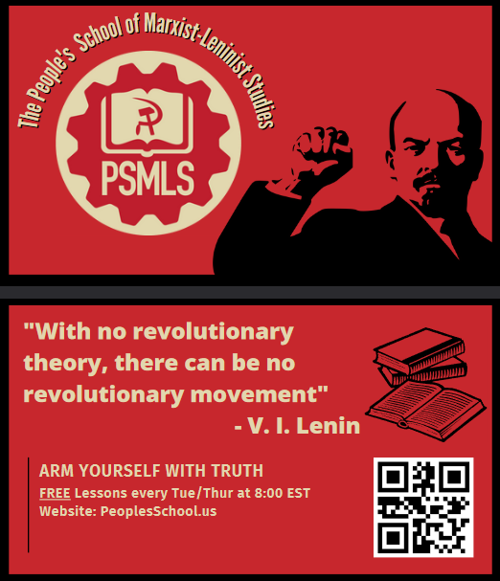
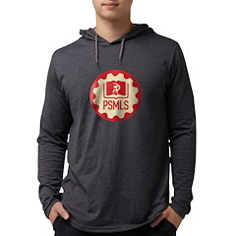
PSMLS Propaganda
peoplesschool.us/media & peoplesschool.us/store
Materials to help promote the school!

Slide 29
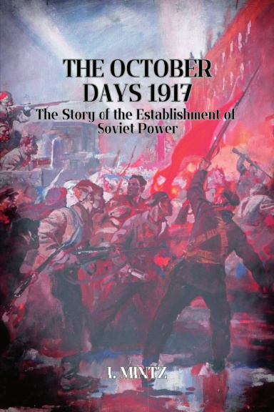
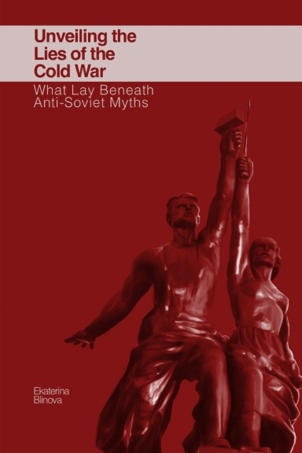
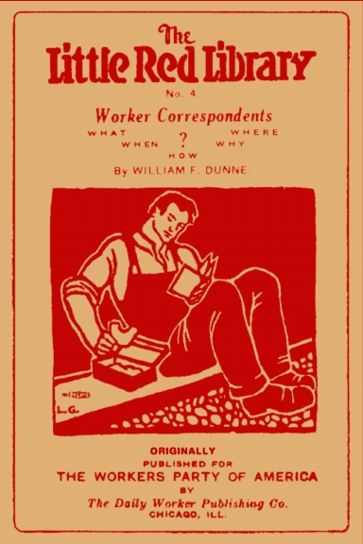
New Outlook Publishers
newoutlookpublishers.store
Latest Releases

Slide 30
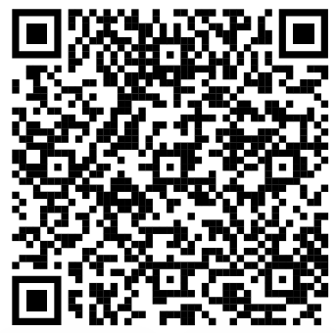
Legal Drive
Last year we were attacked and sabotaged by ultraleft wreckers that tried to steal the PSMLS and destroy the PCUSA. They failed, but they will be held accountable and there are still things they took from us that we’ve not got back, like videos, imagery, audio etc. That is why we still need donations to the legal drive.
If you support the school and want to see us continue to improve and keep delivering this education 51 weeks a year, please pitch in whatever you can and support the GoFundMe for the legal drive @ https://www.gofundme.com/f/legal-fund-to-defend-against-wreckers.
Anything helps!

Slide 31
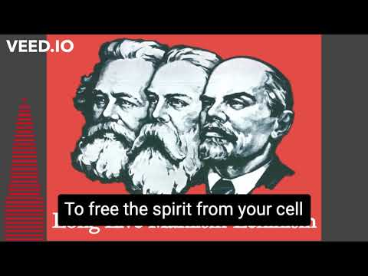
The Internationale - 1933 American Version by “The New Singers”

