Slide 1
The Internationale - 1933 American Version by “The New Singers”

Slide 3
What we’ll be learning today:
Reading from excerpts from Cities Without Crisis Chapter 3: Life Without Landlords by Mike Davidow.
Learning from other pamphlets on the relationship between war, housing and jobs and about their history and today.

Slide 4
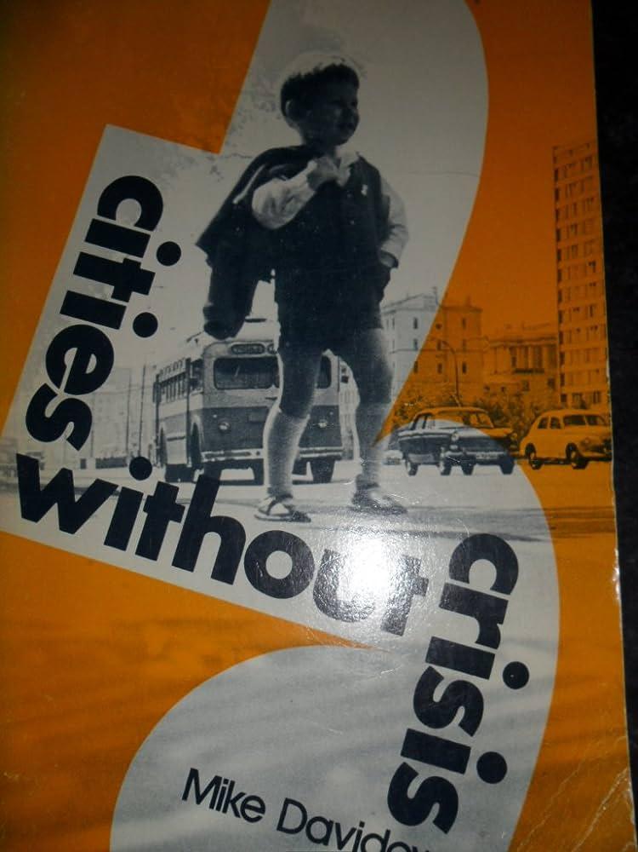
Housing in the USSR
Excerpts from Cities Without Crisis
Chapter 5: Life Without Landlords
By Mike Davidow

Slide 5
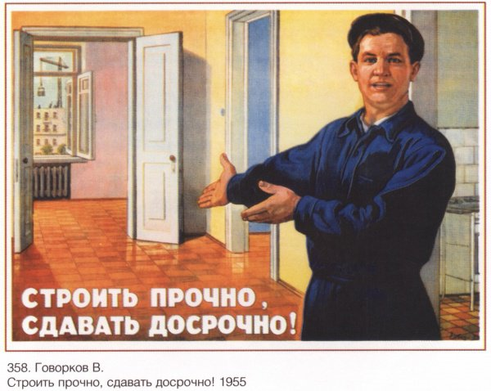
Housing in the USSR
The social worries facing the Soviet people arise largely from unresolved problems that still exist in Soviet society in the period of socialism and are complicated by the effects of World War II. Among them is the serious housing shortage. But the Soviet people know that these are temporary worries. This knowledge is based not on blind faith or self-delusion, but on solid reality.
This is hardly the outlook our urban dwellers have. Let me just illustrate it with this one fact. The New York Times (June 5, 1969) notes that at the rate of public-housing construction of homes people with low incomes could afford in the United States, such families “could expect to move into a project in 51 years.” It points out: “To solve this problem, New York City needs right now 780,000 new subsidized apartments but the federal housing program, in its 34-year history, has produced only 800,000 units across the entire country.’ ’ [My emphasis, M.D.] By contrast, the Soviet Union constructed 1 1,350,000 new or improved apartments in the five-year period 1966-70, about 2.3 million a year, and another 12 million during the 9th Five Year Plan (1971-75).
These homes will be constructed for those who need them and not for those who can afford to pay most for them. Homes are built/or people not for profit.
Soviet housing poster reads: “built to last and built fast”

Slide 6
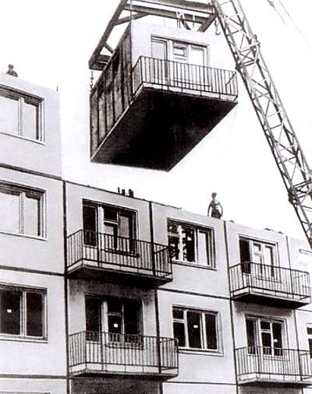
Housing in the USSR
Soviet citizens have no rent worries. This is not only because they have no landlords but because they hardly pay rent: 4 percent or less of one’s income. U.S. rent payers would "laugh” at Soviet rents. Take our family. When we left the States we were paying $150 a month rent — not too high by U.S. standards. But when my wife Gail visited our apartment in the Bronx in May, 1972, the rent had gone up to $235 a month. By contrast, our rent in Moscow remained static for five years, at 18 rubles 30 kopecks a month! (About $20 at the official exchange rate.)
We had three large rooms (they don’t count the kitchen as a room there) with all modern conveniences. I have before me our rent book. Here is how it breaks down: 12 rubles, 32 kopecks for the apartment itself; 4 rubles, 19 kopecks for heat (all apartments are centrally heated); one ruble, 20 kopecks for water and sewage; 50 kopecks for radio; 15 kopecks for the TV antenna. And in comparison with our friends, ours was a higher than average rent. As for our utilities: for gas, the average monthly charge was 22 kopecks per person. (It was recently reduced from 32 kopecks — can Americans remember their last utility reduction?) Electricity was a little higher, about 4 or 5 rubles a month in winter and about 5 rubles in summer. We paid 2 rubles, 50 kopecks a month for telephone for unlimited local calls.
Pre-fabricated housing made it possible to rapidly reconstruct post-WW2 Soviet cities

Slide 7
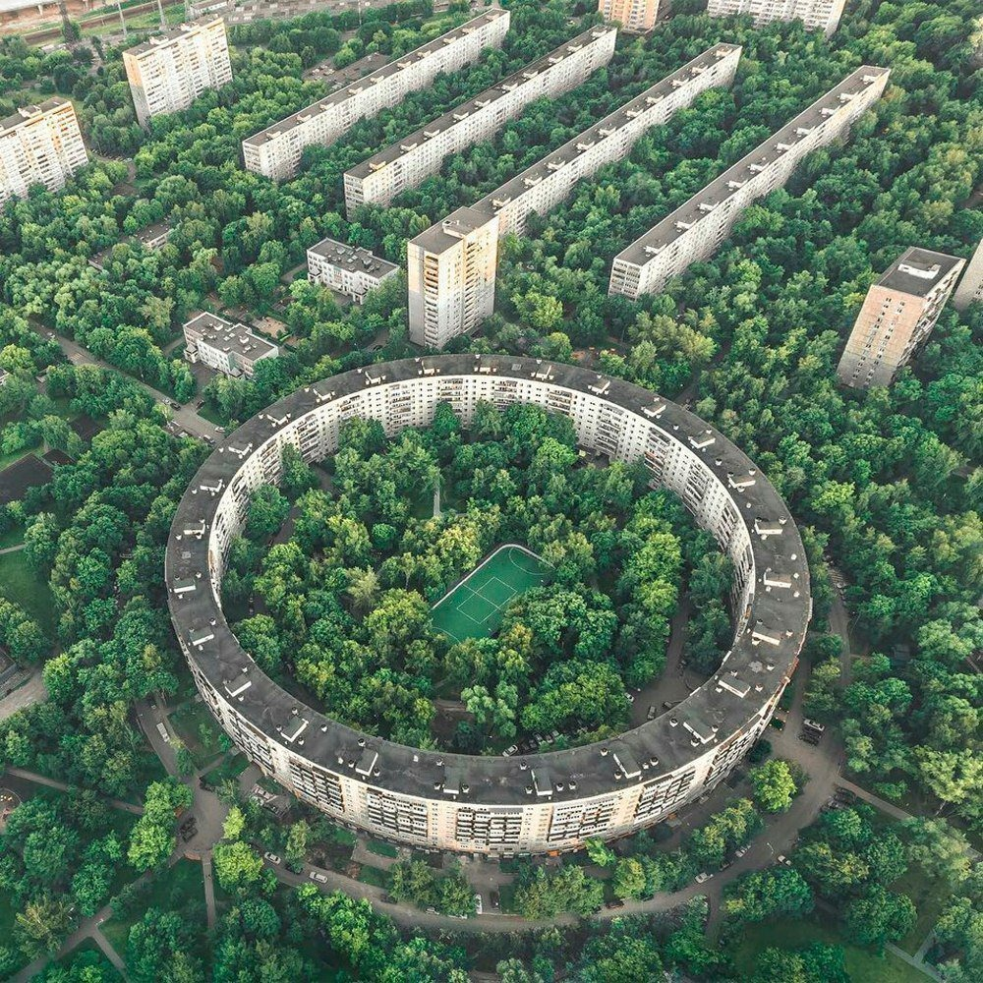
Housing in the USSR
The Soviet Union is well on the road to becoming the first country in history to solve the housing problem for its people. No social system besides socialism ever set itself such a goal, let alone demonstrated that it can be done. What this means in respect to resolving the problems of modern cities can hardly be overestimated — for the problem of urban living is first of all— homes. I often thought: what would be the effect on the lives of the mass of U.S. urban dwellers, especially in the Black ghettos, Puerto Rican and Chicano barrios, if they were truly guaranteed the “security of their homes,’’ if they lived with the realization that they were assured “the comforts of home’’ as their normal right? And what effect would all this have on reducing the tensions which are ripping our cities apart?
A. Allen Bates, director of the Office of Standards Policy of the U.S. Department of Commerce, told a congressional hearing: “The Soviet Union is the first, and thus far the only, nation which has solved the problem of providing acceptable low-cost housing for the mass of its citizens. . . . In the USSR, all housing built in the last twenty years has been deliberately designed as low-cost housing. In the United States, no housing built during that period, or now designed for future construction, can be characterized as low-cost housing.” And Bates added: ‘ Slums are not profitable under the Russian form of economy.” And one may well ask: Why should they be profitable in our country?

Slide 8
Housing in the USSR
It had to construct not only for those who lived in the cities at the time of the Revolution but for the millions who were streaming into the cities from the countryside under the impact of the socialist industrialization program. This program transformed the Soviet Union in record time from a backward agricultural country into an advanced industrial country.
In terms of urban problems this meant that between 1926 and 1971 the population of the cities increased by more than 110 million (it is now more than 140 million out of 250 million). In 1940, after substantial progress had been made in urban housing construction, the Soviet Union was struck by the Nazi holocaust. No country in history ever suffered such destruction of life and property as did the Soviet Union in the four war years: 1,710 towns and urban settlements, 70,000 villages, 32,000 industrial enterprises, thousands of medical, educational and cultural establishments were destroyed. Great cities like Kiev, Stalingrad, Minsk, Sevastopol, Odessa, Novgorod, Pskov, and Orel were turned into ruins. Heroic Leningrad lost one-third of its population (900,000) and much of the city was severely damaged. Not only were there 20 million war dead but 25 million people were homeless. This was the housing problem the Soviet Union confronted: The inheritance from a backward past, the demands arising from unprecedented industrialization and the destruction wrought by the most barbaric war machine in history. Never before did a country face such a combination of problems all packed within the space of half a century.

Slide 9
Discussion

Slide 10
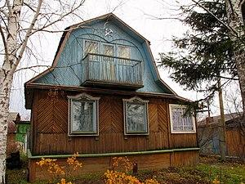
Housing in the USSR
Contrary to the false picture of a propertyless population under socialism, Soviet citizens can and do own their own homes. Under Soviet law, however, they can’t use their property to exploit tenants. Soviet citizens are permitted to build one- or two-story private homes, generally with not more than five rooms. They are allotted plots of land by the state free of charge.
Such individual private homes are quite widespread in rural areas and small towns, and they constitute one-third of the total housing. These homes, which compare favorably with our own workers’ and farmers’ homes, are usually built by collective or state farm construction organizations with state assistance. Loans are provided at about 2 percent interest. Incidentally, summer homes are quite numerous. Those who want to build dachas are given land free.
Dacha(vacation home) in the Soviet Union. Notice the Hammer and Sickle below the roof overhang.

Slide 11
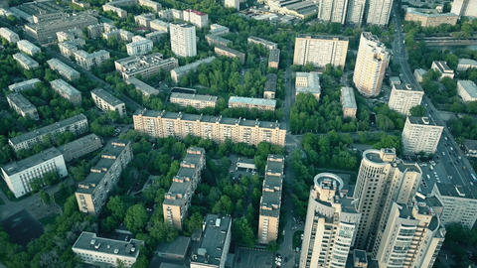
Housing in the USSR
Soviet housing is much more than bricks and concrete. It is trees and greenery. I’m not speaking now of parks which occupy so much of their cities’ areas. Moscow, for example has 20 square meters of greenery per person; its surrounding environs bring the numbers up to 30. I’m referring to the little parks that make up the “back yards,” courtyards. Every cluster of houses has one. It consists of a wooded area with park benches where one can rest and relax and children can play. One of the duties of the maintenance workers is to keep this area in good condition. Just the sight of the trees provides Soviet urban dwellers with relief from the oppressiveness of brick and concrete.
Trees can form a natural part of the Soviet housing scene because they constitute a natural element in the planning of housing construction.
Soviet housing grows with the city. It is part of a carefully thought out plan whose aim is convenience, comfort and culture brought to where people live. When a new area goes up, nurseries, schools, polyclinics, cinemas, sport fields, stores — all go with them. The name given to these “little cities within a city” is “micro-area.”

Slide 12
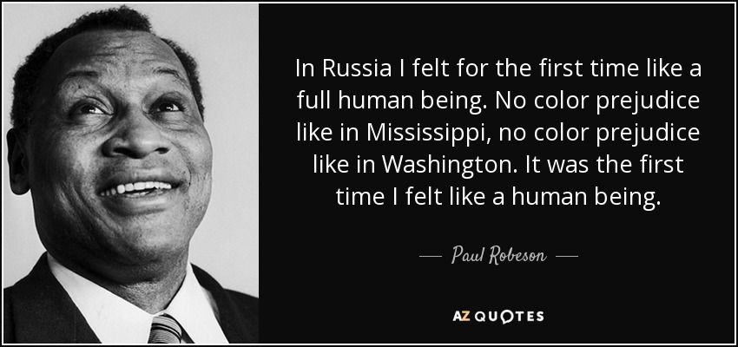
Housing in the USSR
In the more than five years I walked the streets of Moscow and numerous cities in 14 Republics, I never came across any racial or national ghettos. I never came upon slums or “poor neighborhoods.” I saw old run-down houses but no areas where the underprivileged live. No district in Moscow or in any Soviet city can be identified by race or nationality.
This is true even in cities in the non-Russian republics where, of course, citizens of that particular nation or nationality predominate. In Alma Ata (Kazakhstan) for example, Russians, Ukrainians and other national groups live side by side with Kazakhs and Uigars. In Moscow, Leningrad, Kiev, Odessa, Kishinev, Riga, Vilnius, and Minsk, there are large numbers of Jews but I never once came across a ‘‘Jewish neighborhood.”

Slide 13
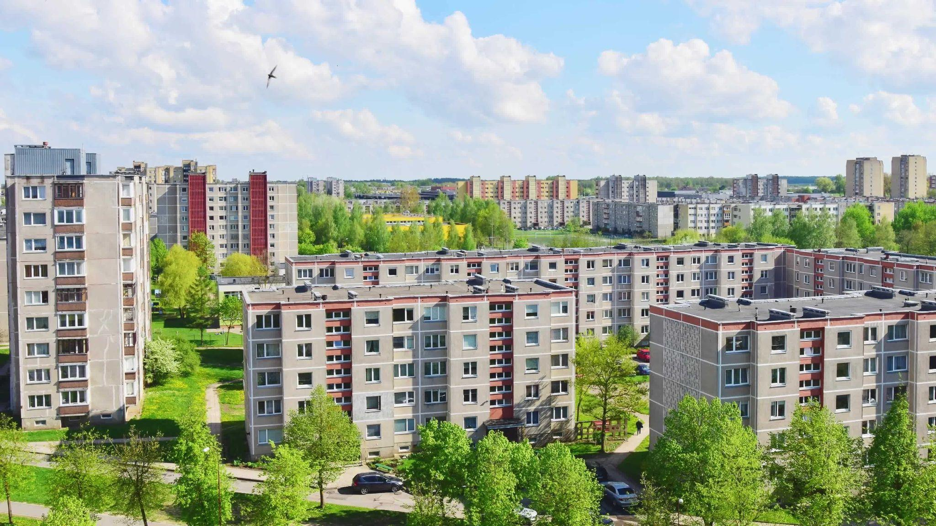
Housing in the USSR
There are no “poor” neighborhoods because there are no poor, no underprivileged. Though under socialism there are those of higher income, you can never tell by the neighborhoods they live in. There are no slums because there are no slumlords. Thus, the buildings as well as those living in them are respected and cared for.
There are no ghettos because racism and national discrimination which create and profit from ghettos have long been eliminated. Nothing more distinguishes Soviet cities from our own than the absence of these social sores that have made our urban centers cities of crisis. No Soviet citizens return from a day’s work to depressing areas defined by their class position or the color of their skins. This is the meaning of life without landlords. Where one lives in our society determines how one lives. All this is wrapped up in the class character of our housing. This is the essence of ghetto slum living.
Apartment complexes in Siauliai City, Lithuania built in the Lithuanian SSR.

Slide 14
Discussion

Slide 15
War, Housing, and Jobs - History and Today - US Economy and Housing

Slide 16
REAL WAGES IN A WAR ECONOMY
(From War Economy and Crisis - Hyman Lumer 1954)
Significance of Real Wages
There is a widespread belief that in the United States, in contrast to other countries, the effect of war economy is not to depress but to improve the living standards of the workers, and in particular to raise the level of real wages. Indeed, much has been made of this by the warmongering protagonists of the “American way of life.” It is essential, therefore, to examine the actual trend of real wages in wartime and in periods of extensive war preparations, in order to determine whether or not this allegedly exceptional position of the United States has any basis in fact.
Real wages, or wages in relation to prices, are a most important measure of workers’ purchasing power. However, they are only a partial yardstick. For one thing, they generally describe the status only of those workers who are employed, and hence do not take into account the ravaging effects of unemployment. Nor do they show the destructive effects of discrimination and segregation, which force the Black worker especially to pay sky-high prices for inferior goods and the most fantastic rents for the most wretched housing, and thus render his purchasing power considerably less than that of a white worker receiving the same money wages.

Slide 17
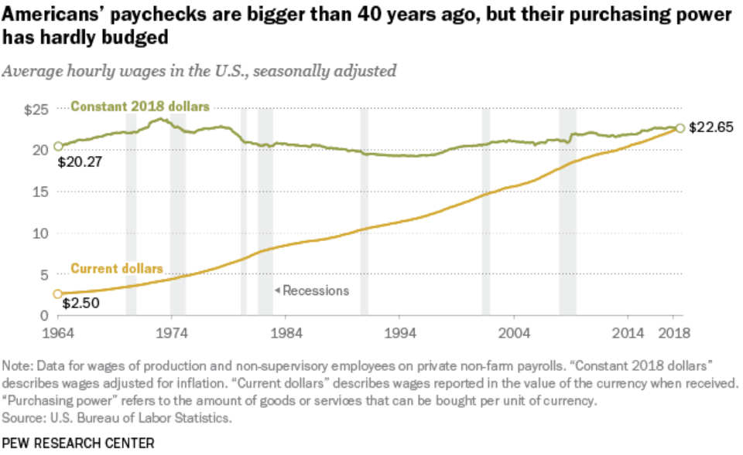
REAL WAGES IN A WAR ECONOMY
(From War Economy and Crisis - Hyman Lumer 1954)
In addition, there are certain factors which become especially pronounced in wartime. Chief among these are greater food requirements as a result of longer hours of work and speedup, increased living costs arising from the uprooting and shifting around of workers and their families, the wartime deterioration in quality of consumer goods with no corresponding drop in prices, and the growth of black markets in the necessities of life. To a considerable extent, these factors can be measured or estimated, and their effects included in computations of real wages. To that extent, their complete omission in official cost-of-living statistics represents a deliberate distortion. But they are only partially subject to measurement; hence real wage statistics in wartime must increasingly overstate the actual level of purchasing power.
The fight for higher wages in wartime or under conditions of growing war preparations is simply a part of the never-ending struggle which the workers are compelled to wage under all conditions against their growing impoverishment and without which, as Marx states, “they would be degraded to one level mass of broken down wretches past salvation.” This struggle is especially important in the conditions of a war economy, from which the big capitalists derive enormous superprofits through increased exploitation of the workers. The fight for increased
wages is therefore absolutely indispensable in the struggle to offset the effects of inflation. Without the wage increases the degree of inflation would be no less, but the gap between prices and wages, and the impoverishment of the workers, would be all the greater.

Slide 18
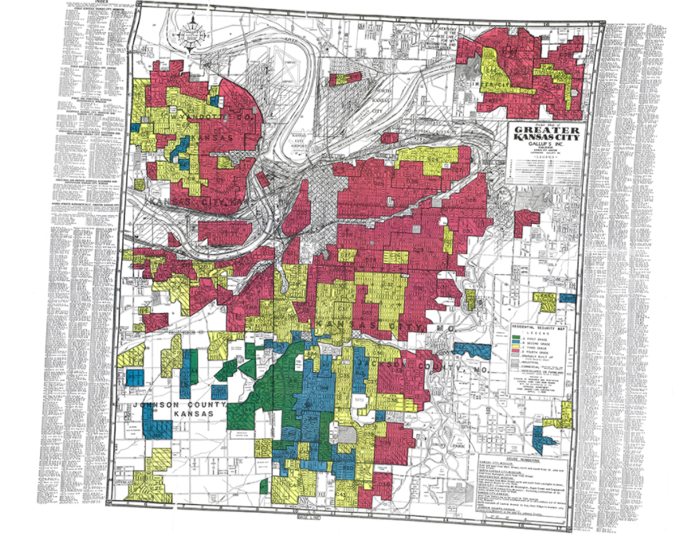
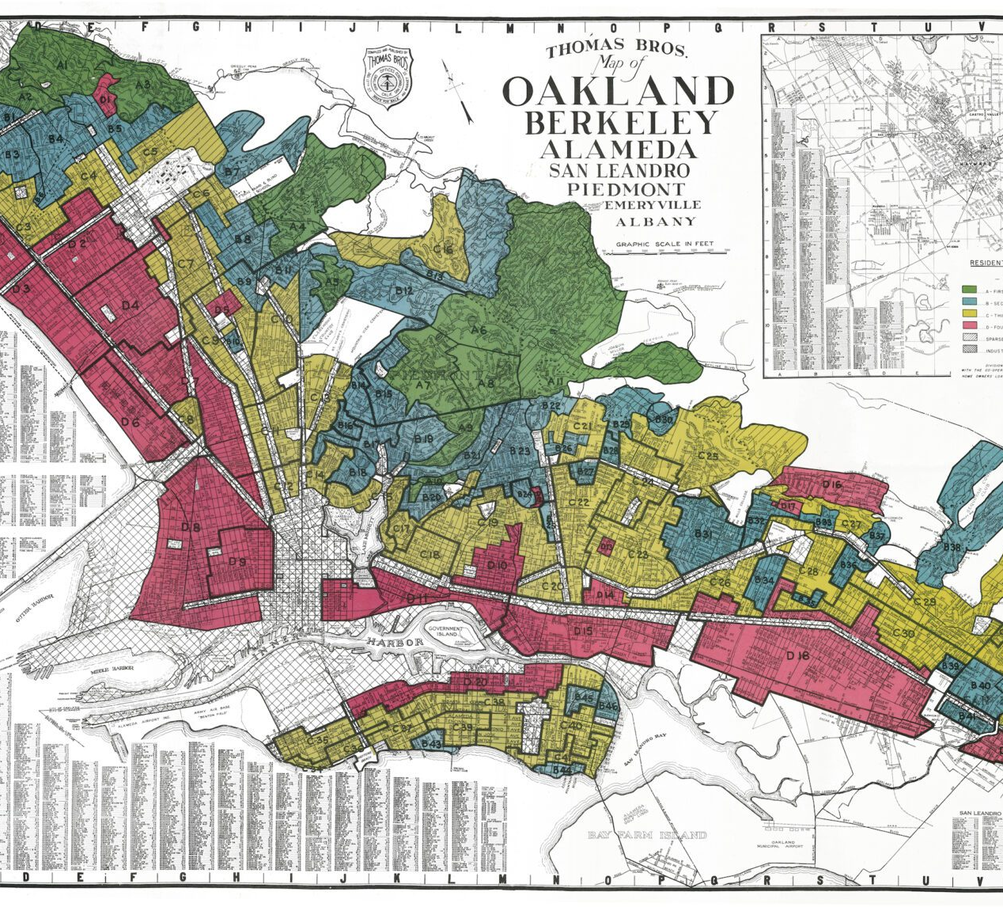
War Economy and Crisis
Wartime Economy and Blacks
The limitation of the wartime gains of the Black workers within the bounds of the Jim Crow pattern, is nowhere more clearly demonstrated than in respect to housing. Here the pattern of discrimination remained virtually untouched. The effect of the extensive cityward migration was to crowd the Black people still more into the already greatly overpacked ghettoes, from which there was almost no outlet. To be sure, there developed a general housing crisis, affecting all sections of the working class. But the significant fact remains that while some means of alleviation were found for whites, almost nothing was done to ease the desperate plight of the Black urban populations. Literally no advance was made in cracking the Jim-Crow ghetto system.
All in all, says Haywood, the war boom “forced a temporary breach in the bastion of job Jim Crow... The precarious beachhead to industrial opportunity was widened. The ‘job
ceiling’ was slightly raised. . . . But the pattern was not broken.”

Slide 19
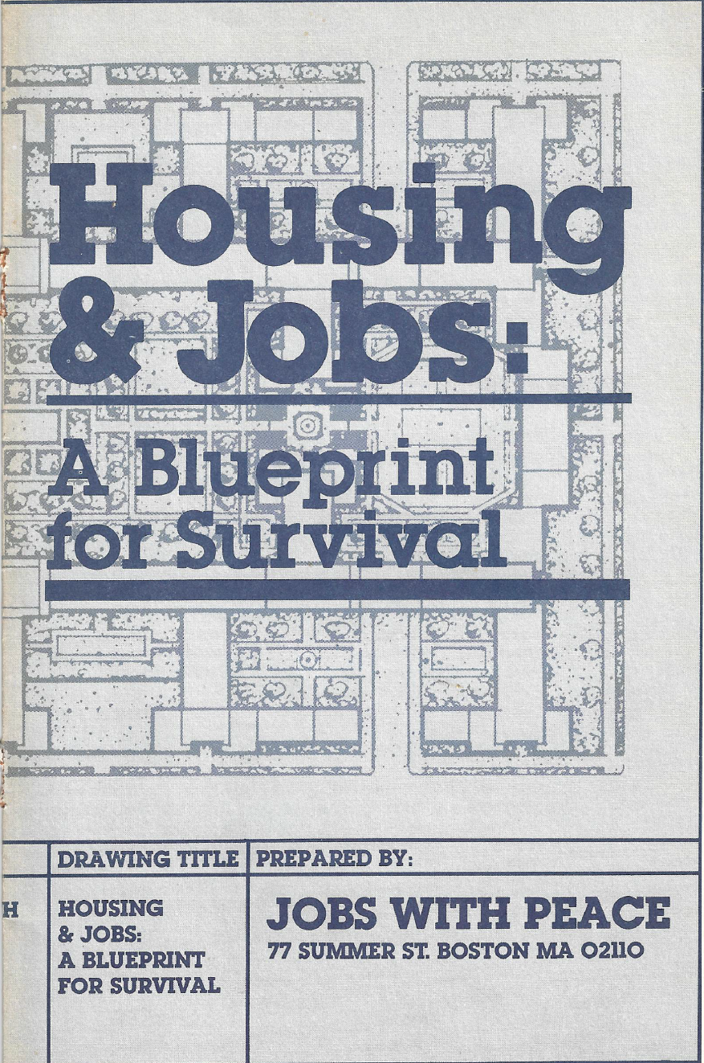
The US in crisis with housing.
Housing in America is facing its worst crisis since the 2008 housing crisis. Homebuilders can no longer afford to construct moderately priced homes. Rental units are becoming increasingly scarce and costly. Available housing is siphoned off by those who can afford it. Housing has become an attractive investment for the wealthy.
A little more than 1 million housing units are built every year since 2011, though we need build about 2 million units each year to keep up with housing demands before the end of 2027.
The current median price in 2023 of a new home is $480,000, almost double of what it was in 2013.
To build a house or buy one, a bank requires that mortgage payments not exceed 28% of income, which means that a family making $70,000 gross (the median household) borrowing at 7.5% can't obtain a loan for more than $210,000 which doesn’t go far in today’s market.

Slide 20
Capitalism is a system that creates booms and busts in the economy. In the past 50 years, home ownership in the U.S. fluctuates from 68% to 62%.
Homeownership Percentage
Just in the past two decades, 2008 and 2020, homeownership percentage plummeted leaving 100s and thousands of new families and people without a home or left to pay someone else to live under a roof.
And even with apartments since covid, eviction rates are at an all time record high where some cities have a 50% increase in evictions since pre-covid.
Source: Labor Bureau of Statistics

Slide 21
In 2023, Americans whether they are renting or living in a house are paying higher and higher prices on their rents and mortgage proportional to their salaries and wages.
Households paying 50% or more on housings.
Households paying 30% or more on housings.
14% of households are spending 30% or more on housing
25% of renting households are spending 30% or more on housing
9% of home-owning households are spending 30% or more on housing
50% of renting households are spending 30% or more on housing
The poorer you are the more you must pay. Most households (95%+) that pay 50% or above their income to housing are in the $50,000 annual income bracket.
31% of households are spending 30% or more on housing
21% of home-owning households are spending 30% or more on housing
31% is over 40 million households!
Source: Census Bureau

Slide 22
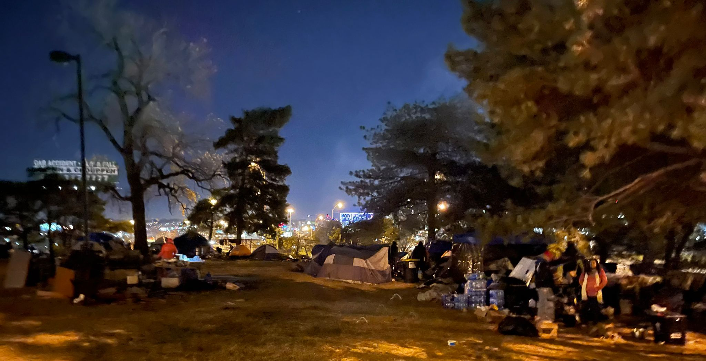
The US in crisis with housing and jobs
In 2023, compared to 2013:
There are more people renting than owning houses. (percentage-wise)
There are more people (percentage-wise) working more than one job to pay rent or mortgages. They are also forced to live with others to pay rent.
It takes longer pay off mortgages than it does.
There are more people are moving from the coast because they are outpriced and moving to other locations which makes it more expensive in those places.
There are more areas in the cities for people living in tents which are eventually displaced to other locations.

Slide 23
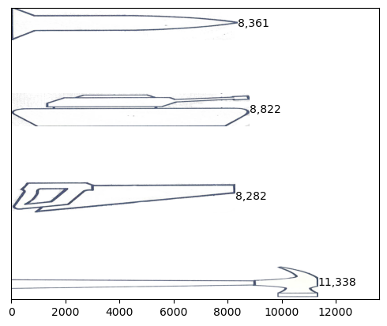
US Military taking away from decent living and jobs
Unemployment may be low (3.6%) but median income for a week is $1,100 (before taxes). For part-time (35 hours or less) median income is $358! These are NOT livable wages.
Many people today are employed with ‘gig’ jobs. People have work but its not necessarily work that applies their skillset, and so they are not making good wages and are forced into worse conditions. We need to take steps towards realizing full-housing and full-employment.
In 2023, for Military, taxpayers in the United States are paying $920.81 billion.
The government loses decent paying jobs when it puts money into our “defense” budget instead of putting money in housing like construction jobs. As the chart shows, $3 billion spent on military hardware such as guns, tanks, or missiles provides about 15% fewer jobs than would building new homes or apartments. And those military jobs unlike construction work are concentrated in a few areas in the economy.
Comparison of jobs created by $3 billion project in 2023
Military
Hardware
Direct jobs
Jobs in related industries
Housing Construction
Jobs in related industries
Direct jobs
Source: Labor Bureau of Statistics

Slide 24
Discussion & New Members Introductions

Slide 25
New Member Introductions
What is your name, pronouns and state (or country/territory)?
Where do you work? Is it unionized?
How did you find out about the People’s School?
What do you think about tonight's class?

Slide 26
Section 3 The Fight for the Unemployed and Houseless

Slide 27
Henry Winston and the Council for the Unemployed

Slide 28
Discussion & Wrap Up Introductions

Slide 29
Announcements
THE KONONOVITCH BROTHERS NEED US, SHARE THIS ARTICLE:
https://dailyworkerusa.com/stop-the-kiev-regimes-calls-for-the-murder-of-the-kononovitch-brothers/
We are looking for content submissions for Vol III 2023 of New Masses! Send any submissions to info@partyofcommunistsusa.net and kamryns@johnreedcenter.net

Slide 30
Volunteers Needed!
We are in need of volunteers for the staff of the People’s School! Here’s a few roles we need filled:
People to help manage posting on our social media and podcast platforms
Video Editors, Audio Editors, Graphic Designers, Artists, Narrators
Facilitators, Web Controls, Moderators
Email info@peoplesschool.us if you’re interested and try to attend our next staff meeting on ______ if possible.

Slide 31
PSMLS Propaganda
peoplesschool.us/media & peoplesschool.us/store
Materials to help promote the school!

Slide 32
New Outlook Publishers
newoutlookpublishers.store
Latest Releases

Slide 33
Legal Drive
Last year we were attacked and sabotaged by ultraleft wreckers that tried to steal the PSMLS and destroy the PCUSA. They failed, but they will be held accountable and there are still things they took from us that we’ve not got back, like videos, imagery, audio etc. That is why we still need donations to the legal drive.
If you support the school and want to see us continue to improve and keep delivering this education 51 weeks a year, please pitch in whatever you can and support the GoFundMe for the legal drive @ https://www.gofundme.com/f/legal-fund-to-defend-against-wreckers.
Anything helps!

Slide 34
The Internationale - 1933 American Version by “The New Singers”

Slide 35
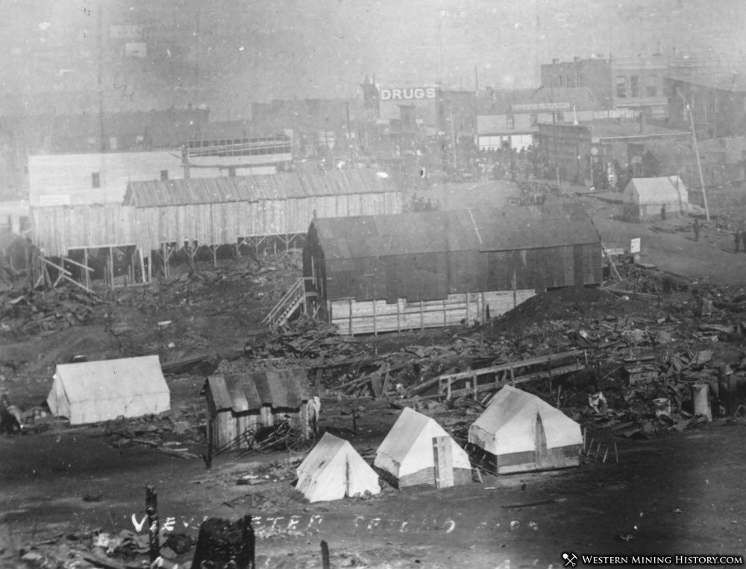
War Economy and Crisis
Since the close of the first world war, every capitalist country has been plagued with chronic mass unemployment, with the existence of a huge reserve army of unemployed workers not fully absorbed even in peak periods of peacetime booms.
To this pattern there has been but one exception. Only in times of war have the armies of unemployed been absorbed and a condition of full employment temporarily restored. In fact, present-day capitalism knows of no other means of eliminating unemployment. It has become a commonplace, says Beveridge, “that the only sovereign remedy yet discovered by democracies for unemployment is total war.”
In the characteristic manner of capitalism, this state of chaos was left chiefly to resolve itself. As war production approached all-out levels, and as the demand for workers in war plants became ever more frantic, growing numbers of workers and their families migrated as best they could to the centers of war production, there to shift for themselves in conditions of extreme shortages of housing, schools, health facilities and other essential needs. The situation in a typical “boom town”—Mobile, Alabama—is described by Corson as follows:
Around the city is a ring of unhealthy-looking tent and trailer camps, with no sewage, no water system, and only erode toilets. Within the city, despite the willingness of many native families to take “war guests” into their homes, workers with families can find practically no place to live. They look for tents, trailers, or shacks outside the city. Single men are more fortunate; they can choose between the extravagantly priced private rooms, “hot beds,” nightmarish “boardinghouses,” or their own car, if it still holds together. In the face of these conditions a score of the city’s doctors have gone into the army.

Slide 36
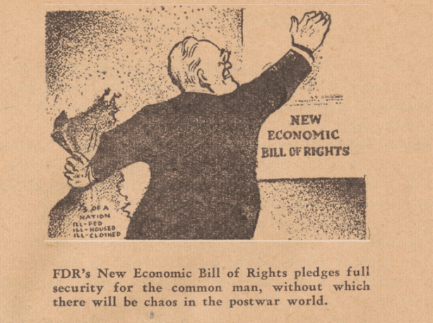
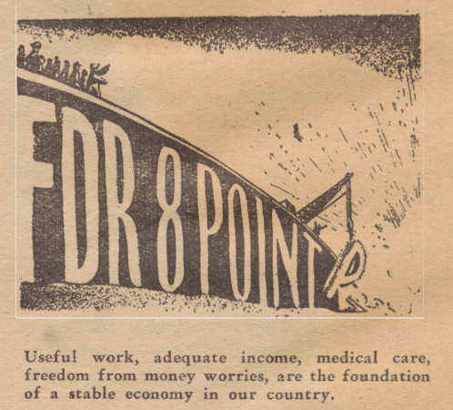
War Economy and Crisis
It was such living conditions as these which, for millions of American workers, were associated with the wartime “full employment” boom. Although there is no doubt that far more could have been done to alleviate them than was actually attempted, such conditions were not fortuitous, but an inevitable consequence of the one-sided, chaotic character of war production and employment. And when, at the end of the war, demobilization and reconversion to peacetime production took place, the same confused reshuffling of masses of human beings was repeated, this time in reverse.
Monopoly capital can hold out only one “solution”—to go on endlessly expanding military production to all-out levels and to thrust the nation into a new world war. Either mass unemployment and depression or the frightfulness of an atomic war; these are the alternatives to which reliance on war economy as an answer to unemployment leads.
In the thirties, American labor fought against such false conceptions. And in 1936, Franklin D. Roosevelt, speaking before the Inter-American Peace Conference in Buenos Aires, said: “Vast armaments are rising… the work of creating them employs men and women by the millions… Such employment is false employment... it builds no permanent structures and creates no consumers’ goods for the maintenance of a lasting prosperity. We know that the nations guilty of these follies inevitably face the day either when their weapons of destruction must be used against their neighbors or when an unsound economy like a house of cards will fall apart.” How well these words apply to the suicidal course of the American ruling class today!

Slide 37
War Economy and Crisis
There are also certain wartime factors, no less important, which cannot be measured numerically at all. Among them are the worries, heartaches and troubles attending the splitting up of families, the physical and emotional effects of the wretched living conditions forced on many war workers, the debilitating effects of endless hours of work, increase of industrial accidents, and, above all, the casualties and horrors of war itself.
Despite these limitations, real wages remain the most important single gauge of living standards. This importance is attested to by the exceptional amount of manipulation and distortion to which cost-of-living statistics are subjected by government agencies. Such doctored statistics are useful to the capitalist class as a device for holding wages down in periods of rising prices, and especially as a basis for freezing wages in periods of large-scale war production. In fact, it was for the purpose of instituting wage freezes during World War I that the shamelessly rigged “consumers’ price index” was originally devised by the Bureau of Labor Statistics (BLS). Today this index is used as the basis of the escalator clauses which help to guarantee a declining standard of living for the nearly three million workers covered by them.

Slide 38
War Economy and Crisis
Hours of Work in Wartime
It has been noted in an earlier chapter that once relatively full employment is achieved, the possibilities of further expansion in production are sharply limited. As a matter of fact, the only ways in which additional increases in output can then be obtained are through longer hours of work or through increased productivity. In time of war, the most obvious immediate measure which suggests itself is, of course, the lengthening of the work week. And in a total war economy the necessities of all-out war production sooner or later drive the length of the work week up to, and even beyond, the limits of endurance of the worker.
Nowhere is this more strikingly illustrated than in the war economy of Nazi Germany where, with the destruction of the labor unions and the complete subjection of the working class to the employers, both hours and intensity of labor were swiftly pushed to the utmost limit of human endurance.
In many war industries, by 1939, 11-, 12- and 14-hour days, seven days a week, had become the rule, and frequently employers were permitted to introduce work weeks of even unlimited length, as they saw fit. Along with this, the German workers were subjected to the most merciless, back-breaking speedup in all history. The inevitable end result was the complete physical and mental exhaustion of the workers, and a reduction in their output despite the extra hours of toil.
During World War II, a considerable lengthening of the work week took place also in the United States. The average work week in manufacturing rose to a peak of 45.5 hours in 1944, and in a number of war industries it was much higher. A 48-hour minimum scheduled work week for key war production areas was established by executive order, and by 1944 it had been introduced in 135 labor market areas.12 And in many war industries workers found themselves putting in as much as 70 hours a week over fairly long periods of time.

Slide 39
War Economy and Crisis
Living Standards and the Cold War
The period since the end of World War II has been marked by a continued upsurge in prices and living costs, considerably surpassing the rise of the war years. There was a big initial spurt in the immediate postwar period, due chiefly to the scrapping of price controls, but also in part to rising military expenditures. This upward movement of prices was temporarily halted by the economic slump in 1949, but with the invasion of Korea in the following year and the ensuing jump in arms spending, it was resumed.
From June 1950 to the end of 1951, according to BLS figures, wholesale prices rose by about 13% and consumer prices by 11%. Subsequently, as the effects of the shot in the arm of increased military expenditures wore off, the tide of rising prices abated, and wholesale prices began slowly to fall. But living costs continued an irregular upward course, and by August 1953 they were 15% higher than in June 1950.
What effect has this had on real wages and living standards? Nominal wages, of course, continued to rise. Average weekly wages grew to $58.85 in June 1950, and to $71.53 in June 1953. But real wages [which takes into account inflation] showed no such increase. Even according to the BLS figures, net spendable weekly earnings (that is, after deduction of social security and income taxes), when expressed in 1939 dollars, were scarcely higher in June 1953 than in 1945.

