Slide 1
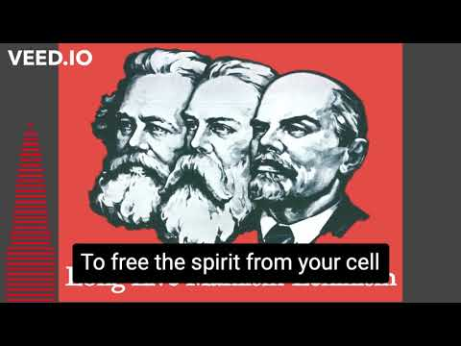
The Internationale - 1933 American Version by “The New Singers”

Slide 2
Why Animal Rights?
PSMLS 09/05/23 - 09/07/23

Slide 3
Introduction
The Animal Rights subject is being presented
from a dialectical perspective, not a moral perspective
THE FOLLOWING PRESENTATION ENCOMPASSES:
CHAUVINISM (SPECIESISM)
EXPLOITATION
OPPRESSION
CRUELTY
SLAVE LABOR
CULLING

Slide 4
What we’ll be learning today:
Why the PCUSA, as a Marxist-Leninist Communist Party considers Animal Rights as an upcoming issue, a new frontier for the workers movement.
A short historical perspective of exploitation viewed through the lens of Dialectical Materialism.
An analysis of the present day conditions regarding the exploitation of one species over another.

Slide 5
2: “the process of development in nature and society which passes from insignificant quantitative changes to open and fundamental changes”
Dialectics
(History C.P.U.S.)
Marxist Glossary Book - Gould

Slide 6
The Level of Consciousness on various issues at various times was at a different level
For Example
Thomas Jefferson owned slaves at the same time that he played a progressive role during the conflict with Britain (1770s)
Climate Change or Global Warming was not on any agenda
LGBT+ activity was criminalized
Pollution and Extinction of Species was not on any agenda
What was once thought true can change with new scientific discoveries and small incremental changes in society which must continually be viewed through the lens of Dialectical Materialism.

Slide 7
Marxist-Leninist ideology responds to continuing changes of material and societal conditions
Changes in the Soviet Union were made possible as experience and the level of consciousness increased their world view, always utilizing the scientific method and dialectical materialism.
Example:
Soviet Union realized that a Popular Front strategy was needed (1930's) against Fascism versus the previous reality (1920's) with the emphasis on class against class struggle. (Third Period)

Slide 8
“Throughout history, class struggle has been the main force of change. “ Marx
Today, in the 21st century, the current level of consciousness demands that we include other species that are suffering and oppressed under the yoke of monopoly capitalism.
Entire species are extinct because of monopoly capitalism. Side effects include pollution, destruction of habitat, excessive harvesting, etc.
As communists, to leave behind other oppressed species while we fight for our freedom from oppression, sounds hypocritical. How do we justify this exclusionist attitude?
Quote from an old PCUSA Labor Brochure:
“We leave no one behind.”
Engels on Dialectics -
Dialectics - “The science of the general laws of motion, both of the external world and of human thought.”
Lenin on Dialectics -
“The reflection of nature in man’s thought must not be understood in a ‘dead manner,’ ‘abstractly,’ without movement, without contradiction, but as an eternal process of movement, [with] the emergence of contradiction and their resolution.”

Slide 9
What is exploitation?
Exploitation
Living off of another’s labor regardless of the particular species being exploited.
Throughout history many species were victims of exploitation - used to further increase profits through increased productivity.
As newer implements were developed, (the plow), production (labor power) was increased by even more exploitation.

Slide 10
EXAMPLES OF EXPLOITATION
BRIEF HISTORICAL OVERVIEW
Slave and Master
Oxen, horse, dog, cattle, etc. as commodities
Serfs, as property, in Feudal Times
Women and Children as Property
Labor - wage slavery

Slide 11
EXAMPLES OF EXPLOITATION
IN THE CAPITALIST & IMPERIALIST ERA
Currently computer simulations can extract the same results that animal tests once provided. But it is more expensive, therefore animal testing still occurs because it is cheaper.
Factory farming and cash crops are more profitable because the damage to land, soil, air and water are born by workers and inhabitants. Corporations get “deals” from city councils, etc. to waive taxes and environmental controls, sometimes for years.
Meat-packing plants are notorious for worker exploitation including accidents and deaths. Slaughterhouses, in addition to the above, are noted for above average domestic violence and suicides.

Slide 12
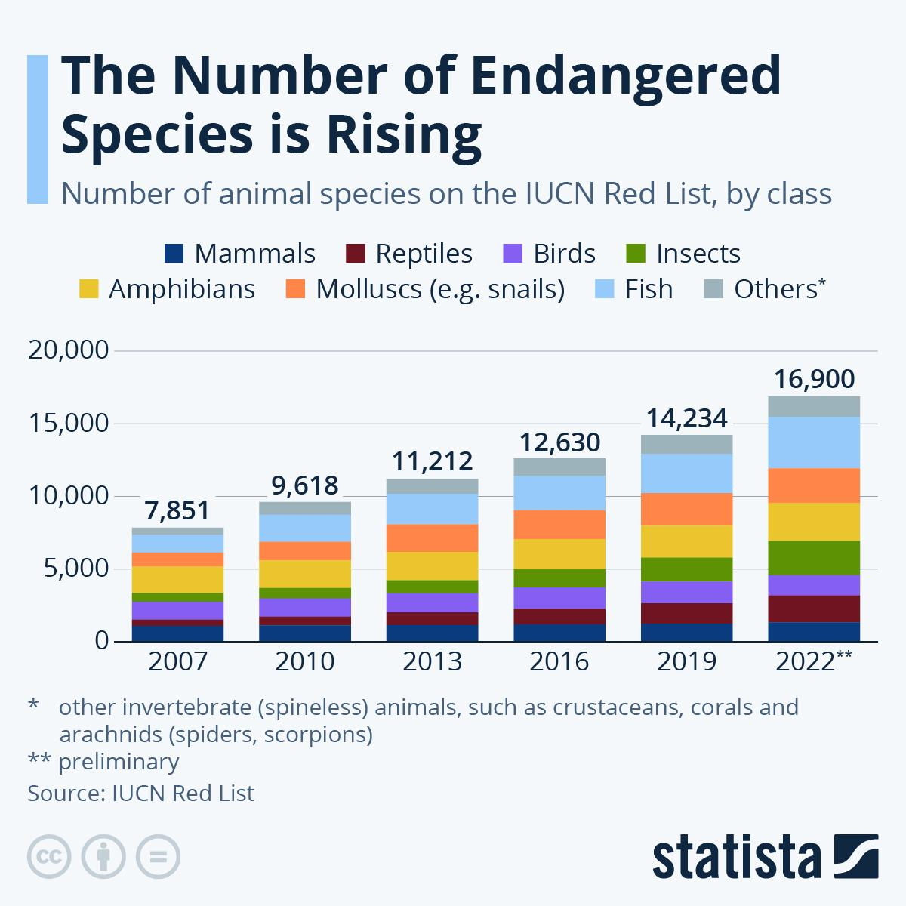
DISCUSSION
Intensive animal farming, industrial livestock production, and macro-farms, also known by opponents as factory farming, is a type of intensive agriculture, specifically an approach to animal husbandry designed to maximize production, while minimizing costs. Wikipedia

Slide 13
Chauvinism/Speciesism

Slide 14
Chauvinism
Speciesism
The definition of Chauvinism, as described in the Marxist Glossary by L. Harry Gould, is “One of the forms of imperialist ideology, specifically, imperialist conquest and oppression, designed to create among the masses hatred and contempt for other peoples, races and nations.” (Gould, pg. 17). It is therefore that capitalists use the supposed idea of human superiority as a method for the mistreatment of animals in society.
Speciesism is a form of chauvinism that places the human race above that of another species.
speciesism-noun
: prejudice or discrimination based on species
especially : discrimination against animals
: the assumption of human superiority on which speciesism is based
Merriam Webster Dictionary

Slide 15
PCUSA Pledge and Constitution
The Central Committee and the Politburo shall establish ad hoc commissions to carry out special areas of work. The following commissions are regularly functioning commissions of the PCUSA.
Agriculture Commission
Animal Rights Commission
Arts & Culture Commission
Asian Commission
Civil Liberties Commission
Environmental Commission
Health & Disability Commission
PLEDGE
…I solemnly pledge to take my place in the forefront of the struggle for the rights of all nationally oppressed people; against anti-Soviet sentiments and behavior, anti-Communism, racism, misogyny, ageism, xenophobia, homophobia, transphobia, police brutality, discrimination against the disabled, and to struggle against the chauvinist lies of the capitalist class.
cont’d.
8. History Commission
9. Indigenous Peoples Commission
10.Jewish Commission
11. Labor Commission
12. Legislative & Electoral Commission
13. LGBTQ+ Commission
14. Peace & Solidarity Commission
15. Religious Affairs Commission
16. Veteran’s Commission
17. Women’s Commission

Slide 16
Communist Party of Ireland
“…there are of course bourgeois forms of feminism, LGBT+ activism, anti-racism etc. that are actively opposed to the emancipation of the working class, and hostile to communism. This is not in doubt.
However, it does not follow that the struggles of women, trans comrades, victims of racism and other forms of bigotry and prejudice are in any way counter-revolutionary or anti-communist simply because there exist bourgeois interests who attempt to co-opt them.
To think and act otherwise is to fall into the trap of chauvinism.”
Raymond Ó Dubhghaill
‘Most human beings are speciesists. The following chapters show that ordinary human beings—not a few exceptionally cruel or heartless humans, but the overwhelming majority of humans—take an active part in, acquiesce in, and allow their taxes to pay for practices that require the exploitation and suffering of other species in order to promote the most trivial interests of our own species.’
Animal Liberation by P. Singer

Slide 17
3: Reality Changes

Slide 18
Animal Liberation pg 318 Peter Singer
How can anyone who has not made a thorough study of the topic possibly know that the problem of animal suffering is less serious than problems of human suffering?
But pain is pain,
and the importance of preventing unnecessary pain and suffering does not diminish because the being that suffers is not a member of our species. What would we think of someone who said that “whites come first” and that therefore poverty in Africa does not pose as serious a problem as poverty in Europe?
“If ‘human problems come first’ I cannot help wondering what exactly it is that they are doing for human beings that compels them to continue to support the wasteful, ruthless exploitation of [other species].”
AS COMMUNISTS we are late on the scene. The bourgeoisie have been on the scene since 1866. Does this mean we have nothing to offer?
What about Central Planning?
Eliminating the profit motive?
What about the liberation of all exploited workers regardless the species?

Slide 19
“As a business gets larger, it begins to enjoy a different kind of advantage having less to do with efficiencies of operation, and more to do with its ability to wield economic and political power, by itself or in conjunction with others.
In other words, a firm may not actually become more efficient as it gets larger but
may become better at raising prices
or keeping out competitors.”
This is as true in agriculture as in other sectors.
“The overall trend of increasing consolidation in the meat industry has continued since 2000, evolving into what today is a highly concentrated global meat complex controlling inputs, production and processing of mass quantities of food animals.
Reports of the USDA’s Economic Research Service and Grain Inspection, Packers and Stockyards Administration (GIPSA) was shuttered by the Trump administration in 2016.”
https://www.iatp.org/documents/revisiting-crisis-design-corporate-concentration-agriculture
Institute for Agriculture and Trade Policy

Slide 20
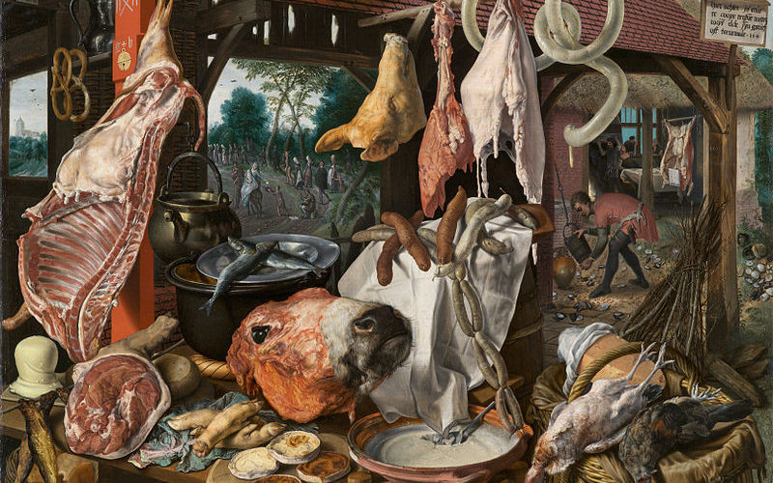
Kill Capitalism - Not Animals (CPI)
https://socialistvoice.ie/2019/08/kill-capitalism-not-animals/
“The food we eat masks so much cruelty. The fact that we can sit down and eat a piece of chicken without thinking about the horrendous conditions under which chickens are industrially bred in this country is a sign of the dangers of capitalism, how capitalism has colonised our minds. The fact that we look no further than the commodity itself, the fact that we refuse to understand the relationships that underlie the commodities that we use on a daily basis.”
Angela Davis.

Slide 21
What is to be Done?
Unity within the PCUSA that all species subject to exploitation, oppression, and suffering under the Capitalist’s quest for profits, be recognized as “workers.”
Promote Central Planning as the Communist Value that will eliminate the needless exploitation of our land and the needless suffering of all species.
The Animal Rights Commission PCUSA
Meets monthly - 3rd Wednesday
Current Educational :
Animal Liberation by Peter Singer
Mission:
To incorporate all species in the struggle against capitalism.

Slide 22
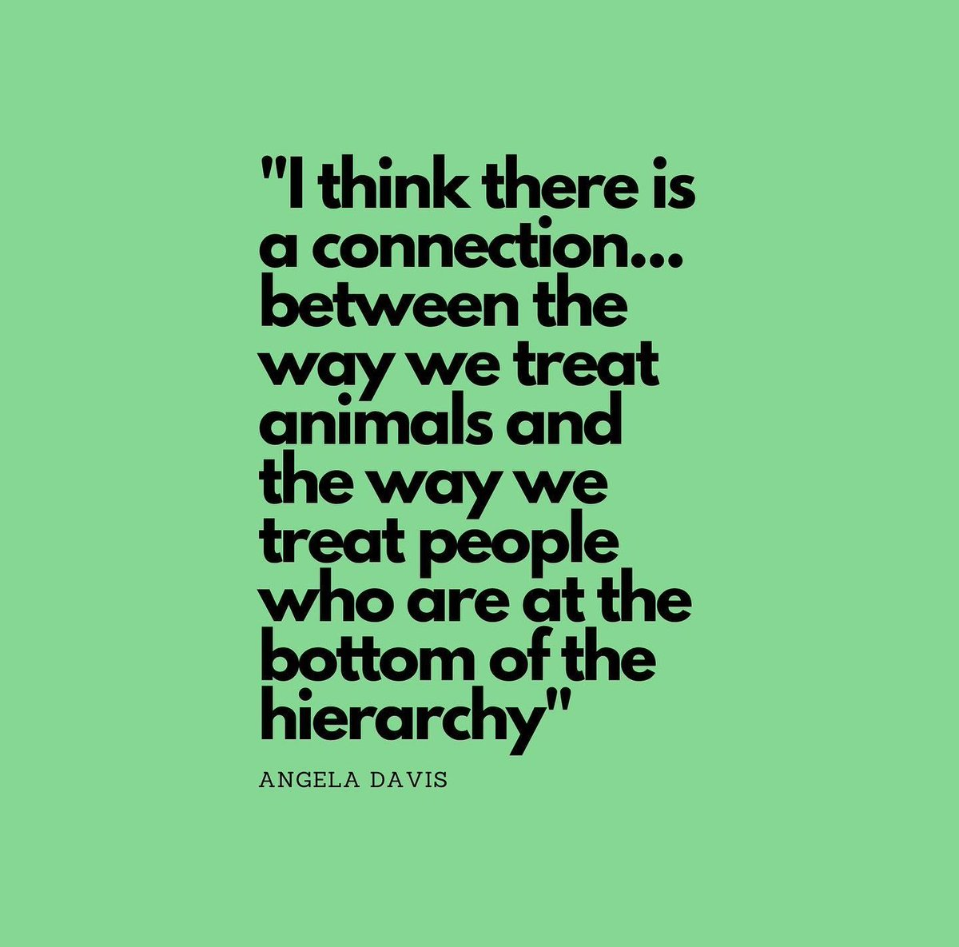
DISCUSSION

Slide 23
Announcements
THE KONONOVITCH BROTHERS NEED US, SHARE THIS ARTICLE:
https://dailyworkerusa.com/stop-the-kiev-regimes-calls-for-the-murder-of-the-kononovitch-brothers/

Slide 24
Volunteers Needed!
We are in need of volunteers for the staff of the People’s School! Here’s a few roles we need filled:
People to help manage posting on our social media and podcast platforms
Video Editors, Audio Editors, Graphic Designers, Artists, Narrators
Facilitators, Web Controls, Moderators
Email info@peoplesschool.us if you’re interested and try to attend our next staff meeting on Sept 7th if possible.

Slide 25
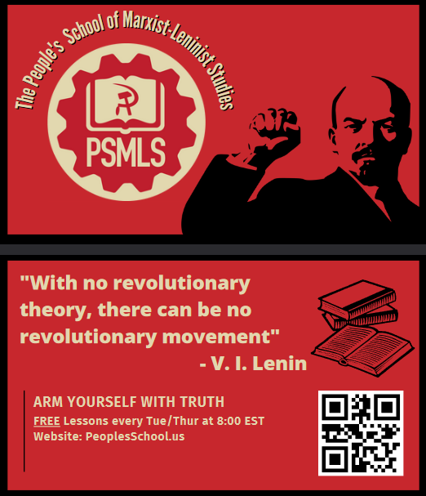
PSMLS Propaganda
peoplesschool.us/media & peoplesschool.us/store
Materials to help promote the school!

Slide 26
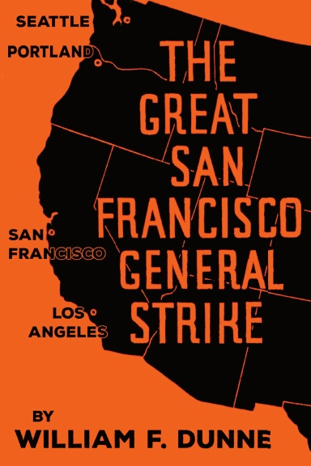
New Outlook Publishers
newoutlookpublishers.store
Latest Releases

Slide 27
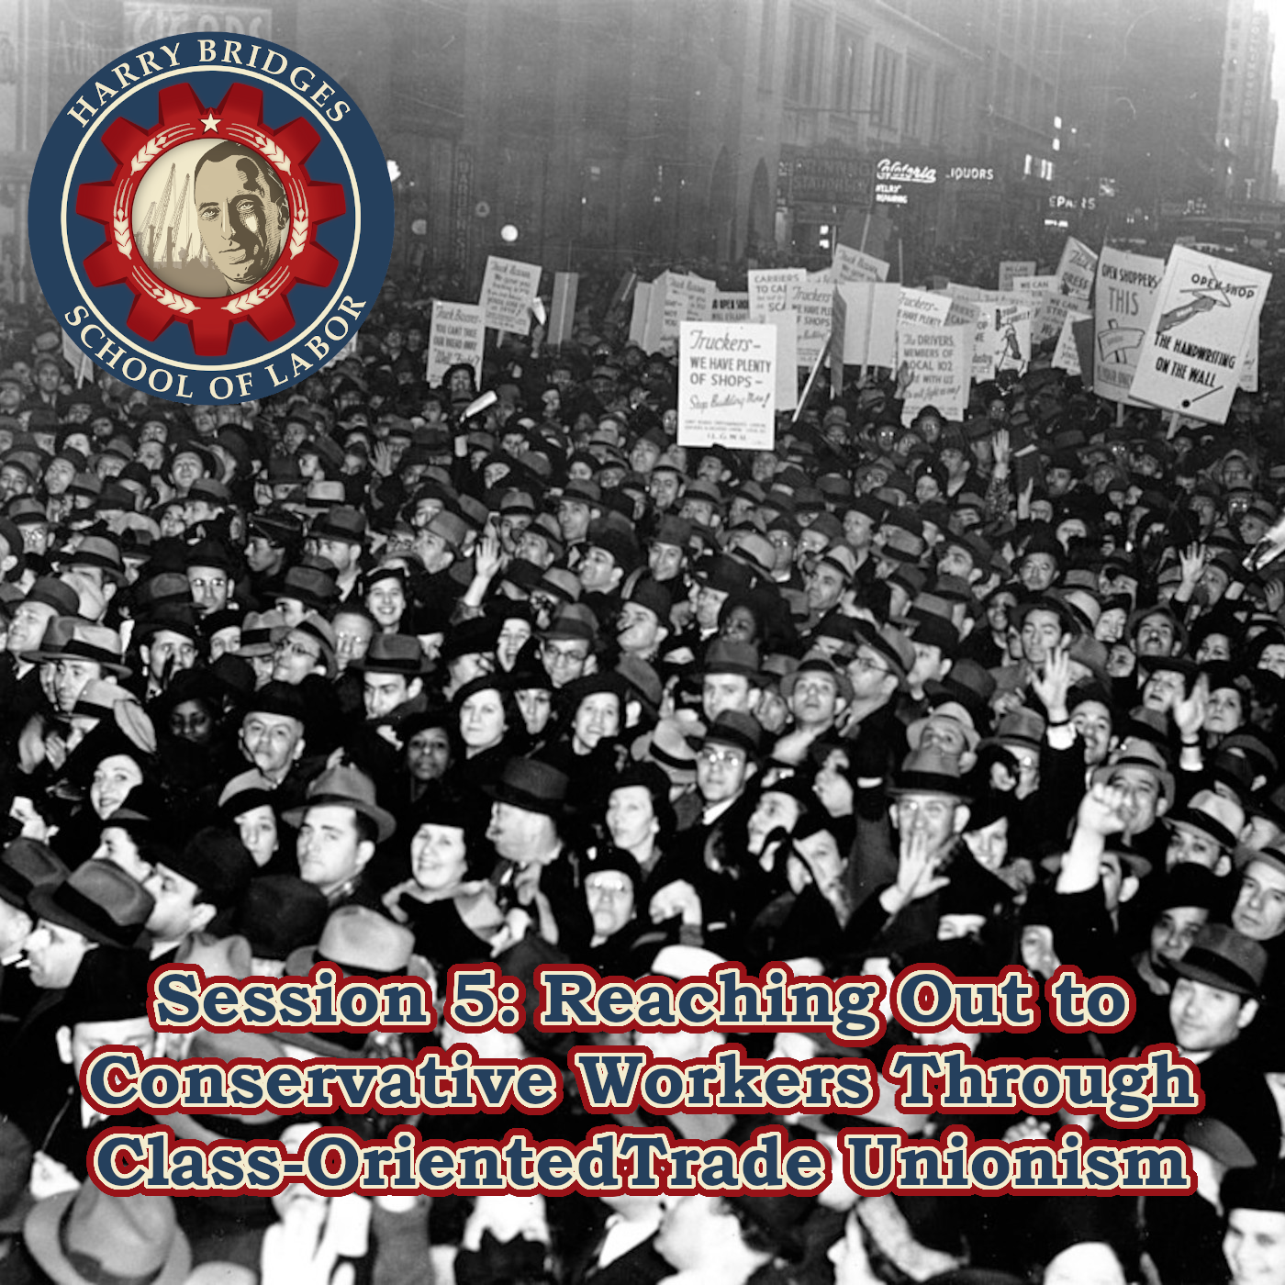
Harry Bridges School of Labor
luel.us/laborschool/
The Harry Bridges School of Labor is a monthly class held 2x per month. Classes cover a variety of topics aimed at building class conscious among union members.
September’s class is “How to Connect with Conservative Workers Through Class-Oriented Trade Unionism” and is Sept 6th, at 9 pm EST and the second session is on Sept 9th, at 7 pm EST.

Slide 28
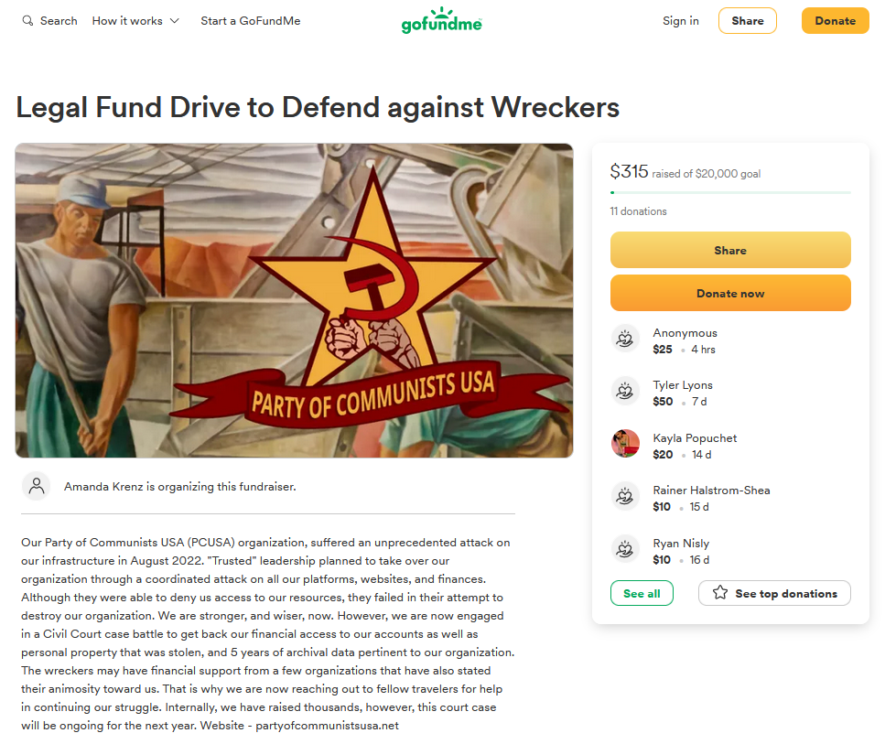
Legal Drive
Last year we were attacked and sabotaged by ultraleft wreckers that tried to steal the PSMLS and destroy the PCUSA. They failed, but they will be held accountable and there are still things they took from us that we’ve not got back, like videos, imagery, audio etc. That is why we still need donations to the legal drive.
If you support the school and want to see us continue to improve and keep delivering this education 51 weeks a year, please pitch in whatever you can and support the GoFundMe for the legal drive @ https://www.gofundme.com/f/legal-fund-to-defend-against-wreckers.
Anything helps!

Slide 29
The Internationale - 1933 American Version by “The New Singers”

