Slide 1

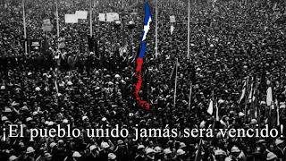
¡El Pueblo Unido! - The People United!

Slide 2
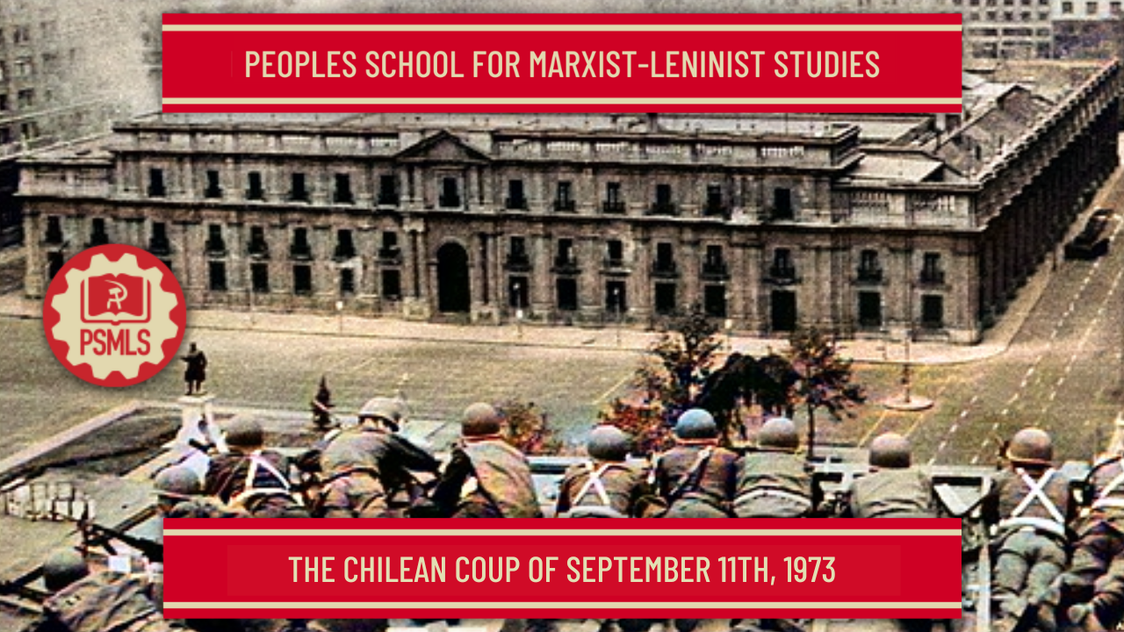
PSMLS mm/dd/yy - mm/dd/yy

Slide 3
What we’ll be learning today:
Yesterday was the 50th anniversary of the CIA sponsored overthrow of Salvador Allende's Popular Front government by the Chilean military. September 11th, 1973 marked the end of the progressive anti-imperialist régime in Chile, and the end of Salvador Allende's life.
Thus began a dark era, the ushering of a 17 year brutal fascist military dictatorship, during which thousands of Chilean workers, peasants and intellectuals were tortured, murdered and disappeared.

Slide 4
Background

Slide 5
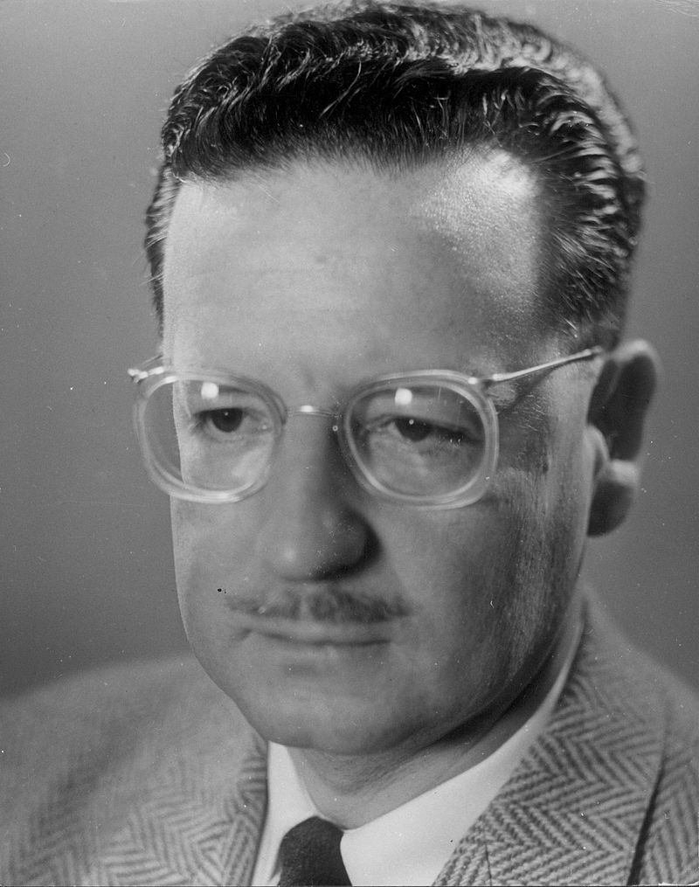
Background
Salvador
Allende
Salvador Allende
Let us recall the life of Salvador Allende, one of Latin America's greatest revolutionaries.
Salvador Allende was born in 1908 in Santiago, capital of Chile. He was of Basque descent on his father's side, and of Belgian descent on his mother's side. He went to medical school and became a doctor. His field was social medicine. He was a leader of the union of doctors.
At age 25 Allende co-founded the Socialist Party of Chile and became its president. In 1937 a Popular Front was formed in Chile, that included the Socialist Party, the Communist Party and other progressives. In 1938, the Popular Front won the elections and Allende became Minister of health at age 30. That is when progressive laws were enacted in Chile for the first time in history: safety laws for workers, maternal care, free school lunches, pensions for widows. Allende denounced the persecution of Jews by Hitler as early as 1938.

Slide 6
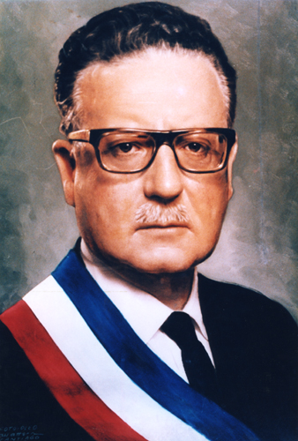
Background
After the war, Allende served as senator and became president of the Senate in 1966. During the 50's he introduced laws that created the Chilean National Health Service, the very first universal health care system in the whole American continent, North and South.
Allende ran for president of Chile 3 times in a row, unsuccessfully: in 1952, 1958, 1964. In Chile presidential elections took place every 6 years. Declassified documents revealed that throughout the 50's and 60's, the CIA was highly aware of Allende and viewed him as a major threat and a bad example for South America. During the 1964 elections, the CIA spent $6M to defeat Allende and assure the victory of his opponent Eduardo Frei.
But the 4th time was a charm for Salvador Allende. In 1970 a Popular Front was once again formed in Chile, it was called Unidad Popular (Popular Unity), including communists, socialists and progressives. Allende was its leader and candidate for the 1970 elections, and received the highest score of 36.2% higher than 2 other rightists candidates. It wasn't the majority of the vote so the Senate had to elect the president according to the constitution. Allende won the presidency of Chile.

Slide 7
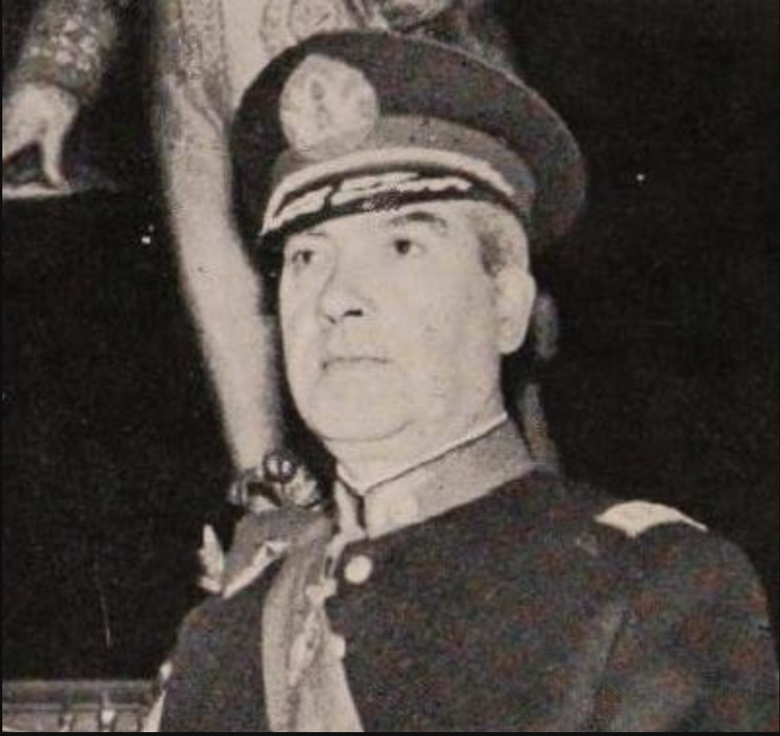
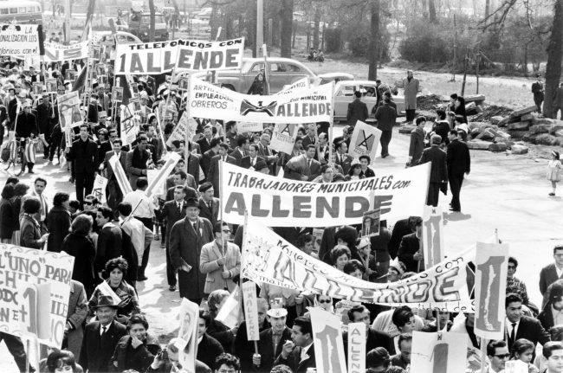
Background
To be noted that during that time a split was already evident inside the military. A wing represented by Commander-in-Chief René Schneider stood for the respect of the constitution at all costs, even if a leftist president was elected. General Schneider was assassinated by the fascist wing of the military, under CIA's control. A new Commander-in-Chief was named, it was Carlos Prats, who stayed loyal to Allende until the end. Carlos Prats was himself assassinated by Pinochet's secret service in Buenos Aires in 1974, a year after the September 11th coup.
It is crystal clear that the CIA had Allende in its sights already in the 50's and 60's, long before his election as president. But after the 1970 elections, Allende turned into Nixon's and Kissinger's number one enemy, like Che and Fidel had been before him. The CIA was told to put an end to the Chilean experiment, by any means necessary and ASAP.
As soon as he was elected, Allende began to implement a progressive program: he nationalized key industries such as copper mining and banking. He expanded public universal health care and free education. He implemented seizure of big land estates and redistributed them to landless peasants. Social security was expanded, public housing programs were launched. Mapuche peoples were integrated into public education.
René
Schneider

Slide 8
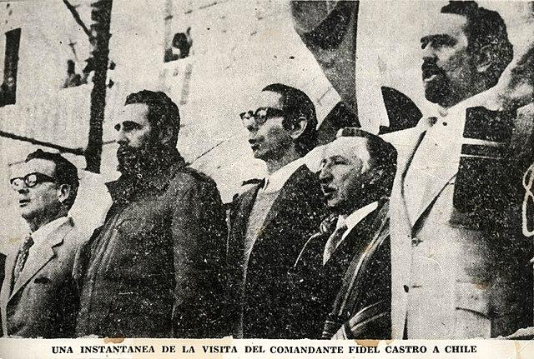
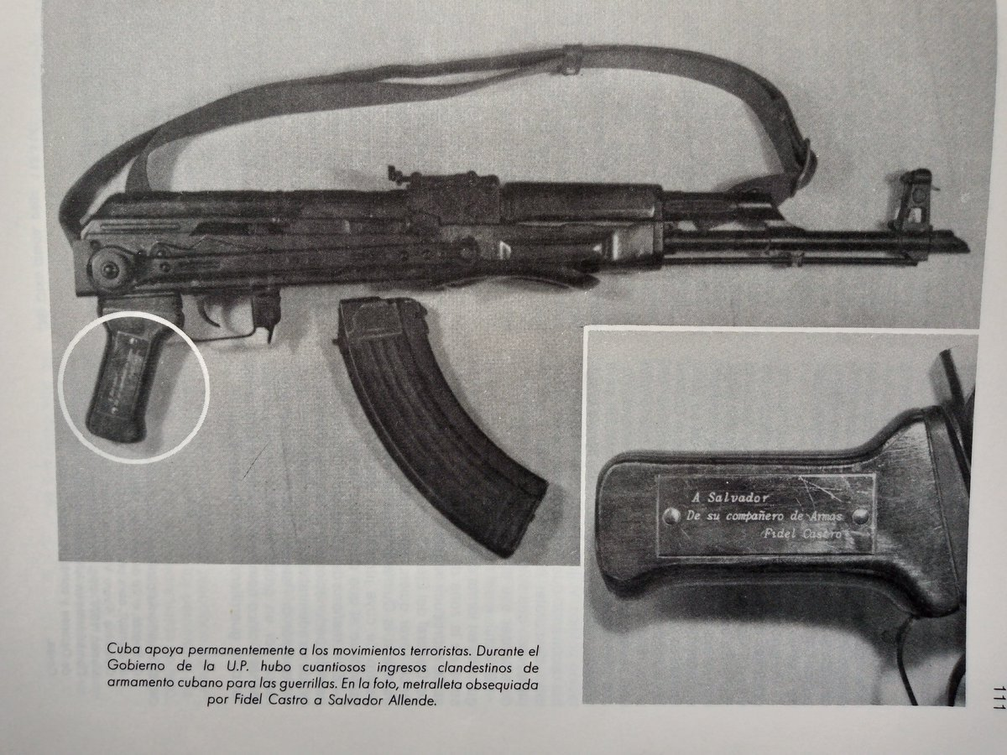
Background
In 1971, Allende committed the ultimate mortal sin in the eyes of Henry Kissinger, Nixon's National Security advisor. He re-established diplomatic relations with Socialist Cuba. Shortly after, in November 1971, Fidel made a triumphant visit to Chile where he stayed nearly one month. It was Fidel's very first visit to a South American country since the revolution.
Fidel toured Chile from north to south, a distance of 4300km, north of the Tropic of Capricorn all the way to the southern tip of South America near Antarctica. Fidel met extensively with Allende, Luis Corvalan leader of the Communist Party and Carlos Altamirano leader of the Socialist Party. Fidel's trip culminated on December 2nd, 1971 with a giant meeting in Santiago's football stadium where he pronounced an historical farewell speech.
Prior to leaving, Fidel gifted Allende an AK-47 with an engraved golden plate that said: "to my friend and Comrade-in-arms, Fidel Castro". Sadly, this is the rifle that Allende used to end his life on the early afternoon of September 11th, 1973, rather than be taken alive by the fascist beasts. Also in January 1972, a Soviet delegation visited Chile to discuss bilateral relations with the UP government. Obviously that wasn't lost on Kissinger. U.S. imperialism got frantically busy about Chile. Nixon's doctrine was: "If, in the wake of Vietnam, I can no longer send in the Marines, then I will send in the CIA".

Slide 9
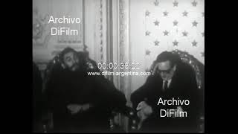
Fidel Castro visits Chile

Slide 10
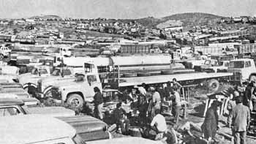
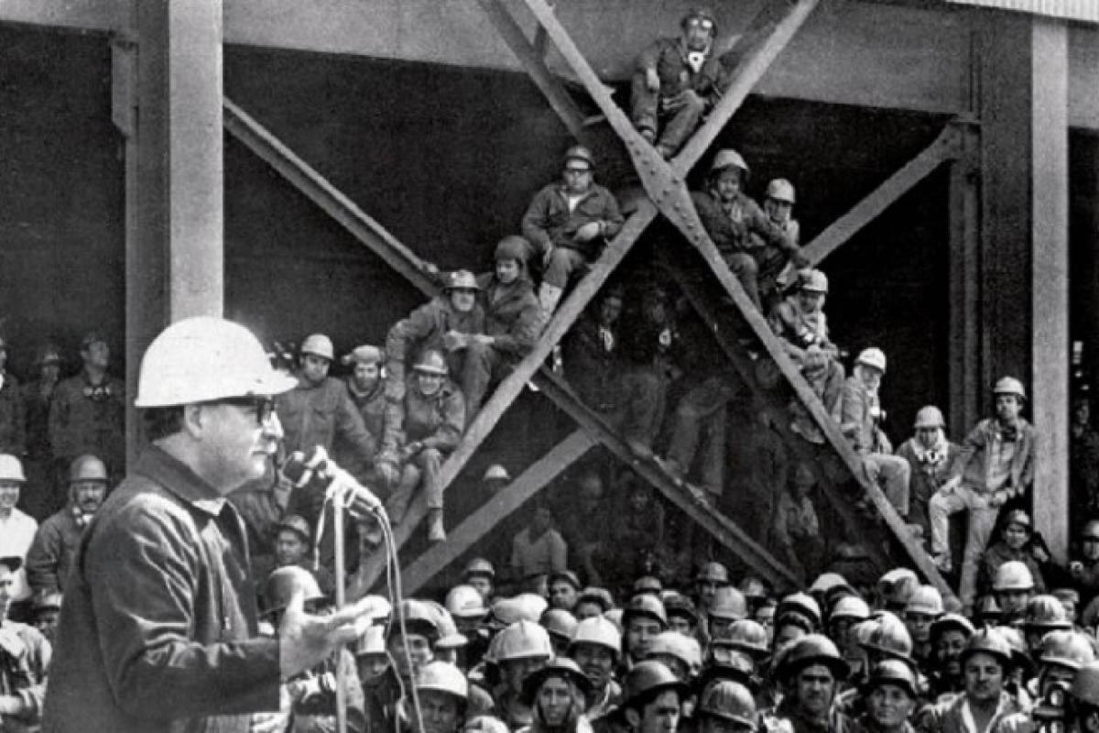
Background
Sending the CIA he did! It actively destabilized Allende's government from the get go, beginning in 1970. Chile is the longest country on earth north to south, and also the narrowest, a mere 217 miles at its widest point. For this reason trucking was Chile's economic lifeline in the 70's. The CIA is very smart and very dialectical, so they figured that having independent small truckers go on strike would create the ultimate conditions to ruin the economy, and to turn the general population against Allende's UP government.
So the CIA lavishly funded the trucker's strikes and the shutdown of small businessmen. In October 1972, the trucker's union calls for national strike. In January 1973, transportation workers go on strike in the capital of Santiago, followed by railroad workers. Self-defense organizations of merchants are created against government programs. Copper workers joined the strikes, including an unlimited strike that would last 74 days. The largest paper manufacturing plant is nationalized which infuriates the opposition. In May 1973, state of emergencies were declared in the province of Santiago, and in the copper producing central province.
Tensions are mounting all over Chile and Allende declares: "using the law first, I will use revolutionary violence later if necessary." In retrospect, it's fair to say revolutionary violence should have been used first. The military is preparing for battle.

Slide 11
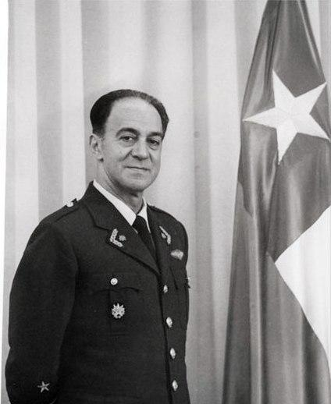
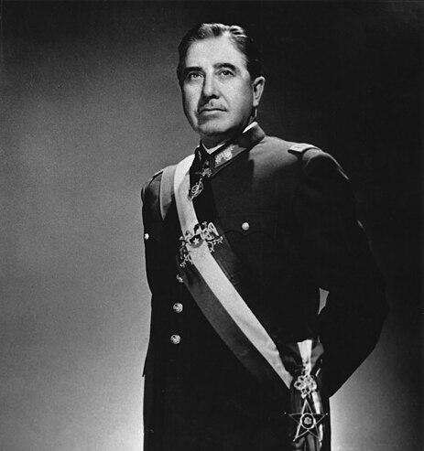
Background
The military is preparing for battle. A dress rehearsal of September 11th takes place in June 1973 when a regiment of the Chilean army attempts to overthrow the government. The rebellion is put down by loyalist Commander-in-Chief Carlos Prats, but it's an ominous sign. In July an indefinite strike of the Confederation of Truck Owners of Chile begins. CIA's money is put into good use.
On August 21st , Allende made a blunt mistake: he appointed Gustavo Leigh as head of the Air Force. Just 20 days later, Leigh would become the most radical member of the 4 men fascist junta who, hours after the coup, vowed that the military would "eradicate the Marxist cancer from our fatherland, until the last consequences.". A day later Carlos Prats resigned due to his belief he had lost the confidence of military officers.
That is when Allende made another fatal mistake and appointed Augusto Pinochet as Commander-in-Chief of the Army. It must be said Pinochet had openly posed as a loyalist of the UP and carefully kept hidden his future fascist agenda. Another general strike of unions is declared and joined by the Single Confederation of Professionals of Chile. On September 9th 1973, the High Command of the Armed Forces (Army, Navy, Air Force) plus the Carabineros de Chile (military police) set the date of the coup d'état for September 11th.
Now, Salvador Allende has only 48 hours left to live.
Gustavo
Leigh
Augusto
Pinochet

Slide 12
Discussion

Slide 13
September 11th, 1973

Slide 14
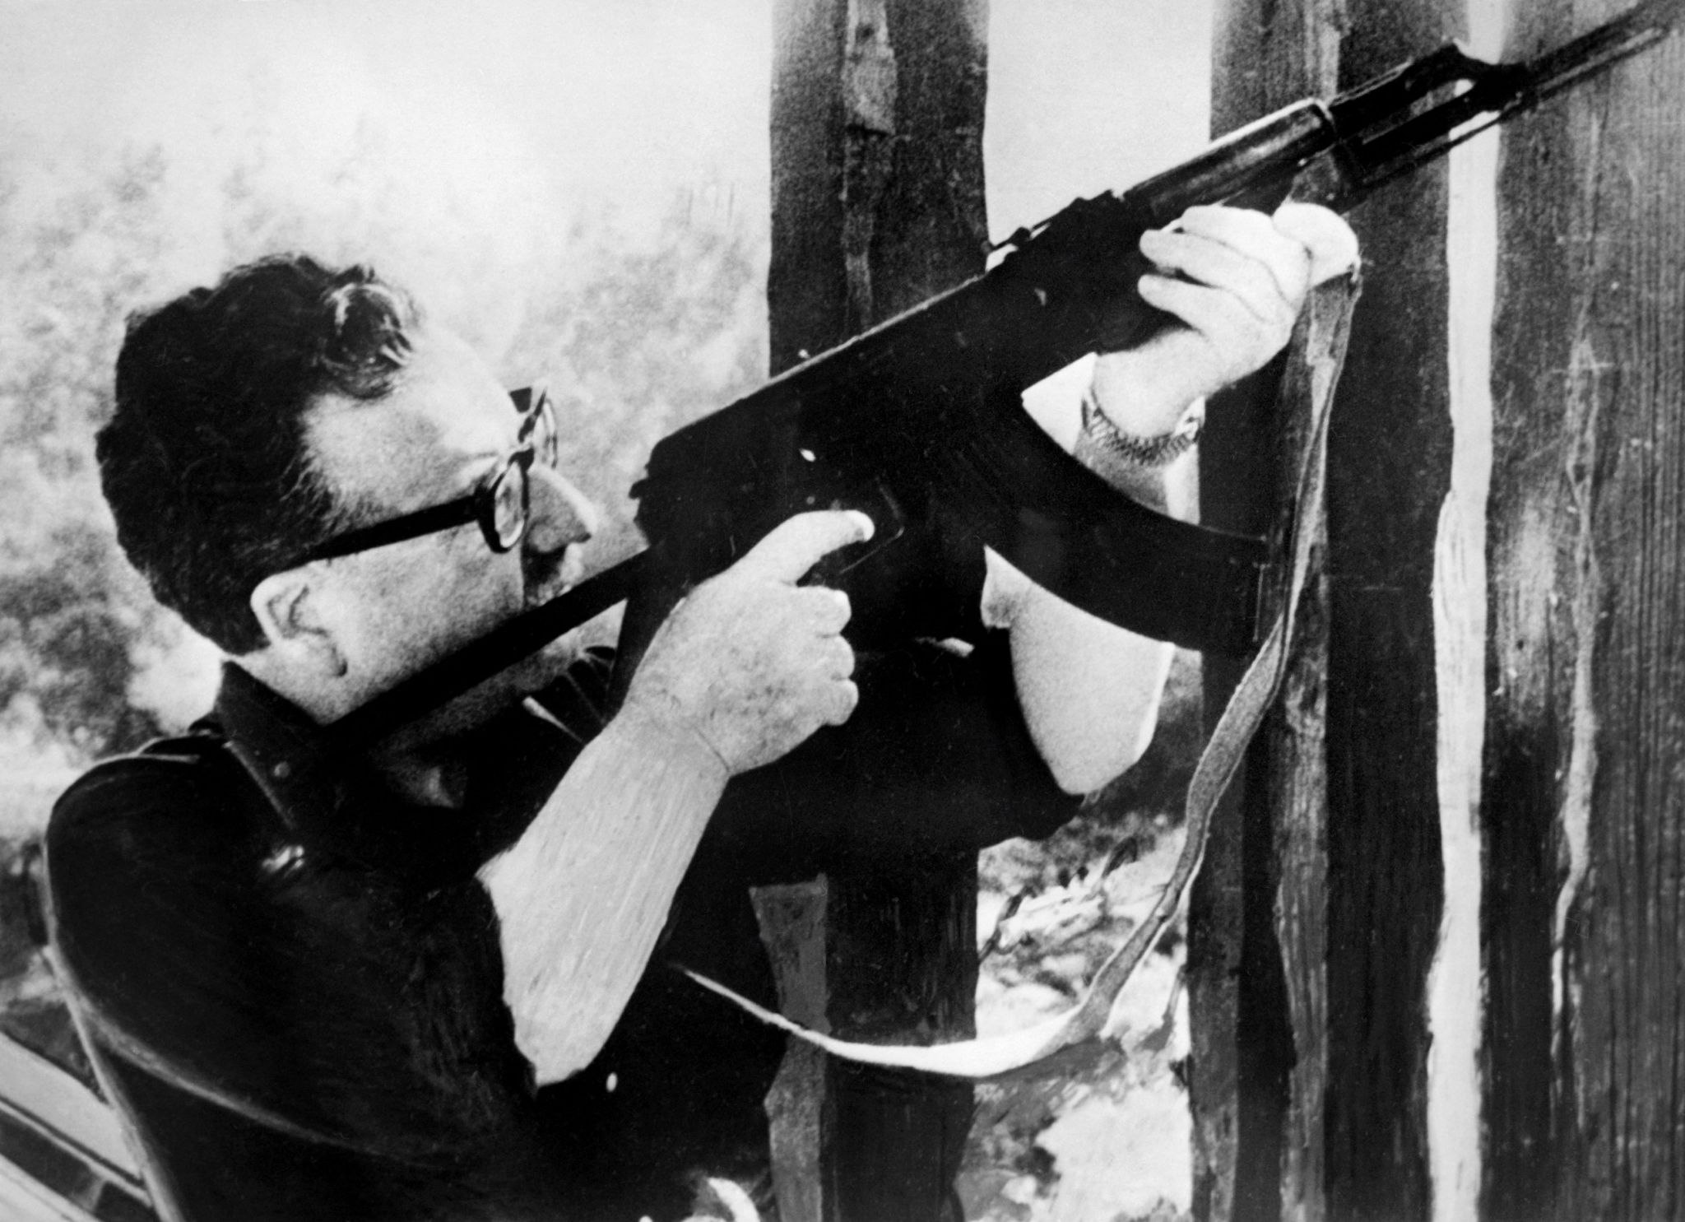
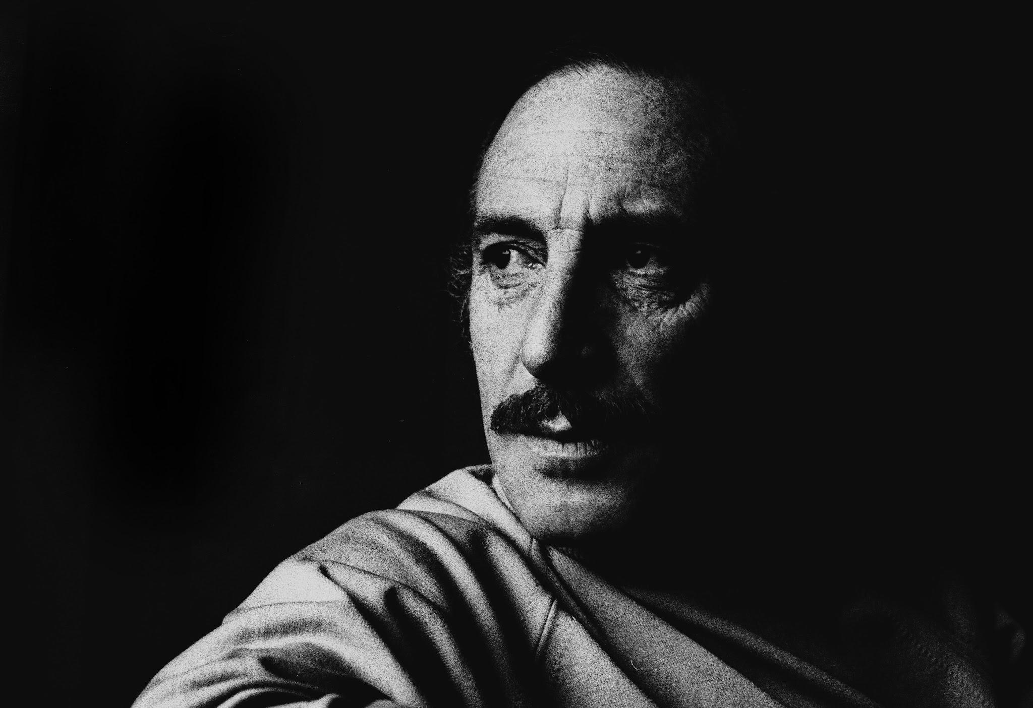
Chilean Coup of 1973
Side note: The date was no coincidence. Chile’s 1924 Junta Coup occurred on September 11th. This is why 9/11/73 was chosen for the date of the coup.
September 11th, 1973
7:00 AM, Valparaiso, Chile: The coup begins. The Chilean Navy captures the port city on the central coast of Chile, stations marine forces there and closes radio and television networks. The news of this is conveyed to Allende in Santiago, and the “Group of Personal Friends” (GAP), the armed guard of the Socialist Party of Chile serving as Allende’s bodyguard moved with him to the presidential palace.
8:00 AM, Santiago Chile: The Chilean Army and Chilean Air Force have destroyed the radio and television stations in Santiago. Allende is unaware that the entire Chilean Armed Forces are implementing the coup, and at this point, is under the assumption that only the Chilean Navy has turned on him.
He and Minister of Defense, Orlando Letelier, try to reach military leaders. Augusto Pinochet and Gustavo Leigh do not pick up. Navy Admiral Montero is unreachable as his telephone service and car were sabotaged by the coup plotters beforehand. The Director of the Chilean Police and Head of Investigations Police answer Allende and rush to the palace. Letelier then went to the Ministry of Defense and was arrested by Admiral Patricio Carvajal, and became the first prisoner of the coup.
Orlando
Letelier

Slide 15
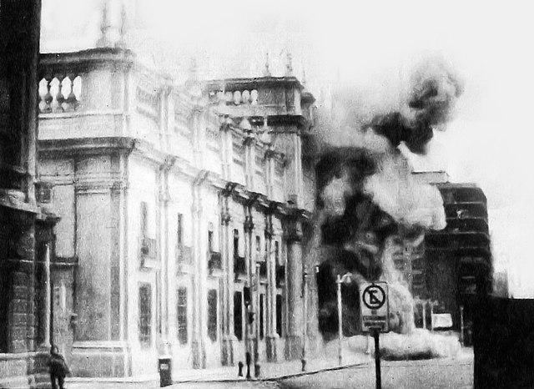
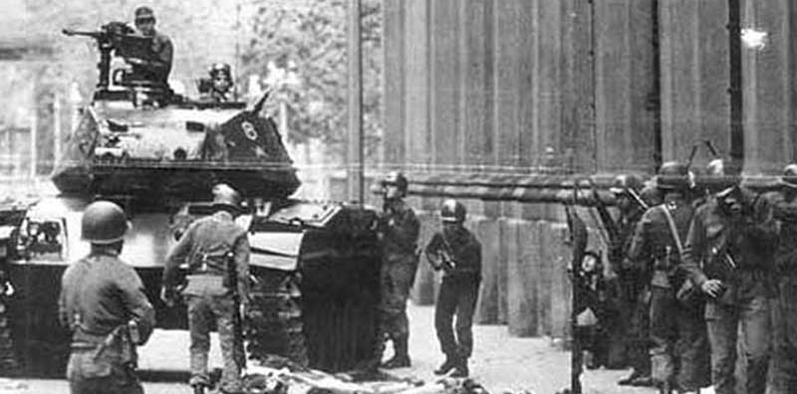
Chilean Coup of 1973
September 11th, 1973
9:00 AM: Chilean Military Forces control the entire nation of Chile, save for a pocket of Allende’s resistance around the presidential palace. The police abandoned Allende at the presidential palace at this time as well. General Leigh ordered a bombing of the palace by the Chilean Air Force, but was told it would take 40 minutes to arrive. Meanwhile, General Pinochet ordered his army to advance on the palace.
The Presidential Palace was defended by GAP snipers, which slowed the advance of Chilean Armed Forces. General Arellano ordered support from helicopter gunships from the Chilean Army’s puma squadron. Then, the air support ordered by Leigh arrived and bombed the palace.
11:00 AM: As the Presidential Palace itself is under assault, Allende, having refused to flee and launch a counter-coup, gives a farewell address to the nation, refusing to resign and give in to the fascists. Following this speech, the GAP continued defending the palace until 2:30 PM. It is believed that Allende died, allegedly by suicide with the AK-47 gifted by Fidel Castro, at 2:00 PM. The coup is successful, and the Pinochet era of fascism in Chile begins.

Slide 16
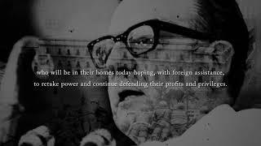
Allende's Last Words

Slide 17
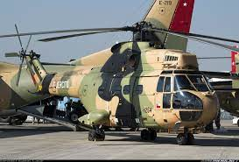
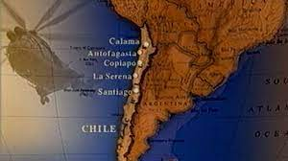
Chilean Coup of 1973
Caravan of Death
In the immediate aftermath of the coup and the coming to power of Augusto Pinochet, a death squad was formed out of the Chilean Army known as the “Caravan of Death”, which operated puma helicopters and went from prison to prison, carrying out the execution of a little less than 100 Chilean leftists between the coup and October 22nd, 1973. Members of this caravan included Manuel Contreras, a School of the Americas trained CIA agent that became head of the National Intelligence Directorate of Chile, and Sergio Arellano Stark, who was an aide of former president of Chile preceding Allende, Montalva.
Victims were murdered by gunshots, stabbings, dismemberment and flight deaths (being tossed out from the helicopter, either over the Ocean, Andes mountains or Atacama Desert.) General Lagos explained why he didn’t return prisoners bodies to their families, saying “I was ashamed to see them. They were torn into pieces. So I wanted to put them together, at least leave them in a human form. Yes, their eyes were gouged out with knives, their jaws broken, their legs broken ... At the end they gave them the coup de grace. They were merciless. [...] The prisoners were killed so that they would die slowly. In other words, sometimes they [...] shot them [in] parts[: first, the legs, then the sexual organs, then the heart. In that order the machine guns were fired”
Few involved were ever indicted for this, Pinochet cheated accountability with his death in 2004 and the United States has never apologized for being involved.
Chilean SA-330
Puma Helicopter

Slide 18
Discussion & New Members Introductions

Slide 19
New Member Introductions
What is your name, pronouns and state (or country/territory)?
Where do you work? Is it unionized?
How did you find out about the People’s School?
What do you think about tonight's class?

Slide 20
Pinochet’s Chile and Operation Condor

Slide 21
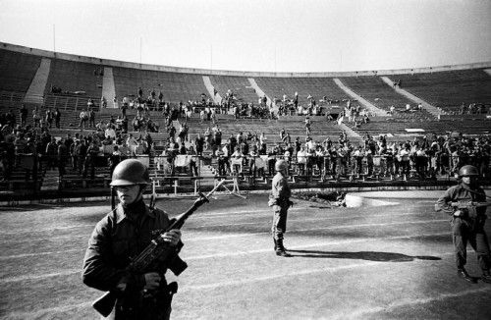
Repression Under Augusto Pinochet
Under Augusto Pinochet’s 17 year reign, thousands of Chilean Communists and other Left Oppositionists were killed and thousands more disappeared. The numbers are still contested due to the unreliability of data recorded by the regime.
200,000 Chileans were estimated to have been forcibly exiled and hundreds of thousands more left due to economic collapse following the coup.
The Pinochet dictatorship created Concentration Camps, the most famous being the National Stadium which imprisoned and tortured 40,000 Communists and other Leftists and murdered thousands.
Estadio Nacional in Chile being used as a Concentration Camp

Slide 22

Dirrecion de Inteligencia Nacional (DINA)
Established in November of 1973
Dubbed “Pinochet’s Gestapo”
Involved in the arrest and torture of left opposition voices
Decree #521 allowed DINA to round up anyone under the the pretext of national emergency
Worked to censor any pro-Allende/Popular Unity Party media and radio transmissions
Logo of DINA

Slide 23
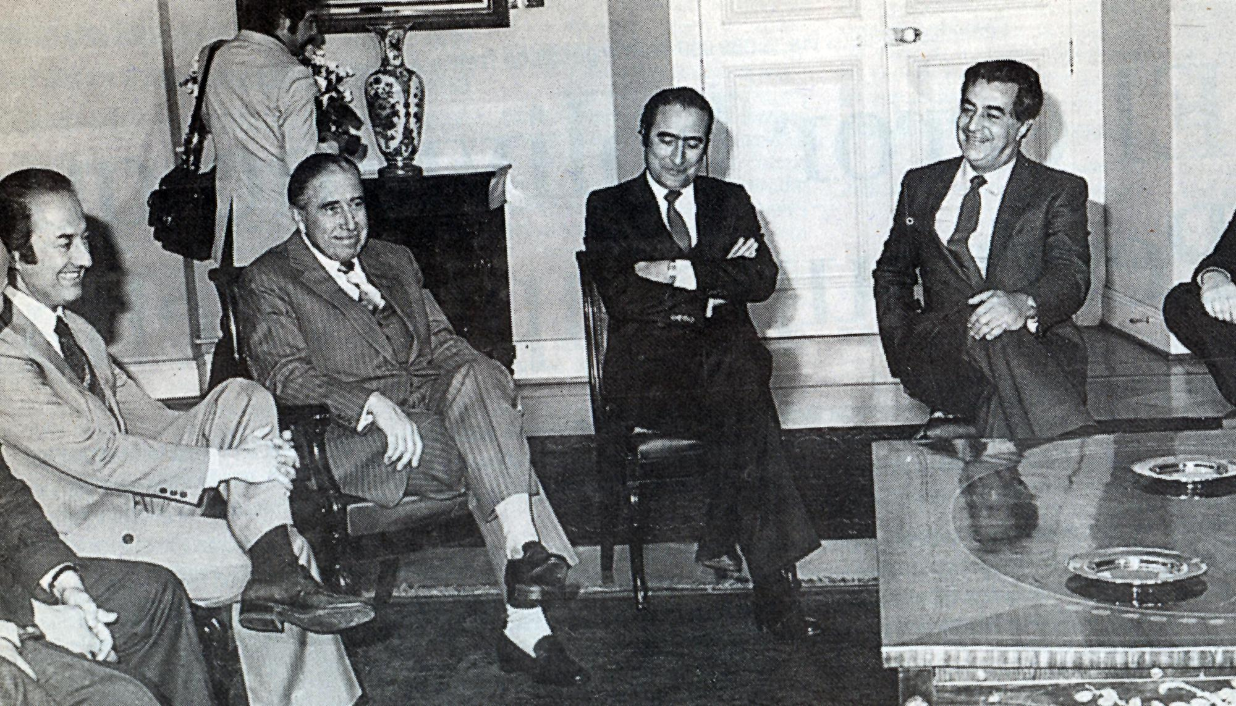
Neoliberal “Shock Therapy” in Chile
Trained at the University of Chicago under Milton Friedman, the Chilean economists dubbed the “Chicago Boys” applied Neoliberal policies which set to reverse the Nationalization efforts under Allende and privatize most aspects of Chilean society.
Under Pinochet the healthcare system, the pension system, and natural resources were privatized, a reversal from the Nationalization under Allende.
American-based Multinational corporations such as Dow Chemical and Firestone regained control over the Chilean economy
The economic reforms under Pinochet resulted in the Economic Crisis of 1982
Chicago Boys with Augusto Pinochet

Slide 24
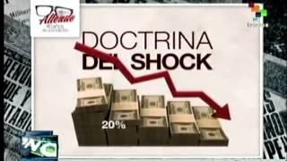
Neoliberal “Shock Therapy” in Chile

Slide 25
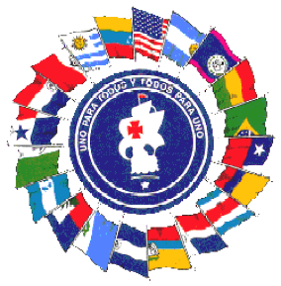
Operation Condor
Training Fascist Death Squads
In 1946 the U.S. army founded the Latin American Training Center, located in the Panama Canal Zone. Its purpose was to train Latin American military personnel to use American made weapons. After the 1959 Cuban Revolution, Kennedy ordered the Center to focus on teaching anti-communist counter-insurgency tactics to Latin Americans. In 1963 the Center was renamed School of the Americas.
Part of the training was learning torture techniques based on practical experience gained in the Vietnam and Algerian wars. It is estimated that 60k graduates put their newly acquired skills in practice in their home countries, as death squads operatives and assassins. In the 60's and 70's, plans were discussed at the School of the Americas about coordinating the internal Security Forces among Latin American countries in order to deal with perceived "Marxist subversion".
Logo of the School of the Americas

Slide 26
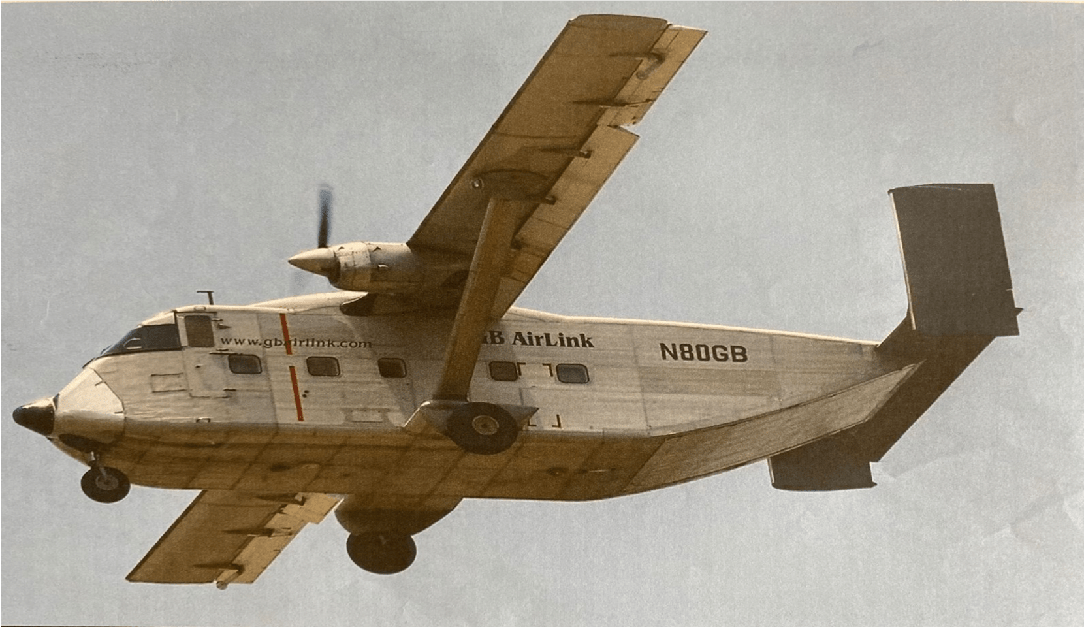
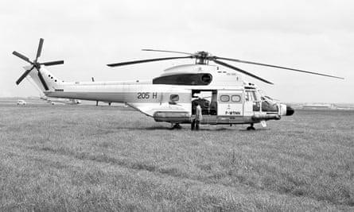
Operation Condor
In early 1974, a few months after the Sept 11th coup in Chile, security officials from Argentina, Paraguay, Uruguay, Chile and Bolivia met in Buenos Aires, to plan coordinated actions.
On November 25th, 1975 on the day of Pinochet's 60th birthday, the military intelligence of the 5 countries met in Santiago and officially created Plan Condor. 4 months later a military junta led by General Videla overthrew the government of Isabel Peron in Argentina, even though Isabel had let anti-communist death squads operate freely, and established a fascist dictatorship that lasted 7 years.
Operation Condor in Argentina was implemented in the so-called Dirty War and resulted in the murder and disappearance of at least 30k people, often after brutal torture. During Operation Condor, "Death Flights" were put into practice in Argentina and Chile. Prisoners were thrown off helicopters or planes into the frigid waters of the South Atlantic or the South Pacific. Also on top of high Andes peaks.

Slide 27
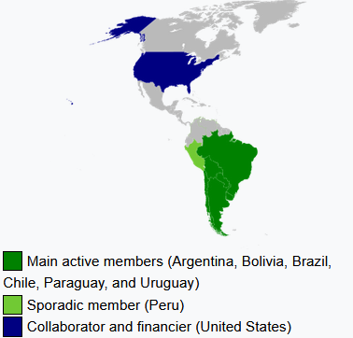
Operation Condor
Argentinian officers had learned this procedure from their French counterparts during the Algerian War from 1954 to 1962. The first to use "Death Flights" was Marcel Bigeard, call sign "Bruno", a former paratroop commander taken prisoner by the VietMinh at the Battle of Dien Bien Phu in 1954.
Sent to Algeria in 1956 after his release, he invented the "Death Flights" over the Mediterranean. It was Bigeard's superior, General Aussaresses who advised Pinochet and Videla on the use of torture, counter-insurgency warfare and "Death Flights" during Operation Condor, after he moved to Brazil in 1973.
The primary target of Operation Condor were communist guerillas and sympathizers, but also included students, trade unionists, journalists, artists, just about any citizens suspected of being left wing. The front troops of Condor were the Chilean DINA and its Argentinian counterpart SIDE. In Chile, it is estimated that Condor was responsible for the murder and disappearance of 10k people. But Condor did not stop at the borders of Chile, Argentina, Uruguay, Paraguay and Bolivia. Opponents were targeted in France, Italy, Portugal, Mexico and the United States.

Slide 28
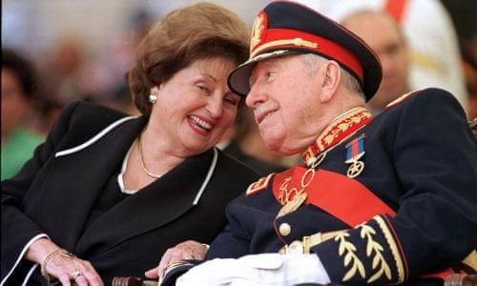
Operation Condor
Orlando Letellier was a diplomat, economist, member of the Socialist Party, and Foreign Minister under Allende's presidency. He was imprisoned after September 11th and tortured by the régime. Released after intense international diplomatic pressure, Letellier took refuge in Venezuela.
In 1975, Letellier moved to the U.S. where he was offered a position at the American University in Washington DC. He wrote articles condemning the 'Chicago Boys" free market economic policies being promoted by Pinochet under the fascist dictatorship. That is when the long arm of the Chilean secret police (DINA), reached out to him and assassinated him on September 21st, 1976 together with his American co-worker, in a car bomb terror attack.
General Augusto Pinochet who left the presidency in 1990, was arrested in London in 1998 under genocide and terror charges but later released, and was never brought to trial for the murders, despite evidence implicating him as having ordered them. Pinochet died of a heart attack, at the age of 91, while at home in Santiago under house arrest.

Slide 29
1980 Constitution
On September 11th 1980(Seven year anniversary of the Coup d’etat) a referendum was held to replace the 1925 Constitution.
The new Constitution gave more power to the executive branch and the President and allowed Pinochet to remain in power for longer.
The new constitution had provisions restricting political parties similar to those outlined in the Smith Act:
  “Parties, movements or other forms of organization whose objectives, actions or conduct do not respect the basic principles of democratic and constitutional rule, who seek to establish a totalitarian system, as well as those which use violence, advocate or incite it as a method of political action, are unconstitutional. It will correspond to the Constitutional Court to declare this unconstitutionality.”
The constitution restricted trade unions from “intervening in partisan political activities”
On top of being more restrictive, though the Constitutional Referendum had a majority vote of “yes”. The methods used for the referendum were criticized of being full of irregularities and anti-democratic.

Slide 30
Discussion & Wrap Up Introductions

Slide 31
Announcements
THE KONONOVITCH BROTHERS NEED US, SHARE THIS ARTICLE:
https://dailyworkerusa.com/stop-the-kiev-regimes-calls-for-the-murder-of-the-kononovitch-brothers/

Slide 32
Volunteer!
We are in need of volunteers for the staff of the People’s School! Here’s a few roles we need filled:
People to help manage posting on our social media and podcast platforms
Video Editors, Audio Editors, Graphic Designers, Artists, Narrators
Facilitators, Web Controls, Moderators
Email info@peoplesschool.us if you’re interested and try to attend our next staff meeting on Oct 5th if possible.

Slide 33

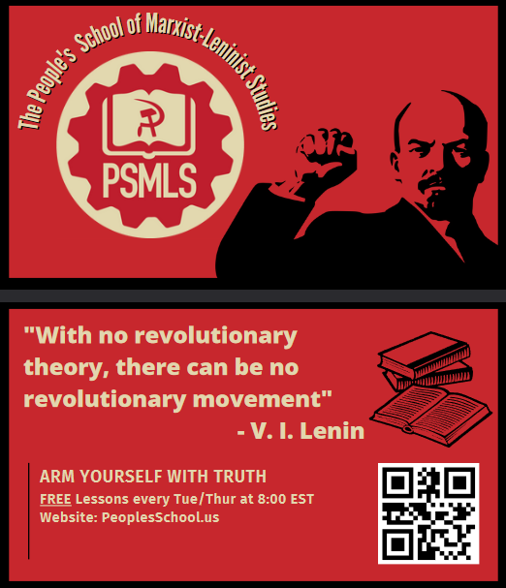
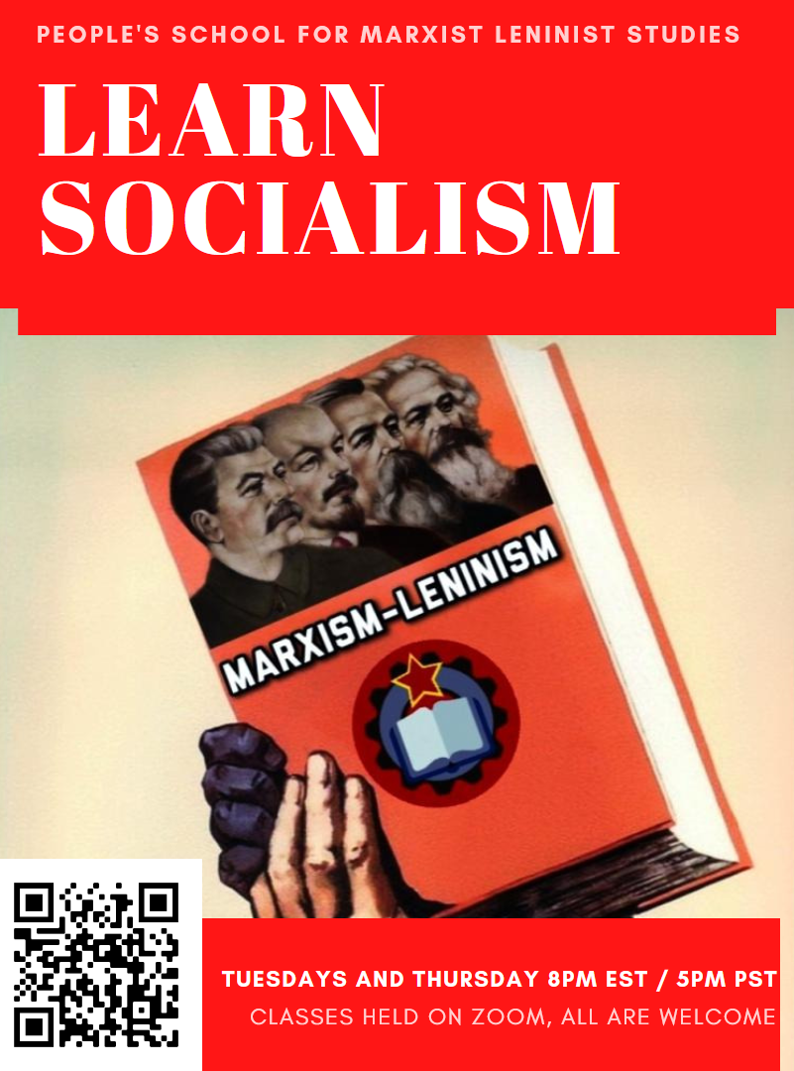

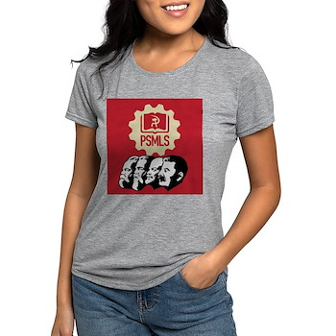
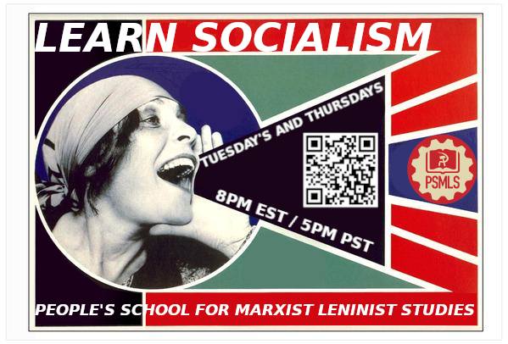
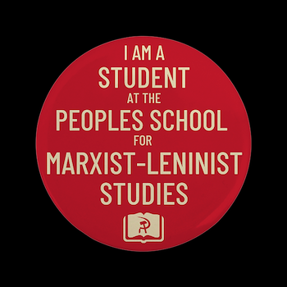

PSMLS Propaganda
peoplesschool.us/media & peoplesschool.us/store
Materials to help promote the school!

Slide 34

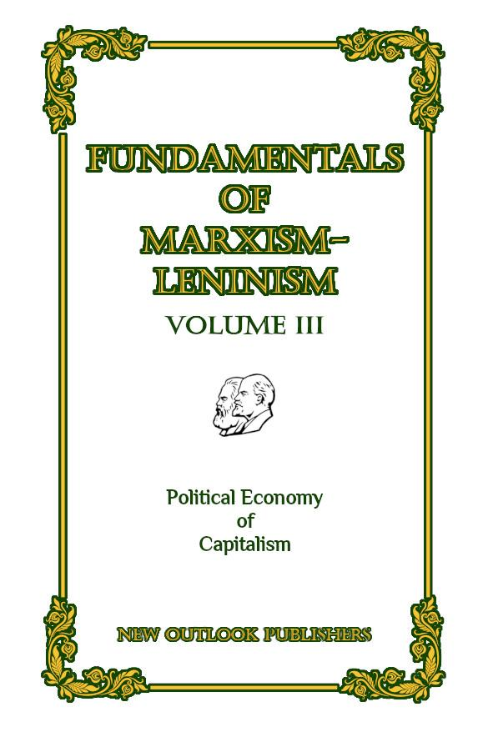
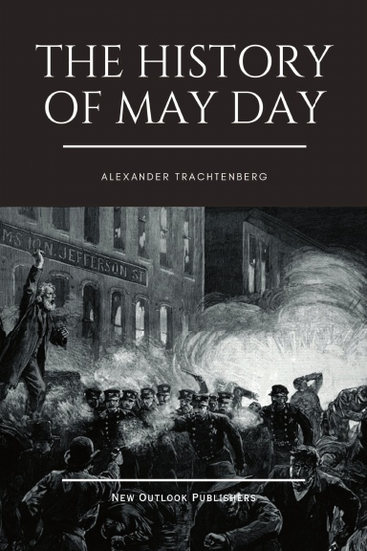
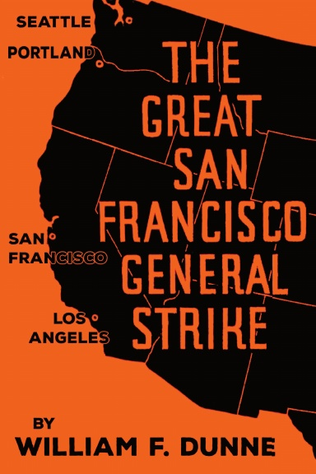

New Outlook Publishers
newoutlookpublishers.store
Latest Releases

Slide 35
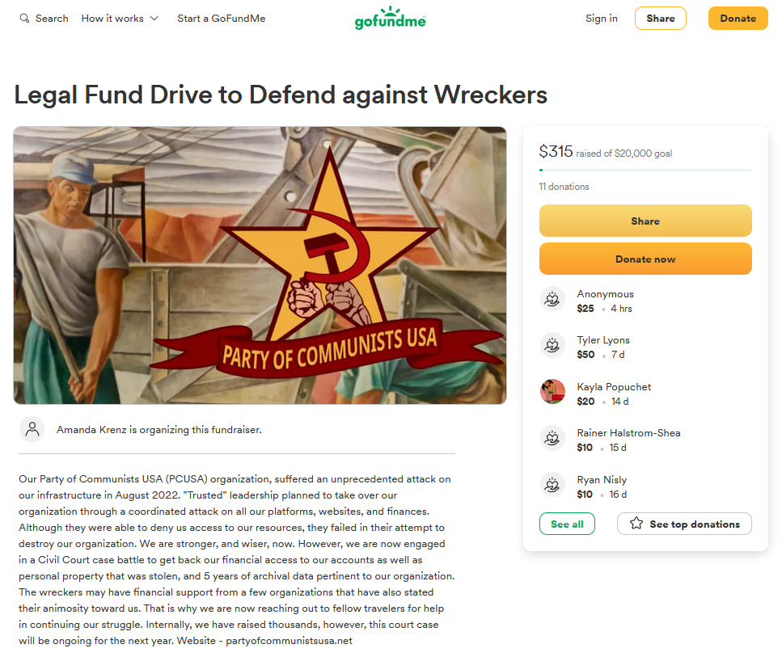
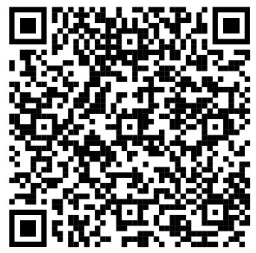
Legal Drive
Last year we were attacked and sabotaged by ultraleft wreckers that tried to steal the PSMLS and destroy the PCUSA. They failed, but they will be held accountable and there are still things they took from us that we’ve not got back, like videos, imagery, audio etc. That is why we still need donations to the legal drive.
If you support the school and want to see us continue to improve and keep delivering this education 51 weeks a year, please pitch in whatever you can and support the GoFundMe for the legal drive @ https://www.gofundme.com/f/legal-fund-to-defend-against-wreckers.
Anything helps!

Slide 36
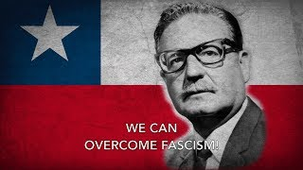
¡Venceremos! - We Shall Prevail!

