Slide 1
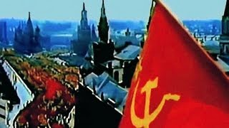
National Anthem of the USSR - 1984 Version

Slide 2
PSMLS mm/dd/yy - mm/dd/yy

Slide 3
What we’ll be learning today:
The events of Black October 1993, including from the eyes of eyewitnesses to the event.
US and western support for the coup, and the misinforming of Yeltsin regarding the future of NATO.
The significance of Black October 1993, including audio excerpts from Angelo D’Angelo from last years class.

Slide 4
Black October 1993

Slide 5
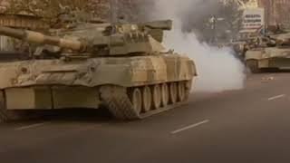
Video Explaining Events of Black October 1993.

Slide 6
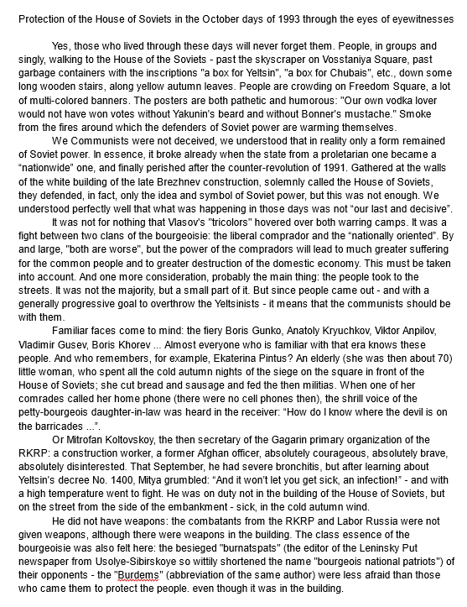
Protection of the House of the Soviets in the October days of 1993 Through the Eyes of Eyewitnesses
From the RCWP

Slide 7
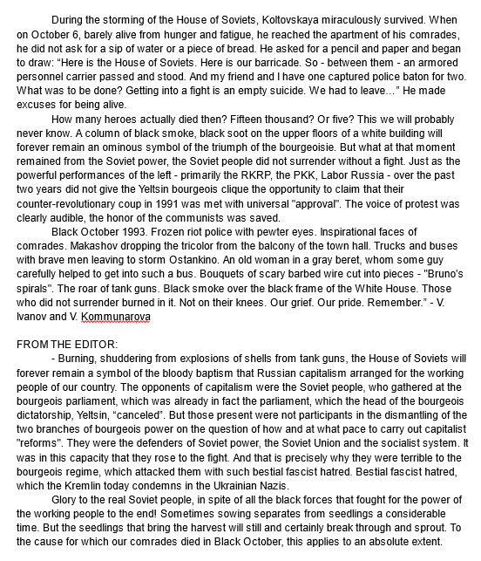
Protection of the House of the Soviets in the October days of 1993 Through the Eyes of Eyewitnesses
From the RCWP

Slide 8
Discussion

Slide 9
US Support for Black October

Slide 10
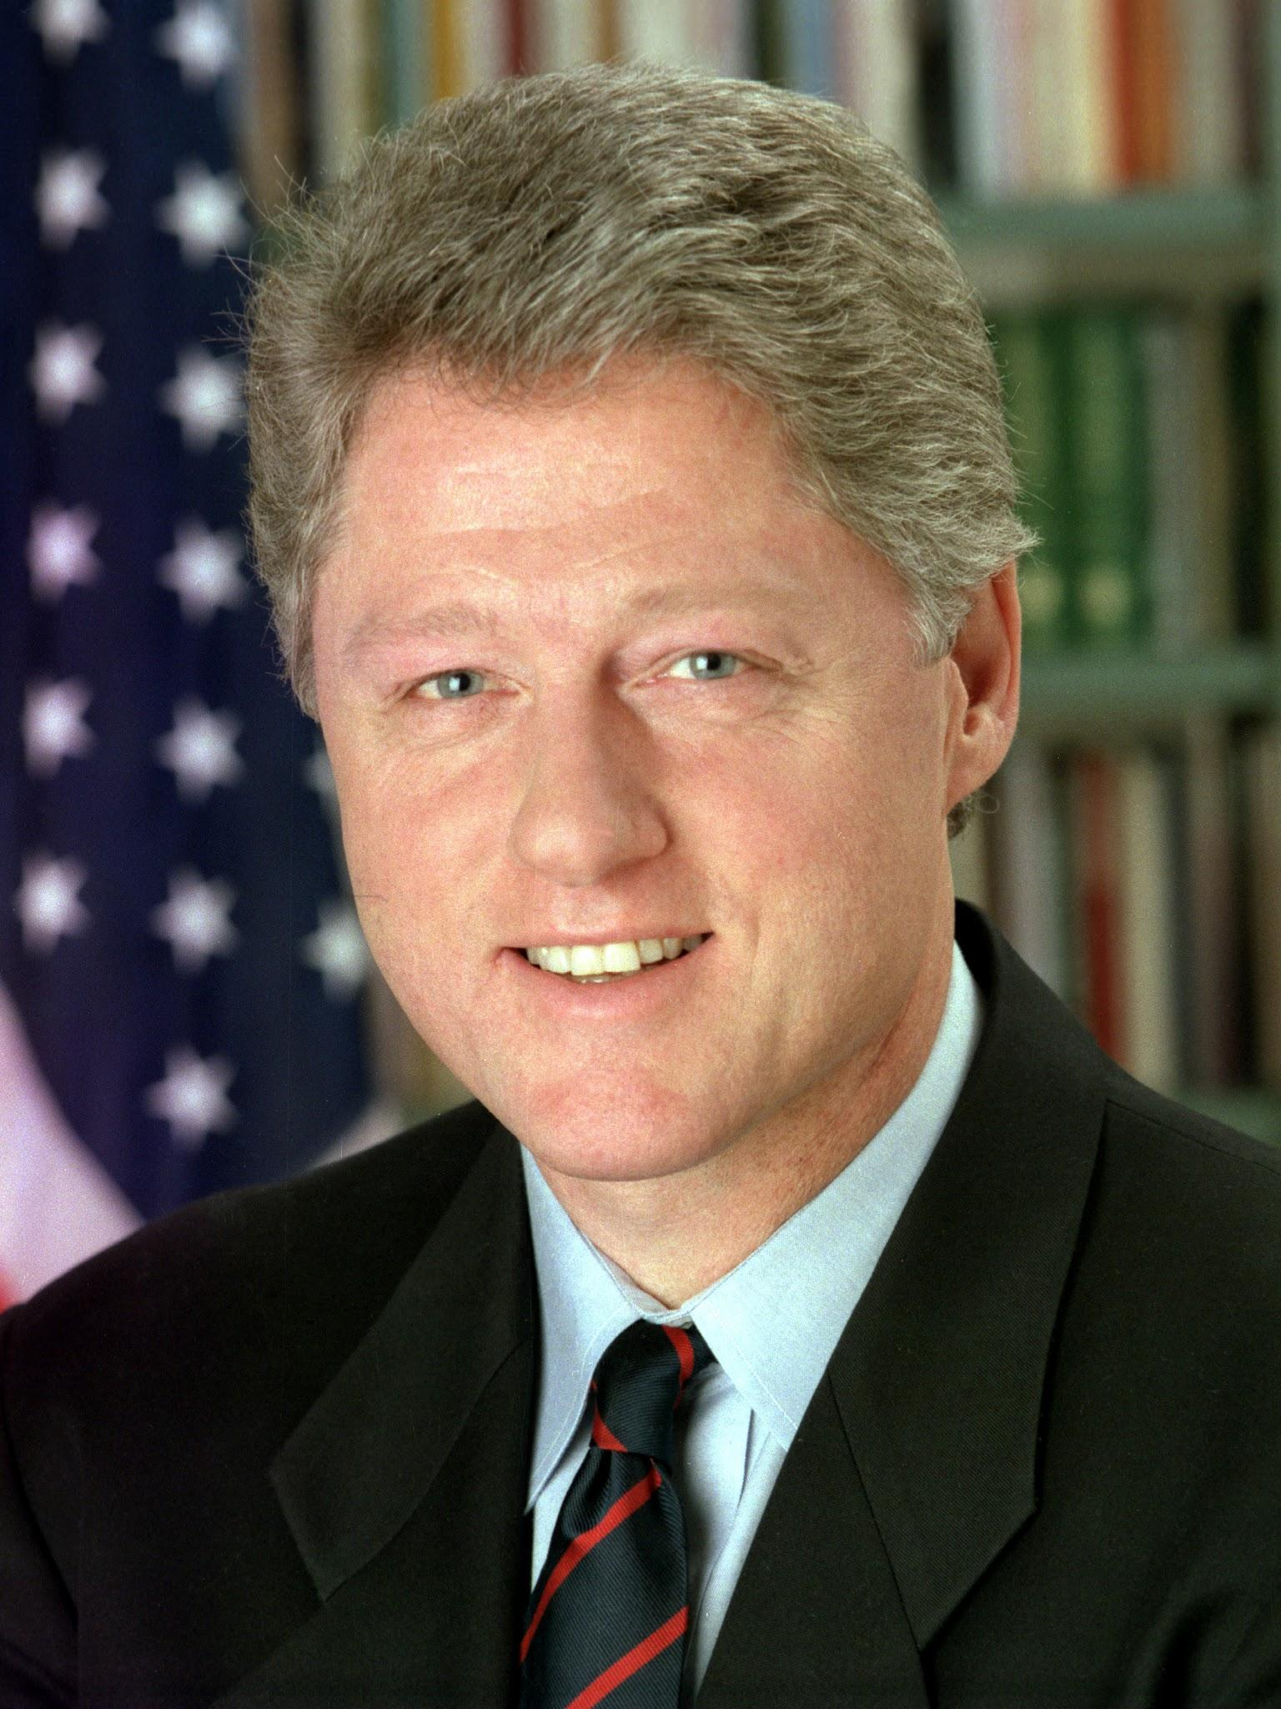
The West Loves Yeltsin’s Coup
Western Admiration for the Coup
Western imperialists, already having felt victorious from seeing the counter-revolution destroy the Soviet Union 2 years earlier, were happy to see Yeltsin crack down on the remnants of the Soviets and congratulated Yeltsin for it. President Bill Clinton said:
“It is clear that the opposition forces started the conflict, and President Yeltsin had no other alternative but to try to restore order…The US supported Yeltsin because he is Russia's democratically-elected leader…I have no reason to doubt the personal commitment that President Yeltsin made to let the Russian people decide their own future in elections.”
Various documents declassified by the National Security Archive, including telephone memorandums between Yeltsin and Clinton and other transcripts of US-Russian dialogue show the depth of this support.

Slide 11
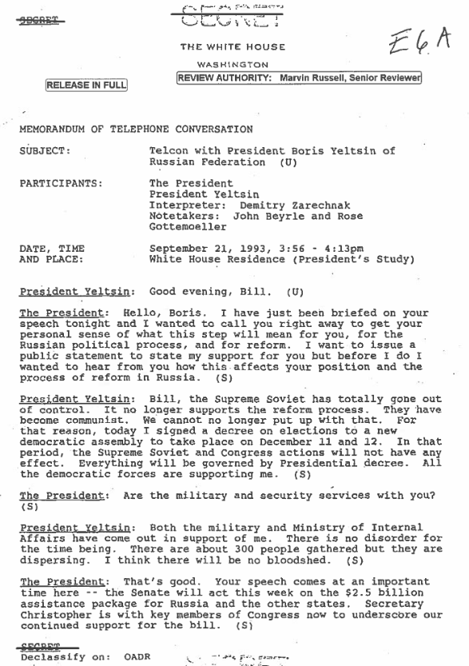
NSA Archive Memorandum of Telephone Conversation on September 13th, 1993
Between Yeltsin and Clinton

Slide 12
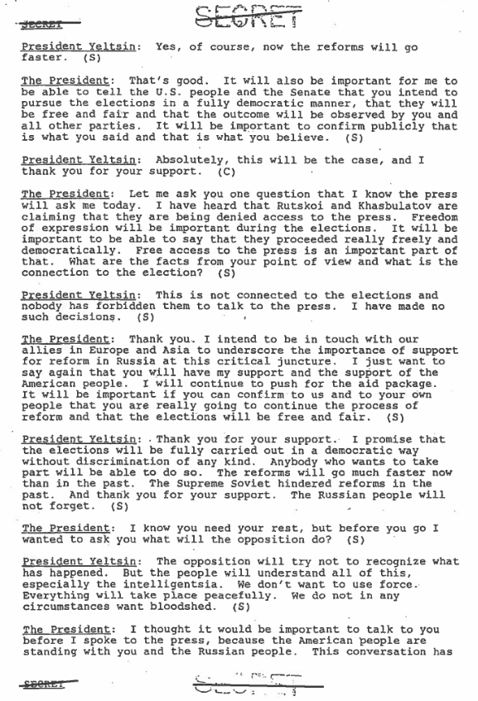
NSA Archive Memorandum of Telephone Conversation on September 13th, 1993
Between Yeltsin and Clinton

Slide 13
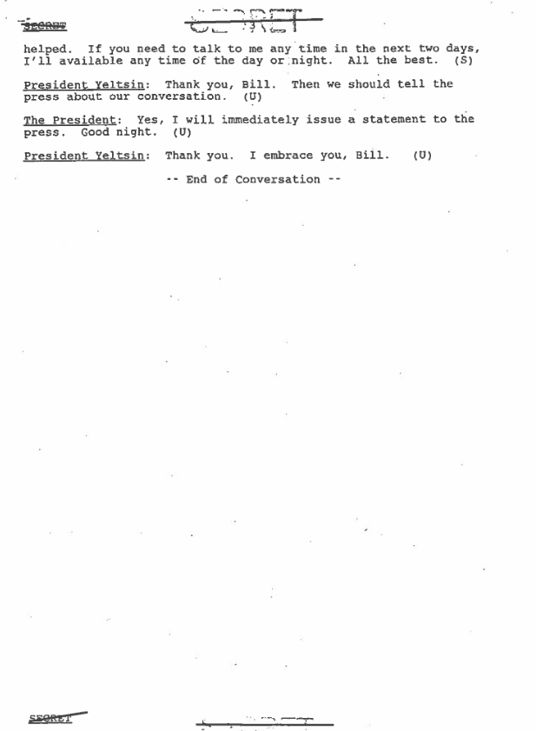
NSA Archive Memorandum of Telephone Conversation on September 13th, 1993
Between Yeltsin and Clinton

Slide 14
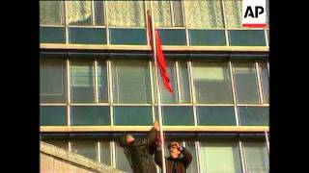
Footage of Black October 1993.

Slide 15
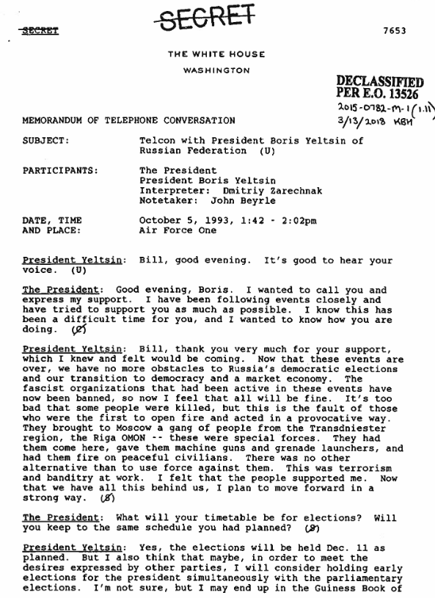
NSA Archive Memorandum of Telephone Conversation on October 5th, 1993
Between Yeltsin and Clinton

Slide 16
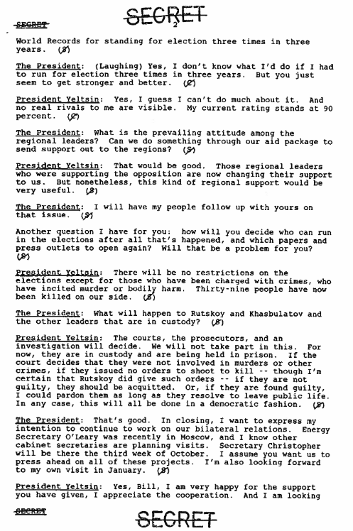
NSA Archive Memorandum of Telephone Conversation on October 5th, 1993
Between Yeltsin and Clinton

Slide 17
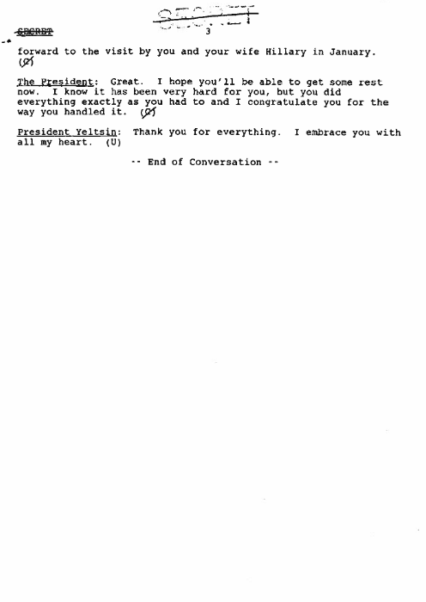
NSA Archive Memorandum of Telephone Conversation on October 5th, 1993
Between Yeltsin and Clinton

Slide 18
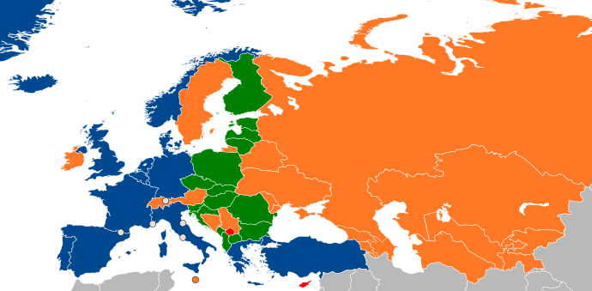
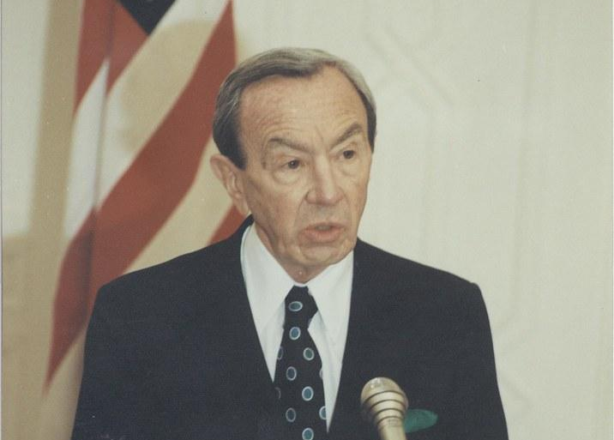
NATO Takes Advantage
Yeltsin Misinformed on NATO
In the talks that followed the events in October, Yeltsin began to bring up the discussion of NATO expansion and Russia’s national security concerns.
According to the National Security Archive, it was recorded in a Oct 20th cable that “[Chargé d'Affaires and future Ambassador to Russia] James Collins' view, "what the Russians hope to hear from you is that NATO is not moving precipitously and that any policy NATO adopts will apply equally to them." Their "neuralgic" attitude stems from the fear that they will "end up on the wrong side of a new division of Europe." Therefore, Collins counsels Christopher to make sure the Russians know that the U.S. is actively promoting Russia's "complete reintegration into the family of Western states."
On Oct 22nd, Secretary of State Warren Christopher meets with Yeltsin, and reveals to him Clinton’s proposal for a “Partnership for Peace”, which he leads Yeltsin to believe is an alternative to the expansion.

Slide 19
NSA Archive
Secretary Christopher's Meeting with President Yeltsin on October 5th, 1993

Slide 20
Discussion & New Members Introductions

Slide 21
New Member Introductions
What is your name, pronouns and state (or country/territory)?
Where do you work? Is it unionized?
How did you find out about the People’s School?
What do you think about tonight's class?

Slide 22
Significance of Black October

Slide 23
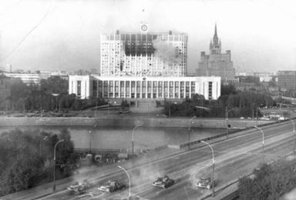
Significance of Black October
Tragedy for Communists, Opportunity for Imperialists
Black October of 1993 showcased the worst violence against communists following the 1991 counter-revolution and remains a solemn memory in the minds of Russian communists. For the western imperialists, it was great to see communists facing this and it was an opportunity to swindle and exploit the Yeltsin government, who it quickly came to the fond praise of following the event.
Michael Parenti said of this event in his 1997 book, Blackshirts and Reds,
"In late 1993, facing strong popular resistance to his harsh free-market policies, Yeltsin went further. He forcibly disbanded the Russian parliament and every other elected representative body in the country, including municipal and regional councils. He abolished Russia's Constitutional Court and launched an armed attack upon the parliamentary building, killing an estimated two thousand resisters and demonstrators. Thousands more were jailed without charges or a trial, and hundreds of elected officials were placed under investigation. Yeltsin banned labor unions from all political activities, suppressed dozens of publications, exercised monopoly control over all broadcast media, and permanently outlawed fifteen political parties. He unilaterally scrapped the constitution and presented the public with a new one that gave the president nearly absolute power over policy while reducing the democratically elected parliament to virtual impotence. For these crimes he was hailed as a defender of democracy by U.S. leaders and media."

Slide 24
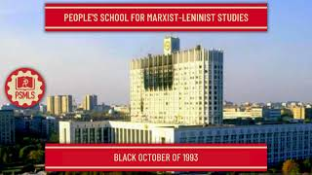
“They were us. We are them” - General Secretary Angelo D’Angelo in 2022 Class

Slide 25
General Secretary Angelo D’Angelo relates to Ukraine in 2022 Class

Slide 26
Discussion & Wrap Up Introductions

Slide 27
Announcements
THE KONONOVITCH BROTHERS NEED US, SHARE THIS ARTICLE:
https://dailyworkerusa.com/stop-the-kiev-regimes-calls-for-the-murder-of-the-kononovitch-brothers/

Slide 28
Volunteers Needed!
We are in need of volunteers for the staff of the People’s School! Here’s a few roles we need filled:
People to help manage posting on our social media and podcast platforms
Video Editors, Audio Editors, Graphic Designers, Artists, Narrators
Facilitators, Web Controls, Moderators
Email info@peoplesschool.us if you’re interested and try to attend our next staff meeting on Nov 2nd if possible.

Slide 29
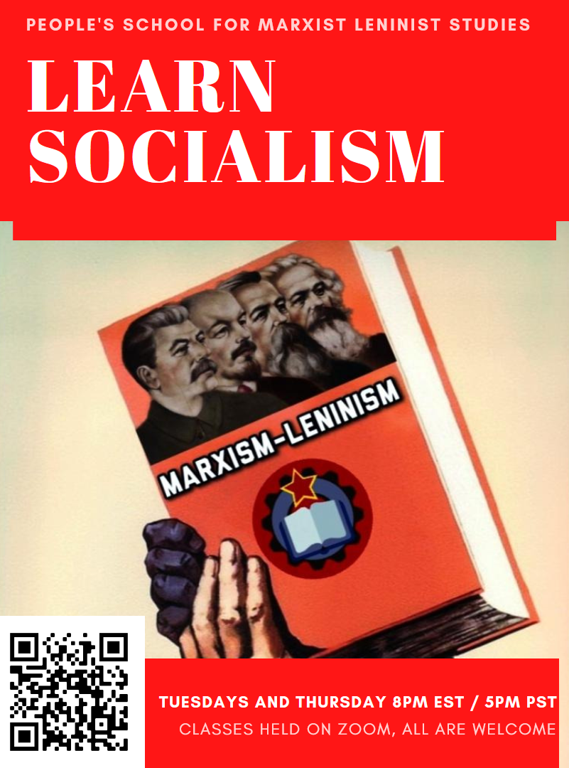
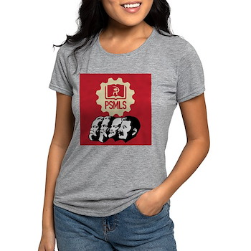
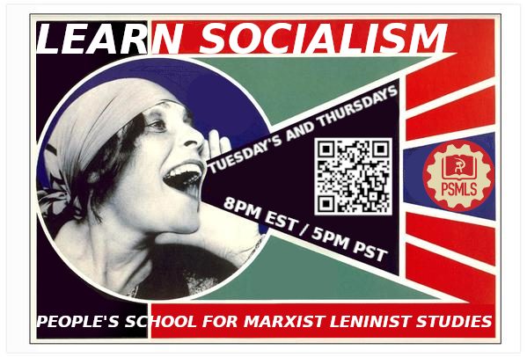
PSMLS Propaganda
peoplesschool.us/media & peoplesschool.us/store
Materials to help promote the school!

Slide 30
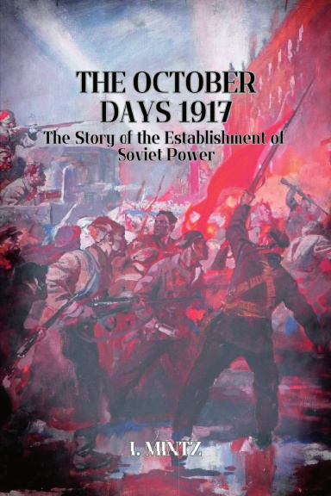
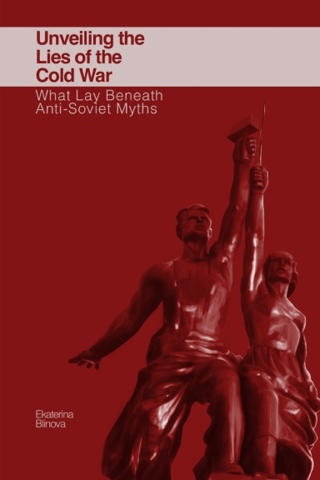
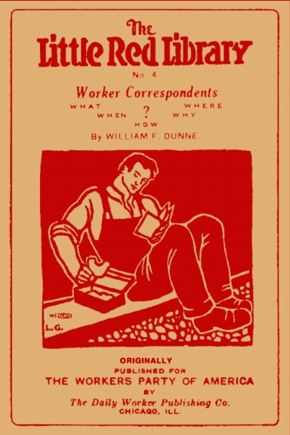
New Outlook Publishers
newoutlookpublishers.store
Latest Releases

Slide 31
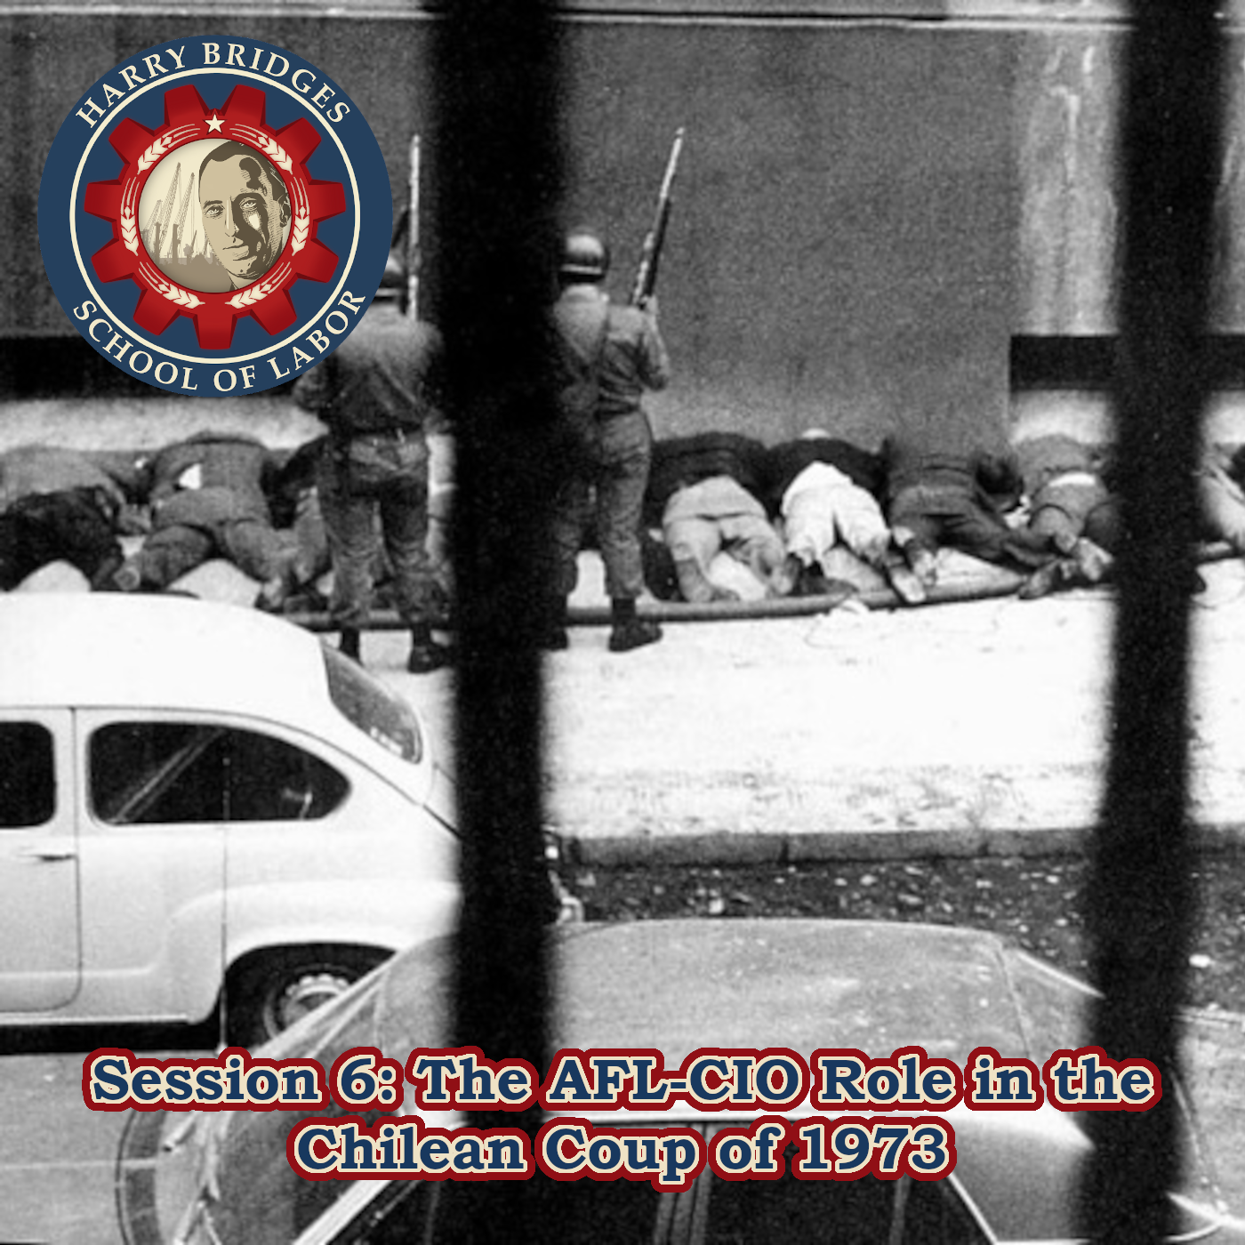
Harry Bridges School of Labor
luel.us/laborschool/
The Harry Bridges School of Labor is a monthly class held 2x per month. Classes cover a variety of topics aimed at building class conscious among union members.
September’s class is “The AFL-CIO Role in the Chilean Coup of 1973” and is October 4th, at 9 pm EST and the second session is on October 7th, at 7 pm EST.

Slide 32
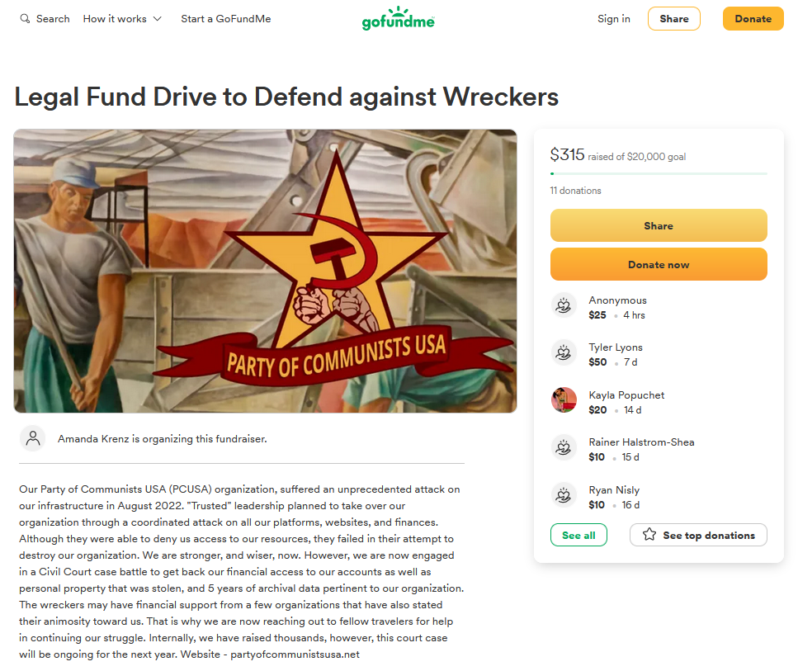
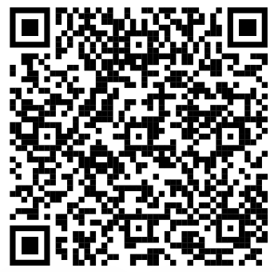
Legal Drive
Last year we were attacked and sabotaged by ultraleft wreckers that tried to steal the PSMLS and destroy the PCUSA. They failed, but they will be held accountable and there are still things they took from us that we’ve not got back, like videos, imagery, audio etc. That is why we still need donations to the legal drive.
If you support the school and want to see us continue to improve and keep delivering this education 51 weeks a year, please pitch in whatever you can and support the GoFundMe for the legal drive @ https://www.gofundme.com/f/legal-fund-to-defend-against-wreckers.
Anything helps!

Slide 33
National Anthem of the USSR - 1984 Version

