Slide 1
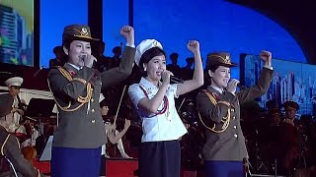
Advancing in Socialism - Moranbong Band

Slide 2
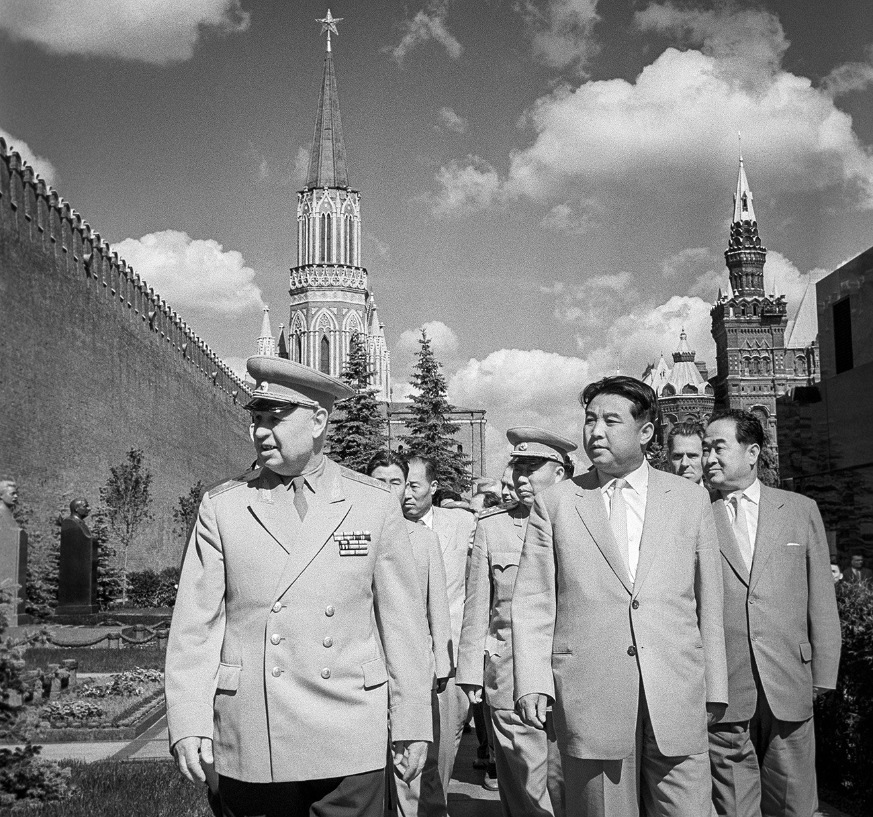
The Great Patriotic War and the Great Fatherland Liberation War
How the anti-fascist war from 1941-1945 helped create the Democratic People's Republic of Korea
PSMLS 10/10/23 - 10/12/23

Slide 3
What we’ll be learning today:
Korea under Japanese colonialism
General Kim Il-Sung’s role in fighting off Japanese imperialism
National Liberation and the Founding of DPRK

Slide 4
Korea Under Japanese Colonialism

Slide 5
Soviet Far-East
1930’s
Manchukuo Puppet State
China at War; Japanese Invasion
Korea as a Japanese colony

Slide 6
Soviet - Japanese Relations
Japan had defeated Russia in the Russo-Japanese War in 1905, which helped spark the 1905 Revolution
The Empire of Japan assisted with the other forces fighting against the Bolshevik Revolution in Russia
Soviet forces re-established control among the former Russian Empire areas
A high ranking NKVD officer named Genrikh Lyushkov defected to the Japanese Empire in 1938, providing Japan with Soviet military and state secrets
Nazis had taken control in Germany; former German Weimar Republic-Soviet secret military cooperation backfired against the USSR and gave the Third Reich spies within the Soviet military
The Japanese created the million strong Kwantung Army, their best forces, to defend Manchukuo, China and the Soviet border
Japan joined forces with Nazi Germany, which kept expanding east towards the Soviet Union, with appeasement by Britain, the United States and France

Slide 7
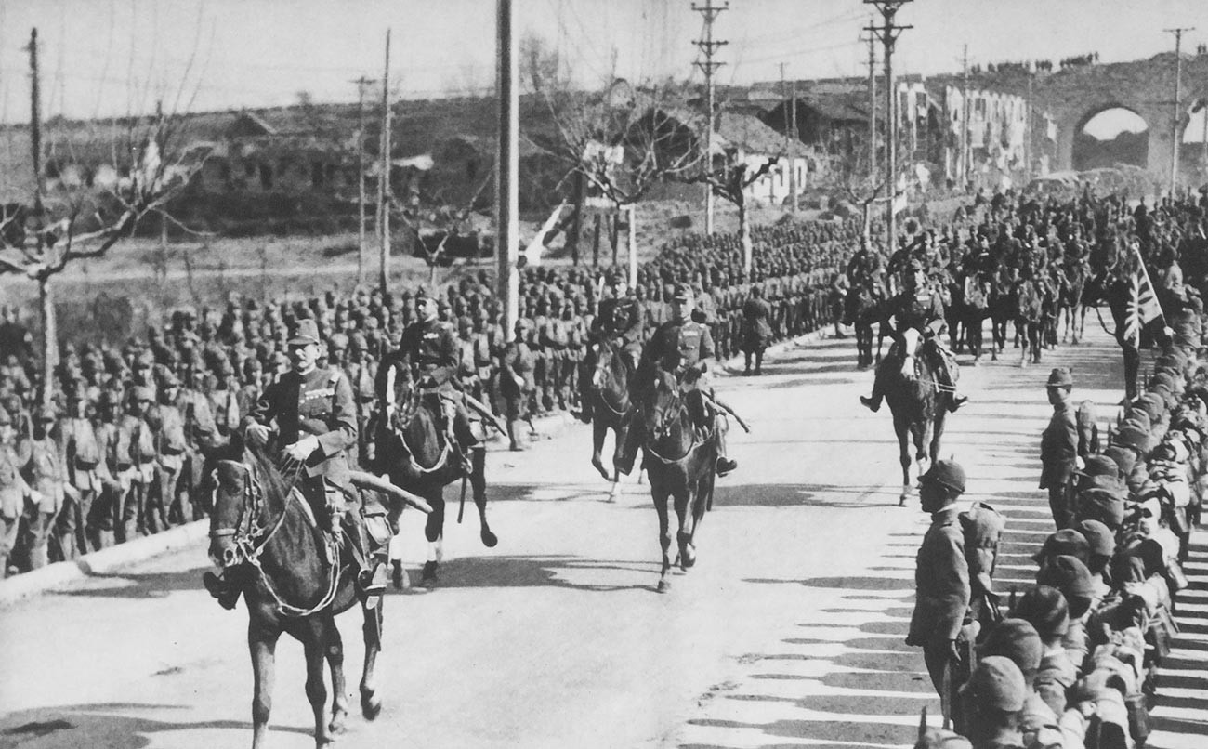
Imperial Japan’s Occupation
While the Third Reich was still building up its strength in the West to fight for more "living space for the German people", Japan was already fully engaged in creating a Greater East Asia under its own domination. In 1931, the Japanese invaded China’s Manchuria province, where the puppet state of Manchukuo was soon set up.
Korea had been a Japanese colony officially since 1910 with the Korea-Japan Treaty and renamed Korea to be “Chosen,” which lasted until Japan’s defeat in 1945.
The Imperial Japanese Army marches into Nanking, December, 13 1937.

Slide 8
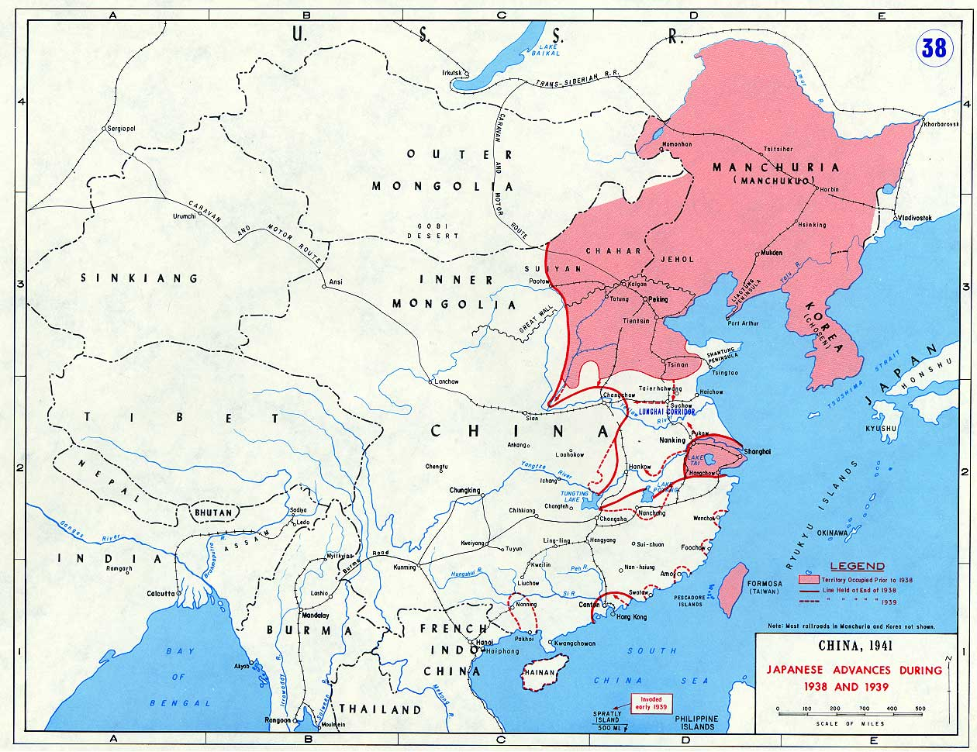
Imperial Japan’s Occupation
The Soviet Union watched Japanese expansion with alarm, rightly believing that sooner or later it would spread to its own Far East.
Japanese-occupied Korea was notorious for the “comfort women” who served in military brothels; these women maintained contact after the war and shared their stories.
The Korean Communist Party (KCP) was set up in 1925 and was originally a member of the Comintern (Communist International).

Slide 9
Problems of the Korean National Liberation Movement and within the Communist Party of Korea - Excerpts from “The Path of the Korean Revolution” by Kim Il Sung, 1930.
On May 30, 1930, opportunistic ultraleft factions calling themselves the KCP organized a revolt in Manchuria, trying to gain international attention to themselves and especially from the Comintern. Instead, Japan used the event to send in armed forces, and after a second incident in 1931, the puppet Manchukuo state was created.
“Let us see how the factionalists acted in connection to the problem of party building in our country . . . the M-L group, the Tuesday group, the North Wind Association group and other factions, each insisting that it was the only "orthodox" and genuine "Marxist" group, approached the Comintern for approval, instead of building up the party. Thus, the KCP failed to strike its roots among the masses deeply enough to overcome Japanese imperialist oppression, and in the long run, was expelled from the Comintern.”

Slide 10
Battle of Lake Khasan 1938
Participants pose for a group photo Saturday in Kraskino, in Russia's Far East, while re-enacting the 1938 Battle of Lake Khasan, also known as the Changkufeng Incident, between Imperial Japanese and Soviet troops. The event was held to mark the 75th anniversary of the clash. (photo from August 2013)

Slide 11
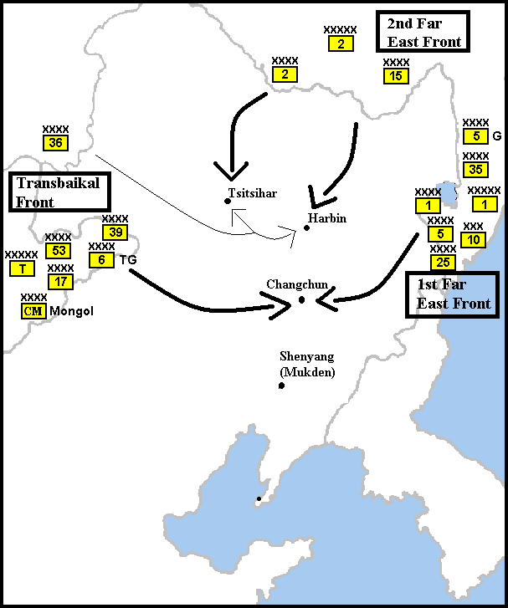
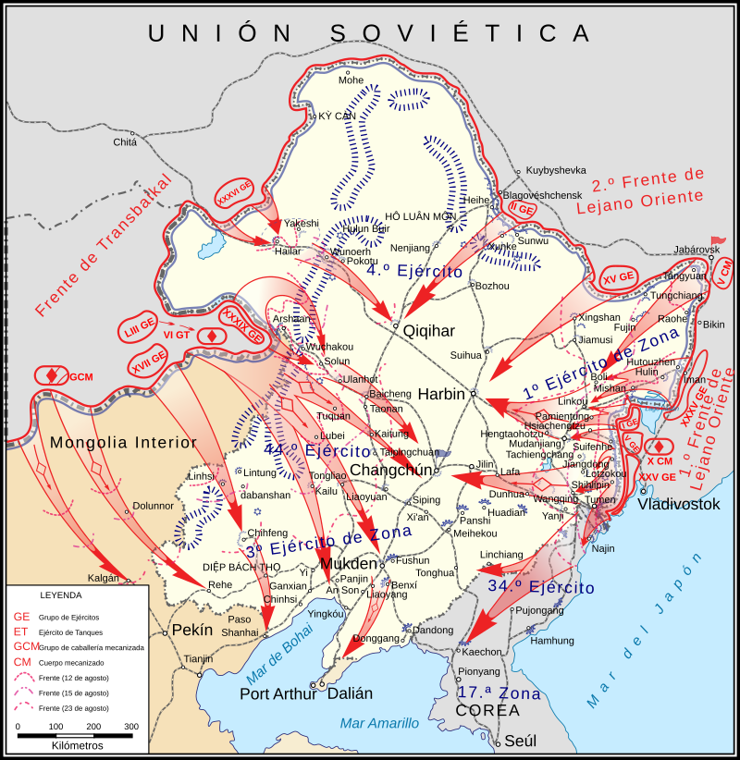
Manchurian Strategic Offensive Operation - 1945

Slide 12
Red Army Support for Korean Liberation
The senior command was the Far East Theater Headquarters, headed by Marshal of the Soviet Union Alexsandr Mikailovich Vasilevsky. He participated in the Stalingrad, Kursk, and Belorussian operations before taking command of the 3rd Belorussian Front in East Prussia in 1945. That same year he was designated to command the Soviet Forces, Far East.
Commanding the Trans-Baikal Front was Marshal of the Soviet Union Radion Yakovlevich Malinovsky, who had previously commanded a front in the Battles of Odessa, Budapest, and Vienna.
Malinovsky’s compatriot was 48-year-old Marshal of the Soviet Union Kirill Meretskov and his 1st Far Eastern Army, with the 5th Guards Army, 1st Red Banner Army, 25th and 35th Armies, 10th Mechanized Corps, and Chuguevsk Operational Group, supported by the 9th Air Army.

Slide 13
A motorized Soviet convoy advances across the Grand Khingan Mountain Range in south central Manchuria.

Slide 14
Japanese troops lay down their arms after surrendering to the Red Army in Harbin, Manchuria, August 20, 1945.

Slide 15
Discussion

Slide 16
Liberation of the DPRK

Slide 17
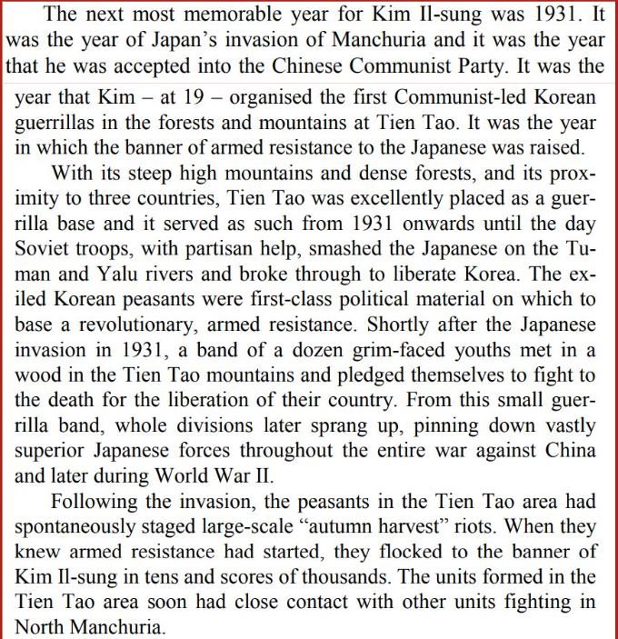
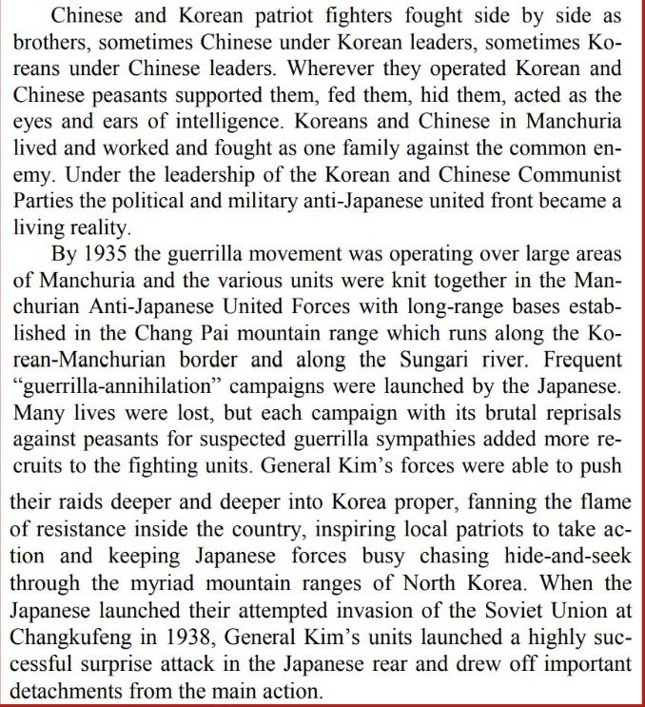
Excerpt from The Monstrous War by W.G. Burchett

Slide 18
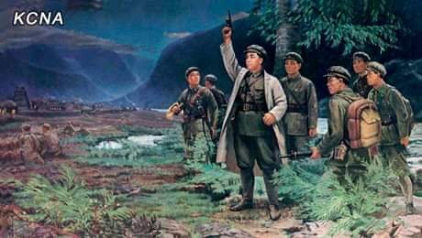
Battle of Pochonbo
June 4, 1937
The time around the Pochonbo Battle was rigorous under the barbaric colonial rule of the Japanese imperialists. In the middle of the 1930s the Japanese imperialists perpetrated unheard-of fascist tyranny against the Korean people.
One of the intensive expressions was their wicked moves to remove the spoken and written Korean language. Feeling more painful at the misfortunes of the Korean nation than anybody else, the great Kim Il Sung decided to strike in Pochonbo, the northern border area of Korea.
Leading the main unit of the Korean People´s Revolutionary Army, Kim Il Sung crossed the River Amnok and arrived at the Konjang Hill in the homeland at night on June 3, Juche 26 or 1937. At 10 p.m. on June 4 he fired his gun into the quiet night sky of Pochonbo in the homeland.

Slide 19
Battle of Pochonbo
June 4, 1937
Due to a powerful attack of the Korean People's Revolutionary Army, the police substation was destroyed and a number of the enemy´s ruling organs such as sub-county office, post office, foresters´ office and fire department hall were wrapped in flames.
The enemy was defeated without proper resistance and flames flared up in the whole city of Pochonbo pushing away the darkness.
Later in his reminiscences “With the Century,” Kim-Il Sung wrote:
“The Battle of Pochonbo showed that imperialist Japan could be smashed and burnt up, like rubbish. The flames over the night sky of Pochonbo in the fatherland heralded the dawn of the liberation of Korea, which had been buried in darkness.
The Pochonbo Battle was a historic battle which not only showed to the Korean people who thought Korea to be dead that Korea is not dead but alive, but also gave them the confidence that when they fight, they can achieve national independence and liberation.”

Slide 20
Discussion & New Members Introductions

Slide 21
New Member Introductions
What is your name, pronouns and state (or country/territory)?
Where do you work? Is it unionized?
How did you find out about the People’s School?
What do you think about tonight's class?

Slide 22
Hiroshima and Nagasaki US Nuclear Strikes

Slide 23
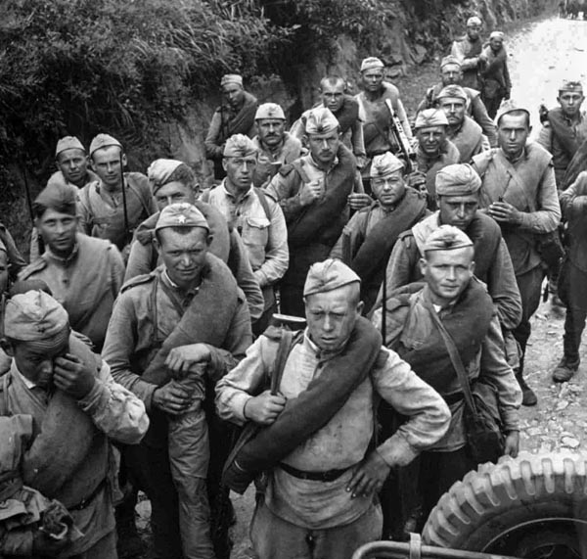
End to Japanese Occupation
The Soviet Manchurian Campaign destroyed the last vestige of Japanese military power outside Japan.
After the Soviets launched an amphibious operation in Japanese-occupied Korea on August 14, the Red Army stopped at the 38th Parallel at the proposal of the United States, thus establishing the later border between North and South Korea.

Slide 24
National Liberation and the Founding of DPRK
“The situation in our country underwent a radical change after liberation. When the anti-fascist world war was brought to a victorious conclusion thanks to the decisive role played by the Soviet army, the system of barbarous Japanese imperialist rule collapsed in Korea, too, and the way was opened up for building a Korea for the Koreans, for building a new country and a new life in conformity to our people's will and demands.”
Kim Il Sung, August 26, 1946 from, 'For the Establishment of a United Party of the Working Masses: Report to the Inaugural Congress of the Workers' Party of North Korea’
Thus, the national liberation that led to the founding of the Democratic People's Republic of Korea was a product of the anti-fascist war.
The German Democratic Republic and other Socialist countries were all also products of the anti-fascist conflict of which the USSR was victorious.

Slide 25
The People's Committees
(Inmin Wiwŏnhoe)
Socialist-sounding names of local government councils set up in both the North (Soviet occupation zone) and South (American occupation zone) which consisted of all political strata of post-Japan Korea
Communists, nationalists, conservatives, religious groups and others participated in the People’s Committees
Workers’ Party of Korea formed in 1946
Democratic People's Republic of Korea formed September 9, 1948
Soviets leave their occupation zone in Korea; US stays and suppresses the People’s Committees

Slide 26
US Military Law and fascism in Korea
Synghman Rhee installed by United States as South Korean leader
Rhee assassinated political opponents in South Korea and set up concentration camps called “Rehabilitation Camps” which led to the deaths of over 200,000 people from 1948-1954
Former Manchukuo infrastructure left in place under US administration, like Manchukuo Imperial Army officer Park Chung Hee, who would take power in a coup de tat in 1961.
August Uprising 1946, called Daegu Incident by South Korean government, general strike of workers put down by US Army military government and martial law
Jeju Uprising in 1948, protests against US-UN military expansion, which resulted in massacre of over 30,000 people from Jeju Island

Slide 27
Uprisings against US colonialism in Korea, 1946-1950
Skirmishes along 38th parallel occurred in the lead up to the Korean War
Border fighting was initiated by the South Korean (and former Imperial Japanese) leadership on the orders of the United States, beginning in 1949
Kim Suk-won, a Korean who served in the Japanese Kwantung Army, led the “Kim II-Sung Activities Unit” and was personally awarded by Emperor Hirohito and then led South Korean military forces and their engagements on the 38th parallel in 1949

Slide 28
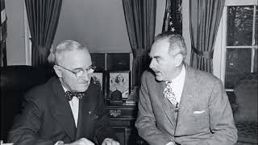
US started the Korean War

Slide 29
Discussion & Wrap Up

Slide 30
Announcements
THE KONONOVITCH BROTHERS NEED US, SHARE THIS ARTICLE:
https://dailyworkerusa.com/stop-the-kiev-regimes-calls-for-the-murder-of-the-kononovitch-brothers/

Slide 31
Volunteers Needed!
We are in need of volunteers for the staff of the People’s School! Here’s a few roles we need filled:
People to help manage posting on our social media and podcast platforms
Video Editors, Audio Editors, Graphic Designers, Artists, Narrators
Facilitators, Web Controls, Moderators
Email info@peoplesschool.us if you’re interested and try to attend our next staff meeting on ______ if possible.

Slide 32
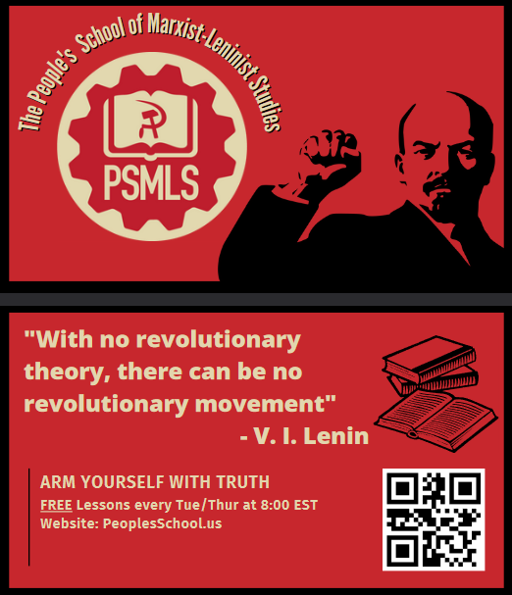
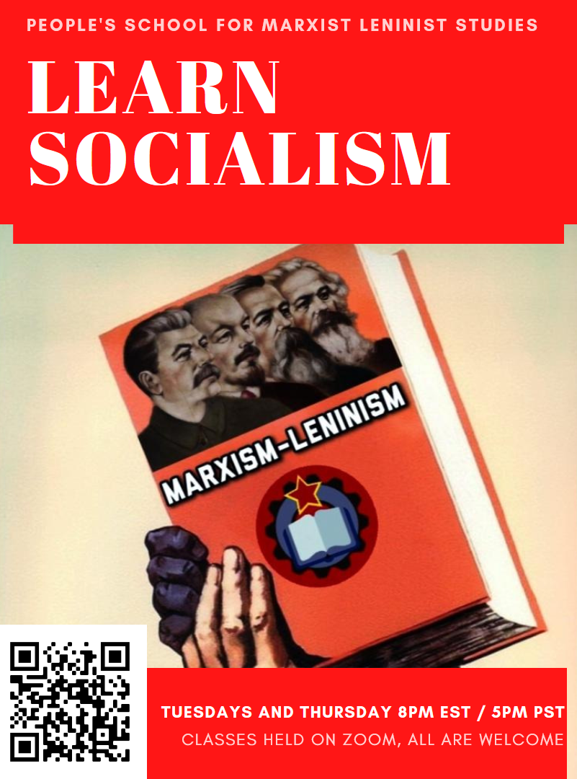
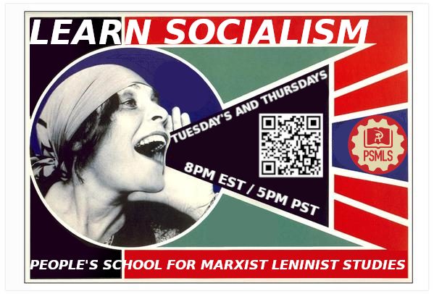
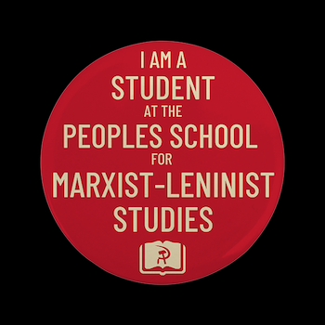
PSMLS Propaganda
peoplesschool.us/media & peoplesschool.us/store
Materials to help promote the school!

Slide 33
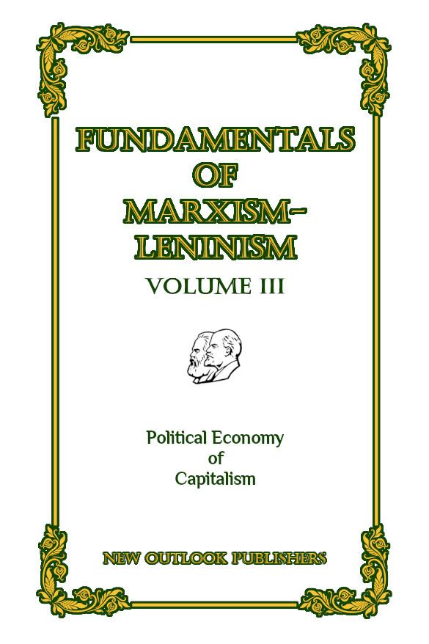
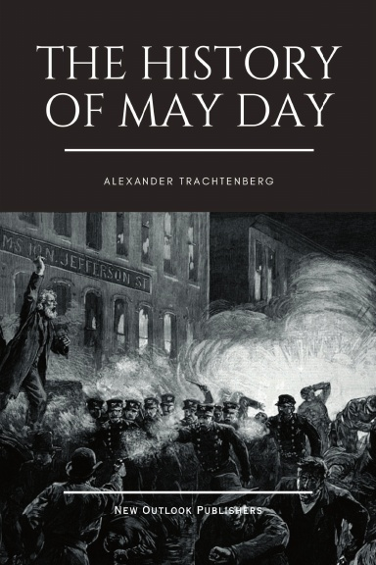
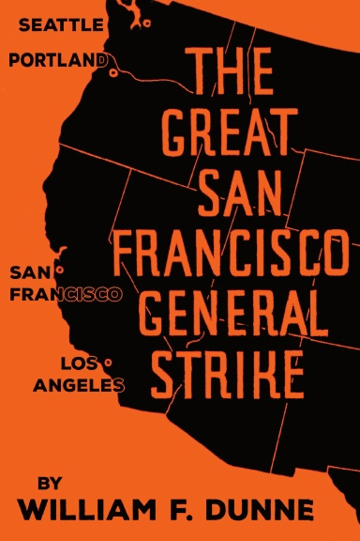
New Outlook Publishers
newoutlookpublishers.store
Latest Releases

Slide 34
Legal Drive
Last year we were attacked and sabotaged by ultraleft wreckers that tried to steal the PSMLS and destroy the PCUSA. They failed, but they will be held accountable and there are still things they took from us that we’ve not got back, like videos, imagery, audio etc. That is why we still need donations to the legal drive.
If you support the school and want to see us continue to improve and keep delivering this education 51 weeks a year, please pitch in whatever you can and support the GoFundMe for the legal drive @ https://www.gofundme.com/f/legal-fund-to-defend-against-wreckers.
Anything helps!

Slide 35
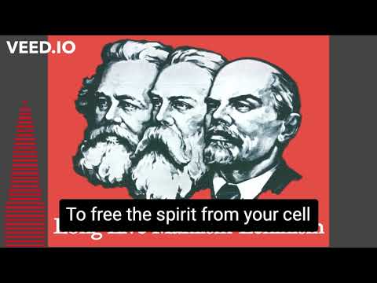
The Internationale - 1933 American Version by “The New Singers”

