Slide 1
Born in the U.S.A. - 1984 Anti-War Song by Bruce Springsteen.

Slide 2
PSMLS mm/dd/yy - mm/dd/yy

Slide 3
What we’ll be learning today:
American interventions in West Asia, Latin America, Africa and other international events during the late 1970’s and into the 1980’s.
Domestic events in the Reagan Era, including changes in economics and decline in anti-war organizing.

Slide 4
Interventions in West Asia

Slide 5
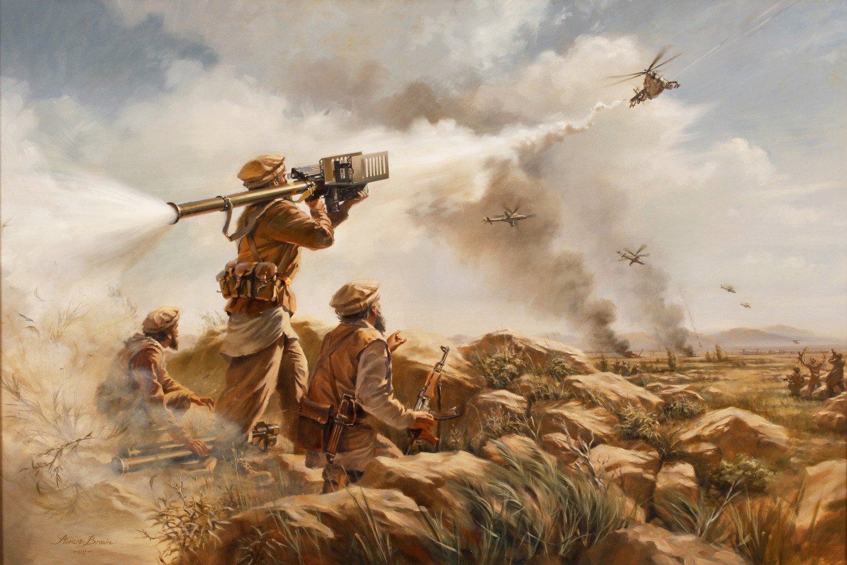
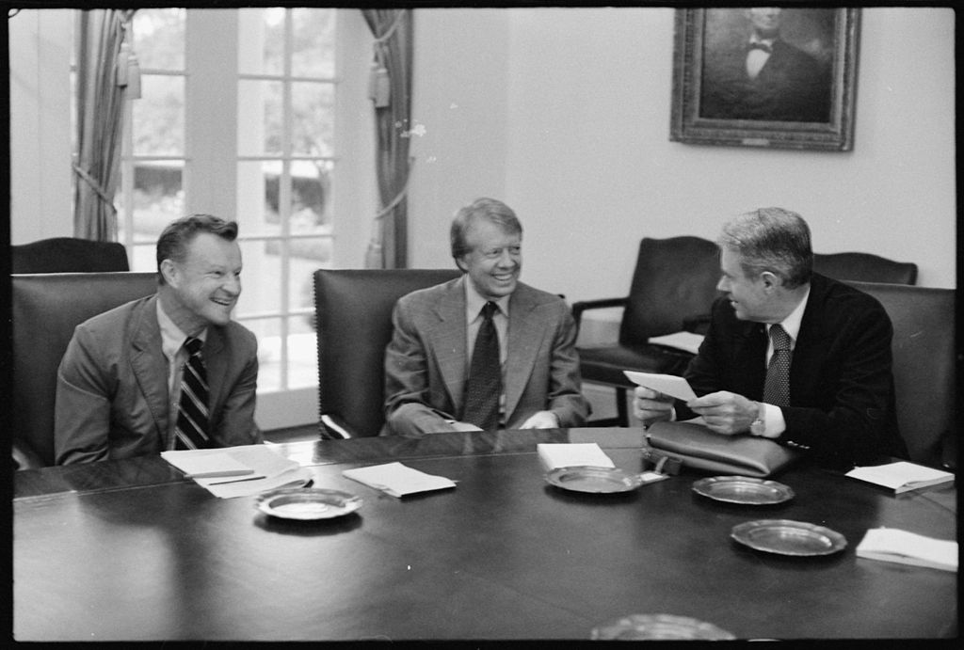
US Intervention in Soviet-Afghan War
Operation Cyclone
In 1979, under the Carter Administration, the Central Intelligence Agency began Operation Cyclone, a program to aid and arm the Afghan mujahideen under Gulbuddin Hekmatyar, via Pakistan’s Zia Al-Huk, against the Democratic Republic of Afghanistan, both to topple the socialist government and to induce a Soviet intervention. British MI6, the Pakistani Inter-Services Intelligence, and Saudi General Intelligence Presidency were also involved.
Zbigniew Brzeziński, the National Security Advisor to Jimmy Carter, said that it would give the “USSR’s Vietnam.” Funding began at $695,000 in 1979, but rose nearly 1000% by 1987 to ~$630 million. FIM-92 Stinger surface-to-air missiles were a notable armament sent to the insurgency. In December of 1979, after a request to intervene by the DRA, the Soviet Union launched a military intervention in Afghanistan against the Afghan Mujahideen.

Slide 6
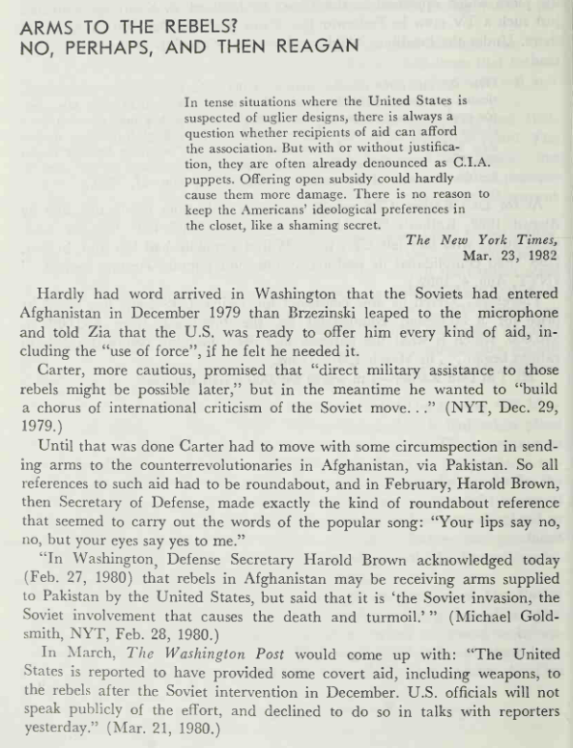
Afghanistan: Washington's Secret War by Phillip Bonosky

Slide 7
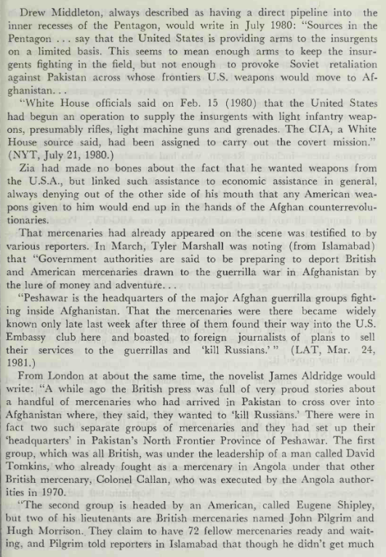
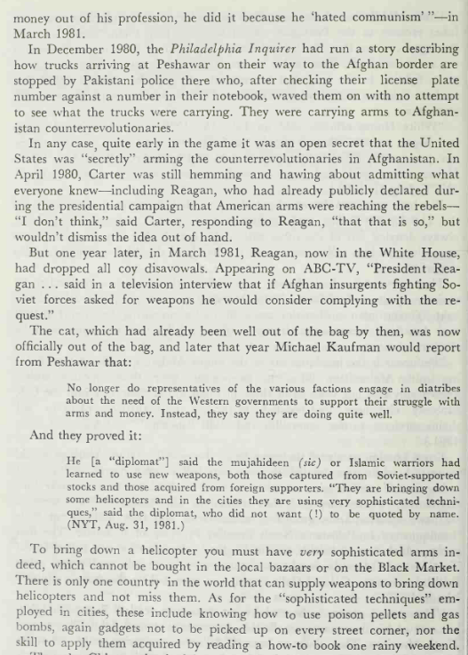

Slide 8
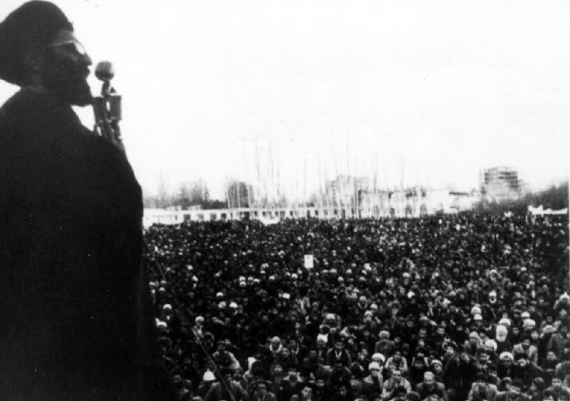
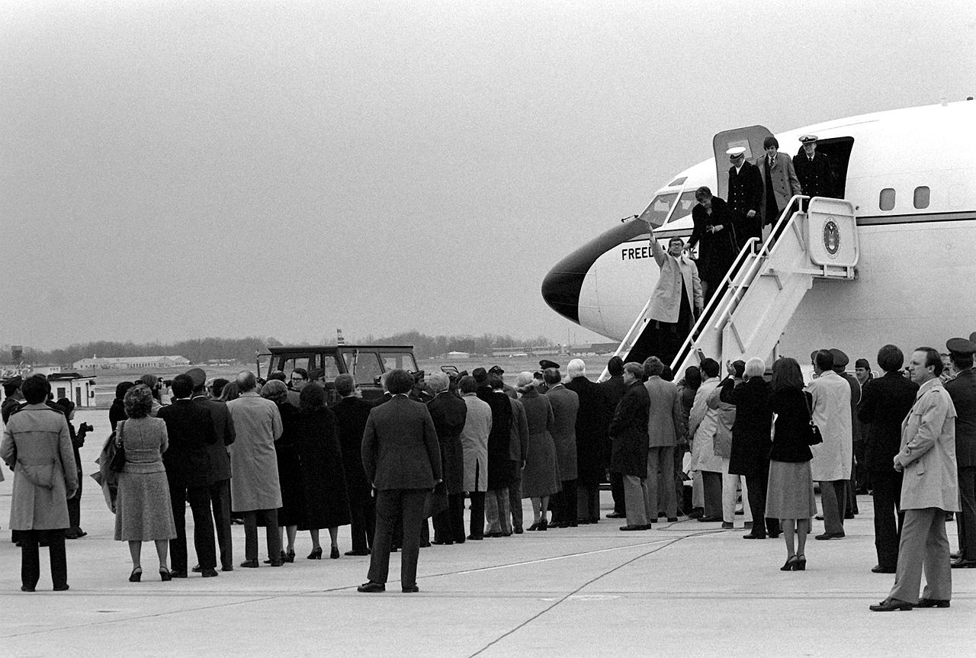
Iran - Revolution & Hostage Crisis
Also in 1979, the US-backed monarchic government of the Mohammed Reza Pahlavi, or “The Shaw”, which had been in power since the 1953 US-backed coup that ousted Mossadegh, was overthrown in a revolution led by Ayatollah Khomenei.
US control in Iran was ended, and when the Shaw was flown to the US for cancer treatment in October of 1979, a group of students from the Muslim Student Followers of the Imam's Line, stormed the US embassy in Tehran and held hostage all of its staff. They wanted the Shaw in exchange for the hostages so he could face trial and execution for his brutal reign in Iran.
Hostages were held for 444 days, and the crisis ended with the Algiers Accords on January 19th, 1981. The hostages returned to American custody the same day as Ronald Reagan’s first inauguration. Carter was deemed as weak by imperialists for not having performed a larger military intervention to save them, despite a failed rescue attempt in Operation Eagle Claw, in 1980.

Slide 9
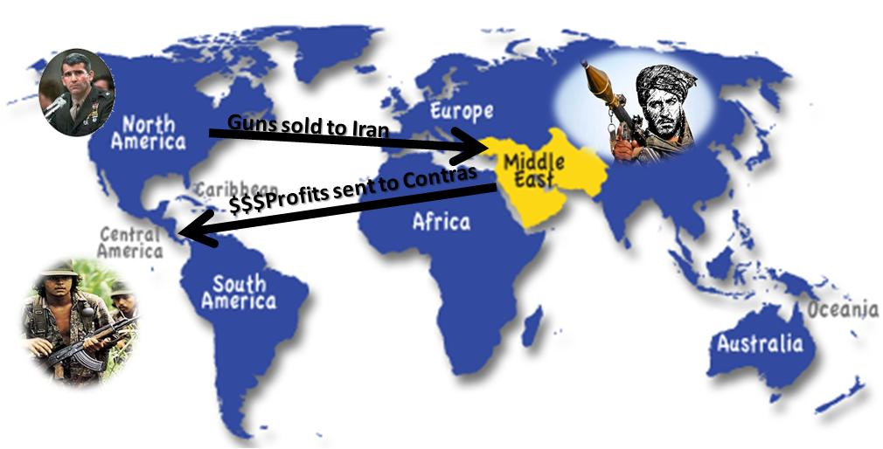
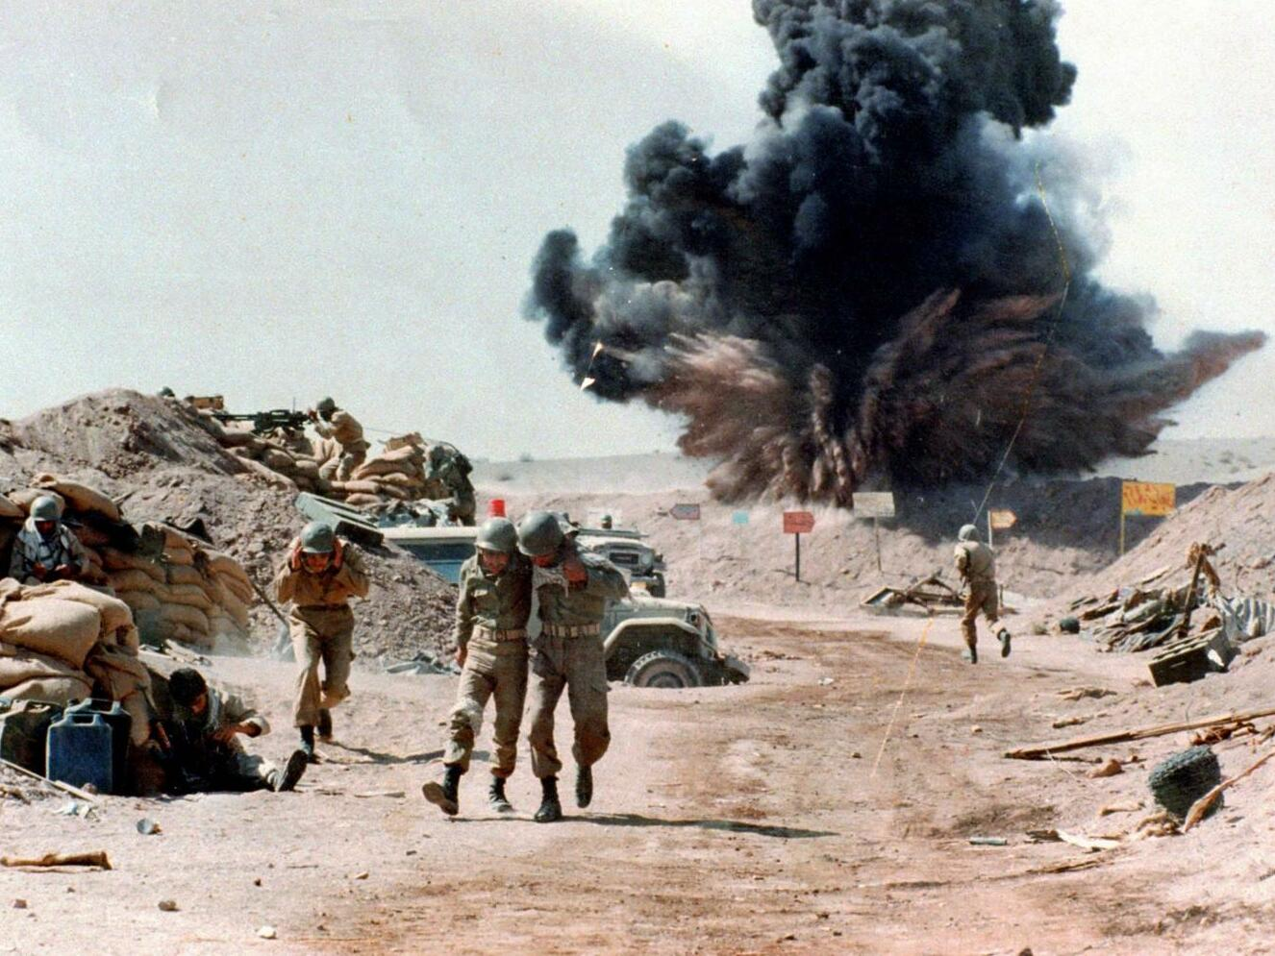
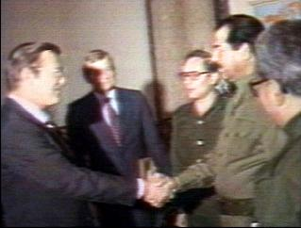
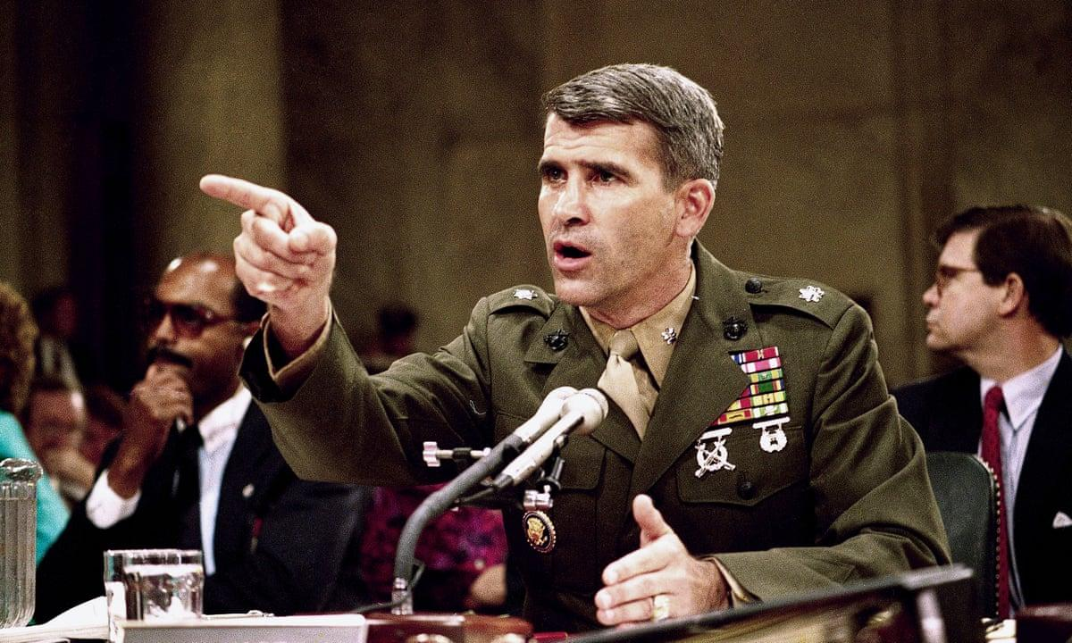
Iran - Iran-Iraq War & Iran-Contra Affair
Iran would continue to be an issue for the imperialists into the Reagan Administration. As the Iran-Iraq War began, the United States began aiding both sides covertly. US companies shipped strains of anthrax and insecticides to Iraq under Saddam Hussein. As for Iran, the Presidential Administration of Ronald Reagan facilitated secret arms sales to Iran, the money from which would be used to fund the counter-revolutionary militants in Nicaragua, the “Contras.”
A confession from a CIA agent who survived a recon plane crash in 1986 revealed this scandal to the world and it became known as the “Iran-Contra Affair” and it rocked the Reagan Administration, yet only 1 person involved with the affair was ever imprisoned. Some participants, such as Elliot Abrams, would go on to be involved in the George W Bush Administration about 15-20 years later. Others, such as Oliver North, continued in places such as the National Rifleman's Association or became commentators on rightwing media.
Ronald Reagan first told the nation it wasn’t true, then said he “my heart tells me that is true but the facts and evidence say otherwise” and managed to avoid any accountability, despite North saying he knew of what went on. George H. W. Bush denied involvement, but it was later revealed from his diary that he was “one of the few people that knew fully the details.”

Slide 10
Other Interventions in West Asia
1980 - Turkey: 43rd Government of Turkey overthrown by rightwing military of Turkey, backed by the CIA. Military junta in Turkey lasted until 1983, the Kurdish language was banned, all political organizations were banned and the Kurdish-Turkish conflict escalated.
1982-1984 - Lebanon: The US set up a Multi-National Peacekeeping Force in Lebanon with the UK, France and Italy as part of the ceasefire agreement brokered to end the 1982 Israeli invasion of Lebanon. In 1983, barracks in Beirut housing American and French soldiers were struck with a powerful explosion from 2 truck bombs, killing ~241 Americans and ~58 French.
1987-1988 - Persian Gulf: During the Iran-Iraq War, the United States Navy made several attacks on Iranian Naval Forces for placing mines in international waters, including with Operation Praying Mantis, where several inoperable oil platforms and ships were struck and sank. This was the most major military escalation with Iran in this period.
Throughout 1980’s - Israel: The US gave about $3 billion of military aid to Israel annually, of which was used against Lebanese forces in the 1982 Lebanon War and the Palestinian resistance forces in the First Intifada. The Reagan Administration issued public criticism of Israel for its usage of these weapons but did not stop sending them arms and ammunition.

Slide 11
Discussion

Slide 12
Interventions in Latin America

Slide 13
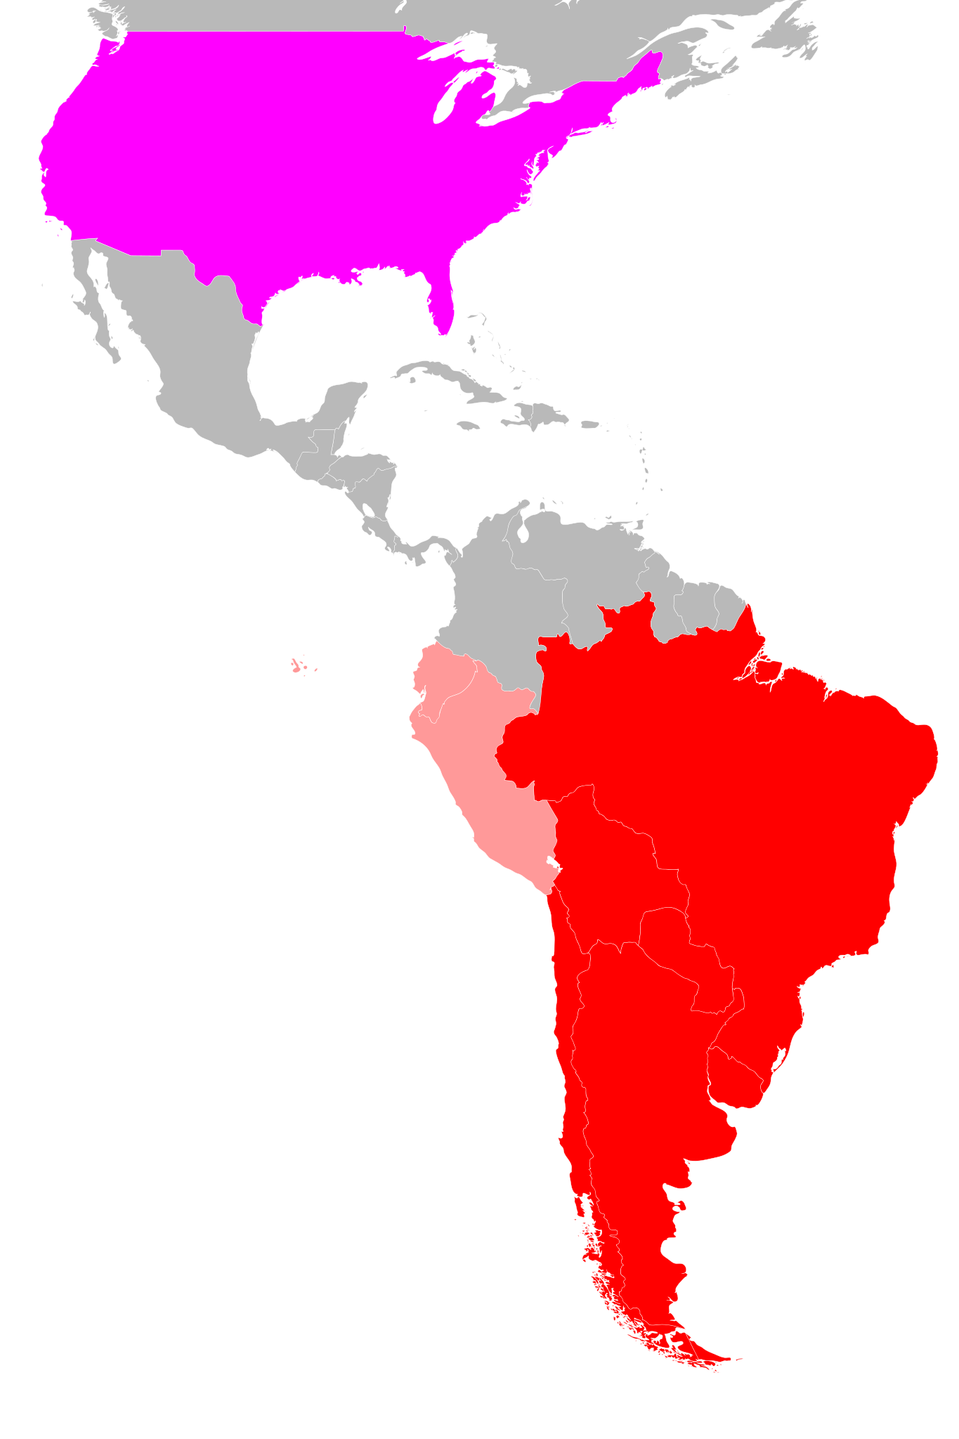
Overthrowing South America
Operation Condor
After the ‘54 Paraguayan coup, ‘64 Brazilian coup, ‘71 Bolivian coup, and ‘73 Uruguayan and Chilean coups, in 1975 General Francisco Morales Bermúdez of Peru overthrew the government of President Alvarado and in 1976, Argentinian General Jorge Rafael Videla overthrew President Isabel Perón (who was the first woman president of any country in history), and set up a military dictatorship over the country.
Rightwing military juntas were installed that were sympathetic to the United States and would carry out murders and disappearances of thousands of suspected communists and other leftists. In November of 1975, Operation Condor was formally created and began to do this as a joint effort of these fascistic dictatorships. This program was carried out under the Presidential Administrations of Gerald Ford, Jimmy Carter and Ronald Reagan, and formally ended in 1989.

Slide 14
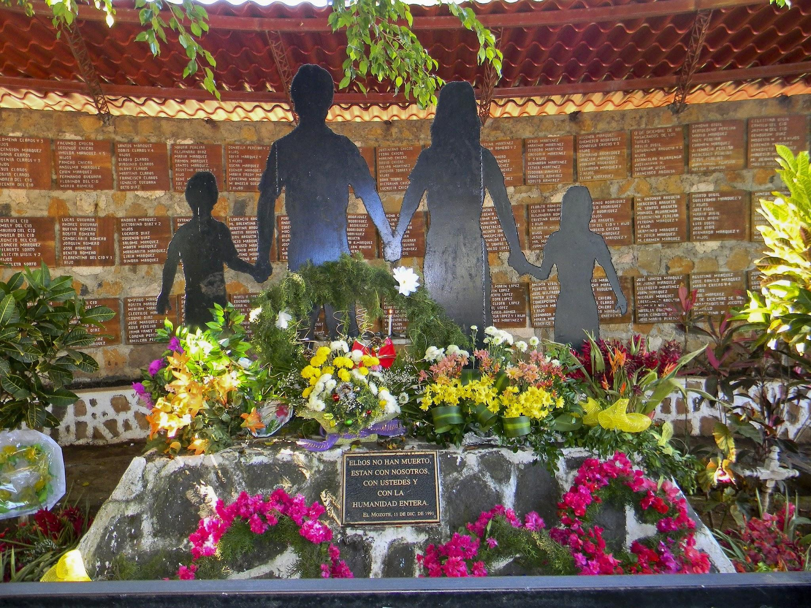
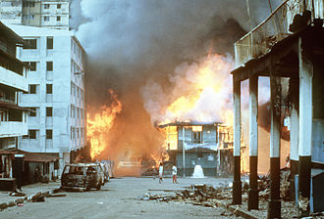
US Intervention in Central America
War on Drugs & Counter-Revolution
In the late 1970’s, the Sandinista National Liberation Front (FSLN) took power in the Nicaraguan Revolution. The United States began training, equipping and funding counter-revolutionary forces, “Contras” against the Sandinistas in the Contra War.
The United States also trained the El Salvadoran Army, which committed the El Mozote massacre in 1981, the murder and rape of some 1000 men, women and children in the town of El Mozote, El Salvador. This is the worst massacre in the Americas in modern history.
Anti-drug operations were carried out covertly throughout Latin America, targeted at cocaine and cannabis mostly. Manuel Noriega was a CIA supported drug trafficker who supported the Contra army for years until the Iran-Contra Affair made Noriega a liability, and allowed the Drug Enforcement Agency (DEA) to go after him on an indictment the CIA blocked them from pursuing years before. Panama was invaded by the United States to remove Manuel Noriega from power on December 20th, 1989, in “Operation Just Cause.”

Slide 15
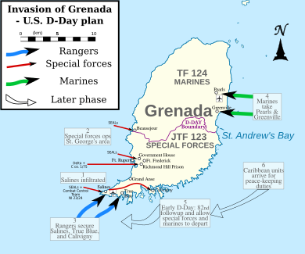
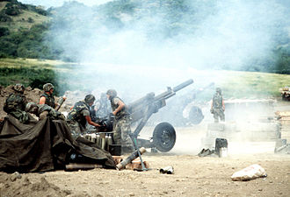
US Invasion of Grenada
Operation Urgent Fury
2 days after the barracks bombings in Beirut, on October 20th, 1983, the United States unexpectedly invaded the Caribbean island nation of Grenada to topple its Peoples Revolutionary Government and expel Cuban and Soviet forces. Maurice Bishop had just been killed in a coup within his government 6 days earlier.
The entire operation was bungled, 19 servicemen were killed and 9 helicopters were destroyed. The US sent 7,300 troops, 4 tanks, 1 LHA, 1 aircraft carrier, 3 destroyers, 2 frigates, 1 ammunition ship, 27 F-14A Tomcats and 353 “peacekeepers” to face off against a mere 1,300 troops, 8 APCs, 2 armored cars, 12 AA guns and 784 Cubans, most of whom were construction workers. The only footage offered to the public was government footage depicting the success of American troops. To make matters worse, 18 civilians at a mental hospital were killed by the US when it was bombed by the Navy, supposedly in an accident.

Slide 16
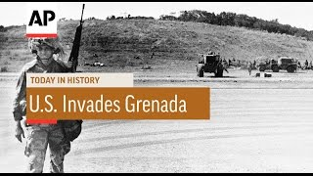
US Invades Grenada News Footage from 1983

Slide 17
Discussion

Slide 18
Interventions in Africa and Other International Events

Slide 19
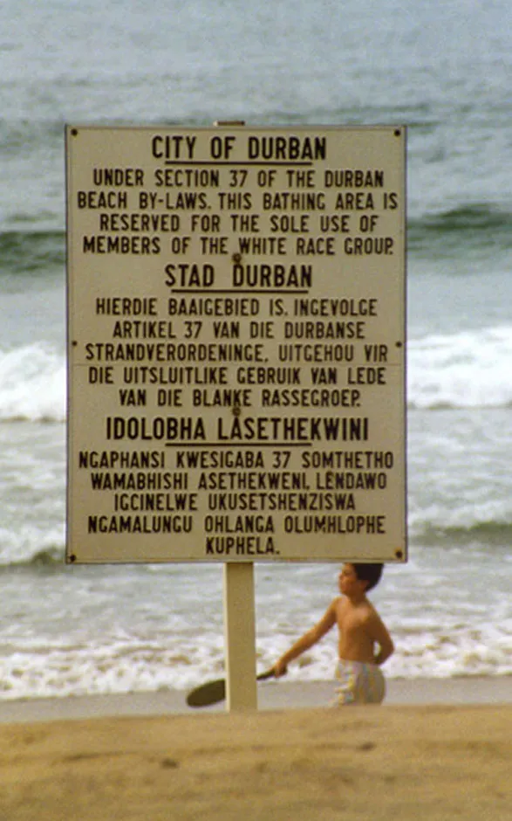
Interventions in Africa
South African Apartheid
From 1948 - 1994, South Africans were subject to a system of institutionalized racist segregation. South Africa was dominated socially, politically and economically by the minority white population. The economic and social effects persist to this day through inequality.
The Population Registration Act of 1950 categorized citizens into different racial groups. As a result, 3.5 million black Africans were forced into segregated neighborhoods. Marriage between people of different ethnic groups was prohibited.
Resistance groups such as the African National Congress (ANC) received violent suppression. Nelson Mandela, a leader of the ANC, was imprisoned.
The Suppression of Communism Act (1950) banned all communist parties and the act defined communism and its aims so sweepingly that anyone opposing government policy risked being labeled a communist.

Slide 20
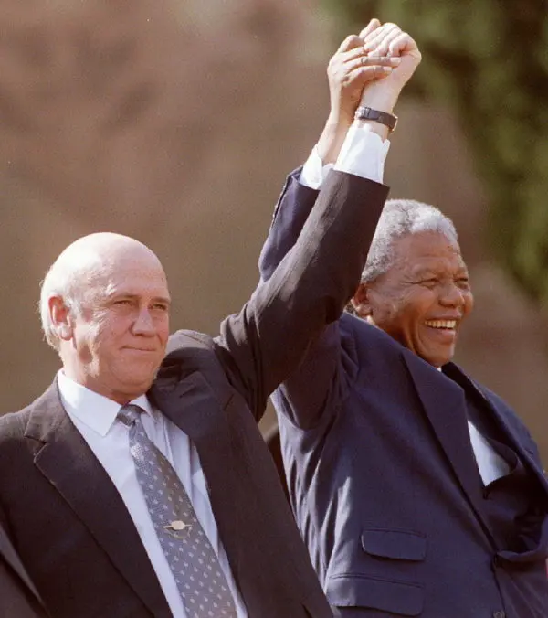
Interventions in Africa
South African Apartheid (cont.)
These practices were condemned internationally as the UN voted for international & economic sanctions and arms embargoes against South Africa. The Soviet Union showed support for the anti - apartheid movement by aiding the ANC through military training. Upon being released from prison in 1990, Nelson Mandela was awarded the Lenin International Peace Prize by the Soviet Union.
The US maintained friendly relations with the National Party due to their anti-communist ideals and to maintain economic ties, particularly because of the US steel industry’s reliance on South African mineral exports.
Despite condemning apartheid, the US continued to block sanctions against South Africa at the UN in the 1960s and the 1970s. The US increased trade with the Apartheid regime and provided diplomatic support in international forums, while describing the ANC as "a terrorist organisation." Similarly, Margaret Thatcher of the UK also vetoed UN economic sanctions.
Mandela with Kennedy, the only US president to adhere to UN sanctions on the apartheid regime
Mandela with de Klerk, the South African President who ended apartheid

Slide 21
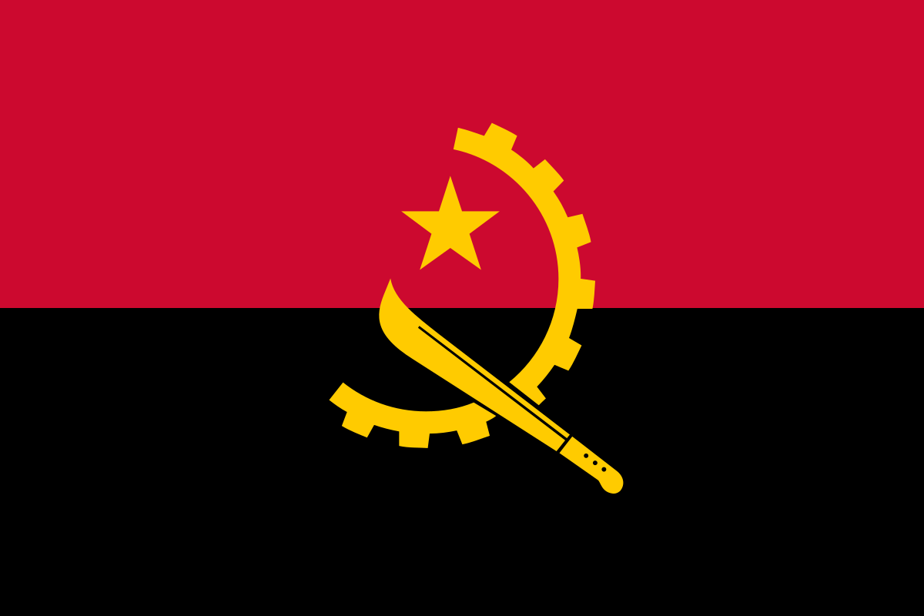
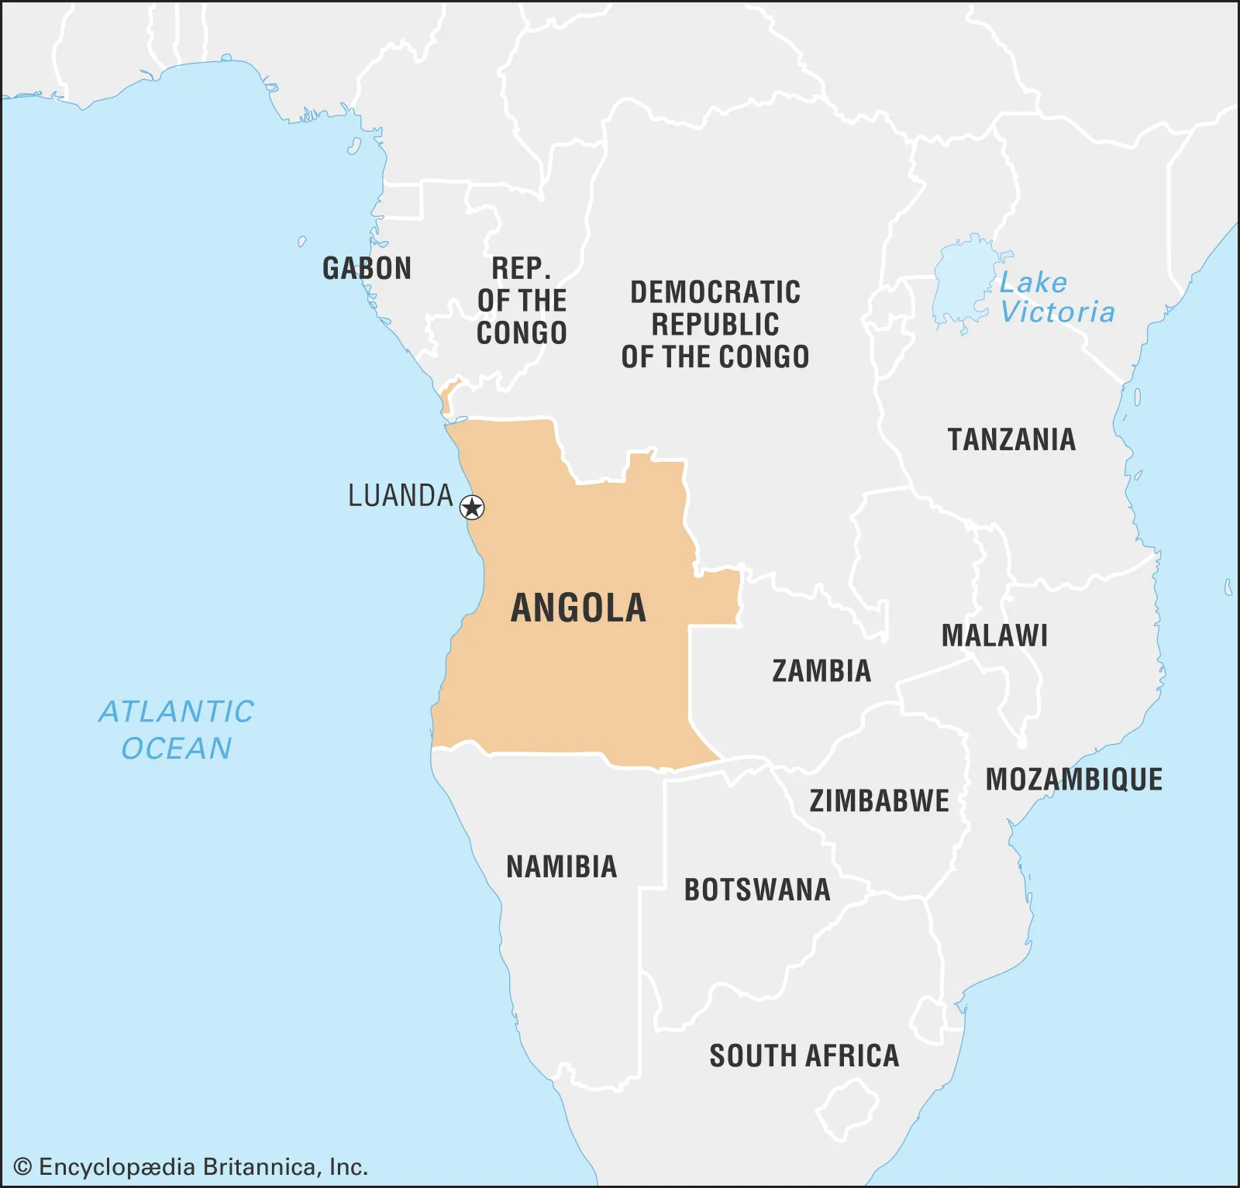
Interventions in Africa
Angolan Civil War (1975 - 2002)
After Angola gained independence from the Portuguese, civil war erupted between two previously anti-colonial guerilla movements: the communist People’s Movement for the Liberation of Angola (MPLA) and the anti-communist National Union for the Total Independence of Angola (UNITA). This created the perfect grounds for a proxy war between the US and the Soviet Union.
Cuba and the Soviet Union provided training and aid to the MPLA, allowing them to win the initial phase of fighting and establish the Angolan government. However, UNITA, funded by the US and South Africa, continued fighting the government until 2002.
By the time the war ended, between 500,000 - 800,000 people perished and much of Angola’s infrastructure was destroyed.

Slide 22
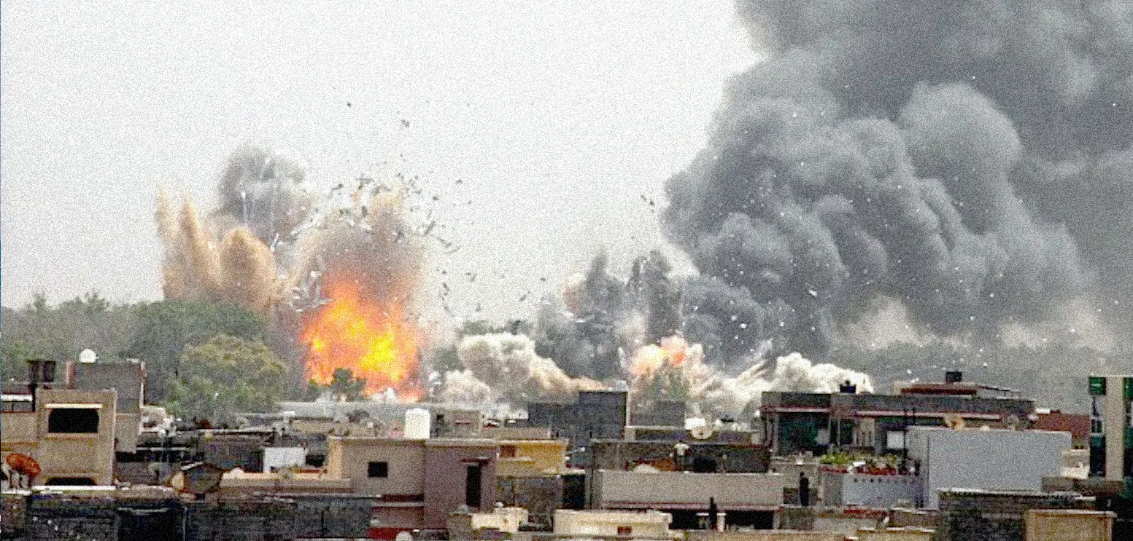
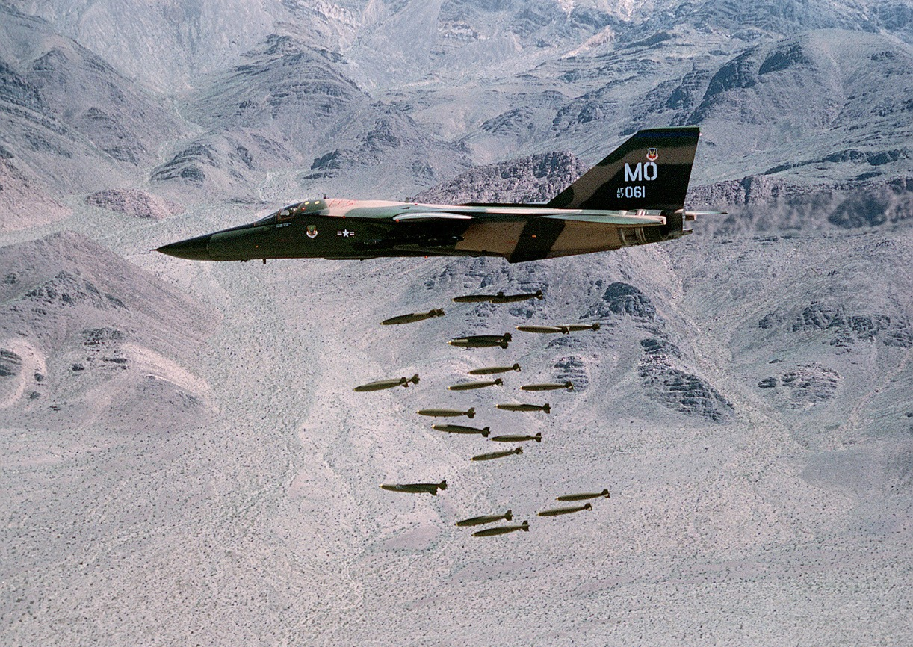
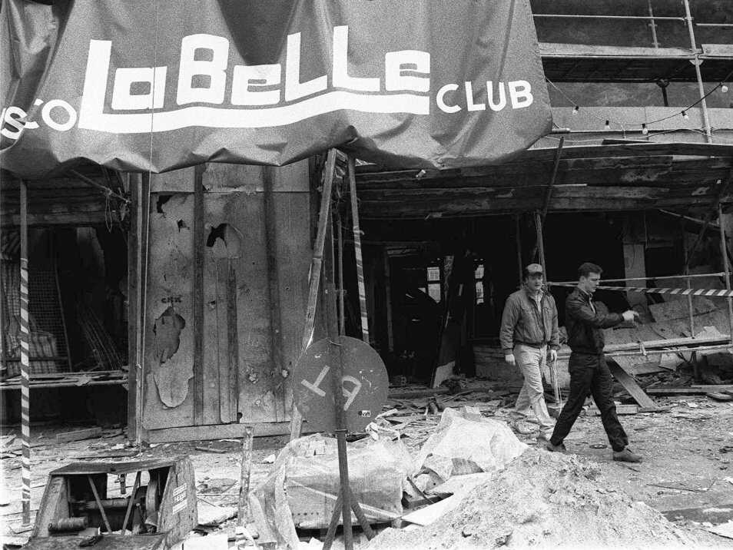
Interventions in Africa
Bombing of Libya
In 1986, the US carried out airstrikes in Libya, code named Operation El Dorado Canyon. 40 Libyan citizens were killed and one US plane was shot down.
This was in retaliation for the bombing of a discothèque in West Berlin that claimed the lives of 3 people. President Reagan blamed the attack on Libyan agents of Muammar Gaddafi.
This was the first attack on the mainland of Libya by the US after many years of conflict over Libyan territorial claims to the Gulf of Sidra.
Reagan saw Libya as a high priority as Gaddafi was anti-Israel and supported Palestine and Syria. There were also reports that Libya was attempting to become a nuclear power. Gaddafi also aimed to start a federation of Arab and Muslim states in North Africa, contrary to US interests.

Slide 23
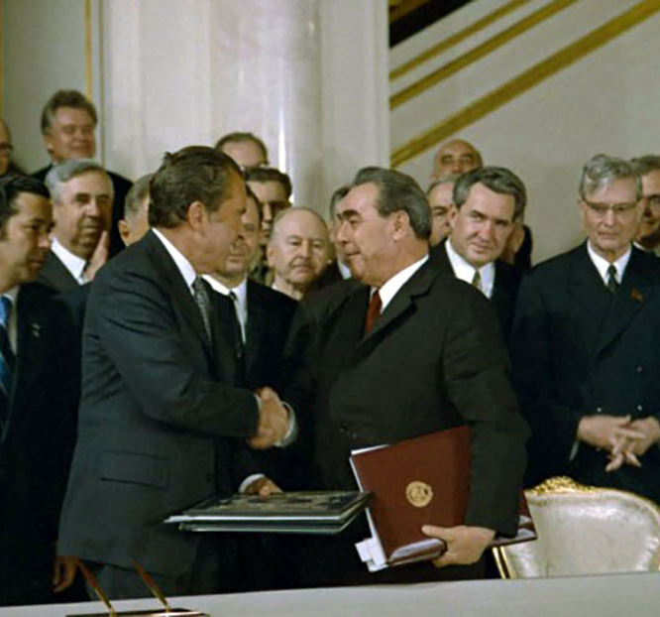
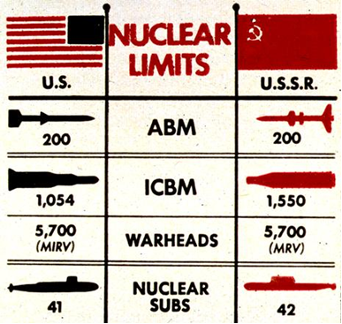
Limiting Nuclear Weapons
Strategic Arms Limitations Talks (SALT)
In November 1969, the US and Soviet Union began bilateral conferences which lead to international treaties. The focus of the discussions was on arms control.
The first negotiations, SALT I, led to the Anti-Ballistic Missile Treaty. This was a limitation on ABMs, which are used to defend against ballistic-missile nuclear weapons. This was intended to reduce pressures to build more nuclear weapons.
Held from 1972-1979, SALT II sought to curtail the manufacture of strategic nuclear weapons. It also banned new missile programs. Though an agreement was reached, the US Senate chose not to ratify the treaty in response to the Soviet invasion of Afghanistan, which took place later that year. The Soviet Union did not ratify it either. The agreement expired on December 31, 1985, and was not renewed, although both sides continued to respect it.

Slide 24
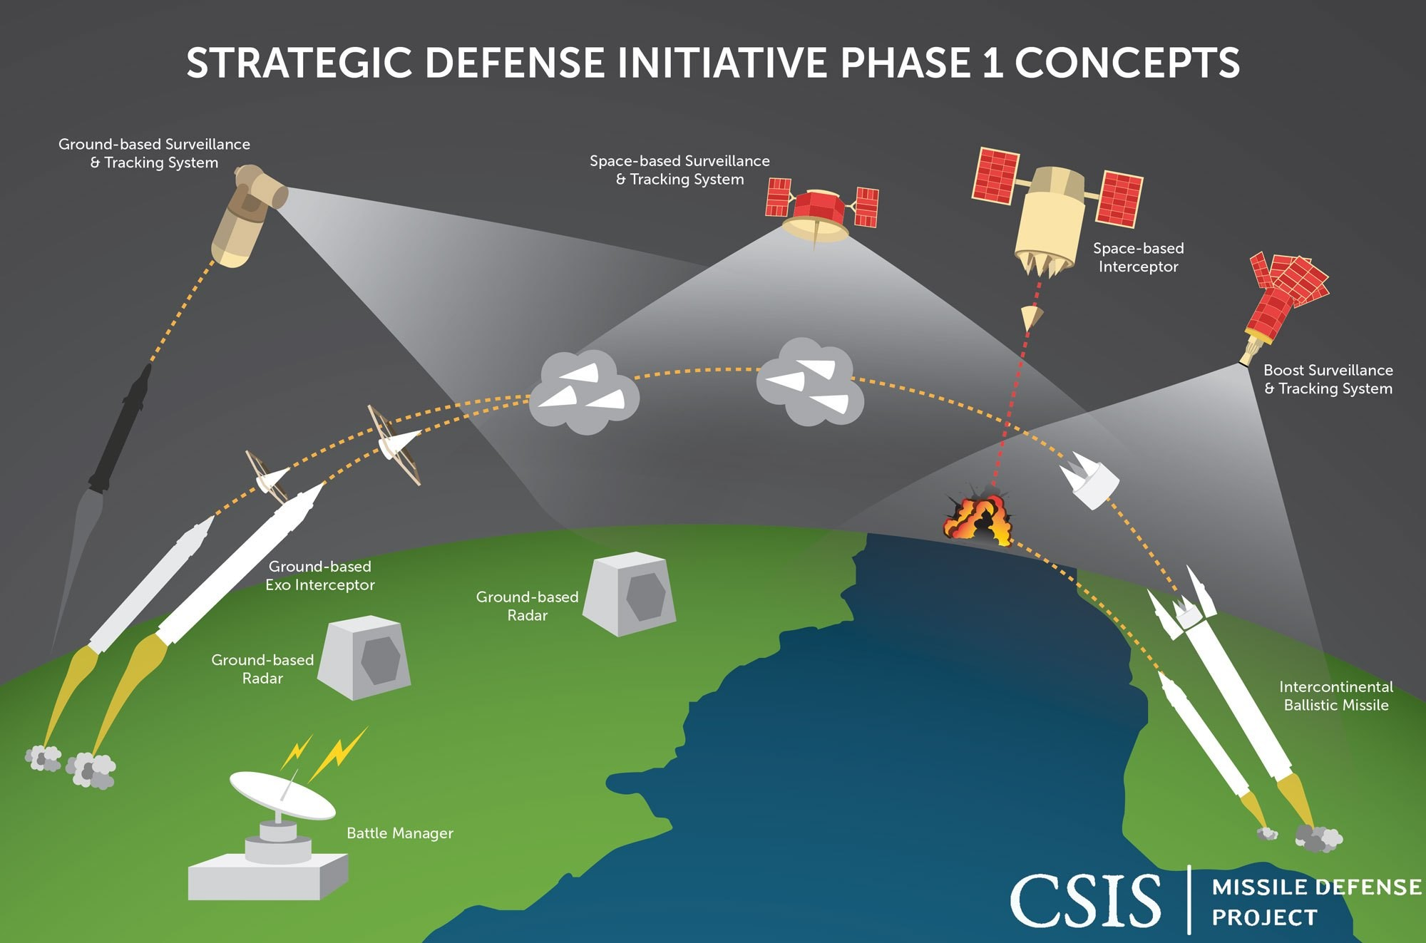
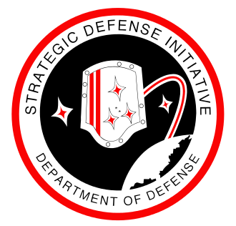
Limiting Nuclear Weapons
Strategic Defense Initiative (SDI)
In March 1983, Reagan called upon American scientists and engineers to develop a system that would render nuclear weapons obsolete. Also known as the “Star Wars Program,” the SDI was a proposed missile defense system intended to protect the US from strategic nuclear weapon attacks.
A wide array of advanced weapon concepts, including lasers, particle beam weapons and ground- and space-based missile systems were studied, along with various computer systems that would be needed to control a system consisting of hundreds of combat centers and satellites spanning the entire globe.
By 1987, the American Physical Society concluded that the proposed technologies were decades away from being ready for use and at least another decade of research was required to know whether such a system was even possible. The SDI’s budget was cut after this finding. The effort was re-focused on using small orbiting missiles, which was expected to be much less expensive to develop and deploy.

Slide 25
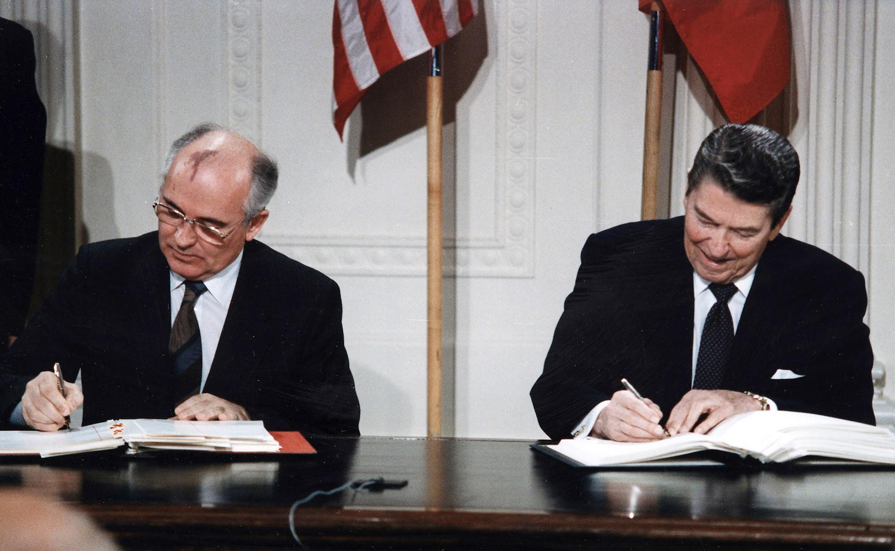
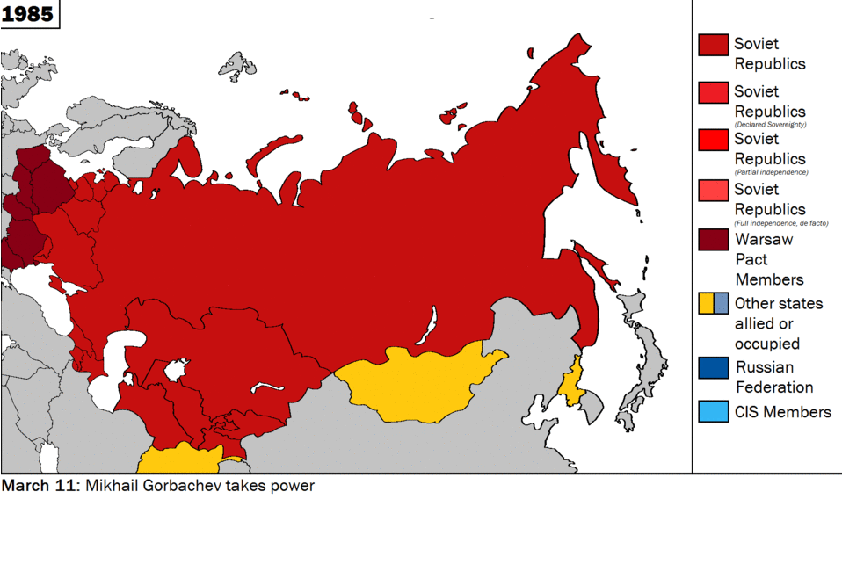
“End” of the Cold War
Counter-Revolution in the USSR
Throughout the 1980’s, the Union of Soviet Socialist Republics were going through an intense political crisis brought about by the efforts at liberalization of the USSR by Mikhail Gorbachev with Glasnost and Perestroika. This of course, began the turn of events that would lead, in December of 1991, to the dissolution of the USSR by counter-revolutionary Yeltsinite forces.
This was a purposeful surrendering to US imperialism. For 4 and a half decades, the USSR was the bulwark in the world against US imperialism, and now it was shattered into several fledgling republics that would all develop differently into the new century, some coming under the control of western imperialism hard, like Ukraine. Others sticking by Russia, like Belarus. These differences would later erupt into several conflicts.
This meant an age of American Unipolarity had begun, and the United States would act more recklessly around the world to extend its empire and imperialize smaller nations. The remaining socialist states would be pressured to succumb to western market pressures, and all 5 would react in different ways.

Slide 26
Discussion & New Members Introductions

Slide 27
New Member Introductions
What is your name, pronouns and state (or country/territory)?
Where do you work? Is it unionized?
How did you find out about the People’s School?
What do you think about tonight's class?

Slide 28
Domestic Events -
The Reagan Era

Slide 29
Economy
Free Trade and Deindustrialization
The surge of free trade policies in the 1980s, viewed through an anti-imperialist lens, is a deliberate strategy by dominant global powers to exploit the resources and labor of developing nations, leading to the dismantling of local industries. The subsequent deindustrialization widened the economic gap between the Global North and the Global South, perpetuating a cycle of dependency on Western economies and reinforcing the dominance of these global powers over weaker nations.
Moreover, the rise of free trade in the 1980s consolidated economic and political control over developing countries, mandating the privatization of state-owned industries and the liberalization of markets, allowing multinational corporations to exploit resources and labor without being held accountable. This entrenched a global economic order that perpetuated the dominance of powerful Western nations, deepening the divide between the wealthy few and the impoverished masses and fueling resentment and resistance among anti-imperialist movements worldwide.

Slide 30
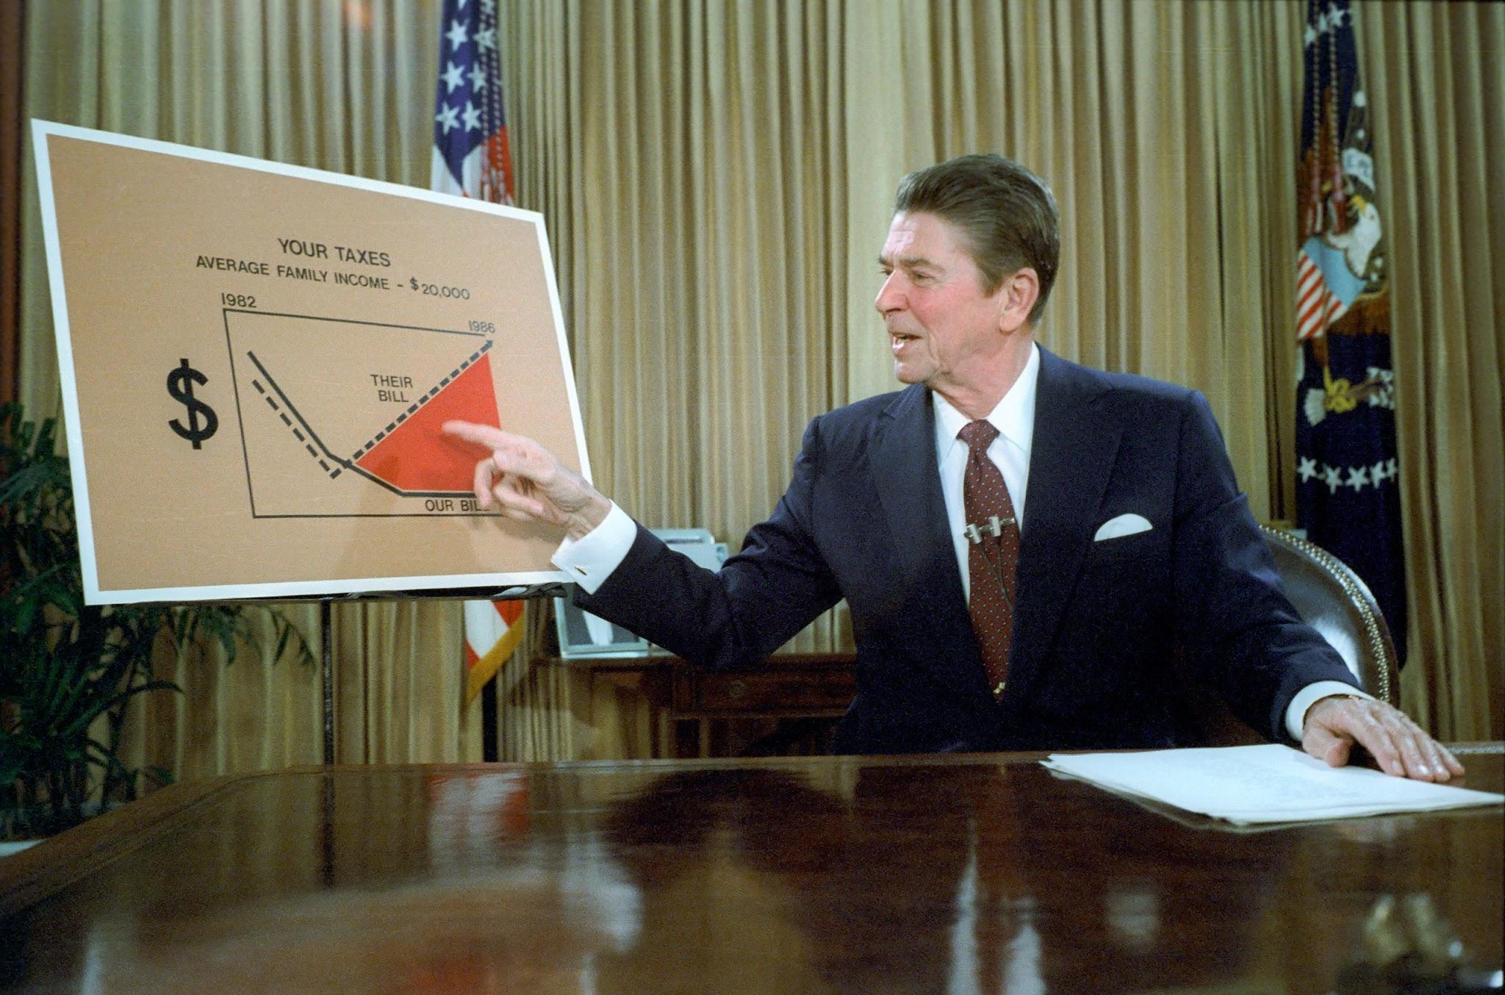
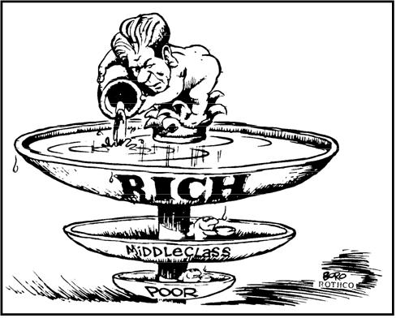
Economy
“Reaganomics”
The economic policies championed by President Ronald Reagan in the 1980s prioritized tax cuts, reduced social spending, and deregulation. Despite initially sparking economic growth, its lasting impact on the working class was damaging. The approach widened income inequality, diminished vital social services, and failed to offer substantial support to working class Americans.
Deregulation also weakened labor rights, leaving workers more vulnerable to exploitation and unstable job conditions. As a result, Reaganomics perpetuated socioeconomic disparities and eroded the economic security of the working class.
Trickle-down economics posited that tax cuts for the wealthy would ultimately benefit everyone through increased investment and job creation. However, this approach ultimately failed to significantly improve the economic prospects of the working class, as the benefits primarily accrued to the top income earners, exacerbating income inequality and leaving many individuals without substantial financial improvements.

Slide 31
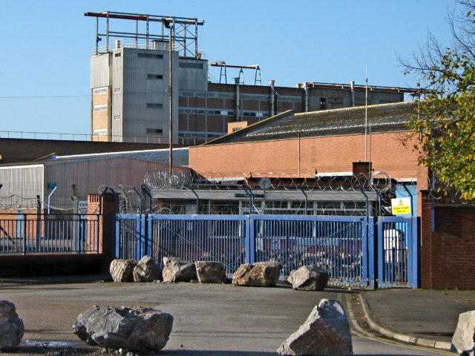
Economy
Losing American Jobs
The Reagan era saw a significant shutdown of domestic factories and production as companies sought to reduce costs by relocating abroad. This trend led to widespread job losses and a decline in the availability of stable employment opportunities for the working class. As manufacturing and production shifted overseas, many communities reliant on these industries experienced economic devastation, contributing to a rise in unemployment and a subsequent decrease in the standard of living.
Furthermore, the outsourcing of jobs exacerbated the precarious situation for the working class, as the remaining employment opportunities often offered lower wages and reduced benefits. With the loss of well-paying manufacturing jobs, many workers were forced to settle for positions in the service sector, which typically provided less financial security and fewer opportunities for upward mobility. This shift in employment dynamics further deepened the economic struggles faced by the working class, contributing to a sense of economic insecurity and stagnation that continued to impact communities long after the Reagan era.

Slide 32
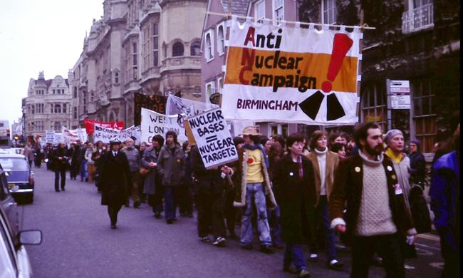
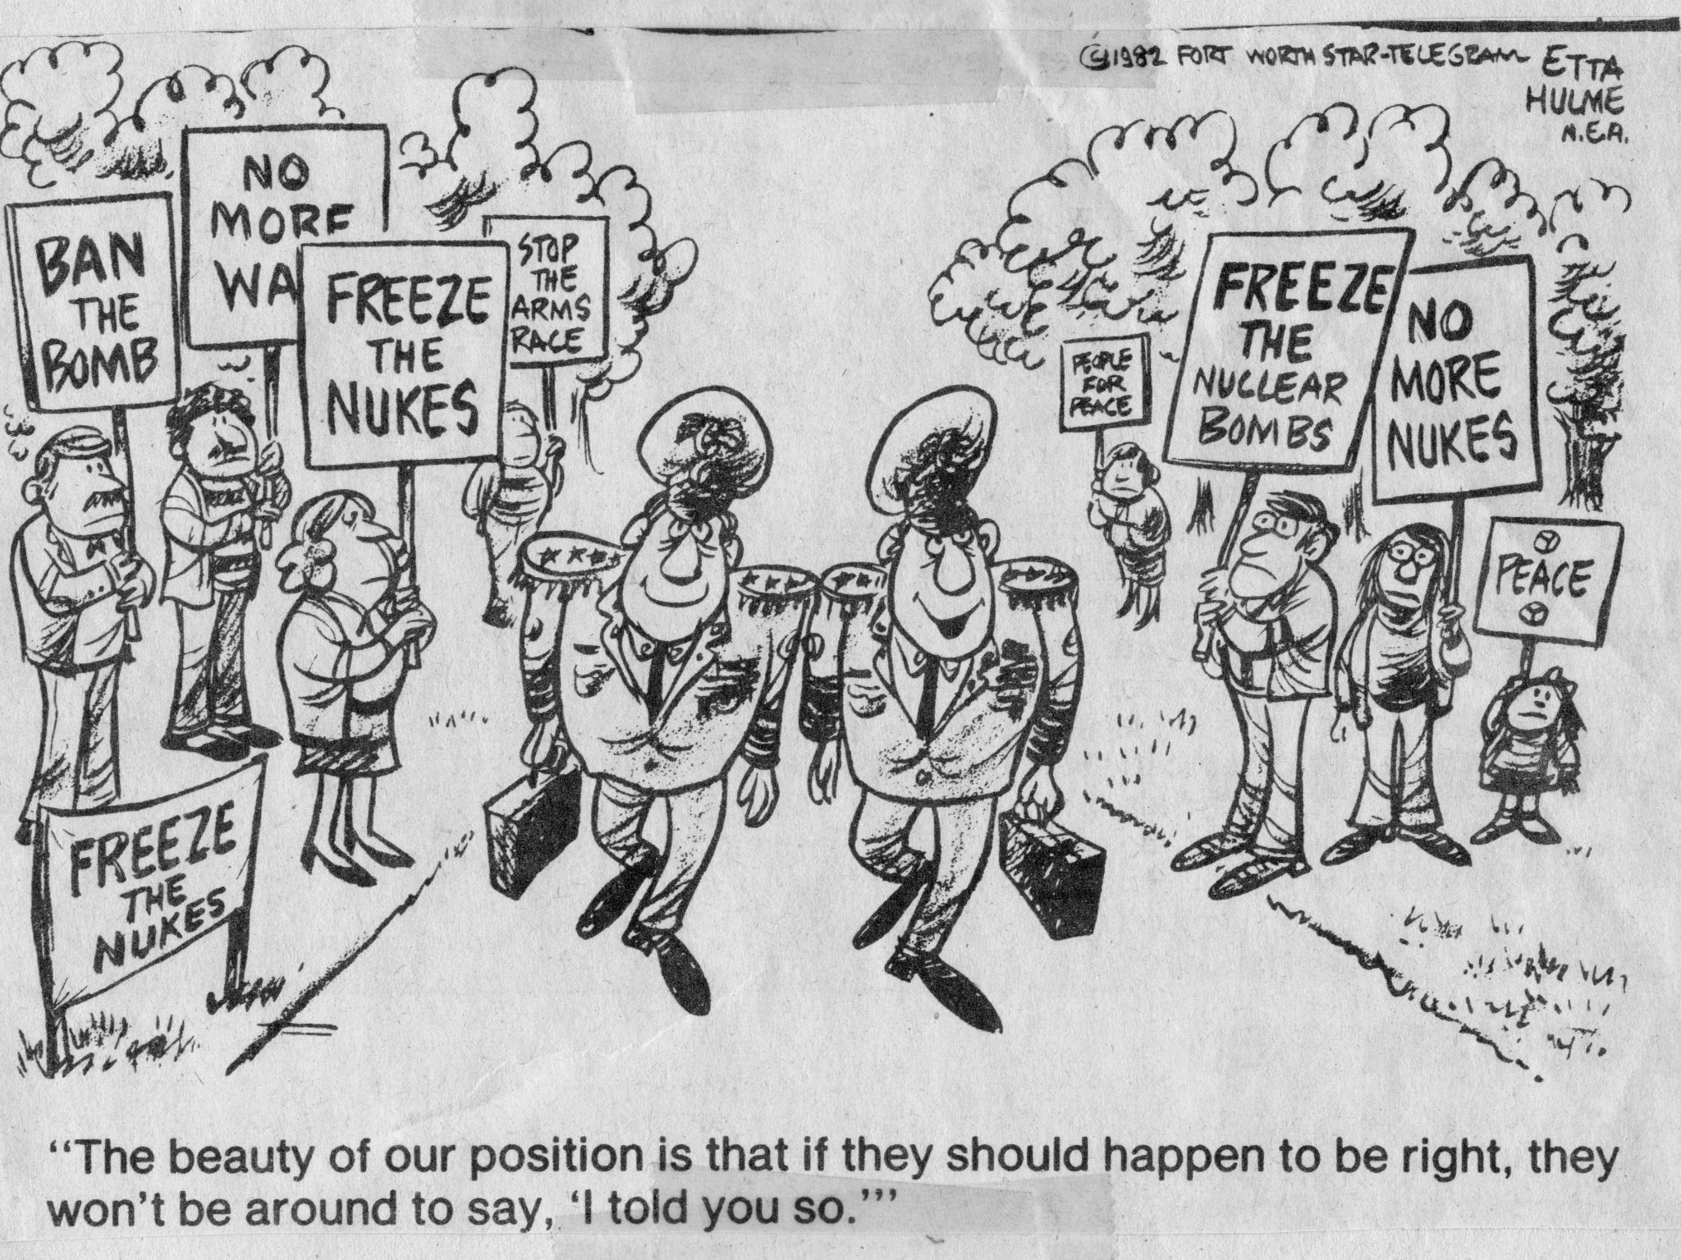
Anti-Imperialism in the 1980s
Decline in the Anti-War Movement
Anti-war organizing in the United States diminished during the 1980s due to several factors, including the end of the Vietnam War, the effects of McCarthyism and CoIntelPro and a shift in public focus towards domestic economic concerns.
The fading memory of the Vietnam War, coupled with the Reagan administration's emphasis on a strong defense stance against the Soviet Union, led to a decrease in public mobilization against military interventions and conflicts. Additionally, the prevailing sentiment of patriotism and the perception of a heightened external threat dampened the momentum of the anti-war movement during this period.
Amidst this context, the Bomb Freeze Campaign emerged as a prominent grassroots effort in the early 1980s, aiming to halt the further production and deployment of nuclear weapons by the United States and the Soviet Union. The campaign, driven by concerns over the escalation of the Cold War arms race, called for a mutual freeze on the development and deployment of nuclear weapons as a step towards disarmament. With widespread public support and the involvement of various peace and activist groups, the Bomb Freeze Campaign gained substantial traction and highlighted the growing global concern regarding the dangers of nuclear proliferation, contributing to the eventual negotiations and agreements.

Slide 33
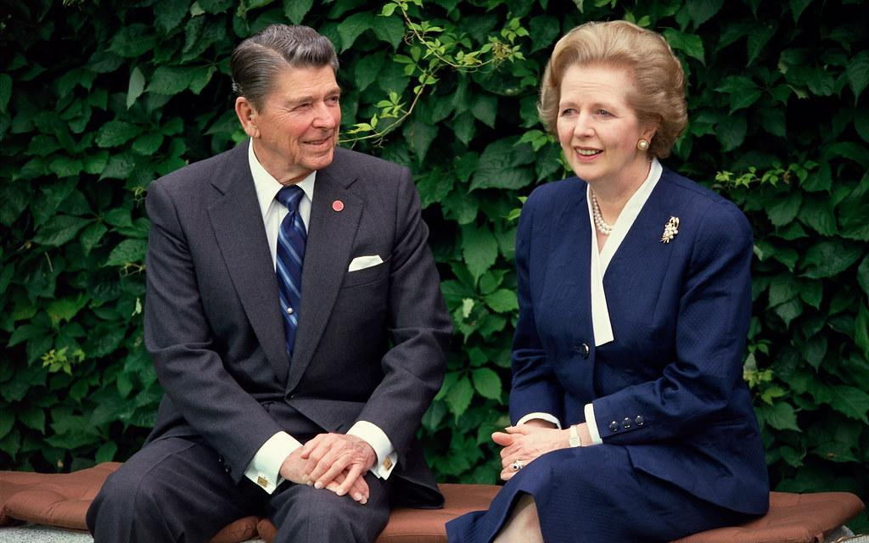
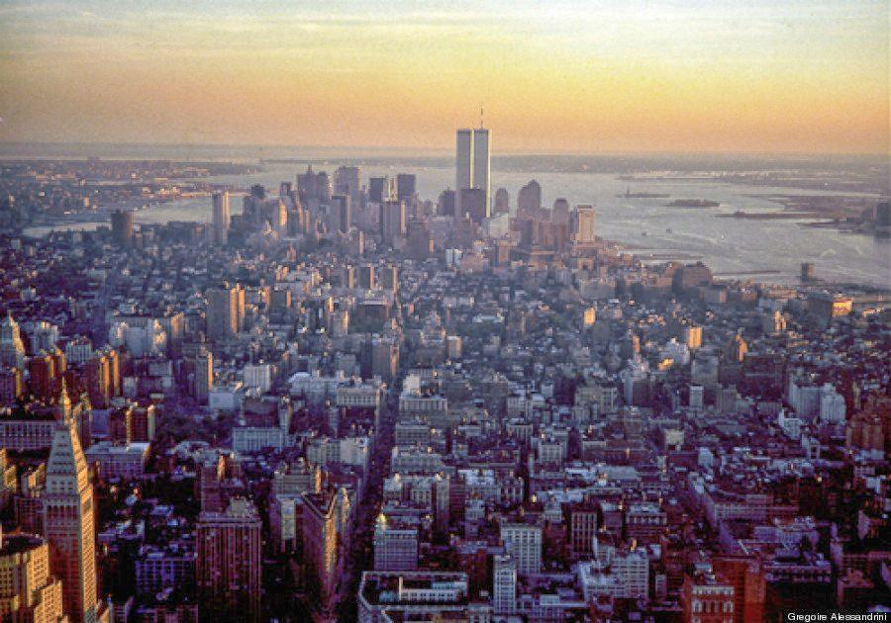
State of US Imperialism
American Imperialism in 1990
The 1980s witnessed the significant rise of neoliberalism, a political and economic ideology emphasizing the reduction of state intervention, deregulation, and the promotion of free-market capitalism and increased intervention and interference abroad. Spearheaded by figures like Ronald Reagan and Margaret Thatcher, this ideology gained traction globally, influencing policies that prioritized privatization, free trade, and reduced government spending, fundamentally reshaping economic systems and global trade relationships.
By the 1990s, the United States had solidified its position as a dominant global power, with American imperialism manifesting through military interventions and diplomatic influence in various regions, particularly in the West Asia and Latin America. With the end of the Cold War, the counter-revolution in the Soviet Union, and the dissolution of other socialist states, the United States emerged as the sole superpower, starting a period of American unipolarity. This newfound dominance allowed the U.S. to exert its influence in global affairs, shaping international policies, trade agreements, and military interventions, thereby solidifying its position as the primary arbiter of global geopolitics.
This series will be continued in the History of U.S. Imperialism: Rise of American Unipolarity, covering from ~1990-2005.

Slide 34
Discussion & Wrap Up

Slide 35
Announcements
THE KONONOVITCH BROTHERS NEED US, SHARE THIS ARTICLE:
https://dailyworkerusa.com/stop-the-kiev-regimes-calls-for-the-murder-of-the-kononovitch-brothers/
The PSMLS will be having a Video Edit Workshop on Monday, October 30th at 7 pm EST/4 pm PST, where we will edit a class in real time for our prospective video editors to observe and learn how this is done. We hope many will show up to learn how to perform this task and help the school with it so as to get videos out!

Slide 36
Volunteers Needed!
We are in need of volunteers for the staff of the People’s School! Here’s a few roles we need filled:
People to help manage posting on our social media and podcast platforms
Video Editors, Audio Editors, Graphic Designers, Artists, Narrators
Facilitators, Web Controls, Moderators
Email info@peoplesschool.us if you’re interested and try to attend our next staff meeting on Nov. 2nd if possible.

Slide 37
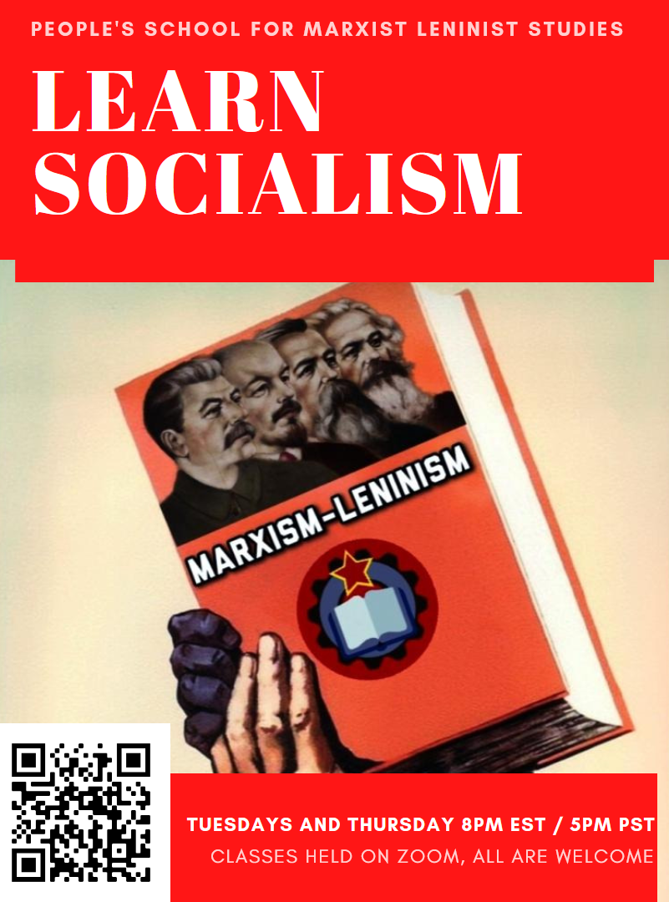
PSMLS Propaganda
peoplesschool.us/media & peoplesschool.us/store
Materials to help promote the school!

Slide 38
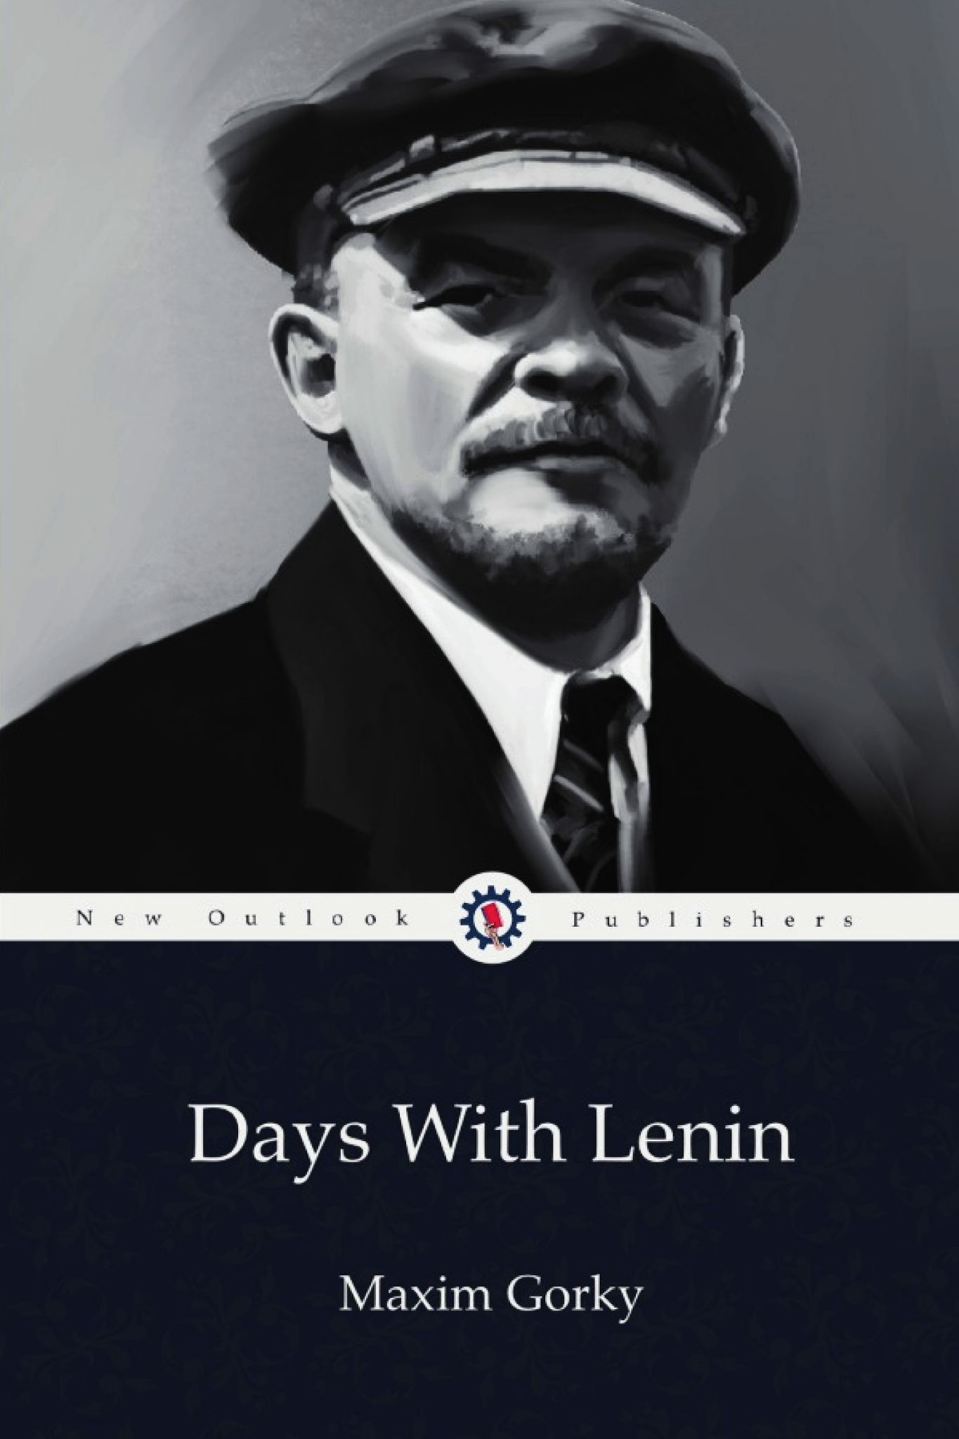
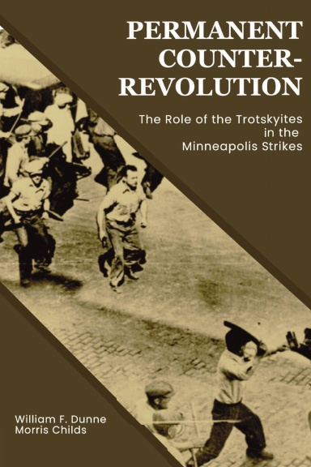
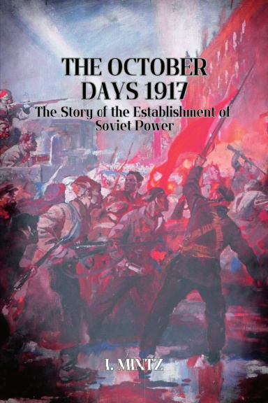
New Outlook Publishers
newoutlookpublishers.store
Latest Releases

Slide 39
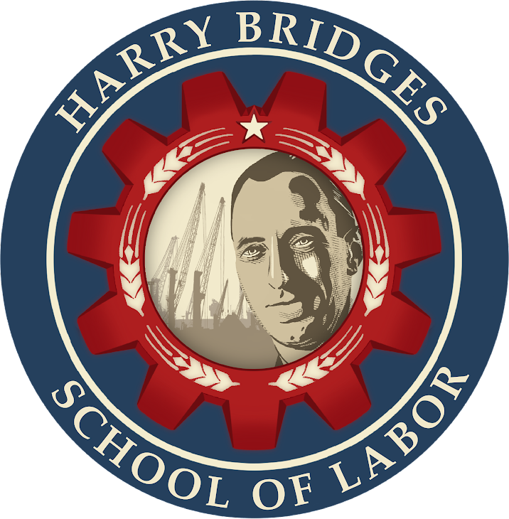
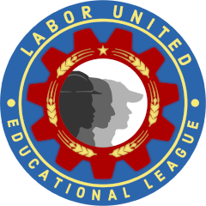
Harry Bridges School of Labor
luel.us/laborschool/
The Harry Bridges School of Labor is a monthly class held 2x per month. Classes cover a variety of topics aimed at building class conscious among union members.
November’s class is “History of the Congress of Industrial Organizations (C.I.O)” and is November 1, 2023 at 9pm EST/6pm PST and Saturday November 4, 2023 at 7pm EST/4pm PST.

Slide 40
Legal Drive
Last year we were attacked and sabotaged by ultraleft wreckers that tried to steal the PSMLS and destroy the PCUSA. They failed, but they will be held accountable and there are still things they took from us that we’ve not got back, like videos, imagery, audio etc. That is why we still need donations to the legal drive.
If you support the school and want to see us continue to improve and keep delivering this education 51 weeks a year, please pitch in whatever you can and support the GoFundMe for the legal drive @ https://www.gofundme.com/f/legal-fund-to-defend-against-wreckers.
Anything helps!

Slide 41
Hammer to Fall - 1985 Anti-War Song by Queen, Performed at Live Aid

