Slide 1
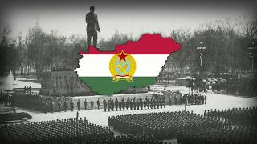
“A felszabadulás dala”(A Song of Liberation) - Written by Erno Rossa

Slide 2
PSMLS mm/dd/yy - mm/dd/yy

Slide 3
What we’ll be learning today:
Background of Hungarian history
Conditions that led to the Counter-Revolution
The 1956 Counter-Revolution
Drawing parallels to Euromaidan and the present day

Slide 4
Background

Slide 5
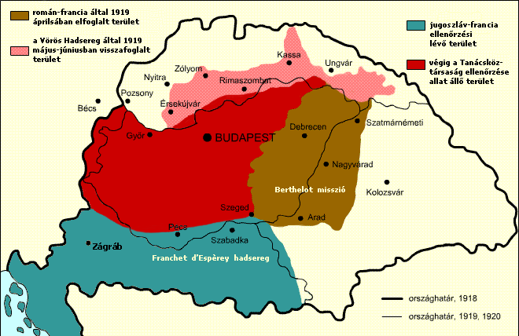
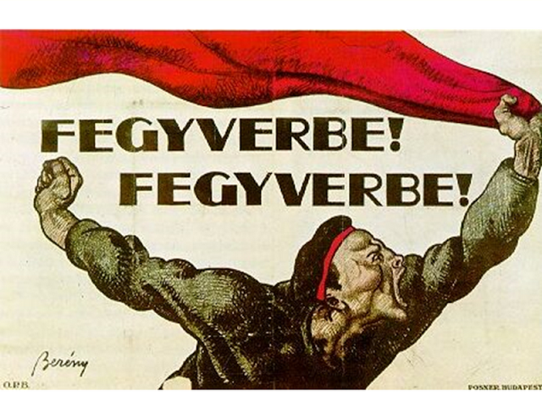
Hungarian Socialist Revolution of 1919
The History of the Hungarian Soviet Republic (1919)
Post WWI a wave of socialist revolutions occurred across Europe (Russia, Germany, Finland, Hungary).
Hungary became a Socialist Republic for 133 days under Bela Kun and the Hungarian Red Army. Held immense support amongst industrial proletariat, little in the countryside.
French, Romanian, Yugoslav, Czechoslovak intervention to defeat the Hungarian Soviet Republic. Led to defeat of Red Hungary and the rise of Miklos Horthy & the White Terror.

Slide 6
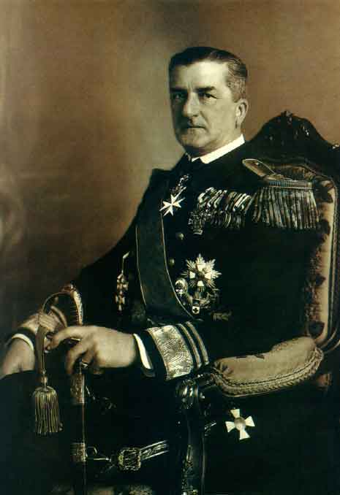
White Terror & Horthy Regime
Horthy: The Franco of Hungary
Miklos Horthy was a Hungarian admiral who led counter revolutionary forces during the Hungarian Revolution. Came to power through the defeat of the Hungarian Soviet Republic. Propped up by the Entente.
Horthy’s White terror imprisoned tens of thousands and murdered thousands. Banned all communist & workers parties, trade unions, mass organizations. Established a fake “parliament” with only rightist parties allowed. Similar to Finland in the interwar period.
State backed anti-semitism, no Jews were allowed in universities or government positions. Hungarian nationalism & anti-semitism paved the way for the Holocaust of Hungarian Jews during WWII.

Slide 7
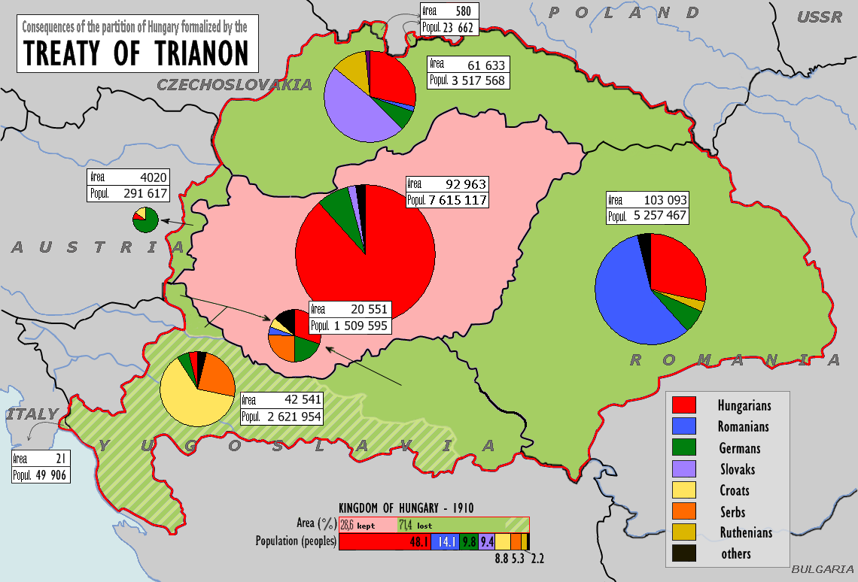
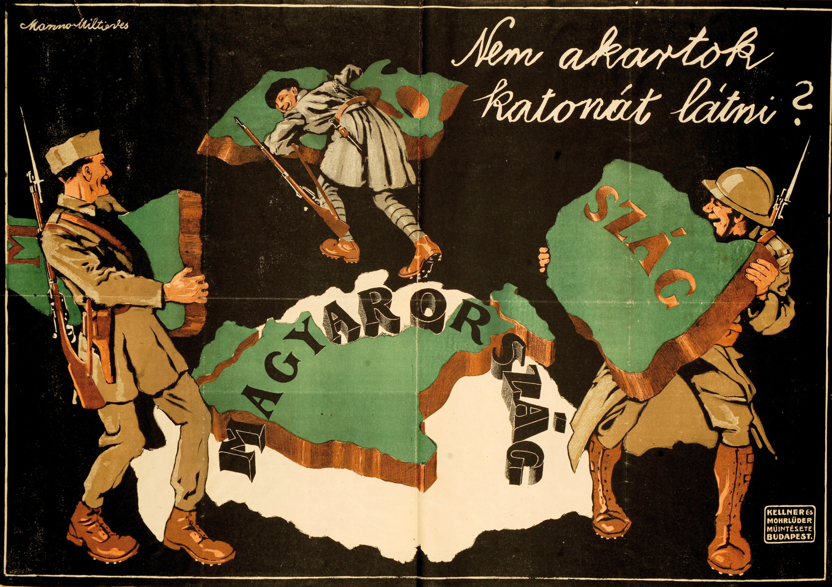
The Interwar Period
Hungary During the Interwar:
The Treaty of Trianon led to Hungary losing ⅓ of its entire population and intense revanchism in Hungary, similar to Germany during the interwar period.
Semi-feudal conditions in the countryside. Vast majority of the population were peasants who owned less than 8.25% 0f all land in Hungary. A collection of 400 magnate families & the Catholic Church owned most of the land in Hungary.
Government of the estate owners of the Esterhazy-Karolyi class. Less than 30% of Hungarians were allowed to vote. Hungarian ruling class even opposed industrial capitalism. Weak capitalist class, most industry and financed were foreign owned.
Close connections with Fascist Italy and Nazi Germany.

Slide 8
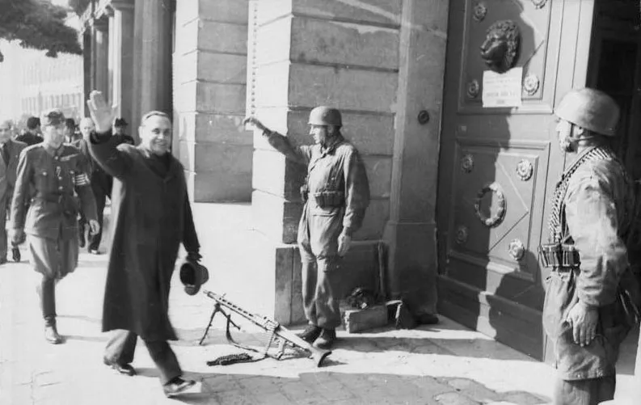
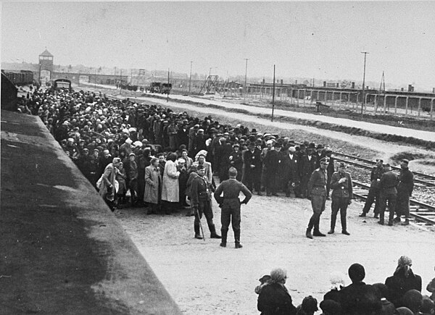
WWII
Hungary during WWII
Hungary joined the Anti-Comintern Pact (The Axis) in 1940. Helped Germany invade the USSR in 1941 with Operation Barbarossa.
Hungarian Armies committed horrific war crimes in the USSR alongside the Germans. The Hungarian Second Army was wiped out in the Battle of Stalingrad.
Horthy sabotaged resistance efforts to switch sides with constant anti-Sovietism. Nazi coup occurred in 1944 Hungary leading the Arrow Cross Party to rise to power.
564,000 Hungarian Jews were deported and killed as a result of the Holocaust in Hungary.
The Soviets liberated Hungary in 1945 and established a provisional government (not a communist one).

Slide 9
Discussion

Slide 10
Conditions that led to 1956 Counter-Revolution

Slide 11
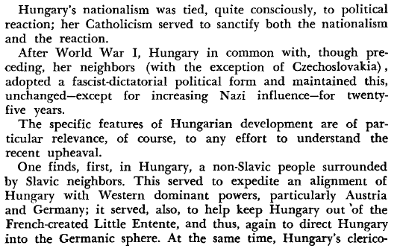
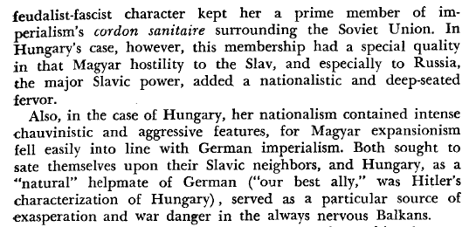
Hungarian Nationalism
Hungarian nationalism was deeply ingrained in the monarchy and church. From the 1830s, language laws required voters, lawyers and priests to be fluent in Hungarian. These laws discriminated against Slavic and Romanian minorities. Jewish people were barred from holding any sort of political position. By the 1900s, anti-Semitism was a deep, pervasive idea held among all classes and segments of Hungarian society.
During the rise of the Austro-Hungarian Empire, Hungarians sought Magyar national power over the ethnic minorities instead of full political independence. The Croats, Serbs, Slovaks and Romanians were minorities, but in combination they nearly equalled the number of ethnic Magyars.
The Roman Catholic church was an integral part of the ruling class. In property, politics and ideology it was identical with and a bulwark of the clerical feudalist fascist regimes which ruled over Hungary for a thousand years.

Slide 12
Problems with Socialist Reforms
Legitimate Grievances
The transition to socialism in Hungary was faced with much opposition from the ruling class.
Hungary was deeply entrenched in feudalism and not as industrialized as other European countries.
Socialist reforms such as land redistribution, construction of public facilities and industrialization greatly improved the lives of many Hungarians.
However, the citizens still had some legitimate grievances, as outlined in Herbert Aptheker’s work, The Truth About Hungary.

Slide 13
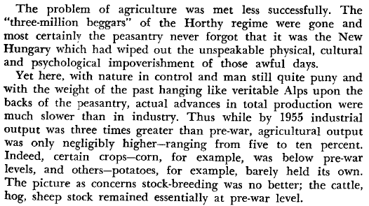
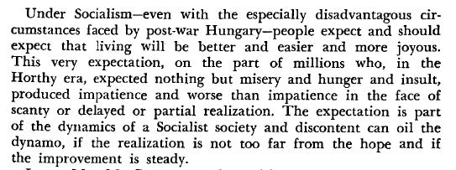
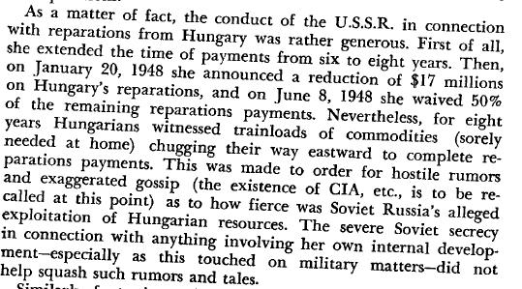
Problems with Socialist Reforms cont.

Slide 14
Importation of Fascists to the US
Committee for a Free Europe (1949) & the Lodge Act (1950)
The Committee for a Free Europe was an anti-communist CIA front organization. It was funded by corporations such as Standard Oil, US Steel and Ford Motor Company. Related to it was Radio Free Europe and the Free Europe Press. This front utilized political exiles to establish psychological warfare techniques to be used against the Soviet Union and its satellites.
Defection was encouraged and defectors rewarded to engage in propaganda and infiltration as well as to return to their native lands as “sleeper” leaders for future crises. Many of the members were reactionaries and conducted acts of terrorism and violence. The influence of these groups was directly linked to the 1956 uprising. Ferenc Nagy, former prime minister of Hungary, was one such asylum seeker who was intended to be a “sleeper” leader for Hungary had the attempted revolution succeeded.
The Lodge Act provided for the recruitment of an anti-communist “Foreign Legion” selected from defectors of Soviet countries. These men received “specialized” training and after 5 years in the US army, rewarded with citizenship.

Slide 15
Effects of Khrushchev's Secret Speech
Anti-Stalinism in Herbert Aptheker’s work
Khrushcev’s infamous Secret Speech which was delivered at the 20th Congress of the CPSU denounces Stalin as a “cult of personality” and paints him as an oppressive tyrant who murdered thousands of innocent people through purges. Khrushchev likely did this to discredit other party members loyal to Stalin, like Molotov, Malenkov and Kaganovich.
The speech was a huge blow to the Communist movement worldwide, leading many to abandon the cause or engage in anti-Stalin revisionism. It should be noted that even many western historians were skeptical about Khrushchev's efforts to lay all the blame on Stalin. The speech also fails to explain how the Soviet Union remained progressive and democratic all throughout Stalin’s time as Premier if he was supposedly a tyrant.
Unfortunately, Aptheker adopted this anti-Stalinist view, writing that “it is clear and admitted now by all that the USSR itself, under the leadership of Joseph Stalin, practiced bullying tactics which were often contemptuous of the national feelings of the fraternal, but weaker, states seeking to build socialism.”
This bias should be kept in mind when interpreting his work.

Slide 16
Discussion

Slide 17
The Hungarian Counter-Revolution

Slide 18
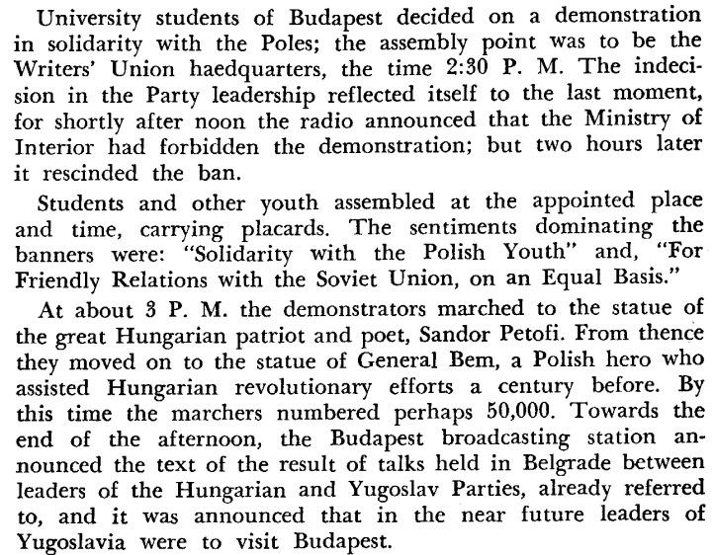
Hungarian Students Inspired by Polish Counter-revolution Attempt

Slide 19
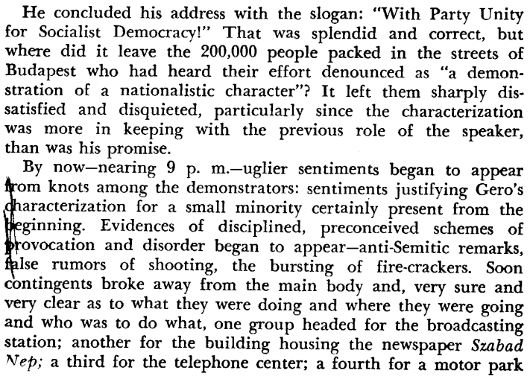
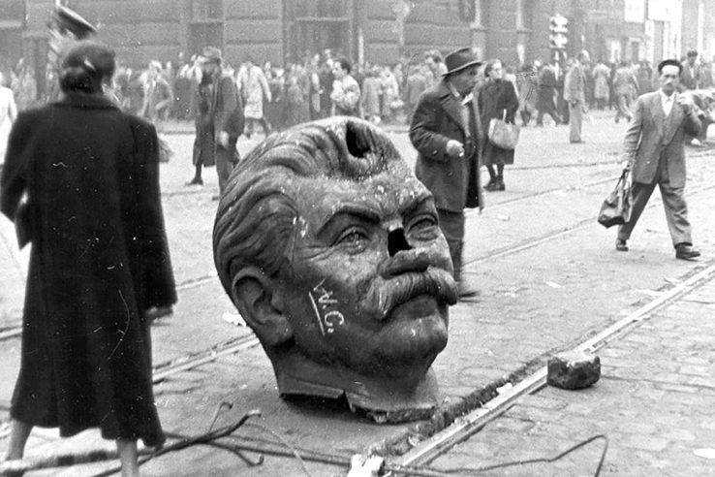
October 23, 1956
Toppled statue of Joseph Stalin
Budapest, Hungary
October 23, 1956

Slide 20
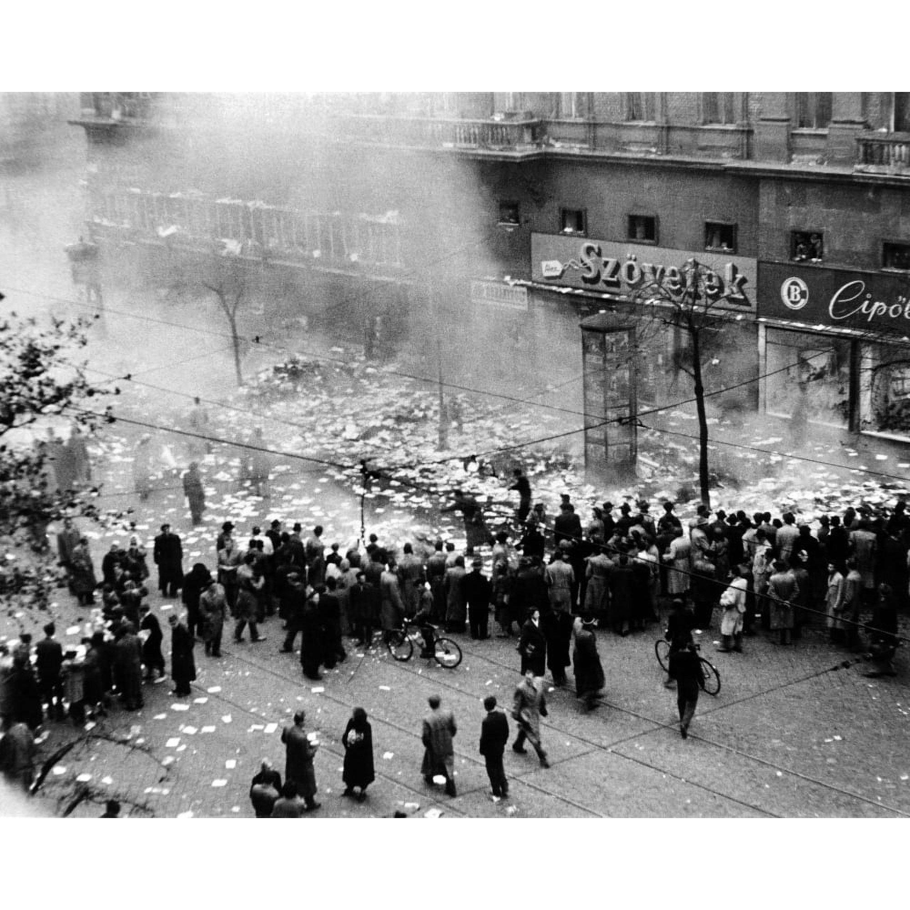
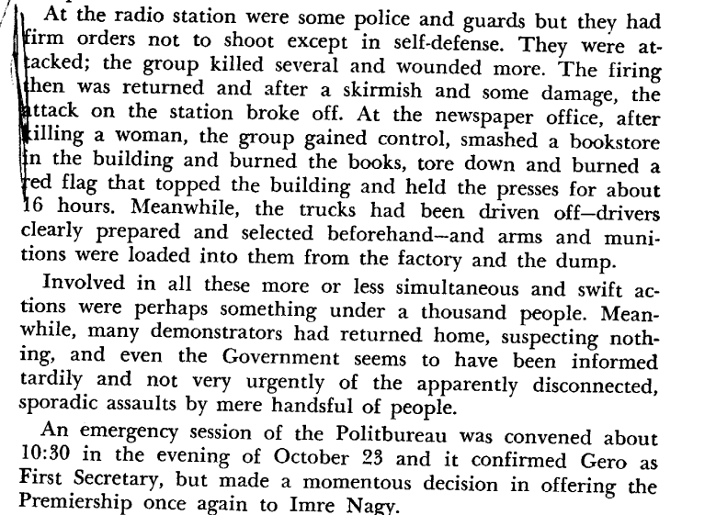
Protesters destroy Budapest Bookstore and Marxist-Leninist Literature

Slide 21
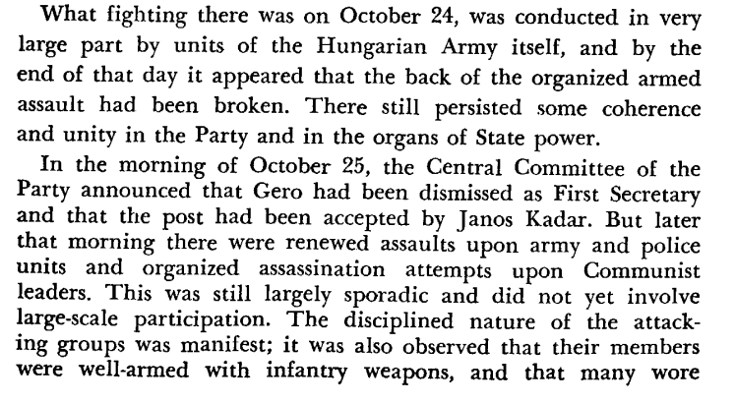
October 24 and 25

Slide 22
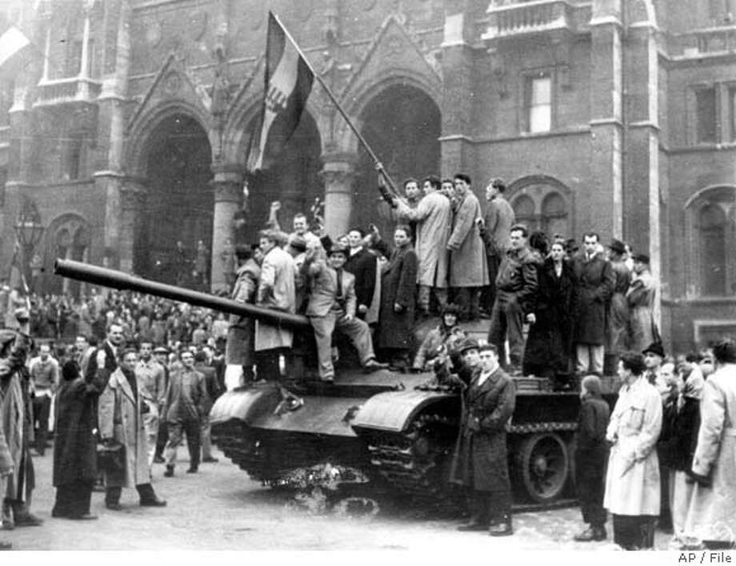
Demonstrators join in fraternity with the Soviet Union after attacks by fascist attacks

Slide 23
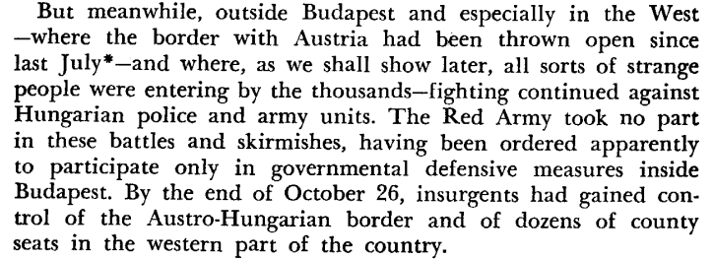
October 26

Slide 24
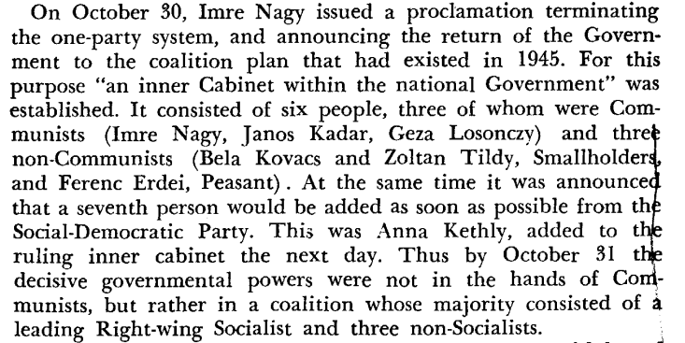
October 30

Slide 25
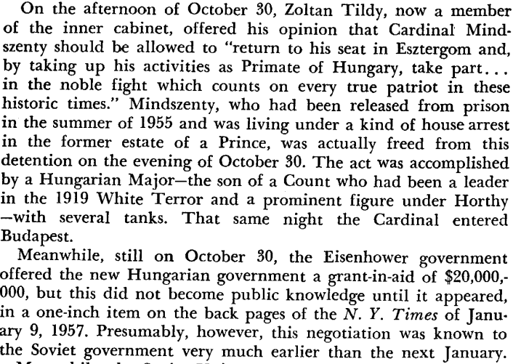
October 30 - Release of Cardinal Mindszenty

Slide 26
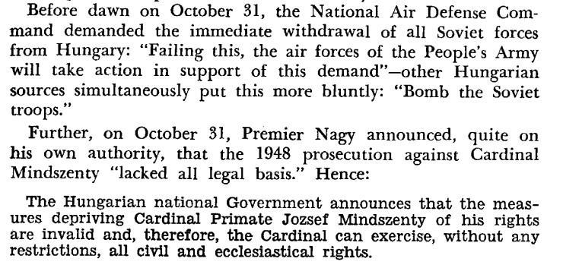
October 31

Slide 27
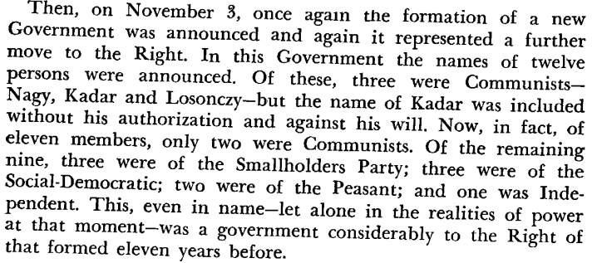
November 3

Slide 28
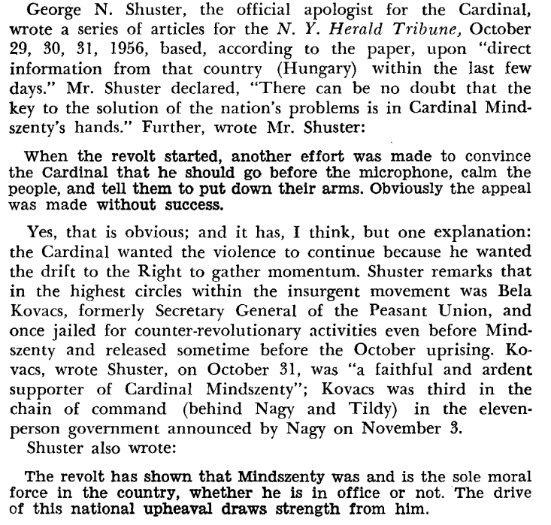
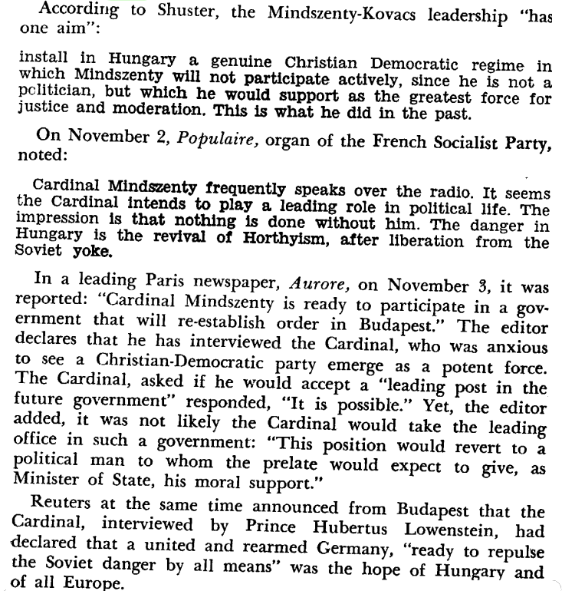
The US and Europe planned for Cardinal Mindszenty to take over Hungary

Slide 29
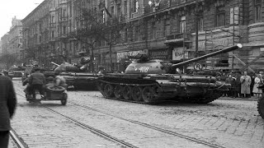

Slide 30
Discussion & New Members Introductions

Slide 31
New Member Introductions
What is your name, pronouns and state (or country/territory)?
Where do you work? Is it unionized?
How did you find out about the People’s School?
What do you think about tonight's class?

Slide 32
Drawing parallels to now and Euromaidan

Slide 33
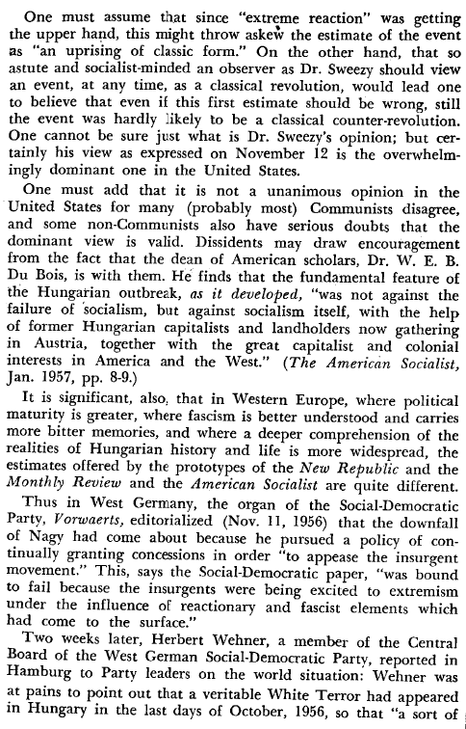
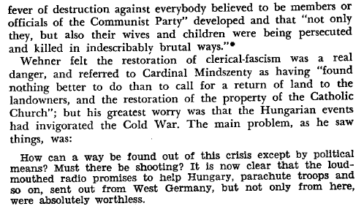
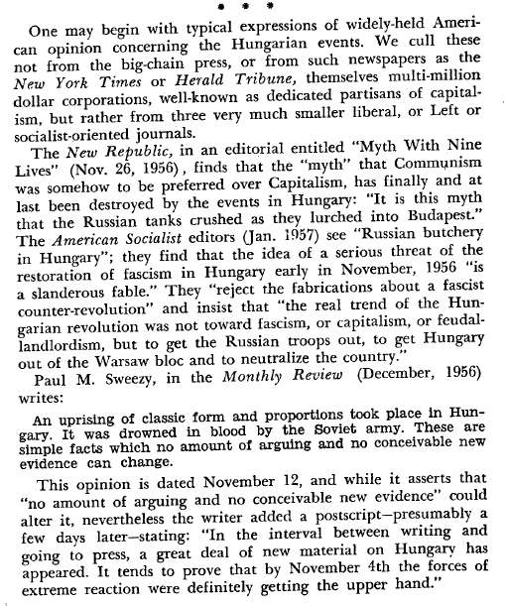
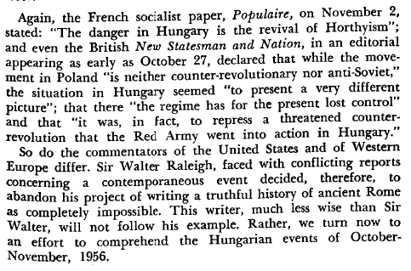
Portrayal of Hungary in the US vs Europe

Slide 34
Color Revolutions
Drawing parallels to the 21st century’s so-called “color revolutions” and Euromaïdan.
It’s fair to say the 56 Hungarian counter-revolution was an example of what is known today as a “color
Revolution”.
The term “color revolution” was coined in the early 21st century to designate at first popular
movements, but later directed at establishing in Eastern Europe regimes favorable to Western so-called
liberal democracies.
In 2000 it was the “Bulldozer Revolution” in Yugoslavia, 2003 the “Rose Revolution” in Georgia, 2004 the “Orange Revolution” in Ukraine, 2005 the “Tulip Revolution” in Kyrgyzstan.
These so called “revolutions” did not actually overthrow socialist governments, but mostly capitalist
ones, but who carried a mortal sin, namely to be not friendly enough to Western imperialism.
The method Is always the same: support popular and worker’s grievances thru the intense use of
internet and foreign NGO’s, and bring to power Western puppets.

Slide 35
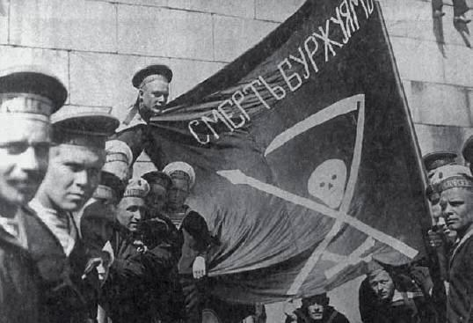
Kronstadt anti-Soviet Uprising 1921
One could say the first color revolutions were the many anti-communist uprisings of the 20th century.
It began in March 1921 at Kronstadt, outside of Petrograd when sailors rebelled against the Soviet
Republic. They reflected the discontent of peasant masses after 4 years of “war communism” at the end of the Civil War. Their slogan was: “Soviet yes, but without the Bolsheviks”. They were fully supported by French British and Russian capitalists, including White Tsarists.
Kronstadt Sailors

Slide 36
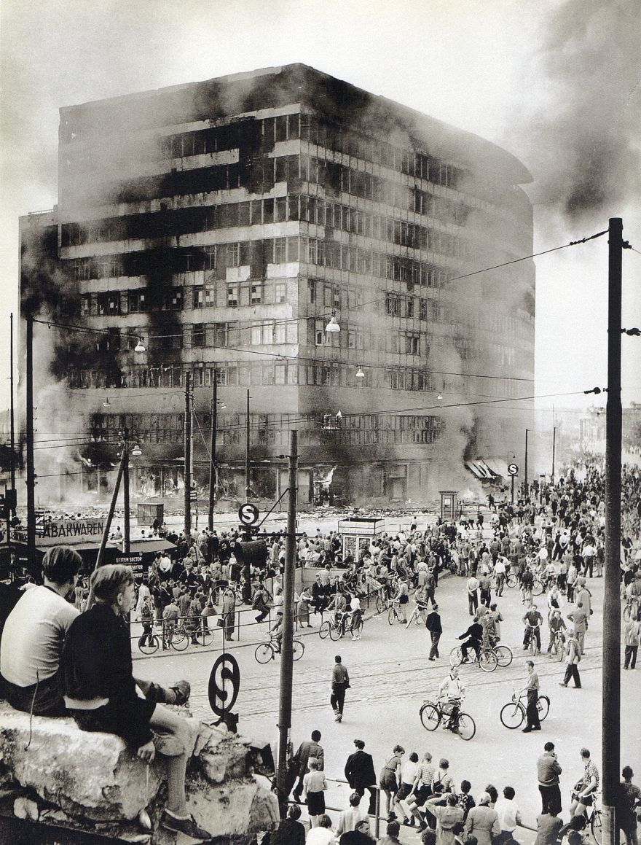
German Democratic Republic Uprisings 1953
32 years later in June 1953, shortly after Stalin’s death, a similar revolt happened in East Berlin. The economic situation was difficult in the young German Democratic Republic, founded 4 years earlier.
Unlike in West Germany flooded with U.S. dollars of the Marshall plan, the USSR couldn’t afford much help to the GDR. Workers began a strike and soon there were widespread demonstrations throughout the country. Thanks to Soviet T-34’s, socialist order was quickly restored. The radio in the American sector of West Berlin had been blasting the news of the first workers going on strike in order to fan the flames of anti-communism in East Germany.
The events of October 1956 In Hungary followed that familiar playbook.
Columbus House Building on fire during June 17, 1953 riots in East Berlin

Slide 37
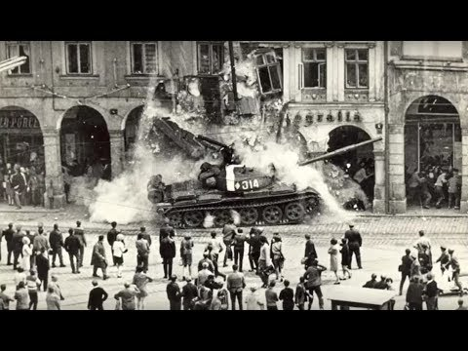
Prague Spring
12 years later was the turn of Czechoslovakia during the infamous Prague Spring. This time the slogan
was “socialism with a human face”. In these 20th century “color revolutions”, it was never openly proclaimed to abolish socialism, but always to improve it.
To get rid of one’s dog, one will accuse it of having rabies.
The goal of the “Prague Spring” was in fact to end People’s Democracy and get Czechoslovakia out of the Warsaw pact and straight into NATO’s arms. Again Soviet tanks came to the rescue in August 1968 and socialism was saved for the time being. From the early spring throughout the summer of 1968 the “Prague Spring” was all over the newspapers front pages and TV screens of the so-called Free World.
Prague 1968

Slide 38
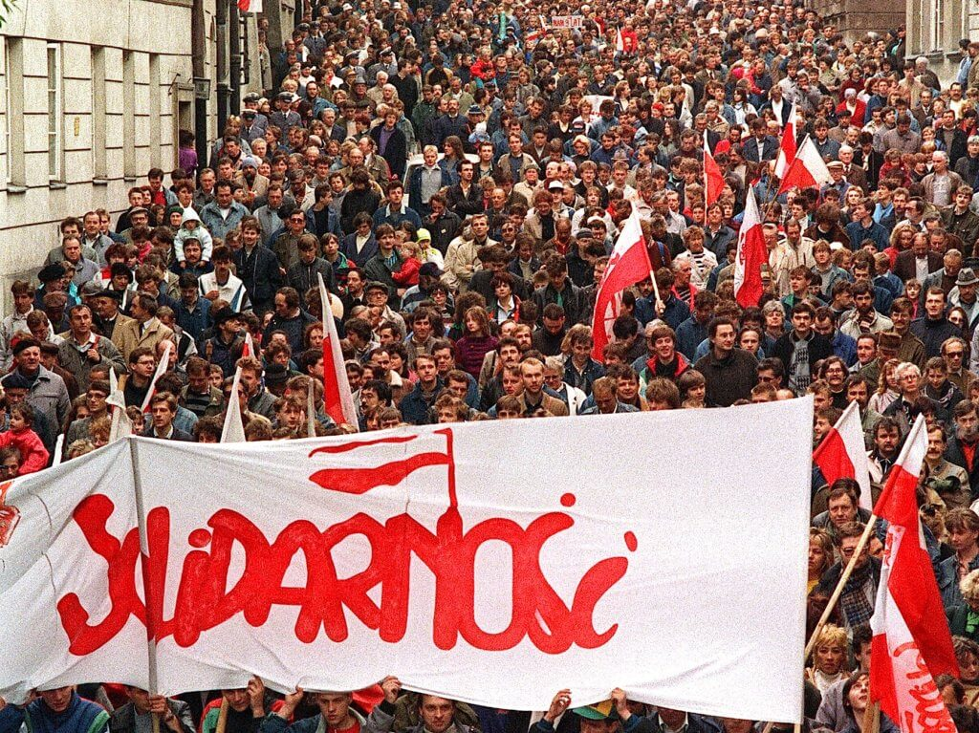
Solidarity Movement - Poland
Once again there was a 12 year gap until the next color revolution. This time it was Poland in 1980 with the Solidarity movement.
In 1978 a new Catholic pope had been elected in Rome, John Paul II born in Poland, a rabid anti-communist. This wasn’t lost on the CIA who saw a great opportunity. In August 1980 a trade union was founded at the Lenin shipyard in Gdansk. Its name was Solidarity, its leader Lech Walesa, also a rabid anti-communist. Solidarity had the CIA’s and the Vatican’s fingerprints all over. Lech Walesa quickly became the poster child of the so-called Free World.
By 1981 Solidarity reached a membership of an incredible 10 millions.
In 1983 Walesa received the Nobel Peace Prize, in passing that same prize awarded in 2009 to Obama, the U.S. president who ordered the most drone strikes, and once said “turns out I’m really good at killing People”. Solidary was instrumental in overthrowing socialism and Walesa became capitalist Poland's first president from 1990 to 1995.

Slide 39
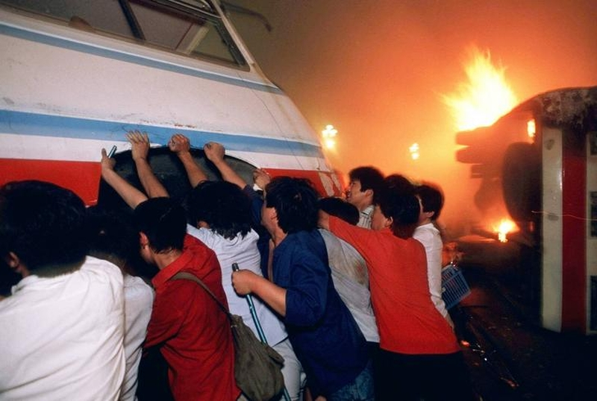
Chinese Color Revolutions
The People’s Republic of China wasn’t spared either by color revolutions.
In June 1989 the Tiananmen Square protests were an attempt to overthrow the Communist Party of China. It must be noted that the so-called “democracy protestors” were marching at the sound of the Internationale. Once again they never openly rejected socialism but pretended to improve it.
The CIA and Western ideologues are expert dialecticians and master wolves who know how to invite the sheep to the dinner table.
In 2019-2020 the West pulled the “Water Revolution” in Hong Kong.
Protests were broadcasted 24/7 in Western media, and protestors didn’t even hesitate to march with
U.S. and U.K. flags.
Protesters burn and flip buses outside Tiananmen Square 1989

Slide 40
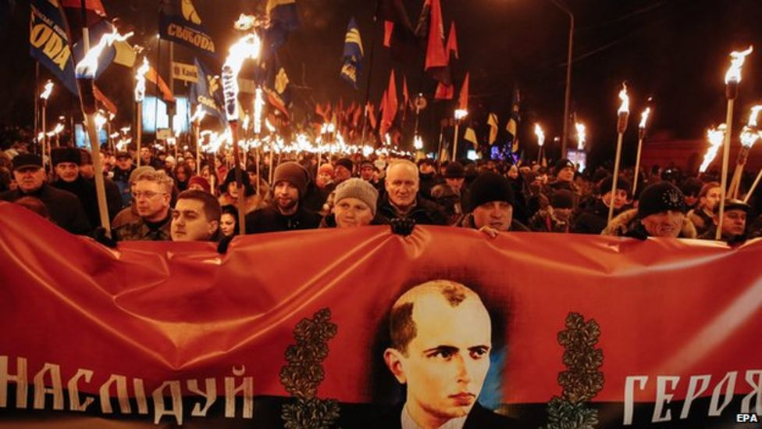
EuroMaidan - Ukraine 2013 and 2015
Of course the most infamous “color revolution” of late was the 2014 Euromaïdan that overthrew a bourgeois government in Kiev, whose mortal sin was to be too friendly with Russia and not friendly enough with EU & NATO. The American Queen of neo-cons Victoria Nuland, Obama’s special envoy to Ukraine in 2014, who actually hand-picked herself the new Kiev government at the time, publicly
admitted years later that the U.S. had spent $5B to bring “freedom and democracy” to Ukraine.
Just like all color revolutions from Kronstadt to Budapest, Euromaïdan began with somewhat of a legitimate popular discontent, and was quickly funneled by the West into installing a lapdog puppet régime, this time openly fascist.
Annual Ukrainian march to celebrate Nazi leader Stepan Bandera’s birthday. January 2015.

Slide 41
Discussion & Wrap Up

Slide 42
Announcements
THE KONONOVITCH BROTHERS NEED US, SHARE THIS ARTICLE:
https://dailyworkerusa.com/stop-the-kiev-regimes-calls-for-the-murder-of-the-kononovitch-brothers/
The PSMLS will be having a Video Edit Workshop on Monday, October 30th at 7 pm EST/4 pm PST, where we will edit a class in real time for our prospective video editors to observe and learn how this is done. We hope many will show up to learn how to perform this task and help the school with it so as to get videos out!

Slide 43
Volunteers Needed!
We are in need of volunteers for the staff of the People’s School! Here’s a few roles we need filled:
People to help manage posting on our social media and podcast platforms
Video Editors, Audio Editors, Graphic Designers, Artists, Narrators
Facilitators, Web Controls, Moderators
Email info@peoplesschool.us if you’re interested and try to attend our next staff meeting on Nov 2nd if possible.

Slide 44
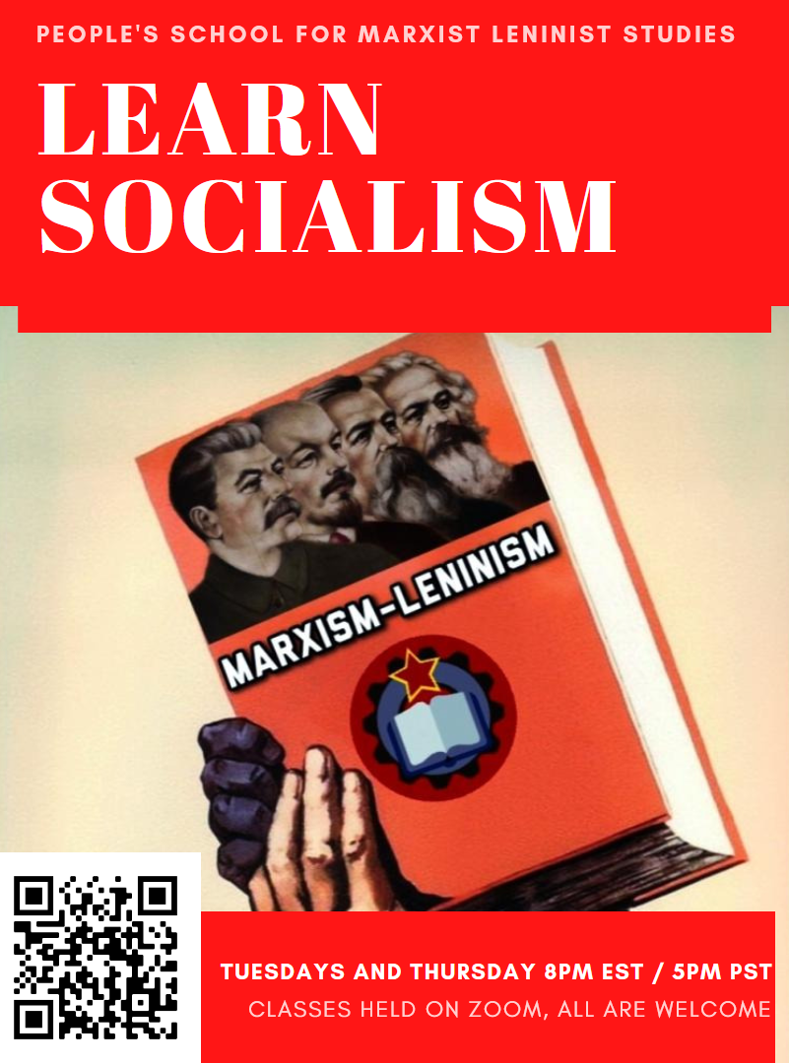
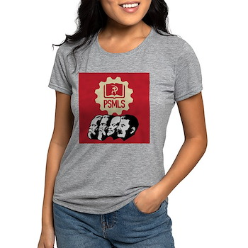
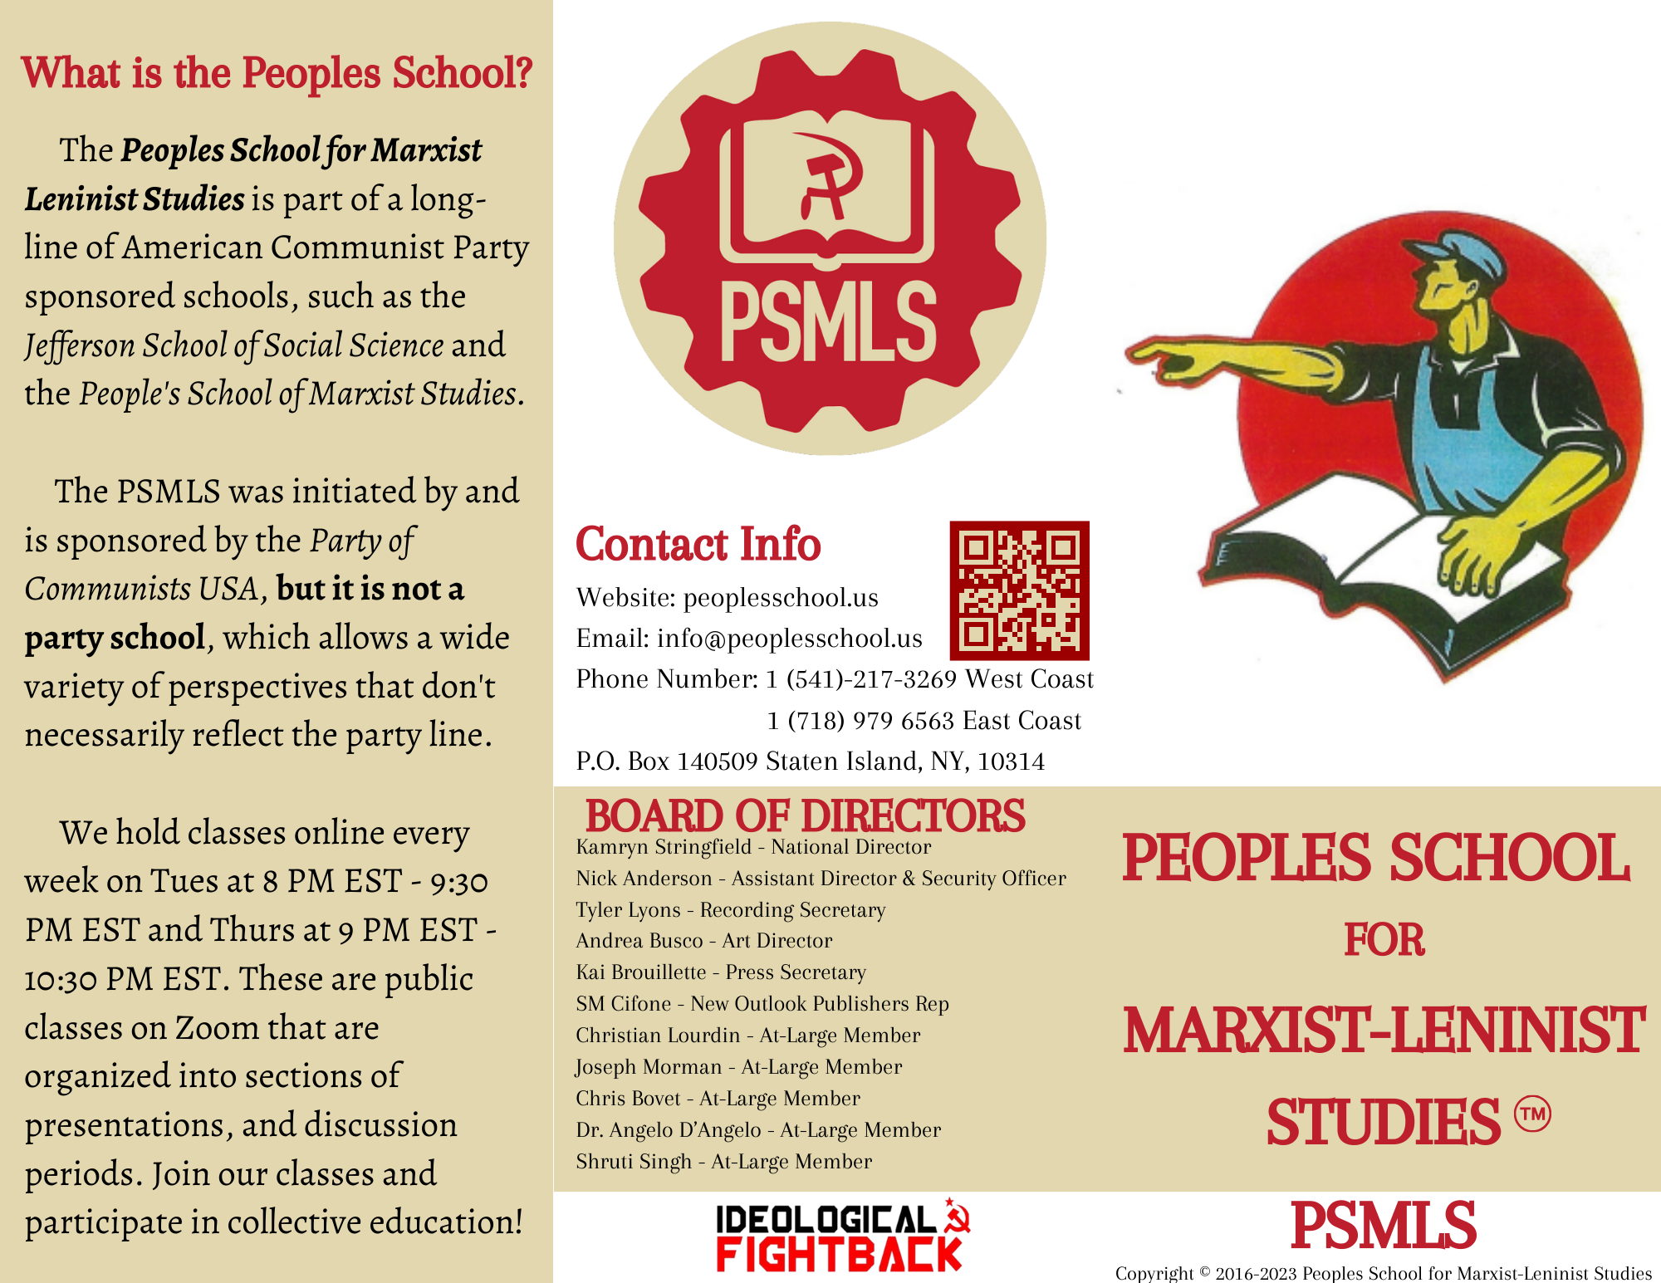
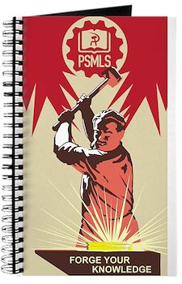
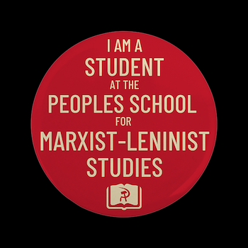
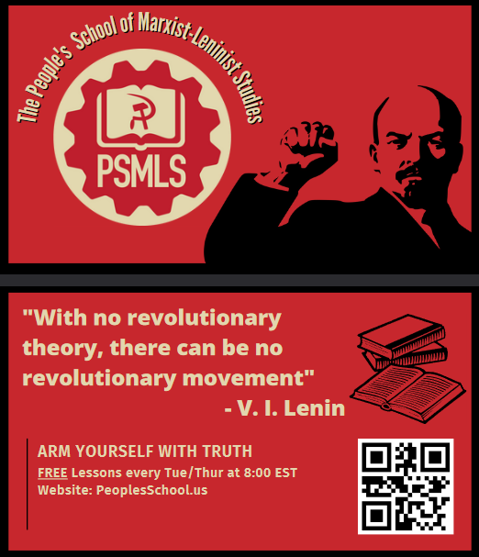
PSMLS Propaganda
peoplesschool.us/media & peoplesschool.us/store
Materials to help promote the school!

Slide 45
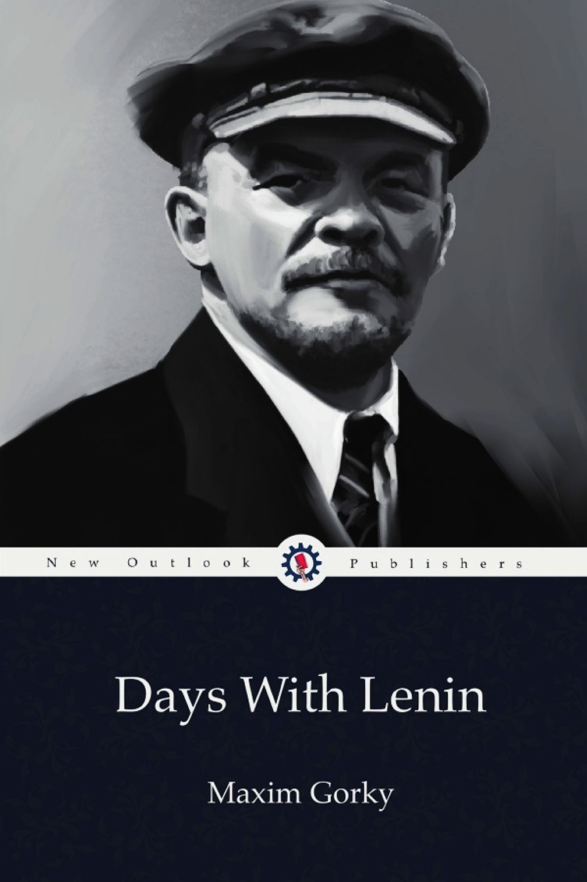
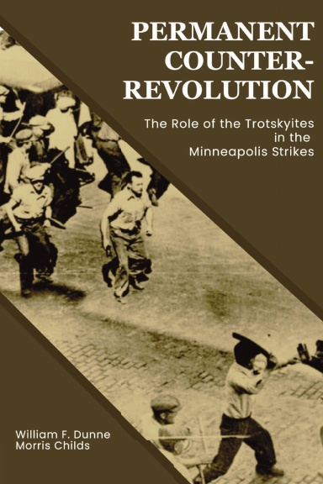
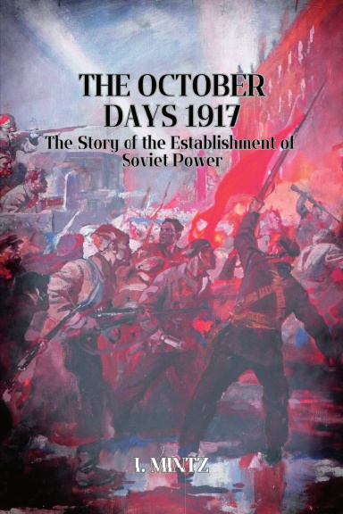
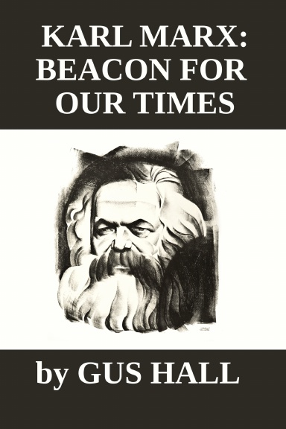
New Outlook Publishers
newoutlookpublishers.store
Latest Releases

Slide 46
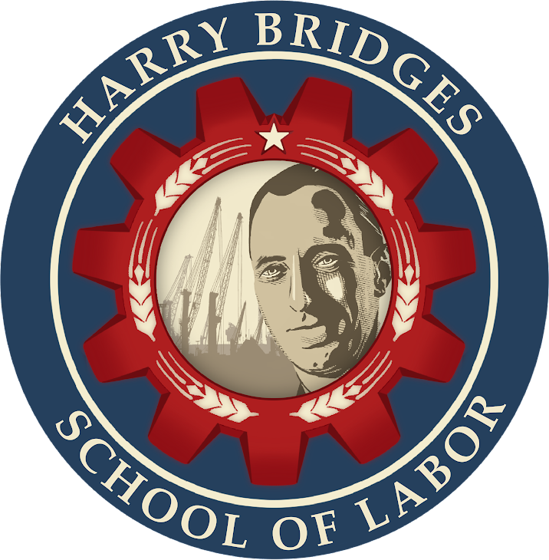
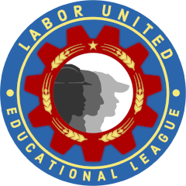
Harry Bridges School of Labor
luel.us/laborschool/
The Harry Bridges School of Labor is a monthly class held 2x per month. Classes cover a variety of topics aimed at building class conscious among union members.
November’s class is “History of the Congress of Industrial Organizations (C.I.O)” and is November 1, 2023 at 9pm EST/6pm PST and Saturday November 4, 2023 at 7pm EST/4pm PST.

Slide 47
Legal Drive
Last year we were attacked and sabotaged by ultraleft wreckers that tried to steal the PSMLS and destroy the PCUSA. They failed, but they will be held accountable and there are still things they took from us that we’ve not got back, like videos, imagery, audio etc. That is why we still need donations to the legal drive.
If you support the school and want to see us continue to improve and keep delivering this education 51 weeks a year, please pitch in whatever you can and support the GoFundMe for the legal drive @ https://www.gofundme.com/f/legal-fund-to-defend-against-wreckers.
Anything helps!

Slide 48
Internacionálé- Hungarian Soviet Republic Anthem [1919]

