Slide 1
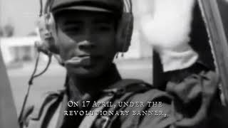
Dap Prampi Mesa Chokchey - National Anthem of Democratic Kampuchea

Slide 2
PSMLS mm/dd/yy - mm/dd/yy

Slide 3
What we’ll be learning today:
Background on politics in the region of Indochina, the history of the Indochinese CP and the formation of the Khmer Rouge.
History of Democratic Kampuchea under Pol Pot and the Khmer Rouge and the genocide committed in this era.
The Vietnamese intervention in 1979 and the establishment of the People’s Republic of Kampuchea.

Slide 4
Background -
Indochina Communists

Slide 5
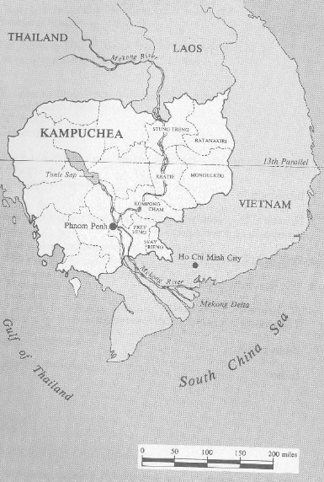
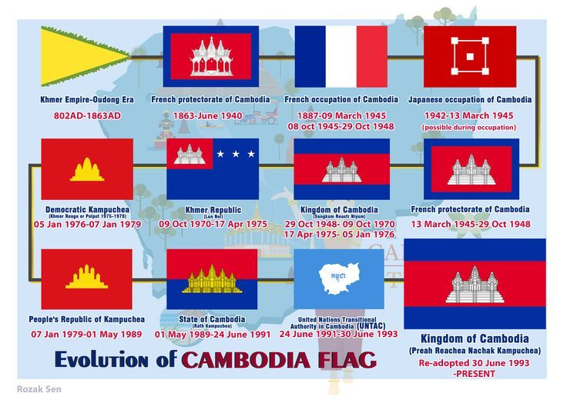
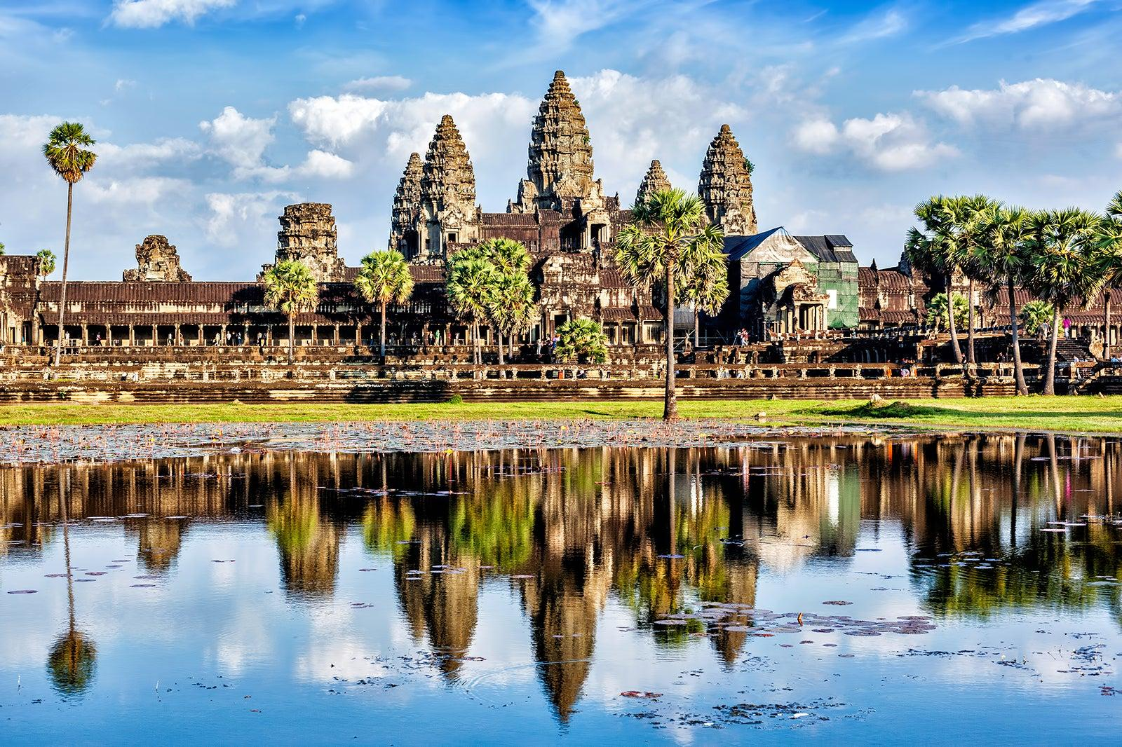
Basic Info about Kampuchea
Kampuchea, also known as Cambodia, is a country in Southeast Asia, and is bordered by Thailand and Laos to the north and Vietnam to the east and south, and has a coastline on the Gulf of Thailand.
The country had a population of ~6.3 million people in 1976, ~6 million people in 1979 and has ~16.86 million today. The capital city, which is also the most populated city, is Phnom Penh.
Cambodia was a colony of France between 1867 and 1953. Between 1941 and 1945 it was occupied by Japan. Upon independence, it existed as a constitutional monarchy known as the Kingdom of Cambodia.

Slide 6
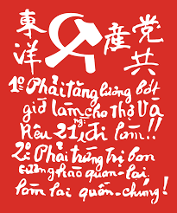
Founding of the Indochinese Communist Party
ICP was created at the Comintern’s request
In 1929, the Communist Party of Indochina (only active in Tonkin) and Communist Party of Annam were formed and in February of 1930, they joined together with the Communist League of Indochina to form the Vietnamese Communist Party.
The Comintern criticized the Vietnamese communist movement for its factionalism at the time and brought Ho Chi Minh to Hong Kong to preside over a conference to unite the communist formations in Indochina and rename the party to the “Indochinese Communist Party.” After this occurred, the Indochinese communists, especially the Vietnamese, got to work building the party, setting up mass organizations and training cadre for a revolutionary struggle.
In November of 1945, the Indochinese Communist Party issued a communique to dissolve itself, under pressure from China and the U.S.

Slide 7
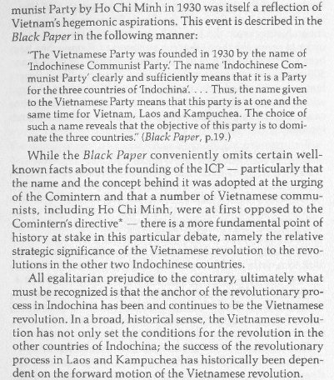
Kampuchea: The Revolution Rescued by Irwin Silber

Slide 8
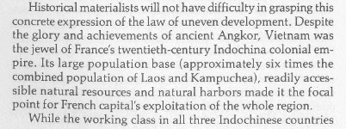
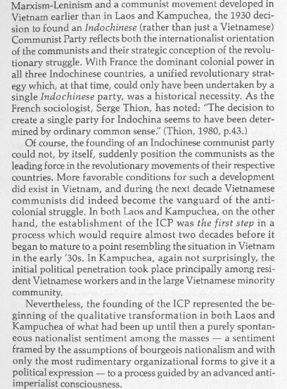
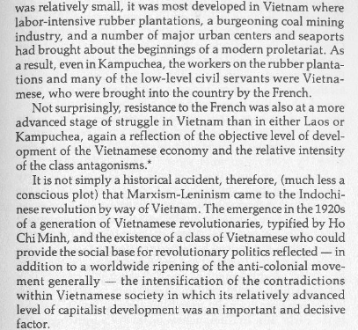

Slide 9
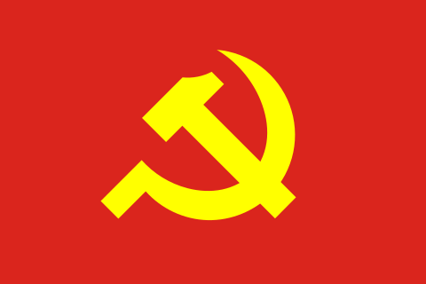
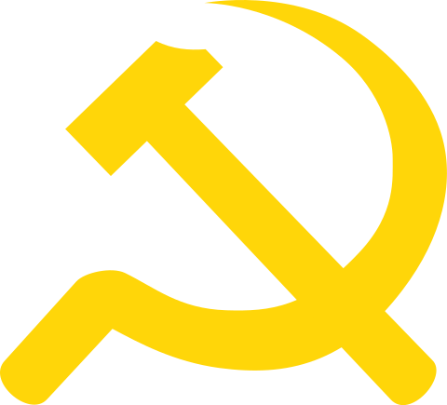
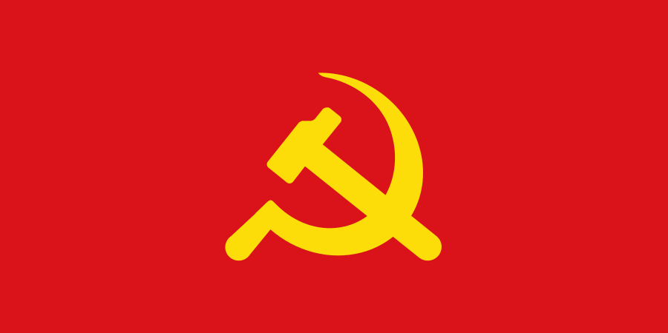
Origin of the Khmer Rouge
Post-ICP Indochinese Parties
Members of the ICP would go on to re-establish communist parties in their respective countries in the early 1950’s, including the Workers’ Party of Vietnam and Kampuchean People's Revolutionary Party (KPRP) in 1951 and Lao People’s Party in 1955.
The KPRP created a legal party, Krom Pracheachon, to participate in the National Assembly elections in 1955 and 1958. It gained little support in these elections and was drove underground in 1962. Two factions began to form, the “urban” faction with similar views to the Vietnamese that the government of Sihanouk was a valuable asset in the struggle in the liberation of South Vietnam, and a “rural” faction which advocated an immediate overthrow of Sihanouk.
Sieu Heng led the rural committee, but then actually defected to the Sihanouk government and gave them intel which led to the destruction of most of the party’s rural apparatus.
Workers Party of Vietnam
KPRP
Lao People’s Party
Krom Pracheachon

Slide 10
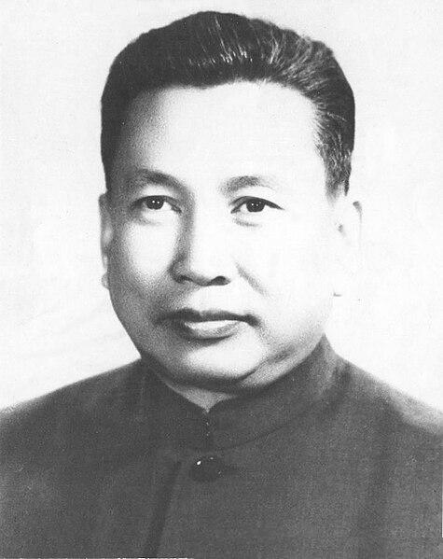
Origin of the Khmer Rouge
Pol Pot
Pol Pot, born Saloth Sâr, was a Cambodian who was born to a wealthy farmer in 1925. He was able to attend elite schools in Cambodia and in Paris and upon return to Cambodia, he went to the North Vietnamese and pleaded for a military operation against Sihanouk to which the North Vietnamese denied the request and told Pol Pot to take up a political struggle instead.
Sihanouk was then overthrown by Lon Nol in a US-backed rightwing coup in March 1970. Sihanouk fled to China, where Pol Pot was, and the Chinese and Vietnamese parties convinced Sihanouk and Pol Pot to form a National United Front of Kampuchea to fight Lon Nol’s govt.
Pol Pot then flew to Hanoi and pleaded Lê Duẩn for the Vietnamese to provide the Khmer Rouge with weapons to overthrew Lon Nol themselves. Lê Duẩn instead launched an invasion of Cambodia to attack Lon Nol’s govt, officially pulling Cambodia into the Vietnam War and bringing U.S. bombing raids to Cambodia. The Khmer Rouge would take reign after Vietnamese withdrawal.

Slide 11
Discussion

Slide 12
“Democratic Kampuchea”
Pol Pot, Khmer Rouge and Genocide

Slide 13
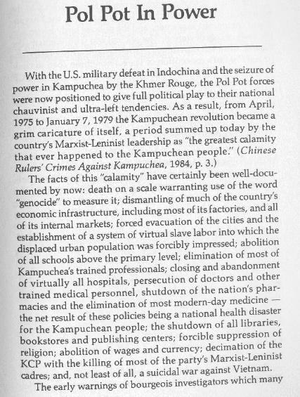
Kampuchea: The Revolution Rescued by Irwin Silber

Slide 14
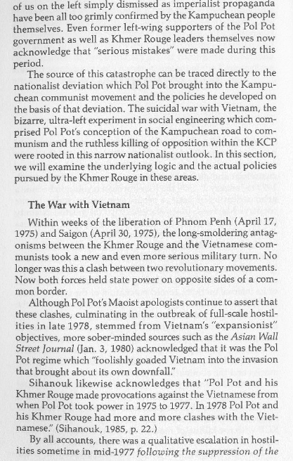
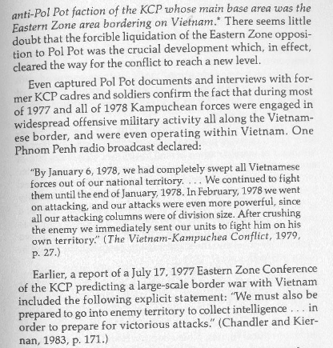

Slide 15
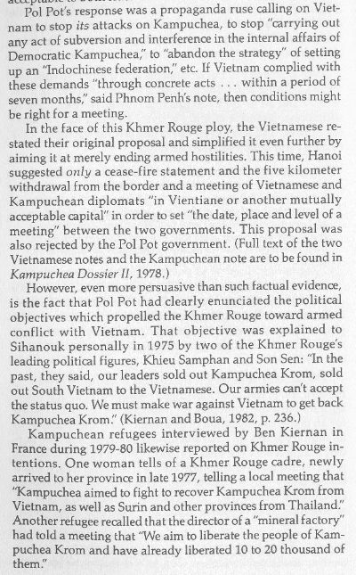
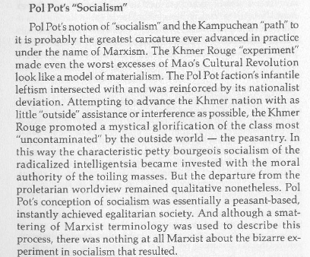
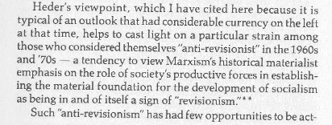
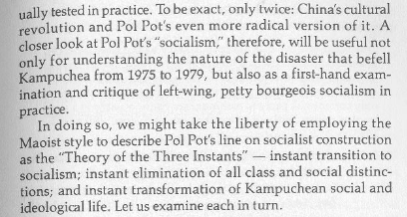

Slide 16
The Cambodian Genocide

Slide 17
Discussion & New Members Introductions

Slide 18
New Member Introductions
What is your name, pronouns and state (or country/territory)?
Where do you work? Is it unionized?
How did you find out about the People’s School?
What do you think about tonight's class?

Slide 19
Vietnamese Intervention & People’s Republic of Kampuchea

Slide 20
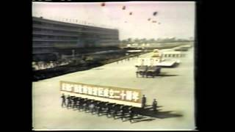
The Cambodian Genocide

Slide 21
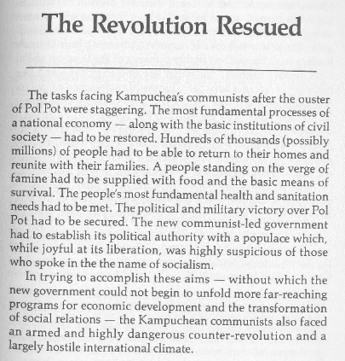
Kampuchea: The Revolution Rescued by Irwin Silber

Slide 22
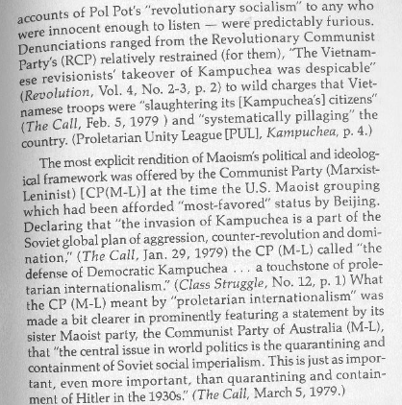
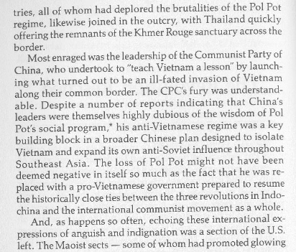

Slide 23
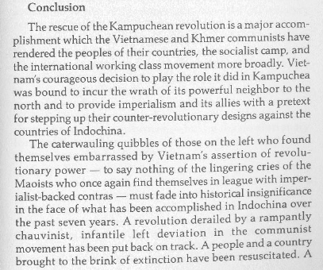
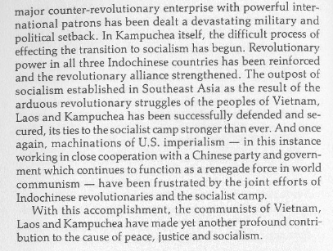

Slide 24
Discussion & Wrap Up

Slide 25
Announcements
THE KONONOVITCH BROTHERS NEED US, SHARE THIS ARTICLE:
https://dailyworkerusa.com/stop-the-kiev-regimes-calls-for-the-murder-of-the-kononovitch-brothers/
Next week’s class will be a presentation from USFSP on the October Revolution! This will occur on Tuesday, October 7th and the recording will be replayed on Thursday. Please attend this class and invite some people!

Slide 26
Volunteers Needed!
We are in need of volunteers for the staff of the People’s School! Here’s a few roles we need filled:
People to help manage posting on our social media and podcast platforms
Video Editors, Audio Editors, Graphic Designers, Artists, Narrators
Facilitators, Web Controls, Moderators
Email info@peoplesschool.us if you’re interested and try to attend our next staff meeting on Dec 7th if possible.

Slide 27
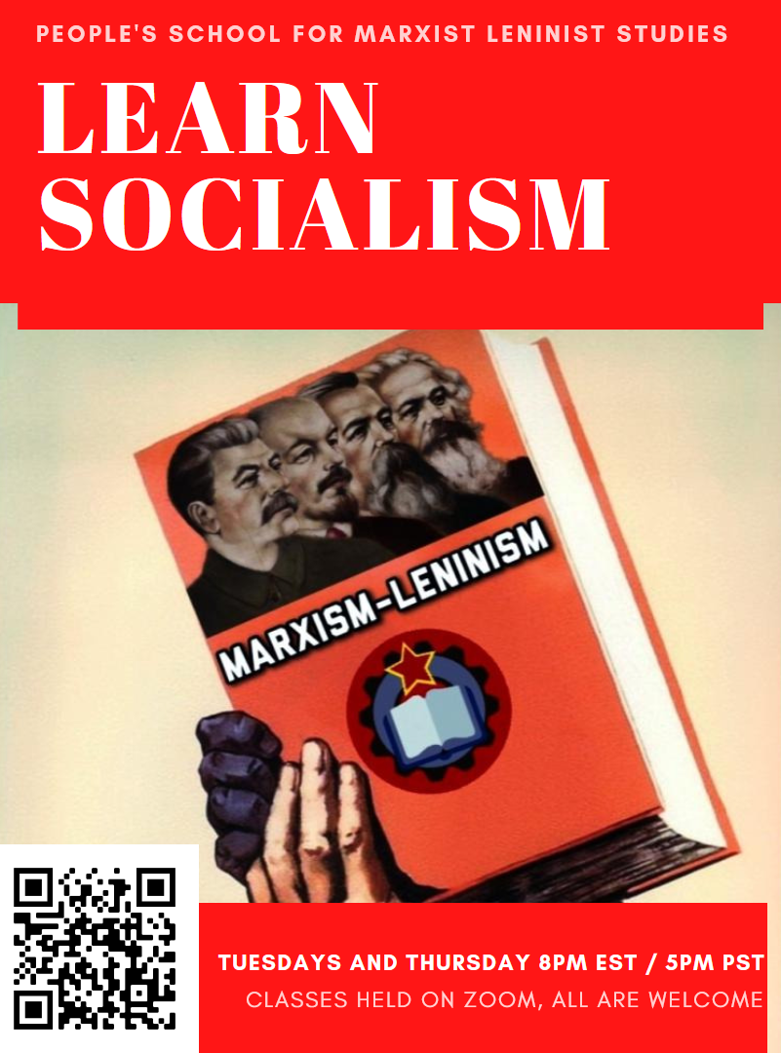
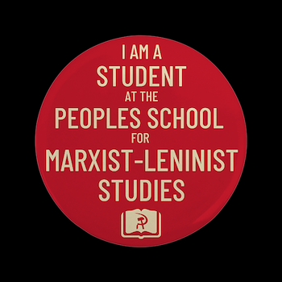
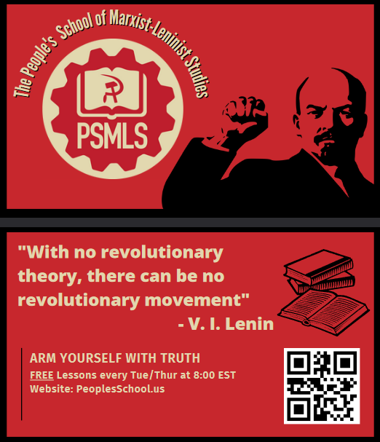
PSMLS Propaganda
peoplesschool.us/media & peoplesschool.us/store
Materials to help promote the school!

Slide 28
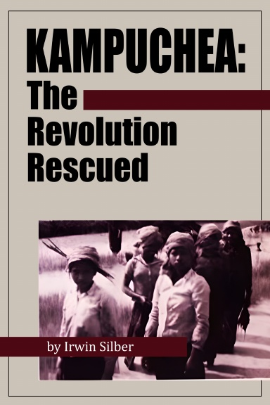
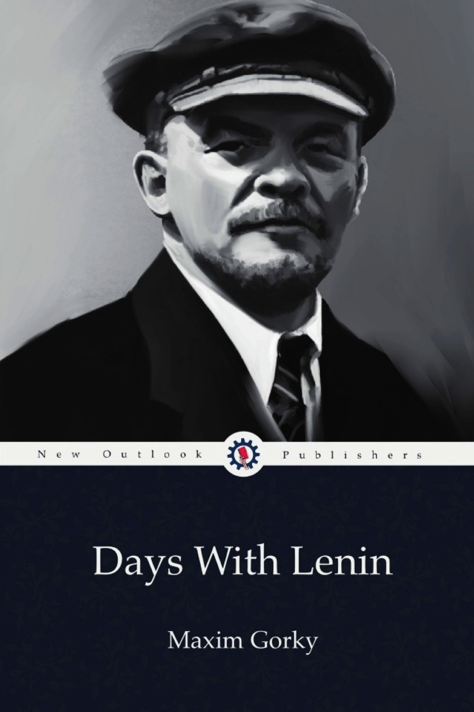
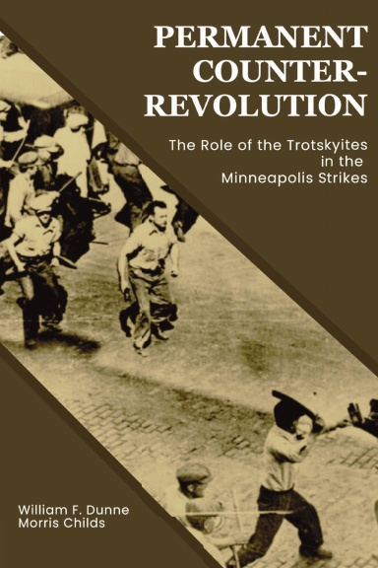
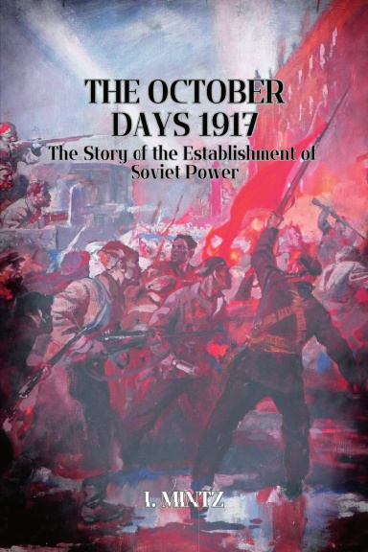
New Outlook Publishers
newoutlookpublishers.store
Latest Releases

Slide 29
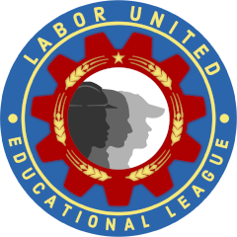
Harry Bridges School of Labor
luel.us/laborschool/
The Harry Bridges School of Labor is a monthly class held 2x per month. Classes cover a variety of topics aimed at building class conscious among union members.
November’s class is “History of the Congress of Industrial Organizations (C.I.O)” and is November 1, 2023 at 9pm EST/6pm PST and Saturday November 4, 2023 at 7pm EST/4pm PST.

Slide 30
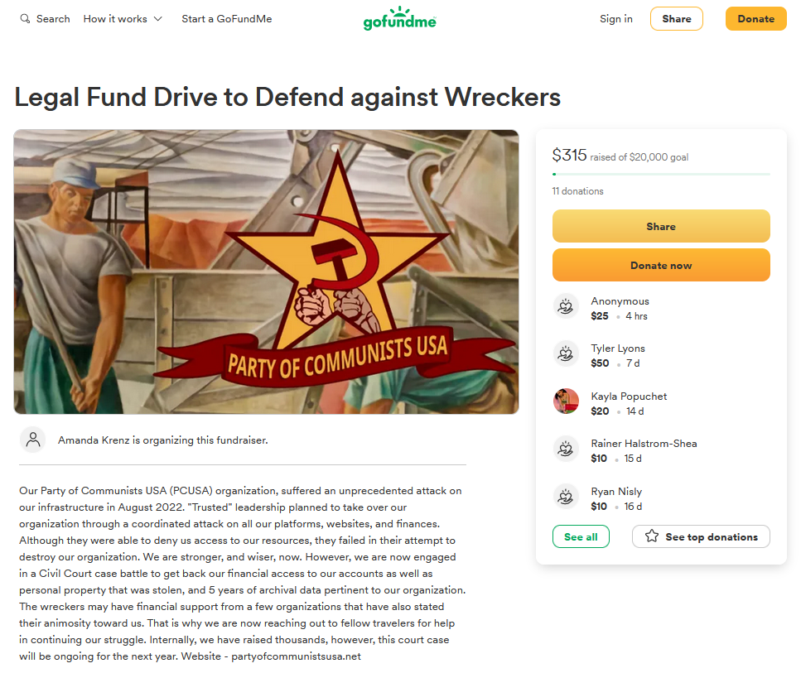
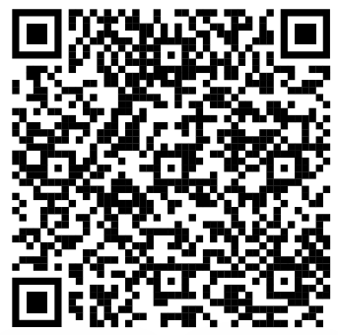
Legal Drive
Last year we were attacked and sabotaged by ultraleft wreckers that tried to steal the PSMLS and destroy the PCUSA. They failed, but they will be held accountable and there are still things they took from us that we’ve not got back, like videos, imagery, audio etc. That is why we still need donations to the legal drive.
If you support the school and want to see us continue to improve and keep delivering this education 51 weeks a year, please pitch in whatever you can and support the GoFundMe for the legal drive @ https://www.gofundme.com/f/legal-fund-to-defend-against-wreckers.
Anything helps!

Slide 31
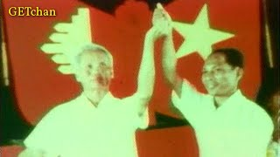
ចម្រៀងនៃសាធារណរដ្ឋប្រជាមានិតកម្ពុជា - Anthem of the People’s Republic of Kampuchea

