Slide 1
"Canción del Frente Popular"- Song of the Popular Front

Slide 3
What we’ll be learning today:
Background on Earl Browder
Democracy or Fascism
The American Tradition
Democracy and the Constitution
Trotskyism (Ultraleftist) Position on the Popular Front

Slide 4
Background: Earl Browder

Slide 5
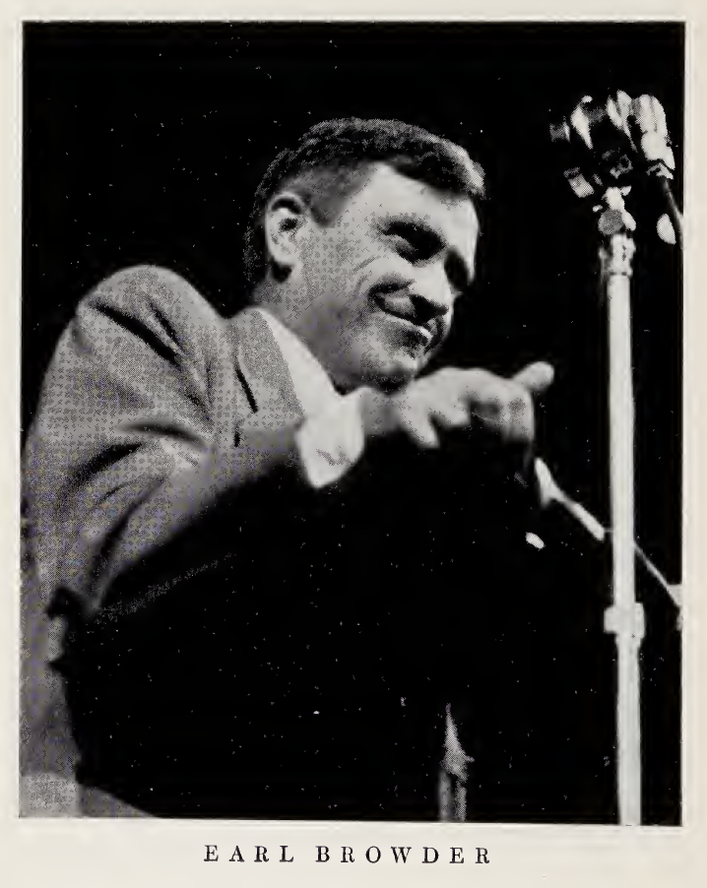
Earl Browder
Biography
Born in Wichita, Kansas on May 20, 1891.
Member of the Socialist Party and protested the First World War, jailed in 1917 under the Espionage Act
Along with John Reed, Elizabeth Gurley Flynn, Louis Fraina, Max Shachtman, Michael Golde, William Donne, Charles Ruthenburg, and others was a founding member of the Communist Party USA in 1919.
Became leader of the Party in 1932.
Wrote many books linking the Communist movement with democratic, revolutionary, and labor traditions in the country.
Ran on Presidential Ballots in 1936 and 1940.
Ousted from the Party in 1946.
Passed away at Princeton, NJ on June 27th, 1973.

Slide 6
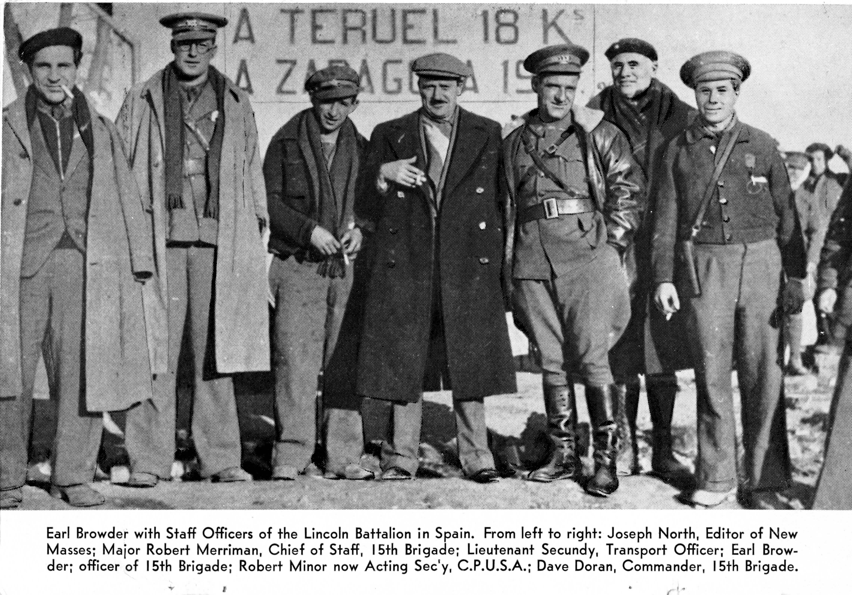
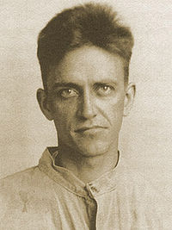
The People’s Front by Earl Browder
Book was published in 1938 by International Publishers.
This volume is a collection of reports, speeches and artiles wirtten during 1936 and 1937. Meant as a companion volume and continuation of Communism in the United States published in July 1935.

Slide 7
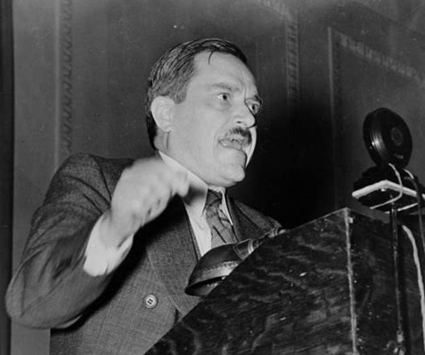
DEMOCRACY OR FASCISM
“THE world is torn between two main directions of development:
on the one hand stand those forces striving to maintain the rights and living standards of the masses in the midst of capi­talist crisis and decay, and to maintain world peace;
on the other side are the forces of fascism, striving to wipe out popu­lar rights and throw the full burden of the crisis onto the masses, and driving us toward a new world war.” BROWDER - 1938

Slide 8
There are two chief and opposite directions of possible development in American political life in the [1936 ] elections. All parties and groups must be judged by their relation to these two fundamental political tendencies. One stems from the most reactionary circles of finance capital, Wall Street; its direction is toward fascism and war. The fundamental aims of this camp can be summarized in five points:
1. Restore capitalist profits by cutting wages, raising prices, checking the growth of trade unions, subverting them, and eventually wiping them out; squeeze out the poor farmers from agriculture, transforming them into propertyless workers.
2. Wipe out social and labor legislation, balance the budget by eliminating unemployment relief, cutting taxes of the rich and throwing the tax burden onto the poor by means of sales taxes.

Slide 9
drive toward the curtailment and eventual destruction of democratic liberties and civil rights; create the storm troops of reaction, etc.
3. Remove all remnants of popular influence upon the government, by
4. Seize control of all governmental machinery toward a full-fledged fascist regime, in “American” and and "constitutional" ways.
5. Develop extreme jingoistic nationalist moods among the masses; drive toward preparing for a new world war.
vesting all final power in the hands of an irresponsible judiciary—the Supreme Court;

Slide 10
“It is possible to defeat the fascists and war-makers. It is pos­sible to move toward progress, to maintain peace. But to do this requires that we recognize and make full use of all factors, even the smallest, that work toward this end, even temporarily. It requires a drive toward one united international policy, around which is rallied the growing armies of progress and peace.”
ONE UNITED INTERNATIONAL POLICY

Slide 11
THE ISSUE DEMOCRACY OR FASCISM [1936]
What forces are there in the United States, strong enough to defeat this threat of the ‘reactionary camps’?
The only way the ‘reactionary camps’ can be decisively defeated is through building a broad People’s Front. It is the main purpose of the Communist Party [in this election] to further in every way the building of such a united front against the reactionaries.
Clearly, the most important of these forces are to be found in the trade union movement, the farmers’ organizations, progressive groupings in the old parties and the organizations grouped around the Socialists and Communists. Here are the potential elements of an American People’s Front.
That is why we say the issue is democracy or fascism, progress or reaction—an issue for which the broad potential People’s Front is prepared, upon which it can be organized now,
and not the ultimate issue of socialism or capitalism, a choice which the progressive forces currently are not ready to make.

Slide 12
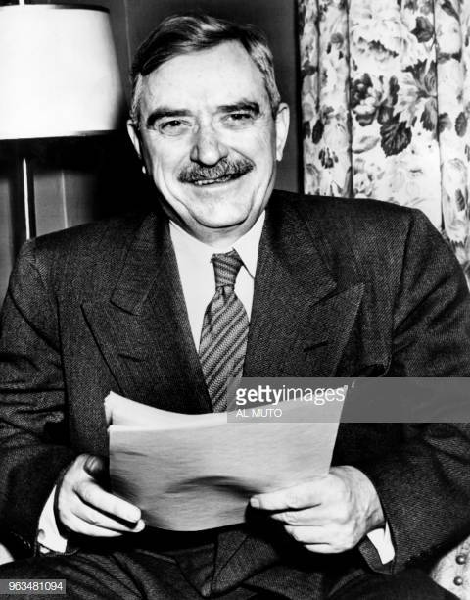
“But since when is revolution anti-American?”
“In waging this fight against reaction the American people are but carrying on their glorious revolutionary traditions, which are the most precious heritages of our people. Reactionaries of all shades attack socialism as revolutionary. But since when is revolution anti-American?” (Browder, 113)

Slide 13
The American Tradition

Slide 14
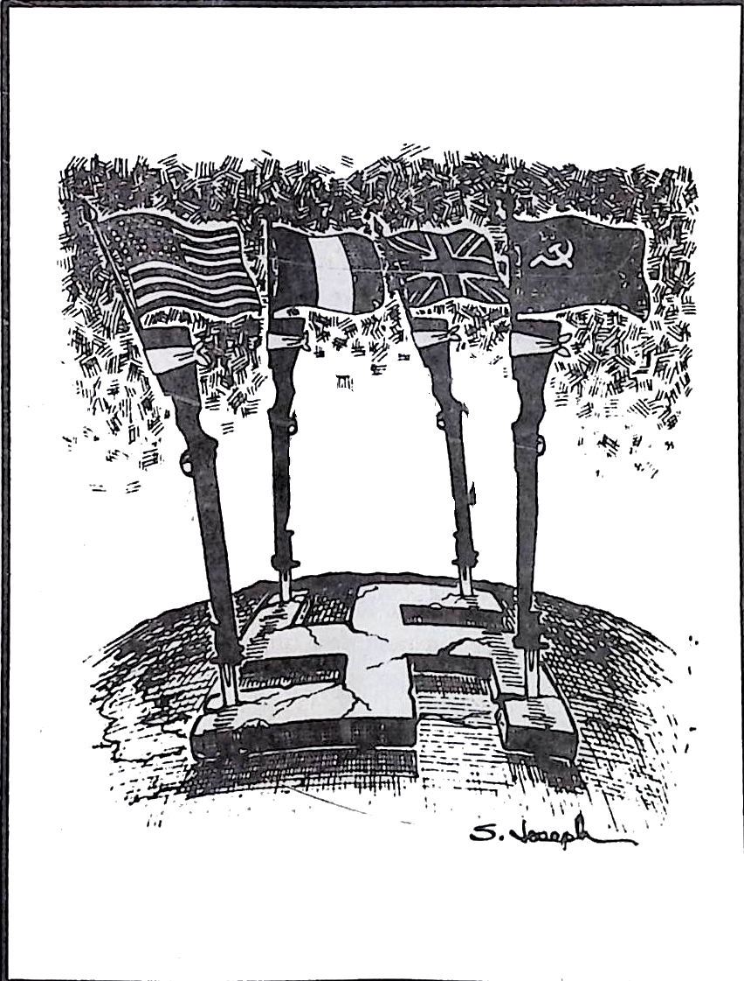
The Communist in the People’s Front
“Reaction and fascism have received a series of defeats which, if followed up on a world scale, create the preconditions for its downfall everywhere.”
“Not the least important front in this world struggle is the United States, where it is upon our still numerically small Party that responsibility rests in the first place to ensure the halting of the forces of reaction, fascism and war. These forces in the United States are gathering, preparing a counter-offensive against the rising movement of the democratic elements in this country.”

Slide 15
“…the special task of concentrating the attention of our Party upon a few key questions, which, through our correct and energetic orientation, will place the Party in a position to meet its responsibilities most effectively in all fields. We have chosen four such points of concentration:
(1) the next tasks in building the People’s Front in the U.S.A.;
(2) the struggle for progressive industrial unionism and for labor unity;
(3) organizing the mass movement for an effective peace policy; and
(4) building the Communist Party and the Daily Worker.”

Slide 16
The Path of Struggle Before the US
“Every inch of the people’s front the road will be contested by the enemy, and by the inertia of the past. The complications of the daily problems will be multiplied. From all those who are influenced by Trotskyism and opposition in principle to the People’s Front, there will come a chorus of super-revolutionary wails about our betrayal of the class struggle, etc. But we, and with us all the best forces of the labor and people’s movements, by a decisive course, and by constant vigilance, will prove the correctness of this policy in life, by its achievements in the organization of the masses and the improvement of their position in all respects.”

Slide 17
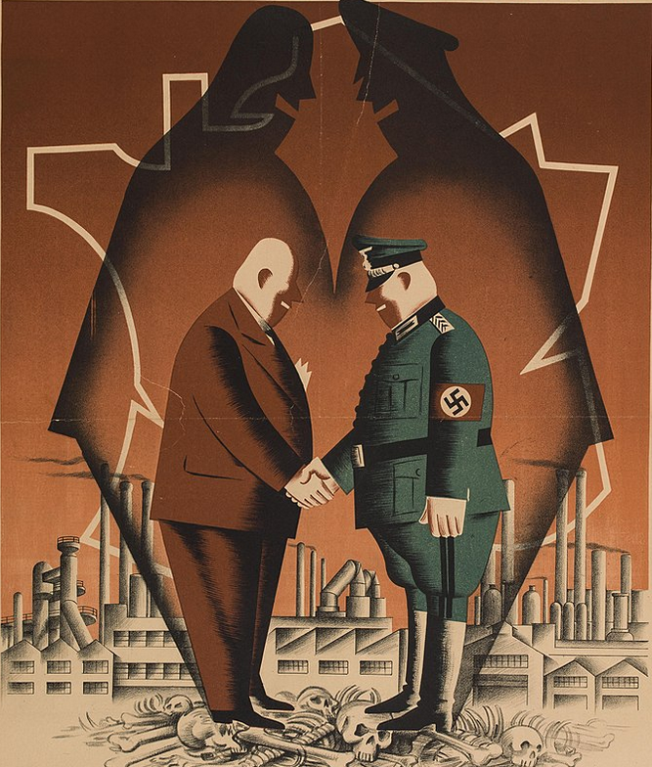
“The People’s Front must be directed towards identifying these enemies.”
“In this connection it has been shown innumerable times what constitutes the organizing center of the enemies that we have to fight. It is that small group recently popularized as the economic royalists that dominate the United States…
We must make a thorough survey of who these economic royalists are and identify them before the masses in the local elections, in the preparations for the Congressional elections, in the whole drive towards the People’s Front in America.”

Slide 18
The Path of Struggle Before the US
Through breaking down the judicial dictatorship and by setting up a national electoral system that guarantees in life the rights of citizenship, promised in the Constitution, can we abolish all restrictions on the franchise and provide direct and proportional representation in each state. It is towards this more complete conception of national unity that we Communists must direct the thought of the broad people’s movement. In doing this we will continue under the conditions of today that democratic work begun by Washington, Jefferson and Paine, and continued by Lincoln. We Communists must become known as the most energetic champions of the full national unification of our country.

Slide 19
Discussion

Slide 20
The Popular Front Democracy and the Constitution

Slide 21
Democracy and the Constitution
“One hundred fifty years ago we received our United States Constitution, product of the revolution which had stirred the whole world, and representing a compromise between the conflicting interests which fought the war. Eighteen years ago was born the Communist Party, the Party destined to carry on and complete the work begun by Tom Paine, George Washington, Thomas Jefferson and Abraham Lincoln.
There is no party and no leader which has a mortgage upon the American people today. Old allegiances, old flags, old parties have lost their magic. Old alignments are being dissolved. The people are putting to the test every program, every party, every slogan, every leader. A new political alignment, a new party system is in the making today in America. Our country is in a deep political crisis.”

Slide 22
Democracy and the Constitution
“American democracy, as established by the Constitution and the victory of Jefferson in 1800, is in danger of being destroyed. But it is not threatened by the Communists, nor by any vague proletarian dictatorship. It is threatened only from the side of the privileged, the rich, the Liberty Leaguers, Wall Street and their agents and lackeys. The Communist Party throws all its resources into forming and strengthening the united front of all progressive and democratic people to defeat the reactionary threat, to preserve the Constitution for the people, to maintain and extend American democracy.”

Slide 23
Democracy and the Constitution
“The Communist Party repudiates now as in the past, all theories or proposals looking toward a forcible imposition of Socialism or any utopia upon the majority of the people. We repudiate the “reckless resolve to seize power” by any minority. If there should arise in America anything similar to the situation in Spain, where the democratic republic while repulsing the fascist invasion was stabbed in the back by the “uncontrollable extremists” (a minority of the anarchists and the Trotskyist P.O.U.M.), that we, like our brothers of the Spanish Communist Party would be in the forefront of the struggle to suppress such “extremists,” who are really agents of fascism, and render them harmless.”

Slide 24
Democracy and the Constitution
“The threat of reaction and fascism comes not only from within, but also from without. Jefferson recognized this clearly in the first years under our Constitution. As Secretary of State under Washington, it was Jefferson who threw American influence squarely behind the new French Republic, gave credits to it, and threatened an embargo against any power that invaded France. It was the economic royalists of that day who fought for “neutrality,” behind which they conspired with the enemies of France, and as Jefferson foresaw, finally conspired also against their own country, the United States.”

Slide 25
Democracy and the Constitution
“Today, the Communist Party has drawn to itself everything vital in the revolutionary traditions of our land, it is bone and flesh of the American workers, farmers and intellectuals, it embodies the great American tradition of the melting-pot which fuses the best from all the world, it realizes the great slogan of Tom Paine who said: “The world is my country, to do good is my religion.” Our Party has been able to become so thoroughly American precisely because it has nurtured itself upon the teachings of the greatest thinkers of the world, Marx, Engels, Lenin and Stalin.”

Slide 26
Discussion & New Members Introductions

Slide 27
New Member Introductions
What is your name, pronouns and state (or country/territory)?
Where do you work? Is it unionized?
How did you find out about the People’s School?
What do you think about tonight's class?

Slide 28
Trotskyism (UltraLeft) Position on the Popular Front

Slide 29
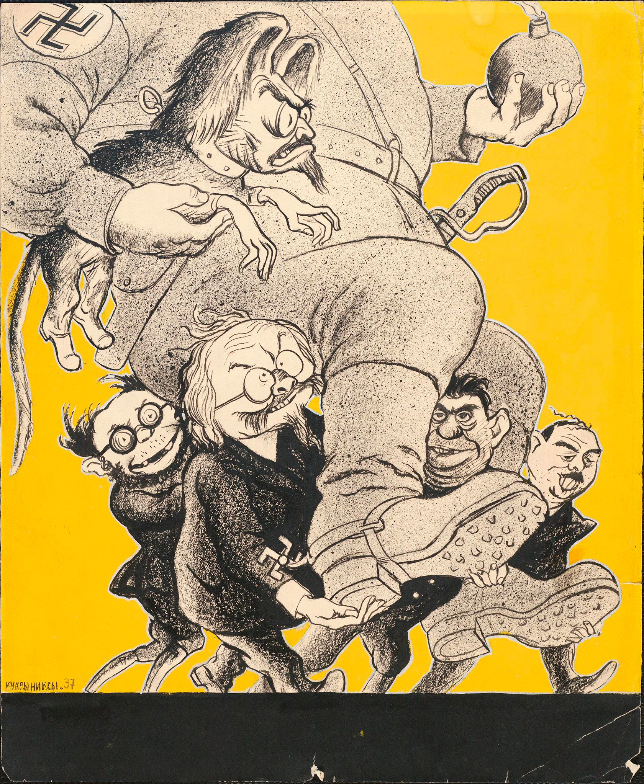
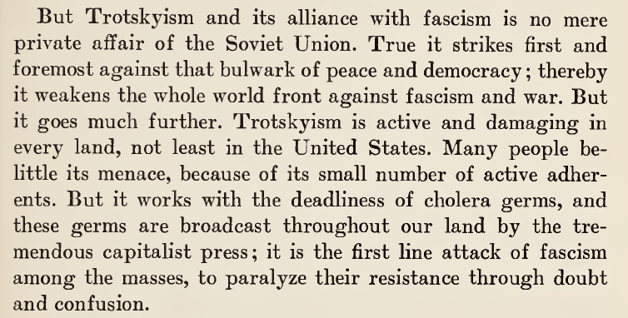
Trotskyism (UltraLeft) Position on The Popular Front
Trotskyism (UltraLeft) Against World Peace

Slide 30
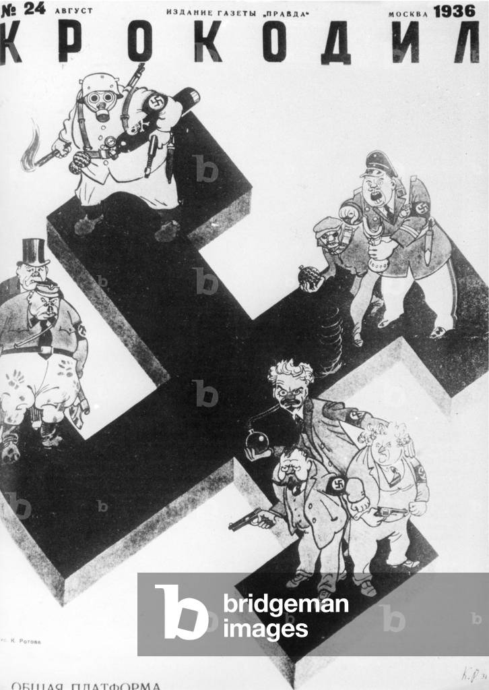
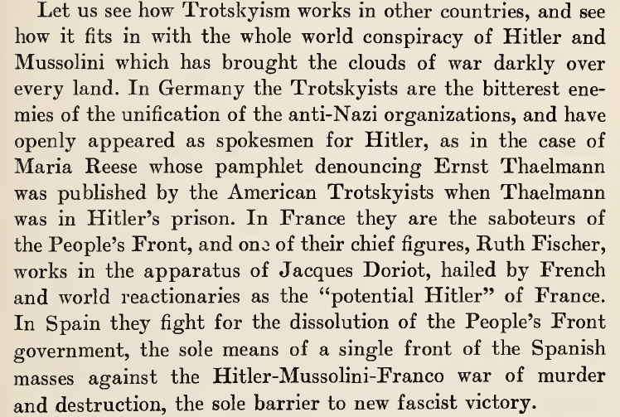
Trotskyism (UltraLeft) Position on The Popular Front

Slide 31
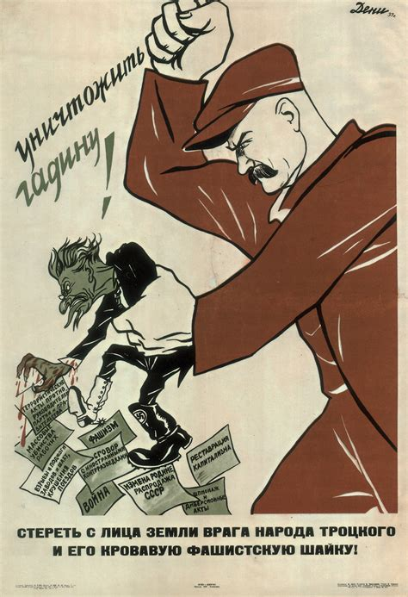
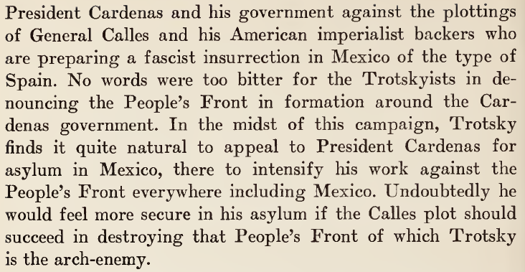
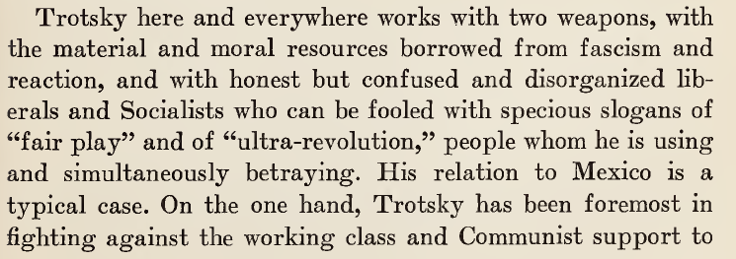
Trotskyism (UltraLeft) Position on The Popular Front

Slide 32
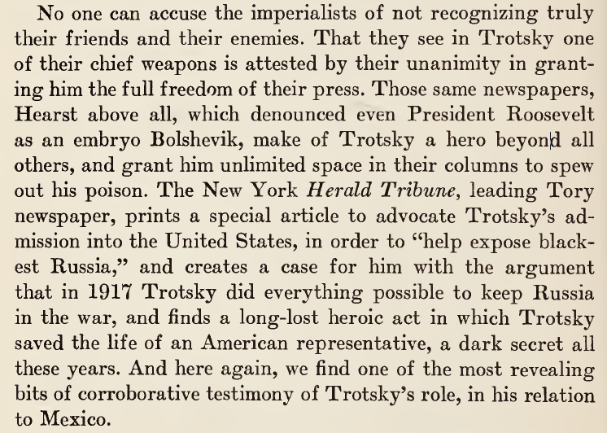
Trotskyism (UltraLeft) Position on The Popular Front

Slide 33
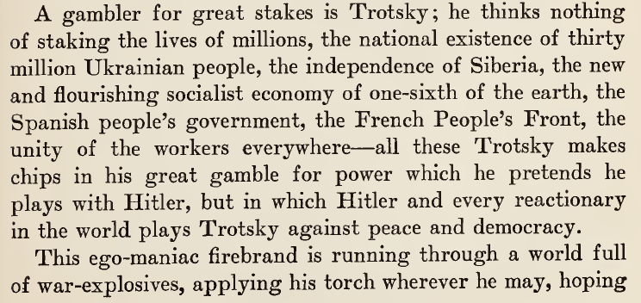
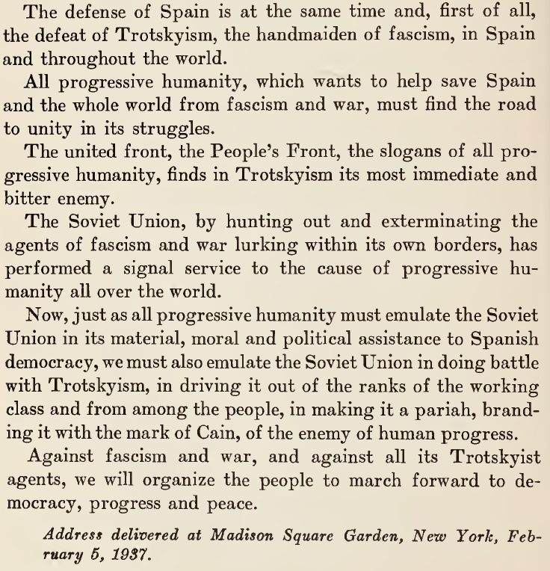
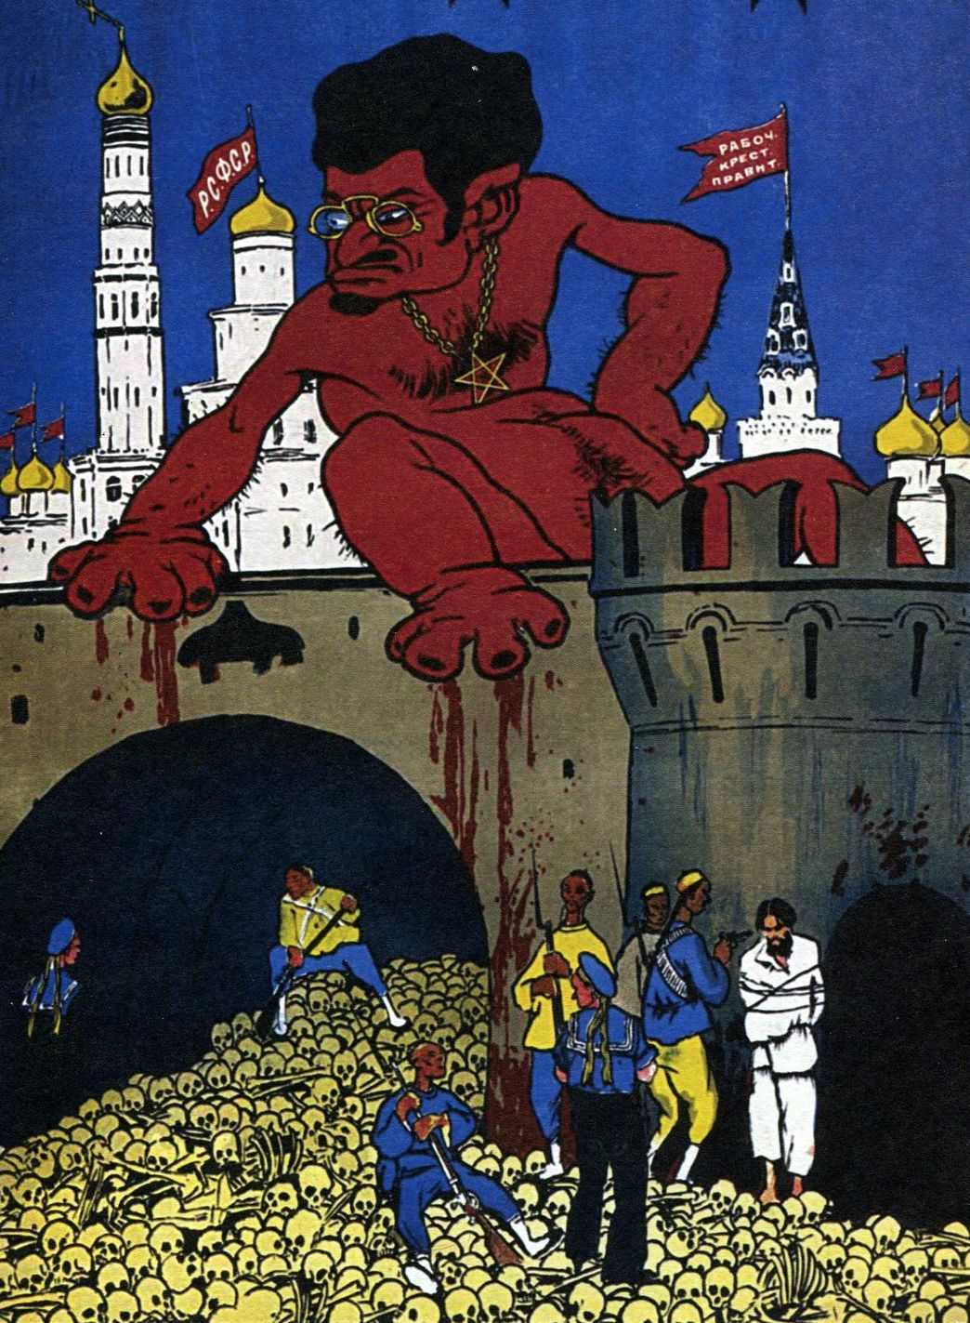
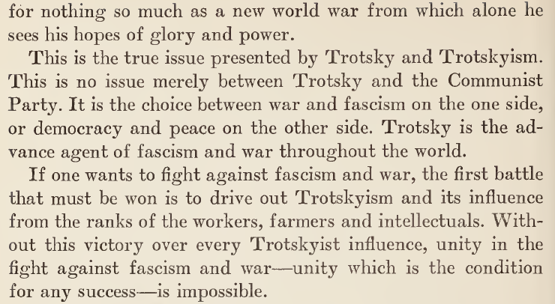
Trotskyism (UltraLeft) Position on The Popular Front

Slide 34
Discussion & Wrap Up Introductions

Slide 35
Announcements
THE KONONOVITCH BROTHERS NEED US, SHARE THIS ARTICLE:
https://dailyworkerusa.com/stop-the-kiev-regimes-calls-for-the-murder-of-the-kononovitch-brothers/
We are looking for content submissions for Vol III 2023 of New Masses! Send any submissions to info@partyofcommunistsusa.net and kamryns@johnreedcenter.net
The Peoples School for Marxist Leninist Studies has began posting videos on our TikTok channel @peoplesschool! Please subscribe to the channel and like and share our content!

Slide 36
Volunteers Needed!
We are in need of volunteers for the staff of the People’s School! Here’s a few roles we need filled:
People to help manage posting on our social media and podcast platforms
Video Editors, Audio Editors, Graphic Designers, Artists, Narrators
Facilitators, Web Controls, Moderators
Email info@peoplesschool.us if you’re interested and try to attend our next staff meeting on January _ if possible.

Slide 37
PSMLS Propaganda
peoplesschool.us/media & peoplesschool.us/store
Materials to help promote the school!

Slide 38
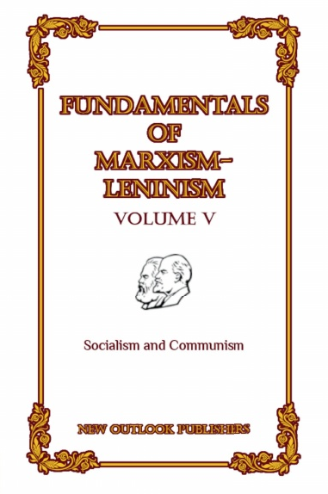
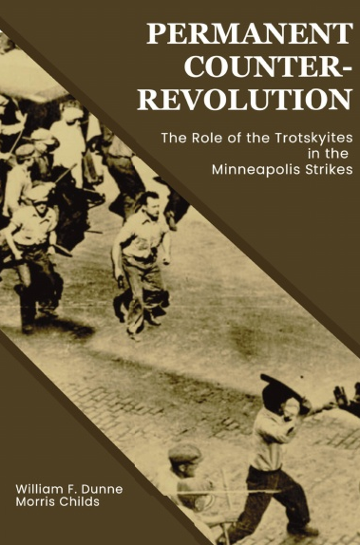
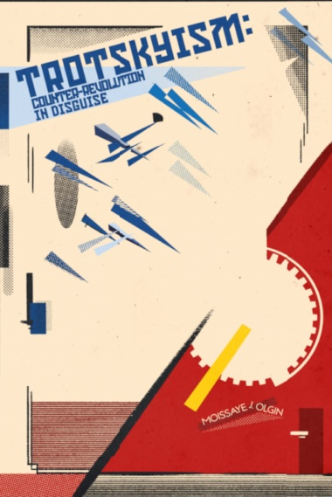
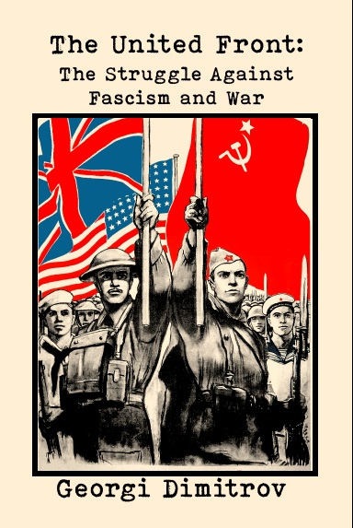
New Outlook Publishers
newoutlookpublishers.store
Latest Releases and (some) Titles Offered:

Slide 39
New Outlook Publishers – Volunteers Needed!
New Outlook Publishers is looking for volunteers! NOP is looking for assistance in the following areas:
Layout Editors
Cover Artists
Proofreaders
Please reach out to scottc@johnreedcenter.net if interested and attend the next New Outlook Publishers staff meeting on January 24th at 8:30 PM EST.

Slide 40
Legal Drive
Last year we were attacked and sabotaged by ultraleft wreckers that tried to steal the PSMLS and destroy the PCUSA. They failed, but they will be held accountable and there are still things they took from us that we’ve not got back, like videos, imagery, audio etc. That is why we still need donations to the legal drive.
If you support the school and want to see us continue to improve and keep delivering this education 51 weeks a year, please pitch in whatever you can and support the GoFundMe for the legal drive at https://www.gofundme.com/f/legal-fund-to-defend-against-wreckers. Anything helps!

Slide 41
No Mercy to the Bastards! - Soviet Anti-Fascist Song

